Slide 1
Nb₃Sn Magnet status & plan for FCC-hh
Stefania Farinon e Massimo Sorbi

Slide 2
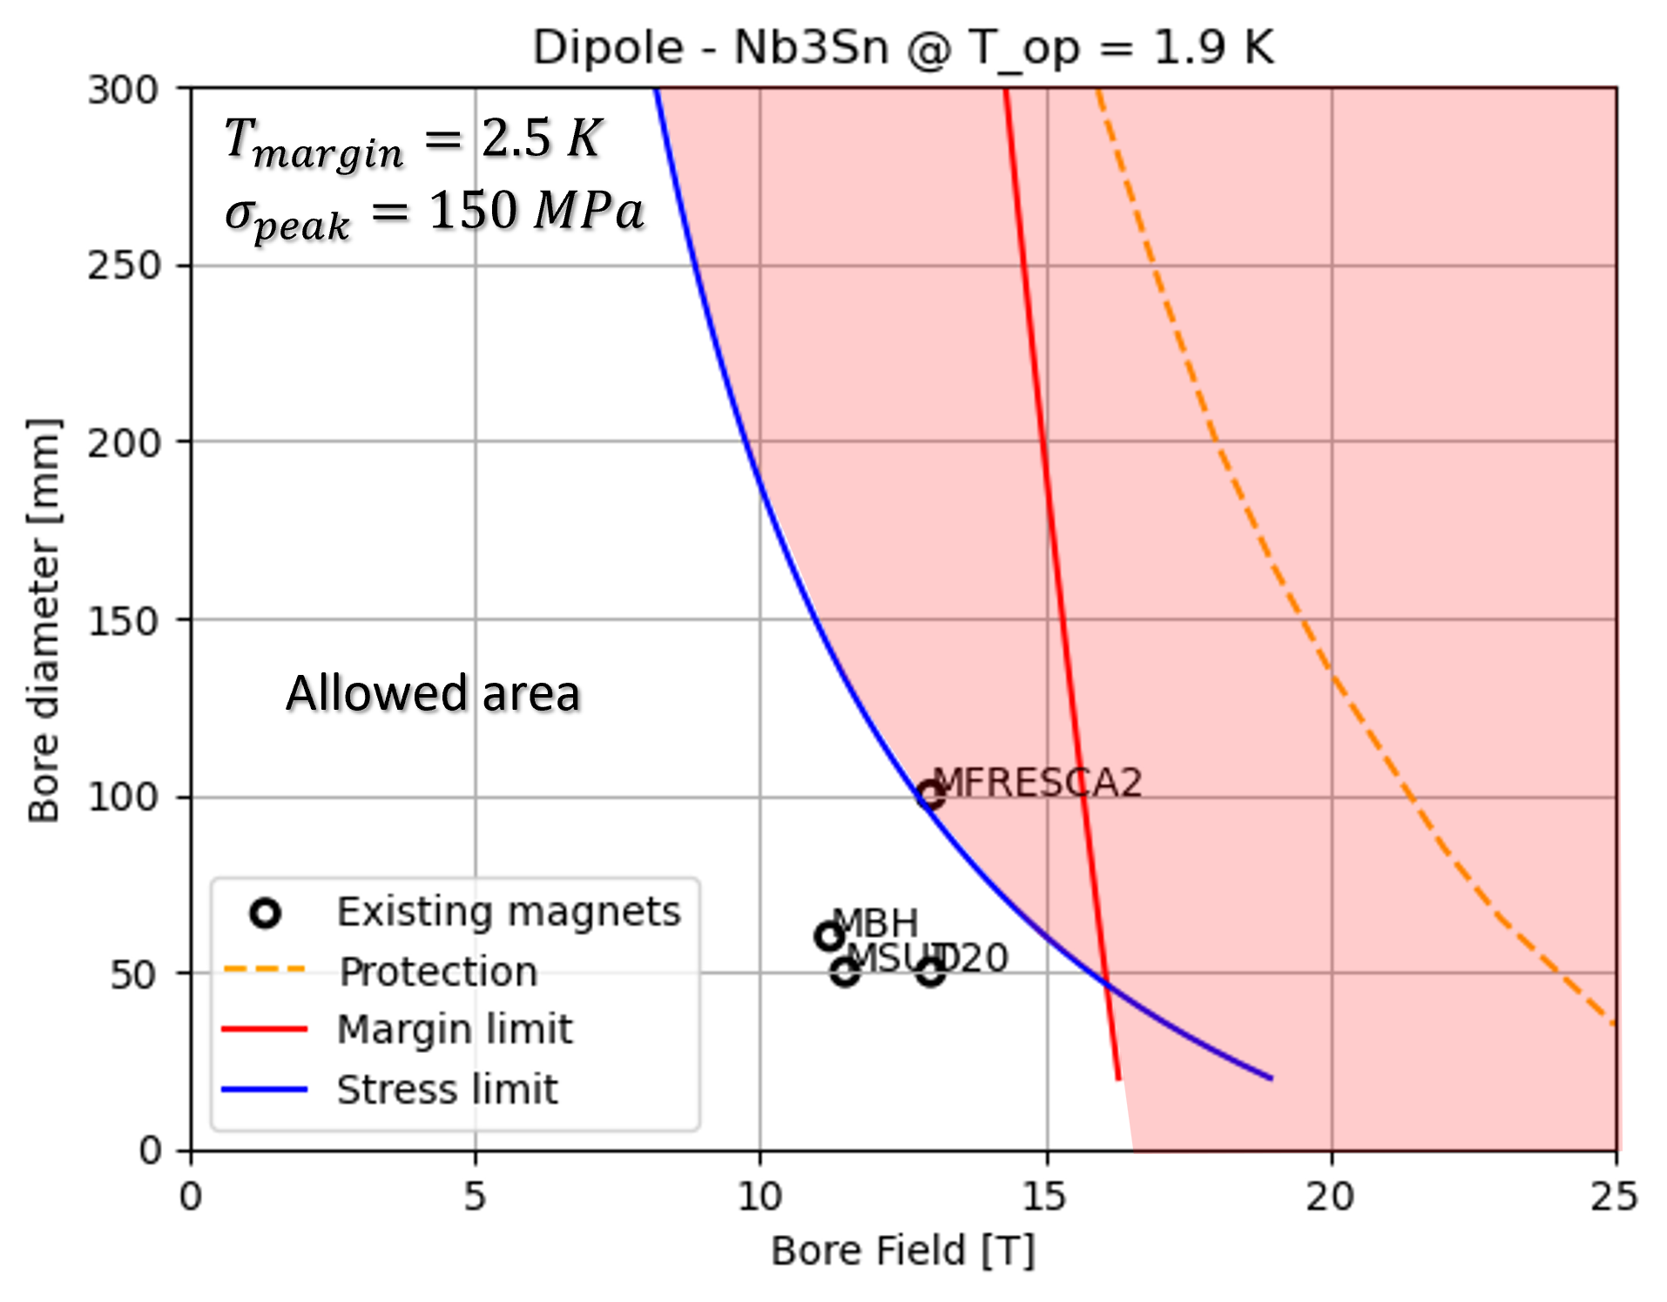
Understanding Nb₃Sn
Nb₃Sn in an intermetallic compound of Nb and Tin which is superconductor below 18 K and 30 T.
State of the art Nb₃Sn strands can carry up to J_{C}(16 T, 4.2 K)=1200 A/mm².
14 T are within reach, 16 T could potentially be unachievable even at 1.9 K.
14
16
Courtesy D.Novelli

Slide 3
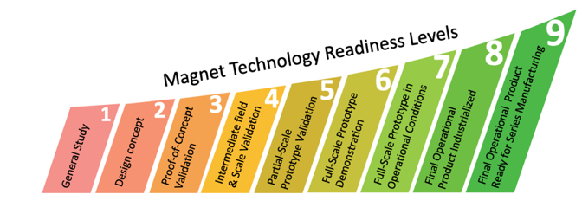
Technology Readiness Level
Can we forego the use of Nb₃Sn in developing the dipoles for future accelerators?
NO: HTS are still in R&D phase (TRL 2−3)
Is Nb₃Sn ready?
12 T dipoles are close to demonstration (TRL 6−7)
14-16 T dipoles still need ~5 years of R&D (TRL 4−5)
If the HEP community settles for 12 T, FCC-hh could be ready by 2045─2050

Slide 4
R&D on Nb₃Sn conductor
R&D is not only required for magnets but also for conductors
for transport properties:
J_{C}(16 T, 4.2 K)=1200 A/mm² state of the art of Nb₃Sn strands (HiLumi)
J_{C}(16 T, 4.2 K)=1500 A/mm² target performance for FCC-hh @ 16 T
for field quality:
SC filament diameter is currently 45-50 μm (HiLumi), which leads to field quality errors of the order of 50-60 units due to persistent currents (these errors are of the order of 7 units in the LHC)
corrective actions may include: - reducing the filament diameter to 25-30 μm - implementing passive correction systems and enhancing active correction capability

Slide 5
M.Benedikt, HFM Meeting, Oct. 2023

Slide 6
M.Lamont, CERN HFM program
Limits of Nb₃Sn are in the 14─16 T range
Why confirming the 12 T (FalconD) step?

Slide 7
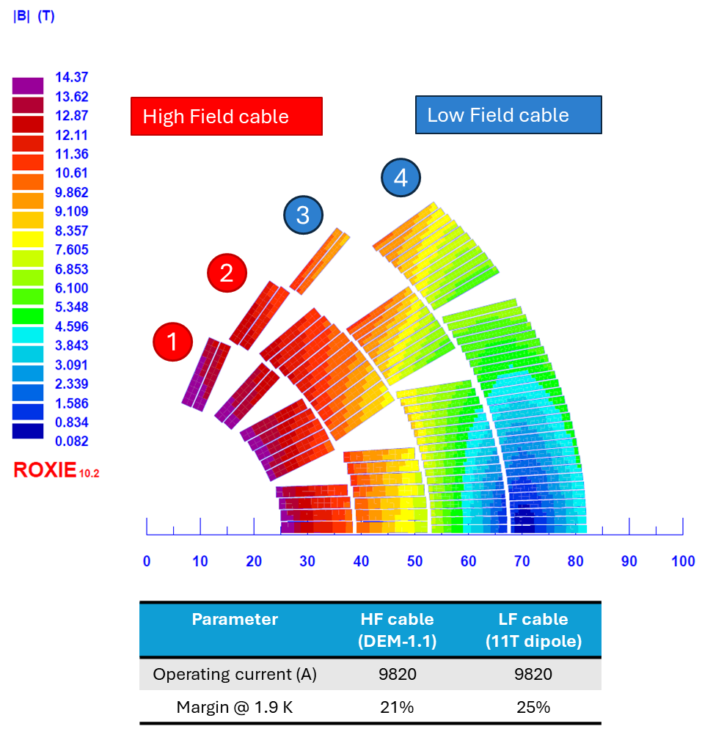
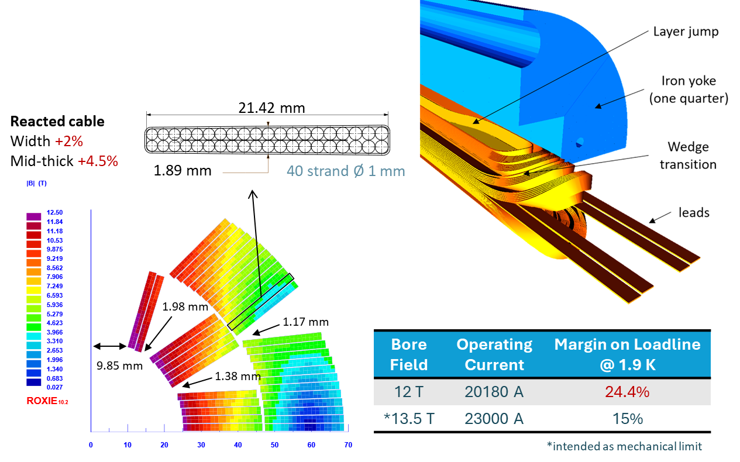
Nb₃Sn dipoles: 12 T vs 14─16 T
There is a significant technological leap between achieving a magnetic field strength of 12 T and that of 14-16 T
16 T
12 T

Slide 8
Why confirming the 12 T step?
Feasibility Assessment: By mastering the FalconD project, we validate our capability to construct Nb3Sn coils and manage associated mechanical challenges. Also, we demonstrate our readiness to advance to higher field strengths.
Technical Validation: The FalconD project serves as a validation of our technical expertise and infrastructure in handling Nb₃Sn technology. It provides an opportunity to identify any potential issues or limitations early in the process.
Progressive Approach: Opting for a 12 T step allows for a measured and progressive approach towards higher field strengths. It provides a solid foundation upon which to build future developments and advancements in magnet technology.
Timely Deployment: Focusing on the FalconD project ensures timely deployment of a 12 T magnet, which can have significant implications for ongoing research and future accelerator projects.
Overall, confirming the 12 T step with FalconD is essential for ensuring the successful development and deployment of Nb₃Sn coils while laying the groundwork for future advancements in magnet technology.

Slide 9
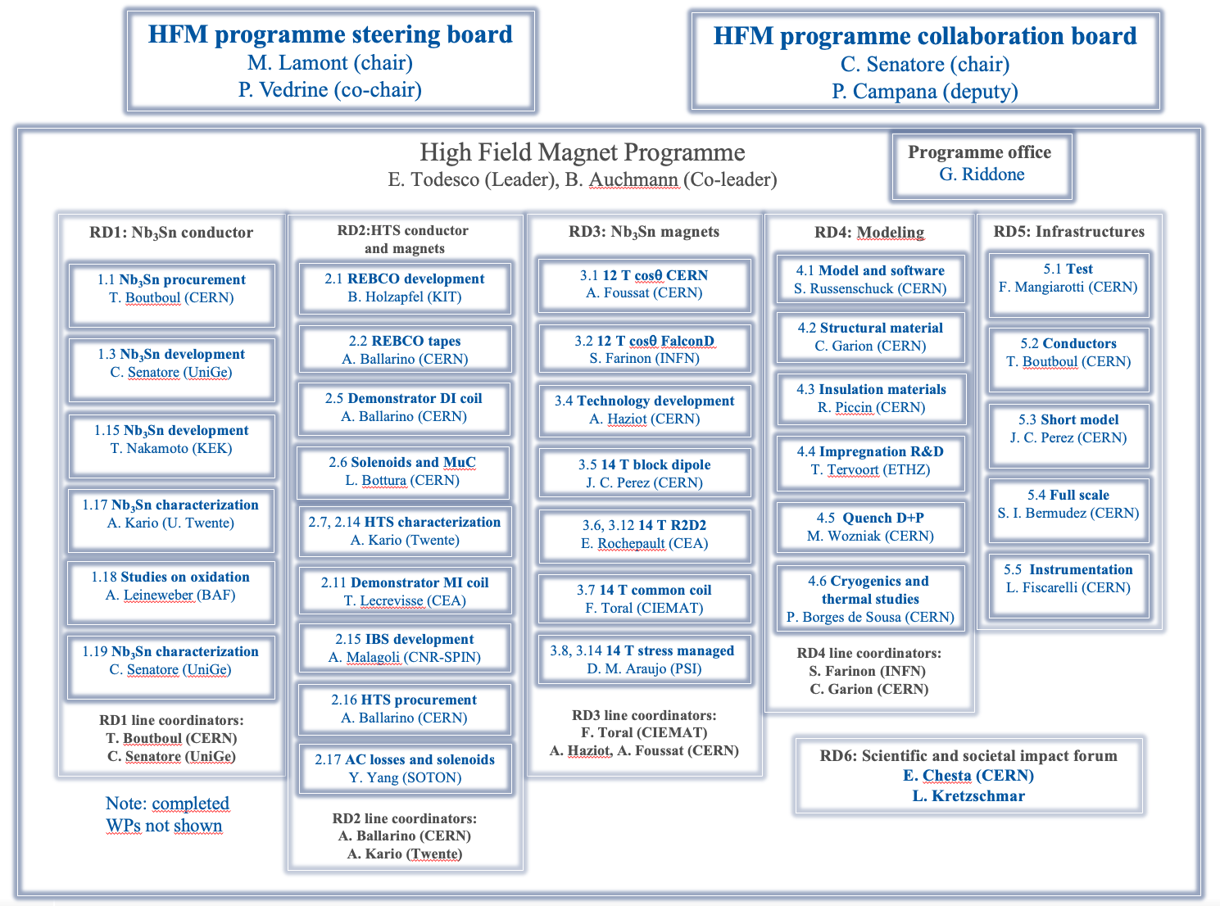
FalconD in the HFM program
FalconD plays a crucial role in the CERN HFM program's structure.
CERN has confirmed its commitment to the 12 T dipole program.

Slide 10
The FalconD program
The FalconD program, signed in 2018, is being developed in accordance with the CERN/INFN KE 4102 agreement.
An amendment was issued on March 2023 to update the project's scope and schedule.
The project involves the development and construction of a short model Nb₃Sn dipole with the following specifications:
Single aperture with an inner bore of 50 mm.
2-layer cos-theta coil, providing a bore field of 12 T at 1.9 K.
Mechanical assembly using bladder & key technology.
The total coil length is 1.5 m.

Slide 11
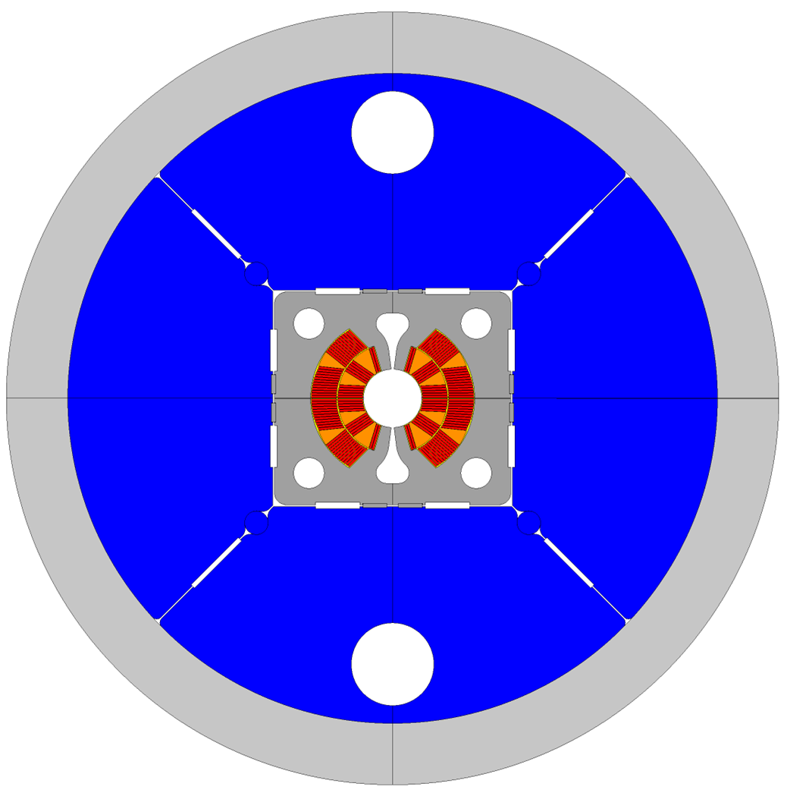
The FalconD project
The FalconD project includes the following activities:
At ASG-Superconductors, the manufacturing of:
1 dummy pole wound with copper cable
2 practice poles wound with Nb₃Sn cable
5 poles wound with Nb₃Sn cable for the single aperture dipole
At INFN-LASA Lab
the mechanical assembly and testing @ 4.2 K of the FalconD magnet
CERN supports all activities and supplies the magnet components, including the cable, spacers, and other necessary items.
ASG Superconductors is responsible for manufacturing the coils, which include 7 Nb₃Sn coils and 1 dummy copper coil.
INFN is responsible of the magnet design, B&K assembly, and preliminary test @ 4.2 K
at LASA laboratory in Milan.

Slide 12
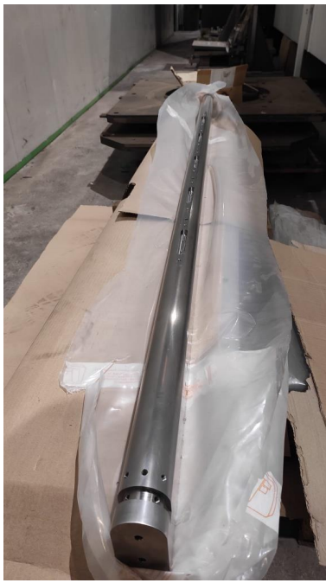
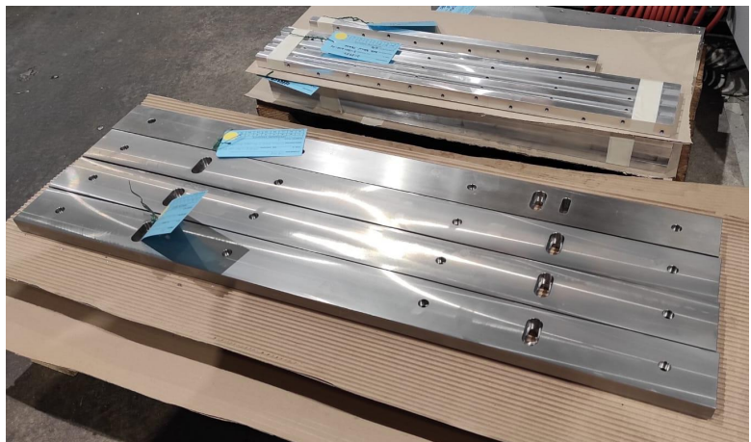
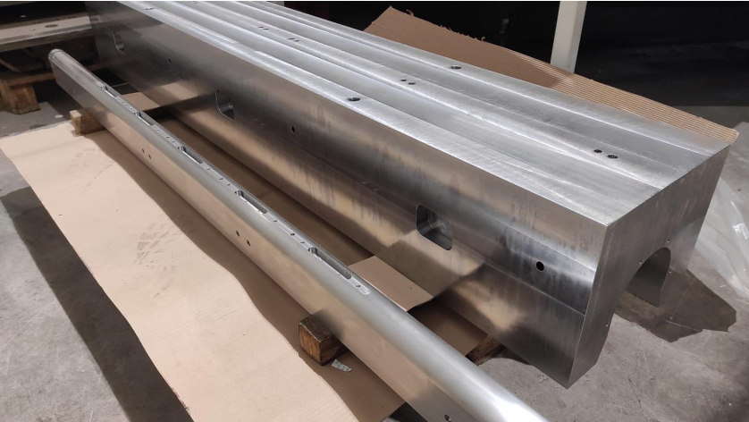
Coil production status
The coil drawings are close to be ready
The longitudinal have been procured from Luvata
We are finalizing the end spacers; the order has been placed with Tosti
ASG ordered all the tooling from Fantini, with the first batch to be delivered by the end of May
The dummy coil is expected to be ready by the end of this year
2─3 coils could be manufactured in 2025 → first magnet assembly in 2026
winding mandrel
curing mould
pressing bars

Slide 13
Industry in the HFM program
FalconD is the only HFM program that involves industry. This precise strategy adopted since the beginning of the project presents several advantages:
Expertise and Resources: Industry brings specialized knowledge, experience, and resources which could enhance the program's capabilities and efficiency.
Scale-up and Production: Industrial partners can easily scale up production processes, enabling larger-scale manufacturing of Nb₃Sn coils and magnets.
Cost Efficiency: Leveraging industry expertise can lead to cost-effective solutions, optimizing the use of resources and potentially reducing overall program costs.
Quality Control: Industry is adept at implementing robust quality control measures, ensuring the reliability and performance of Nb₃Sn coils and magnets.
Overall, partnering with industry in the Nb₃Sn program can accelerate progress, improve efficiency, and enhance the quality, ultimately advancing the field of Nb₃Sn magnet technology.

Slide 14
The future of Nb₃Sn at INFN
While involving industry in the Nb₃Sn program offers numerous advantages, there are also some potential disadvantages to consider:
Loss of Control: Entrusting key aspects of the program to industry may result in a loss of direct control over certain processes or decisions, potentially impacting the program's direction and outcomes.
Cost Considerations: While industry involvement can lead to cost efficiencies, it may also incur additional expenses, which could affect the overall program budget.
Potential Conflict of Interest: Industrial partners may prioritize commercial interests over scientific or research objectives.
Limited Flexibility: Collaborating with industry may require adhering to established protocols, procedures, or timelines, limiting the program's flexibility to adapt to evolving research needs or opportunities.
For these reasons, INFN, under the IRIS program, is developing a new facility specifically designed for continuous low-intensity research and development of superconducting magnets.

Slide 15
IRIS Infrastructure at LASA

Slide 16
IRIS Infrastructure at LASA

Slide 17
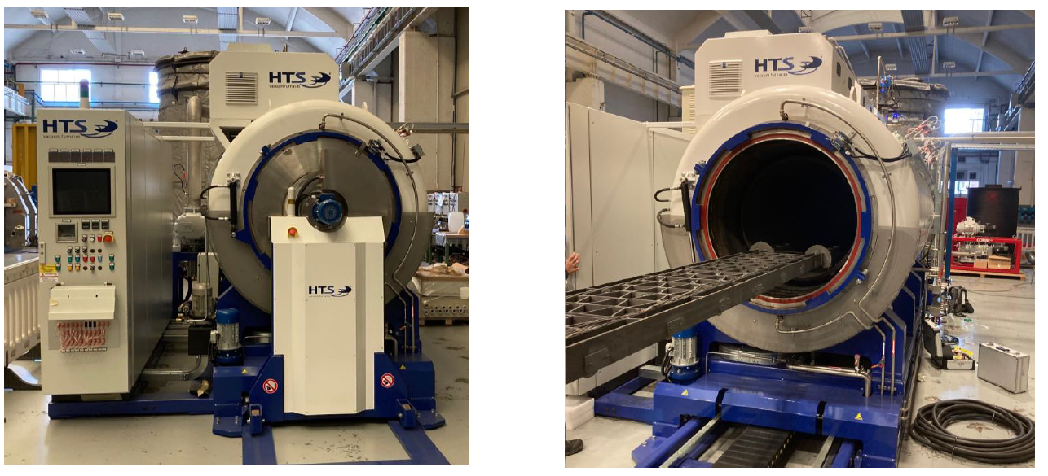
Heat treatment furnace
The heat treatment furnace temporary installed at ASG for the FalconD project has been procured by INFN.
Following the completion of the FalconD project, the furnace will be relocated to LASA in preparation for the 14+ T program.

Slide 18
INFN 14⁺ T program (2025─2030)
We are currently discussing with INFN/CERN a program that is a natural evolution of previous efforts (to be funded 50%−50%).
The main objective of this program is to design and implement a demonstrator of an Nb₃Sn 14⁺ T dipole:
it is designed to reach 14 T at T$≤$4 K (with less margin)
… and 15.5-16 T at 1.9 K
additional task if the FalconD program will produce 4 viable coils:
assembly at LASA a double aperture 12 T magnet
→ double aperture 12 T dipole can be proved by 2026-27! Important input of the EU strategy.
Full approval received from E.Todesco (HFM Program Leader)

Slide 19
Nb₃Sn 14+ T program timeline
Year 1 (Jun-2024):
Focus on electromagnetic design to optimize temperature margin, enhance windability, and assess conductor and cable feasibility.
Conduct 2D mechanical design to manage peak stress levels.
Select materials for components and establish manufacturing processes such as curing and impregnation.
Conduct tests and studies on critical aspects and design choices, including splicing and quench protection.
Year 2:
Refine design based on simulation results and insights from mockup testing.
Procure necessary materials, components, and tooling.
Establish the cold test station at the LASA laboratory in Milan.
Continuously improve and refine the quench protection system for enhanced safety and efficient energy removal.
Year 3:
Conduct initial tests on the conductor to evaluate windability under realistic conditions.
Analyze test results and identify areas for improvement in design and manufacturing processes if necessary.
Construct the first dummy coil and initiate the mechanical assembly process.
Year 4:
Finalize design and manufacturing processes for the four-layer Nb³Sn accelerator magnet.
Start manufacturing of the final magnet version, including spares.
Complete the configuration of the test station settings.
Year 5:
Conduct comprehensive testing of the magnet and perform measurements under various operating conditions.

Slide 20
Conclusions
FalconD activities are well progressing:
First dummy coil will be ready by 2024
First 23 Nb3Sn coils ready by 2025
First 12 T dipole assembled and tested in single aperture mode in 2026
If the new Nb₃Sn program will be approved:
First 14+ T dipole ready by 2030
First 12 T dipole assembled and tested in double aperture mode in 2026/2027

Slide 21
Thanks for the attention

