Slide 1
The workshop will focus on the continuing development of the scientific case for a 22 GeV upgrade to CEBAF at Jefferson Lab.
This workshop will showcase the continued staff and user community efforts to develop increasingly realistic projections for experiments that would become possible with an energy upgrade that maintains the world-leading luminosity of CEBAF.

Slide 2
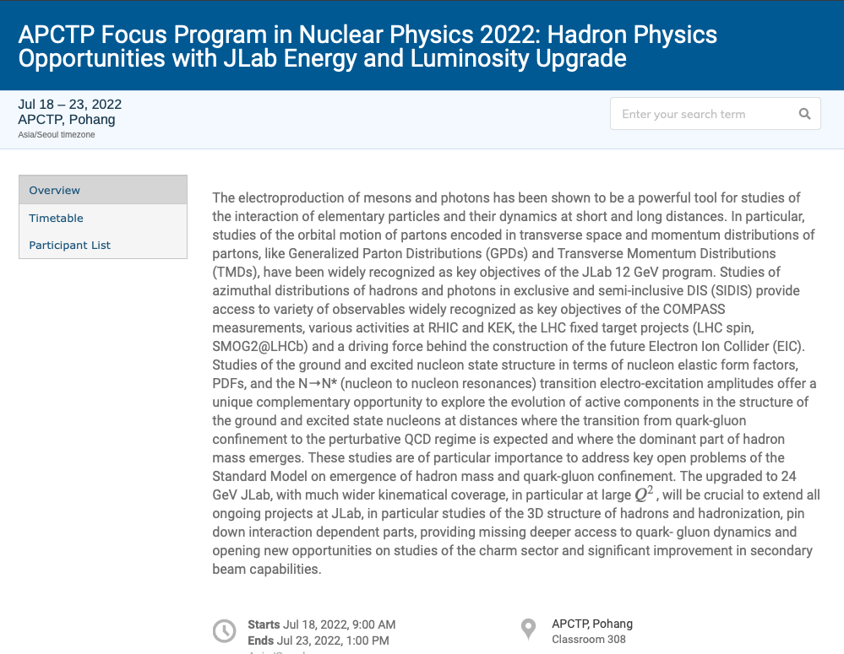
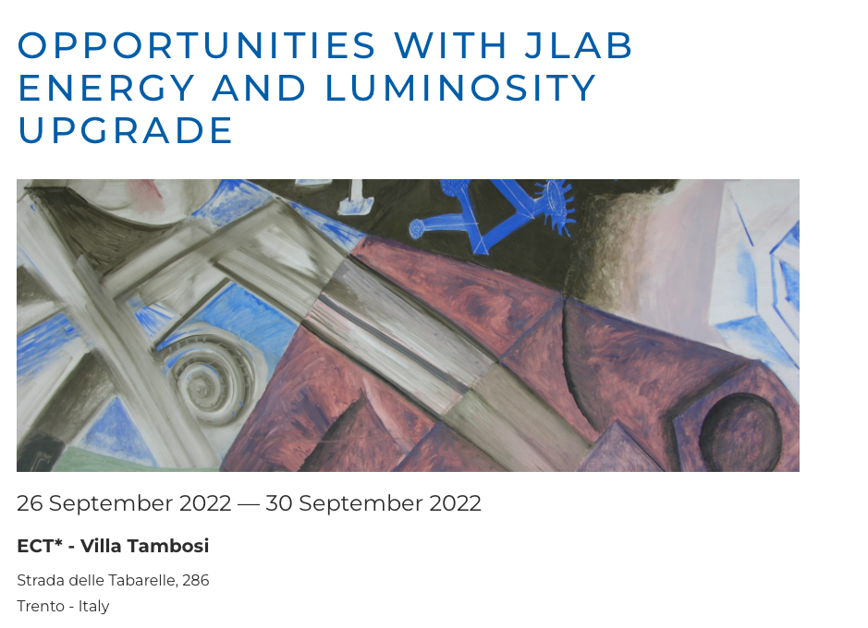
Development of a Science Case for an Energy Upgrade
International Workshops
March-Sep 2022
Intense linearly pol. photon beam
Effort started in 2022 in preparation of the 2023 US NP Long Range Plan
Summer Series @ Jlab
Jun-Aug 2022
Hadron Spectroscopy with a CEBAF Energy Upgrade
The Next Generation of 3D Imaging
Mid x: Anti-shadowing and the Role of the Sea
J/Psi and Beyond
Physics Beyond the SM
CW e- : E_{max}, =12 GeV GeV, Pol.~ 90%
Science at the Luminosity Frontier: JLab at 22 Gev
January 23-25, 2023
APS April Meeting 2023
Apr 15 & 16, 2023
B15/K16 Mini-Symposium:
Opportunities with Jlab Upgrades in Energy, Luminosity and a Positron Beam
Fragmentation, Transverse Momentum and Parton correlations
Hadron-quark transition and nuclear dynamics at extreme conditions
Low-energy tests of the Standard Model and Fundamental Symmetries
Spectra and structure of heavy and light hadrons asprobes of QCD
Sea and valence partonic structure and spin
Form Factors, Generalized Parton Distributions and Energy-Momentum Tensor
https://www.jlab.org/conference/luminosity22gev
2

Slide 3
The Outcome
Intense linearly pol. photon beam
Highlighted in the 2023 US Long Range Plan for Nuclear Science:
“Recently, the Cornell Brookhaven Electron Test Accelerator (CBETA) facility demonstrated eight-pass recirculation of an electron beam with energy recovery employing arcs of fixed-field alternating gradient magnets. This exciting new technology could enable a cost-effective method to double the energy of CEBAF…”
The 22 GeV energy upgrade “…will allow access to a new sector of hadron spectroscopy and offer an unprecedented view of the complex nucleon structure in the valence region, one not accessible at other machines.”
CW e- : E_{max}, =12 GeV GeV, Pol.~ 90%
White Paper (~450 authors) Eur.Phys.J.A 60 (2024) 9, 173
Fragmentation, Transverse Momentum and Parton correlations
Hadron-quark transition and nuclear dynamics at extreme conditions
Low-energy tests of the Standard Model and Fundamental Symmetries
3

Slide 4
Moving Forward…
Intense linearly pol. photon beam
A small study group (11 people) from Jab management, Physics, Accelerator and Theory Divisions, and 3 representatives of the user community, meets monthly
Define the roadmap for the development of the positrons and the 22 GeV beams technology
Bi-weekly meetings open to the whole community https://wiki.jlab.org/jlab22/index.php/22_GeV_Open_Discussion
CW e- : E_{max}, =12 GeV GeV, Pol.~ 90%
The goal is to the refine the scientific case for the 22 GeV upgrade
Aim for 15 minutes of presentation followed by a critical discussion necessary to develop a strong scientific argument
Slides and also some notes and questions posted on the wiki
Fragmentation, Transverse Momentum and Parton correlations
Hadron-quark transition and nuclear dynamics at extreme conditions
Low-energy tests of the Standard Model and Fundamental Symmetries
In preparing your talks for this workshop, we hope you have found helpful to look through some of the questions and discussion points. We imagine that we will revisit them in the presentations and parallel discussion. They are definitely not an "all-inclusive" list of questions!
4

Slide 5
Program
Intense linearly pol. photon beam
 | Monday | Tuesday | Wednesday | Thursday | Friday
MORNING | Spectroscopy | Partonic structure and spin | Spatial Structure, Mech. Properties, and Emergent Hadron Mass | Nuclear Dynamics | General Interest talks 22 GeV Accelerator Positrons Summary talks Path forward
 |  | Hadronization and Transverse Momentum
Lunch | Lunch | Lunch | Lunch | Lunch
AFTERNOON | Partonic structure and spin | Hadronization and Transverse Momentum | EXCURTIONS | QCD confinement, Fund. Symmetries and BSM
 | WELCOME PARTY | 3 PARALLEL SESSIONS | SOCIAL DINNER | 3 PARALLEL SESSIONS
CW e- : E_{max}, =12 GeV GeV, Pol.~ 90%
5

Slide 6
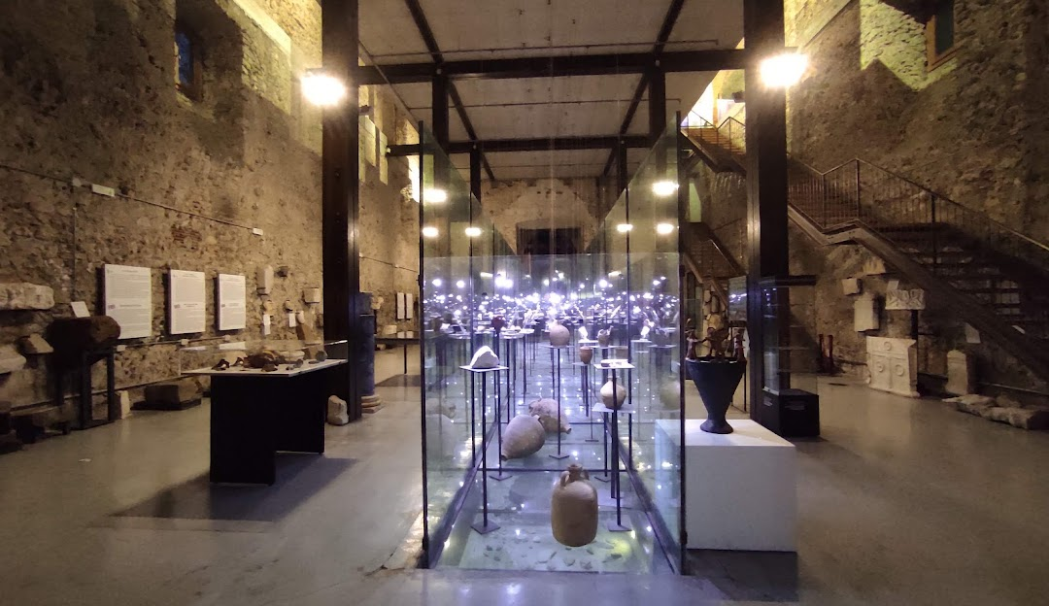
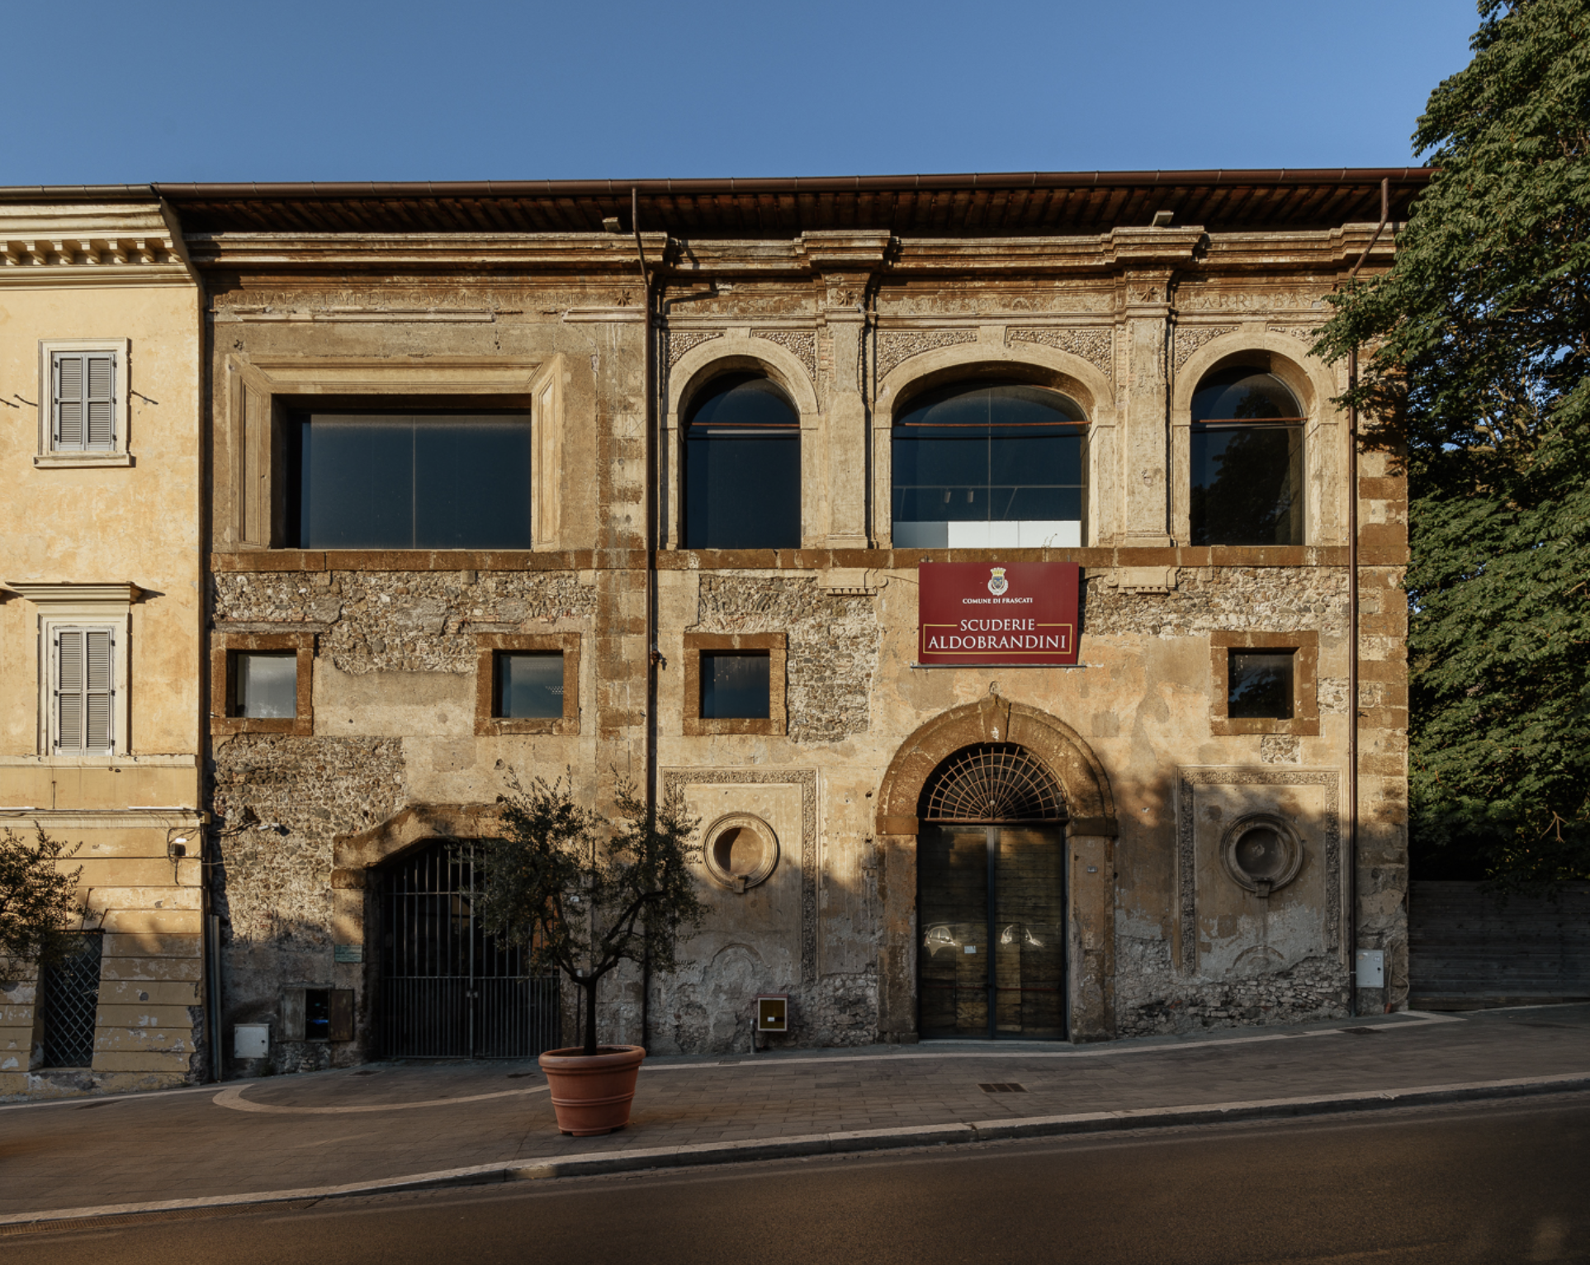
Welcome Party – Monday Dec 9
Scuderie Aldobrandini
Piazza Roma, Frascati
Bus transportation
From LNF at 6 pm, meeting in front of the building 36
From Piazza Roma at 9 pm to:
Hotel Villa Grazioli
Domus Park Hotel
Hotel Villa Mercede
Laboratori Nazionali di Frascati
Tor Vergata train station
A seventeenth-century building which houses the Museo Tuscolano. Its collection includes ancient Roman artefacts and models of the Ville Tuscolane
Last train Frascati-RomeTermini: 22:36
Last train Tor Vergata-Rome Termini: 23:13
Guided Tour during the reception

Slide 7
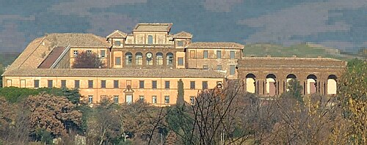
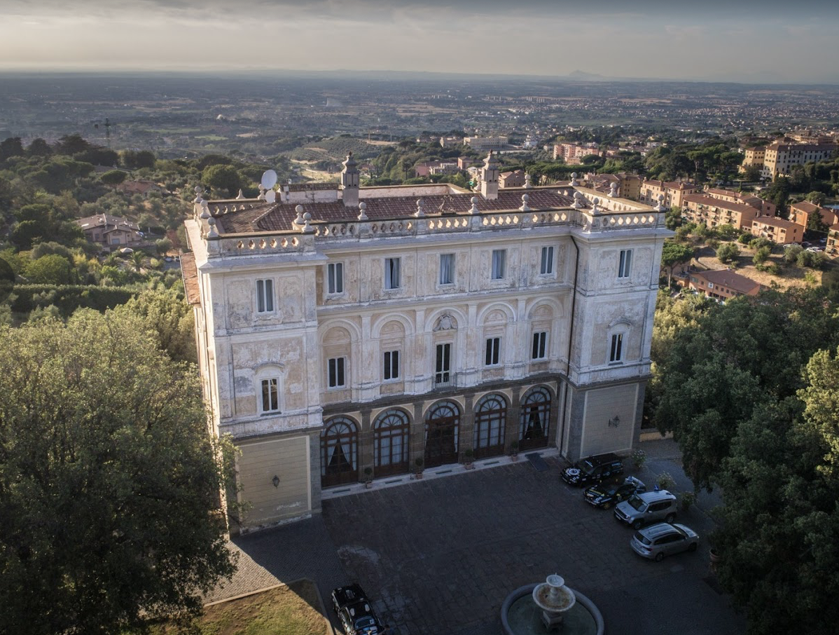
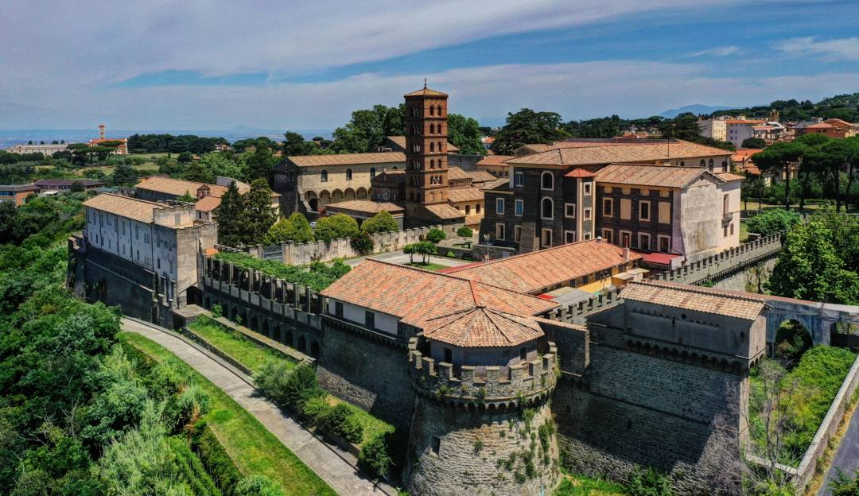
Excursions & Social Dinner – Wednesday Dec 11
Villa Mondragone
Social Dinner
Villa Grazioli
Construction began in 1573 by Cardinal Mark Sittich von Hohenems Altemps
Abbazia di San Nilo
Founded in the year 1004 of Greek-byzantine origins, houses an important Library containing more than a thousand ancient manuscripts and around 50.000 volumes
The Abbey features the famous Laboratorio di Restauro del Libro Antico (Workshop for the conservation of ancient books) among which the “Antlatic Codex” by Leonardo da Vinci.
Built in the 16th century (by commission of Cardinal Carafa, is a masterpiece of the Renaissance, home to prestigious historical frescoes that reflect centuries of art and culture
Guided Excurtions
Notes:
Ville Tuscolane, a series of patrician villas built in the surrounding countryside between the 16th and 17th centuries.

Slide 8
Practical Information
Registrations are open at the front desk
Please, remember to upload the abstract of your talk or send it to marco.mirazita@lnf.infn.it
Lunch at the canteen not before 1.30 pm
Daily meal vouchers are inserted in the badge holder, to be handed over at the cashier
First Course
Second Course
Side Dish
Fruit
Bread
Dessert (when available)

