Slide 1
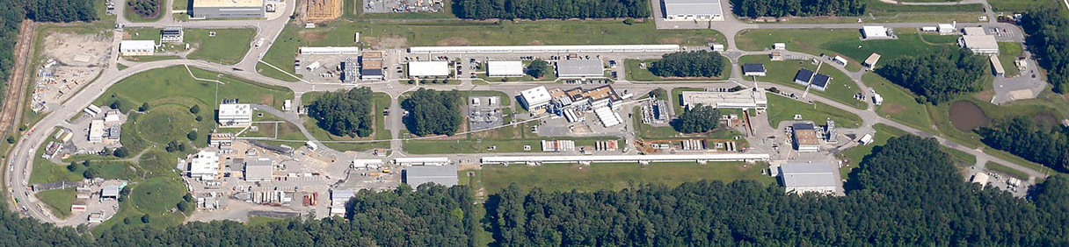
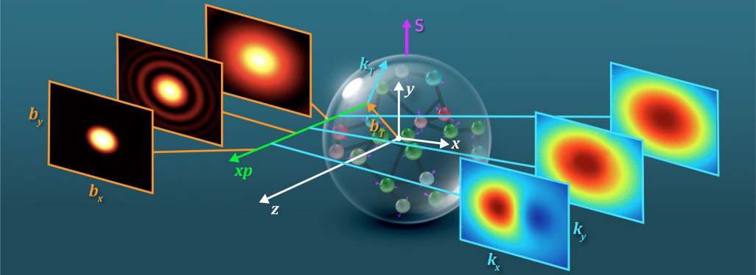


Advance Planning for Potential 22 GeV and
Positron Capabilities at Jefferson Lab
Allison Lung
Project Assurance Officer
Presented To:
Science at Luminosity Frontier
December 9 - 13, 2024
Position
Momentum
Direction of Proton

Slide 2
OUTLINE
Jefferson Lab continues to work with the community to articulate the scientific motivation for positron beams and for an increase in the maximum electron beam energy from 12 GeV to 22 GeV.
Such capabilities could be realized in the future through a DOE construction project, which means that advance planning is important now to assess the key elements of a pre-conceptual project plan and the technical feasibility of the design.
An overview of the DOE process for projects from establishing the mission need for a scientific capability (Critical Decision-0) through to project completion (Critical Decision-4) will be presented together with a brief look at early planning activities.

Slide 3
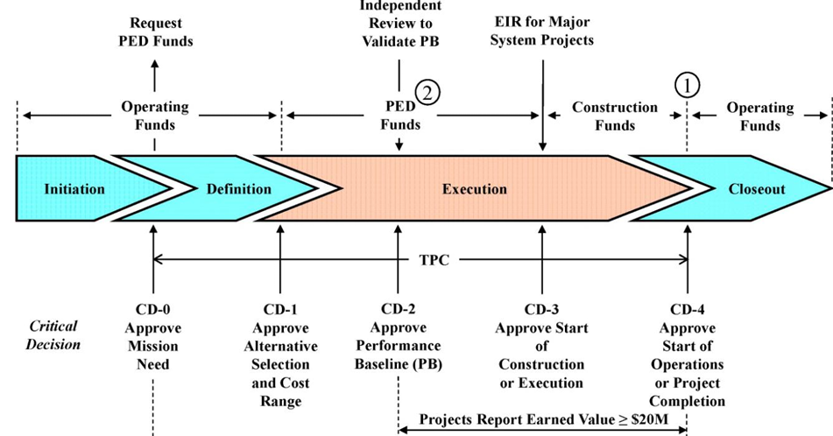
Department of Energy (DOE) Project Planning & Phases
Projects are planned in Phases which are “gated” by Critical Decision (CD) reviews and approval:
CD-0 Mission Need
  Science Case
CD-1 Cost Range
CD-2 Baseline
CD-3 Construction
CD-4 Completion
  Transition to Ops
22 GeV Upgrade is in pre-project development mode.
Focus on science case and technical feasibility.

Slide 4
Pre-R&D Studies are Critical to Initial Project Planning
Demonstrating technical feasibility is the foundation for defining the scientific capability as well as the range of cost, schedule, and scope.
What has Jefferson Lab been doing in this arena?
  Investing annually through Accelerator R&D ($K)
  Requested an increase from DOE Nuclear Physics to $3M level annually
  Investing in Lab Directed R&D (LDRD)
Activities toward improving existing facility | Past Years | FY23 Actual | FY24 Est. | FY25 Est. | TOTAL ($K)
Positrons for CEBAF | 542 | 514 | 518 | 523 | 2,097
22 GeV CEBAF | 128 | 350 | 354 | 358 | 1,190
Total | 670 | 864 | 872 | 881 | 3,287
LDRD Awards - FY25 | Principal Investigator
High-intensity, polarized-beam prototype photogun for the Ce+BAF positron source | Max Bruker
Positron injector model integrator | Joe Grames
FFA@CEBAF permanent magnet resiliency in real radiation environment | Ryan Bodenstein
Total | ~$600K

Slide 5
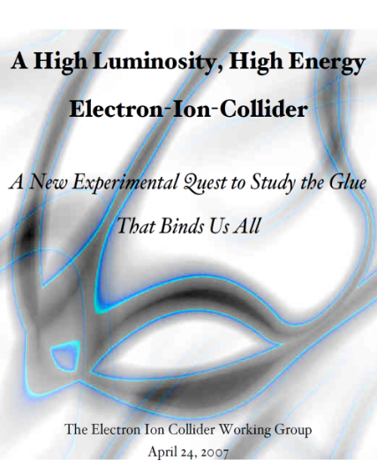




Scientific Foundation for An Electron-Ion Collider was Built
Long Range Plans; White Papers; NSAC Reviews; NAS Study; Yellow Report
“a high-energy high-luminosity polarized EIC [is] the highest priority for new facility construction following the completion of FRIB.”
2007
The science questions that an EIC will answer are central to completing an understanding of atoms as well as being integral to the agenda of nuclear physics today.”
2009
2010
Gluons and the Quark Sea at High Energies
2012
2013
2015
Science Requirements and Detector Concepts for the EIC – Drives the requirements of EIC detectors
Major Nuclear Physics Facilities for the Next Decade
2018
2021
“…essential accelerator and detector R&D [for EIC] should be given very high priority
in the short term.”
NSAC
2023
We recommend the expeditious completion of the EIC as the highest priority for facility construction.
“We recommend the allocation of resources …to lay the foundation for a polarized Electron-Ion Collider…”
“..a new dedicated facility will be essential for answering some of the most central questions.”
March 14, 2013
“The quantitative study of matter in this new regime [where abundant gluons dominate] requires a new experimental facility: an Electron Ion Collider..”
arXiv:2103.05419
22 GeV would require similar activities, progression quicker to match size

Slide 6
Next Steps in Pre-Project Planning
Draft a Preliminary Technical Design Report (TDR)
  Capture the urgent questions that must be answered
  Define and execute the plan to answer those questions through Pre-R&D, LDRD, modeling, etc
  Update to full TDR as the results are known and the design matures
Continue to develop the most compelling science case
  Synthesize the most impactful results into language non-physicists understand
  Users and Lab lead the way; highlight international collaborations
  See Closing Talk by Thia Keppel
Work during this preliminary phase advances the field of nuclear physics through technology development and a refined understanding of critical science questions…..and creates the foundation for a 22 GeV Project.

Slide 7

Discussion

