Slide 1

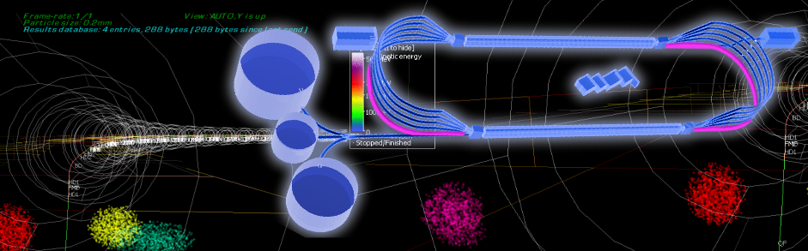
Probing the EMC effect thru the measurement of super-fast quarks in nuclei
John Arrington, Lawrence Berkeley Lab
Science at the Luminosity Frontier: JLab at 22 GeV, Dec 12, 2024 Frascati
Notes:
Not a new idea, but JLab12 is first chance to test the technique, 22 GeV is where we can gain new and unique ways to test explanations of the EMC effect

Slide 2
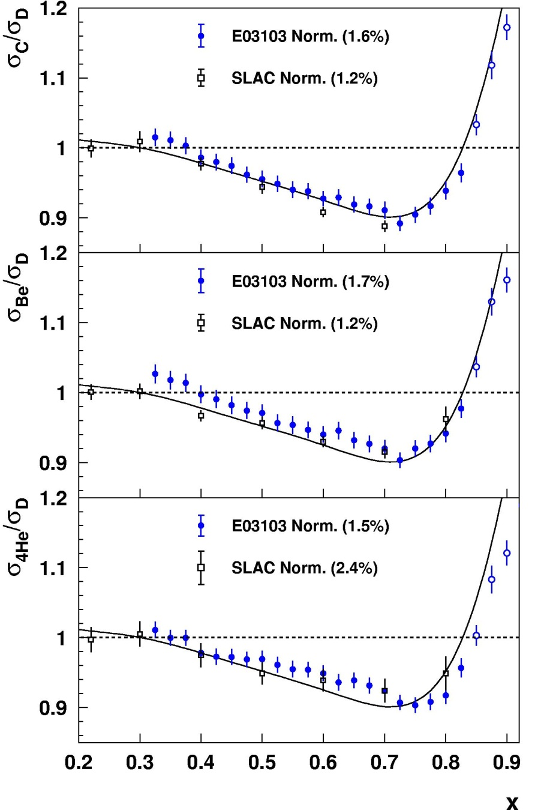
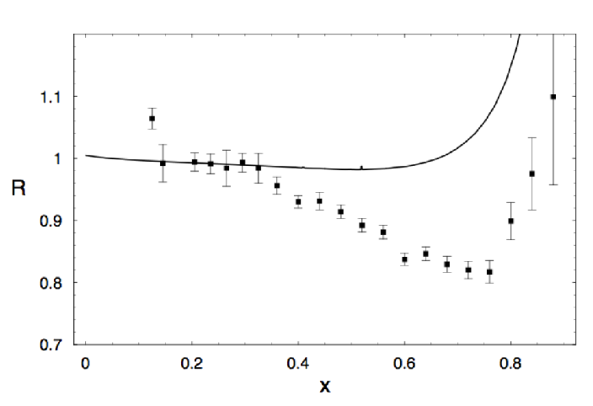
EMC effect
¹²C
EMC measured Fe/D cross section ratios in DIS regime; found strong suppression of nuclear PDFs in valence region
→ Significant suppression of high-x quark distribution in Fe
JLab E03-103 measured EMC effect for ^{3,4}He, ⁹Be, ¹²C Consistent shape for all nuclei (curve is SLAC ¹²C fit)
R = F₂^{Fe}(x) / F₂^{D}(x)
⁹Be
J. J. Aubert, et al., PLB 123, 275 (1983)
⁴He
We quantify the EMC effect using the slope in the linear region (0.35<x<0.7)
J.Seely, et al., PRL103, 202301 (2009)

Slide 3
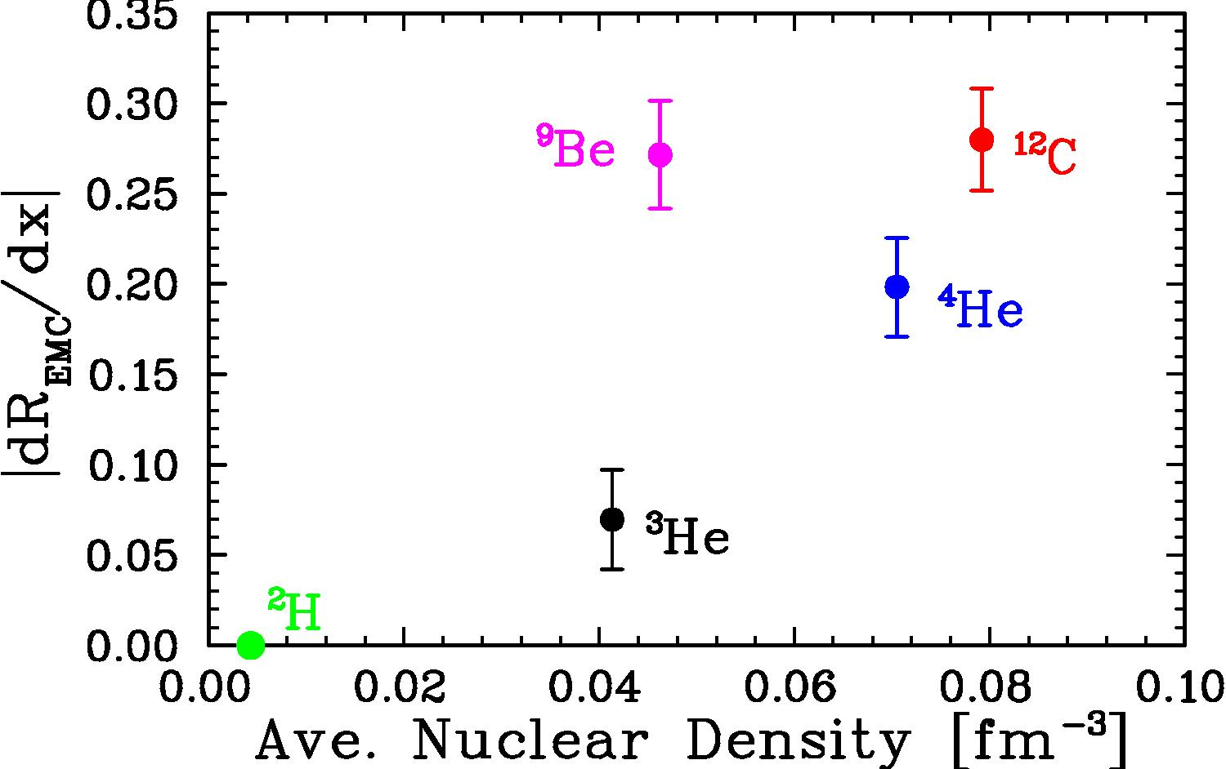
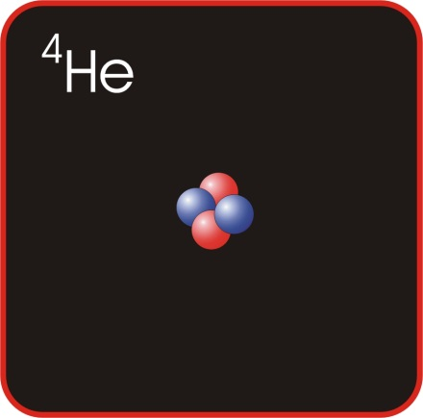
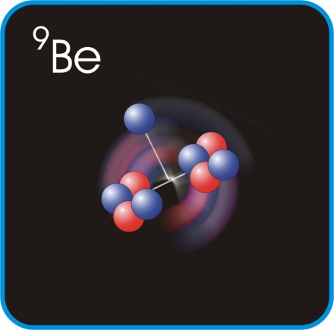
EMC effect
J.Seely, et al., PRL103, 202301 (2009)
Conventional binding/smearing can explain up to half of the effect in some models. Has much smaller impact in light-front calculations
Several more exotic explanations proposed; many can explain the conventional EMC effect, but may be excluded by other observables
Insight from the Jefferson Lab program:
Light nuclei measurements led to examining more detailed nuclear structure
Notes:
Initially interpreted as connection to local density

Slide 4
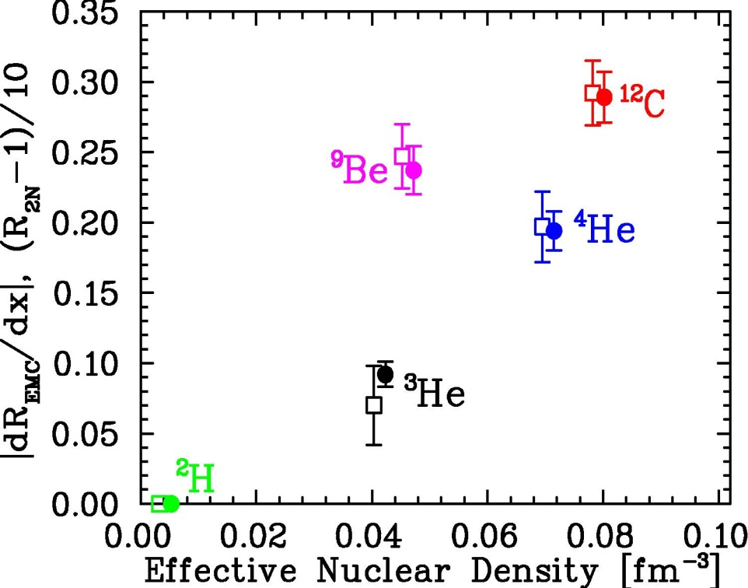
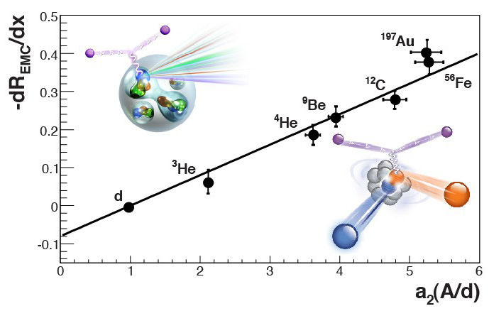
EMC effect
J. Arrington, et al., PRC 86 (2012) 065204
Conventional binding/smearing can explain up to half of the effect in some models. Has much smaller impact in light-front calculations
Several more exotic explanations proposed; many can explain the conventional EMC effect, but may be excluded by other observables
Insight from the Jefferson Lab program:
Light nuclei measurements led to examining more detailed nuclear structure
Demonstrated non-trivial EMC-SRC correlation – often explained in terms of Local-Density or High-Virtuality effects
New data (12 GeV): A and N/Z dependence, spin dependence, flavor dependence (SoLID), tagged EMC can provide tests of various models
22 GeV: Nuclear PDFs at x>1 (SFQ distributions), provide entirely new test of EMC effect; needs high energy for clean interpretation
L. Weinstein, et al., PRL 106 (2011) 052301
Notes:
Connection to SRC consistent with LD picture. But could also be a direct connection to large momenta.

Slide 5
Nuclear PDFs at x>1 (SFQs)
In a simple convolution model, SFQs are associated with high-x quarks in high-momentum nucleons
Both the PDF and the nucleon momentum distribution fall rapidly at large momenta
SFQ distribution falls very rapidly at large x values (esp. for deuteron)
If nuclear PDF in SFQ regime is very small, certain effects may be much easier to see
Additive contributions
Shifting of strength from lower x
Off-shell effects associated with very high-momentum nucleons will be maximized
Most models show increasing modification at large x
Virtuality increases at large nucleon momenta

Slide 6
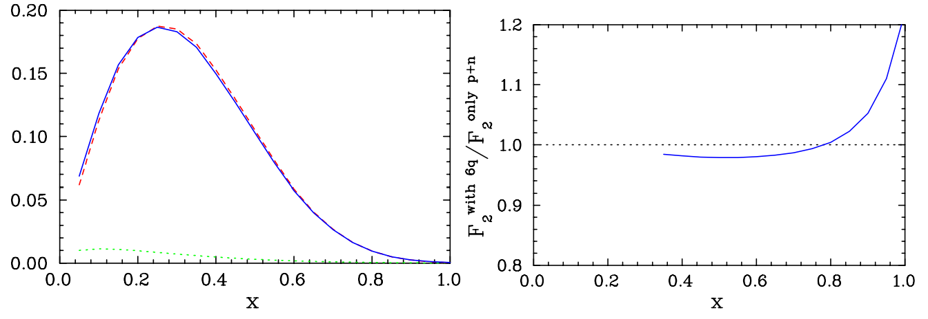
Nuclear PDFs at x>1 (SFQs)
q_{D}(x)
p+n (+smearing)
Six-quark bag was potential explanation for the EMC effect
  Two interacting 3q bags ≠ one 6q bag
  Small impact EMC region, much larger in SFQ region
Momentum sharing more important at
95% (p+n) plus
5% 6q bag
6-quark bag (x0.05)
Adding 5% 6q bag gives 2% EMC effect for deuteron
J. Arrington, APHA 21 (2004) 295, arXiv:hep-ph/0304213

Slide 7
Nuclear PDFs at x>1 (SFQs)
q_{D}(x)
p+n (+smearing)
Six-quark bag was potential explanation for the EMC effect
  Two interacting 3q bags ≠ one 6q bag
  Small impact EMC region, much larger in SFQ region
In a simple convolution model, the super-fast quarks are associated with high-x quarks in high-momentum nucleons
  Falls rapidly at large x values (esp. for deuteron)
Momentum sharing more important at largest quark momenta
  Dramatic enhancement (potentially order of magnitude) over taking highest-x quarks in highest-momentum nucleons
95% (p+n) plus
5% 6q bag
6-quark bag (x0.05)
p+n with 5% 6q
Smeared p+n
J. Arrington, APHA 21 (2004) 295, arXiv:hep-ph/0304213

Slide 8
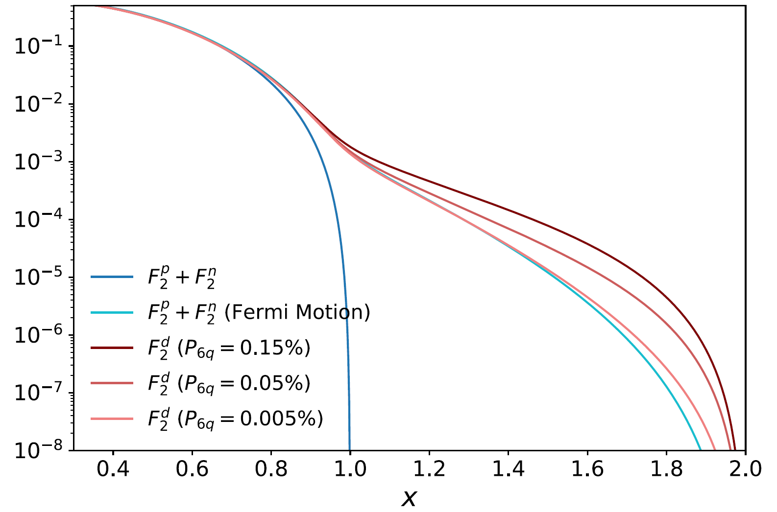
Nuclear PDFs at x>1 (SFQs)
M. Sargsian, NPA 782 (2007) 199
Six-quark bag was potential explanation for the EMC effect
  Two interacting 3q bags ≠ one 6q bag
  Small impact EMC region, much larger in SFQ region
In a simple convolution model, the super-fast quarks are associated with high-x quarks in high-momentum nucleons
  Falls rapidly at large x values (esp. for deuteron)
Momentum sharing more important at largest quark momenta
  Dramatic enhancement (potentially order of magnitude) over taking highest-x quarks in highest-momentum nucleons
Similar for any mechanism that allows direct momentum sharing
D. Kim, G. Miller
D. Kim and G. Miller, PRC 109 (2024) 045203

Slide 9
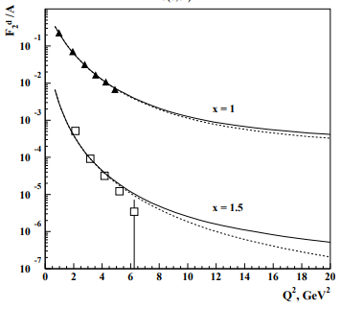
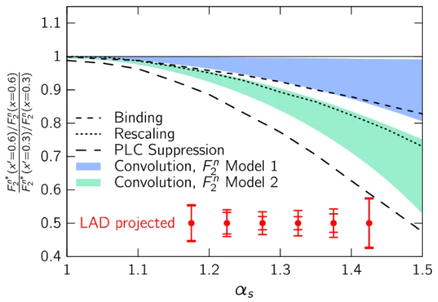
Other models for super-fast quarks
M. Sargsian, et al., JPG 29 (2003) R1
Nucleon overlap/quark momentum sharing predict significant enhancement in the nuclear PDFs at x>1 (100-1000+%)
A range of other models (color screening, PLC suppression, rescaling, off-shell) can yield significant suppression in this region (factor of 2)
Simple enough concept, but need systematic evaluation of models
Baseline F2d, predications
Models: x dependence, A dependence, Q² dependence
Verification that data at x>1 show scaling
Color screening model
JLab E12-11-10 experiment
F. Hauenstein, et al., EPJA 60 (2024) 201
R ~ F₂^{tagged}/F₂^{untagged}

Slide 10
Theory input needed
Calculations of SFQ distributions for the deuteron based on conventional effects
Need to determine the 'baseline' distributions and uncertainties
(discussed PDFs so far, but need full structure function, including HT at correct Q²)
Evaluate models of the EMC effect in a consistent fashion (same observables, kinematics)
Some calculations exist, some have been evaluated for tagged DIS but not inclusive
Examine A-dependence, Q² dependence
Should be straightforward, but no systematic evaluations
Need to define/determine scaling region
Typical W² cut not applicable to nuclei (x=1 is W²=.88 GeV² at all Q²)
There are relatively straightforward ways to estimate and evaluate whether or not data behave like DIS (e.g. contribution from DIS in e-N subsystem)
22 GeV is absolutely critical here

Slide 11
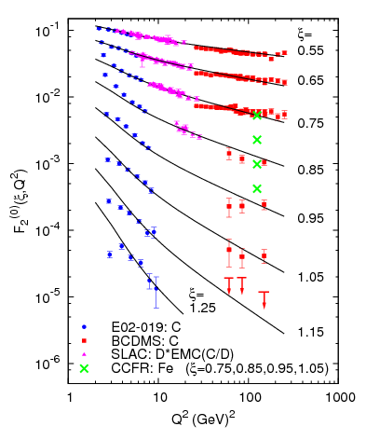
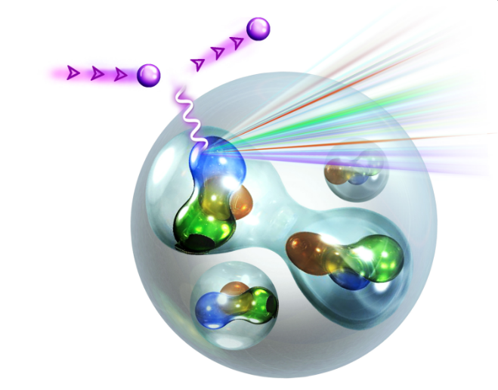
Super-fast quarks
6 GeV data show partonic-like scaling behavior for x>1, despite being dominated by resonance + quasi-elastic (quark-hadron duality)
Recent 12 GeV experiment doubles JLab Q² range, similar DIS and resonance region, small QE contribution
22 GeV: Dominated by DIS, small resonance and negligible QE contributions
N. Fomin et al, PRL 105, 212502 (2010)

Slide 12
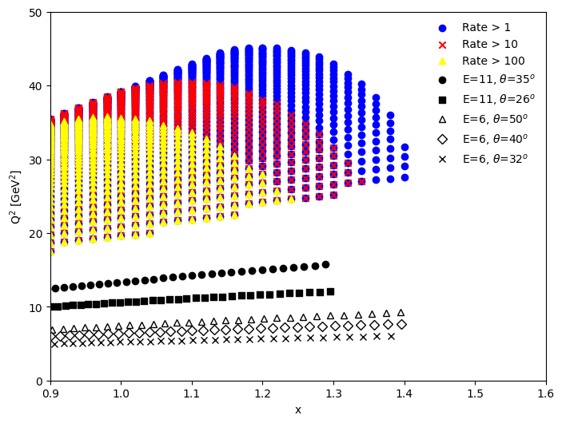
Kinematic projection
Kinematic coverage for 6, 11, and 22 GeV from the 22 GeV White Paper
Blue (red, yellow) shows 1 (10, 100) counts/hour: 50uA on 2% ¹²C target
Updated from the 22 GeV white paper
A.Accardi, et al., EPJA 60 (2024) 173
Factor ~4 improvement in Q² coverage, comparable statistics at a largest x values
[11 GeV coverage is estimate – may go a bit further in x]
Notes:
6 and 11 GeV points correspond to minimum rates of 1-10 Hz

Slide 13
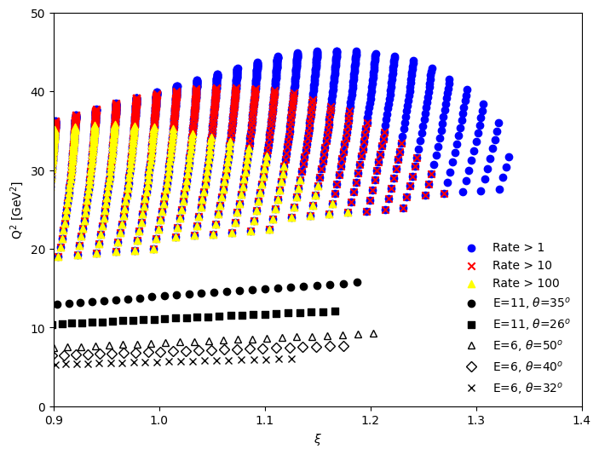
Kinematic projection
Kinematic coverage for 6, 11, and 22 GeV from the 22 GeV White Paper
Blue (red, yellow) shows 1 (10, 100) counts/hour: 50uA on 2% ¹²C target
Updated from the 22 GeV white paper
A.Accardi, et al., EPJA 60 (2024) 173
For DIS, better to look at coverage in ξ and Q²
ξ is 'improved' version of x for finite Q²
50% Q² increase and higher statistics over the current ξ range
Significantly higher ξ values, up to double the Q²
2009 study (MEIC) showed reasonable statistics up to ξ≈1 for Q² approaching 100 GeV²
Does not reach ξ values where large effects predicted
Current EIC luminosity is lower
Notes:
EIC: From 2009 study, Q2 up to ~100 GeV2 with useful (marginally) statistics up to xi=1 or so

Slide 14
Where do we go from here?
Theory:
Compare baseline convolution calculations, including TMC, HT effects
Extract the inclusive x>1 structure function from various models vs x, Q²
JLab@11 GeV (E12-06-105):
Quantify observed scaling of F₂ PDFs at these kinematics over significant Q² range
Look for increase (suppression) over baseline convolution
If observe large, statistically significant effect
  Compare A-dependence to calculations: 2H, 4He, 12C, 40Ca
  Very exciting, but validity of scaling will be a question
JLab@22 GeV: Only option to reach necessary kinematics with sufficient precision
Higher Q² makes data cleaner, more interpretable
Extends ξ range to values where several models show rapid variation
Examine A and Q² dependence

Slide 16
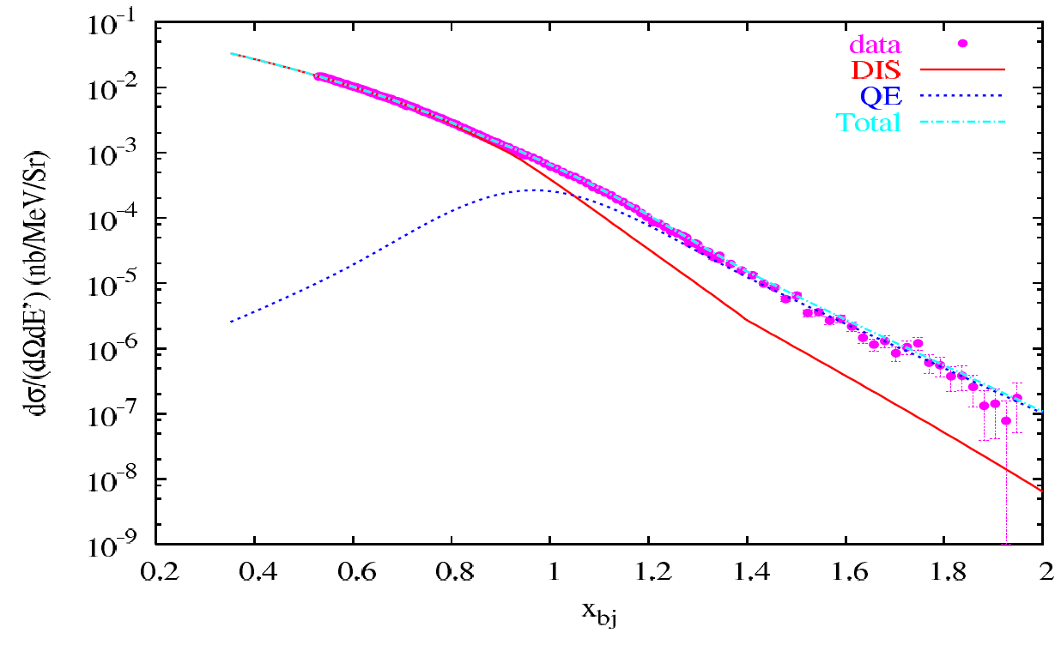
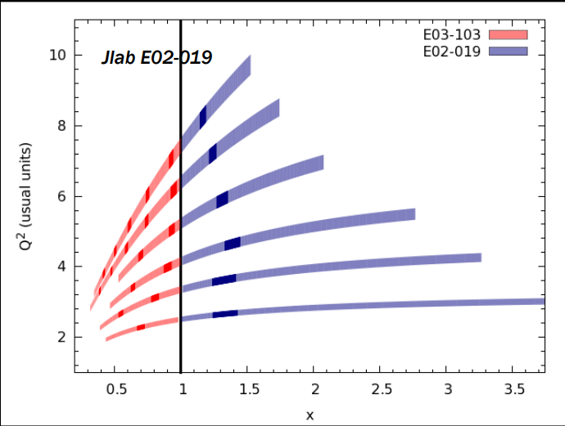
Challenges to interpreting SFQ distributions
High energies needed to isolate DIS at large x
  6 GeV experiment limited to 8-9 GeV²
Cross section very small (x>1, high Q²)
Need reliable calculations to use as 'baseline'
Carbon target
θ = 32 degrees
QE (blue) vs Inelastic (DIS + Resonance) (red)
QE dominated for x>1.1, and inelastic has significant resonance and DIS contributions
Not at all clear that structure function would provide access to PDFs or scale like DIS

Slide 17
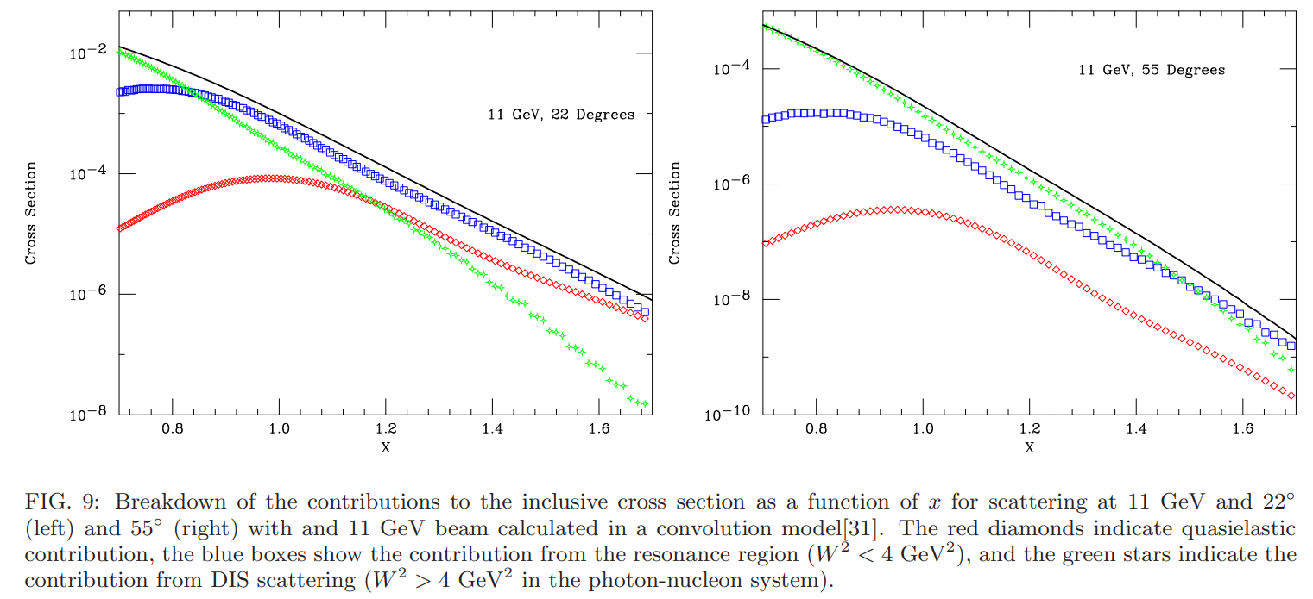
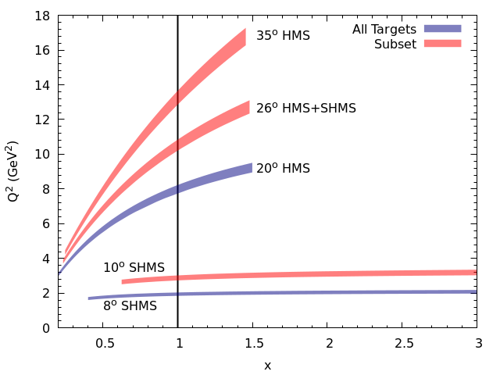
SFQs at 11 GeV: New kinematics
22 degrees: F₂ dominated by resonance region
(QE & DIS small)
55 degrees: DIS dominated x<1.4
resonance important
(QE negligible)
QE
Res
DIS
SRCs at x>1 at 12 GeV
[E06-105: JA, D. Day, N. Fomin, P. Solvignon]
Ran in Hall C with EMC effect experiment E12-10-008, 2022-2023
Inclusive scattering at x>1; push to largest Q² to study super-fast quark distributions
QE
Res
DIS
Notes:
22 degrees (lowest theta): Resonance dominated for x>1 (<20% DIS for x>1.2) vs QE dominated at 6 GeV
55 degrees (highest theta): QE<~10% at all x, DIS dominated up to x=1.4

Slide 18
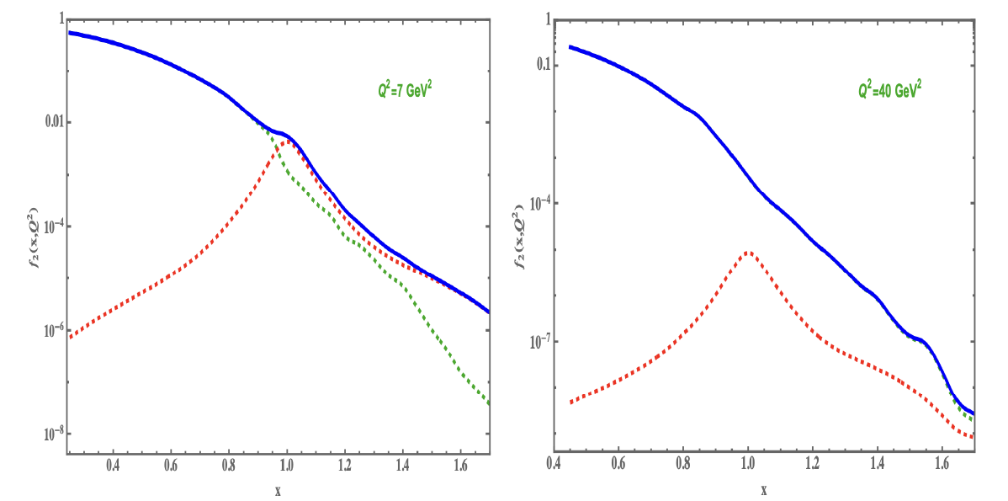
22 GeV
6 GeV data, Q²<8 GeV²: QE dominated, looks ("by eye") consistent with scaling
11 GeV, Q²<16 GeV² : DIS comparable to resonance region; QE small
  Not a precise measurement of PDFs; expect modest scaling violations (which can be measured)
  Could be very compelling if very large deviations observed
22 GeV, Q² ≈ 36 GeV²
  Much smaller resonance contributions
  Better check of scaling (Q² dependence)
  Push to higher x at 'lower' Q²: larger predicted effects
  Real A dependence studies possible
Plot (Sargsian) illustrates small QE contribution
Need to update Resonance vs DIS estimate
Notes:
6 GeV data doesn't prove anything, but gives hope. 11 GeV data will test scaling quantitatively over significant Q2 range

Slide 19
Challenges to interpreting SFQ distributions
N. Fomin et al, PRL 105 (2010) 212502
High energies needed to isolate DIS at large x
  6 GeV experiment limited to 8-9 GeV²
Cross section very small (x>1, high Q²)
Need reliable calculations to use as 'baseline'
At 6 GeV, high Q² data consistent with DIS data up to x ≈ 0.8 and consistent with QCD scaling behavior for x>1
Consequence of quark-hadron duality
JA, et al, PRC 73 (2006) 035205

Slide 20
