Slide 1
Seeking Dark Matter in the Southern Hemisphere with PAUL
Marcello Messina and Fairouz Malek on behalf of the PAUL project
Jul 8-12 2024 L'Aquila (Italy)

Slide 2
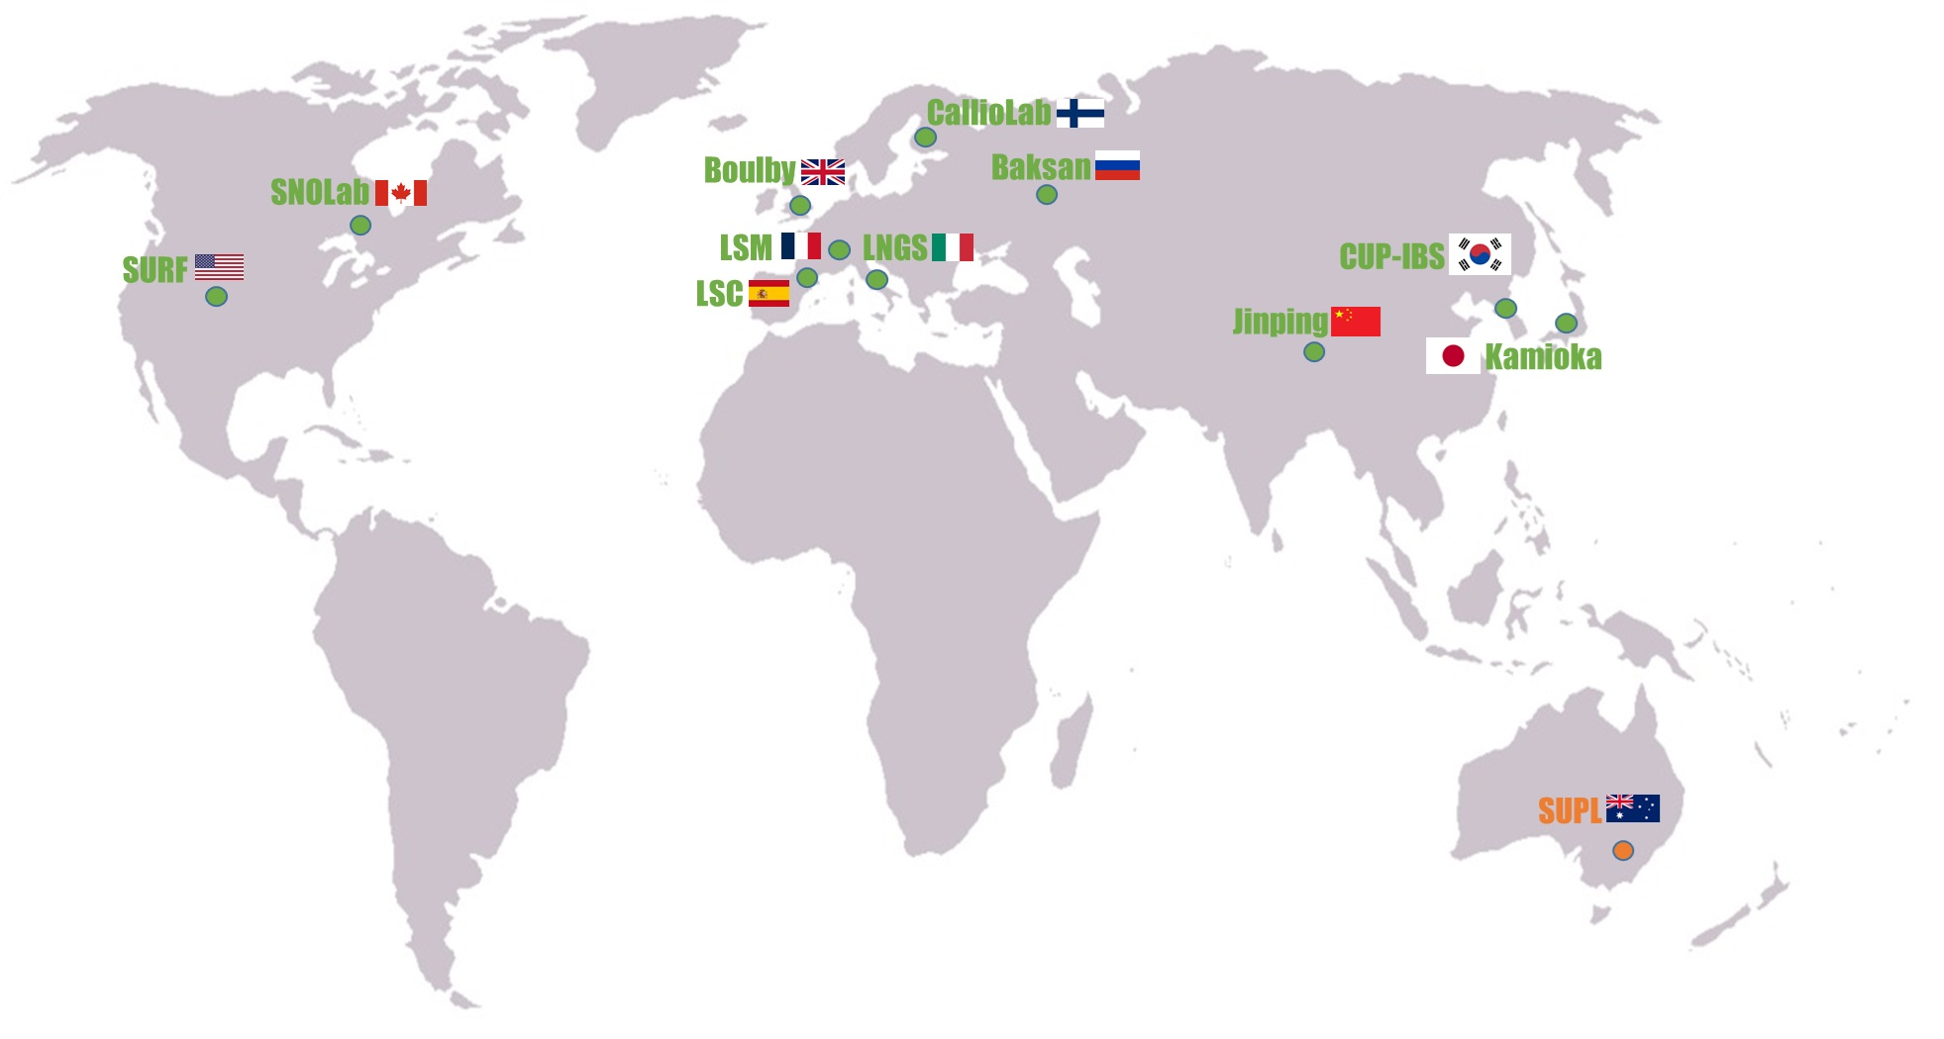
Main operational underground labs
Map of the existing underground laboratories. SUPL facility in Australia is being commissioned and will operate soon.

Slide 3
Some history
2015: Towards the South African Underground Laboratory
2019: Latest Updates on Developments of the Underground Neutrino Facility in South Africa

Slide 4
New Impetus

Slide 5
South African Astronomical Observatory
Square Kilometer Array
iThemba LABS

Slide 6
World Class Universities
Stellenbosch University
University of Cape Town
University of the Western Cape

Slide 7
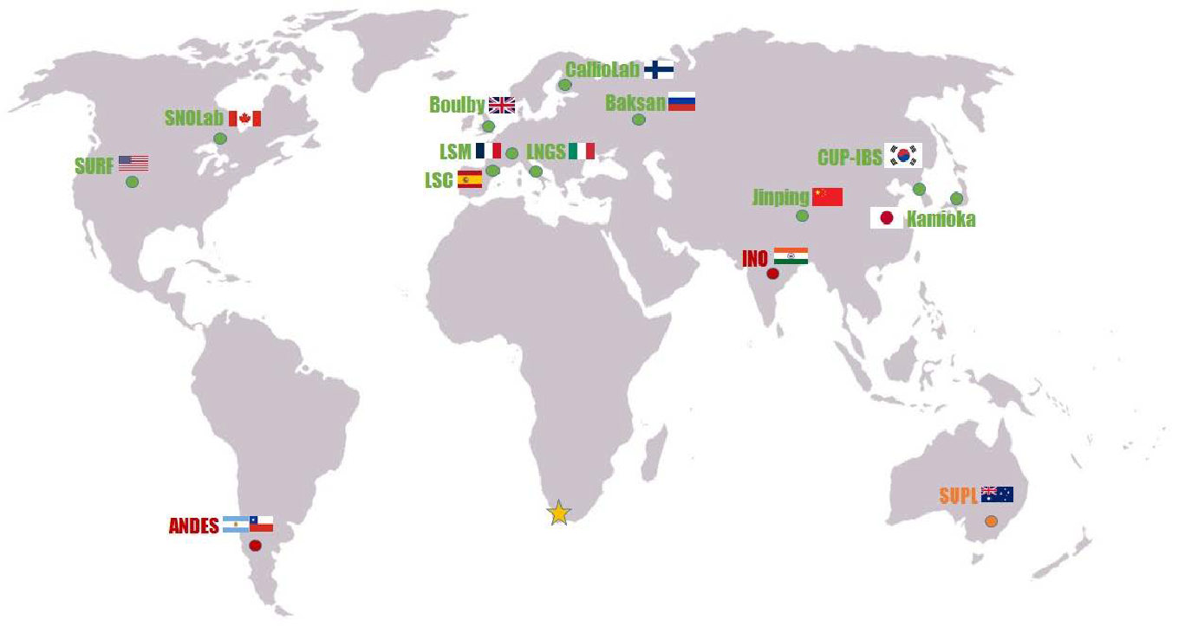
The future underground laboratory
PAUL
Paarl Africa Underground Laboratory
Red dots: Planned ULabs, ANDES at the Argentina-Chile border and INO in India. Yellow star is the planned PAUL in South Africa in the Cape Town Region.

Slide 8
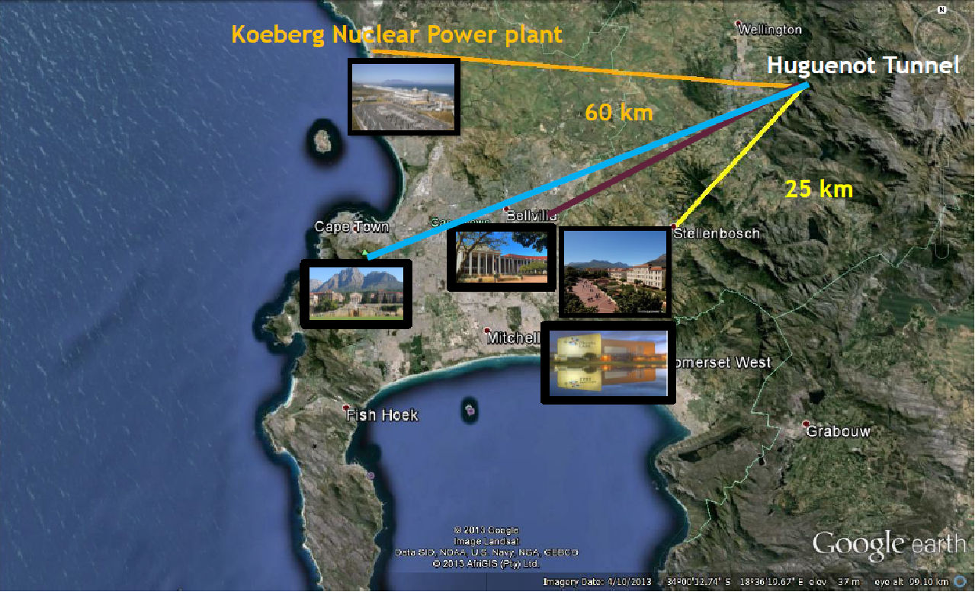

Slide 9
The Huguenot-Tunnel
South Bore
(operating car trafic tunnel)
Worcester -> Paarl
North Bore
Being upgraded in 2025
Paarl -> Worcester

Slide 10
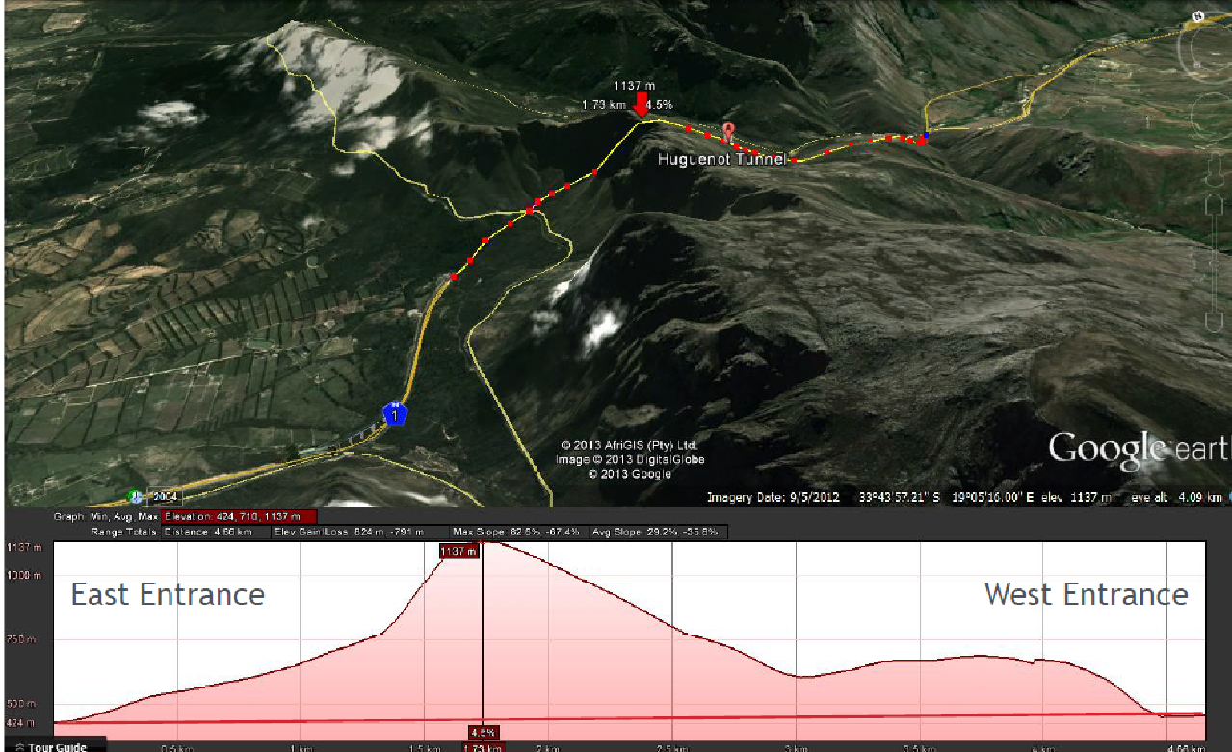
West Entrance
East Entrance
Paarl
Worcester
The range mostly consists of Table Mountain sandstone, an erosion-resistant quatzitic sandstone

Slide 11
Preliminary mock-up of the facility
A possible 10,000 m³ laboratory (40x16x16) in the Huguenot tunnel.
Courtesy: Joaquin Venturino (CNEA), April 2023.

Slide 12
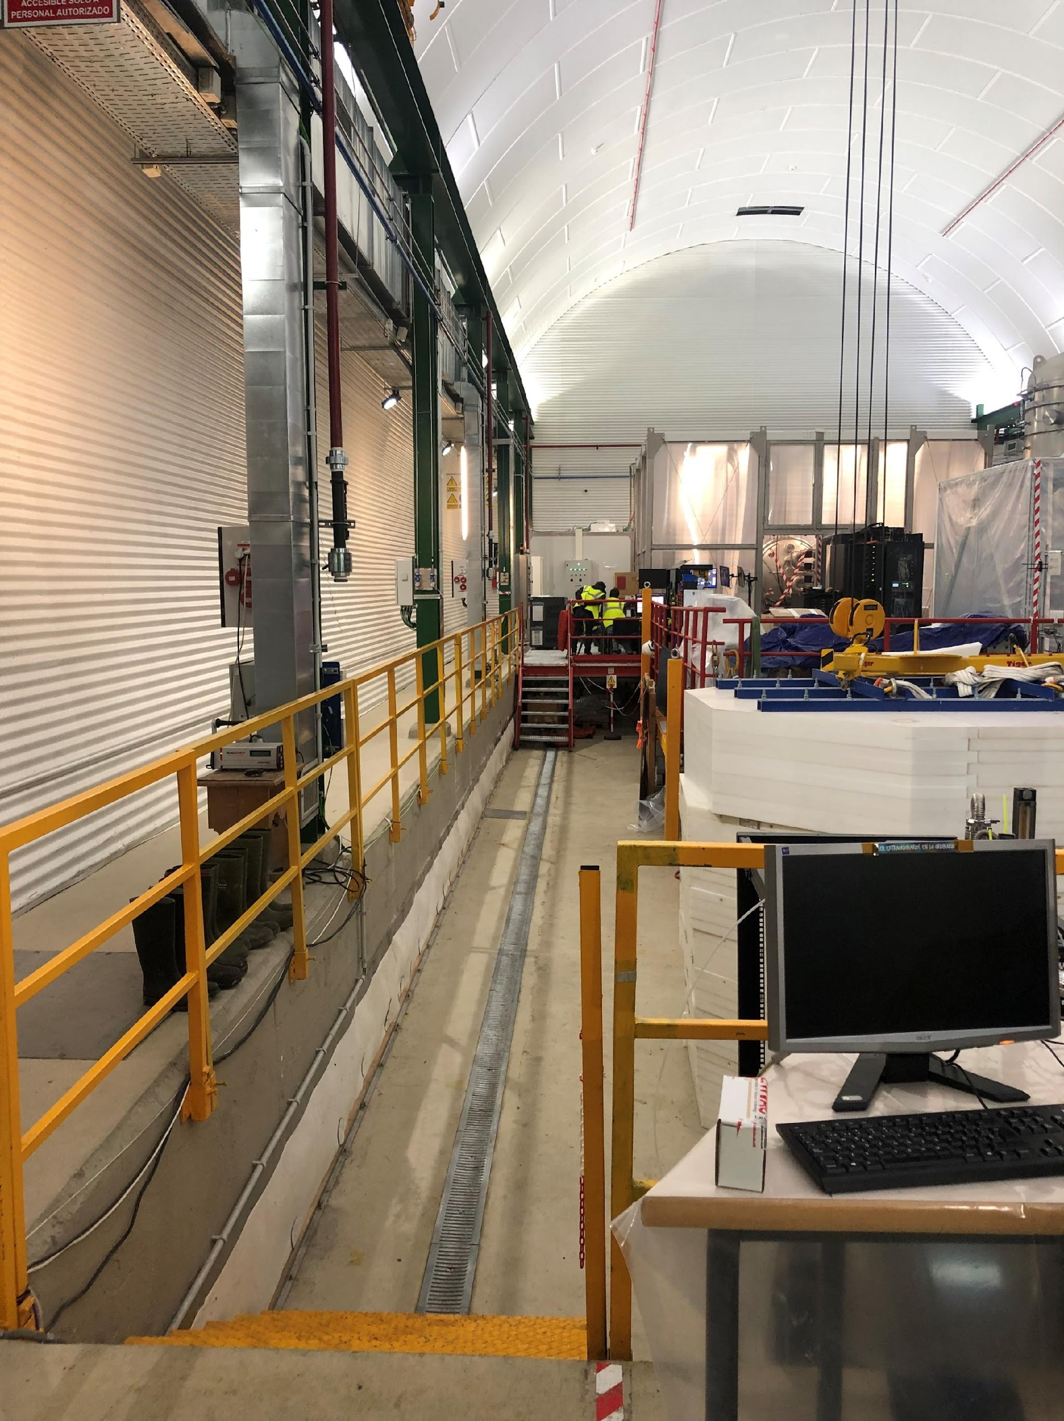
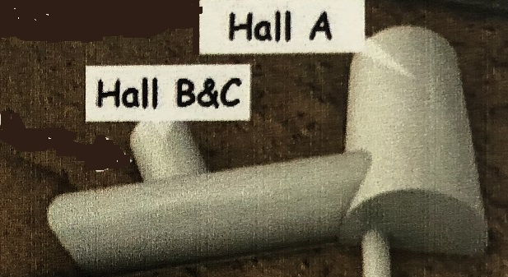
The final version would look like LS-Canfranc
LSC-Hall A

Slide 13
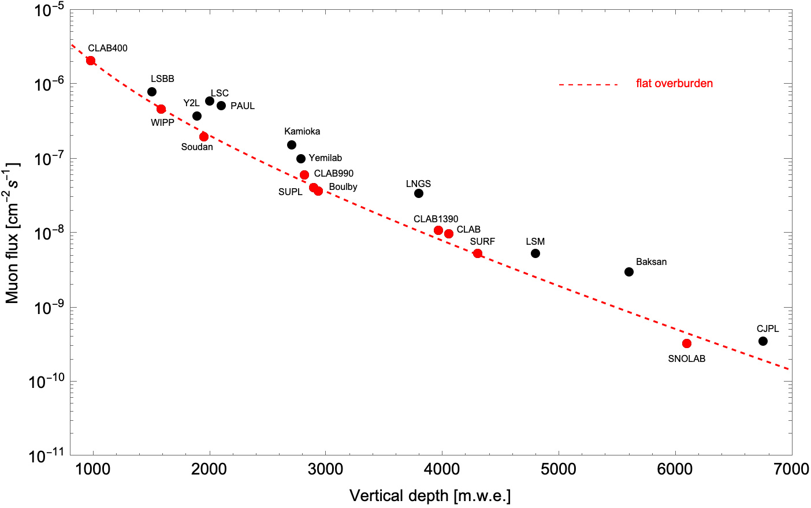
Muon Flux attenuation
Courtesy; Aldo Ianni, April 2024

Slide 14
Envisaged science at PAUL
Ultra-low radioactivity
Biological science (effect of cosmic radiation on cells and reference organisms – radiation biology)
Possibly anti-neutrino monitoring (radiated from Koeberg Nuclear Power Station) (neutrino physics)
Dark Matter search (compare Northen and Southern hemisphere data)
To complement indirect searches for Dark Matter (e.g. with SKA)

Slide 15
Possible Dark Matter searches @PAUL
The challenge @PAUL
is to develop detectors with very low energy thresholds and excellent control over detector backgrounds.
Technology and experiments @PAUL
✔ Charge Coupled Devices (CCDs), Skipper-CCD (SENSEI, DAMIC, OSCURA)
✔ Solid-state cryogenic detectors (Ge, Si, ..), operating at T<15 mK, (Edelweiss)
Noble Liquid target (Xe, Ar)
Dark matter with mass below the proton (sub-GeV)
@PAUL

Slide 16
The preliminary work to be followed during 2024 and 2025
1- Design and study of PAUL facility including the excavation work; This is accomplished together with SMEC, the tunnel company for the civil engineering aspect and SANRAL, South African National Roads Agency, for the more strategic aspect of the work; → Seed-funding from DSI of R 5 million (250 K€)
Budget (R 20=1€)
item
excavation
structural reinforcement
foundation work
utilities
interior finishes
Cost in Rands
10000000,00
24000000,00
12000000,00
14400000,00
30000000,00
5000000,00
above ground offices/workshops
Grand Total + 20 % contingencies
120000000,00 (6 M€)

Slide 17
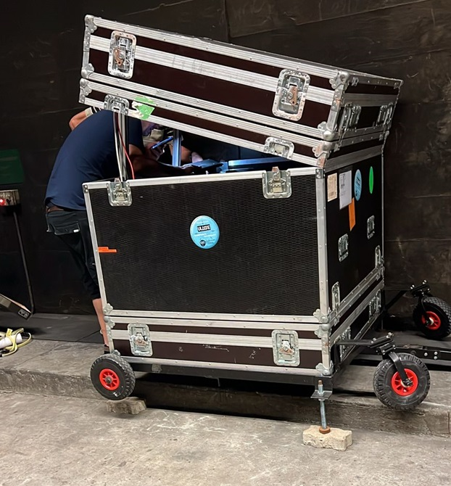
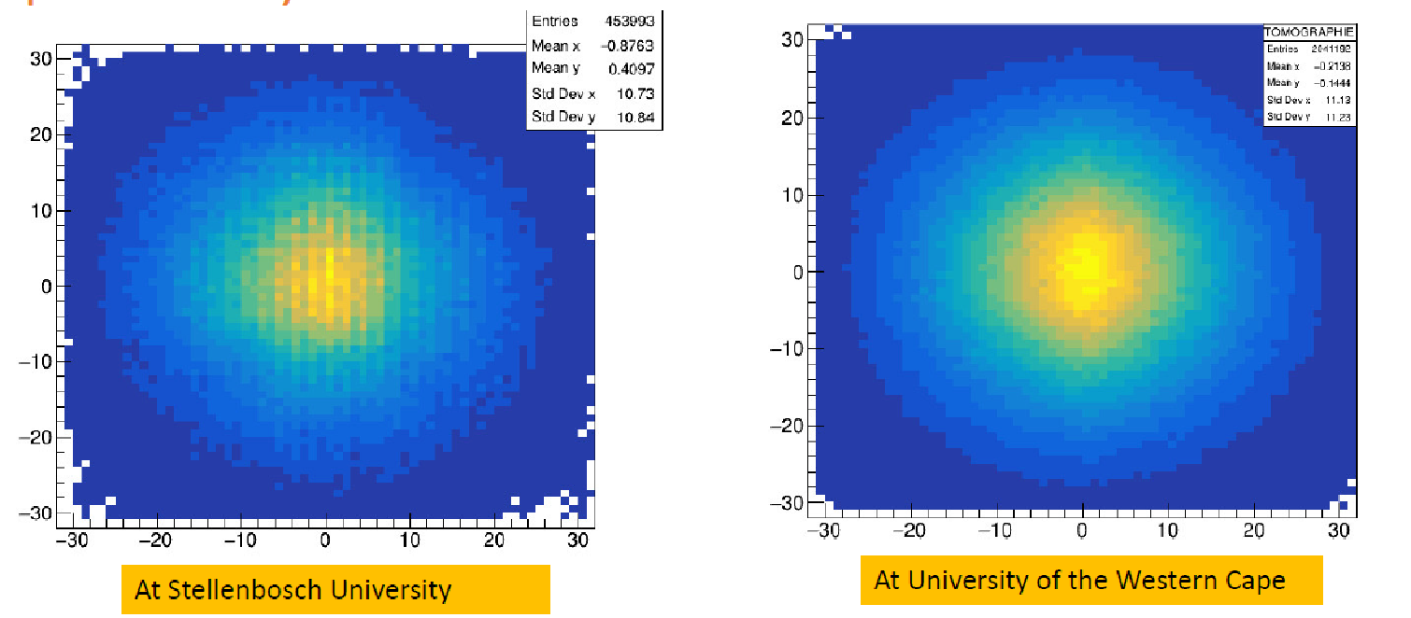
The preliminary work to be followed during 2024 and 2025
2- Radiation measurement inside the tunnel to establish the specifications of PAUL facility;
b- Cosmic measurements open sky at Stellenbosch university + University of the Western Cape

Slide 18
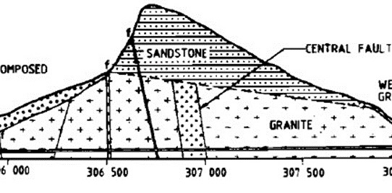
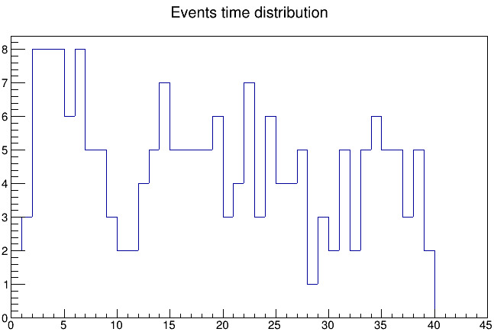
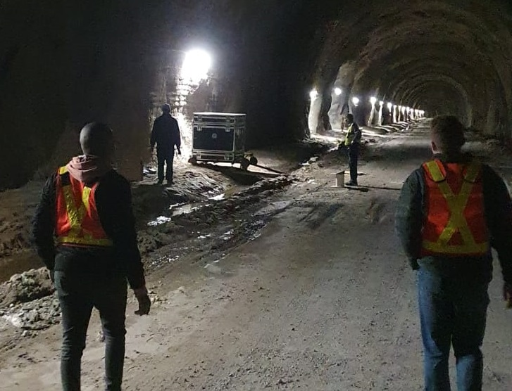
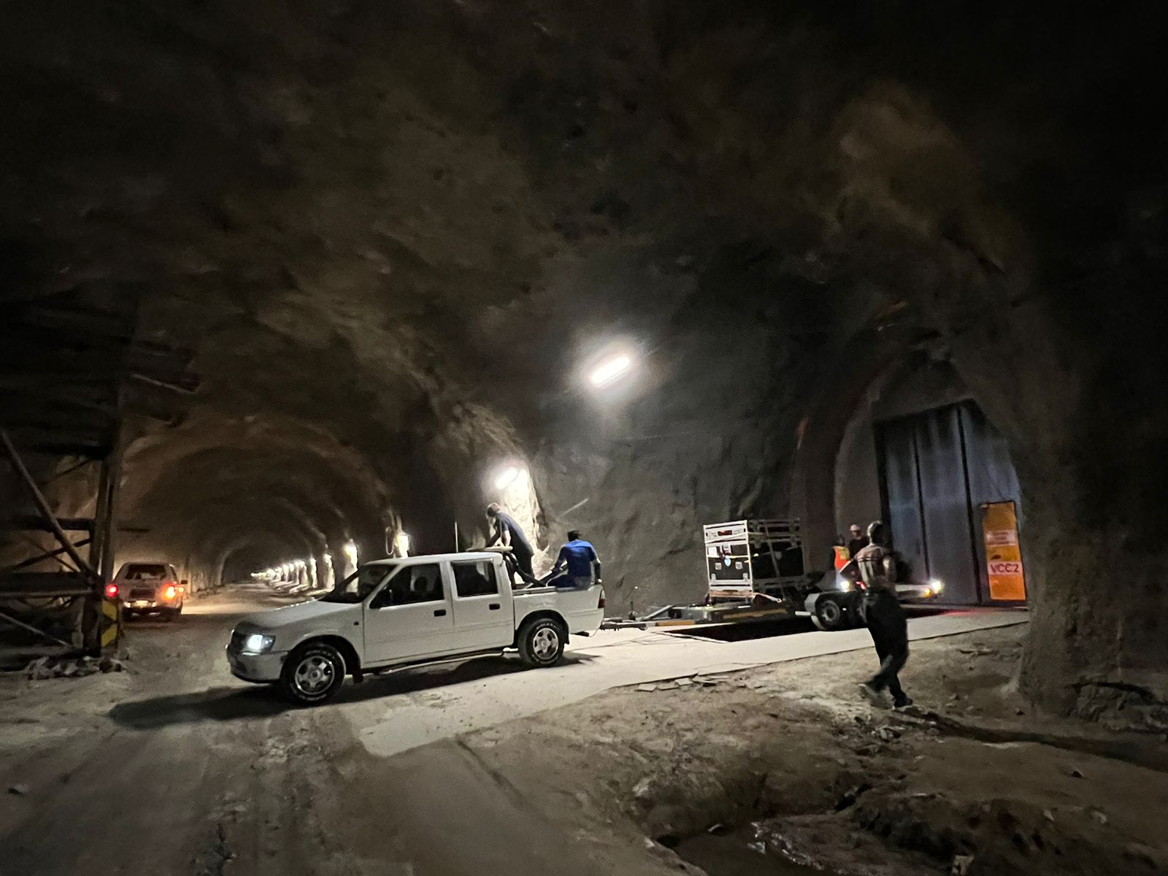
The preliminary work to be followed during 2024 and 2025
b- Now measurements are on-going inside the tunnel at the position VCC2 → ~5 cosmic/per day
and VCC1 → < 5 cosmic/per day (~max overburden)
VCC1
VCC2
Fault
VCC1
VCC2

Slide 19
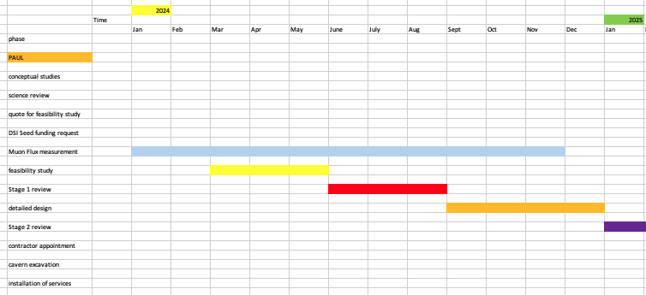
Project Timeline
Current estimate to construct PAUL: R 130 million (~ US$ 6.5 million)

Slide 20
Project Timeline > 2025
Current estimate to construct PAUL: R 130 million (~ US$ 6.5 million)

Slide 21
Conclusions
PAUl project Launched January 2024, R 5M (250 K€) DSI Seed-Funding, Feasibility Study on-going;
Kicked-off a collaboration with the geology community at Wits (Johannesburg);
Prepare for the participation to the actual experiments and their R&Ds, e.g. Damic-M and SAFIRE at Modane;
Other plan are being discussed, eg. exploring life science underground;
5 years grant for the International Research Network programme PAULINE (CNRS-FR/Africa/Canfranc/LNGS).

Slide 22
Back up slides

Slide 23
Organisation
Steering Committee
Project Management office being constituted (July 24)
International Advisory Board
Task Forces:
Biology
Dark Matter
Design and study
Geophysics
Muography
Quantum Computing
Low radiation and neutrons measurements
All info on Twiki Home page: https://twiki.cern.ch/twiki/bin/view/PaulLab/WebHome
Note: PAUL not yet a legal entity

Slide 24
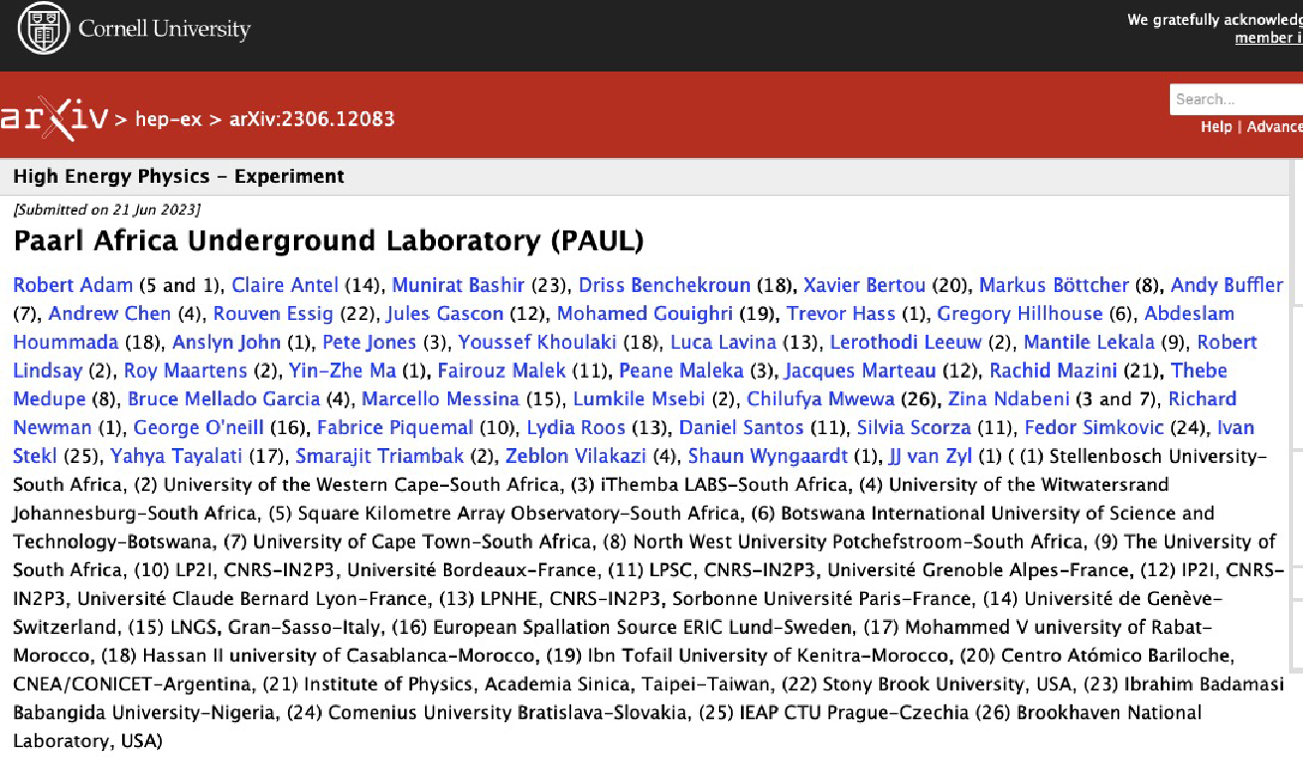
Founding article

Slide 25
Founding Symposium
https://indico.cern.ch/event/1316503/

