Slide 1
The PICO-40L Direct Detection Experiment
Derek Cranshaw
On behalf of the PICO collaboration
IDM 2024 – L’Aquila, Italy
July 8, 2024

Slide 2
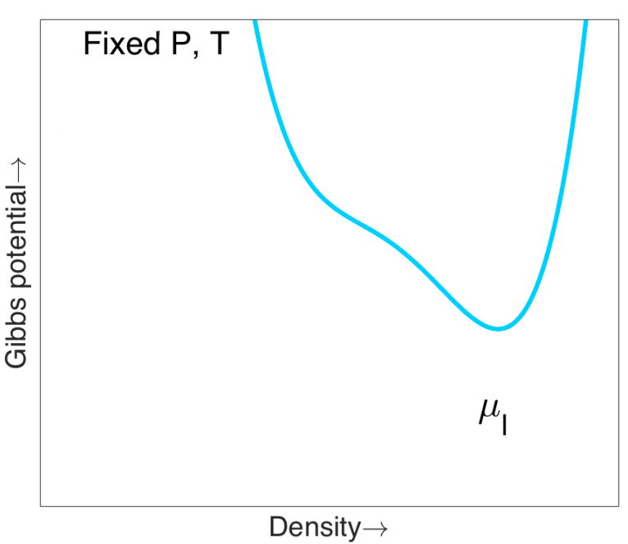
How do Bubble Chambers Work?
Target
Bellows
*Plots from E. Dahl
System begins in “compressed” liquid state.

Slide 3
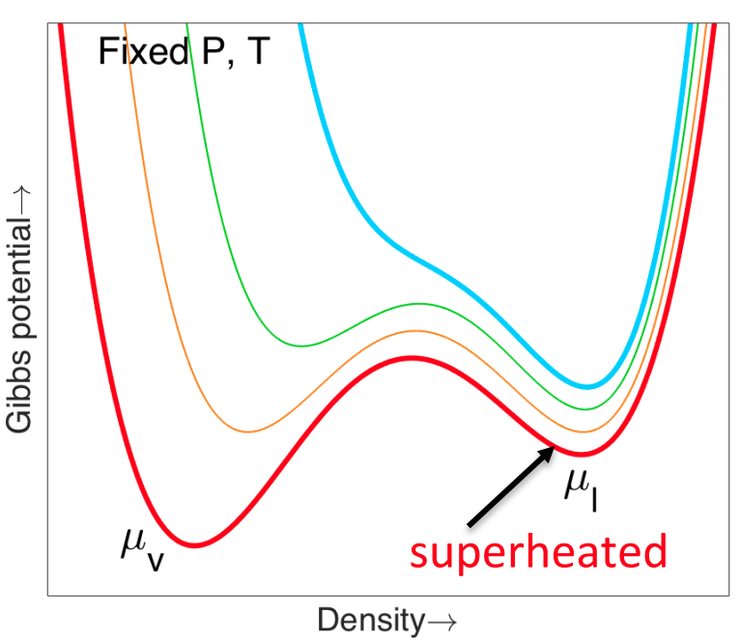
How do Bubble Chambers Work?
Target
Bellows
(Expansion)
*Plots from E. Dahl
System begins in “compressed” liquid state.
As pressure decreases, minimum free energy at vapor state μ_{v} .
Energy barrier keeps system at metastable liquid state μ_{l} – liquid is “superheated”.

Slide 4
How do Bubble Chambers Work?
Target
χ
Bellows
(Expansion)
*Plots from E. Dahl
System begins in “compressed” liquid state.
As pressure decreases, minimum free energy at vapor state μ_{v} .
Energy barrier keeps system at metastable liquid state μ_{l} – liquid is “superheated”.
Sufficient energy deposition within a small radius can overcome the energy barrier and form a bubble.

Slide 5
How do Bubble Chambers Work?
Target
Bellows
(Compression)
*Plots from E. Dahl
System begins in “compressed” liquid state.
As pressure decreases, minimum free energy at vapor state μ_{v} .
Energy barrier keeps system at metastable liquid state μ_{l} – liquid is “superheated”.
Sufficient energy deposition within a small radius can overcome the energy barrier and form a bubble.
After bubble forms, target is rapidly recompressed in preparation for next event.

Slide 6
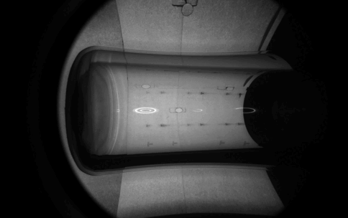
Main Advantage – Background Rejection
γ
γ
Electron Recoil
χ
χ
Nuclear Recoil
Energy depositions from electron recoils insufficiently localized to form a bubble.
Chamber is effectively blind to electron recoil interactions.
2024-01-11 Single Bubble Event
(0.1x speed)

Slide 7
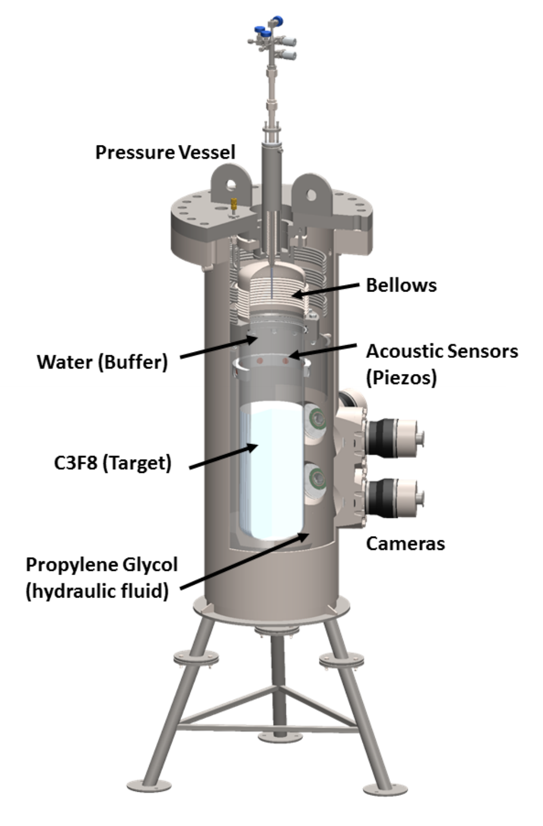
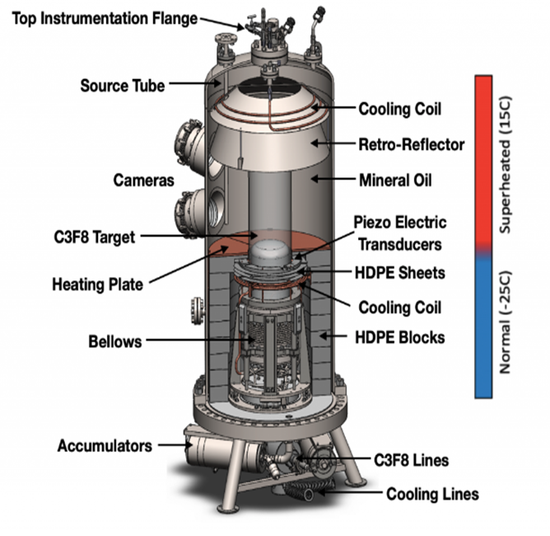
PICO-40L and the Right-Side-Up (RSU) Design
World-leading WIMP-proton cross-section limits in 2019. (https://arxiv.org/abs/1902.04031)
Bellows above the active fluid, separated by a buffer fluid (water).
Excess of background events at buffer-target interface.
Geometry inverted relative to PICO-60, buffer fluid removed.
Thermal gradient suppresses bubbles near bellows.
Additionally validates the RSU design in anticipation of larger detectors.

Slide 8
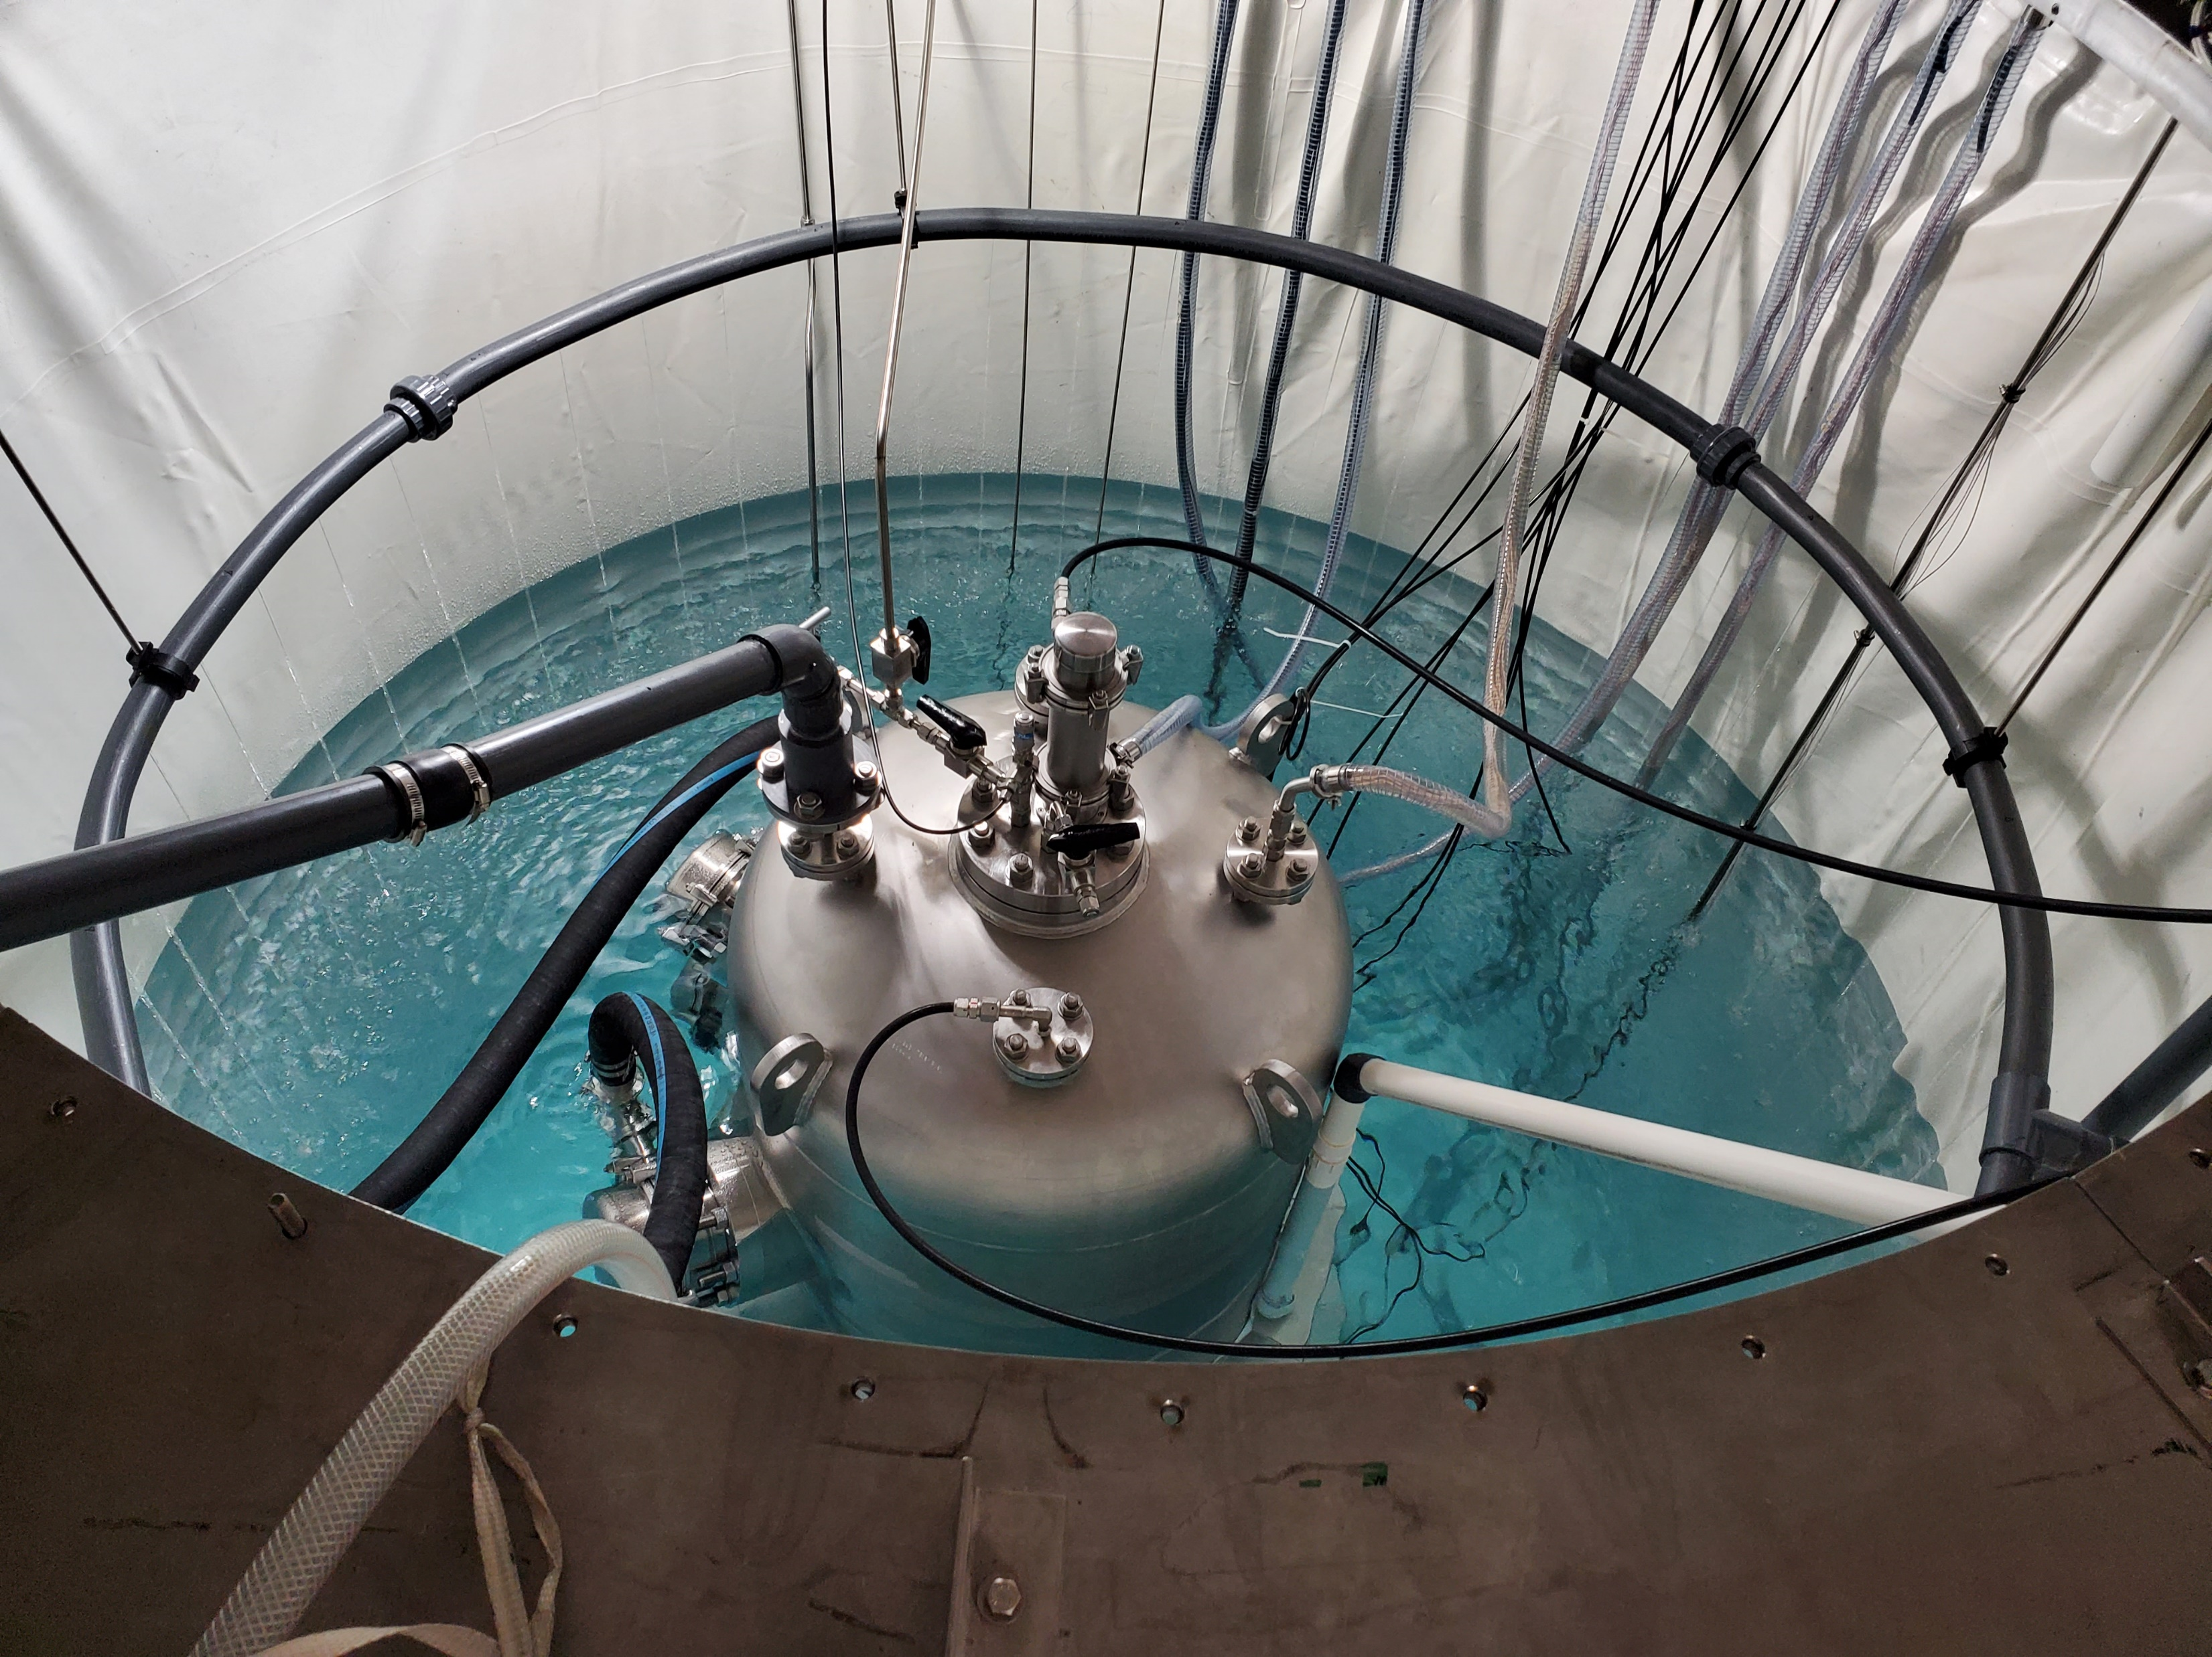
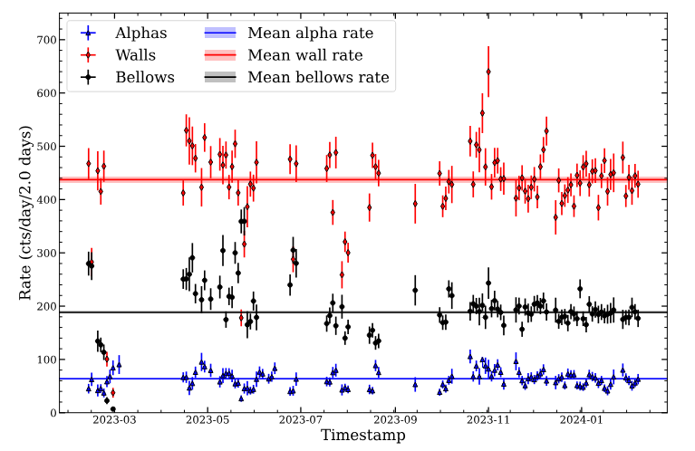
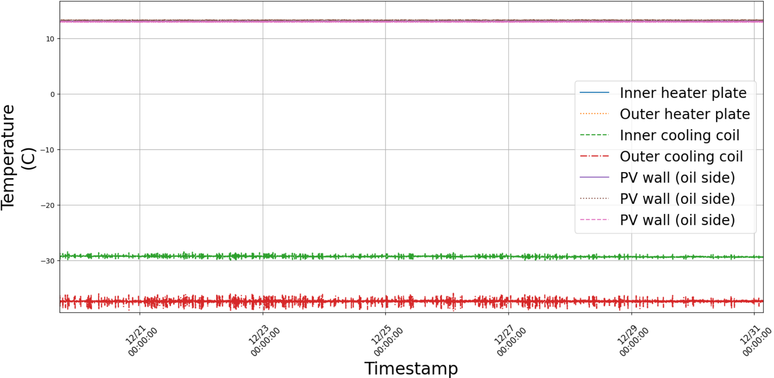
Current Status
*Plot by C. Moore
Detector fully assembled and operational, water shielding in place.
Stable long term event rates.
Exquisite thermal stability and control during operation.

Slide 9
Current Status
*Plot by C. Moore
Detector fully assembled and operational, water shielding in place.
Stable long term event rates.
Exquisite thermal stability and control during operation.

Slide 10
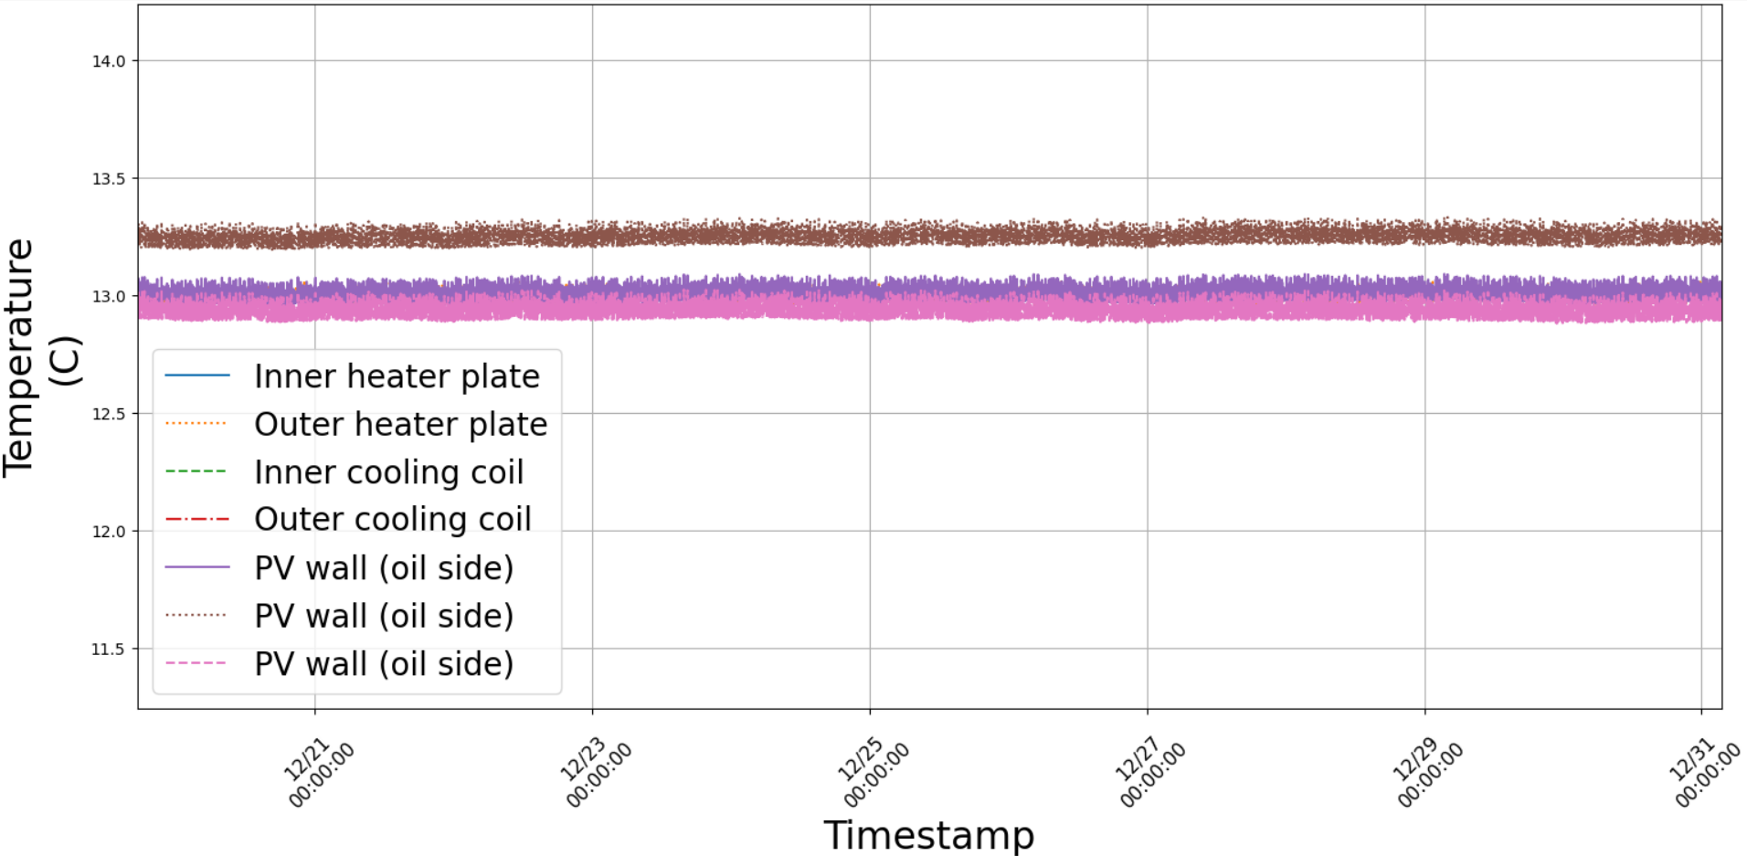
Current Status
*Plot by C. Moore
Detector fully assembled and operational, water shielding in place.
Stable long term event rates.
Exquisite thermal stability and control during operation.

Slide 11
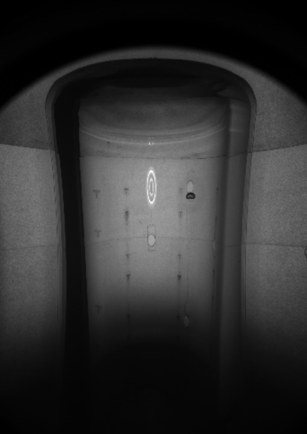
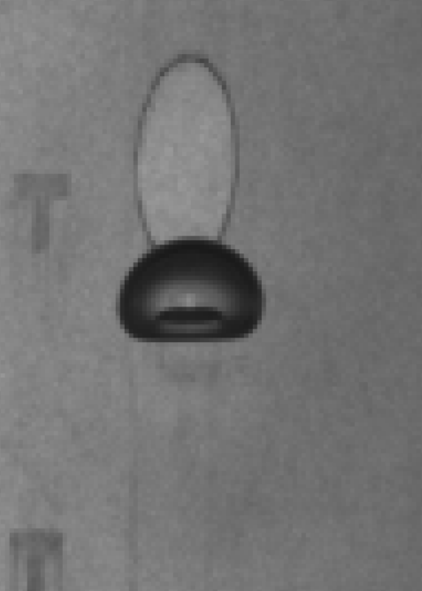
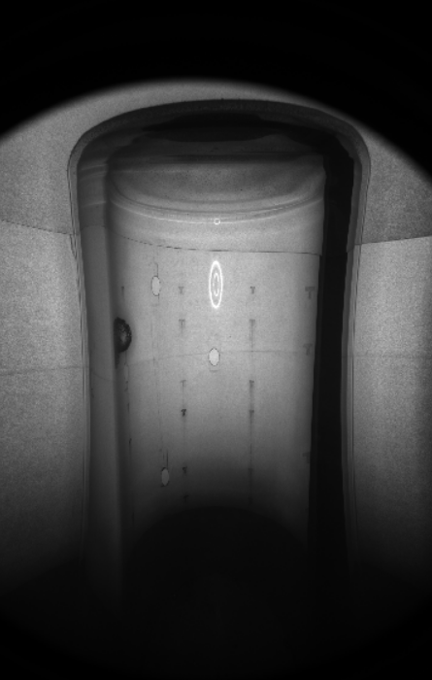
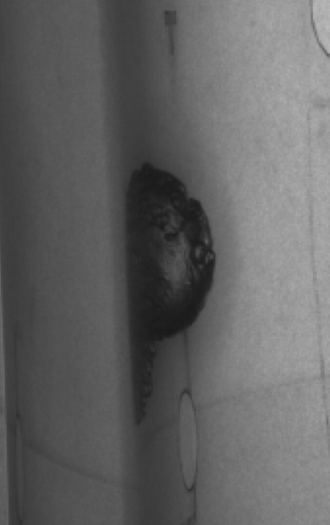
Wall Events and Bulk Events
Bulk Event (2023-02-27)
Wall Event (2023-02-09)
DM expected to scatter in target bulk, but imperfections in vessel can trigger bubble nucleation on the walls.
Distinguishable by eye from bulk events – can “handscan” to remove wall events.

Slide 12
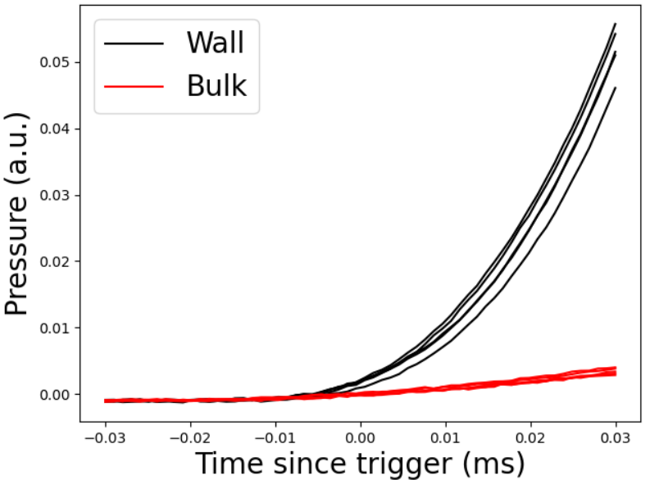
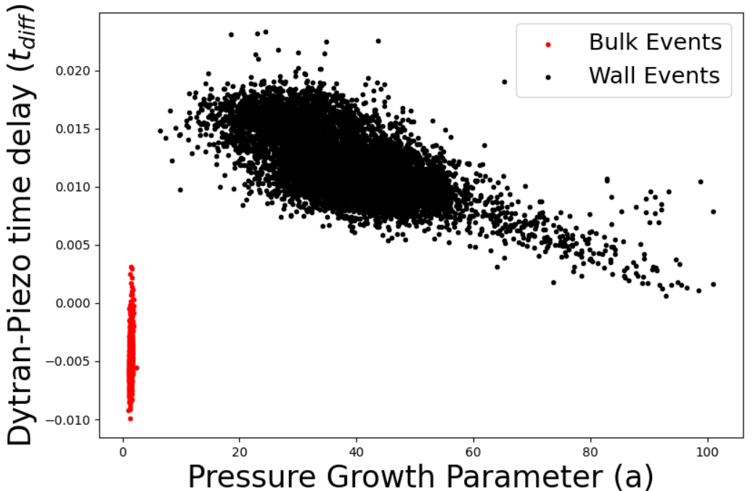
Wall Events and Bulk Events
PICO is instrumented with Dytran pressure sensors at top and bottom of PV – records fast pressure change during event.
Dytran traces can be used to distinguish wall from bulk events.

Slide 13
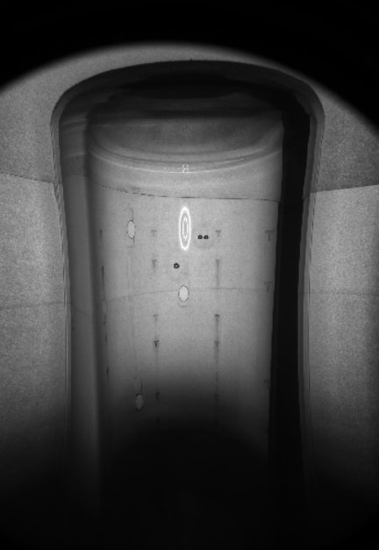
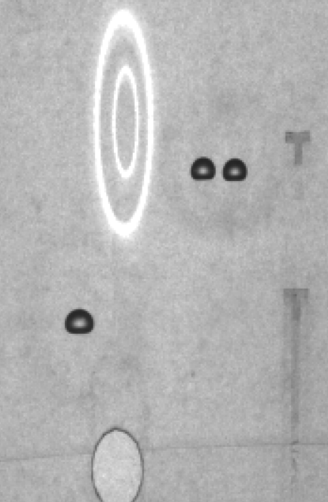
Neutron Suppression and Rejection
n
n
Triplet Event (2023-03-03)
Single scatter neutrons indistinguishable from WIMPs.
Large water shielding tank and careful material selection minimizes neutron background from external and internal sources, respectively.
Neutrons likely to scatter multiple times in PICO-40L, leading to a multi-bubble event.
Ratio of multiples to singles (3:1) allows estimate of neutron contribution to signal.
Less than 1.0 single bubble event from neutrons per year expected.

Slide 14
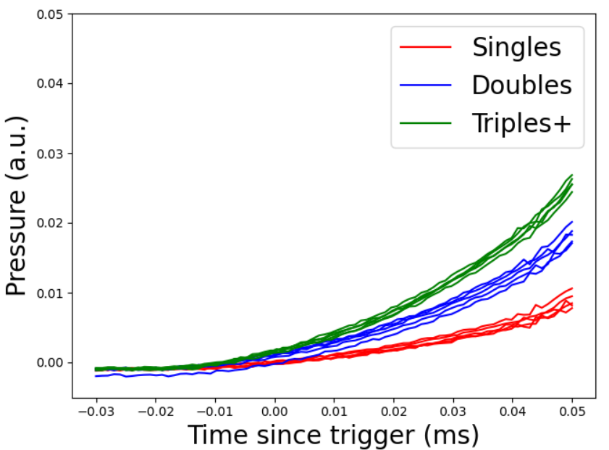
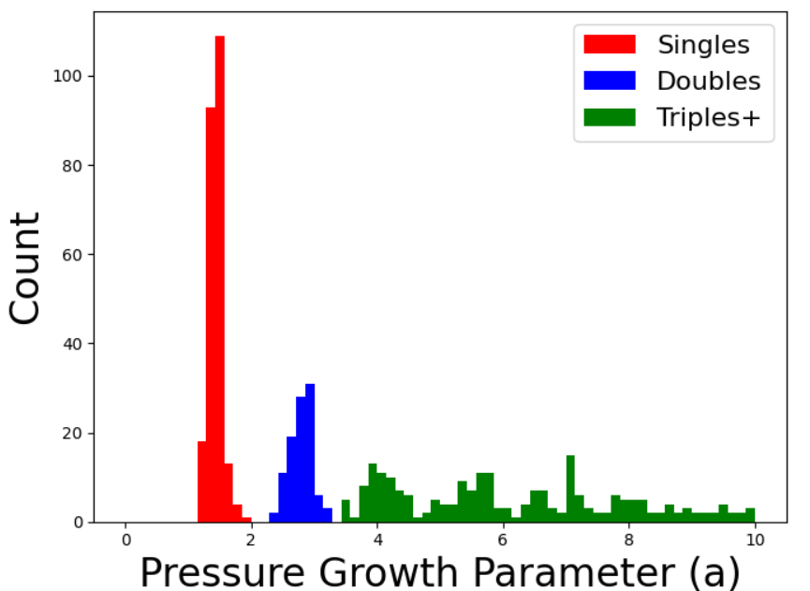
Multiple Scatter Counting
Dytran sensors can also distinguish between single and multiple scattering events.

Slide 15
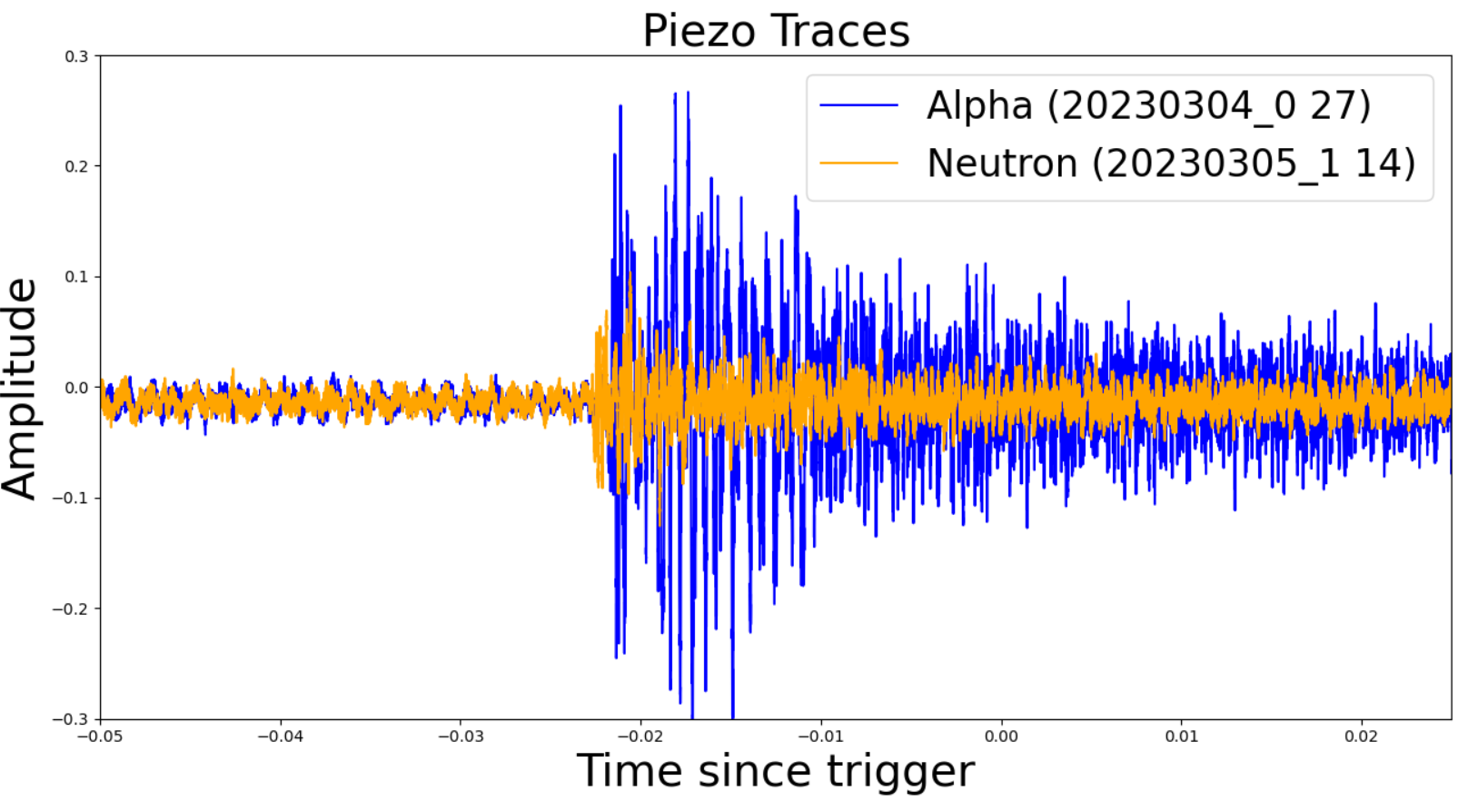
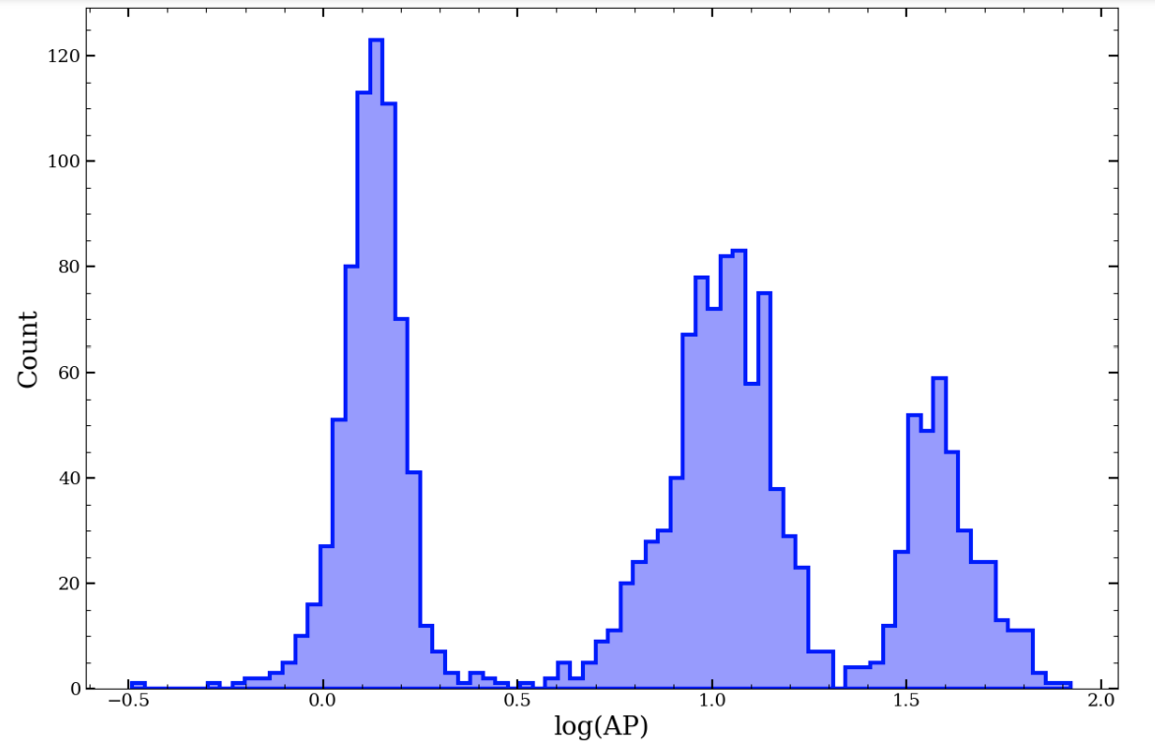
Background Rejection - Alphas
10 piezoelectric sensors read out during bubble formation.
Alpha-induced bubbles several times louder than neutron-induced bubbles.
Discrimination achieved using Acoustic Parameter (AP) – a measure of acoustic power.
Alphas from different parts of the ²²²Rn decay chain are distinguishable in AP

Slide 16
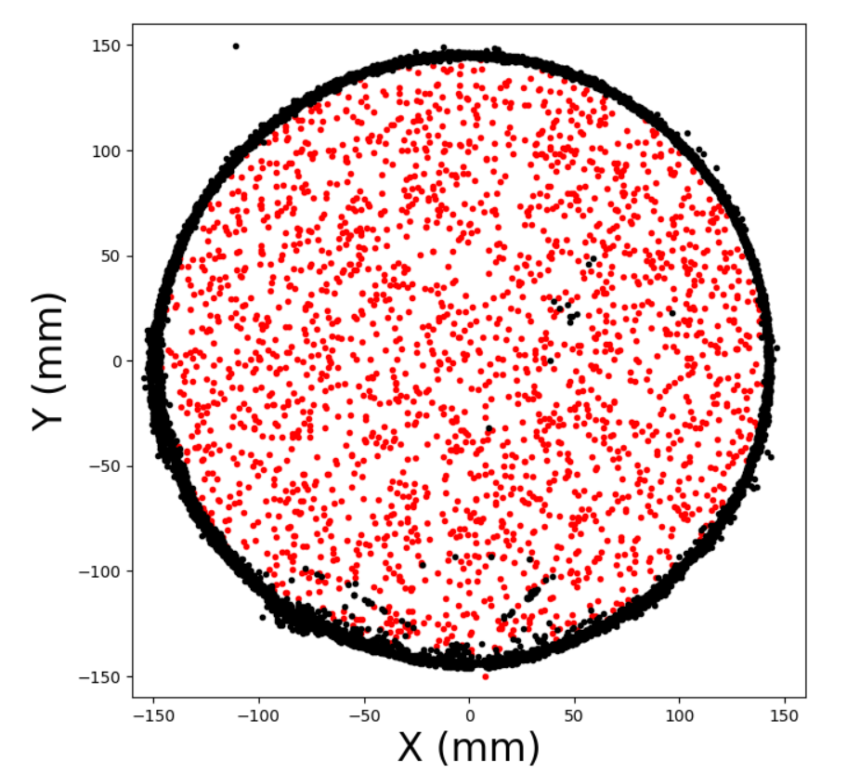
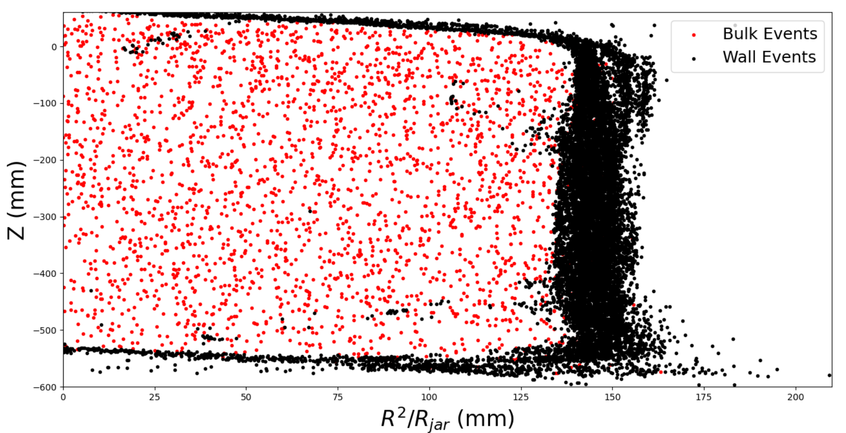
Position Reconstruction
Position reconstruction achieved by calculating intersection of light rays from the cameras through the detector.
Obtained from detailed ray-tracing simulation using full detector geometry.
Work is ongoing to resolve small number of optically mis-reconstructed wall events

Slide 17
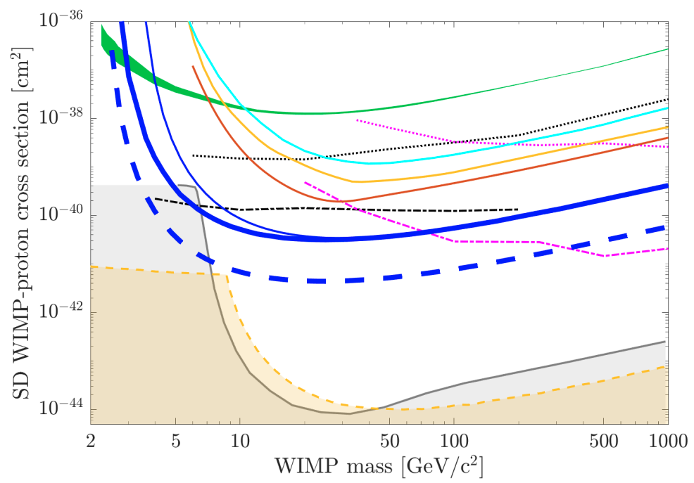
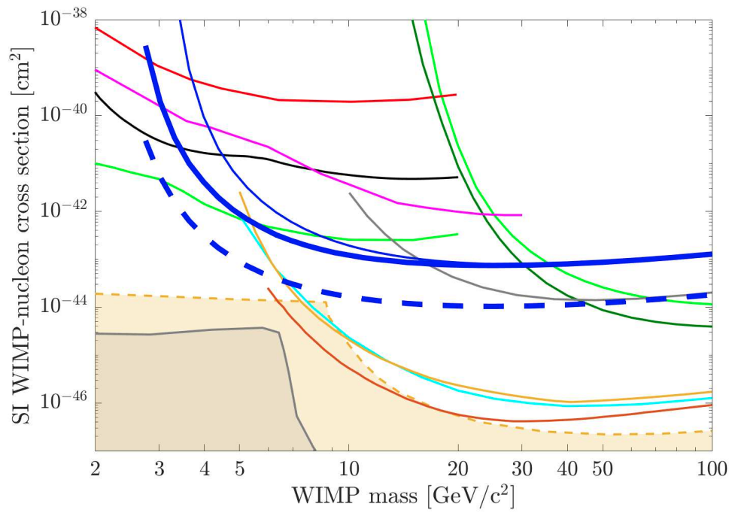
Projected Sensitivity
*Plots from https://arxiv.org/abs/1905.12522
PICO-60
PICO-60
PICO-40L
PICO-40L
Expected factor of 5 improved sensitivity vs. PICO-60 despite similar mass, due to expected reduction in background (assuming 1 live-year of running).
Right-side-up design removed buffer fluid and therefore excess events at buffer-target interface.
Larger pressure vessel provides better neutron shielding.

Slide 18
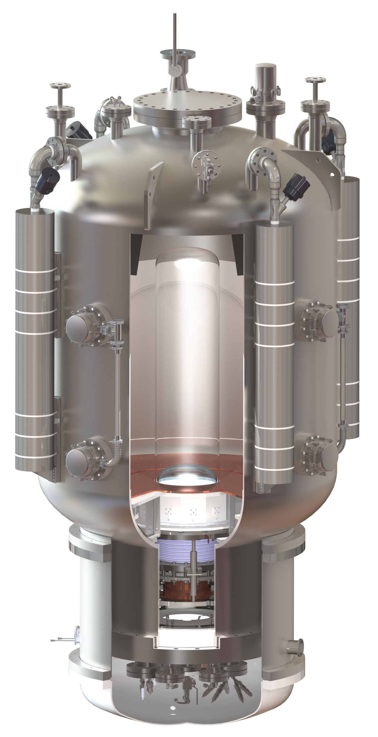
The Future of PICO – PICO-500
Tonne-scale right-side-up bubble chamber.
Like PICO-40L, but bigger!
PICO-40L validates and informs the design of PICO-500
To be constructed in Cube Hall at SNOLAB – assembly of components underground has begun!
Scheduled to begin operation in late 2025.
See poster by J. Savoie for more information about PICO-500, including techniques for background mitigation.
3.8 m

Slide 19
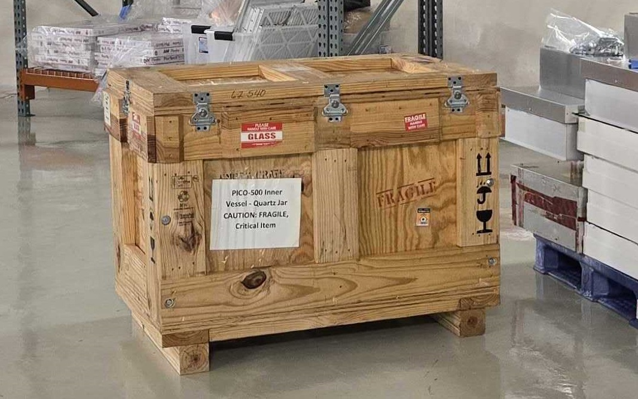
The Future of PICO – PICO-500
Tonne-scale right-side-up bubble chamber.
Like PICO-40L, but bigger!
PICO-40L validates and informs the design of PICO-500
To be constructed in Cube Hall at SNOLAB – assembly of components underground has begun!
Scheduled to begin operation in late 2025.
See poster by J. Savoie for more information about PICO-500, including techniques for background mitigation.
3.8 m

Slide 20
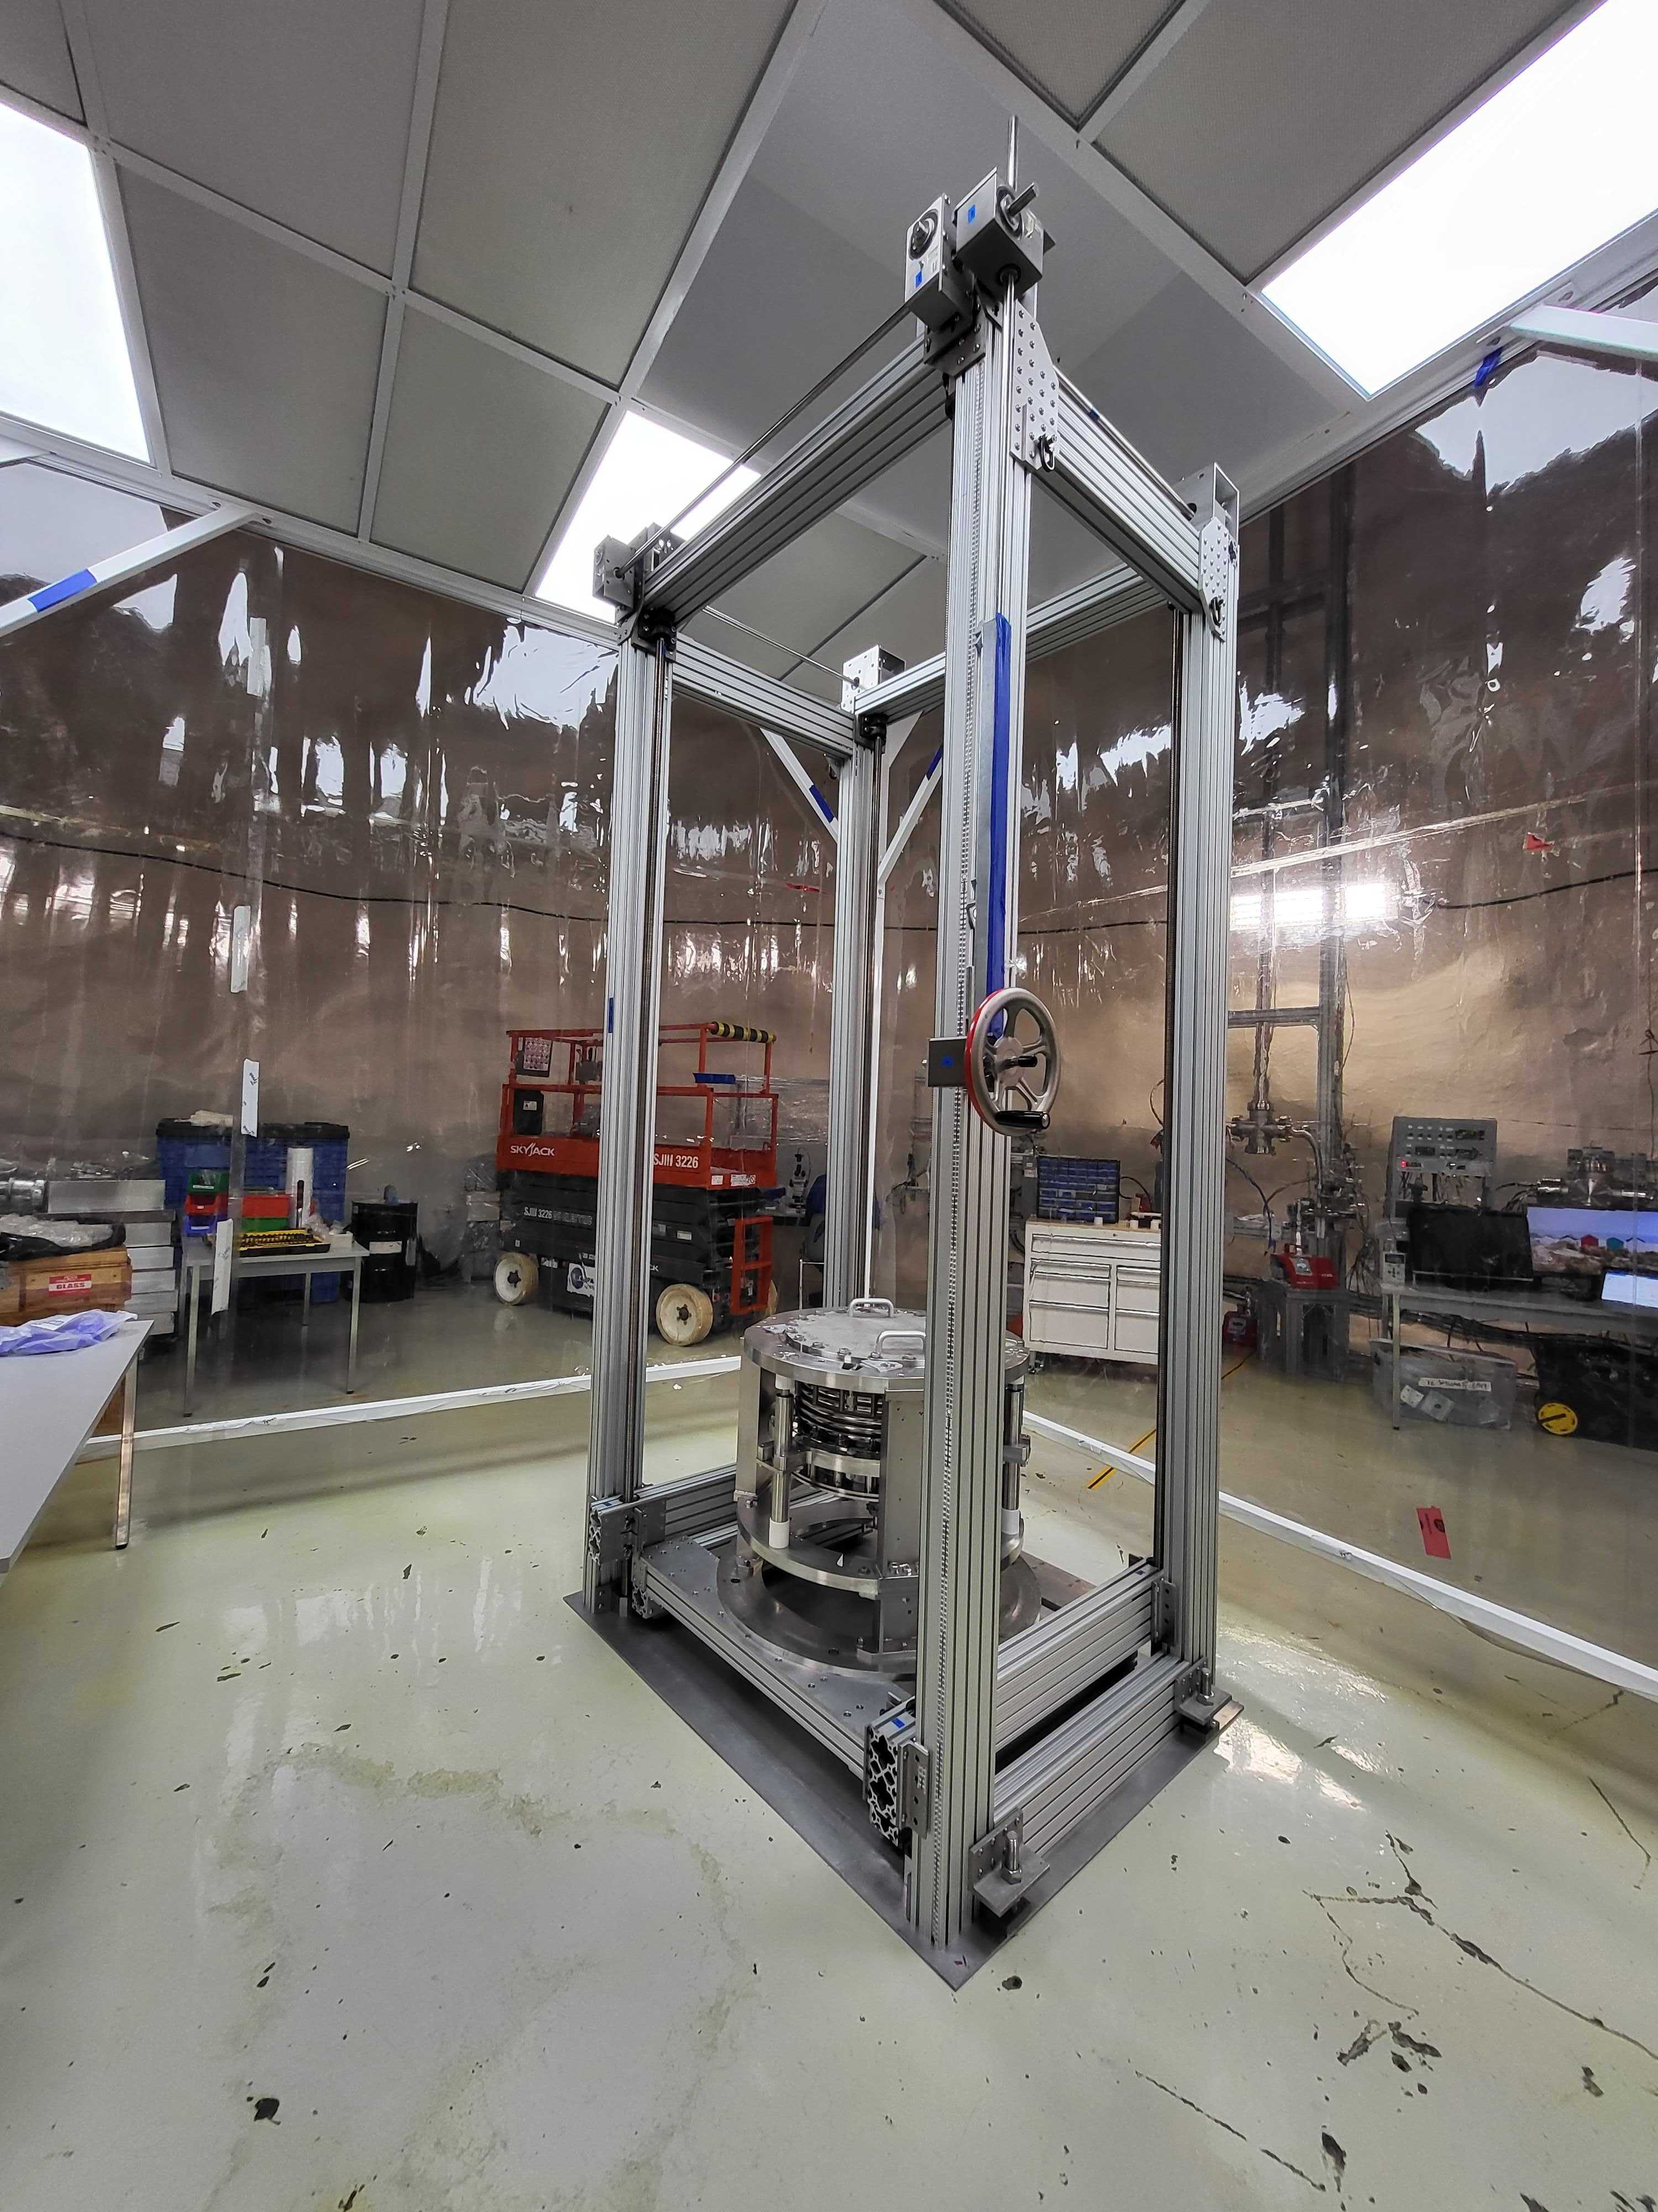
The Future of PICO – PICO-500
Tonne-scale right-side-up bubble chamber.
Like PICO-40L, but bigger!
PICO-40L validates and informs the design of PICO-500
To be constructed in Cube Hall at SNOLAB – assembly of components underground has begun!
Scheduled to begin operation in late 2025.
See poster by J. Savoie for more information about PICO-500, including techniques for background mitigation.
3.8 m

Slide 21
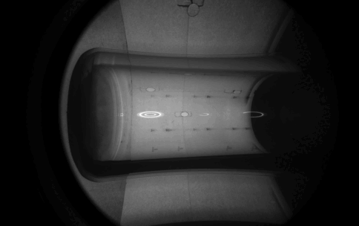
Summary
In addition to its own direct dark matter search, PICO-40L validates the right-side-up design in anticipation of larger detectors (PICO-500 and beyond).
PICO-40L has completed a period of stable running in a variety of operational modes lasting several months – detailed analysis of the data is underway.
Exciting times ahead for PICO!

Slide 23
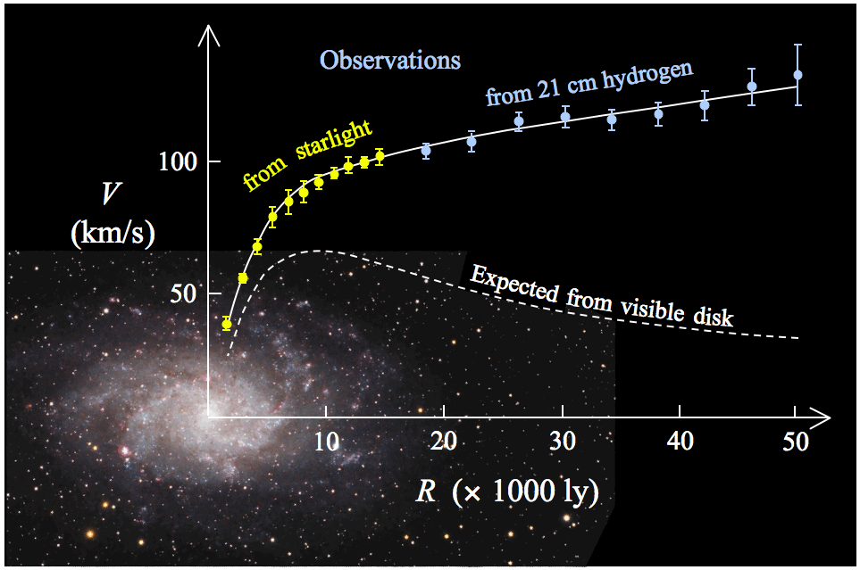
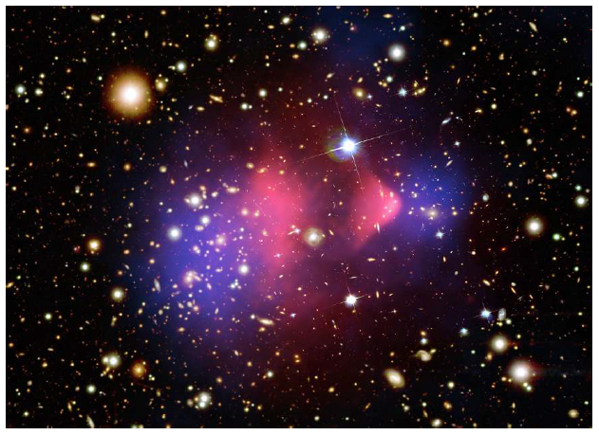
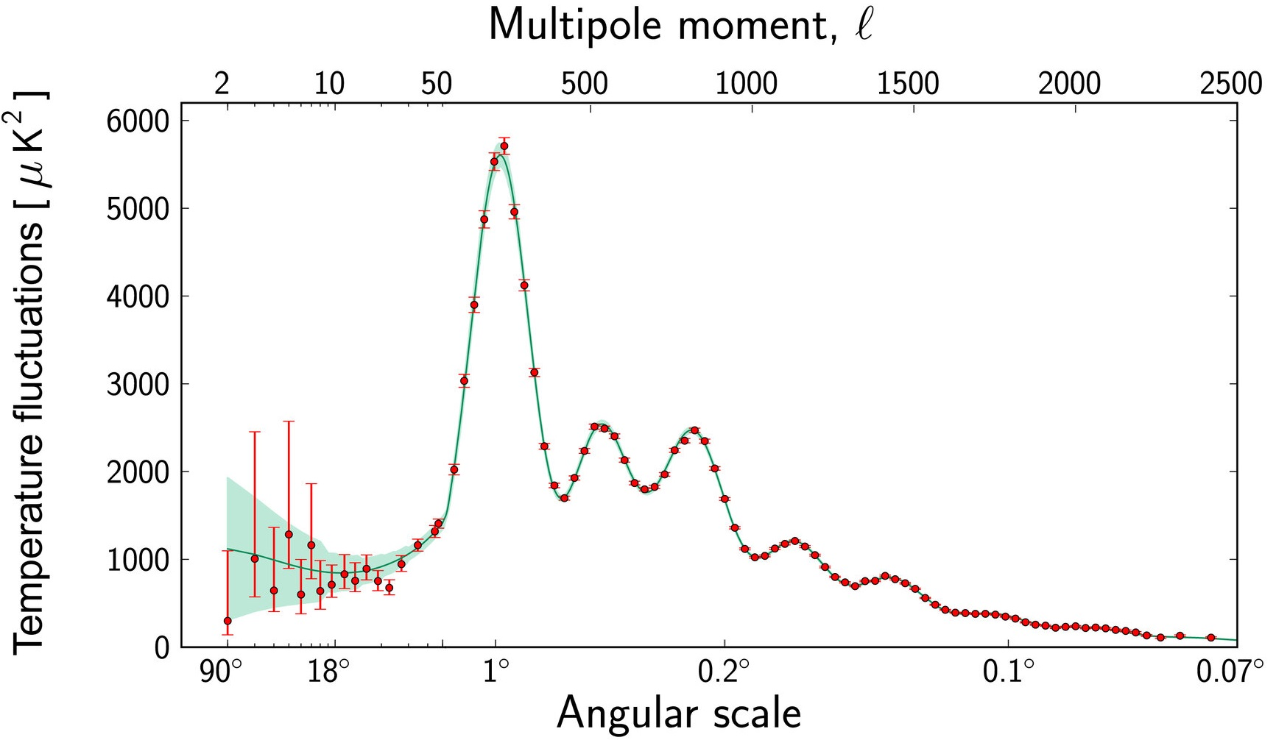
What is Dark Matter?
Evidence for dark matter at a variety of length scales.
Many BSM theories predict stable, neutral, weakly interacting massive particles (WIMPs).

