Slide 1
15th International Workshop on the Identification of Dark Matter 2024
Low-radiactivity argon for dark matter searches and beyond
Riccardo Stefanizzi
Walter M. Bonivento
on behalf of the DarkSide-50 collaboration
GADMC
08/07/24
1

Slide 2
Introduction: Pure argon procurement for DarkSide-20k and other experiments
Step 1. Extraction of underground argon from URANIA in Colorado
Step 2. Argon purification in URANIA
${}_{}^{39}{Ar}$ measurement with DArT in Canfranc (Spain).
(More details about DArT in next presentation by Vicente Pesudo)
Step 3. Further argon purification in ARIA with Seruci-1 distillation column
Step 5. Argon to GranSasso for DarkSide-20k
Coherent Legend
Etc.
Other future uses of purified argon for experiments or purposes.
2

Slide 3
DArT
DS-20k
Urania
Aria
UAr
3

Slide 4
DarkSide and Darkside-20k
S1->Scintillation of argon
S2-> Electron(s) drift
Powerful signal-background discrimination
PMTs detection -> xy-position
Δt-> z-position of interaction
UAr should be chemically and isotopically pure
The underground argon extracted in Uraina must already be isotopically pure
4

Slide 5
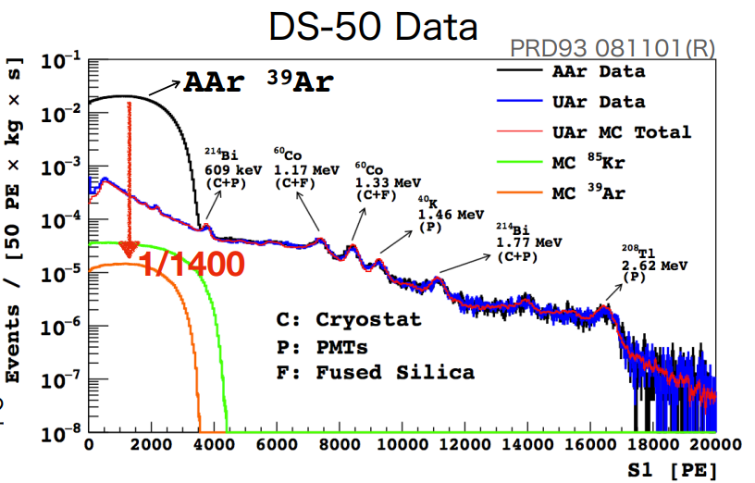
Argon purity requirements
The two main requirements are that the argon be isotopically and chemically, thus we need to
Remove ${}_{}^{39}{Ar}$ as in atmosphere it consists of 1 Bq/kg of β-decays (endpoint 565 keV, ${\text{τ}}_{1/2}$= 268 years). This isotope needs to be reduced as it creates significant background and pile-ups. It can be reduced by taking UAr or purifying via isotopic distillation (Aria isotopic distillation). ${}_{}^{39}{Ar}$ is already reduced by using UAr
Use a purification system (e.g. getter) in DarkSide we can constantly remove chemical impurities such as nitrogen, oxygen, methane, etc. However, to function effectively, the argon must already be extremely pure from the start; therefore, chemical distillation with Aria is performed. (Aria chemical distillation). Contaminants in the argon would quench the scintillation light and worsen the pulse shape discrimination.
Reduced up to ppt or ppb
5

Slide 6
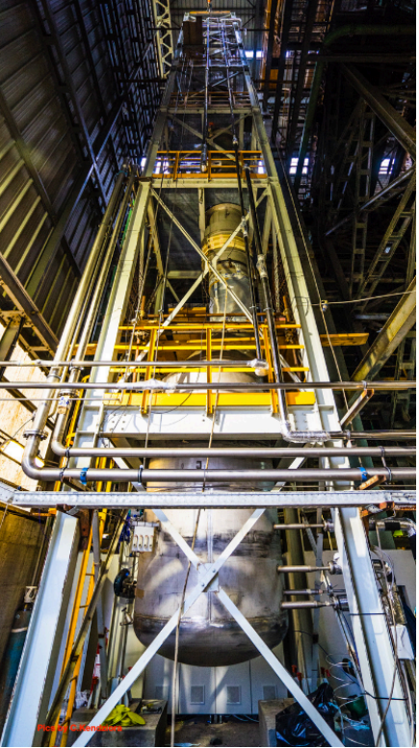
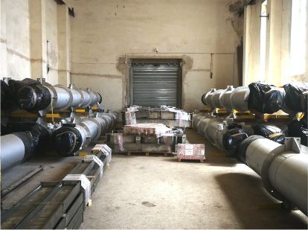
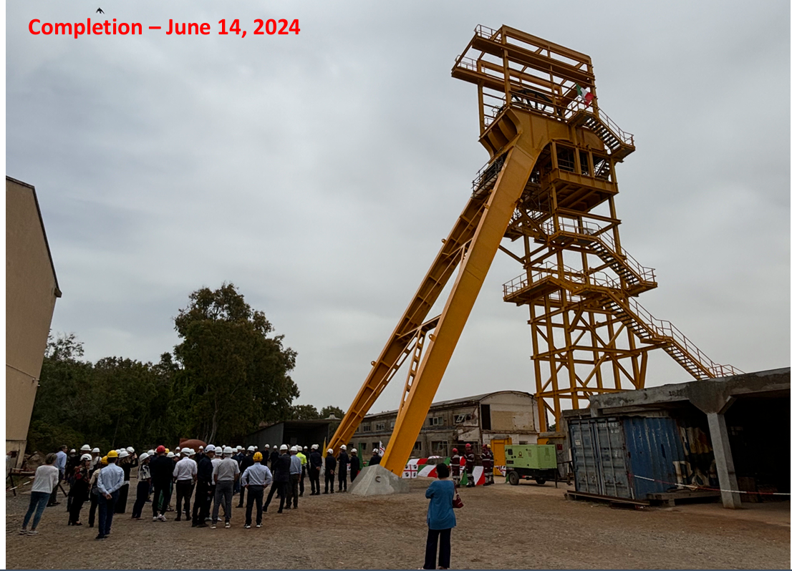
Main Goals and applications of isotopic distillation with Aria
Prototype column Seruci-0
Isotopic distillation
Chemical distillation
It could potentially further reduce ³⁹Ar by a factor of 10
Complete suppression of impurities such as N2/CH4/O2/Kr/CO2 and more
350 m
Seruci-1 under construction
6

Slide 7
Chemical purification of Argon
Optional second distillation in Seruci-1
Gas extracted from the top:
Suppression of every other element
High purity Argon used for DarkSide20k experiments
Up to 1 tonne/day
Distillation in Seruci-1 Liquid extracted from the bottom: suppression of N2
$$\text{<<}{\text{10}}^{\text{−10}}$$
Much below requirements of the getter
$$\text{<<}{\text{10}}^{\text{−10}}$$
$${\text{10}}^{\text{−4}}$$
Presence of contaminants
N2/CH4/O2/Kr/CO2
7

Slide 8
Isotopic distillation
All the data are from simulations. These are based on the experimental measurements taken during the runs of the prototype
High purity Argon ≈ 1-2 tonne/year
Underground Argon extracted in Urania
$${\text{10}}^{\text{−19}}$$
Argon distilled in Aria (Sercui-1)
Natural abundance of ³⁹Ar in atmosferic argon
$${\text{10}}^{\text{−18}}$$
$${\text{10}}^{\text{−15}}$$
21

Slide 9
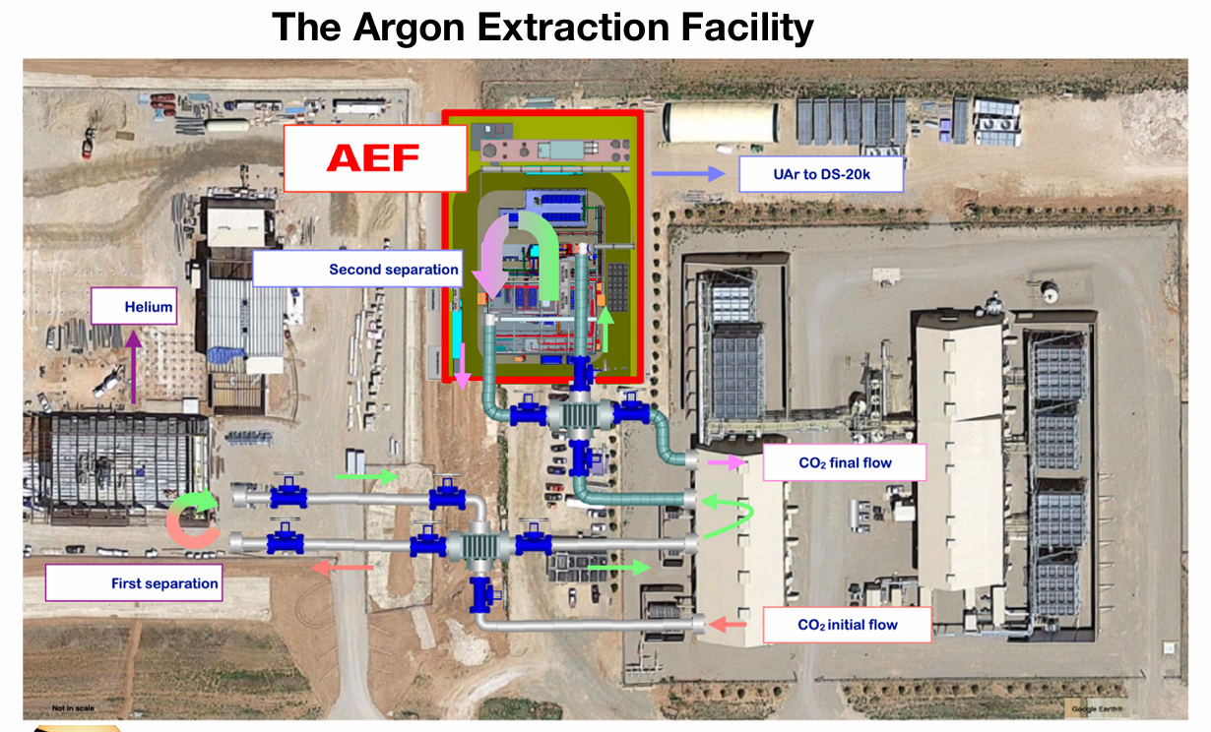
Urania
Urania plant productivity
250-300 kg/day of UAr from CO2
Estimated 99.99% purity.
Nitrogen contaminations can be at most around ${\text{10}}^{\text{−4}}$, while we expect other contaminants to be less than at least ${\text{10}}^{\text{−6}}$
8

Slide 10
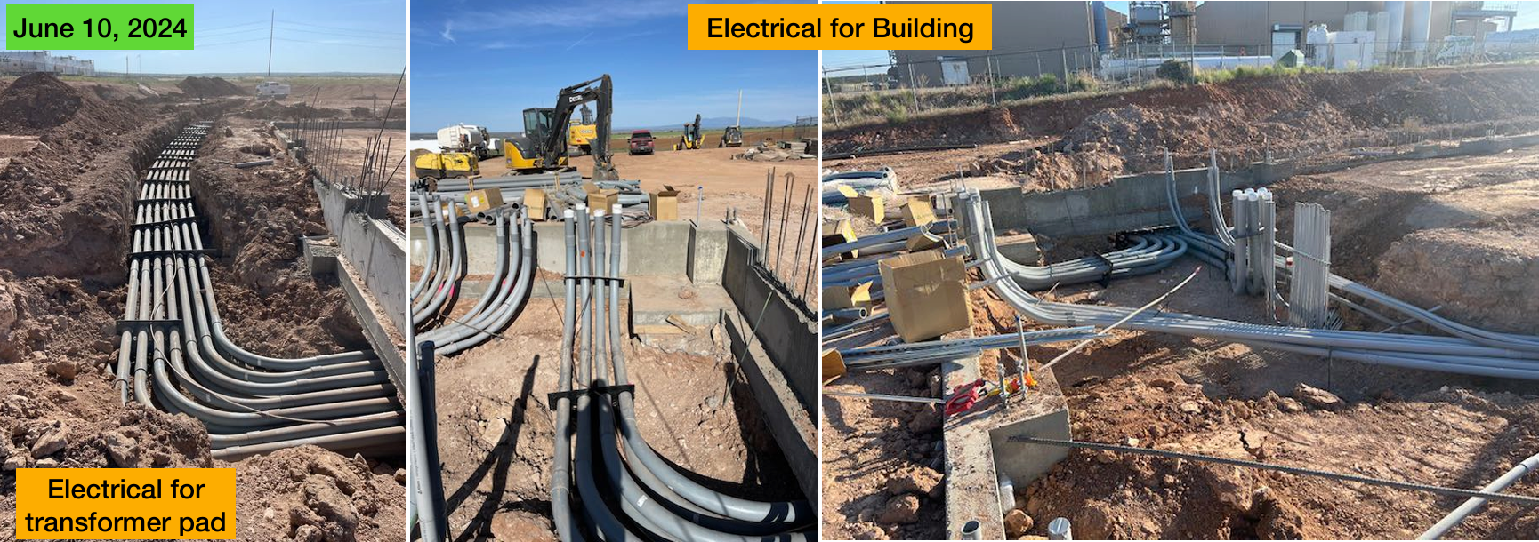
Urania Status:
Currently under construction
9

Slide 11
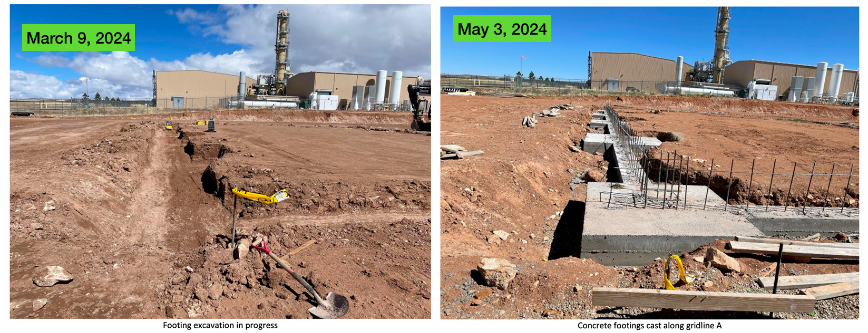
Urania Status:
10

Slide 12
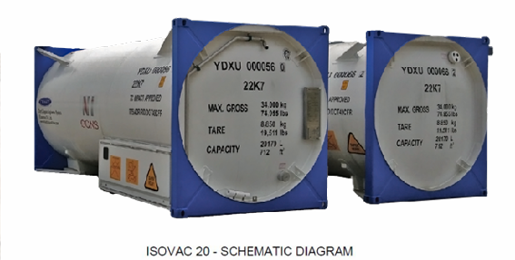
Transport of argon from Urania to Aria
15 ton shipping and storage vessels will be used to transport liquid argon from Urania to Aria (after liquefaction).
The contract has been signed, but the delivery is scheduled and has not yet arrived
The activity of ${}_{}^{39}{Ar}$induced during extraction, purification and transport on surface, in baseline conditions, is evaluated to be <5% of the UAr activity measured in DarkSide-50 (Astropart.Phys. 152 (2023) 102878), and thus considered acceptable.
11

Slide 13
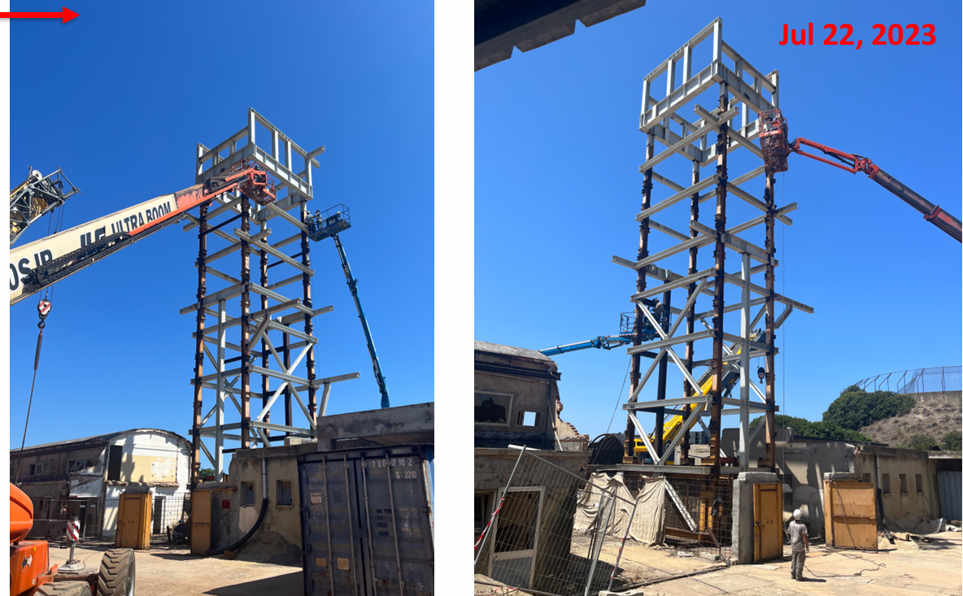
Castello support structure completed!
12

Slide 15
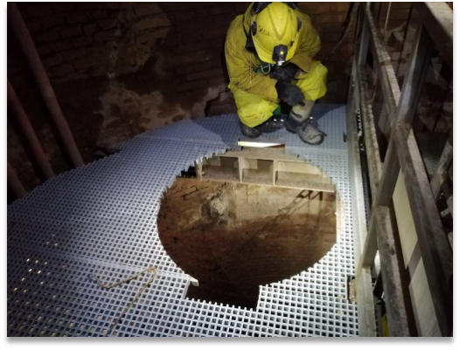
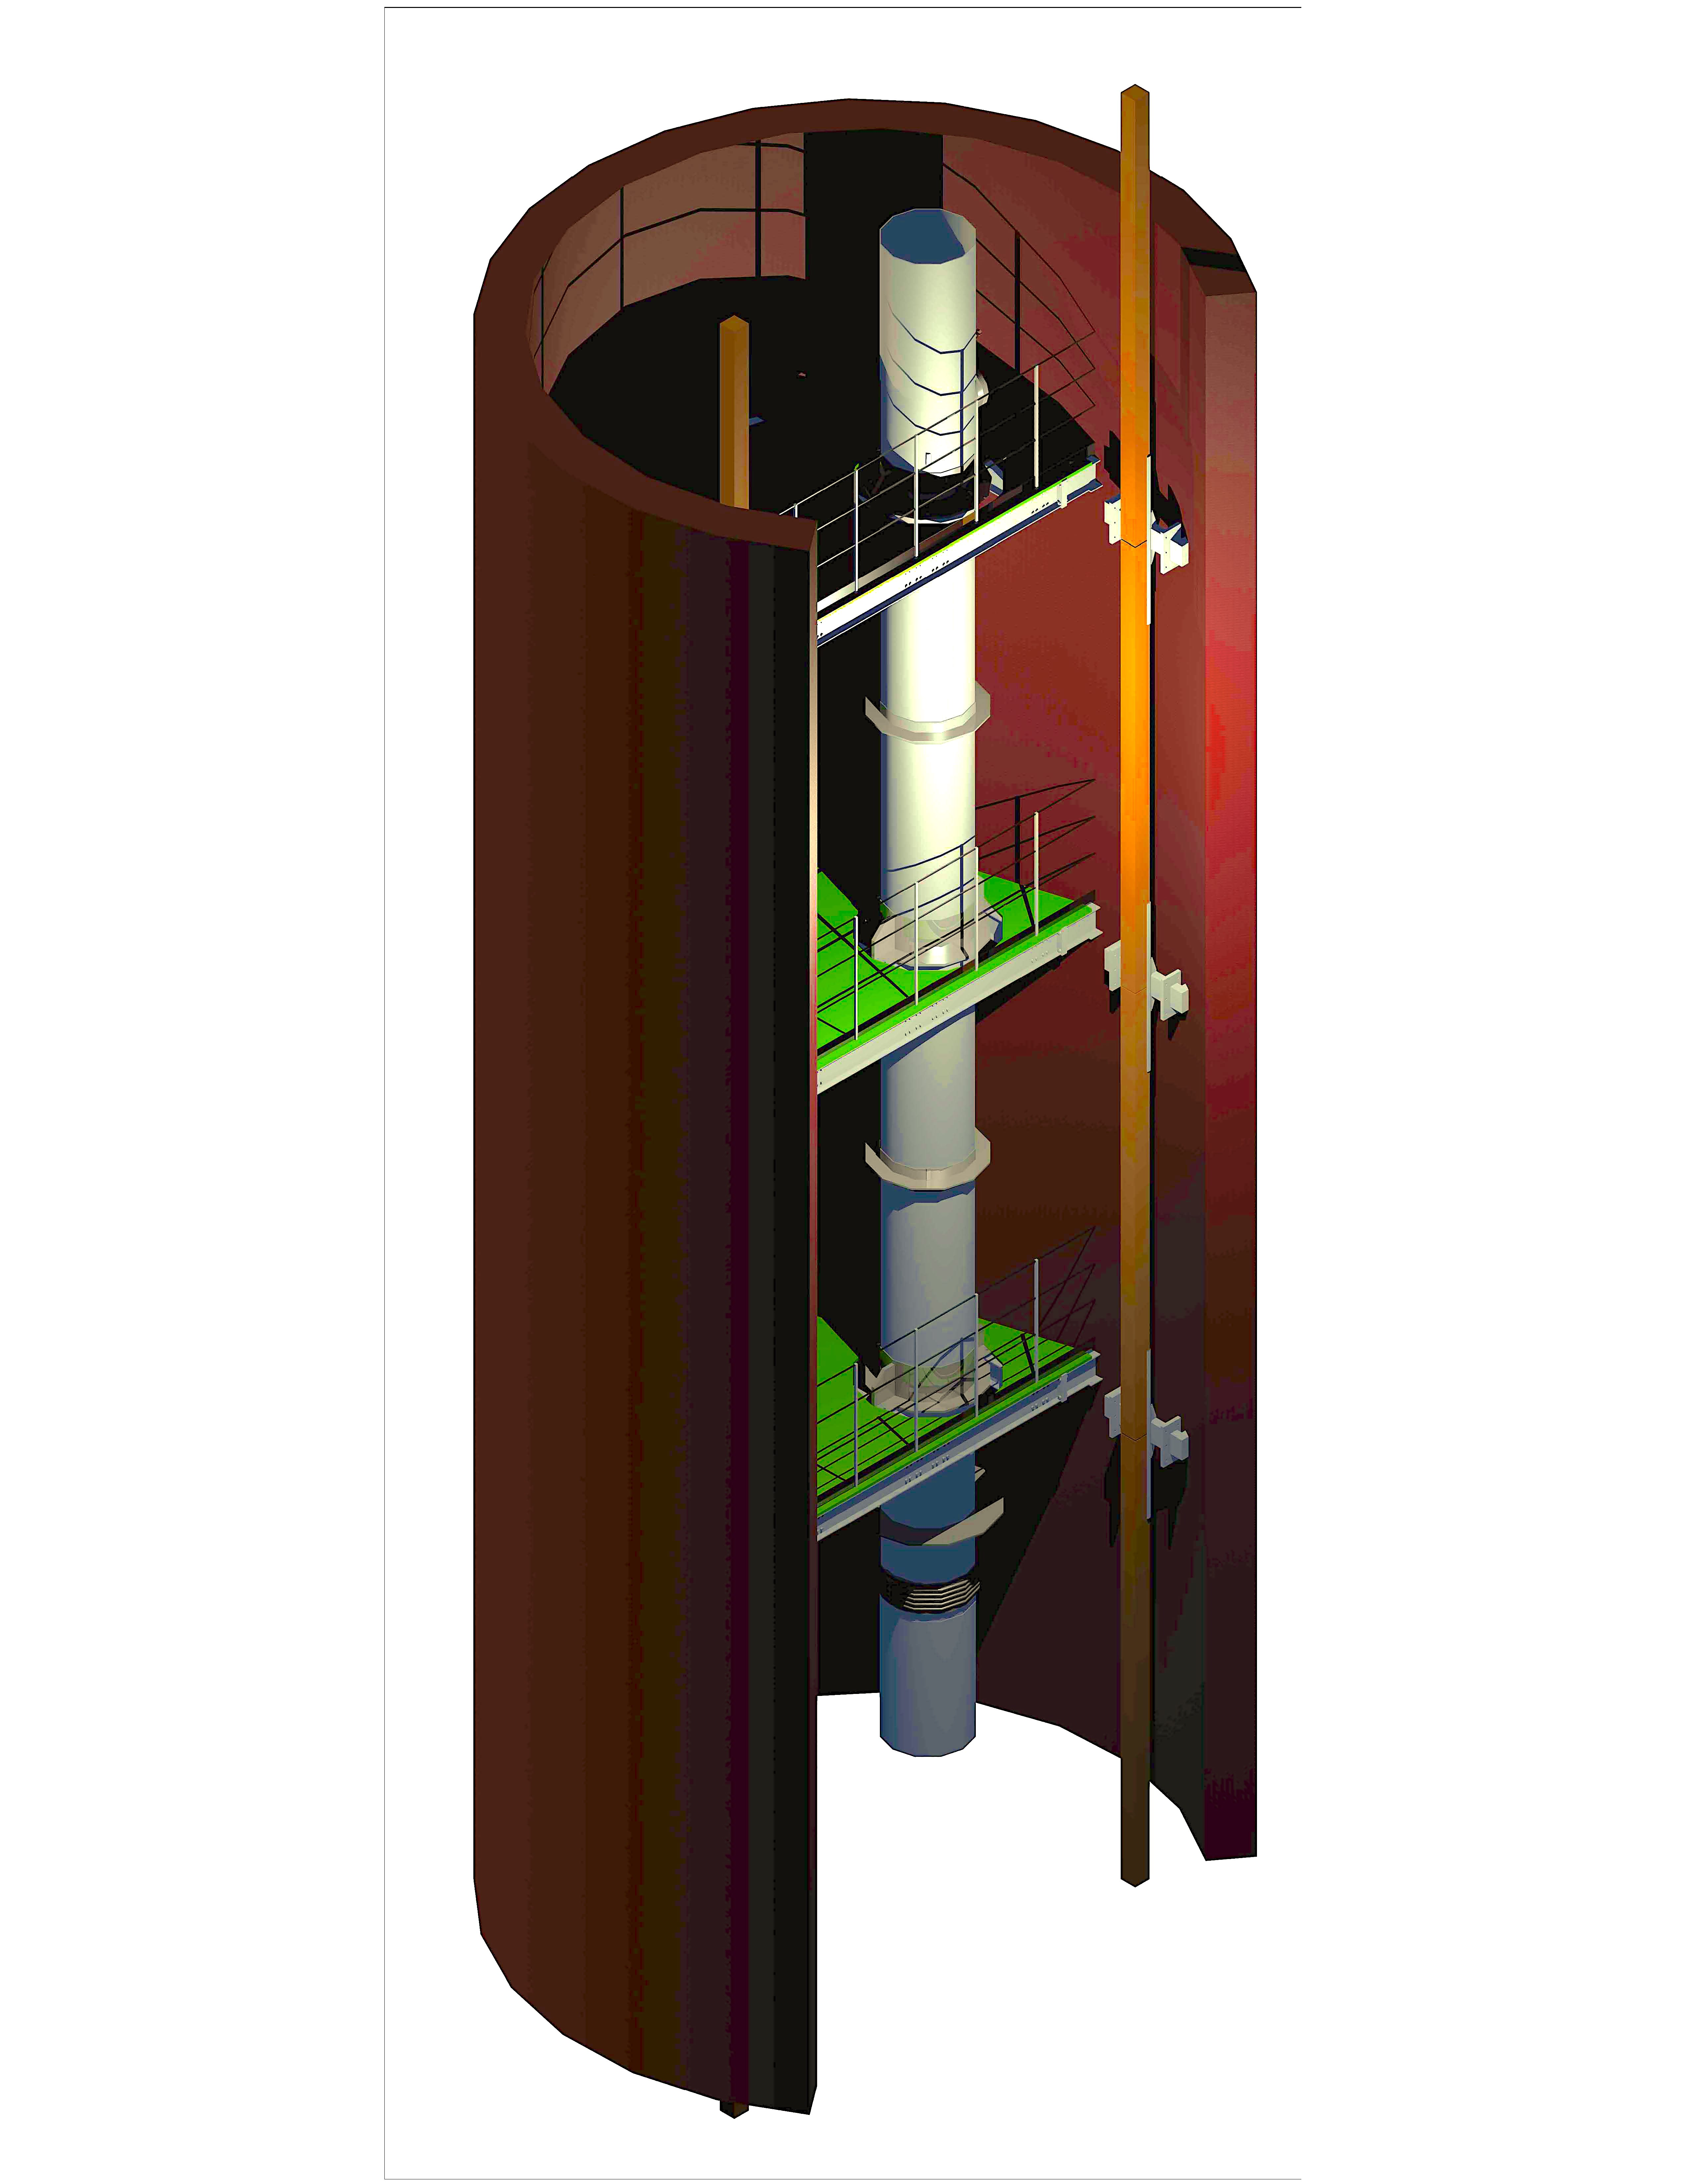
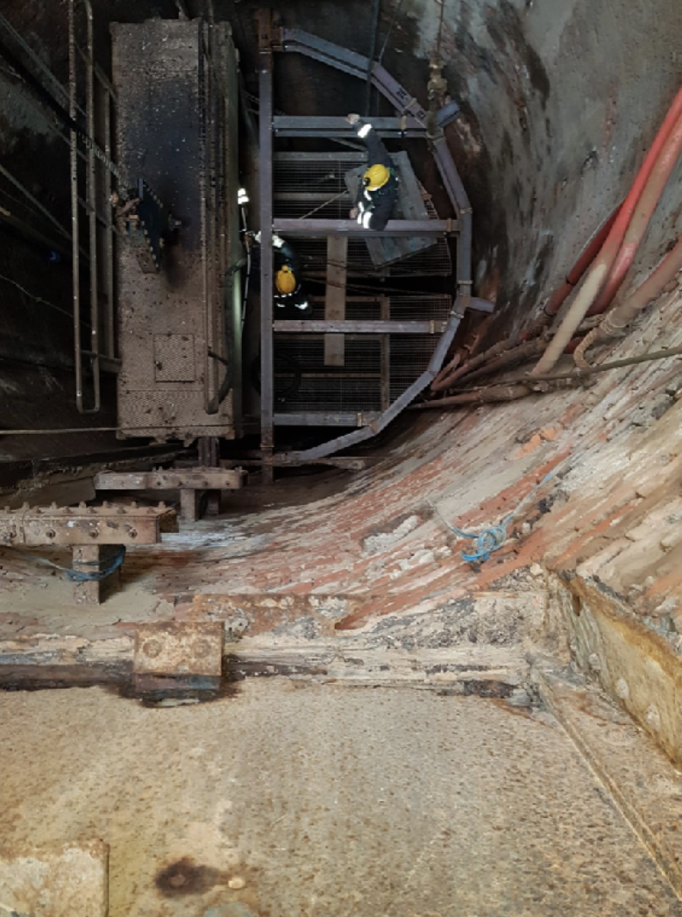
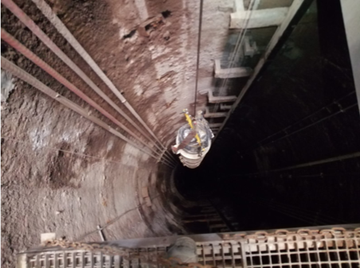
14
Installation of supports and module drop test.

Slide 16
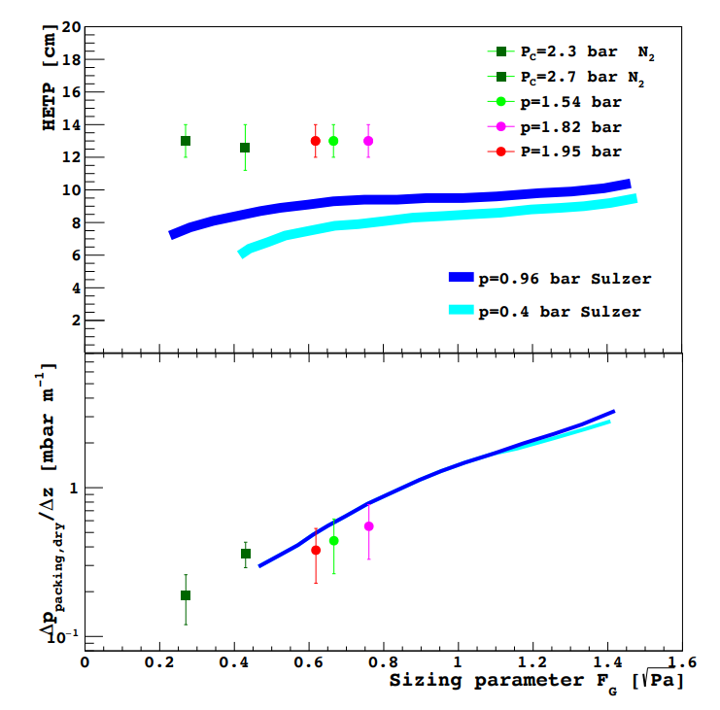
Previous successful runs with the Seruci-0 prototype
Argon run (2021)
³⁶Ar/
⁴⁰Ar 0.336%
0.45%
0.076%
³⁸Ar/
⁴⁰Ar 0.063%
In total reflux conditions: extracting a small flux from the column
Nitrogen run (2019)
¹⁵N
¹⁴N/
¹⁴N
¹⁴N
0.84%
0.91%
Next runs with Seruci-0
Perform chemical separation
Not in total reflux condition (extracting a significant quantity of argon)
15

Slide 17
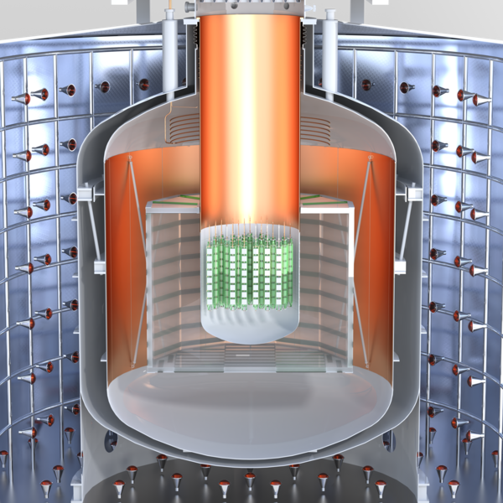
Other purposes of the argon procurement chain and of purification with Aria
In LEGEND 1000 kg of 76Ge are required to look for neutrinoless double beta-decay.
⁷⁶Ge High purity
20 t UAr
Even LEGEND-1000 requires chemically purified argon. Therefore, with the same procedure as for DarkSide-20k, it will also be possible to produce for LEGEND.
200 t AAr
Water Tank
16

Slide 18
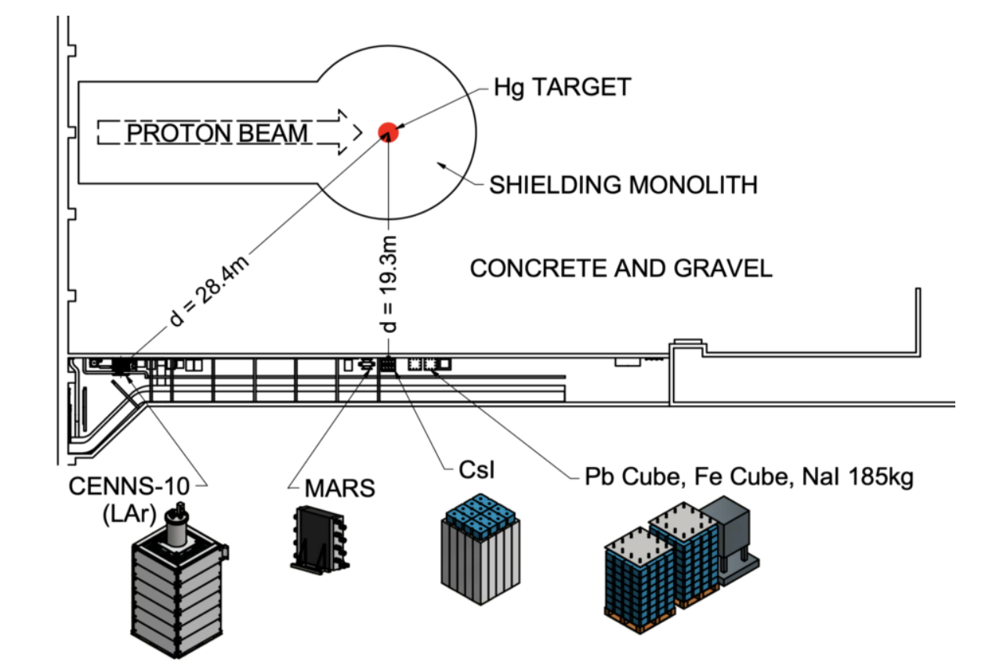
COHERENT and others
The COHERENT experiment studies coherent elastic neutrino-nucleus scattering (CEvNS), a process predicted by the Standard Model of particle physics. It aims to measure this interaction to better understand neutrino properties and test for potential new physics beyond the Standard Model.
They will use LAr TPC with purified argon as well
We will provide 1 ton of purified argon
We are considering possible new requests for purified argon or other isotopes distilled for other experiments…
17

Slide 19
References:
Aria:
Agnes, P., et al. "Separating 39 Ar from 40 Ar by cryogenic distillation with Aria for dark-matter searches." The European Physical Journal C 81.4 (2021): 359.
Aaron, E., et al. "Measurement of isotopic separation of argon with the prototype of the cryogenic distillation plant Aria for dark matter searches." The European Physical Journal C 83.5 (2023): 1-13.
Legend:
Edzards, Frank. Characterization of Point Contact Germanium Detectors and De
velopment of Signal Readout Electronics for LEGEND. Diss. TU München Munich,
2021.
Pictures:
DarkSide Collaboration meeting presentations about Aria (Federico Gabriele) and Urania (Marino Simeone)
Forti Committee review meeting presentations from Federico Gabriele and Farrokh Rad
Walter Bonivento’s talks
DarkSide:
Fan, Alden. "Status and results from DarkSide-50." arXiv preprint arXiv:1511.00676 (2015).
Aalseth, Craig E., et al. "DarkSide-20k: A 20 tonne two-phase LAr TPC for direct dark matter detection at LNGS." The European Physical Journal Plus 133 (2018): 1-129

Slide 20
Conclusions
DarkSide-20k Experiment: Aims to detect dark matter by observing interactions of WIMPs within a 50-ton liquid argon target using double-phase time projection chamber technology.
Argon Source: Low-radioactivity argon depleted in isotope 39 is sourced from the Urania plant in Colorado, extracting approximately 250 kg/day.
Initial Purification: At Urania, the argon undergoes initial purification through distillation columns and a pressure swing absorption stage.
Secondary Purification: The purified argon is transported to the Aria plant in Sardinia, Italy, where a 350 m cryogenic distillation column further reduces residual impurities to detector-grade levels.
Extended Applications: The argon purification process can also be used to produce argon for other experiments such as LEGEND and COHERENT. The Aria distillation column can also be used to produce other isotopes of interest for other experiments
18

Slide 21
Backup

