Slide 1
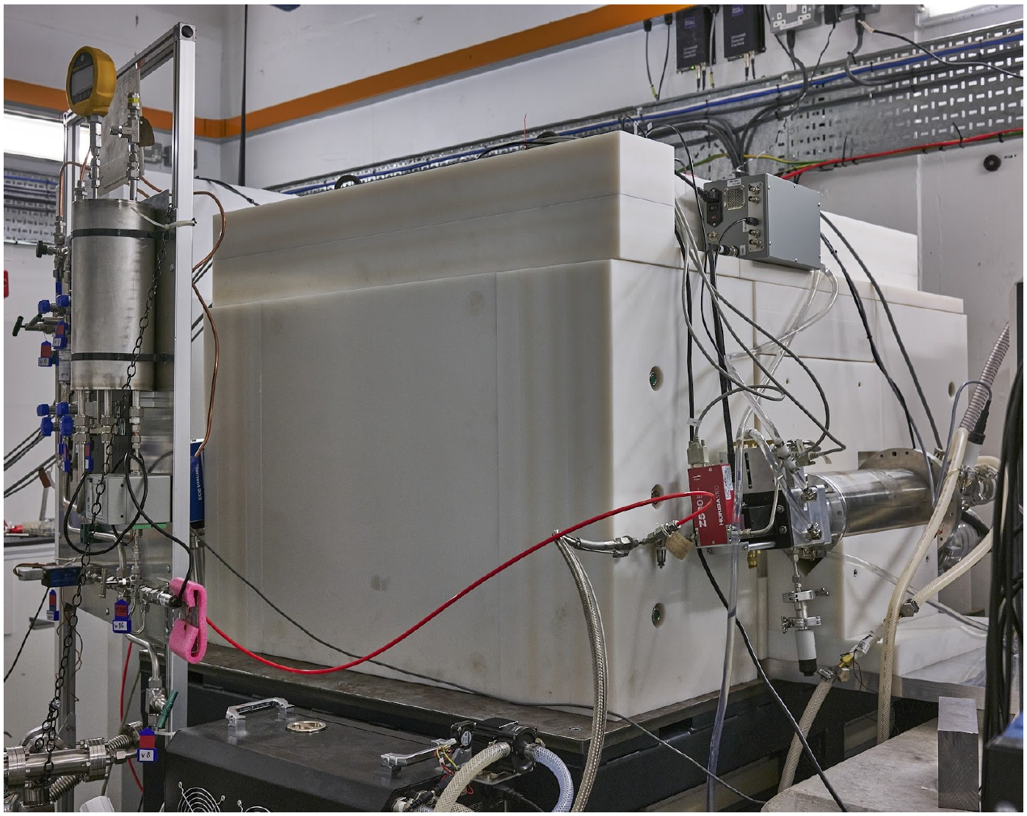
Commissioning of the MIGDAL detector with fast neutrons
Tim Marley
Imperial College London
On behalf of the MIGDAL Collaboration
The 15th International Workshop on the Identification of Dark Matter – 8-12 July 2024 – L’Aquila, Italy

Slide 2
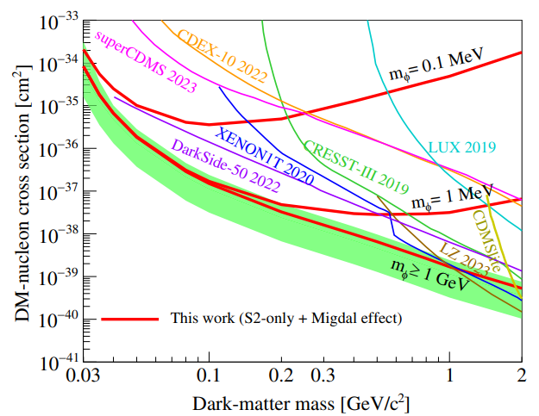
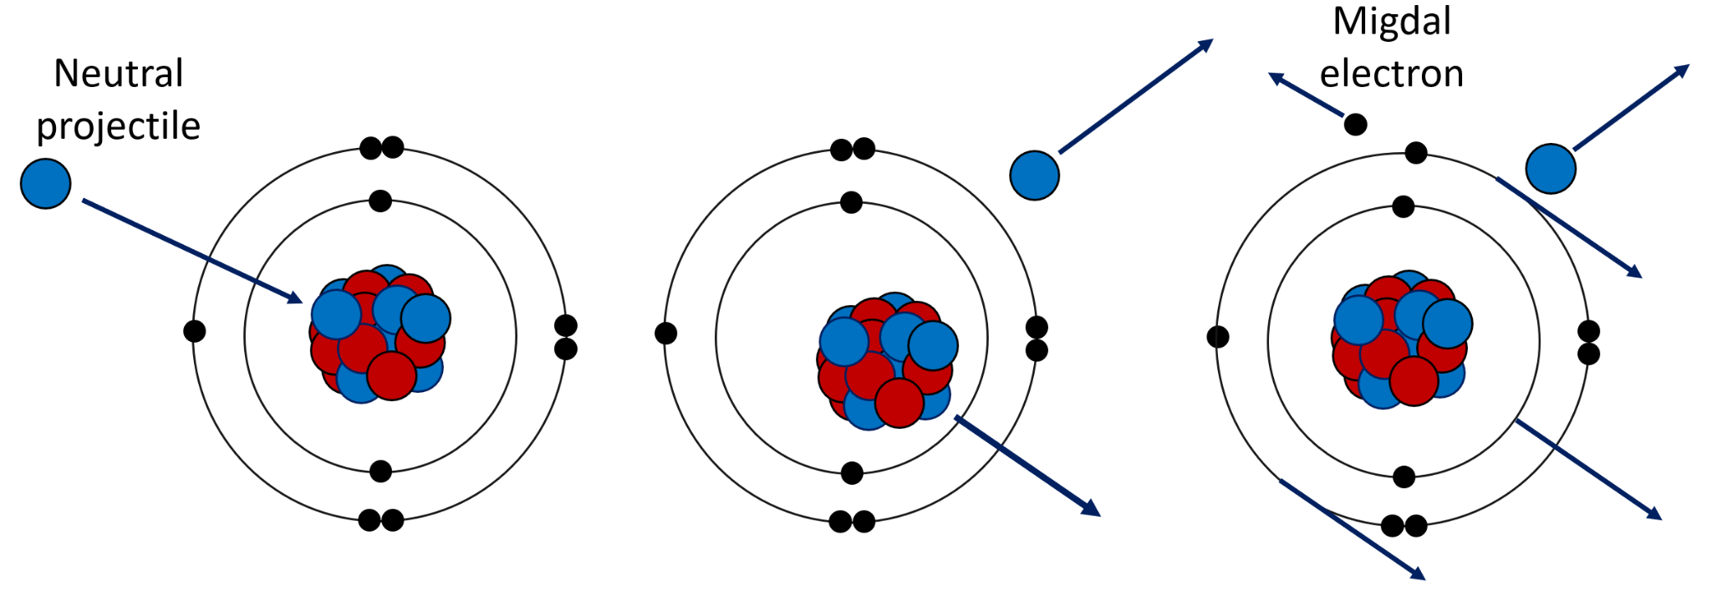
The Migdal effect
Direct DM experiments invoke the Migdal effect to probe energies below their nuclear recoil threshold.
Predicted by A. Migdal in the 1930s/1940s and first observed in radioactive decays in the 1970s – but not yet recorded in nuclear scattering.
Migdal In Galactic Dark mAtter expLoration (MIGDAL) Experiment
We aim to achieve the unambiguous observation (and characterisation) of the Migdal effect using a low-pressure optical TPC and high-energy neutrons.
Migdal topology involves an electron and a nuclear
recoil originating from the same vertex.

Slide 3
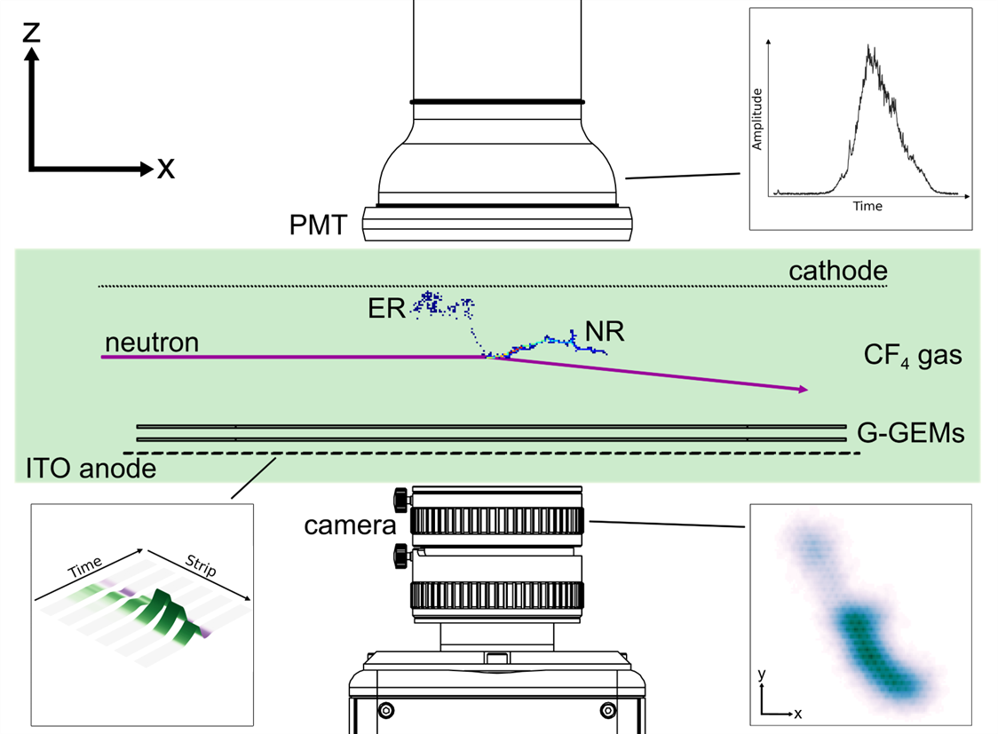
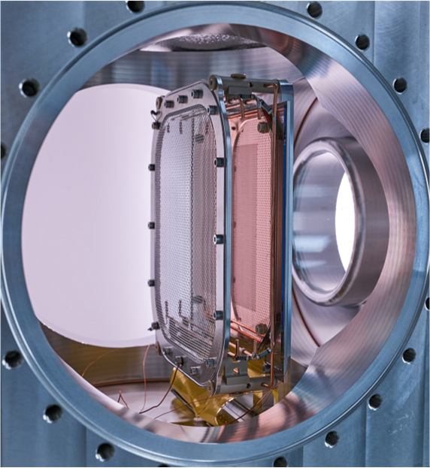
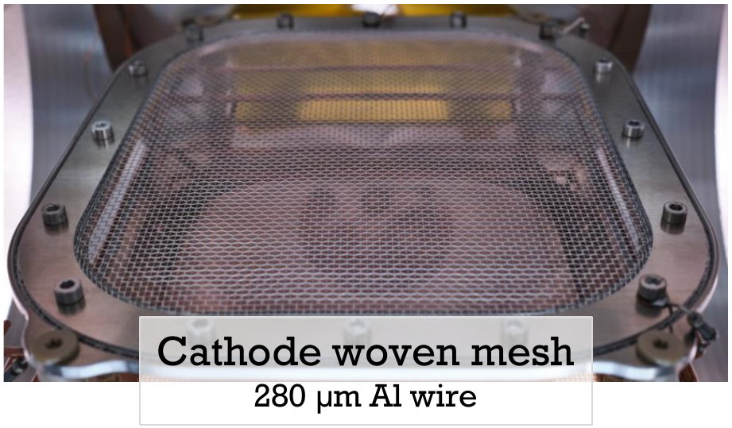
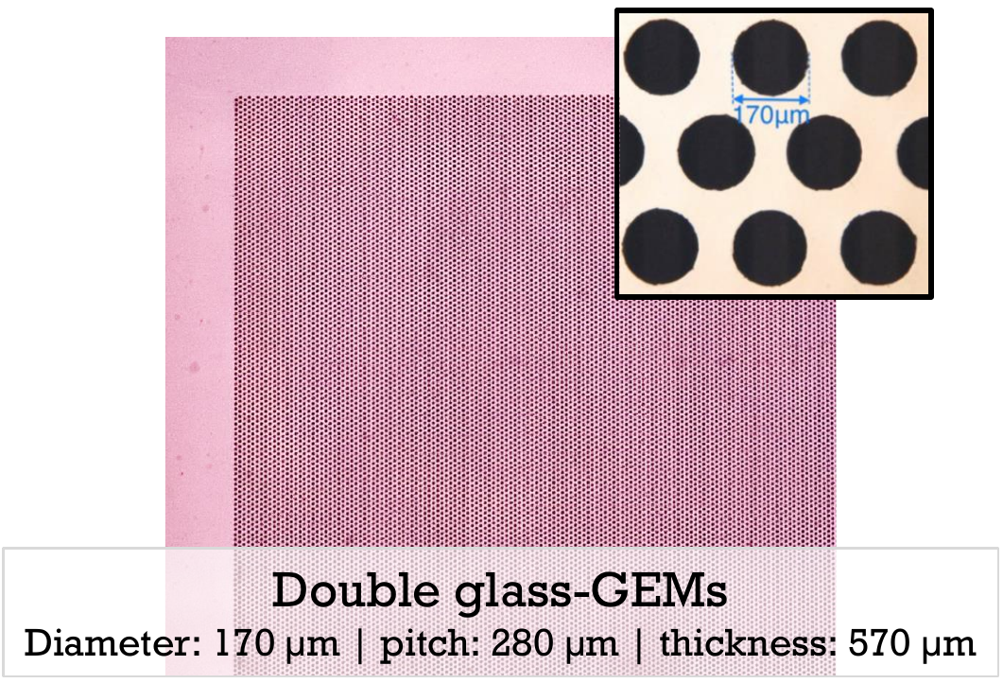
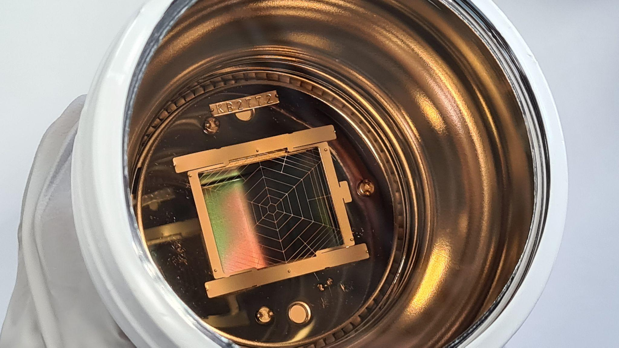
The MIGDAL Experiment
High-yield neutron generator
D-D: 2.47 MeV (10⁹ n/s)
Defined, collimated beam
Low-pressure gas: 50 Torr of CF₄
Visible light + VUV scintillator
Extended particle tracks, Long attenuation length for gamma rays
Can add fraction of noble gases relevant to dark matter searches (Ar / Xe)
Optical TPC
Amplification: 2x glass-GEMs
Optical: camera + photomultiplier tube
Charge: 120 ITO anode strips
Electron and nuclear recoil tracks
Migdal: NR+ER tracks, common vertex
NR and ER tracks have opposite dE/dx profiles
5 keV electron threshold (⁵⁵Fe calibration)
Hamamatsu R11410 PMT (trigger)

Slide 4
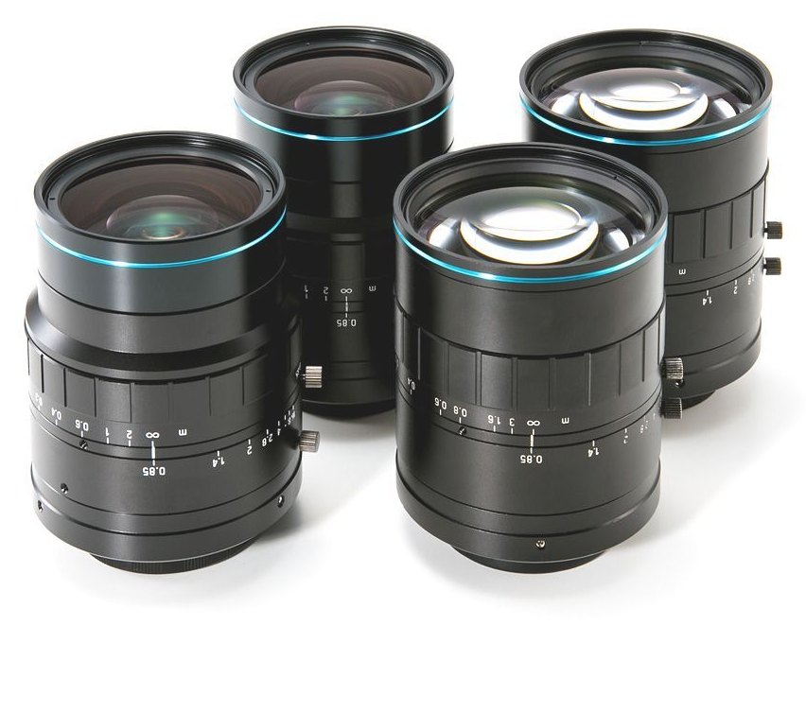
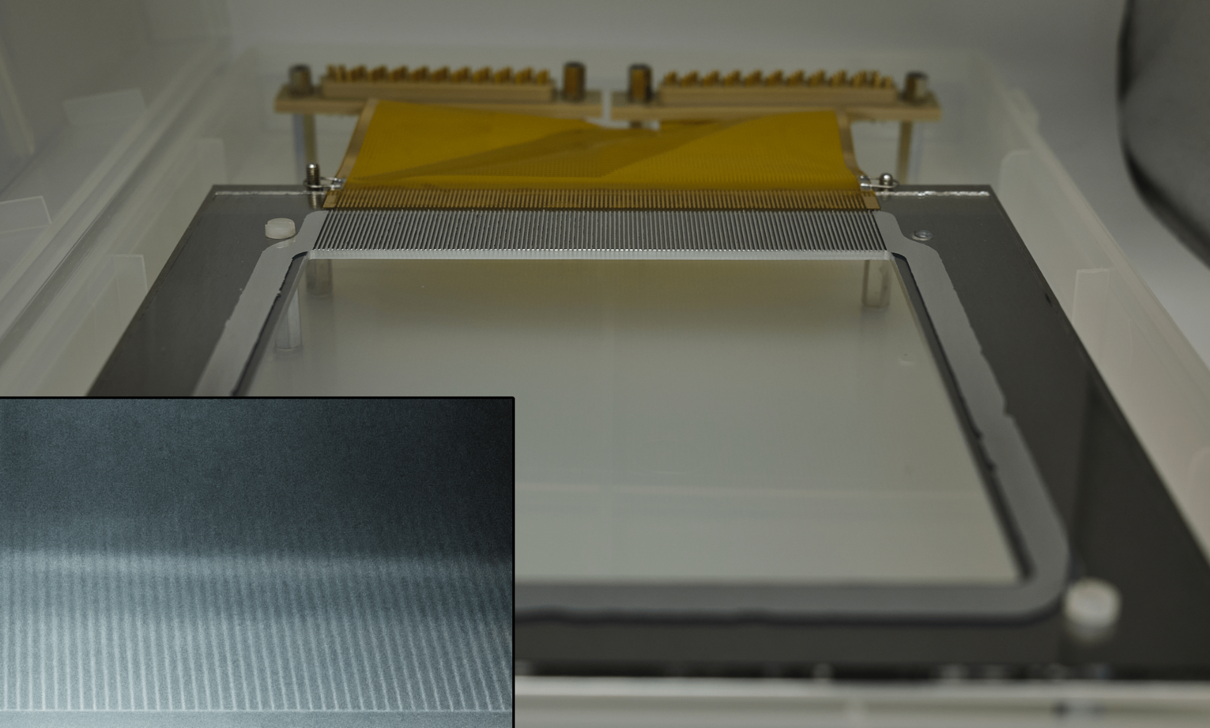
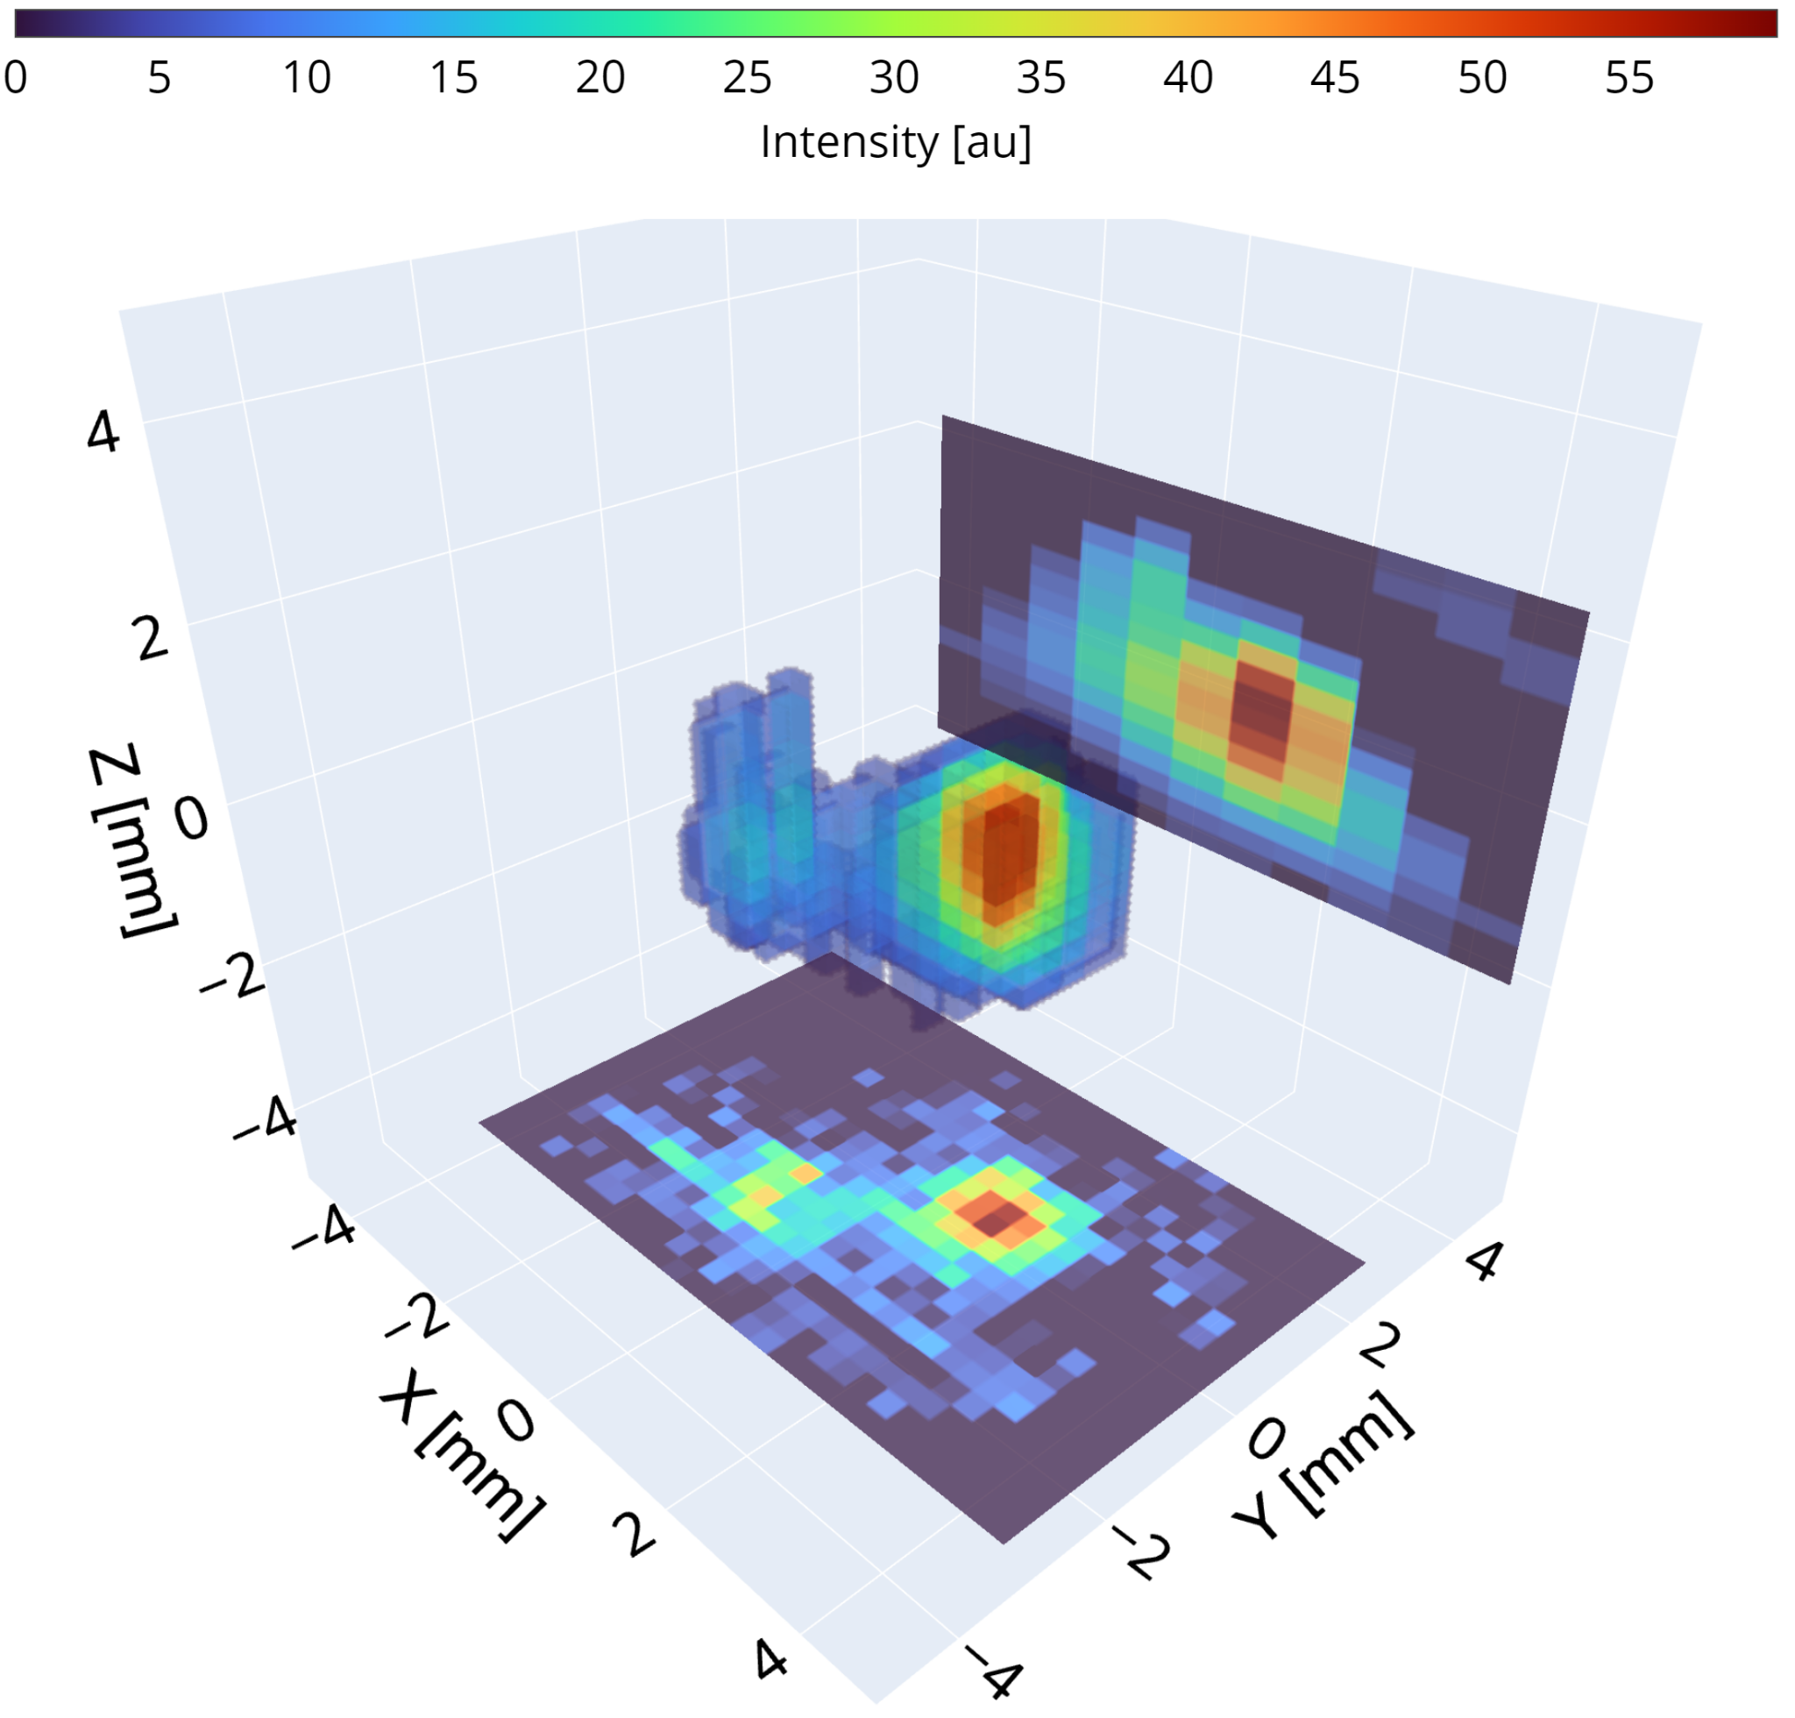
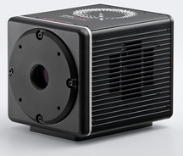
Combining optical and charge readout
Transparent, segmented ITO anode
EHD f/0.85 25 mm lens
ER from ⁵⁵Fe x-ray interaction
(5.9 keV)
anode strips
120 strips
ORCA Quest
ER
direction
120 strips connected to 60 fast commercial amplifiers (LMH6629)
0.6 mm strips with 0.8 mm pitch, 10 cm x 10 cm active area
Digitised with 2 ns sampling rate at 8-bit resolution with Acqiris DAQ
Low-noise qCMOS camera
RMS noise:
0.41e– @ 120 Hz
0.21e– @ 5 Hz
12-bit resolution

Slide 5
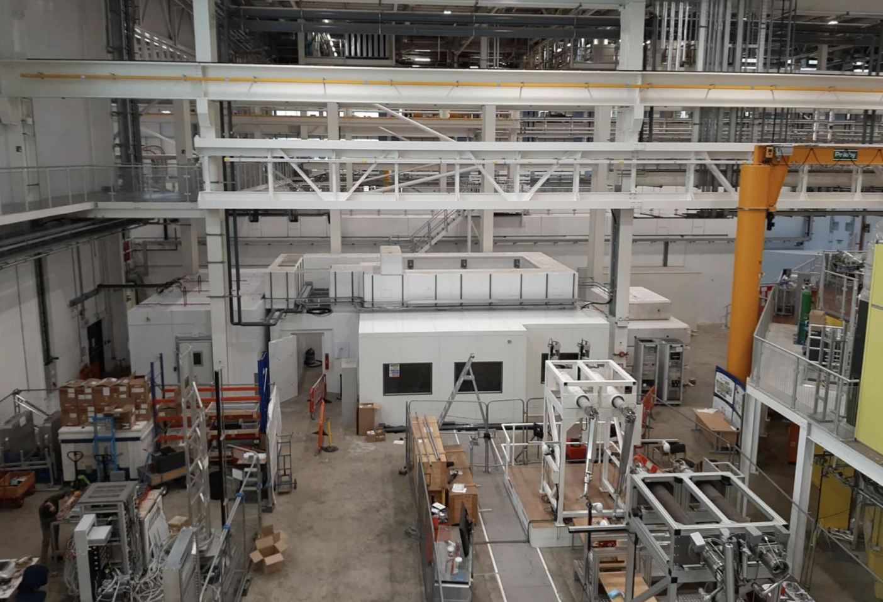
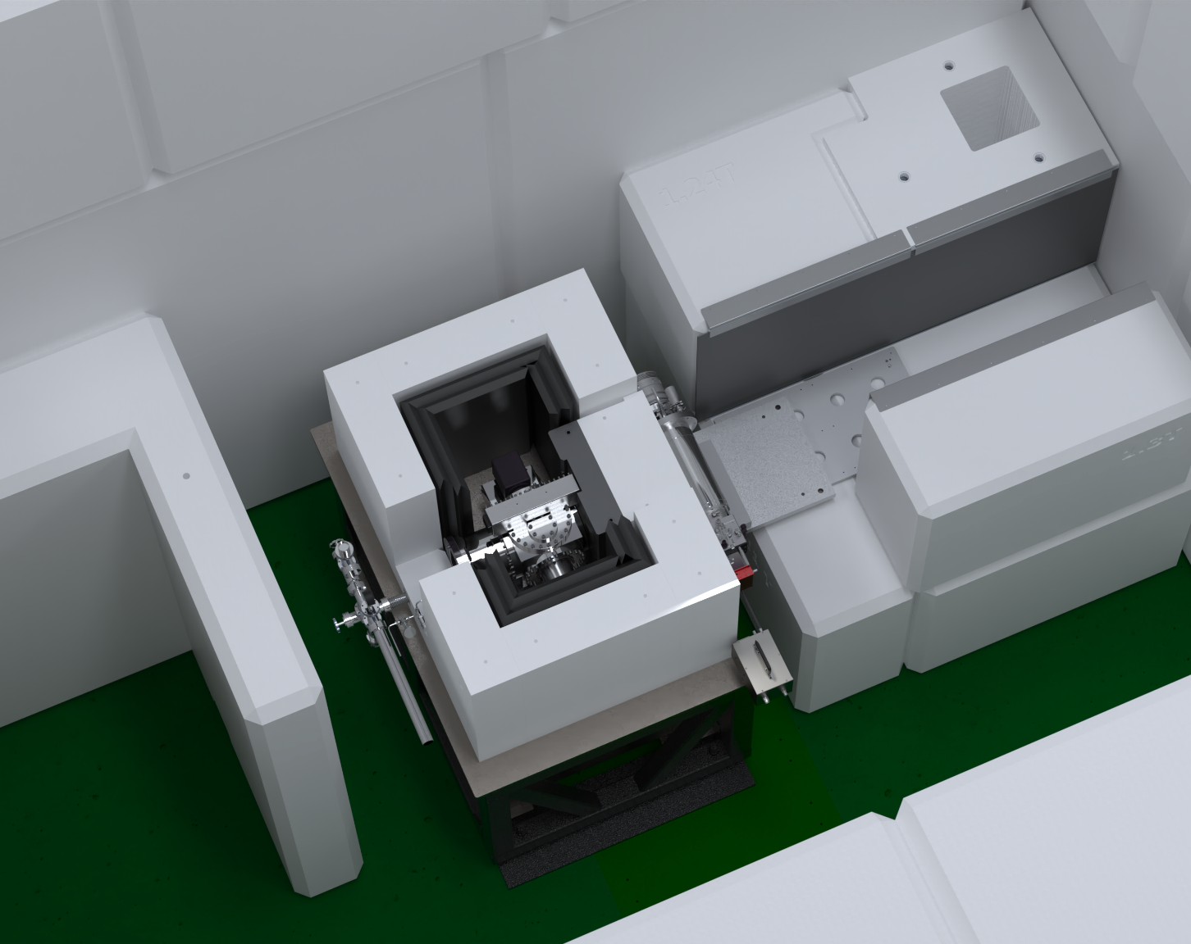
NILE facility at Rutherford Appleton Laboratory, UK
Bespoke DD and DT neutron irradiation facility located within Target Station 2 at ISIS Neutron and Muon Source, RAL
Concrete bunker with interlocked access
MIGDAL experiment sits in the centre of the bunker
Concrete
DD neutron generator
HDPE
Lead
MIGDAL detector
To gas system

Slide 6
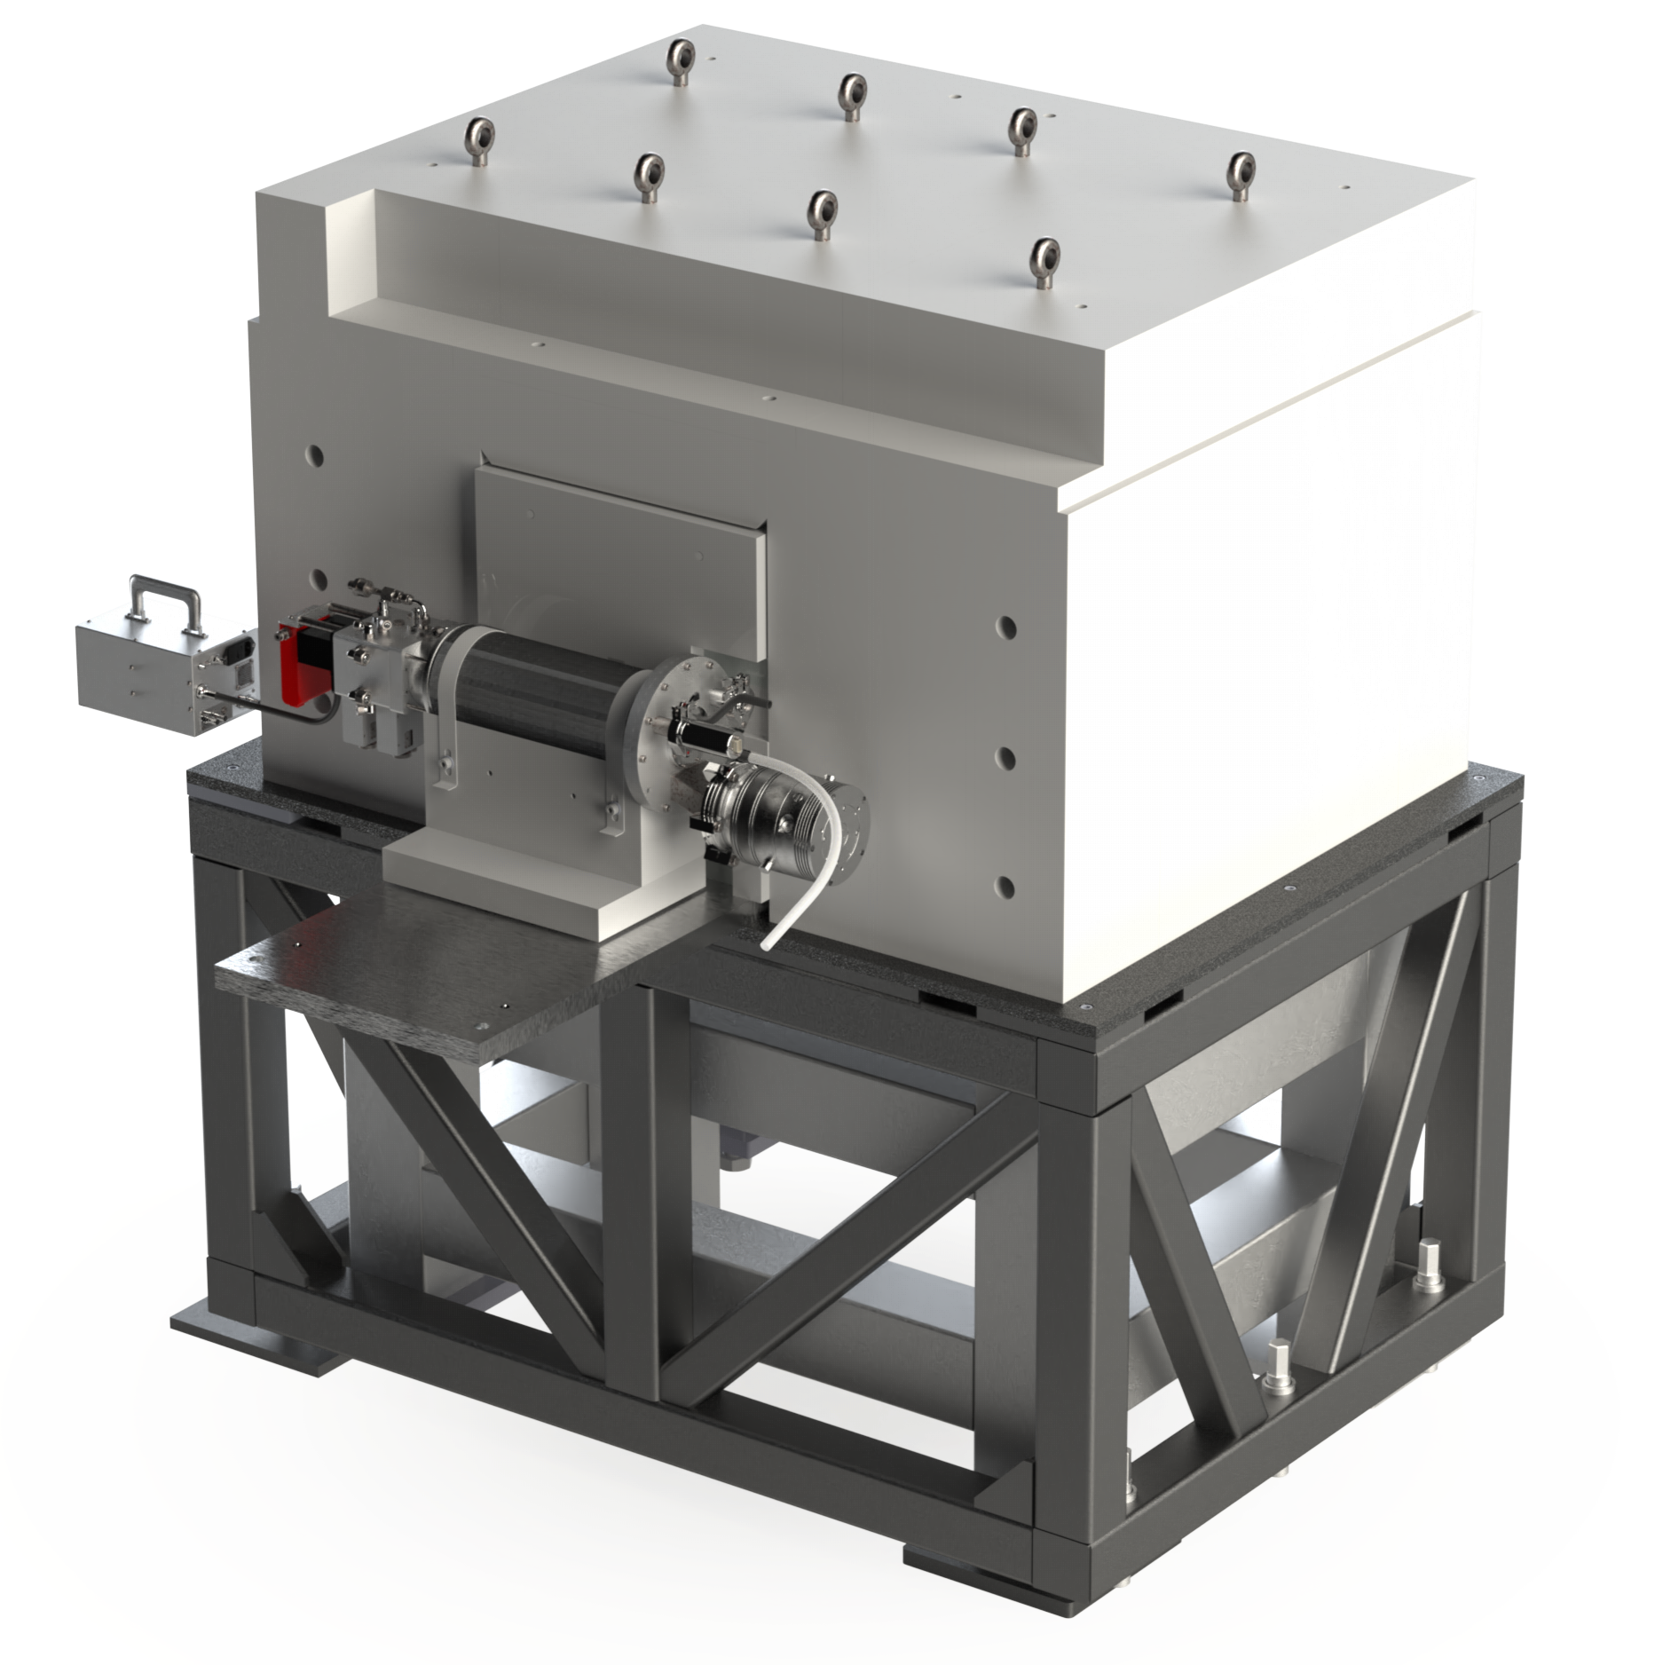
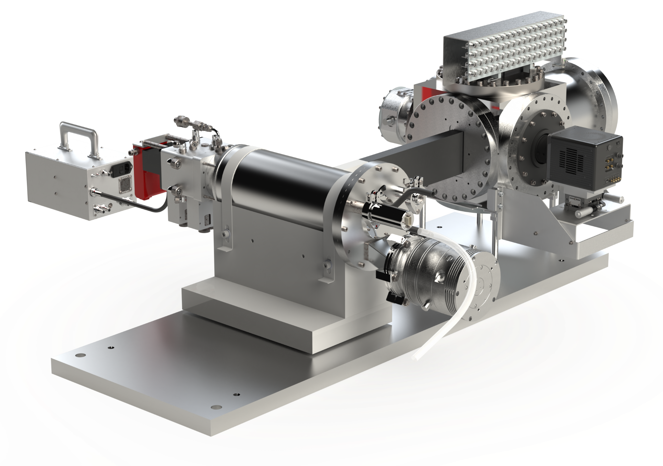
Shielded and unshielded renders of the experiment
Electronics
connectors
HDPE
(20 cm)
Pb within
(10 cm)
PMT
HDPE & Pb collimator
(40 cm)
Al vessel
DD generator
qCMOS camera
Al table
Steel support table

Slide 7
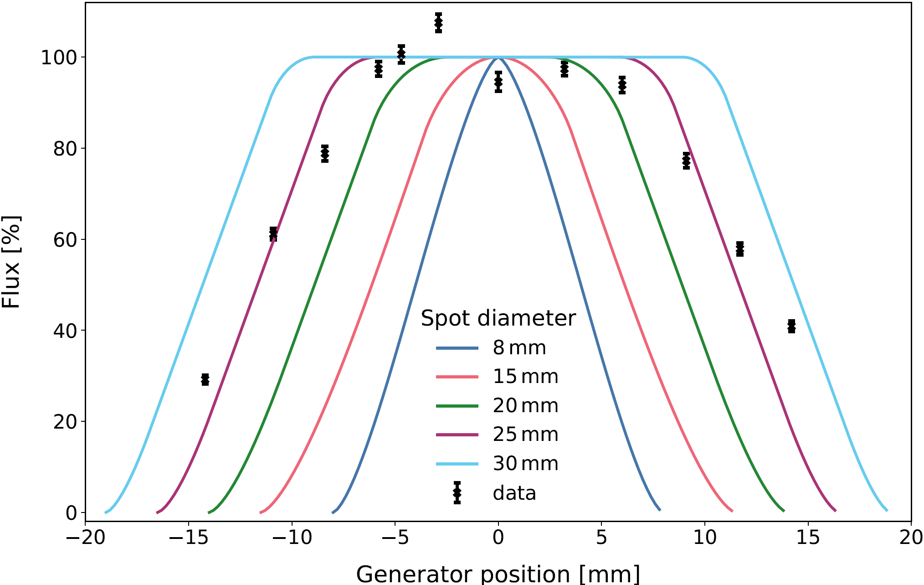
Characterising the neutron and NR rate
Expected 2.6⨉10⁵ n/s entering the active volume, but measured 6⨉10⁴ n/s.
Our collimator was designed around an 8 mm neutron production spot diameter within the DD generator, but the measured diameter was much closer to 25 mm.
This reduced the NR event rate in the active volume from ~15 Hz to ~5 Hz.
The camera was pulled closer to the active volume to capture more light.
This further reduced the contained NR rate in the ROI to ~2 Hz, which we observe in the data.

Slide 8
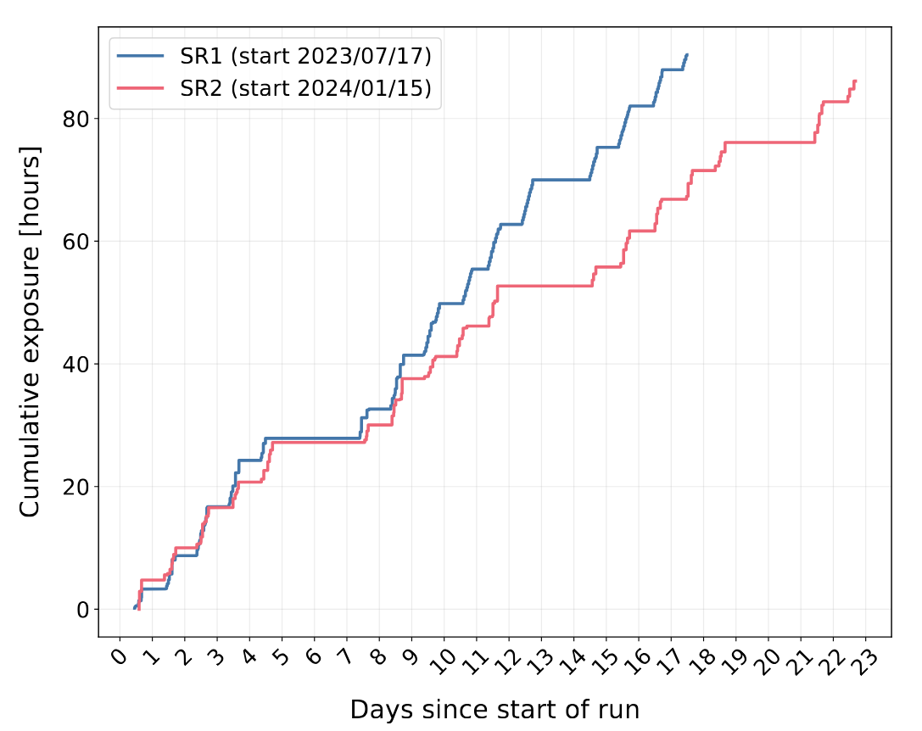
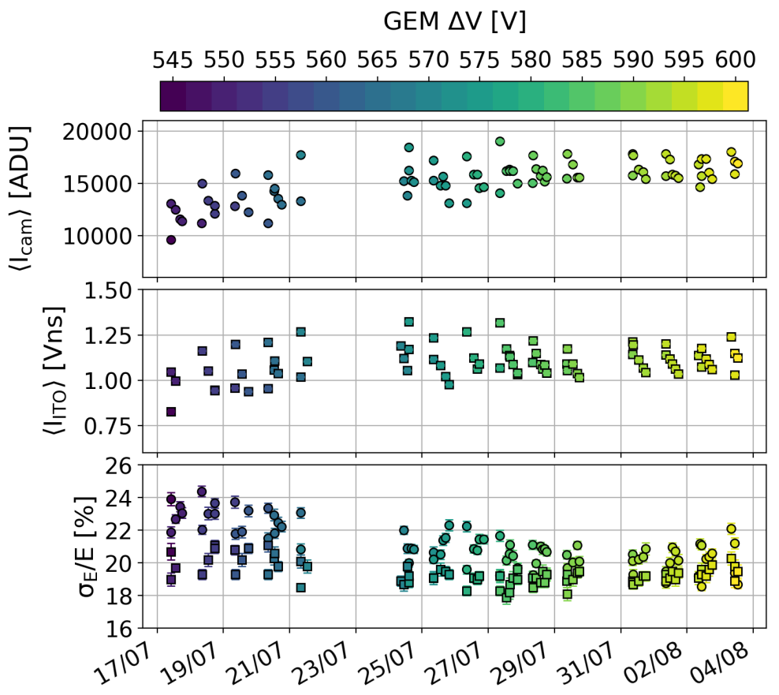
Science operations
First science run
17/07/23 – 03/08/23
Second science run
15/01/24 – 06/02/24
Data taken using D-D neutron generator recorded continuously during 10-hour long shifts.
50% of our data remains blinded.
Approximately 500,000 NRs in total.
Calibration runs with ⁵⁵Fe every 3 hours.
We replaced the gas medium once/twice per week.
Summary of gain and gain resolution over the course of first science run.

Slide 9
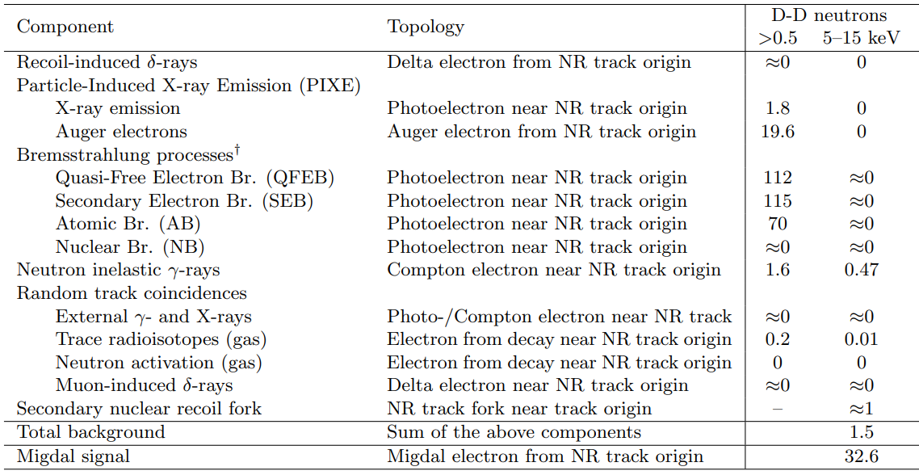
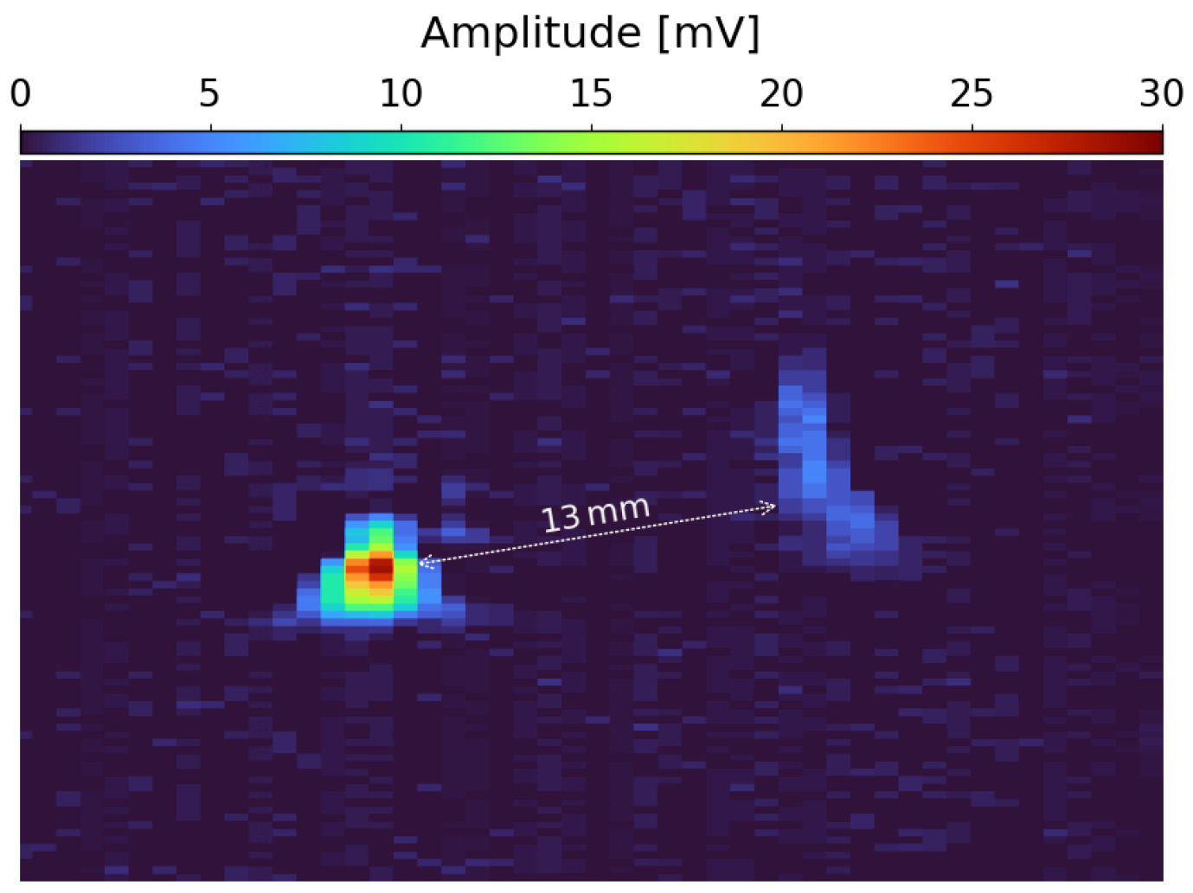
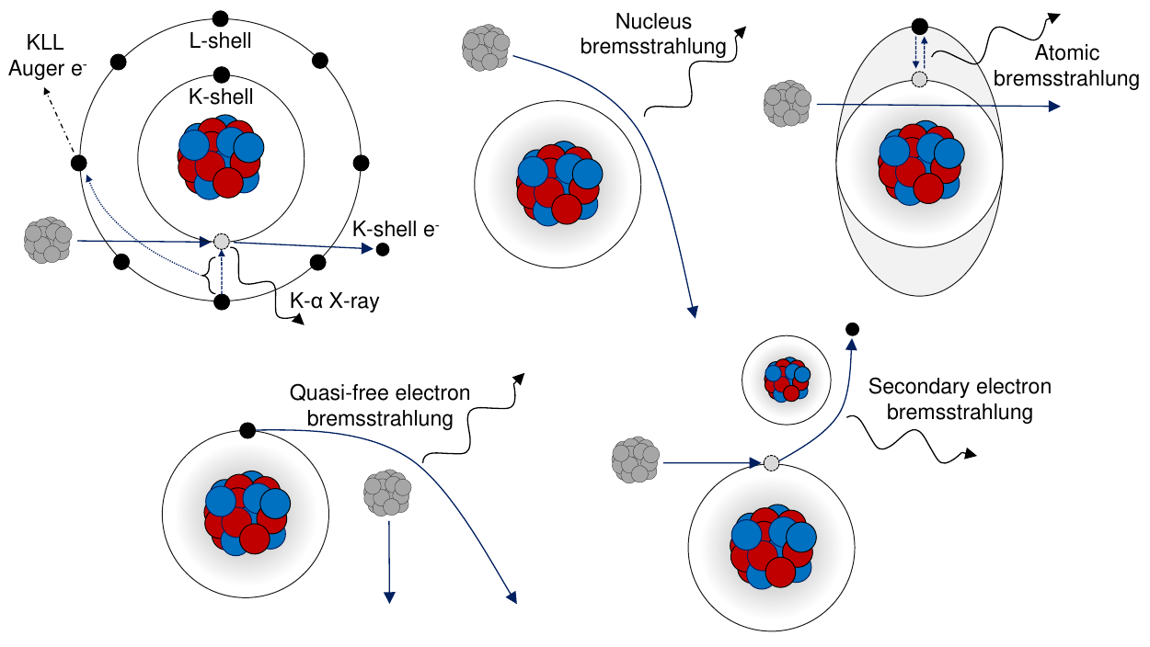
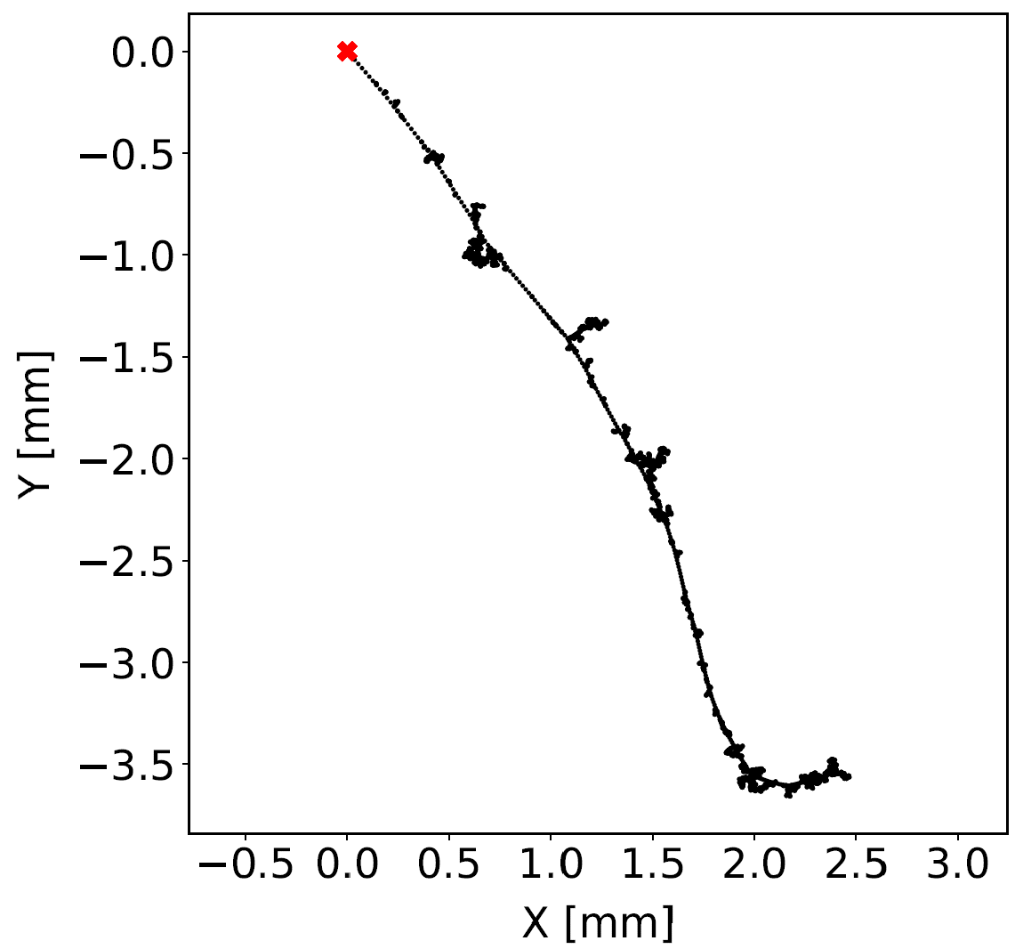
Backgrounds
(Astropart. Phys. 151 (2023) 102853)
We do not expect to be limited by background.
We wanted to confirm this by measuring the sideband outside the energy and spatial ROI.
Secondary NRs could create a split topology, similar to Migdal.
We can exclude these with kinematic and parametric constraints.
Compton scatters of 𝛄-rays from neutron inelastic scattering can create events with NR + ER.
This is the main source of background.
¹⁹F inelastic 𝛄-ray +
Compton scatter (ITO readout)

Slide 10
Backgrounds
(Astropart. Phys. 151 (2023) 102853)
We do not expect to be limited by background.
We wanted to confirm this by measuring the sideband outside the energy and spatial ROI.
Secondary NRs could create a split topology, similar to Migdal.
We can exclude these with kinematic and parametric constraints.
Compton scatters of 𝛄-rays from neutron inelastic scattering can create events with NR + ER.
This is the main source of background.
Eliminated by applying an energy threshold
Eliminated by ITO timing resolution
¹⁹F inelastic 𝛄-ray +
Compton scatter (ITO readout)

Slide 11
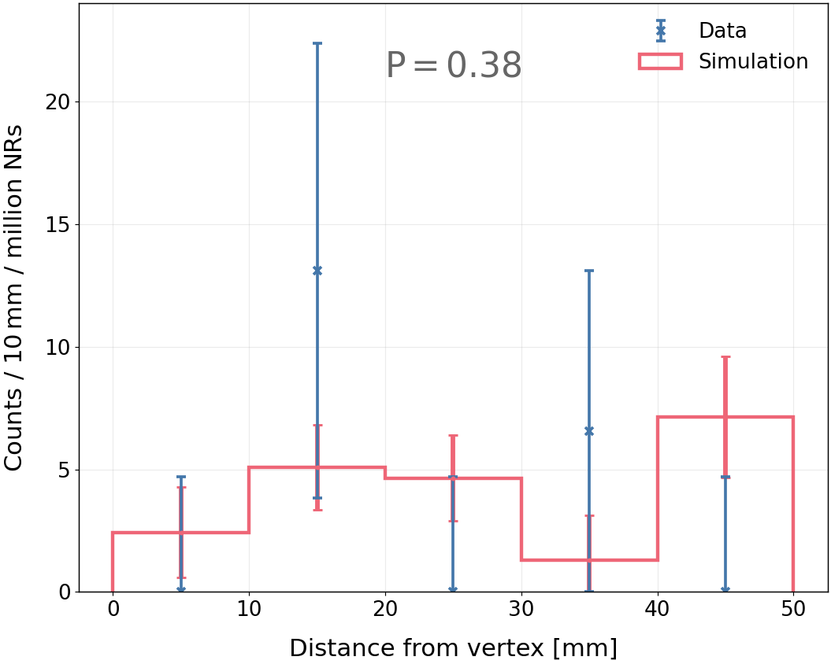
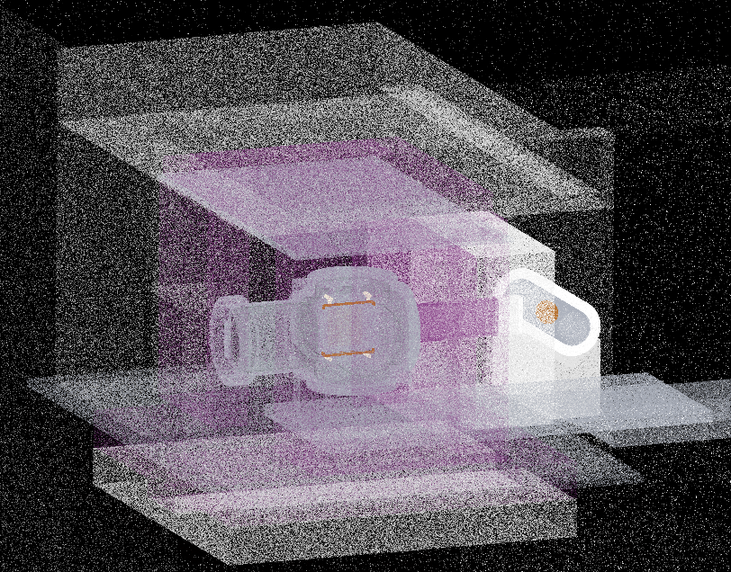
Measuring the neutron inelastic 𝛄-ray sideband
We have constructed a detailed GEANT4 detector geometry to calculate the expected number of 𝛄-rays.
The number of simulated and measured NR + ER coincidences is consistent.
The expected (and measured) number of ERs produced within 3 mm of an NR vertex is very small (good news).
Detailed Geant4 geometry
Preliminary

Slide 12
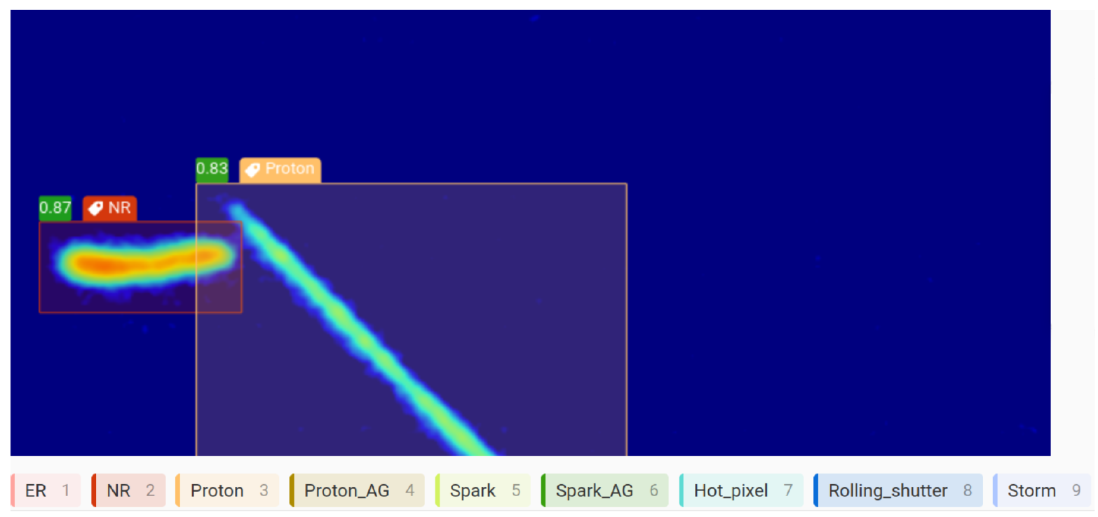
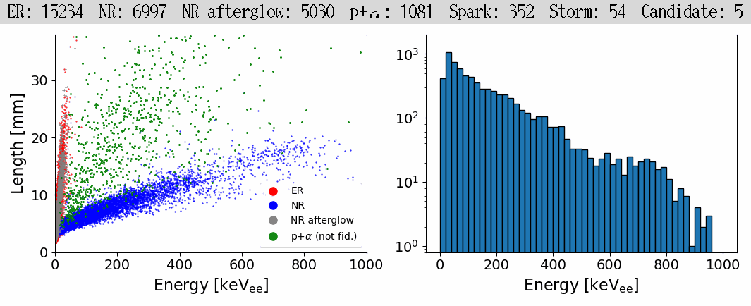
Beginning the search for Migdal with machine learning
YOLOv8 is a state-of-the-art object detection algorithm.
Object detection simultaneously classifies and localizes (with bounding boxes) any number of objects of interest in an image.
Pipeline provides online deliverables, including mixed-field particle ID and NR energy spectra in real time.
¹⁹F endpoint
^{nat}C endpoint
(arXiv.2406.07538)

Slide 13
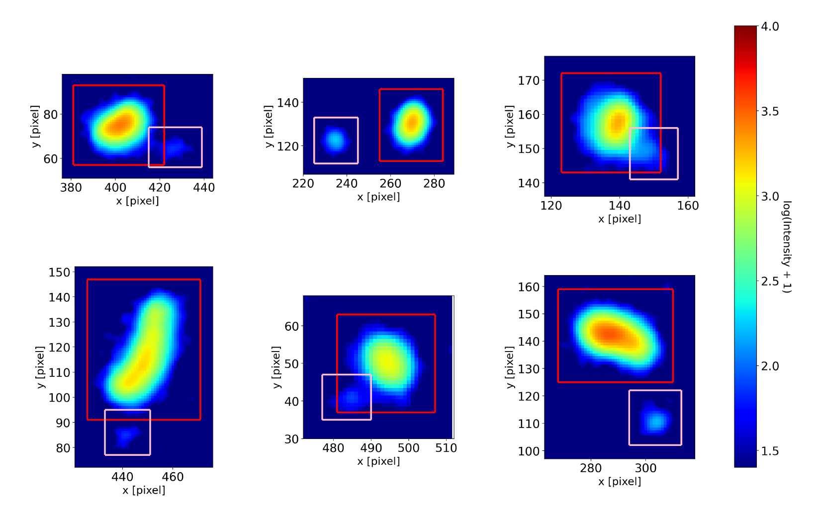
YOLOv8 for data reduction
YOLO currently operates on the images from the camera subsystem.
YOLO finds several ERs within the vicinity of NRs.
Keeping only frames with a single ER and NR within 6 mm of each other reduces a sample of 20 million frames to 1,641.
Are these all Migdal? No.
Camera exposure time (8.33 ms) is long enough for (few) events to pileup.
We can resolve this with the ITO subsystem.
6 randomly chosen events from a sample of ERs + NRs with centroid distance < 6 mm
(arXiv.2406.07538)

Slide 14
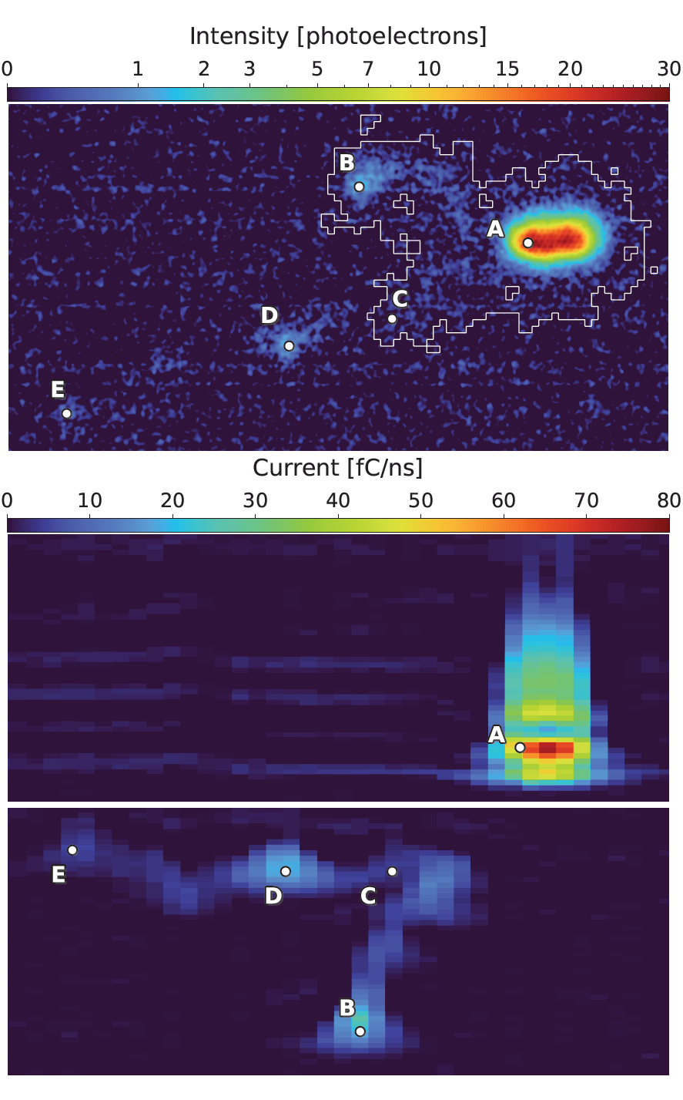
Camera coincidences rejected in ITO
The ITO's 2ns timing resolution allows for separation of events that pileup due to the camera's 8.33ms exposure time.
The example on the right looks Migdal-like in the camera.
In the ITO we see these are two separate events which occurred ~few ms apart.
The ITO is vital for rejecting these coincidences.
If an event does not appear in the ITO, we reject it outright as a coincidence.
Camera
ITO
1
t₀
2
t₀ + 5 ms

Slide 15
Summary
The MIGDAL experiment aims to perform an unambiguous observation of the Migdal effect.
Perpendicular optical and charge based planar readouts are combined to achieve 3D reconstruction of tracks.
The detector is performing as designed.
We have acquired several weeks of stable DD data. We will collect more.
Data analysis of the two science runs is ongoing (stay tuned).
Potential backgrounds appear to be as expected.
YOLOv8 object identification allows fast feedback and event selection (arXiv.2406.07538).

Slide 16
Backup

Slide 17
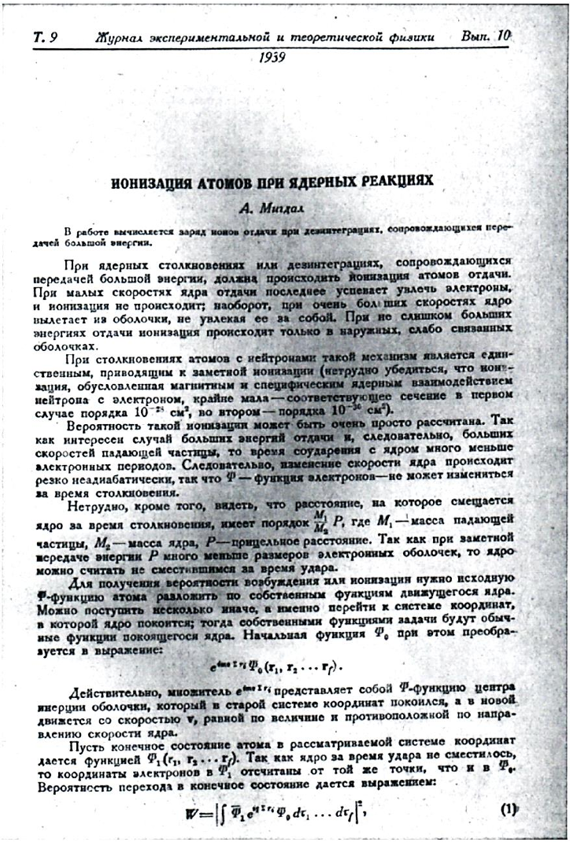
Papers
A. Migdal Ionizatsiya atomov pri yadernykh reaktsiyakh, ZhETF, 9, 1163-1165 (1939).
A. Migdal Ionizatsiya atomov pri α- i βraspade, ZhETF, 11, 207-212 (1941) .
M.S. Rapaport, F. Asaro and I. Pearlman Kshell electron shake-off accompanying alpha decay, PRC 11, 1740-1745 (1975).
M.S. Rapaport, F. Asaro and I. Pearlman L- and M-shell electron shake-off accompanying alpha decay, PRC 11, 1746-1754 (1975).
C. Couratin et al. , First Measurement of Pure Electron Shakeoff in the β Decay of Trapped 6He+ Ions, PRL 108, 243201 (2012).
X. Fabian et al., Electron Shakeoff following the β + decay of Trapped 19Ne+ and 35Ar+ trapped ions, PRA, 97, 023402 (2018).

Slide 18
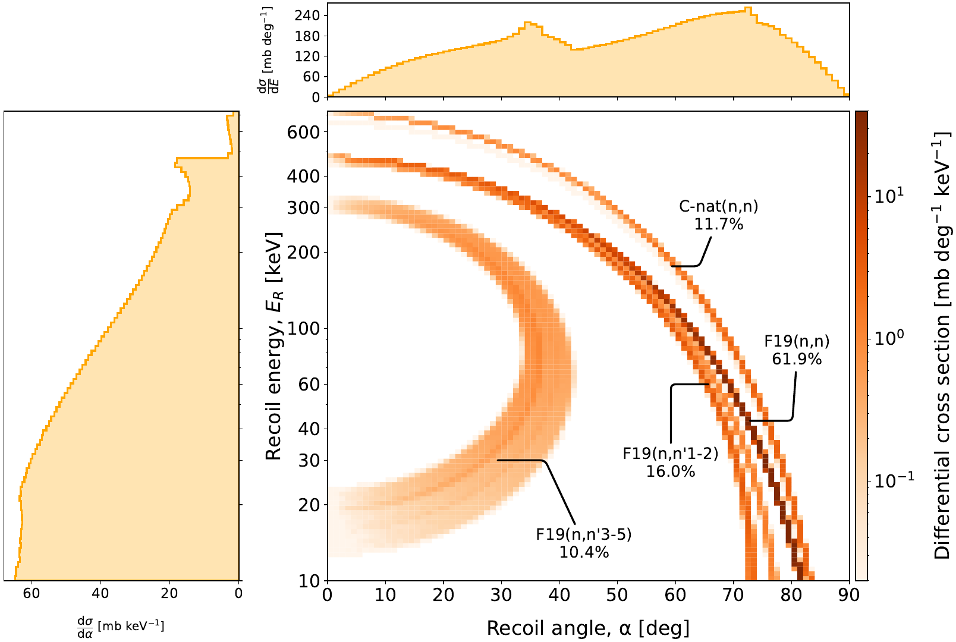
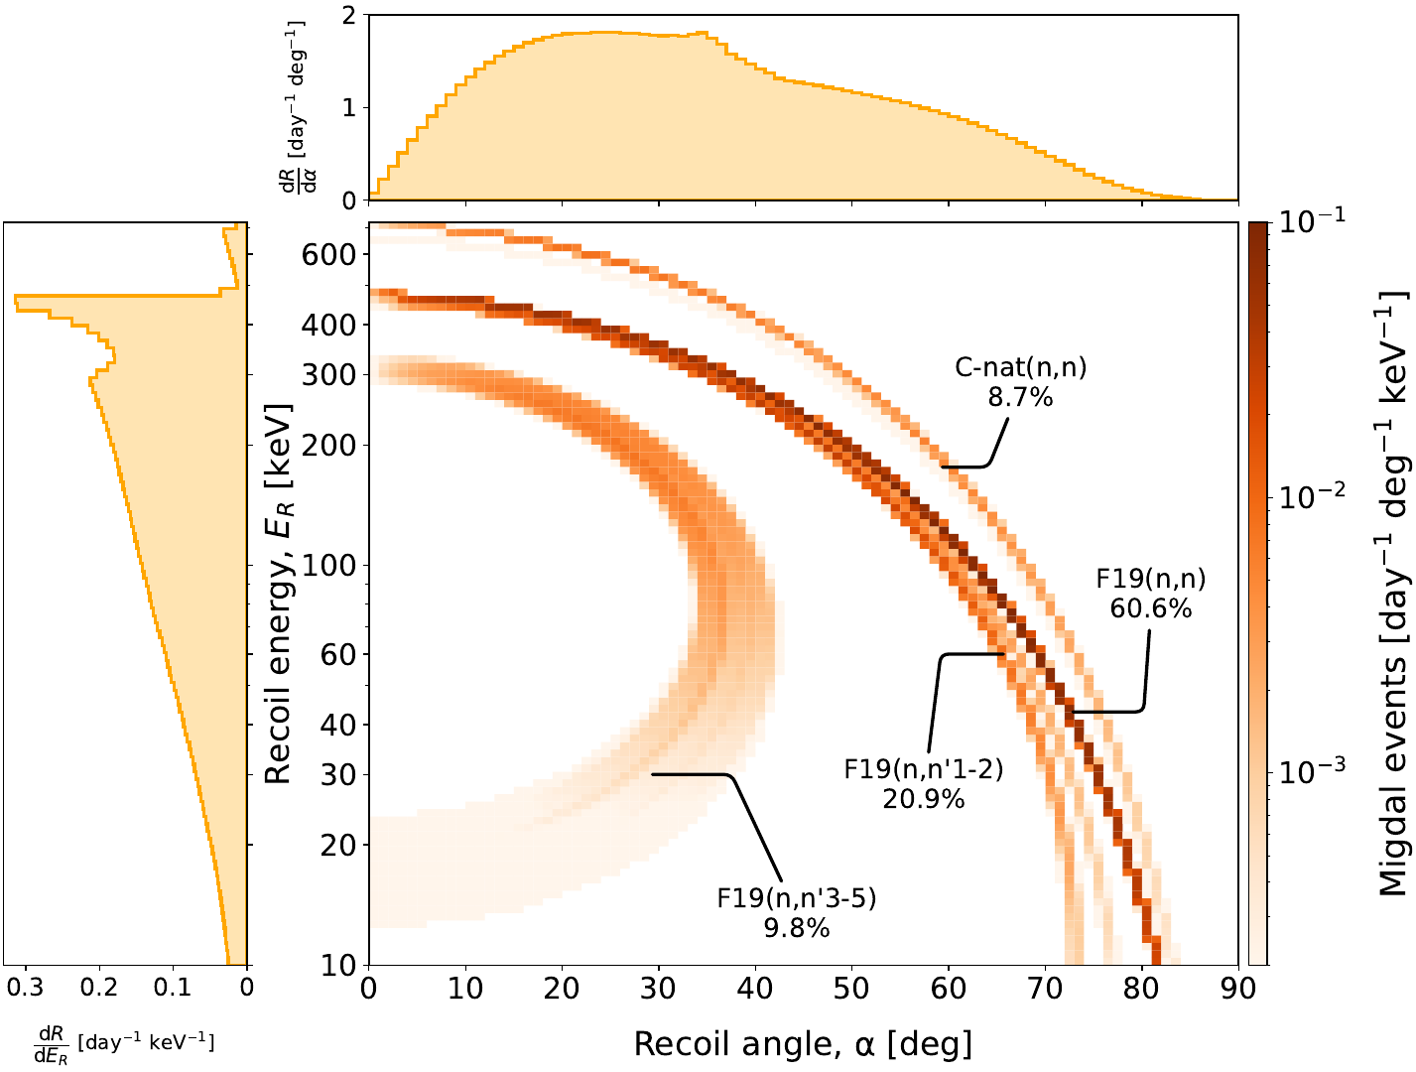
CF4 nuclear recoil spectrum & Migdal rates
Higher rate of NRs at lower energies (Astropart. Phys. 151 (2023) 102853).
Higher rate of Migdal events at higher energies (fluorine kinematic end-point).
NR spectrum
Migdal rate
*per day at nominal neutron rate

Slide 19
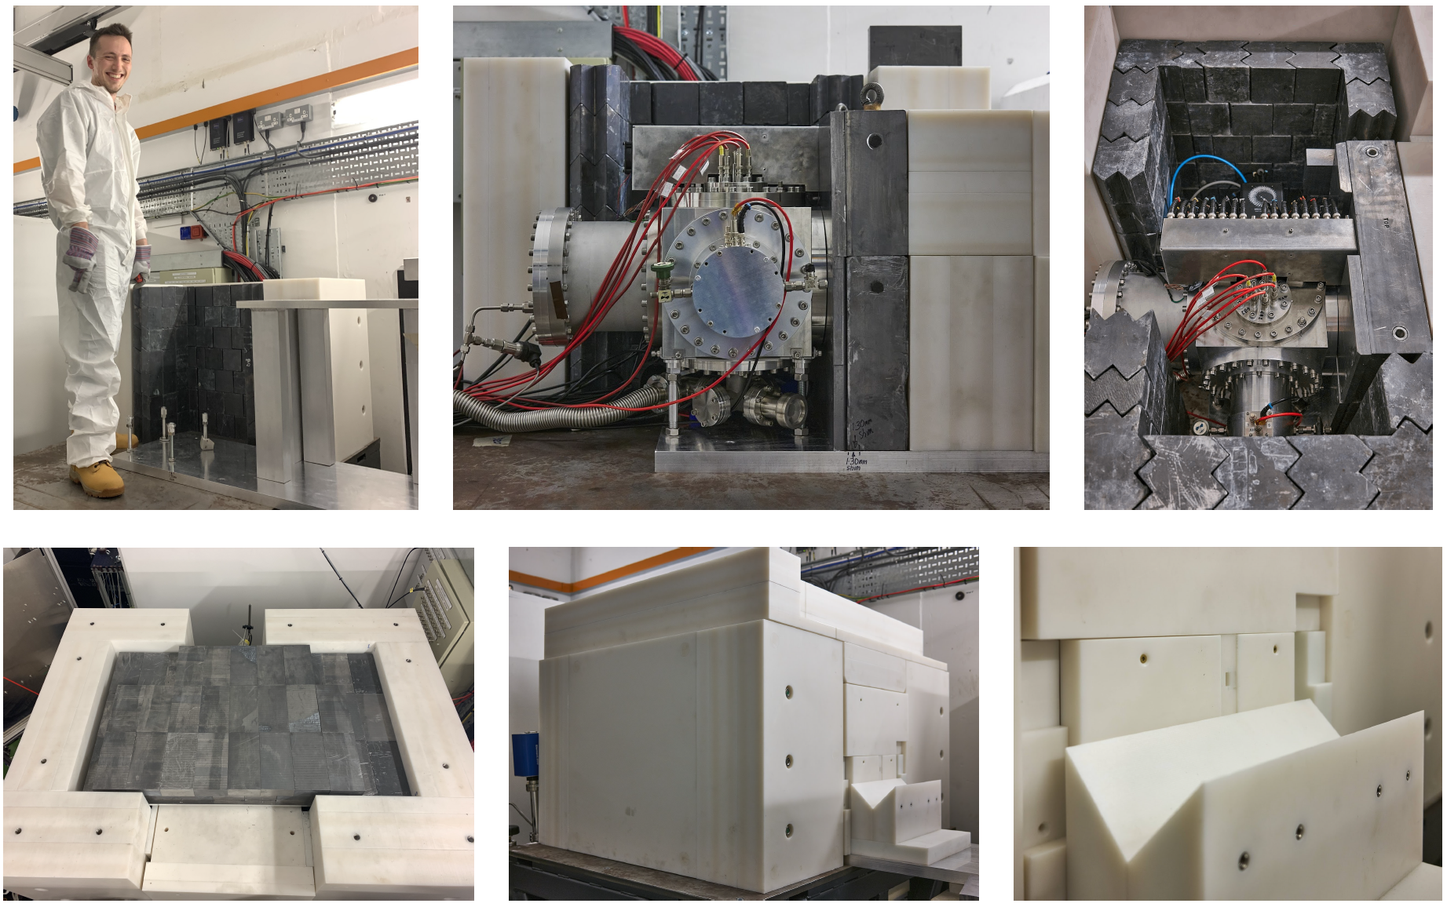
Assembly at NILE

Slide 20
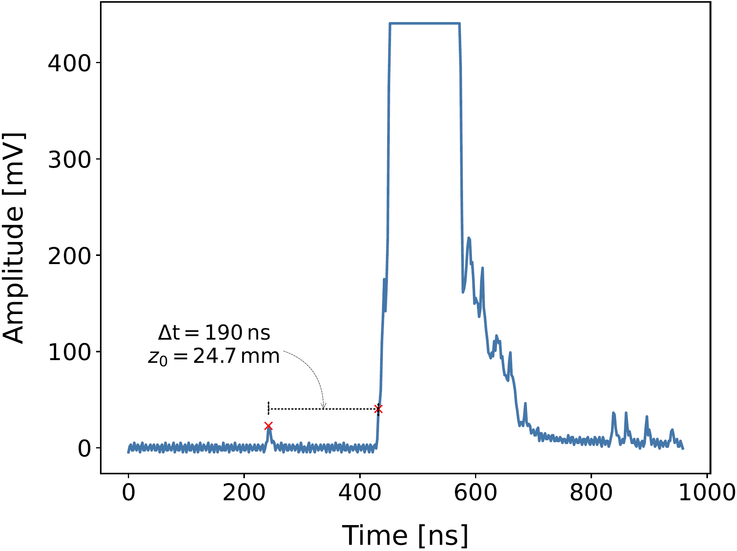
PMT
The PMT is used to trigger the DAQ (on S2 signal) and obtain an absolute depth coordinate.
The depth is calculated from the S1-S2 𝚫t and the drift velocity in the gas.
PMT is digitised at 2 ns with 8-bit resolution.
S2
secondary
Hamamatsu R11410 PMT
S1
primary

Slide 21
GEM mask
Avoid tracks falling outside the camera field of view by attaching a mask to the TPC.
This blocks NRs from being amplified outside the 80 x 45 mm² camera area.
The ITO readout now sees the same active area as the camera.
We also have a 100 x 60 mm² mask.
We plan to test this configuration soon.

Slide 22
Optical distortion correction
We characterise the distortion by imaging a regular grid and measuring the deflection of the lines as a function of radial distance.
Barrel distortion in the camera can be parameterised by a 5th-order polynomial.
Imaging closer to the focal plane increases distortion.

Slide 23
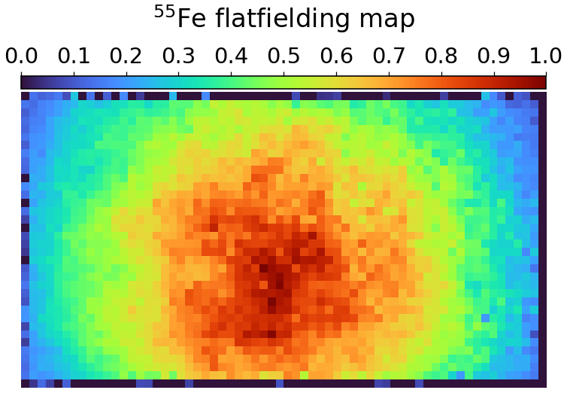
Flat field correction in the camera
We use an ⁵⁵Fe source as an energy calibration.
Interactions occur over the entire volume, so we can perform a position-dependent calibration.
Below is a map of the relative intensities of ⁵⁵Fe events.

Slide 24
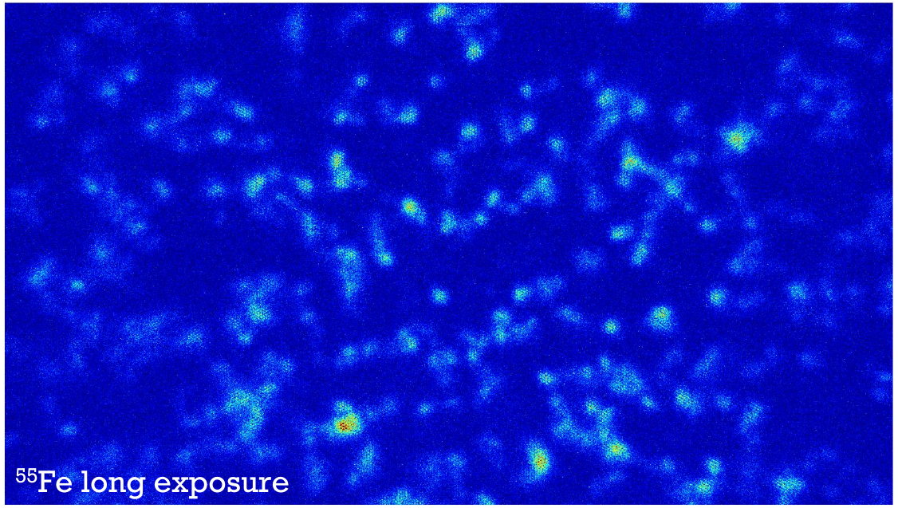
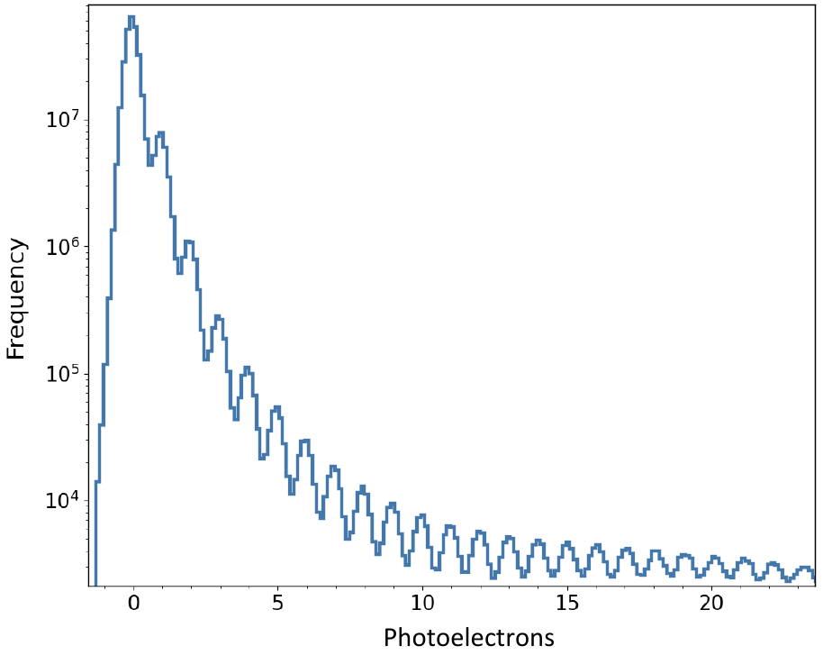
Capabilities of the ORCA Quest
The ORCA Quest is capable of ‘photon-number resolving’ at the cost of a slower, 5 Hz readout rate.
Using this mode risks pileup of events, only useful for low-noise calibration.
Able to resolve individual photon peaks

Slide 25
Camera afterglow
The ORCA Quest appears to feature an ‘afterglow’ in the subsequent frame following bright events.
In the frame which follows each high-energy track, we see an afterglow of ~1 photoelectron in many pixels.
This appears to be a persistence for {N} frames, rather than {T} exposure time.
We can simply mask bright areas in the subsequent frame to avoid confusion.

Slide 26
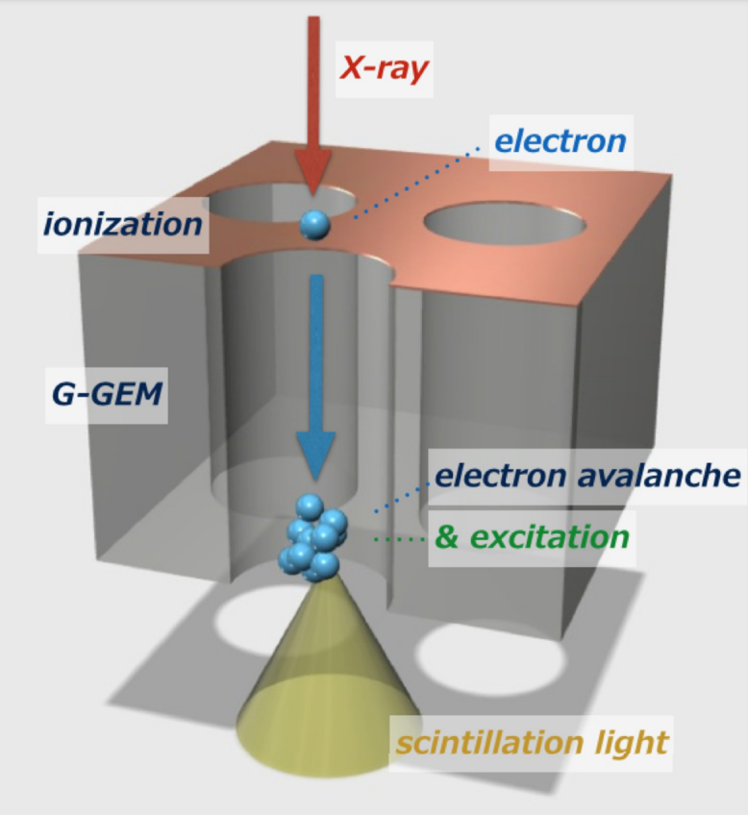
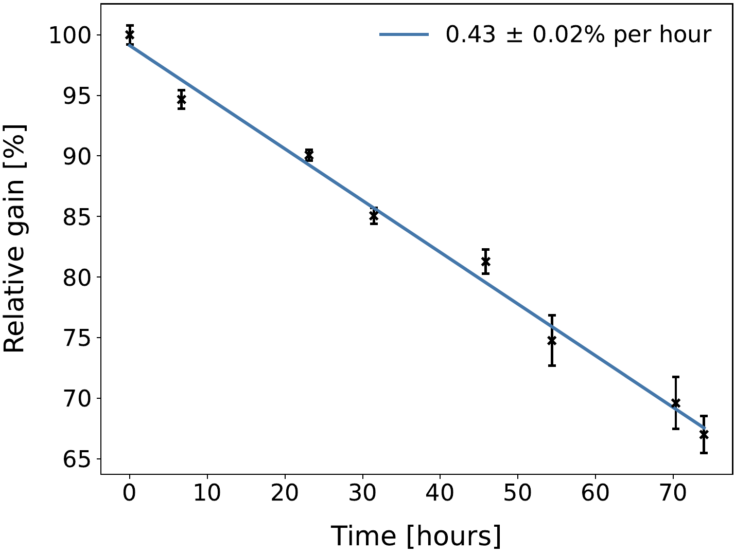
Glass GEM considerations
Light can refract in the glass substrate and reflect on the copper surfaces.
We experience a continuous reduction in the gas gain while operating with highly ionising particles, requires regular voltage adjustment to maintain gain.
Reflections

Slide 27
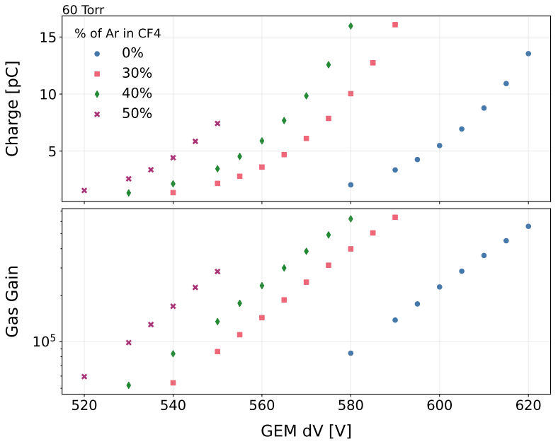
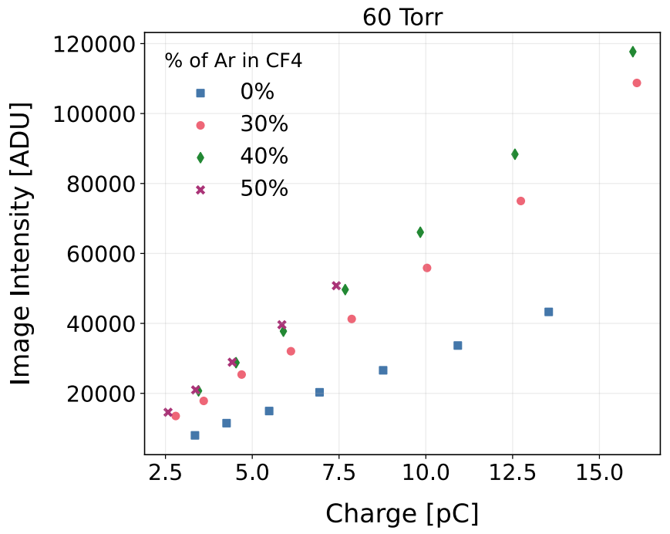
Noble gas mixtures
We plan to operate with DD neutrons in a fraction of argon gas later in 2024.
Preliminary
Preliminary
Preliminary
Light yield enhanced with addition of Ar.
L. Millins (MIGDAL), 16th Pisa Meeting on Advanced Detectors
May 31 2024, Isola d’Elba

Slide 28
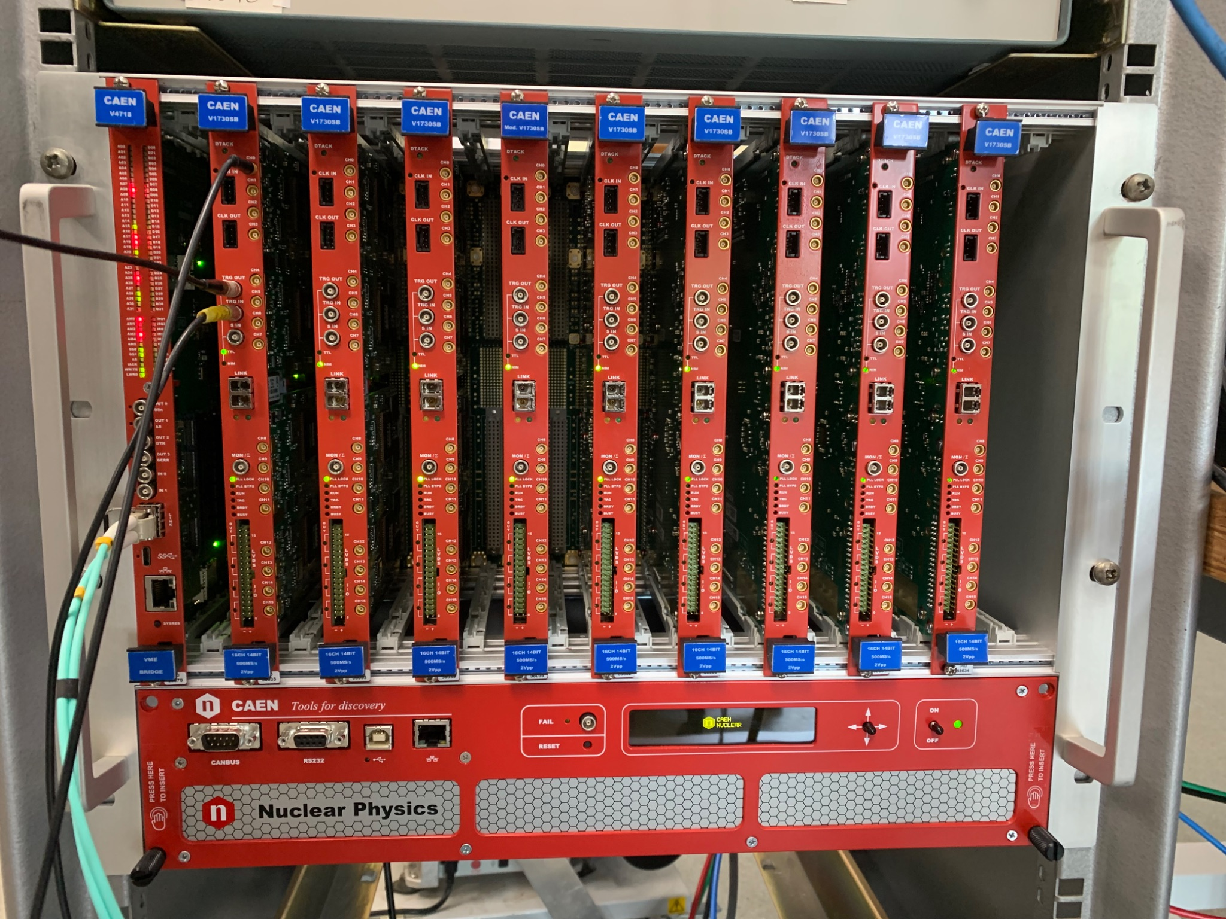
MIGDAL upgrade
Higher resolution digitiser (CAEN V1730).
14-bit instead of 8-bit.
Doubling the number of ITO strips to 240, increasing spatial resolution in the ITO subsystem.
0.417 mm instead of 0.833 mm.
Additional amplification stage.
Testing addition of a third GEM (kapton, glass, or ceramic).
Testing different structures (M-ThGEMs).
Reduction of reflections.
Opaque GEMs.
Considering dark-coating TPC.

