Slide 1
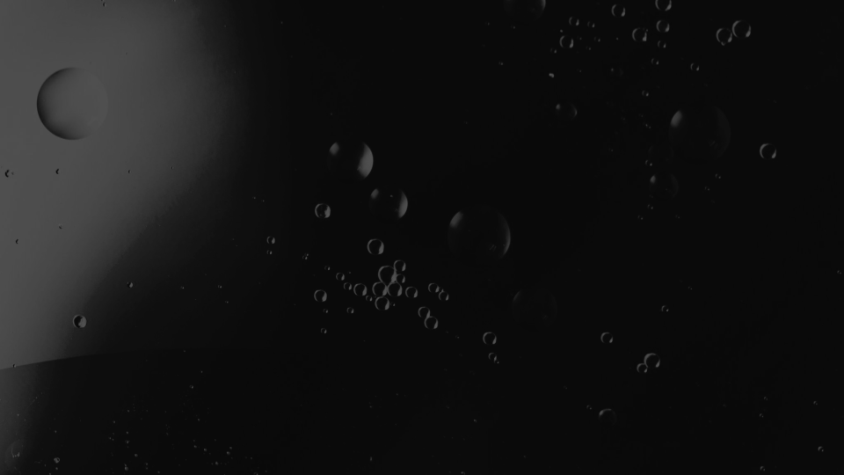

High Frequency Microwave Cavity Design Innovations for Axion Dark Matter Searches
Heather Jackson
PhD Candidate
UC Berkeley
GSSI Rectorate, Auditorium
L’Aquila, Italy
8 July 2024

Slide 2
High Frequency Microwave Cavity Design Innovations for Axion Dark Matter Searches
Heather Jackson
PhD Candidate
UC Berkeley
GSSI Rectorate, Auditorium
L’Aquila, Italy
8 July 2024

Slide 3
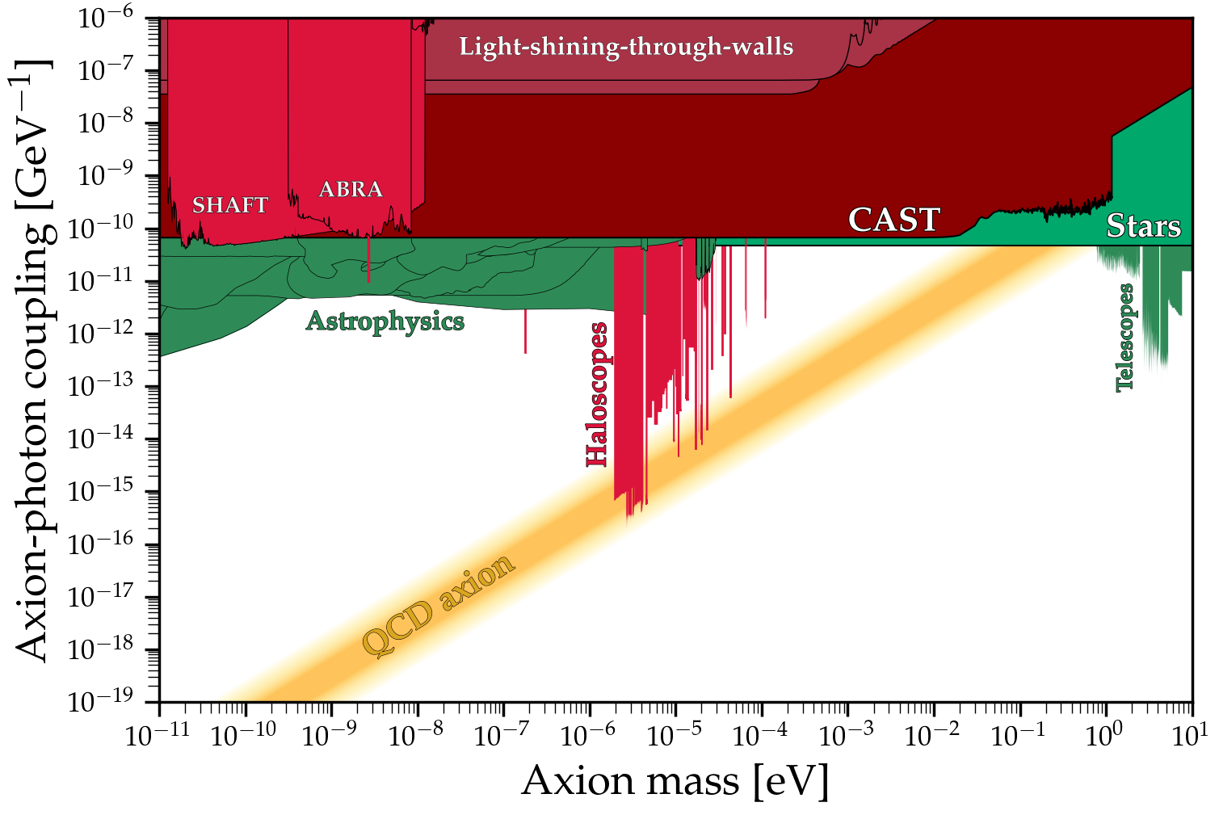
Axion Parameter Space
Ciaran O'Hare

Slide 4
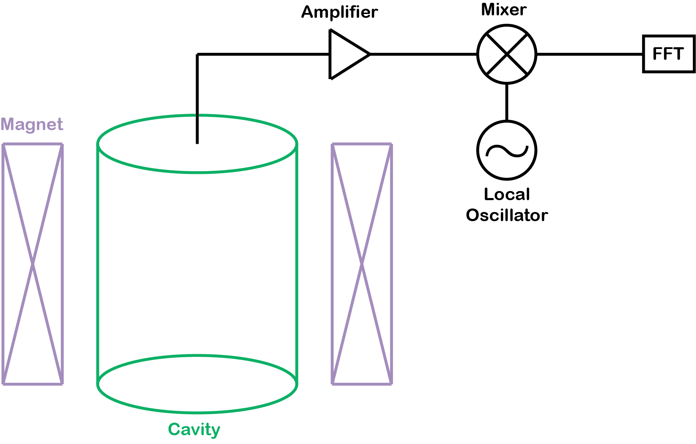
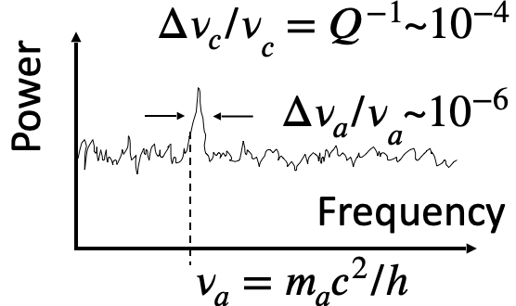
Detecting the Axion with A Haloscope

Slide 5
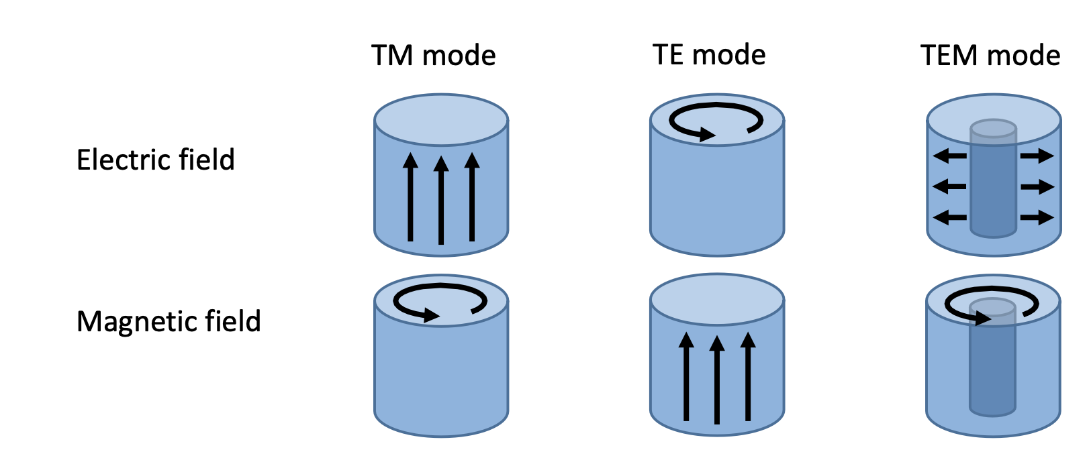
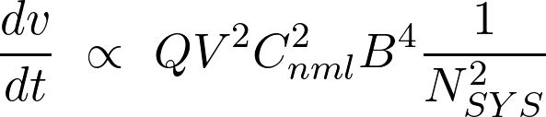
Cavity Figure of Merit
x
x
= Quality Factor
(Volume)²
(Form Factor)²
Losses from cavity material and geometry
Space inside cavity not occupied by metal
ratio of electric field aligned with magnetic field
Noise
Cavity

Slide 6
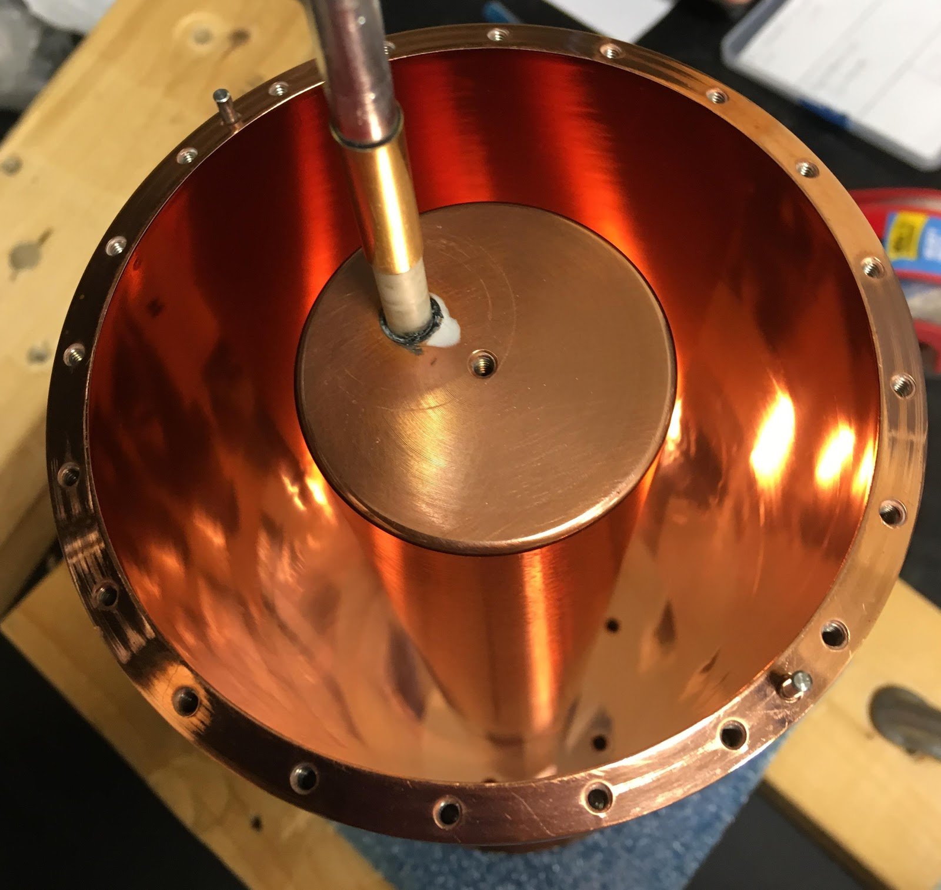
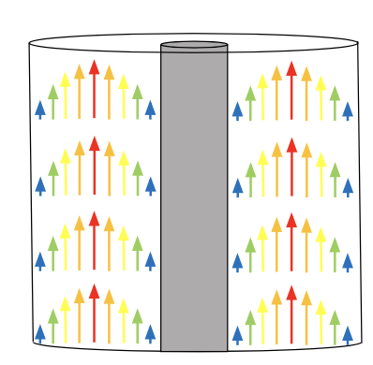
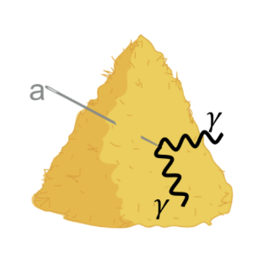
HAYSTAC cavity
Copper coated body with off axis tuning rod
TM010 mode: tunable over 3.6 – 5.8 GHz
Length: 10”
Diameter: 4”
Cavity
TM010 Electric Field

Slide 7

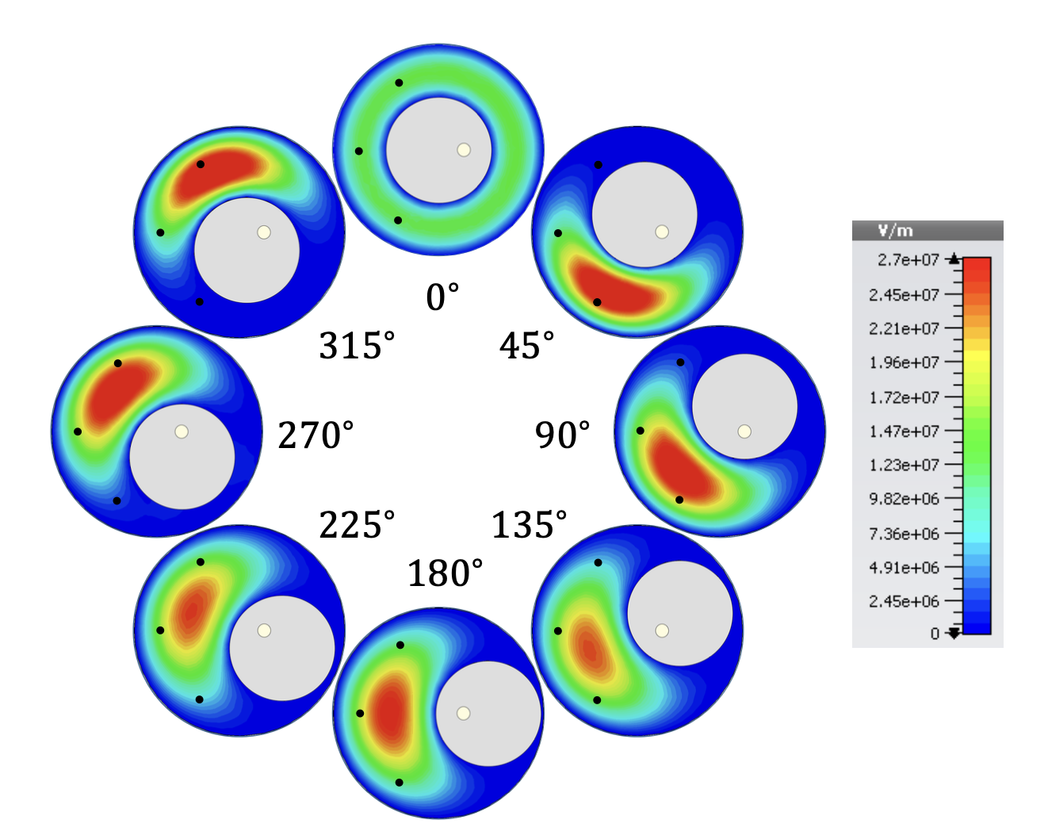
Optimizing Cavity Design
Symmetric = High Figure of Merit

Slide 8
Optimizing Cavity Design
Symmetric = High Figure of Merit
Mode Localization = Low Figure of Merit

Slide 9
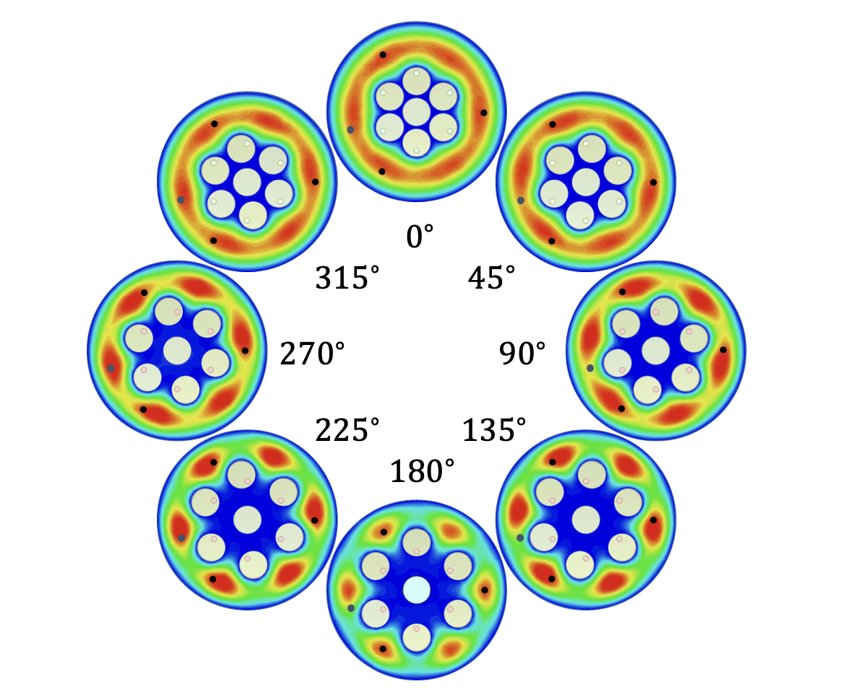
Optimizing Cavity Design
High Figure of Merit
High Figure of Merit
everywhere

Slide 10
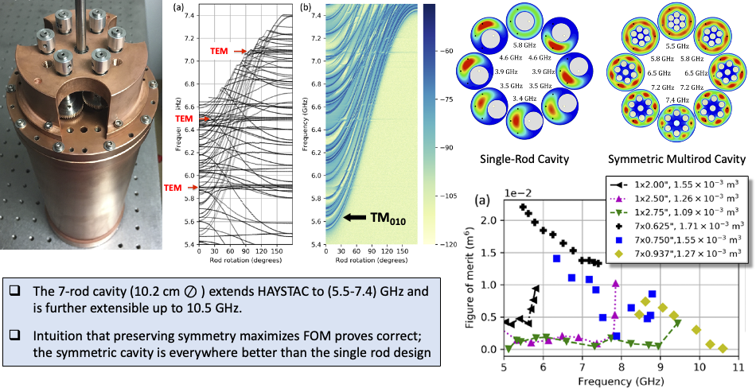
The Symmetric
Multirod Cavity
(M. Simanovskaia, Rev. Sci. Instrum. 92 (2021) 033305)

Slide 11
The Symmetric
Multirod Cavity
(M. Simanovskaia, Rev. Sci. Instrum. 92 (2021) 033305)

Slide 12
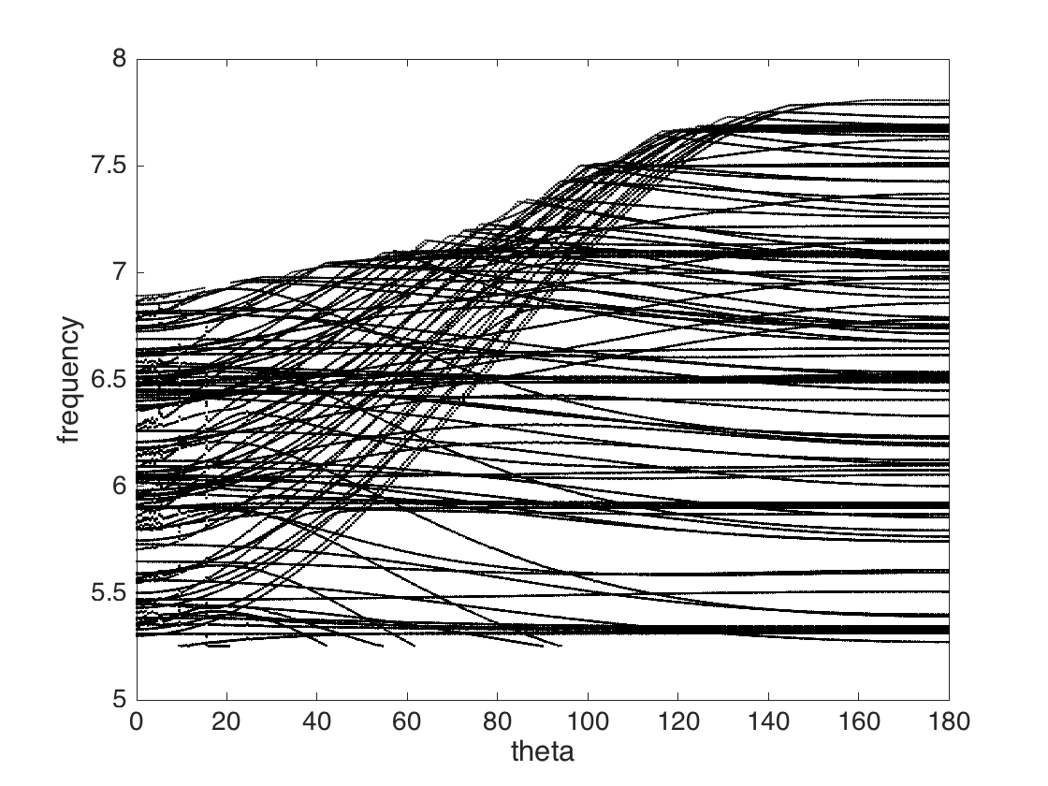
Frequency vs Rod Rotation
The Symmetric
Multirod Cavity
(M. Simanovskaia, Rev. Sci. Instrum. 92 (2021) 033305)

Slide 13
Frequency vs Rod Rotation
Each curve is a mode
The Symmetric
Multirod Cavity
(M. Simanovskaia, Rev. Sci. Instrum. 92 (2021) 033305)

Slide 14
Frequency vs Rod Rotation
Each curve is a mode
The Symmetric
Multirod Cavity
(M. Simanovskaia, Rev. Sci. Instrum. 92 (2021) 033305)
TM010 mode

Slide 15
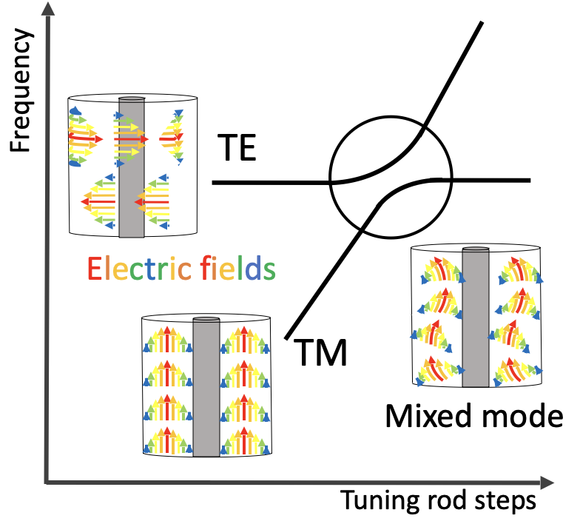
The Symmetric
Multirod Cavity
(M. Simanovskaia, Rev. Sci. Instrum. 92 (2021) 033305)
Frequency vs Rod Rotation
Mode crossing
Intruding modes
TM010 mode

Slide 16
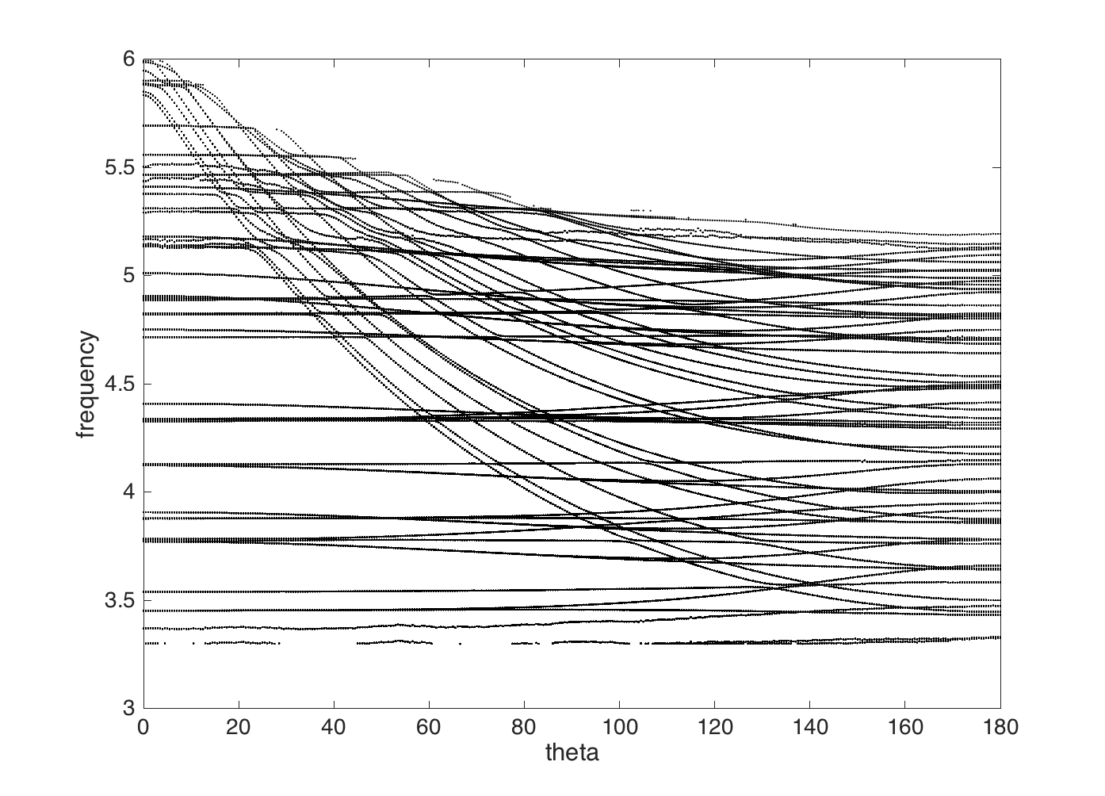
Single Rod Cavity vs 7 Rod Cavity
Intruding modes
Intruding modes

Slide 17
Single Rod Cavity vs 7 Rod Cavity
Intruding modes
Intruding modes
Major obstacle: substantial increase in mode density

Slide 18
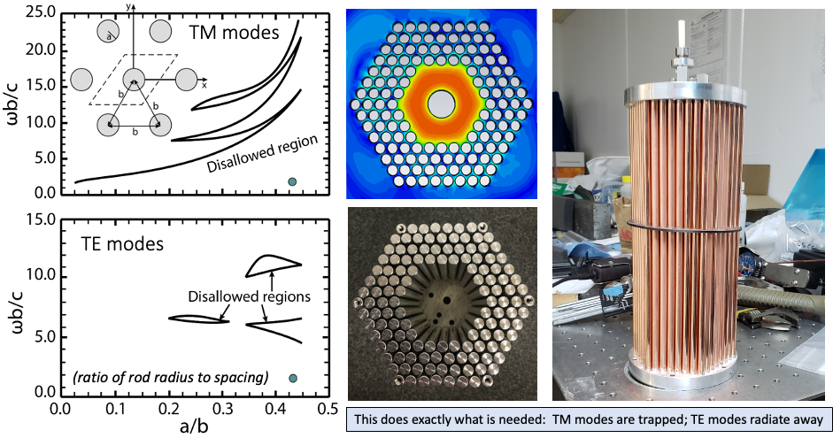
Photonic Band Gap (PBG) Resonator
Adapted from: Smirnova, et al.,
J. Appl. Phys., 2002

Slide 19
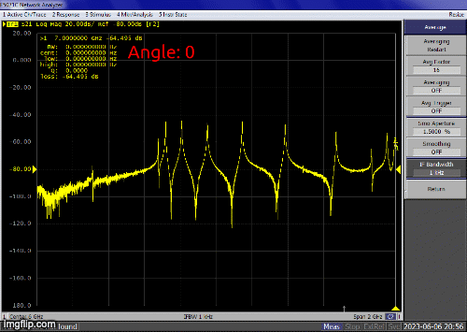
Photonic Band Gap (PBG) Resonator
TEM modes
n = 9
n = 10
n = 11
TM_{01n} modes

Slide 20
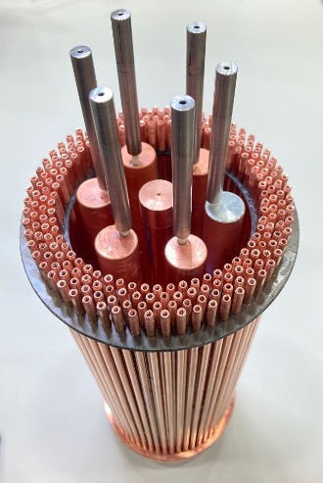
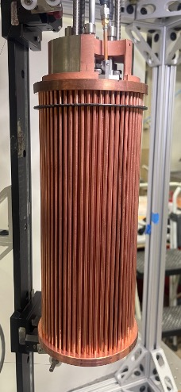
Single Rod PBG vs Multirod PBG

Slide 21
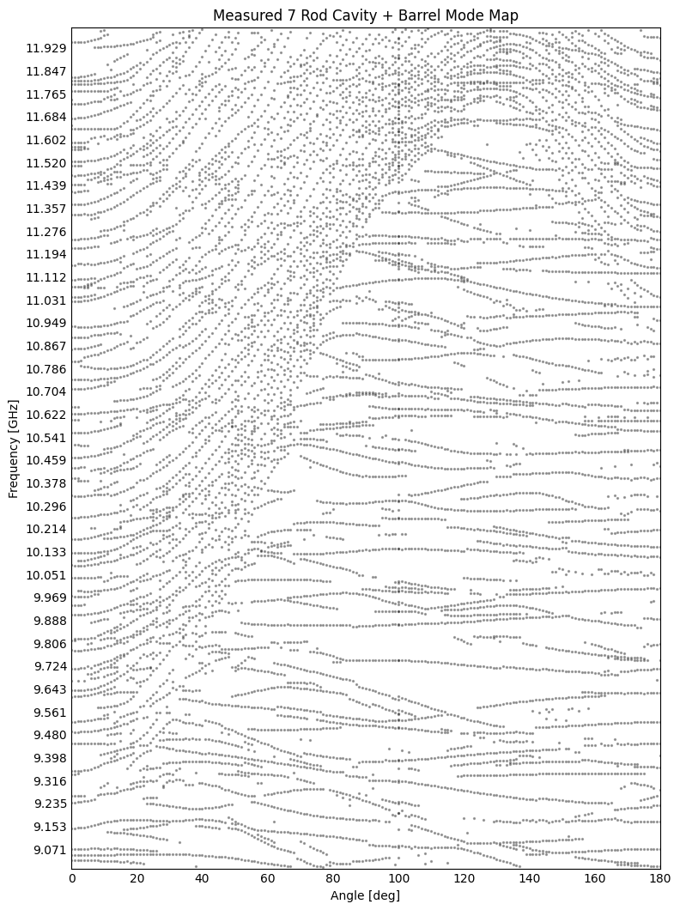
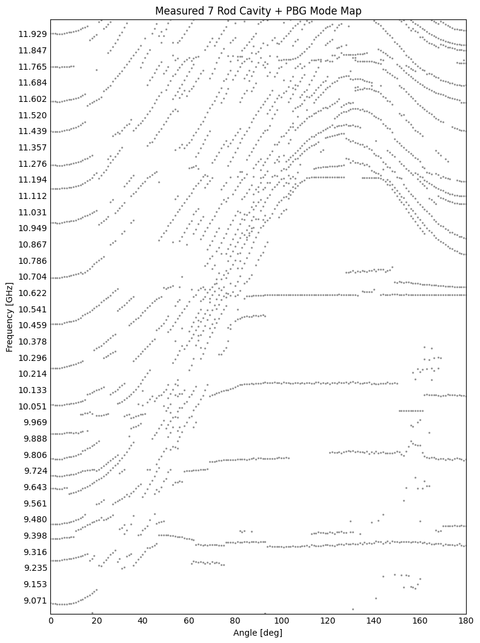
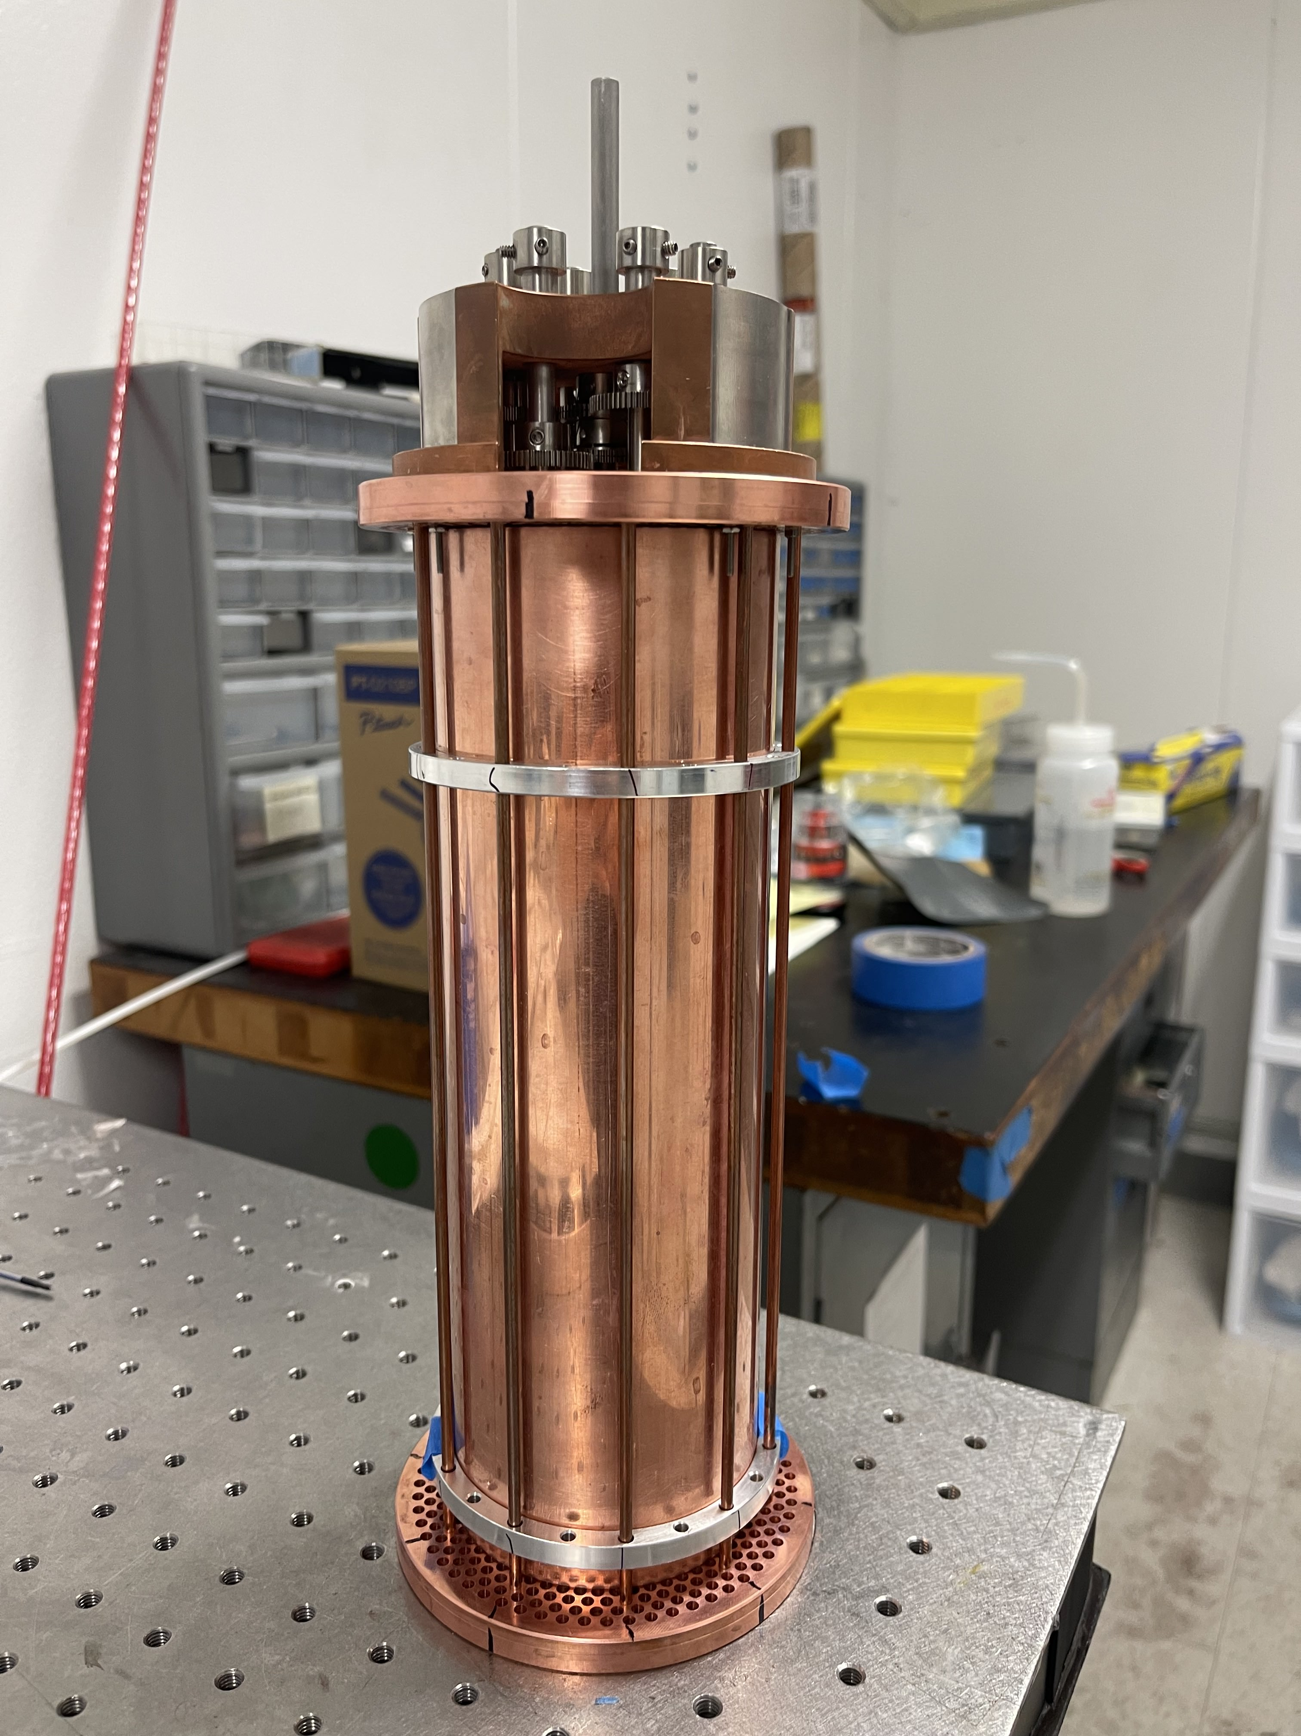
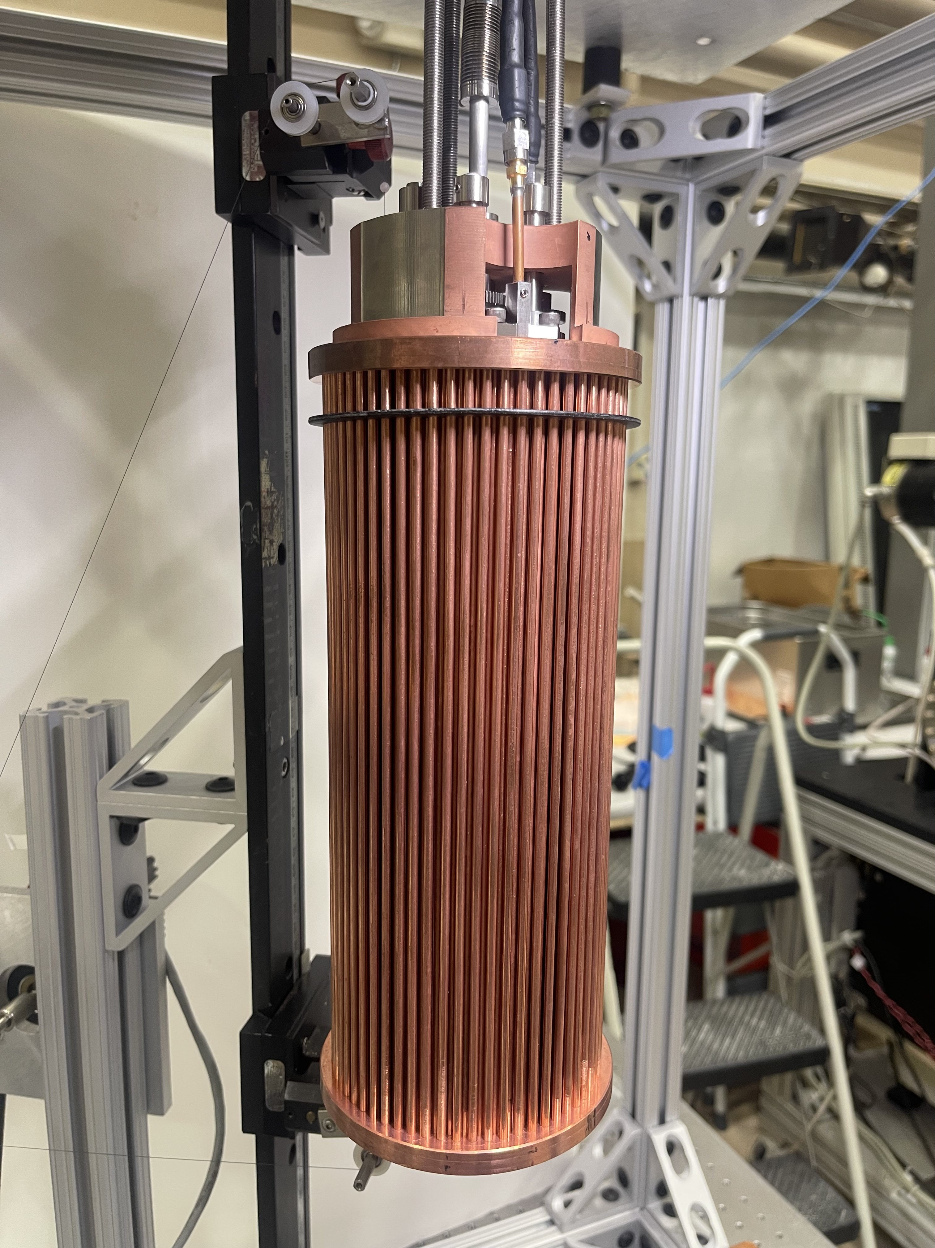
Measured Mode Map for 7 Rod + Barrel vs 7 Rod + PBG

Slide 22
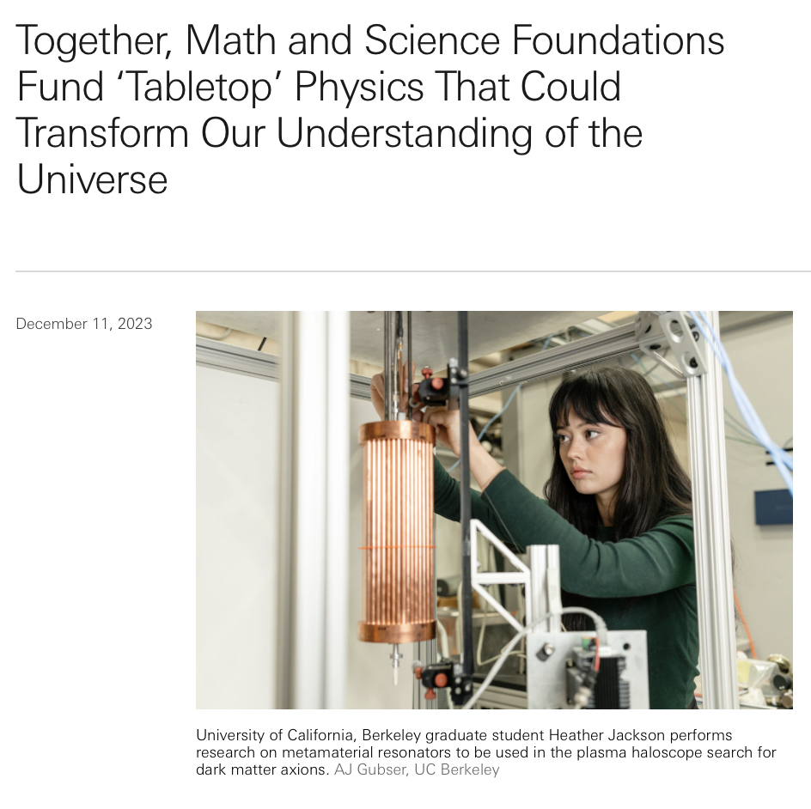
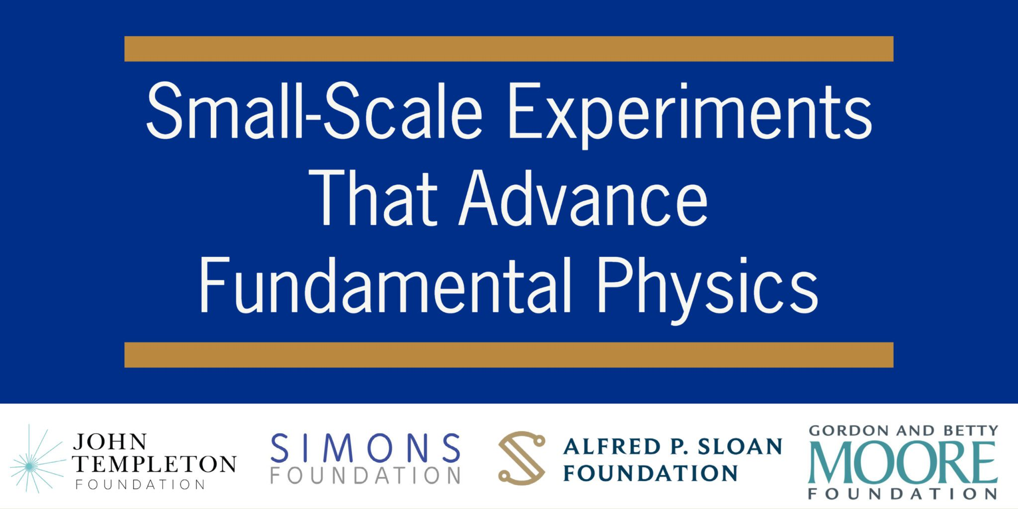
Axion Longitudinal Plasma Haloscope
UC Berkeley
Yale University
Colorado University
MIT
Johns Hopkins University
Arizona State University
Wellesley College
Oak Ridge National Laboratory
Stockholm University
ITMO
Cambridge University

Slide 23
Axion Longitudinal Plasma Haloscope
UC Berkeley
Yale University
Colorado University
MIT
Johns Hopkins University
Arizona State University
Wellesley College
Oak Ridge National Laboratory
Stockholm University
ITMO
Cambridge University
Hear more from Andrea Gallo Rosso next!

Slide 24
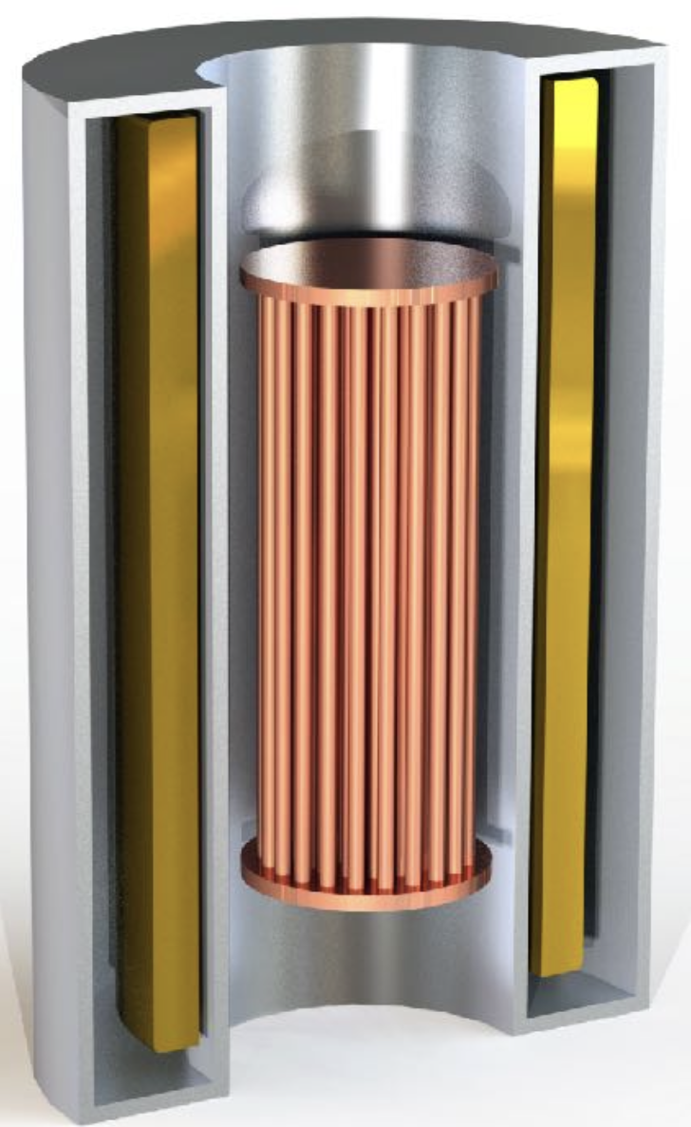
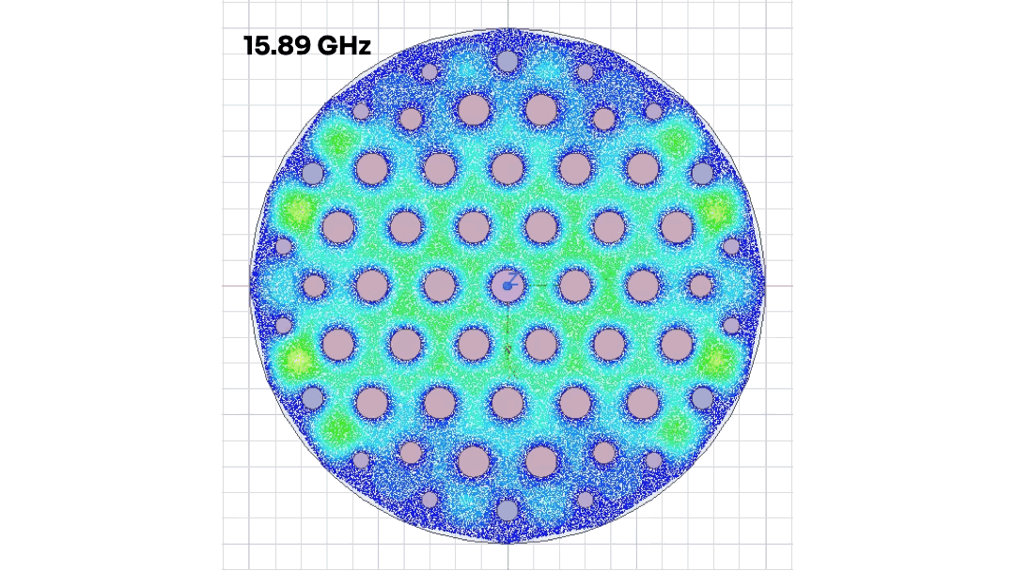
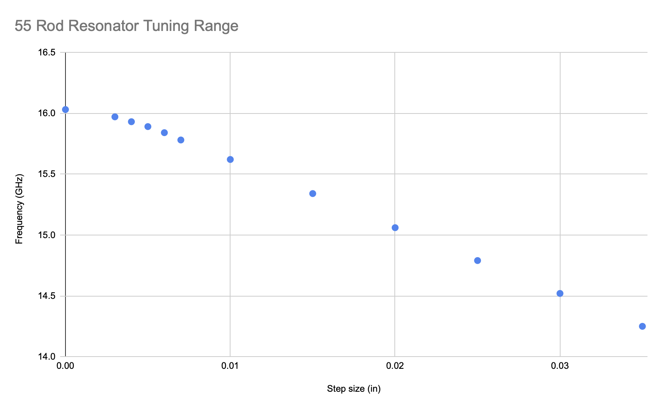
The Phase Ia Resonator
The Phase Ia resonator for ALPHA is being developed by UC Berkeley
It builds on existing engineered designs of microwave cavities for HAYSTAC to meet early deployment goals in ALPHA
The design integrates a tunable symmetric lattice and photonic bandgap structure, culminating a long R&D program
Frequency Tuning Range

Slide 25
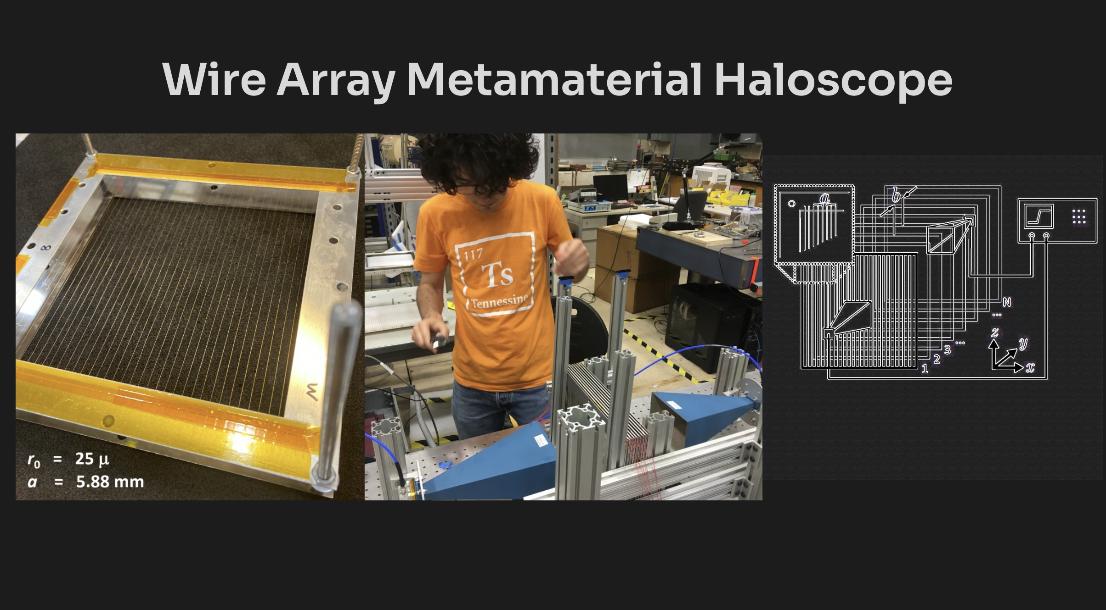

Slide 26
The Phase Ia Resonator
The Phase Ia resonator for ALPHA is being developed by UC Berkeley
It builds on existing engineered designs of microwave cavities for HAYSTAC to meet early deployment goals in ALPHA
The design integrates a tunable symmetric lattice and photonic bandgap structure, culminating a long R&D program
Frequency Tuning Range

Slide 27
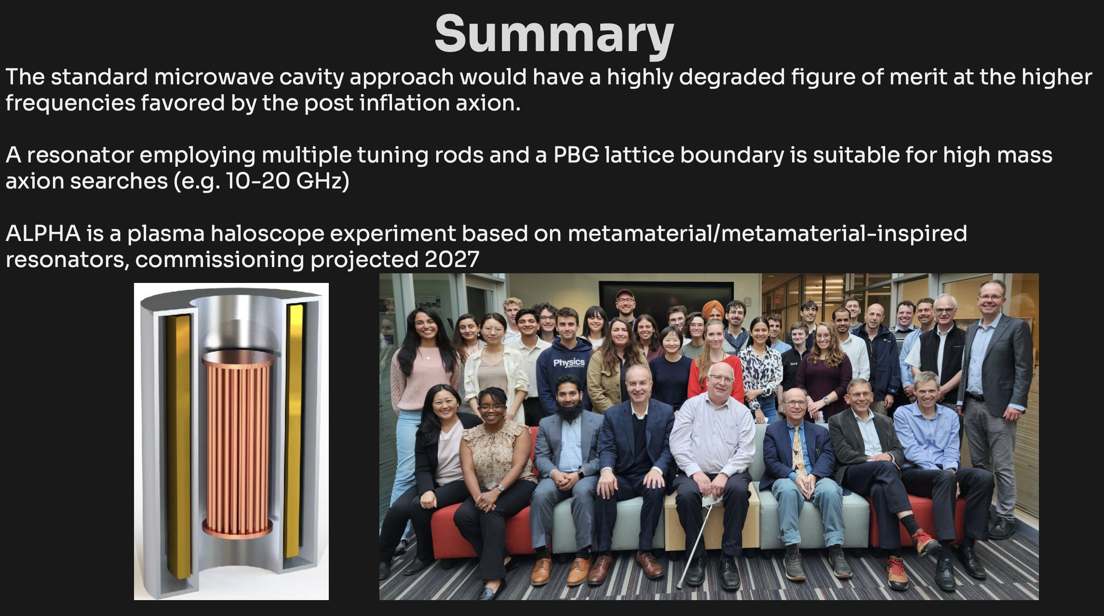

Slide 28
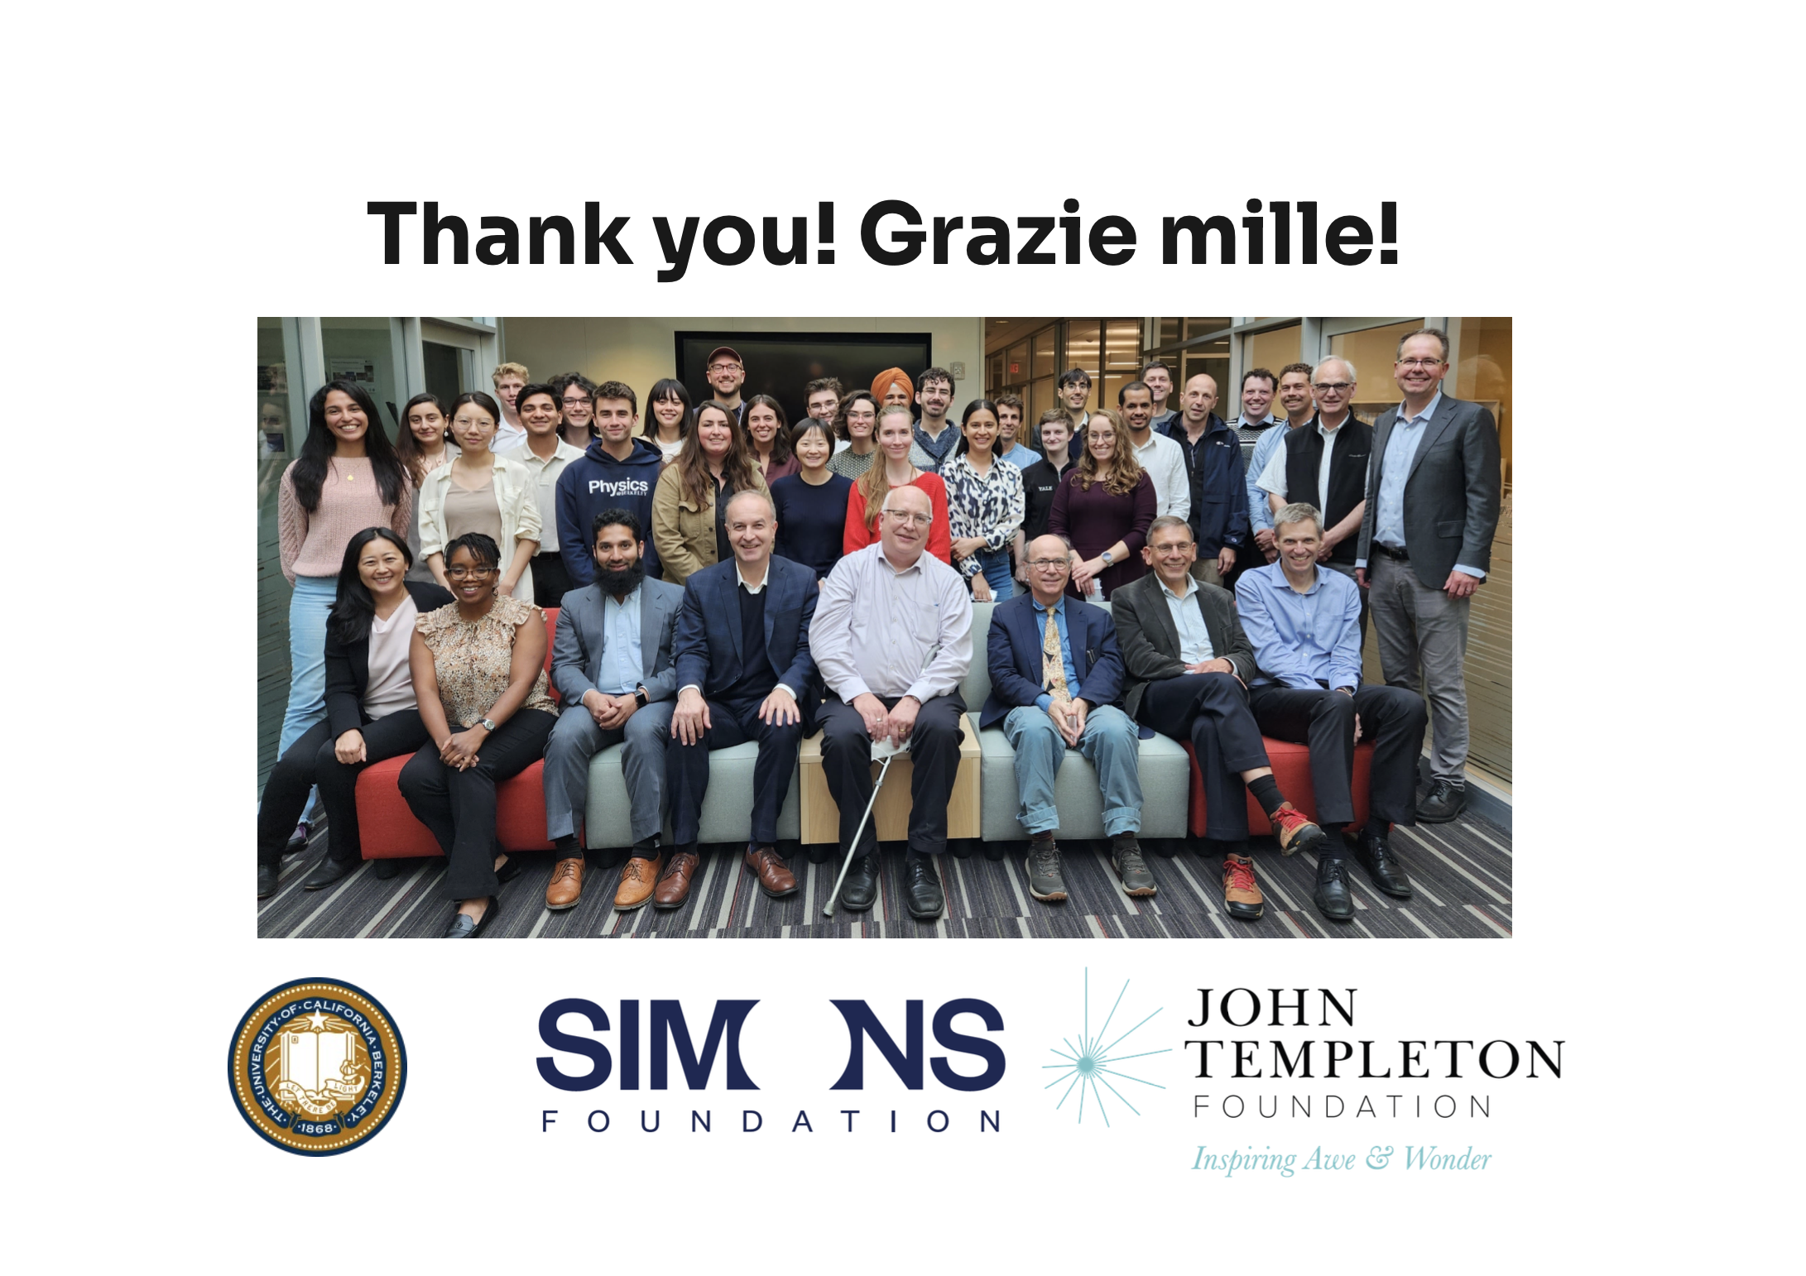

Slide 29
Additional Slides

Slide 30
ALPHA Phase 1A Resonator
•54 mobile rods connected by gear system
•Symmetric electric field throughout tuning range
•Covers frequency range ~14-16 GHz, extendable up to 20 GHz
•Berkeley is currently optimizing for potential first run of ALPHA (Axion Longitudinal Plasma Haloscope)

Slide 31
ALPHA
Axion Longitudinal Plasma Haloscope
Plasma haloscope: artificial plasma using wire array
11 institution collaboration* funded by four foundations consortium
16T magnet
~10-20 GHz range
Hear more from Andrea Gallo Rosso next!
*11 institutions: UC Berkeley, Yale, Colorado University, MIT, Johns Hopkins University, Arizona State University, Wellesley College, Oak Ridge National Laboratory, Stockholm University, ITMO, Cambridge University

Slide 32
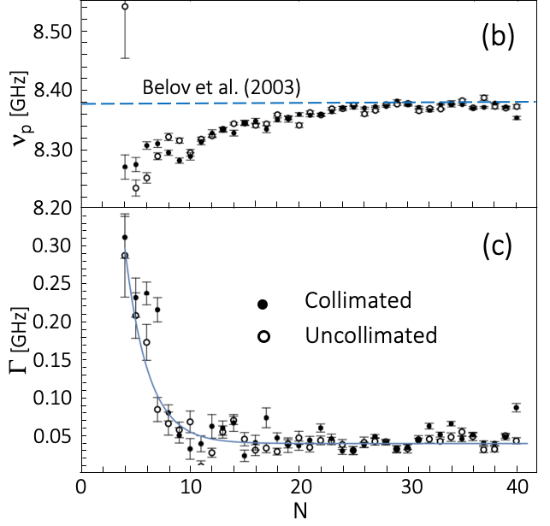
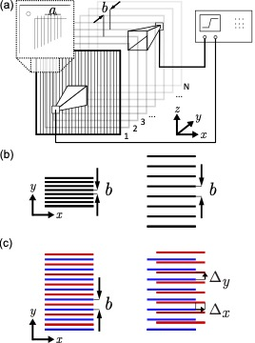
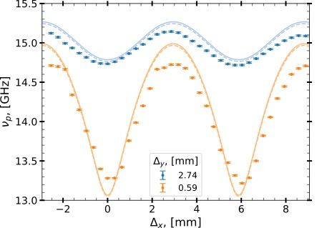
Superconducting Metamaterial Resonator
M. Wooten et al., Ann. Phys. (2023) 2200479
N. Kowitt et al., Phys. Rev. Appl. (2023) 044051

Slide 33
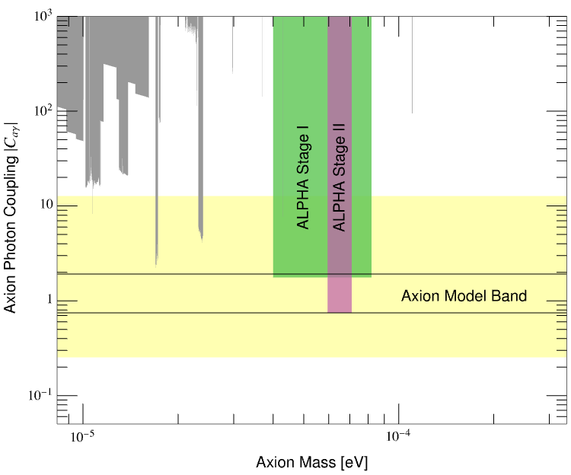
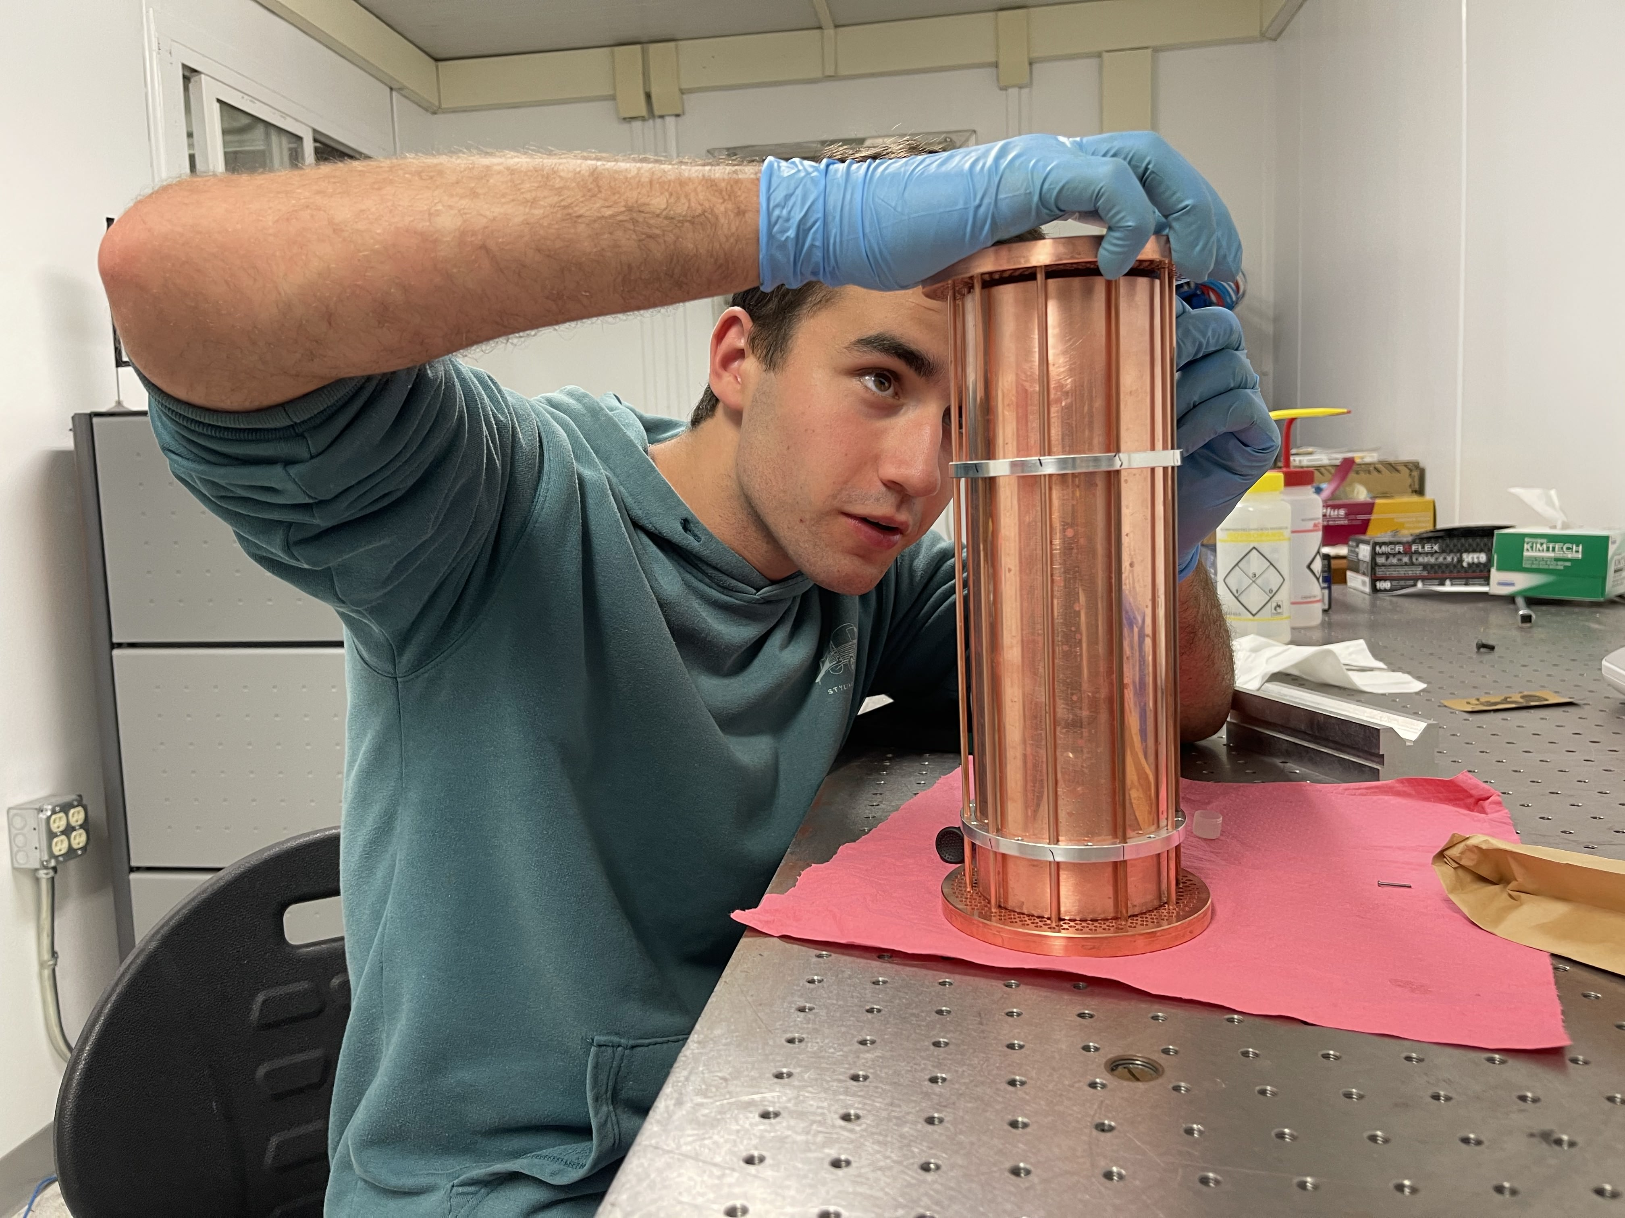
ALPHA Projected exclusion + Pablo!
Pablo Castano
Phase I: Quantum-limited
Phase II: Quantum-enhanced
m_{a} [eV]

Slide 34
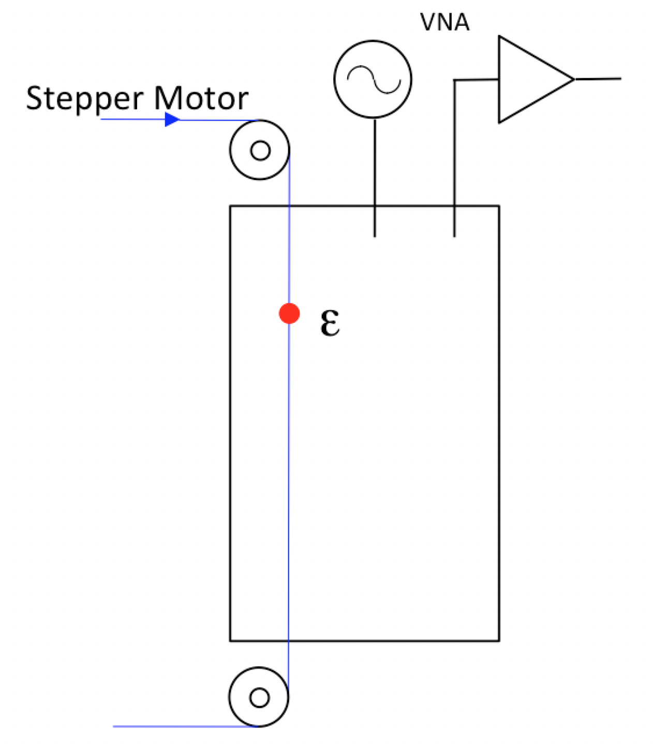
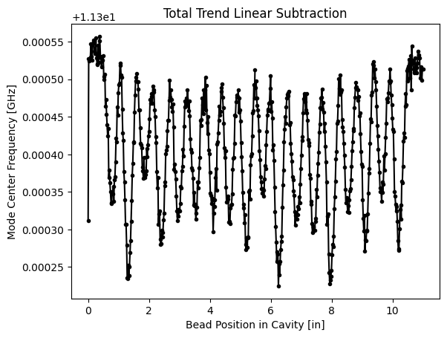
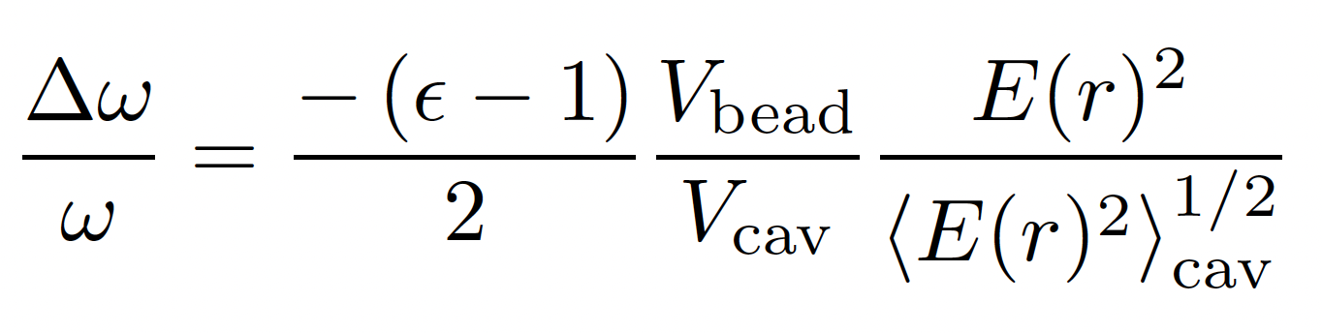
Field Mapping – the Bead Perturbation method
“Discontinuities in Waveguides”, J. Schwinger & D. Saxon (1968)
TEM (n = 19)
Example
Bead is typically a sphere or cylinder of a few mm diam.

Slide 35
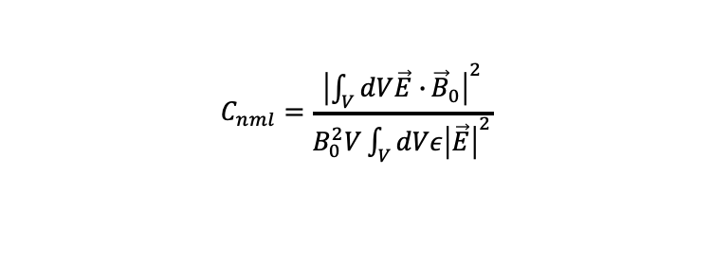

Detecting the Axion with A Haloscope
$ℒ_{aγγ}=−g_{aγγ} a \vec{E}∙\vec{B}$
Cavity
$$C_{nml}=\frac{{\left|\int_{V}^{ }{dV\vec{E}∙}{\vec{B}}_{0}\right|}^{2}}{B_{0}^{2}V\int_{V}^{ }{dVε{\left|\vec{E}\right|}^{2}}}$$

Slide 36


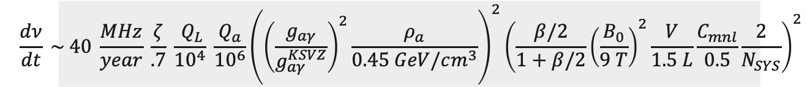

Axion Signal Detection
Power: $P=g_{aγγ}^{2}{\left(ℏc\right)}^{3}\left(\frac{ρ_{a}}{m_{a}^{2}}\right) {\frac{β}{1+β}ω_{c}\frac{1}{μ_{0}}B}_{ext}^{2}QVC_{nml}\frac{1}{1+{\left(\frac{2δν}{Δν_{c}}\right)}^{2}}$
Signal to noise ratio:
$$SNR=\frac{P}{k_{B}T_{S}}\sqrt{\frac{t}{Δν_{a}}}$$
Signal power
Scan rate:
Frequency
$$\frac{dν}{dt} \sim 40 \frac{MHz}{year} \frac{ζ}{.7} \frac{{ Q}_{L}}{{10}^{4}} \frac{Q_{a}}{{10}^{6}}{\left({\left(\frac{g_{aγ}}{g_{aγ}^{KSVZ}}\right)}^{2}\frac{ρ_{a}}{0.45 GeV/cm^{3}}\right)}^{2}{\left(\frac{β/2}{1+β/2}{\left(\frac{B_{0}}{9 T}\right)}^{2}\frac{V}{1.5 L}\frac{C_{mnl}}{0.5}\frac{2}{N_{SYS}}\right)}^{2}$$
$ℒ_{aγγ}=−g_{aγγ} a \vec{E}∙\vec{B}$
$g_{aγγ}=\frac{{αg}_{γ}}{πf_{a}}$
Theory parameters

Slide 37
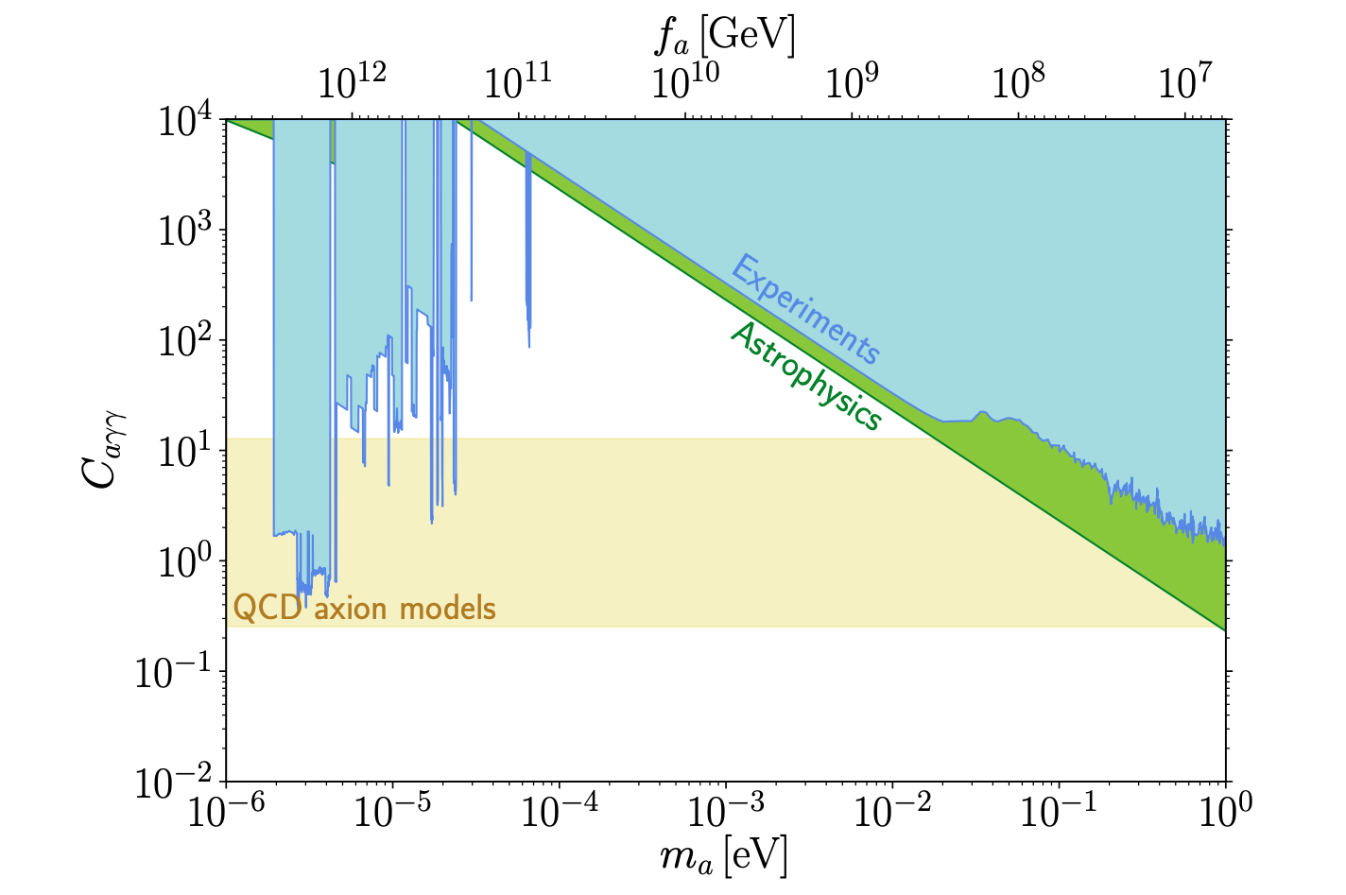
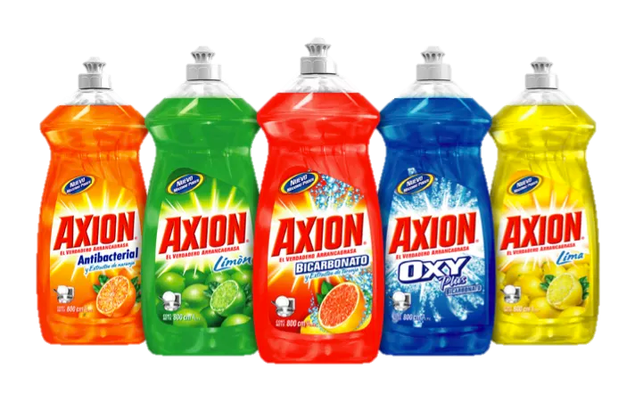
Axion Dark Matter
Axion - hypothetical particle proposed to solve the strong CP problem
Dark matter properties
Low frequency cavity – faster scan rate
Why are high frequencies so challenging to search?

Slide 38
Axion Dark Matter
Axion - hypothetical particle proposed to solve the strong CP problem
Dark matter properties
Low frequency cavity – faster scan rate
Why are high frequencies so challenging to search?

Slide 39
Measured Mode Map for 7 Rod + Barrel vs 7 Rod + PBG

Slide 40
Measured Mode Map for 7 Rod + Barrel vs 7 Rod + PBG
TEM Modes

Slide 41
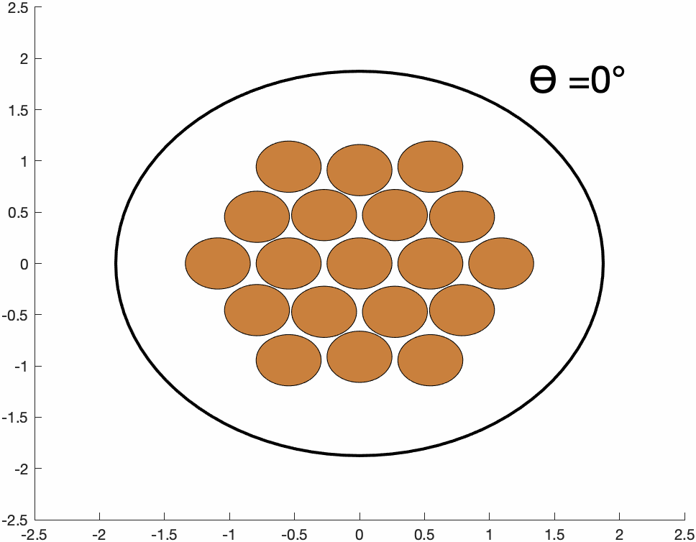
19 Rod Tuning Scheme

Slide 42
The Symmetric Multirod Cavity (M. Simanovskaia, Rev. Sci. Instrum. 92 (2021) 033305)

Slide 43
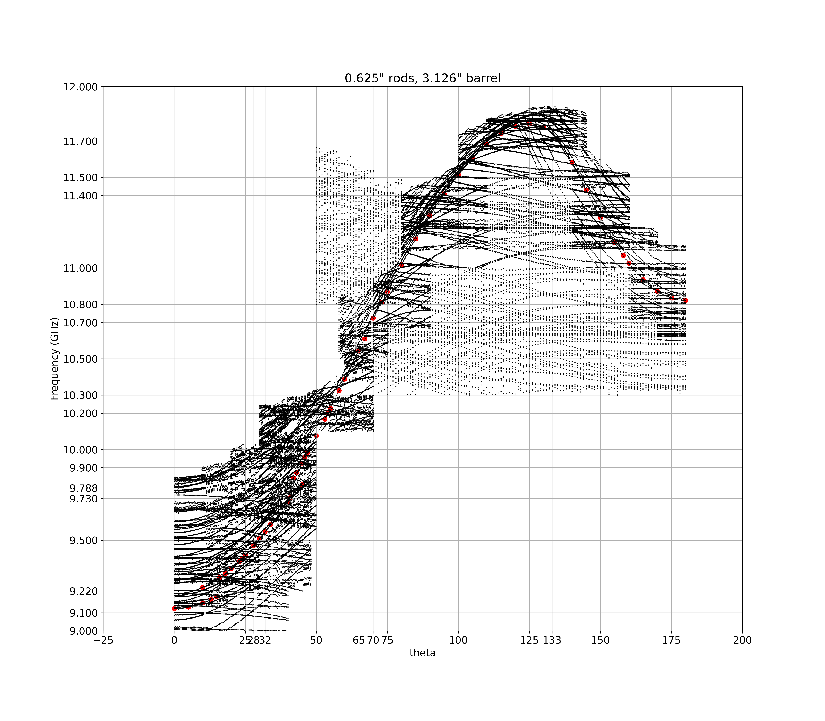
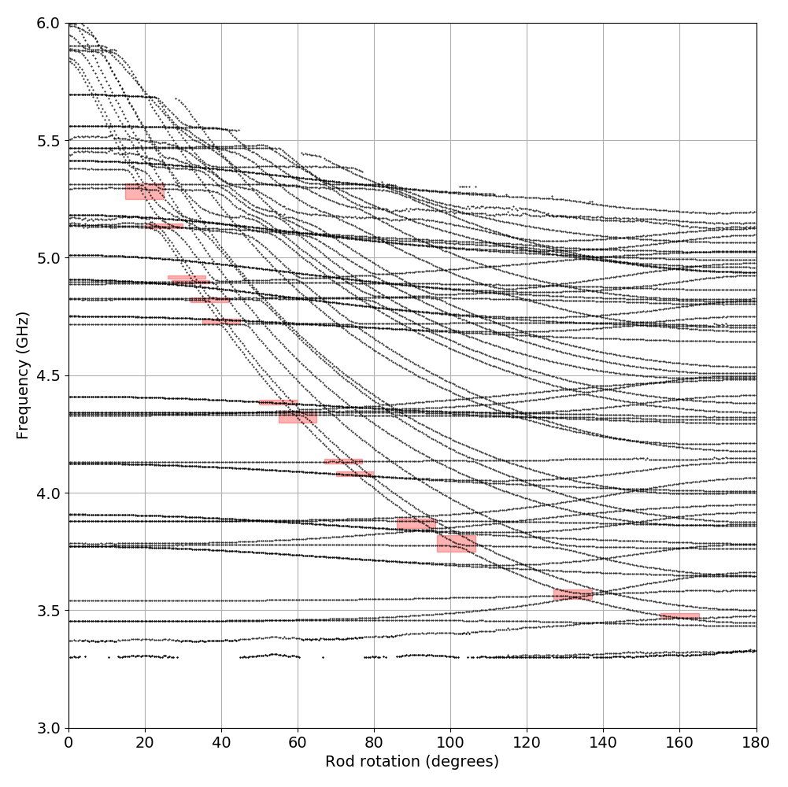
Multirod cavity 5.5-7.4 GHz vs Multirod Cavity 9.1-11.8 GHz

Slide 44
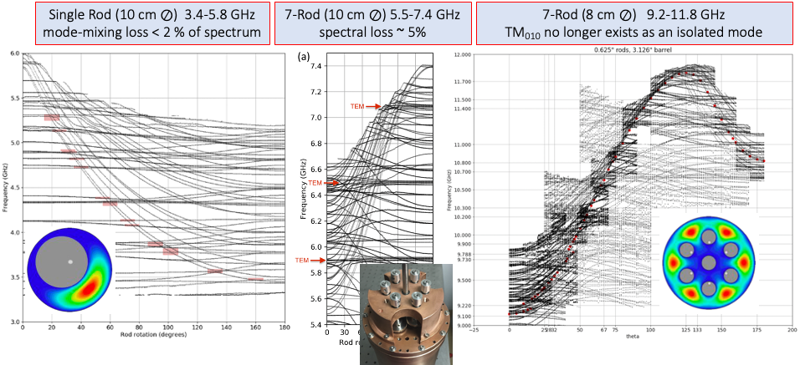
Motivation for Photonic Band Gap (PBG) Structures

Slide 45
Quality Factor
Q = the ratio of the stored energy to the dissipated power, multiplied by the resonant mode frequency
quality factor is determined primarily by the material and geometry of the cavity
varies greatly between resonant modes
materials with a higher conductivity typically have smaller skin depths and therefore higher quality factors -> we choose to use OFHC Cu

Slide 46


Evidence for Dark Matter
Galactic Rotation Curves
Expected Observed
What we know —
Dark Matter
Dark Energy
Credit: Ingo Berg, Wikipedia Commons

Slide 47


Axion Exclusion - HAYSTAC Phase IIc Preliminary Results
~ 4.54-4.71 GHz
(Preliminary)
Scan rate:

Slide 48

The Strong CP Problem
SM
CP Symmetry is violated
nEDM prediction:
d_{N} ~ 10⁻¹⁶ θ_{QCD} e . cm
0 ≤ θ_{QCD} ≤ 2π
Reality
No CP violation observed
nEDM experimental limit:
d_{N} < 10⁻²⁶ θ_{QCD} e . cm [ref]
θ_{QCD} < 10⁻¹⁰
E. SIEGEL / BEYOND THE GALAXY

Slide 49

Haloscope At Yale Sensitive to Axion Cold Dark Matter (HAYSTAC)

