Slide 1
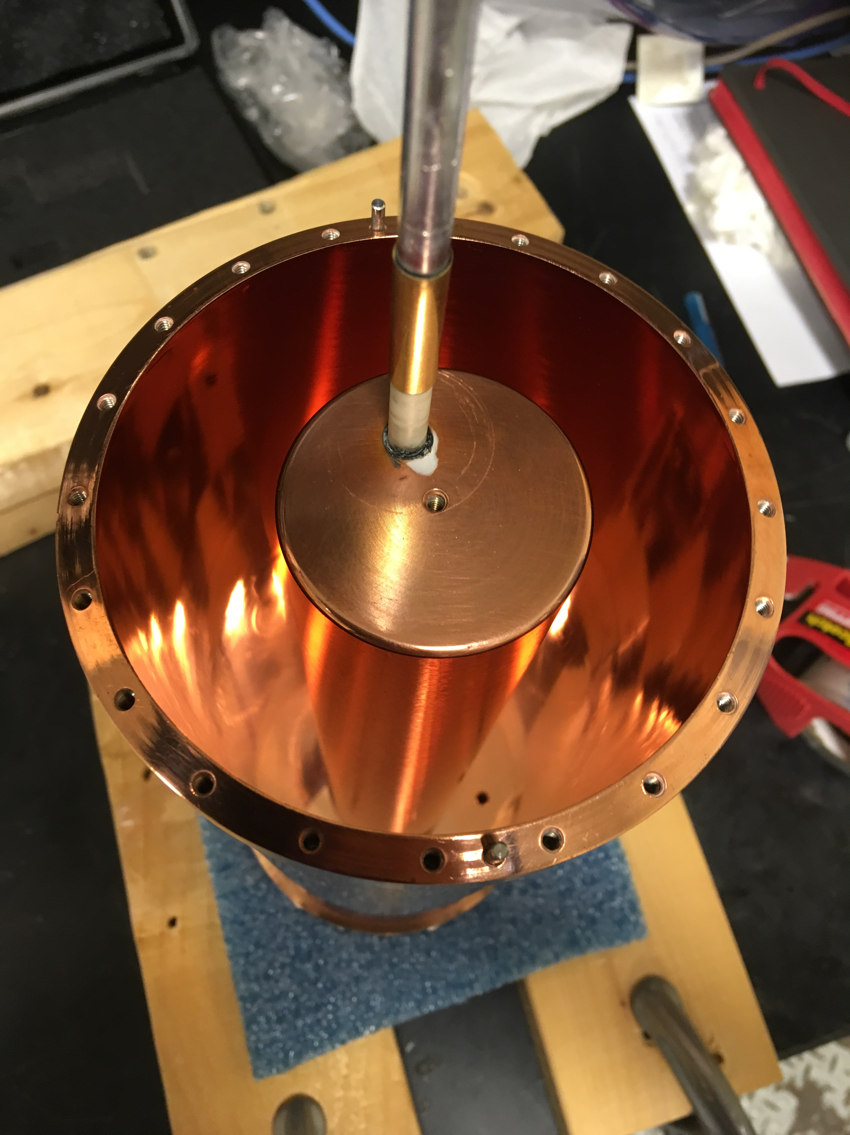
The HAYSTAC Experiment
Status & New Developments
IDM XV
Karl van Bibber
L’Aquila – 8 July 2024

Slide 2








Slide 3

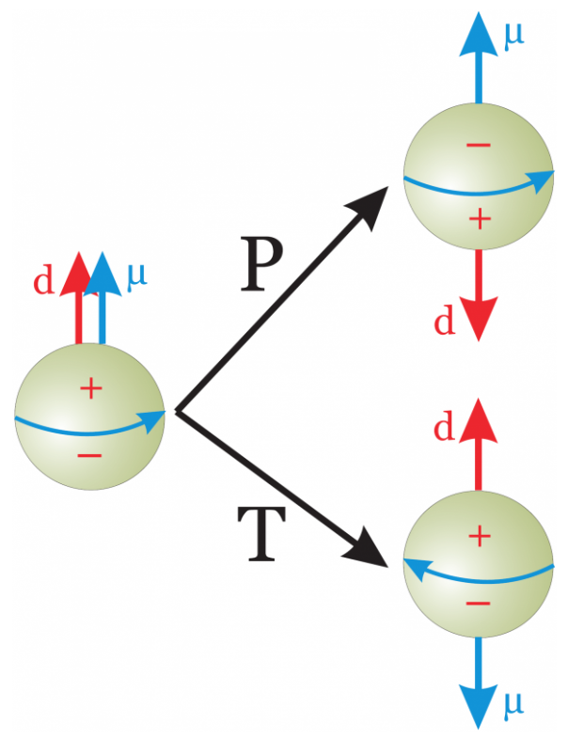
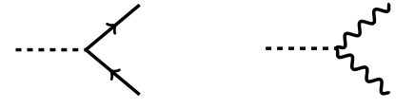
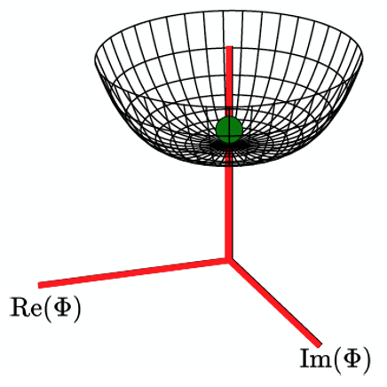
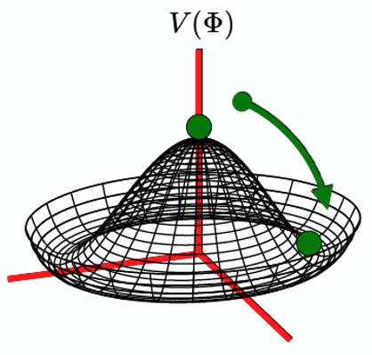
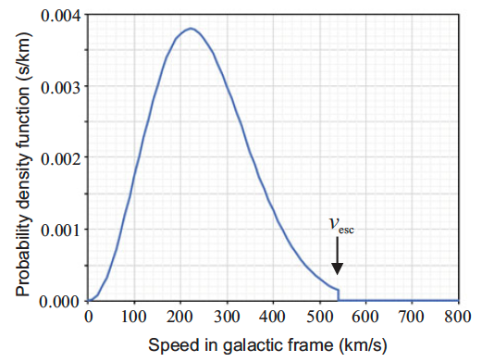

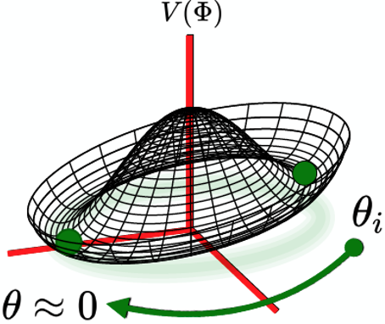
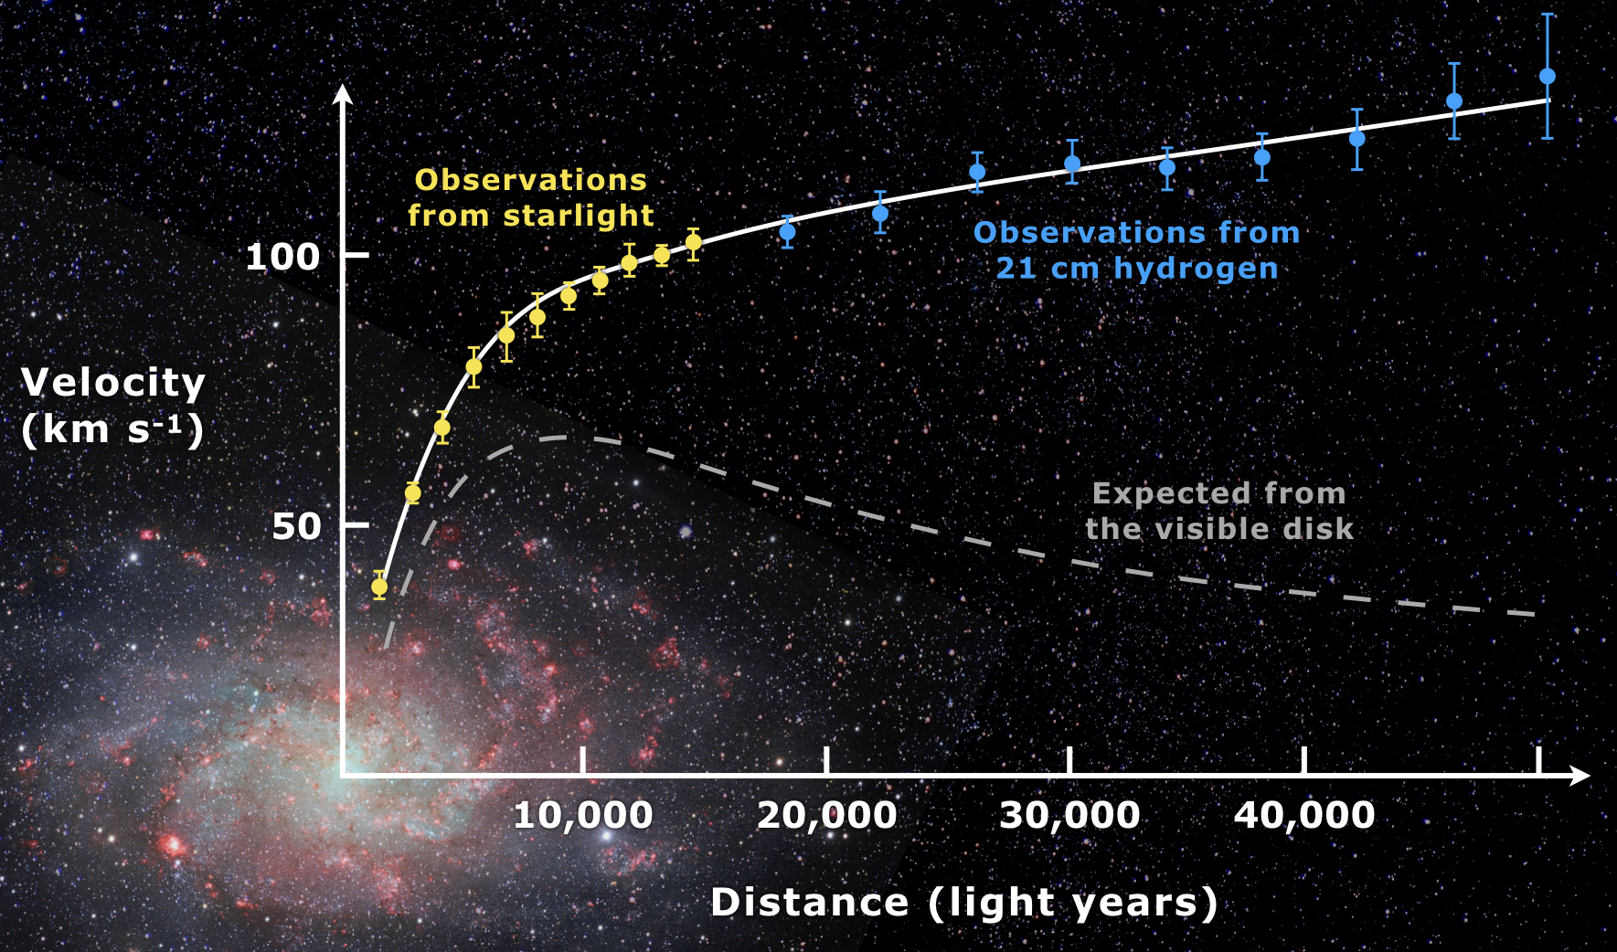


Peccei-Quinn
Weinberg-Wilczek
The axion
a
a
$${m_{a}\text{ ,} g}_{aii}∝ f_{a}^{−1} ∴{ g}_{aii} ∝{ m}_{a}$$
10^{–12} eV < m_{a} < 60 meV
T < f_{a}
The axion as halo dark matter
$E_{a}= m_{a}^{2} \left(1+O\left(β^{2}\right)\right)$
β ² ~ 10^{–6}
For m_{a} ~ 10 μeV
T < T_{QCD}
• ρ_{a} ~ 10¹⁴ cm^{–3}
• λ_{deB} ~ 100 m
This is wavelike dark matter,
treat as a classical field!
θ = O(1) → m_{a} = O(10 μeV)
to saturate the dark matter

Slide 4
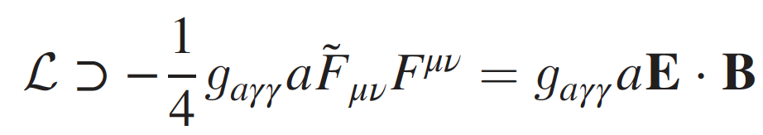
The Microwave Cavity Dark Matter Experiment P. Sikivie, Phys. Rev. Lett. 51 (1983) 1415
Magnet
Preamplifier
Cavity
γ
a
Δf / f ~ 10^{–6}
Power
γ∗
×
f = m_{a}c² / h
Frequency

Slide 5
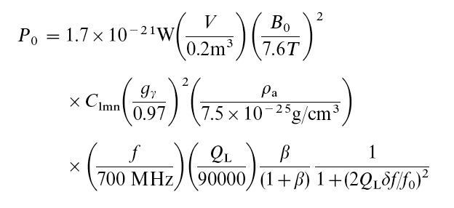
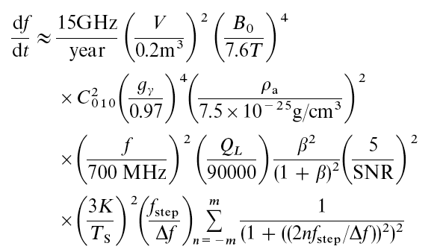
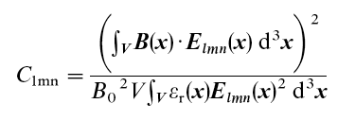
Conversion power, scan rate
Signal power
Scanning rate
Q_{L} = Q₀/(1+β) Loaded Q-value; β coupling
δf = f - f₀ Offset from central
C_{lmn} Cavity form factor
Δf Cavity bandwidth
f_{step} Frequency tuning steps
n Overlapping tuning steps
Form factor & Quality Factor

Slide 6

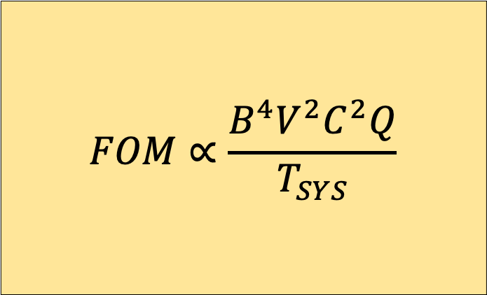
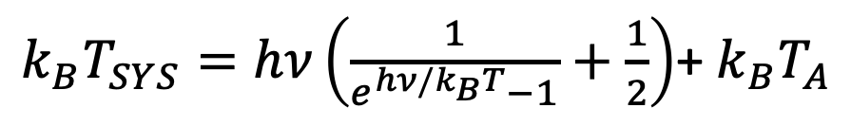
System noise temperature, Figure-of-merit
System Noise Temperature
The Standard Quantum Limit
for Linear Amplifiers
T_{A} > T_{SQL}
where
k_{B} T_{SQL} = hν
Dicke radiometer equation:
$$SNR=\frac{P}{k_{B}T_{SYS}}\sqrt{\frac{t}{{Δν}_{a}}}$$
$k_{B}T_{SYS}=hν\left(\frac{1}{e^{hν/k_{B}T}−1}+\frac{1}{2}\right)$+ $k_{B}T_{A}$
$$FOM∝\frac{B^{4}V^{2}C^{2}Q}{T_{SYS}}$$
T Physical temperature
T_{A} Amplifier noise temperature
t Integration time

Slide 7
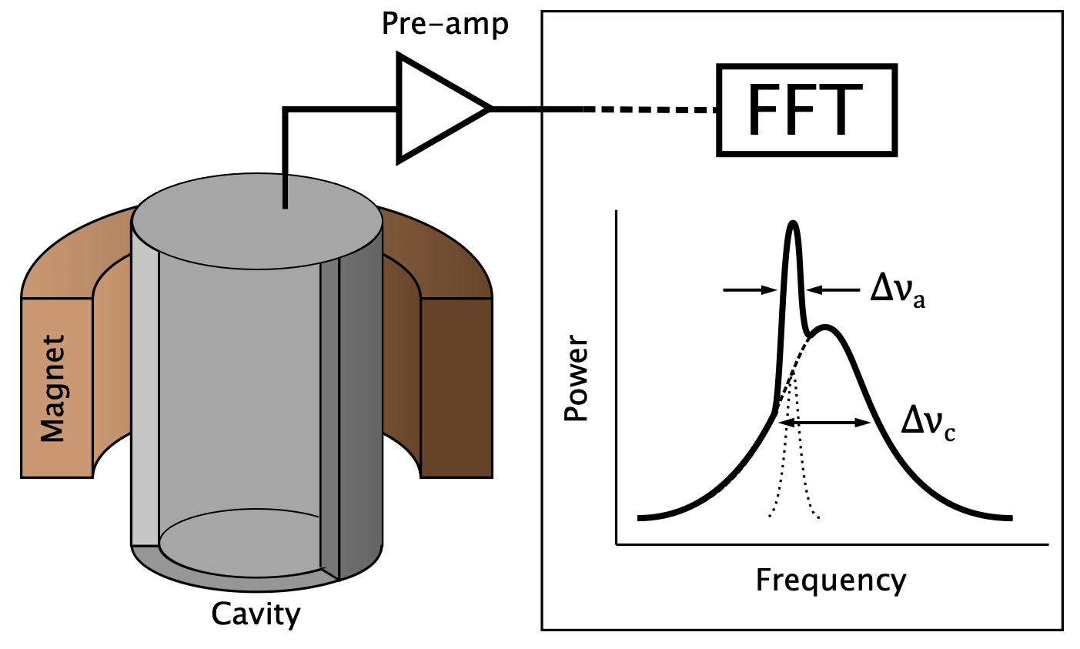

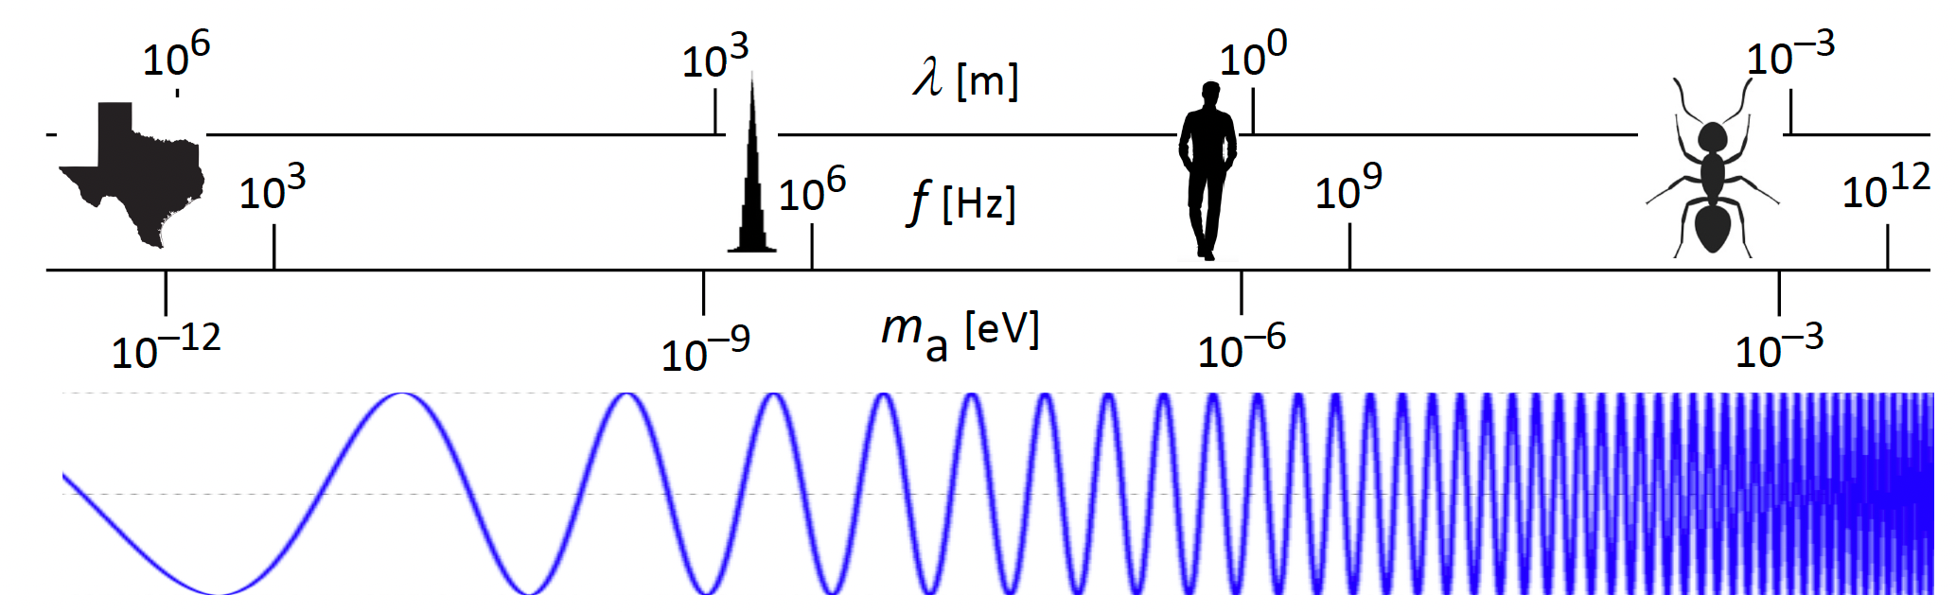
Vacuum Realignment
m_{a} ~ O(10 μeV)
ν ~ O(GHz)
d ~ λ_{C} ~ O(0.1-1 m)
microwave cavities
Ciaran O’Hare
https://cajohare.github.io/AxionLimits/
HAYSTAC

Slide 8
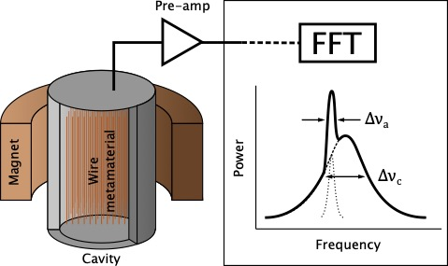
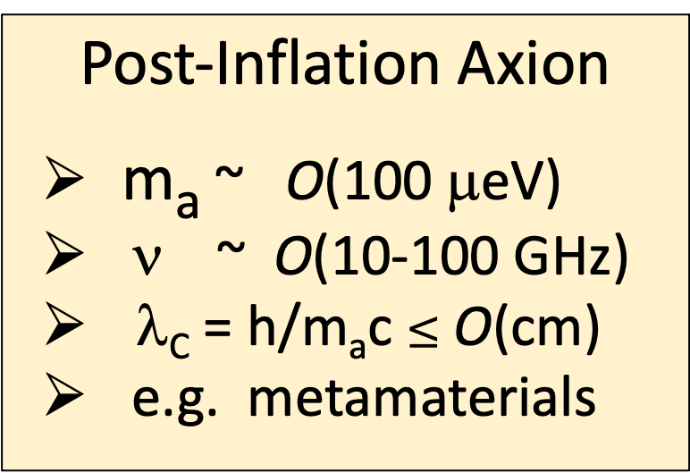
Post-Inflation Axion
m_{a} ~ O(100 μeV)
ν ~ O(10-100 GHz)
λ_{C} = h/m_{a}c $≤$ O(cm)
e.g. metamaterials
Ciaran O’Hare
https://cajohare.github.io/AxionLimits/
HAYSTAC
See H. Jackson, A. Gallo Rosso

Slide 9
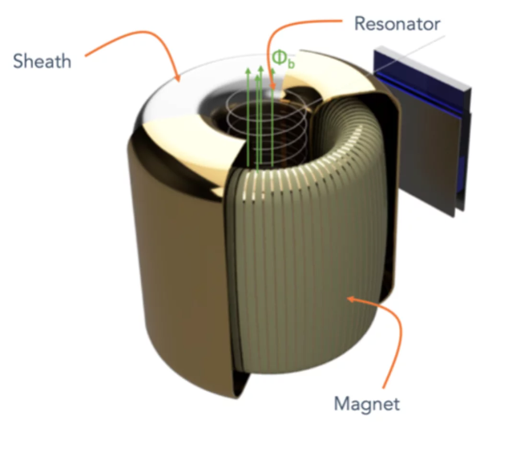
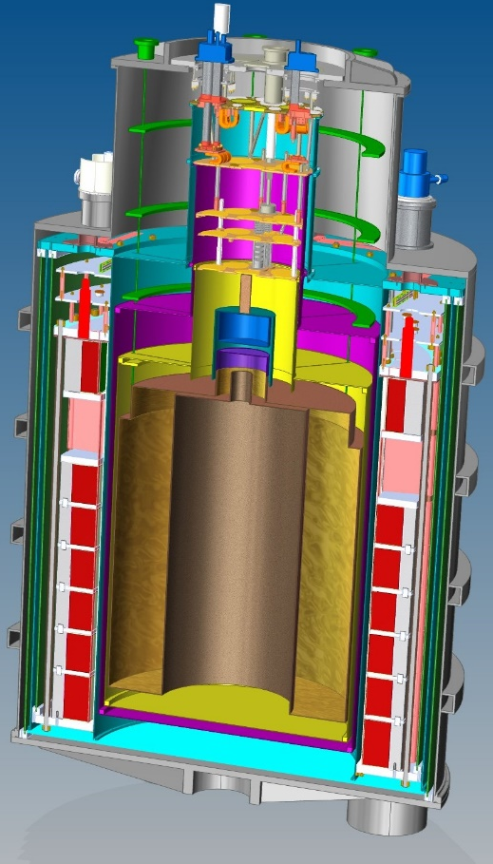
GUT-scale Axions
m_{a} ~ O(neV)
ν ~ O(kHz-MHz)
λ_{C} = h/m_{a}c ~ O(km)
lumped-element circuit
Ciaran O’Hare
https://cajohare.github.io/AxionLimits/
HAYSTAC
DM Radio 50L
DM Radio M³
See A. Droster

Slide 10
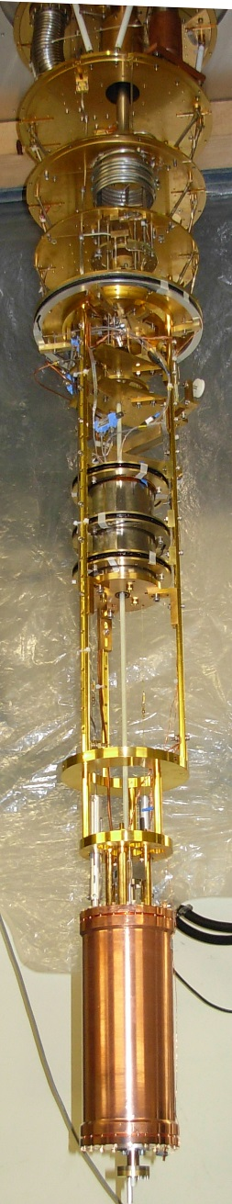
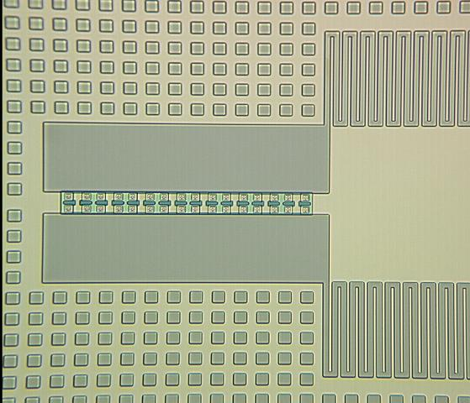
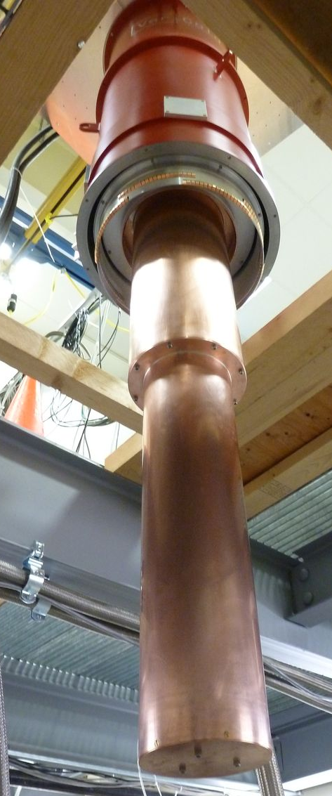
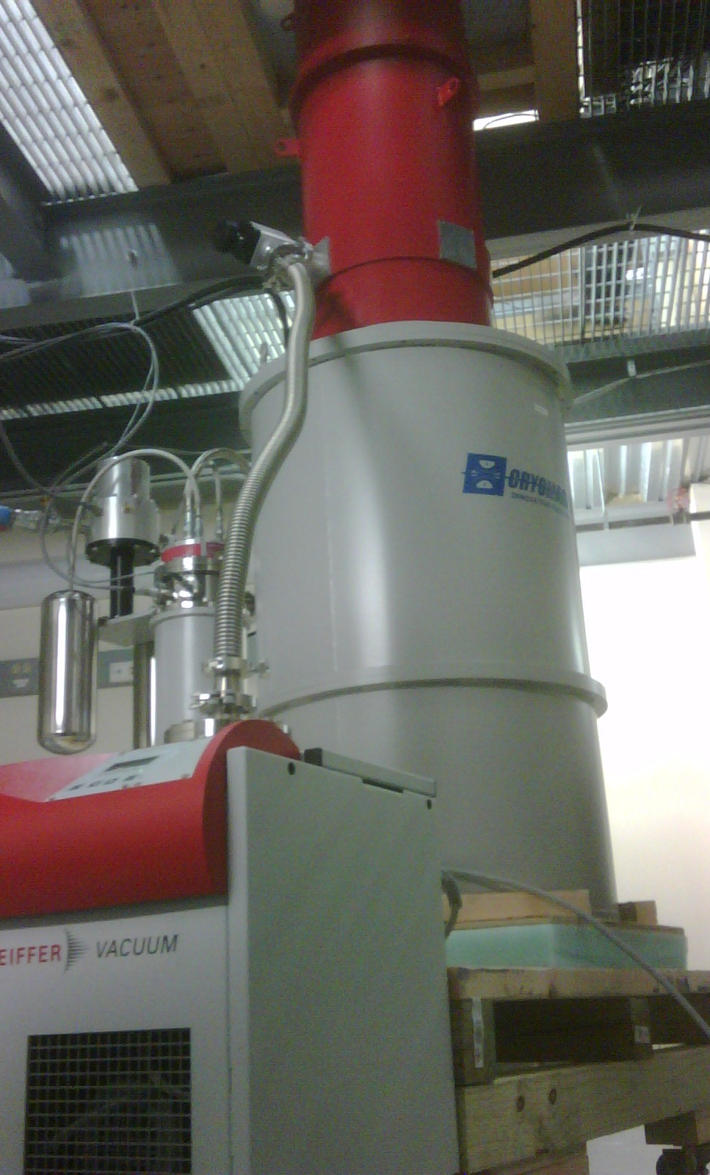
HAYSTAC – Pathfinder & Technology Testbed toward Post-Inflation Axion
JPA-based Squeezed-State Receiver
³He/⁴He Dilution
Refrigerator
9.4 Tesla, 10 Liter Magnet
Microwave Cavity (copper)

Slide 11
HAYSTAC Phase I – single Josephson Parametric Amplifier (JPA)
Operated at T_{SYS} ~ (2-3) x T_{SQL} at 6 GHz
11

Slide 12
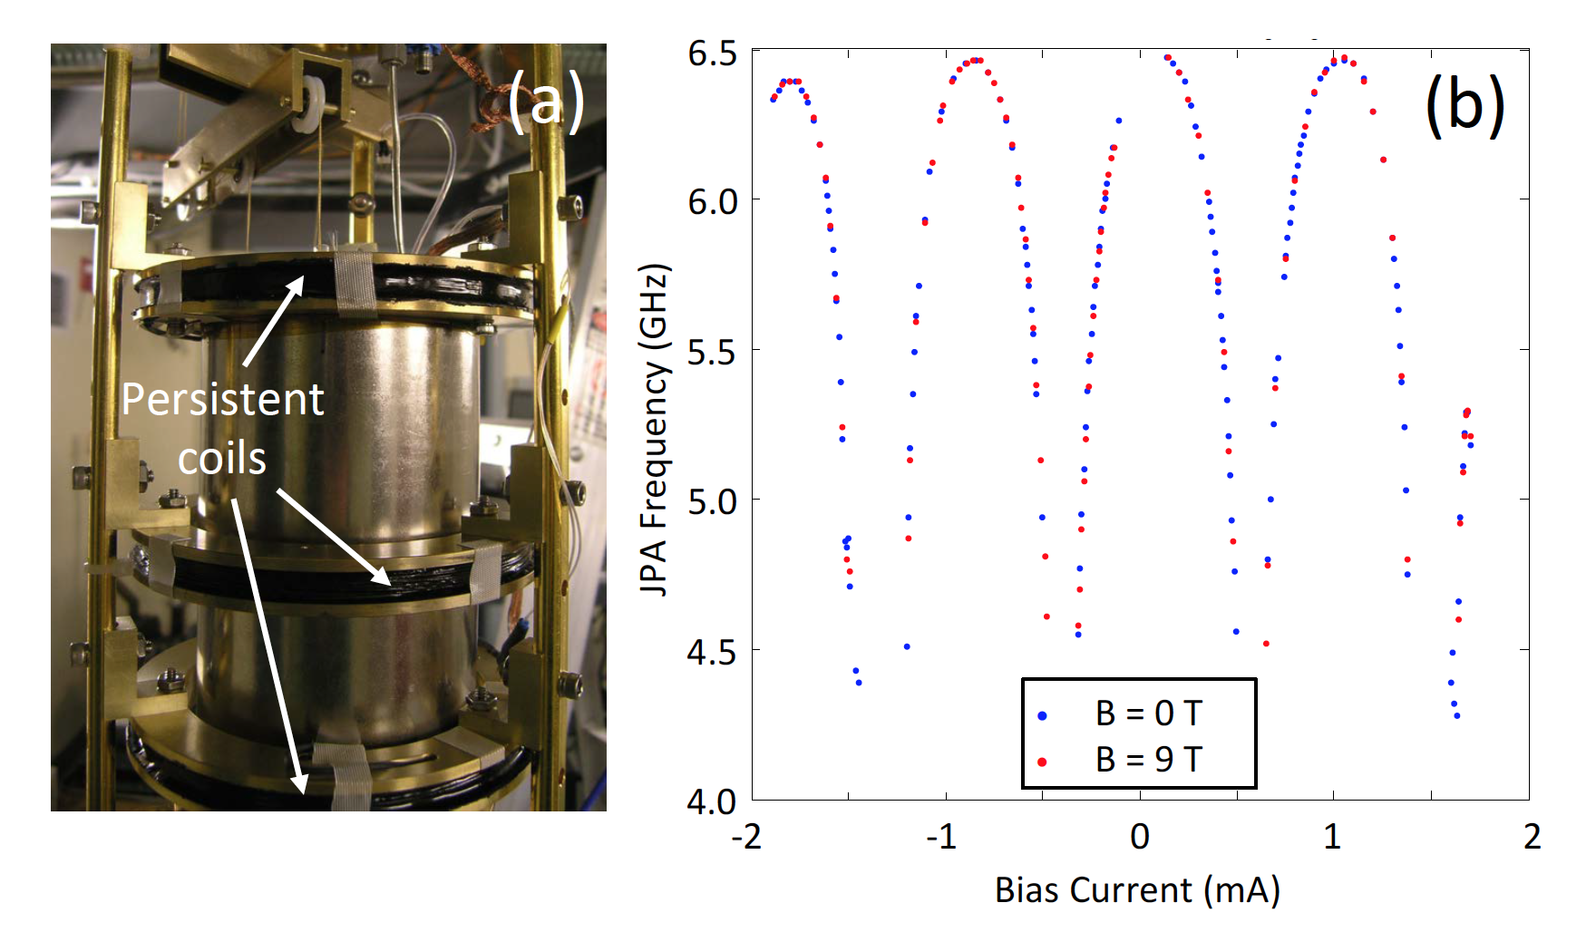
The major challenge – magnetic shielding of the JPA
“Defense in depth”
• Active bucking coil
• Persistent coils (4)
• Cryoperm (2 layers)
• S’con lead sheet
• S’con aluminum sheet
Remnant field at JPA ultimately reduced to < 0.01 flux quantum
12

Slide 13
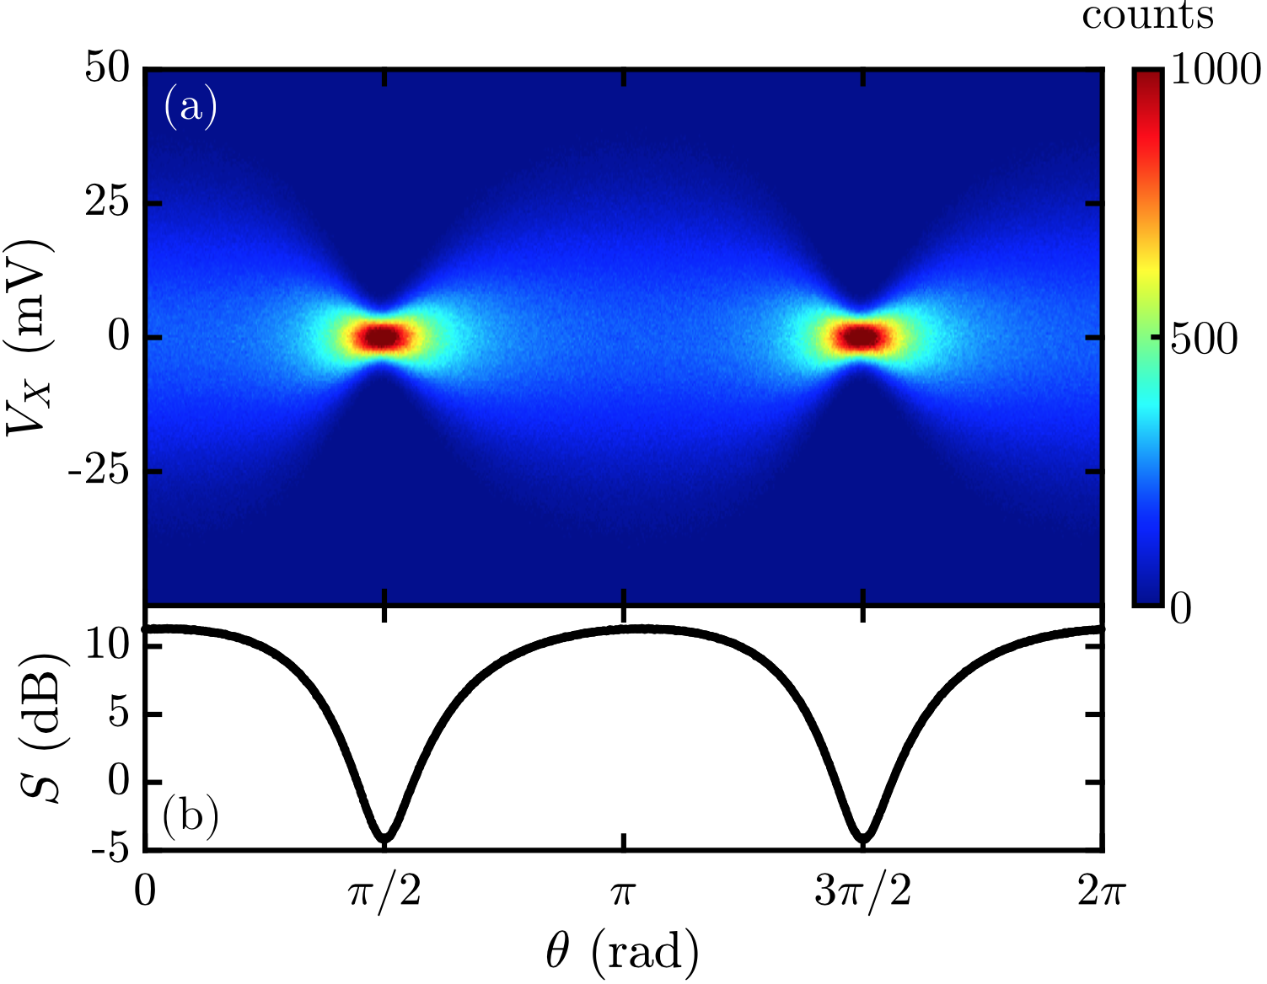
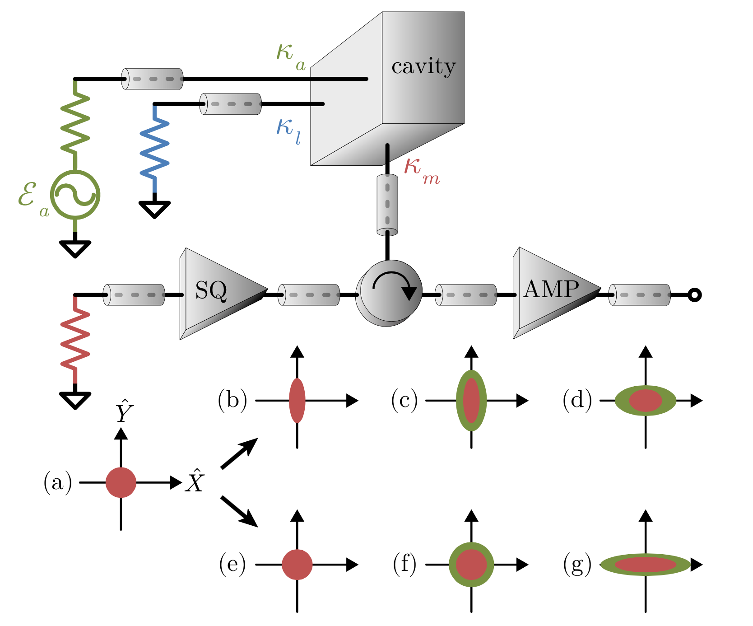

HAYSTAC Phase II – Squeezed State Receiver (M. Malnou et al., Phys. Rev. X 9 (2019) 021023)
JILA test-bed, twin system to HAYSTAC
Squeezing and amplifying in the same quadrature yielded –4.5 ± 0.1 dB, as predicted by modeling

Slide 14
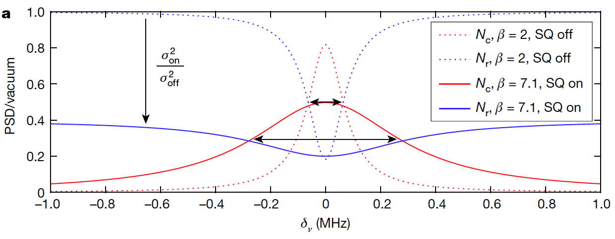
Squeezing in detail
Overcoupling is essential to the acceleration

Slide 15
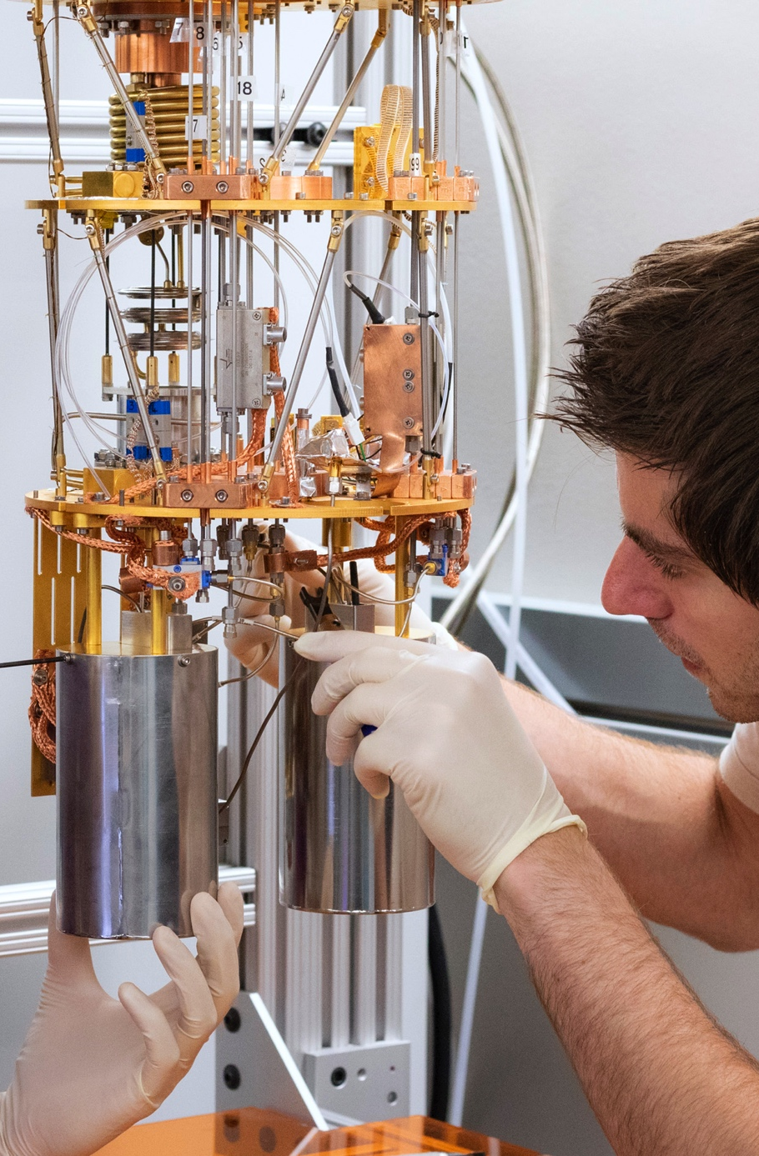
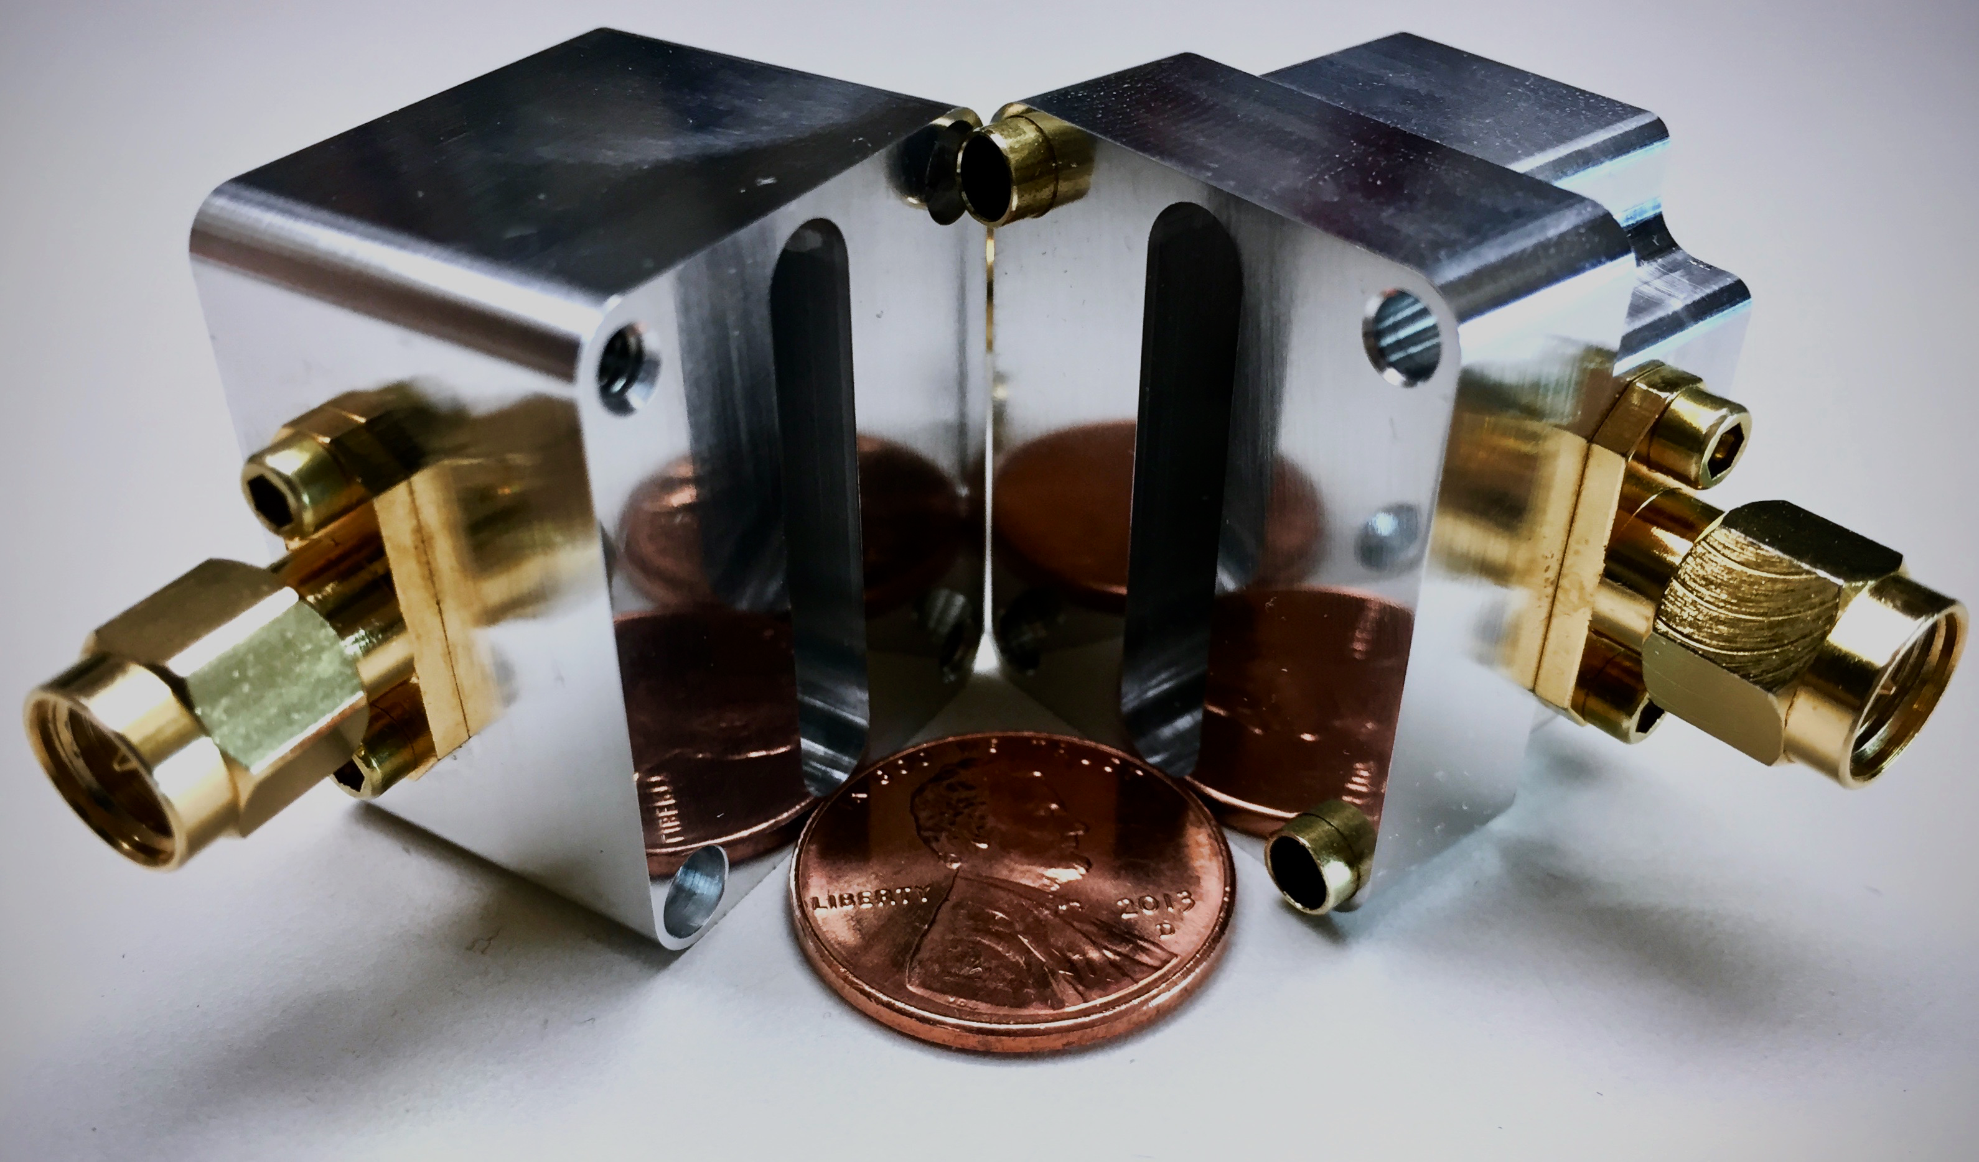
JILA/Colorado
SSR Test-bed
7 GHz Cavity
Flux line
Capacitor
SQUID array
100 μm

Slide 16
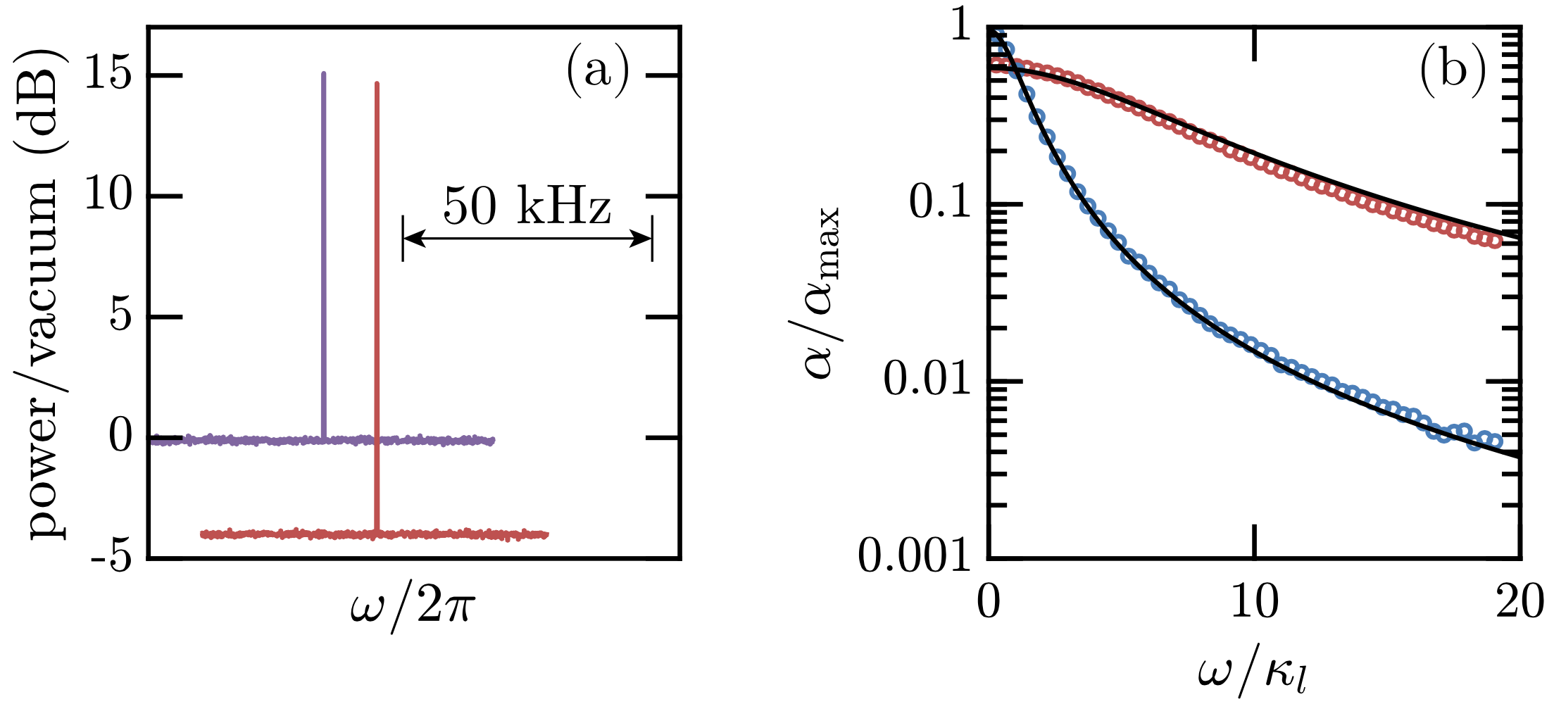
Squeezing implies uniformly higher S/N over a wider bandwidth
κ_{m}=10κ_{l}
Squeezed
κ_{m}=10κ_{l}
Not squeezed
κ_{m}=1.5κ_{l}
The scan rate with squeezing optimizes at large overcoupling of the cavity, thus higher BW

Slide 17
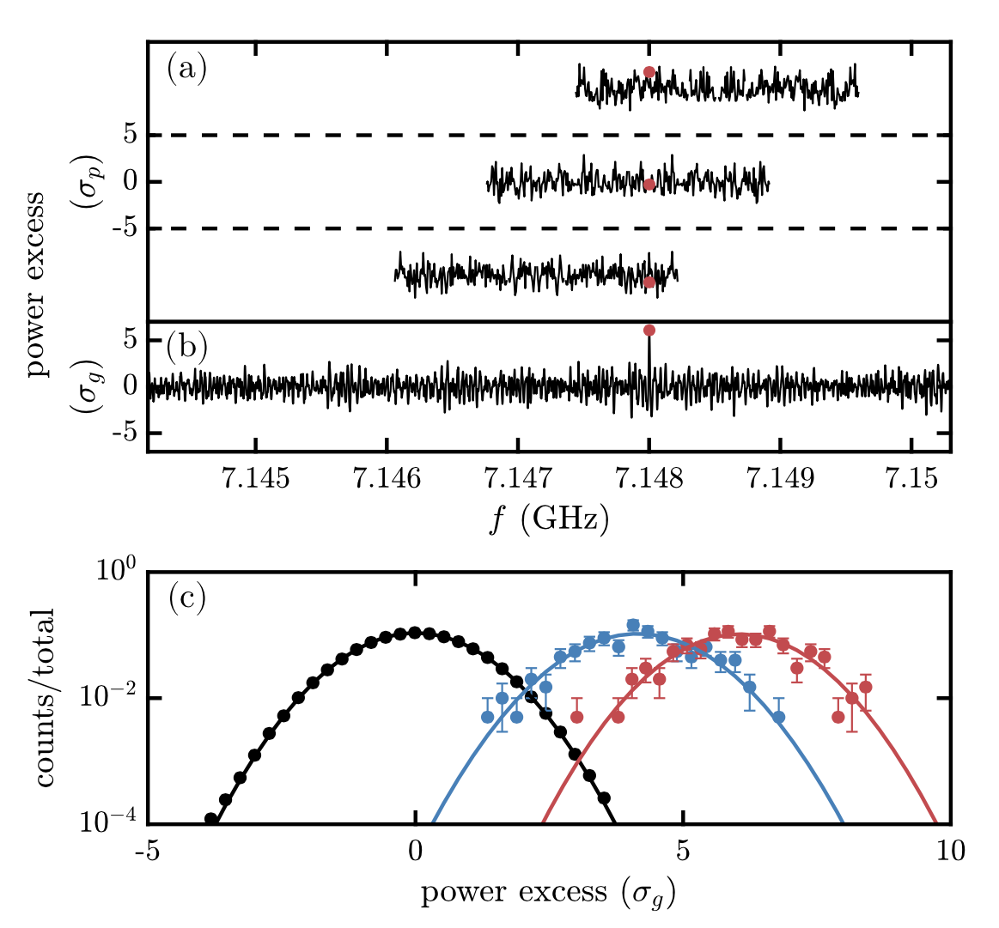
Factor of 2.1 speedup in testbed; HAYSTAC achieved 1.9 in situ data taking
Mock axion search done at JILA testbed
Synthetic signal injected into the system of unknown frequency
Search protocol repeated 200 times for each configuration
Results are μ_{s} = 6.05 ± 0.07 (with squeezing), μ_{s} = 4.15 ± 0.07 (w/o), leading to 2.12 ± 0.08 speedup
HAYSTAC Phase II Run 1 achieved ~ x2 speedup from SSR, x3 speedup overall

Slide 18
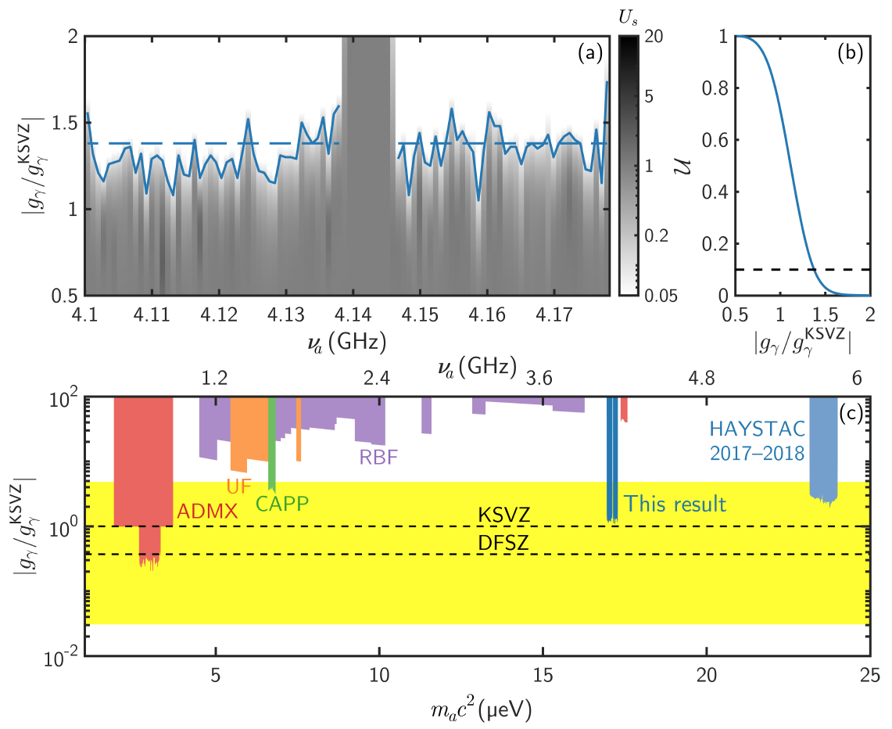
HAYSTAC Phase II Run 1: First quantum-enhanced dark matter experiment; reaches 1.38 x KSVZ
SSR reduced run time by ½
Analysis incorporated new Bayesian analysis method (Palken et al., PRD 101 (2020) 123011)
Sensitivity at 1.38 x KSVZ
K.M. Backes et al., Nature 590 (2021) 238

Slide 19
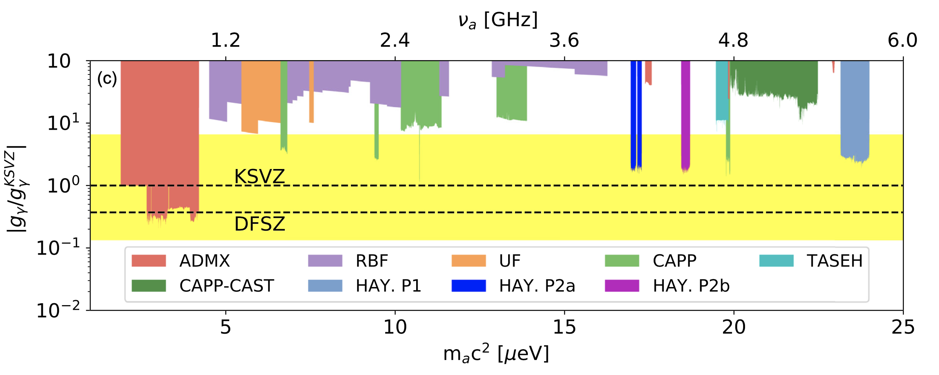
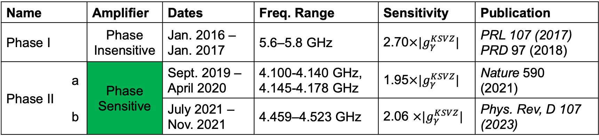
HAYSTAC data (2016 – )
Name |  | Amplifier | Dates | Freq. Range | Sensitivity | Publication
Phase I |  | Phase Insensitive | Jan. 2016 – Jan. 2017 | 5.6–5.8 GHz | 2.70$×|g_{γ}^{KSVZ}|$ | PRL 107 (2017) PRD 97 (2018)
Phase II | a | Phase Sensitive | Sept. 2019 – April 2020 | 4.100-4.140 GHz, 4.145-4.178 GHz | 1.95$×|g_{γ}^{KSVZ}|$ | Nature 590 (2021)
 | b |  | July 2021 – Nov. 2021 | 4.459–4.523 GHz | 2.06 $×|g_{γ}^{KSVZ}|$ | Phys. Rev, D 107 (2023)
Phase II c, d Phase Sens. 2023-24 4.178-4.779 GHz ~ 2.7 $×\left|g_{γ}^{KSVZ}\right|$ Preliminary
HAY P2c
HAY P2 c&d (Preliminary)

Slide 20
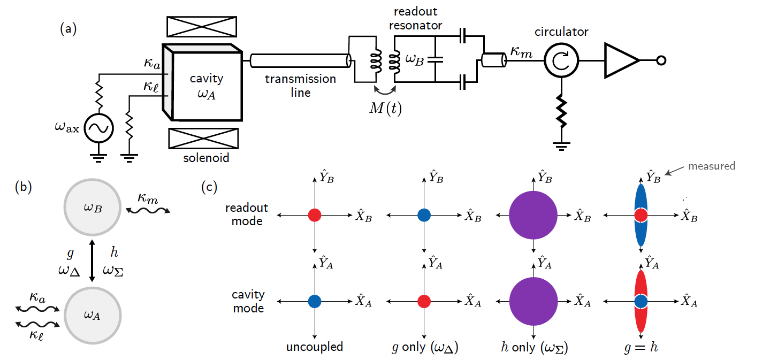
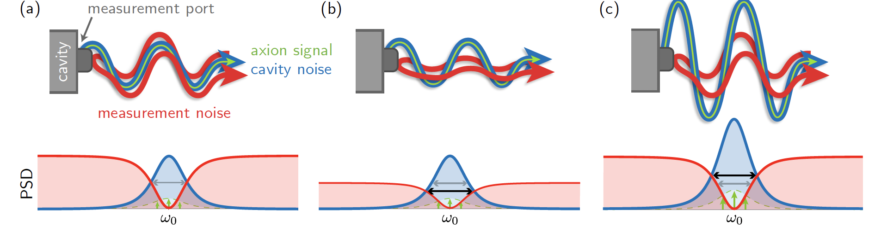
Phase III: CEASEFIRE – Cavity Entanglement and State Exchange for Improved Readout Efficiency
K. Wurtz et al., PRX Quantum 2 (2021) 040350
Y. Jiang et al., PRX Quantum 4 (2023) 020302
Following the same pattern of prototype-experiment twins
To deploy in HAYSTAC 2025
Projected ×8 scan speedup
Linear amplifier
Squeezing
Squeezing with state exchange

Slide 21
Crossover point between Linear Amplifiers etc. and Single Quantum Detection
There is a frequency range above which photon counting will be more sensitive and the advantage will grow with frequency, roughly 10 GHz. See:
S.K. Lamoreaux et al., Phys. Rev. D 88 (2013) 035020
E. Graham et al., Phys. Rev. D 109 (2024) 032009
Challenges with single-quantum detection will be in implementing it into an axion haloscope, i.e. efficient coupling to the conversion chamber, tunability, and dark counts above expectation.
RAY (Rydberg At Yale) aims to deliver a single-quantum detector for HAYSTAC

Slide 22
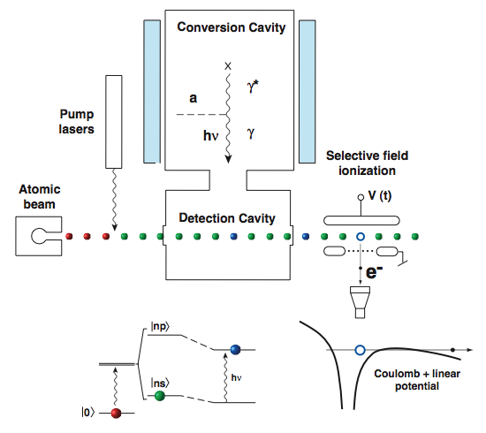
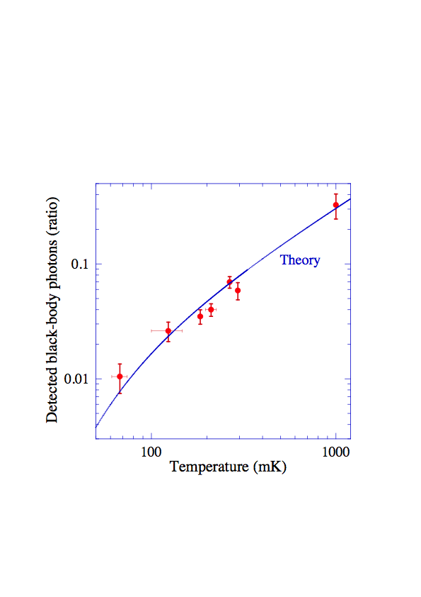
The CARRACK (Kyoto) Rydberg-atom Single Photon Detector (S. Matsuki et al.)
N.B.: Not QND
Fraction ⁸⁵Rb 111s_{1/2} → 111p_{3/2}
Tada et al. Phys. Lett. A 349:488 (2006) demonstrated a receiver a factor ~2 below SQL at 2.527 GHz (~120 mK).
DFSZ exclusion at ~10 μeV presented at conference (Matsuki, 1997), but never published in a refereed journal.
RAY: See Y. Zhu et al, Phys. Rev. A (2021), E. Graham et al., Phys. Rev. D 109 (2024) 032009

Slide 23
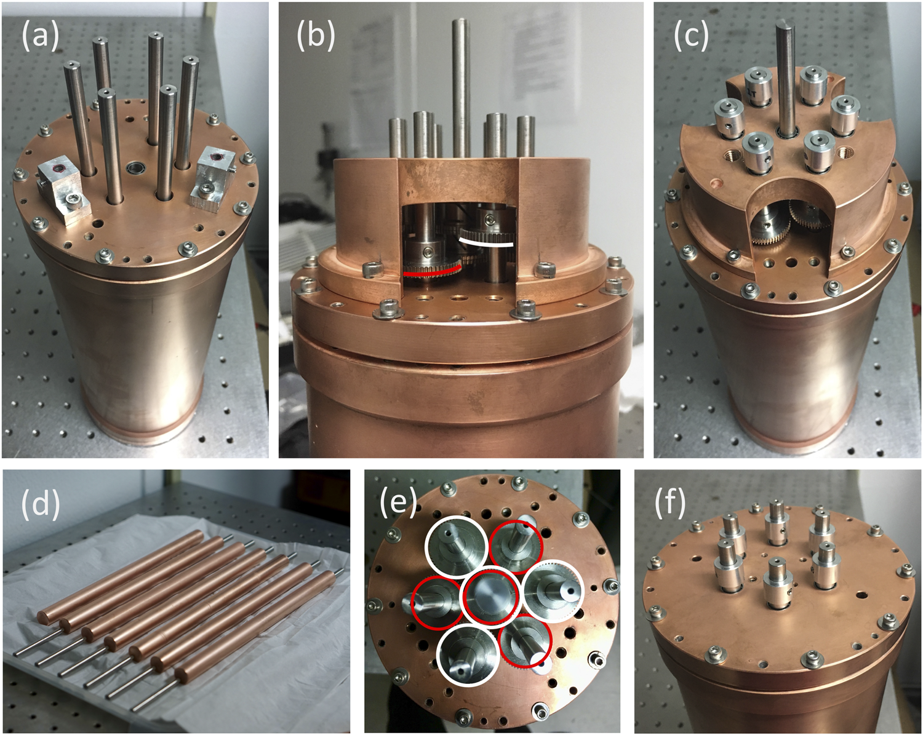
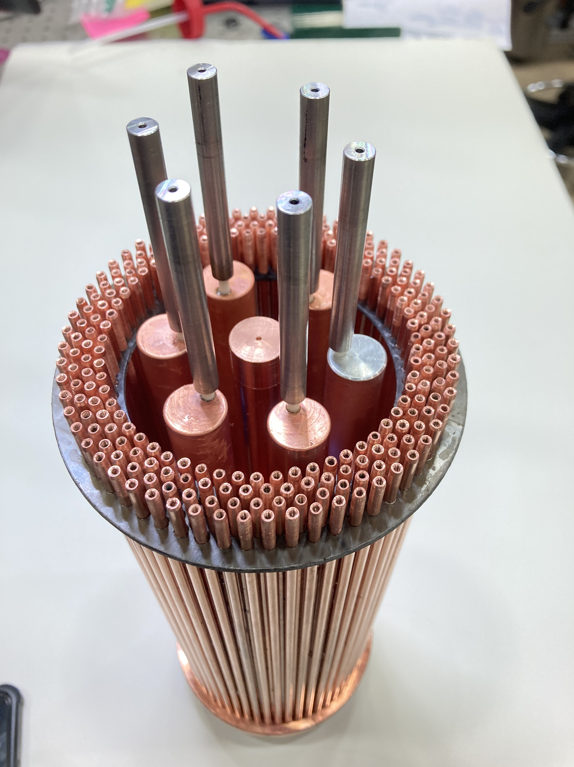
HAYSTAC Phase IIIa – Lattice-type cavity M. Simanovskaia et al., Rev. Sci. Instr. 92, 033305 (2021)
(left) 7-rod cavity, tuned by varying the scale factor; (below) with Photonic Band Gap structure for TE mode suppression

Slide 24
Final remarks
HAYSTAC has proven to be an effective testbed for new detector and resonator innovations
It remains the only spectral dark matter axion experiment that has circumvented the Standard Quantum Limit; a more advanced cavity entanglement and state exchange scheme should produce an order of magnitude speedup in scanning
Symmetric lattice & metamaterial designs show promise for higher frequency resonators without loss of volume; Photonic Band Gap structures can eliminate the TE mode forest (See talk of Heather Jackson)
ALPHA will incorporate these innovations in the search for the post-inflation axion, initially in the 10-20 GHz range (See talk of Andrea Gallo Rosso)

Slide 25
Additional Slides

Slide 26
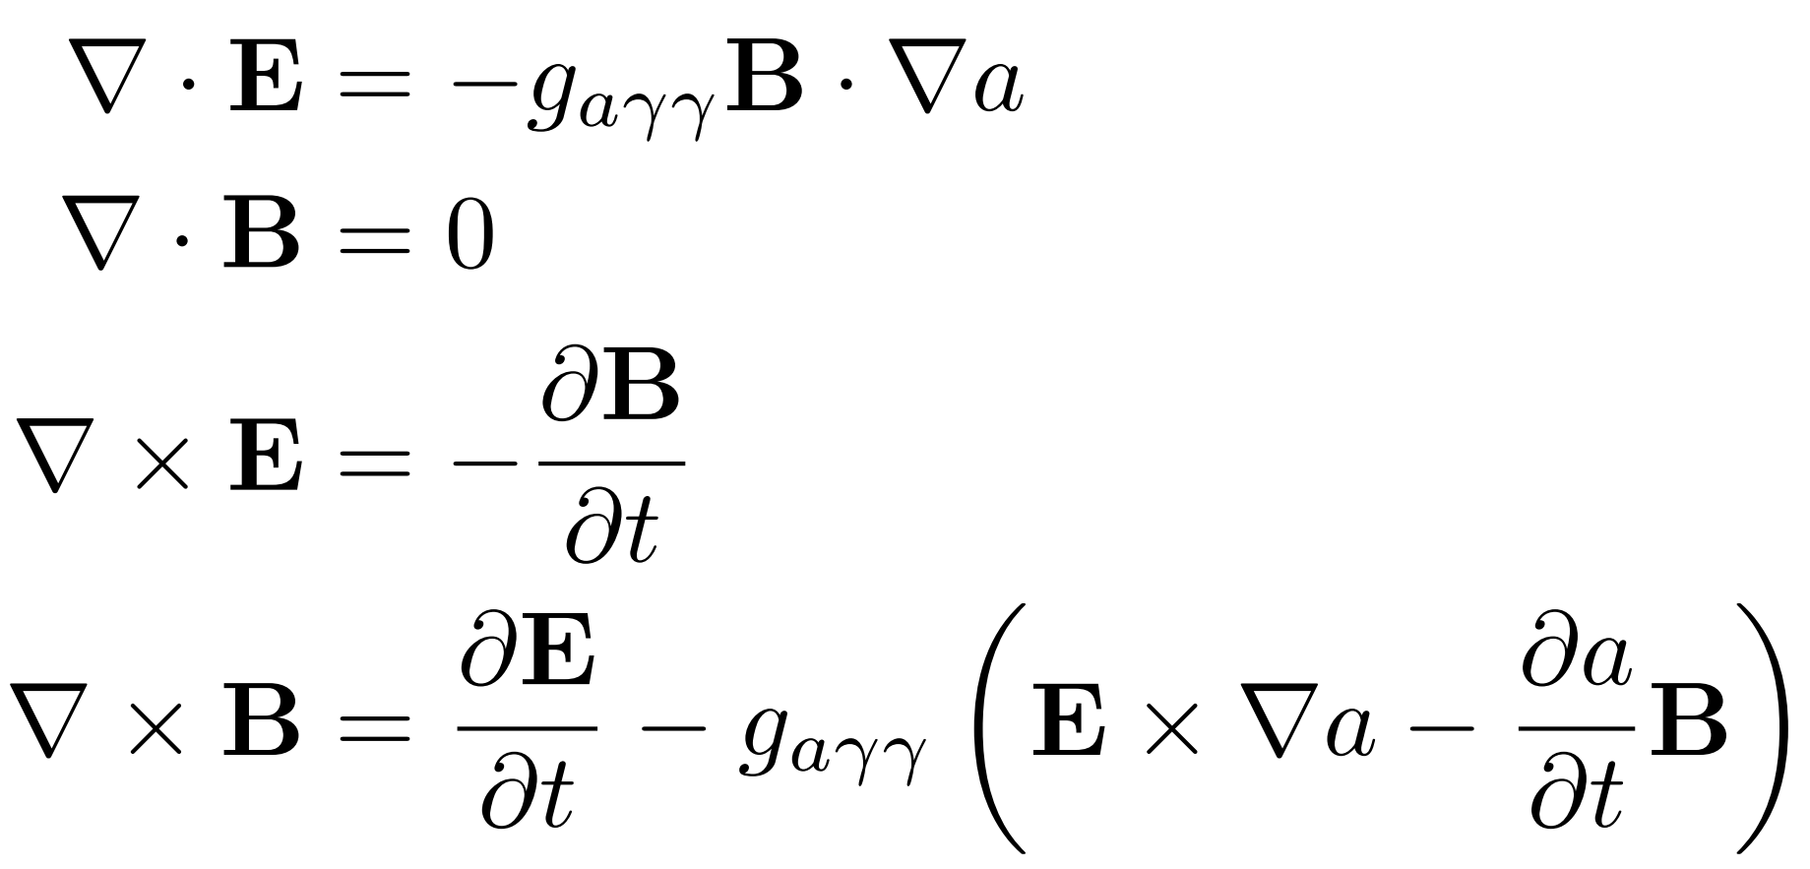
Axion electrodynamics
0
An effective AC current generated by the axion in the direction of a static magnetic field
0

Slide 27
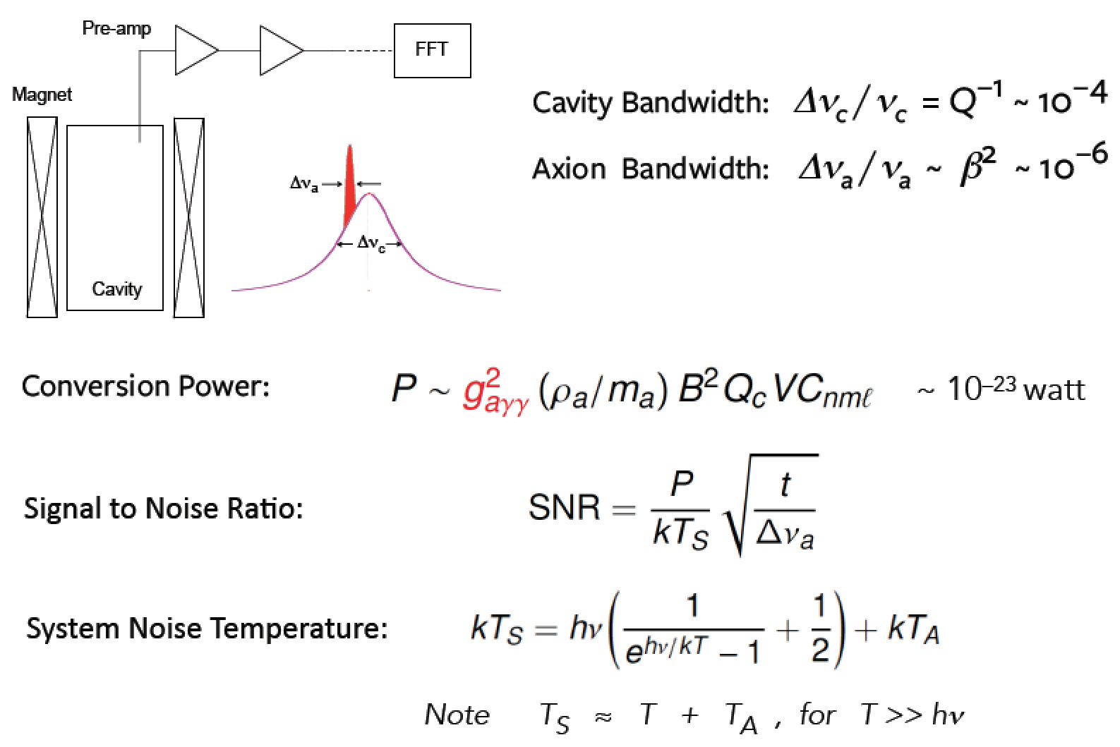
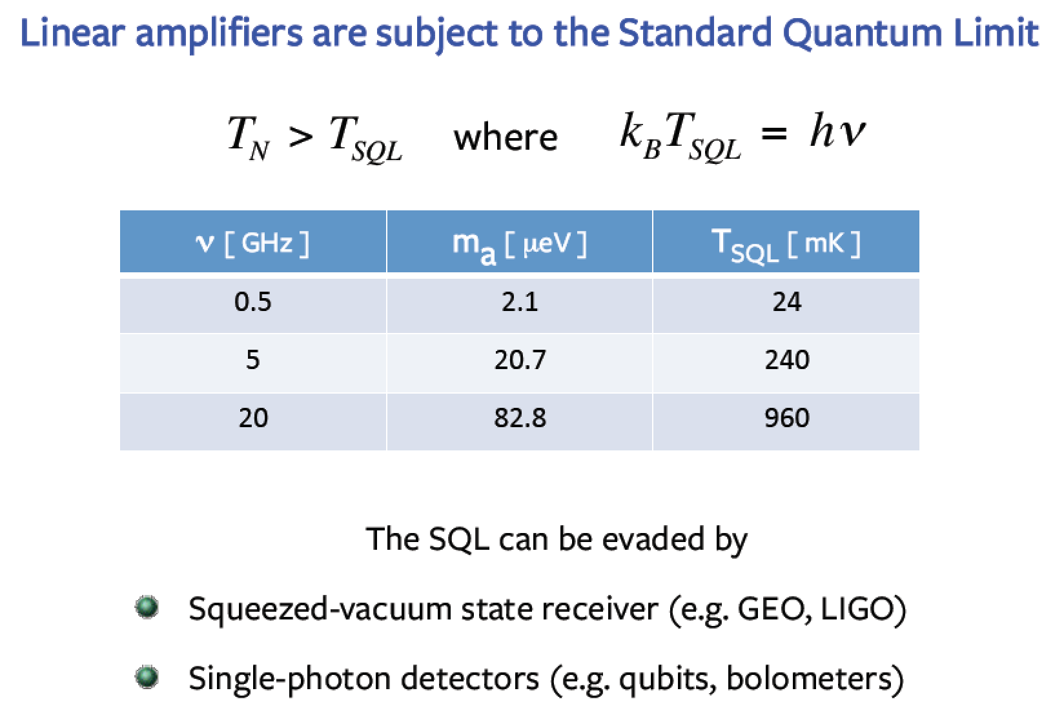
Conversion power, Sources of Noise & the Standard Quantum Limit
The Dicke Radiometer Equation dictates the Experimental Strategy
Linear Amplifiers are subject to the Standard Quantum Limit (SQL)

Slide 28
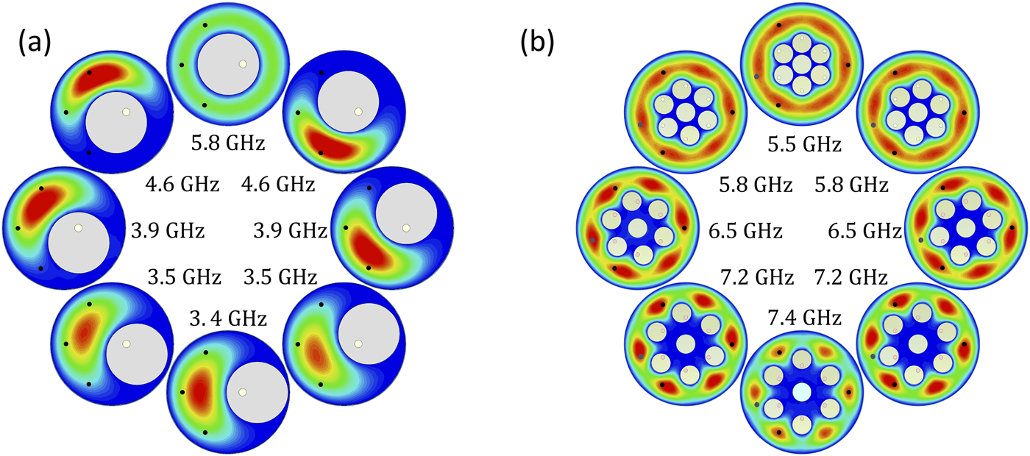
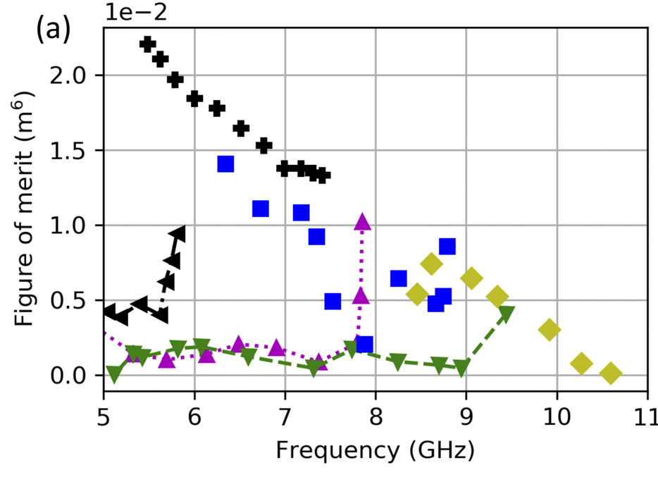
Role of symmetry in Figure-of-Merit

Slide 29
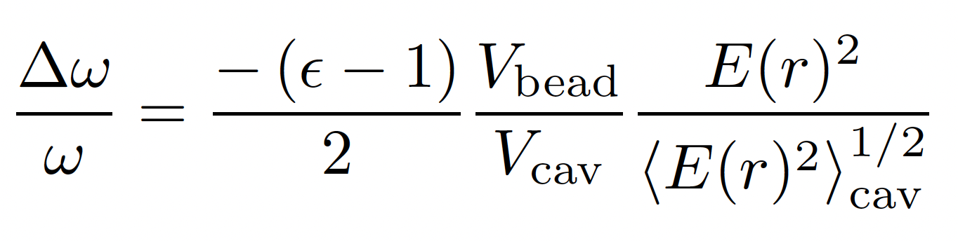
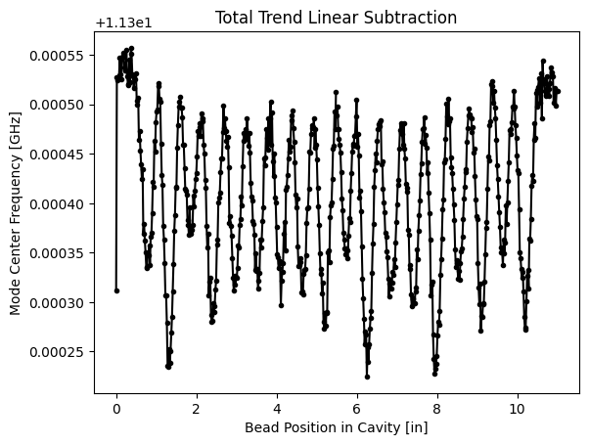
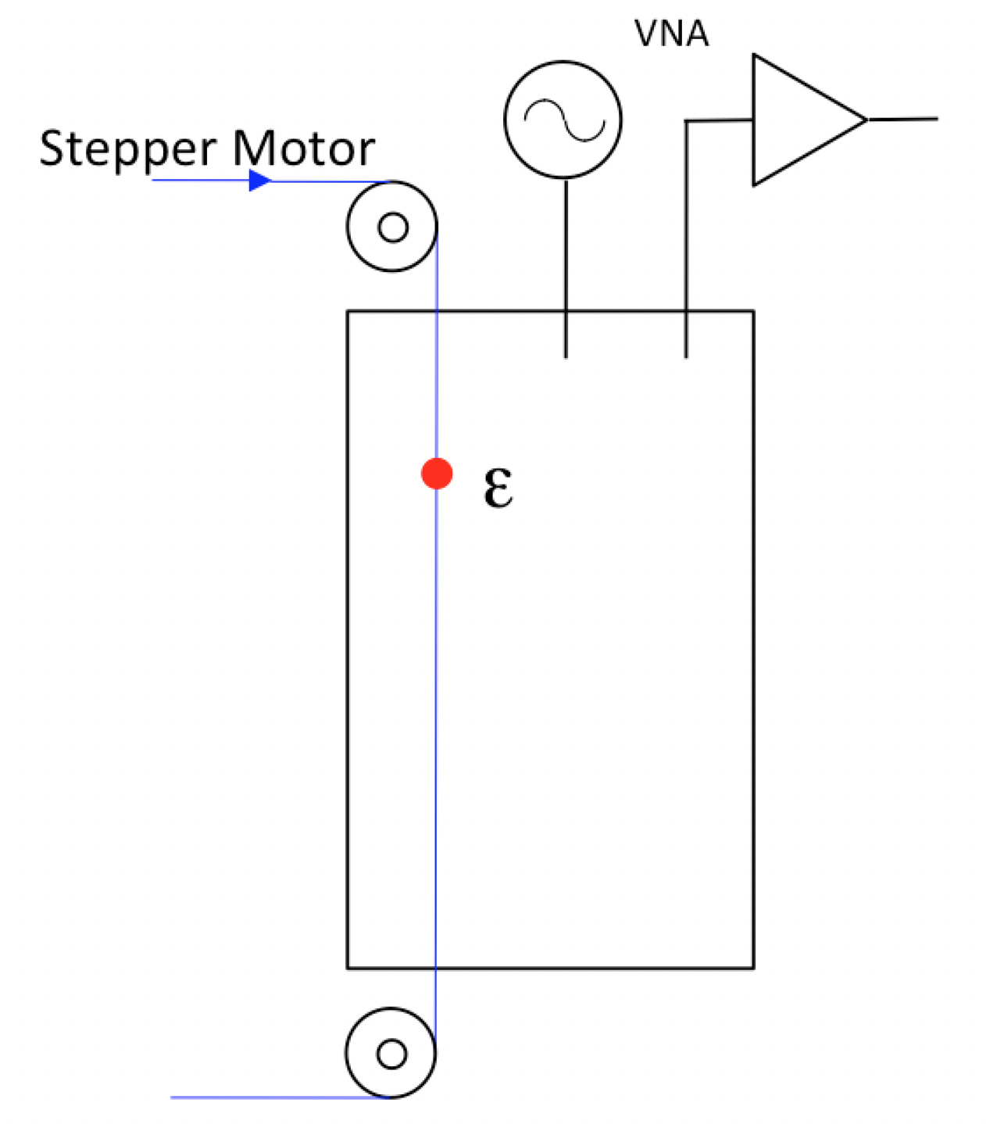
Field Mapping – Bead Perturbation method Discontinuities in Waveguides, J. Schwinger & D. Saxon (1968)
Example: TEM (n = 19)

Slide 30


Field mapping essential to understand mode hybridization
TM₀₁₀
TE₀₆₀
Two-mode mixing
Some crossings benign; most require excision of a large notch in frequency

