Slide 1
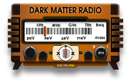
Searching for sub-𝜇eV axions with DMRadio: Overview and Status
Alex Droster
July 10, 2024
IDM 2024, L’Aquila
A. Droster

Slide 2
Outline
The pre-inflationary axion
Lumped-element detection
DMRadio-50L
Design
Projected sensitivity
DMRadio-m³
DMRadio-GUT
What’s happening now in DMRadio?
Summary
A. Droster

Slide 3
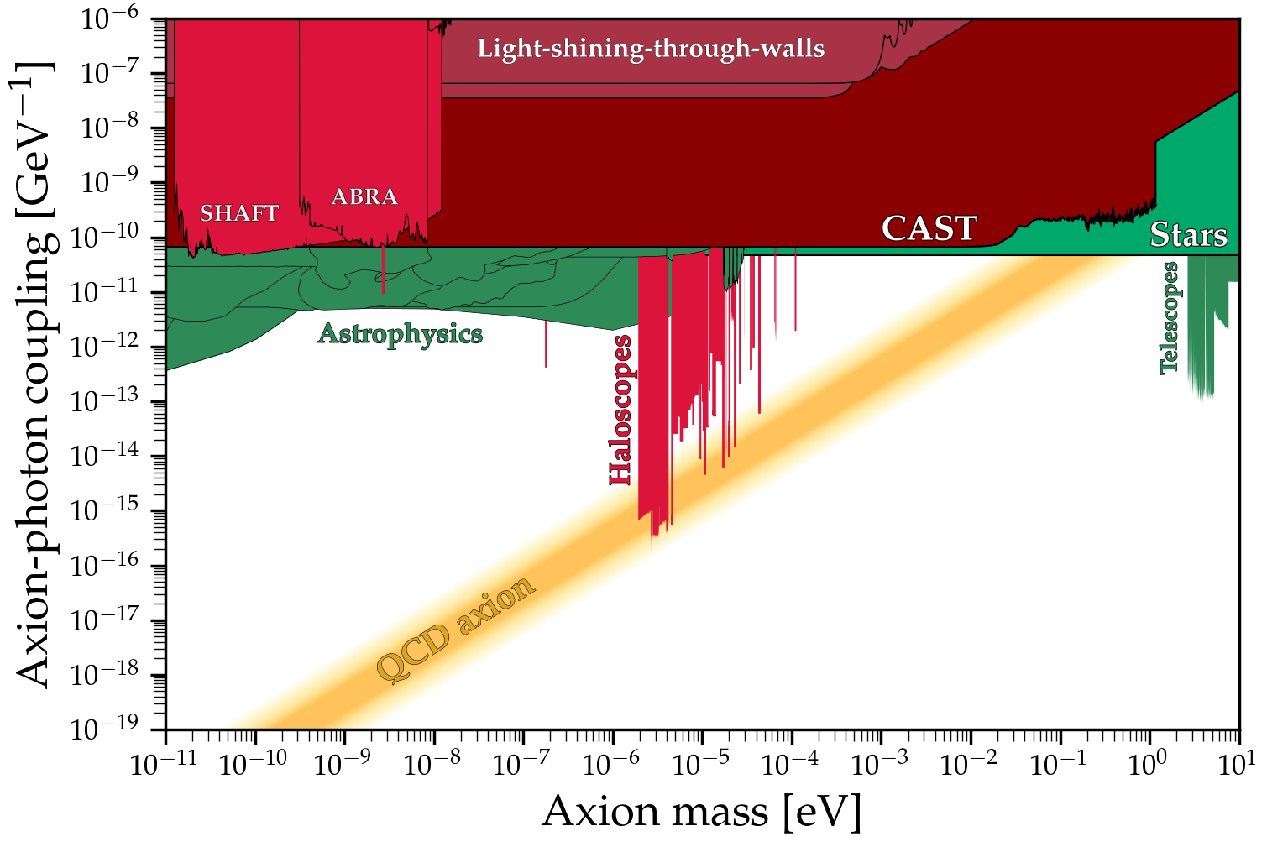
Axion parameter space
KSVZ
DFSZ
Image: Ciaran O’Hare
A. Droster
Notes:
CAST searches for solar axions by pointing a telescope at the sun with a 9 T magnetic field, and X-ray detector optics

Slide 4
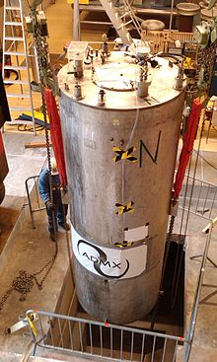
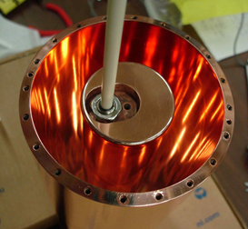
Axion parameter space
Wavelength 𝝀 ≤ 1 m
Axion frequency matches cavity mode frequency
Many of us here today!
KSVZ
DFSZ
ADMX
Image: Ciaran O’Hare
A. Droster
Notes:
TRANS: DM Radio exclusion

Slide 5
Axion parameter space
Wavelength 𝝀 ≤ 1 m
Axion frequency matches cavity mode frequency
Many of us here today!
KSVZ
DFSZ
ADMX
Image: Ciaran O’Hare
Much well-motivated parameter space left to explore!
A. Droster
Notes:
TRANS: DM Radio exclusion

Slide 6
Axion parameter space
Wavelength 𝝀 ≤ 1 m
Axion frequency matches cavity mode frequency
Many of us here today!
Wavelength 𝝀 ≫ 1 m
Axion frequency matches LC circuit resonance frequency
KSVZ
DFSZ
ADMX
Image: Ciaran O’Hare
DMRadio: Probe low-mass axions by decoupling the detector’s frequency its geometry
A. Droster
Notes:
TRANS: DM Radio exclusion

Slide 7
DMRadio collaboration
C. Bartram, H.M. Cho, W. Craddock, D. Li, W. J. Wisniewski, A. K. Yi
SLAC National Accelerator Laboratory
J. W. Foster, J. T. Fry, J. L. Ouellet, K. M. W. Pappas, S. Ghosh, L. Winslow
Laboratory of Nuclear Science
Massachusetts Institute of Technology
A. AlShirawi, J. Corbin, P. W. Graham, K. D. Irwin,, S. Kuenstner, A. Kunder, N. M. Rapidis, C. P. Salemi, M. Simanovskaia, J. Singh, E. C. van Assendelft, K. Wells
Department of Physics
Stanford University
R. Henning
Department of Physics
University of North Carolina Chapel Hill
Triangle Universities Nuclear Laboratory
Alex Droster, A. Keller, A. F. Leder, J. Echevers, K. van Bibber
Department of Nuclear Engineering
University of California Berkeley
Y. Kahn
Department of Physics
University of Illinois at Urbana-Champaign
S. Chaudhuri, R. Kolevatov
Department of Physics
Princeton University
A. Phipps
California State University, East Bay
L. Brouwer
Accelerator Technology and Applied Physics Division Lawrence Berkeley National Lab
B. R. Safdi
Department of Physics
University of California Berkeley
B. A. Young
Department of Physics
Santa Clara University
A. Droster
Notes:
3 mins?

Slide 8
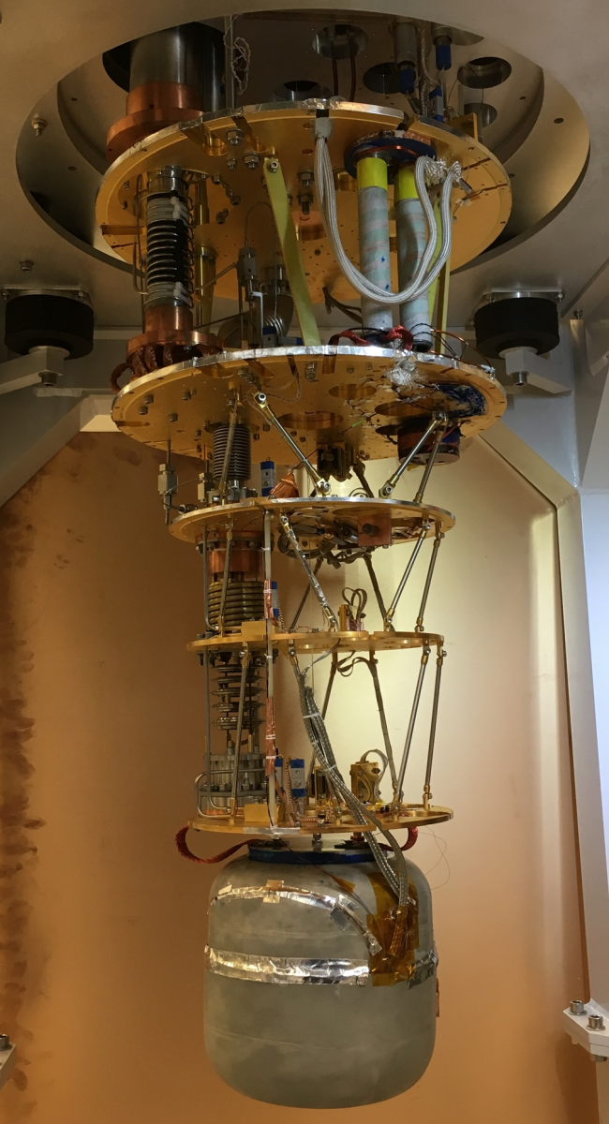
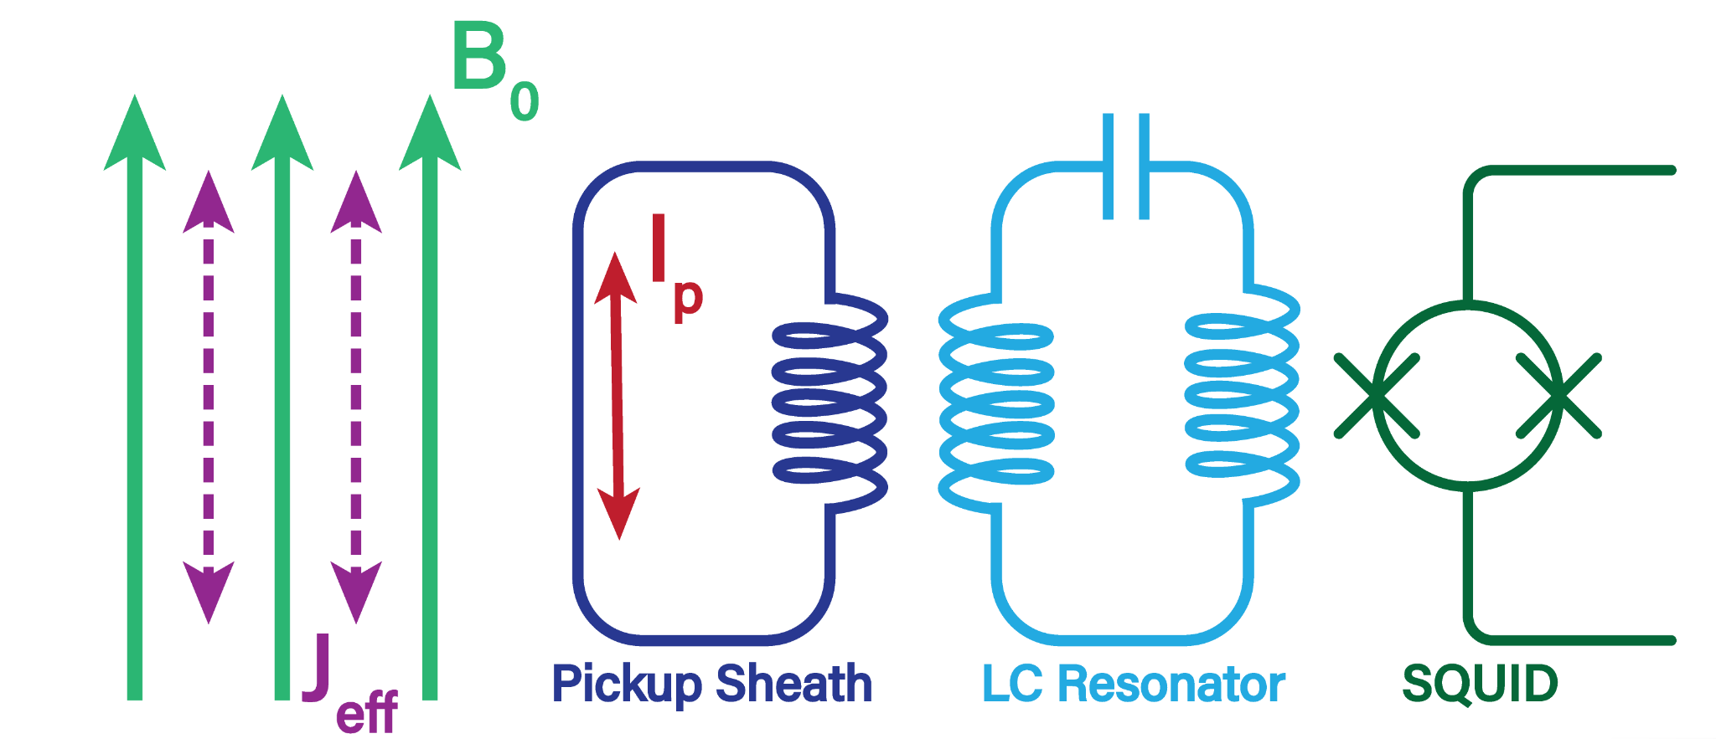
Lumped-element detection
ABRACADABRA-10cm: Broadband search for neV axions!
Others: SHAFT, ADMX SLIC, DMR Pathfinder
B_{a}
C. Salemi et al., “The search for low-mass axion dark matter with ABRACADABRA-10cm,” Phys. Rev. Lett. 127, 2021
Notes:
World-leading results for neV axions

Slide 9
Lumped-element detection
DMRadio: Resonant search for neV axions!
B_{a}
A. Droster

Slide 10
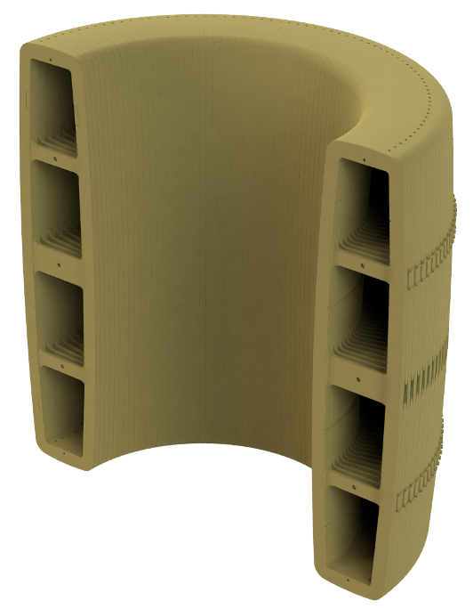
The 50L detector
Magnet
B₀
J_{eff}
Applied magnetic field B₀ induces effective axion current, J_{eff}
A. Droster
Notes:
4:30ish

Slide 11
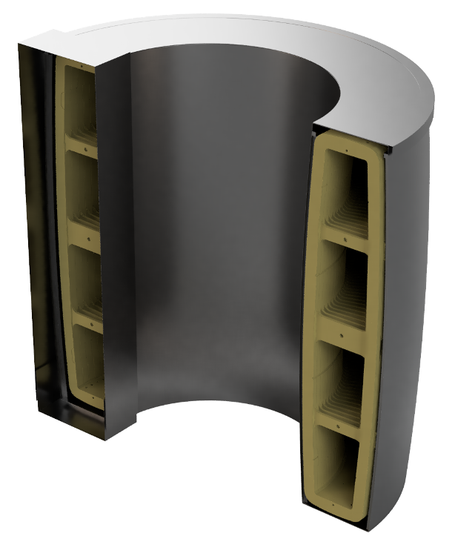
The 50L detector
Magnet + pickup sheath
Magnet
I_{p}
B₀
B_{a}
J_{eff}
Applied magnetic field B₀ induces effective axion current, J_{eff}
Axion current J_{eff} in turn induces a poloidal RF magnetic field, B_{a}, inducing currents I_{p} in a superconducting sheath which surrounds the toroidal magnet
B_{a}
A. Droster

Slide 12
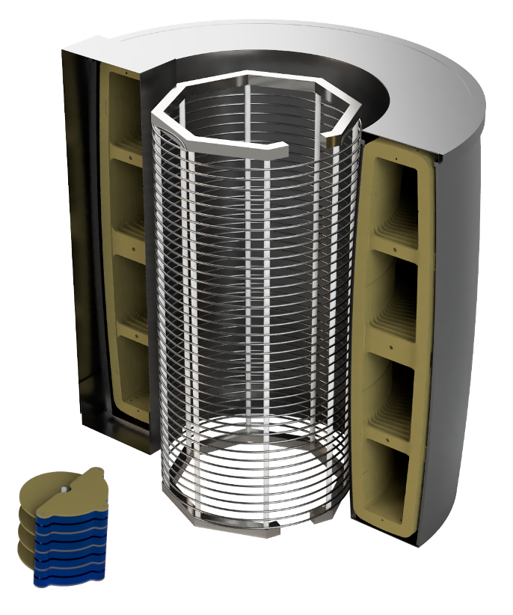
The 50L detector
Magnet + pickup sheath +LC resonator
Magnet + pickup sheath
Magnet
I_{p}
B_{induced}
B₀
B_{a}
J_{eff}
I_{signal}
Applied magnetic field B₀ induces effective axion current, J_{eff}
Axion current J_{eff} in turn induces a poloidal RF magnetic field, B_{a}, inducing currents I_{p} in a superconducting sheath which surrounds the toroidal magnet
I_{p} may be sensed by a pickup loop coupled to an LC resonator
B_{a}
B_{a}
A. Droster

Slide 13
The 50L detector
Magnet + pickup sheath +LC resonator
Magnet + pickup sheath
Magnet
I_{p}
B_{induced}
B₀
B_{a}
J_{eff}
I_{signal}
signal
Applied magnetic field B₀ induces effective axion current, J_{eff}
Axion current J_{eff} in turn induces a poloidal RF magnetic field, B_{a}, inducing currents I_{p} in a superconducting sheath which surrounds the toroidal magnet
I_{p} may be sensed by a pickup loop coupled to an LC resonator
B_{a}
B_{a}
A. Droster

Slide 14
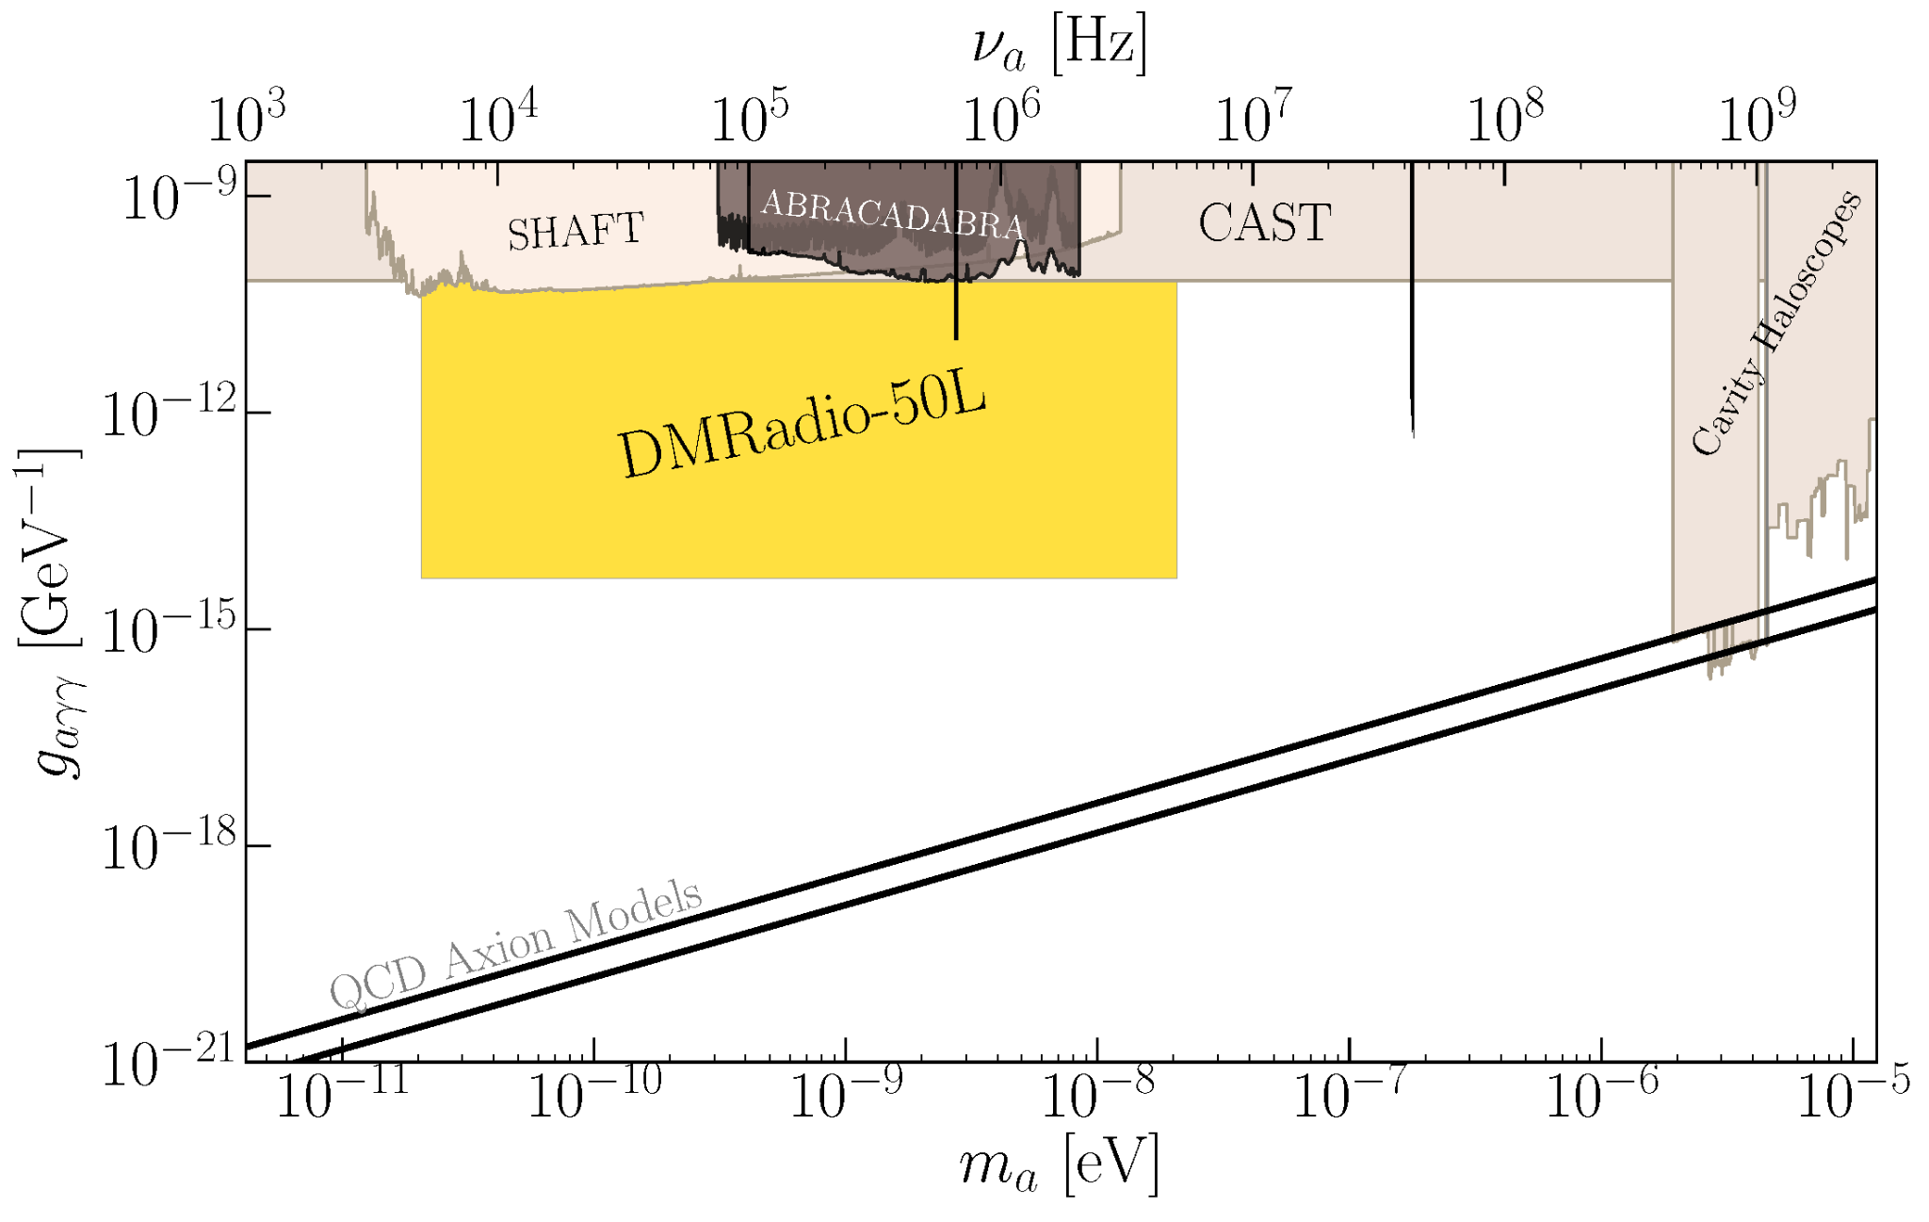
DMRadio-50L projected exclusion
A. Droster
Notes:
8 mins
Summary of dmradio50L design, and our projected sensitivity looks like this. 5 kHz-5 MHz

Slide 15
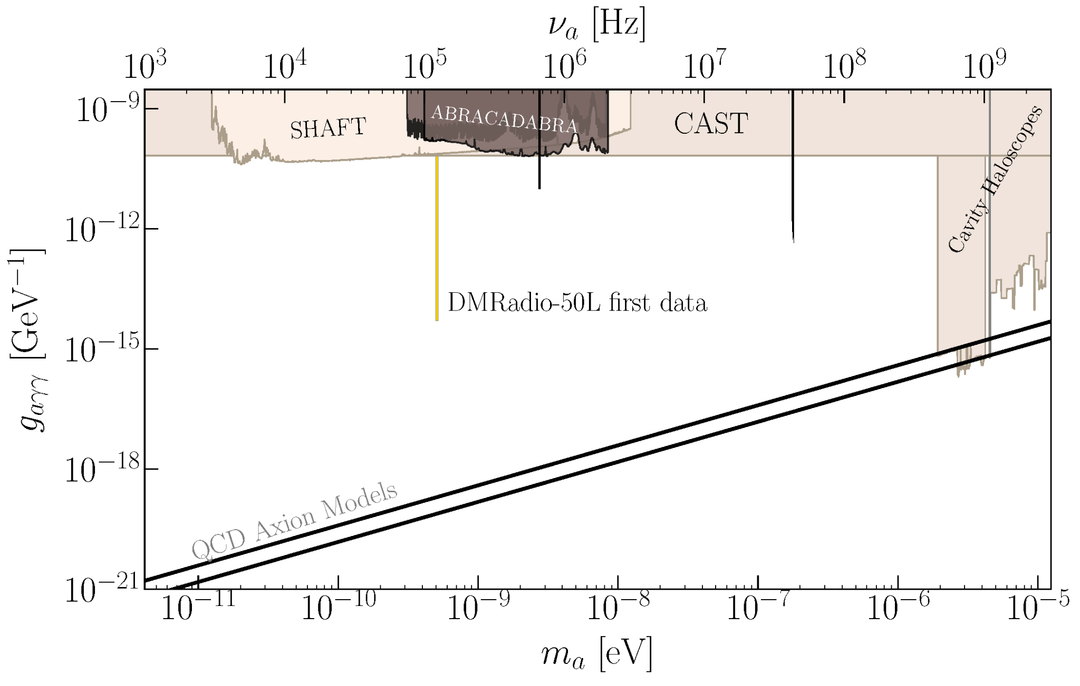
DMRadio-50L first data projected exclusion
“Needle” in parameter space
Expected early 2025!
A. Droster
Notes:
Non-tuneable capacitor
thesis

Slide 16
Scan rate
axion and dark matter physics
Experimental parameters
S. Chaudhuri et al., (2018), arXiv:1803.01627 [hep-ph].
A. Droster
Notes:
Overview of detector design and projected sensitivity, but how can we do better?

Slide 17
Scan rate
Magnetic field
Quality factor
volume
Amplifier noise
axion and dark matter physics
Experimental parameters
S. Chaudhuri et al., (2018), arXiv:1803.01627 [hep-ph].
A. Droster

Slide 18
Scan rate
Magnetic field
Quality factor
volume
Amplifier noise
axion and dark matter physics
Experimental parameters
Motivates new experiments with improved designs!
S. Chaudhuri et al., (2018), arXiv:1803.01627 [hep-ph].
A. Droster

Slide 19
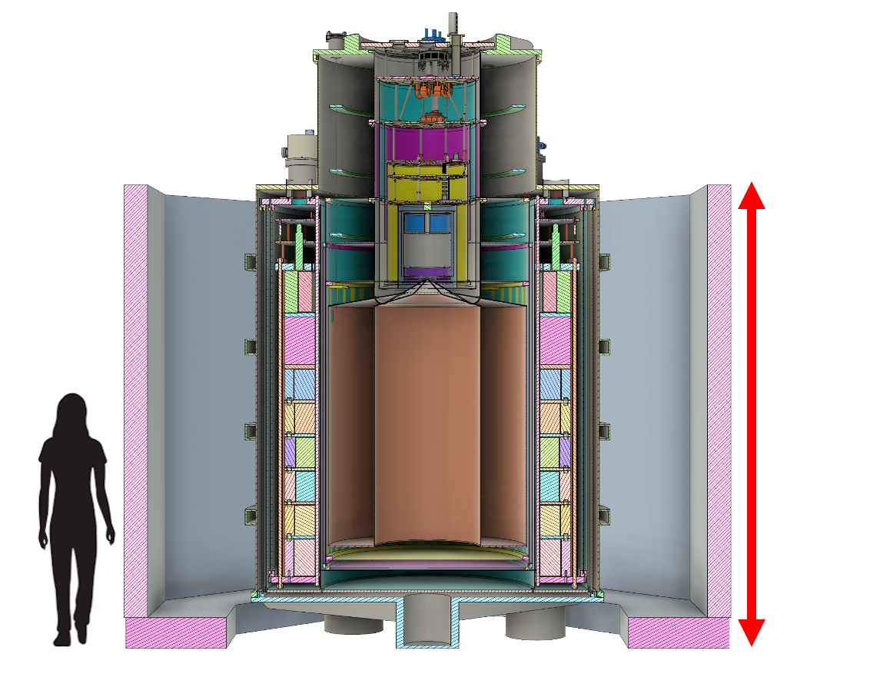
DMRadio-m³
DOE Dark Matter New Initiatives Program
Q: Expected quality factor of Q=10⁶ with copper “coax” - state of the art!
V: Improved volume 1 m³
B: Improved magnetic field: B_{RMS} = 5 T
𝜂: SQUID readout, 100X SQL (50L) → ~20X SQL
Probes QCD axion coupling 5-200 MHz
First science in 2028
3 m
Phys. Rev. D, 106 (2022)
High frequency modeling, arXiv: 2302.1408
Falferi 1998; Ulmer 2016
A. Droster
Notes:
Chief among these improved designs is DMRadio-m3…
DOE DMNI project

Slide 20
DMRadio-GUT
Ambitious long-term goal for GUT-scale QCD axion search
Requires beyond SQL quantum sensing in 1 kHz-100 MHz range
Q: 10⁶ → 20⨉10⁶
Resonator work ongoing
Active components
V: 1 m³ → 10 m³
B: 5 T → 16 T using REBCO tapes
𝜂: -20 dB backaction noise reduction via RF quantum upconverters (RQUs), currently in development
Probes QCD axion coupling over wide frequency range (~100s peV - 100 neV)
A. Droster
L. Brouwer et al., “Introducing DMRadio-GUT, a search for GUT-scale QCD axions,” PRD 106, 112003 (2022) (Arxiv:2203.11246)

Slide 21
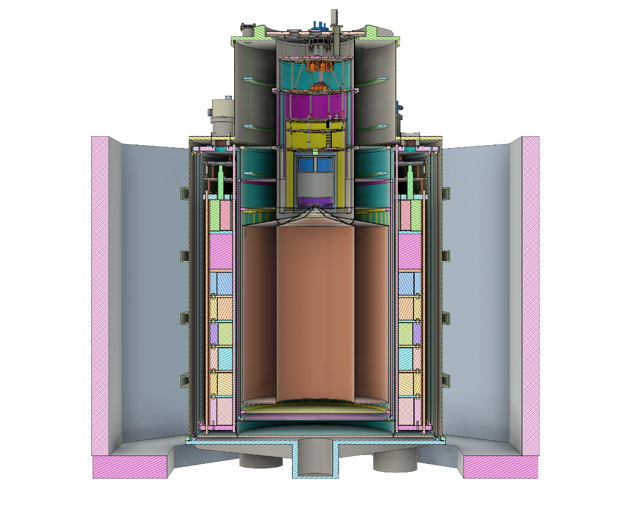
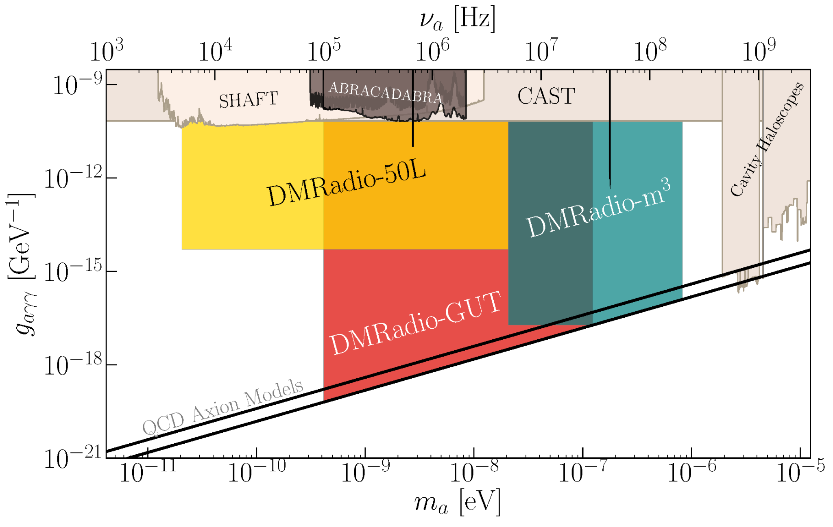
DMRadio projected exclusion
Next-gen experiment 😀
A. Droster
Notes:
12 mins

Slide 22
What’s happening now on DMRadio?
A. Droster

Slide 23
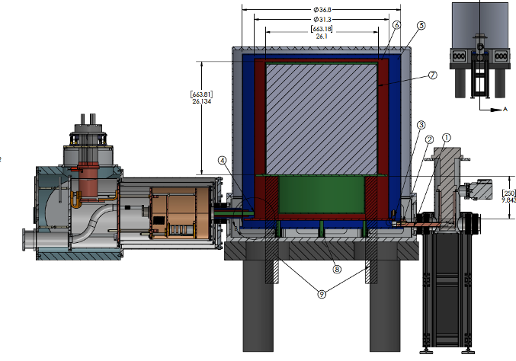
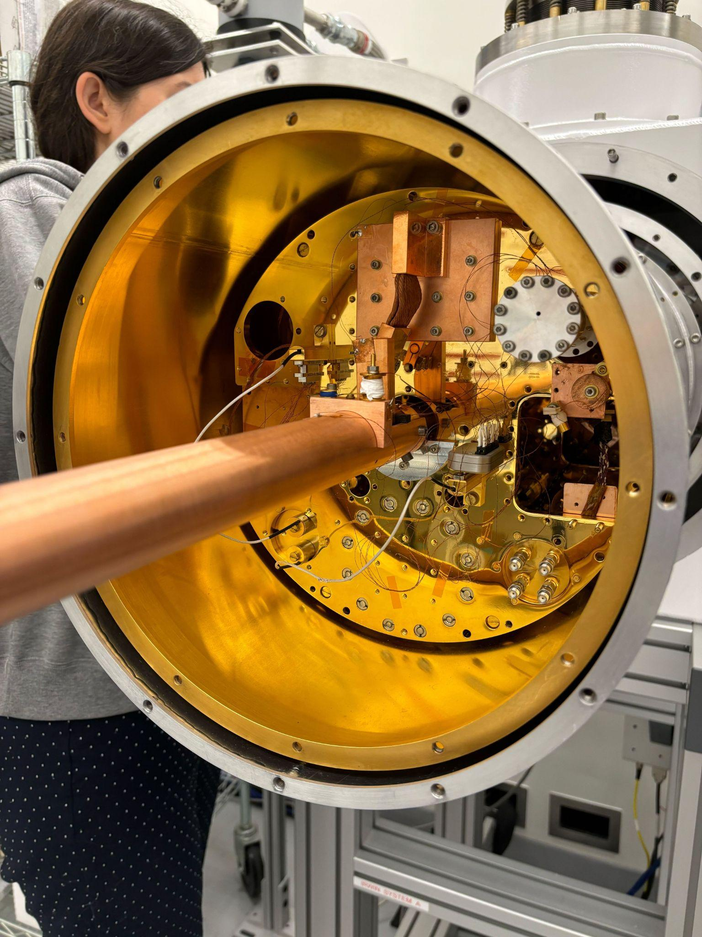
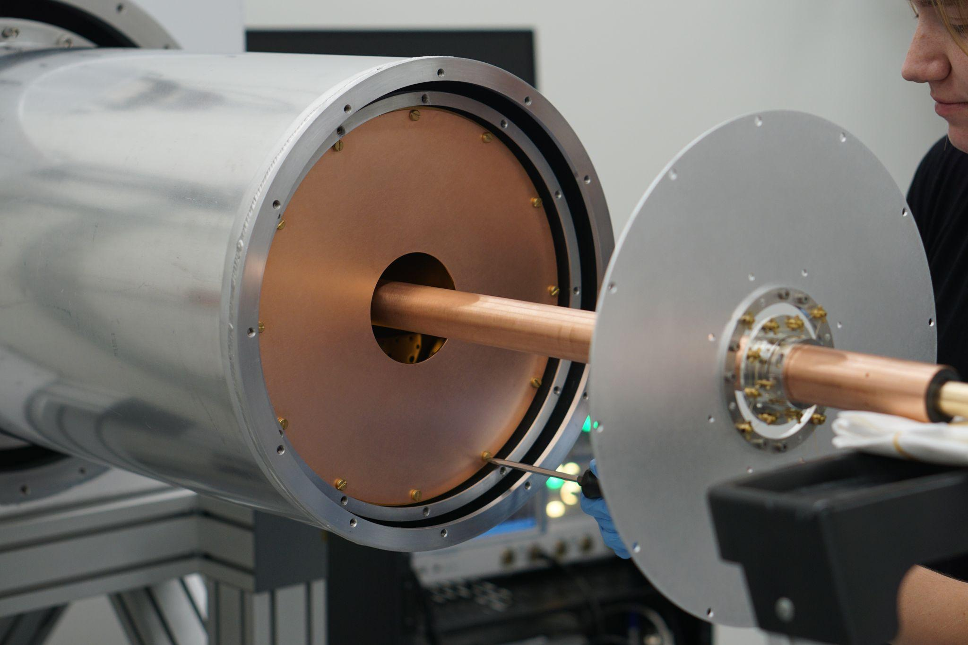
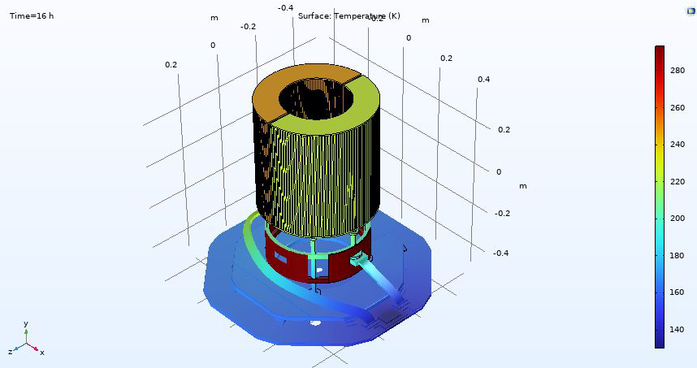
Cryogenics
Dual cryogenic system (Four Nines Design, Maria Simanovskaia)
Cold snout testing (Aya Keller, Maria Simanovskaia, Nicholas Rapidis, Elizabeth Berzin)
Thermalization modeling (Alex Droster, Jessica Fry)
A. Droster
Notes:
Start with dual cryogenic system

Slide 24
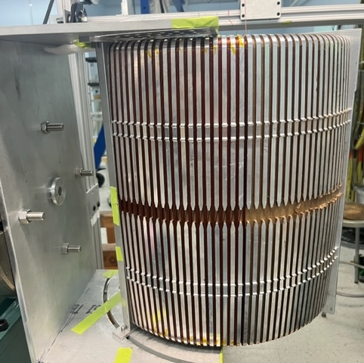
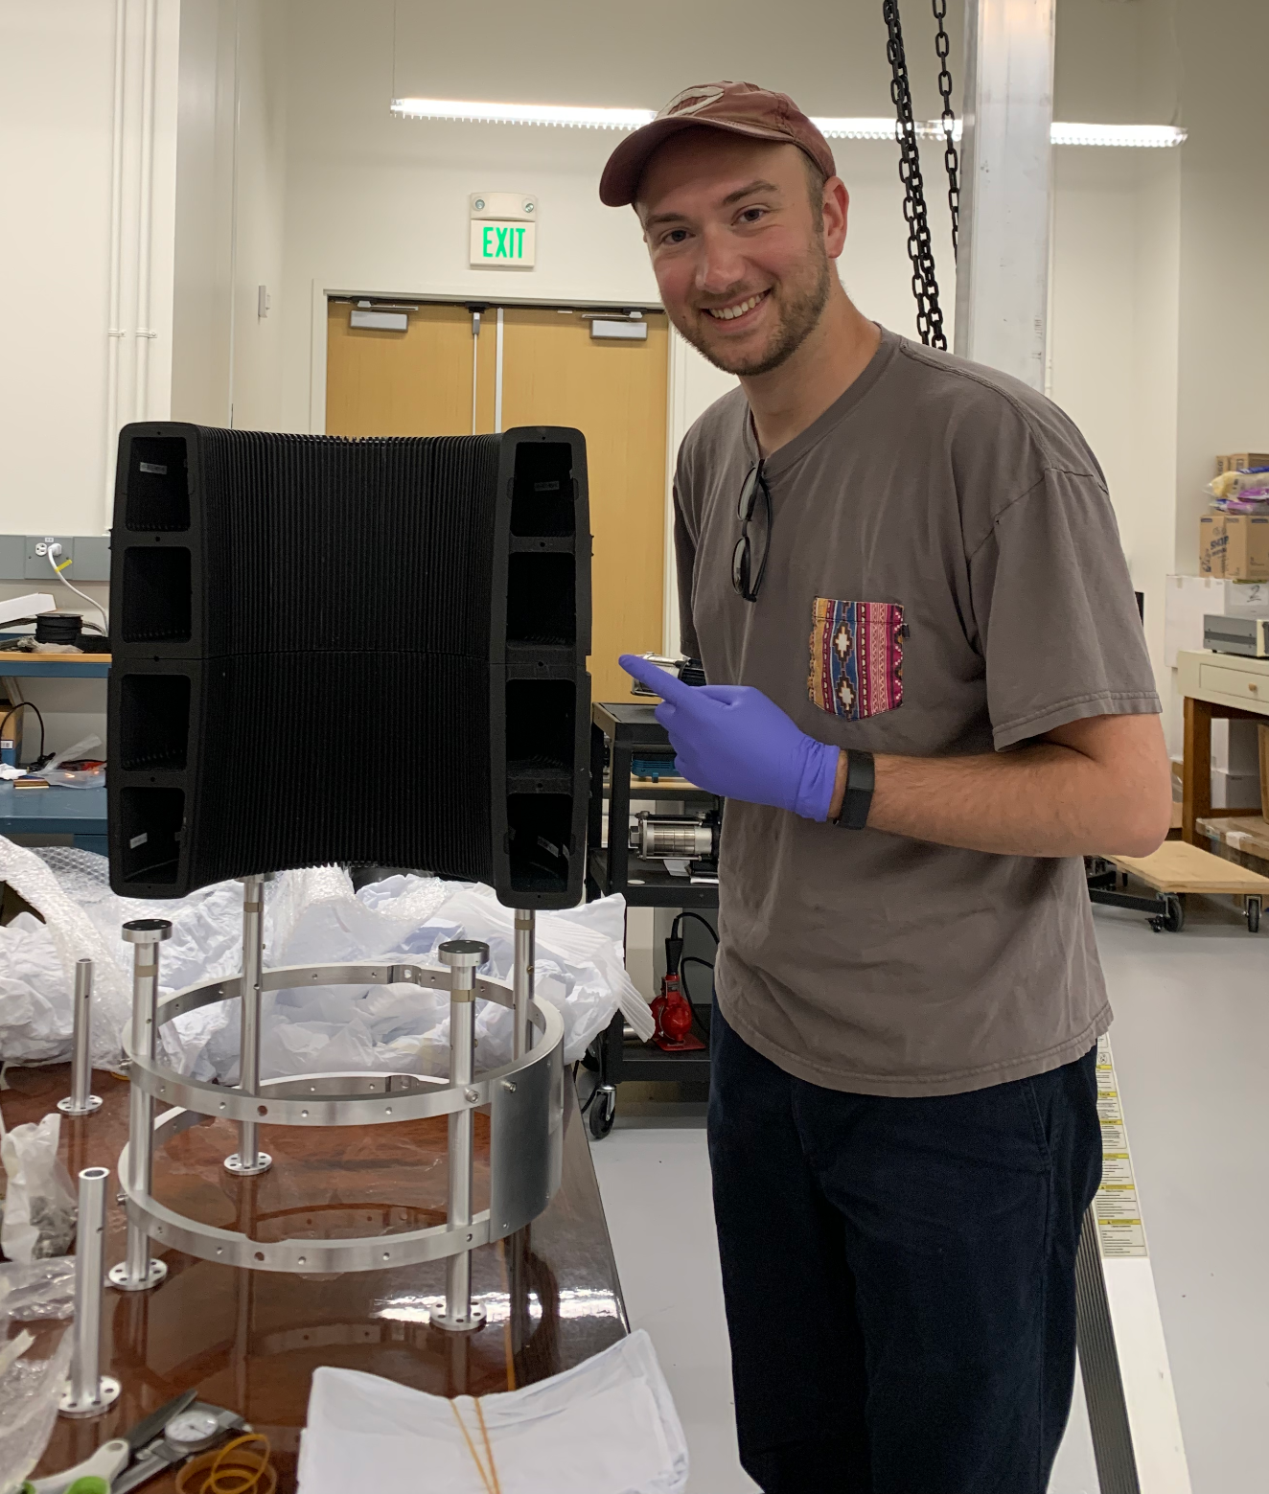
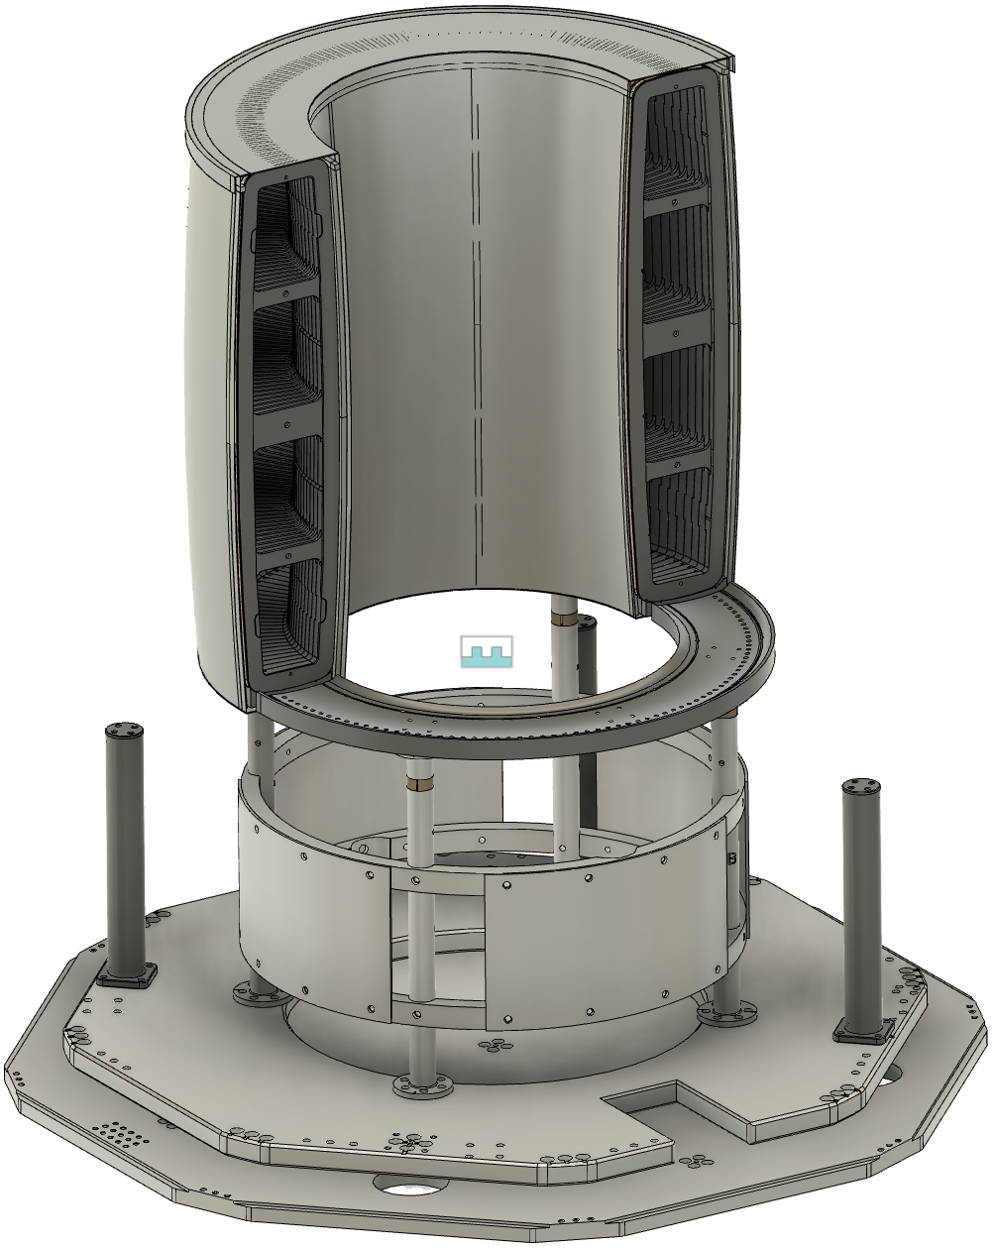
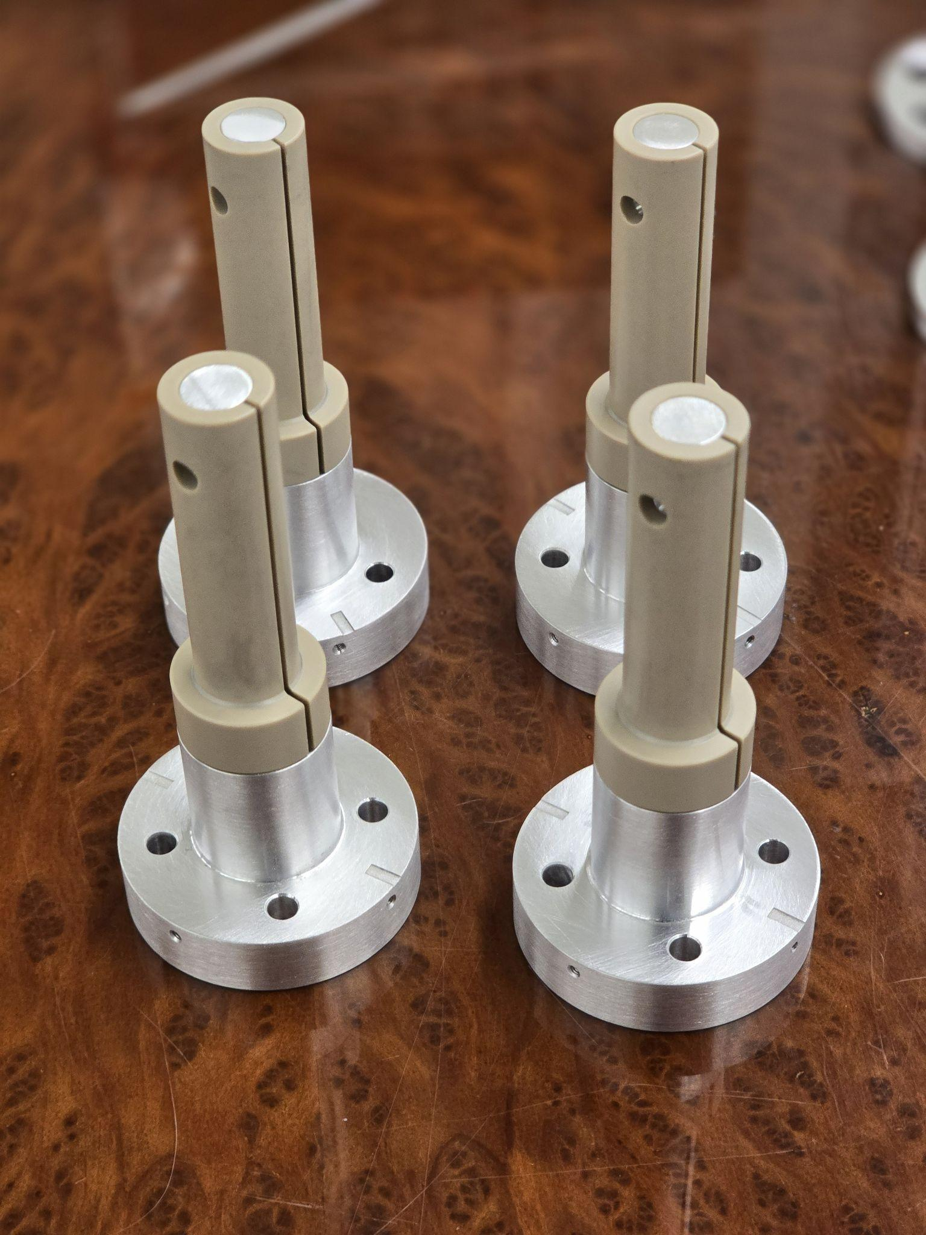
Magnet
Structural support construction at Stanford (Alex Droster, Johny Echevers)
Magnet winding & testing at Superconducting Systems, Inc (SSI)
A. Droster

Slide 25
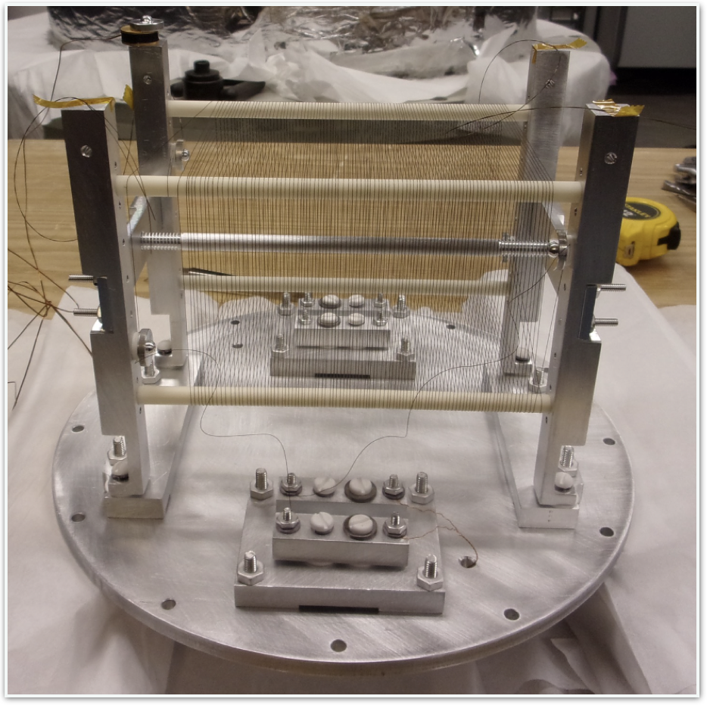
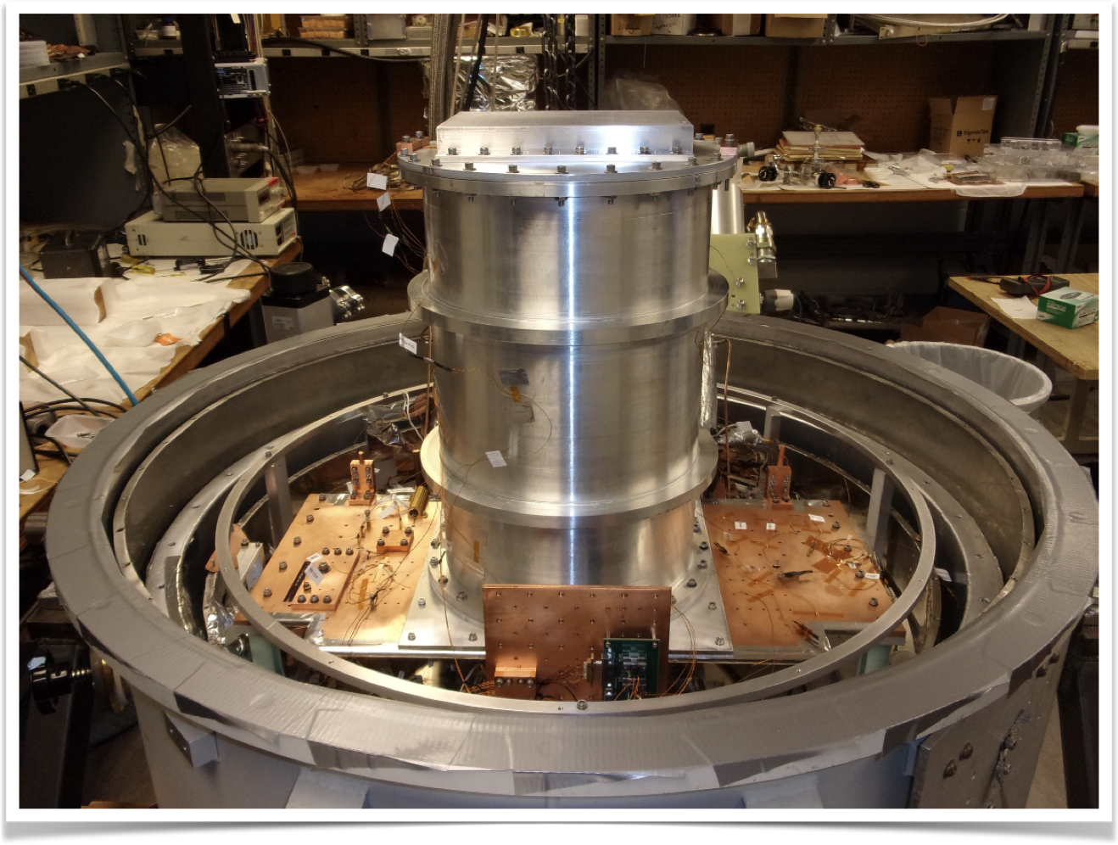
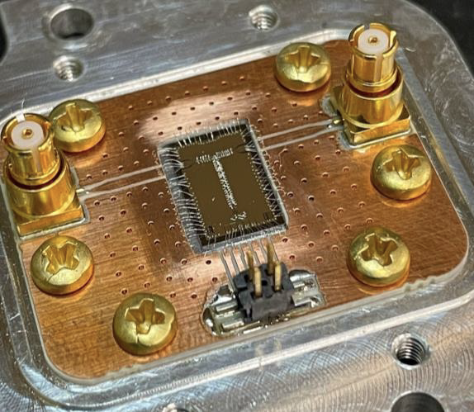
Resonator
RF quantum upconverters (RQUs) (Andrew Yi, Chelsea Bartram)
Prototype inductor & Q testing (Roman Kolevatov & Saptarshi Chaudhuri
Dip probe for SQUID testing (Joe Singh, Chiara Salemi)
A. Droster

Slide 26
DMRadio-m³ sensitivity simulations in COMSOL
Projected scan rate
Multiple “coaxes” required due to TEM modes
Projected sensitivity
(Nicholas Rapidis, Joshua Foster, Alex Droster)
A. Droster
A. AlShirawi, et a. “Electromagnetic Modeling and Science Reach of DMRadio-m³,” https://arxiv.org/pdf/2302.14084

Slide 27
DMRadio collaboration
C. Bartram, H.M. Cho, W. Craddock, D. Li, W. J. Wisniewski, A. K. Yi
SLAC National Accelerator Laboratory
J. W. Foster, J. T. Fry, J. L. Ouellet, K. M. W. Pappas, S. Ghosh, L. Winslow
Laboratory of Nuclear Science
Massachusetts Institute of Technology
A. AlShirawi, J. Corbin, P. W. Graham, K. D. Irwin,, S. Kuenstner, A. Kunder, N. M. Rapidis, C. P. Salemi, M. Simanovskaia, J. Singh, E. C. van Assendelft, K. Wells
Department of Physics
Stanford University
R. Henning
Department of Physics
University of North Carolina Chapel Hill
Triangle Universities Nuclear Laboratory
Alex Droster, A. Keller, A. F. Leder, J. Echevers, K. van Bibber
Department of Nuclear Engineering
University of California Berkeley
Y. Kahn
Department of Physics
University of Illinois at Urbana-Champaign
S. Chaudhuri, R. Kolevatov
Department of Physics
Princeton University
A. Phipps
California State University, East Bay
L. Brouwer
Accelerator Technology and Applied Physics Division Lawrence Berkeley National Lab
B. R. Safdi
Department of Physics
University of California Berkeley
B. A. Young
Department of Physics
Santa Clara University
A. Droster

Slide 28
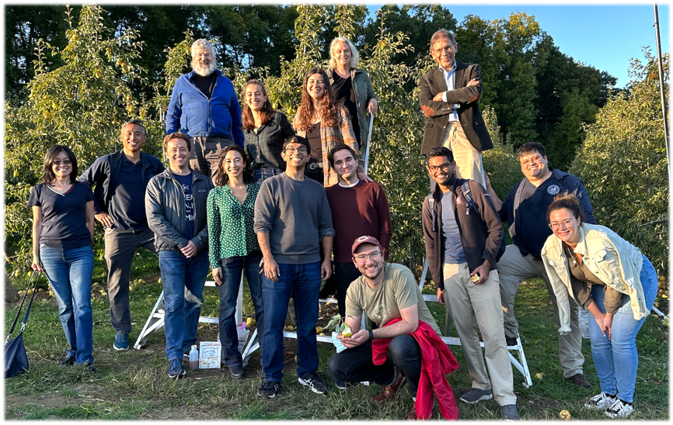
Outlook + conclusions
Grazie mille!
Lumped-element detection enables searching for the pre-inflationary axion
The DMRadio suite of experiments will search for axion dark matter from 5 kHz-200 MHz (m_{a}=0.02-800 neV)
DMRadio-50L is under construction– we hope for “first dark” in early 2025 🤯🤞
DMRadio-m³ is in the design and development stages
DMRadio-m³ and DMRadio-GUT will be sensitive to the QCD axion
A. Droster
Notes:
16 mins

Slide 29
Extras
A. Droster

Slide 30
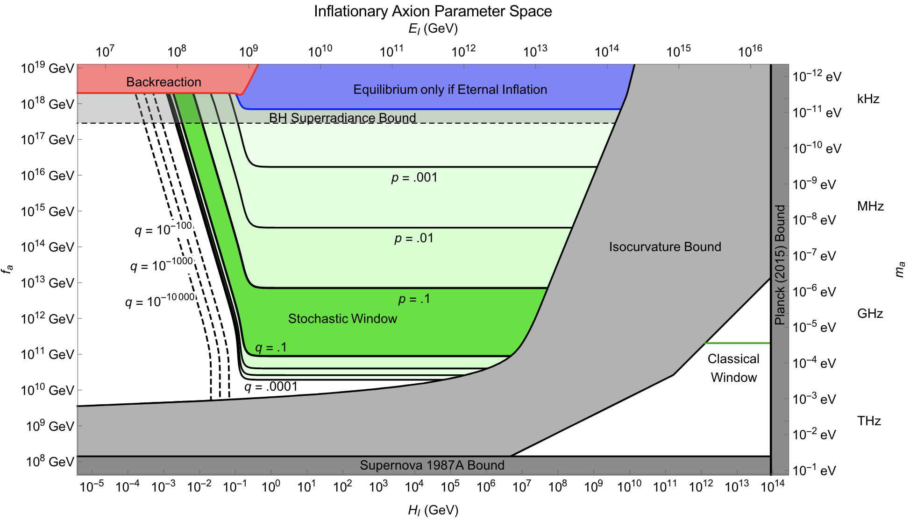
Pre-inflationary axion
A. Droster
P. Graham & A. Scherlis, “The Stochastic Axion Scenario” Phys. Rev. D 98, 2018

Slide 31
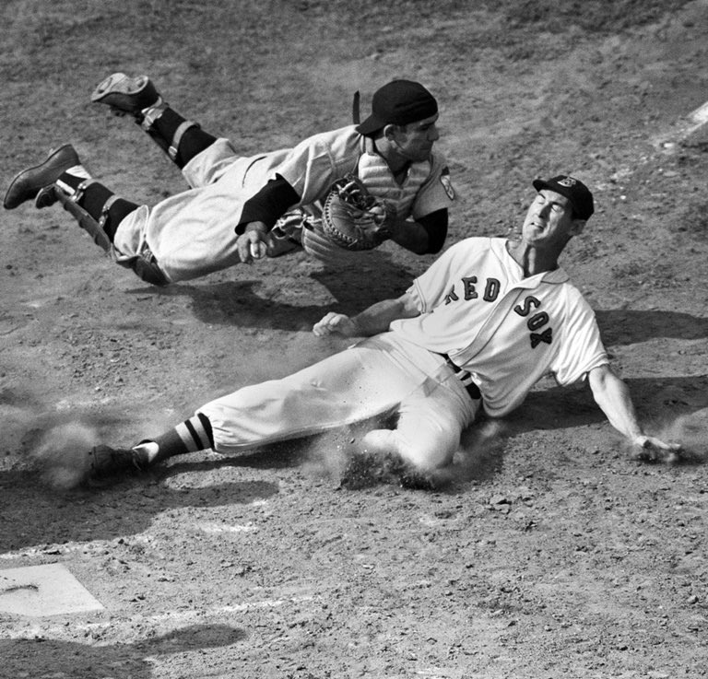
Design philosophy
“You can observe a lot by watching” - Yogi Berra (1925-2015)
A. Droster

Slide 32
Design philosophy
“You can observe a lot by watching” - Yogi Berra (1925-2015)
DMRadio: a lumped-element search for low-mass QCD axions
A. Droster

Slide 33
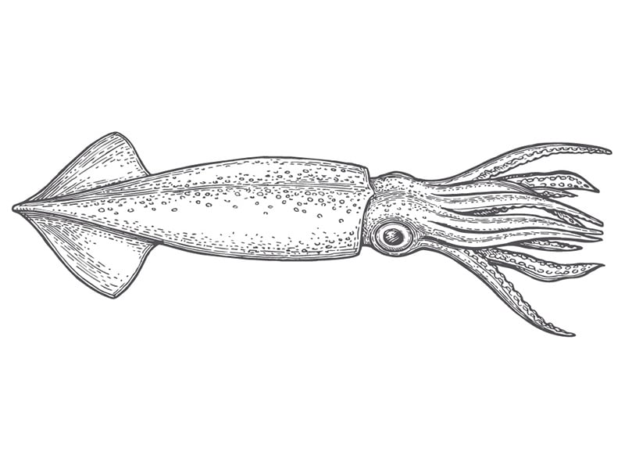
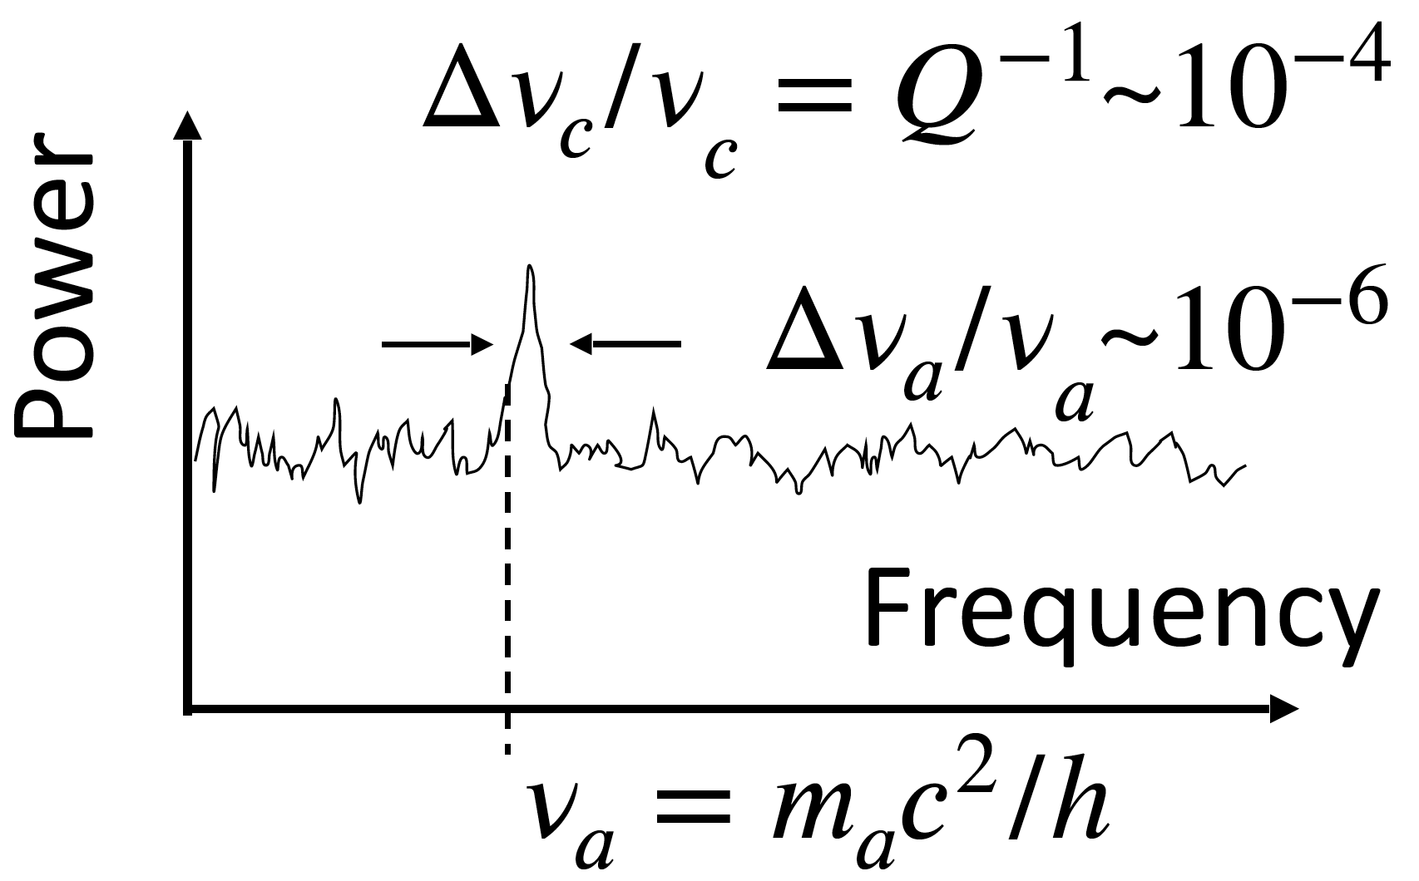
Axion signal
Tune detector and stack multiple spectra
DAQ
A. Droster

Slide 34
Scan rate in a different form
Resonator quality factor
Axion induced voltage
Noise parameter
Resonator inductance
A. Droster

Slide 35
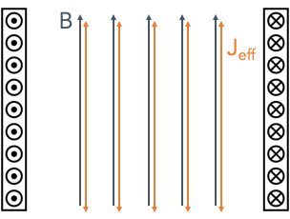
Detection principle for DMRadio-m³
Applied magnetic field B₀ induces effective axion current, J_{eff}
A. Droster

Slide 36
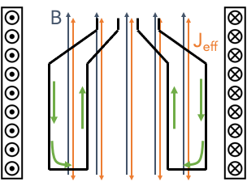
Detection principle for DMRadio-m³
Applied magnetic field B₀ induces effective axion current, J_{eff}
Axion current J_{eff} induces an RF magnetic field (not shown), which in turn induces screening currents on the surface of a coaxial copper sheath
Screening currents
sheath
A. Droster

Slide 37
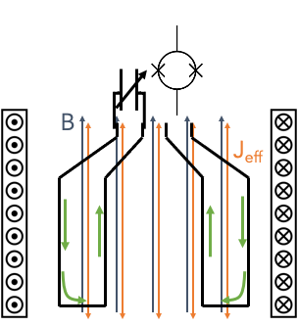
Detection principle for DMRadio-m³
Applied magnetic field B₀ induces effective axion current, J_{eff}
Axion current J_{eff} induces an RF magnetic field (not shown), which in turn induces screening currents on the surface of a coaxial copper sheath
The screening currents may be sensed by a DC SQUID coupled to a tunable LC circuit
Screening currents
sheath
A. Droster

Slide 38
Detection principle for DMRadio-m³
Applied magnetic field B₀ induces effective axion current, J_{eff}
Axion current J_{eff} induces an RF magnetic field (not shown), which in turn induces screening currents on the surface of a coaxial copper sheath
The screening currents may be sensed by a DC SQUID coupled to a tunable LC circuit
Screening currents
sheath
A. Droster

Slide 39
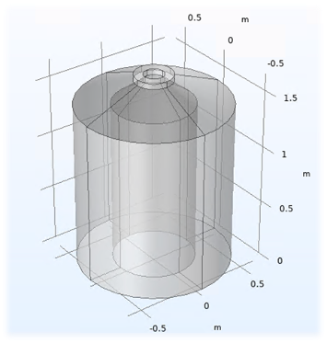
Detection principle for DMRadio-m³
Applied magnetic field B₀ induces effective axion current, J_{eff}
Axion current J_{eff} induces an RF magnetic field (not shown), which in turn induces screening currents on the surface of a coaxial copper sheath
The screening currents may be sensed by a DC SQUID coupled to a tunable LC circuit
Screening currents
Solenoidal geometry is preferred at higher frequencies (>50 MHz)
B₀
sheath
A. Droster

Slide 40
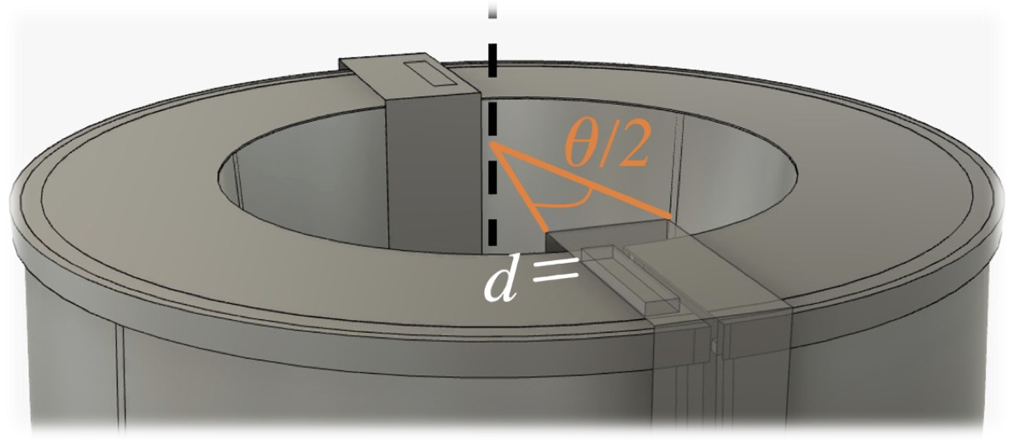
DMRadio-m³ design
A. Droster
Notes:
DMRadio-m³ will be a very different geometry than 50L. At the low frequencies of 50L, a toroid is best.
Toroid can’t work for m3, let’s see why

Slide 41
DMRadio-m³ design
Intended current path (inside + outside surface)
A. Droster
Notes:
In 50L, currents go like this

Slide 42
DMRadio-m³ design
Parasitic capacitance, C_{p}, shorts out signal!
Parasitic capacitance also defines a resonance frequency:
Parasitic current
Intended current path (inside + outside surface)
A. Droster
Notes:
But if you have too much capacitance, then currents can jump the gap
This effect sets an upper bound on frequency you can probe w a toroid
With 50L dimensions, this frequency is 50 MHz
Scaling up dimensions to achieve 1 cubic meter requires physically unrealistic sheath covers to avoid this parasitic resonance

Slide 43
DMRadio-m³ design
Parasitic capacitance, C_{p}, shorts out signal!
Parasitic capacitance also defines a resonance frequency:
Parasitic current
Intended current path (inside + outside surface)
Scaling up to 1 m³ volume requires d/𝜃 ≥ 50 m to ensure f_{p}>200 MHz!
A toroidal design cannot be used for DMRadio-m³ due to problems at high frequency
A. Droster

Slide 44
DMRadio-m³ design
Parasitic capacitance, C_{p}, shorts out signal!
Parasitic capacitance also defines a resonance frequency:
Parasitic current
Intended current path (inside + outside surface)
Scaling up to 1 m³ volume requires d/𝜃 ≥ 50 m to ensure f_{p}>200 MHz!
A toroidal design cannot be used for DMRadio-m³ due to problems at high frequency
B₀
Therefore, DMRadio-m³ will use a 5 T solenoidal magnet and a coaxial copper pickup
A. Droster
Notes:
TRANS: let’s see detection principle for DMRadio-m3

Slide 45
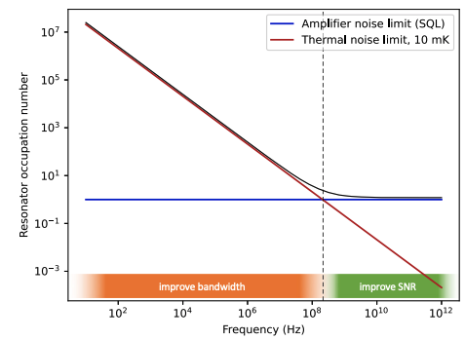
Noise in DMRadio
PHYS. REV. D 106, 112003 (2022)

Slide 46
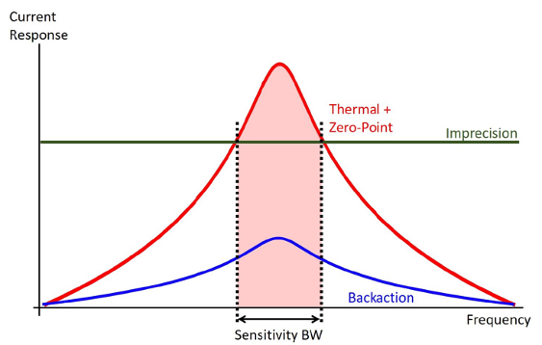
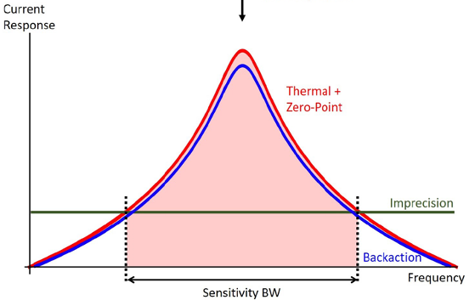
Proposed solution: DMRadio
Two design principles give DMRadio an advantage in searching for low mass axions:
Decouple detector geometry from resonant frequency by using a tunable LC circuit
Overcoupling enables an increase in scan rate
Thermal + quantum noise filtered by resonator lineshape
Decrease imprecision noise at the expense of increasing backaction noise
Measurement uncertainty
Measuring state affects the state
A. Droster
Notes:
Sensitivity bandwidth: the bandwidth over which an axion’s SNR is more or less constant
In SQUIDs, the imprecision noise consists of intrinsic voltage fluctuations on the amplifier output
and the backaction noise consists of circulating currents in the SQUID loop, which induce a voltage and thus resonantly enhanced currents in the input coil [89,90].

Slide 47
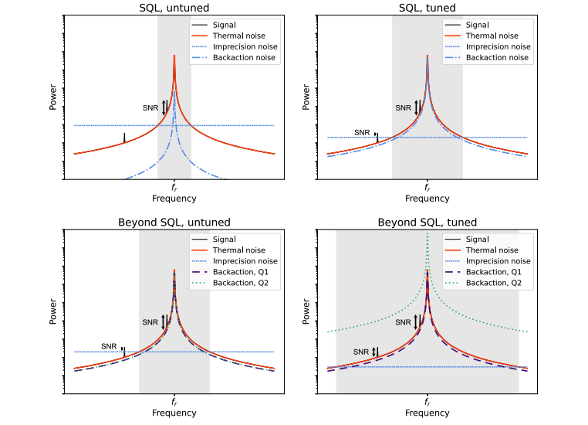
Noise in DMRadio
A. Droster

Slide 48
Slide courtesy of A. K. Yi

