Slide 1

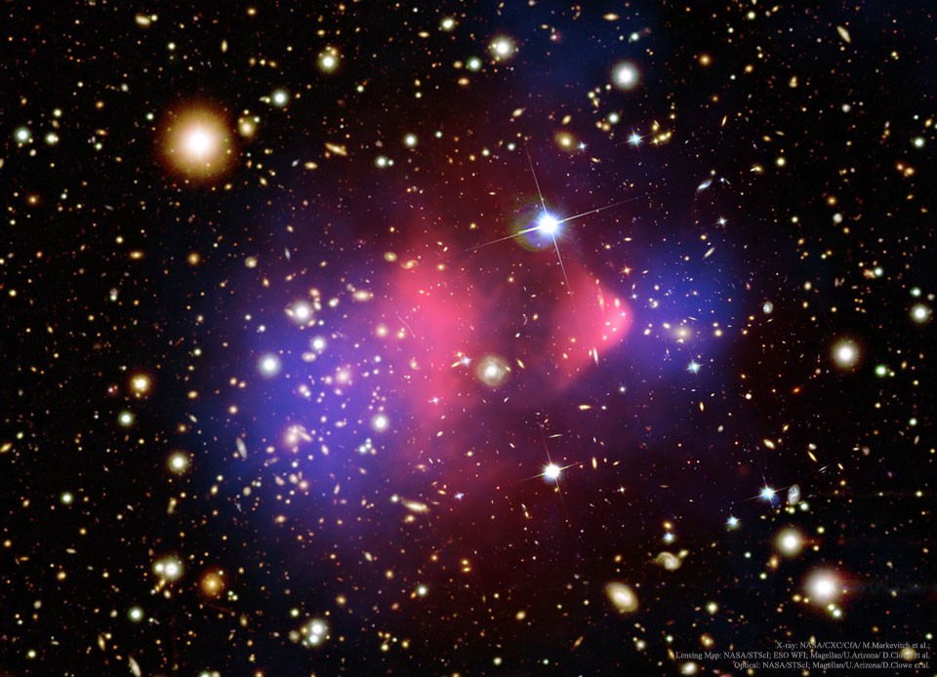

Spin-1 Thermal Targets for Dark Matter Searches at Beam Dump and Fixed Target Experiments
Riccardo Catena and Taylor R. Gray
JCAP11(2023)058
Chalmers University of Technology
IDM 2024

Slide 2








Sub-GeV Dark Matter
Thermal equilibrium between DM and SM in the early universe.
Thermal DM Window
$m_{χ}$ (GeV)
$${10}^{−30}$$
$${10}^{−20}$$
$${10}^{−10}$$
$${10}^{0}$$
$${10}^{10}$$
$${10}^{20}$$
sub-GeV
WIMPs
$$m_{χ}$$
KeV
MeV
GeV
TeV
Notes:
`

Slide 3
Sub-GeV Dark Matter
Thermal equilibrium between DM and SM in the early universe.
Thermal DM Window
$m_{χ}$ (GeV)
$${10}^{−30}$$
$${10}^{−20}$$
$${10}^{−10}$$
$${10}^{0}$$
$${10}^{10}$$
$${10}^{20}$$
sub-GeV
WIMPs
$$m_{χ}$$
KeV
MeV
GeV
TeV
DM produced through freeze-out near weak scale
GeV-TeV scale thermal DM already widely tested
Notes:
`

Slide 4
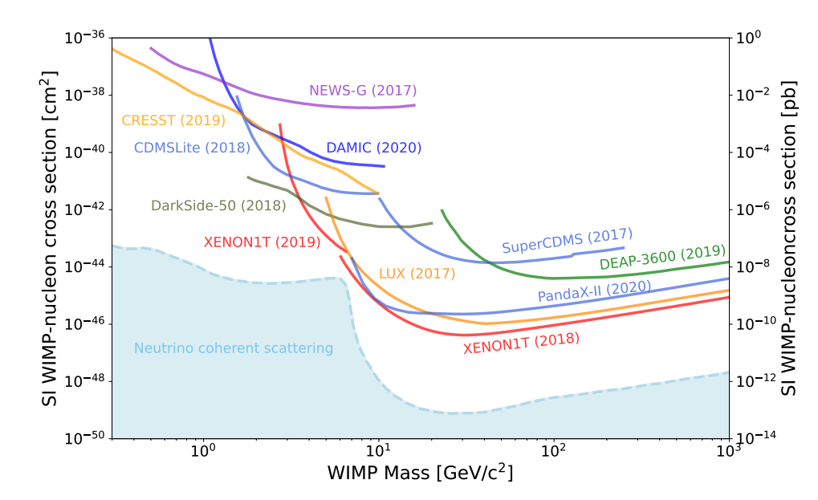
Nuclear Recoil Direct Detection
Status
Sensitive to GeV-TeV scale DM masses
Approaching neutrino “fog”
PDG
DM
nucleus

Slide 5
Sub-GeV Dark Matter
Thermal equilibrium between DM and SM in the early universe.
Thermal DM Window
$m_{χ}$ (GeV)
$${10}^{−30}$$
$${10}^{−20}$$
$${10}^{−10}$$
$${10}^{0}$$
$${10}^{10}$$
$${10}^{20}$$
sub-GeV
WIMPs
$$m_{χ}$$
KeV
MeV
GeV
TeV
Sub-GeV DM is largely experimentally unexplored..
  Out of reach of nuclear recoil direct detection exps
  Electron recoils and accelerator exps
DM produced through freeze-out near weak scale
GeV-TeV scale thermal DM already widely tested
Notes:
`

Slide 6
Sub-GeV Dark Matter
Thermal equilibrium between DM and SM in the early universe.
See Sowmiya’s poster on Sub-GeV DM Global Fits!!
Thermal DM Window
$m_{χ}$ (GeV)
$${10}^{−30}$$
$${10}^{−20}$$
$${10}^{−10}$$
$${10}^{0}$$
$${10}^{10}$$
$${10}^{20}$$
sub-GeV
WIMPs
$$m_{χ}$$
KeV
MeV
GeV
TeV
Sub-GeV DM is largely experimentally unexplored..
  Out of reach of nuclear recoil direct detection exps
  Electron recoils and accelerator exps
DM produced through freeze-out near weak scale
GeV-TeV scale thermal DM already widely tested
Notes:
`

Slide 7
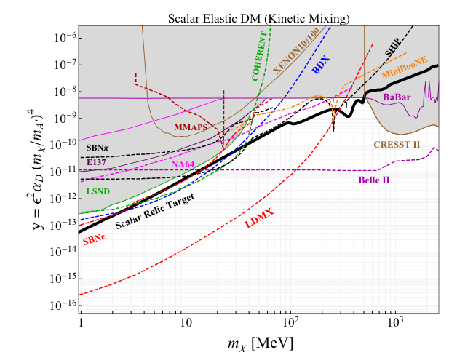
Accelerator Based DM Experiments
Complementarity with direct detection experiments!

Slide 8
Accelerator Based DM Experiments
Complementarity with direct detection experiments!
Types
  beam dump
  missing momentum/energy
  missing mass
  direct dark photon search
    (visible dark photon decay)

Slide 9
Accelerator Based DM Experiments
Complementarity with direct detection experiments!
Types
  beam dump
  missing momentum/energy
  missing mass
  direct dark photon search
    (visible dark photon decay)

Slide 10
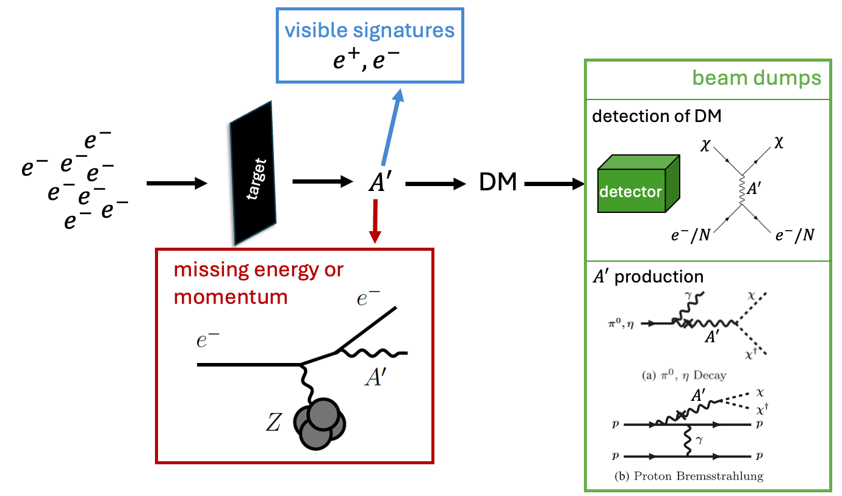
Fixed Target Experiments

Slide 11
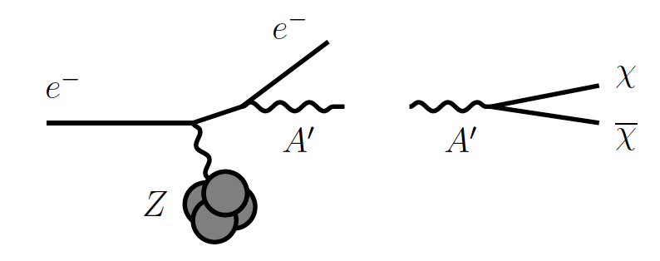
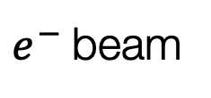



Limits/Projections
Fixed Target
Electron Dark-Bremsstrahlung
+ (In)Visible Decay
$e^{−}$ beam
$$A′$$
$$χχ$$

Slide 12
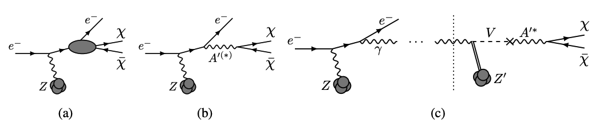

Limits/Projections
Fixed Target
Electron Dark-Bremsstrahlung
+ (In)Visible Decay
$e^{−}$ beam
$$A′$$
$$χχ$$
LDMX [Light Dark Matter eXperiment] (arXiv:1808.05219)
  Future Experiment
  Missing Energy/Momentum experiment
  pT and E distributions of recoil $e^{−}$
See Einar’s talk Thursday at 14:00!!

Slide 13
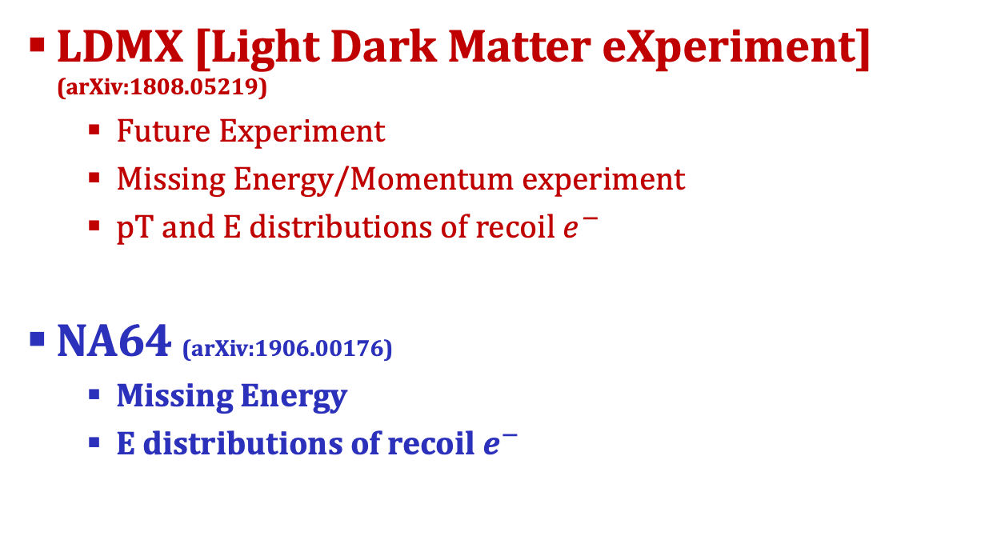
Limits/Projections
Fixed Target
Electron Dark-Bremsstrahlung
+ (In)Visible Decay
$e^{−}$ beam
$$A′$$
$$χχ$$
LDMX [Light Dark Matter eXperiment] (arXiv:1808.05219)
  Future Experiment
  Missing Energy/Momentum experiment
  pT and E distributions of recoil $e^{−}$
NA64 (arXiv:1906.00176)
  Missing Energy
  E distributions of recoil $e^{−}$

Slide 14
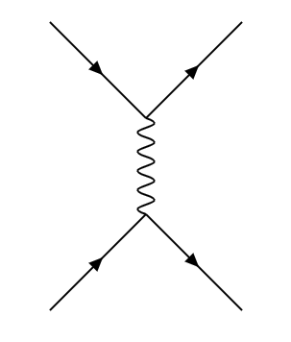


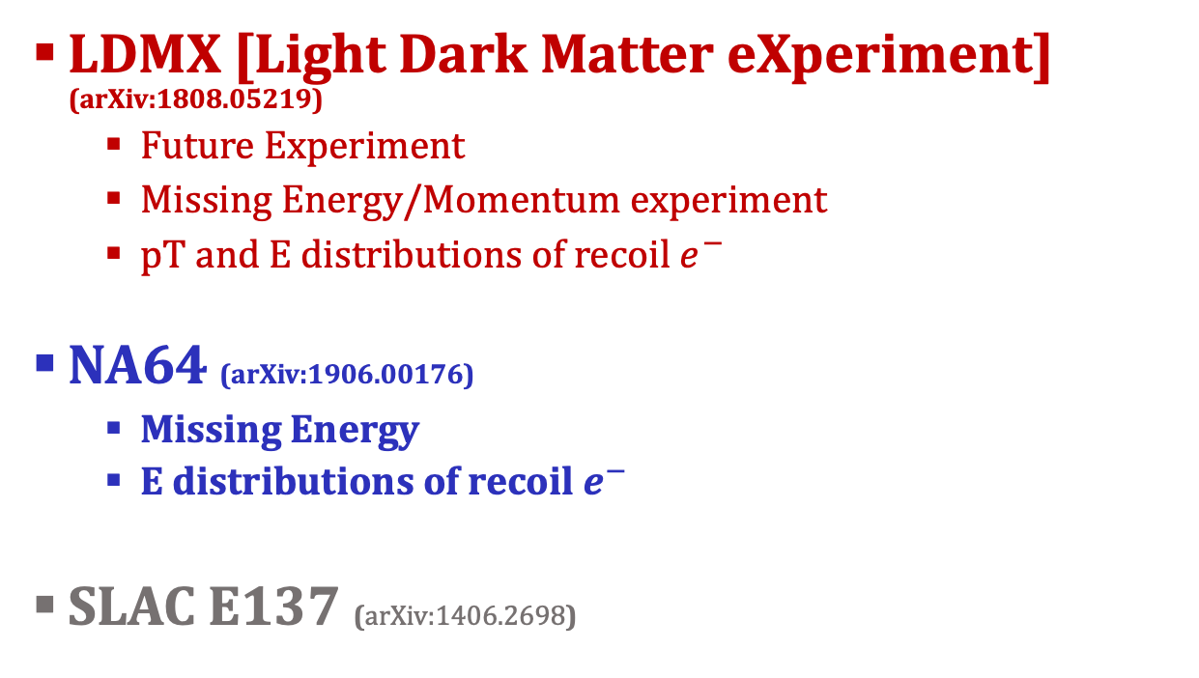



Limits/Projections
Fixed Target
Electron Dark-Bremsstrahlung
+ (In)Visible Decay
Detector
$e^{−}$ beam
$$A′$$
$$χχ$$
$$χ$$
$$χ$$
LDMX [Light Dark Matter eXperiment] (arXiv:1808.05219)
  Future Experiment
  Missing Energy/Momentum experiment
  pT and E distributions of recoil $e^{−}$
NA64 (arXiv:1906.00176)
  Missing Energy
  E distributions of recoil $e^{−}$
SLAC E137 (arXiv:1406.2698)
$$A^{′}$$
$$e^{−}$$
$$e^{−}$$

Slide 15
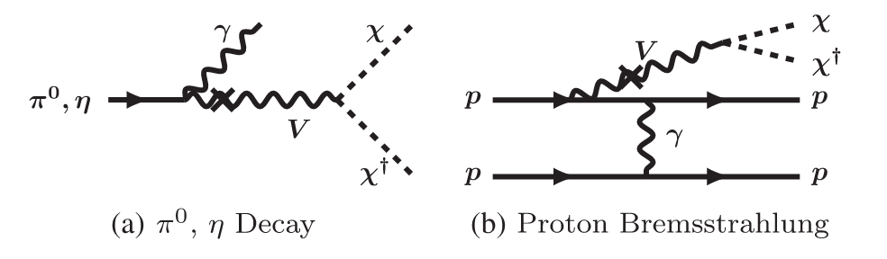


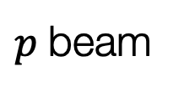
Limits/Projections
Fixed Target
Proton Beam Dumps with Downstream DM Detector
BdNMC software
Detector
$p$ beam
$$A′$$
$$χχ$$
$$χ$$
$$χ$$
$$A^{′}$$
LSND (arXiv:1107.4580)
  DM-electron scattering
MiniBooNE (arXiv:1702.02688)
  DM-electron/nucleon scattering
$${N/e}^{−}$$
$${N/e}^{−}$$

Slide 16
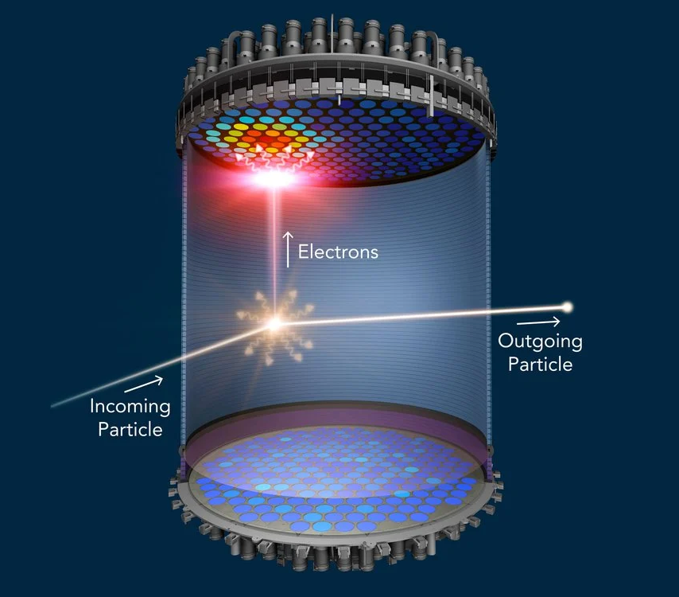






Limits/Projections
Direct Detection (arXiv:2210.07305)
Monophoton Searches
$$e^{+}e^{−}→γA^{′}, A^{′}→XX$$
$$χ$$
$$χ$$
$$A^{′}$$
Edelweiss
Sensei
Xenon1T
Xenon10
BaBar (arXiv:1702.03327)
Belle II
  Future experiment
$$e^{−}$$
$$e^{−}$$

Slide 17
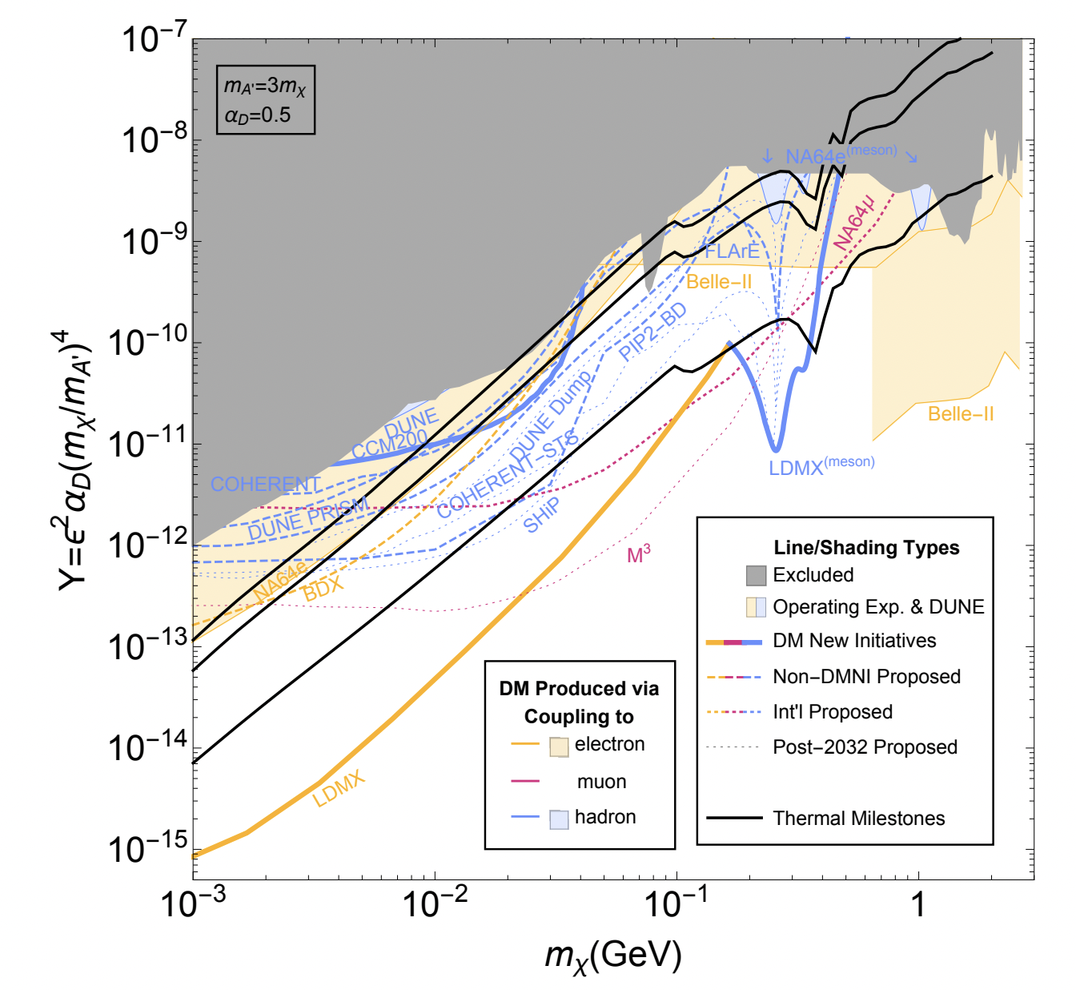

Slide 18
Spin-0

Slide 19
Spin-0
Spin-1/2

Slide 20
Spin-1??
Spin-0
Spin-1/2

Slide 21
The Goal of arXiv:2307.02207
Broaden the existing studies on sub-GeV DM at fixed target experiments
We consider,
  a set of simplified spin-1 DM candidates which have a dark photon mediator

Slide 22
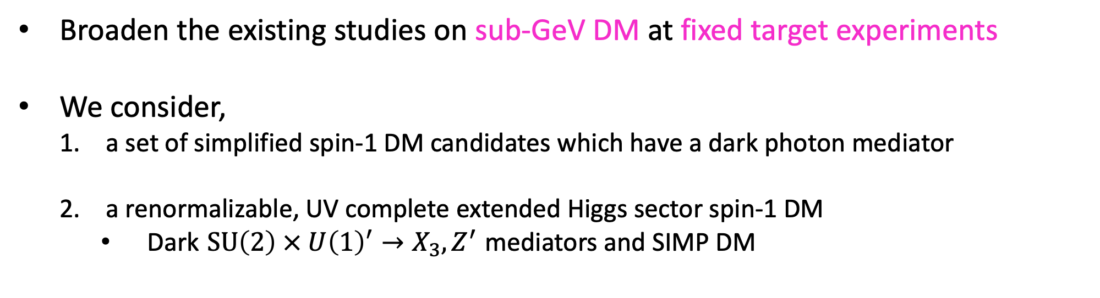
The Goal of arXiv:2307.02207
Broaden the existing studies on sub-GeV DM at fixed target experiments
We consider,
  a set of simplified spin-1 DM candidates which have a dark photon mediator
  a renormalizable, UV complete extended Higgs sector spin-1 DM
    Dark $SU\left(2\right) × U{\left(1\right)}^{′}→X_{3}, Z^{′}$ mediators and SIMP DM

Slide 23

The Goal of arXiv:2307.02207
Broaden the existing studies on sub-GeV DM at fixed target experiments
We consider,
  a set of simplified spin-1 DM candidates which have a dark photon mediator
  a renormalizable, UV complete extended Higgs sector spin-1 DM
    Dark $SU\left(2\right) × U{\left(1\right)}^{′}→X_{3}, Z^{′}$ mediators and SIMP DM
    Dark $SU\left(2\right)→Z′$ mediator
      where $m_{Z′}<2m_{X}$, leading to off-shell DP production and visible signatures
ongoing work at Chalmers!

Slide 24
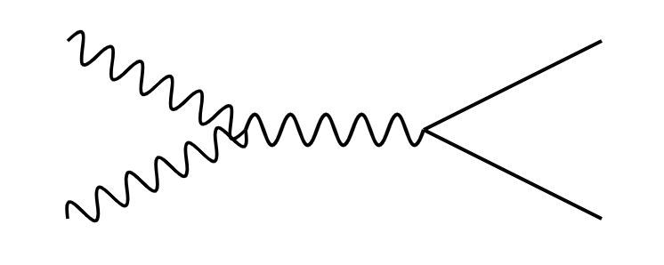



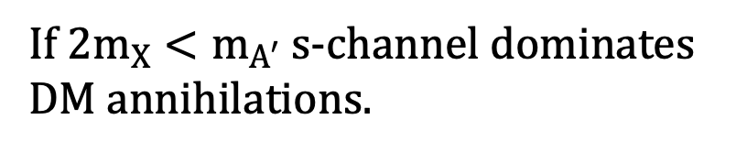





Simplified Spin-1 Dark Matter Models with a Dark Photon Mediator
DM Freeze-Out
$b_{5}$: real
$b_{6}$: complex
$b_{7}$: complex
$h_{3}$: real
$$X$$
$$f$$
$$A′$$
$$h_{3}≡εe$$
$$\overline{f}$$
$$X^{†}$$
$f$: SM leptons and quarks
If ${2m}_{X}<m_{A′}$ s-channel dominates DM annihilations.

Slide 25
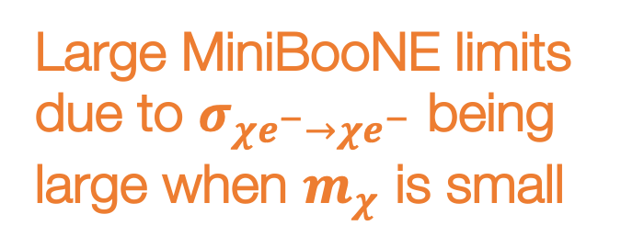
Strong Limits on Spin-1 Relic Targets
Large MiniBooNE limits due to $σ_{χe^{−}→χe^{−}}$ being large when $m_{χ}$ is small
Ruled out by current experiments and CMB respectively..

Slide 26
Spin-1 DM is the first to be probed by LDMX!
Let's now consider a UV complete model where unitarity is not violated!

Slide 27
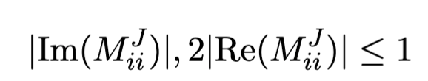
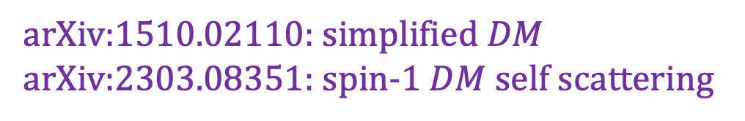
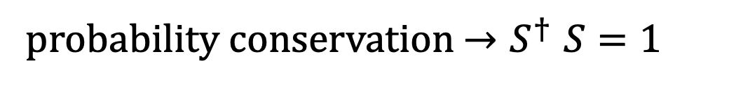
an aside on Unitarity Violation…
probability conservation ${→S}^{†}S=1$
  Must be careful for the simplified spin-1 DM models…
  But, the renormalizable and UV complete SIMP spin-1 DM model by construction does not violate unitarity!
If the matrix elements in the theory are too large at tree level, additional fields or higher order diagrams are needed to restore unitarity of the S matrix.
arXiv:1510.02110: simplified $DM$
arXiv:2303.08351: spin-1 $DM$ self scattering

Slide 28
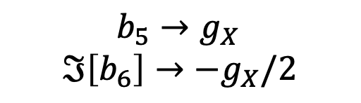

SIMP Spin-1 Dark Matter with $Z′$ and $X_{3}$ as mediators
$b_{5}→g_{X}$
$$ℑ\left[b_{6}\right]→−g_{X}/2$$
arXiv:1904.04109

Slide 29
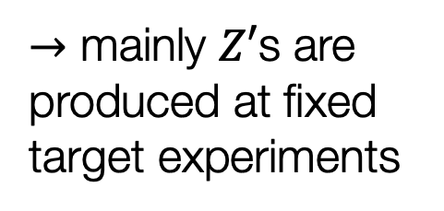
SIMP Spin-1 Dark Matter with $Z′$ and $X_{3}$ as mediators
$b_{5}→g_{X}$
$$ℑ\left[b_{6}\right]→−g_{X}/2$$
$→$ mainly $Z′$s are produced at fixed target experiments
arXiv:1904.04109

Slide 30





SIMP Spin-1 Dark Matter with $Z′$ and $X_{3}$ as mediators
$b_{5}→g_{X}$
$$ℑ\left[b_{6}\right]→−g_{X}/2$$
$$X_{+}X_{−}→f\overline{f}$$
processes setting the relic density
$$→$$
$$X_{+}X_{+}X_{−}→X_{+}{\tilde{X}}_{3}$$
$→$ mainly $Z′$s are produced at fixed target experiments
$X_{+}X_{−}→{\tilde{X}}_{3}$ ${\tilde{X}}_{3}$
Dominant since $g_{X}≫eϵ$
arXiv:1904.04109

Slide 31
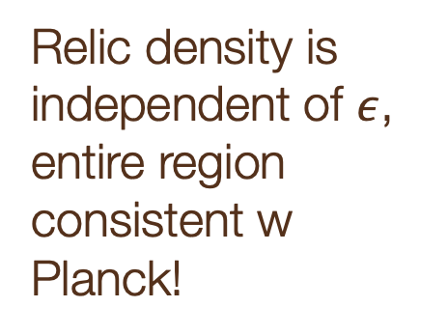
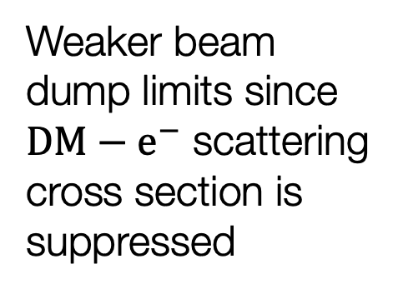
Weaker beam dump limits since $DM−e^{−}$ scattering cross section is suppressed
Relic density is independent of $ε$, entire region consistent w Planck!

Slide 32
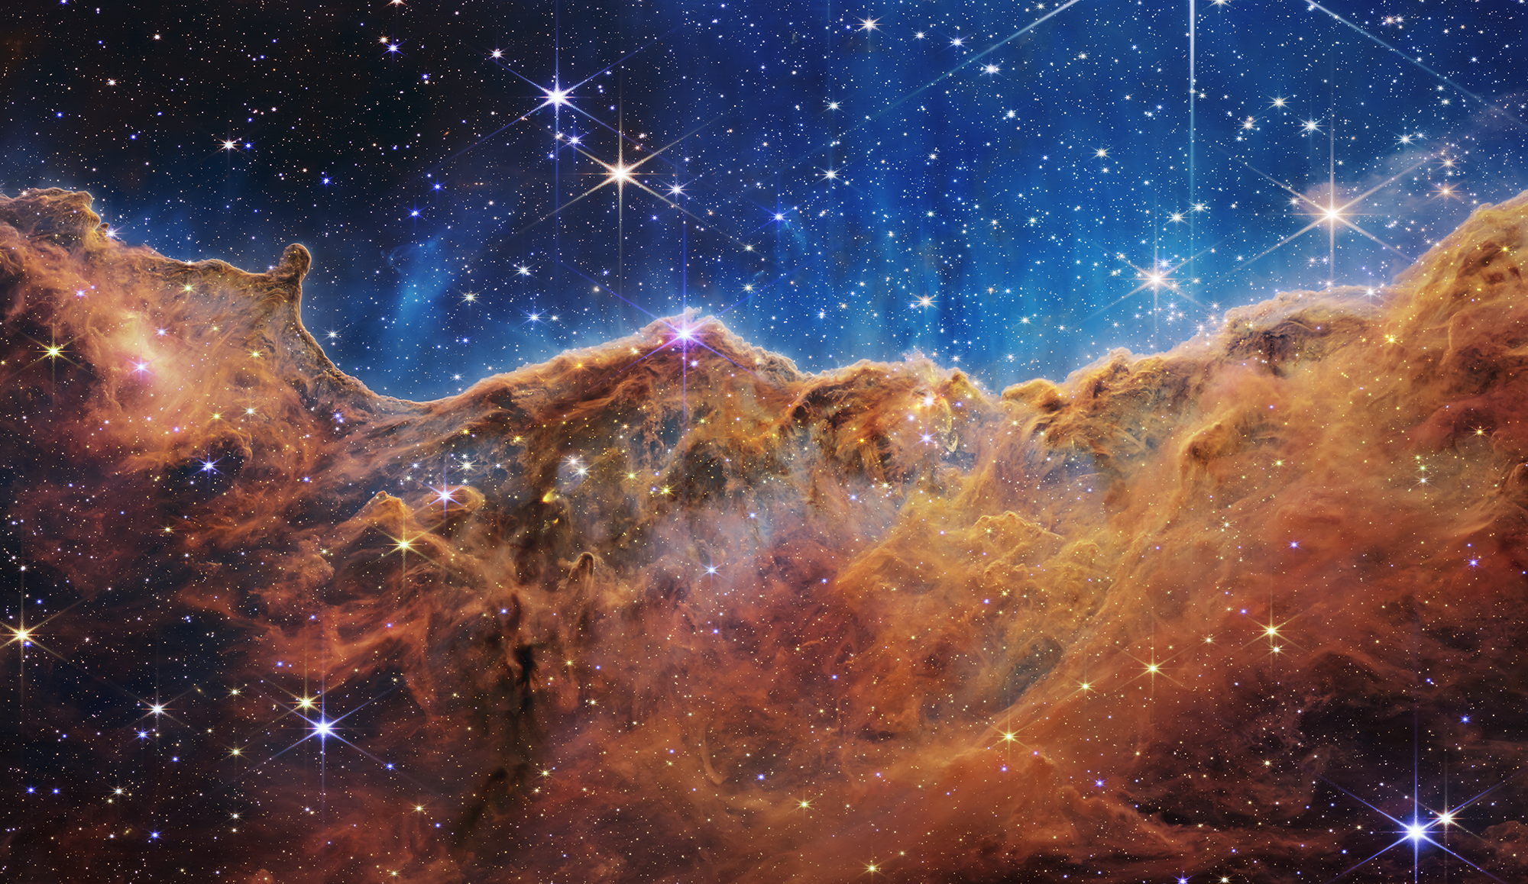
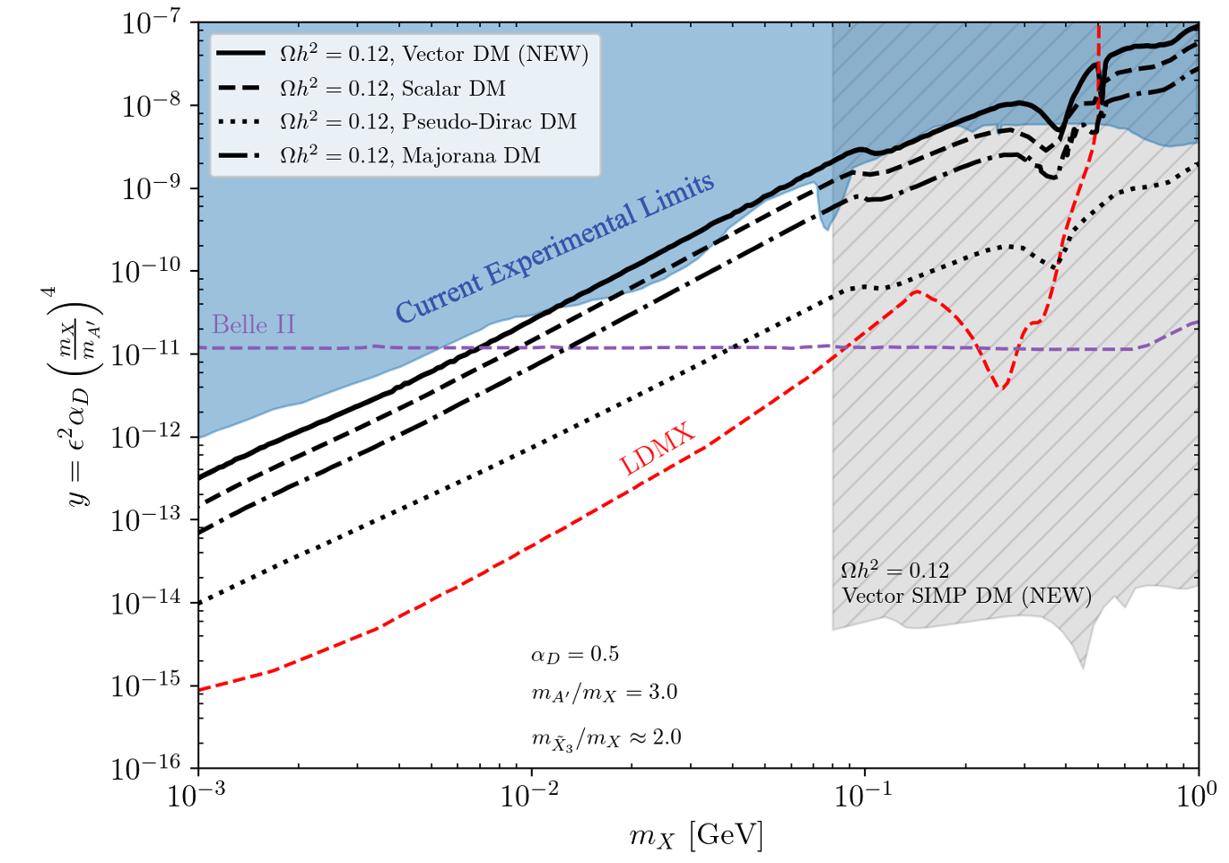
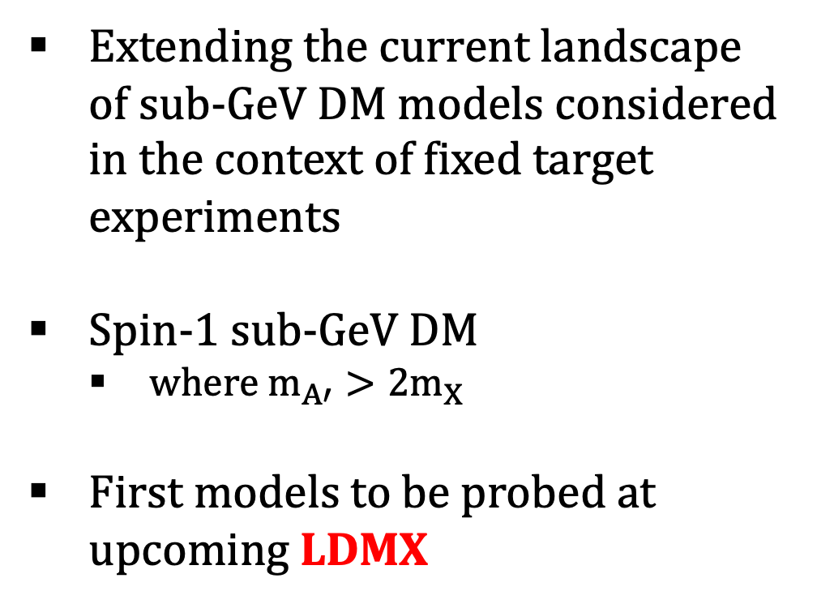
Summary
Extending the current landscape of sub-GeV DM models considered in the context of fixed target experiments
Spin-1 sub-GeV DM
  where $m_{A′}>2m_{X}$
First models to be probed at upcoming LDMX

Slide 33
Backup Slides

Slide 34
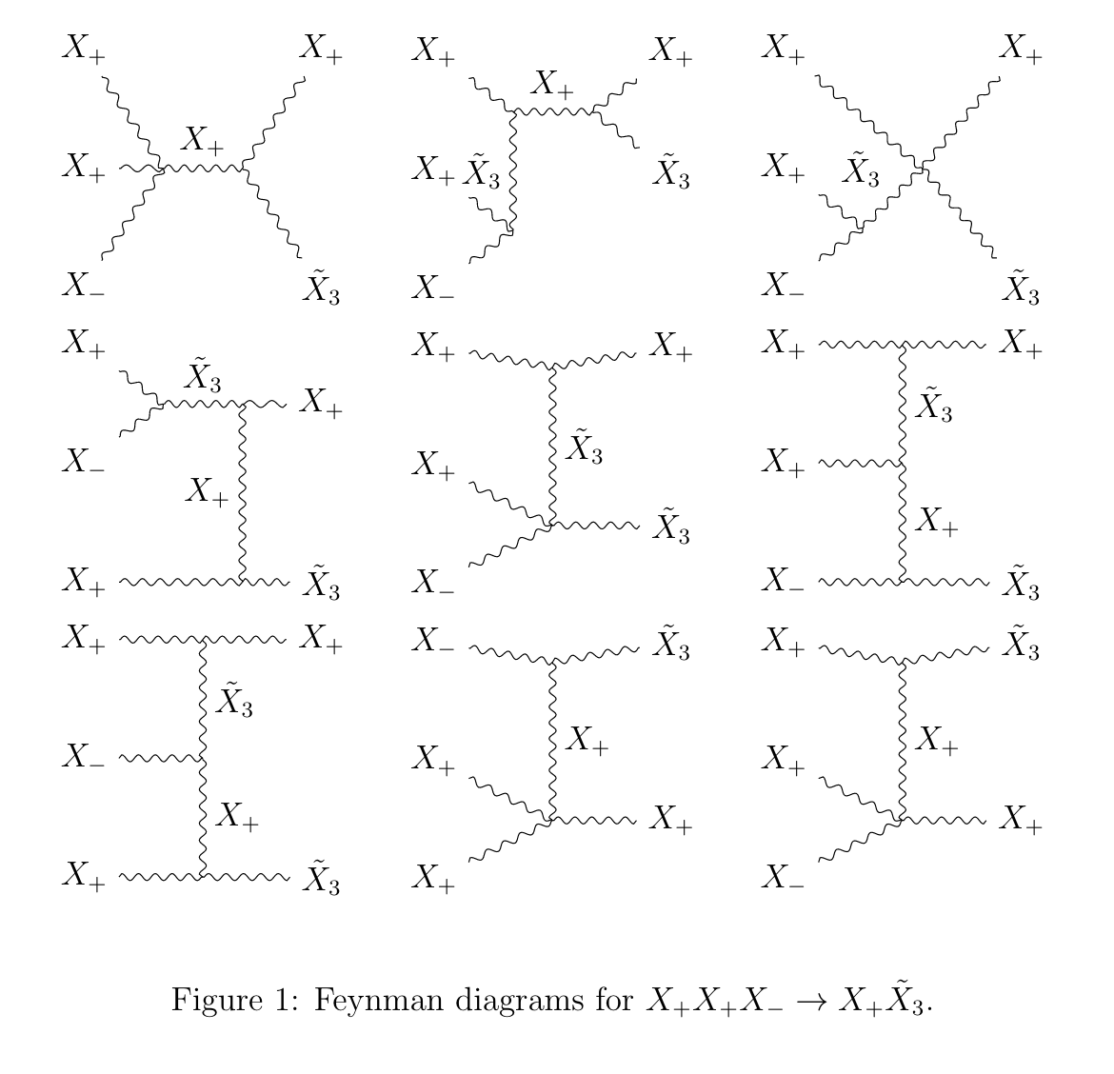
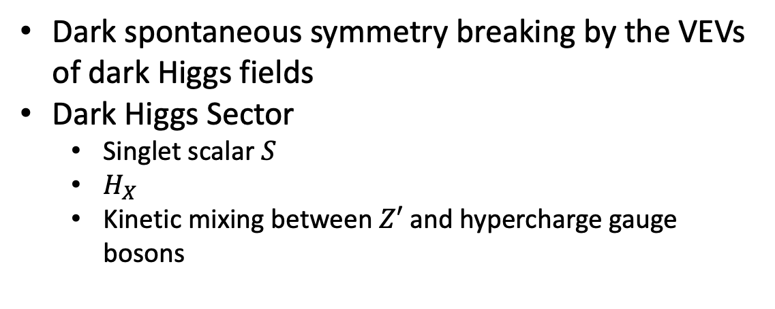
SIMP spin-1 DM
Dark spontaneous symmetry breaking by the VEVs of dark Higgs fields
Dark Higgs Sector
  Singlet scalar $S$
  $H_{X}$
  Kinetic mixing between $Z′$ and hypercharge gauge bosons

Slide 35
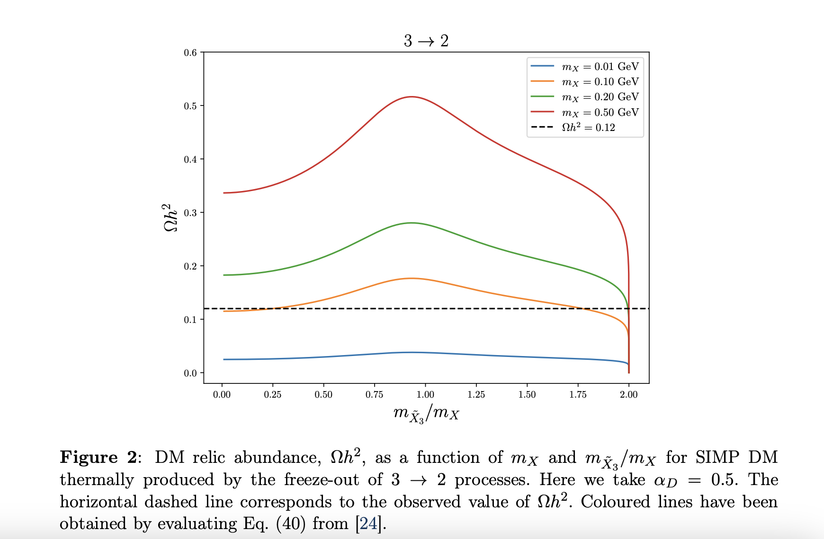

Slide 36
Experiments

Slide 37
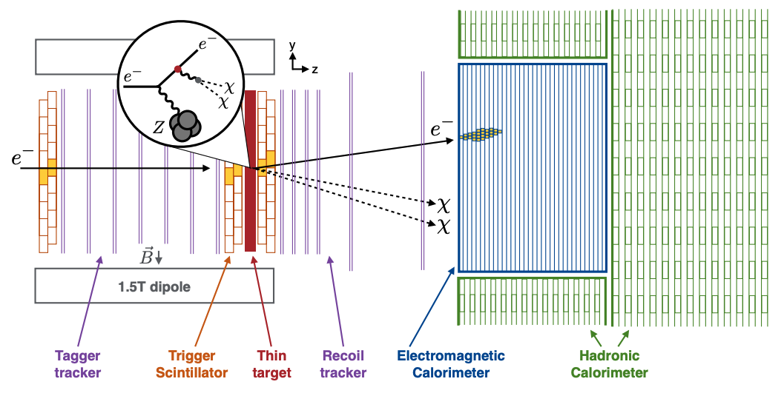
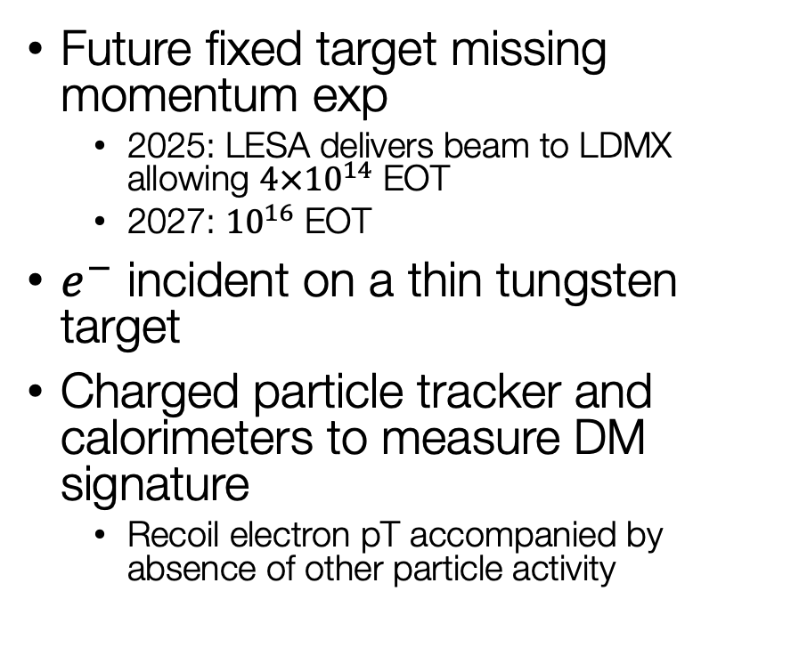
Light Dark Matter eXperiment (LDMX)
Future fixed target missing momentum exp
  2025: LESA delivers beam to LDMX allowing $4×{10}^{14}$ EOT
  2027: ${10}^{16}$ EOT
$e^{−}$ incident on a thin tungsten target
Charged particle tracker and calorimeters to measure DM signature
  Recoil electron pT accompanied by absence of other particle activity

Slide 38
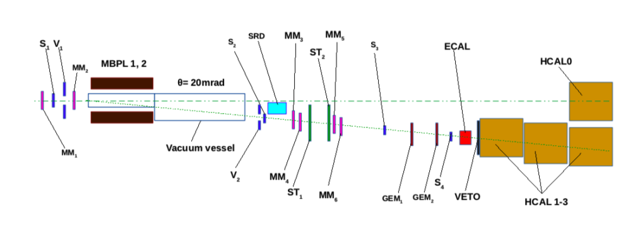
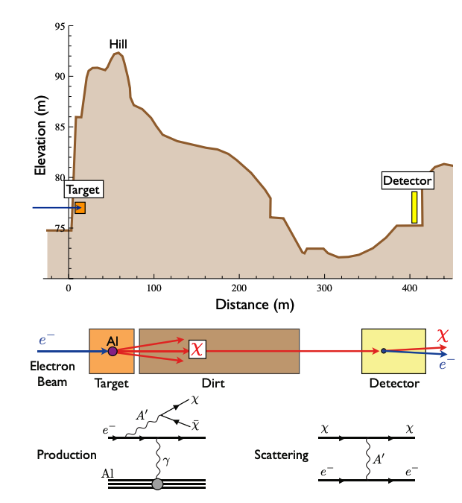
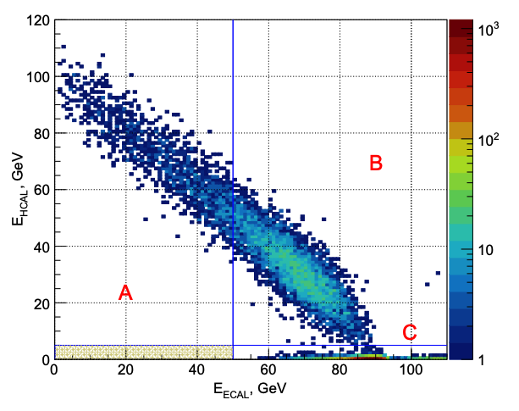
Electron Beam Dumps
E137
arXiv:1406.2698
DM produced from electron-target collisions
20 GeV beam incident on a set of aluminum plates interlaced with cooling water.
Downstream detector
NA64
arXiv:1710.00971
100 GeV electron beam incident on a lead target
Event: single electron produced and missing energy

Slide 39
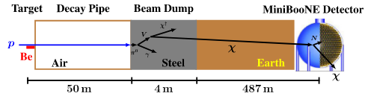
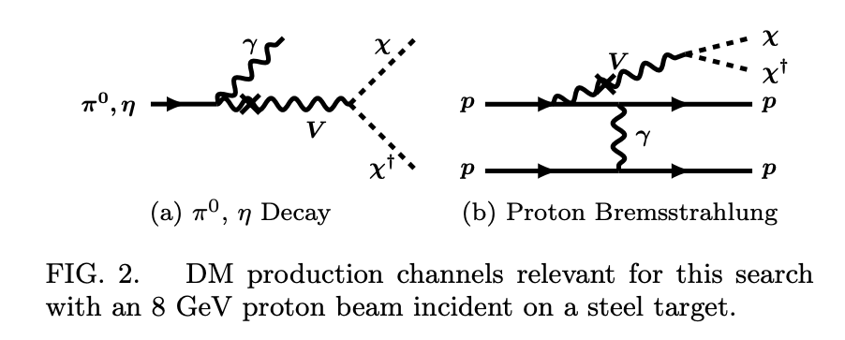
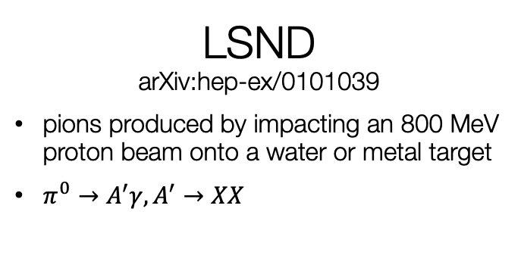
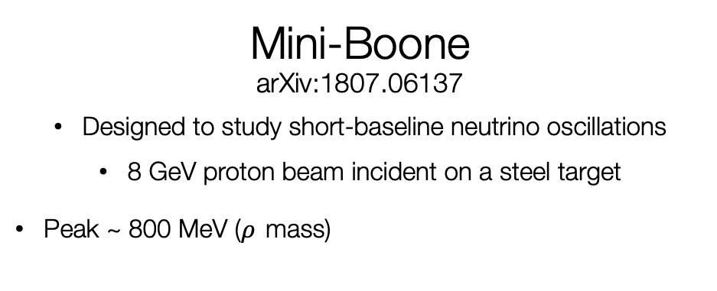
Proton Beam Dumps arXiv:1107.4580
Mini-Boone
arXiv:1807.06137
Designed to study short-baseline neutrino oscillations
8 GeV proton beam incident on a steel target
Peak ~ 800 MeV ($ρ$ mass)
DM scatterings mimic neutrino scatterings!
(Neutral current-like scatterings)
LSND
arXiv:hep-ex/0101039
pions produced by impacting an 800 MeV proton beam onto a water or metal target
$π^{0}→A^{′}γ,A^{′}→XX$

Slide 40

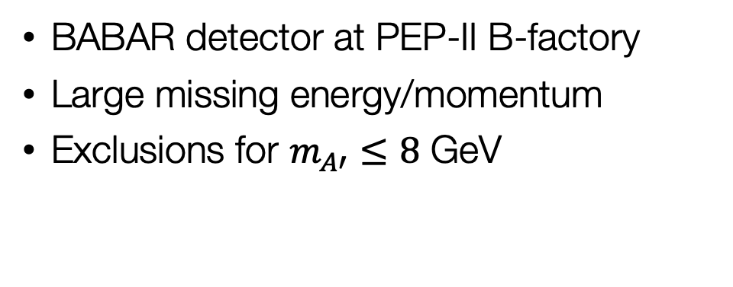


arXiv:1702.03327
Monophoton Searches
Search for single photon events in $e^{+}e^{−}$collision data
$$e^{+}e^{−}→γA^{′}, A^{′}→XX$$
Belle-II
arXiv:1808.10567
Experiment operated at SuperKEKB
First data taken in 2019, more to come..
7 GeV electrons with 4 GeV positrons
BABAR detector at PEP-II B-factory
Large missing energy/momentum
Exclusions for $m_{A′}≤8$ GeV

Slide 41
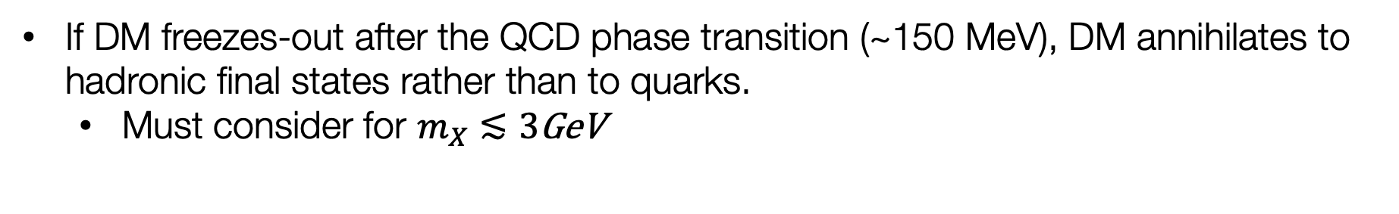
Hadronic Resonances
If DM freezes-out after the QCD phase transition (~150 MeV), DM annihilates to hadronic final states rather than to quarks.
  Must consider for $m_{X}≲3$GeV

