Slide 1
15th International Workshop on the Identification of Dark Matter
GSSI, L’Aquila, Italy, 8 - 12 July 2024
Introduction
Theoretical
Framework
Empirical
Measures
Conclusions
GR & DM
How dragging and general relativity could explain the missing mass problem
Federico Re, federico.re@unimib.it
Dipartimento di Fisica Giuseppe Occhialini, Università di Milano-Bicocca
Collaboration: Massimo Dotti, Sergio Cacciatori, Vittorio Gorini, Francesco Haardt,
Davide Astesiano, Marco Galoppo, David Wiltshire, Frederic Hessman…

Slide 2
KEY IDEAS
Strategies for the Missing Mass Problem
Introduction
Theoretical
Framework
Empirical
Measures
Conclusions
Most natural idea:
Existing invisible mass
KI #1: all the MMP
have gravitational nature
Is the Missing Mass a clue of misunderstanding in gravity?
Dark matter:
MaCHOs?
Hot DM (sterile neutrinos)?
Cold DM (WIMPs)?
Galaxy rotation curves
Virial of clusters
Gravitational lensing
Temperature of hot gases
Bullet clusters
CMB anisotropies
SNIa redshift measures
Etc…
All gravitational attractions
or space-time distortions,
i.e. gravitational wells
Attempts to modify the
Newtonian Gravity (MOND)
Milgrom 1983,
Bekenstein&Milgrom 1984,
Bekenstein 2004
KI #2: GR is already a “modified gravity”

Slide 3
KEY IDEAS
GR is more than post-Newtonian corrections
Introduction
Theoretical
Framework
Empirical
Measures
Conclusions
Intuition: GR = Newton +
post-Newtonian corrections
KI #3: GR allows non-Newtonian phenomena in low energy régime
$g_{μν}=\left(\begin{matrix}g_{00} & g_{0i} \\ g_{0i} & g_{ij}\end{matrix}\right)$,
where $g_{0i}$dragging term
Galactic dynamics in
low energy régime:
Sub-relativistic speeds
Weak forces
Astesiano+3 2022
KI #4: galaxy surrounded by dragging vortex
supporting rotation curve
Carlotto-Shoen shielding metrics
Geons (solitonic GW)
Balasin&Grumiller 2008
Crosta+ 2020
Astesiano+5 2022
Re&Galoppo 2024
PN terms have magnitude $\sim \frac{v^{2}}{c^{2}}$:
Negligible corrections
A galaxy is an extended source:
Not globally Newtonian
Ciotti 2022,
Lasenby+ 2023,
Costa+ 2023,
Glampedakis&Jones 2023
Costa&Natàrio 2023
Re-weight DM amount
in disc galaxies
DM phenomena $=$
fake DM from GR $+$ true DM

Slide 4
KEY IDEAS
Low energy limit and non-commutativity
Introduction
Theoretical
Framework
Empirical
Measures
Conclusions
Widespread intuition:
Switch the order:
Require small metric perturbations (classical limit):
$$g_{μν}=η_{μν}+c^{−2}h_{μν}$$
Start with full Einstein Eqs
They don’t commute!
Then expand formulas at the lowest order in $v/c$:
Low Energy Limit (LEL)
Then deduce Einstein Eqs
Find in Newtonian limit:
$4πGρ=∆Φ+O\left({v^{2}}/{c^{2}}\right)$, …
Find non-negligible corrections to Newtonian eqs!:
$4πGρ=∆Φ+something$, …

Slide 5
$\left(η, H\right)$ MODEL
Metric and source
Introduction
Theoretical
Framework
Empirical
Measures
Conclusions
Lewis–Papapetrou–Weyl metric:
$${ds\left(r, z\right)}^{2}=−c^{2}e^{{2Φ}/{c^{2}}}{\left(dt+Adφ\right)}^{2}+e^{−{2Φ}/{c^{2}}}\left[r^{2}{dφ}^{2}+e^{{2k}/{c^{2}}}\left({dr}^{2}+{dz}^{2}\right)\right]$$
No velocity dispersion: $U^{μ}={\left(−H\right)}^{−1/2}\left(∂_{t}+Ω∂_{φ}\right)$
Perfect fluid: $T_{μν}=ρU_{μ}U_{ν}$
Generalization of BG metric
Balasin&Grumiller 2008
Crosta+ 2020
Galoppo+ 2022
Beordo+2024
In Low Energy Limit (LEL):
$A≈−\frac{rv_{D}}{c^{2}}$ with finite $v_{D}$ “dragging speed”,
$Φ/{c^{2}},k/{c^{2}}=O\left({v^{2}}/{c^{2}}\right)$,
$U^{μ}U_{μ}=−c^{2} ⇒H=−1+O\left({v^{2}}/{c^{2}}\right)$.

Slide 6
$\left(η, H\right)$ MODEL
Metric and source
Introduction
Theoretical
Framework
Empirical
Measures
Conclusions
${ds\left(r, z\right)}^{2}=−c^{2}e^{{2Φ}/{c^{2}}}{\left(dt+Adφ\right)}^{2}+e^{−{2Φ}/{c^{2}}}\left[r^{2}{dφ}^{2}+e^{{2k}/{c^{2}}}\left({dr}^{2}+{dz}^{2}\right)\right]$,
$U^{μ}={\left(−H\right)}^{−1/2}\left(∂_{t}+Ω∂_{φ}\right)$, $T_{μν}=ρU_{μ}U_{ν}$
$\left(η, H\right)$ family of exact solutions.
Fully generated by the choice of functions $η\left(r,0\right)$ and $H\left(η\right)$
$\hat{∆}\tilde{η}=0$ s.t. $\hat{∆}=∂_{r}^{2}−{∂_{r}}/r+∂_{z}^{2}$ Grad-Shafranov operator,
and $\tilde{η}\left(r,z\right)≔η+\frac{c^{2}}{2}r^{2}\int{\frac{H^{′}}{H}\frac{dη}{η}}−\frac{1}{2}\int{\frac{H^{′}}{H}ηdη}$ Velocity Field Equation (VFE)
$$Ω\left(η\right)=1/2\int{H′\left(η\right){dη}/η}$$
$g_{tt}=H−2vrΩ+\frac{r^{2}Ω^{2}}{−Hγ^{2}}$,
$g_{tφ}=rv+\frac{r^{2}}{γ^{2}H}Ω$, $g_{φφ}=\frac{r^{2}}{−Hγ^{2}}$, s.t. $γ=γ\left(v_{Z}\right)$
$8πGρ=\frac{v^{2}{\left(2−ηl\right)}^{2}−r^{2}l^{2}}{4e^{μ}}\frac{η_{r}^{2}+η_{z}^{2}}{η^{2}}$ s.t. $l\left(η\right)≔{H′}/H$
Astesiano+3 2022
Astesiano+5 2022
Re&Galoppo 2024

Slide 7
$\left(η, H\right)$ MODEL
What speed?
Introduction
Theoretical
Framework
Empirical
Measures
Conclusions
Zero Angular Momentum Observers (ZAMO):
$e_{Z}^{0}=\frac{\sqrt{g_{φφ}}}{W}\left(∂_{t}+χ∂_{φ}\right)$, $e_{Z}^{1}=\frac{1}{\sqrt{g_{φφ}}}∂_{φ}$, $e_{Z}^{2}=e^{−{\left(Φ−k\right)}/{c^{2}}}∂_{r}$, $e_{Z}^{3}=e^{−{\left(Φ−k\right)}/{c^{2}}}∂_{z}$;
where $χ=−{g_{tφ}}/{g_{φφ}}$ “ dragging angular speed”
Measures speed $v_{Z}=\frac{e_{Z}^{1}∙U^{μ}}{e_{Z}^{0}∙U^{μ}}=\frac{W\left(Ω−χ\right)}{−Hγ_{Z}^{2}}=η/r$
In LEL:
$$v_{Z}≈r\left(Ω−χ\right)$$
Stationary (not static!) Observers:
$e_{S}^{0}=e^{−Φ/{c^{2}}}∂_{t}$, $e_{S}^{1}=\frac{e^{Φ/{c^{2}}}}{W}\left(∂_{φ}−A∂_{t}\right)$, $e_{S}^{2}=e^{−{\left(Φ−k\right)}/{c^{2}}}∂_{r}$, $e_{S}^{3}=e^{−{\left(Φ−k\right)}/{c^{2}}}∂_{z}$
Measures speed $v_{S}=\frac{e_{S}^{1}∙U^{μ}}{e_{S}^{0}∙U^{μ}}=$ $γ_{S}^{−1}e^{−Φ/{c^{2}}}WΩ$
In LEL:
$$v_{S}≈rΩ\sim {10}^{−3}$$
Dragging speed: $v_{D}=\frac{e_{S}^{1}∙e_{Z}^{0}}{e_{S}^{0}∙e_{Z}^{0}}=\frac{g_{φφ}χ}{W}$
In LEL:
$$v_{D}≈rχ\sim {10}^{−3}$$
Re&Galoppo 2024

Slide 8
$\left(η, H\right)$ MODEL
What speed?
Introduction
Theoretical
Framework
Empirical
Measures
Conclusions
Measure rotation curves with redshift. In SR, for a edge-on galaxy: $1+z=\frac{1+v/c}{\sqrt{1−{v^{2}}/{c^{2}}}}≈1+{v_{obs}}/c$
A still observer at spatial infinity measures $1+z_{dr}=\frac{1}{\sqrt{−H}}\left[1+e^{−{2Φ}/{c^{2}}}\frac{Ω}{c}\left(W+\frac{g_{φφ}χ}{c}\right)\right]$
In LEL:
$$1+z≈1+{v_{S}}/c$$
Astesiano+5 2022, Re&Galoppo 2024
Analog if measure our speed from the CMB dipole. According SR: $\left\langle a_{T,10}\right\rangle =−2\sqrt{π/3}\left\langle T\right\rangle {v_{obs}}/c$
Inside a dragging metric we see
$$a_{T,10}=\int{\frac{T\left(\hat{n}\right)}{1+z_{dr}\left(\hat{n}\right)}{Y_{1}^{0}\left(\hat{n}\right)}^{∗}d^{2}\hat{n}}$$
In LEL:
$$\left\langle a_{T,10}\right\rangle ≈−2\sqrt{π/3}\left\langle T\right\rangle {v_{S}}/c$$
Re, Galoppo, Dotti (coming soon)
We measure the speed $v_{S}$, but the dynamics is determined by the angular momentum, proportional to the (different!) speed $v_{Z}≈v_{S}−v_{D}$

Slide 9
PHANTOM DARK MATTER
Corrections on required density
Introduction
Theoretical
Framework
Empirical
Measures
Conclusions
$8πGρ=\frac{v^{2}{\left(2−ηl\right)}^{2}−r^{2}l^{2}}{4e^{μ}}\frac{η_{r}^{2}+η_{z}^{2}}{η^{2}}$
In LEL:
$8πGρ≈4\frac{v_{S}}{r}\frac{dv_{S}}{dr}−2\frac{d\left(rv_{S}\right)}{r dr}\frac{d\left(rv_{D}\right)}{r dr}+{\left(\frac{d\left(rv_{D}\right)}{r dr}\right)}^{2}$
$$−ρ_{II}$$
$$+ρ_{I}$$
$$+ρ_{I}$$
Cfr non-linear gravitomagnetic formalism: $\vec{G}≔−∇Φ$, $\vec{H}≔e^{Φ/{c^{2}}}∇×\left(A∂_{φ}\right) ⇒$
$\left\{\begin{aligned}\begin{matrix}∇∙\vec{G}={{\vec{G}}^{2}}/{c^{2}}+{{\vec{H}}^{2}}/{2c^{2}}−4πGρ \\ ∇×\vec{G}=0\end{matrix} \\ \begin{matrix}∇∙\vec{H}=−{\vec{G}∙\vec{H}}/{c^{2}} \\ ∇×\vec{H}=2{\vec{G}×\vec{H}}/{c^{2}}−16πG{\vec{j}}/{c^{3}}\end{matrix}\end{aligned}\right.$, being $j^{μ}=−\frac{T^{μν}U_{ν}}{c^{2}}$ momentum density
$$\dot{\vec{v}}=\vec{G}+\frac{\vec{v}}{c}×\vec{H}$$
We don’t measure directly $G$
We measure $v_{S}$. With $H →$ less $G →$ less $ρ$
$$−ρ_{II}$$
Re&Galoppo 2024

Slide 10
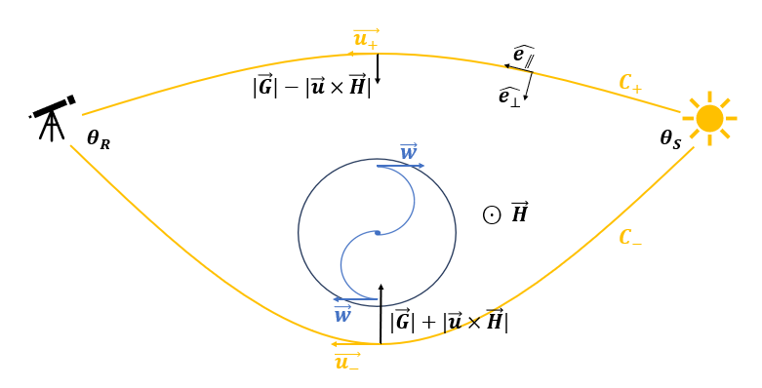
PHANTOM DARK MATTER
Corrections on gravitational lensing
Introduction
Theoretical
Framework
Empirical
Measures
Conclusions
Gauss-Bonnet ($χ\left(S\right)=1$)
Gravitomagnetism:
$κ_{g}=\left(\vec{G}+\vec{u}×\vec{H}\right)∙{\hat{e}}_{⊥}$, $\left|\vec{u}\right|≡c$
Asymmetric geodesics:
$$r_{±}≈r_{0}±∆r$$
Far from the centre:
$$G_{,r}, H_{,r}<0$$
$$θ_{R}+θ_{S}≈{\left(θ_{R}+θ_{S}\right)|}_{Newt}−2c\int_{C_{±}}^{ }{H_{,r}\left(r_{0}\right) ∆r dλ}$$
Galoppo+ 2022
Re&Galoppo 2024

Slide 11
ESTIMATION OF DRAGGING SPEED
With Newtonian ad-hoc term
Introduction
Theoretical
Framework
Empirical
Measures
Conclusions
$$8πG\left(ρ_{B}+αρ_{DM}\right)≔8πGρ≔\frac{η_{,r}^{2}}{r^{2}}−r^{2}Ω_{,r}^{2}+2\frac{v_{S}^{2}}{r^{2}}$$
Fraction $1−α$ of DM explained by dragging $v_{D}=v_{S}−η/r$
$$4πG\left(ρ_{B}+ρ_{DM}\right)=2\frac{v_{S}v_{S,r}}{r}+\frac{v_{S}^{2}}{r^{2}}$$
$α=1 ⇔v_{D}≡0$: spherically symmetric
Newtonian model with 100% of DM
Evaluate for MW: $ρ_{B}≔ρ_{B0}e^{−r/{r_{B}}}$ exponential, $ρ_{DM}≔ρ_{DM0}\frac{r_{DM}}{r}{\left(1+\frac{r}{r_{DM}}\right)}^{−2}$ NFW,
$r_{B}≅2.1$ kpc, $r_{DM}≅5.69$ kpc, $v_{∞}≅220$ km/s, $ρ_{DM0}≅6.4\% ρ_{B0}$
At $r_{⊙}≅8.6$ kpc: $w\left(r_{⊙}, 0\right)≅\left(1−α\right)∙71$ km/s
Example: $α=1/2 ⇒v_{D}\left(r_{⊙}, 0\right)≈35$ km/s in our neighborhood
Re&Galoppo 2024

Slide 12
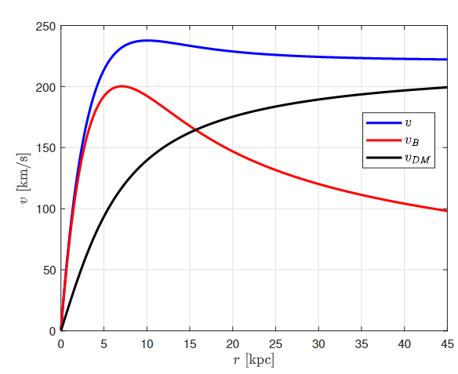
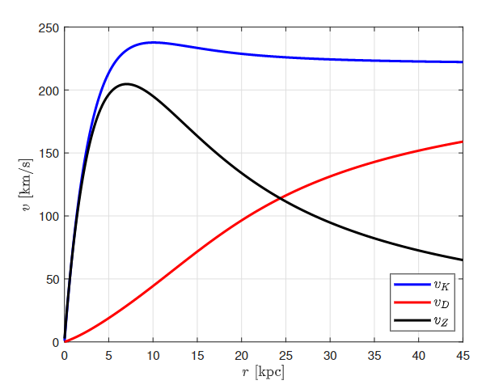
ESTIMATION OF DRAGGING SPEED
With Newtonian ad-hoc term
Introduction
Theoretical
Framework
Empirical
Measures
Conclusions
Newtonian description
General-relativistic description

Slide 13
ESTIMATION OF DRAGGING SPEED
Coming soon: more precise formulas with pressure!
Introduction
Theoretical
Framework
Empirical
Measures
Conclusions
Newtonian description
General-relativistic description
Galoppo, Wiltshire, Re (coming soon)

Slide 14
EMPIRICAL MEASURES
Counter-rotating matter
Introduction
Theoretical
Framework
Empirical
Measures
Conclusions
Some disc galaxies have counter-rotating stars or gas
Kuijken+ 1996,
Corsini 2014
The counter-rotating component is also dragged! $v_{+}+v_{−}∝v_{D}$
Re (coming soon)
Consider geodesics for a test particle with tangent motion $\frac{∂φ}{∂τ}≅\tilde{Ω}≅{\tilde{v}}/r$
Without dragging ($v_{D}≡0$): depends only on the potential $Φ$ s.t. $g_{tt}=−e^{{2Φ}/{c^{2}}}$, $\frac{∂Φ}{∂r}=\frac{v_{S}^{2}}{r}$
Geodesic $\ddot{r}≅\frac{{\tilde{v}}^{2}−v_{S}^{2}}{r} ⇒$symmetric $v_{±}≅±v_{S}$
With dragging $w$:
$\frac{∂Φ}{∂r} ≅v_{S}\left(\frac{v_{Z}}{r}−\frac{∂v_{D}}{∂r}\right)$
Geodesic
$\ddot{r}≅\frac{{\tilde{v}}^{2}−v_{S}^{2}}{r}+\frac{v_{S}−\tilde{v}}{r}\frac{∂\left(rv_{D}\right)}{∂r}$
Asymmetric
$v_{+}≅v_{S}$, $v_{−}=−v_{S}+\frac{∂\left(rv_{D}\right)}{∂r}$
Non-negligible deviation from Newton!
14/17

Slide 15
CONCLUSIONS
What has been done and what remains to be done
Introduction
Theoretical
Framework
Empirical
Measures
Conclusions
What we know:
GR non-linearities allow solitonic solutions for the dragging terms
Strong dragging implies non-negligible deviations from Newton
A quite small dragging vortex sustains flat rotation curve
It returns also a suitable correction on the gravitational lensing
The dragging speed can be measured with counter-rotating matter components
Future perspectives:
Generalize equations (in LEL) for non-negligible pressure (bulge, elliptical galaxies…)
Consequences of the dragging on CMB
Measure the actual dragging with the counter-rotating matter
Apply GR to other MMP (gravitational lensing, universe expansion…)
Galoppo, Wiltshire, Re (coming soon)
Stay tuned!
Re, Galoppo, Dotti (coming soon)
Re (coming soon)
Galoppo+ 2022; Re 2020, Re 2021, Vigneron&Buchert 2019, Buchert 2008

Slide 16
CONCLUSIONS
Introduction
Theoretical
Framework
Empirical
Measures
Conclusions
Thanks for your attention!

Slide 17
CONCLUSIONS
Minimal bibliography
Introduction
Theoretical
Framework
Empirical
Measures
Conclusions
H. Balasin and D. Grumiller (2008), “Non-newtonian behavior in weak field general relativity for extended rotating sources” Int. J. Mod. Phys. D 17 475–488 arXiv:astro-ph/0602519
M. Crosta, M. Giammaria, M. G. Lattanzi, and E. Poggio (2020), “On testing CDM and geometry-driven Milky Way rotation curve models with Gaia DR2” MNRAS 496 2107–2122 arXiv:1810.04445
W. Beordo, M. Crosta, M. G. Lattanzi, P. Re-Fiorentin and A. Spagna (2024), “Geometry-driven and dark-matter-sustained Milky Way rotation curves with Gaia DR3” MNRAS 529 (4) 4681-4698
D. Astesiano, S. L. Cacciatori, V. Gorini, and F. Re (2022), “Towards a full general relativistic approach to galaxies” EPJ C 82 (6) 554 arXiv:2204.05143
D. Astesiano, S. L. Cacciatori, M. Dotti, F. Haardt, and F. Re (2022), “Re-weighting dark matter in disc galaxies: a new general relativistic observational test” arXiv:2204.05143
M. Galoppo, S. L. Cacciatori, V. Gorini, and M. Mazza (2022), “Equatorial Lensing in the Balasin-Grumiller Galaxy Model” arXiv:2212.10290
F. Re and M. Galoppo (2024), “On GR dragging and effective galactic dark matter” arXiv:2403.03227

