Slide 1
Dark Sector Tunneling Field Potentials for a Dark Big Bang
Richard Casey & Cosmin Ilie
Colgate University
Credit: New Scientist

Slide 2
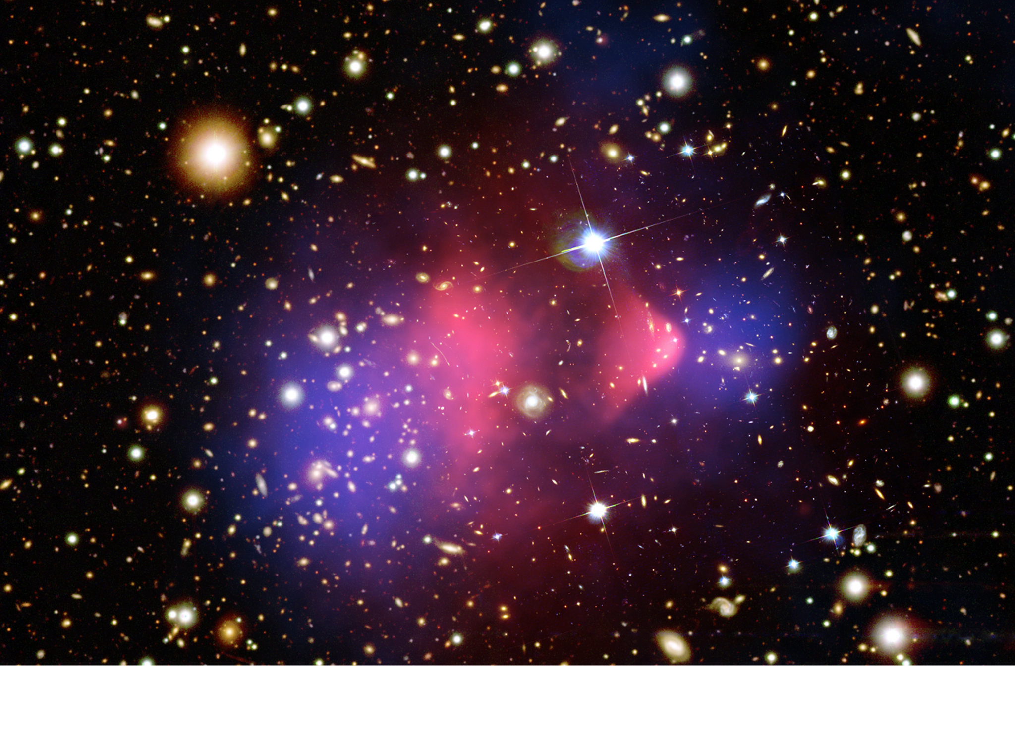
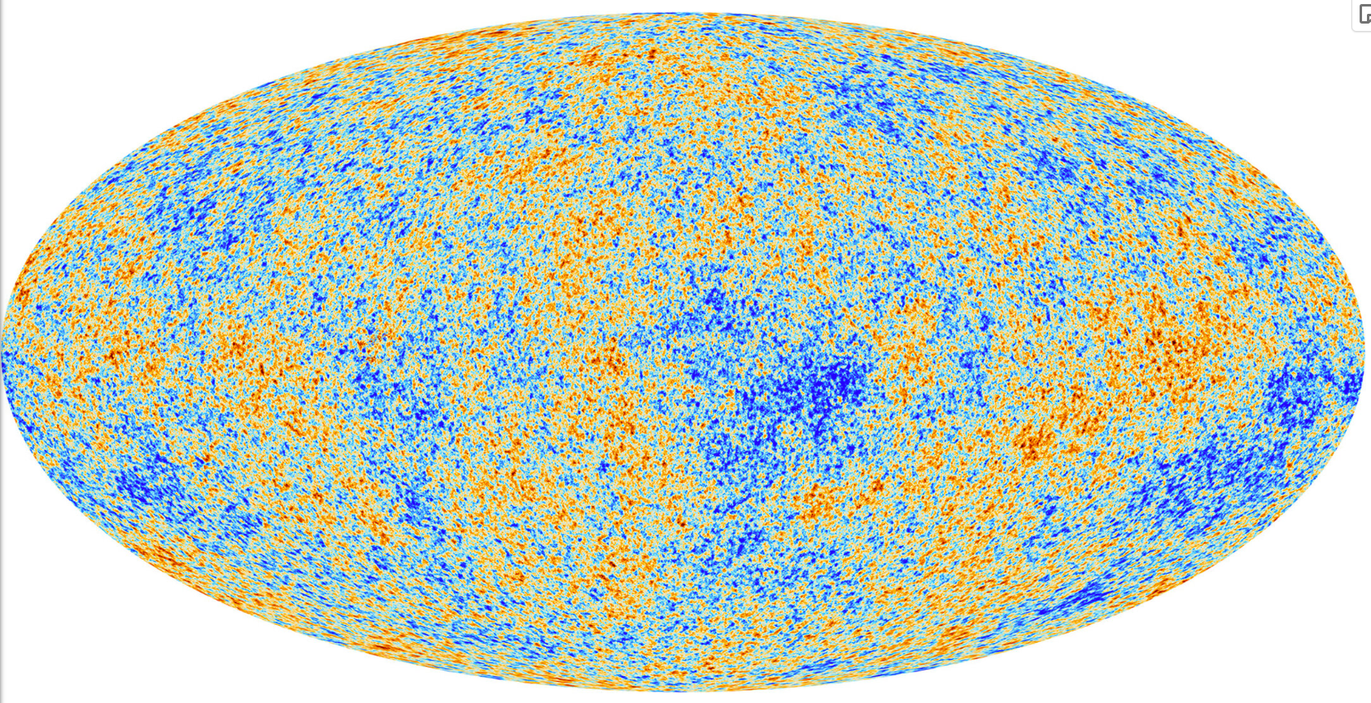
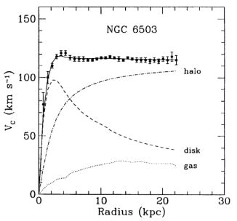
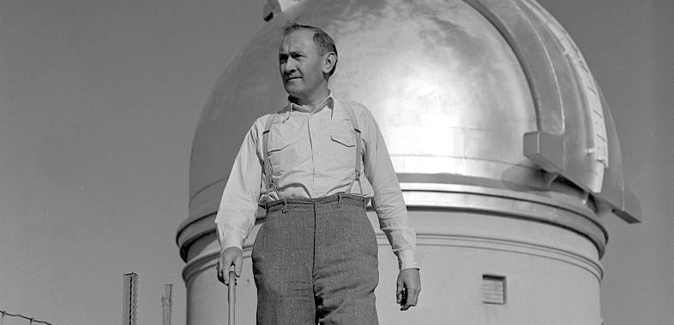
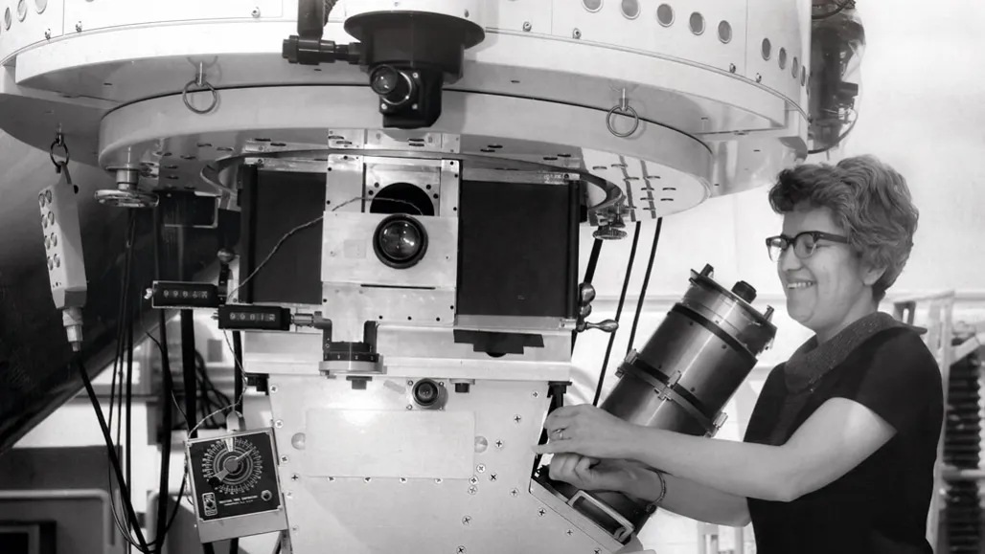
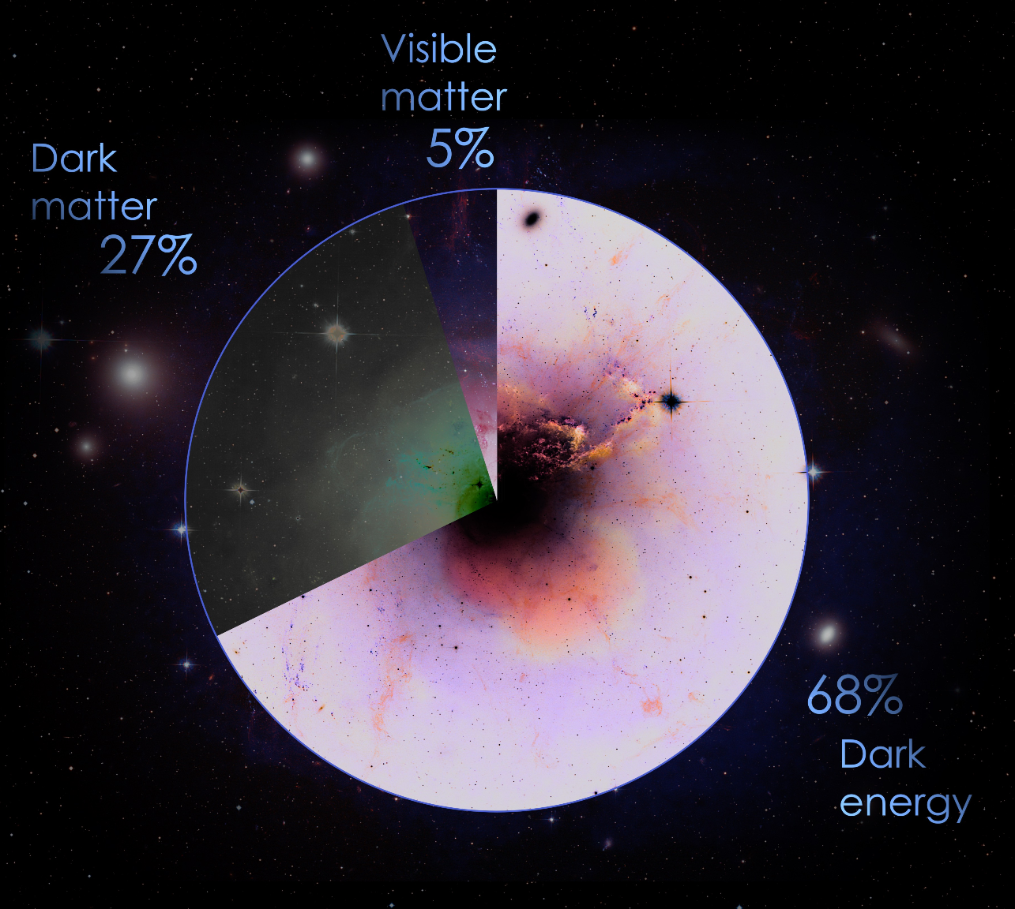
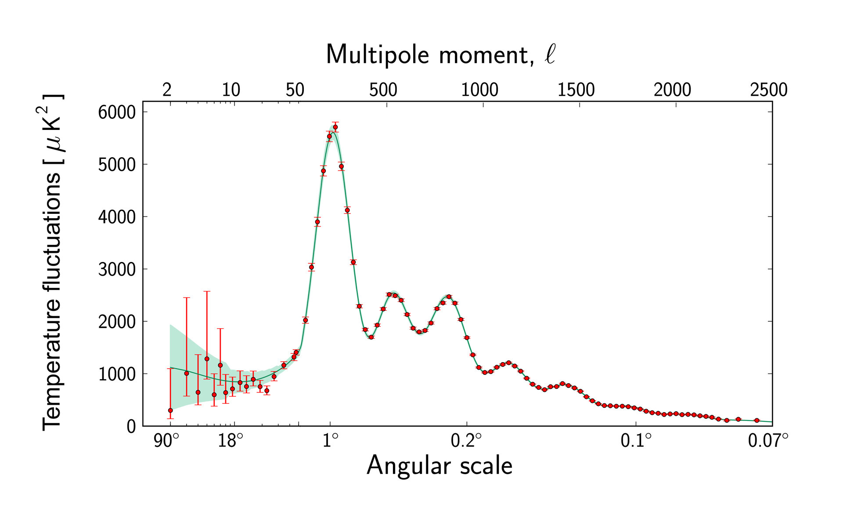
What is Dark Matter?
Credit: Bettmann Archive
Credit: NSF’S OPTICAL-INFRARED ASTRONOMY RESEARCH LABORATORY/KPNO/AURA
Credit: NASA/CXC/CfA/M. Markevitch; Optical and lensing map: NASA/STScI, Magellan/U. of Arizona/D. Clowe; Lensing map: ESO WFI
Credit: NASA
Credit: Katherine Freese
Credit: Planck Collaboration/ ESA
Credit: M. Tripathi and M. Woods

Slide 3
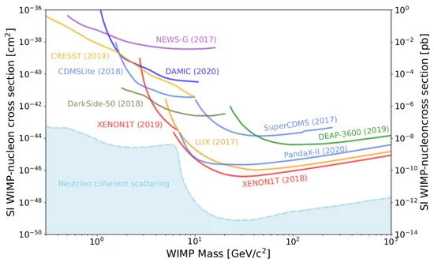
Why a Dark Big Bang?
No definitive non-gravitational evidence for dark matter
Maybe dark matter interacts solely through gravity
Dark Big Bang → new observables for decoupled dark matter
Credit: Particle Data Group, et al. "Review of particle physics." Progress of theoretical and experimental physics 2022.8 (2022): 083C01.

Slide 4
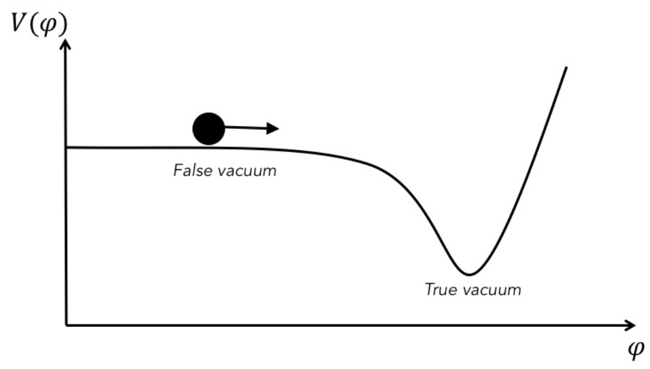
Hot Big Bang: Slow-Roll Inflation
All matter
Inflation
Reheating
t ≳ 10⁻³⁴ s

Slide 5
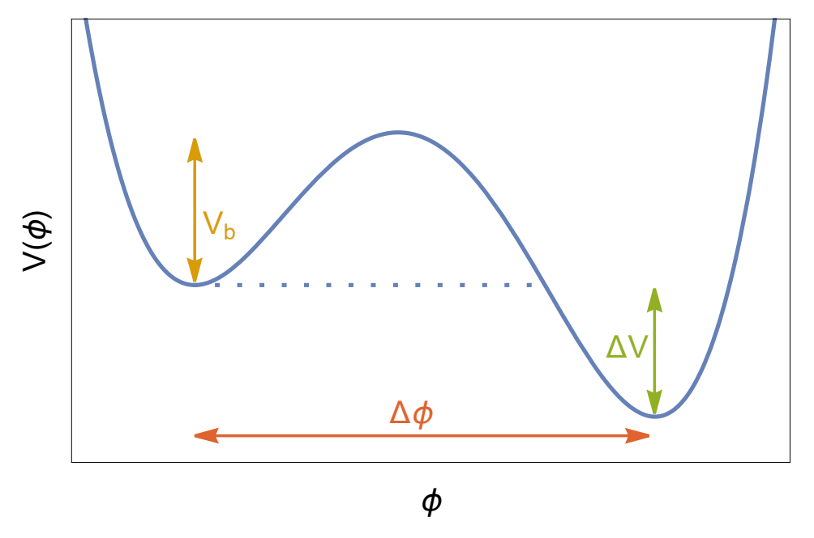
Dark Big Bang: First-Order Phase Transition
Dark matter
False Vacuum
Quantum Tunneling
True Vacuum
t < 32.5 days

Slide 6
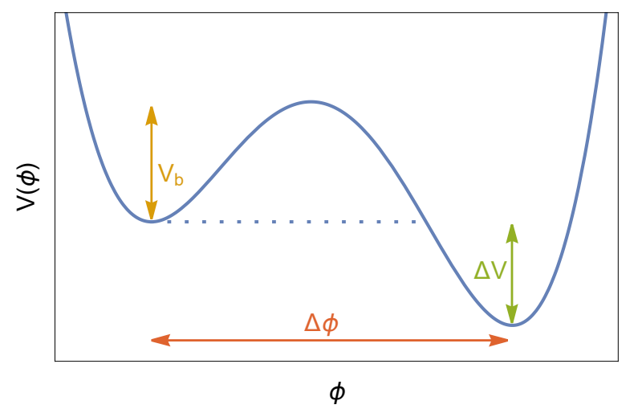
Model Potential for a Dark Big Bang
Ref: K. Freese and M. W. Winkler, Physical Review D 107, 083522 (2023).

Slide 7
Phase Transition Characteristics
Time of the Dark Big Bang (t*)
Visible Sector temperature (T*)
Dark Sector temperature (T_{DS,*})
Strength of the Dark Big Bang (⍺): defined as ratio of dark / visible sector energy densities right after phase transition
Ref: K. Freese and M. W. Winkler, Physical Review D 107, 083522 (2023).

Slide 8
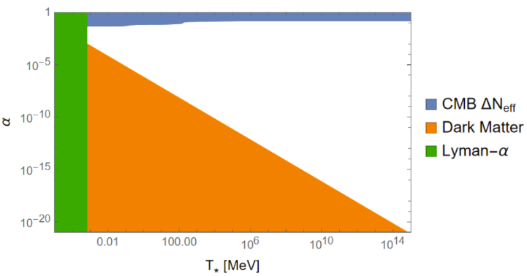
Bounds on the strength of the DBB
Equations: K. Freese and M. W. Winkler, Physical Review D 107, 083522 (2023).

Slide 9
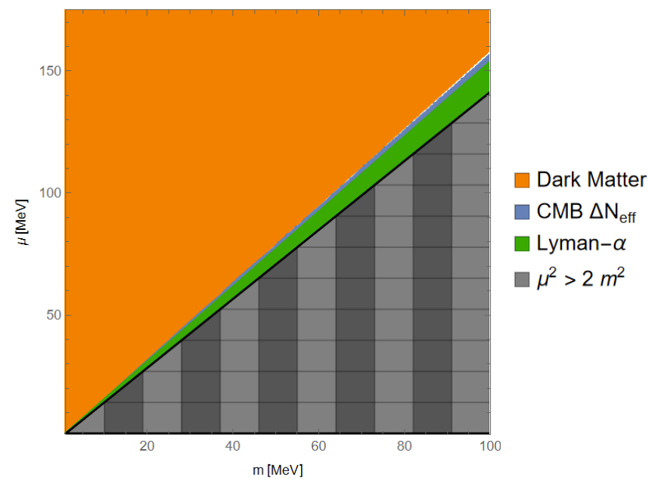

Slide 10
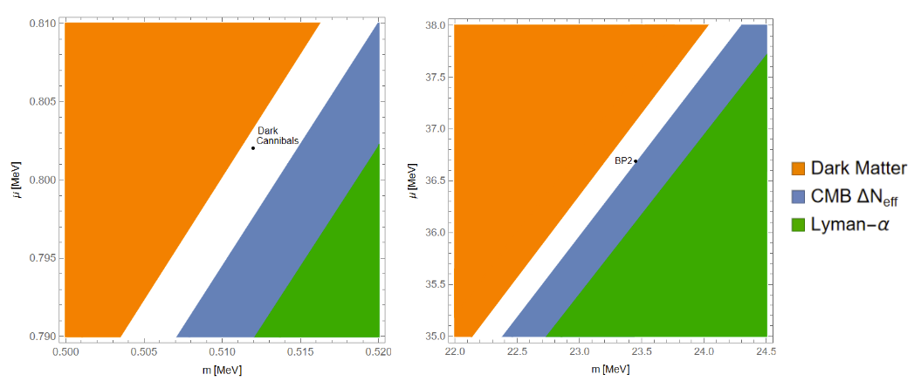
Zoomed In Regions and Benchmark Cases
Benchmark Parameters: K. Freese and M. W. Winkler, Physical Review D 107, 083522 (2023).

Slide 12
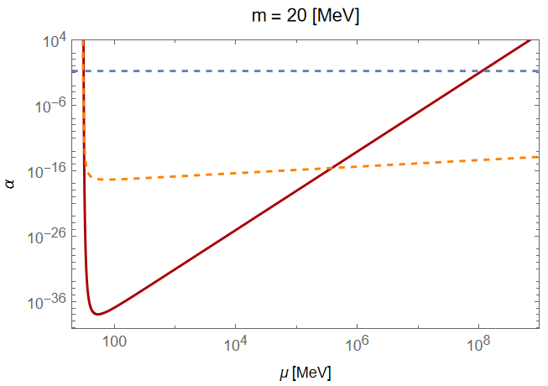
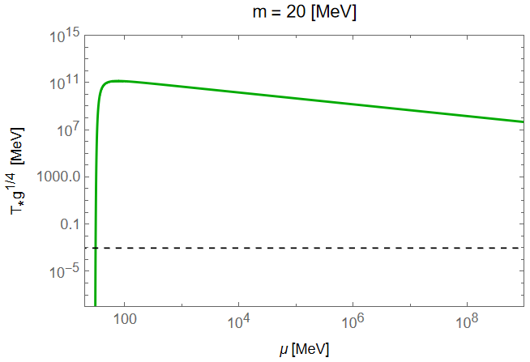
Fixing m, ranging 𝜇

Slide 13
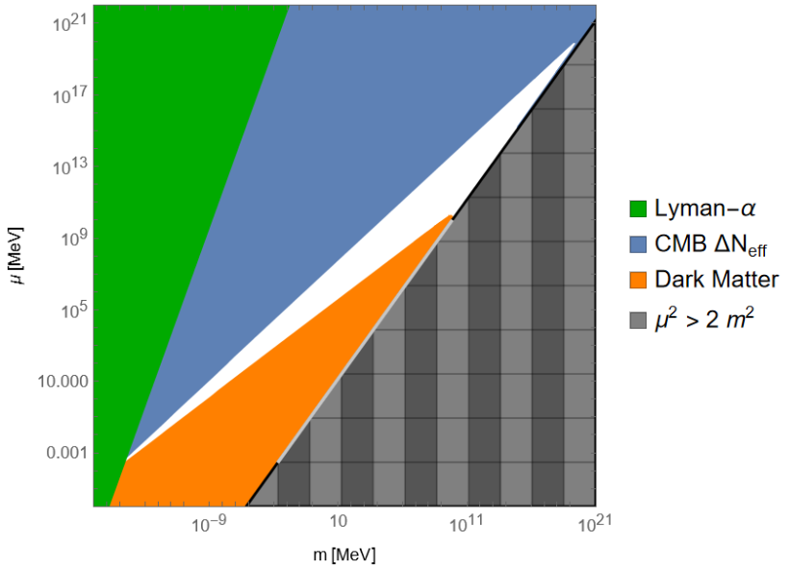
Region 2

Slide 14
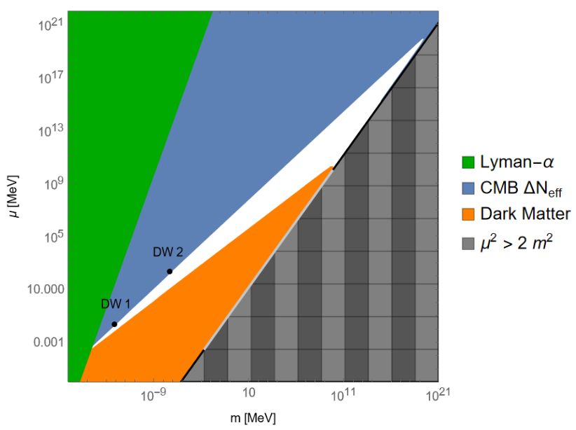
Benchmarks: Late and Strong
Lagrangian:
K. Freese and M. W. Winkler, Physical Review D 107, 083522 (2023).

Slide 15
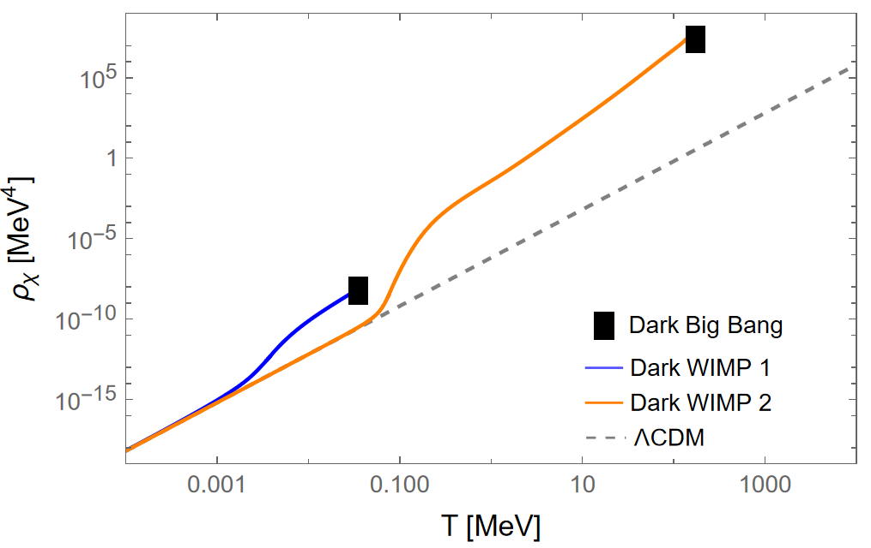
m_{𝜒}= 500 keV
m_{𝜒}= 10 keV
Ω_{DM}h² = 0.120 ± 0.001

Slide 16
Future Work
Consider DBB with a dark sector with minimal couplings to standard model
Via Higgs, neutrino, vector, or axion portal
Look for signatures of DBB in CMB and gravity wave surveys

Slide 17
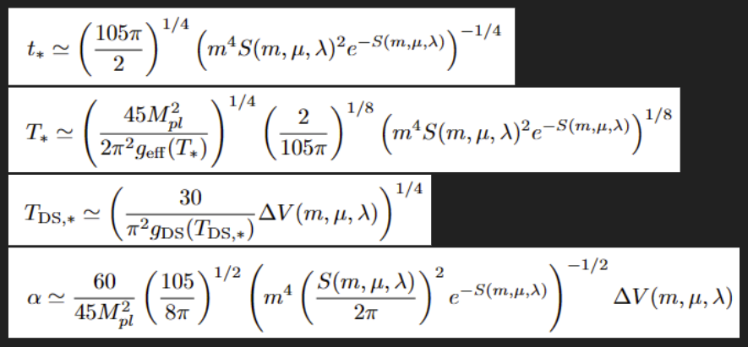
Thanks for Listening!
Questions?
Funding for this work was provided by:
Colgate University Department of Physics and Astronomy
Volgenau Wiley Endowed Research Fellowship
Special thanks to:
Saiyang Zhang for listening to an earlier version and the insightful questions that followed.

Slide 18
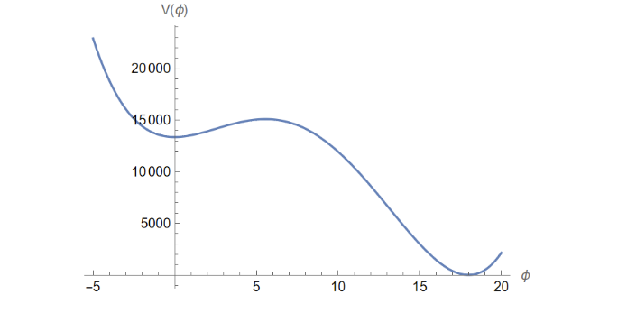
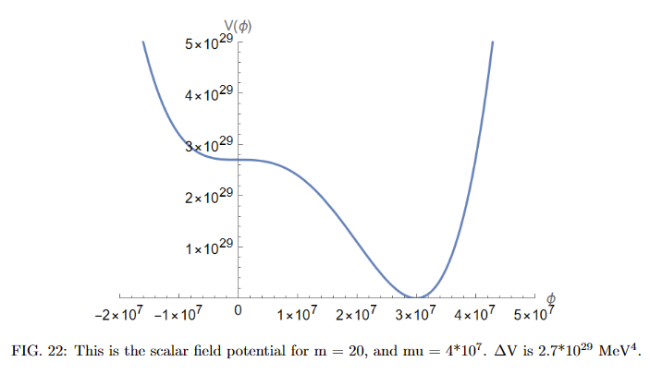
Potential Examples: m = 20 MeV
Region 1: 𝜇 = 31.4 MeV
Region 2: 𝜇 = 4x10⁷ MeV
Inflation Scales:
(ΔV)^{¼} = 10.75 MeV
(ΔV)^{¼} = 2.28x10⁷ MeV

Slide 19
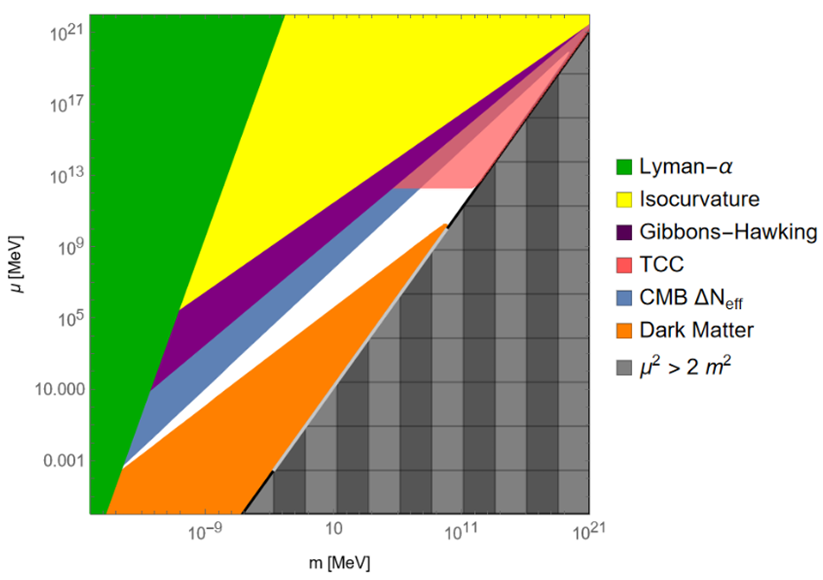
False Vacuum Stability & Inflation Scale

Slide 20
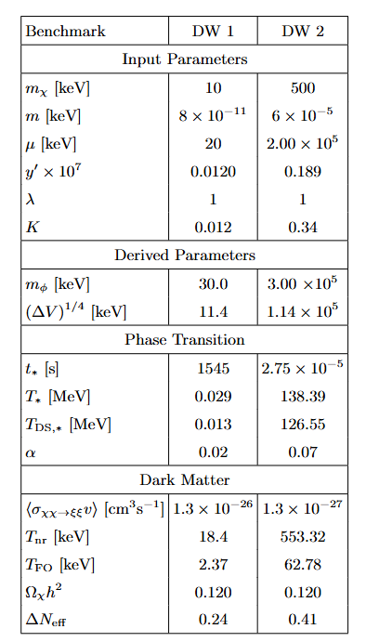
Benchmarks

Slide 21
Dark Sector Lagrangian
Ref: K. Freese and M. W. Winkler, Dark matter and gravitational waves from a dark big bang, Physical Review D 107, 083522 (2023).

Slide 22
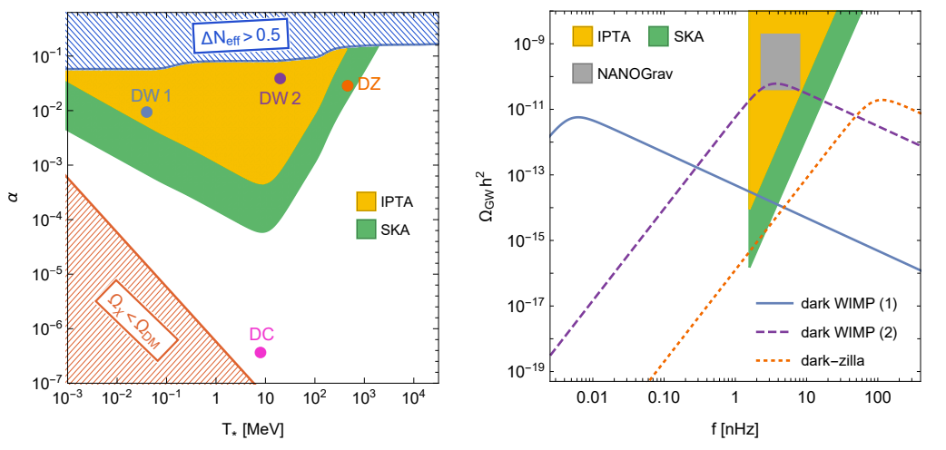
Gravity Waves
Ref: K. Freese and M. W. Winkler, Dark matter and gravitational waves from a dark big bang, Physical Review D 107, 083522 (2023).

Slide 23
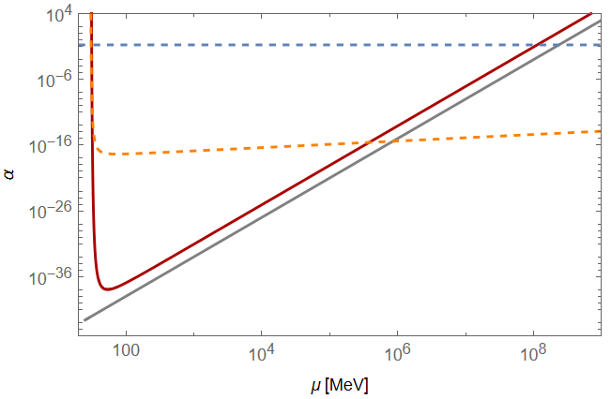
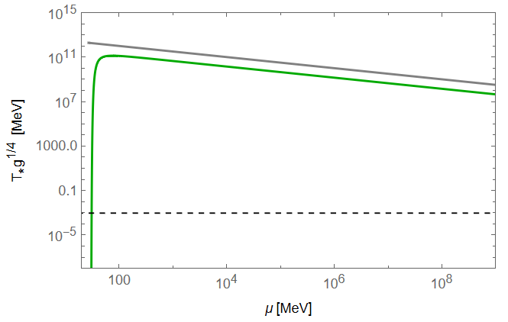
Analytic Scaling

Slide 24
Equations Used

Slide 25
Equations Used (cont)
Ref: K. Freese and M. W. Winkler, Dark matter and gravitational waves from a dark big bang, Physical Review D 107, 083522 (2023).

Slide 26
Dark WIMPs
Ω_{dm}h² = 0.120 ± 0.001
𝜒
DR (𝜉)
m_{𝜒} = ? (keV)
𝜎 = ?
𝜒
DR (𝜉)

Slide 27
Boltzmann Equation

Slide 28
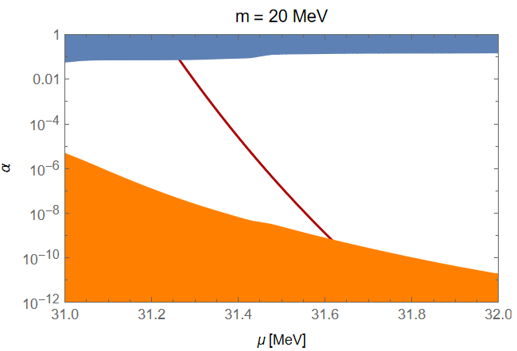
Fixed m plot clarification
𝛼

Slide 29
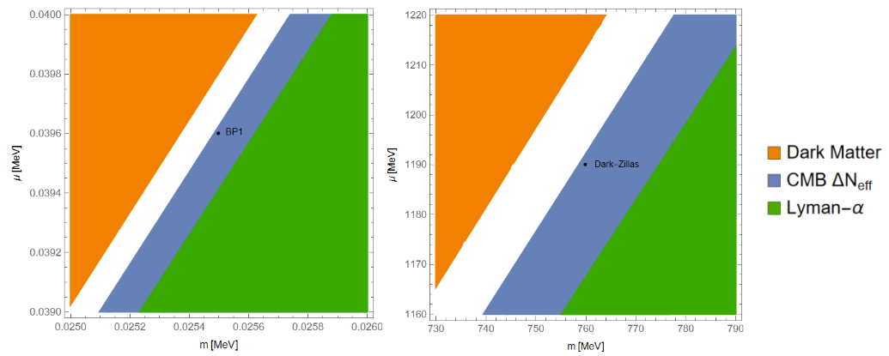
Discrepancies

Slide 30
Weakly Interacting Massive Particles (WIMPs)
DM
SM
Weak Coupling
𝝈_{EW} ~ 10⁻⁸ GeV⁻²
DM
SM

Slide 31
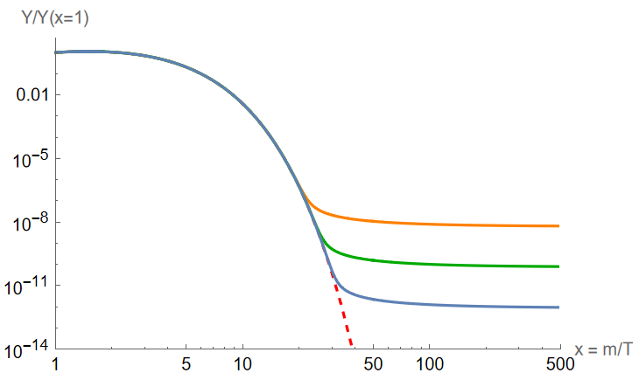
WIMP “Miracle”
m_{𝜒} = 200 GeV ~ E_{EW}
“Freeze Out”
Increasing 𝝈
𝝈 = 10⁻⁸ GeV⁻²
Ω_{𝜒}h² = 0.120

