Slide 1
Tracing Cosmic Evolution through Dark Matter Phenomena: The Origin of Supermassive Black Holes in JWST Era
Presenter: Saiyang Zhang
Cosmic Frontier Center & Weinberg Institute
Department of Physics, University of Texas at Austin
Collaborators: Katherine Freese(UT Austin), Volker Bromm(UT Austin), Cosmin Ilie(Colgate Univ), Boyuan Liu(Cambridge Univ)
IDM 2024

Slide 2
Content
Supermassive Black Holes (SMBHs): an overview
Results from the latest JWST observations
Beyond Standard Model physics on SMBH seeding
IDM 2024
Saiyang Zhang

Slide 3
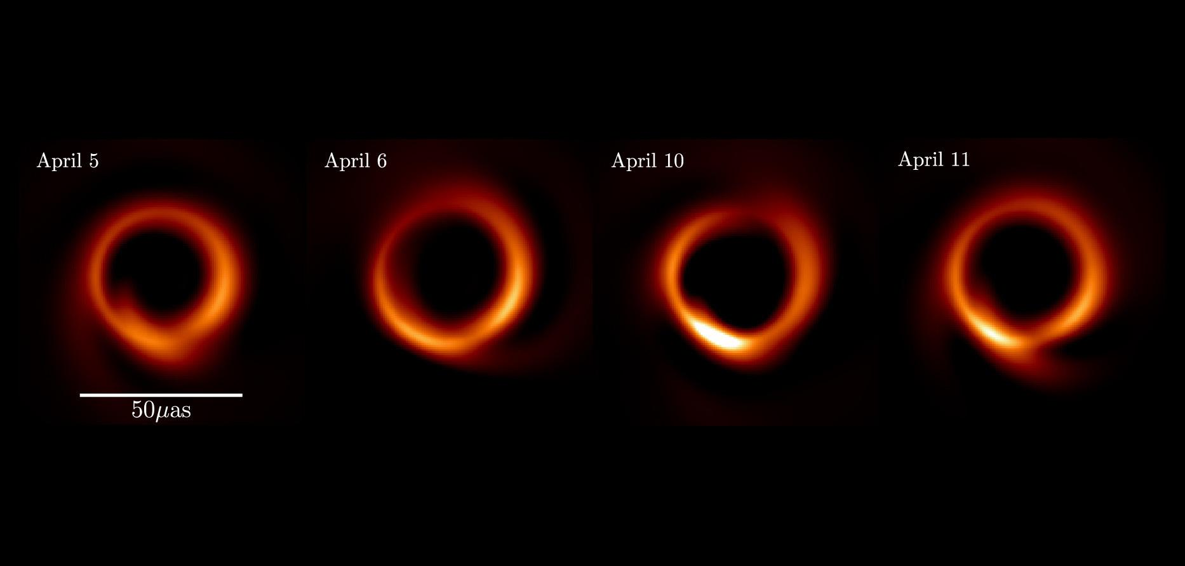
Supermassive Black Hole (SMBH)
Mass >10⁶ solar mass black holes
Accrete surrounding material through gravity and form accretion disk
Produce copious amount of X-ray emission, also a radio source
Could be observed through emission line broadening (fast moving clouds)
M87, Medeiros et al. (2023) [2304.06079]
IDM 2024
Saiyang Zhang

Slide 4
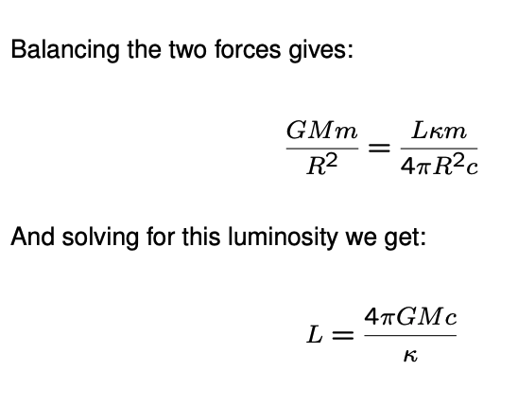
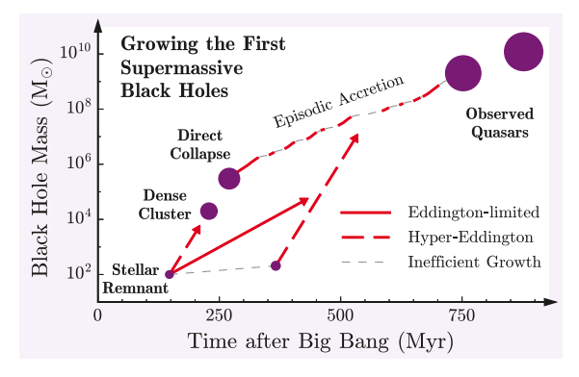
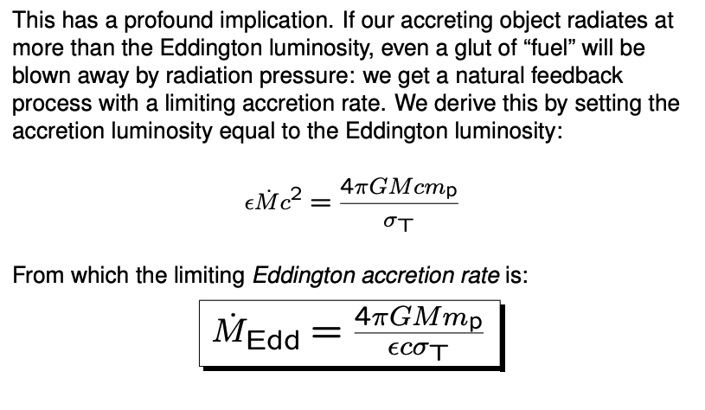
Black Hole Growth and Eddington Limit
https://www-astro.physics.ox.ac.uk/~garret/teaching/lecture7-2012.pdf
IDM 2024
Saiyang Zhang
Smith et al. (2017) [1703.03083]
Notes:
Salpeter time, as time scale to which BH growth by e-fold from its original seed

Slide 5
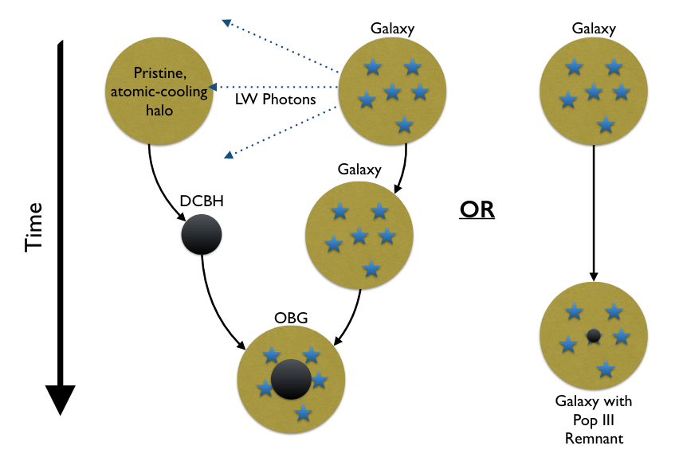
Light Seed vs. Heavy Seed in ΛCDM Model
Pop III star remnants
Dense Star Cluster
Direct Collapse Black Hole (DCBH)
IDM 2024
Saiyang Zhang
Smith et al. (2019) [1904.12890]

Slide 6
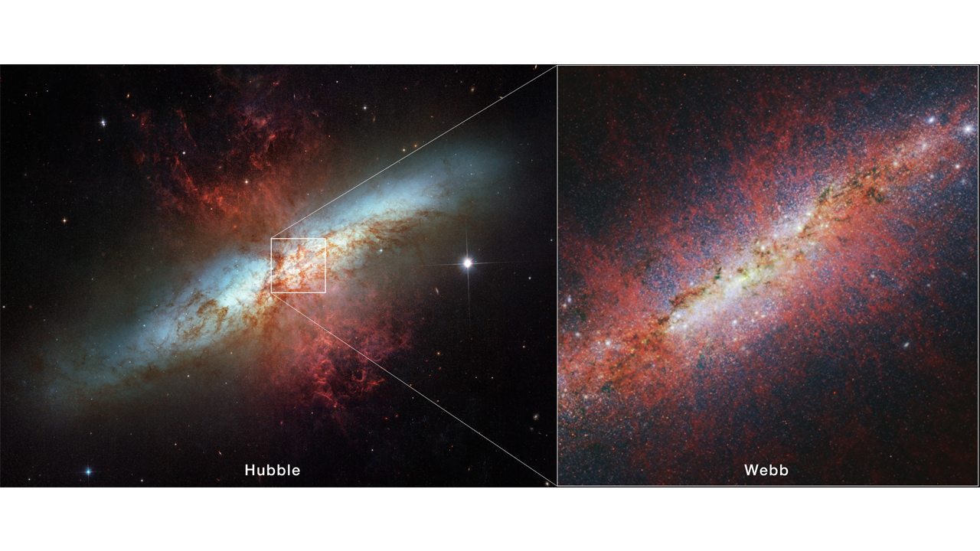
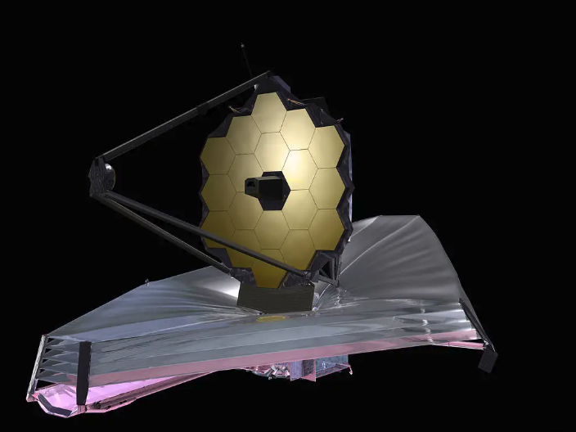
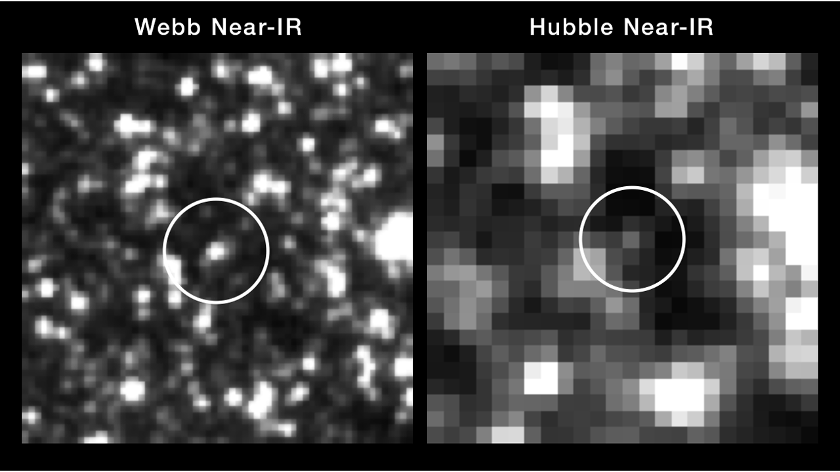
James Webb Space Telescope (JWST)
https://www.nasa.gov/image-article/james-webb-space-telescope-jwst/
IDM 2024
Saiyang Zhang

Slide 7
Questions on Cosmology from JWST Discovery
Stress testing standard universe model (Boylan-Kolchin (2023) [2208.01611])
Discovery of too massive galaxies with stellar mass >10⁹ solar mass at high redshift z >10
Challenging current cosmic structure/galaxy formation theory and simulations
Need new theory/models to explain, or over-prediction of stellar mass (Wang et al. (2024) [arXiv:2403.02399])
Early Supermassive Black Hole formation
See next page
IDM 2024
Saiyang Zhang

Slide 8
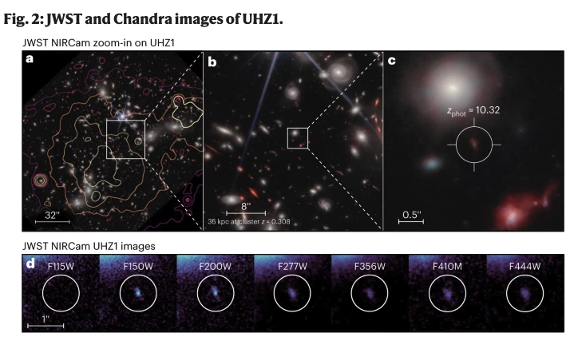
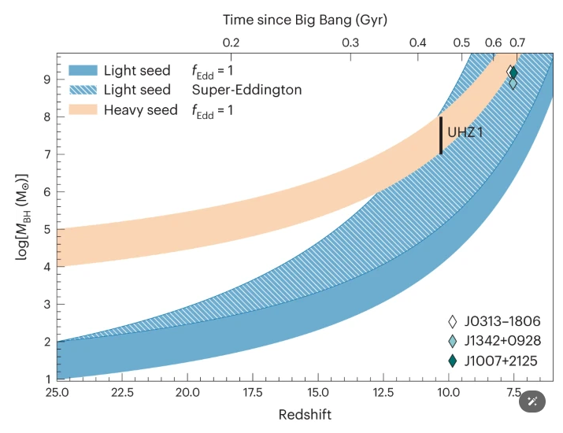
Some Recent Discoveries from JWST
z=10 AGN: UHZ-1
Bodgan et al. (2024) [2305.15458]
IDM 2024
Saiyang Zhang

Slide 9
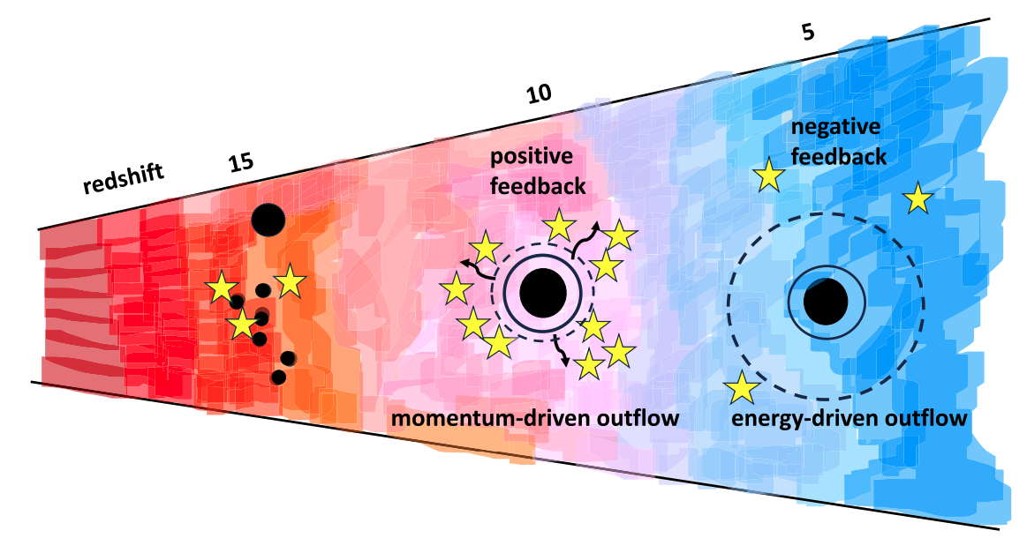
Co-evolution of SMBH with Galaxy
Chicken or Egg? Silk et al. (2024) [2401.02482]
IDM 2024
Saiyang Zhang
Notes:
Early time: cooling effective, material out flow, foster star formation
Late time: cooling ineffective, due to higher IGM temperturature,

Slide 10
Beyond Standard Model Path
Supermassive Dark Star (WIMP)
(Massive) Primordial Black Holes (PBH)
Self-interacting Dark Matter (SIDM, see tomorrow’s planetary talk)
…
IDM 2024
Saiyang Zhang

Slide 11
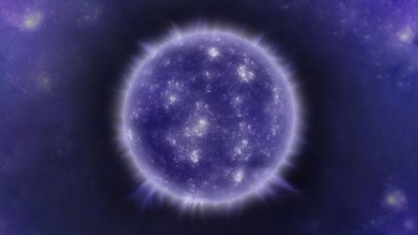
About Dark Stars
Formed in the center of mini-halo
Powered by DM(WIMPs), no fusion reaction
Capture DM to refuel
Can grow supermassive to about ~10⁷ solar mass
Collapse into massive black hole seed after fuel depleted
https://www.sci.news/astronomy/webb-supermassive-dark-stars-12096.html
Freese et al. (2008) [0802.1724]
IDM 2024
Saiyang Zhang

Slide 12
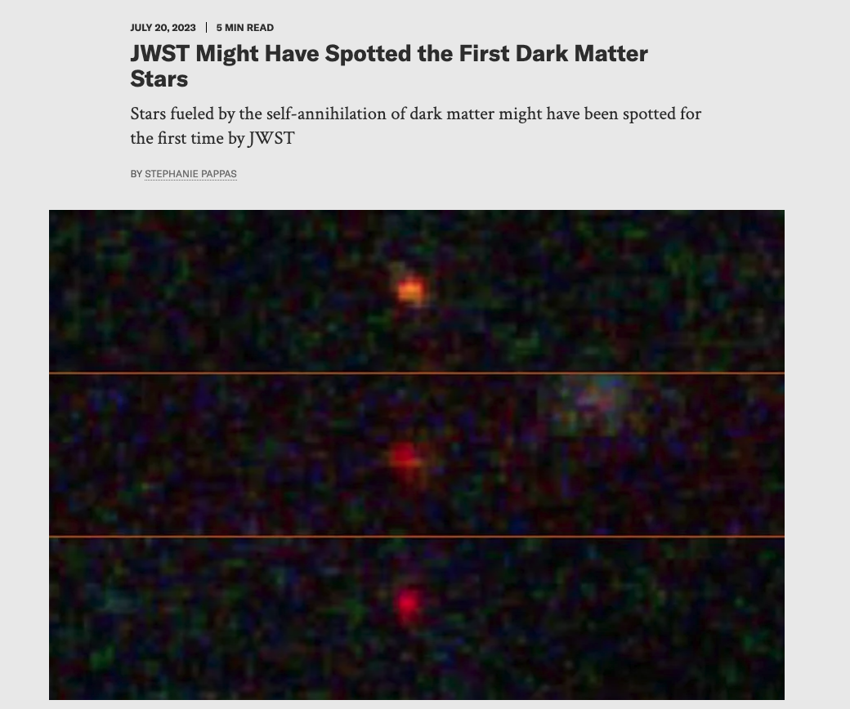
https://www.scientificamerican.com/article/jwst-might-have-spotted-the-first-dark-matter-stars/
IDM 2024

Slide 13
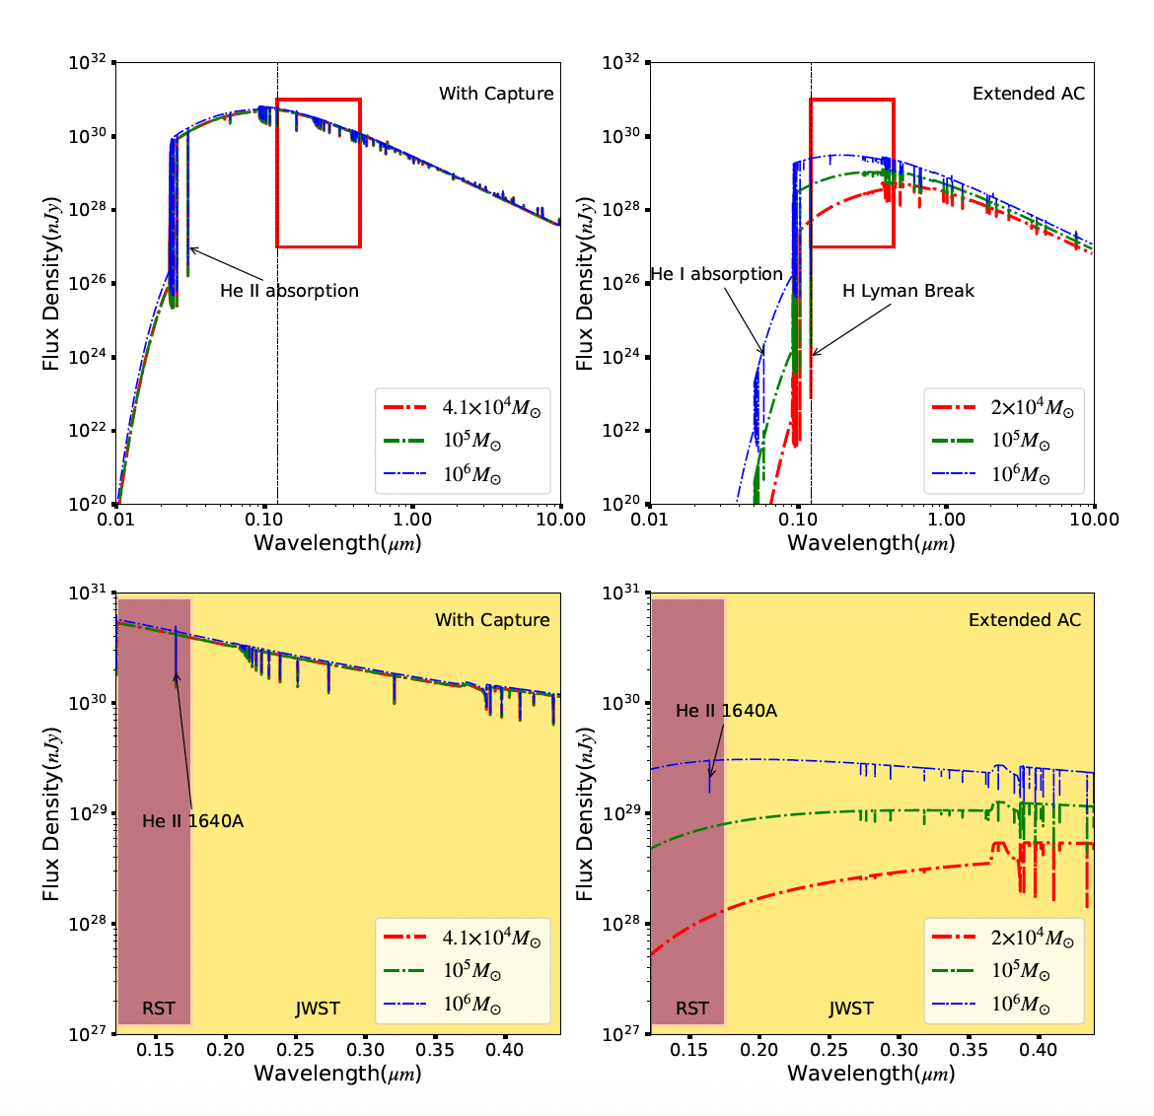
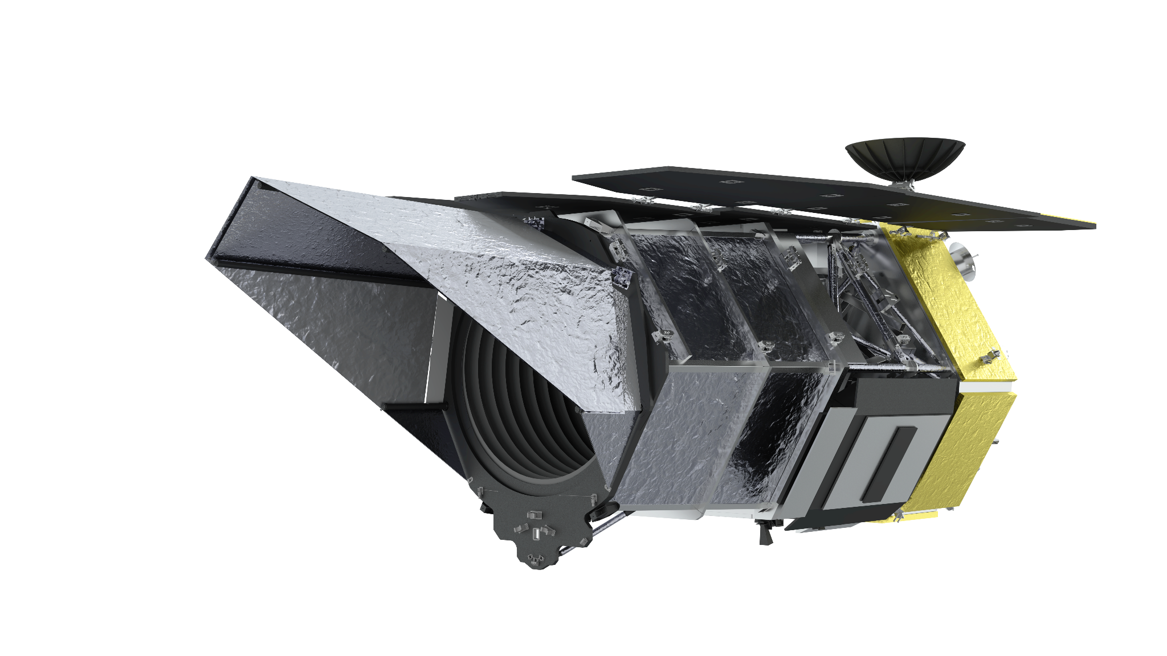
Dark Stars Detectable by Roman Space Telescope (RST)
RST have similar detection limit as JWST but have much wider field of view
RST could detect supermassive dark stars up to z~14, and capable of distinguishing them from early galaxies by unique spectral features
Lensing by foreground object can help us find less massive dark stars
Zhang et al.(2024) [2306.11606]
IDM 2024
Saiyang Zhang
Notes:
Right: smoking gun for DS
Capable of finding more DS candidates, and follow up observation by JWST

Slide 14
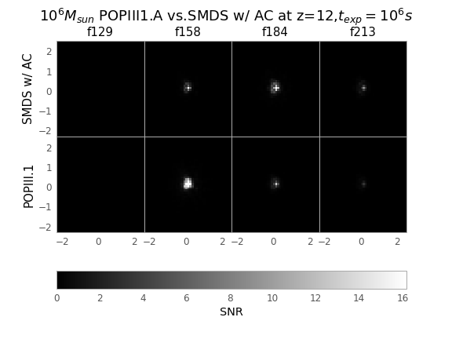
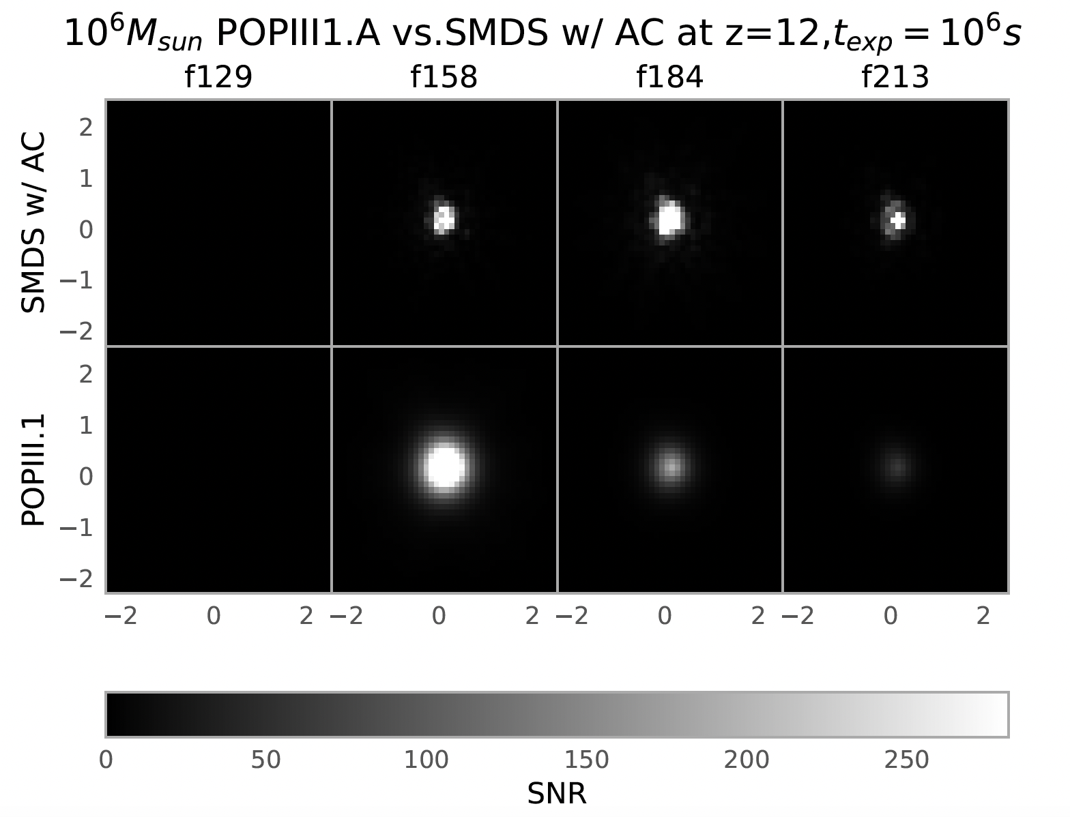
Dark Stars Detectable by Roman Space Telescope (RST)
No Lensing
Zhang et al.(2024) [2306.11606]
100x Lensing
IDM 2024
Saiyang Zhang
Notes:
Mock image of DS observation, lensing can boost the magnitude of the object, make it much brighter with higher SNR, help us see it better

Slide 15
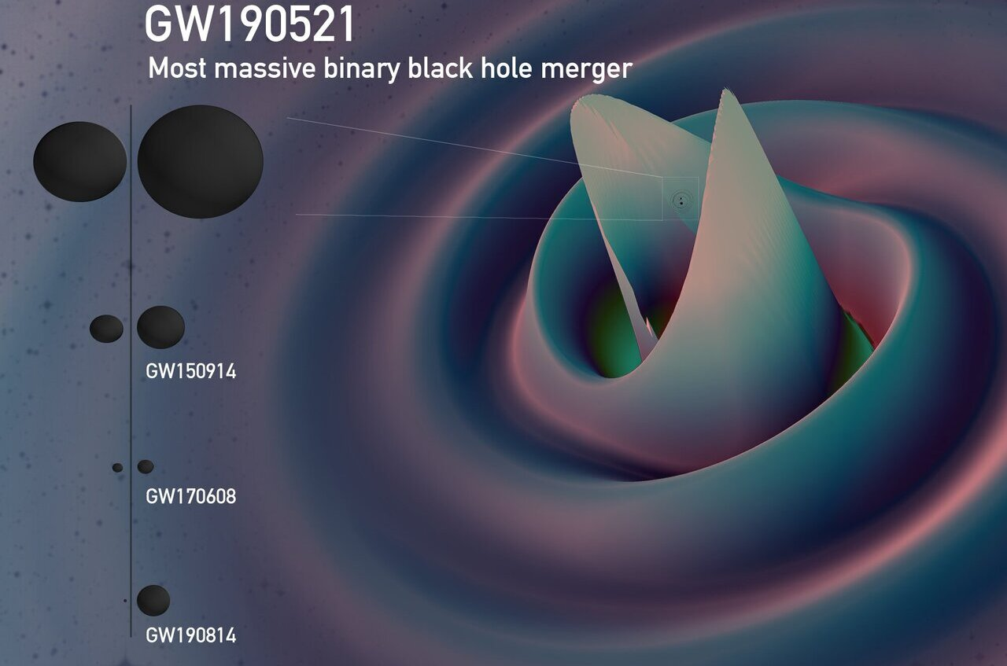
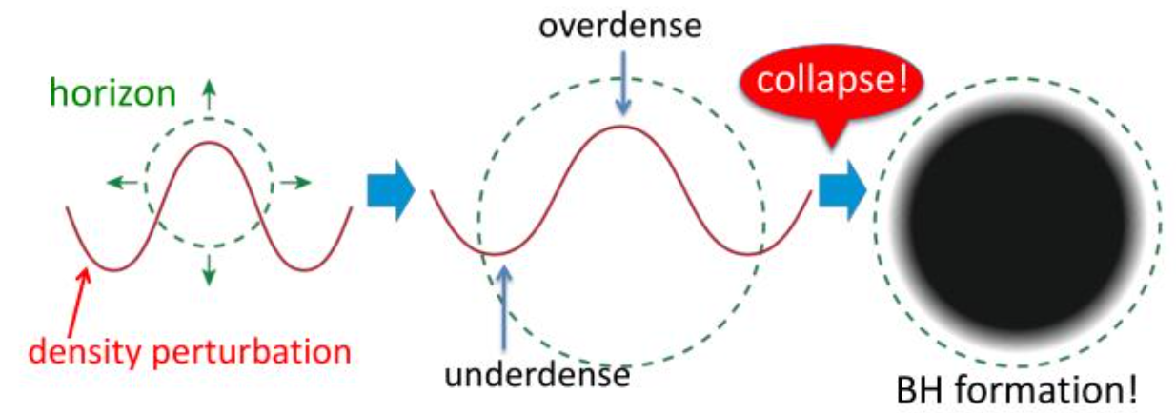
Primordial Black Holes
Formation
Gravitational Wave as a Probe
https://phys.org/news/2021-03-gw190521-event-primordial-black-holes.html
https://en.wikipedia.org/wiki/Primordial_black_hole
IDM 2024
Saiyang Zhang

Slide 16
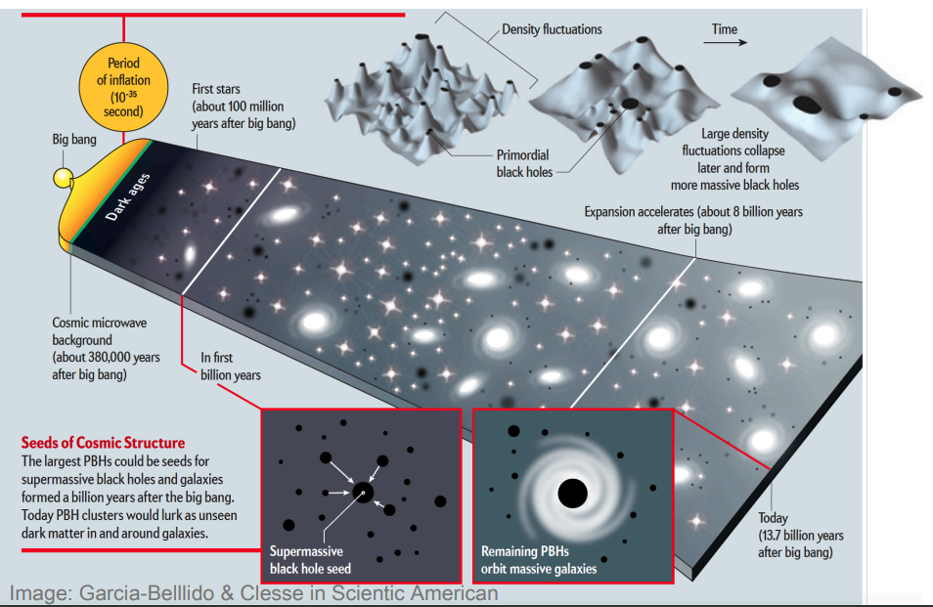
Credit: https://kspa.soe.ucsc.edu/sites/default/files/Lecture1_PN.pdf
IDM 2024
Saiyang Zhang

Slide 17
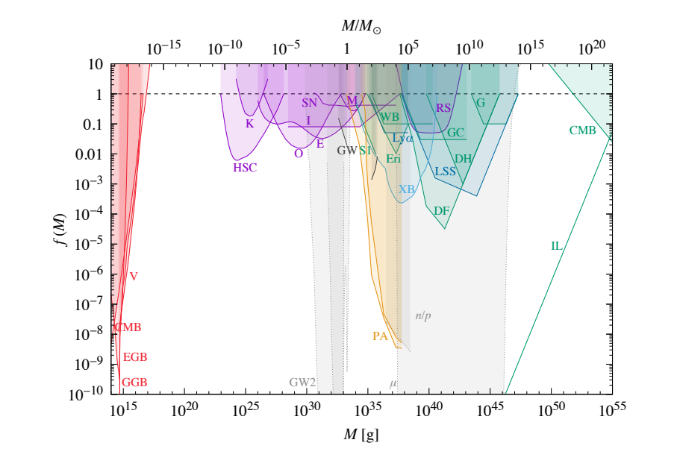
Evaporation
Lensing
Dynamical Friction
Accretion & Gravitational wave
Large-scale Structure
Fig 10: Carr et al. (2021) [2002.12778]

Slide 18
Primordial Black Holes and Structure Formation
10⁶ solar mass Primordial Black Hole candidate used in this work
Primordial Black Holes will seed the formation of halos surrounding them
Primordial Black Hole seeded halos will engulf newly formed neighboring halos
Zhang et al. (2024) [2405.11381]
IDM 2024
Saiyang Zhang
Notes:
Do not tweet this yet
In light of JWST observation, we hope to study its influence on structure formation, DM only
Run till z~10

Slide 19
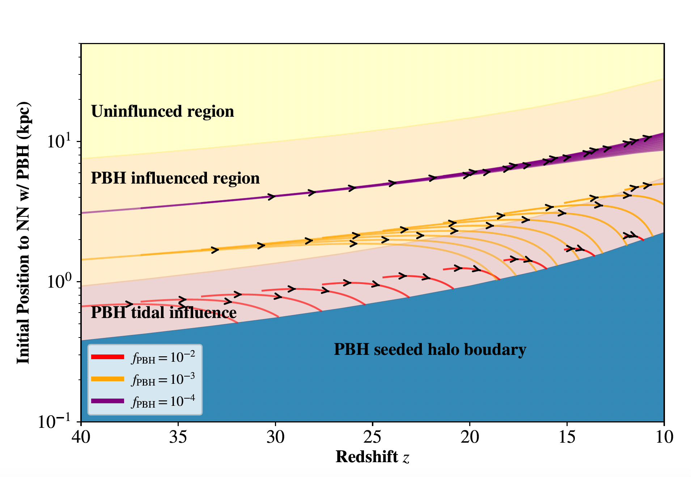
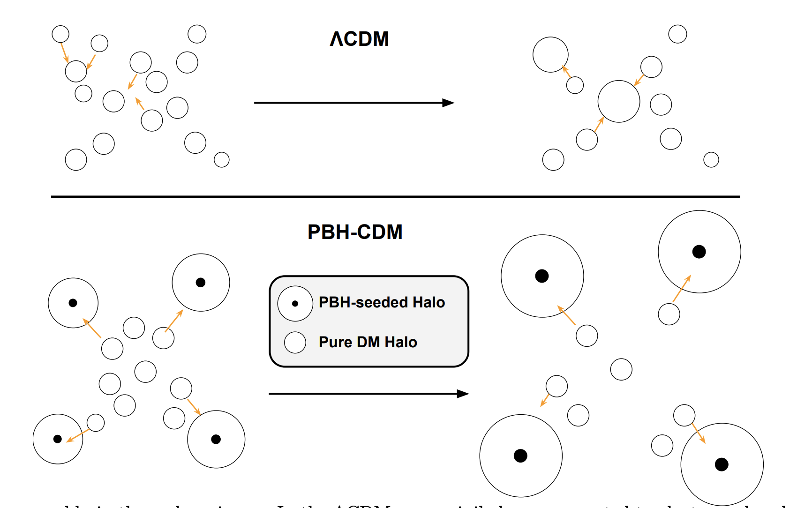
Halo Dynamics in PBH Universe
Zhang et al. (2024) [2405.11381]
IDM 2024
Saiyang Zhang

Slide 20
Zhang et al. (2024) [2405.11381]
IDM 2024
Saiyang Zhang
Notes:
Left: standard cosmology
Right: PBH cosmology, early seed for galaxies

Slide 21
In the Future
Run more cosmological simulations with different initial conditions/scales for Primordial Black Holes
Study how would different Primordial Black Hole candidates influence the formation of the first stars and galaxies
Find more possible observational features from Dark Stars and Primordial Black Holes
Data mining from available JWST dataset
IDM 2024
Saiyang Zhang

Slide 22
Summary
In the era of deep sky surveys, we are closer to understand the formation of SMBH in early universe
Early JWST results favor the heavy seed scenario
Different astrophysical phenomenologies from beyond standard model DM could also form massive seeds to solve the problem involving supermassive black hole formation
IDM 2024
Saiyang Zhang

Slide 23
Thank you!
Grazie!
IDM 2024
Saiyang Zhang

