Slide 1
Robust inference of the Galactic centre gamma-ray excess spatial properties
Chris Gordon (University of Canterbury, NZ)
Based on: D. Song, C. Eckner, CG, F. Calore, O. Macias, K. N. Abazajian, S. Horiuchi, M. Kaplinghat and M. Pohl, MNRAS 530 (2024) no.4, 4395-4411
Some directly related talks: Dan Hooper (Wednesday, Thursday); Francesca Calore (Thursday); Jason Kumar (Thursday)

Slide 3
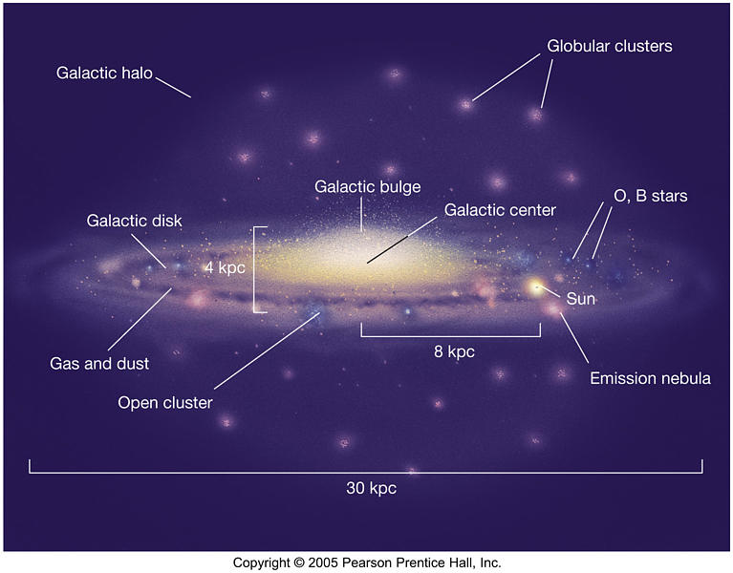
Edge-on view of the Milky Way

Slide 4
Galactic Center Excess Candidates

Slide 5
Galactic Diffuse Emission
Generated using gas column densities, and a GALPROP (Strong+2007) generated Inverse Compton (IC) intensity map.

Slide 6
Used Pohl et al. (2008) 3D hydrodynamic model.

Slide 7







Bulge Templates
Freudenreich (1998)
Cao et al. (2013)
Coleman et al. (2020)
McDermott et al. (2023)
Bulge templates after they are convolved with the point spread function (PSF) at 1.02-1.32 GeV.

Slide 8
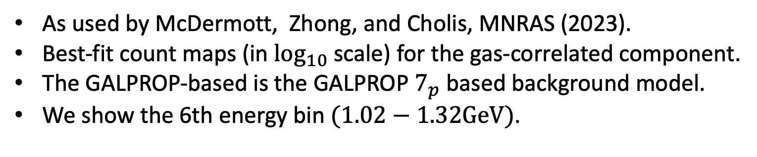
Masks
As used by McDermott, Zhong, and Cholis, MNRAS (2023).
Best-fit count maps (in $\log_{10}$ scale) for the gas-correlated component.
The GALPROP-based is the GALPROP $7_{p}$ based background model.
We show the 6th energy bin $(1.02−1.32GeV)$.

Slide 9
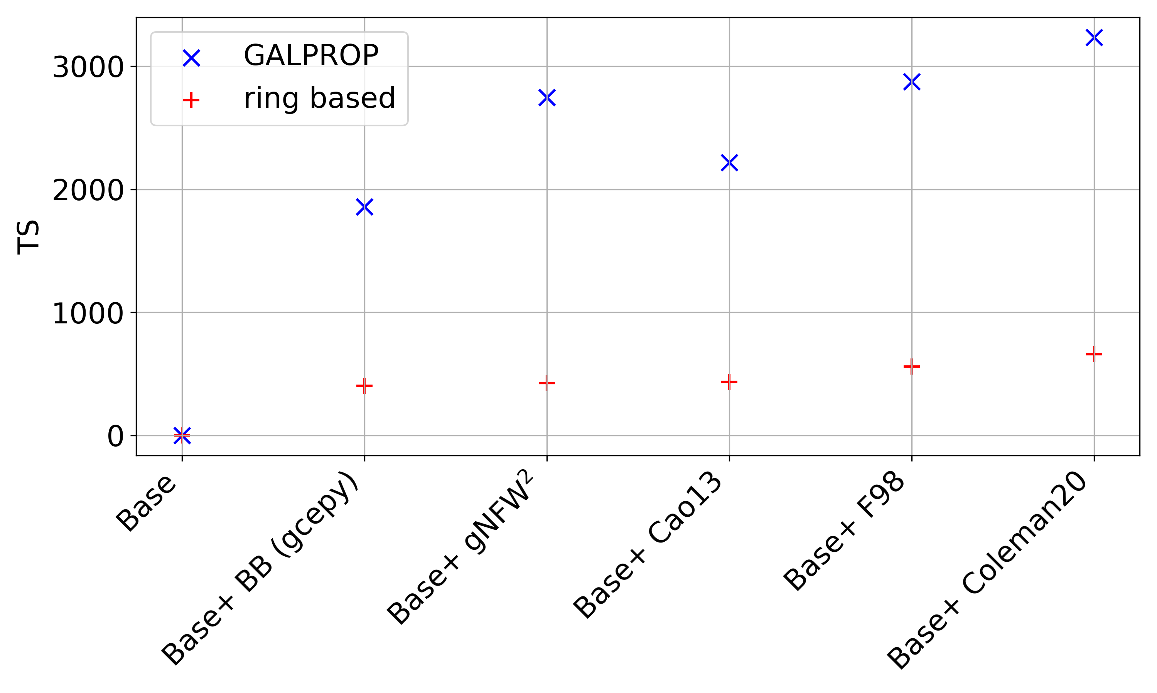

Slide 10



Larger Mask
A comparison of the fraction of the sky masked.
Note that in both cases, the plot is for the combined point source and Galactic plane mask.

Slide 11
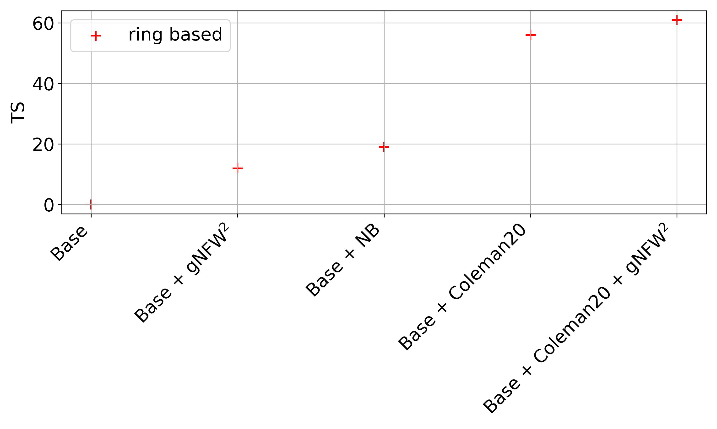
Larger Mask

Slide 12
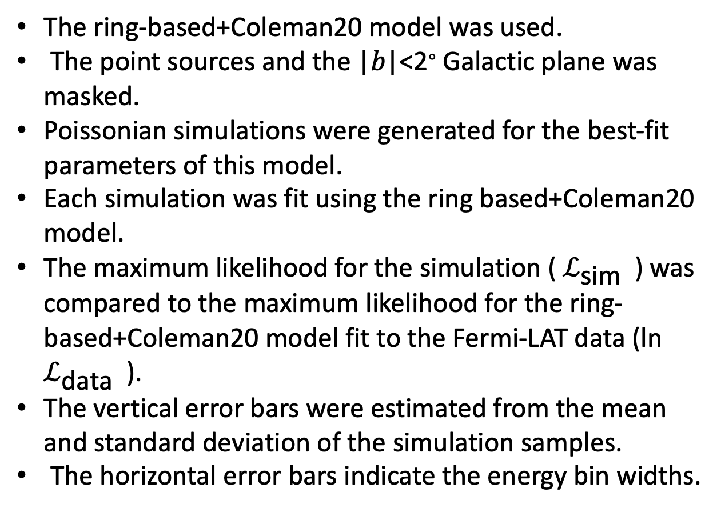
Monte Carlo Simulations
The ring-based+Coleman20 model was used.
The point sources and the |𝑏|<2∘ Galactic plane was masked.
Poissonian simulations were generated for the best-fit parameters of this model.
Each simulation was fit using the ring based+Coleman20 model.
The maximum likelihood for the simulation ( $ℒ_{\text{sim} }$ ) was compared to the maximum likelihood for the ring-based+Coleman20 model fit to the Fermi-LAT data (ln $ℒ_{\text{data} }$ ).
The vertical error bars were estimated from the mean and standard deviation of the simulation samples.
The horizontal error bars indicate the energy bin widths.

Slide 13
skyFACT Modulation
skyFACT (Storm et al. 2017; Bartels et al. 2018; Calore et al. 2021) uses adaptive template fitting, invoking a large number of modulation parameters whose ranges are controlled by user-input hyper-parameters.
The degree of variation in these modulation parameters is restricted via a penalising likelihood function adding to a standard Poisson likelihood term to prevent overfitting.
For each of the considered background model setups, we performed a fit to the Fermi-LAT data by enabling spatial re-modulation.
We obtain what we call "optimised" versions of the original background model setups.

Slide 14
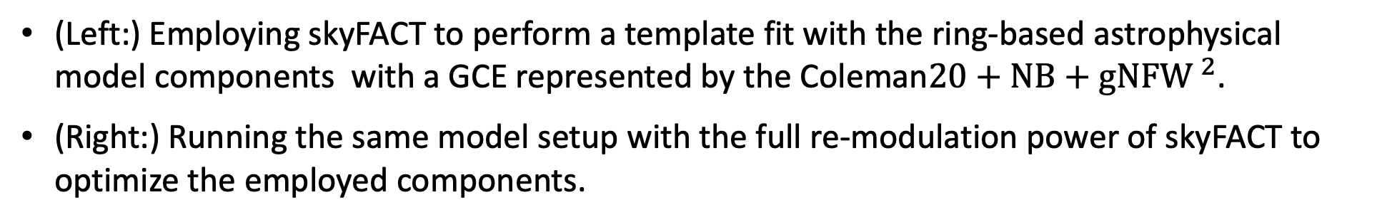
skyFACT Modulation
(Left:) Employing skyFACT to perform a template fit with the ring-based astrophysical model components with a GCE represented by the Coleman$20+NB+gNFW ^{2}$.
(Right:) Running the same model setup with the full re-modulation power of skyFACT to optimize the employed components.

Slide 15
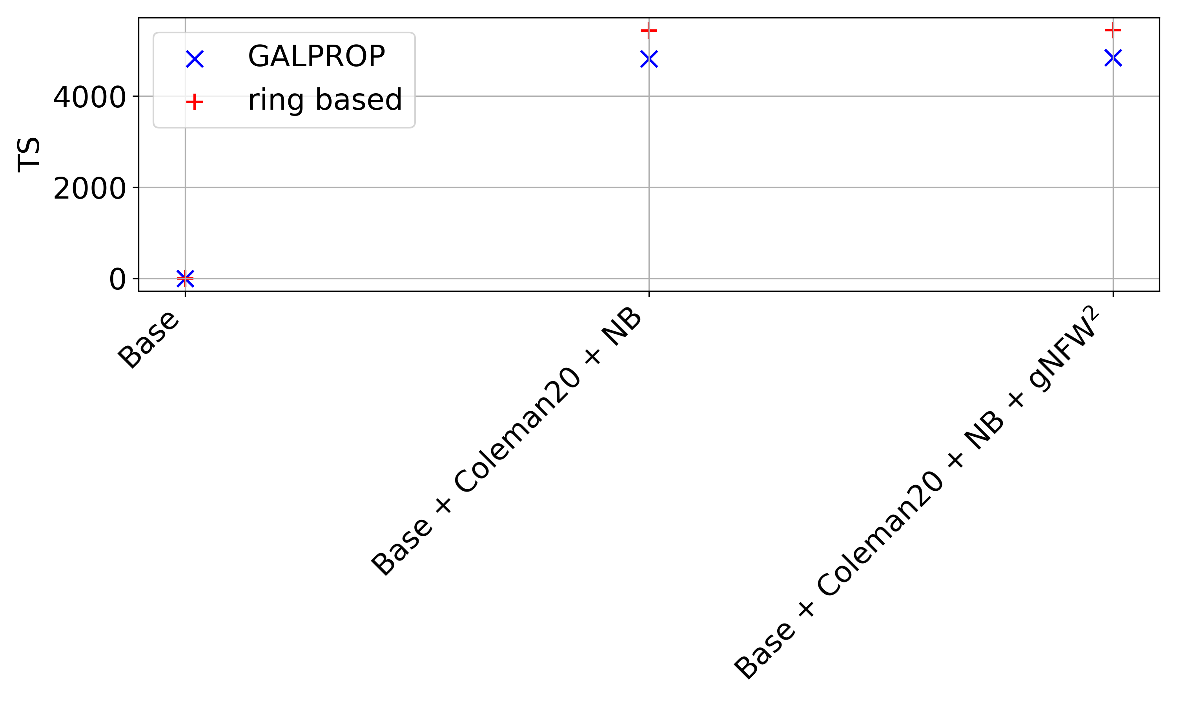
skyFACT Modulation

Slide 16
Zhong and Cholis, PRD, 2024
They use different masks constructed from Fermi point source catalogues and a wavelet method.
They also look at a range of different GALPROP templates.
They find that compared to various stellar bulge profiles, a spherical dark matter annihilation profile has a similar TS to the Coleman20 bulge template.
They use non-gradient descent optimisation.

Slide 17
Conclusions
Using the same mask and GALPROP background templates as McDermott, Zhong, and Cholis, MNRAS (2023), we found the Coleman20 bulge provided a better fit to the GCE than the dark matter gNFW² template.
This conclusion was robust to using ring-based background templates, significantly larger masks and also skyFACT modulation.

Slide 18
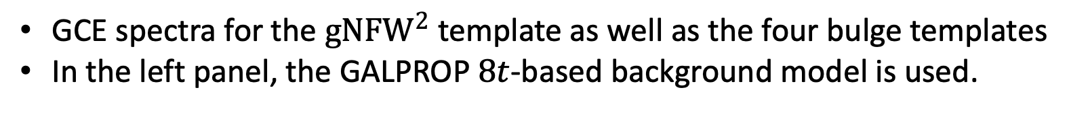
GCE spectra
GCE spectra for the ${gNFW}^{2}$ template as well as the four bulge templates
In the left panel, the GALPROP $8t$-based background model is used.

Slide 19
Background Spectra
Best-fit spectra for the HI, H2, ICS, negative and positive dust corrections
Ring-based background model.
The results are obtained with no GCE template and are from the L-BFGS-B algorithm.

Slide 20
Isotropic Diffuse Gamma-Ray Background Emission (IGRB) Spectrum
The above spectra are for the GALPROP-based background model, using different GCE templates (including no excess).

Slide 21
Isotropic Diffuse Gamma-Ray Background Emission (IGRB) Spectrum
The above spectra are for the Ring-based background model, using different GCE templates (including no excess).

Slide 22
Distribution of Disk and Bulge Millisecond Pulsars (MSPs)
See Ploeg, Gordon, Crocker, and Macias, “Comparing the Galactic Bulge and Galactic Disk Millisecond Pulsars”, JCAP12(2020)035 for more details.

