Slide 1
Light DM in Direct Detection: Plasmon and Migdal Effects
Lei Wu
Nanjing Normal University
thanks to all my collaborators in this talk
2401.11971
2309.09740

Slide 2
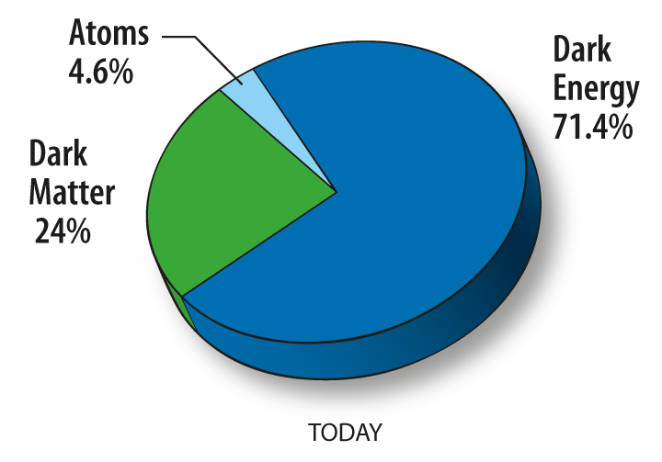
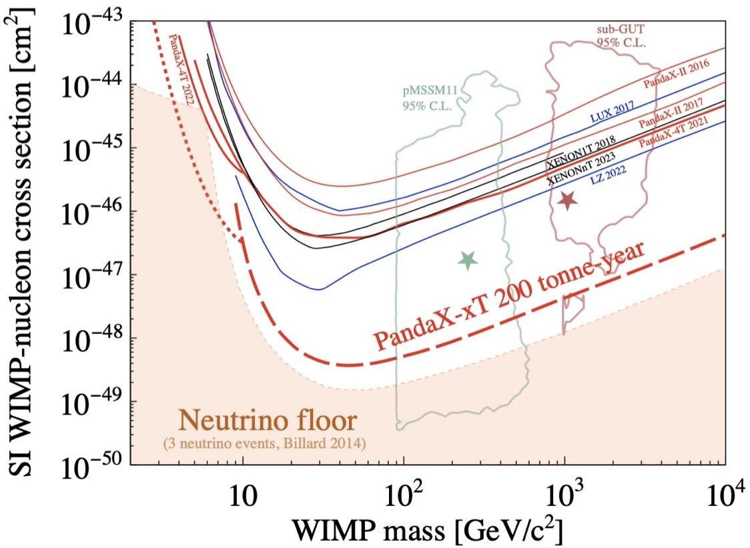
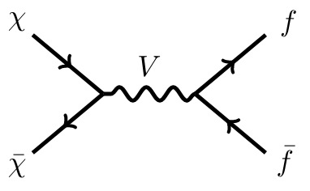
1. From WIMPs to Light DM
SUperSYmmetry
Weakly Interacting Massive Particles
PandaX collaboration, 2402.03596
Notes:
As we know, the existence of dark matter has been supported by many astrophysical and cosmological observations. The amount of dark matter is about 5 times of ordinary matter. But so far, we have only known the gravitational interactions of dark matter. Like the study of ordinary matter, exploring the microscopic properties of dark matter is an essential task. In the past decades, people have proposed lots of dark matter candidates. Among them, the weakly interacting massive particles are very attractive. If a dark matter has a mass around 100 GeV and a weakly coupling with SM particles, then the dark matter can naturally freeze out and give the correct relic density. Besides, WIMP dark matter is widely predicted in many famous new physics models, such as supersymmetry. However, from this plot, we can see that the sensitivity of direct detection has been approaching to the neutrino floor, and the recent null results of searching for WIMPs have excluded a large portion of parameter space of two popular SUSY models. So this motivates people to think about other options.

Slide 3
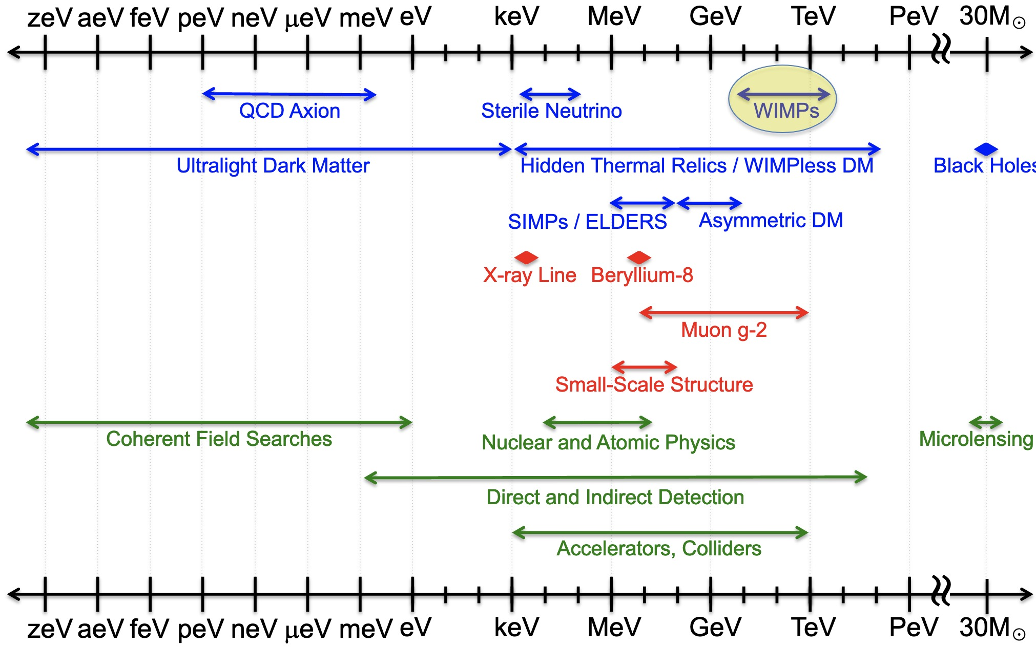
1. From WIMPs to Light DM
Wave-like
Particle-like
Macroscopic
Feng 2212.02479
Notes:
Besides WIMP dark matter, we also have may other candidates, such as axion dark matter, light dark matter, primordial black hole and etc. In this talk, I will focus on the light dark matter, whose mass is lighter than a proton mass. In some way, this kind of dark matter can be considered as the variants of conventional WIMP dark matter. The light dark matter may also relate with other new physics hints, such as muon g-2, small scale structure, and etc. The probes of light dark matter are plentiful. We can probe the light dark matter from particle physics, astrophysics and cosmology. Here, I will talk about searching for light dark matter in direct detections.

Slide 4
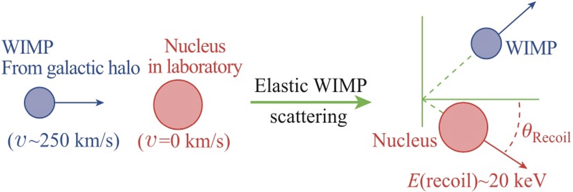
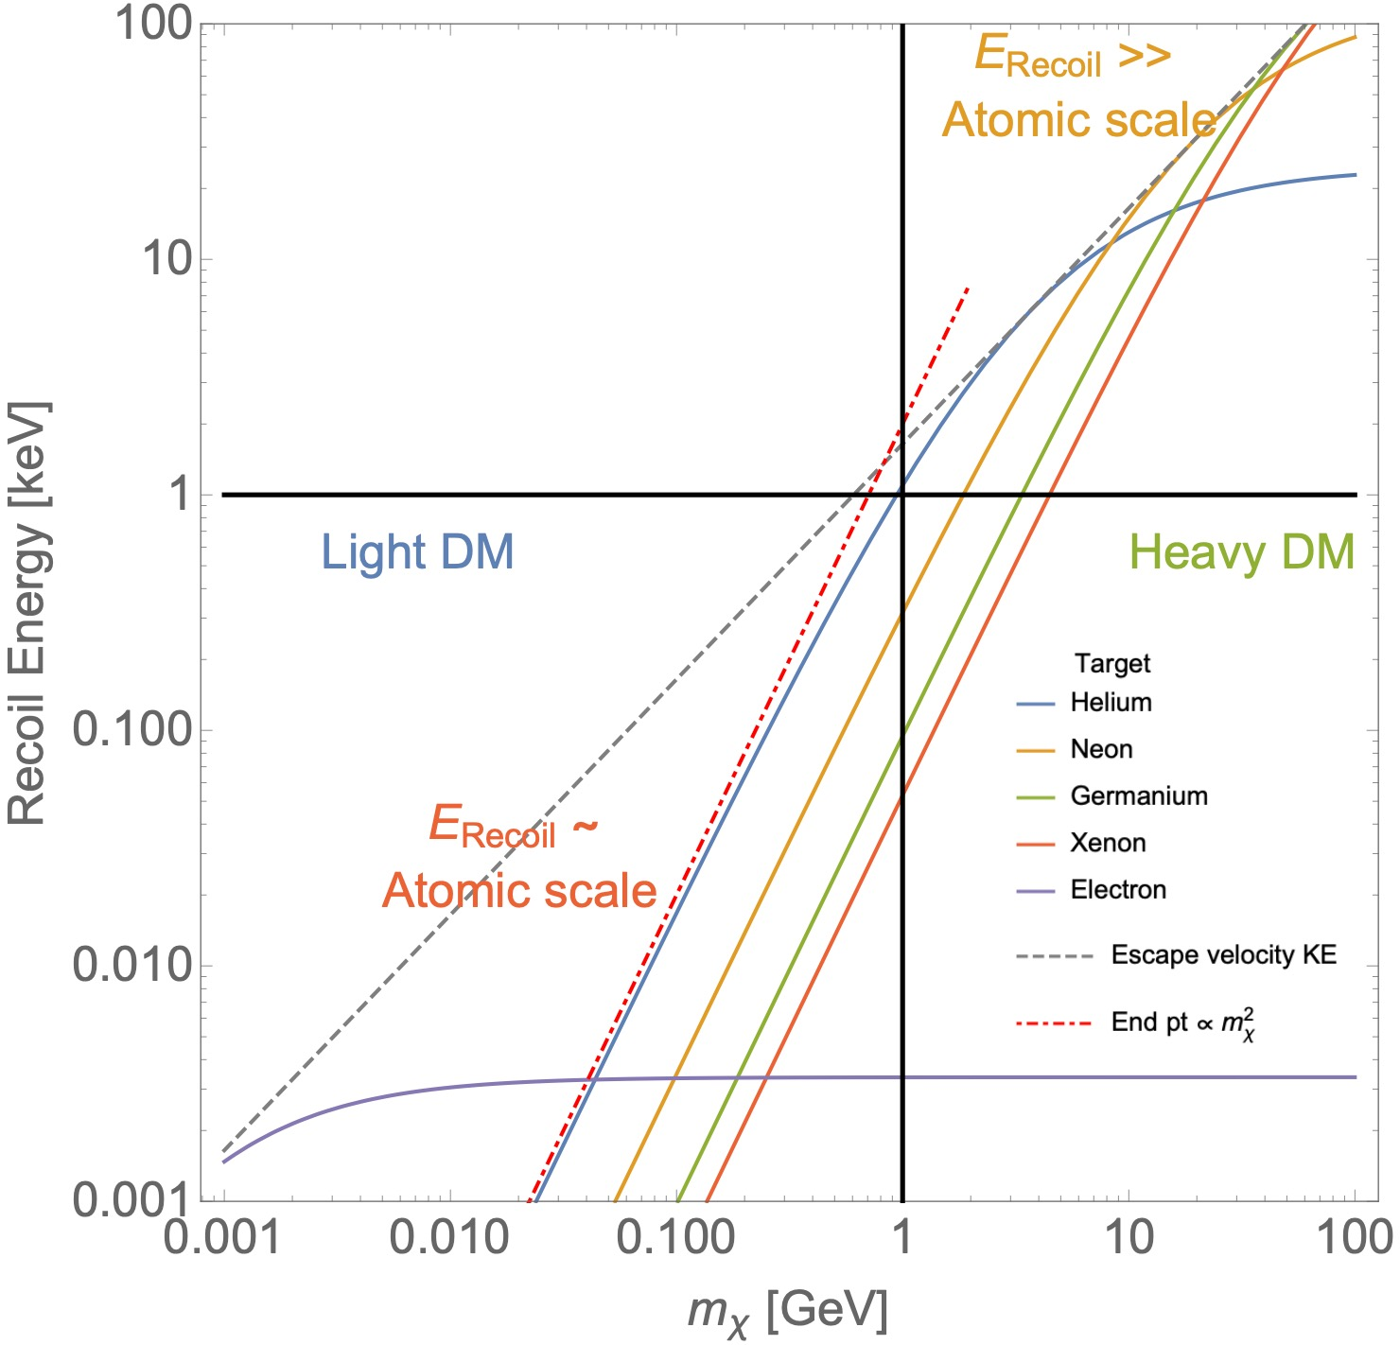
2. Light DM and Low Energy Ionization
From EW scale to sub-GeV Thermal DM
1
Relic Density and Models
2
Direct Detection
threshold of nucleus recoil for Xenon experiment : ~ keV
Light Non-SM Mediator
Notes:
When we shift from WIMPs to light dark matter, there are two important questions to address: the first is how to get the correct relic density. A fessible way is to introduce the light non-SM mediator, such as secluded dark matter or other new mechanisms. The second question is whether we can detect the light dark matter in direct detection experiments. As we know, if the dark matter mass is lighter than 1 GeV, its nucleus recoil energy in elastic scattering process are usually below the threshold of the detector, and thus can not be observed.

Slide 5
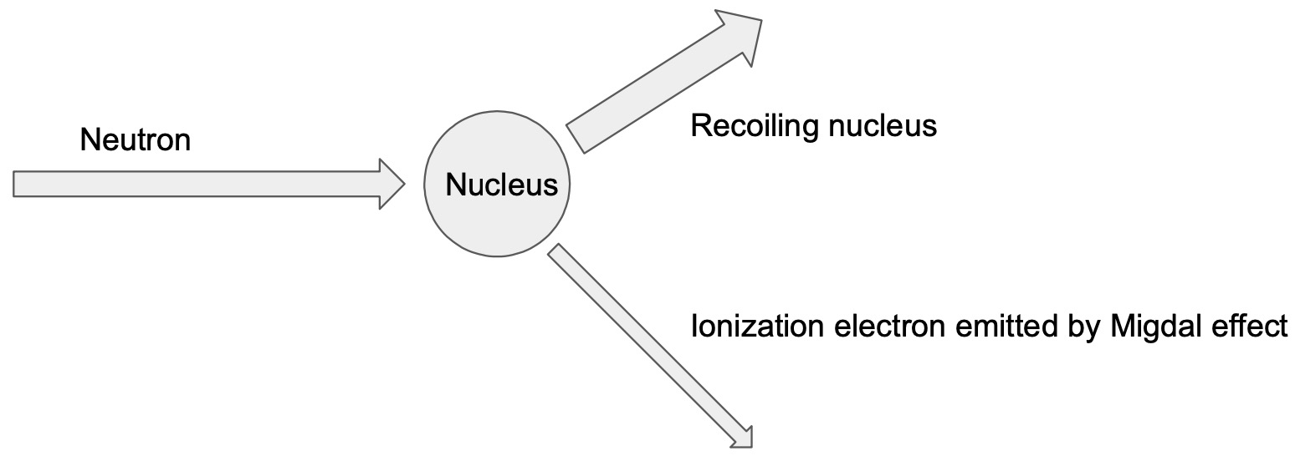
2. Light DM and Low Energy Ionization
Ionization signal provides a promising way to detect sub-GeV DM
e.g. threshold of electron recoil for Xenon experiment : ~ 100 eV
1. Migdal Effect
short
Two tracks
DM
No quenching!
long
Notes:
On the other hand, it should be noted that, besides elastic scattering, the dark matter can scatter with the nucleus inelastically, and lead to the ionization signals, namely the Migdal effect. Of course it is in low chance, but it provides us a new way to extend the sensitivity to sub-GeV dark matter. In experiment, the signature of Migdal scattering consists of two tracks from the same vertex. There is no quenching effects in this process.

Slide 6
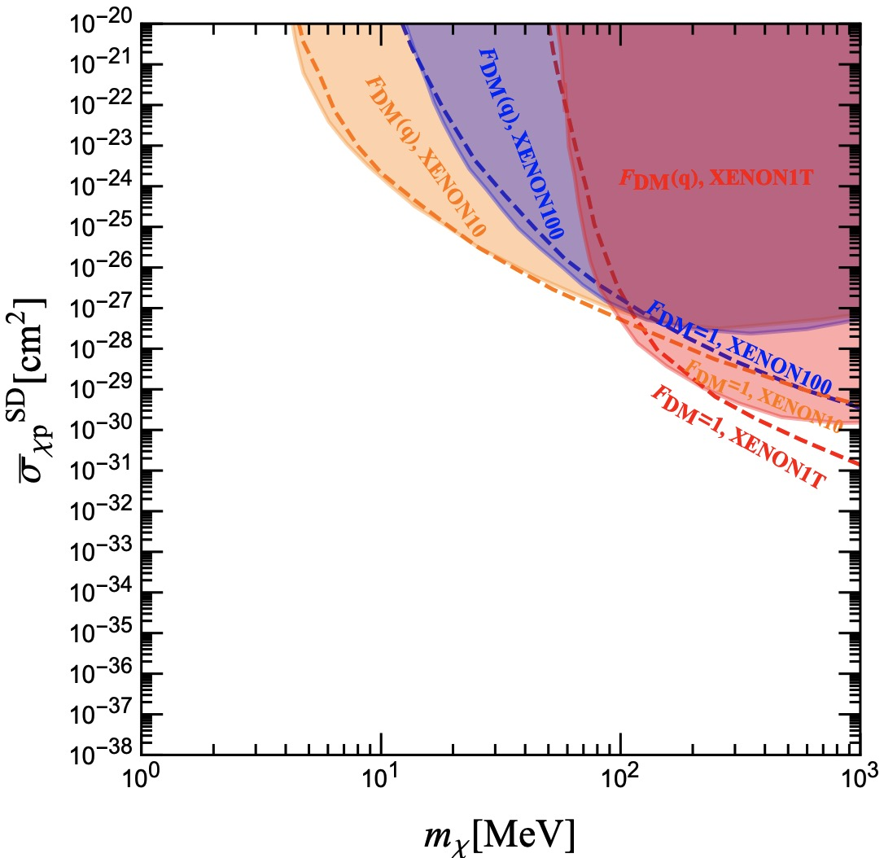
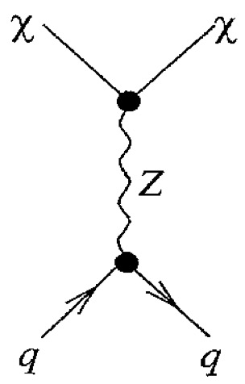
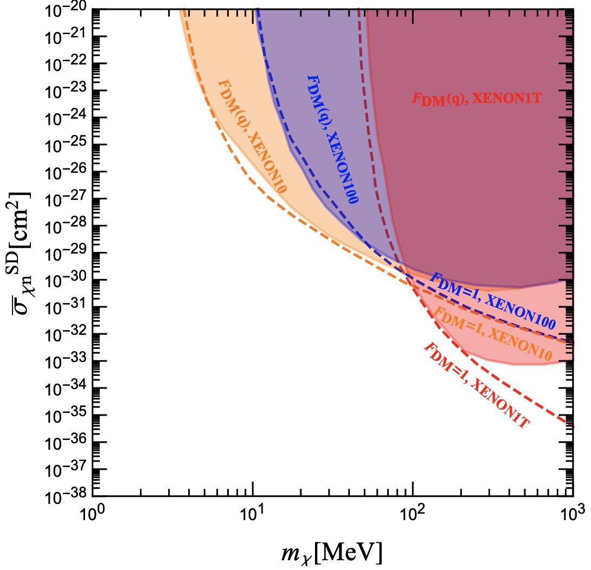
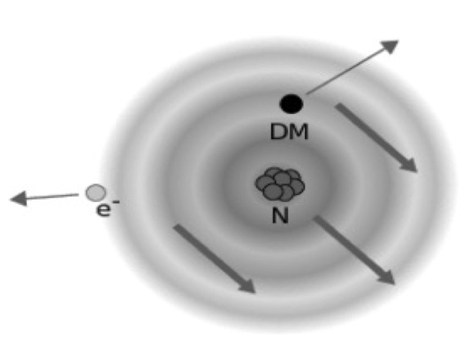
2. Light DM and Low Energy Ionization
1. Migdal Effect
Gu, Su, WU, Zhu, 2309.09740
Li, Su, WU, Zhu, 2210.15474
Wang, WU, Wu, Zhu, 2112.06492
Spin-dependent
(transverse and the longitudinal electric projections of the axial current)
S_{n}(q) >> S_{p}(q)
(4s, 4p, 4d, 5s and 5p)
Notes:
We studied the spin-dependent Migdal scattering, where the vector and axial-vector interactions are considered. There are four important factors affecting the scattering rate, which are the DM velocity distribution, nucleus structure factor, dark matter form factor, and the ionization factor. Different from the spin-independent case, the nucleus structure function leads to the different exclusion limits for DM-proton and DM-neutron scattering cross sections.

Slide 7
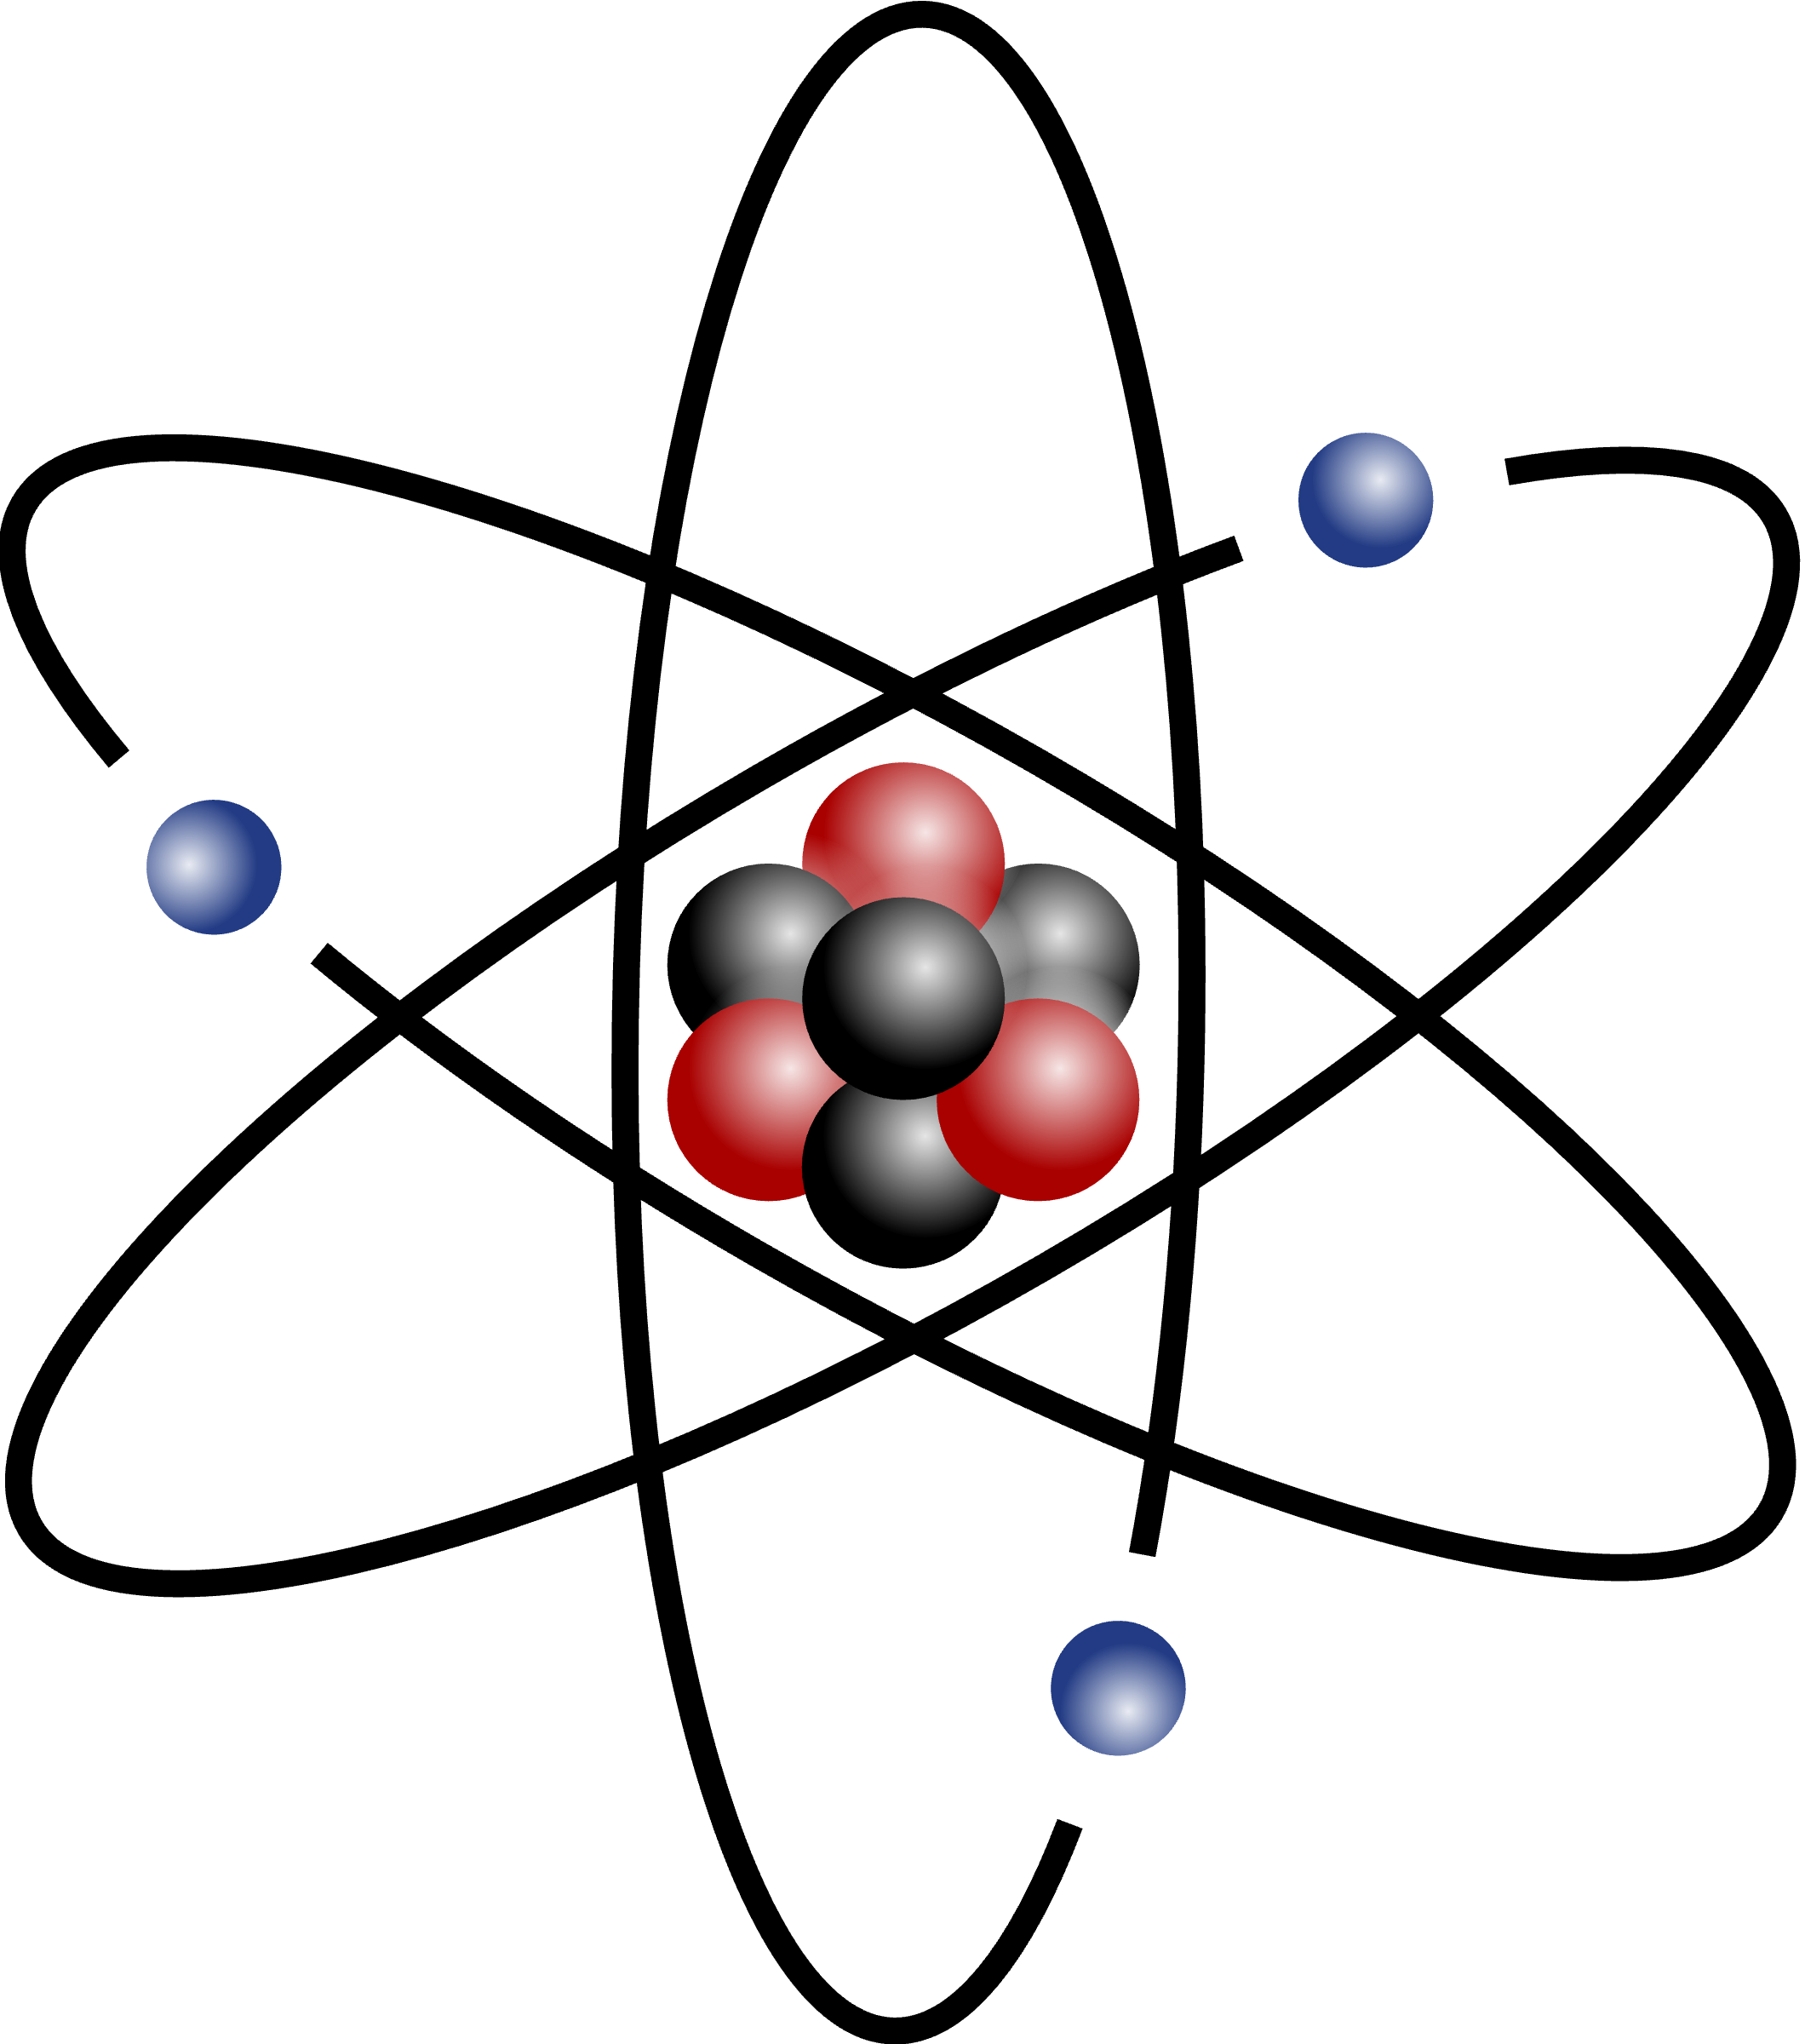
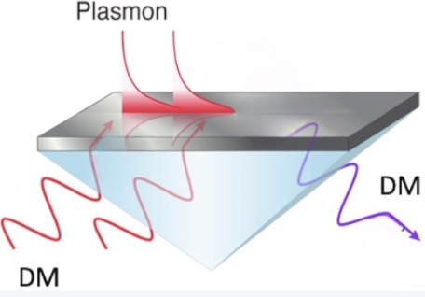
2. Light DM and Low Energy Ionization
2. Plasmon Effect
Conduction bands
Ionized electron
e
detector
DM
DM
Bandgap: ~ eV
DM
DM
Valence bands
Semi-conductor
Collective Excitation
of Valence Electrons
Dielectric Function:
Electronic Structure
(polarization)
Dissipation Processes
(absorption and scattering)
Notes:
Besides nucleus recoils, the dark matter may interact with the electron directly. In particular, for the semiconductor, the energy gap between the conduction band and valence band are very small. This indicates we can access to a lighter dark matter in the solid detector. Moreover, the collective excitation effect, namely the plasmon effect in the semiconductor, can be further used to improve the limits. In the condensate physics, such an effect can be described by the dielectric function. It is a complex function. The real part reflects the electronic structure of the material, and the imaginary part reflects the dissipation process.

Slide 8
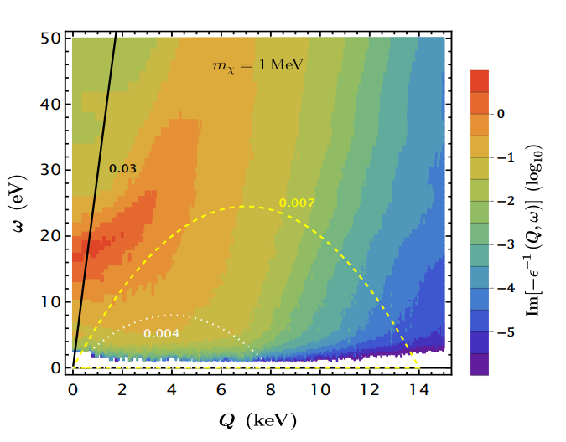
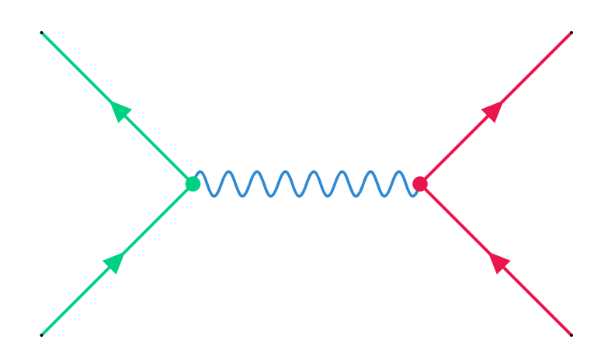
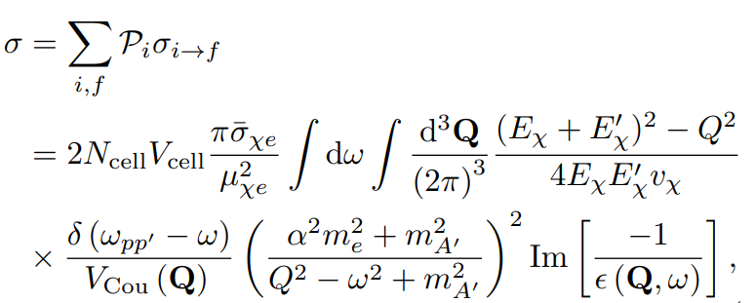
2. Light DM and Low Energy Ionization
thermal distribution of initial target state
Liang, Su, WU, Zhu, 2401.11971
DM velocity
Density Functional Theory
Energy Loss Function (ELF)
Relativistic Particles
Notes:
Supposing a vector interaction between dark matter and the electron, we can derive the scattering cross section, which is proportional to the imaginary part of the inverse dielectric function. We usually call it energy loss function, which can be calculated by the density functional theory. Here you can see the energy loss function can be very large in the low transferred energy and momentum region. This is so called plasmon effect. We also check the condition for a DM to produce such an effect. We found that a relativistic DM is needed.

Slide 9
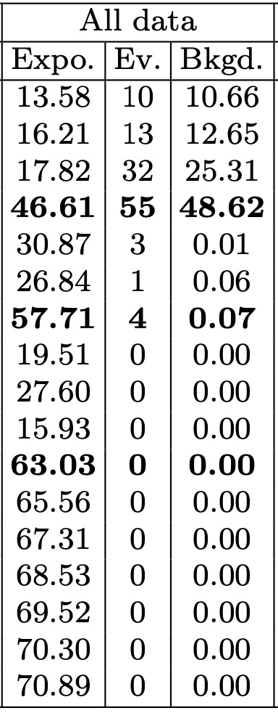
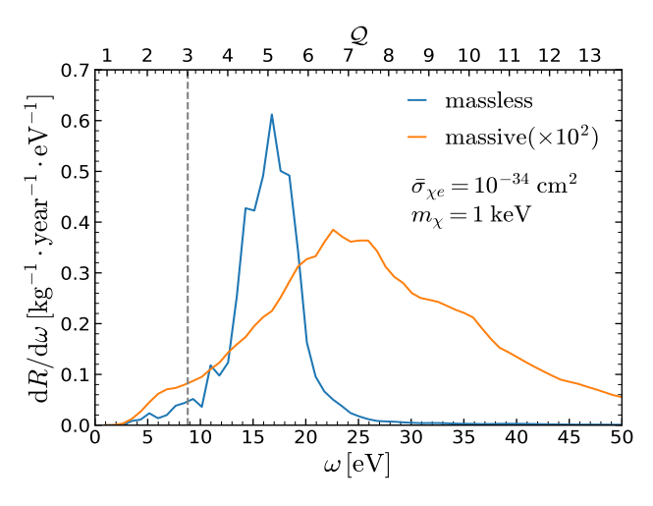
2. Light DM and Low Energy Ionization
Cosmic Ray DM
1810.07705, 1810.10543
SENSEI @ SNOLAB
2312.13342
CRs
CRs
DM
DM
Liang, Su, WU, Zhu, 2401.11971
Notes:
So we considered the cosmic ray boosted dark matter, in which the dark matter get more energy via its interaction with the electron and positron in high energy cosmic rays. Then, using the sensei data from snolab, we can get the electronic excitation rate andthen transfer the spectrum into observable ionization charge.

Slide 10
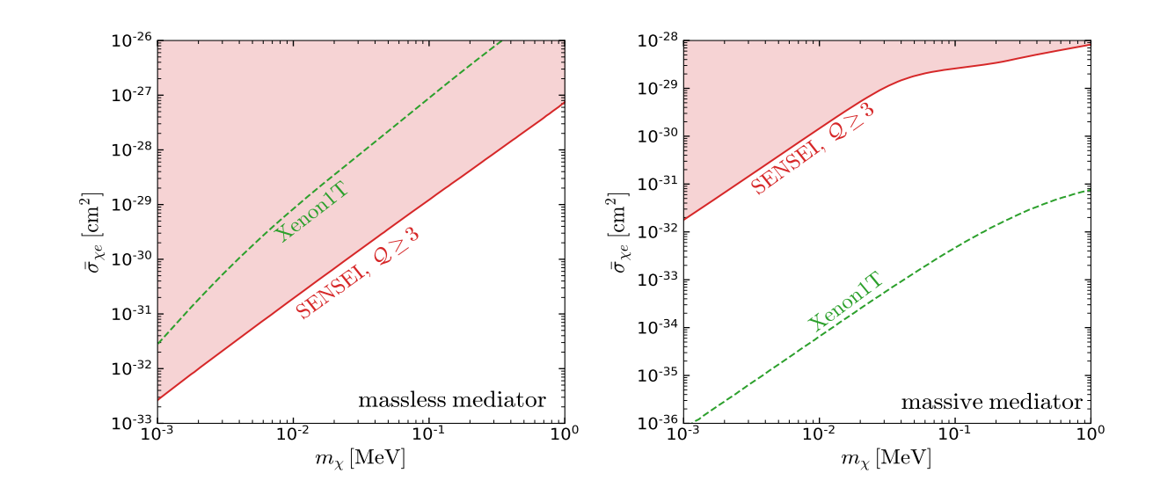
2. Sub-GeV DM and Low Energy Ionization
Plasmon + DM with high velocity + massless mediator
Liang, Su, WU, Zhu, 2401.11971
Light Dark Matter | Noble Liquid Detector (large volume, high threshold) | Solid detector (small volume, low threshold)
Non-Relativistic | Migdal Effect (Inelastic Scattering) | ✔️
Relativistic | ✔️ | Plasmon Effect (Collective Excitations)
Notes:
Finally, we can derive the limits of DM-electron scattering cross sections. We can see that the limit for light mediator is stronger than that from the Xenon1T, while in the heavy mediator case, it is much weaker than that from xenon1T.
To summarize, a non-relativistic light dark matter can be probed via the Migdal effect in the large noble liquid detector even with the high threshold, while for a relativistic light dark matter, in light of the plasmon effect, one can get a stronger limit even in small solid detector with the low threshold.

Slide 11
Conclusions
Multi-disciplines + Multi-messengers
A New Era in the Quest for Dark Matter
Thank you very much !

Slide 12
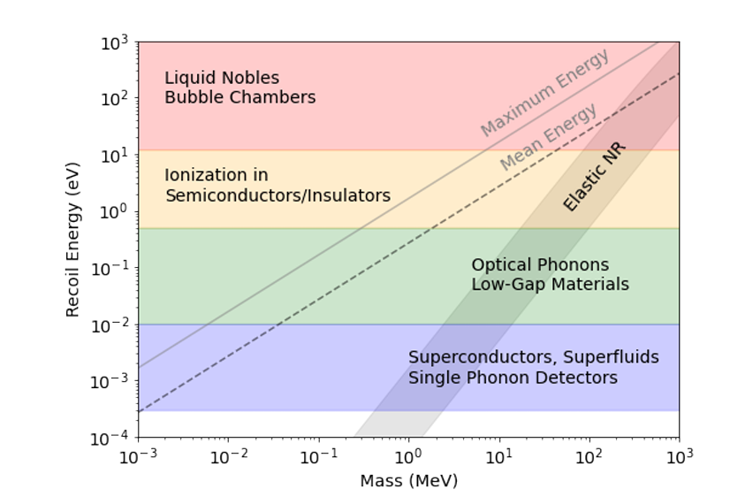
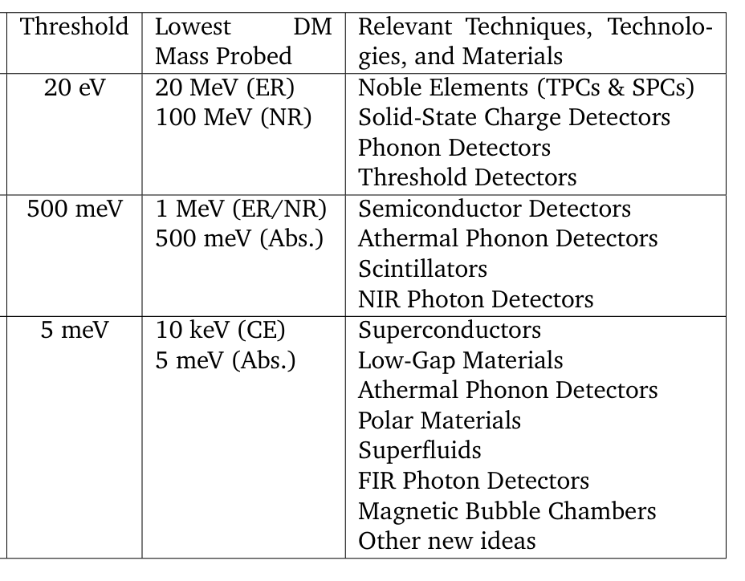
Back Up
Rouven Essig, et.al, arxiv: 2203.08297

Slide 13
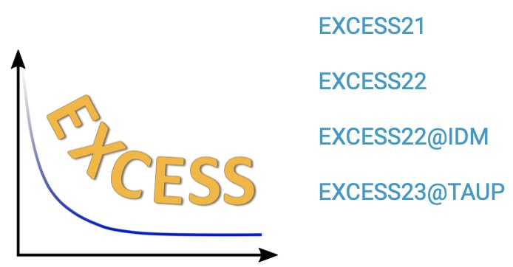
Back Up
excess may corresponds to a WIMP with mass ∼2.5 GeV/c² and a WIMP-nucleon scattering cross section ∼3 × 10⁻⁴⁰ cm².

Slide 14
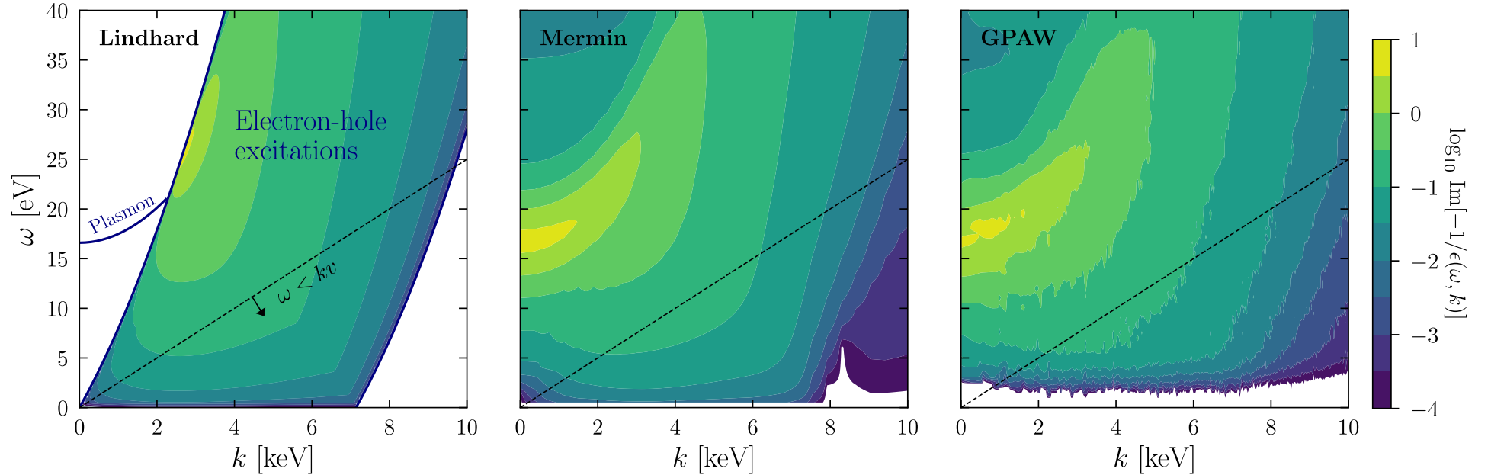
Back Up
The calculation of dielectric function:
DarkELF: Including the real and imaginary parts of the dielectric function calculated using the DFT software GPAW.
Simon Knapen, Jonathan Kozaczuk, and Tongyan Lin, Phys. Rev. D 105, 015014(2021).
The Lindhard method:
The Mermin method:
The GPAW method:
Assuming homogenous material and neglecting all dissipation effects.
A generalization of the Lindhard which includes dissipation.
It relies on a first principles calculation with package GPAW.

Slide 15
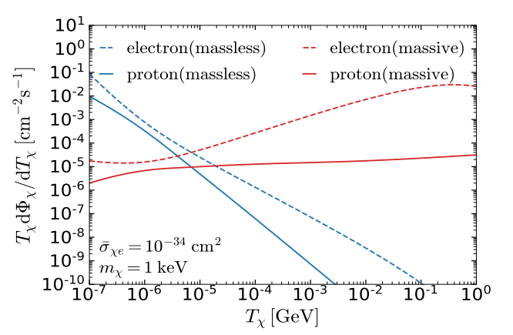
Back Up
e.g. Cosmic Ray DM
CRs
CRs
DM
DM
differential electronic excitation rate:

Slide 16
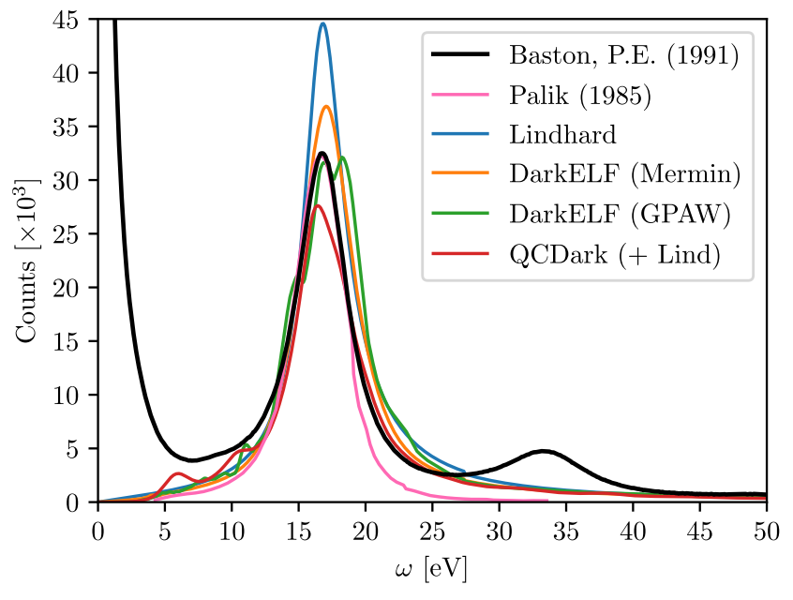
Back Up
DM-Electron scattering in semiconductor
Comparison with EELS data:
The results an incident electron beam kinetic energy of
The data of EELS
Overestimating the response
The position and height of peak is consistent, but GPAW predicts a slightly broader peak.
Underestimates
Ionization charge:
The elastic scattering between incident electrons and lattice, not electron-hole pair excitations.
1509.01598
Silicon: E_{gap} = 1.2eV and ε = 3.8eV.
Rouven Essig, et.al, arxiv: 2403.00123

Slide 17
介电函数（dielectric function）是描述材料对电磁场响应的一个复数函数，它在固体物理和材料科学中非常重要。对于硅这样的材料，介电函数的表达式可以描述电子气对电磁波的集体响应，特别是等离子体激元（plasmons）的特性。
在论文中提到的介电函数的表达式通常具有实部和虚部，可以写成如下形式：
\[ \varepsilon(\omega, k) = \varepsilon_1(\omega, k) + i\varepsilon_2(\omega, k) \]
其中，\( \varepsilon_1(\omega, k) \) 是介电函数的实部，与材料的电子结构和电磁波的频率 \( \omega \) 及波矢 \( k \) 有关；\( \varepsilon_2(\omega, k) \) 是介电函数的虚部，与材料中电子的耗散过程有关。

Slide 18
在论文中，作者们使用了几种不同的方法来计算或近似介电函数，包括：
1. **Lindhard模型**：这是一个半经典的模型，用于描述低动量转移下的电子气响应。它提供了一个合理的描述，特别是在低动量转移和小能量损失的区域。
2. **密度泛函理论（DFT）和随机相近似（RPA）**：这些方法可以更精确地计算介电函数，包括电子波函数的量子力学计算。DFT结合RPA可以提供对介电函数实部和虚部的全面描述。
3. **QCDark计算**：这是一个基于第一性原理的计算工具，用于计算暗物质与电子散射的介电函数虚部。
4. **DarkELF工具**：这是一个开源软件包，它提供了使用DFT软件GPAW计算介电函数的实部和虚部的功能，并且可以选择使用Lindhard模型来拟合介电函数。
论文中还提到了如何将这些不同的计算方法结合起来，以获得更准确的介电函数表达式，特别是通过使用Lindhard模型来校正QCDark计算的介电函数虚部，从而得到一个在低能量区域表现良好的介电函数模型。这种组合模型在描述等离子体激元峰值方面特别有效，这是因为Lindhard模型在这一区域内提供了可靠的描述，并且与QCDark计算的介电函数虚部的更复杂的计算相匹配。

