Slide 1
Photon beamlines

Slide 2
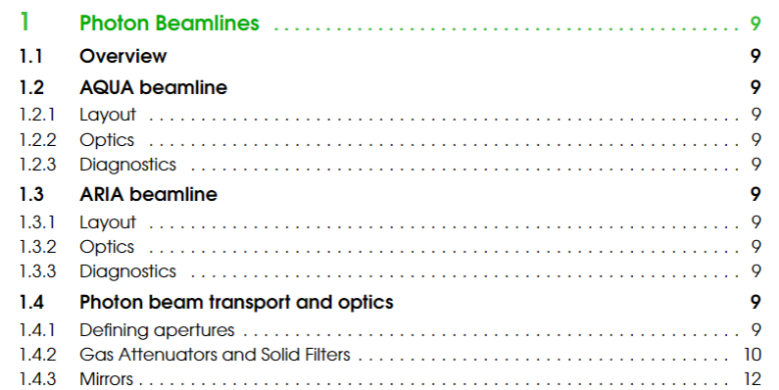
TDR Chapter

Slide 3
TDR chapter priority and layout

Slide 4
TDR tables (overview section)
System | Transmission | #
Mirror chamber | 0.80 (0.85) | 1
BDA | 1.00 | 2
BPM | 0.99 | 8
Spectrometer | 0.75 (0.80) | 1
Monochromator | 0.15 to 0.03 | 1
Intensity monitor | 0.99 | 2
Time measurement | 0.99 | 1
Split & delay | 0.41 (0.52) | 1
Filters chamber | 1 to 0 | 1
YAG screens | 1 or 0 | 4
Valves (1st estimation) | 1 or 0 | 11
K-B focusing | 0.64 (0.72) | 1
Polarization measure | 0.99 | 1
 | FEL parameters (Linear Polarization) | FEL parameters (Circular Polarization)
Central wavelength range (nm, eV) | 4.0 nm, 310eV | 4.0 nm
Spectral bandwidth (rms, % to the central wavelength) | 0.088% | 0.117%
Beam length (rms, fs) | 3.50 fs | 3.76 fs
Beam transverse size (rms, um) | 133 um | 132 um
Beam divergence (half angle, mrad) | 0.023 mrad | 0.022 mrad
Photons per pulse (number) | 2.33*10^11 | 2.77*10^11
Polarization (direction) | H | C
Repetition rate (Hz) | 100 | 100
Total transmission
without monochromator and S&D: 34% (with R=85% mirrors: 44%)
with Split & Delay: 14% (23%)
with monochr. 1-g: 5.1% (6.5%) x $δλ/Δλ$
with monochr. 2-g: 1.0% (1.3%) x $δλ/Δλ$
with monochr. 2-g + S&D: 0.42% (0.68%) x $δλ/Δλ$

