Slide 1
WA 8
31.1.2024
WA 8
Ongoing actions
Outcome closed actions & Decisions
To Do
- TDR responsibilities
(details in the next slides)
- Conferences for 2024
Science@FELs
SILS
…
EuXFEL user’s meeting
__________________
EuPRAXIA@SPARC_LAB users’ meeting
Dates: July 9th-10th 2024 (+ LEAPS 11th-12th)
Do we have a budget to invite speakers?
- Personnel
replacement of a post-doctoral fellow and plans beyond 2025 (including EuPRAXIA-PP)
CRITICAL
- Procurement of R&D elements (mainly for sample delivery)
Early 2024

Slide 2
WA 8
31.1.2024
WA 8
Figures
AQUA ARIA
Parameter | Value
Wavelength | 4-10 nm
Photons/pulse | 10 ¹⁰ - 10 ¹¹
Pulse duration | < 50 fs
Parameter | Value
Wavelength | 50-180 nm
Photons/pulse | 10 ¹³ - 10 ¹⁴
Pulse duration | 20-200 fs

Slide 3
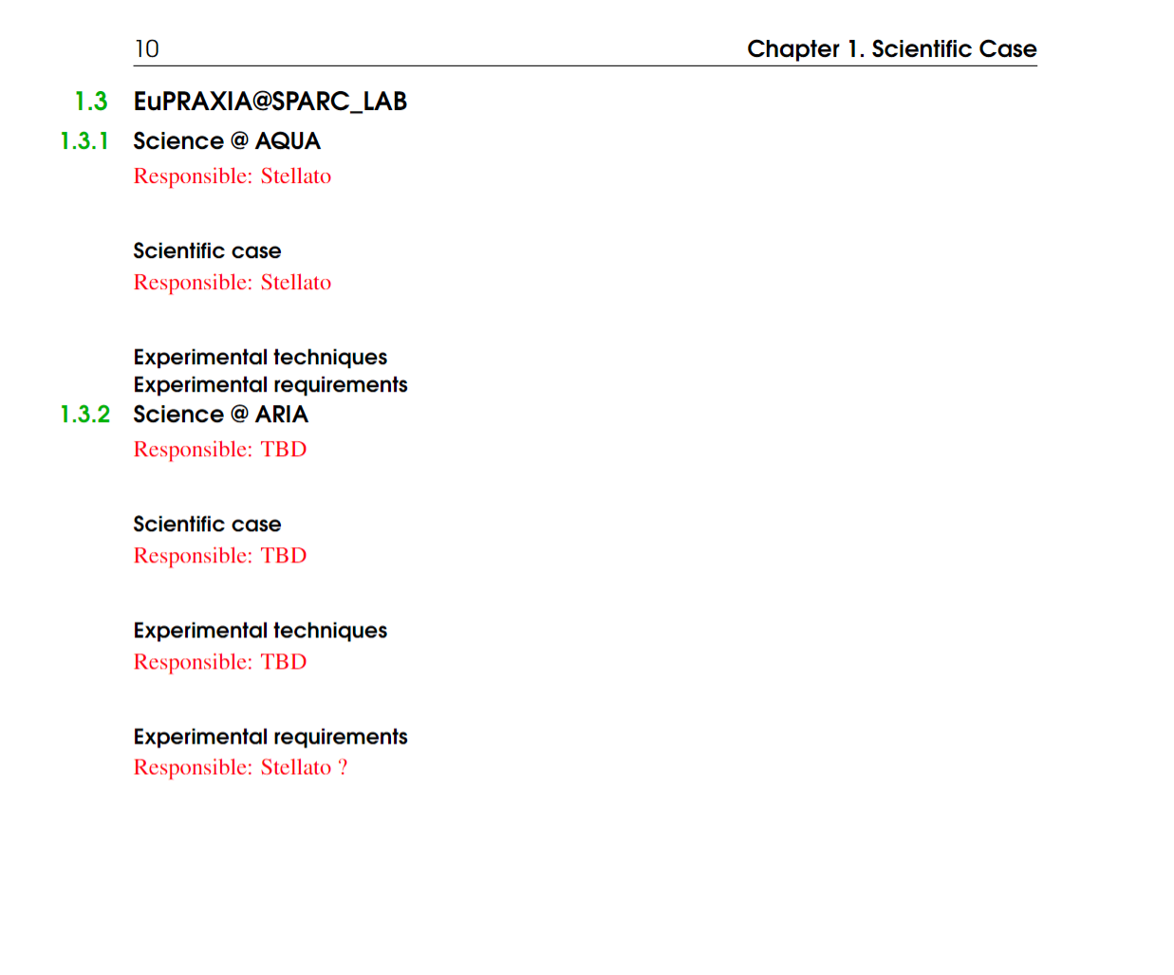
WA 8
31.1.2024
WA 8
Support needed, especially for the ARIA beamline

Slide 4
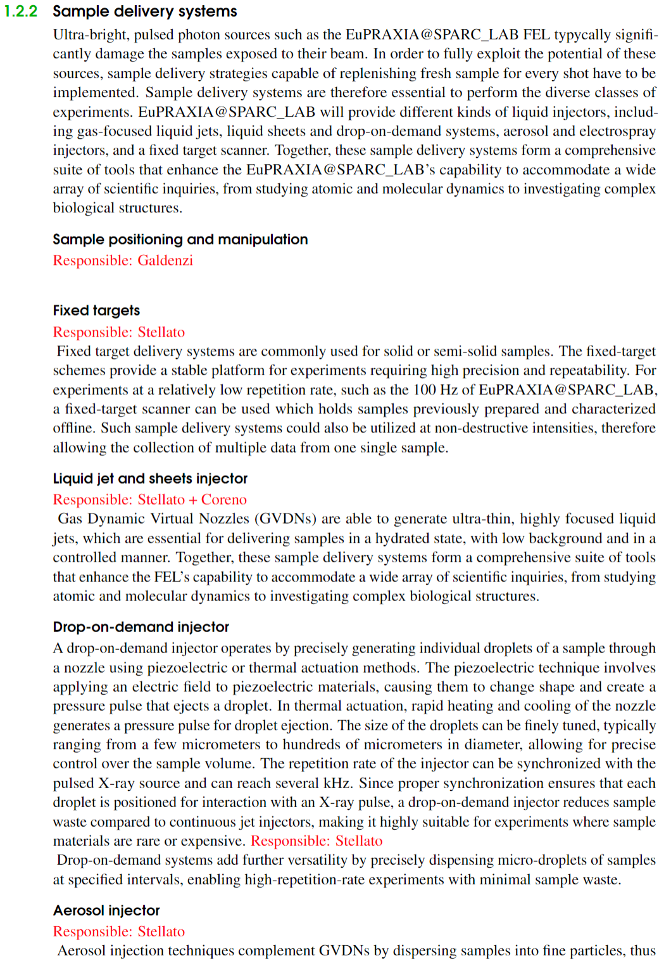
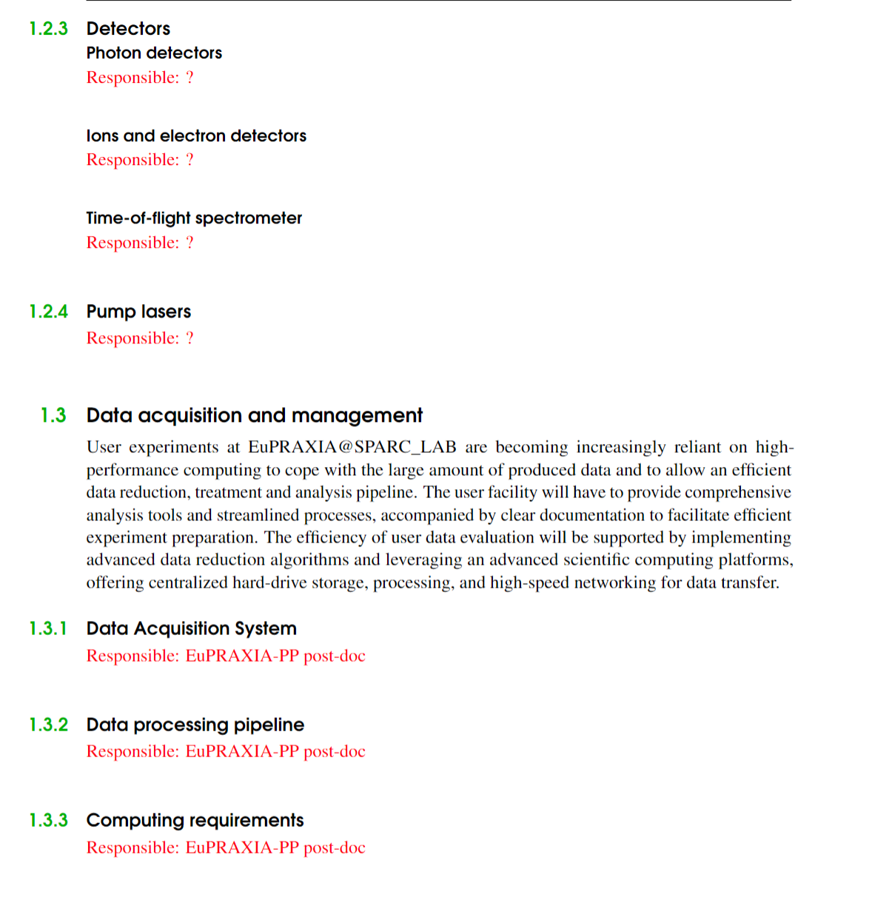
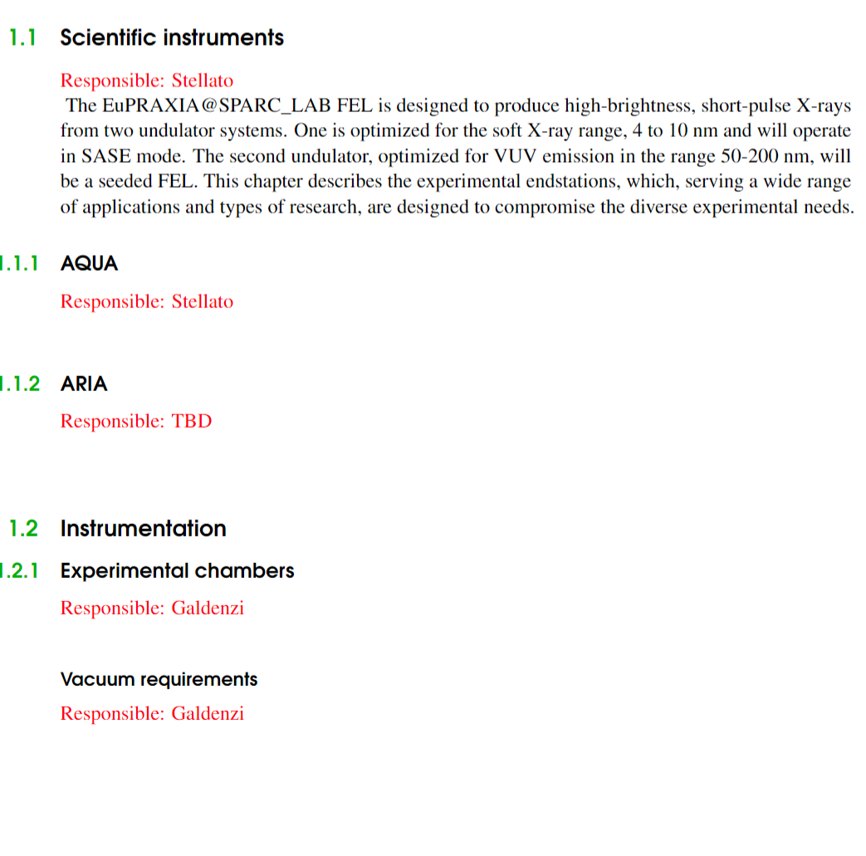
WA 8
31.1.2024
WA 8

