Slide 1
WA1- Beam Physics
C. Vaccarezza
on behalf of WA1- Beam Physics & collaboration team

Slide 2
Chapter 6 - Beam Physics
Beam Physics
6.1 Introduction (codici usati, principi primi…)
6.2 FEL Source Design
6.3 Accelerator Layout
6.3.1 The photoinjector
6.3.2 The Laser heater system
6.3.3 The Bunch Compressor chicane
6.3.4 Linac 1 e 2
6.3.5 Plasma matching and capture line
6.3.6 The Undulator Transfer Lines
6.3.7 Diagnostics and trajectory correction
6.3.8 Beam Dumps (diag. stations)
6.4 Start to end Simulation Results
6.4.1 Selected Working Points
6.4.1.1 Plasma Acceleration
6.4.1.2 X-band RF acceleration
6.5 Jitter and tolerance studies
6.5.1 Photoinjector
6.5.2 Linac
6.5.3 Plasma
6.5.4 Microbunching instability mitigation w LH
6.6 Electron Beam Virtual Measurements and characterization
6.6.1 Low Energy
6.6.2 Medium Energy
6.6.3 High Energy

Slide 3
6.2 FEL source design
Electron Beam Parameters (Nov 2022)
FEL Parameters (Nov 2022)
Parameter | Unit | PWFA | Full X-band
Electron Energy | GeV | 1-1.2 | 1
Bunch Charge | pC | 30-50 | 200-500
Peak Current | kA | 1-2 | 1-2
RMS Energy Spread | % | 0.1 | 0.1
RMS Bunch Length | 𝜇m | 6-3 | 24-20
RMS norm. Emittance | 𝜇m | 1 | 1
Slice Energy Spread | % | ≤0.05 | ≤0.05
Slice norm Emittance | mm-mrad | 0.5 | 0.5
Parameter | Unit | PWFA | Full X-band
Radiation Wavelength | nm | 3-4 | 4
Photons per Pulse | $$×{10}^{12}$$ | 0.1- 0.25 | 1
Photon Bandwith | % | 0.1 | 0.5
Undulator Area Length | m | 30 | 30
𝜌(1D/3D) | $$×{10}^{−3}$$ | 2 | 2
Photon Brilliance per shot | $$\left(\begin{aligned}s {mm}^{2}{mrad}^{2} \\ bw\left(0.1\%\right)\end{aligned}\right)$$ | 1$−2 ×{10}^{28}$ | $$1 ×{10}^{27}$$

Slide 4
6.3 Accelerator layout
X-band
LH
Linac 1
Linac 2
RF
GUN
Plasma
U1
BC
4 S-band
8 X-band
8 X-band
Aria?
Photo
Injector
Linac
Plasma
TL
Undulator
XB
D
D
D
D
Focused on Plasma acceleration operation scheme = WoP1
Checked at each iteration for the High Charge Single Bunch boosted by an All-RF Linac up to 1 GeV = WoP2

Slide 5
6.3 Accelerator Layout subsections:
6.3.1 The photoinjector : Gun+sections: charge range and operating gradients& phase
6.3.2 The Laser heater system: lattice description and magnet specs
6.3.3 The Bunch Compressor chicane: lattice description and magnet specs
6.3.4 Linac 1 e 2: lattice description and magnet specs
6.3.5 Plasma matching and capture line : lattice description and magnet specs
6.3.6 The Undulator Transfer Lines: lattice description and magnet specs
6.3.7 Diagnostics and trajectory correction: virtual measurements (3 setup for beam characterization w res.& prec.), steering magnet& BPM lattice

Slide 6
6.4 Start to end Simulations
6.4.1 Selected Working Points
6.4.1.1 Plasma Acceleration:
The 500-600 MeV Witness+Driver scheme is adopted with a lattice able to drive the two bunches at the plasma entrance with the required characteristics:
6.4.1.1.1 Velocity bunching
6.4.1.1.2 Magnetic&Mask
6.4.1.2 X-band RF acceleration
The 1 GeV energy is achieved by means of 16 X-band RF sections the beam is compressed with a Hybrids scheme: VB + Mag. chicane

Slide 7
Start2End for the basic layout: codici
Elegant (WF, CSR)
Tstep (SC)
Elegant (WF, CSR)
Astra (SC)
Tstep+Astra (SC, Fmaps)
Architect
Genesis 1.3
Photo
Injector
Linac
Plasma
TL
Undulator
XB
D
D
D
D
2
3
1
4

Slide 8
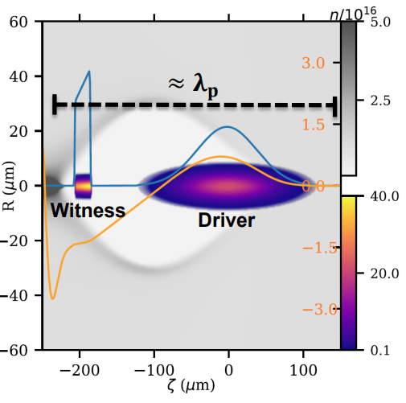
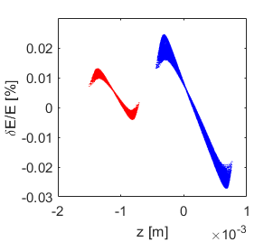
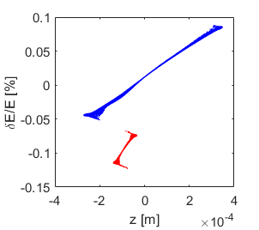
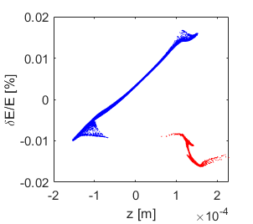
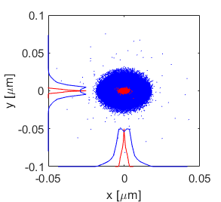
Reference Working point Beam Dynamics
A. Giribono
Beside the FEL specifications, the reference working point has been determined by the plasma module
At least 500 MeV energy gain (in less than 1 m)
Weakly non-linear regime (bubble with resonant behaviour)
200 pC driver + 30 pC witness
plasma density of the order of 10¹⁶𝑐𝑚⁻³ (𝜆_{𝑝} = 334 𝜇𝑚)
Velocity bunching technique
Driver-witness separation of around 0.5 ps ( i.e. 𝜆_{𝑝} /2)
Driver and witness bunches of 200 fs and 10 fs rms
Driver and witness spot size of 4 and 1 µm with α=1
0.5 ps
ơ_{W} = 1.0 µm
ơ_{D} = 4.0 µm
@650 MeV
Laser comb technique
4.8 ps

Slide 9
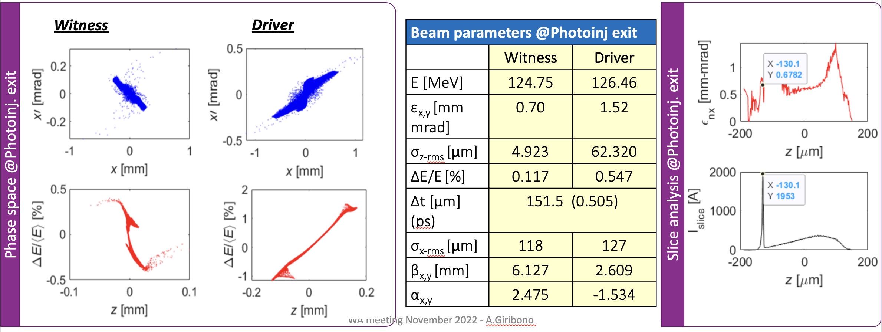
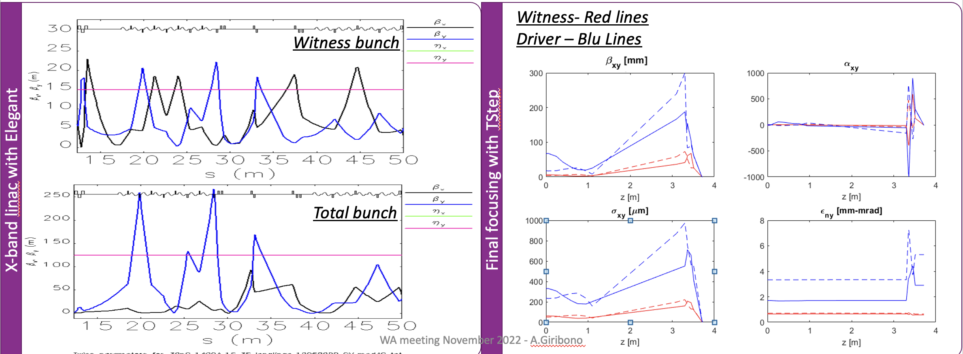
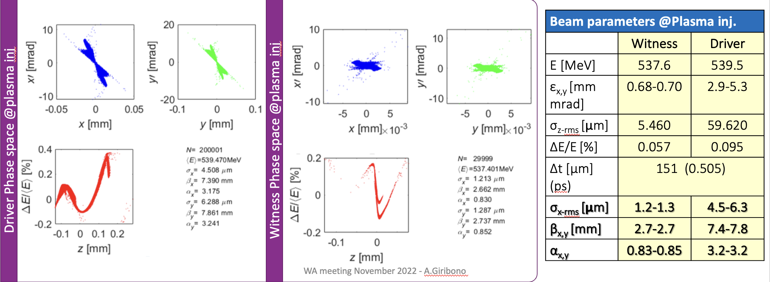
6.4.1.1.1 Velocity bunching 1/4
PhotoInjector
Linac
Capillary entrance
30 + 200 pC

Slide 10
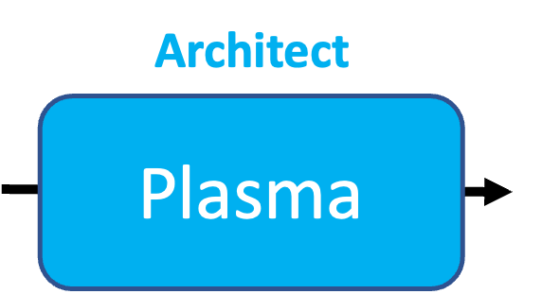
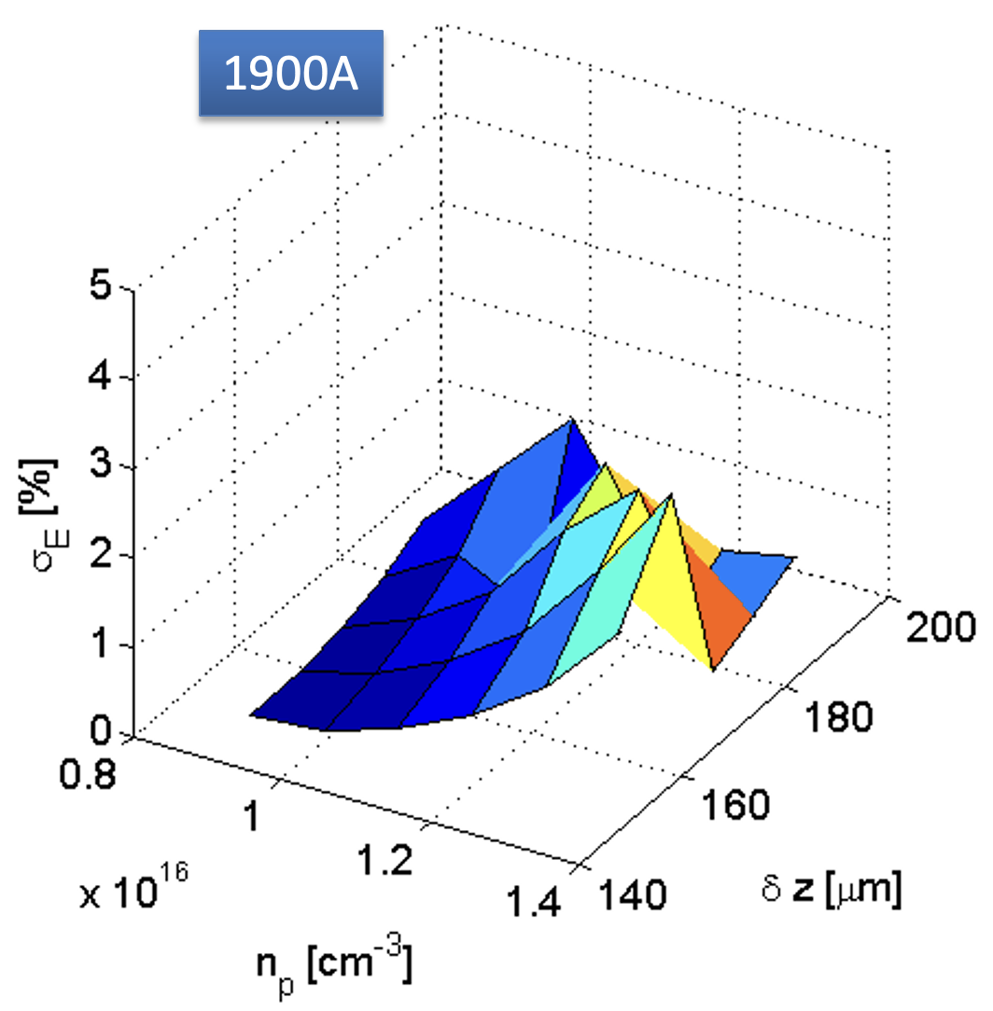
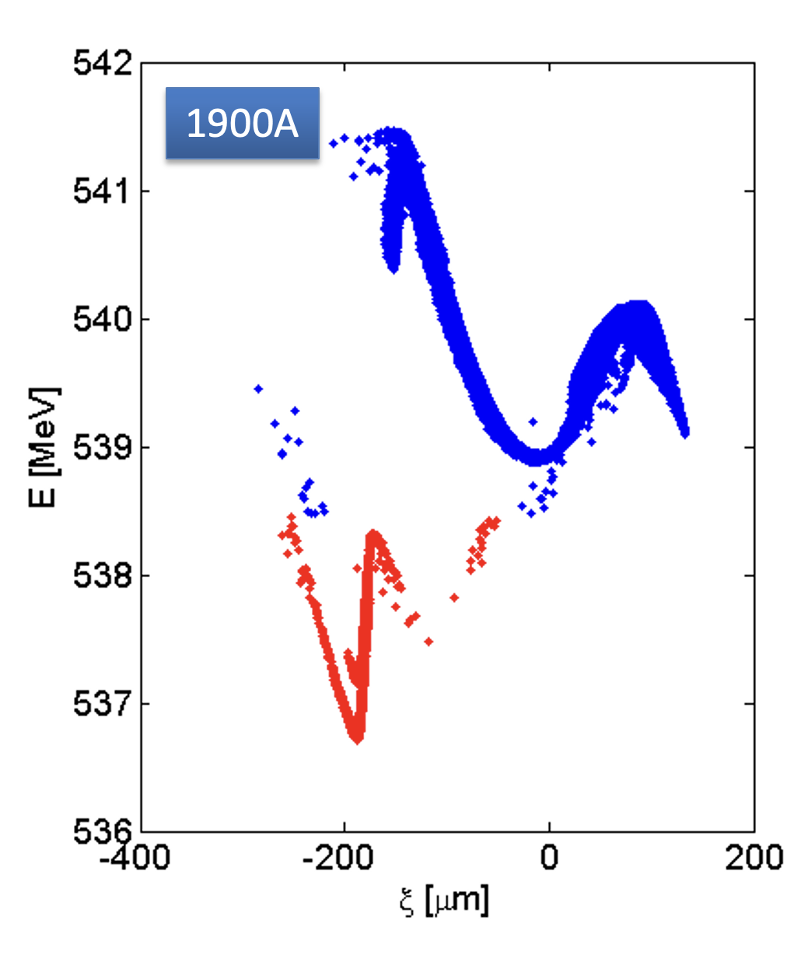
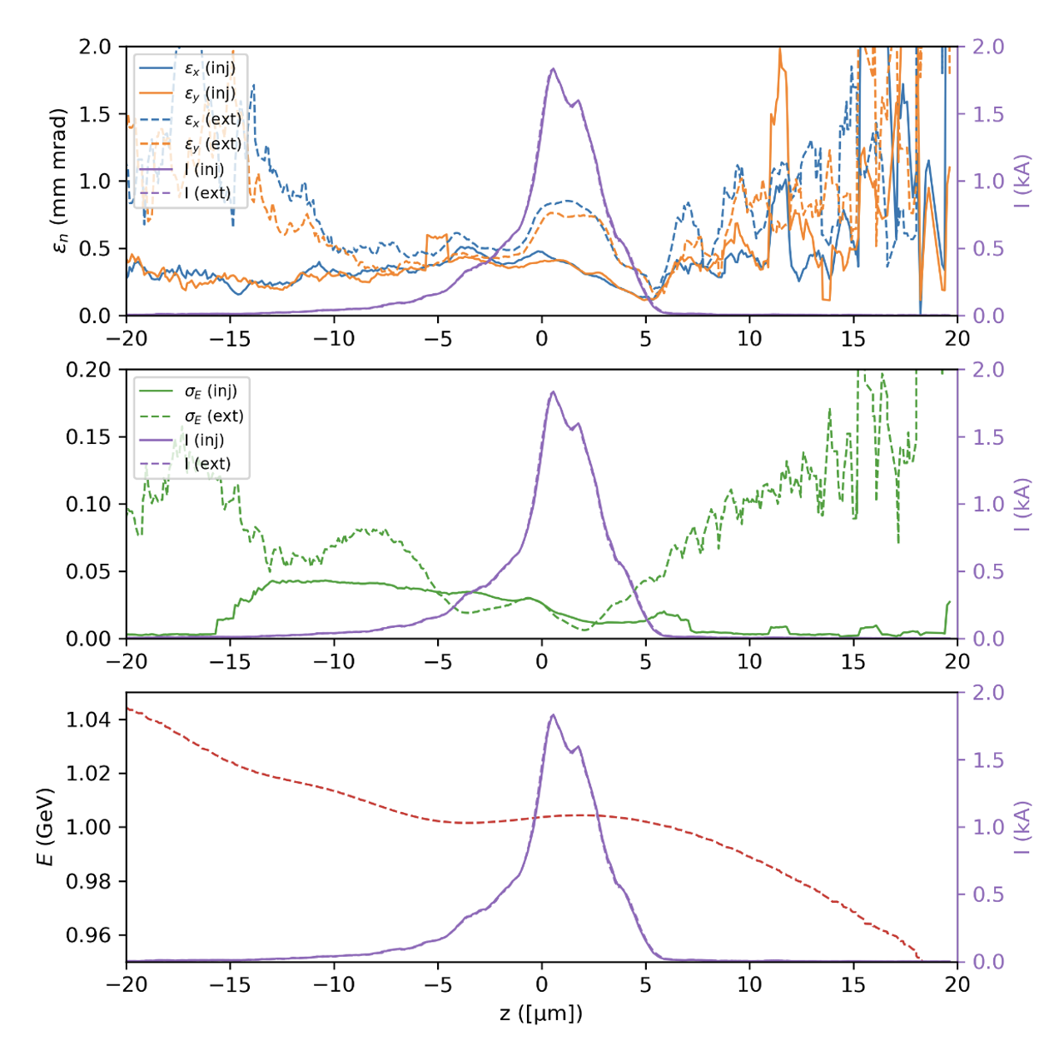
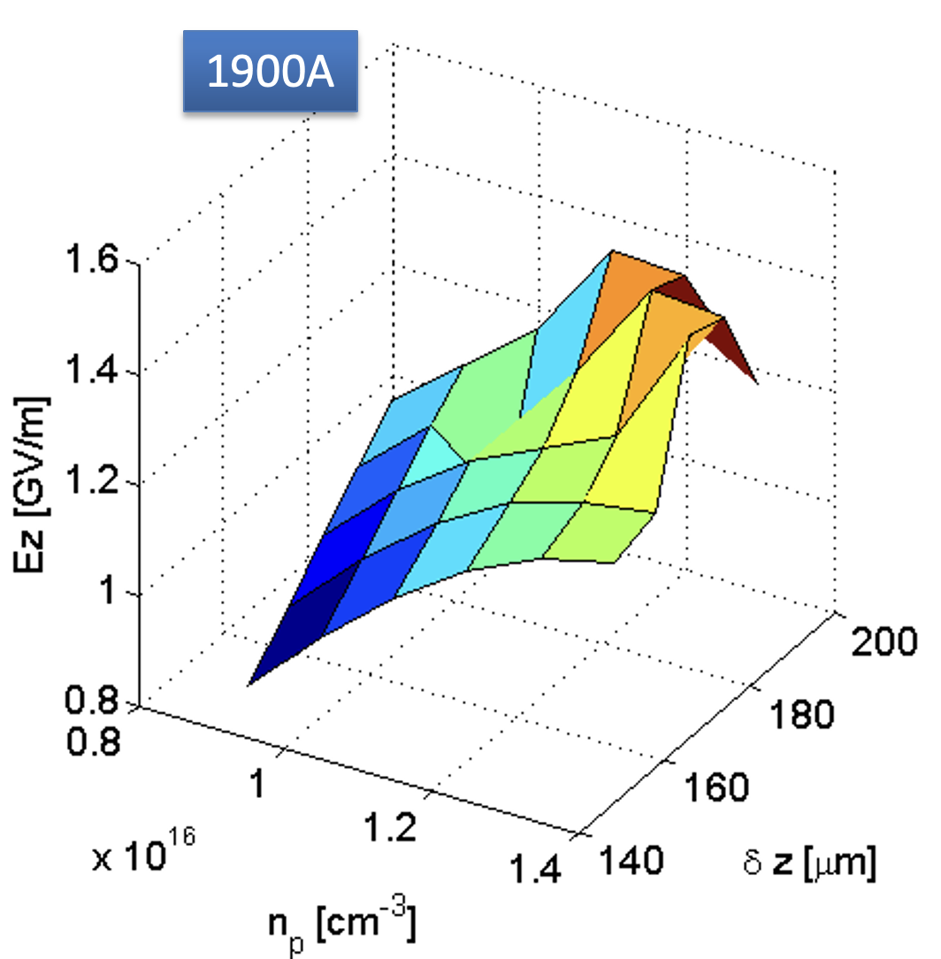
6.4.1.1.1 Velocity bunching: 2/4
$Δz=158 μm$
$n_{p}=0.9⋅{10}^{16} {cm}^{−3}$
$σ_{E}=0.06\%$
$E_{z}=0.9 GV/m$ (including 1 cm injection ramp, so, actually, slightly higher)
Slice energy spread, virtually untouched (or reduced)
Slight emittance increase (to be improved with ramps)
Accelerating length 0.56 m

Slide 11
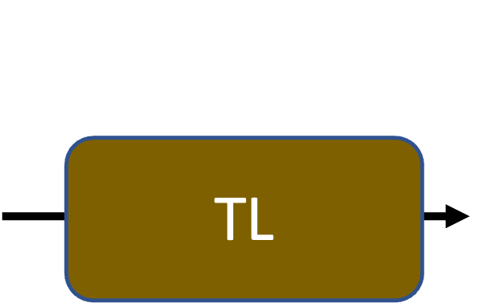
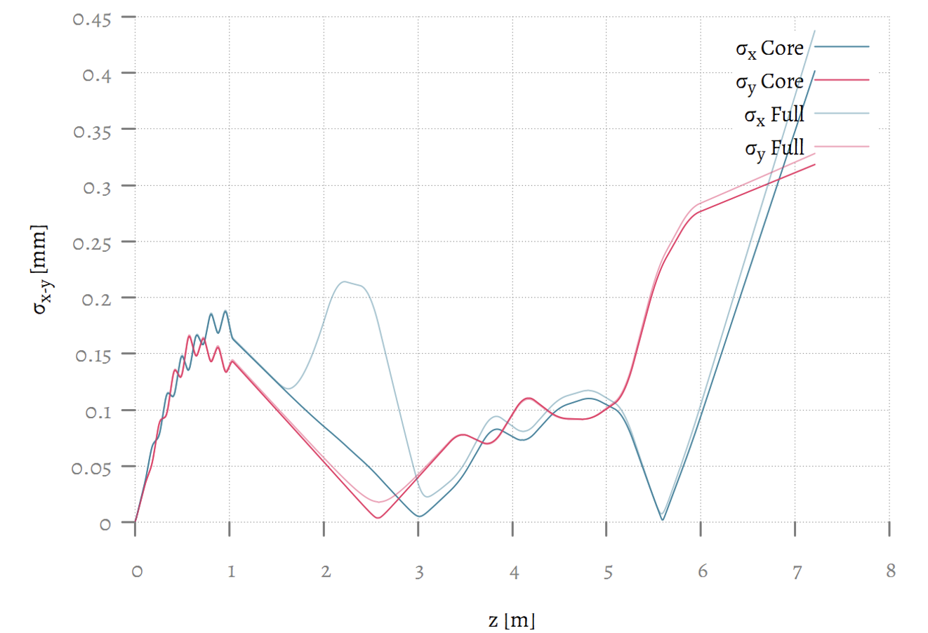
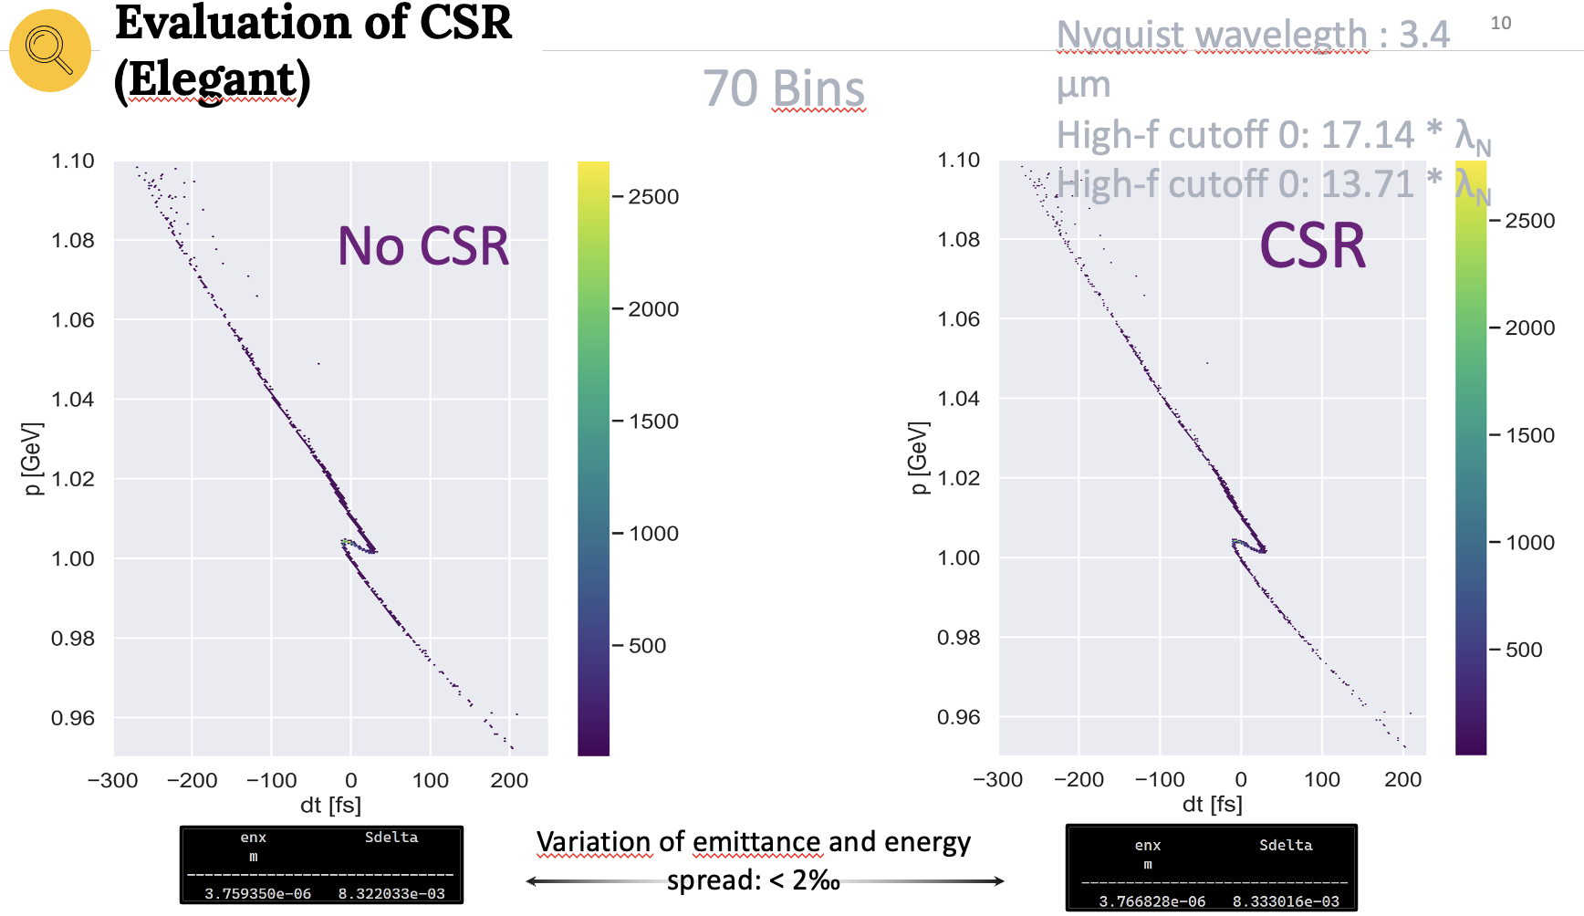
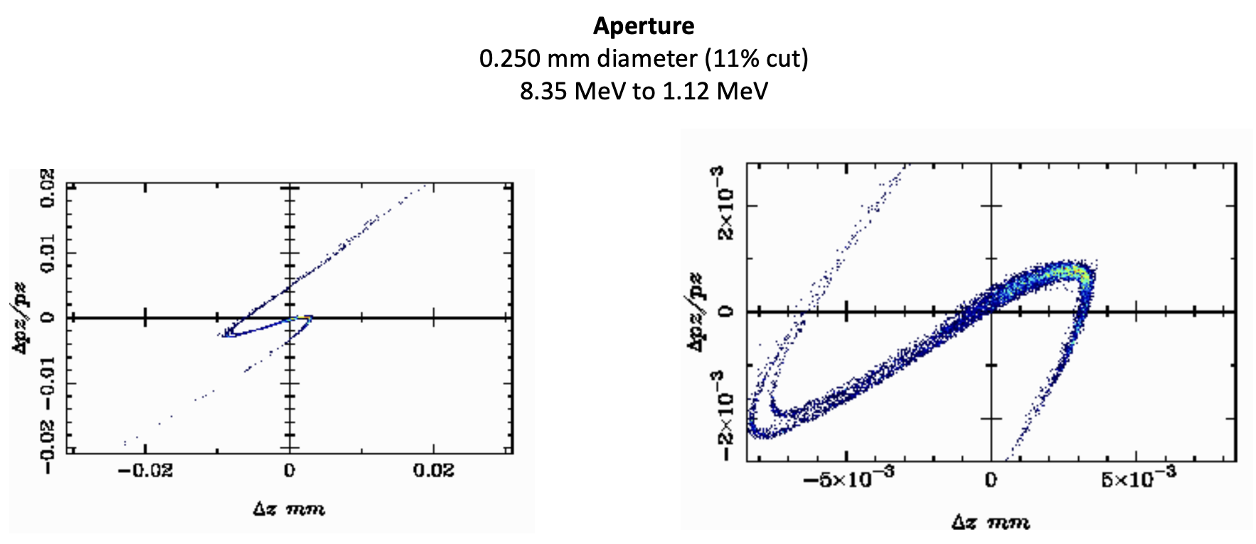
6.4.1.1.1 Velocity bunching : 3/4
Layout
Transverse beam size evolution w Space Charge (Astra)

Slide 12
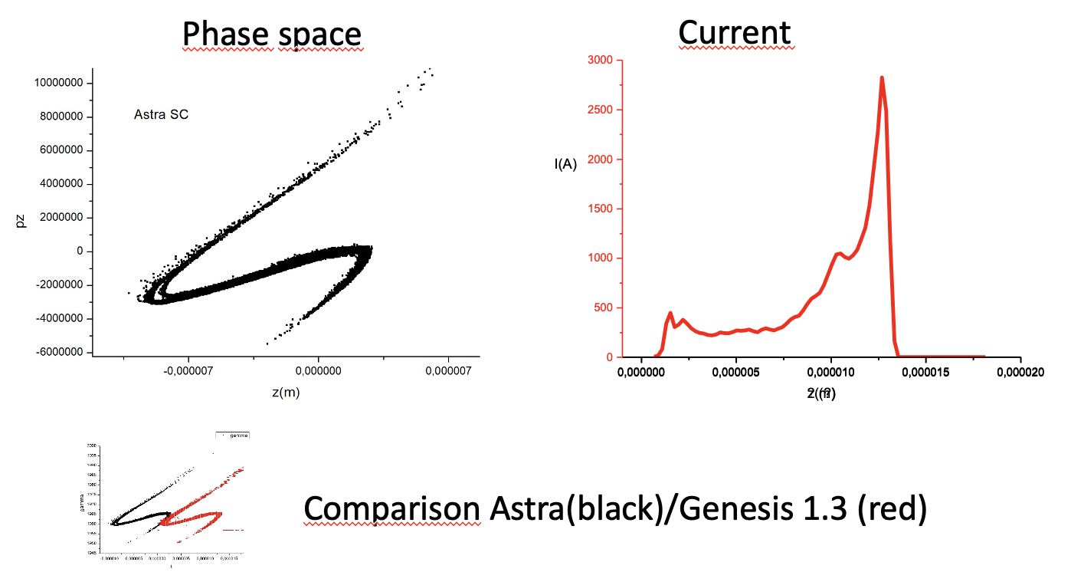
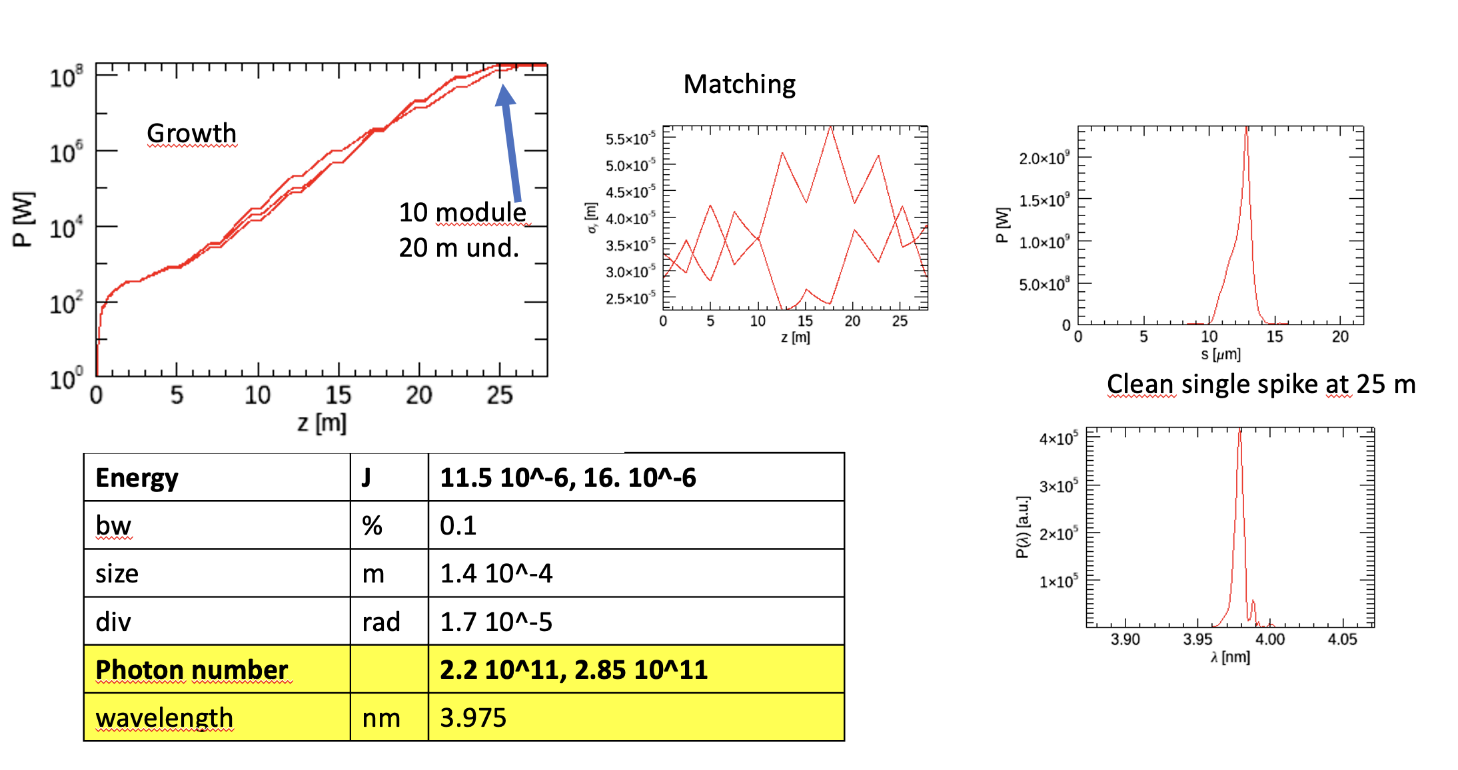
6.4.1.1.1 Velocity bunching : $λ_{r}=4 nm$ 4/4
Beam from TL with space charge E=1GeV, Q= 30 pC.

Slide 13
6.4.1.1.1 Velocity bunching : $λ_{r}=3.3 nm$ 4/4
Beam from TL with space charge E=1GeV, Q= 30 pC.

Slide 14
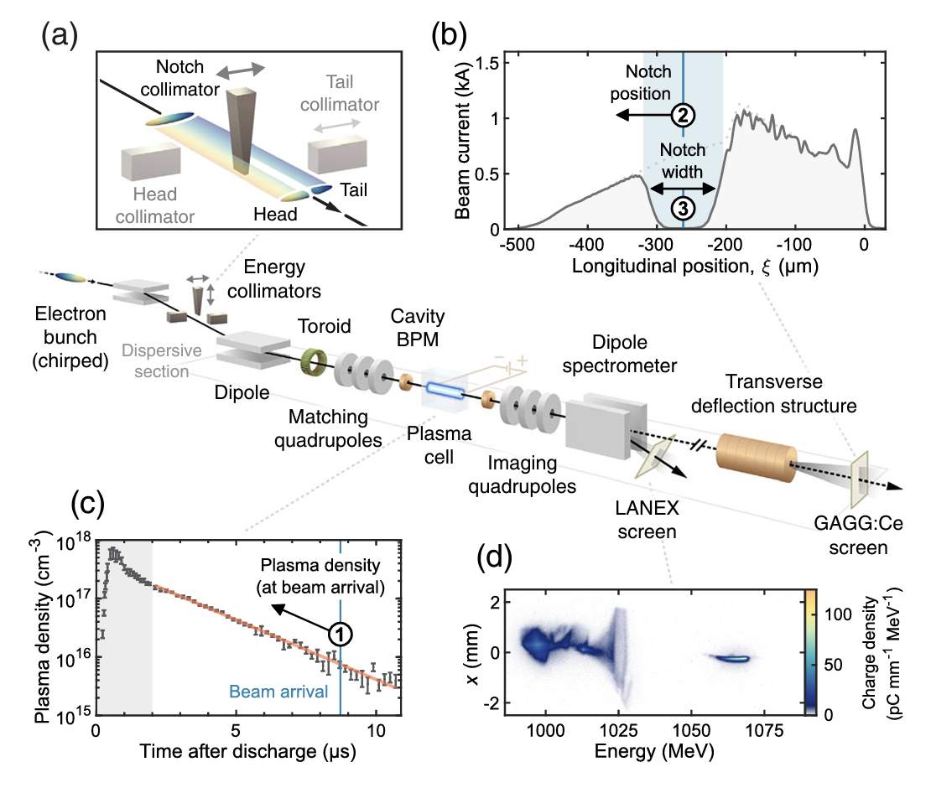
6.4.1.1.2 Magnetic & Mask shaping
To reduce the jitter sensitivity of the Witness-Driver electron beam configuration an alternative solution has been explored:
magnetic compression + transverse beam shaping
in the dispersive section
A numerical cut has been applied to the particles close to the third magnet of the BC chicane to simulate the effect of a vertical wedge-shaped collimator like the one realized at Flash.
To obtain the desired asymmetric current distribution a slightly chirped 400 pC beam (𝜱 = 90°,80°,60°,60°), has been generated in the photoinjector (Tstep code) to be longitudinally compressed in the LH and BC magnetic chicanes.
Taking advantage of the typical double peak current configuration at the bunch edges, applying a central 550 mm cut in the horizontal plane resulted in a Witness-Driver configuration tracked up to the plasma exit by means of Elegant and Architect codes.
A jitter analysis taking into account RF-phase and Voltage of the first Linac section, plus Dipoles Magnetic Field has been performed on 50 runs of the first considered working point
Energy-Spread Preservation and High Efficiency in a Plasma-Wakefield Accelerator
C.A. Lindstrøm (DESY), et al. Phys.Rev.Lett. 126 (2021) 1, 014801

Slide 15
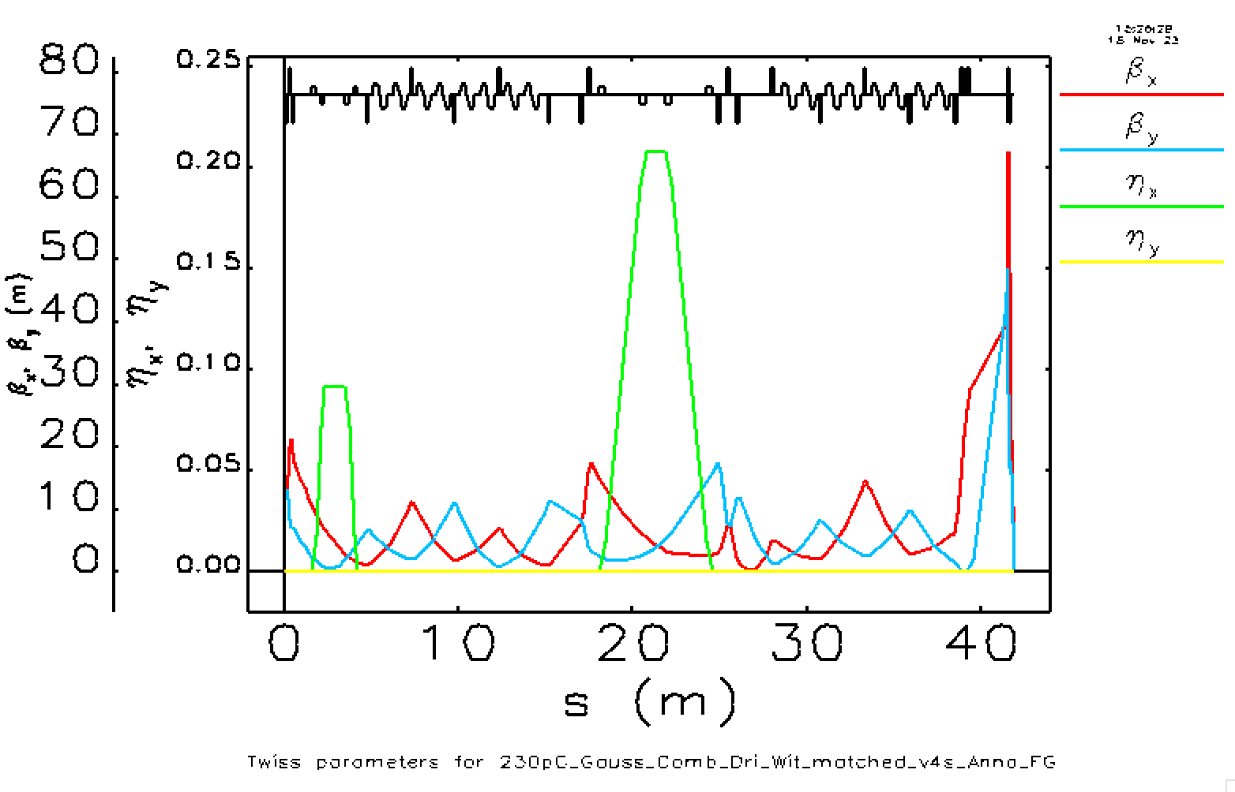
6.4.1.1.2 Magnetic & Mask shaping
Nominal parameters:
RFX_TW1 𝛷=82.3, 𝜃₁=17.9E-2 rad, 𝜃₂=8.8E-2 rad
LH
BC
Linac 1
Linac 2
$$R_{56}≈28 mm$$
$$R_{56}≈10 mm$$
Changes:
The LH chicane magnetic length from 12 cm to 20 cm
The matching upstream Linac2 slightly longer

Slide 16
6.4.1.1.2 Magnetic & Mask shaping
The magnetic solution has to be optimized in terms of transverse emittance of the Witness bunch and BD evolution in plasma for the Driver, and mostly the Jitter analysis must be completed including the Photoinjector.
Moreover, a Montecarlo simulation of the beam interaction with a physical wedge collimator is necessary, together with the feasibility study of the mechanical system.
Finally, the MIB effect and LH efficiency must be included.
….

Slide 17
6.4.1.2 X-band RF Acceleration
All the previous simulations must be done again with the updated lattice, including the jitter sensitivity studies.

Slide 18
6.3.7 Diagnostics and Trajectory correction (dispersion free steering)

Slide 19
6.5 Jitter and Tolerance studies
6.5.1 Photoinjector (RF e B)
6.5.2 Linac (RF e B)
6.5.3 Plasma (n3 e profilo long)
6.5.4 Microbunching instability mitigation w LH

Slide 20
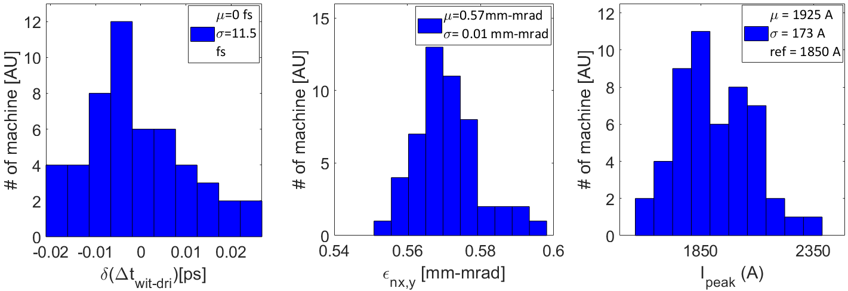
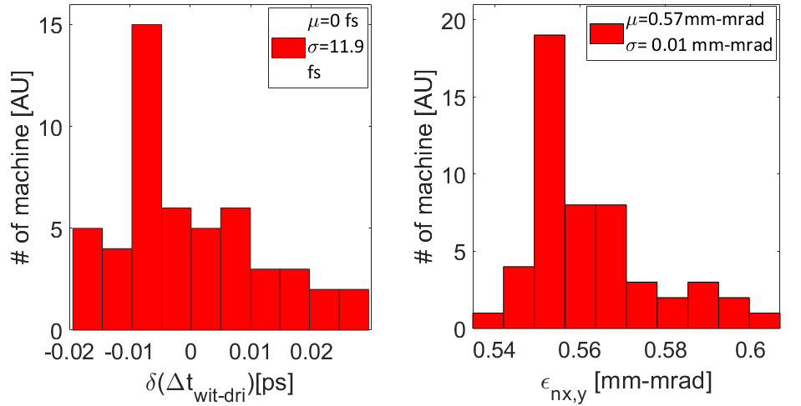
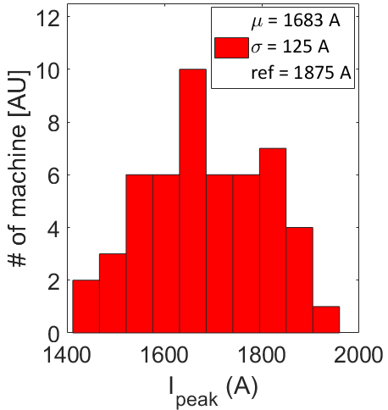
Some Details on the June Jitter analysis in the Linac
Jitter analysis in terms of beam delay, witness emittance and peak current at the photoinjector (upper) and X-band linac (lower) exit
The analysis is performed over 50 samples obtained by means of S2E simulations
The photoinjector is the source of the jittering of the beam separation and final rms beam length and current
The X-band linac is the main responsible for
the energy jitter that is negligible with respect to other parameters ← it operates almost on crest
final Twiss parameters that are almost stable ← the final focusing system is made of permanent magnet
the final profile of the witness peak current
The mean value over the 50 samples is reduced with respect to the photoinjector one with the benefit of a reduced deviation around the mean value

Slide 21
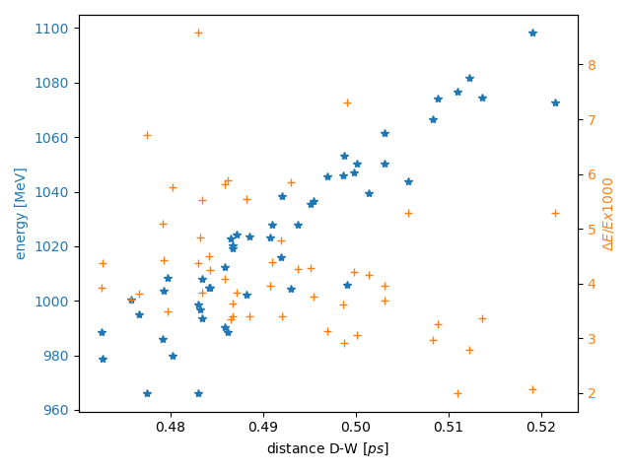
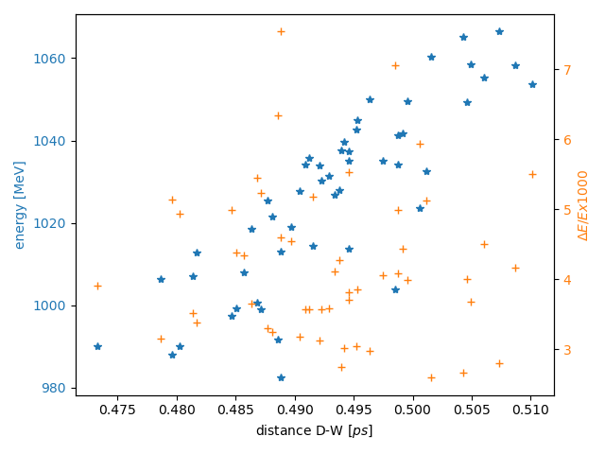
Witness-Driver distance distribution at the plasma module
Capillary length 60 cm
Cut at 80% of 30 pC charge
Nominal jitter case :
RF ampl ± 0.2 % (Sband)
RF phase ± 0.03° (Sband)
RF ampl ± 0.2 % (Xband)
RF phase ± 0.1 ° (Xband)
Half Sband phase&ampl jitter only
(phase value based on C-band solid state modulator performances and amplitude best performance at SPARC_LAB)
Nominal Jitter case
Half Sband phase&ampl jitter
A. Del Dotto, S. Romeo

Slide 22
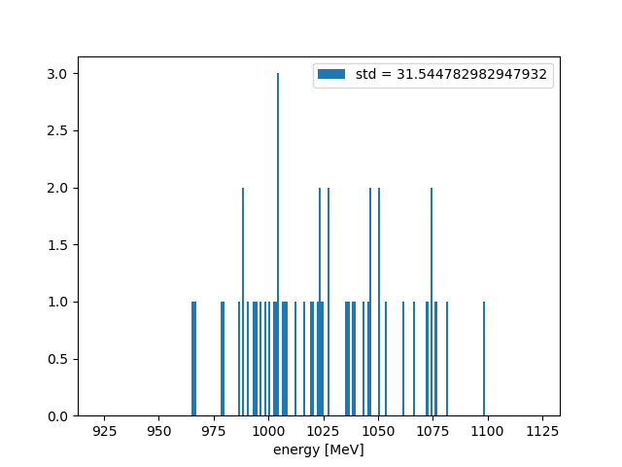
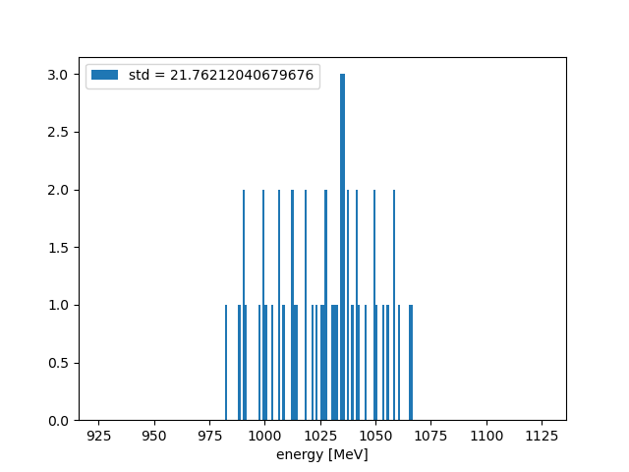
Witness energy distribution at the plasma module exit
A. Del Dotto, S. Romeo
Nominal jitter case:
RF ampl ± 0.2 % (Sband),RF phase ± 0.03° (Sband), RF ampl ± 0.2 % (Xband), RF phase ± 0.1 ° (Xband)
vs half of RF S-band phase&ampl value
Results: energy = 1025 MeV, std ∼ 3%
vs 1025 MeV, std ∼ 2%
Capillary length 60 cm
Cut at 80% of 30 pC charge
Nominal case
Half sband-phase jitters

Slide 23
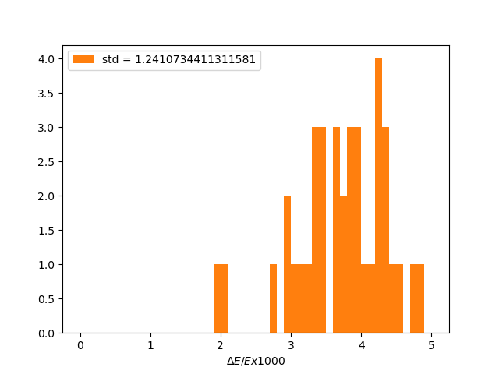
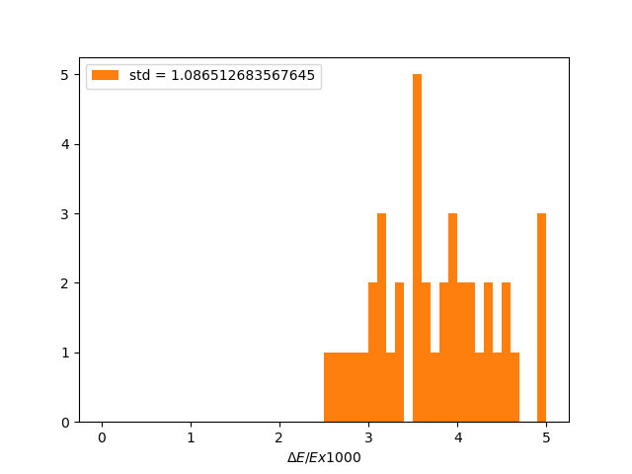
Witness energy spread distribution at the plasma module exit
A. Del Dotto, S. Romeo
Nominal jitter case:
RF ampl ± 0.2 % (Sband),RF phase ± 0.03° (Sband), RF ampl ± 0.2 % (Xband), RF phase ± 0.1 ° (Xband)
vs half of RF phase&ampl value
Results: $σ_{δ}=0.4\% , std 0.1\%$
vs $σ_{δ}=0.4\%, std 0.1\%$
Capillary length 60 cm
Cut at 80% of 30 pC charge
Nominal case
Half sband-phase jitters

Slide 24
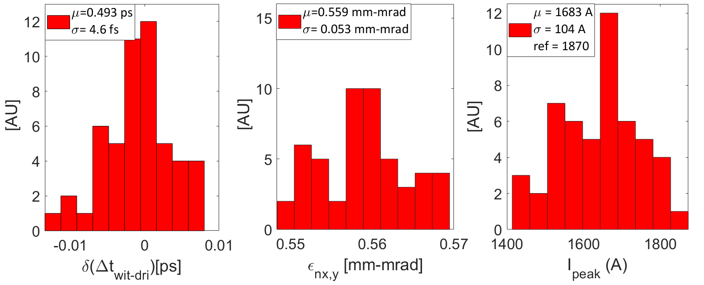
Updated analysis for Photoinjector w S-band ampl. jitter contribution comparable w phase jitter contribution and neglecting the laser time arrival
Updated machine performances
$\sim 1/2$of Wit-Dri distance and Peak current variation
Updated jitter values have been evaluated as in Table
The major upgrade of the machine regarded the photocathode laser TOA jitter → 0 fs
In the chosen range the timing jitter depends quite linearly on the considered quantities
RF Gun (rms)
RF Voltage [ΔV] | ± 0.030 | %
RF Phase [Δφ] | ± 0.015 | deg
S-band Accelerating Sections (rms)
RF Voltage [ΔV] | ± 0.030 | %
RF Phase [Δφ] | ± 0.015 | deg
X-band Accelerating Sections (rms)
RF Voltage [ΔV] | ± 0.02 | %
RF Phase [Δφ] | ± 0.10 | deg
Cathode Laser System (rms)
Charge [ΔQ] | ± 0.3 | %
Laser time of arrival [Δ𝑡] | ± 0 | fs
Laser Spot size [Δσ] | ± 0.3 | %

Slide 25
Jitter studies including acceleration in plasma for magnetic-mask shaping
50 machines have been tracked trough the Linac up to the plasma entrance applying the RF phase and amplitude jitters in the accelerator according to:
LNF measurements at TeX
PSI measurements (“RF System Performance in the SwissFEL Linac”, C. Beard et al , JACoW LINAC2022 (2022), TH2AA02)

Slide 26
Jitter analysis Summary Table & Open Points
Summary Table
Magnetic Shaping open points:
Witness Transverse emittance optimization
Beam loading check and optimization
Geant4 simulation of the wedge
Complete start2end jitter analysis
Technological solution
Microbunching Instability now priority item
Comb scheme | Q pC | Final Energy std 80% charge | Final Energy Spread 80% charge | Final Energy std 40% charge | Final Energy Spread 40% charge
Velocity Bunching | 30 | 3⇨2 % | 0.4% std=0.1%
Magnetic-shaping | 60 | 0.7 % | 0.2% std=0.03% | 0.7% | 0.05 % std=0.007%

Slide 27
6.6 Electron Beam Virtual Measurements and characterization
3 diagnostic sections for 6D beam characterization:
Low energy (Photoinjector exit)
BC exit
Plasma exit

Slide 28
Thanks for your attention

