Slide 1


Mu2e News
Stefano Miscetti
LNF INFN, Italy
31 Jan 2024
Mu2e Italy Meeting

Slide 2
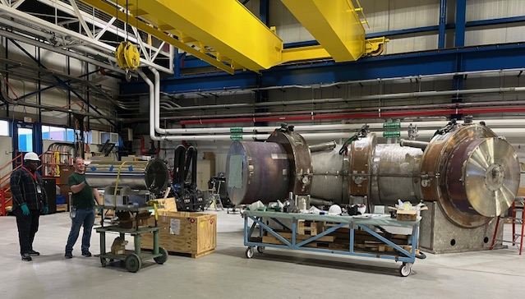
Stato solenoidi – TS is almost done
Installing collimator and then prepare for lifting
Expected to be transported to Mu2e building end of February

Slide 3
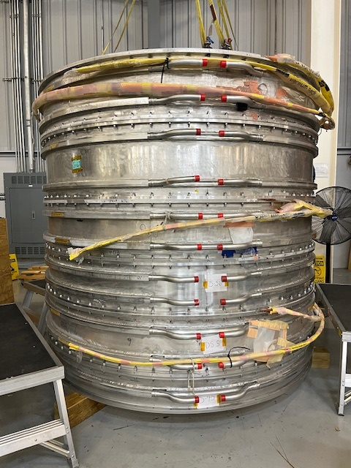
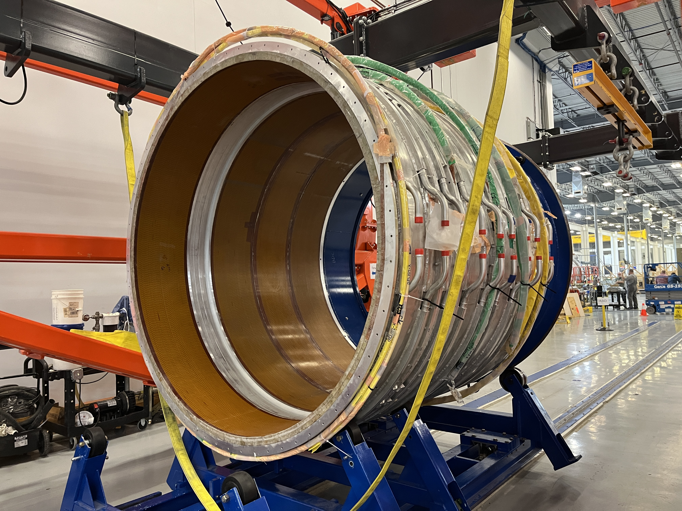
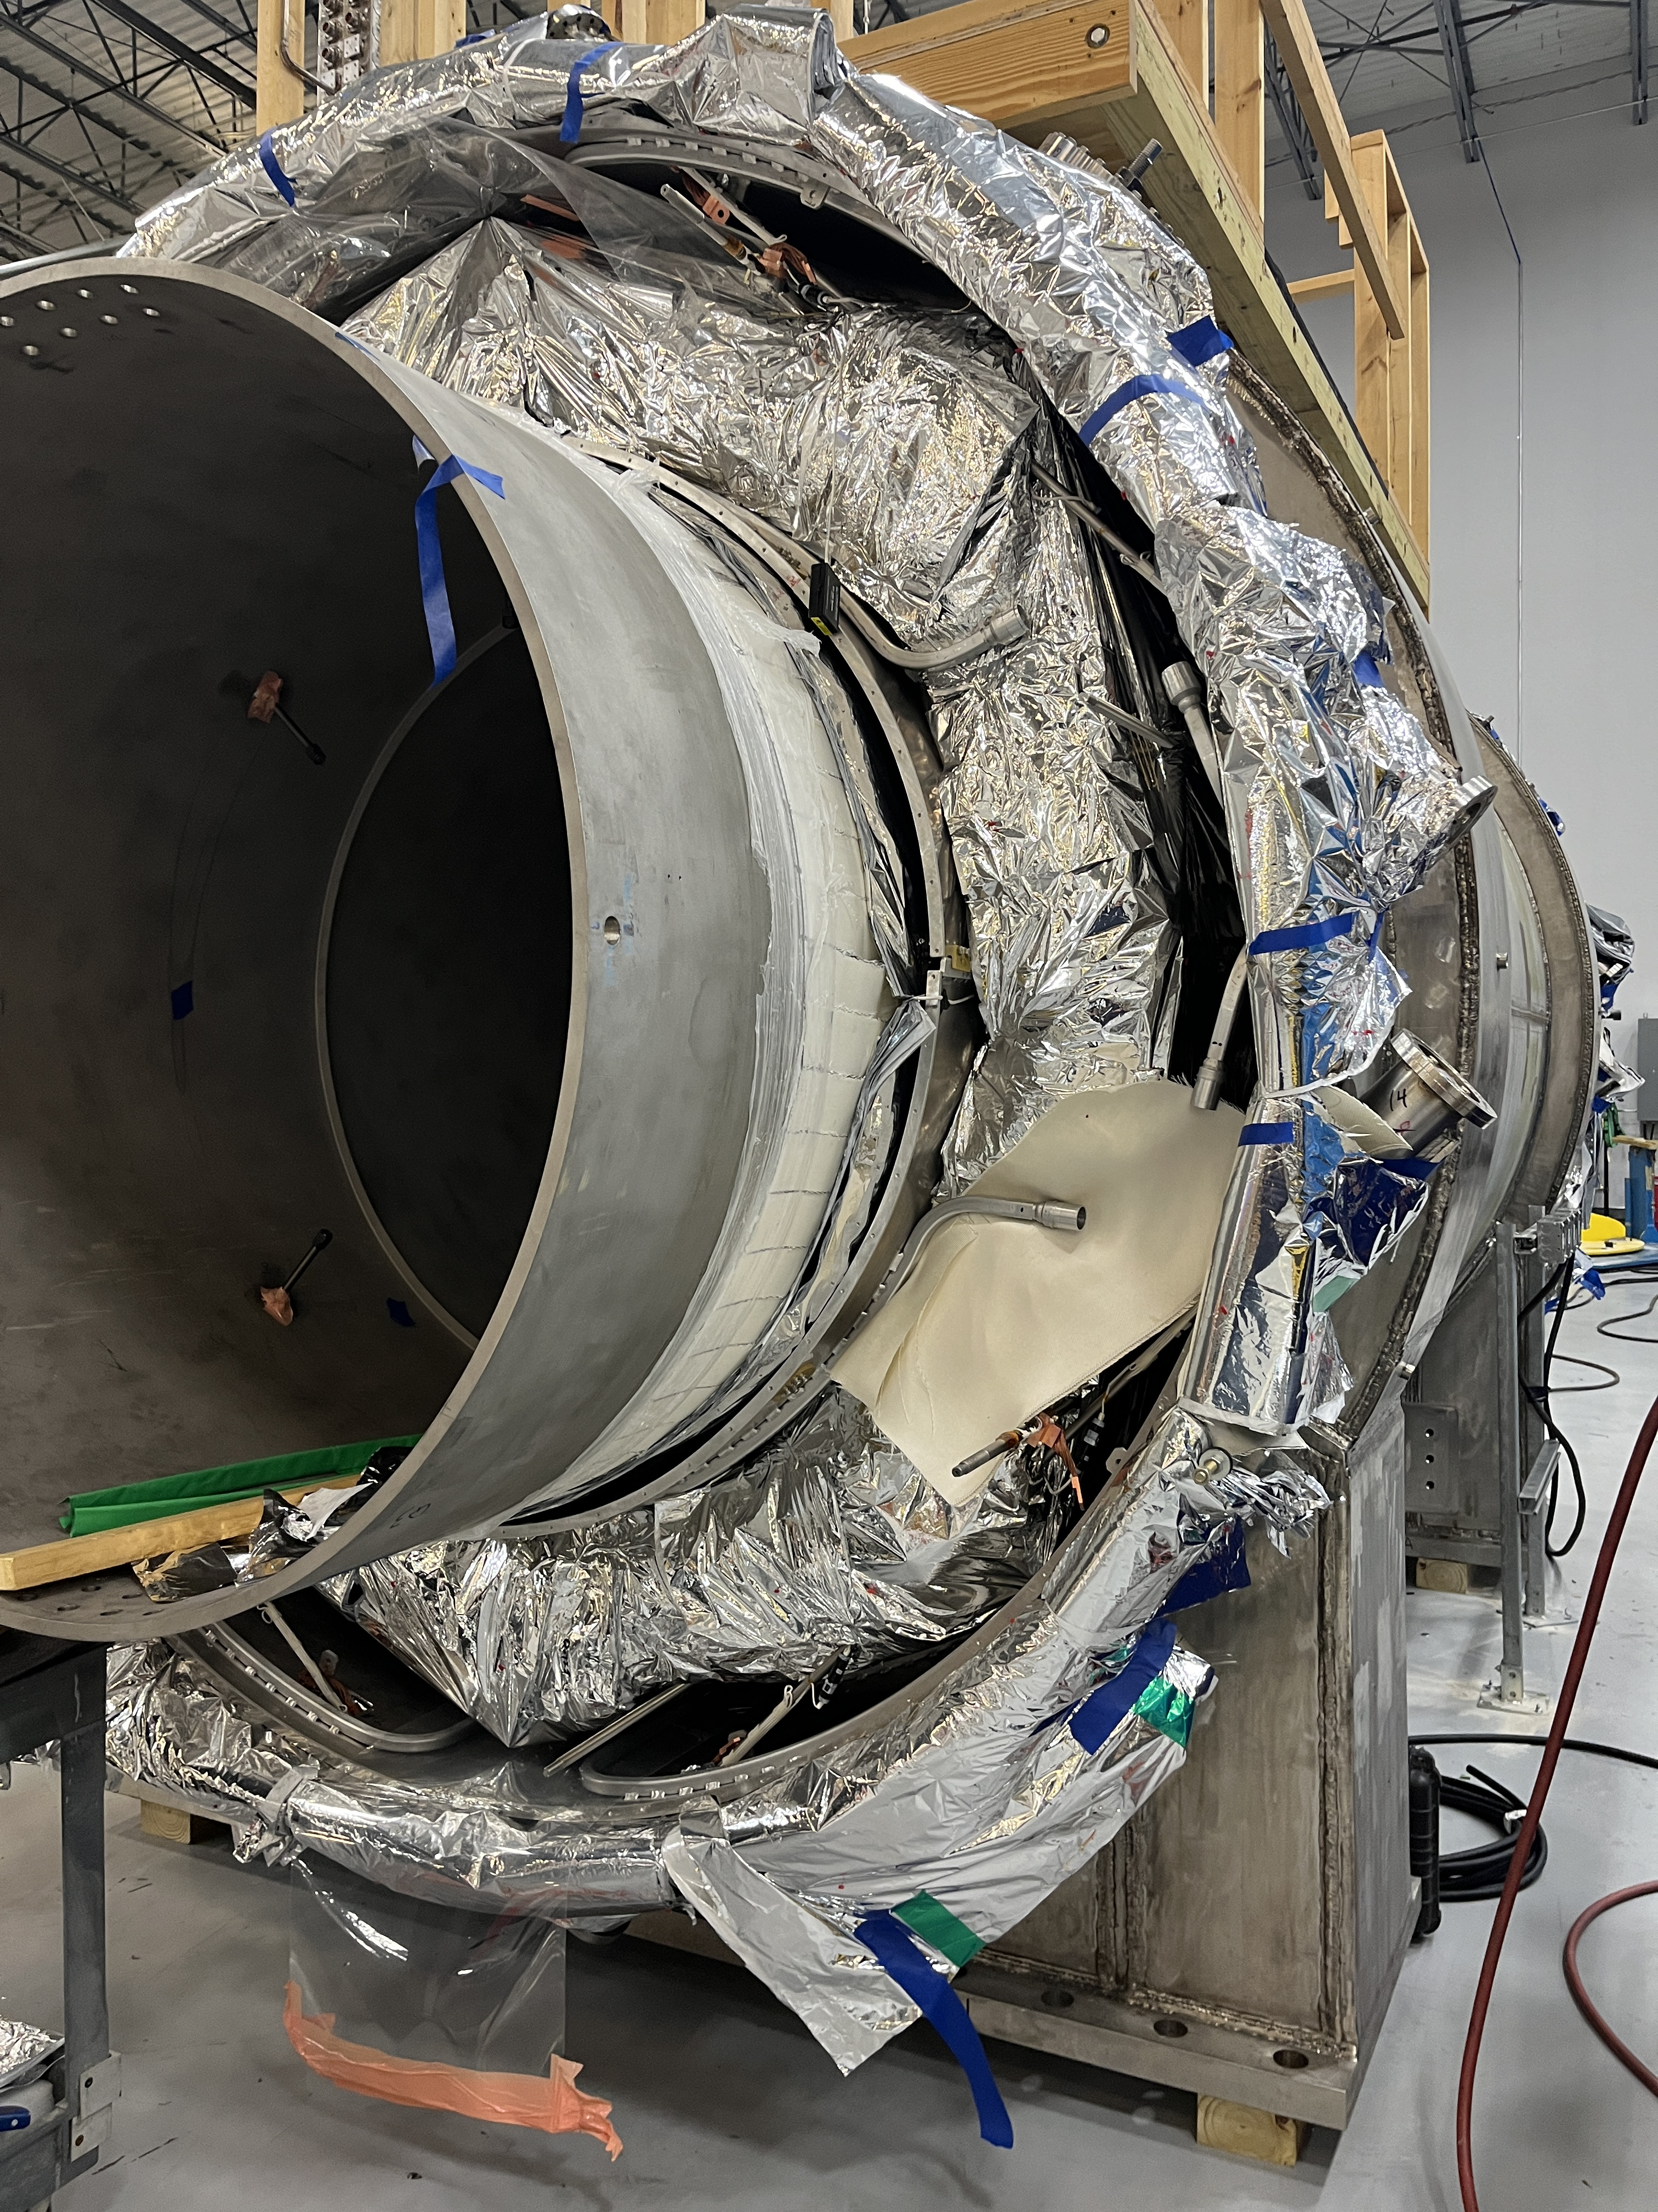
PS and DS : still “a long way to Tipperary”
PS .. Working on
Chimney
Delivery date
May 2024
DS: coil winding is completed
Installation of Coils 1-4, 5-6 OK
Still drives Schedule + 2 months delay wrt IPR
  Delivery date End of October 2024

Slide 4
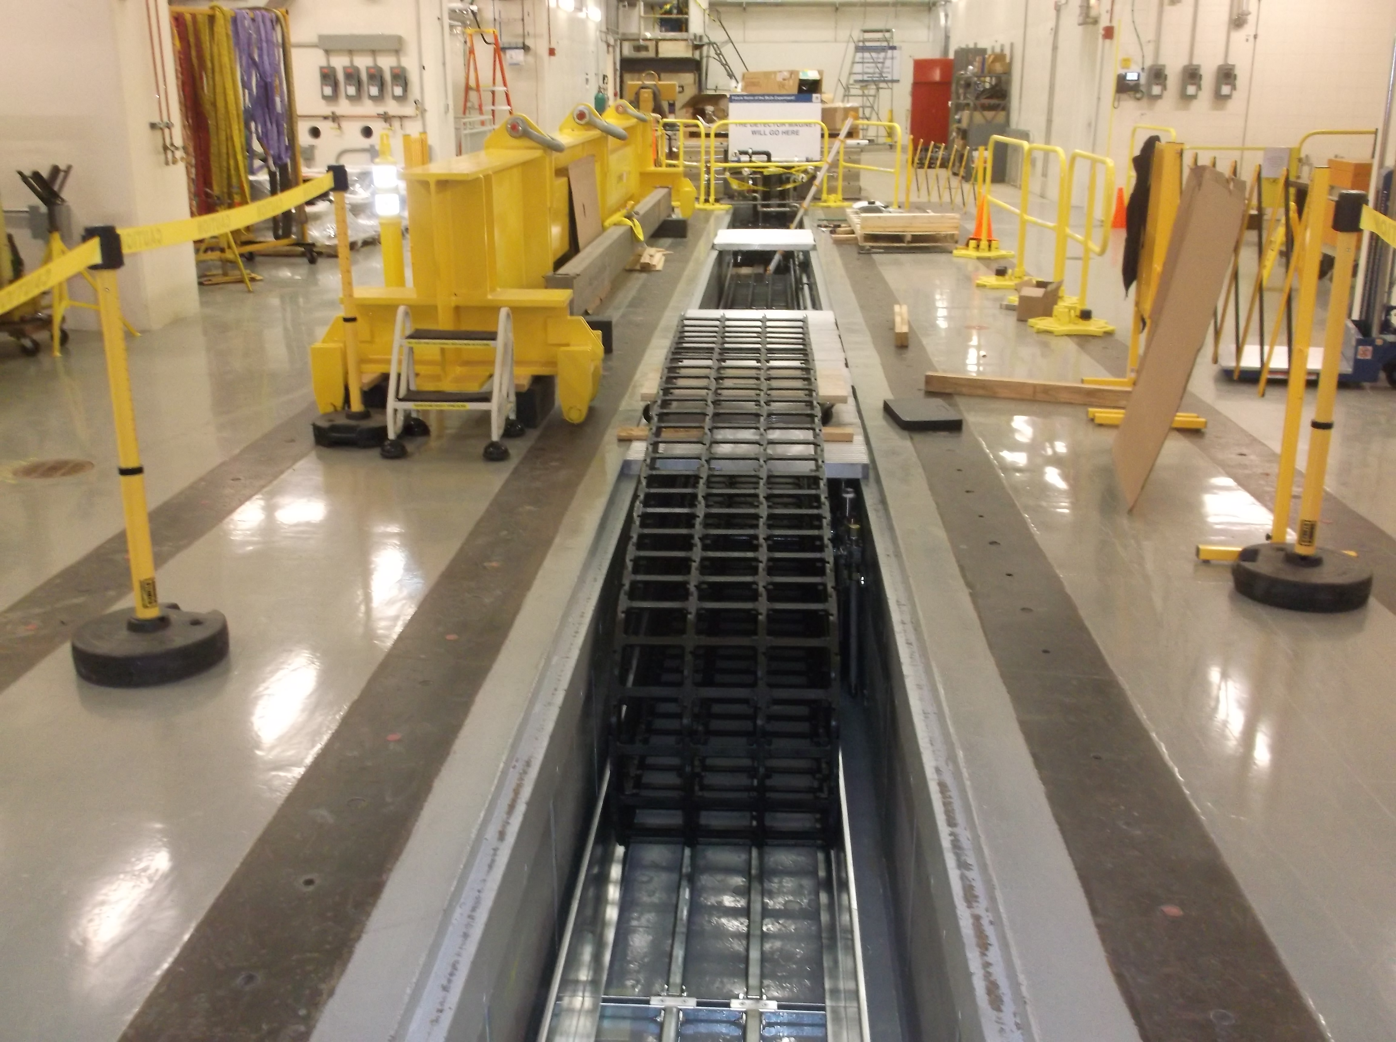
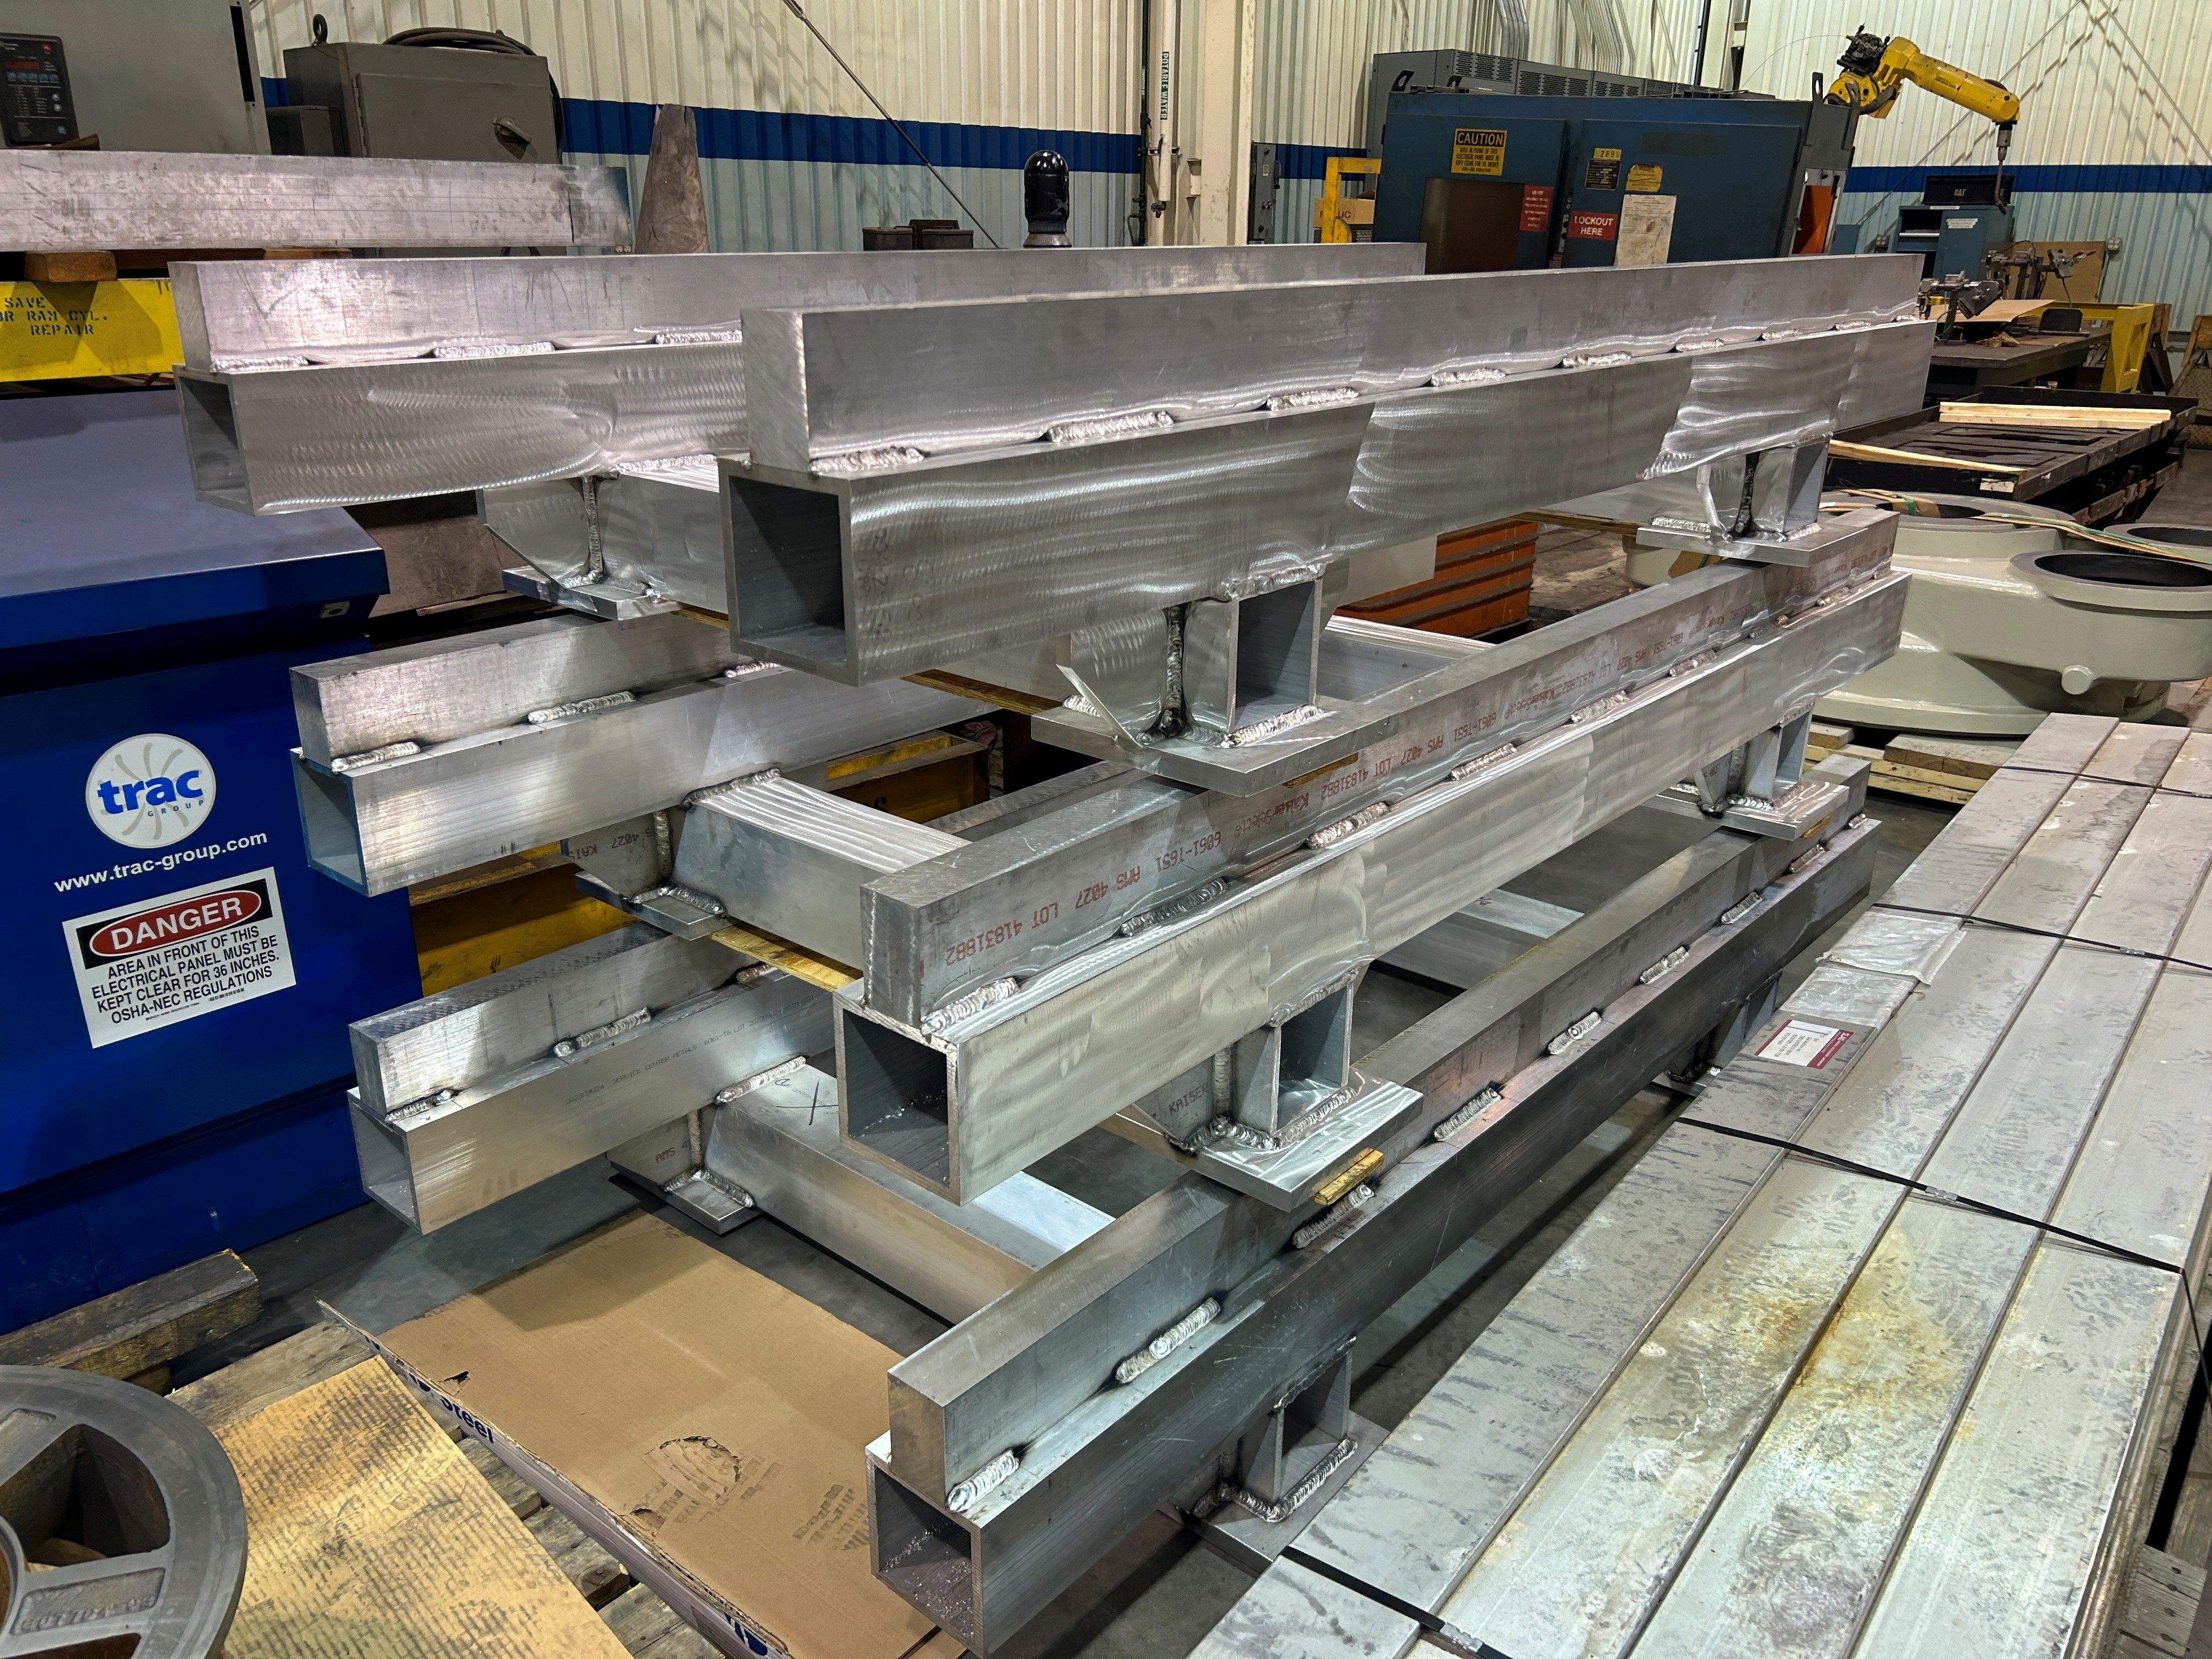
On-the-hall progresses
Very relevant step for startup of operations … filling up Mu2e building also for Detectors
Cable management system is done and installed
Start routing cables on the trenches …
South side first (DAQ+CALO), Center (Tracker), North (CALO,DAQ)
→ Next step once routing finished → installation of rails … IFB procurement in progress

Slide 5
New schedule presented at PAC – Jan 8-12
Beginning of January, two presentations at PAC
→ Program Coordination – B.Casey: Mu2e status
→ Co-Spokes - B. Bernstein – impact of beam delivery on Mu2e
The meeting went pretty well.
Comments during presentation were OK → 3 questions
recommendations back from PAC not yet received.

Slide 6
3 questions from PAC and replies (docdb# 47510)
What is the Impact if the commissioning first physics run get shortened?
Minimum Beam time to get reasonable physics before LS?
- 10% of Total # of POT is needed to make “a good physics case”
- 3 months to commission the beam
- 20 weeks (4-5 months) to get 3.6E19 POT
We put 7 months in the schedule.
Can the g-2 data be used to diagnose the extinction in the Recycler?
- Just barely. It looks like there are not all information just “plots”.
Provide a measurement plan for diagnosing beam profile and extinction?
- Use the upstram ext.monitor done by quartz C detectors with its own DAQ system
- The system will be ready in time for when the beam will be available (March?)
Accelerator team proposed 3 beam studies to measure extinction:
As a function of Recycler beam intensity
As a function of 2.5 MHz recycler RF ramp rate
As a function of Recycler extraction and Delivery injection kickers

Slide 7
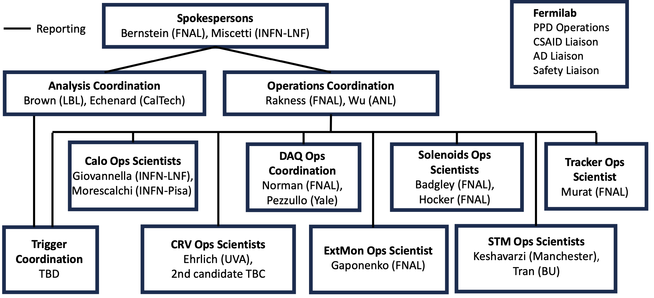
ORG-chart news
- Weekly meeting of EEC started
- OPSCO have been populated, Weekly meeting started
- ANCO structure is almost ready →
presentation next week @ weekly meeting
Then start nominations and selections

Slide 8
Next Mu2e meetings
Mu2e CM from 18 to 23 of March
  ½-1 Day dedicated to OPS review preparation (not yet frozen)
  SW tutorials on Saturday
DOE IPR review on June (25-27)?? – FOR PROJECT
→ schedule & cost
→ probably one detector report, short breakouts
B&R review for operations → scale of $$$ for operation 5 year plan
→ under discussion ..
→ Possibly end of July
→ new OPS team will do it

