Slide 1
BULLKID Readout Electronics
T. Muscheid, R. Gartmann, O. Sander, L. Ardila-Perez, F. Simon

Slide 2
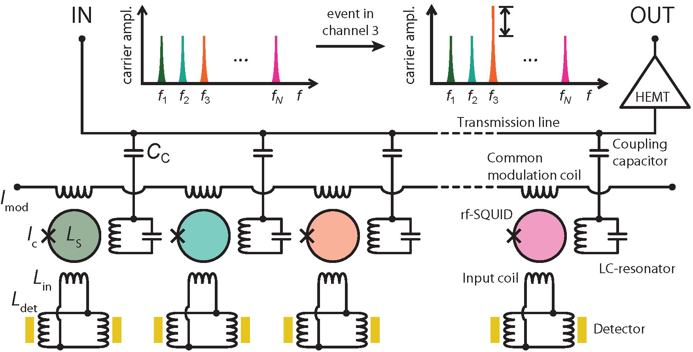
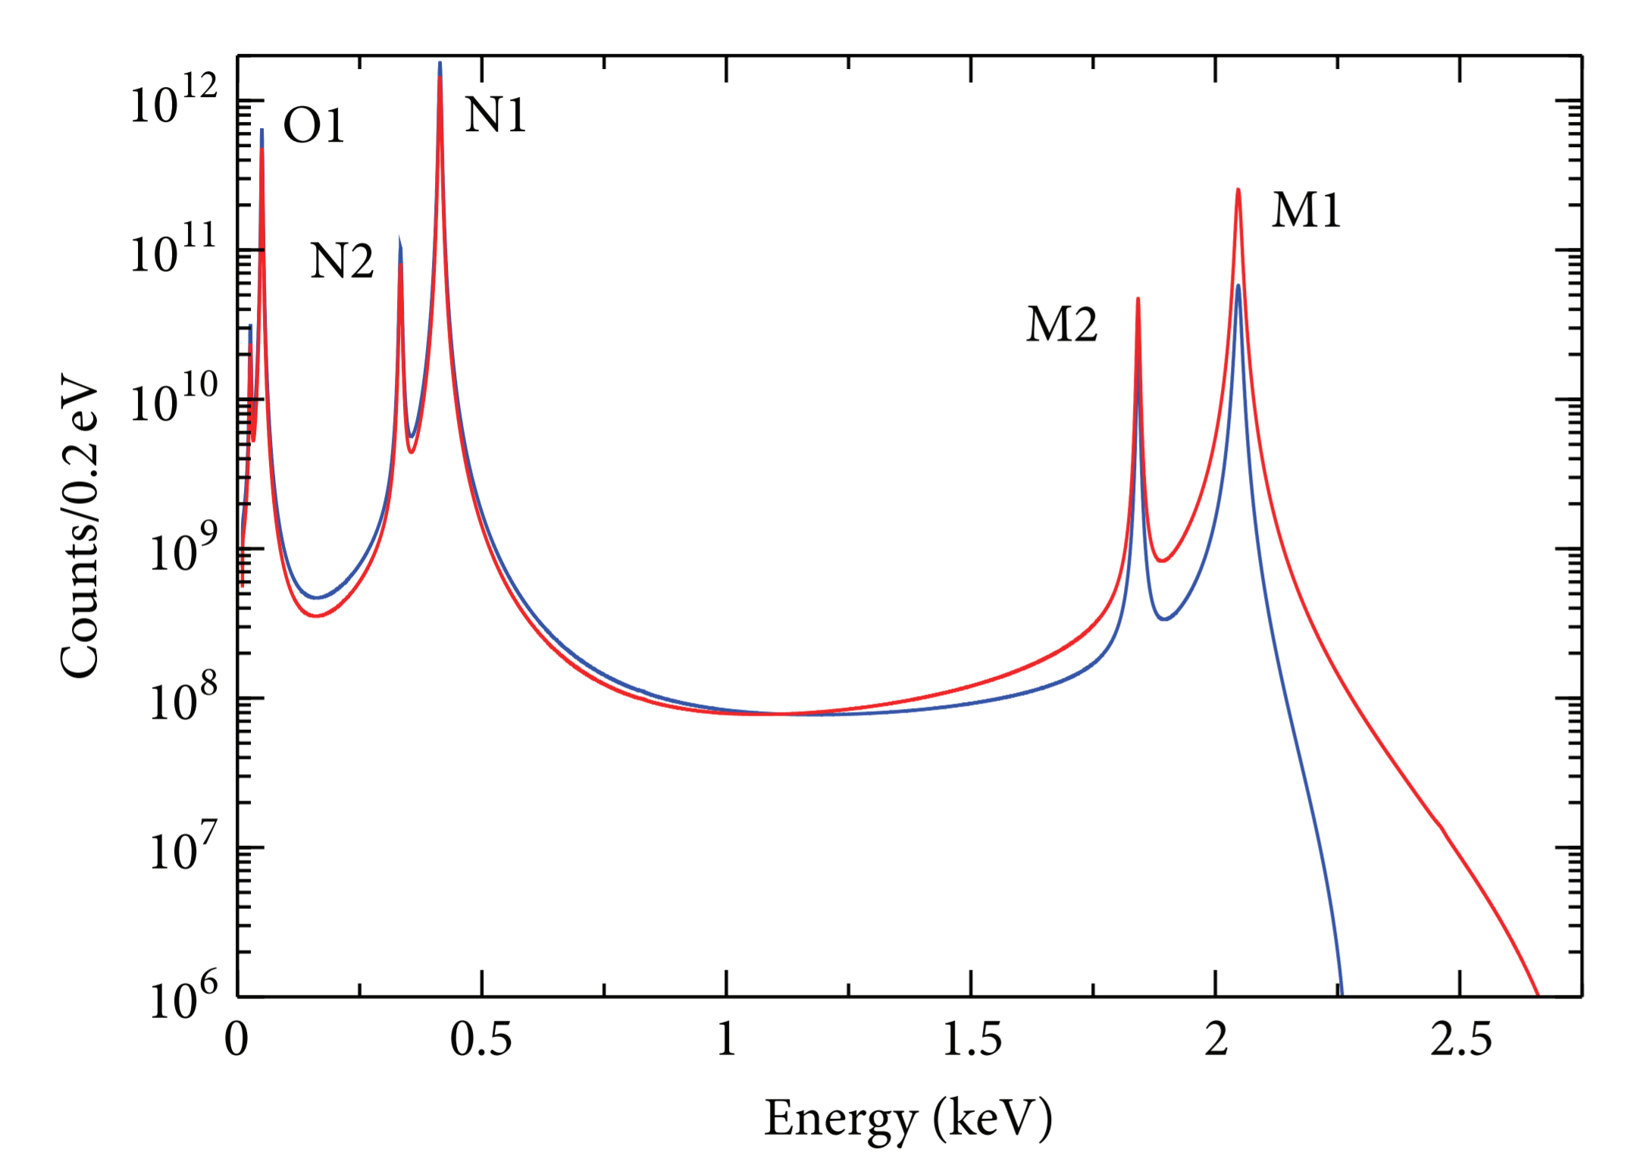
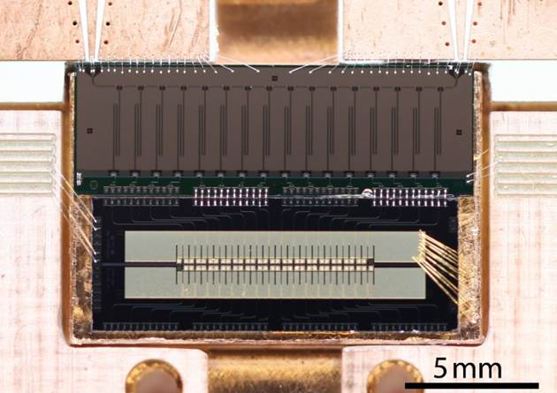
Research background: ECHo experiment
Upper limit of electron neutrino mass
Electron capture using magnetic microcalorimeters
Resonator bandwidth:
1.6 MHz
Ho¹⁶³ decay rate: 10 Bq per MMC pixel
Ho¹⁶³ spectrum:
ECHo detector + μMUX:
400 channels with resonances between 4 – 8 GHz
15 MUX needed for 12.000 sensors!

Slide 3
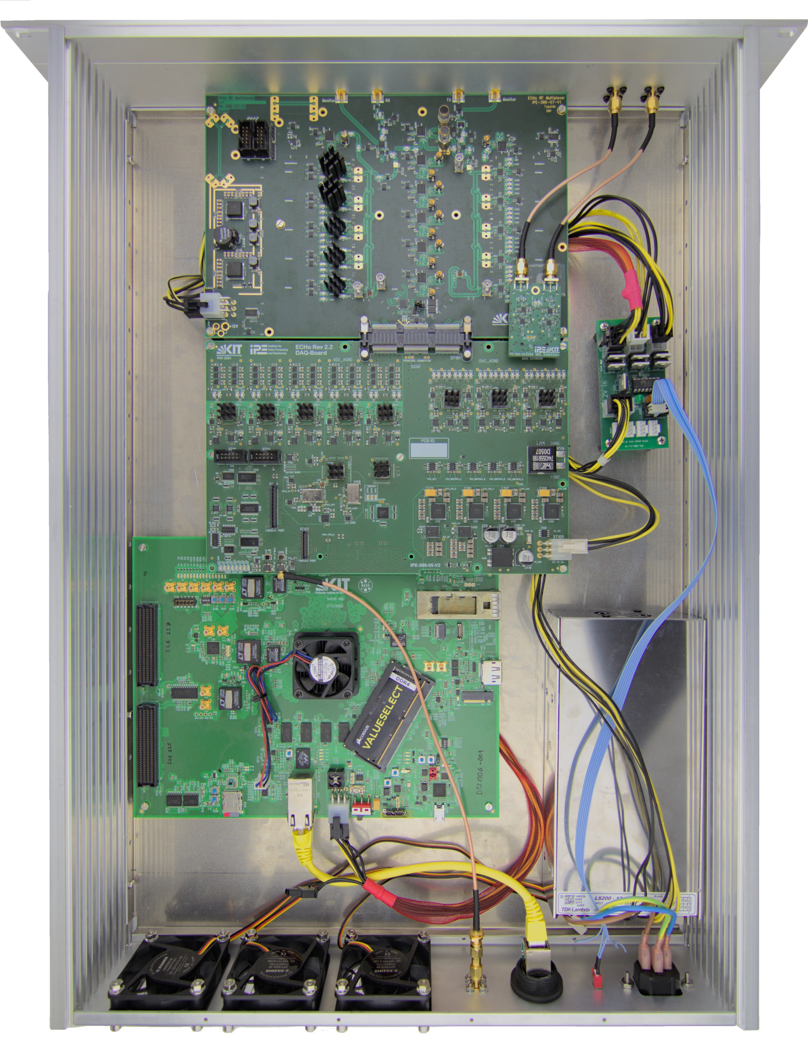
ECHo readout concept & system design
Software-defined radio (SDR) system:

Slide 4
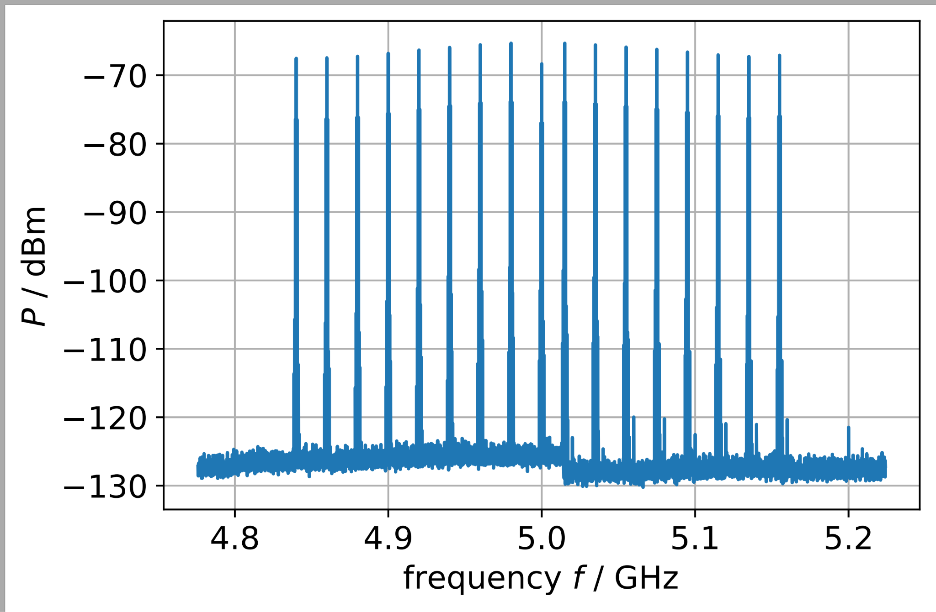
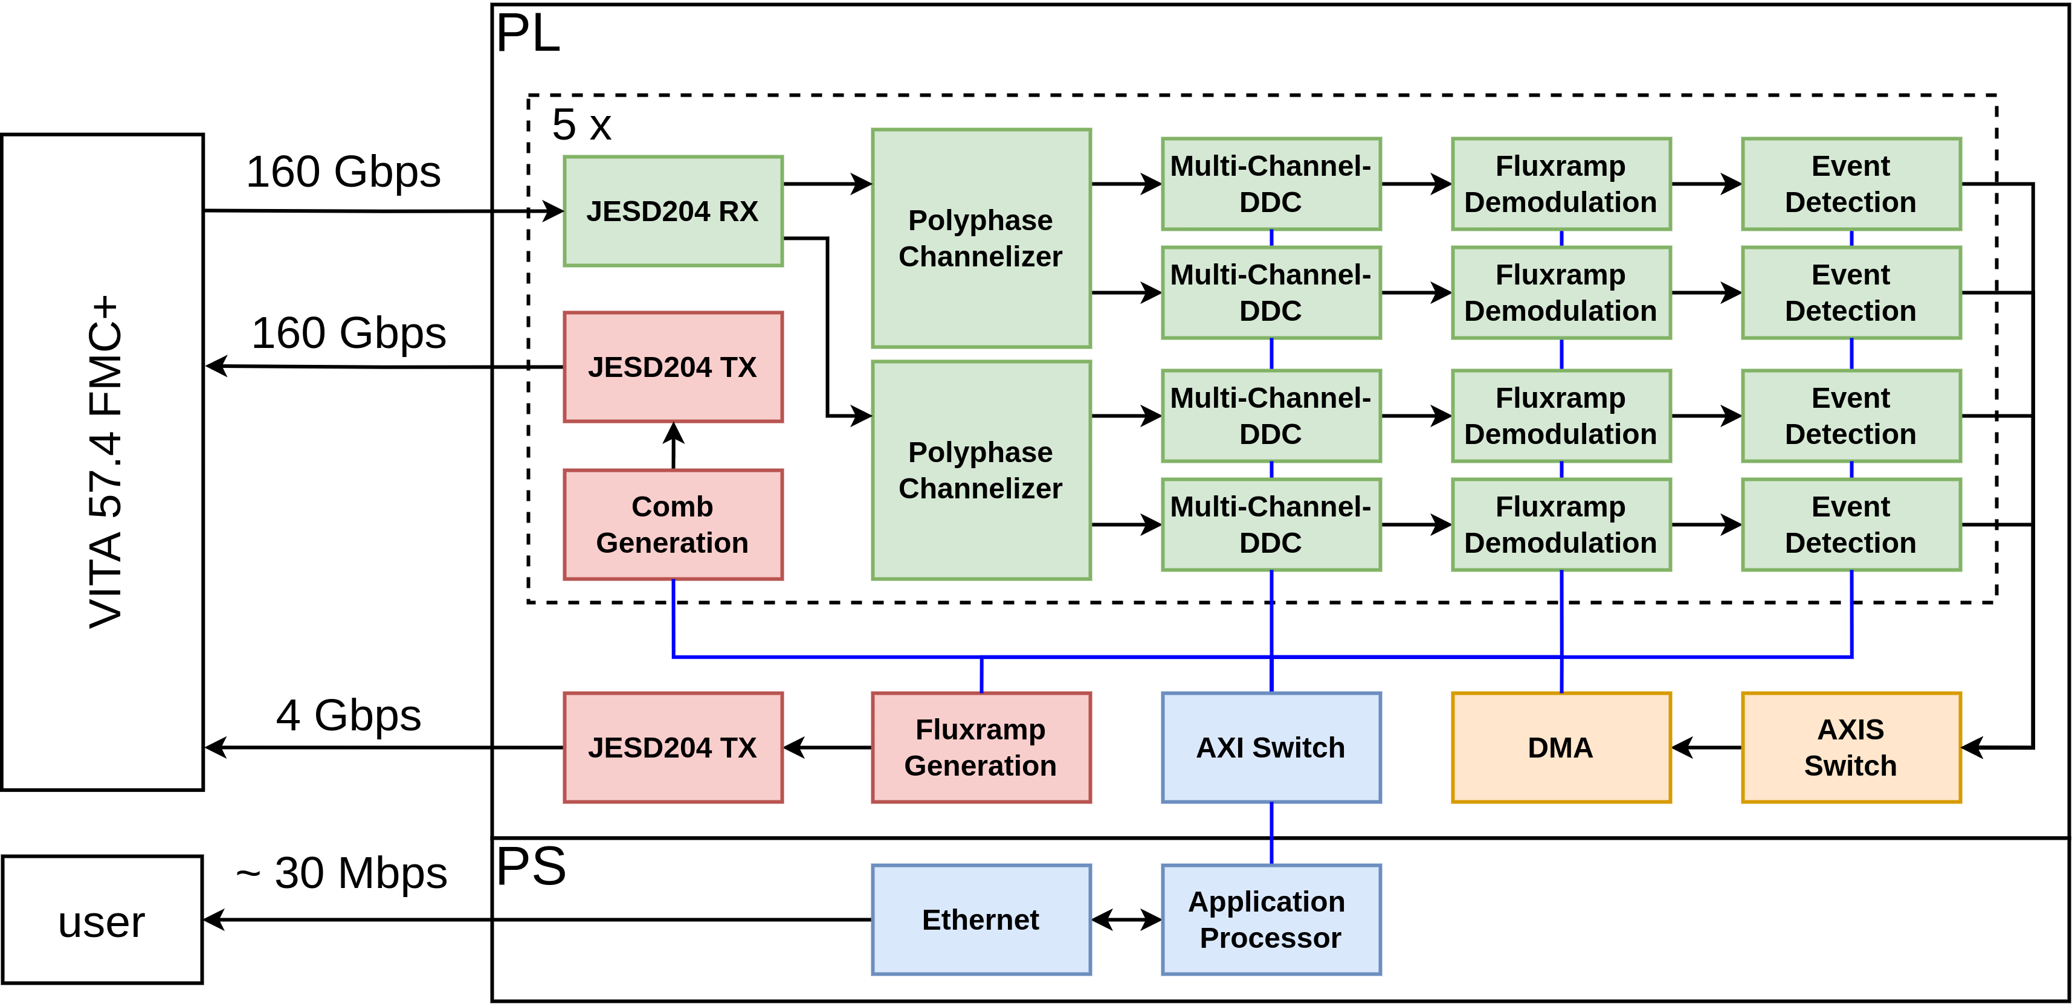
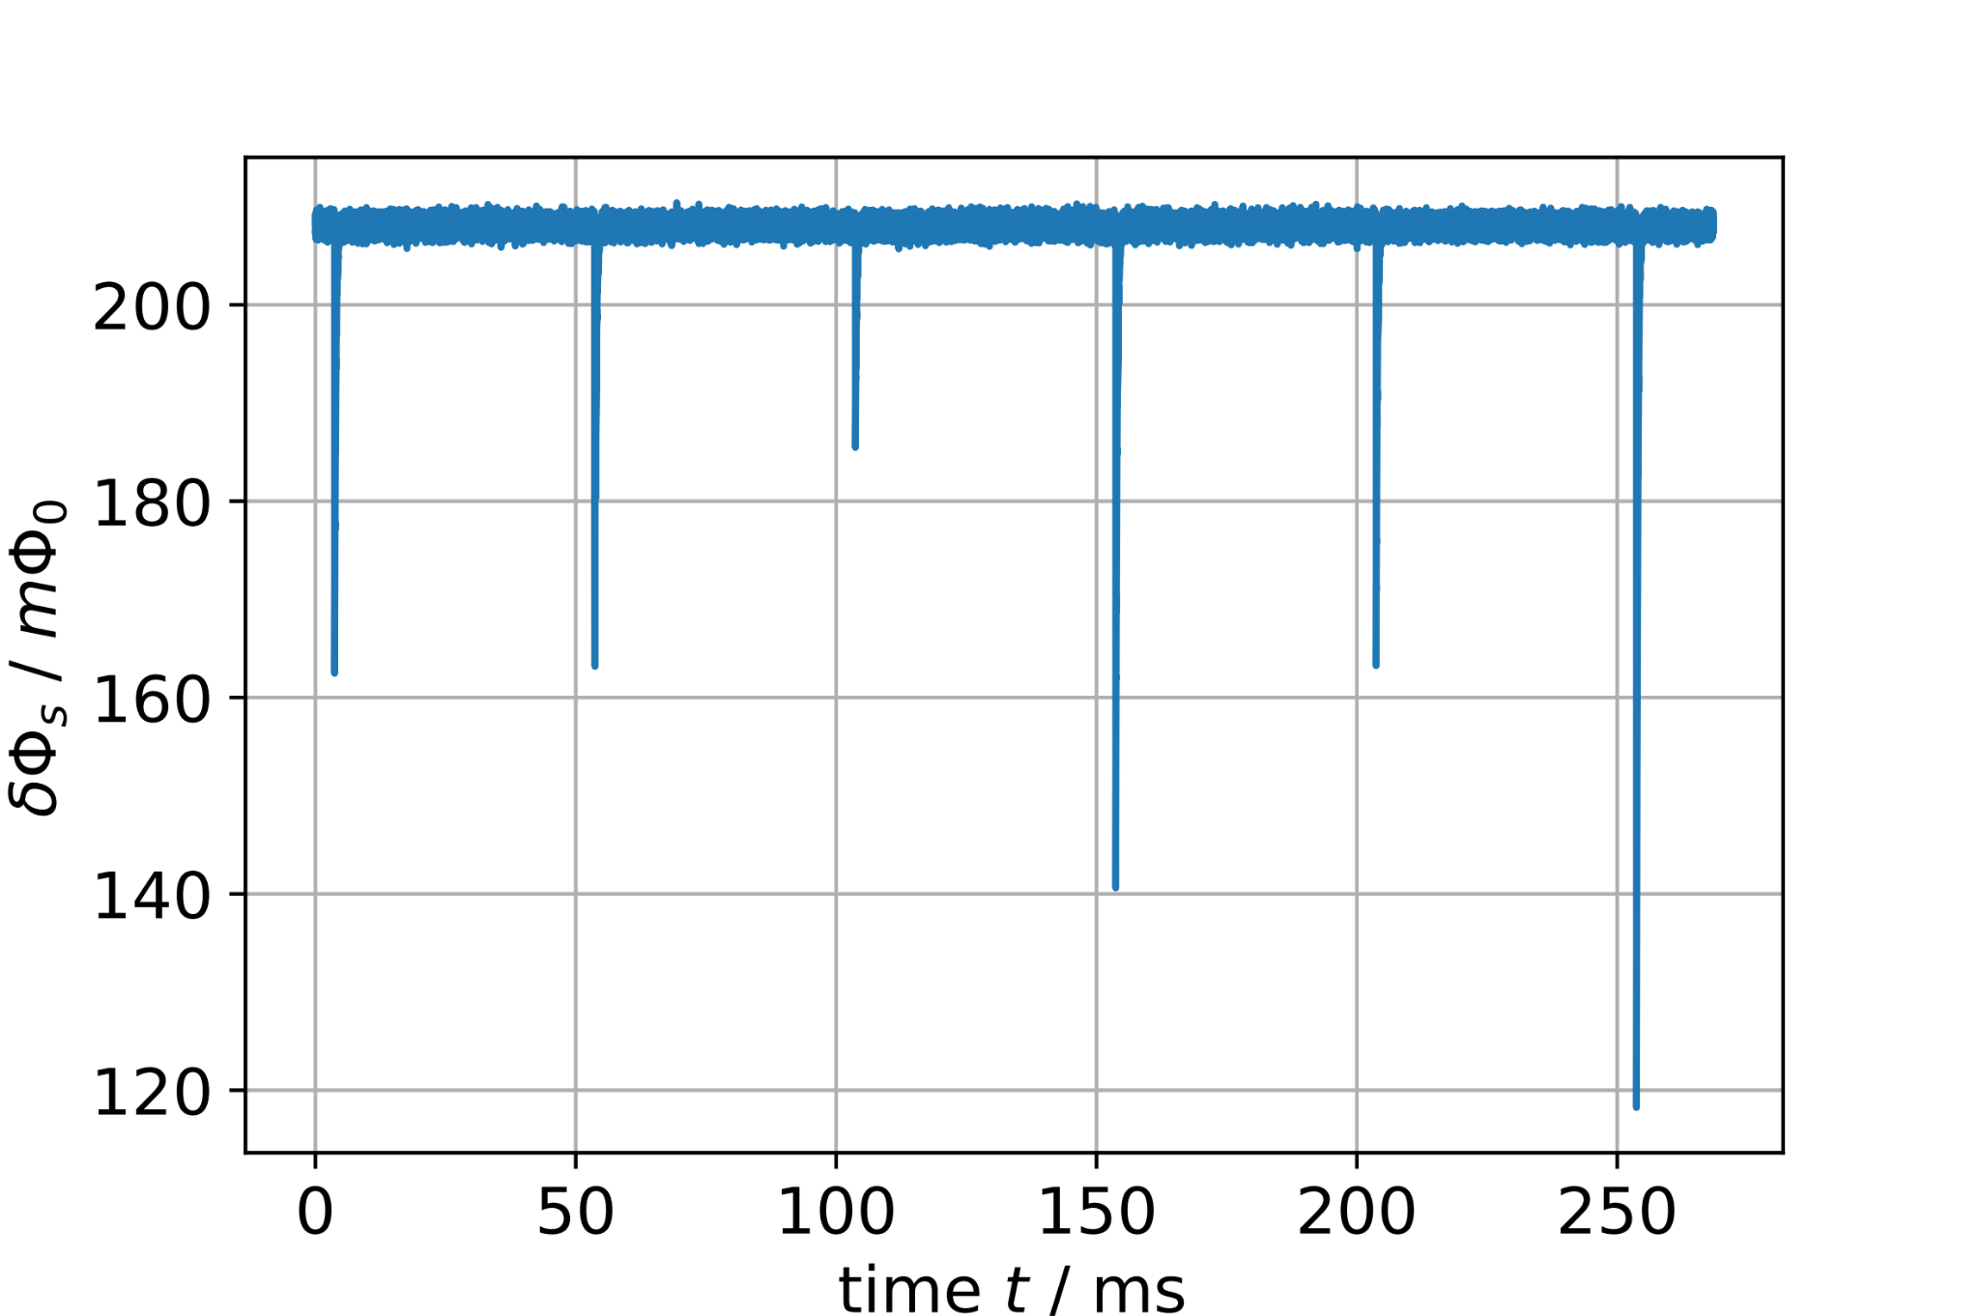
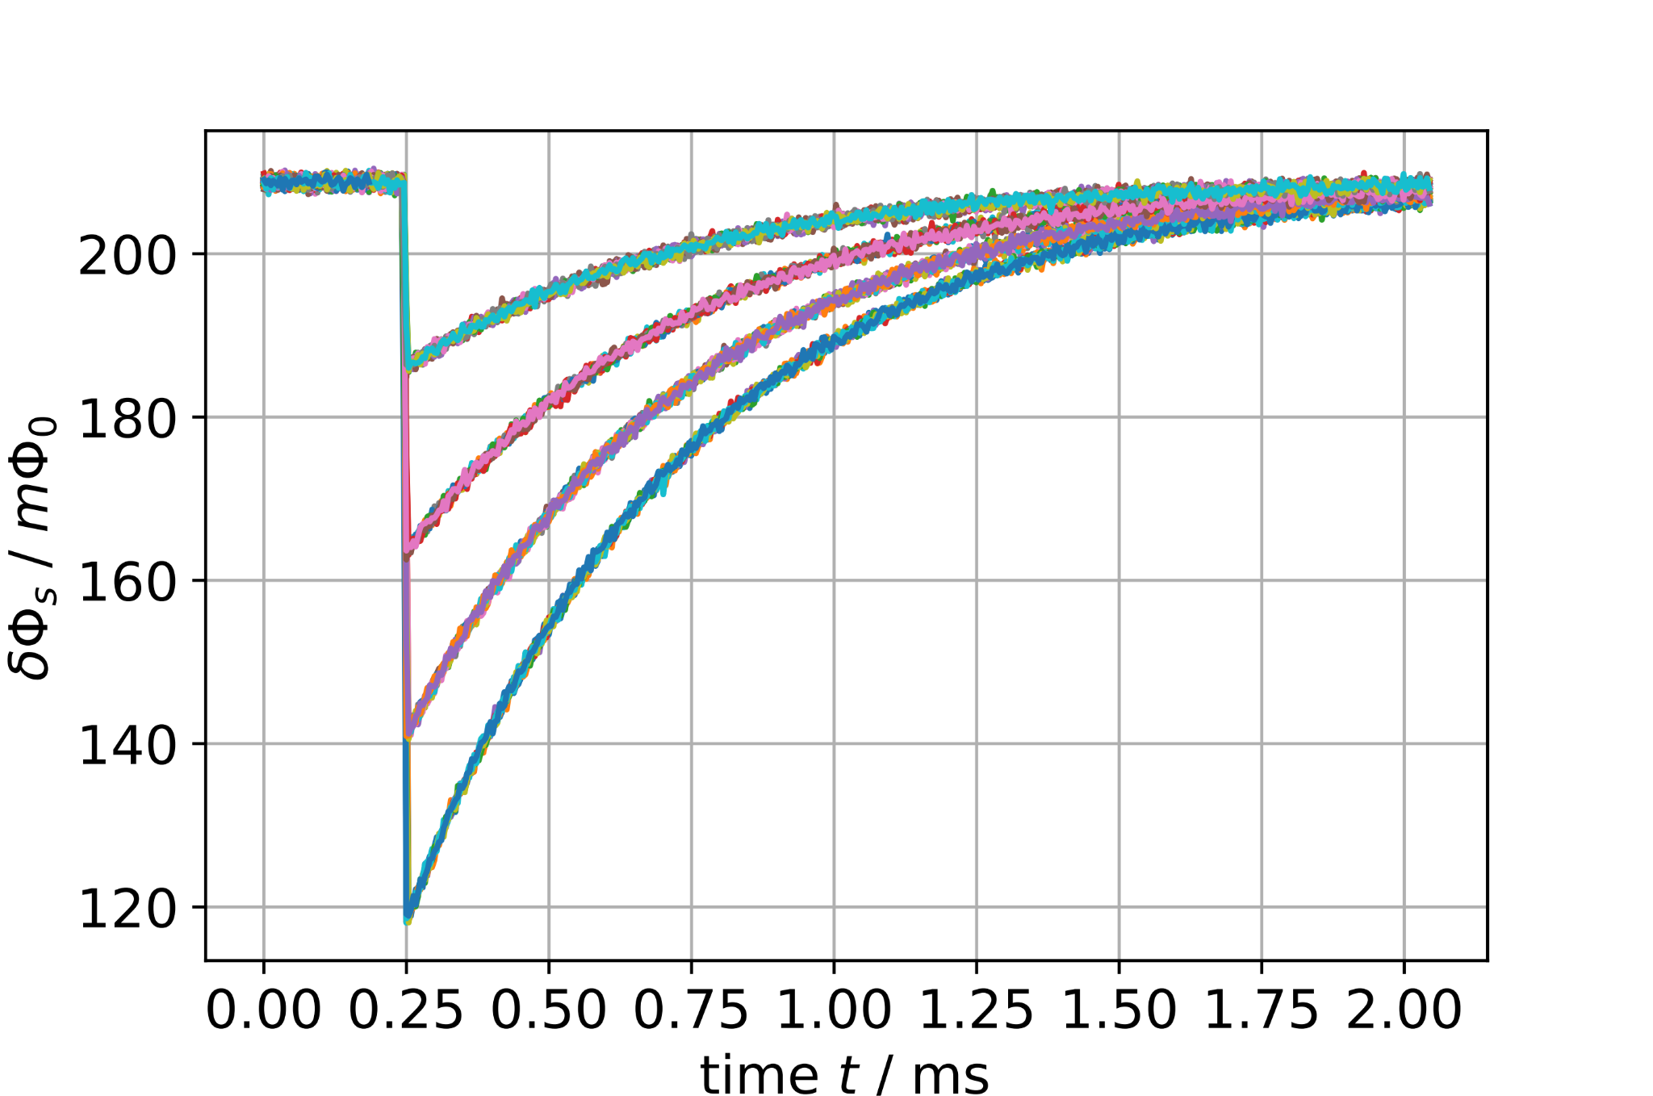
ECHo firmware
Channelization stage
Tone separation into TDM-Scheme
Fluxramp Demodulation
Recovery of raw sensor signal
Event Detection

Slide 5
BULLKID readout requirements
Resonator spectrum:
Preliminary characteristics
Frequency range: 700 – 950 MHz
~ 150 channels per MUX
Channel bandwidth up to 100 kHz
10 – 15 wafers

Slide 6
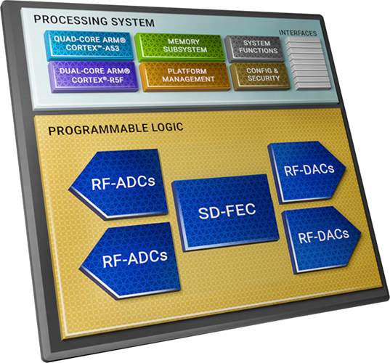
BULLKID readout electronics proposal
Built around AMD RFSoC (Radio Frequency System on Chip)
Source: AMD

Slide 7
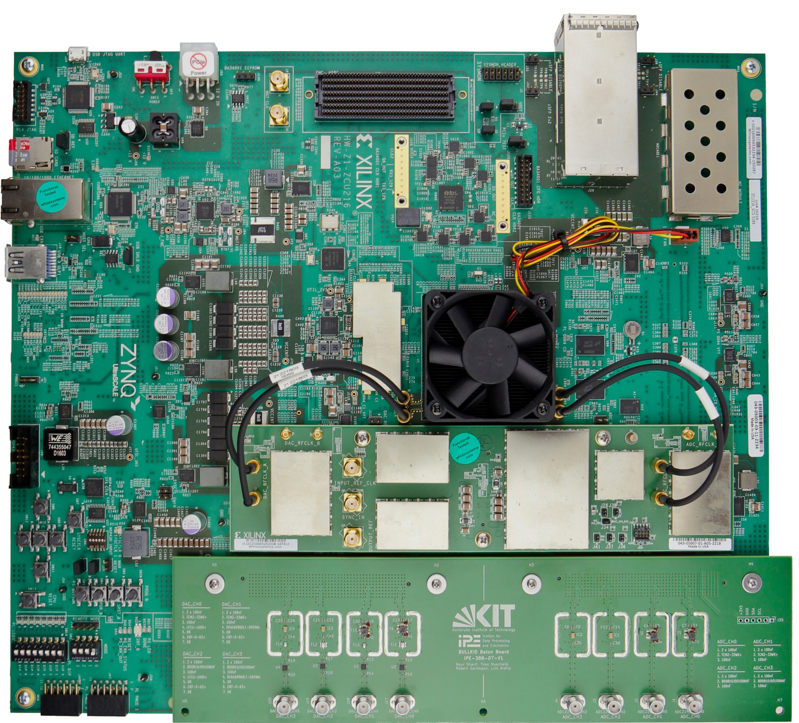
Hardware
ZCU216 Evaluation Board:
16x 14-bit, 9.85 GSPS DAC
16x 14-bit 2.5 GSPS ADC
Plenty of PL resources
CLK104 clock board
Low jitter PLL (LMX2594)
Custom Frontend Board:
BalUn + Lowpass + Equalizer

Slide 8
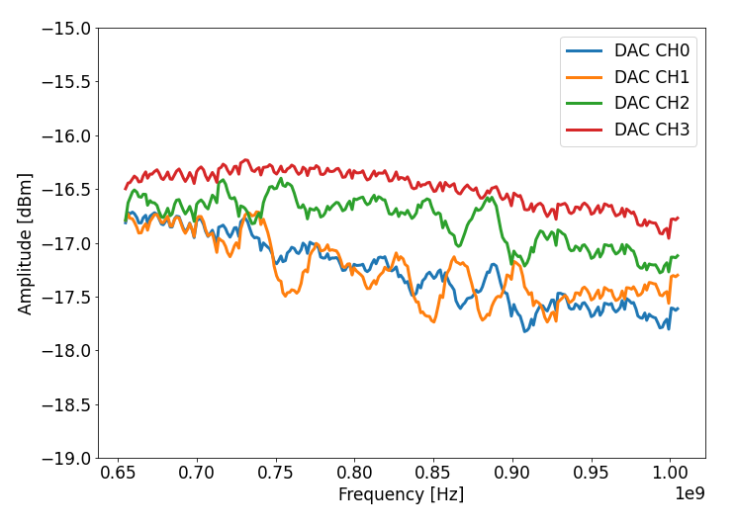
Custom frontend
DAC channel characterization:
Prototype board with 4 channels
Evaluation of various combinations of BalUn transformer and lowpass

Slide 9
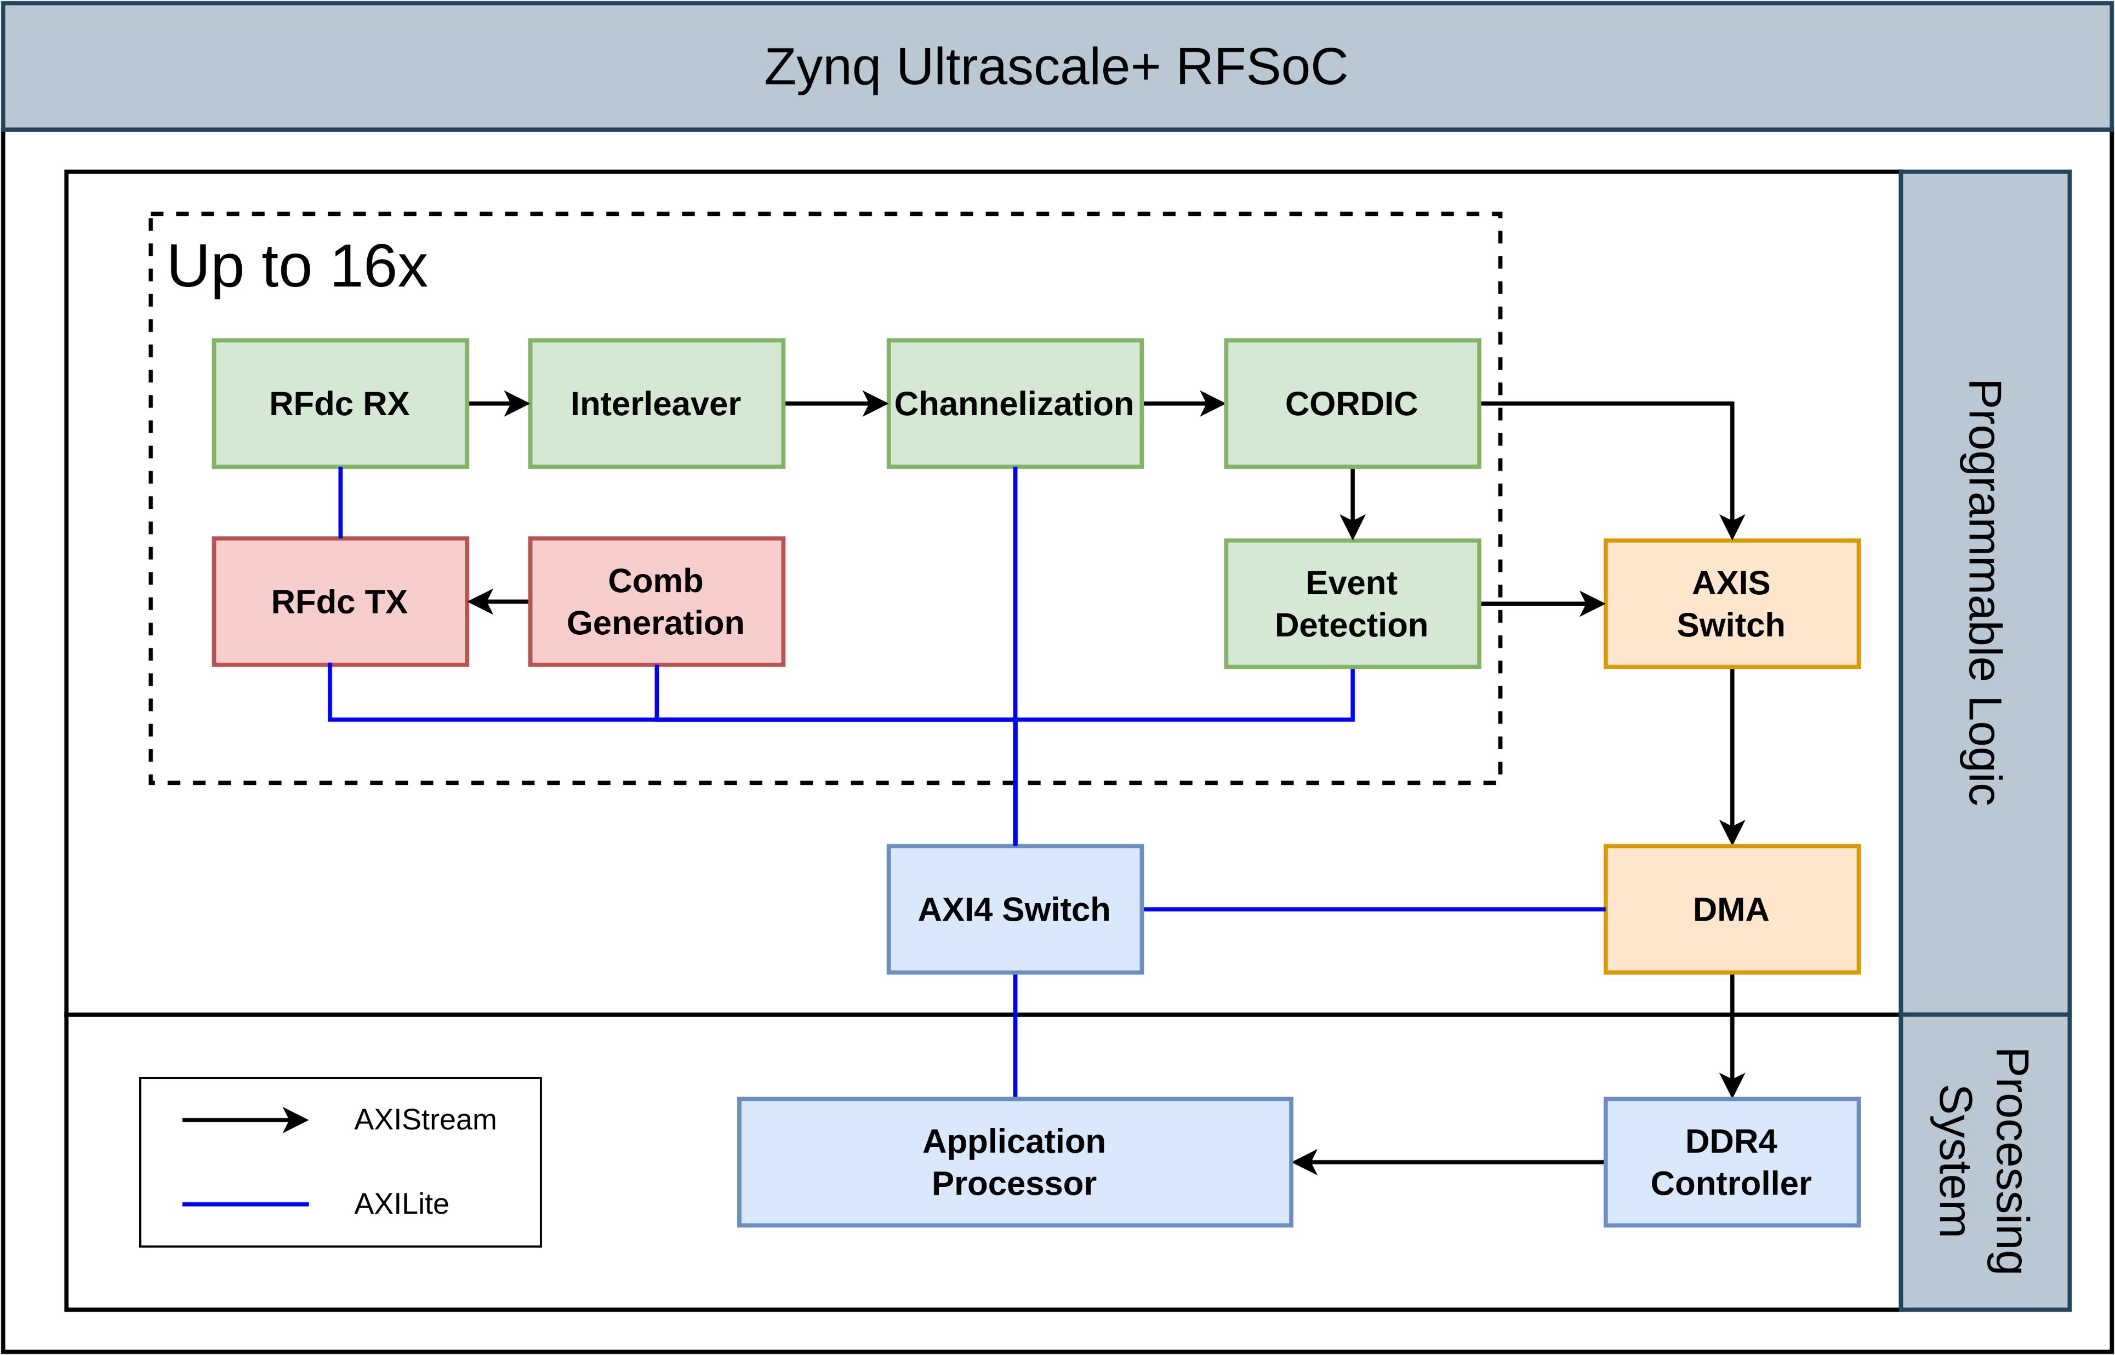
Firmware overview
Resource utilization for 4 chains (16 chains):
BRAM: 40% (180%*)
DSP: 20% (77%)
LUT: 26% (74%)
26 W dissipation
* Additional URAM resources available

Slide 10
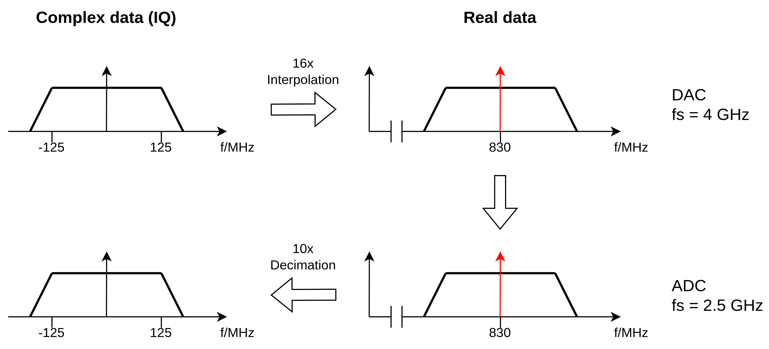
Converter configuration

Slide 11
Converter characterization

Slide 12
Frequency comb generation
250 MHz usable bandwidth
SNR > 70 dBm
Arbitrary number of tones
Configurable frequency, amplitude and phase

Slide 13
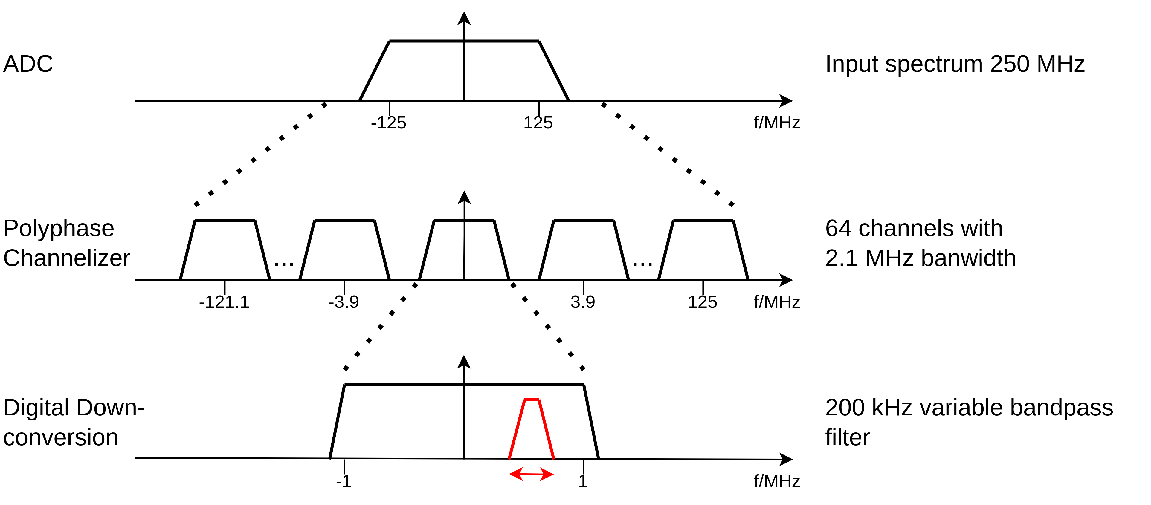
Channelization concept

Slide 14
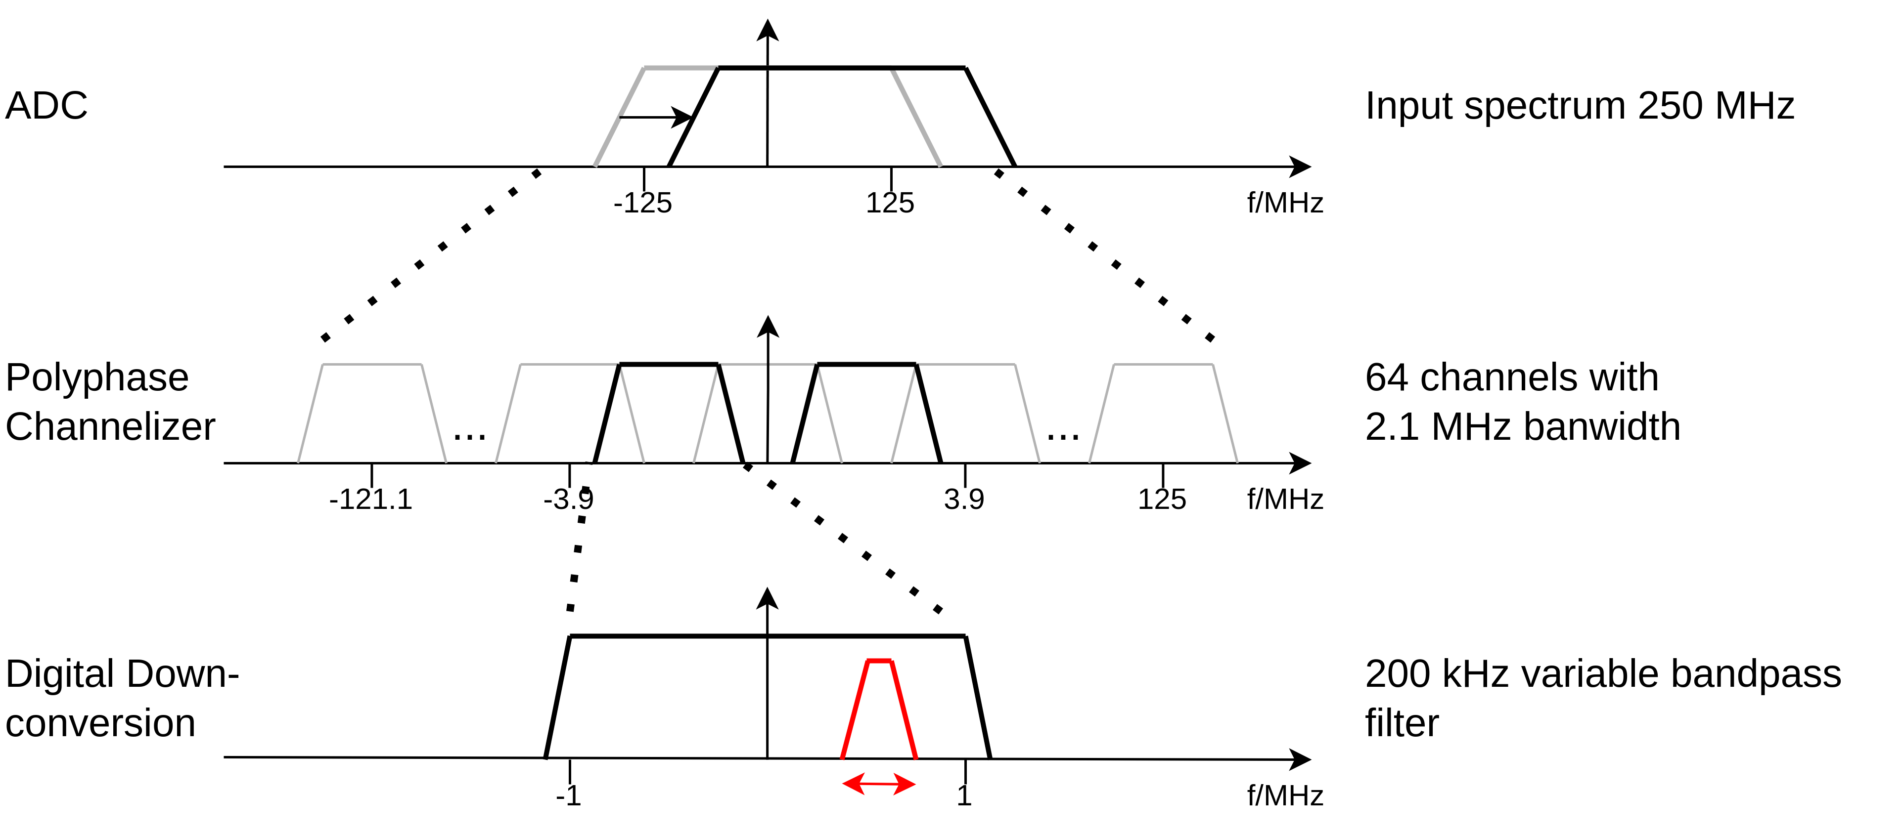
Channelization concept (2)

Slide 15
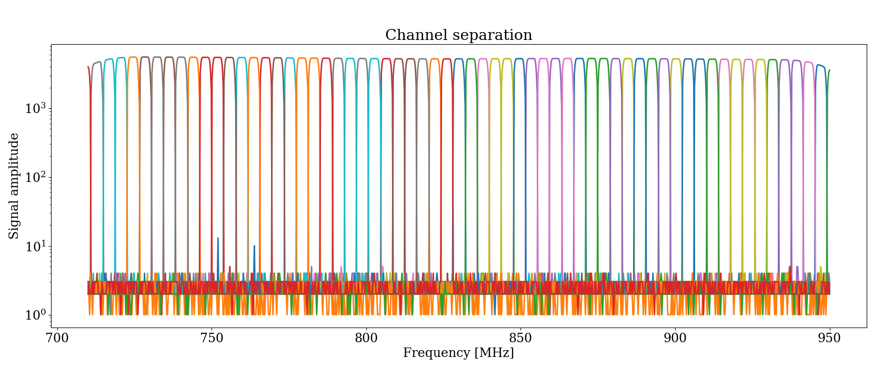
Output of channelization stage

Slide 16
ADC noise measurement
Calculation of PSD with Welch‘s method
Noise increases with increasing number of tones
Strategy for improvement:
Increase power of readout tones
Optimization of DAC and ADC

Slide 17
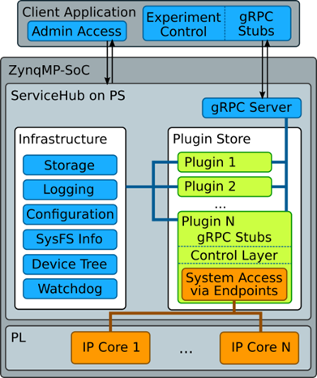
Software stack
Custom C++ server daemon for communication with the platform
Configuration and read-back of PL modules during runtime
Commands are sent via gRPC to the user

Slide 18
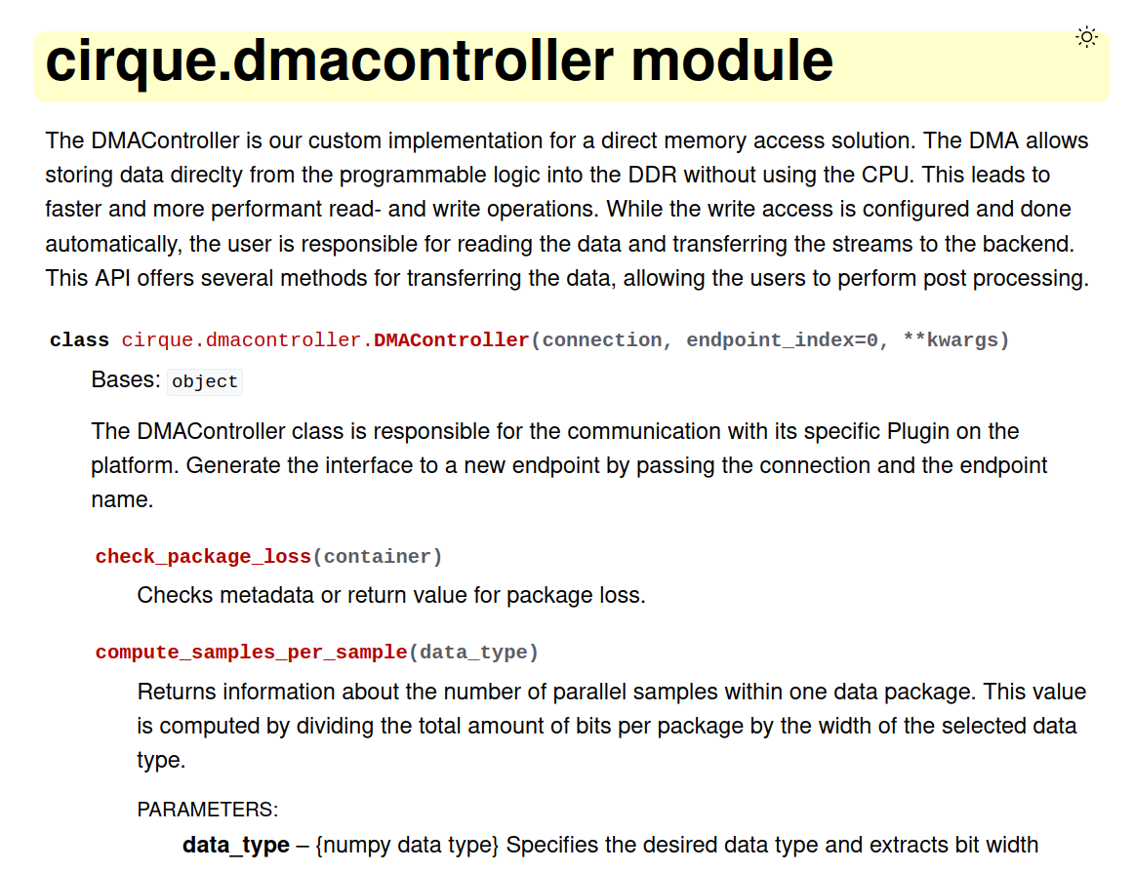
How to use it?
CIRQUE: Communication Interface to Readout electronics for QUantum Experiments
Custom python user interface
gRPC wrapper, no processing
Currently preparing extensive documentation
Package will be published soon as open source on PyPI

Slide 19
Step 1: Connect to platform
from cirque import servicehubutils
from cirque import pimc platform_ip = "192.168.1.105"
con = servicehubutils.FPGAConnection(ip=platform_ip,port=50058)
# Connect to the PIMC (platform information and management core)
pimc = pimc.PIMC(con)
# Check if SDR is ready (Converters and Clocks configured)
print(f"Platform ready: {pimc.get_platform_ready()}")

Slide 20
Step 2: Instantiate available modules
from sdr_utils import platform
platform.print_endpoints(con)
from cirque import stimulation
from cirque import multichannelddc
from cirque import dmacontroller
stim_0 = stimulation.Stimulation(con, "stimulation_0")
ddc_0 = multichannelddc.MultiChannelDDC(con, "ddc_0")
ddc_1 = multichannelddc.MultiChannelDDC(con, "ddc_1")
dma = dmacontroller.DMAController(con)

Slide 21
Step 3: Generate readout tones
Option A: Manually generate tones
from sdr_utils import tone_generation frequencies = tone_generation.set_tone(stim_0, 720e6, 0.2, 0)
Option B: Generate tones from file
from sdr_utils import tone_generation tones = tone_generation.import_tones_from_file("tones.csv")
frequencies = tone_generation.set_tones(stim_0, tones)

Slide 22
Step 4: Configure channelization
from sdr_utils import channel_configuration
chain_0 = channel_configuration.Subchain(ppc_0, ddc_0)
chain_1 = channel_configuration.Subchain(ppc_1, ddc_1)
ddc_chain = channel_configuration.DownConversion()
ddc_chain.add_chain(chain_0)
ddc_chain.add_chain(chain_1)
channel_configuration.initialize_ddc(ddc_chain, frequencies)

Slide 23
Step 5: Data acquisition
from cirque import dmacontroller dma = dmacontroller.DMAController(con)
data, loss = dma.snapshot(samples=1000, dtype=numpy.int16(),
subchains=[0,1], channels=[5,9,18],
package_mode=False)
Data is returned as numpy array
Parallel raw data stream from two processing chains possible
Event-based readout takes data from all chains
Acquisition modes: Snapshot, FileSnapshot, FileStream

Slide 24
Open issues
Tone power needs to be increased!
Fully utilize DAC power
Use external amplifiers
Optimization of filter values
Compromize between attenuation and ressource consumption
Depends on other parts of readout chain
Modify and extend event detection module
Switch between amplitude and phase signal
Implementation of additional trigger logic to acquire neighboring channels

Slide 25
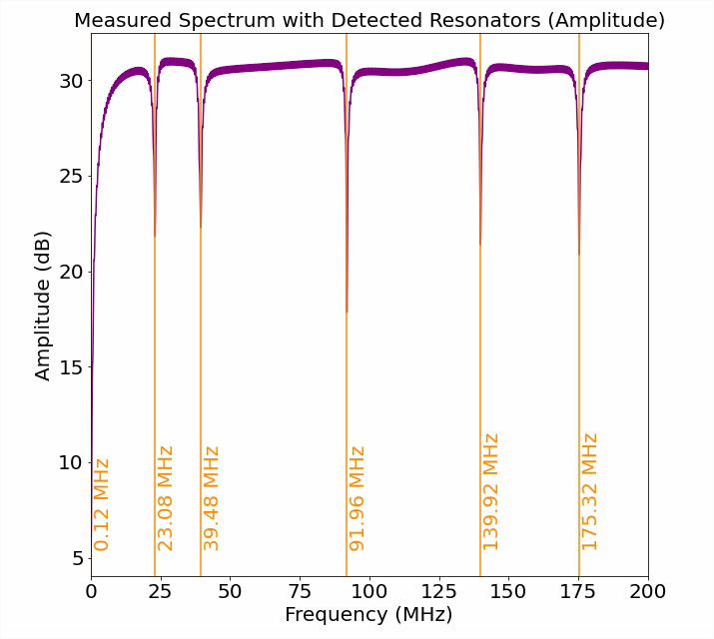
Outlook
Measurements at INFN Rome this week
Scale up firmware and hardware to 16 channels
Implement new features such as automatic peak finder via integrated VNA
Optimization of channelization and system configuration according to application-specific requirements

Slide 26
Conclusion
Coarse processing chain successfully implemented
Signal generation
Channelization, down-conversion and data decimation
Event detection
Data acquisition and storage
Custom frontend for transceiver evaluation and optimization assembled
Firmware to be optimized iteratively with sample measurements

