Slide 1
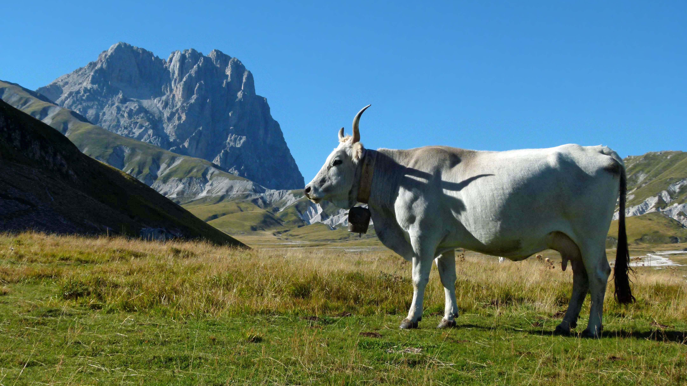
Review on CoTS boards
Mario De Lucia
Università di Pisa, INFN – Sezione di Pisa

Slide 2
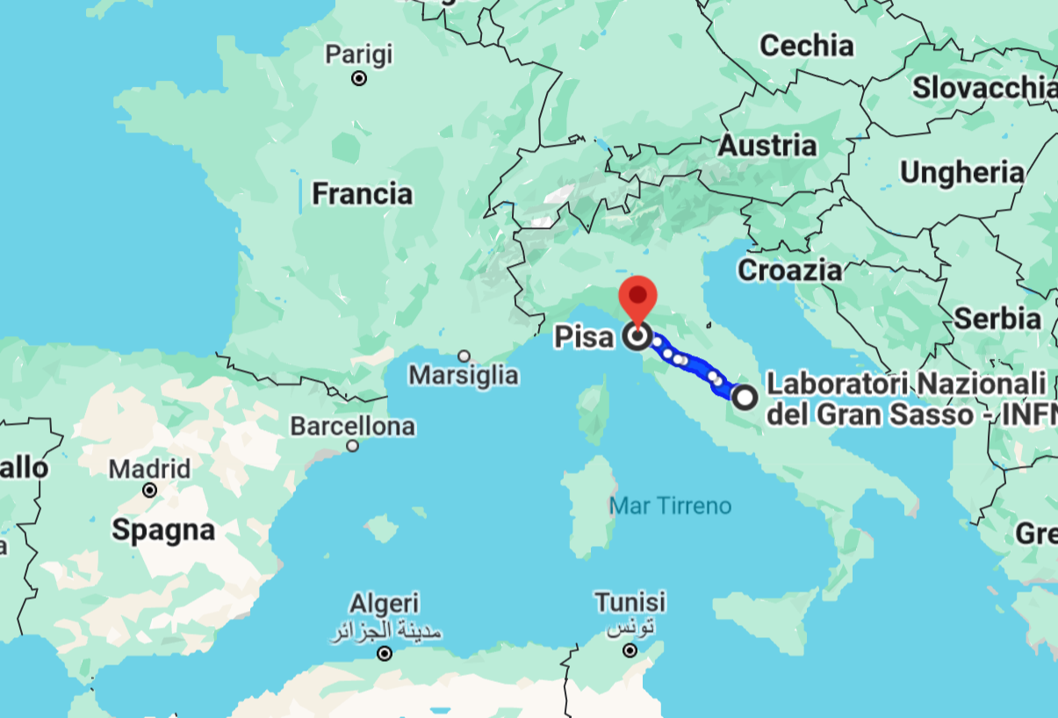
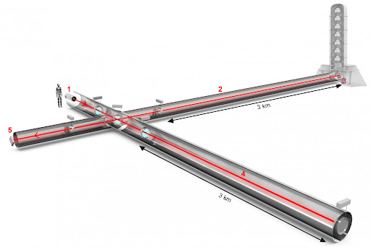
Pisa
PISA LAB:
Low temperatures Group with over 10 members across all backgrounds and career stages
VIRGO

Slide 3
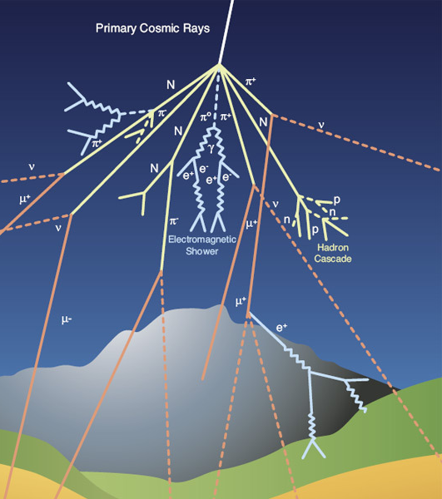
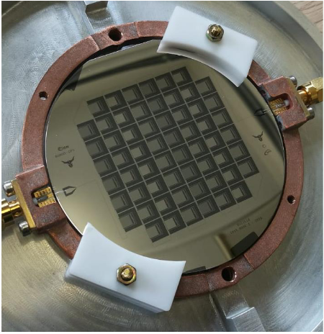
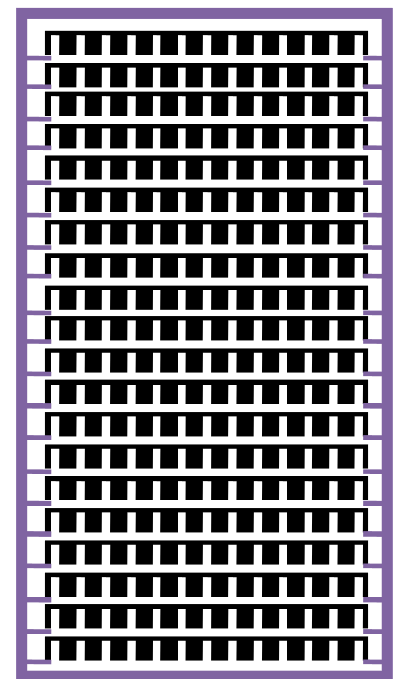
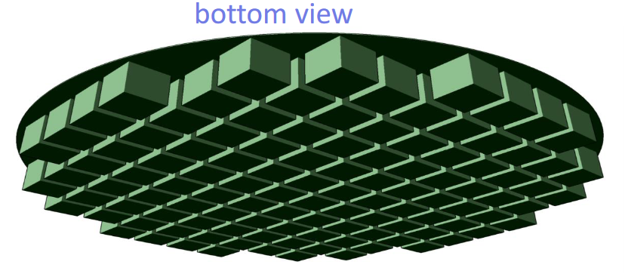
A background as small as possible…

Slide 4
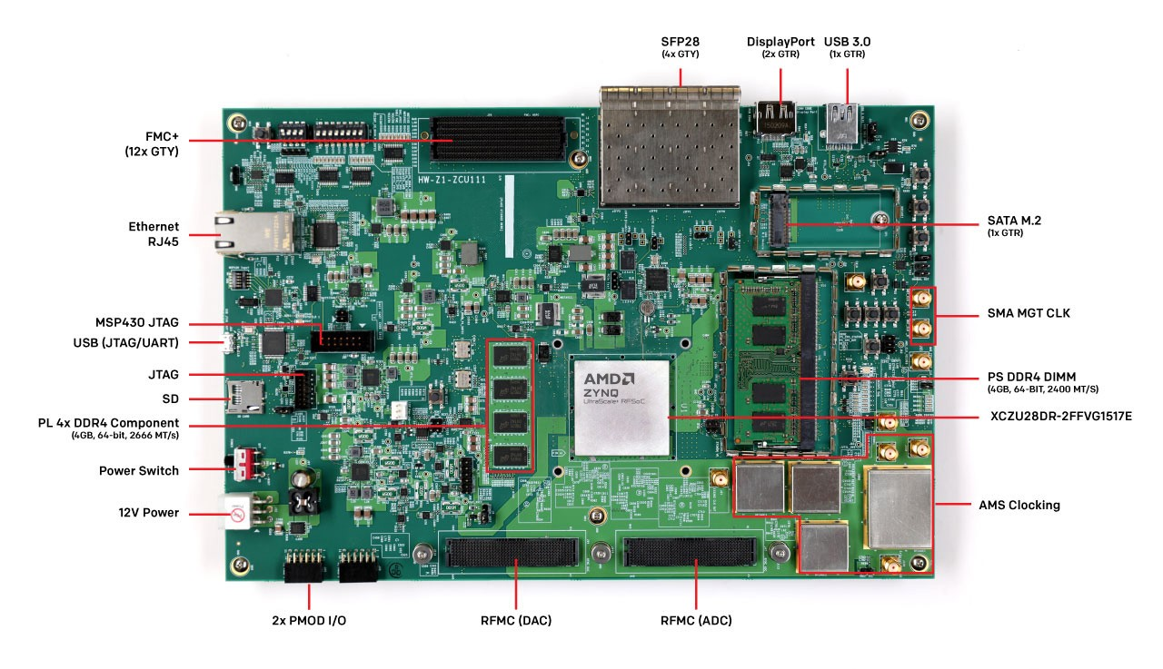
Overview:
Why?
What for?
What do we need?
What’s available?

Slide 5
Overview:
Who? + Why?
What for?
What do we need?
What’s available?

Slide 6
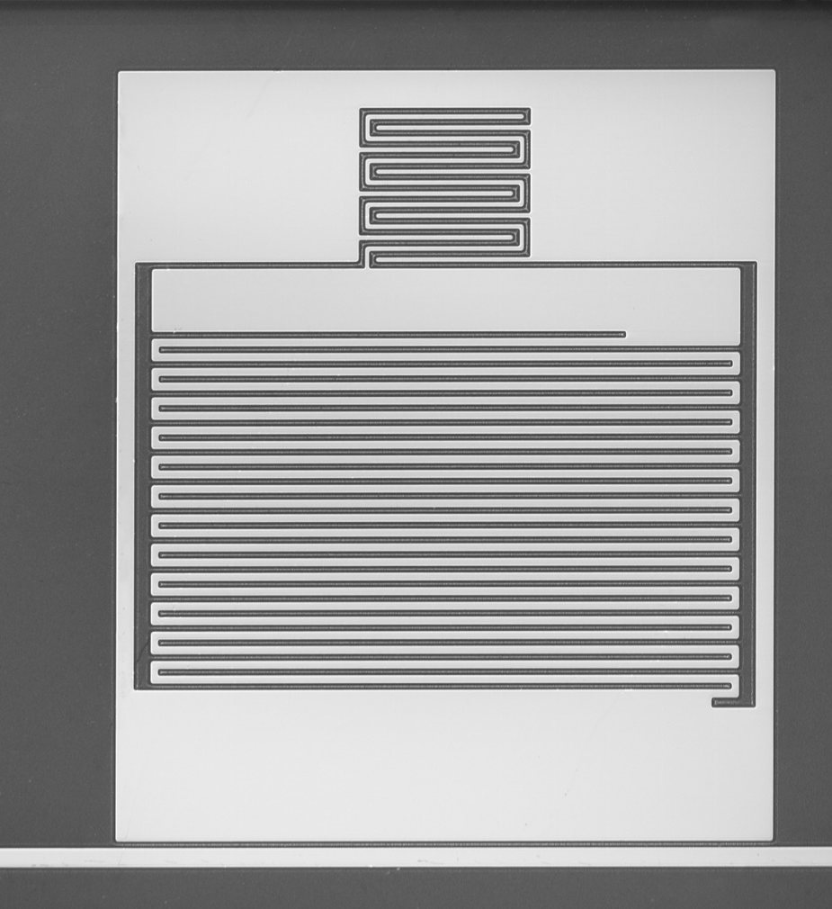
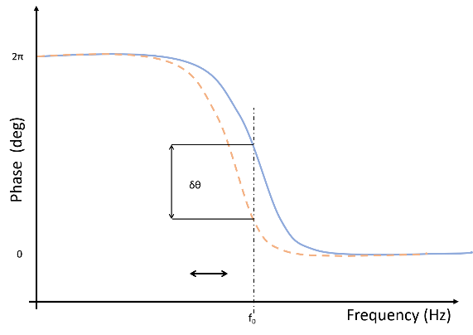
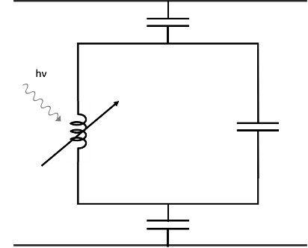
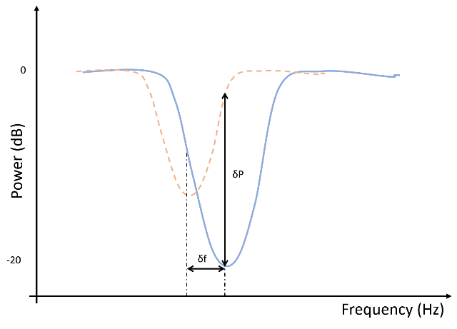
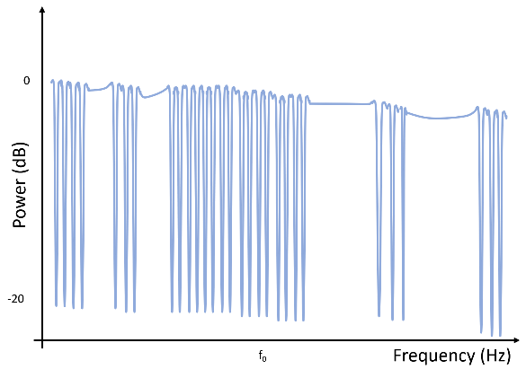
Microwave Kinetic
Inductance Detectors
Meandered
inductor
Interdigitated
capacitor

Slide 7
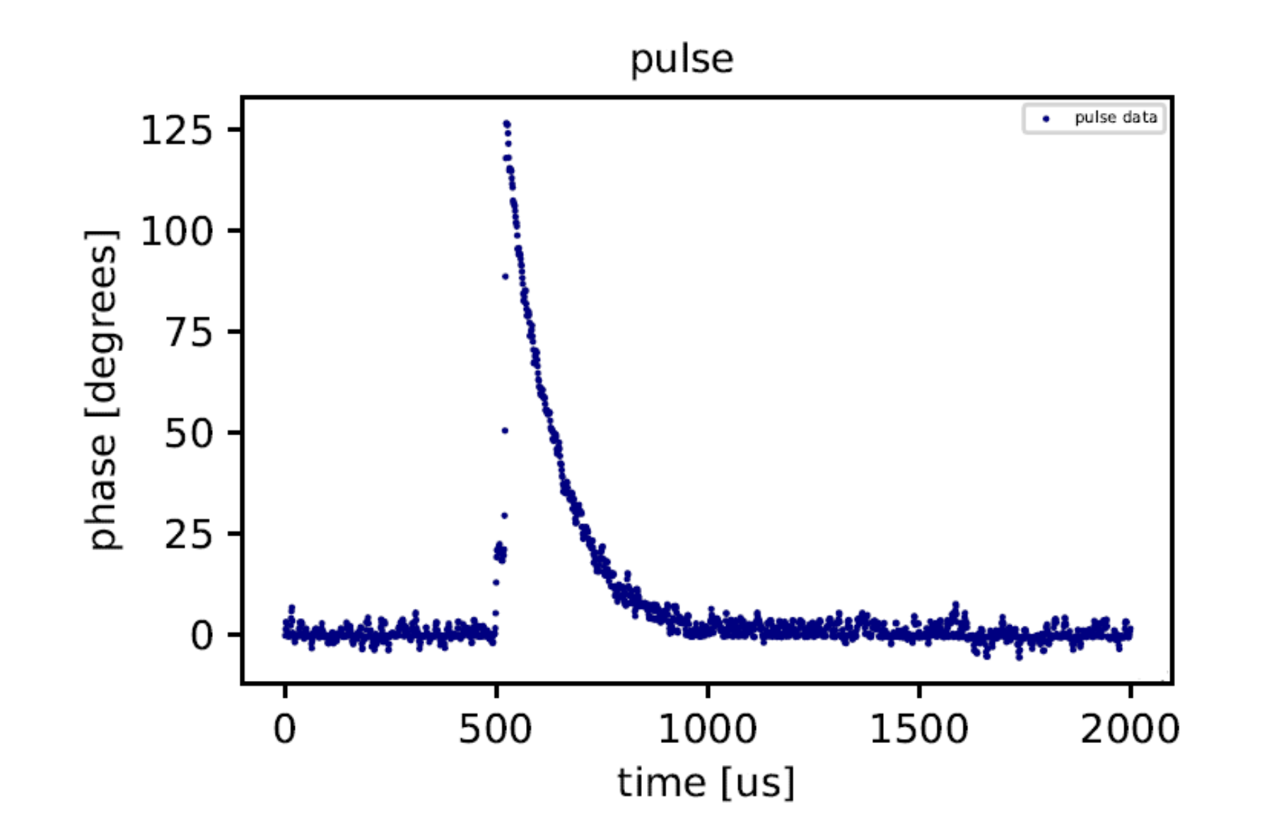
Microwave Kinetic Inductance Detectors
Main interesting features:
Single Photon Sensitivity
Energy resolving detectors
µs Time resolution
No Dark Count Rate
Inherent multiplexibility (FDM)
Easy to fabricate

Slide 8
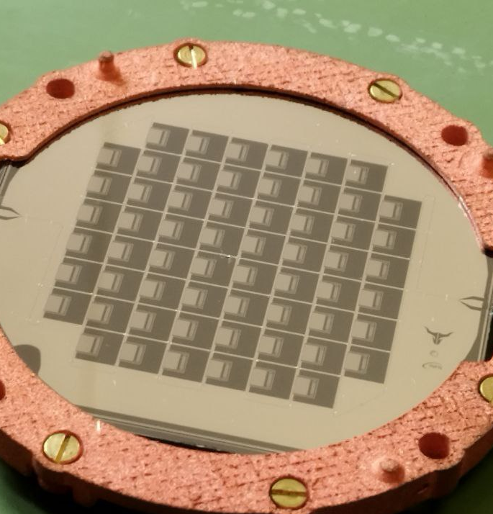
Microwave Kinetic Inductance Detectors
Applications for BULLKID DM
~160 pixels per wafer / Stack of 10 wafers
Energy resolution as low as possible (27±6 eV) *
~ 0.8GHz resonance frequency likely (0.5GHz – 1GHz)
µs Time resolution
No Dark Count Rate
* BULLKID: Monolithic array of particle absorbers sensed by Kinetic Inductance Detectors Cruciani A., et al. 2022

Slide 9
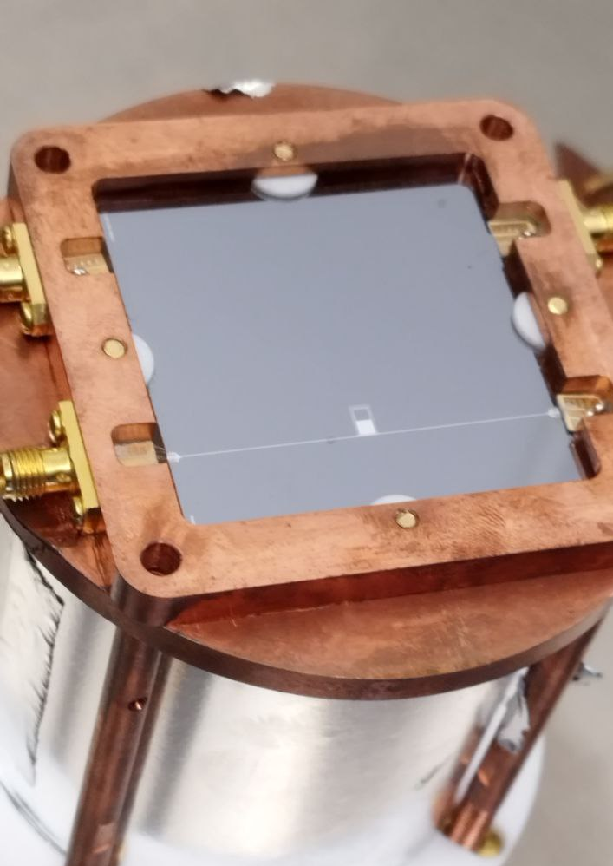
Microwave Kinetic Inductance Detectors
Applications for the Cold Veto System
~1 pixel per each scintillator / number and geometry of scintillators TBD
Energy resolution as low as possible (61±6 eV) *
~ 2300MHz resonance frequency likely (2GHz – 4GHz)
µs Time resolution / $τ_{qp}$ long. Comparable to $τ_{Scintillator}$
No Dark Count Rate
* CALDER: cryogenic light detectors for background-free
searches., L. Cardani et al. 2015

Slide 10
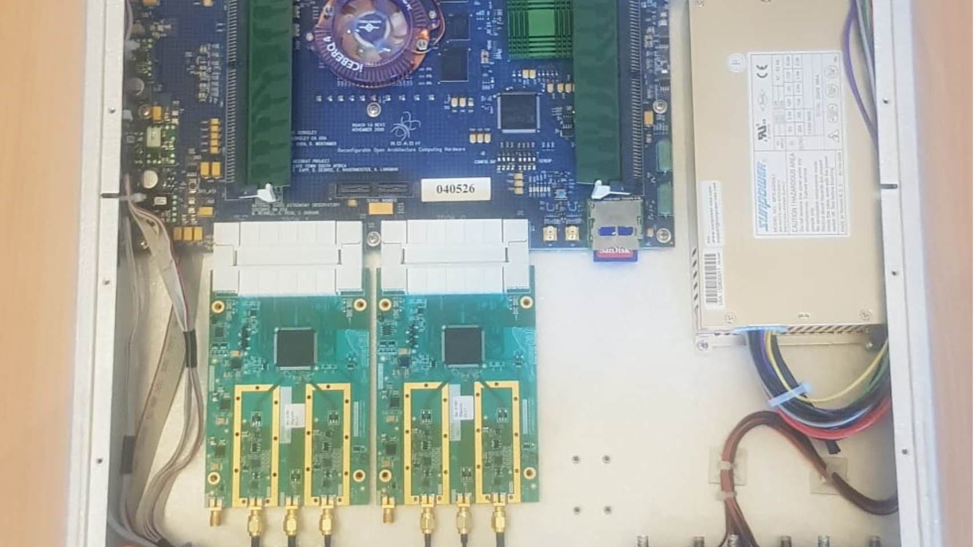
Readout Electronics:
Philosophy
What’s Available?
Pros and Cons - Table

Slide 11
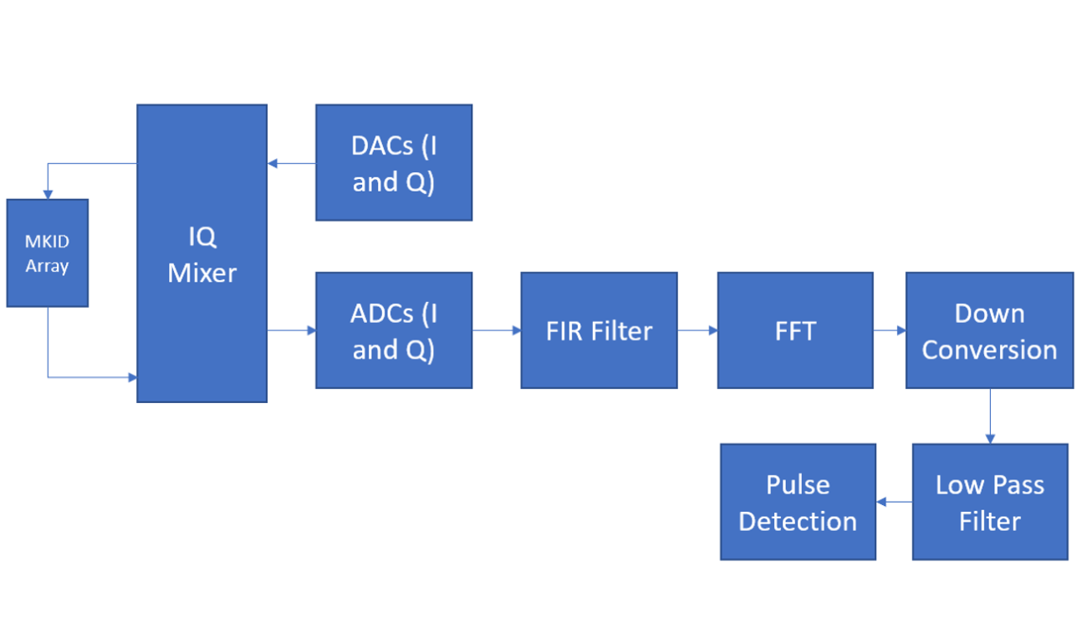
Readout Philosophy
On the board
Mezzanine
Up and down mixing goes here
if necessary

Slide 12
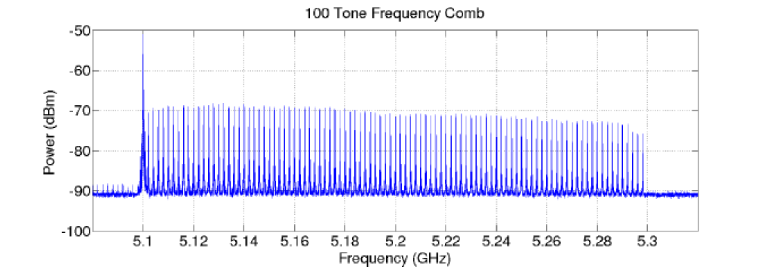
Readout Philosophy
On the board
Mezzanine
Generate and
read tones
Up and down mixing goes here
if necessary

Slide 13
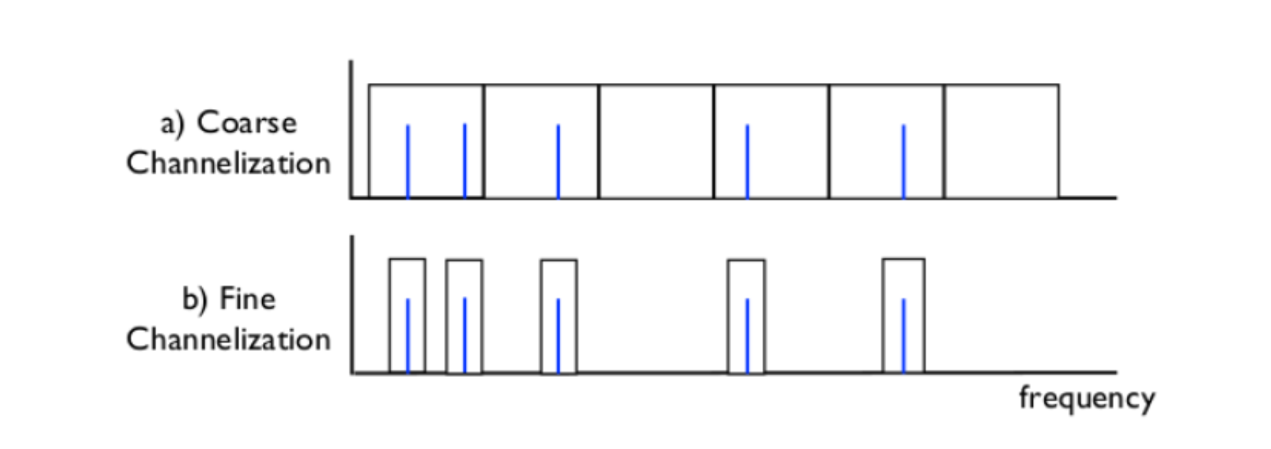
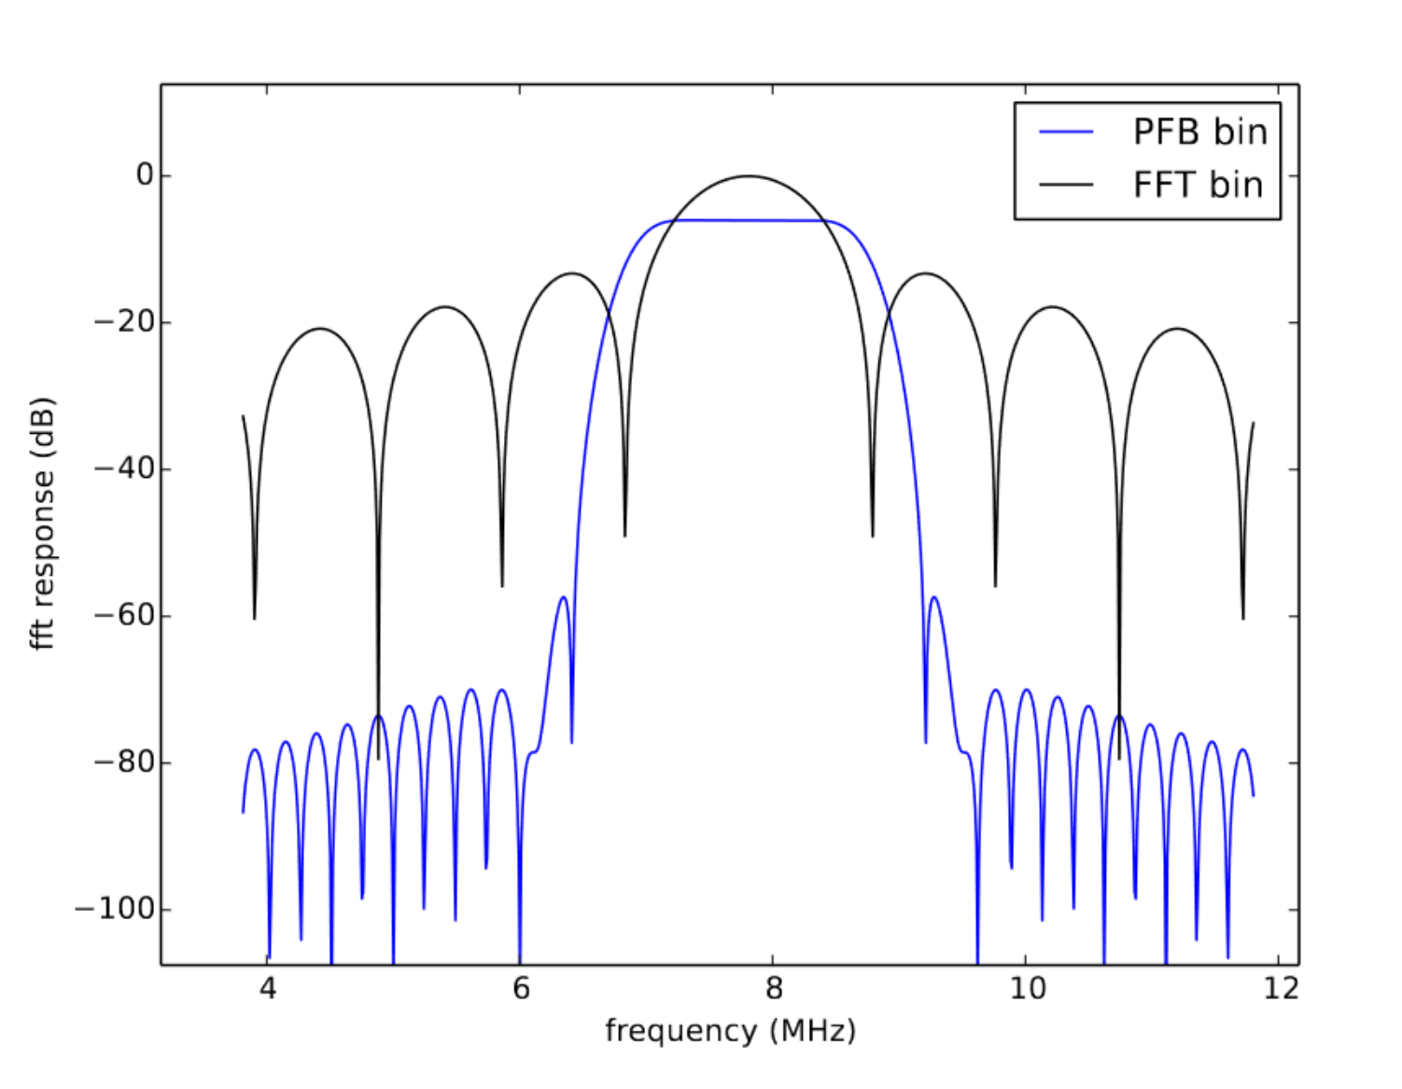
Readout Philosophy
On the board
Mezzanine
Channelisation Coarse + Fine
: Polyphase Filter Bank :
Up and down mixing goes here
if necessary

Slide 14
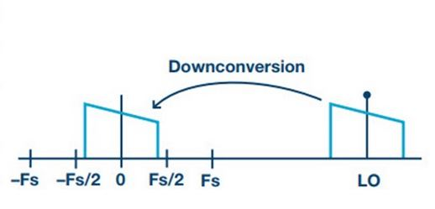
Readout Philosophy
On the board
Mezzanine
Up and down mixing goes here
if necessary
Digital Down Conversion Downsampling

Slide 15
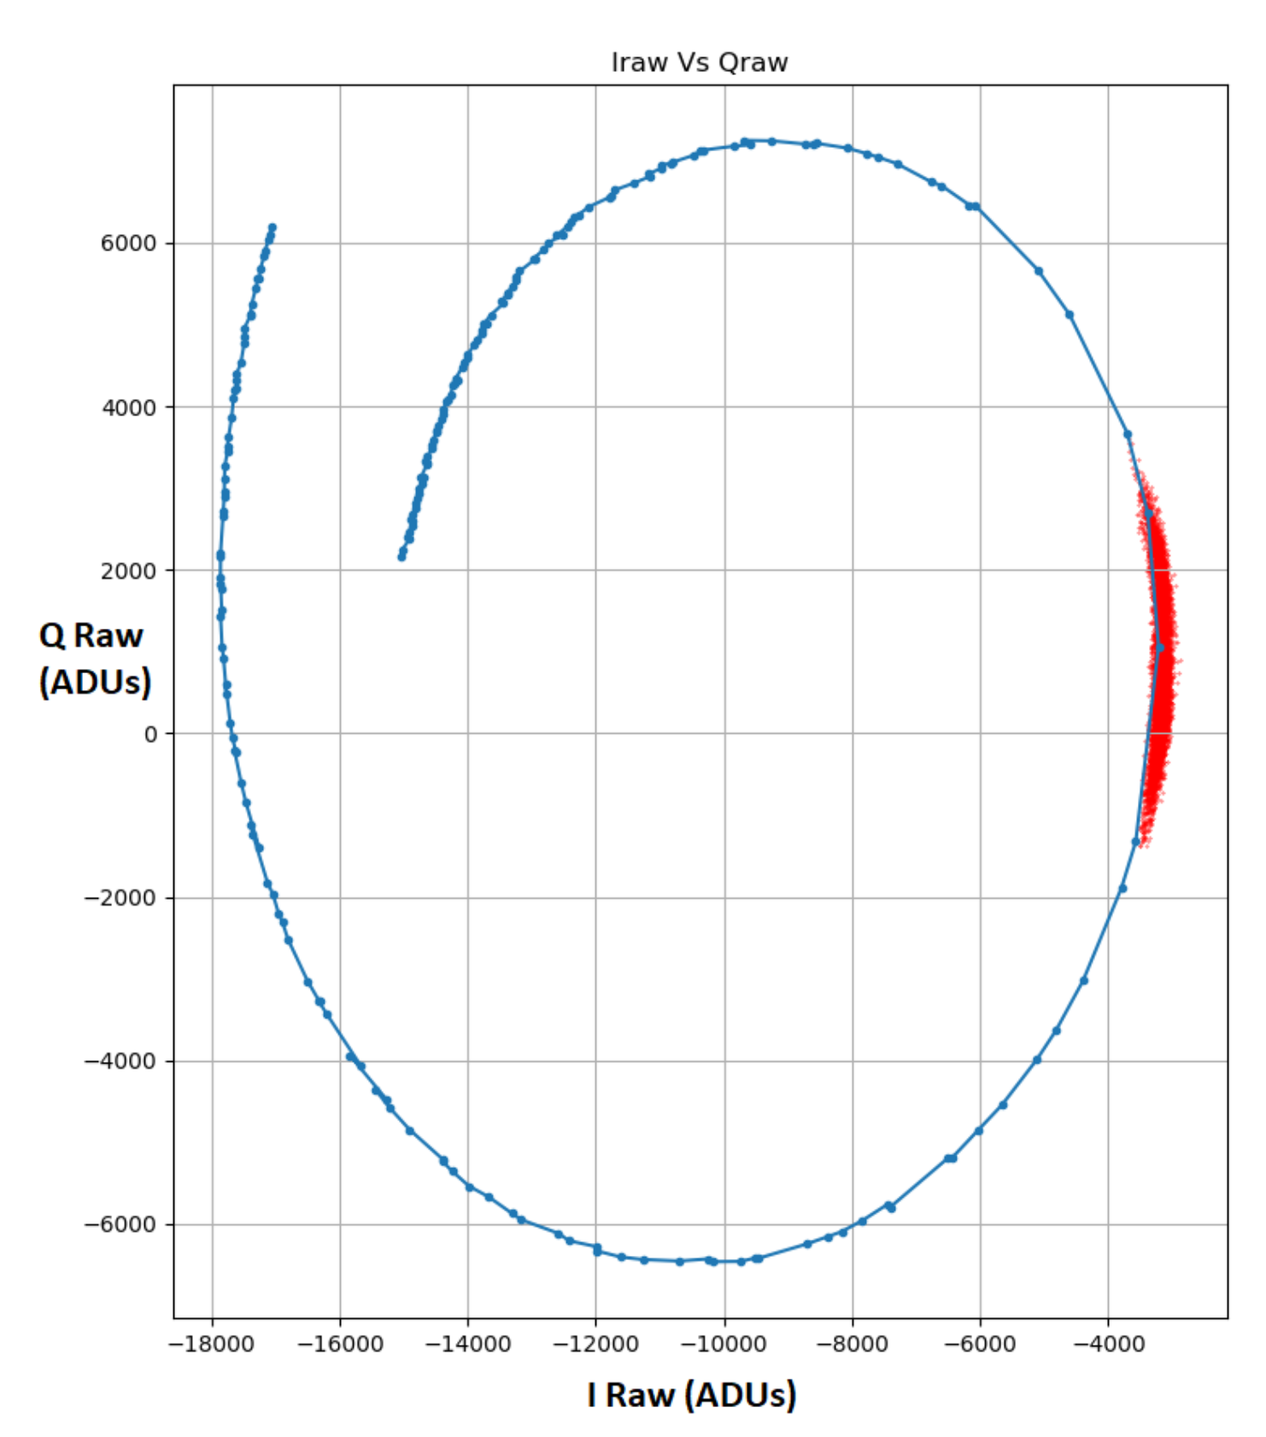
Readout Philosophy
On the board
Mezzanine
Maths, Pulse Triggering
Up and down mixing goes here
if necessary

Slide 16
Overview:
Who? +Why?
What for?
What do we need?
What’s available?

Slide 17
Board name | Logic Blocks | DSP Slices | ADC | DAC | Unit Price (€) | FPGA pixel count | ADCDAC Pixel count | Cost per pixel (max) | Comments
ROACH1 | 7,360 | 640 | 2x 12 bit 550 MSPS | 2x16 bit 1000 MSPS | 4000 | 256 | 512 | 16€ | Prod. Disc.
ROACH2 | 326,400 | 1,120 | 2x 12 bit 2.5 GSPS | 2x 16 bit 2.8 GSPS | 4000 | 1,000 | 1,400 | 4€ | Prod. Disc.
UniboardII | 4.6M | 1,518 | N/D | N/D | 20,000+ | 1,200 | N/D | 16.7€+ | +extra DAC/ADC
VCU118 | 2.586M | 6,840 | N/D | N/D | 5,800+ | 5,600 | N/D | 1.00€+ | +extra DAC/ADC
ZCU111 | 930,000 | 4,272 | 8 x 12 bit / 4.096 GSPS | 8x14 bit 6.554 GSPS | 8,995 | 3,500 | 8,000 | 2.25€ | Redundant +free firmware
4x2 | 930,000 | 4,272 | 4 x 12 bit / 4.096 GSPS | 2x14 bit 6.554 GSPS | 2,149* | 3,500 | 2,000 | 1.00€ | +free firmware *Xilinx edu only
ZCU216 | 930,000 | 4,272 | 16 x 14 bit/ 2.5 GSPS | 16 x 14 bit / 9.85 GSPS | 15,546 | 3,500 | 20,000 | 4.44€ | One board To rule them all
VP430 | 930,00 | 4,272 | 8x 12-bit, 4GSPS | 8x 14-bit, 6.4GSPS | ~15,000 | 3,500 | 8,000 | 4.30€
AMC599 | 1.451M | 5,520 | 2 x 12 bit 6.4 GSPS | 2 x 16 bit 12 GSPS | 20,000 | 4,500 | 3,200 | 6.25€
t0 | 930,000 | 4,272 | 8x 14 bit 5 GSPS | 8x 14 bit 9.85 GSPS | 10/60k | 8,000 | 8,000 | 1.3/7.5€ | Plug & play Support / Dear
USPRx300 | 326,080 | 840 | 2x 14 bit 200 MSPS | 2x 16 bit 800 MSPS | 10,000 | 700 | 200 | 500€ | Quite limited expensive

Slide 18
Board name | Logic Blocks | DSP Slices | ADC | DAC | Unit Price (€) | FPGA pixel count | ADCDAC Pixel count | Cost per pixel (max) | Comments
ROACH1 | 7,360 | 640 | 2x 12 bit 550 MSPS | 2x16 bit 1000 MSPS | 4000 | 256 | 512 | 16€ | Prod. Disc.
ROACH2 | 326,400 | 1,120 | 2x 12 bit 2.5 GSPS | 2x 16 bit 2.8 GSPS | 4000 | 1,000 | 1,400 | 4€ | Prod. Disc.
UniboardII | 4.6M | 1,518 | N/D | N/D | 20,000+ | 1,200 | N/D | 16.7€+ | +extra DAC/ADC
VCU118 | 2.586M | 6,840 | N/D | N/D | 5,800+ | 5,600 | N/D | 1.00€+ | +extra DAC/ADC
ZCU111 | 930,000 | 4,272 | 8 x 12 bit / 4.096 GSPS | 8x14 bit 6.554 GSPS | 8,995 | 3,500 | 8,000 | 2.25€ | Redundant +free firmware
4x2 | 930,000 | 4,272 | 4 x 12 bit / 4.096 GSPS | 2x14 bit 6.554 GSPS | 2,149* | 3,500 | 2,000 | 1.00€ | +free firmware *Xilinx edu only
ZCU216 | 930,000 | 4,272 | 16 x 14 bit/ 2.5 GSPS | 16 x 14 bit / 9.85 GSPS | 15,546 | 3,500 | 20,000 | 4.44€ | One board To rule them all
VP430 | 930,00 | 4,272 | 8x 12-bit, 4GSPS | 8x 14-bit, 6.4GSPS | ~15,000 | 3,500 | 8,000 | 4.30€
AMC599 | 1.451M | 5,520 | 2 x 12 bit 6.4 GSPS | 2 x 16 bit 12 GSPS | 20,000 | 4,500 | 3,200 | 6.25€
t0 | 930,000 | 4,272 | 8x 14 bit 5 GSPS | 8x 14 bit 9.85 GSPS | 10/60k | 8,000 | 8,000 | 1.3/7.5€ | Plug & play Support / Dear
USPRx300 | 326,080 | 840 | 2x 14 bit 200 MSPS | 2x 16 bit 800 MSPS | 10,000 | 700 | 200 | 500€ | Quite limited expensive

Slide 19
Board name | Logic Blocks | DSP Slices | ADC | DAC | Unit Price (€) | FPGA pixel count | ADCDAC Pixel count | Cost per pixel (max) | Comments
ROACH1 | 7,360 | 640 | 2x 12 bit 550 MSPS | 2x16 bit 1000 MSPS | 4000 | 256 | 512 | 16€ | Prod. Disc.
ROACH2 | 326,400 | 1,120 | 2x 12 bit 2.5 GSPS | 2x 16 bit 2.8 GSPS | 4000 | 1,000 | 1,400 | 4€ | Prod. Disc.
UniboardII | 4.6M | 1,518 | N/D | N/D | 20,000+ | 1,200 | N/D | 16.7€+ | +extra DAC/ADC
VCU118 | 2.586M | 6,840 | N/D | N/D | 5,800+ | 5,600 | N/D | 1.00€+ | +extra DAC/ADC
ZCU111 | 930,000 | 4,272 | 8 x 12 bit / 4.096 GSPS | 8x14 bit 6.554 GSPS | 8,995 | 3,500 | 8,000 | 2.25€ | Redundant +free firmware
4x2 | 930,000 | 4,272 | 4 x 12 bit / 4.096 GSPS | 2x14 bit 6.554 GSPS | 2,149* | 3,500 | 2,000 | 1.00€ | +free firmware *Xilinx edu only
ZCU216 | 930,000 | 4,272 | 16 x 14 bit/ 2.5 GSPS | 16 x 14 bit / 9.85 GSPS | 15,546 | 3,500 | 20,000 | 4.44€ | One board To rule them all
VP430 | 930,00 | 4,272 | 8x 12-bit, 4GSPS | 8x 14-bit, 6.4GSPS | ~15,000 | 3,500 | 8,000 | 4.30€
AMC599 | 1.451M | 5,520 | 2 x 12 bit 6.4 GSPS | 2 x 16 bit 12 GSPS | 20,000 | 4,500 | 3,200 | 6.25€
t0 | 930,000 | 4,272 | 8x 14 bit 5 GSPS | 8x 14 bit 9.85 GSPS | 10/60k | 8,000 | 8,000 | 1.3/7.5€ | Plug & play Support / Dear
USPRx300 | 326,080 | 840 | 2x 14 bit 200 MSPS | 2x 16 bit 800 MSPS | 10,000 | 700 | 200 | 500€ | Quite limited expensive
In-house custom developed readout board: full flexiblity probably more expensive

Slide 20
(Xilinx RFSoC ZCU111 – 2000 Channels FDM)
Jenny Smith – UCSB - 2024

