Slide 1
Presentation of the Ferrara Group
Andrea Mazzolari
19/03/2024

Slide 2





Relationships
2x
We are a team of physicists operating in international environments mainly on activities related to crystals design, manufacturing and characterizations.
Channeling, x-ray, medical physics, astrophysics, etc…
Active in channeling field since 2000
2x
CSNI
CSN II
CSN V
Pathfinder
INFN
Ferrara
RISE
Marie Curie

Slide 3
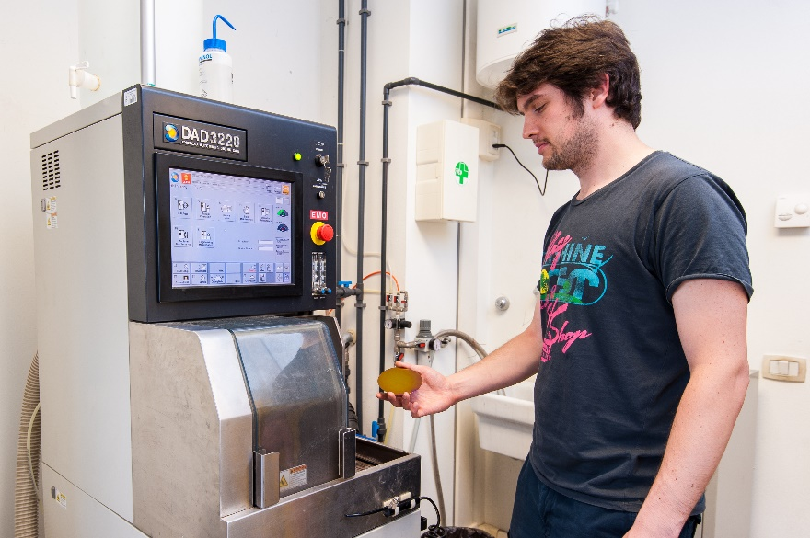
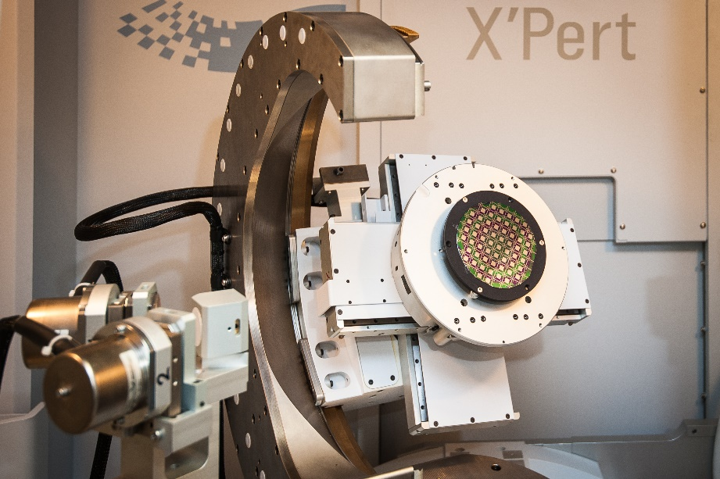
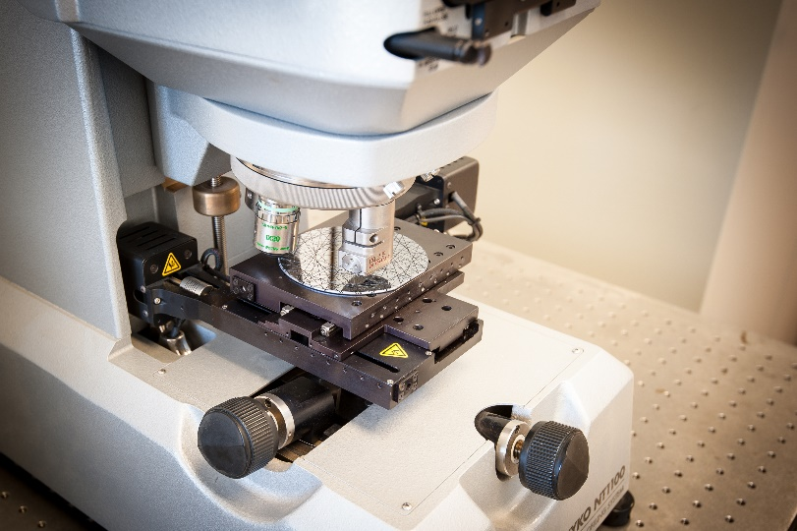
INFN infrastructure
Laboratory fully equipped for silicon micro and nanomachining
ISO4 certified clean room (130 m²)
2X High-resolution x-ray diffraction
Dicing and polishing equipment
White light and Fizeau inteferferometers

Slide 4
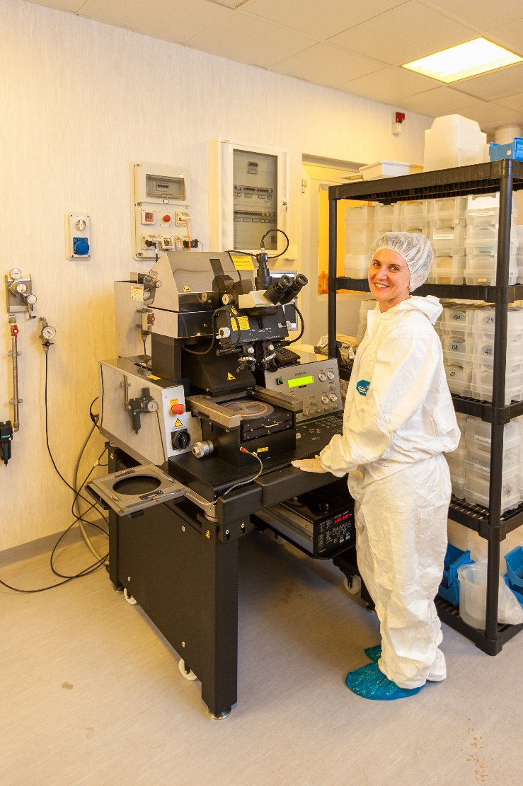
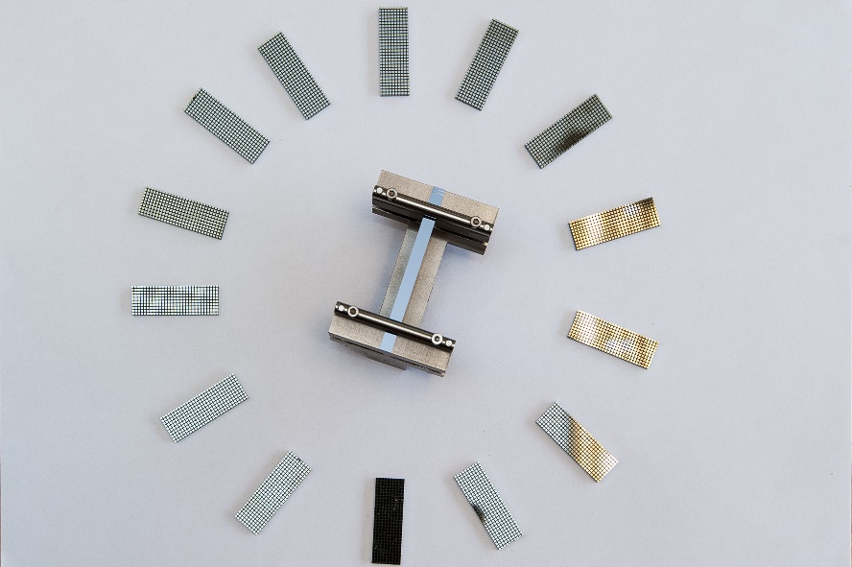

INFN infrastructure
Laboratory fully equipped for silicon micro and nanomachining
Fotolitography
Equipment for silicon etching
Nanoimprint

Slide 5
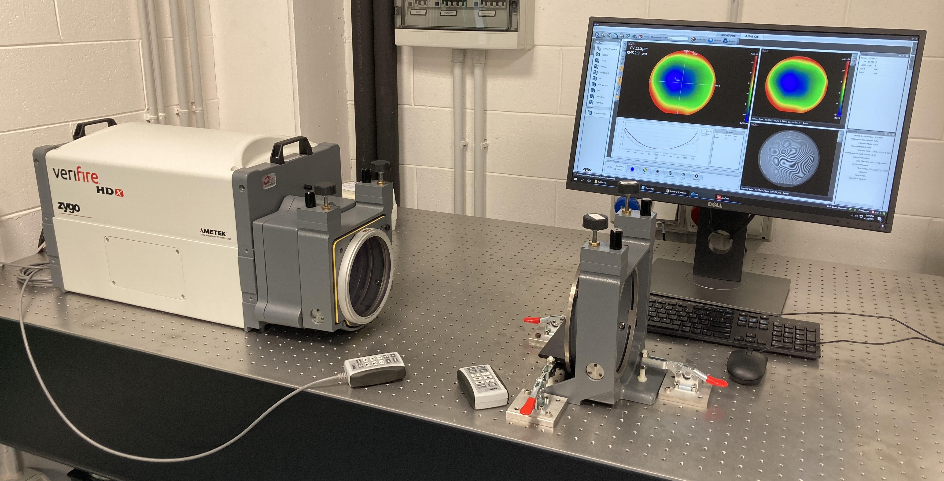
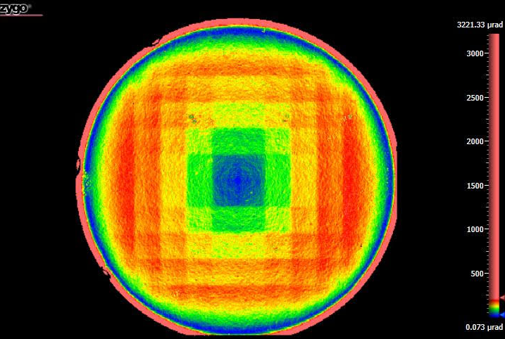
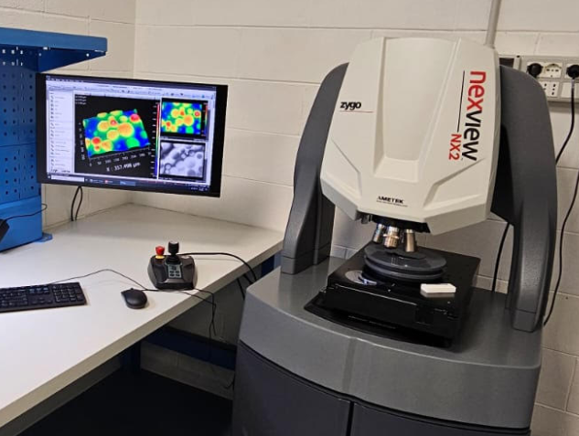
Laser interferomety
Optical interferometry is a well-assesed method to characterize flatness of reflective surfaces.
Used to characherize stress state before and after the chemical etching.
Characterization performed before and after chemical etching to assure complete removal of the stressed and damaged regions.

Slide 6
Laser interferomety
Fizeau interferometry is a well-assesed method to characterize flatness of reflective surfaces.
A commercial tool (Zygo VeriFire HDX) is installead at our lab
We can reach sub-nm resolution along the optical axis and 44 μm lateral resolution, this allows to characterize crystals in the bent and unbent state

Slide 7
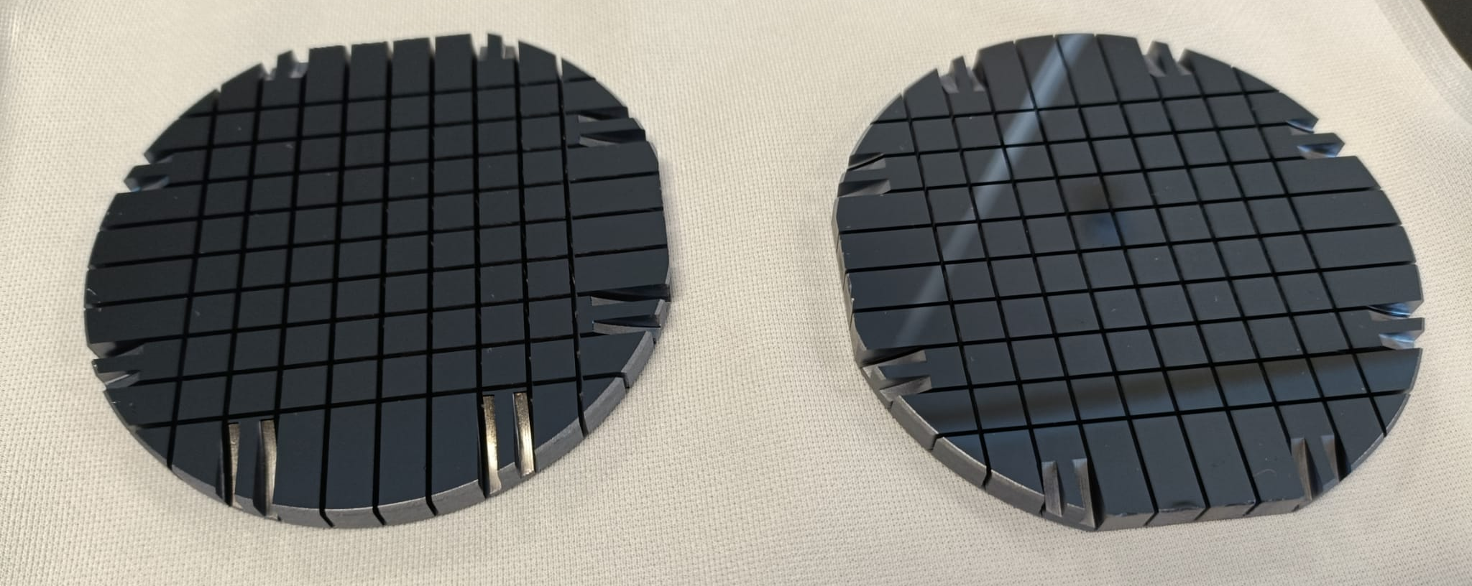
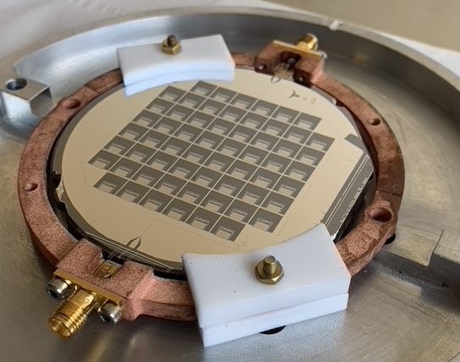
BULLKID2 (CSN-V)→DANAE (ERC)
Ground for ERC DANAE (P.I: M. Vignati)
A. Mazzolari (RTD-B) , M. Romagnoni (RTD-A), V. Guidi (PO), L. Bandiera (Ricercatrice-INFN)
L. Malagutti (Post-Doct), M. Tamisari (RTD-A)

Slide 8
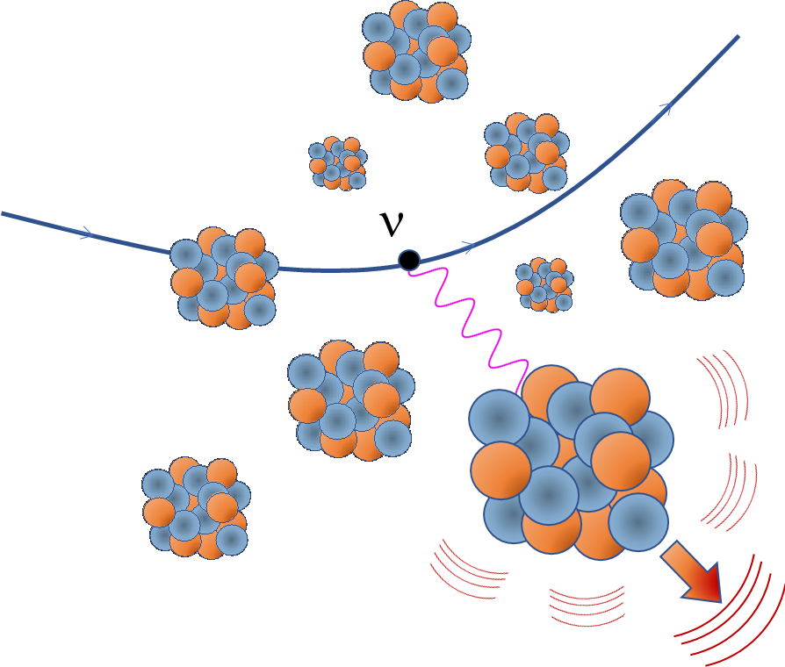
NUCLEUS (CSN-2)
Goal: The NUCLEUS experiment aims at the detection of elastic neutrino-nucleus scattering by using ultra-low-threshold cryogenic detectors.
Scientific Application: Measurement of Coherent Neutrino Scattering

Slide 9
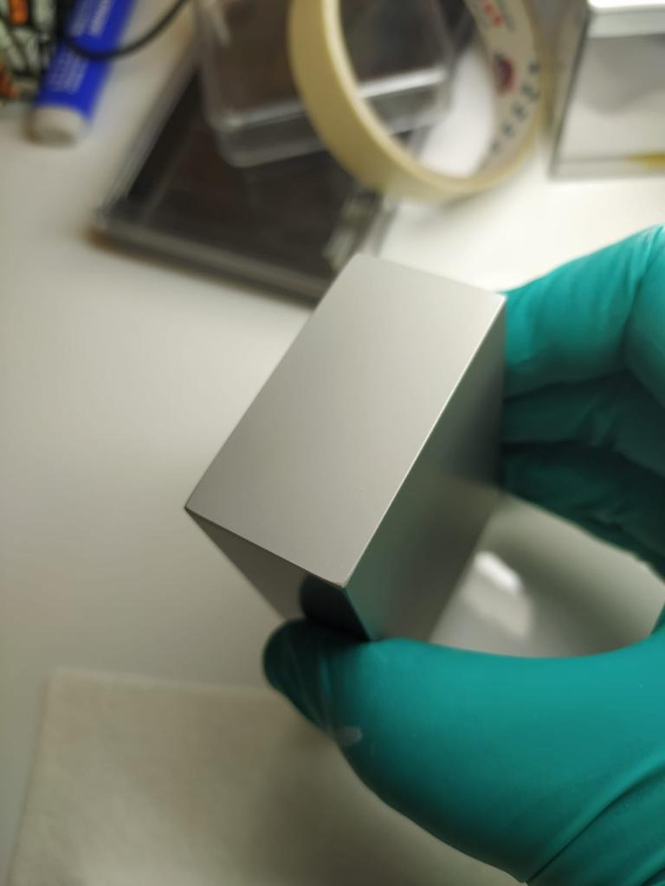
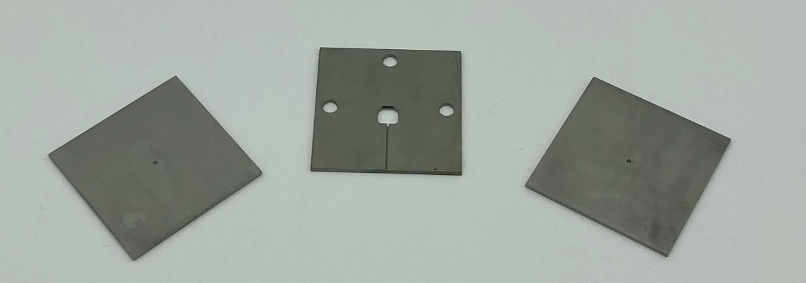
NUCLEUS (CSN-2+ERC)
Machining of HPGe crystals for inner veto
Manufacturing of various crystalline components of silicon and germanium for the detector

Slide 10
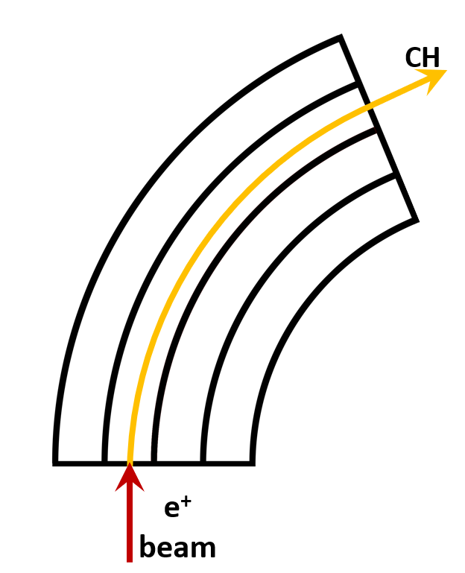
CHANNELING IN BENT CRYSTALS
@ Amorphous:
@ Planar channeling
Atomic crystal plane
+
e
e⁻

Slide 11
BEAM COLLIMATION IN PARTICLE ACCELERATORS
Particle beam collimation: classic approach
LHC circulating beam
Collimation is needed to prevent supermagnets quenching
Primary collimator (bulky «absorber»)
Spray of secondary unwanted particles
Secondary collimator
Tertiary collimator...

Slide 12
BEAM COLLIMATION IN PARTICLE ACCELERATORS
Particle beam collimation: an innovative approach
LHC circulating beam
Bent crystal act as a primary collimator
Avoided spray of secondary particles
Secondary, tertiary... colimators no more needed
Bent
crystal

Slide 13
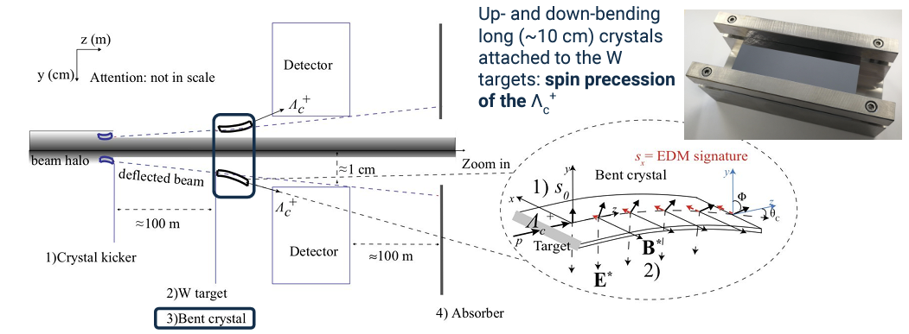
SELDOM (ERC)
Spin precession of polarized particles traveling through a bent crystal theorized in 1979
[V.G. Baryshevsky, Pis’ma Zh. Tekh. Fiz. 5 (1979) 182]
It was later proposed as a technique to measure the MDM of unstable particles
[I.J. Kim, Nucl. Phys. B 229 (1983) 251]
SELDOM: Extraction of LHC beam → production of unstable particles in tungsten target → spin precession by bent crystal
P.I. Nicola Neri

Slide 14
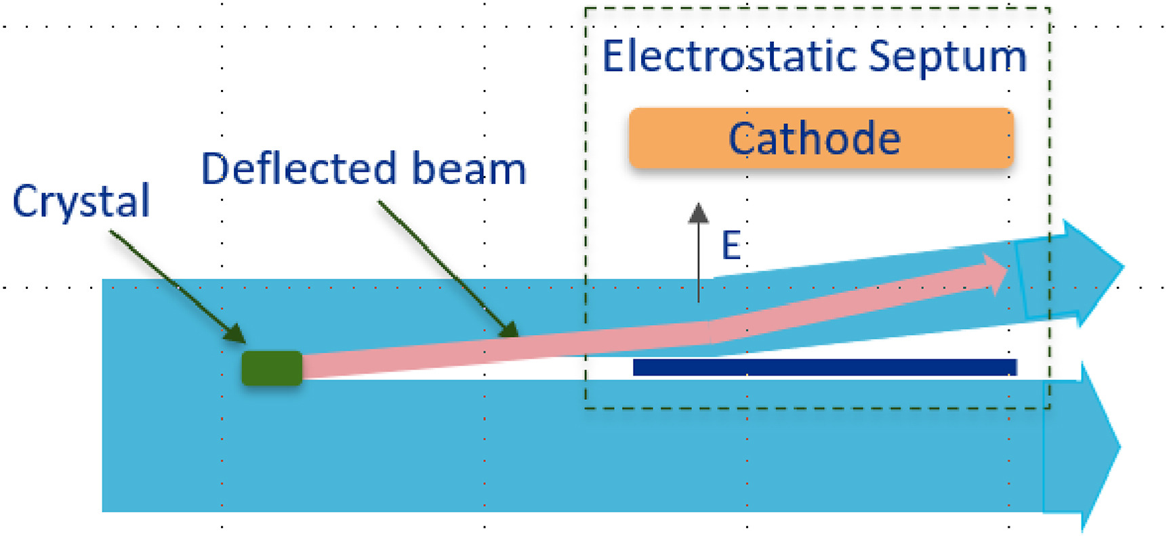
Mu2e (CSN1)
Mu2e experiment @ FERMILAB
Design and manufacturing of a bent crystal for manipulation of circulating particle beam
Aim to improve characteristic of extracted beam (higher intensity lower emittance)
Operations in parasitic mode

Slide 15
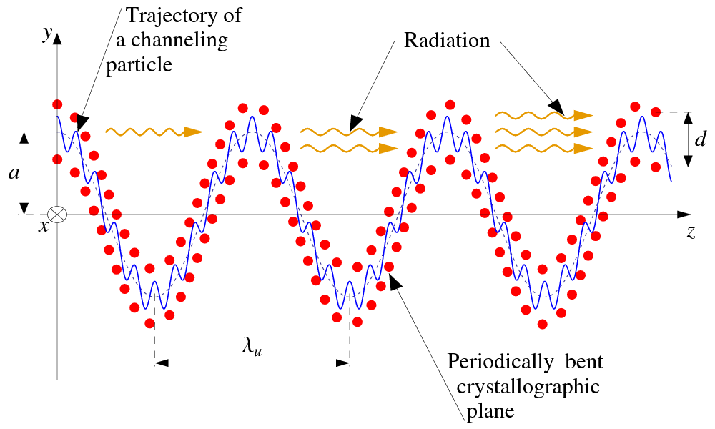
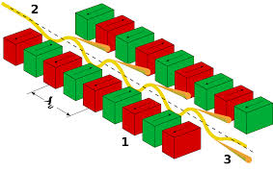
TECHNO-CLS (EU-PATHFINDER)
A classical scheme: FEL
Innovation: crystalline undulator

Slide 16
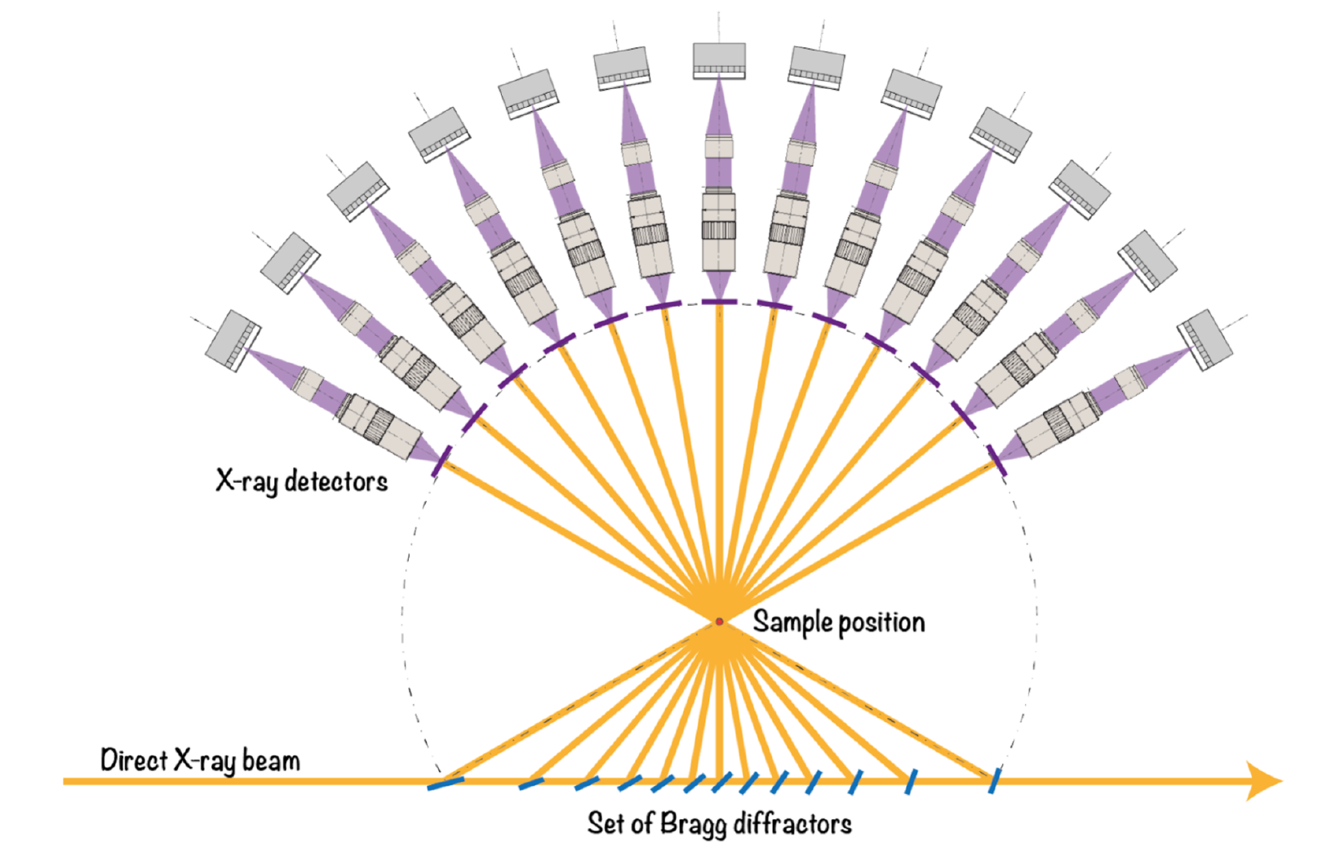
TOMOSCOPY (EU-PATHFINDER)
Efficient diagnostic tools for observing ultrafast phenomena at small scales for modern applications are lacking.
4D X-ray microscopy, achieving higher spatial and temporal resolutions.
Using high-brilliance X-ray sources and multiple X-ray probes, we aim to visualise and characterise dynamics reaching velocities up to some km/s in the micrometre scale.
4D imaging of opaque samples at MHz rates will open up new windows of understanding in many fields.

Slide 17
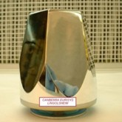
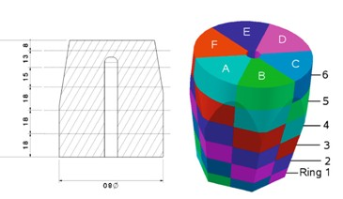
COAXIAL SEGMENTED DETECTORS
Nuclear spettroscopy
Gamma trackers.
B
Li

Slide 18
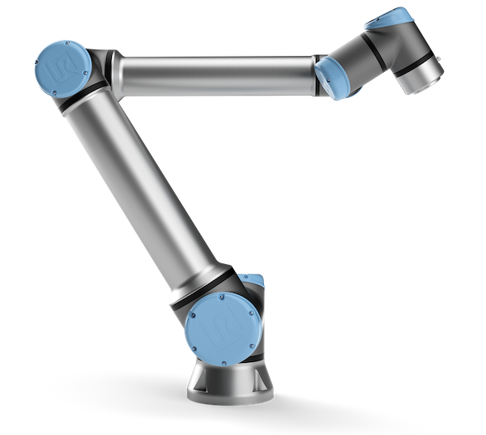
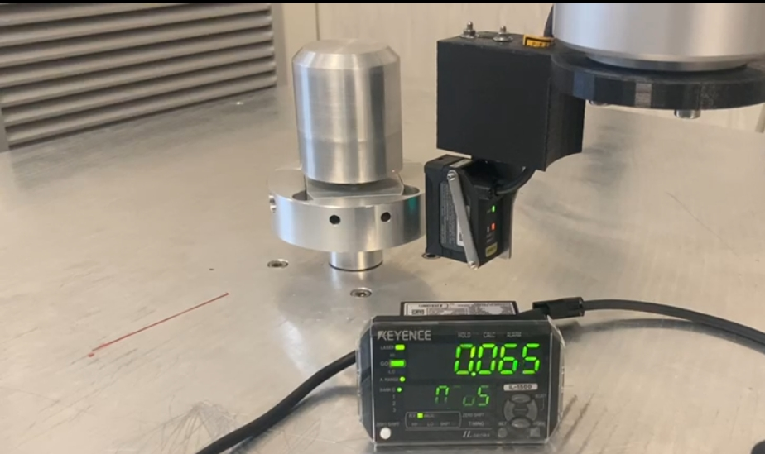
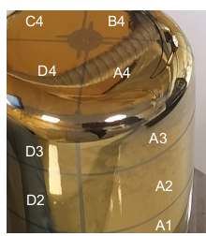
N3G (CALL CSNV)
3D photolitography assiste by collaborative robots

Slide 19
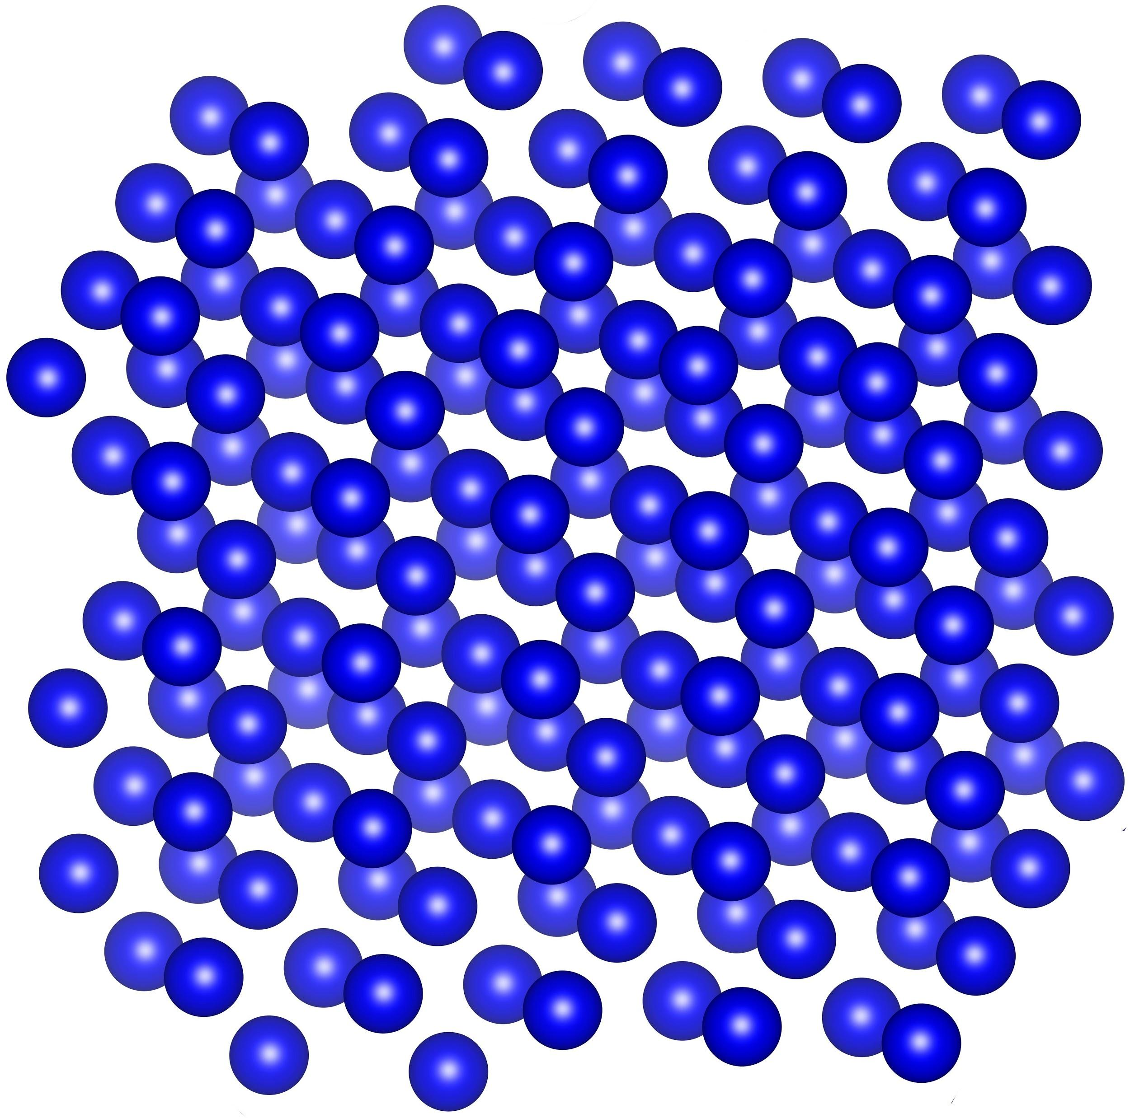

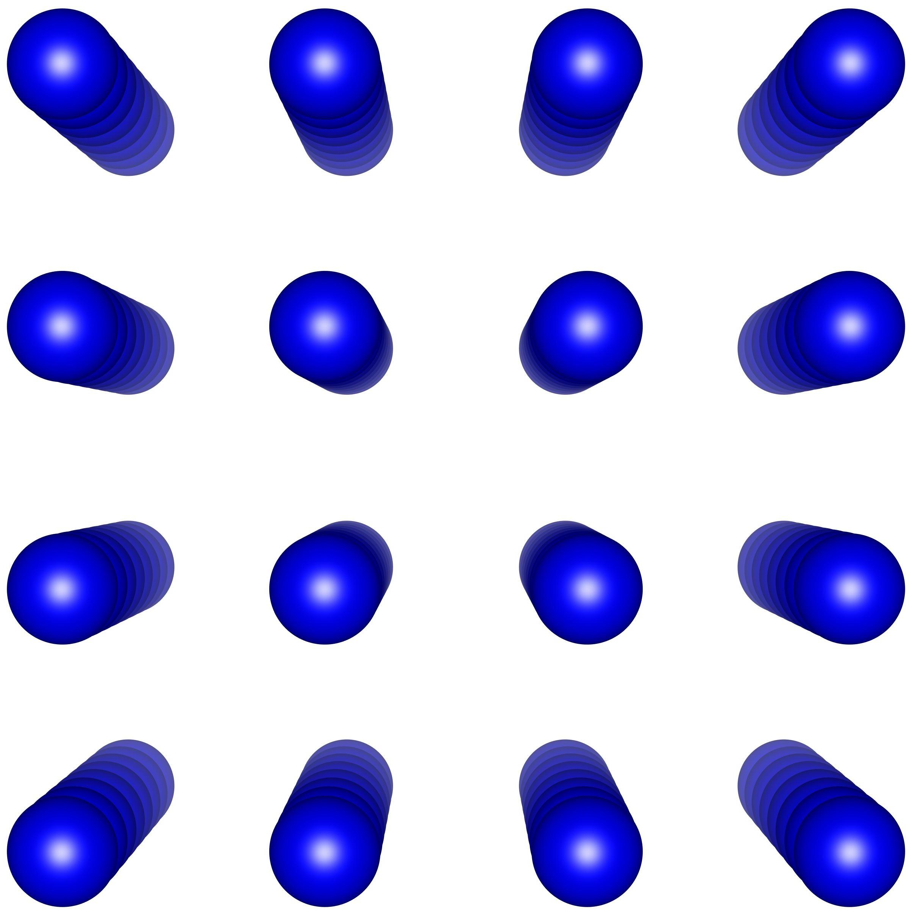
ORiEnted calOrimeter (CSN-V)
Using oriented scintillator crystals one may containing e.m. showers initiated by particles with energies even above 100 GeV in a reduced volume/weight;
Cost reduction!! Increase energy resolution
Interesting application in particle and astroparticle phyiscs!!!!
Phys. Rev. Lett. 121 (2018) 021603

Slide 20
CONCLUSIONS
Multi-disciplinary activities related to crystals manufacturing
High energy physics, neutrino, dark matter, calorimeter, gamma spettroscopy.
Activities within CSN-1, 2 and V of the INFN. Part of EU projects.
  Simulations and design (Geant4)
  Crystals manufacturing
  Crystals characterization
  Test beam at various infrastructures
  Data analysis
  Paper writing

