Slide 1
Search for signatures of a new neutral scalar in the W⁺W⁻ channel with semileptonic final states at the LHC
Olimpia Miniati
University of Florence
olimpia.miniati@edu.unifi.it

Slide 2
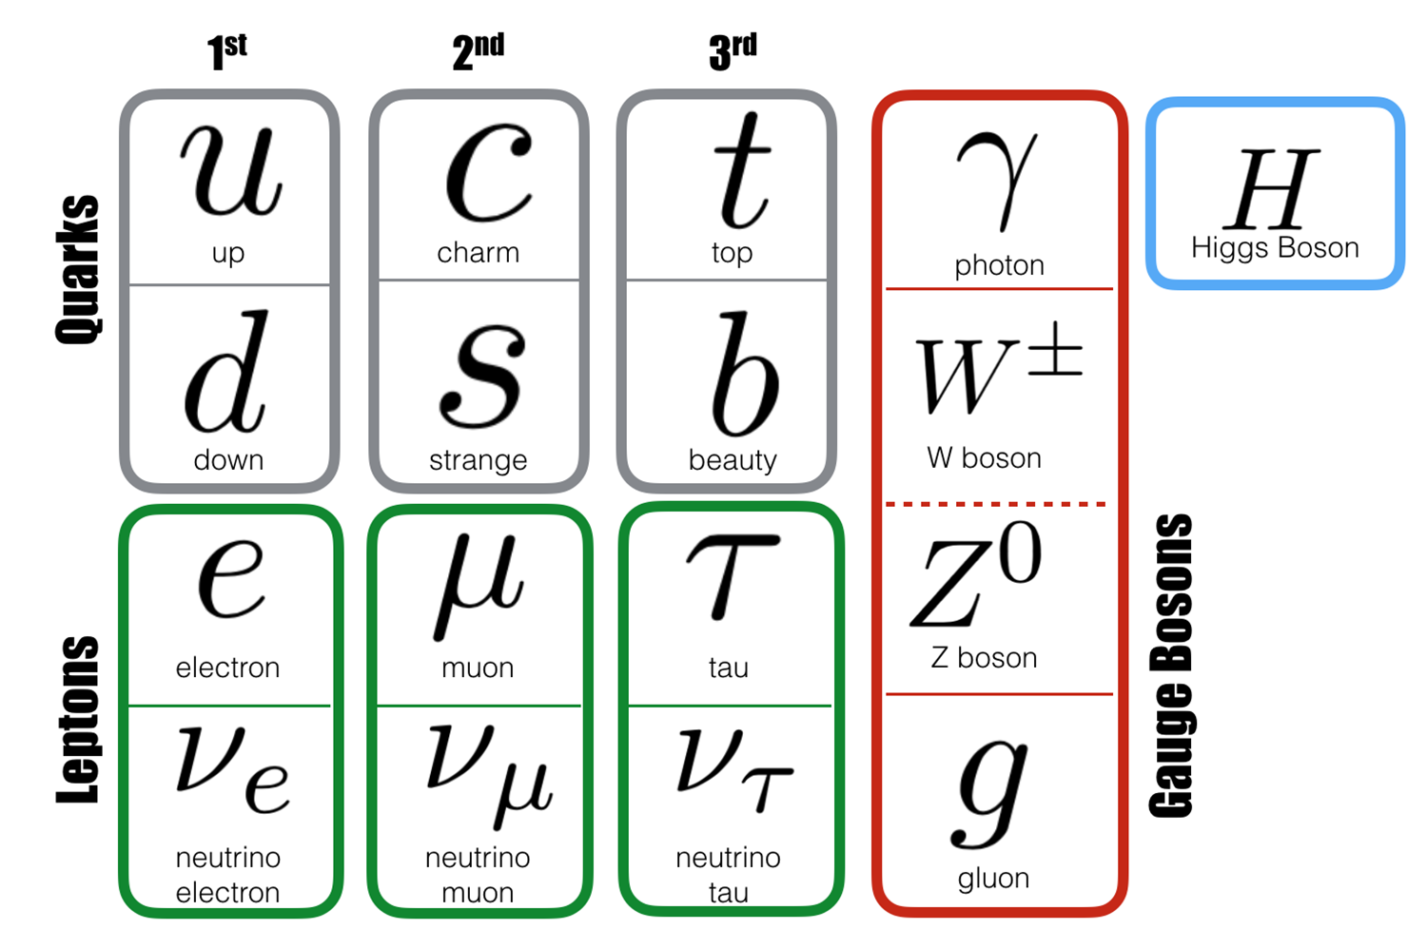
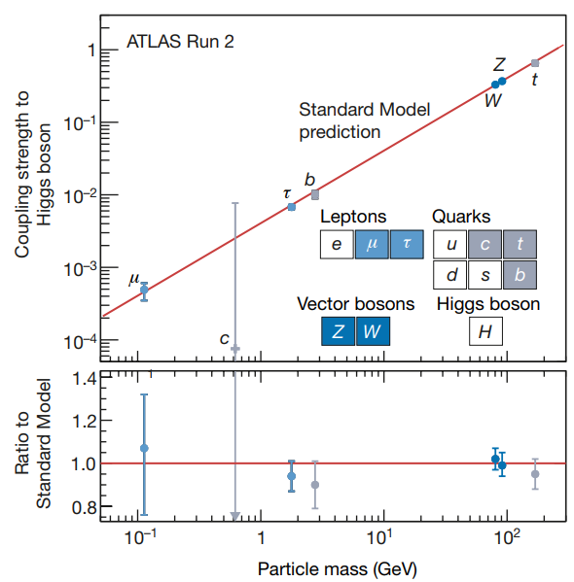
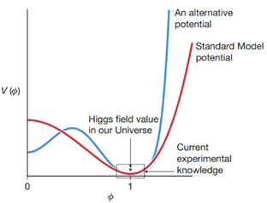
Introduction: Higgs sector in Standard Model
4 July 2012: announcement of the discovery of a new fundamental particle, the Higgs boson.
Standard Model: simplest model to describe fundamental interactions.
Open problems in Higgs sector in SM:
Precision: couplings to other particles known with a maximal precision of 5-20% or not measured yet→ in this range other models are viable, also composite ones.
Shape of the potential: we are unable to explore the potential for the Higgs field for different values of the field → different shapes are consistent with the current data.
13/05/2024
2

Slide 3
Introduction: Higgs and open questions
The Standard Model does not give a complete description of the nature:
Dark Matter → Inert 2HDM can provide a viable candidate of Dark Matter .
Early Universe Inflation, baryonic asymmetry, cosmological phase transition.
Is the Higgs an elementary particle or a composite object? What is the origin of the pattern of masses in the SM matter?
Hierarchy between weak, strong and gravitational interactions.
Beyond Standard Model Theories.
13/05/2024
3

Slide 4
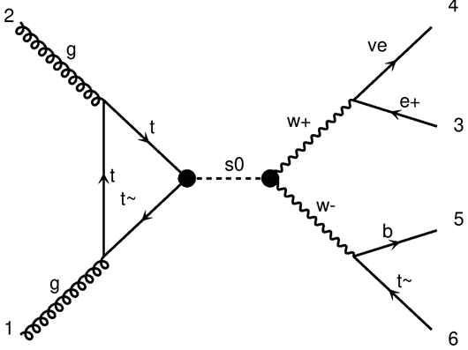
Search of a new heavy scalar in the W⁺W⁻ channel with semileptonic final states
Model with a new neutral scalar :
Simplest model to enlarge the Higgs sector;
Capability of remap specific processes into more complex BSM frameworks.
W⁺W⁻ channel with semileptonic final state:
Analysis in the same channel with dileptonic final state published in 2022 by the CMS collaboration (Search for high mass resonances decaying into W+W− in the dileptonic final state with 138 fb−1 of proton-proton collisions at √ s = 13 TeV , CMS PAS HIG-20-016 );
CMS Florece group currently working on the semileptonic → provide simulations with more flexibility on BSM parameters.
13/05/2024
4

Slide 5
Research strategy
Simulation of events using MadGraph5_aMC@NLO.
Necessity a UFO model for NLO calculation containing the new particle S;
Selection of processes to analyze → starting point is the gluon-gluon fusion ( will be followed by the vector-boson fusion);
Selection of the processes to generate → separation of signal and interference, parton level events (neglecting hadronization and detector simulation);
Selection of BSM parameters → starting point will be SM-like couplings, MS=600GeV, WS=100GeV;
Generation of events at a p-p collider and analysis of the kinematic informations in the LHE file → prediction on the expected events.
13/05/2024
5

Slide 6
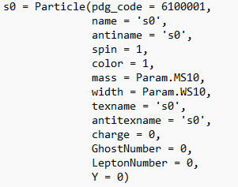
Model Lagrangian
SM Lagrangian: diagonal CKM ,4FNS.
Higgs modified additive couplings (massive quarks, EW bosons) → free independent parameters .
Lagrangian for the new scalar S (s0 in UFO):
neutral under the U_{EM}(1) and SU(3) symmetry groups;
interacting with the EW bosons, Higgs boson and SM matter;
mass, width and couplings free independent parameters .
13/05/2024
6

Slide 7
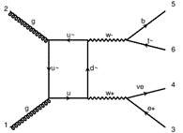
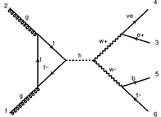
Process: gluon-gluon fusion with SM-like couplings for S
hMOD with SM values ( for interference generation, otherwise zero)
0.987913e+00 # KHTT
0.026995e+00 # KHBB
S0 with SM-like couplings:
-0.698560e+00 # KS10rU3x3
1.000000e+00 # KS10WW
S0 mass and width (in GeV) :
1.000000e+02 # WS10
PDF:
Energy of each proton beam:
-0.019088e+00 # KS10rD3x3
lhapdf 315000 (NNPDF31_lo_as_0118 (315000))
6500.0 GeV
6.000000e+02 # MS10
1.000000e+00 # KHWW
Cuts:
pT(ν) > 30 GeV
pT(l) > 25 GeV
η(l) < 2.5
13/05/2024
7

Slide 8
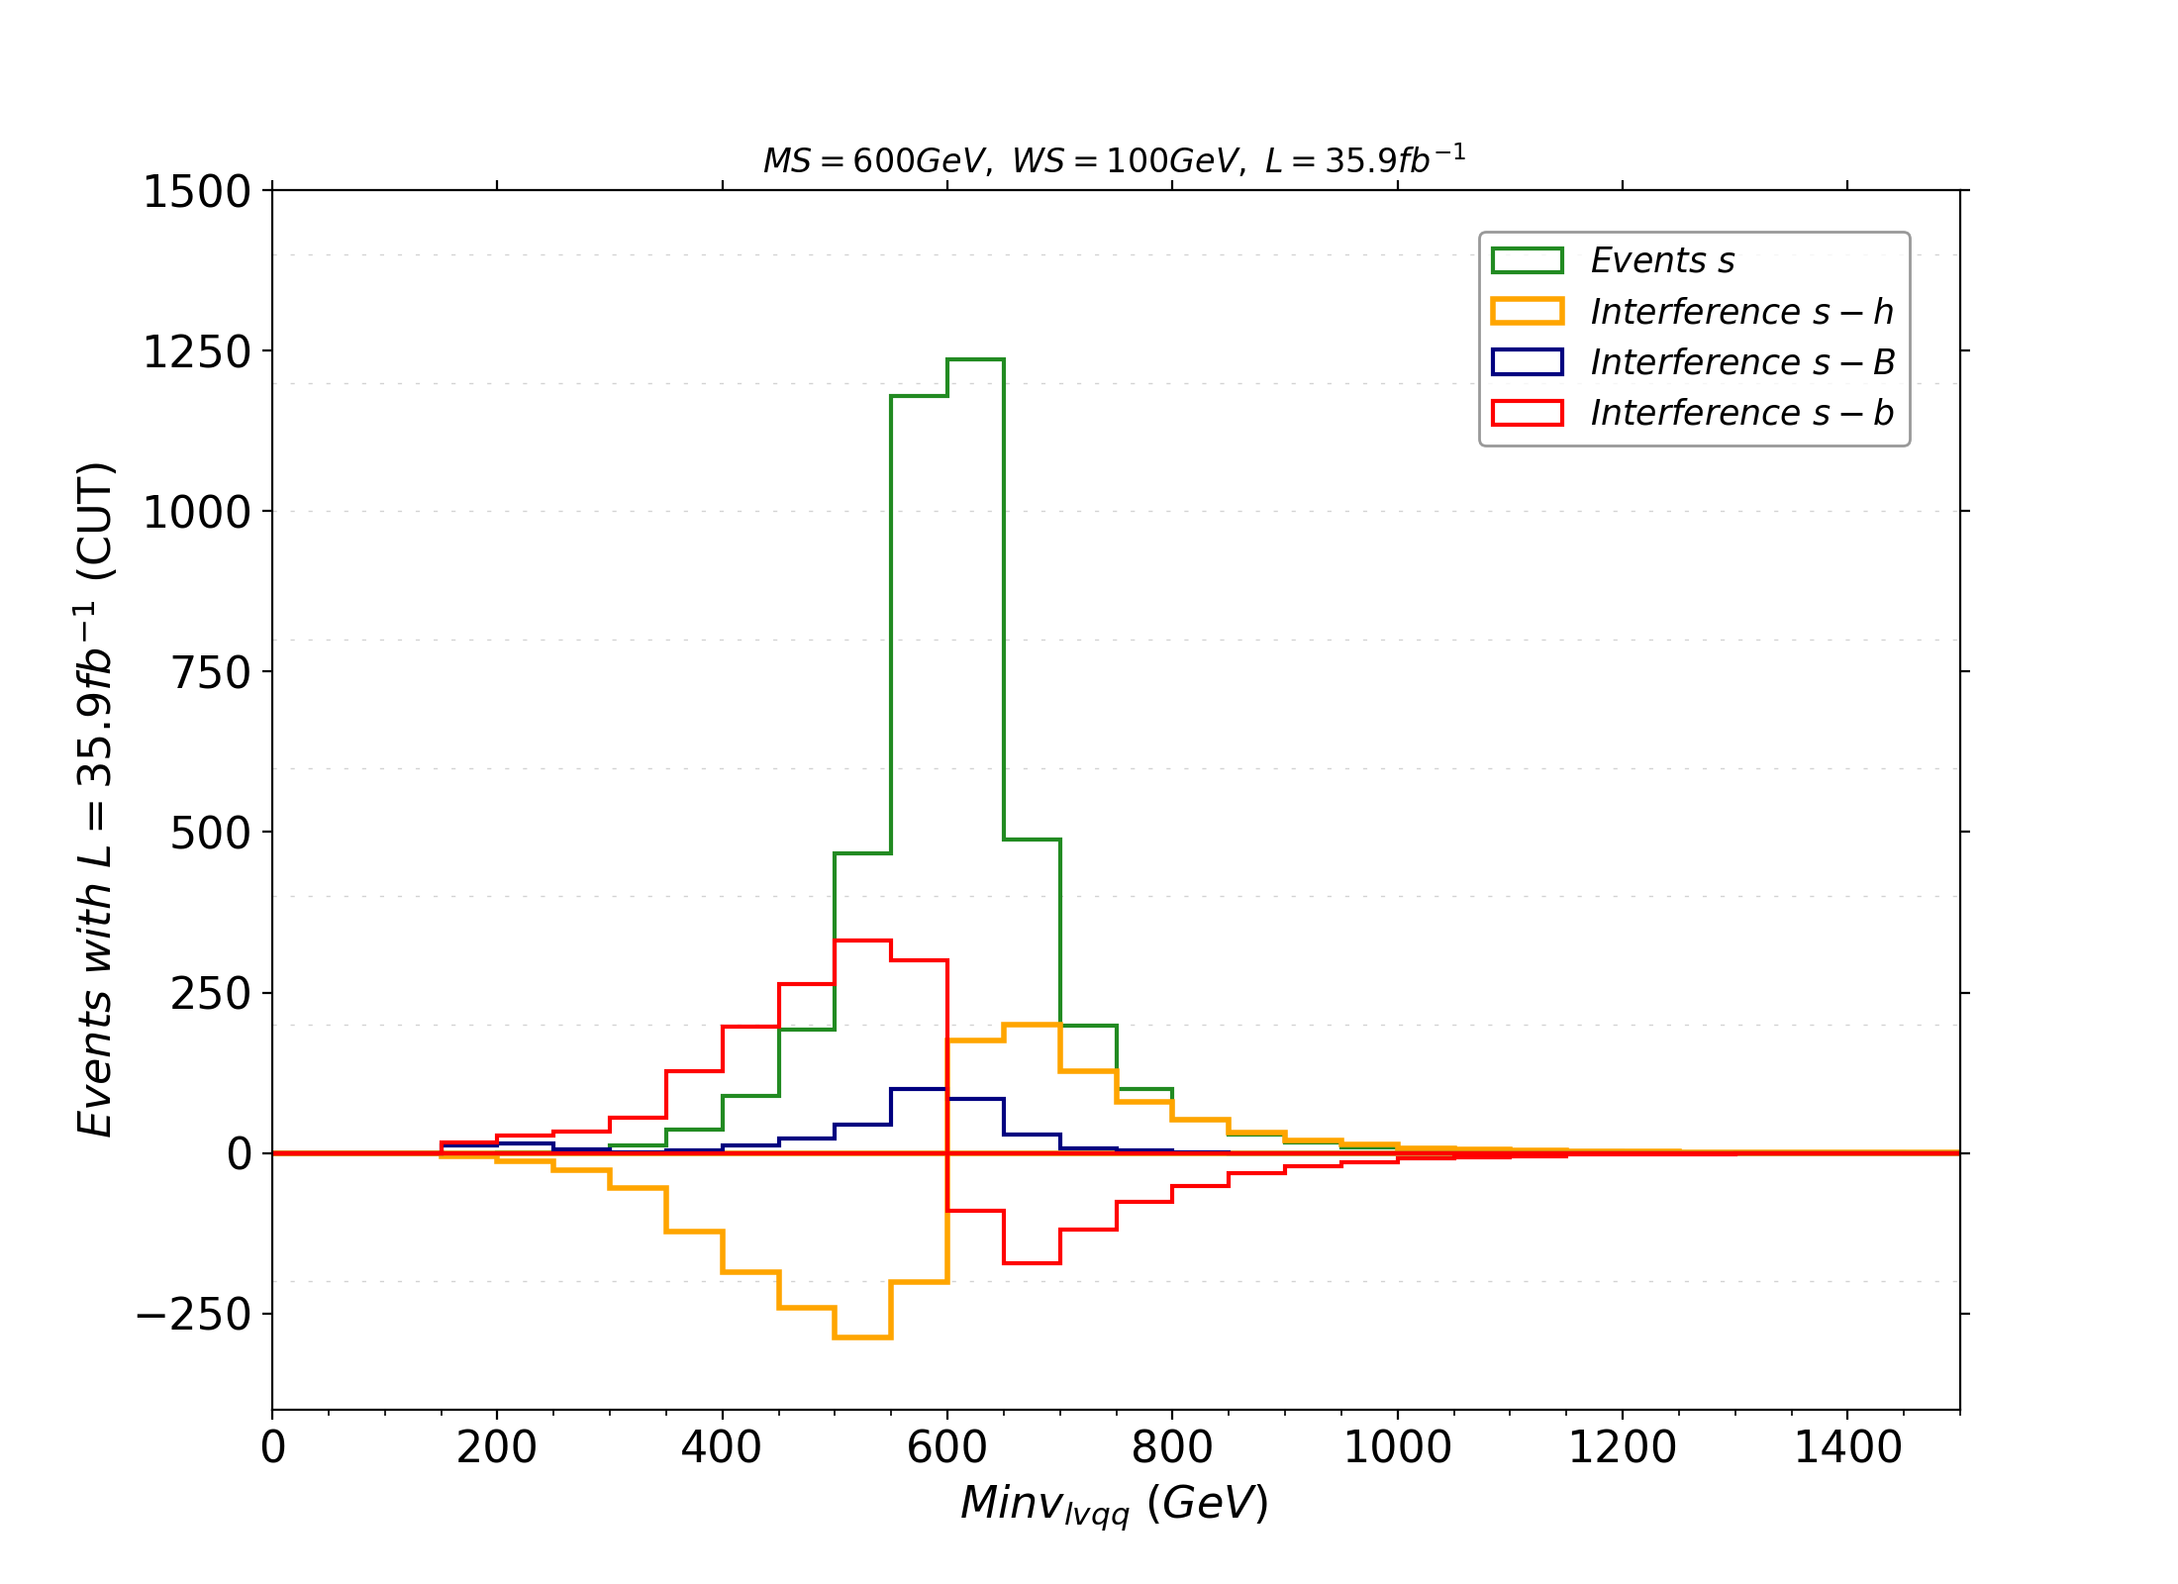
Process: gluon-gluon fusion with SM-like couplings for S
Graph definitions:
h = SM Higgs
B = SM background
b = SM background without the Higgs
13/05/2024
8

Slide 9
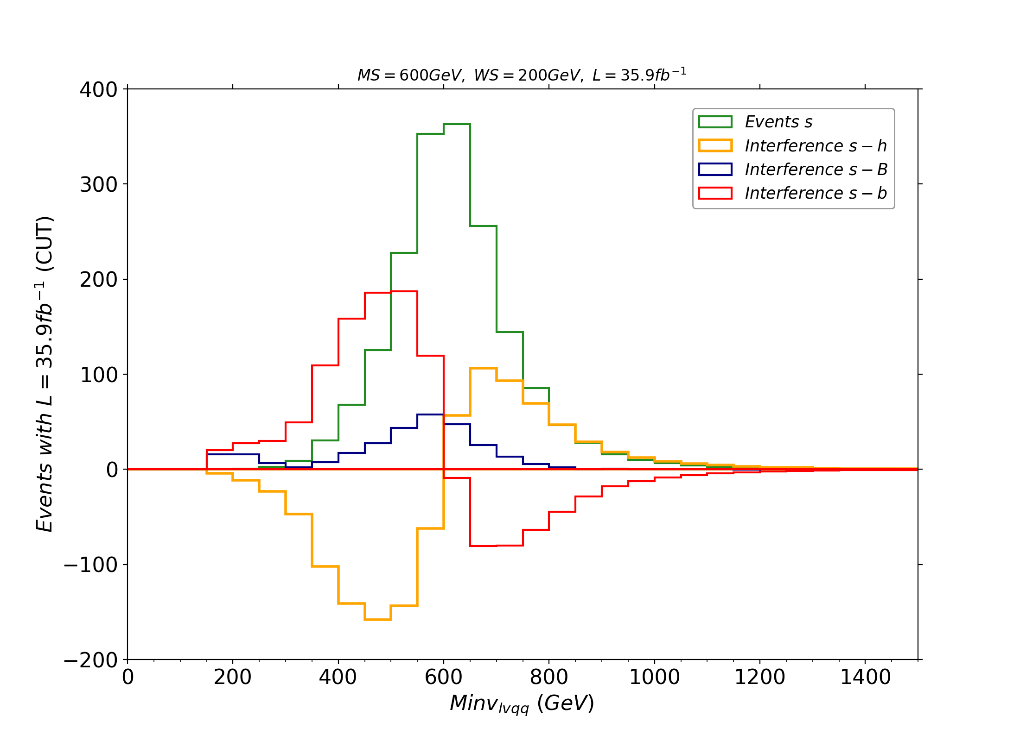
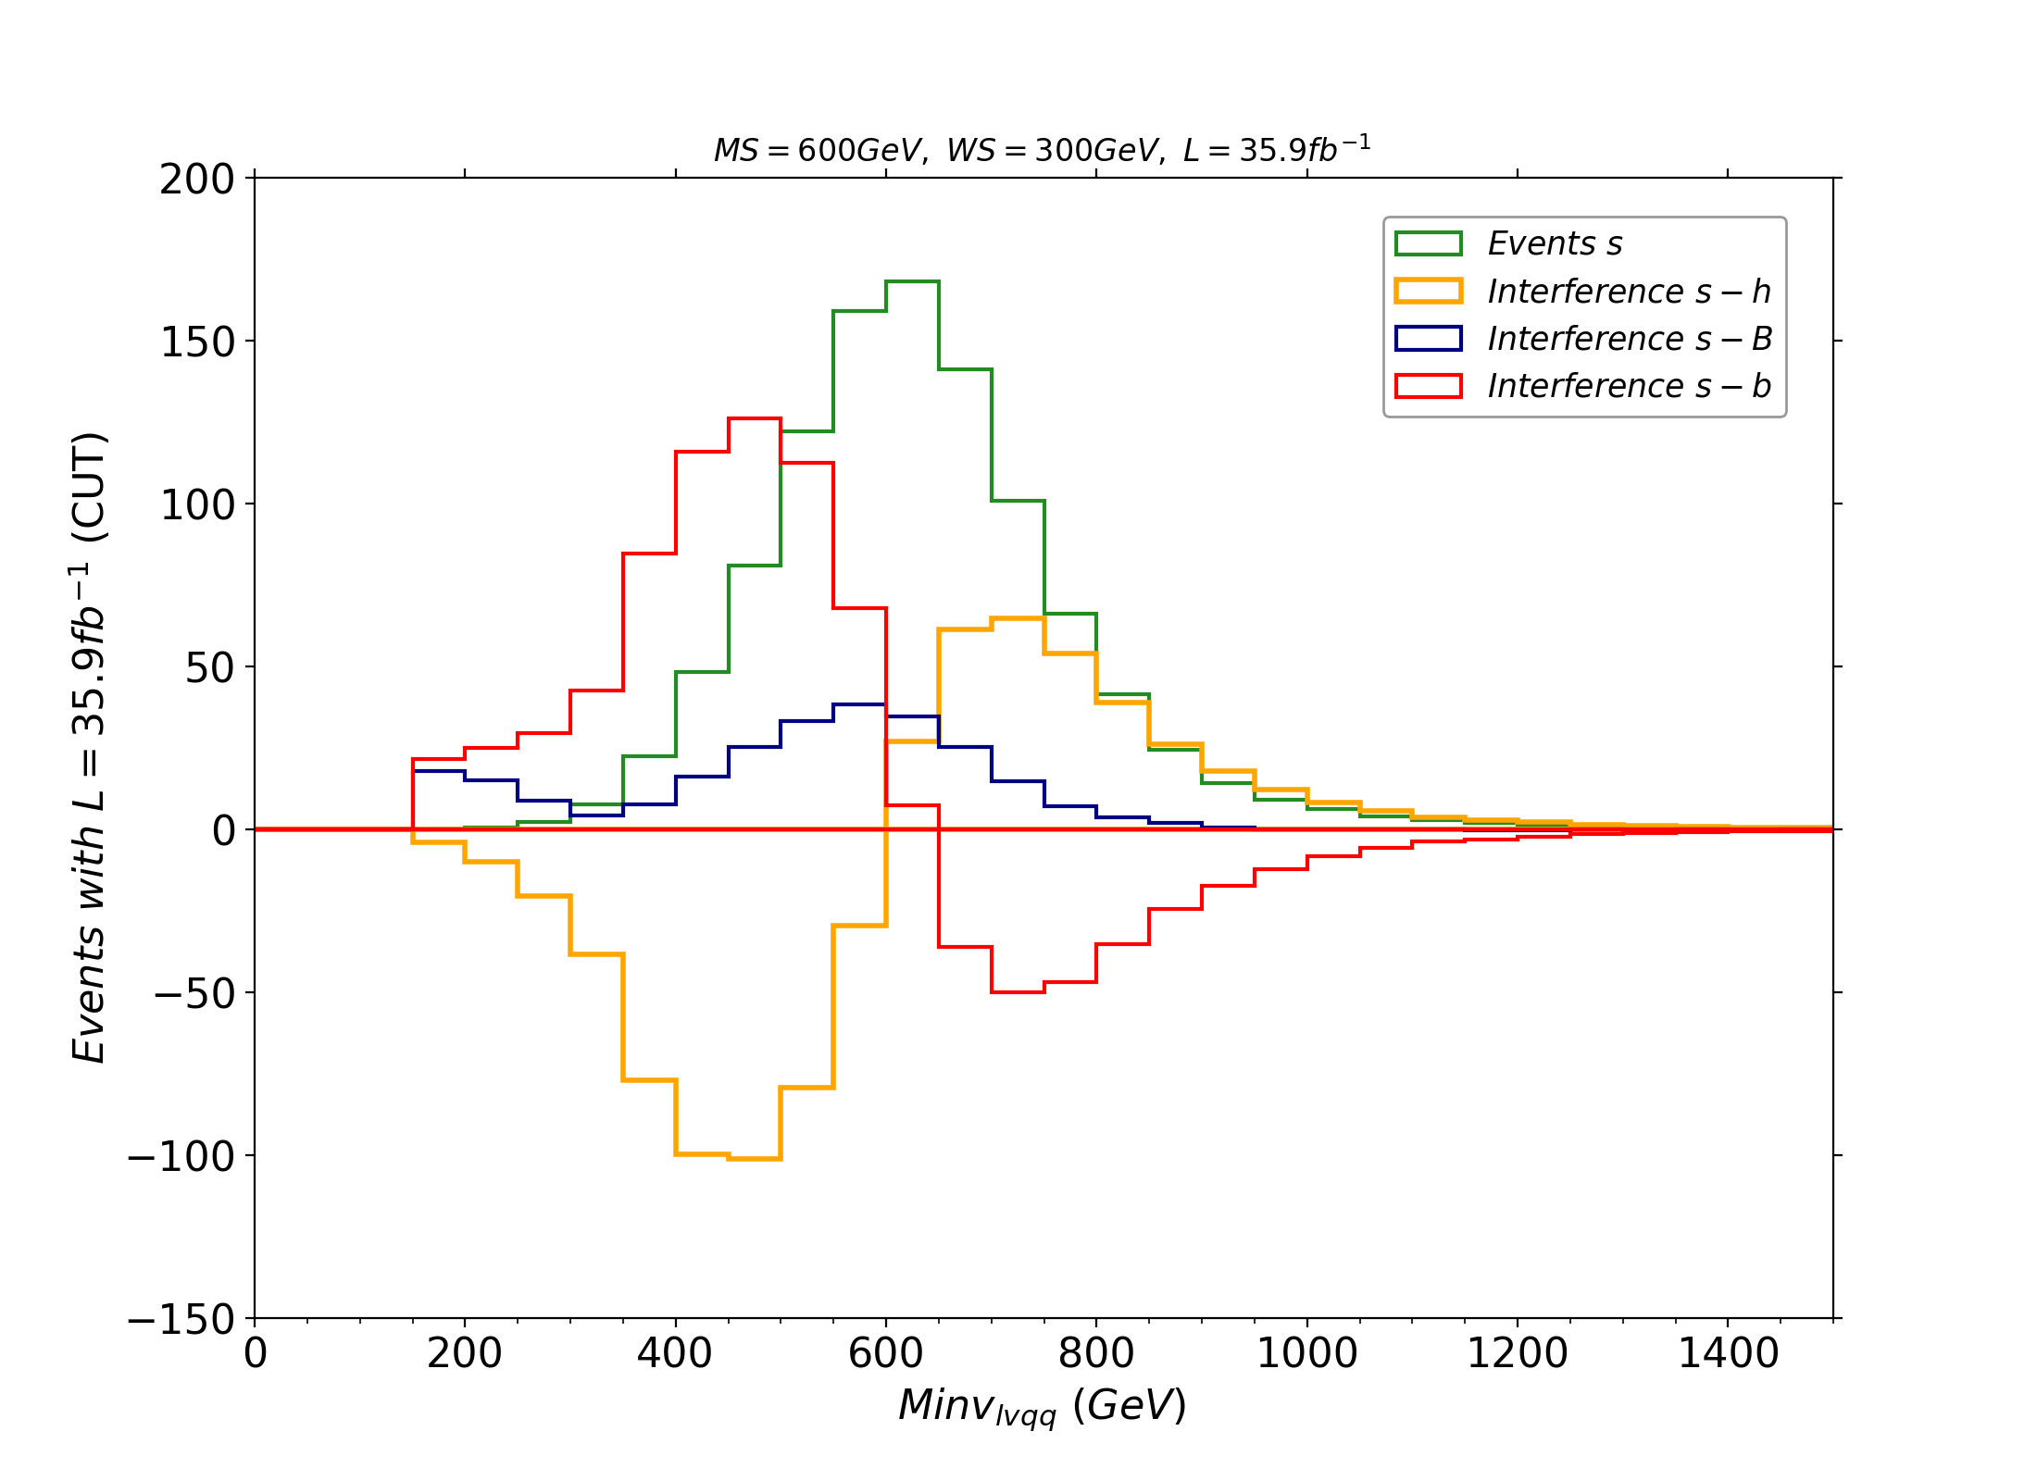
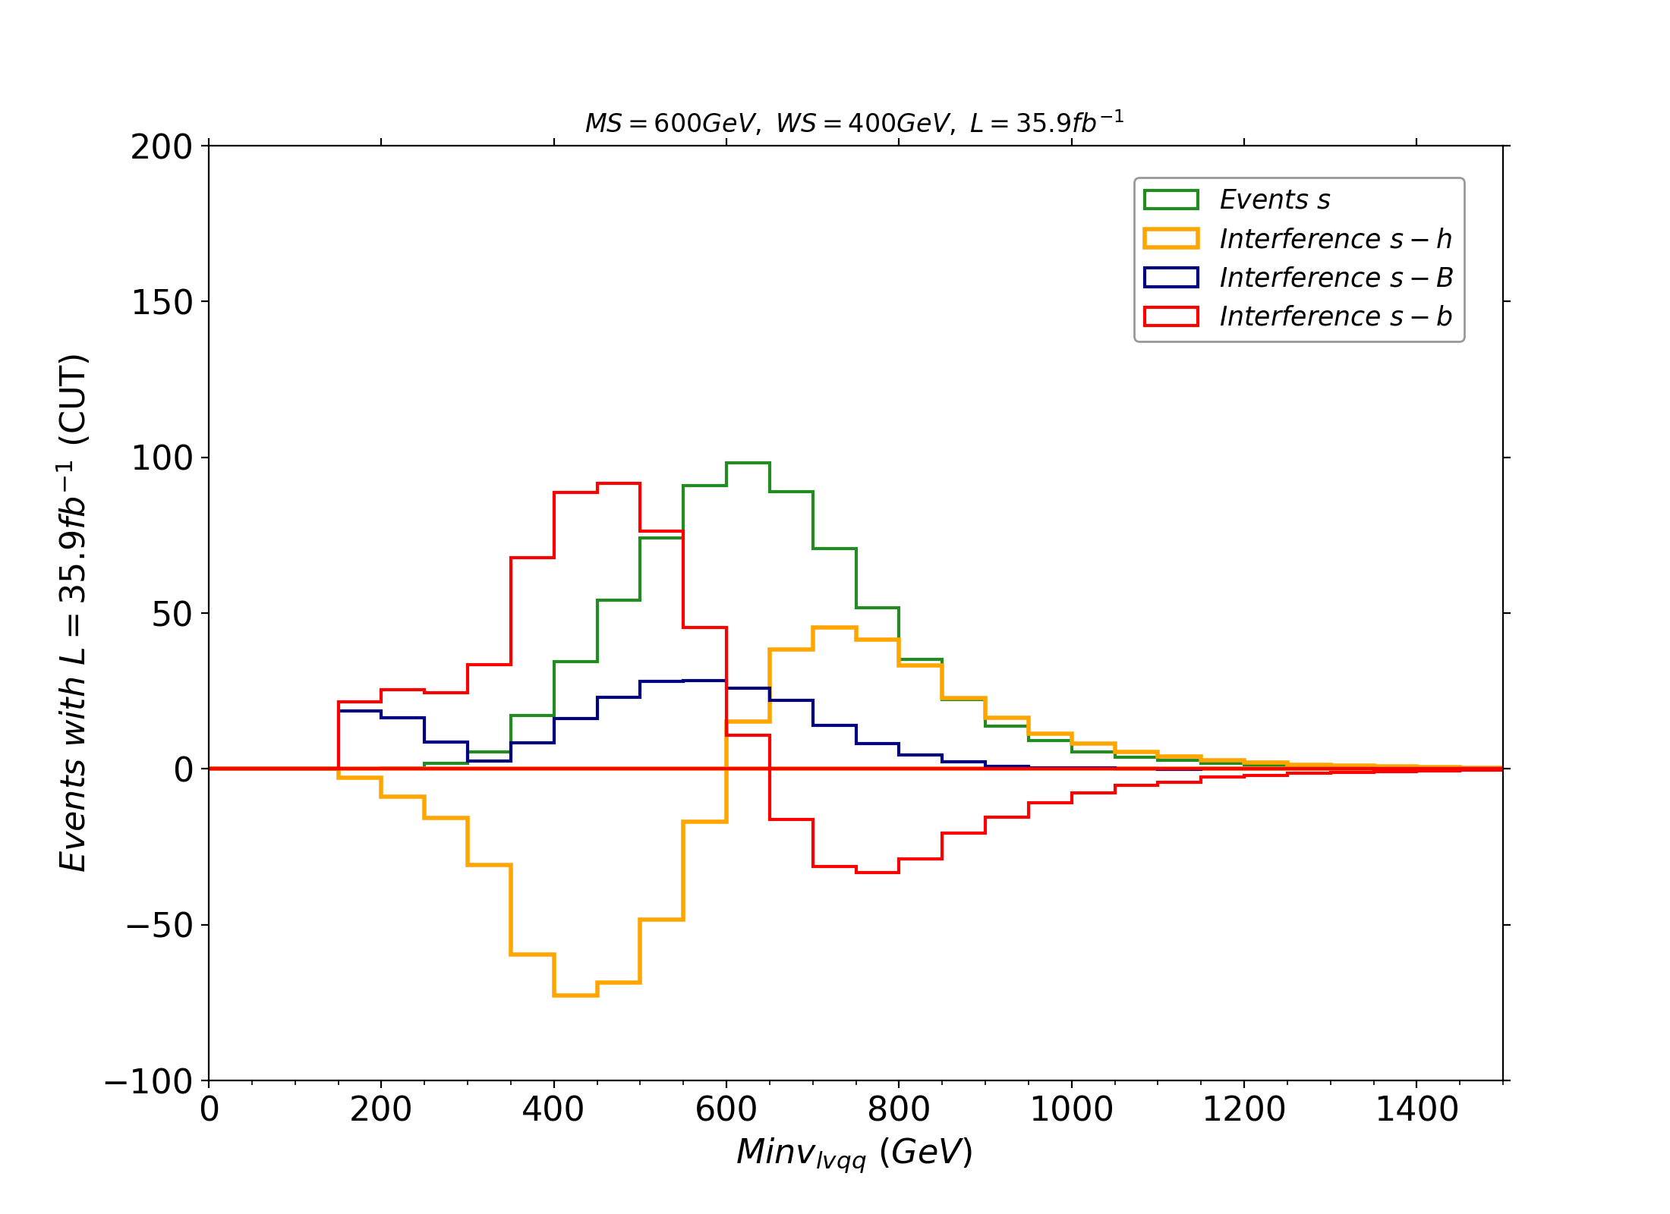
13/05/2024
9

Slide 10
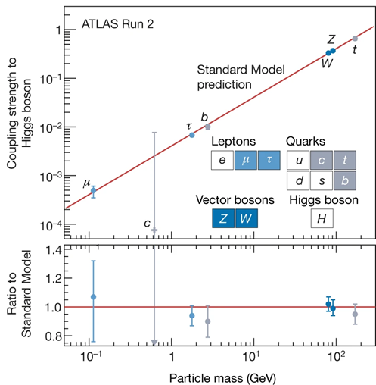
Setting couplings
Changing couplings
Selecting couplings for vertices with S;
Modification of couplings with h using the h_{MOD} couplings → the value must still be consistent with the current limits measured for h couplings (higher precision on hWW coupling) .
Remapping into BSM models → new parameters may not be all independent and free, being function of more fundamental parameters of those models.
13/05/2024
10

Slide 11
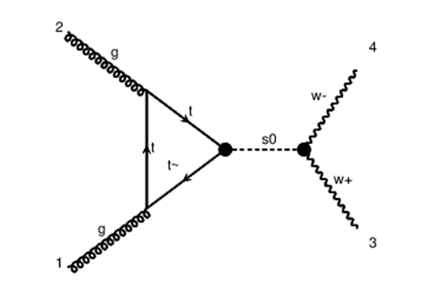
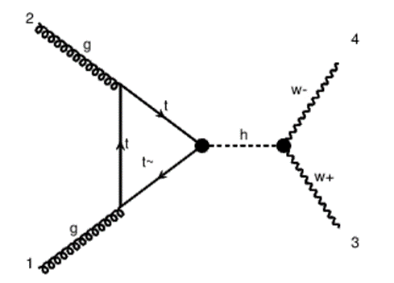
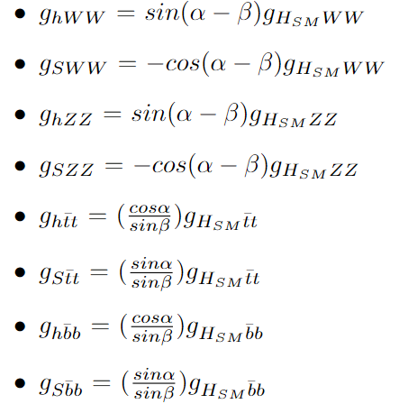
Example: 2HDM type I remapping
2HDM → two SU(2) Higgs doublets with a potential defined by 7 free real parameters (no CP violation);
Type I → all quarks couple to the same doublet;
Two Independent parameters α, β (rotation angles);
Mass eigenstates → 5 physical massive scalars: two charged, one neutral pseudoscalar and two neutral scalars .
The S, h particles in our UFO model represent the physical massive neutral scalars in a 2HDM type I.
BSM couplings depend only on two free parameters.
13/05/2024
11

Slide 12
Future analysis:
Simulations with different values of the couplings, included the 2HDM case.
Simulations of vector-boson fusion processes.
Inclusion of coupling modification of the third generation quarks and of new heavy fermions in the loops as predicted in Composite Higgs Models.
Thank you for your attention
Olimpia Miniati
University of Florence
olimpia.miniati@edu.unifi.it

Slide 13
Backslides
Olimpia Miniati
University of Florence
olimpia.miniati@edu.unifi.it

Slide 14
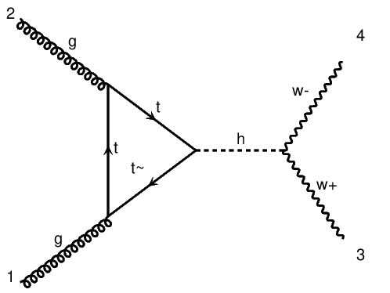
Model: couplings and coupling orders
Each vertex has an associated coupling order:
SM: QCD, QED
Mod. Higgs: HBBMOD, HTTMOD, HWWMOD, HZZMOD
S0 : SFF, SVV
Generation of BSM processes
Generation of interference terms (capability of MadGraph5_aMC@NLO )
All coupling of BSM are free parameters.
Lorentz structure of some interaction can be chosen.
13/05/2024
14

Slide 15
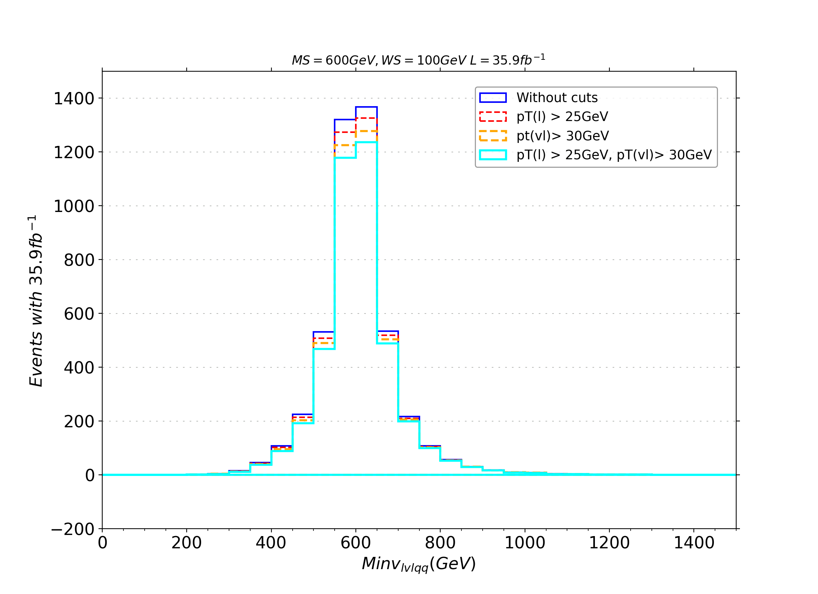
13/05/2024
15

Slide 16
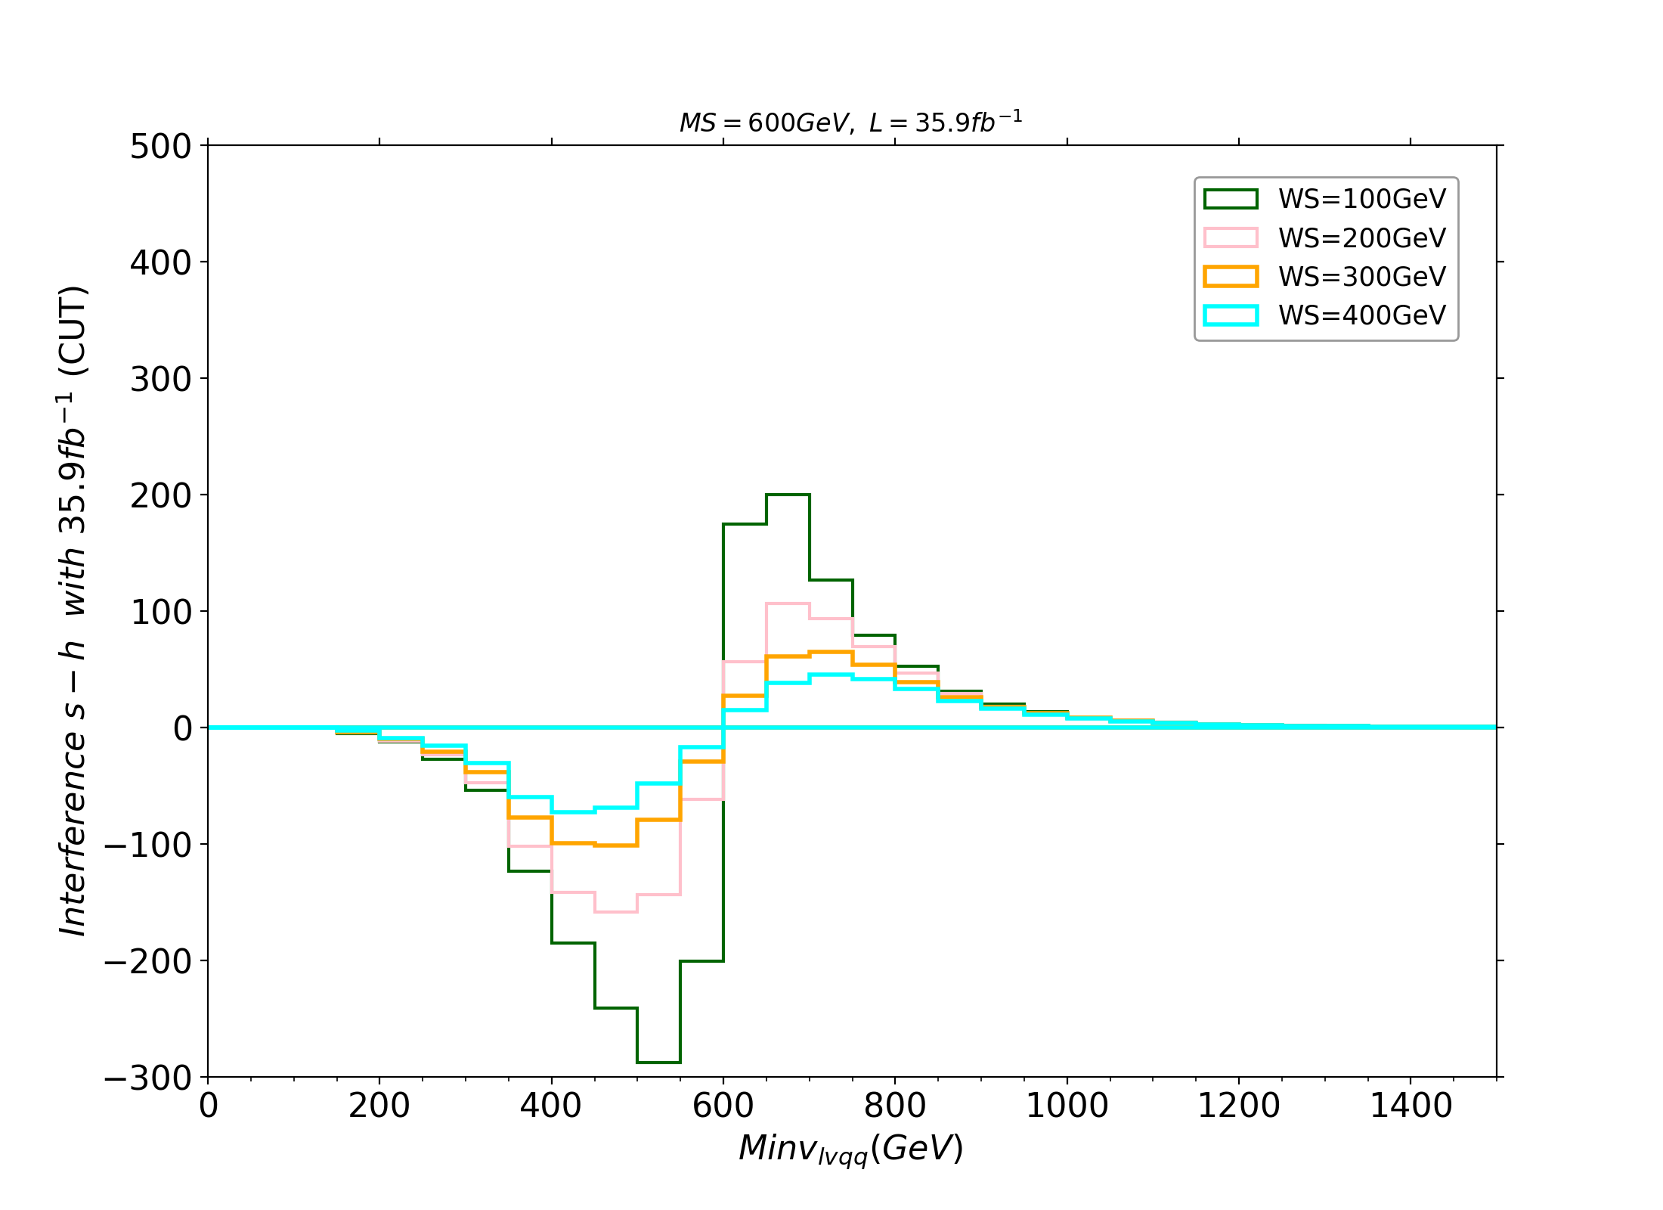
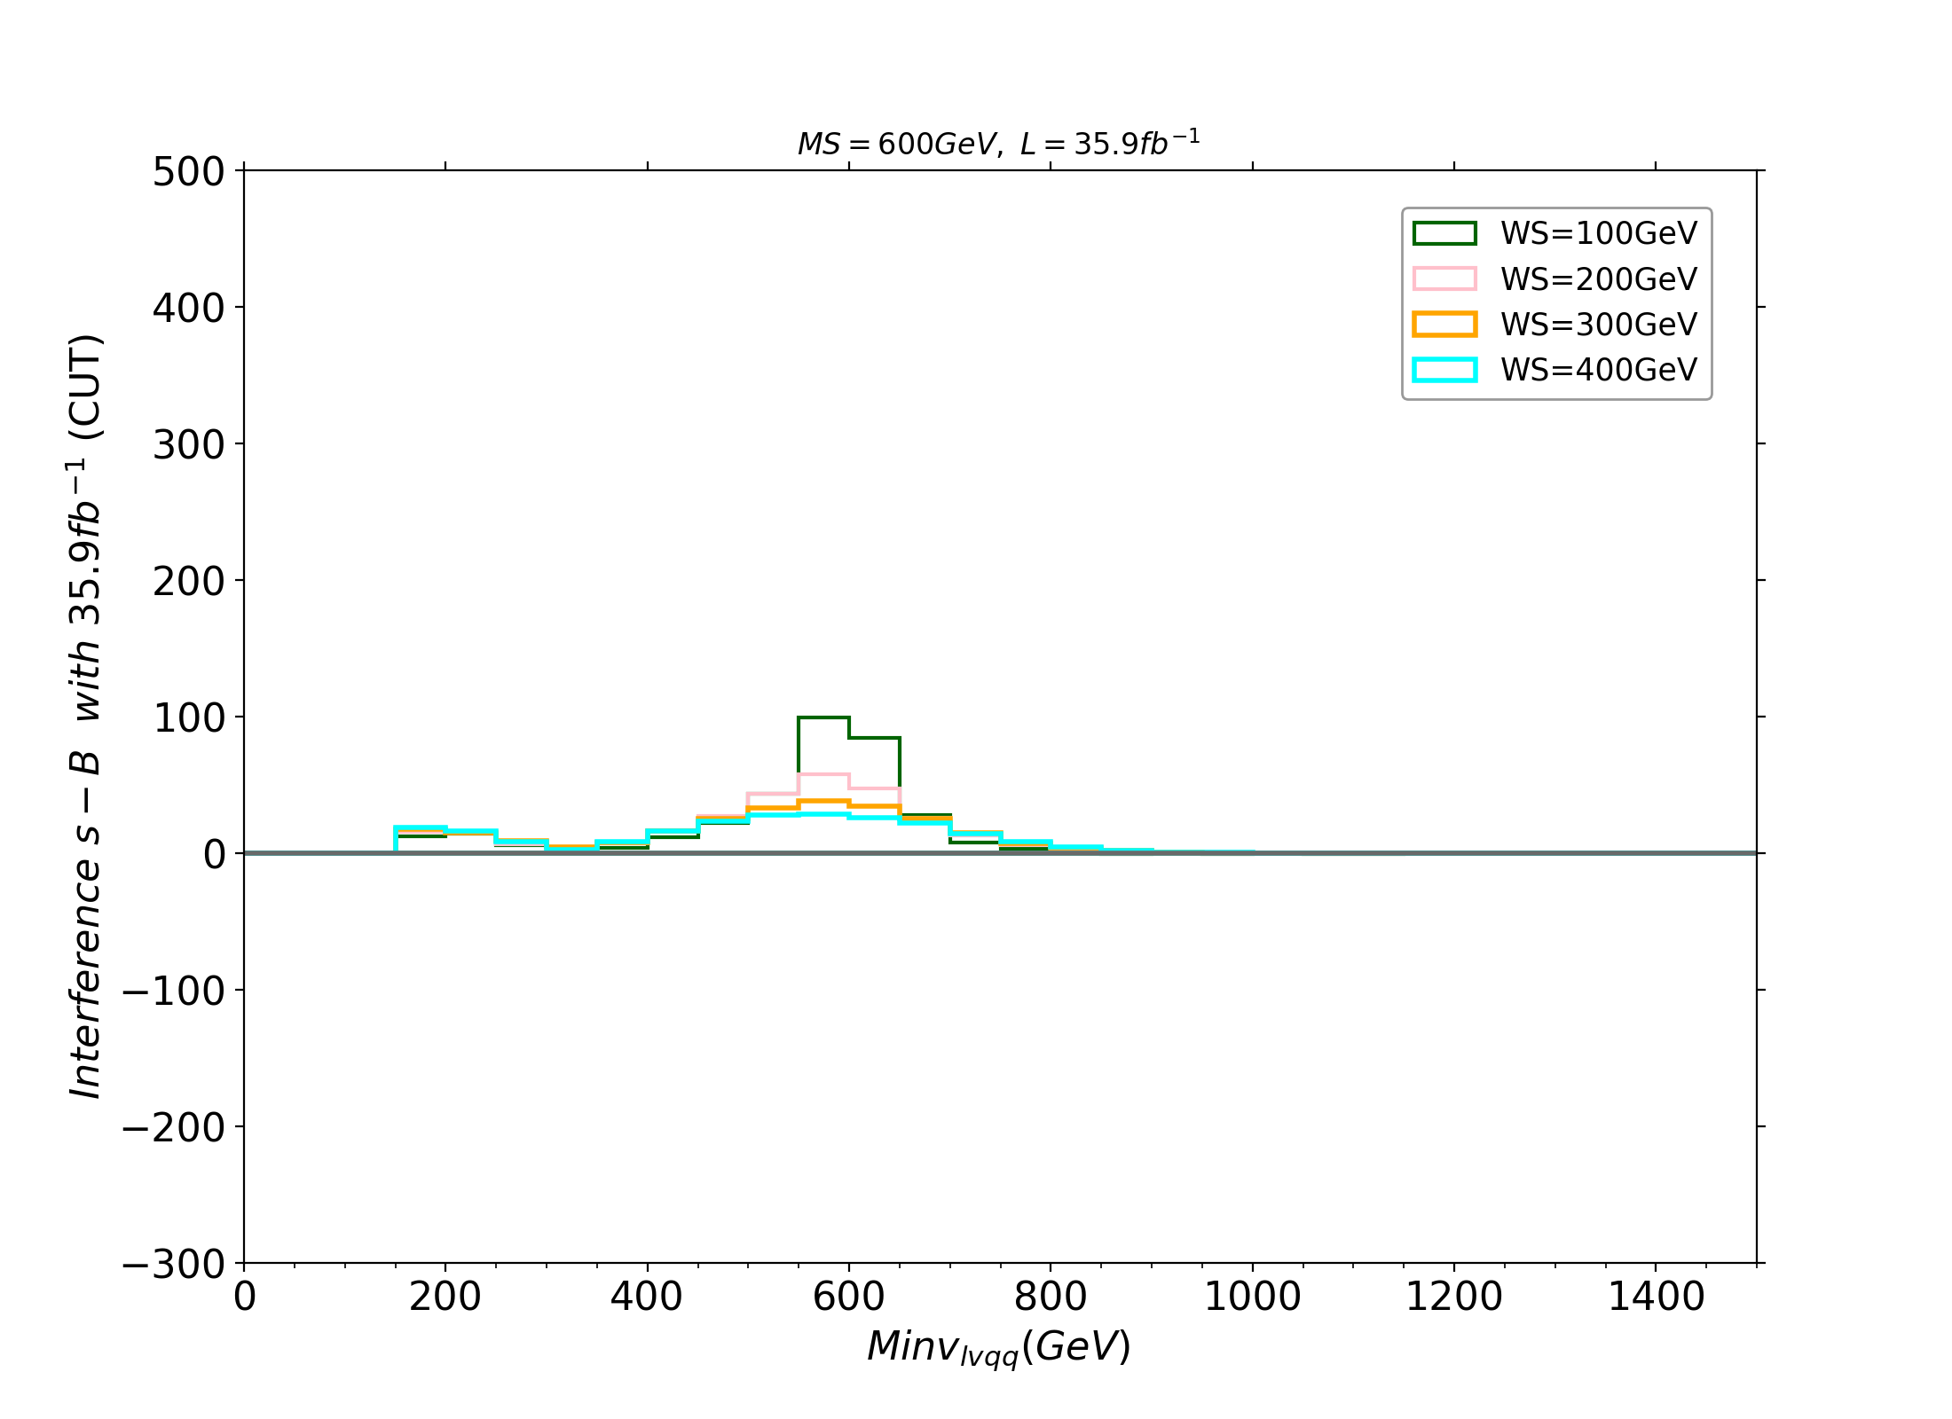
Process: gluon-gluon fusion with SM-like coupling for S
13/05/2024
16

Slide 17
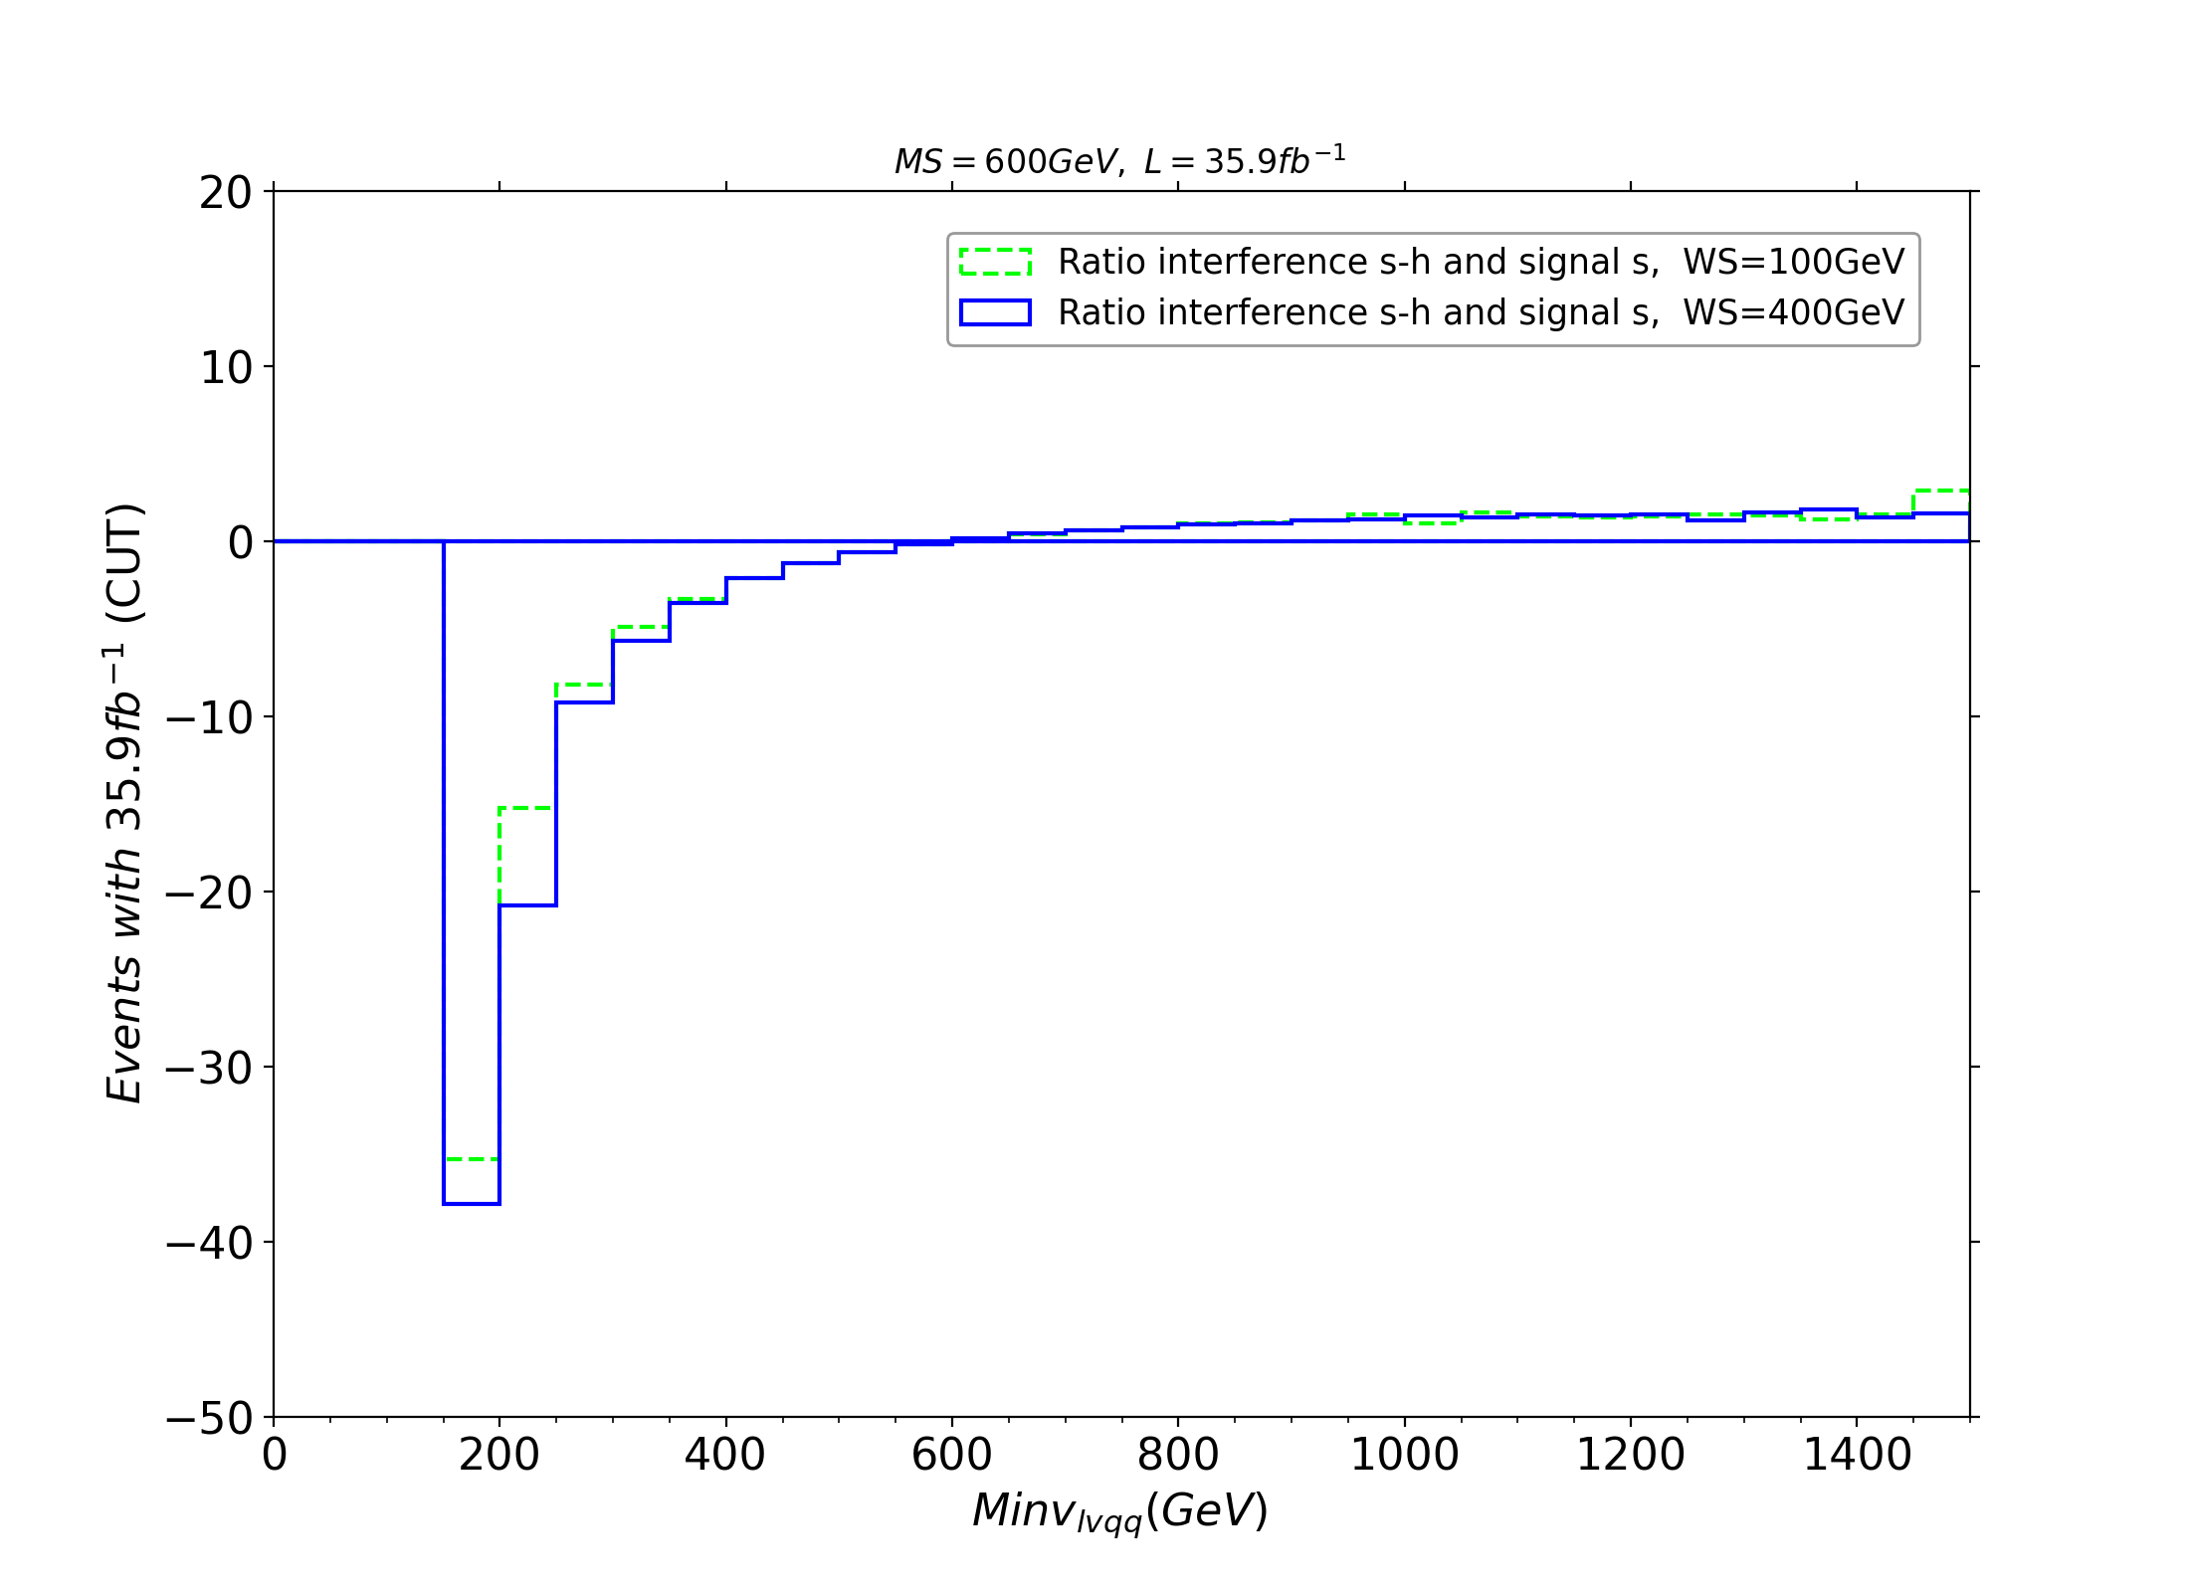
13/05/2024
17

Slide 18
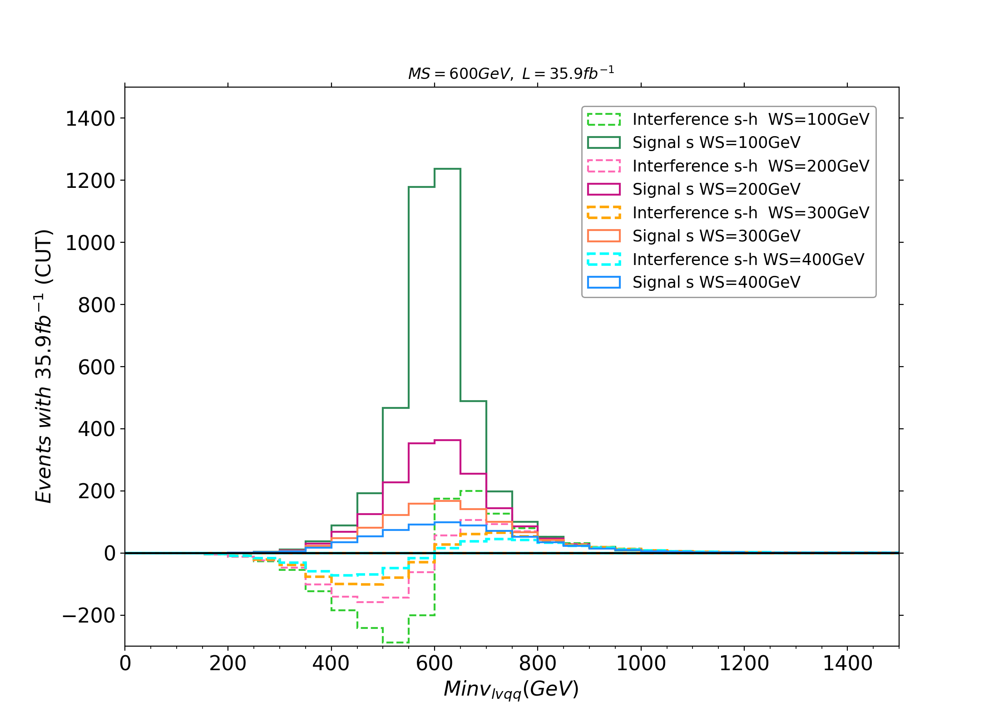
13/05/2024
18

Slide 19
13/05/2024
19

