Slide 1
Modeling nuclear processes for stellar evolution and nucleosynthesis
Introducing the Universe
Big bang nucleosynthesis, CLiP - ⁷Be(n,a) and ⁷Be(n,p) at CERN/n_TOF
Stellar nucleosynthesis
B²FH processes, focus on the s-process
Ages and Old clocks
Nuclear cosmochronometers: neutron cross sections and the Re/Os clock
Alberto Mengoni
ENEA and INFN, Bologna, Italy
XXI LNF Spring School “Bruno Touschek” in Nuclear, Subnuclear and Astroparticle Physics, Frascati, 13-17 May 2024
alberto.mengoni@cern.ch

Slide 2
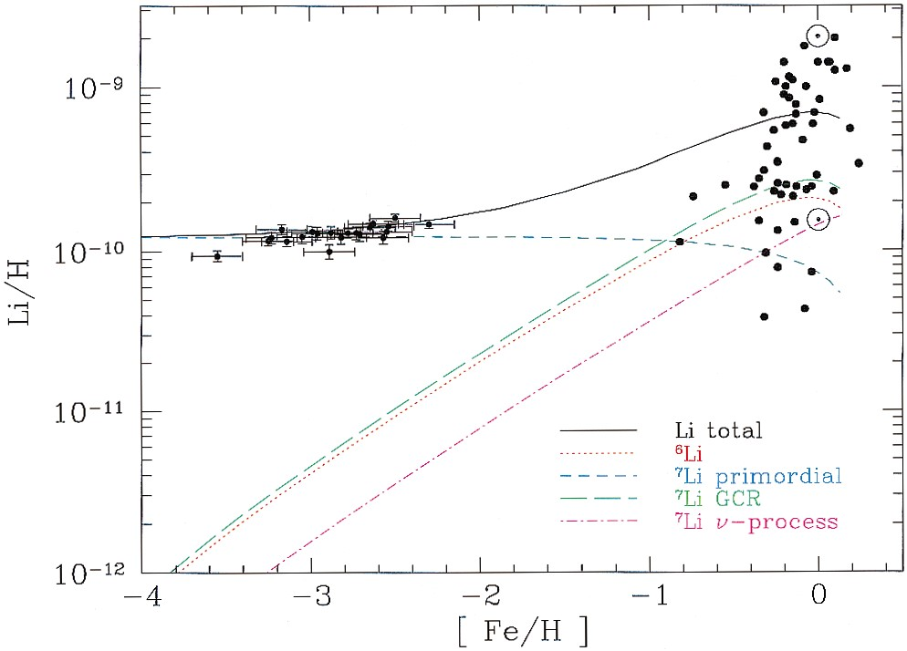
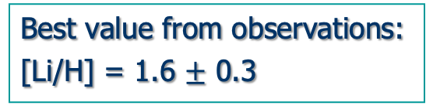


CLiP – Cosmological Lithium Problem
Best value from observations:
[Li/H] = 1.6 $±$ 0.3
Expected from CMB analysis
and standard BBN
[Li/H] = 4.45 $±$ 0.05
Expected from standard BBN
Y_{p} and D
abundance concordance
3.9 $≤$ [Li/H] $≤$ 5.3
Contributions to the total predicted lithium abundance from the adopted GCE model of Fields & Olive (1999a, 1999b), compared with low metallicity stars (RNB) and high-metallicity stars (Lambert, Heath, & Edvardsson 1991). The solid curve is the sum of all components.
[ ] : 10⁻¹⁰
BD Fields et al., PDG Review (2016)
S G Ryan et al. ApJ 530 (2000) L57

Slide 3
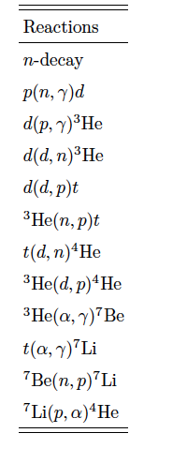
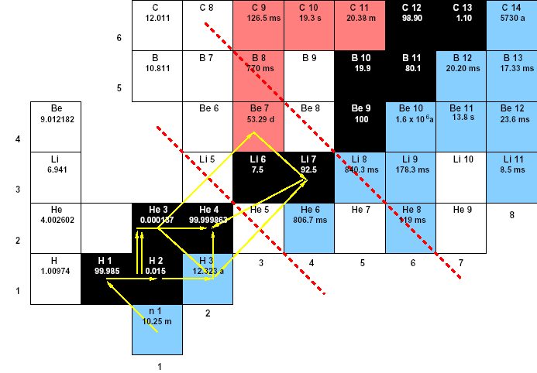
⁴He and ²H concordance
✔️
Yp = 0.245 ± 0.004 (calc.) Yp = 0.246
✔️
D/H = (2.53 ± 0.04) x 10⁻⁵ (calc.) D/H = 2.43 x 10⁻⁵
アメ
Notes:
Yp measured in dwarf galaxies (poor in O and N). ionized He get back one e- a emitting characteristic line (HII line).
There exists a correlation between O content in the dwarf galaxy and Yp. Extrapolation to zero Oxygen provides Yp.
D/H measured by observing absorption lines of distant quasars.
D is quickly destroyed in stars by D + p --> He3 + g

Slide 4
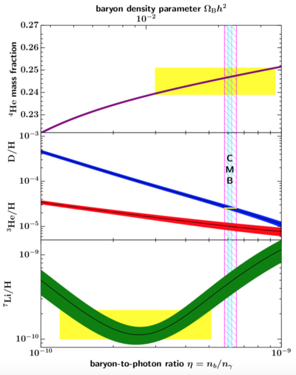
CLiP – Cosmological Lithium Problem
Best value from observations:
[Li/H] = 1.6 $±$ 0.3
Expected from CMB analysis
and standard BBN
[Li/H] = 4.45 $±$ 0.05
Expected from standard BBN
Y_{p} and D
abundance concordance
3.9 $≤$ [Li/H] $≤$ 5.3
[ ] : 10⁻¹⁰
BD Fields et al., PDG Review (2016)

Slide 5
⁴He and ²H concordance
✔️
Yp = 0.245 ± 0.004 (calc.) Yp = 0.246
✔️
D/H = (2.53 ± 0.04) x 10⁻⁵ (calc.) D/H = 2.43 x 10⁻⁵
アメ
Notes:
Yp measured in dwarf galaxies (poor in O and N). ionized He get back one e- a emitting characteristic line (HII line).
There exists a correlation between O content in the dwarf galaxy and Yp. Extrapolation to zero Oxygen provides Yp.
D/H measured by observing absorption lines of distant quasars.
D is quickly destroyed in stars by D + p --> He3 + g

Slide 6
⁷Be destruction by neutrons
Recent measurements @ CERN n_TOF
⁷Be(n,α)⁴He

Slide 7
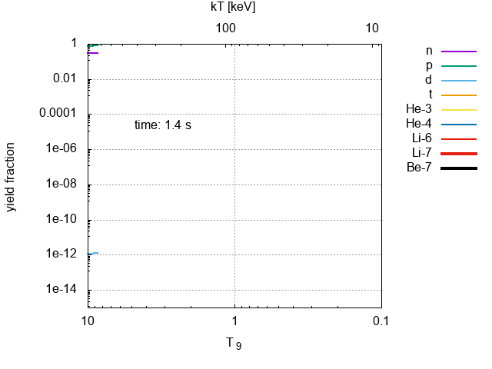
Big bang nucleosynthesis
アメ

Slide 8
⁷Be destruction by neutrons
n_TOF
アメ

Slide 9
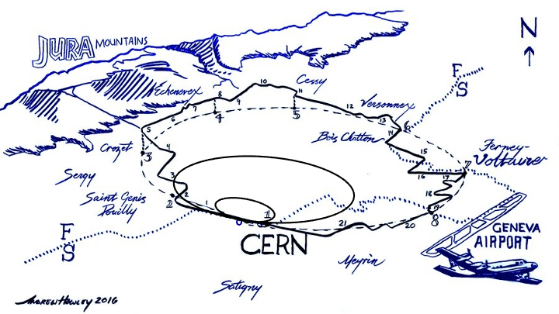
n_TOF @ CERN

Slide 10
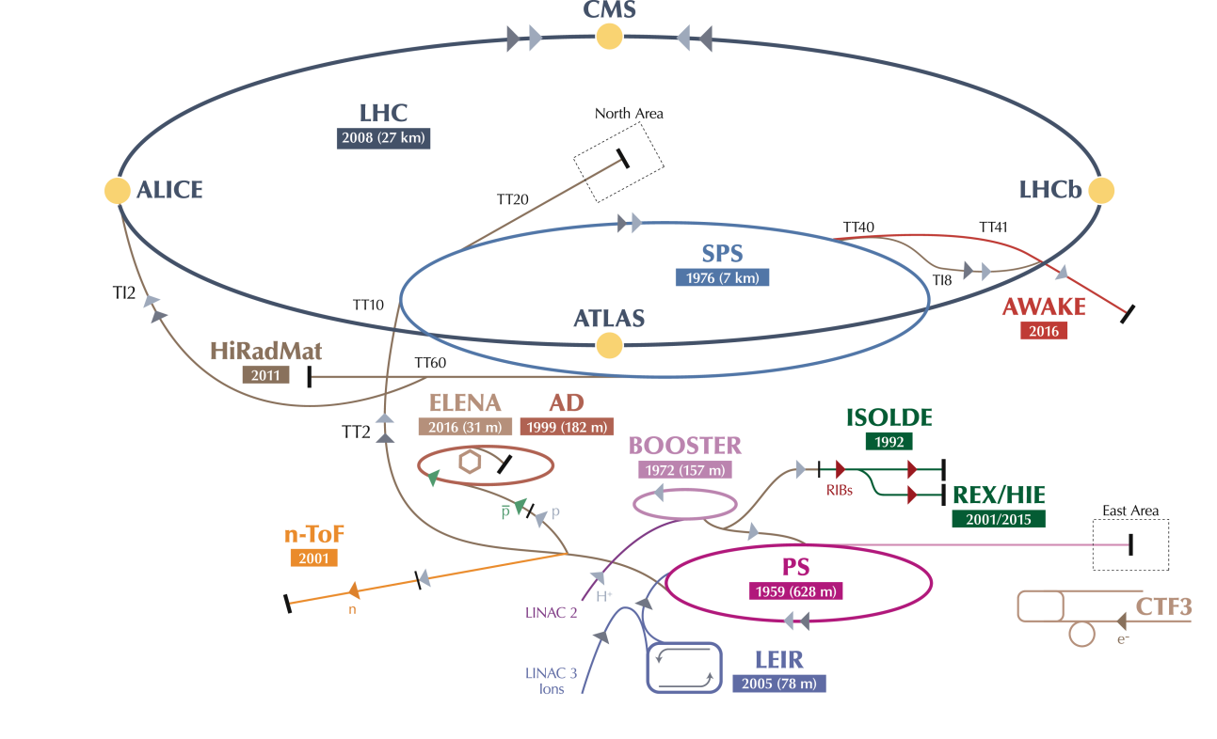

n_TOF @ CERN
C. Rubbia et al., A high resolution spallation driven facility at the CERN-PS
to measure neutron cross sections in the interval from 1 eV to 250 MeV
CERN/LHC/98-02(EET) 1998
n_TOF

Slide 11

n_TOF @ CERN
20 GeV/c proton beam
From the PS accelerator
Two experimental areas (EAR)
Horizontal flight path
EAR1 at 200 m
Vertical flight-path
EAR2 at 20 m
Both beam lines with
1st collimator
halo cleaning, initial beam shaping
Filter station
Sweeping magnet
2nd collimator for beam shaping
Notes:
With greater accuracy

Slide 12
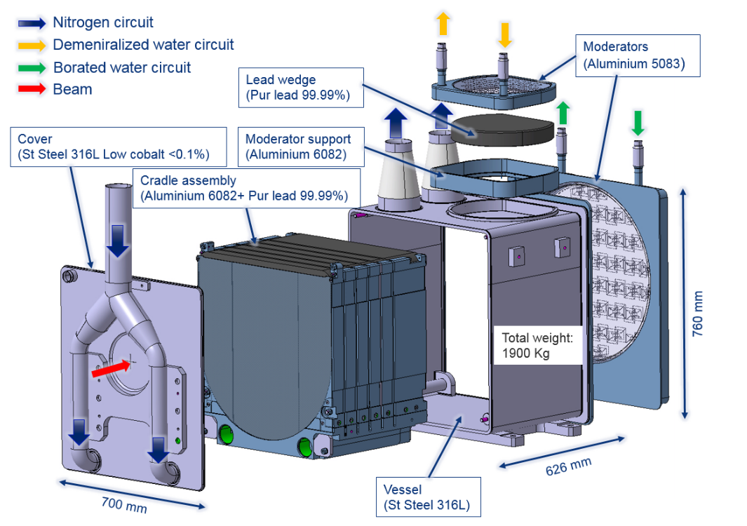



n_TOF @ CERN: 3rd-generation target
3rd generation spallation target, pure Pb based,
N₂-gas cooled, water moderated
Several innovations have been introduced
courtesy of Oliver Aberle and Marco Calviani CERN

Slide 13
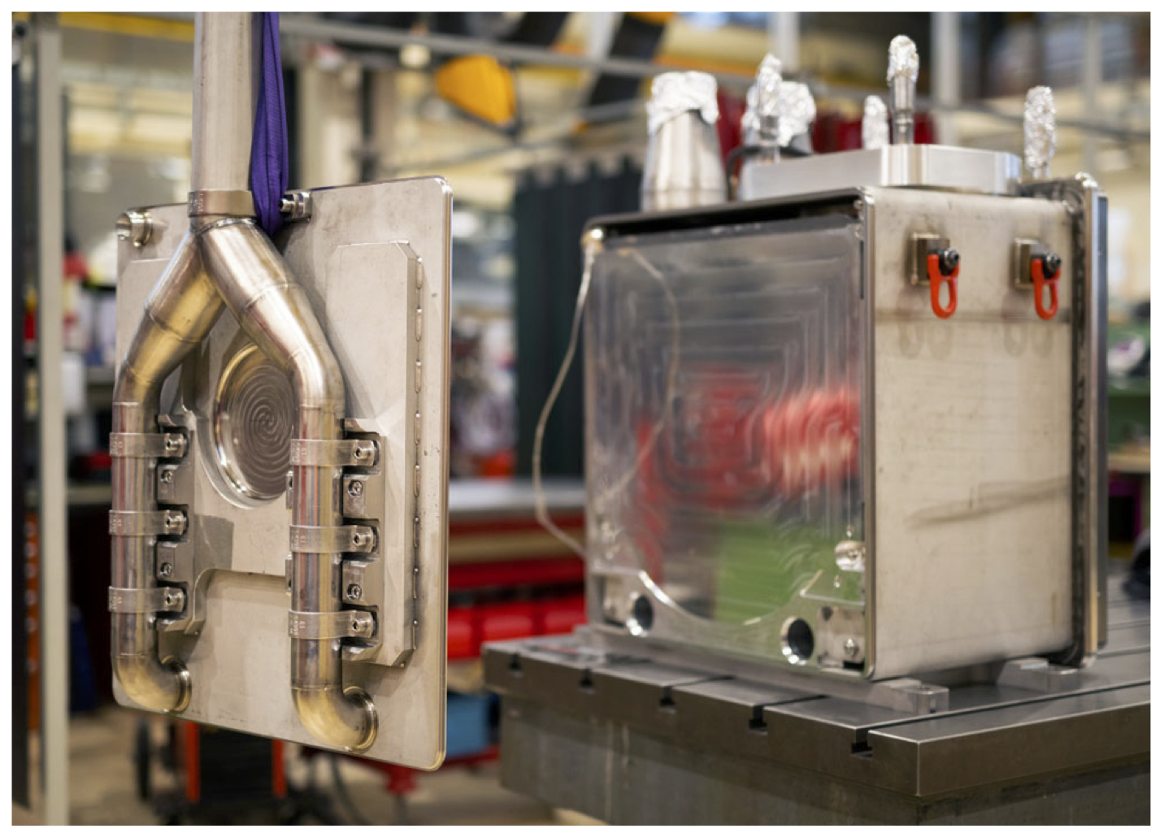
n_TOF @ CERN: 3rd-generation target
courtesy of Oliver Aberle and Marco Calviani, CERN

Slide 14
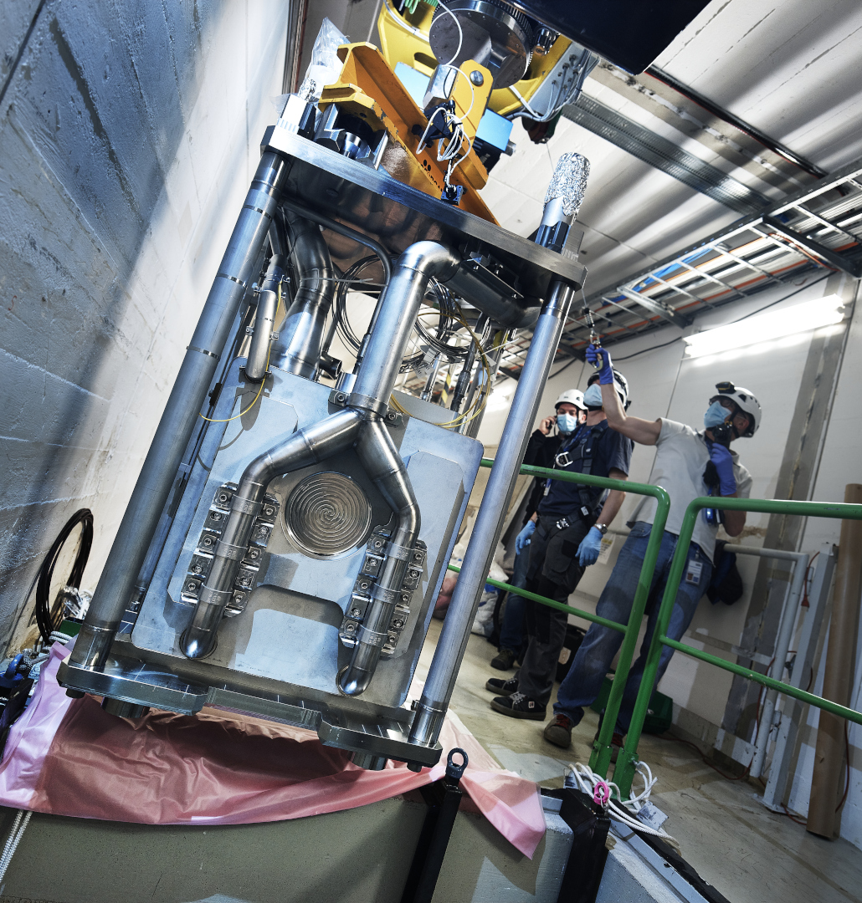
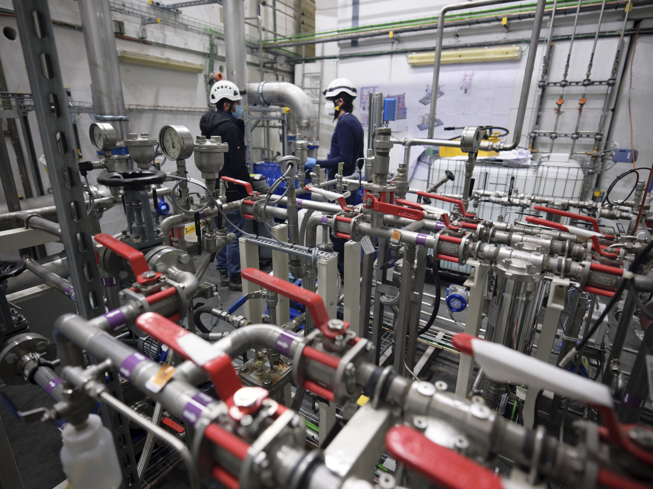
n_TOF @ CERN: 3rd-generation target
Cooling and moderator station
courtesy of Oliver Aberle and Marco Calviani, CERN

Slide 15
n_TOF @ CERN: 3rd-generation target
proton beam momentum | 20 GeV/c
intensity (dedicated mode) | 8.5 x 10¹² protons/pulse
repetition frequency | 1 pulse/1.2s
pulse width | 6 ns (rms)
n/p | > 300
lead target dimensions | 40x46x63 cm³
cooling & moderation material | N₂ & H₂O (borated)
moderator thickness in the exit face | 5 cm
neutron beam dimension in EAR-1 (capture mode) | 2 cm (FWHM)

Slide 16
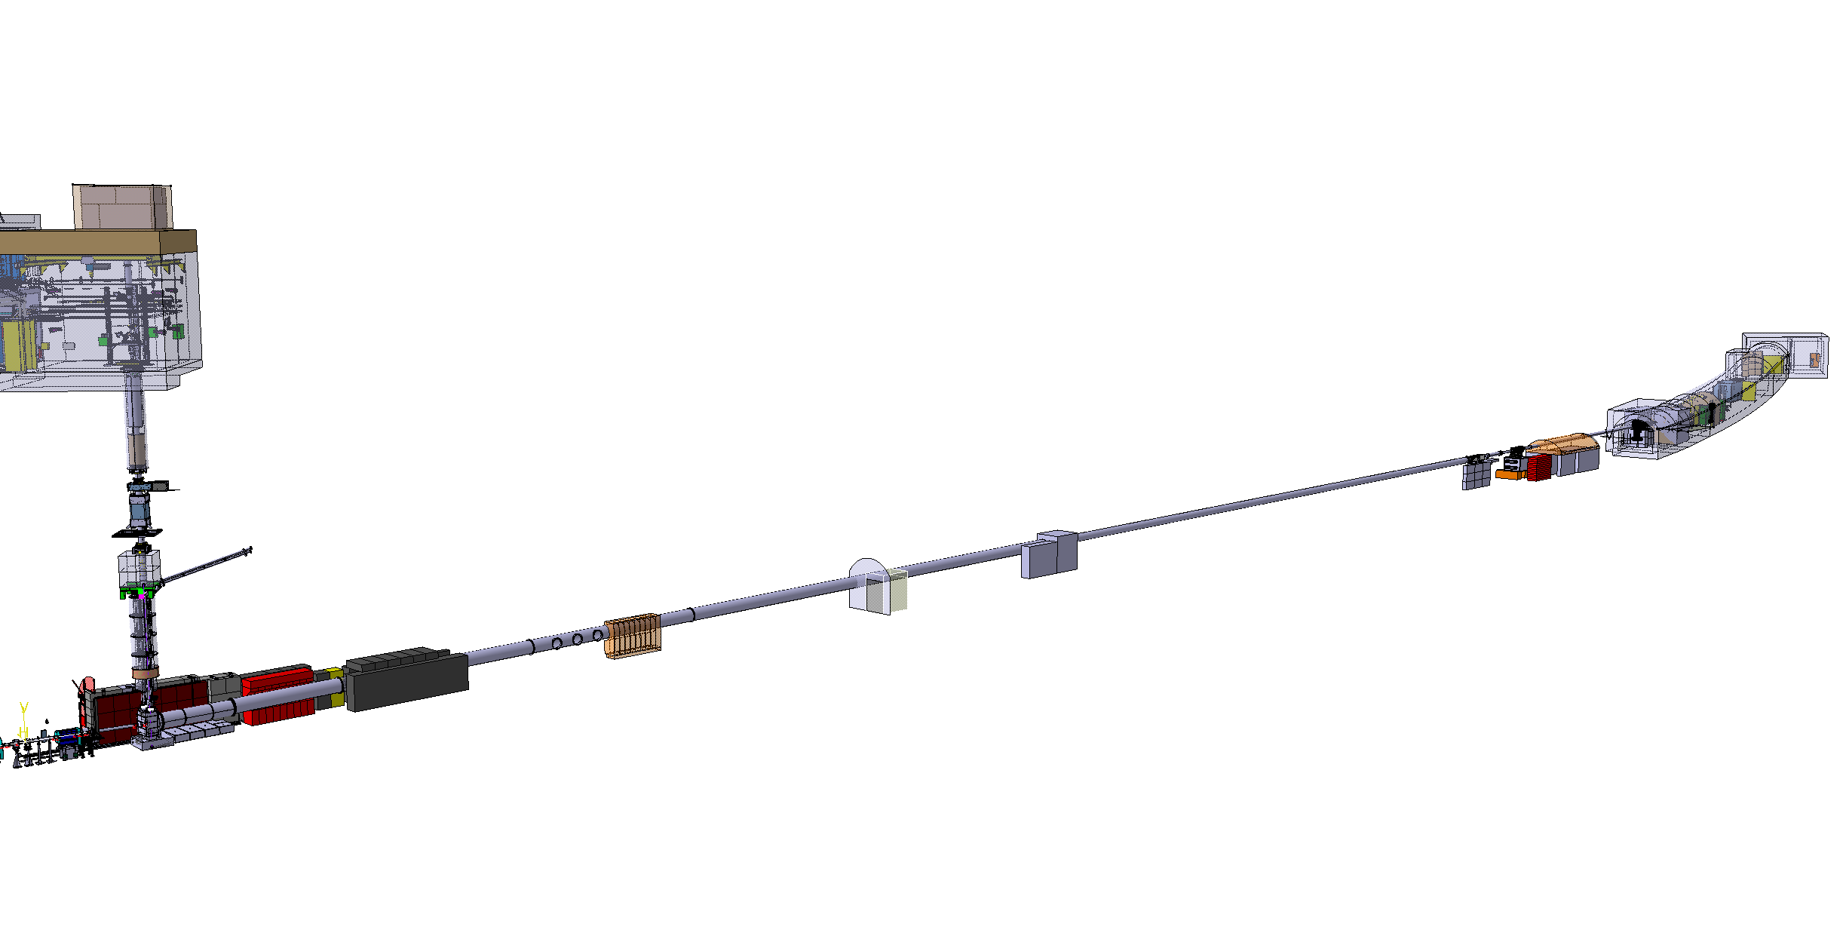
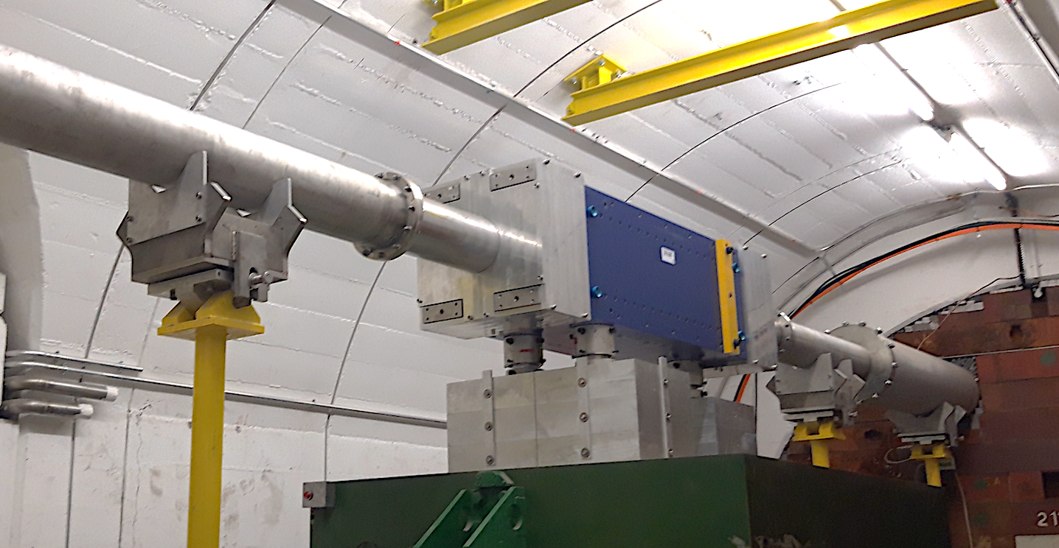
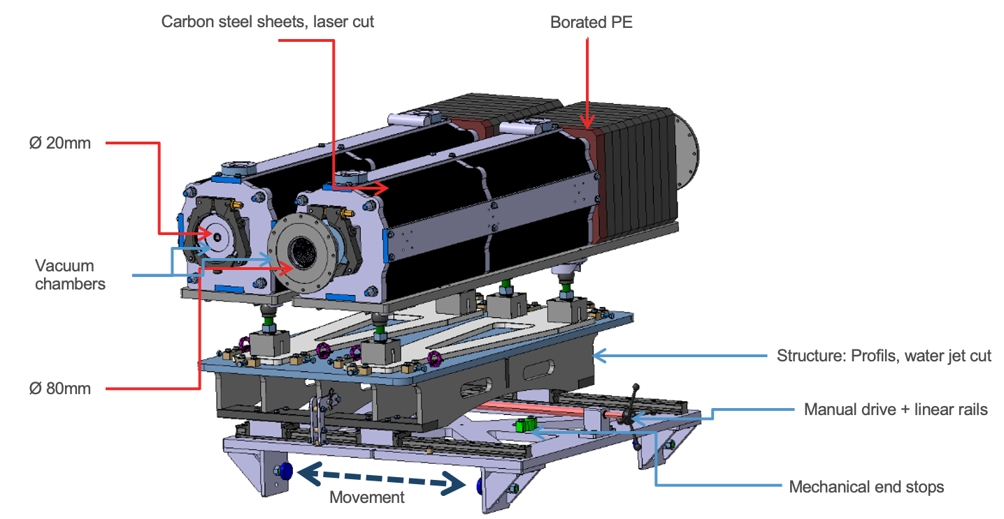
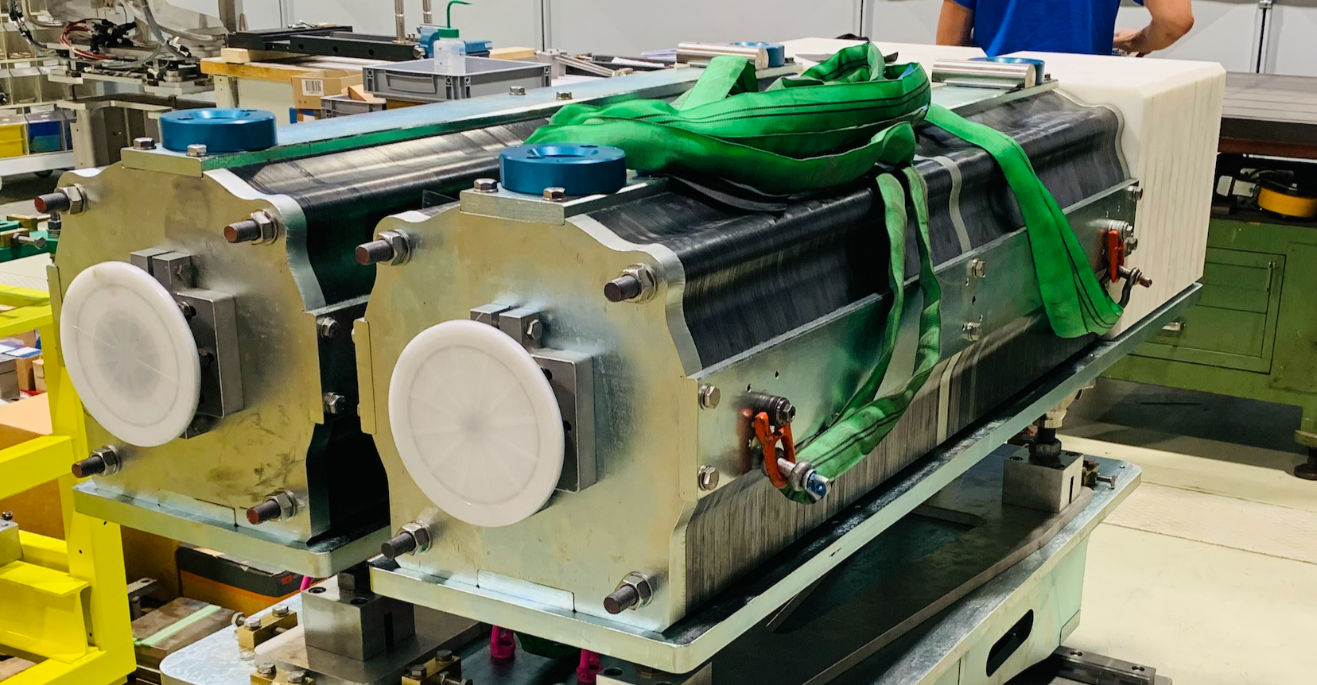
EAR1 beam line
SmCo sweeping magnet
Neutron shielding
1st collimator
2nd “shaping” collimator
Filter station
Spallation target
16

Slide 17
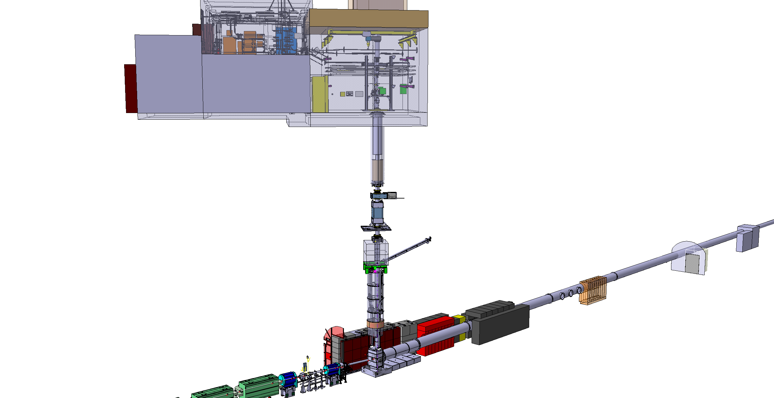
EAR2 beam line
2nd “shaping” collimator
Filter station
1st collimator
SmCo sweeping magnet
Spallation target
17

Slide 18
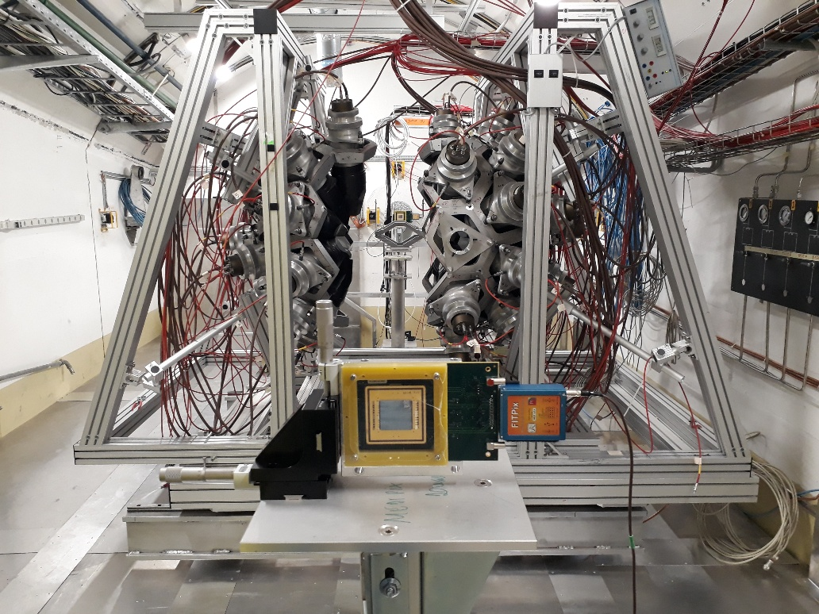
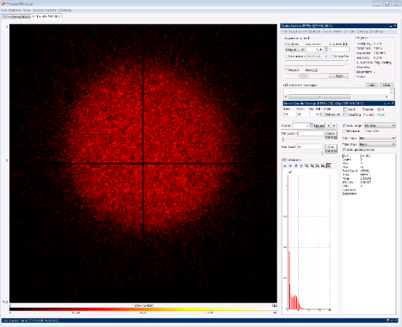
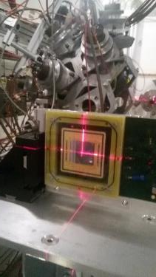
Experimental Area 1 (EAR1)
2-Quad Timepix has been used for beam alignment
and for flux measurement in Phase-2021

Slide 19
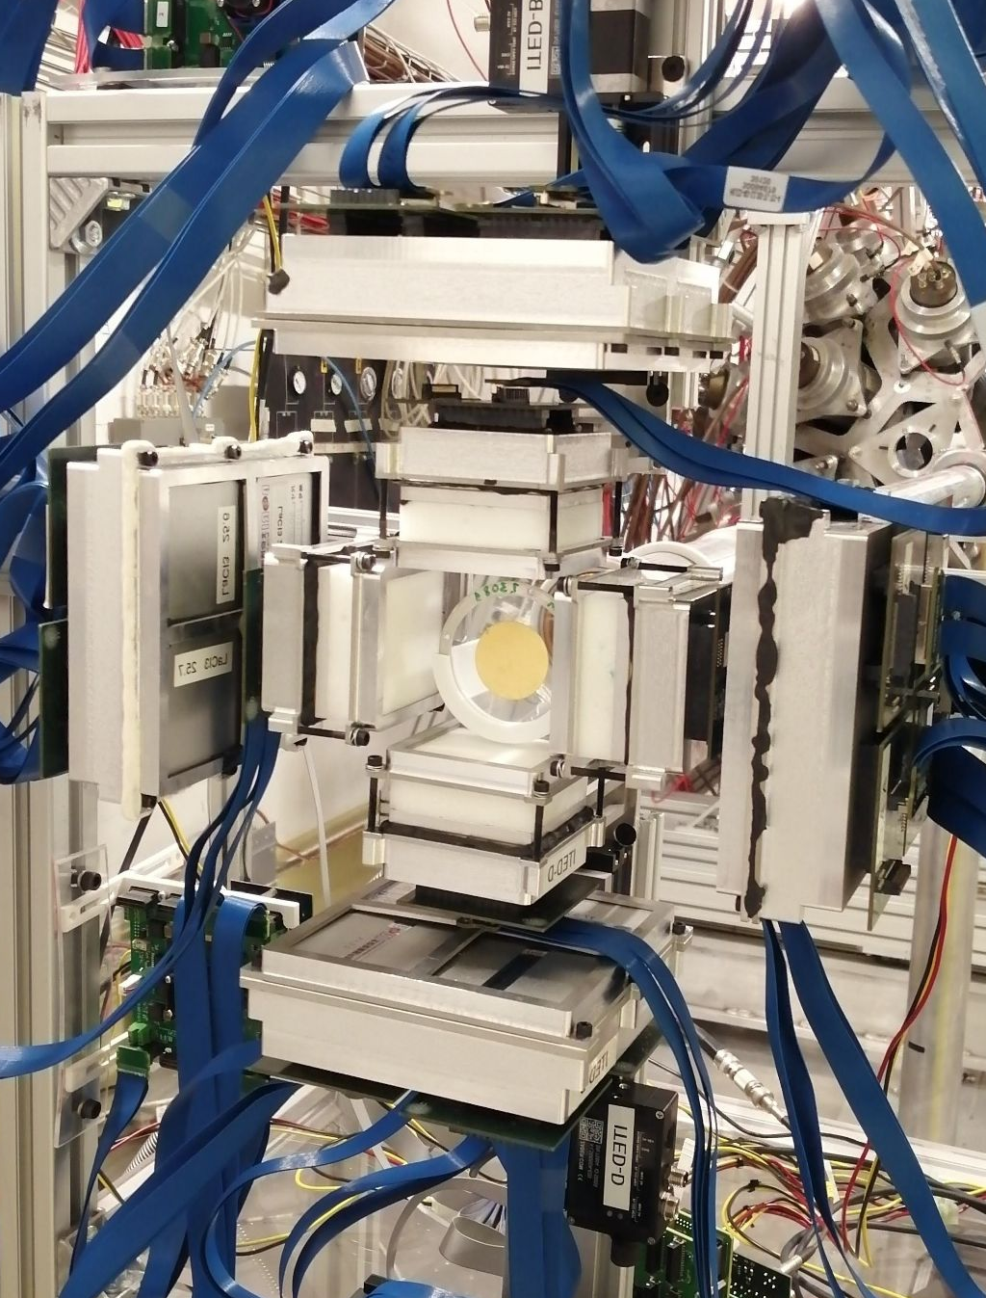
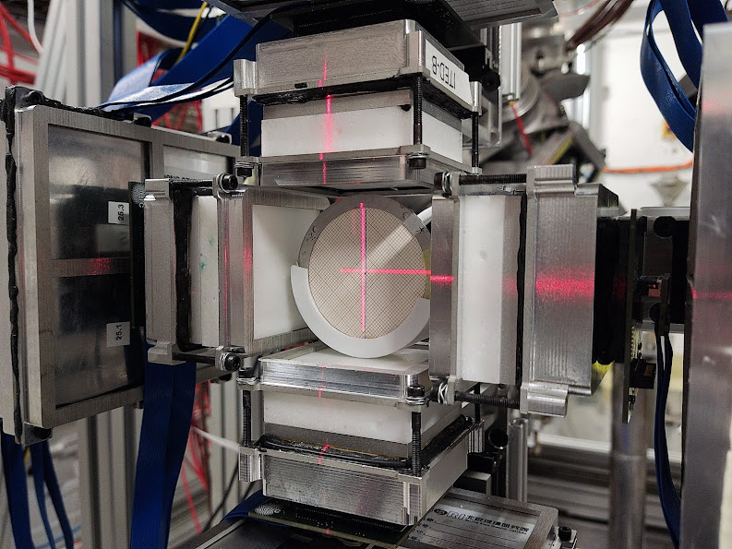
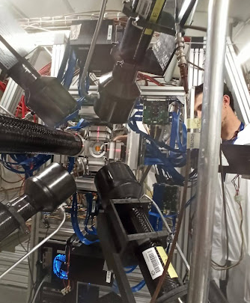
Experimental Area 1 (EAR1)
slides courtesy of Jorge Lerendegui
MAIN SETUP
ANCILLARY SETUP
i-TED detectors @ 5 cm
L-C6D6 detectors @15 cm
L
D
L
E
G
sample holder center shifted: +1.5 mm (timepix)
Based on LaCl₃ crystals
coupled to SiPM’s

Slide 20
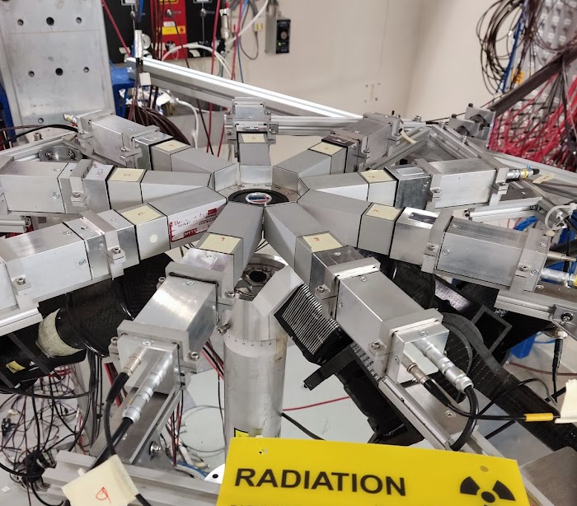
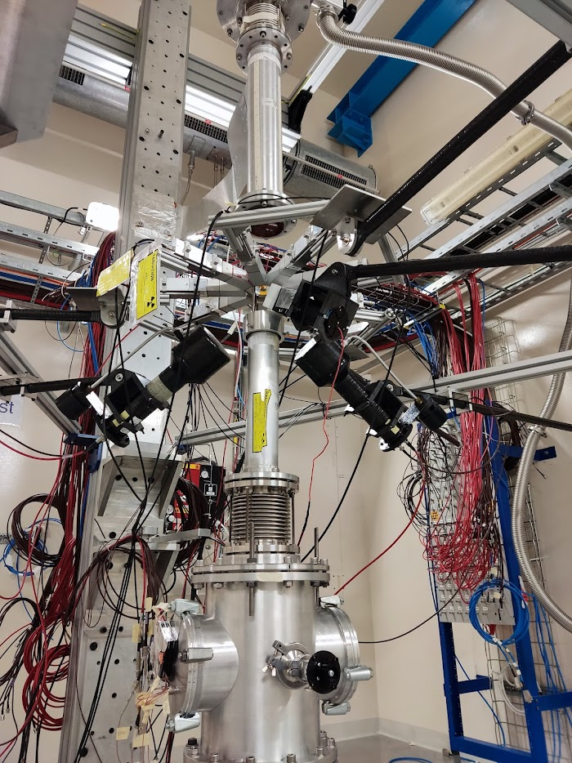
Experimental Area 2 (EAR2)
s-TED ring configuration
to maximize efficiency & S/B
9 s-TED @ 4.5 cm
2 C₆D₆ @ 17 cm
1 LaCl₃ @ 9 cm

Slide 21
EAR1 neutron flux
Transmission correction
to be applied
working material

Slide 22
EAR2 neutron flux
working material

Slide 23
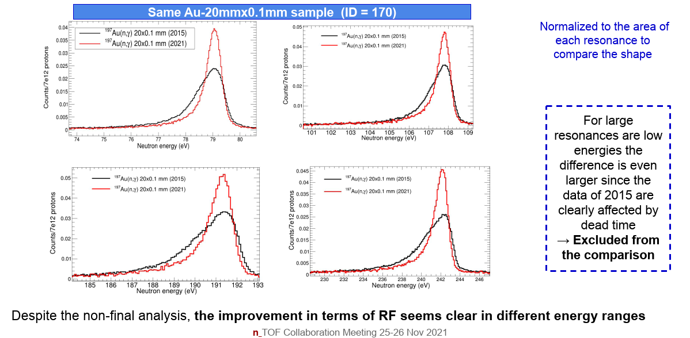
EAR2 energy resolution improved
J. Lerendegui, V. Alcayne, A. Casanovas, F. García, E. Mendoza, E. Musacchio, J.A. Pavón et al. (The n_TOF Collaboration)
working material

Slide 24
What we do at n_TOF
1. Nuclear astrophysics
2. Advanced nuclear technologies
3. Basic nuclear science & applications

Slide 25
What we have done at n_TOF
Radiative capture reactions (n,γ) (89)
Fission reactions (n,f) (37)
EAR2
Light particle emission reactions (n,lcp) (11)
EAR2
²³⁹Pu
Detector developments (6)
EAR2
Imaging
STEFF
²³⁵U
EAR2
²⁴¹Am
²⁴⁶Cm
²⁴⁴Cm
STEFF
²³⁵U
C6D6
²³⁰Th
²⁴¹Am
NEAR
²³⁴U
²³⁶U
²³²Th
²³⁷Np
STEFF
MGAS
EAR1
⁷⁶Ge
⁹⁴Zr
¹⁴⁰Ce
¹⁹⁷Au
⁸⁹Y
FIC0
³³S
²³⁷Np
³⁵Cl
¹⁴N
DDX
HPge
MGAS
MGAS
Si + MGAS
EAR1
HPGe
²⁴⁵Cm
²³³U
²⁴¹Am
²⁴³Am
FIC0
²³⁶U
¹⁶O
²⁴³Am
Si
⁷Be
²⁶Al
⁷Be
DFGIC
MGAS
FIC1
³³S
Si
EAR1
EAR2
²³⁵U
²³⁸U
MGAS
¹⁴⁷Pm
¹⁷¹Tm
²³⁵U
¹²C
²³⁴U
FIC2
²⁴⁰Pu
²⁴²Pu
C6D6
EAR1
RPT
Si
⁷⁹Se
DFGC
TARAT
X17
FIC0
¹⁸⁶Os
¹⁸⁷Os
¹⁸⁸Os
⁹⁰Zr
⁹¹Zr
⁹²Zr
⁹⁴Zr
⁹⁶Zr
²⁴Mg
²⁶Mg
²⁰⁸Pb
¹³⁹La
MGAS
²³⁵U
iTED
²³⁷Np
²³³U
²³⁴U
²⁰⁹Bi
^{nat}Pb
²³²Th
⁵⁹Ni
Si
²³⁵U
²⁴⁴Cm
RPT
²³²Th
²³⁴U
CVD
²³⁸U
EAR1
TAC
²³⁹Pu
²⁴³Am
PPAC
PPAC
TAC
EAR2
²³⁷Np
²³⁷Np
²³⁰Th
TAC
MGAS
⁸⁷Sr
²³²Th
PPAC
PPAC
¹⁵⁴Gd
⁷⁷Se
⁷⁸Se
⁶⁹Ga
⁷¹Ga
⁸⁹Yr
⁸⁸Sr
MGAS
¹⁵¹Sm
²⁰⁴Pb
²⁰⁶Pb
²⁰⁷Pb
²⁰⁹Bi
²³²Th
TAC
¹²C
MGAS
⁷⁹Se
⁹⁴Mo
⁹⁵Mo
⁹⁶Mo
¹⁶⁰Gd
⁵⁰Cr
⁵³Cr
⁷⁹Se
⁹⁴Nb
C6D6
²³⁵U
¹⁴⁷Pm
²⁴²Pu
²⁰⁴Tl
⁷⁶Ge
⁷⁴Ge
⁷⁰Ge
TAC
²³³U
²⁰⁵Tl
³⁵Cl
¹⁴⁰Ce
⁸⁰Se
⁶⁸Zn
sTED
²⁴⁰Pu
²³⁷Np
²⁴³Am
²³³U
TAC
²³⁶U
⁶³Ni
⁶²Ni
⁵⁸Ni
⁵⁷Fe
²³⁸U
²⁵Mg
⁹²Zr
⁹³Zr
C6D6
C6D6
C6D6
EAR1
C6D6
⁷⁹Se
⁹⁴Nb
¹⁶⁰Gd
C6D6
C6D6
¹⁵⁷Gd
¹⁵⁵Gd
⁷²Ge
C6D6
TAC
⁶²Ni
⁵⁶Fe
⁵⁶Fe
²⁴¹Am
¹⁷¹Tm
⁷³Ge
C6D6
C6D6
C6D6
C6D6
C6D6
2001 - 2004
2009 - 2012
2014
2015
2016
2017
2018
2021-…
Phase 1
Phase 2
Phase 3
Phase 4

Slide 26
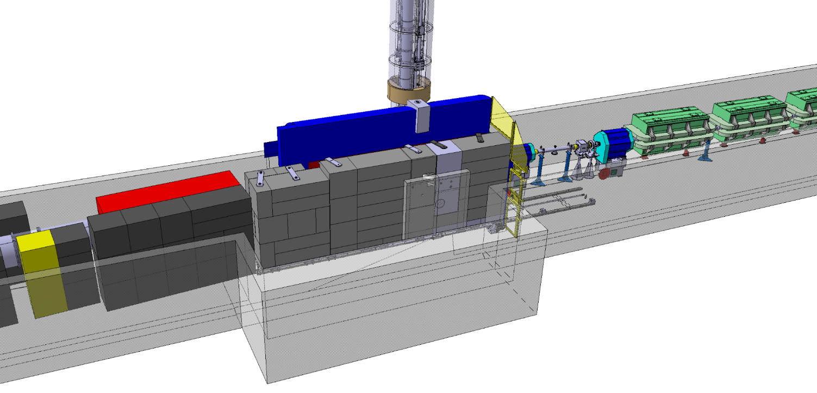
The NEAR Station
during the design studies of the new shielding around the target station the opportunity for a new near-target experimental area appeared
(NEAR station)
NEAR Station area
Measurements for technical and engineering developments
Irradiation of non-metallic materials + SEE (R2M & R2E projects) – up to 1MGy/year, mixed fields
Measurements of MACS by activation for nuclear astrophysics
Fusion-related measurements (cross sections, not irradiation)
Measurements of decay rates of long-lived isotopes

Slide 27
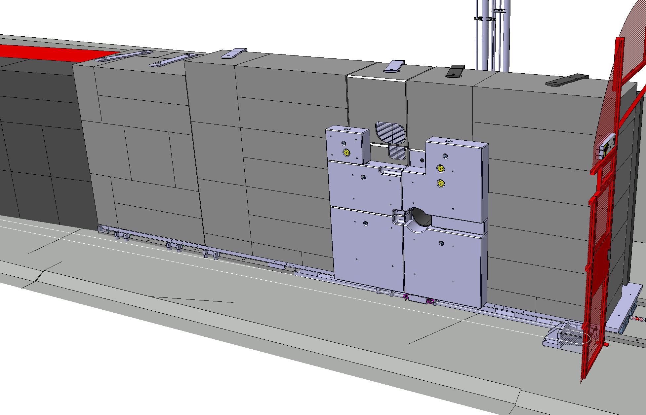
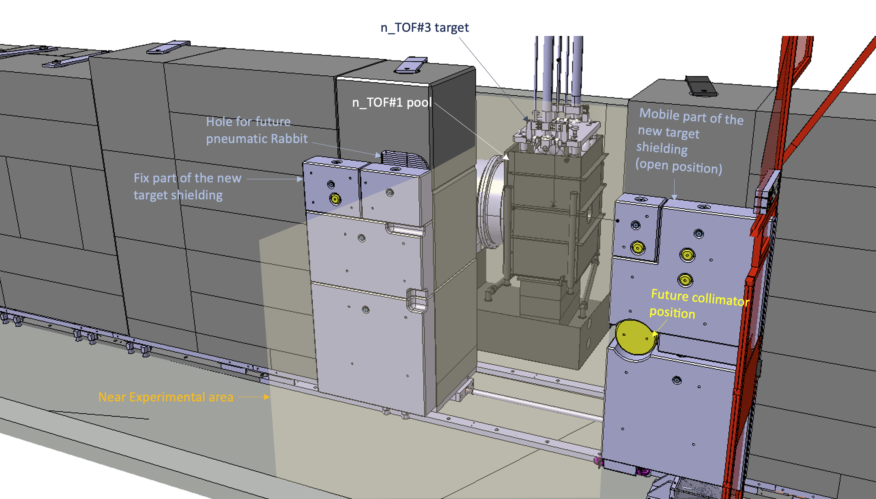
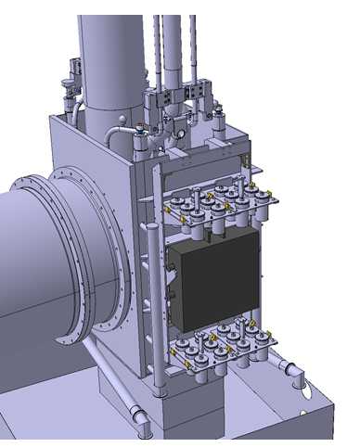
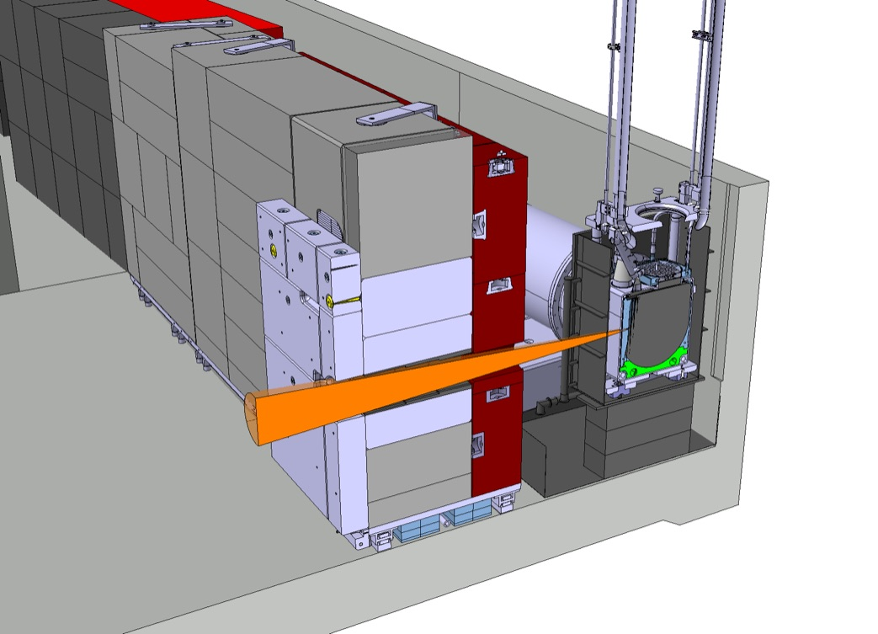
The NEAR Station
Closed configuration
Open configuration

Slide 28
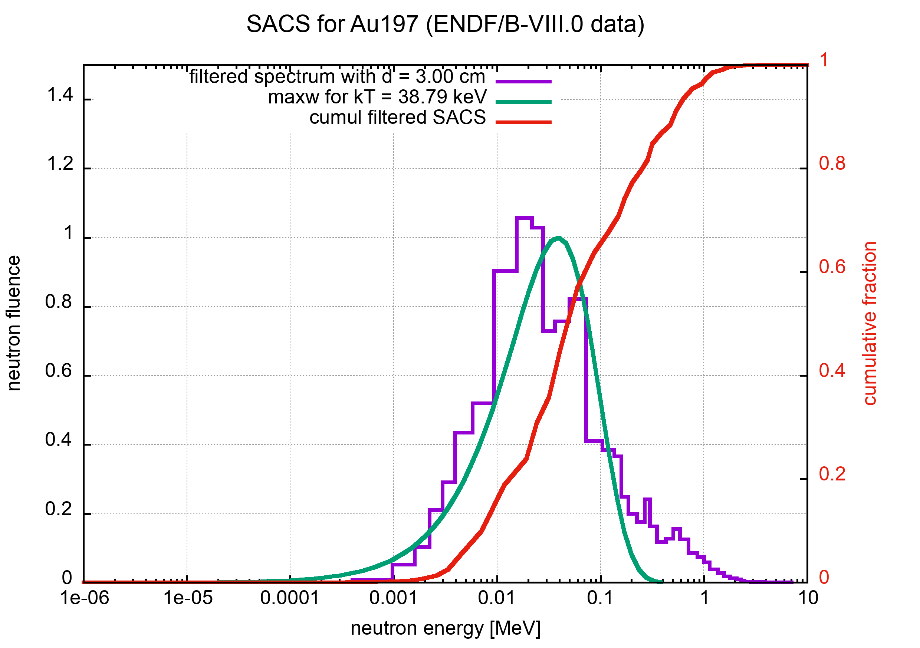
The NEAR Station

Slide 29
The NEAR Station
A sample of Ce-140 of a few mg, imbedded in a Boron Carbide filter case, is placed in position for irradiation at the exit of the neutron beam collimator of the n_TOF NEAR Station
8 June 2022

Slide 30


⁷Be(n,α)⁴He
Silicon detectors insterted directly into the neutron beam
3x3 cm² active area, 140 μm thickness
Two samples with ∼18 GBq activity each (∼1.4 μg of ⁷Be)
Strong rejection of BG events due to tof,
low duty-cycle, coincidence signals for:
det 4
α
protons from the (n,p) channel
γ from ⁷Be activity
n+⁷Li → ⁸Li (β⁻) 840 ms → ⁸Be* → 2α
sample 2
α
det 3
det 2
α
sample 1
α
det 1
neutrons
L. Cosentino et al. (n_TOF Collaboration), NIM A 830 (2016) 197-205

Slide 31
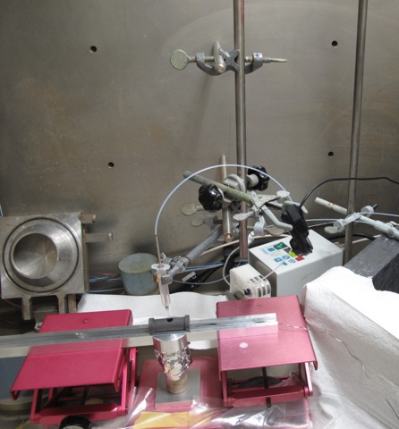
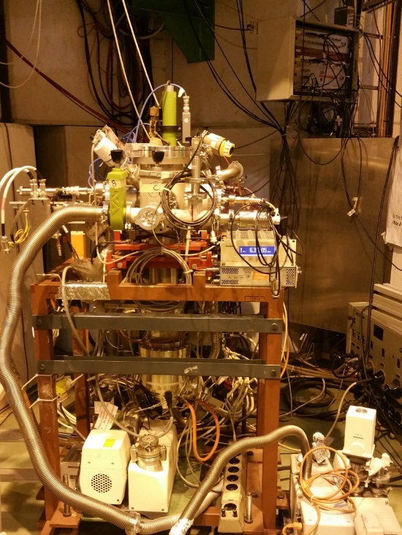
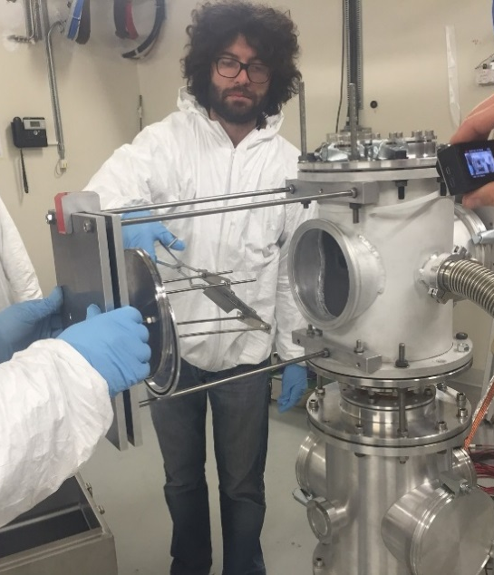



⁷Be(n,p)⁴He
A three-step experiment:
Extraction of 200 GBq from water cooling of SINQ spallation source at PSI
Implantation of the 30 keV (~45 nA) ⁷Be beam on suited backing using ISOLDE-GPS separator and RILIS
Measurement at n_TOF-EAR2 using a silicon telescope (20 and 300 mm, 5x5 cm² strip device)
PSI hot-cell
ISOLDE - GLM
n_TOF EAR2
E. Maugeri et al. (The n_TOF Collaboration), Nucl. Instr. and Meth. A 889 (2018) 138
M. Barbagallo et al. (The n_TOF Collaboration), Nucl. Instr. and Meth. A 887 (2018) 27-3

Slide 32
⁷Be(n,p)⁷Li
Silicon telescope from Lodz University
Detection and identification of protons of 1 and 1.4 MeV
high purity sample, 1 GBq
produced @ ISOLDE
p
E
ΔE
neutrons
E. Maugeri et al. (The n_TOF Collaboration), Nucl. Instr. and Meth. A 889 (2018) 138
M. Barbagallo et al. (The n_TOF Collaboration), Nucl. Instr. and Meth. A 887 (2018) 27-3

Slide 33
⁷Be(n,α)⁴He: implications on CLiP
⁷Li production in standard BBN calculations
remains essentially unchanged
[Li/H] = 4.5
to be compared with
[Li/H] = 4.4
obtained with the ”standard”
reaction rate from Wagoner
[ ] = units of 10⁻¹⁰
M Barbagallo et al. (The n_TOF Collaboration)
Phys. Rev. Lett. 117 (2016) 152701

Slide 34
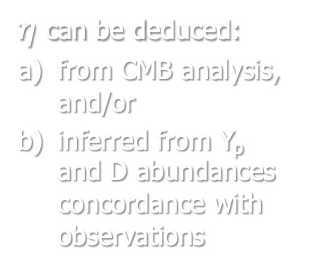


BBN Lithium production
Standard BBN calculations with:
neutron 𝛕_{n}= 880.2 s
3 neutrino species
η = 6.09 x 10⁻¹⁰
$η$ can be deduced:
from CMB analysis, and/or
inferred from Y_{p} and D abundances concordance with observations
a) [$η$] $=$ 6.09 $±$ 0.06
b) 5.8 $≤\text{[}η\text{]}≤$ 6.6 (95% CL)
www.cern.ch/n_TOF

Slide 35
Conclusion
New measurement of the ⁷Be(n,a) and ⁷Be(n,p) reactions
from thermal to keV neutron energies has been performed at n_TOF
high purity samples produced at PSI and ISOLDE
(demonstrating the feasibility of neutron measurements on samples produced at radioactive beam facilities)
The cross sections are higher than previously recognized at low energies
The new estimate of the ⁷Be destruction rate based on the new results
yield a decrease of the predicted cosmological Lithium abundance
insufficient to provide a viable solution to the CLiP
The two n_TOF measurements can finally rule out neutron-induced
reactions, and possibly Nuclear Physics, as a potential explanation of the CLiP, leaving all alternative physics and astronomical scenarios still open
L A Damone et al. (The n_TOF Collaboration)
Phys. Rev. Lett. 121 (2018) 042701
M Barbagallo et al. (The n_TOF Collaboration)
Phys. Rev. Lett. 117 (2016) 152701
www.cern.ch/n_TOF

Slide 36
Solutions for the CLiP come from:
Astrophysiscs
Nuclear Physics
Non-standard Physics

Slide 37
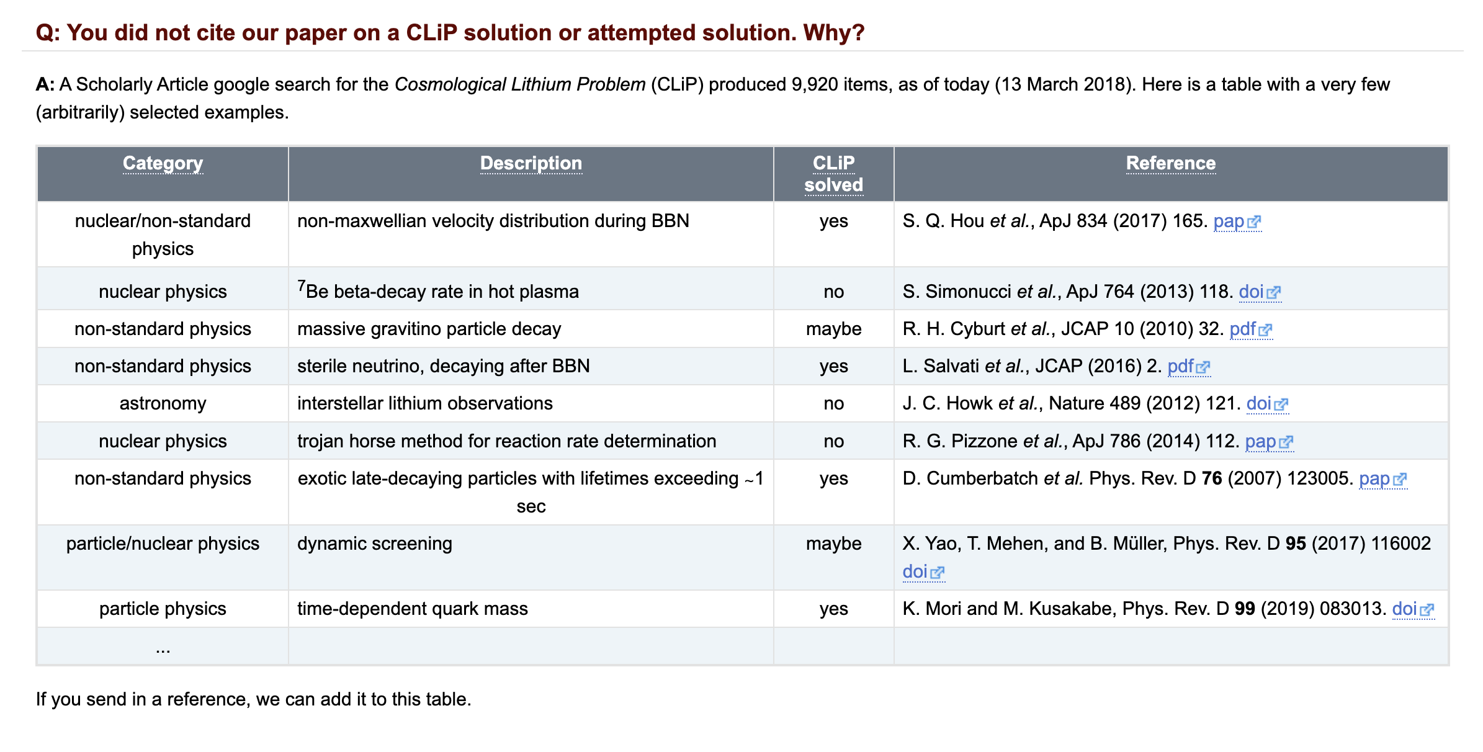
CLiP tentative solutions
https://twiki.cern.ch/twiki/bin/view/NTOFPublic/Be7npPaperDraft

Slide 38
アメ

Slide 39
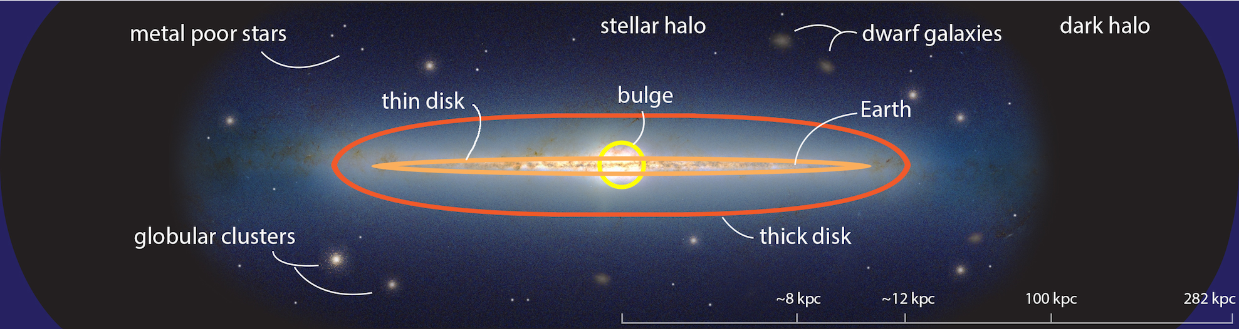
Stellar evolution
The Milky Way (one of the 2000 billion galaxies)
contains 100 - 400 billion stars
1 kpc = 3 x 10¹⁹ m = 3260 light-years
アメ

Slide 40
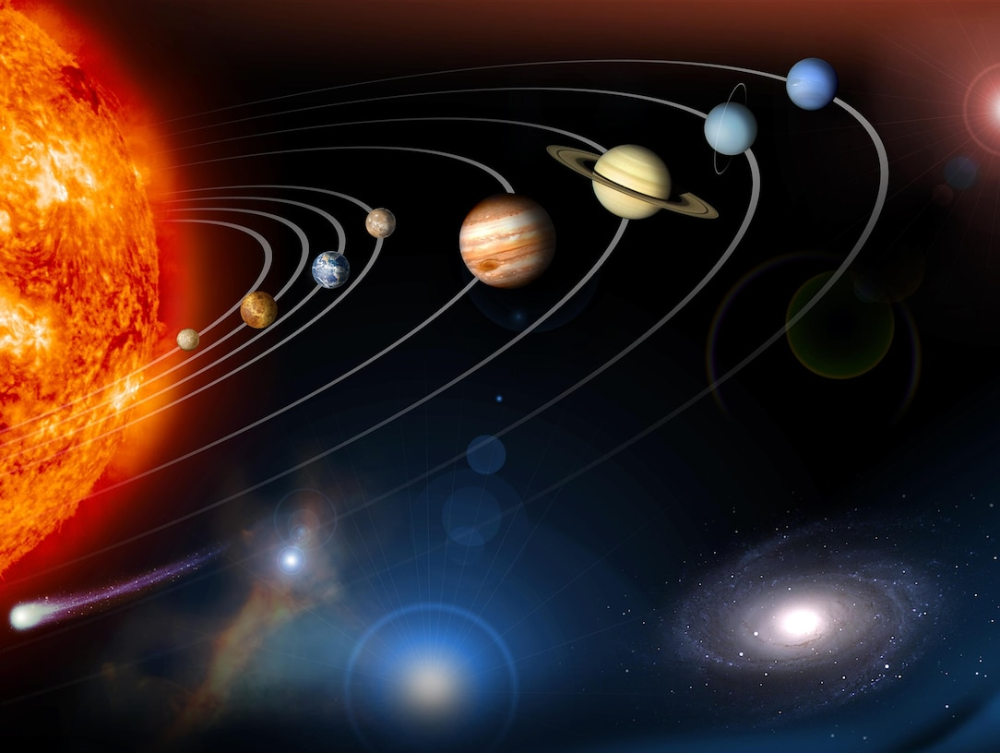
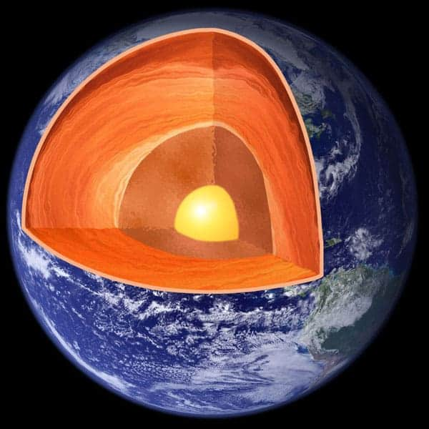

Nuclear
power
Fusion power: 3.8 x 10²⁶ W
(620 Mt/s of H, into 616 Mt/s of He-4)
Natural radioactivity
The heat flows from Earth’s interior into space is about 44 × 10¹² W (TW).
About 20 TW is generated by radioactive decay – 8 TW from the uranium-238 decay chain; 8 TW from the thorium-232 decay chain and the final 4 TW from potassium-40.

Slide 41
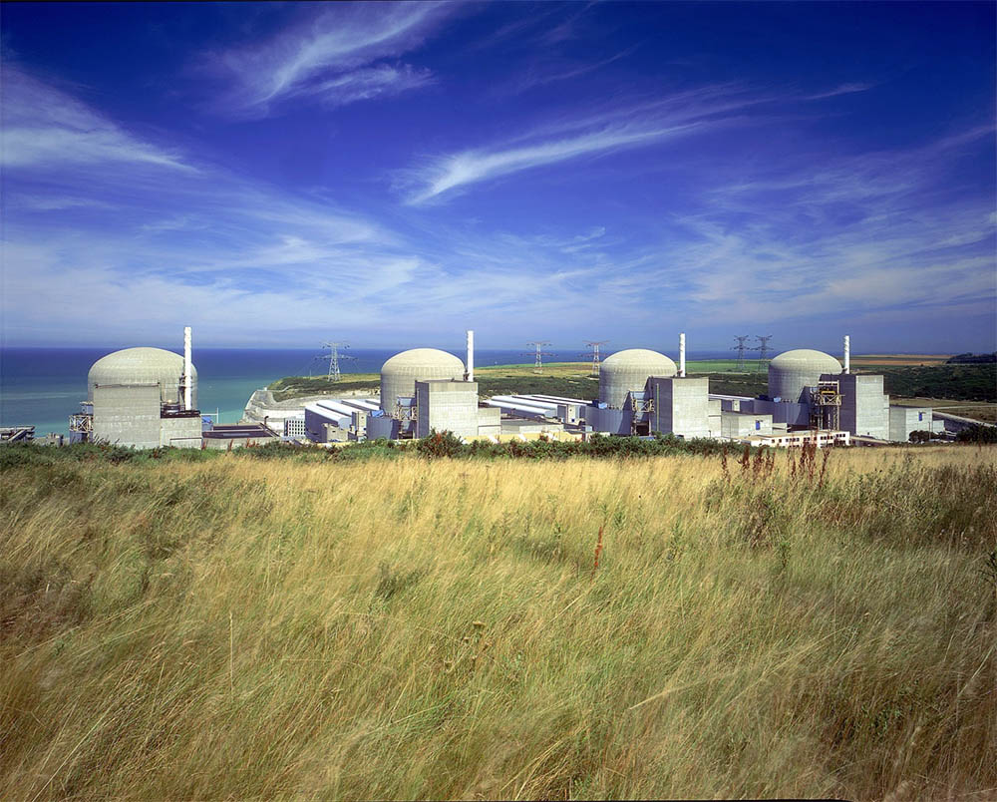
Nuclear
power
Fusion power: 3.8 x 10²⁶ W
(620 Mt/s of H, into 616 Mt/s of He-4)
Fission power: 392 GW, worldwide

Slide 42
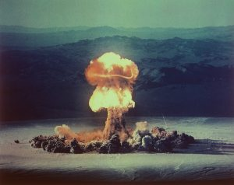
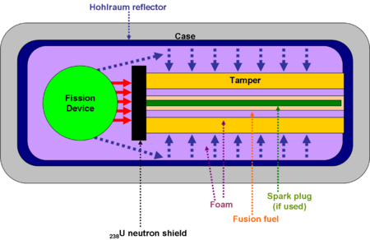
Fission &
Fusion
The power output of a fusion capsule is noteworthy. The largest bomb ever exploded had a yield of 50 Mt, almost all produced by its final fusion stage. Since 50 Mt is 2.1x10¹⁷ joules, the power produced during the burn was around 5.3x10²⁴ watts. This is more than one percent of the entire power output of the Sun (3.8x10²⁶ watts)!!
atomic heritage foundation (Nevada test site)

Slide 43
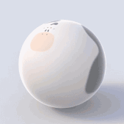
Stellar evolution
A stellar model may be as complex as you want: rotation, magnetic fields, dynamical and secular instabilities of various nature, …
However, most of our knowledge concerning stellar evolution is based on relatively simple models: Self-gravitating, spherical symmetric stars in thermal and hydrostatic equilibrium.
spherical cow (from Wikipedia)

Slide 44
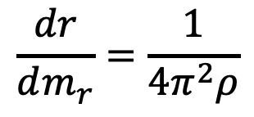
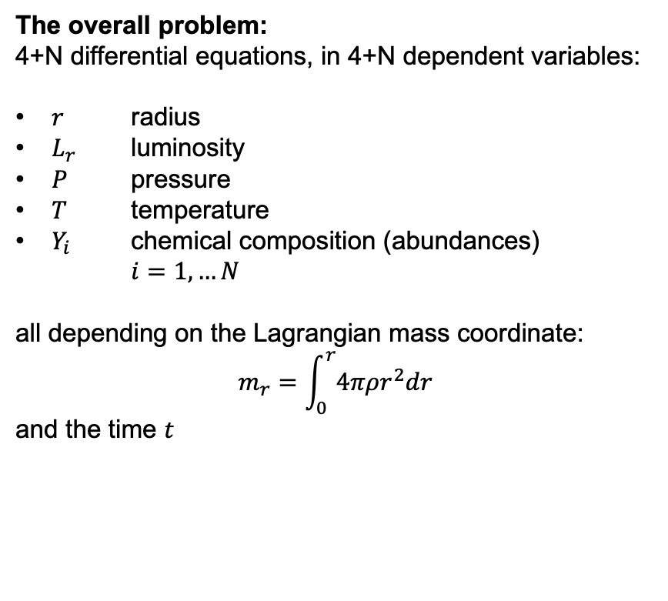
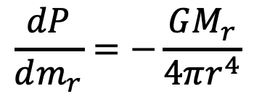
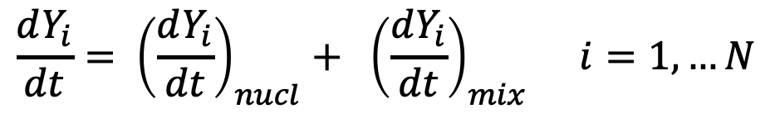
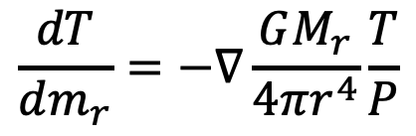
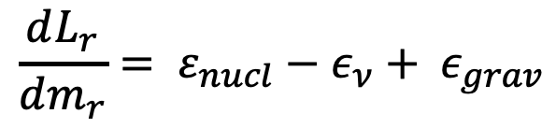
Stellar evolution
$$\frac{dP}{dm_{r}}=−\frac{GM_{r}}{4πr^{4}}$$
The overall problem:
4+N differential equations, in 4+N dependent variables:
$r$ radius
$L_{r}$ luminosity
$P$ pressure
$T$ temperature
$Y_{i}$ chemical composition (abundances)
$i=1, …N$
all depending on the Lagrangian mass coordinate:
$$m_{r}=\int_{0}^{r}{4πρr^{2}dr}$$
and the time $t$
Hydrostatic equilibrium
$$\frac{dr}{dm_{r}}=\frac{1}{4π^{2}ρ}$$
Mass conservation
$$\frac{dL_{r}}{dm_{r}}= ε_{nucl}−ε_{ν}+ ε_{grav}$$
Energy conservation
$$\frac{dT}{dm_{r}}=−∇\frac{GM_{r}}{4πr^{4}}\frac{T}{P}$$
Energy transport
$$\frac{dY_{i}}{dt}= {\left(\frac{dY_{i}}{dt}\right)}_{nucl}+ {\left(\frac{dY_{i}}{dt}\right)}_{mix} i=1, …N$$
Appropriate boundary conditions needed
Spatial & temporal resolution:
1 stellar model contains about 1000 mesh points:
m_{r}.=0 to M
1 evolutionary track contains up to 10⁶ stellar models:
from t = 0 to 13 Gyr or collapse
Nuclear reactions + (turbulent) convection
from Oscar Straniero, CERN n_TOF Winter School, January 2024

Slide 45
Stellar evolution
A star evolves because:
Energy loss, as due to photons and neutrinos emissions
Chemical composition changes, as due to the concurrent action of nuclear burning and mixing

Slide 46






Stellar evolution
Energy loss:
$$\frac{dL_{r}}{dm_{r}}$$
$ε_{γ}$ :
$ε_{ν}$ : Compton + plasmon + bremsstrahlung + pair >>
Energy sources :
$$−T\frac{dS}{dt}=−\frac{dE}{dt}+ \frac{P}{ρ^{2}} − \sum_{i}{μ_{i}\frac{dN_{i}}{dt}}$$
$ε_{grav}$ :
$$\sum_{k}{Y_{i}Y_{j}ρN_{A}{\left\langle σv\right\rangle }_{k}Q_{k}},{ N}_{j}=ρN_{A}Y_{j}$$
$ε_{nucl}$ :

Slide 47


Life of stars
Evolutionary stages of a 25 M☉ star

Slide 48
Life of stars

Slide 49
Herzsprung-Russel
diagram

Slide 50
Stellar nucleosynthesis >>
アメ

Slide 51
The End
アメ

