Slide 1
Modeling nuclear processes for stellar evolution and nucleosynthesis
Introducing the Universe
Big bang nucleosynthesis, CLiP - ⁷Be(n,a) and ⁷Be(n,p) at CERN/n_TOF
Stellar nucleosynthesis
B²FH processes, focus on the s-process
Ages and Old clocks
Nuclear cosmochronometers: neutron cross sections and the Re/Os clock
Alberto Mengoni
ENEA and INFN, Bologna, Italy
XXI LNF Spring School “Bruno Touschek” in Nuclear, Subnuclear and Astroparticle Physics, Frascati, 13-17 May 2024
alberto.mengoni@cern.ch

Slide 2
Introducing the Universe
Our universe is formed
of matter and radiation
Both come in quantized forms
(particles and photons)
アメ

Slide 3
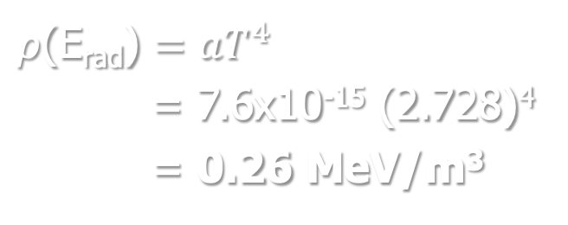
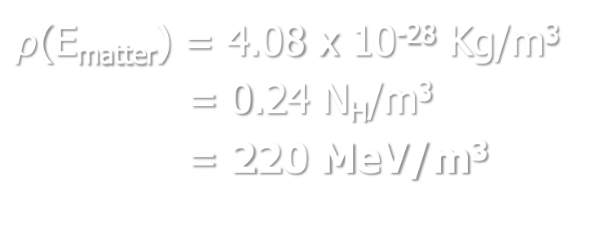
Introducing the Universe
We live (now) in a universe of matter
𝜌(E_{matter}) >> 𝜌(E_{rad})
$ρ$(E_{matter}) = 4.08 x 10⁻²⁸ Kg/m³
= 0.24 N_{H}/m³
= 220 MeV/m³
$ρ$(E_{rad}) $=aT^{4}$
= 7.6x10⁻¹⁵ (2.728)⁴
= 0.26 MeV/m³
アメ
Notes:
a: is the radiation constant, related to the Stefan-Boltzmann constant a = 4sig/c
CMB radiation temperature T=2.728 Kelvin
Matter energy density is from CMB radiation measurements

Slide 4
Introducing the Universe
Atomic nuclei exist in the universe
Radioactivity and nuclear reactions show that nuclei are NOT immutable
objects but that they have been formed somewhere, sometime
アメ

Slide 5
Introducing the Universe
The matter in the universe is essentially in the form of
Hydrogen and Helium
with a tiny addition of “metals”
アメ

Slide 6
Introducing the Universe
⁴He Y_{p} = 0.245 ± 0.004 | not measurable in stars, emission lines from gaseous nebulae in dwarf galaxies, with very low metallicity
²H D/H = (2.53 ± 0.04) × 10⁻⁵ | from quasar absorption lines (nearly unprocessed gas)
³He | Difficult to measure in unevolved objects + uncertain chemical evolution less useful as an observational test
⁷Li ⁷Li/H=(1.6 ± 0.3) × 10⁻¹⁰ | from metal-poor stars in the Galactic halo constant Li/H as function of metal content interpreted as primordial
アメ

Slide 7
Introducing the Universe
The distribution of the abundance of the elements show common patterns for the stars of our galaxy
アメ

Slide 8
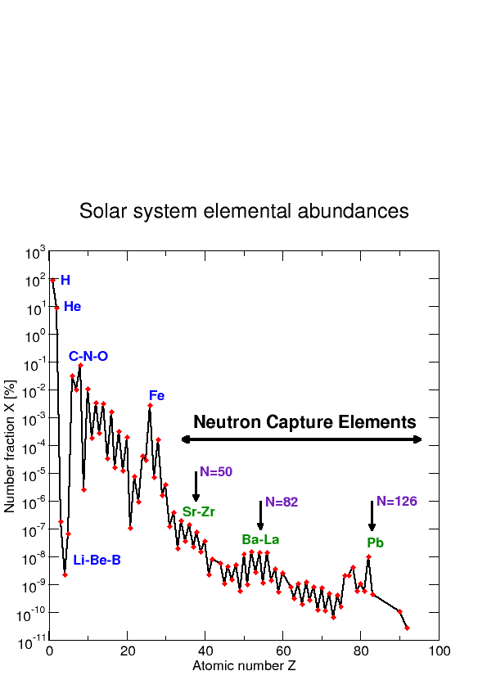
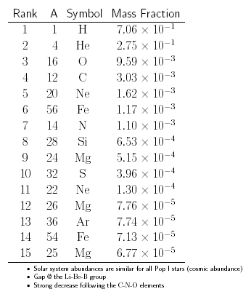
Introducing the Universe
Solar spectrum
Meteorites
98.1%
Earth crust & sea
アメ
alberto.mengoni@cern.ch

Slide 9
Introducing the Universe
Our universe is formed of matter and radiation
Both of them come in quantized forms (particles and photons)
We live (now) in a universe of matter
𝜌(E_{matter}) >> 𝜌(E_{rad})
Atomic nuclei exist in the universe
Radioactivity and nuclear reactions show that nuclei are NOT immutable
objects but that they have been formed somewhere, sometime
The matter in the universe is essentially in the form of Hydrogen and Helium
with a tiny addition of “metals”
The distribution of the abundance of the elements show common patterns
for the stars of our galaxy
アメ
Source: for example C.E. Rolfs and W.S. Rodney, "Cauldrons in the Cosmos”
The University of Chicago Press (1988)

Slide 10
Introducing the Universe
Our universe is formed of matter and radiation
Both of them come in quantized forms (particles and photons)
We live (now) in a 𝚲 dominated universe
Atomic nuclei exist in the universe
Radioactivity and nuclear reactions show that nuclei are NOT immutable
objects but that they have been formed somewhere, sometime
The matter in the universe is essentially in the form of Hydrogen and Helium
with a tiny addition of “metals”
The distribution of the abundance of the elements show common patterns
for the stars of our galaxy
アメ

Slide 11
Time evolution
BANG!
~9 Gyr
4.5 Gyr
Now
(& Here)
Galaxy & star
Formation
(~0.1 Gyr after BB)
Solar-system formation
アメ

Slide 12
Matter evolution
Mixing
(abundance distribution)
gas
gas & dust
condensation
ejection, explosion
Nuclear reactions:
energy generation
nucleosynthesis

Slide 13
Matter evolution
Mixing
(abundance distribution)
gas & dust
condensation
ejection, explosion
Nuclear reactions:
energy generation
nucleosynthesis

Slide 14
Time & space evolution

Slide 15
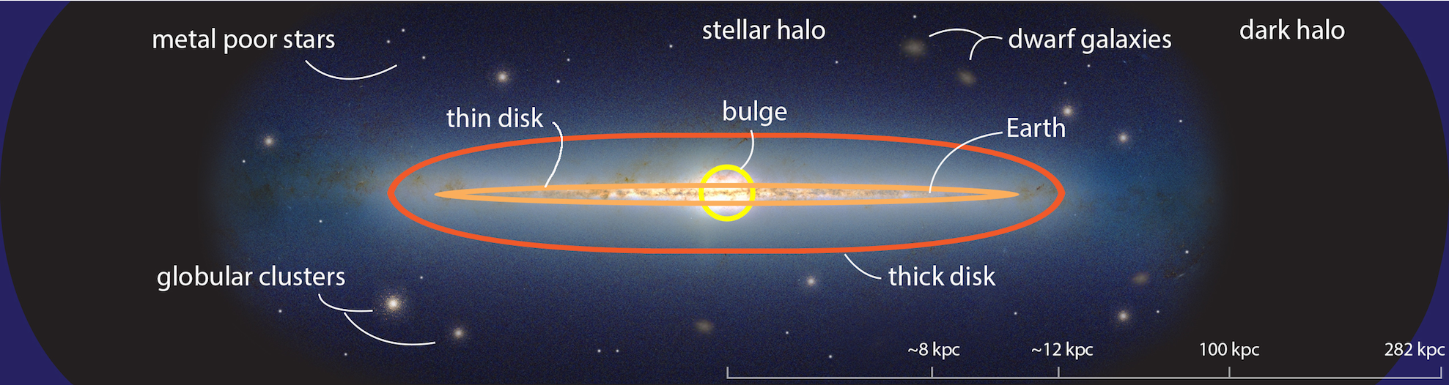
Our neighborhood
The Milky Way (one of the 2000 billion galaxies)
contains 100 - 400 billion stars
1 kpc = 3 x 10¹⁹ m = 3260 light-years
アメ

Slide 16
Time evolution
BANG!
~9 Gyr
4.5 Gyr
Now
(& Here)
Galaxy & star
Formation
(~0.1 Gyr after BB)
Solar-system formation
アメ

Slide 17
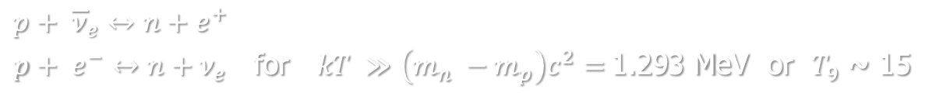

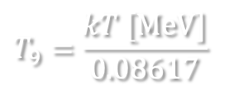

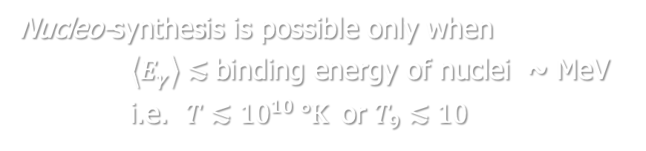



Thermal equilibrium
Thermal equilibrium between particles and antiparticles in a photon bath
$$x+ \overline{x}↔2γ$$
as long as
$$\left\langle E_{γ}\right\rangle \sim kT≫m_{x}c^{2}$$
i.e.
$$p+ \overline{p}↔2γ$$
when
$kT\sim {10}^{3}$ MeV $\sim {10}^{13} °K$
Thermal equilibrium between proton and neutron through weak interaction
$$p+ {\overline{ν}}_{e}↔n+e^{+}$$
$p+ e^{−}↔n+ν_{e}$ for $kT ≫\left(m_{n} −m_{p}\right)c^{2}=$1.293 MeV or $T_{9}$ ~ 15
Nucleo-synthesis is possible only when
$\left\langle E_{γ}\right\rangle ≲$binding energy of nuclei ~ MeV
i.e. $T≲{10}^{10} °K$or $T_{9}≲10$
$$T_{9}=\frac{kT [MeV]}{0.08617}$$
or
$$T_{6}=11.60 kT [keV]$$
アメ

Slide 18

Big bang nucleosynthesis
< 1 sec strongly radiation-dominated homogenous universe
$p+e^{−}⇌{n+ν}_{e}$
$n+e^{+} ⇌p+ {\overline{ν}}_{e}. n/p= e^{−Q/kT}=$ $e^{−1.293/kT}$
freeze-out weak interation at kT ~ 0.7 MeV or T₉ ~ 8
$n/p= e^{−1.293/0.7}= 1/6→1/7$
アメ

Slide 19
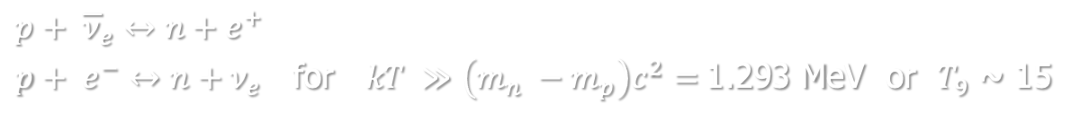
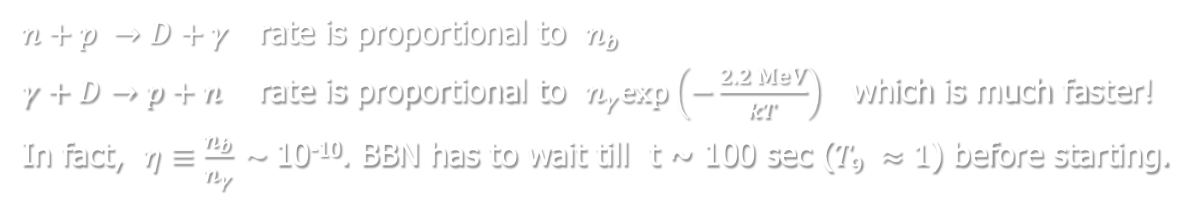
D bottleneck in BBN
Thermal equilibrium between protons and neutrons through weak interaction
$$p+ {\overline{ν}}_{e}↔n+e^{+}$$
$p+ e^{−}↔n+ν_{e}$ for $kT ≫\left(m_{n} −m_{p}\right)c^{2}=$1.293 MeV or $T_{9}$ ~ 15
For $T_{9}\sim$ 15 or lower, $n+p →D+γ$ is possible (it is below $E_{D}$ = 2.2 MeV)
However,
$n+p →D+γ$ rate is proportional to $n_{b}$
$γ+D→p+n$ rate is proportional to $n_{γ}exp\left(−\frac{2.2 MeV}{kT}\right)$ which is much faster!
In fact, $η≡\frac{n_{b}}{n_{γ}} \sim$10⁻¹⁰. BBN has to wait till t ~ 100 sec ($T_{9} ≈1$) before starting.

Slide 20

Big bang nucleosynthesis
< 1 sec strongly radiation-dominated homogenous universe
$p+e^{−}⇌{n+ν}_{e}$
$n+e^{+} ⇌p+ {\overline{ν}}_{e}. n/p= e^{−Q/kT}=$ $e^{−1.293/kT}$
freeze-out weak interation at kT ~ 0.7 MeV or T₉ ~ 8
$n/p= e^{−1.293/0.7}= 1/6→1/7$
~ 100 sec to ~ 20 min: BBN
kT = 100 keV to 1 keV or T₉ = 1 to 0.01
$Y_{p}=\frac{2(n/p)}{1+(n/{p)}}≅0.25$
アメ

Slide 21
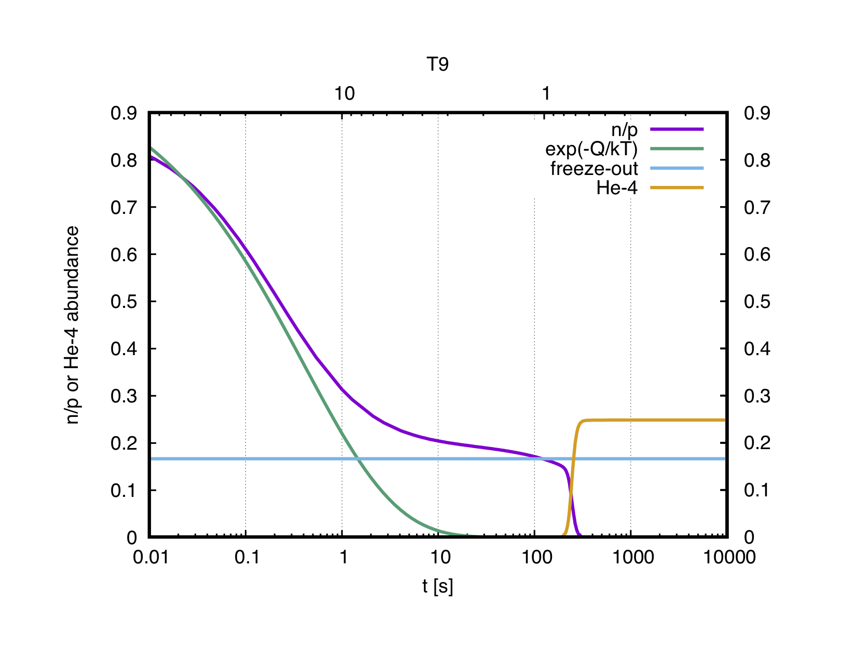

Big bang nucleosynthesis
$$p+e^{−}⇌{n+ν}_{e}$$
$$n+e^{+} ⇌p+ {\overline{ν}}_{e}$$
$e^{−1.293/kT}$
thermal equilibrium
freeze-out
アメ

Slide 22
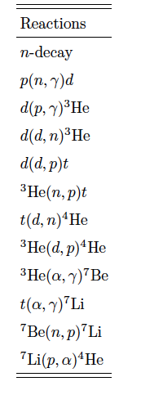
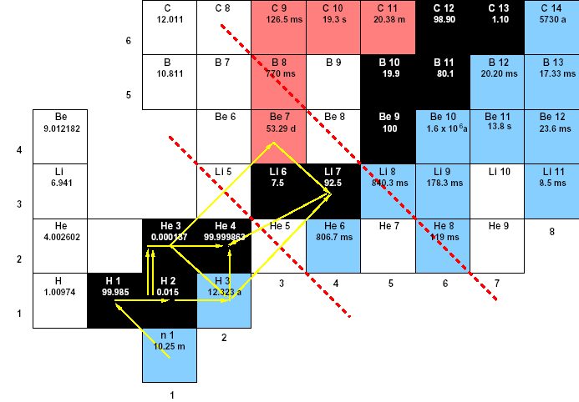
⁴He and ²H concordance
✔️
Yp = 0.245 ± 0.004 (calc.) Yp = 0.246
✔️
D/H = (2.53 ± 0.04) x 10⁻⁵ (calc.) D/H = 2.43 x 10⁻⁵
アメ
Notes:
Yp measured in dwarf galaxies (poor in O and N). ionized He get back one e- a emitting characteristic line (HII line).
There exists a correlation between O content in the dwarf galaxy and Yp. Extrapolation to zero Oxygen provides Yp.
D/H measured by observing absorption lines of distant quasars.
D is quickly destroyed in stars by D + p --> He3 + g

Slide 23
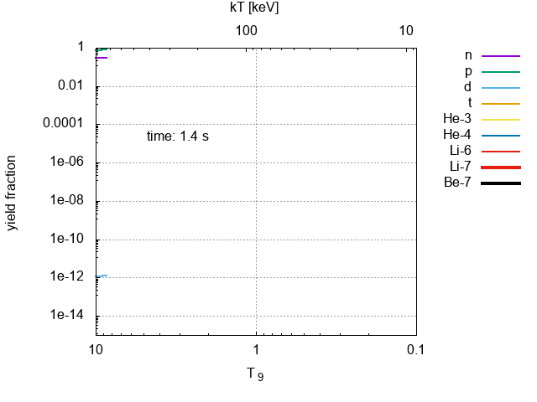
Big bang nucleosynthesis
アメ

Slide 24










Reaction rates
definition:
$$N_{x} , N_{y}$$
number density of particles, i.e. particles/cm³
$$v$$
relative velocity
$$σ(v)$$
cross section
$${r_{xy}=N}_{x} N_{y} v σ(v)$$
$$\left[r\right]$$
number of reactions/cm³/s
in stellar gas: Maxwell-Boltzmann distribution of relative velocities
$$Φ\left(v\right)=4πv^{2}{\left(\frac{μ}{2πkT}\right)}^{3/2}exp\left(−\frac{μv^{2}}{2kT}\right)$$
with
$$μ=\frac{m_{x}m_{y}}{m_{x}+m_{y}}$$
$$E=\frac{1}{2}μv^{2}$$
$$\left\langle r\right\rangle =N_{x}N_{y}\left\langle σv\right\rangle =N_{x}N_{y}{\left(\frac{8}{πμ}\right)}^{1/2}\frac{1}{{\left(kT\right)}^{3/2}}\int{Eσ\left(E\right)exp\left(−\frac{E}{kT}\right)dE}$$
it is common practice to use the quantity:
$$N_{A}\left\langle σv\right\rangle$$
[cm³/mole/s]
アメ

Slide 25
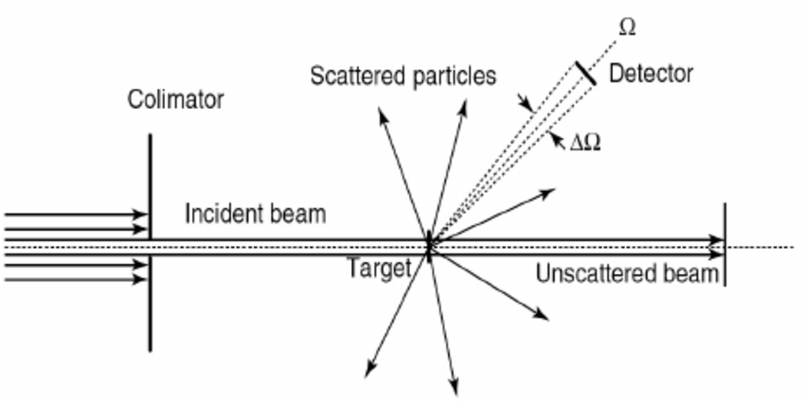




Cross section
$Φ$: flux of incident particles N/L²/T
$C′:$ rate of events, [$C′]=$N/T
cross section: $σ_{R}≡\frac{C^{′}}{Φ}$
$[σ_{R}$] = L²
example: barn (“b”) = 10⁻²⁴ cm²
アメ

Slide 26



Radioactive decays
The variation of the number of nuclei N(t) (due to radioactive decay), is proportional (through $λ$)
to the number of nuclei and the the time interval $∆t$:
$$∆N=−λ∙N(t)∙∆t$$
$$\frac{∆N(t)}{∆t}→\frac{dN(t)}{dt}=−λ∙N(t)$$
$$N\left(t\right)=N_{0}∙e^{−λt}$$
アメ

Slide 27
Reaction rates
アメ

Slide 28
Reaction rates
アメ

Slide 29
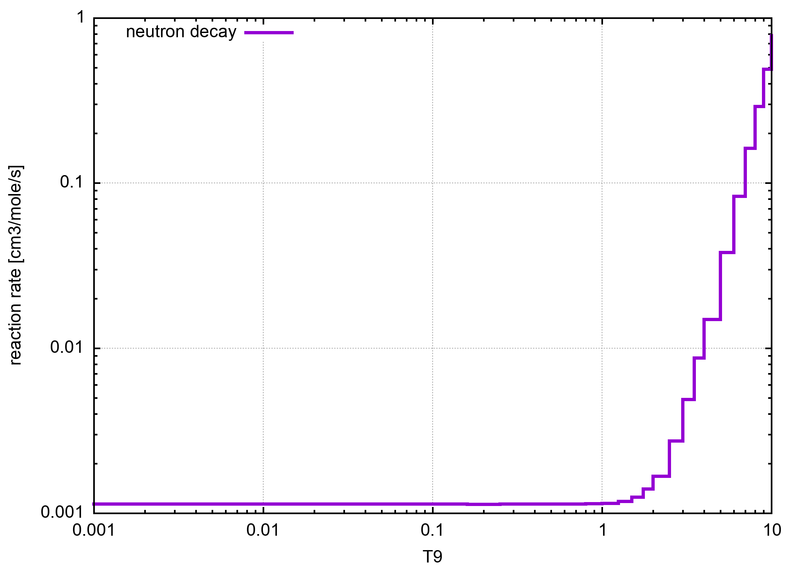


Reaction rates
$$τ=(880 ±1) s$$
$λ=1/τ s$⁻¹
アメ

Slide 30


Reaction rates
$$N_{A}\left\langle σv\right\rangle$$
with
$$σ∝ 1/v$$
アメ

Slide 31





Reaction rates
$$σ\left(E\right)= \frac{S\left(E\right){ e}^{−2πζ}}{E}$$
with the Sommerfield parameter:
$$ζ\left(E\right)= Z_{1}Z_{2}α{\left(\frac{μc^{2}}{2E}\right)}^{1/2}= \frac{1}{2π}{\left(\frac{E_{G}}{E}\right)}^{1/2}$$
and the Gamow energy:
$$E_{G}=2π^{2}Z_{1}^{2}Z_{2}^{2}α^{2}μc^{2}$$
$$E_{0}= E_{G}^{1/3}{\left(\frac{kT}{2}\right)}^{2/3}$$
$$∆E_{0}=\frac{4}{\sqrt{3}}{\left(\frac{E_{0}}{kT}\right)}^{1/2}$$
アメ

Slide 32
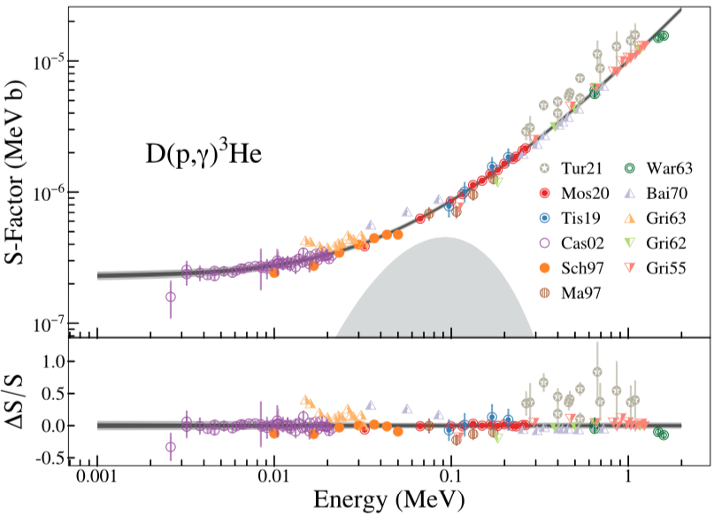
Reaction rates
アメ

Slide 33
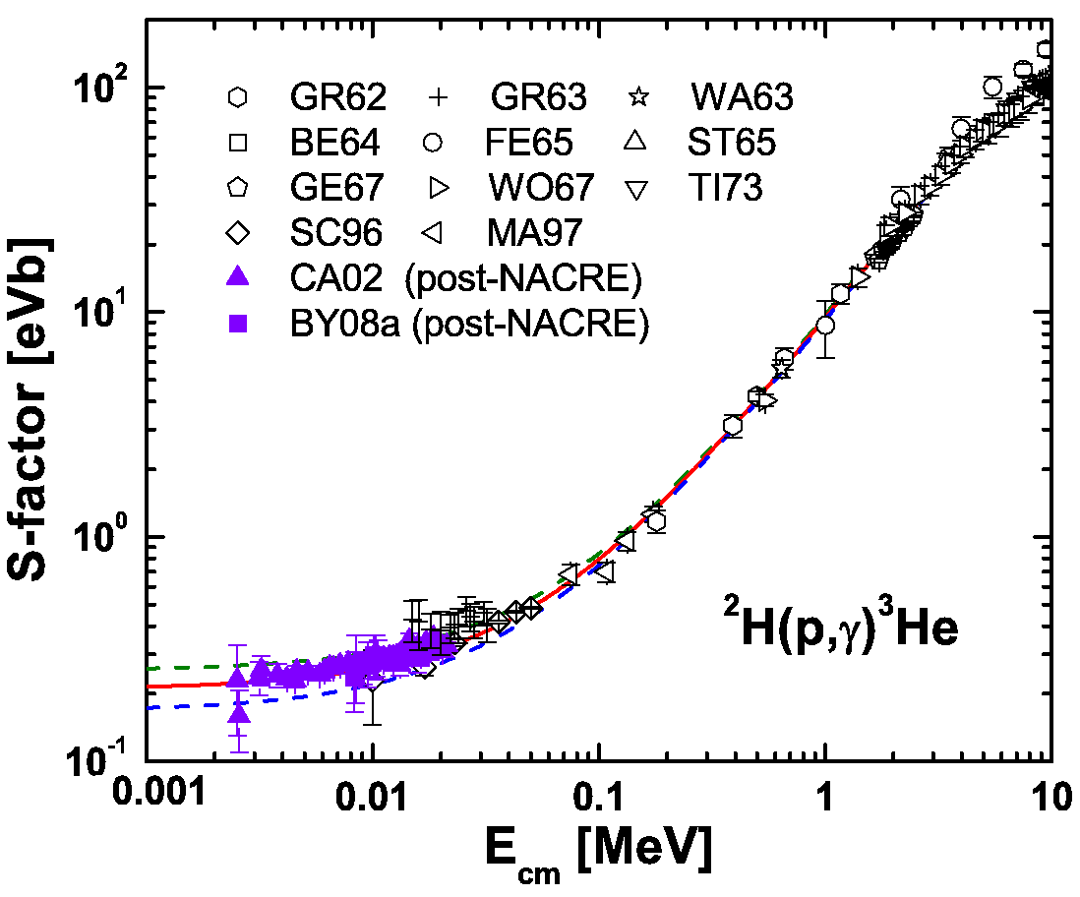
Reaction rates
アメ

Slide 34
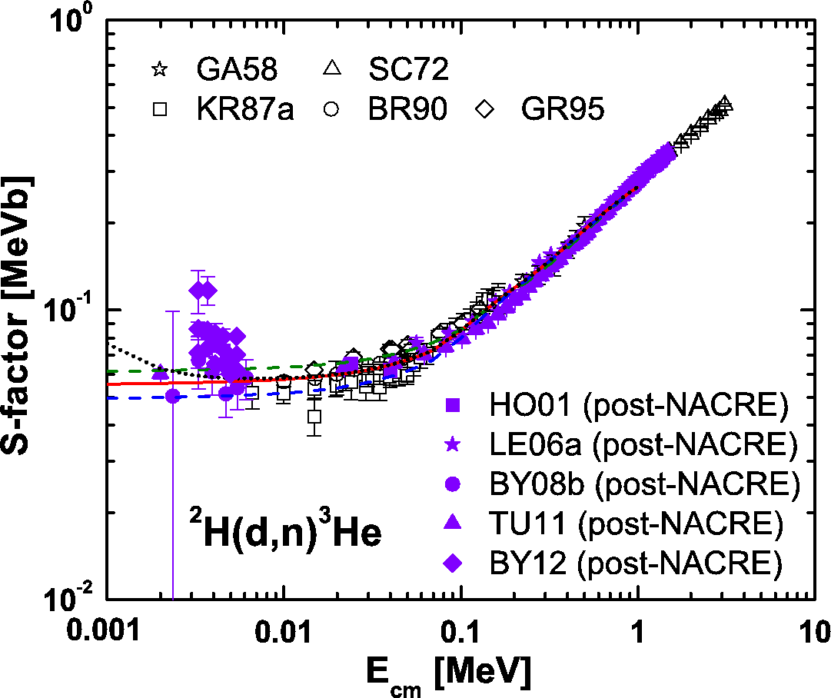
Reaction rates
アメ

Slide 35
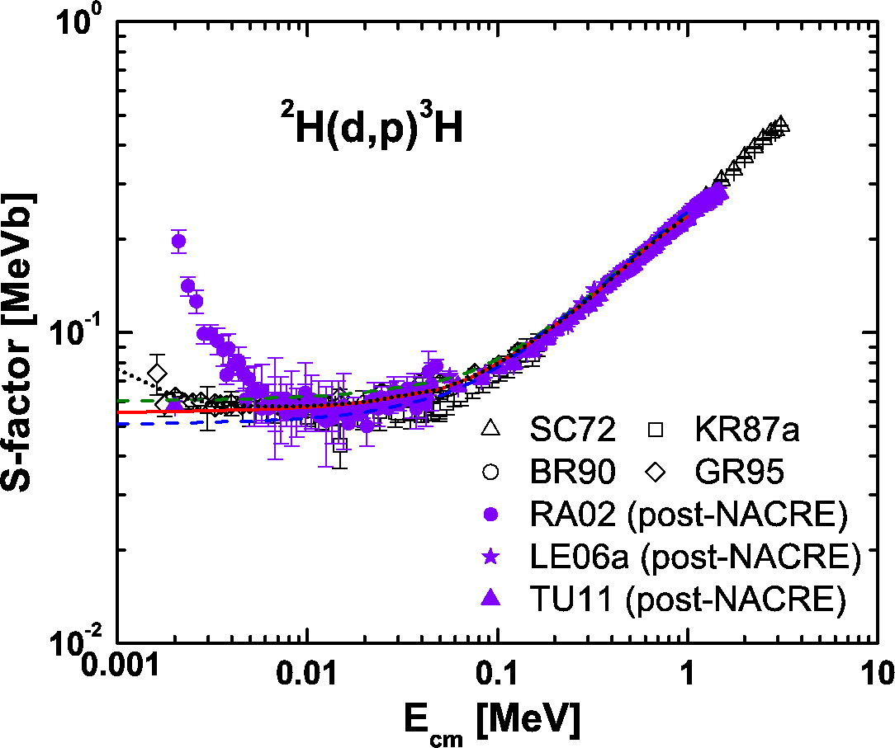
Reaction rates
アメ

Slide 36
Reaction rates
³He(n,p)³H
アメ

Slide 37
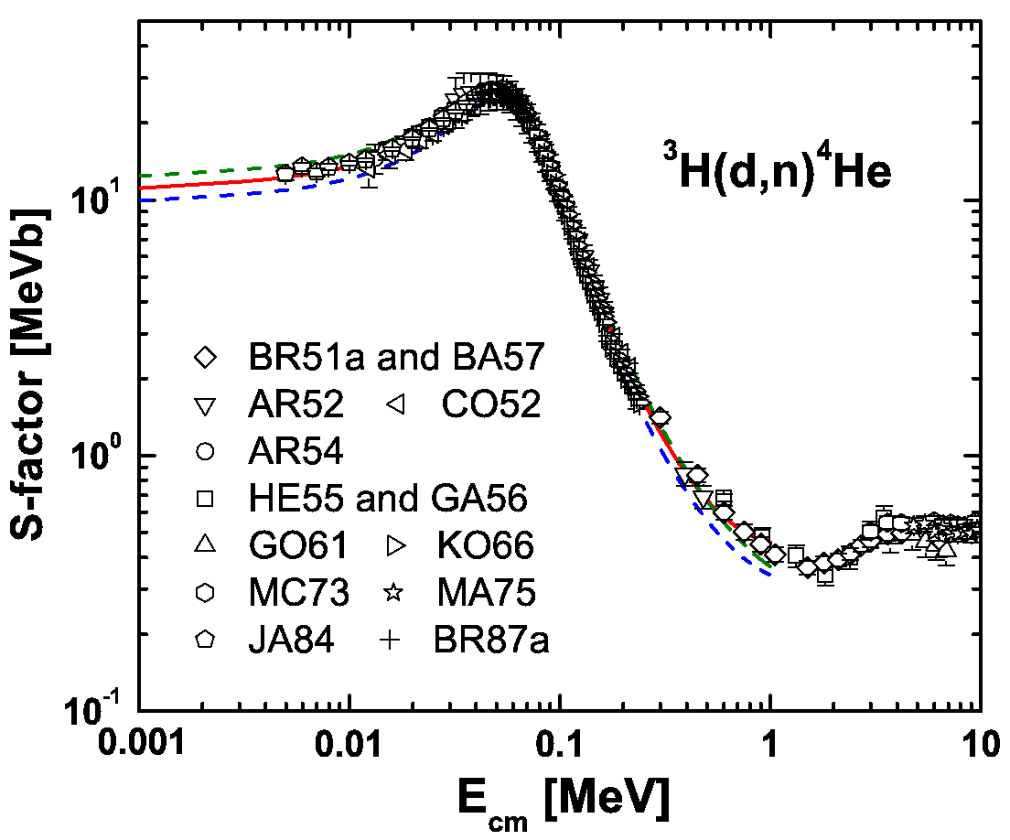
Reaction rates
アメ

Slide 38
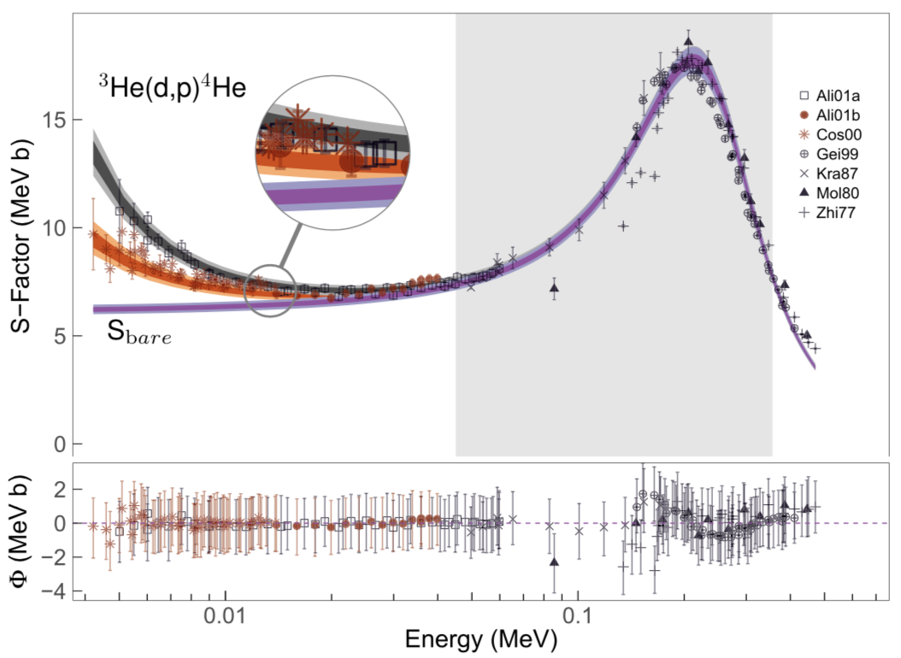
Reaction rates
アメ

Slide 39
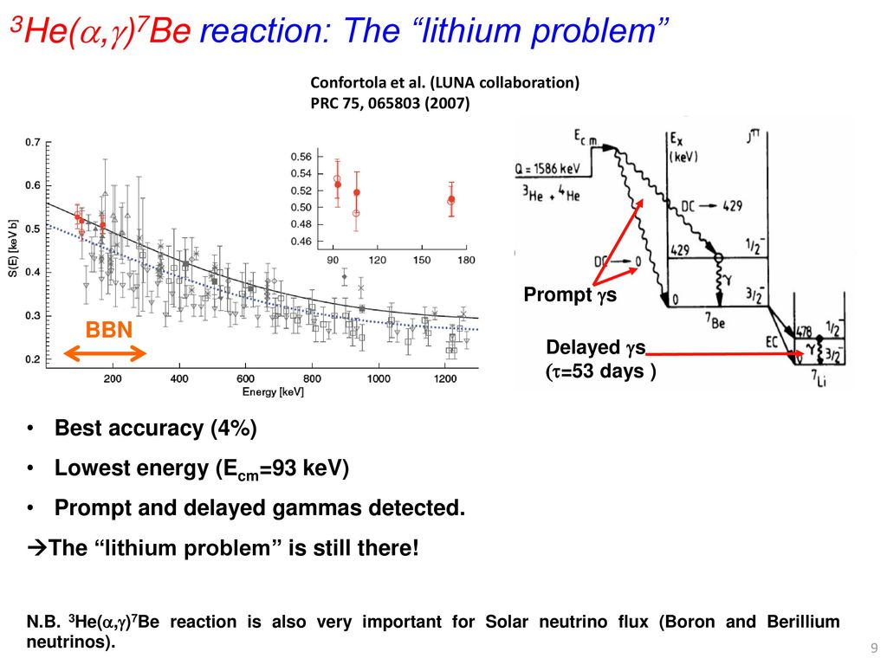
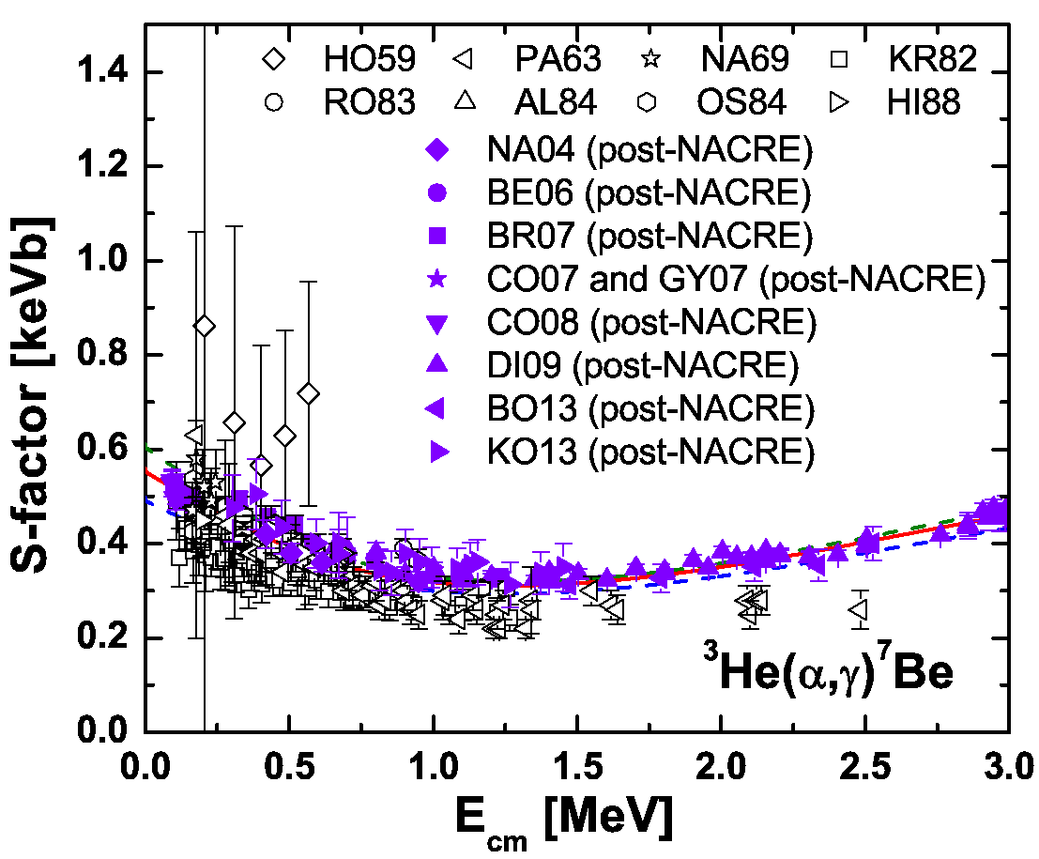
Reaction rates
アメ

Slide 40
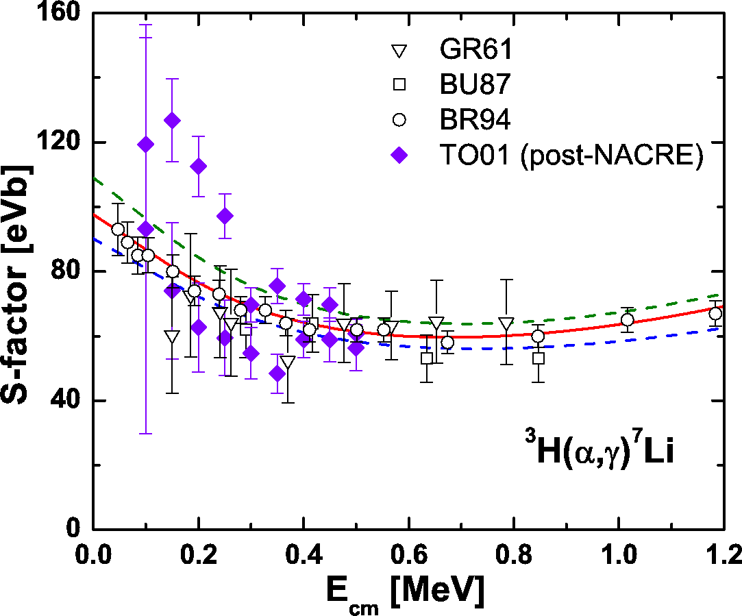
Reaction rates
アメ

Slide 41
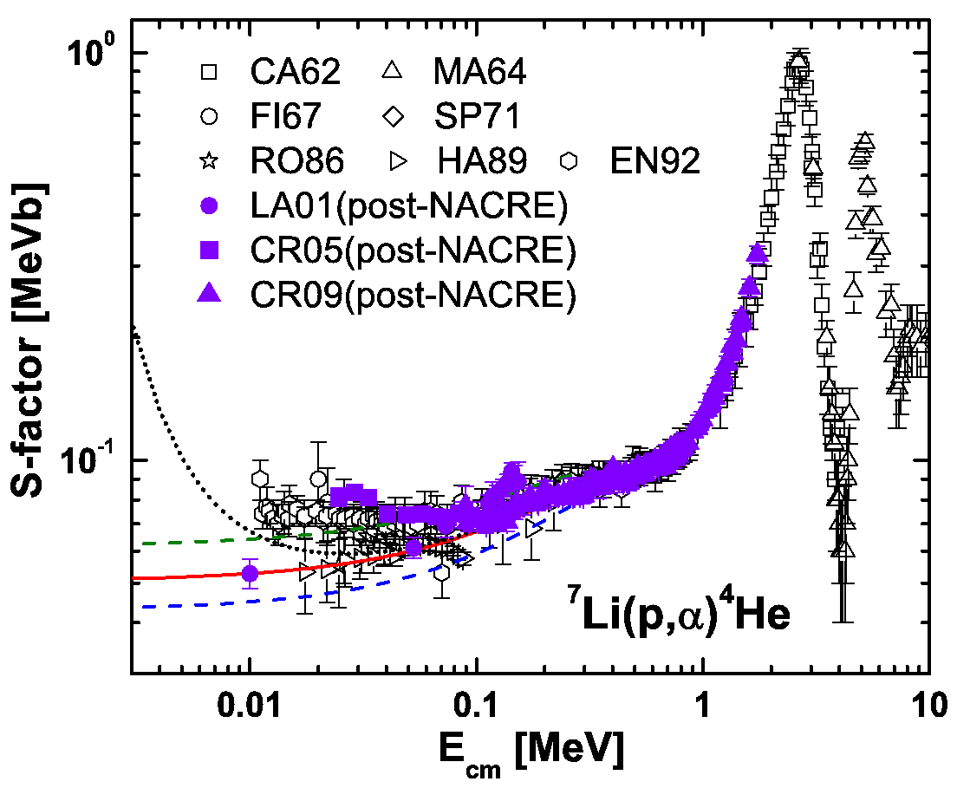
Reaction rates
アメ

Slide 42
Reaction rates
Cosmological Lithium Problem (CLiP)
アメ

Slide 43
⁴He and ²H concordance
✔️
Yp = 0.245 ± 0.004 (calc.) Yp = 0.246
✔️
D/H = (2.53 ± 0.04) x 10⁻⁵ (calc.) D/H = 2.43 x 10⁻⁵
アメ
Notes:
Yp measured in dwarf galaxies (poor in O and N). ionized He get back one e- a emitting characteristic line (HII line).
There exists a correlation between O content in the dwarf galaxy and Yp. Extrapolation to zero Oxygen provides Yp.
D/H measured by observing absorption lines of distant quasars.
D is quickly destroyed in stars by D + p --> He3 + g

Slide 44
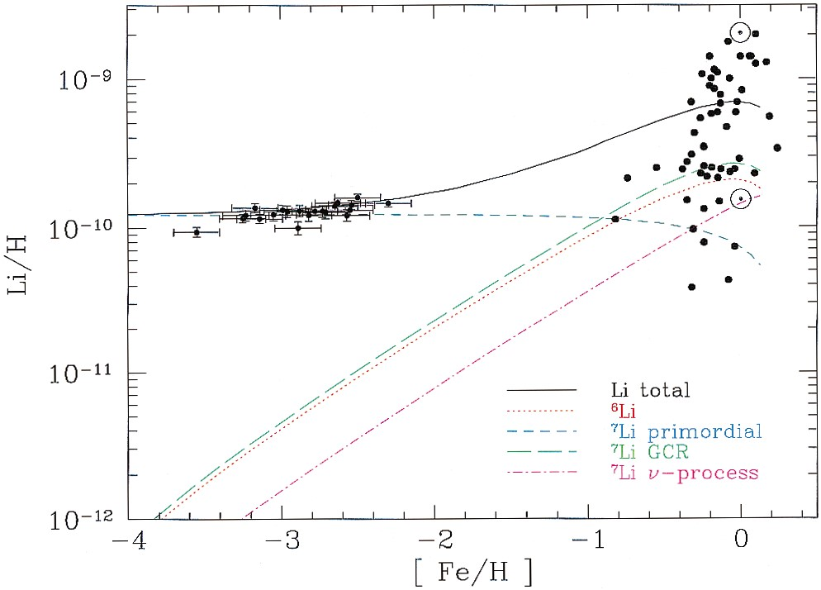



CLiP – Cosmological Lithium Problem
Best value from observations:
[Li/H] = 1.6 $±$ 0.3
Expected from CMB analysis
and standard BBN
[Li/H] = 4.45 $±$ 0.05
Expected from standard BBN
Y_{p} and D
abundance concordance
3.9 $≤$ [Li/H] $≤$ 5.3
Contributions to the total predicted lithium abundance from the adopted GCE model of Fields & Olive (1999a, 1999b), compared with low metallicity stars (RNB) and high-metallicity stars (Lambert, Heath, & Edvardsson 1991). The solid curve is the sum of all components.
[ ] : 10⁻¹⁰
BD Fields et al., PDG Review (2016)
S G Ryan et al. ApJ 530 (2000) L57

Slide 45
⁷Be destruction by neutrons
Recent measurements @ CERN n_TOF
⁷Be(n,α)⁴He

Slide 46
End of lecture 1
アメ

Slide 47
アメ

