Slide 1
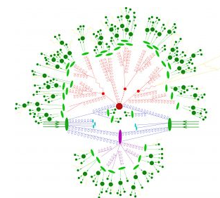
ENP-Napoli
Luigi Cappiello, Ricercatore Univ. Federico II, 100%
Giancarlo D’Ambrosio, Dirigente di Ricerca, 100%
Giulia Ricciardi Prof. Associato, Univ. Federico II, 90%
Activities
neutrino physics
BSM models
kaon physics
Holographic models of QCD

Slide 2
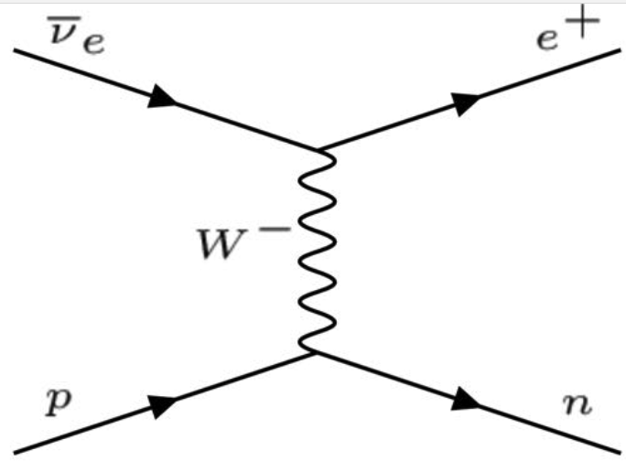
neutrino physics
accurate evaluation of the cross section for inverse beta decay at low energies
(G. R., F. Vissani, Natascia Vignaroli, JHEP 08 (2022) 212)
by far the most important mechanism of interaction of low-energy antineutrinos
--all reactor neutrino oscillation studies (Daya Bay, RENO, JUNO…)
-core-collapse SN neutrino detection (SN1987, Kamiokande-II, IMB, …HyperKamiokande )
-geoneutrinos
In water & scintillator detectors (lots of «free» protons) dominates by orders of magnitude
Precision crucial for high-statistics planned experiments

Slide 3
Most accurate estimates available at the moment were obtained almost 20 years ago: Beacon, Vogel (1999) and Strumia, Vissani (2003)
We update these results:: both the central values and the uncertainties
Neutrino interactions with a free nucleon have the same basic characteristics as those of lepton scattering, though different hadronic current
SCC (recently discussed by Ankovski; Giunti; Ivanov) previously neglected for neutrino-nucleon cross section.
Large source of uncertainty to the cross section from the axial form factor g1

Slide 4
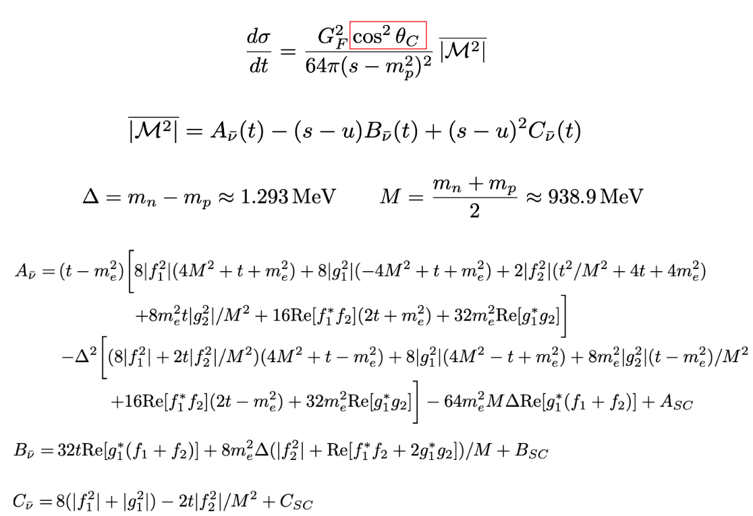
cross section

Slide 5
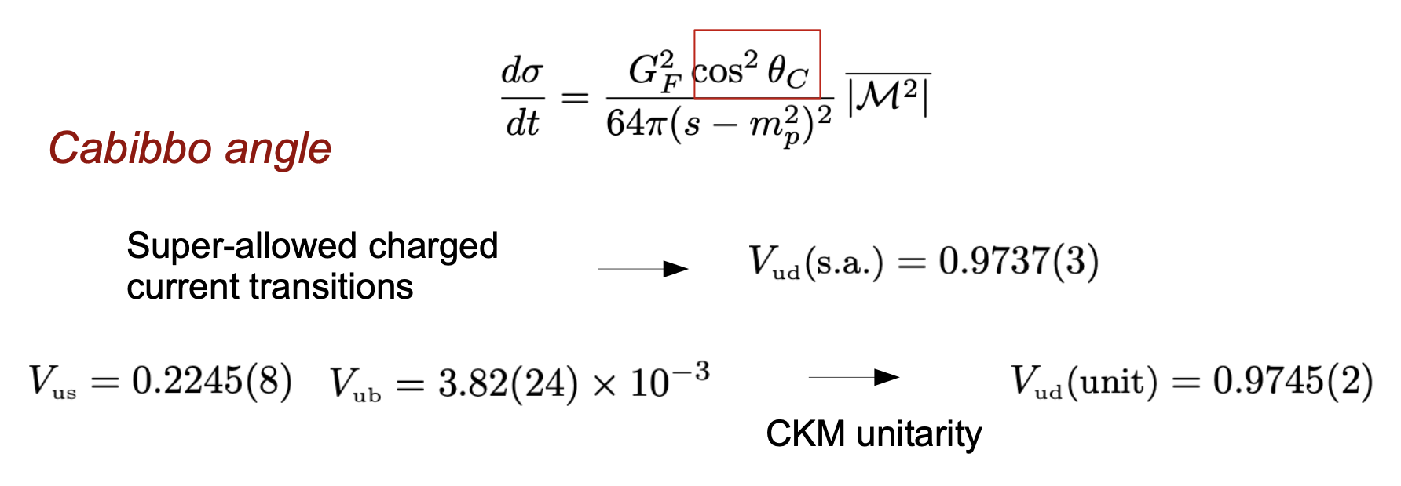

Slide 6
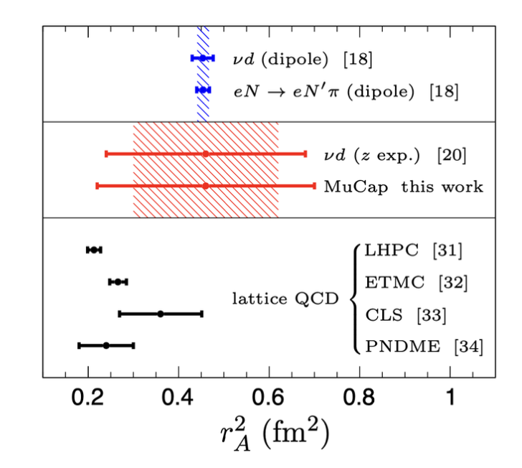
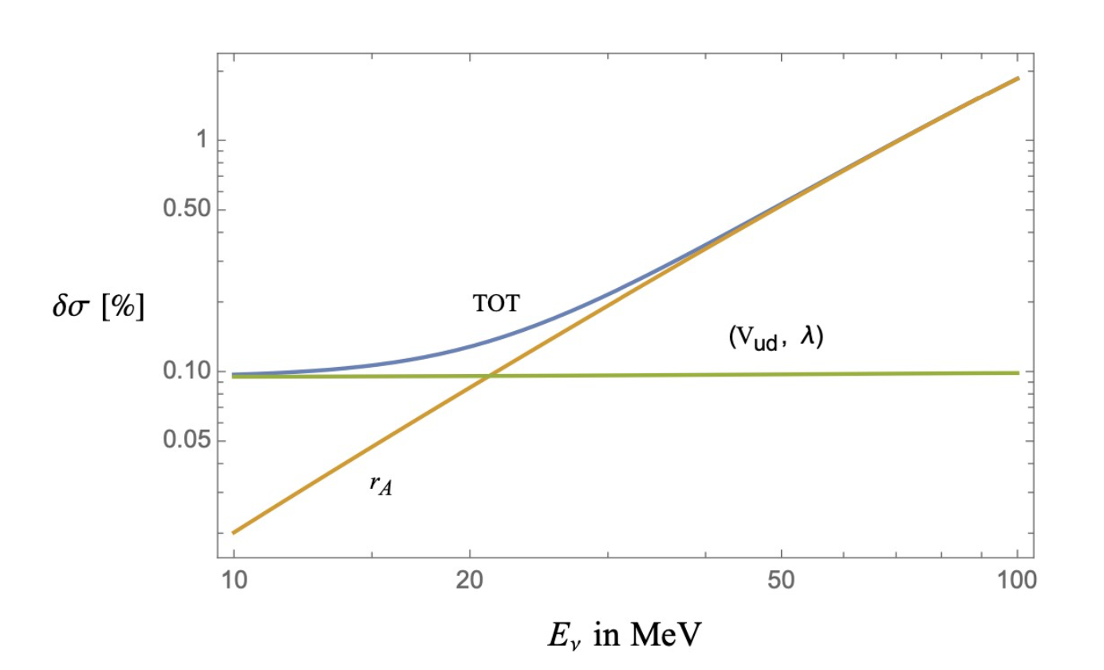

Slide 8
BSM models
https://arxiv.org/pdf/2312.02287.pdf
minimal extension which includes vector-like quarks (VLQs) and new gauge bosons, performing
analysis of the production at LHC of a pair of doubly-charged bileptons.
We include for the first time all the relevant processes where VLQs contribute, and in particular the associate production VLQ-bilepton.
Finally, we extract the bound on the bilepton mass, mY > 1300 GeV, from a reinterpretation of a recent ATLAS search for doubly-charged Higgs bosons in multi-lepton final states.

Slide 9
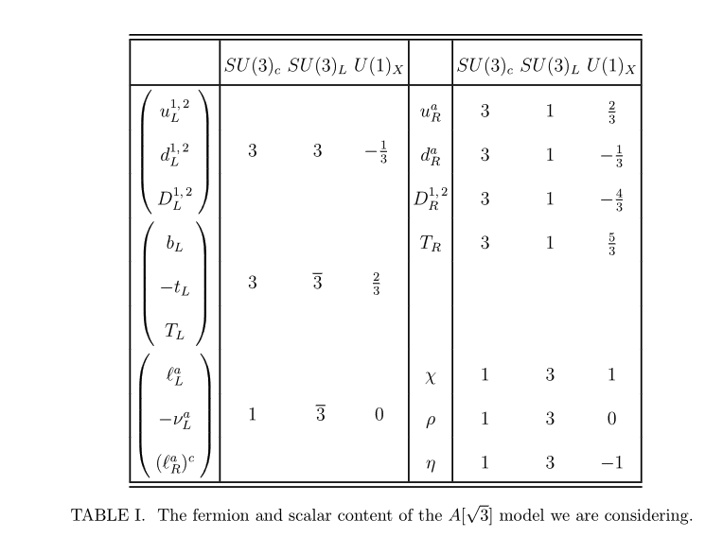

Slide 10
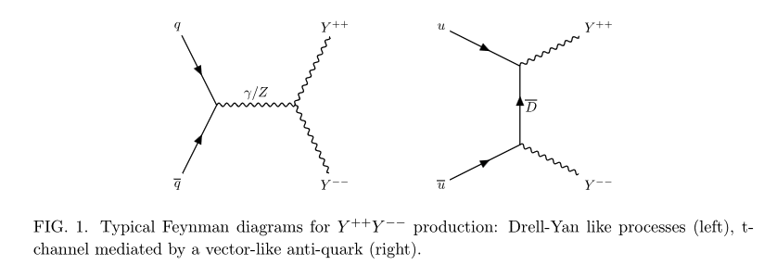

Slide 11
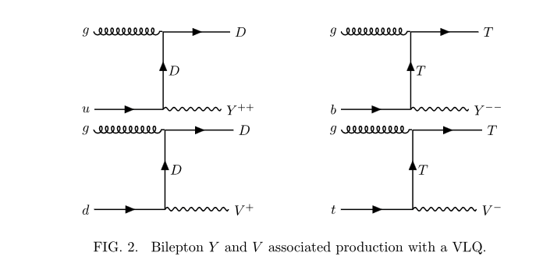

Slide 12
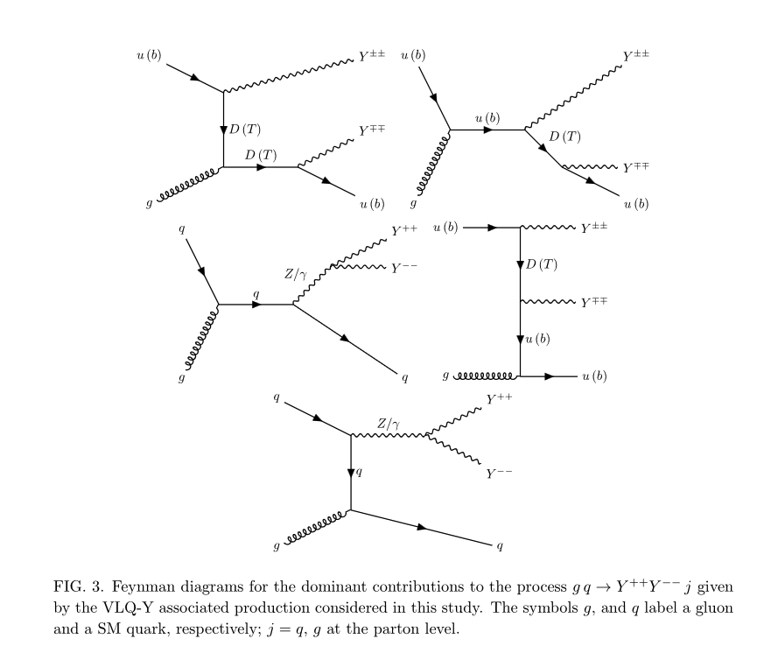

Slide 13
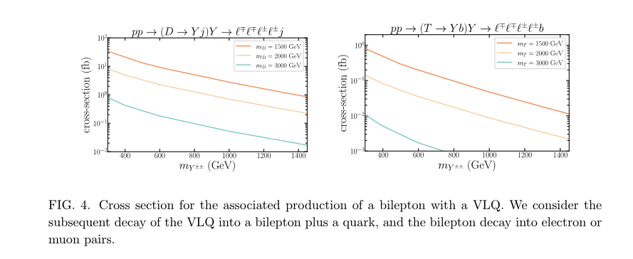
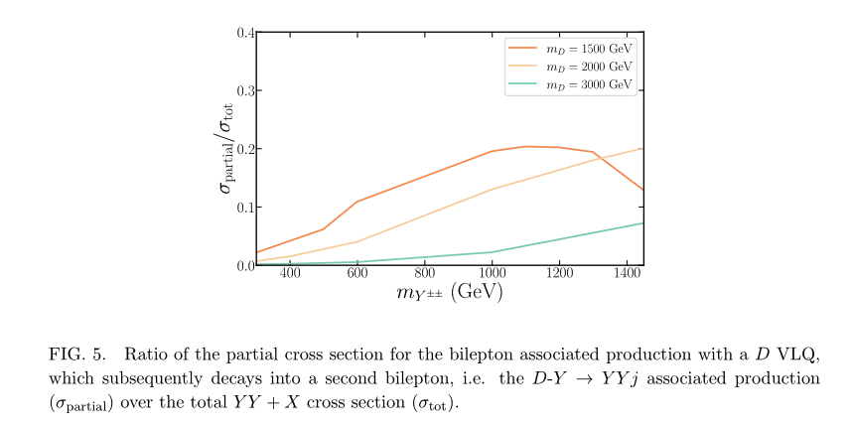

Slide 14
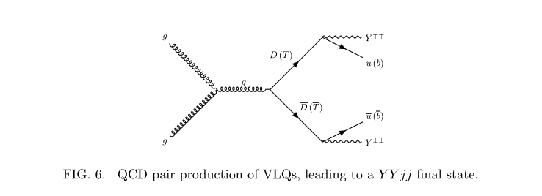

Slide 15
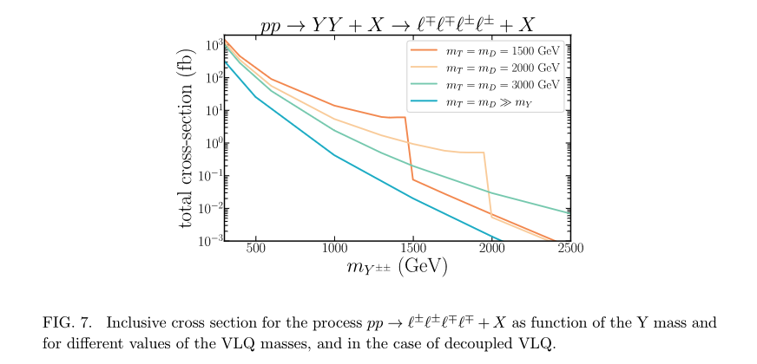

Slide 16
