Slide 1
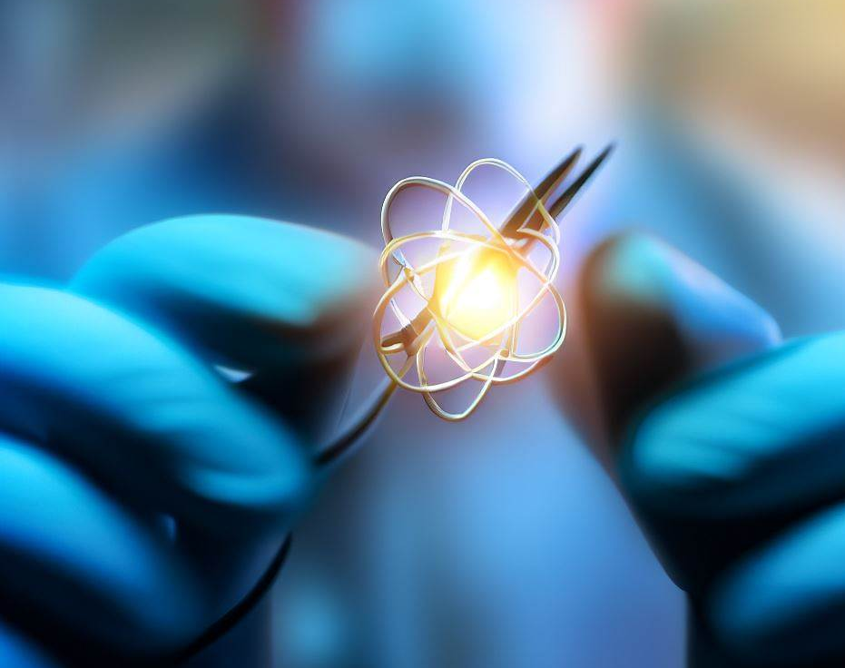
Nuclear and fundamental physics with atomic probes
Ruben de Groote
ruben.degroote@kuleuven.be
Selected topics in Nuclear and Atomic Physics 2024

Slide 2
Two central themes
Part I: Nuclear physics with atomic probes
  Some notions of atomic structure
  Influence of nuclear properties on electrons
  Some examples
  Precision frontier
Part II: Tests of fundamental interactions with atomic and molecular probes
  Modifications* to isotope shifts due to ‘new physics’
  King plot tests with Sr and with Yb
  Molecular probes for eEDMs

Slide 3
Part I
Notions of atomic physics

Slide 4
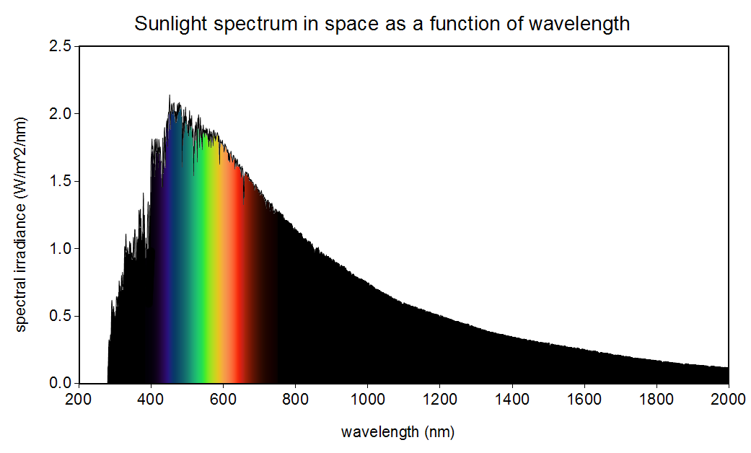
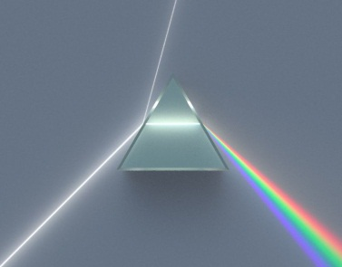
The structure of the atom
As you know, the light from the sun is not just one single colour
‘White light’ is composed of many different wavelengths

Slide 5
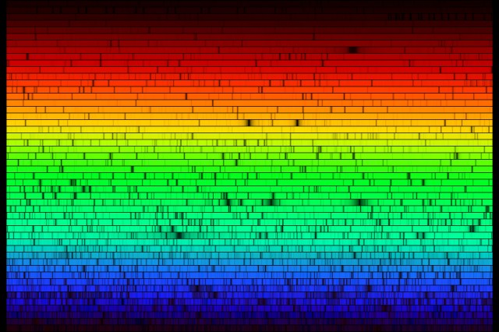
The structure of the atom
By using a higher resolution spectroscope/spectrometer, more details emerge…
Gaps in the spectrum = absorption lines of many different elements in the solar environment

Slide 6

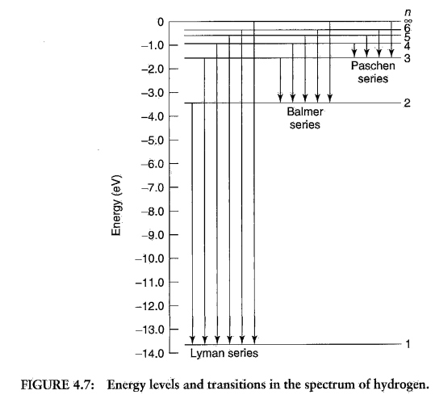
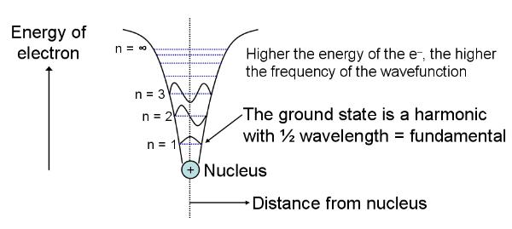

The structure of the atom
Picking out just one of these:
the hydrogen spectrum

Slide 7
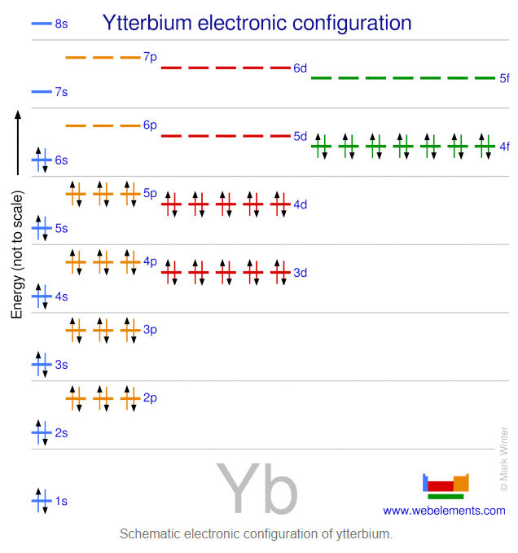
The structure of the atom
Different elements have different absorption lines, because they have a different (quantum) structure
Every dark line corresponds to a transition between two bound states of the atom
In addition to the quantum number
n, electrons have an
orbital and intrinsic angular momentum
L and S, for a total spin of J = L + S
Spectroscopy ‘slang’:
orbital: s, p, d, f, …
Intrinsic: ‘up’ and ‘down’

Slide 8
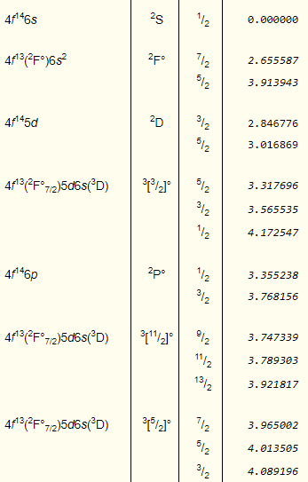
The structure of the atom
Yb⁺
Different elements have different absorption lines, because they have a different (quantum) structure
Every dark line corresponds to a transition between two bound states of the atom

Slide 9
The structure of the atom
Yb⁺
Different elements have different absorption lines, because they have a different (quantum) structure
Every dark line corresponds to a transition between two bound states of the atom
f: L = 3
S = 1/2
So: J = 5/2 or 7/2

Slide 10
The structure of the atom
Yb⁺
Fine structure
Different elements have different absorption lines, because they have a different (quantum) structure
Every dark line corresponds to a transition between two bound states of the atom

Slide 11
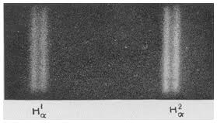
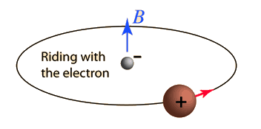
The fine structure of the atom
Fine structure splitting
The coupling between the electron dipole moment and the field due to orbital motion
λ=656.279 nm (N=3 → N=2 in Balmer series)

Slide 12
Part I
Nucleus-electron coupling

Slide 13
The structure of the atom
So far, we’ve not really had to think about the structure of the nucleus.
In fact, it takes a great deal more precision to figure out that the nucleus is not just a point charge!
Two effects are important for us here:
Hyperfine structure (and Zeeman effect)
Isotope shift

Slide 14
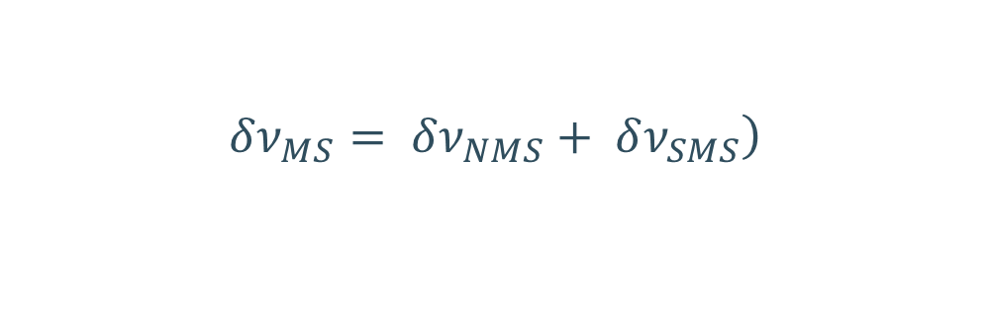
Isotope shift
Different isotopes of the same element have slightly different absorption frequencies
Contribution because of the change in mass:
λ=656.279 nm (N=3 → N=2 in Balmer series)
$$\left.δν_{MS}= δν_{NMS}+ δν_{SMS}\right)$$
Hydrogen
Deuterium

Slide 15


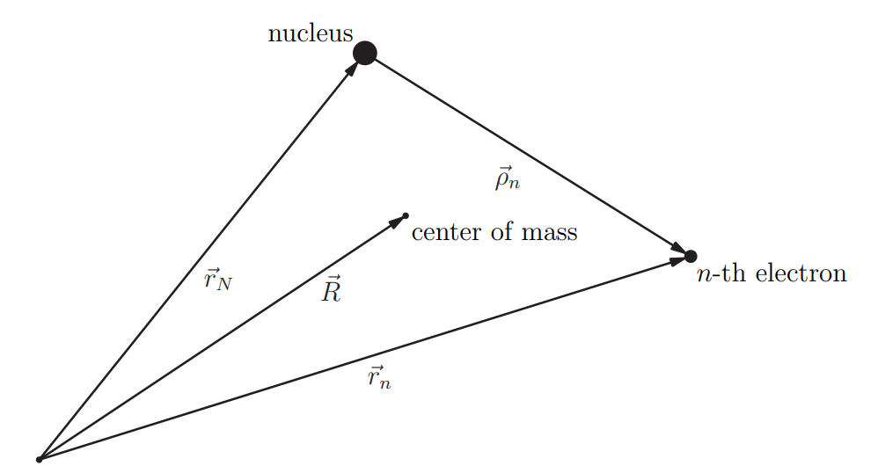
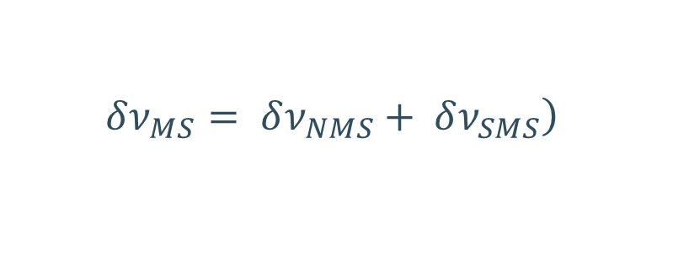
Isotope shift
Contribution because of the change in mass
Since these will be slightly different for different nuclear masses, this is an isotope-dependent effect
$$\left.δν_{MS}= δν_{NMS}+ δν_{SMS}\right)$$
https://www.ptb.de/cms/fileadmin/internet/institute/fpm/QMatter_2019/VL06.pdf

Slide 16
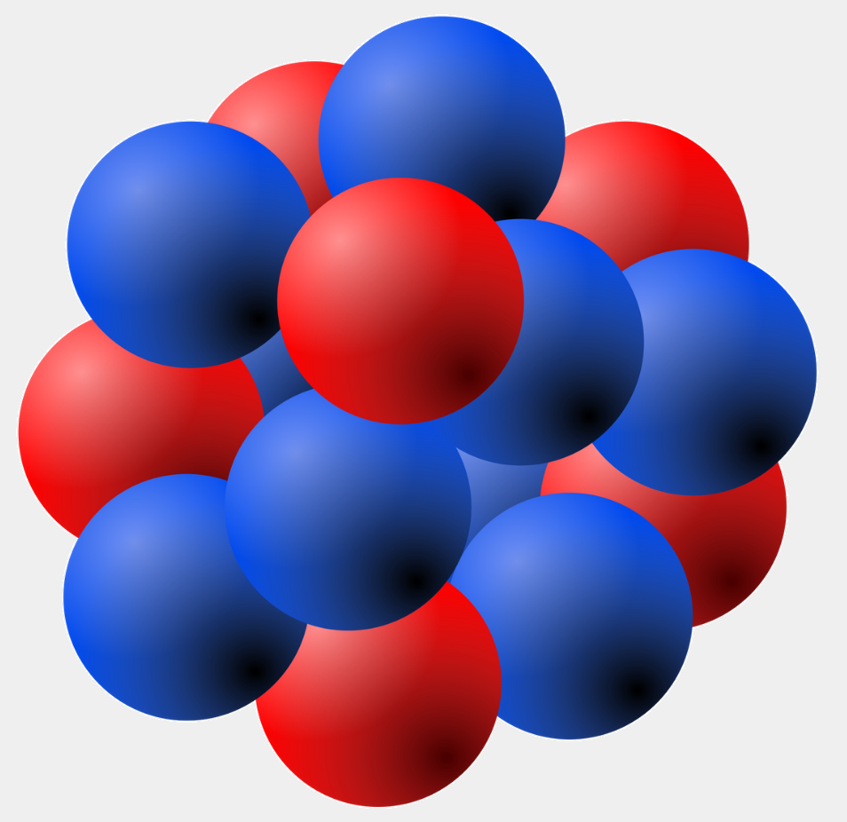
Isotope shift
Contribution because of the change in mass – the mass shift
Contribution because of the change in the size of the nucleus – the field shift
r
Nuclear radius: few × 10⁻¹⁵ m
Atomic radius: few × 10⁻¹⁰ m
Potential is slightly deeper for the
smaller isotope: s-electrons more
tightly bound
V(r)
Isotope shift of atomic level
Point nuclear charge:
Coulomb potential (-1/r)

Slide 17
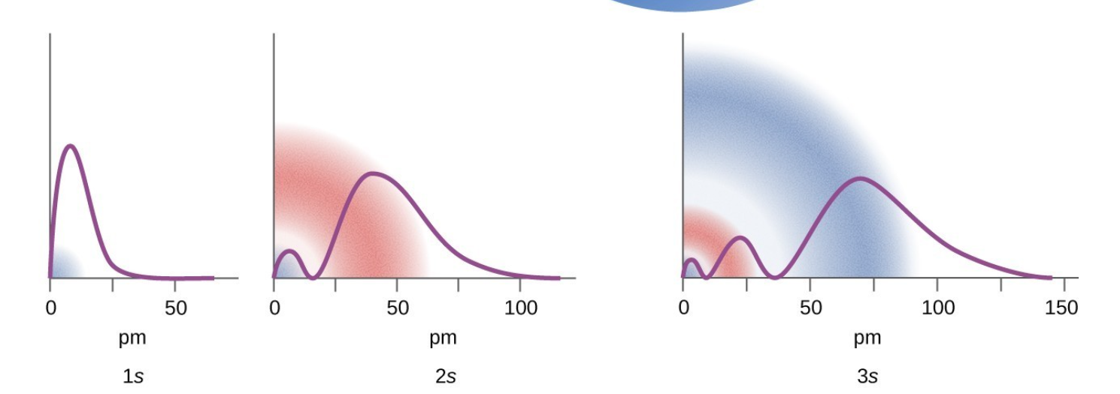
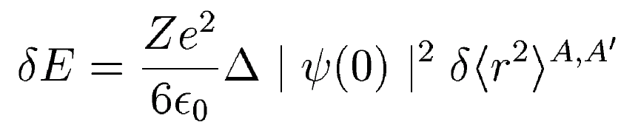
Isotope shift
Contribution because of the change in mass – the mass shift
Contribution because of the change in the size of the nucleus – the field shift
r
Nuclear radius: few × 10⁻¹⁵ m
Atomic radius: few × 10⁻¹⁰ m
Potential is slightly deeper for the
smaller isotope: s-electrons more
tightly bound
V(r)
Isotope shift of atomic level
Point nuclear charge:
Coulomb potential (-1/r)

Slide 18
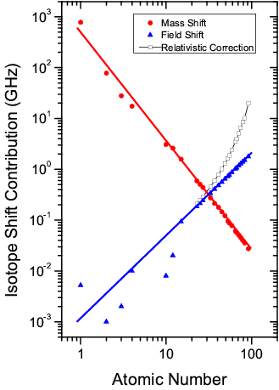

Isotope shift
Contribution because of the change in mass – the mass shift
Contribution because of the change in the size of the nucleus – the field shift
δν_{IS} =
δν_{MS}
+
δν_{FS}
Mass shift
$$δ\left\langle r^{2}\right\rangle x F$$
Field shift
EXPERIMENT
THEORY

Slide 19
A note about model dependence
Laser spectroscopists like to claim they do ‘model-independent’ measurements
We do need atomic theory input at some point
  But state-of-the-art methods don’t use models. ‘Ab-initio’.
  HOWEVER. Whenever a property depends on the overlap of nuclear and atomic wavefunctions, in principle a nuclear model is needed.
  In practice, the nuclear model has so far played a negligible role. So far.
r
Potential is slightly deeper for the
smaller isotope: s-electrons more
tightly bound
V(r)
Point nuclear charge:
Coulomb potential (-1/r)

Slide 20
A note about model dependence
Laser spectroscopists like to claim they do ‘model-independent’ measurements
We do need atomic theory input at some point
  But state-of-the-art methods don’t use models. ‘Ab-initio’.
  HOWEVER. Whenever a property depends on the overlap of nuclear and atomic wavefunctions, in principle a nuclear model is needed.
  In practice, the nuclear model has so far played a negligible role. OR HAS IT?
r
Potential is slightly deeper for the
smaller isotope: s-electrons more
tightly bound
V(r)
Point nuclear charge:
Coulomb potential (-1/r)

Slide 21

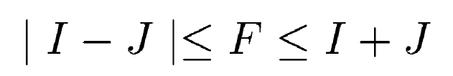
Hyperfine structure
The atomic and nuclear spins couple to form the total angular momentum
F = I + J
Total spin of atom + nucleus is F
Recall the vector picture for angular momentum addition
=> The interaction of the nuclear electromagnetic moments and the fields generated by the electron cloud.
F
J
Each state J has several F-states:
I
* Not true, there is the m_{J} projection quantum number, but that’s removed with a simple external B-field.

Slide 22
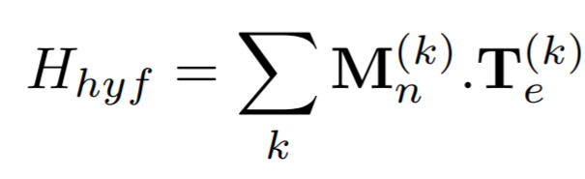
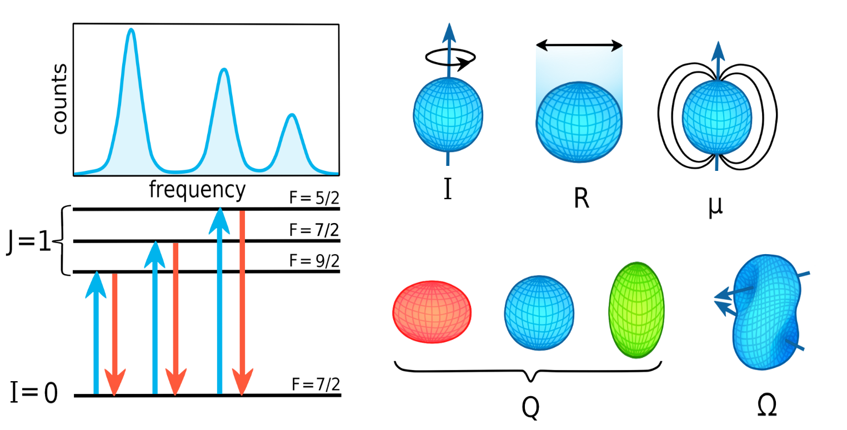
The isotope-dependent hyperfine structure of the atom + nucleus!
The most general form:
Infinite expansion… Each term is significantly smaller than the
previous one.
k = 1: interaction with magnetic dipole moment
k=2: interaction with electric quadrupole moment
…
Fields generated by the electrons
Nuclear electromagnetic moment

Slide 23
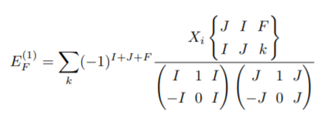
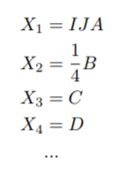
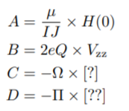
The isotope-dependent hyperfine structure of the atom + nucleus!
1/4 B
F=5/2
5/2 A
5/2 A + 5/4 B
E(J)
F=3/2
-B
3/2 A
3/2 A - 9/4 B
+5/4 B
F=1/2
k=1
k=1 and 2
Nuclear x atomic

Slide 24
The isotope-dependent hyperfine structure of the atom + nucleus!
1/4 B
F=5/2
5/2 A
5/2 A + 5/4 B
E(J)
F=3/2
-B
3/2 A
3/2 A - 9/4 B
+5/4 B
F=1/2
k=1
k=1 and 2
Nuclear x atomic

Slide 25
Isotope shift
Contribution because of the change in mass – the mass shift
Contribution because of the change in the size of the nucleus – the field shift
δν_{IS} =
δν_{MS}
+
δν_{FS}
Mass shift
$$δ\left\langle r^{2}\right\rangle x F$$
Field shift
EXPERIMENT
THEORY

Slide 26
The isotope-dependent hyperfine structure of the atom + nucleus!
Point nucleus + Finite size + Magnetic dipole + Electric quadrupole
F₁
Isotope A
F₂
Isotope (A-1)
F₃
Isotope (A-1)
Isotope A
Mass shift + Field shift
These energy shifts of may be only a few parts per million of the energy of an optical atomic transition. Optical techniques provide the sensitivity and precision required to measure these effects.

Slide 27
The isotope-dependent hyperfine structure of the atom + nucleus!
Point nucleus + Finite size + Magnetic dipole + Electric quadrupole
F₁
+ higher order perturbative HFS
+ higher multipole order HFS
+ higher order radial moment isotope shift
+ Zeeman effect
+ Bohr Weisskopf effect
+ Breit-Rosenthal effect
+ isotope shift of the atomic
g_{J}-factor
+ ….
Isotope A
F₂
Isotope (A-1)
F₃
Isotope (A-1)
Isotope A
Mass shift + Field shift
These energy shifts of may be only a few parts per million of the energy of an optical atomic transition. Optical techniques provide the sensitivity and precision required to measure these effects.

Slide 28
The isotope-dependent hyperfine structure of the atom + nucleus!
Point nucleus + Finite size + Magnetic dipole + Electric quadrupole
F₁
+ higher order perturbative HFS
+ higher multipole order HFS
+ higher order radial moment isotope shift
+ Zeeman effect
+ Bohr Weisskopf effect
+ Breit-Rosenthal effect
+ isotope shift of the atomic
g_{J}-factor
+ ….
Isotope A
F₂
Isotope (A-1)
F₃
Isotope (A-1)
Isotope A
All of this is not ‘new’ physics. It is (in practice often poorly!) known.
Mass shift + Field shift
These energy shifts of may be only a few parts per million of the energy of an optical atomic transition. Optical techniques provide the sensitivity and precision required to measure these effects.

Slide 29
Let’s talk about energy scales…
Optical transitions: 100’s of THz, a few eV, 10000s of cm⁻¹, 100s of nm
Hyperfine splitting: 100’s of MHz, a few μeV, ~0.01 cm⁻¹
Optical linewidth: 10’s of MHz, a fraction of μeV, ~0.001 cm⁻¹
1 cm⁻¹: ~ 30000 MHz
1eV: ~ 8000 cm⁻¹

Slide 30
Now that we understand atomic structure and atomic spectra…
How do we measure these effects in practice?
We use lasers to induce transitions in the atom, and record
the response of the atom as function of laser frequency
=
Laser spectroscopy

Slide 31

Laser spectroscopy
non-resonant
ionization
excitation of
auto-ionizing states
ionization of
Rydberg-states
extraction
field or
collisional
ionization
IP
higher excited states
first excited state
Detect the photons the atom emits when it
relaxes back to the ground state
energy
E₁
ground state
E₀
0 eV

Slide 32
Laser spectroscopy
non-resonant
ionization
excitation of
auto-ionizing states
ionization of
Rydberg-states
extraction
field or
collisional
ionization
IP
higher excited states
first excited state
Detect the photons the atom emits when it
relaxes back to the ground state
= Fluorescence detection
Further excite with additional lasers and peel
off the electron
= Laser resonance ionization (RIS)
energy
E₁
ground state
E₀
0 eV

Slide 33
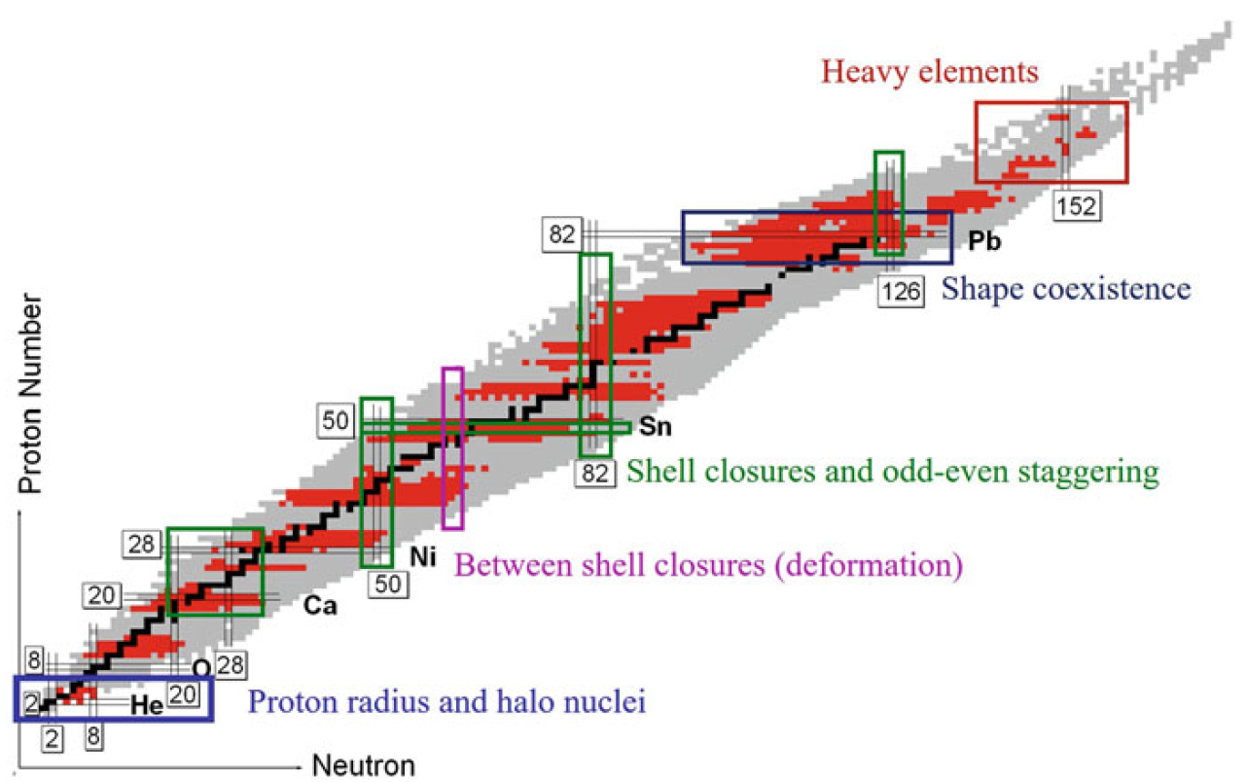
Active areas – moments, radii, spins
Structure near exotic shell closures as tests of nuclear theory
  Many Pre-2019 papers
  Miller, Andrew J., et al. Nature physics 15.5 (2019): 432-436.
  Gorges, C., et al. Physical review letters 122.19 (2019): 192502.
  de Groote, R. P., et al. Nature Physics 16.6 (2020): 620-624.
  Yordanov, Deyan T., et al. Communications physics 3.1 (2020): 107.
  Koszorús, Á., et al. Nature Physics 17.4 (2021): 439-443.
  Reponen, M., et al. Nature Communications 12.1 (2021): 4596.
  Goodacre, T. Day, et al. Physical review letters 126.3 (2021): 032502.
  Sommer, Felix, et al. Physical Review Letters 129.13 (2022): 132501.
  Vernon, Adam R., et al. Nature 607.7918 (2022): 260-265.
Deformation and shape coexistence
  Marsh, B. A., et al. Nature Physics 14.12 (2018): 1163-1167.
  Geldhof, S., et al. Physical Review Letters 128.15 (2022): 152501.
  Barzakh, A., et al. Physical review letters 127.19 (2021): 192501.
Structure of lightest nuclei
  Maaß, Bernhard, et al. Physical Review Letters 122.18 (2019): 182501.
(S)HE: atomic and nuclear structure
  Voss, Annika, et al. Physical Review A 95.3 (2017): 032506.
  Ferrer, R., et al. Nature communications 8.1 (2017): 14520.
  Raeder, S., et al. Physical Review Letters 120.23 (2018): 232503.
Probing EOS with r²
  Kaufmann, S., et al. Physical Review Letters 124.13 (2020): 132502.
  Pineda, Skyy V., et al. Physical Review Letters 127.18 (2021): 182503.
Only papers since 2017-04/2023!
… and many more I missed (sorry!)
Very strong theory input in all papers.

Slide 34
Part I
Examples

Slide 35
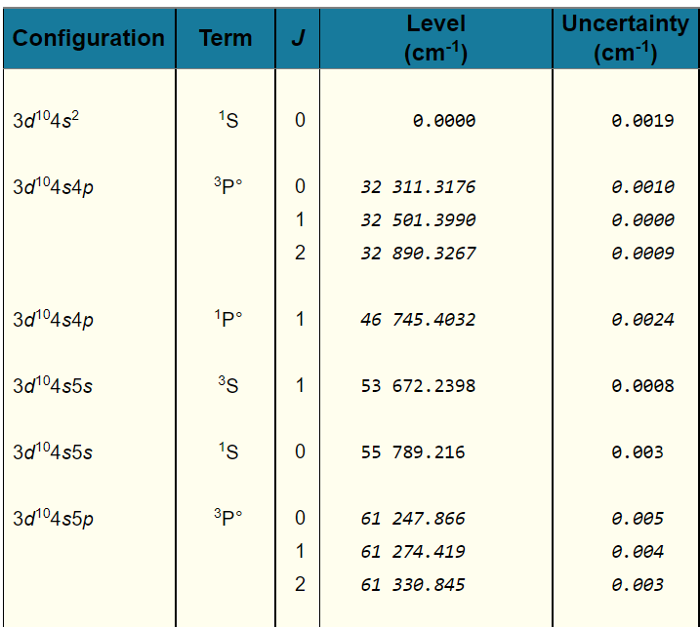
Case study – zinc isotopes
0. atomic structure
Zinc has 30 protons
Singly-charged Zn: difficult wavelengths
Neutral zinc therefore has 30 electrons
Atomic structure:
https://physics.nist.gov/PhysRefData/ASD/levels_form.html
  Filled atomic d-shell
  Two valence electrons can be placed in 4s, 4p, 5s, 5p, … to form lowest-energy atomic states

Slide 36
Case study – zinc isotopes
0. atomic structure
Spectroscopy from ground state?
Ground state: J=0
=> no sensitivity to nuclear moments: there is no hyperfine splitting!

Slide 37
Case study – zinc isotopes
0. atomic structure
Spectroscopy from ground state?
Ground state: J=0
=> no sensitivity to nuclear moments
Only option is a transition to J = 1*
=> J = 1: hyperfine structure will only contain three peaks, not enough to get isotope shift, A, B and nuclear spin
(4 parameters with only three measurable frequencies)
So: not ideal.
*J=0 to J=0 is very weak, only because of mixing not totally forbidden

Slide 38
Case study – zinc isotopes
0. atomic structure
Spectroscopy from ground state?
Not ideal.
Luckily, there is a long-lived metastable state!

Slide 39
Case study – zinc isotopes
0. atomic structure
Luckily, there is a long-lived metastable state!
Furthermore, convenient optical transition
4s 4p ³P⁰ -> 4s 5s ³S₁
Pro:
418 nm: easy wavelength with modern Ti:sapphire laser systems
J = 2 to J = 1: measuring all observables a priori possible
Transition excites a 4p electron to 5s: expect large field shift
Con:
Producing atoms in a metastable state?

Slide 40
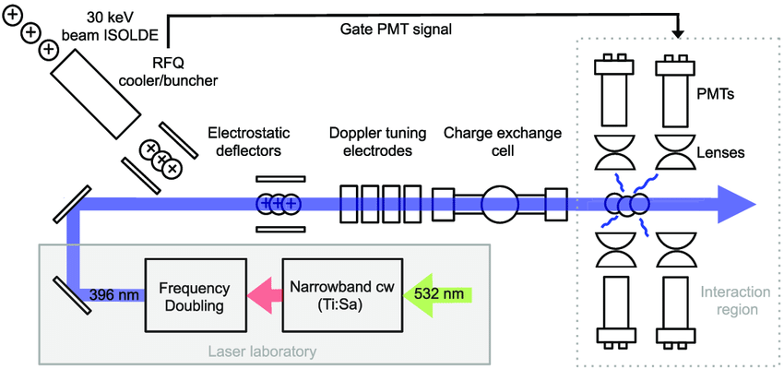
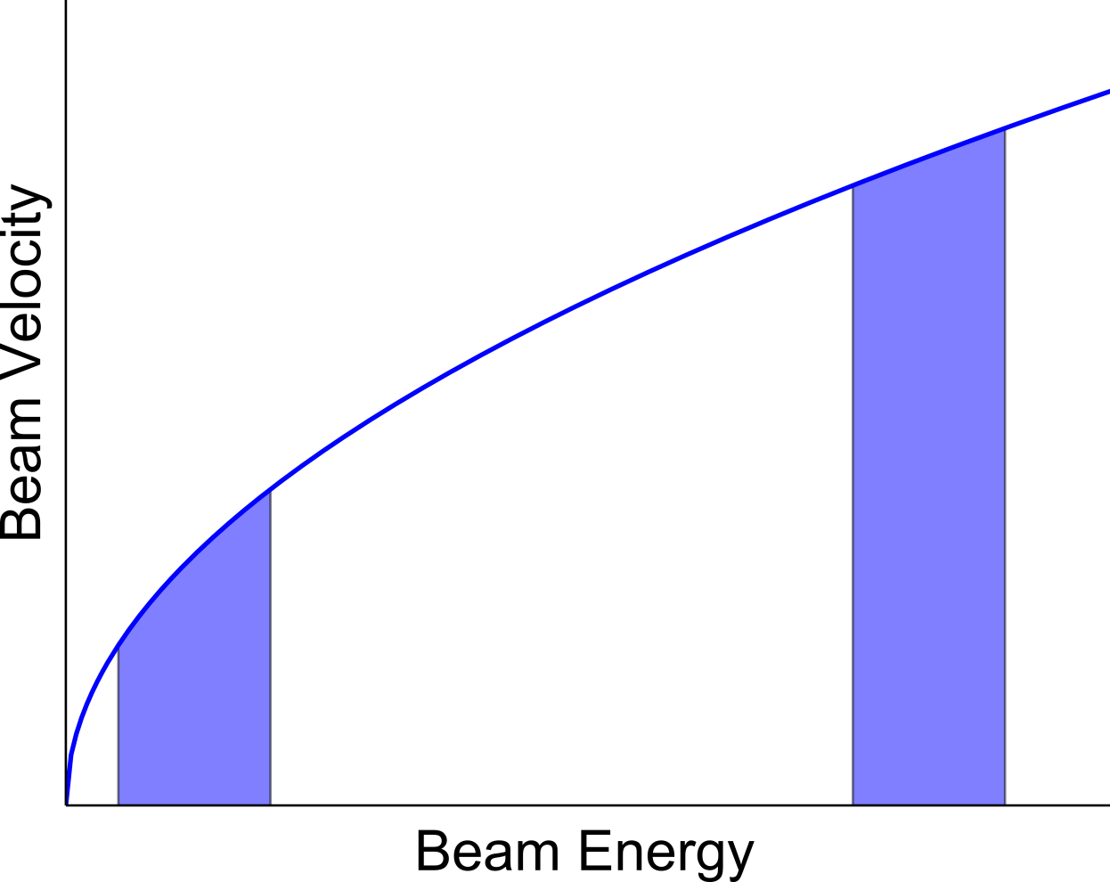
Case study – zinc isotopes
1. spectroscopy
Collinear laser spectroscopy
Accelerating ions squashes down their velocity spread
In vacuum: no pressure broadening

Slide 41
Case study – zinc isotopes
1. spectroscopy
Collinear laser spectroscopy
Charge exchange:
cell which is filled with e.g. sodium and heated to produce a vapour
At beam energies of a few keV, large cross section for:
Zn⁺ + Na -> Zn + Na⁺

Slide 42
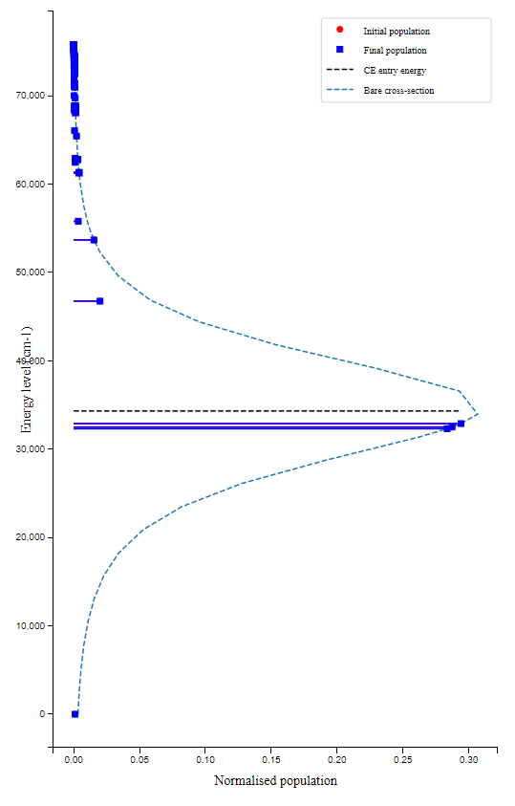
Case study – zinc isotopes
1. spectroscopy
Collinear laser spectroscopy
Charge exchange:
cell which is filled with e.g. sodium and heated to produce a vapour
At beam energies of a few keV, large cross section for:
Zn⁺ + Na -> Zn + Na⁺

Slide 43
Case study – zinc isotopes
1. spectroscopy
I = 9/2
J = 1
J = 2
C. Wraith et al. / Physics Letters B 771 (2017) 385–391

Slide 44
Case study – zinc isotopes
1. spectroscopy
I = 9/2
J = 1
J = 2
7/2
9/2
11/2
F
5/2
7/2
9/2
11/2
13/2
F
C. Wraith et al. / Physics Letters B 771 (2017) 385–391

Slide 45
Case study – zinc isotopes
1. spectroscopy
I = 9/2
J = 1
J = 2
7/2
9/2
11/2
F
Selection rules:
9 transitions!
5/2
7/2
9/2
11/2
13/2
F
C. Wraith et al. / Physics Letters B 771 (2017) 385–391

Slide 46
Case study – zinc isotopes
1. spectroscopy
I = 9/2
J = 1
J = 2
I = 1/2
J = 1
J = 2
7/2
9/2
3/2
11/2
1/2
F
F
Selection rules:
3 transitions
Selection rules:
9 transitions!
5/2
7/2
5/2
9/2
3/2
11/2
13/2
F
C. Wraith et al. / Physics Letters B 771 (2017) 385–391

Slide 47
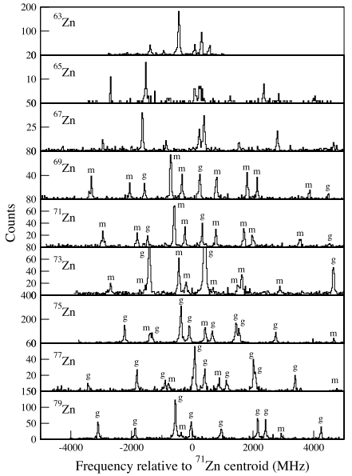
Case study – zinc isotopes
1. spectroscopy
I = 9/2
J = 1
J = 2
7/2
9/2
11/2
F
5/2
7/2
9/2
11/2
13/2
F
C. Wraith et al. / Physics Letters B 771 (2017) 385–391

Slide 49
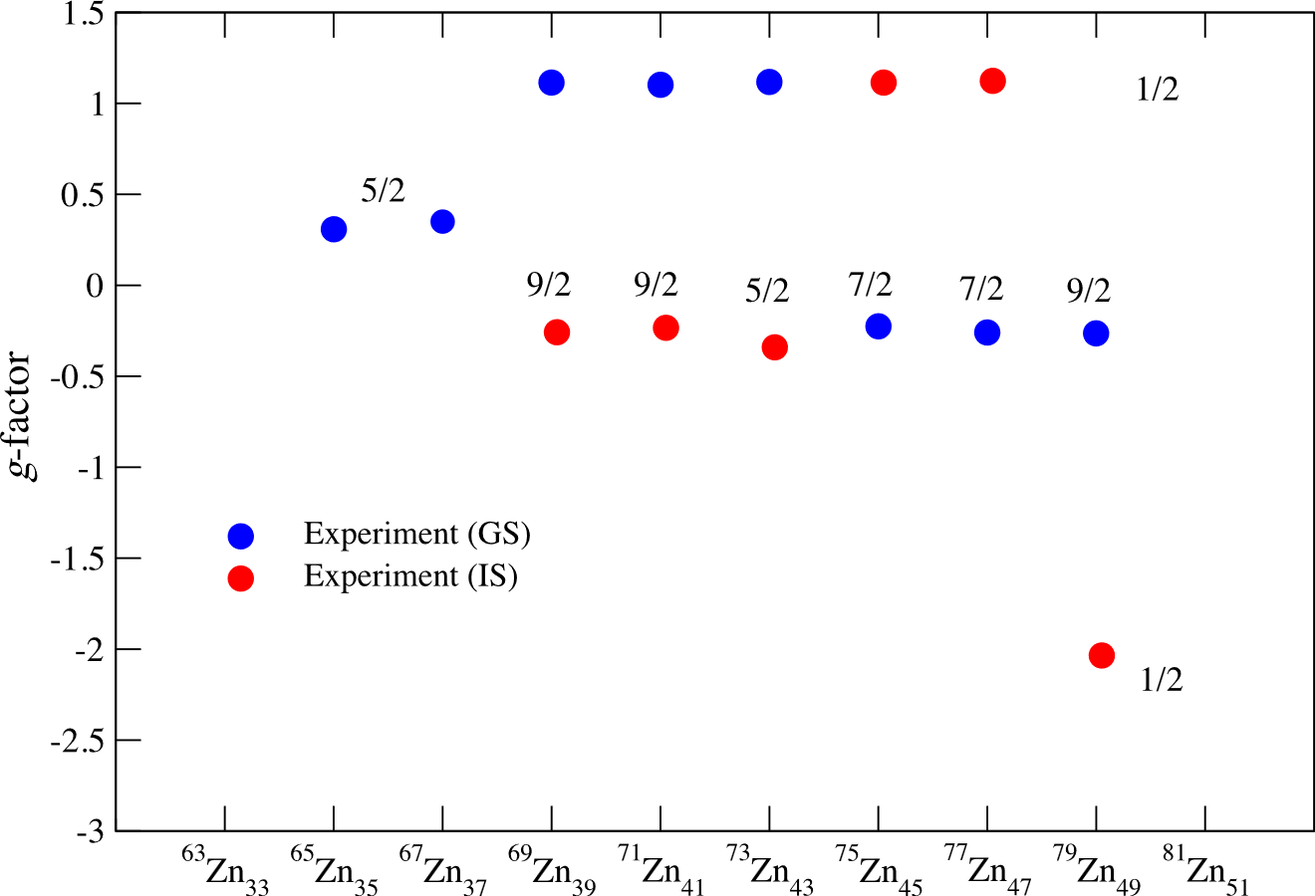

Slide 50
Magnetic moments – what can they tell us?
From the definition:
We can see that the magnetic moment depends on the orbital and spin angular momentum.
Measuring a magnetic moment is an excellent way to learn more about the wavefunction/configuration of the nucleus.
Protons: g_{l} = +1 g_{s} = +5.586
Neutrons: g_{l} = 0 g_{s} = -3.826
(These are values for a free proton/neutron)
μ
L
r
v
q,m
Magnetic dipole

Slide 51
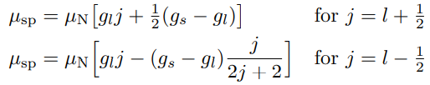
Magnetic moments – what can they tell us?
Assume a single, unpaired nucleon outside
of a core that it does not interact with at all.
All nucleons inside the nucleus neatly pair up to spin zero, thus not contributing to the magnetic moment, and we find:
These expressions summarize the so-called Schmidt moments.

Slide 52
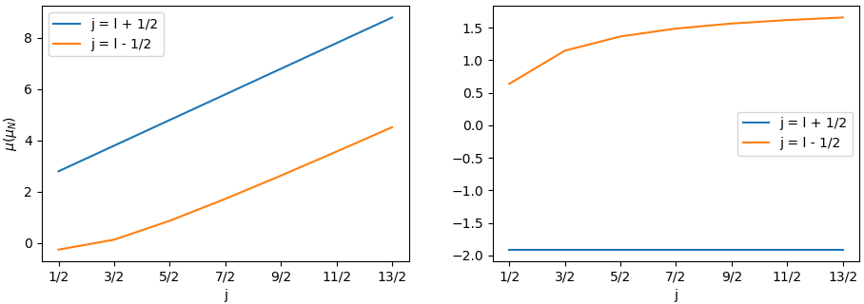
Magnetic moments – what can they tell us?
For protons:
For neutrons:
neutron has no charge
=> no orbital contribution
Proton moments
→ increase with j
→ only πp_{1/2} negative !
Neutron moments
→ constant negative value for neutron in a l+1/2 orbit
→ (small) positive values for l-1/2 orbits

Slide 53
Magnetic moments – what can they tell us?
For protons:
For neutrons:
Note:
Protons: larger values
Moment depends very strongly on the relative alignment of spin and orbital moment!
Relative to our experimental accuracy (to be discussed next), these are very large differences in μ for a given configuration
Proton moments
→ increase with j
→ only πp_{1/2} negative !
Neutron moments
→ constant negative value for neutron in a l+1/2 orbit
→ (small) positive values for l-1/2 orbits

Slide 54
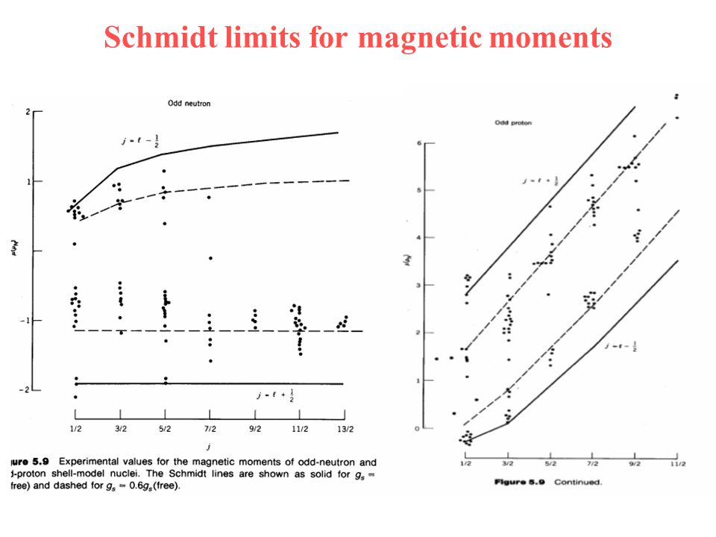
Magnetic moments – what can they tell us?
Experimentally, we find the general trend is correct, but there is a consistent deviation from Schmidt lines
g_{s} = 0.7 g_{s,free}
Cause?
  Nucleons are not free but are embedded in nuclear medium
  Configuration mixing: our assumption of a perfect single-particle behaviour is imperfect.

Slide 55
Case study – zinc isotopes
3. physics discussion
In nearly all isotopes, two long-lived states were found in the spectra
The plot on the right summarizes the g-factors
g = μ/I
and the nuclear spins
C. Wraith et al. / Physics Letters B 771 (2017) 385–391

Slide 56
Case study – zinc isotopes
3. physics discussion
Observations?
  Some g-factors positive, some negative
  => relative alignment of l and s
  g-factors line up very nicely ⁶⁹⁻⁷⁹Zn
  Two I=1/2 states have very different g-factor

Slide 57
Case study – zinc isotopes
3. physics discussion
Observations?
  Some g-factors positive, some negative
  => relative alignment of l and s
  Two I=1/2 states have very different g-factor

Slide 58
Case study – zinc isotopes
3. physics discussion
Observations?
  Some g-factors positive, some negative
  => relative alignment of l and s
  Two I=1/2 states have very different g-factor
  g-factors line up very nicely ⁶⁹⁻⁷⁹Zn

Slide 59
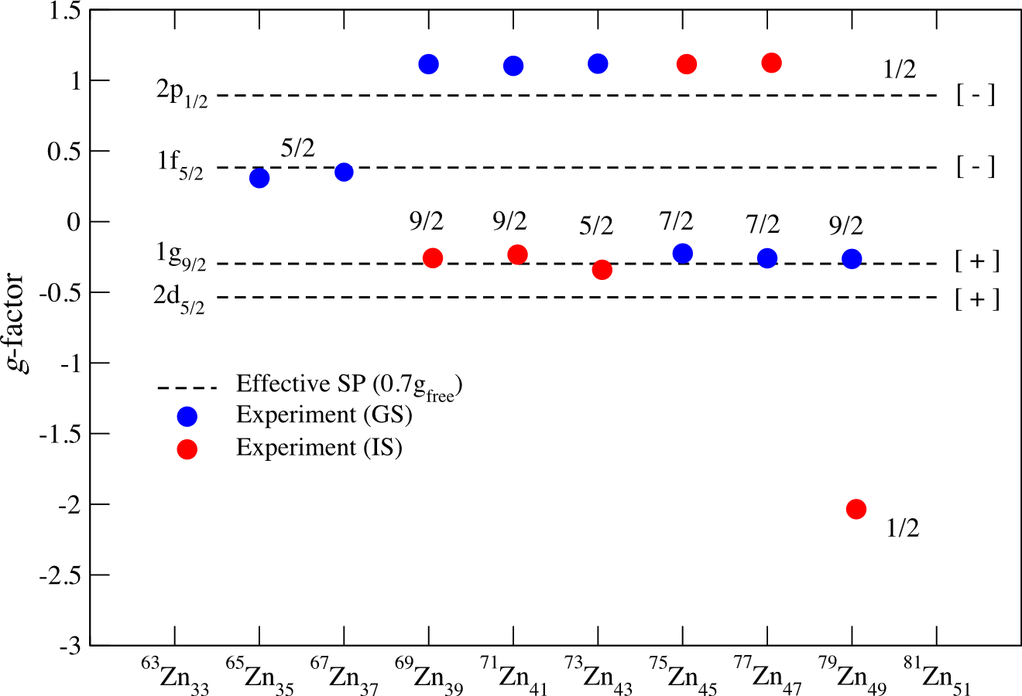
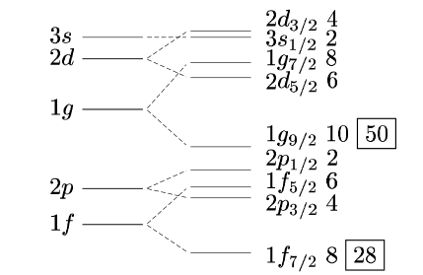
Case study – zinc isotopes
3. physics discussion
Observations?
  Some g-factors positive, some negative
  => relative alignment of l and s
  Two I=1/2 states have very different g-factor
  g-factors line up very nicely ⁶⁹⁻⁷⁹Zn
We can now easily suggest some configurations
dashed line: single-particle magnetic moment with g_{s} = 0.7g_{s,free}

Slide 60
Case study – zinc isotopes
3. physics discussion
Observations?
  Some g-factors positive, some negative
  => relative alignment of l and s
  Two I=1/2 states have very different g-factor
  g-factors line up very nicely ⁶⁹⁻⁷⁹Zn
We can now easily suggest some configurations
dashed line: single-particle magnetic moment with g_{s} = 0.7g_{s,free}

Slide 61
Case study – zinc isotopes
3. physics discussion
Observations?
  Some g-factors positive, some negative
  => relative alignment of l and s
  Two I=1/2 states have very different g-factor
  g-factors line up very nicely ⁶⁹⁻⁷⁹Zn
We can now easily suggest some configurations
dashed line: single-particle magnetic moment with g_{s} = 0.7g_{s,free}

Slide 62

Case study – zinc isotopes
3. physics discussion
Observations?
  Some g-factors positive, some negative
  => relative alignment of l and s
  Two I=1/2 states have very different g-factor
  g-factors line up very nicely ⁶⁹⁻⁷⁹Zn
We can now easily suggest some configurations
dashed line: single-particle magnetic moment with g_{s} = 0.7g_{s,free}

Slide 63
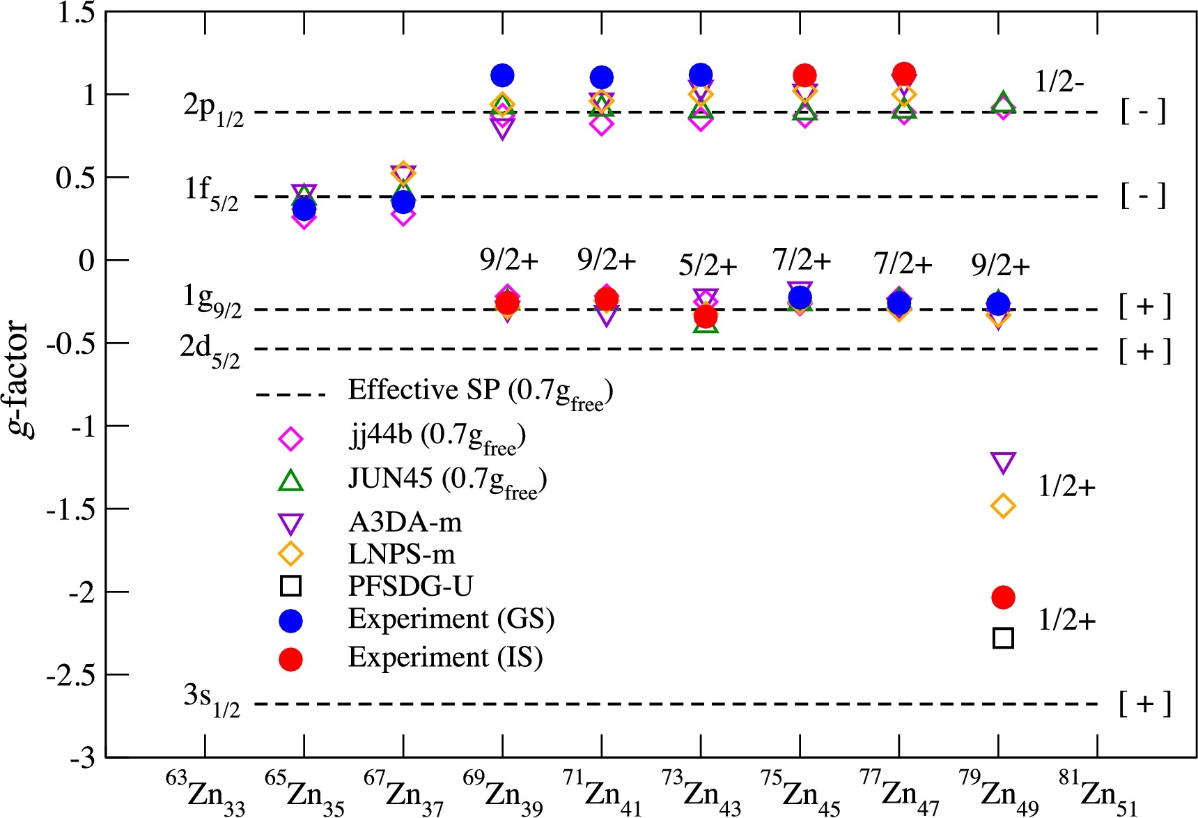

Slide 64

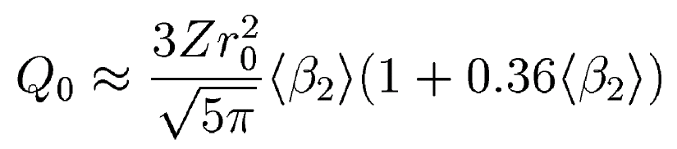
Quadrupole moments
Q>0
Q<0
One way to write down the definition of Q:
For a spherical system Q is zero.
Value of Q tells us whether the shape is oblate or prolate
Can be linked to deformation parameter as well

Slide 65
Quadrupole moments
Prolate
J=1
J=1
J=0
J=0
Prolate
Slightly oblate
Oblate
3 peaks maximum for each nuclear state
Yttrium contains many isomeric (long-lived) nuclear states
The ⁹⁸Y is at a ”critical point” whereby the ground state exhibits a weakly oblate shape, the isomer a rigid prolate shape
N=50 shell closure
B. Cheal et al., Phys. Lett. B 645 (2007) 133
Notes:
Quadrupole moments indicate a shape transition from (weakly) oblate to (strongly) prolate

Slide 66
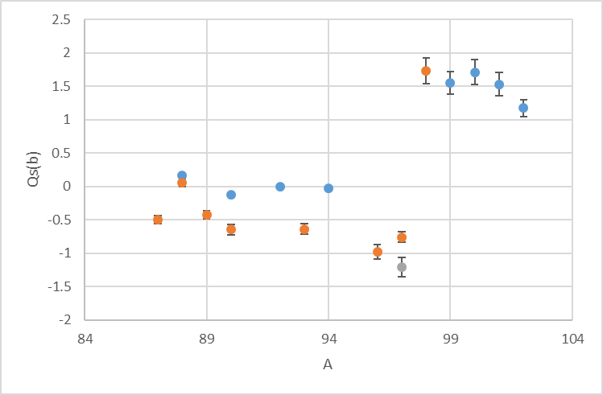
Quadrupole moments
J=1
J=1
J=0
J=0
Prolate
Oblate
3 peaks maximum for each nuclear state
Yttrium contains many isomeric (long-lived) nuclear states
The ⁹⁸Y is at a ”critical point” whereby the ground state exhibits a weakly oblate shape, the isomer a rigid prolate shape
B. Cheal et al., Phys. Lett. B 645 (2007) 133
Notes:
Quadrupole moments indicate a shape transition from (weakly) oblate to (strongly) prolate

Slide 67
Notes:
Quadrupole moments indicate a shape transition from (weakly) oblate to (strongly) prolate

Slide 68
What can we learn from the charge radii?
₄₀Zr
Droplet model isodeformation lines
β₂=0.4
β₂=0.3
β₂=0.0
N=50 shell closure
Notes:
At A~100, the δ<r2> arising from size increase on addition of 1 neutron is ~0.07fm2. If shape changes from $\left\langle {β2}_{}^{2}\right\rangle$ =0 to 0.1, an order of magnitude larger increase is expected! Extreme sensitivity of δ<r2> to changes in nuclear shape!

Slide 69
What can we learn from the charge radii?
₄₀Zr
From a simple droplet model approach – we can expand a deformed charge distribution in terms of spherical harmonics.
Droplet model isodeformation lines
β₂=0.4
Quadrupole deformation parameter (shape)
β₂=0.3
Radius of spherical nucleus of the same volume
β₂=0.0
Note: the sign of the deformation cannot be obtained!
N=50 shell closure
Notes:
At A~100, the δ<r2> arising from size increase on addition of 1 neutron is ~0.07fm2. If shape changes from $\left\langle {β2}_{}^{2}\right\rangle$ =0 to 0.1, an order of magnitude larger increase is expected! Extreme sensitivity of δ<r2> to changes in nuclear shape!

Slide 70
₄₀Zr
Droplet model isodeformation lines
β₂=0.4
β₂=0.3
β₂=0.0
N=50 shell closure
Notes:
Quadrupole moments indicate a shape transition from (weakly) oblate to (strongly) prolate

Slide 71
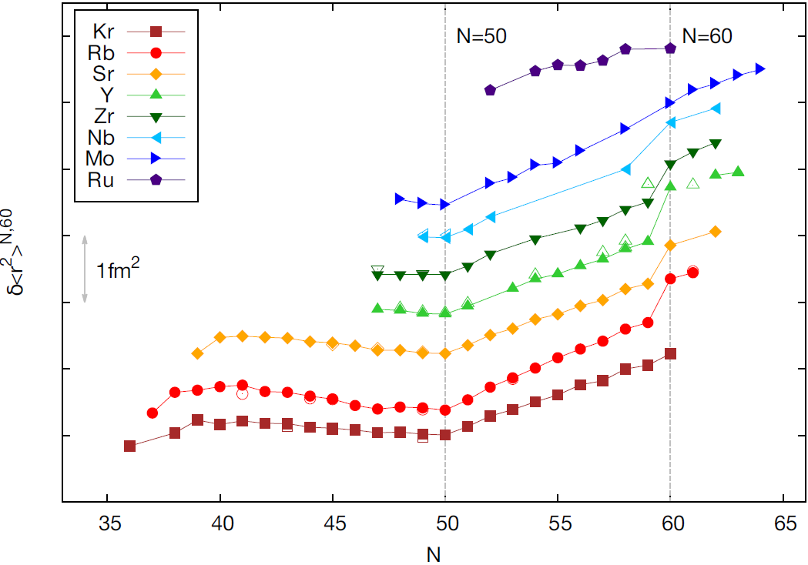
Ru (only stable isotopes)
JYFL
⁹⁷⁻⁹⁹Tc (U-Mainz)*
Due to increase in mean-
square deformation
ISOLDE
N=60 shape change
N=Z=36 (⁷²Kr)
N=50 shell closure
Notes:
Sudden onset of deformation shows up in the ms charge radii. Symmetric in onset and loss of collectivity around Y. Tc long-lived isotopes at U-Mainz with PI-LIST.
It would be very nice to go across N=60 in Kr – ISOLDE? GANIL?

Slide 72
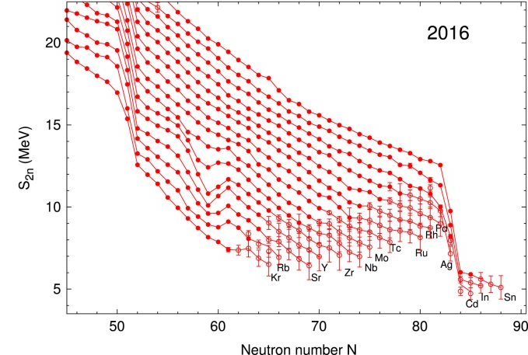

Complementarity: the nuclear mass surface
Pd to Sn
N=82 shell closure
N=50 shell closure
N=60 shape change
T. Eronen et al., PPNP 91 (2016) 259
Notes:
The overall trend is a monotonic decrease of the 2-n separation energy as a function of neutron number due to the filling of less bound, higher orbitals. The kink near N=60 from Kr to Mo is known to be due to the distinct shape change between N=58 and N=60 at which point strong prolate deformation sets in.

Slide 73
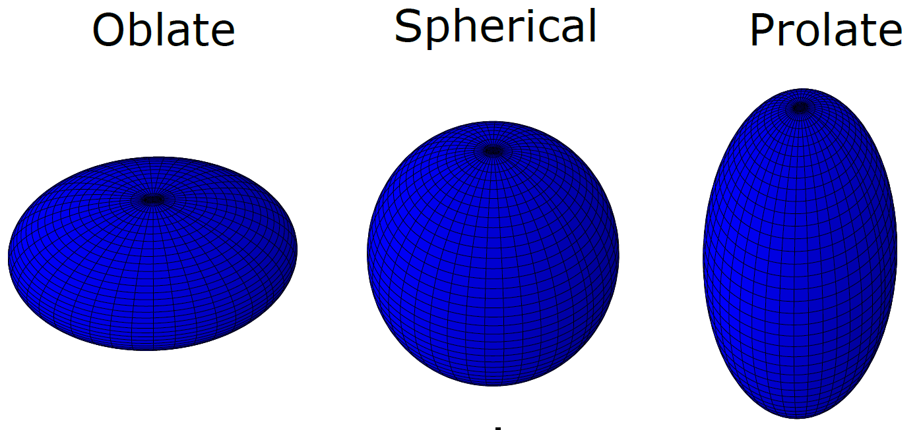
Staggering in the charge radii of Hg isotopes
Huge increase in
charge radius around the neutron mid-shell (N=104);
^{181,183,185}Hg
Shape coexistence established in ¹⁸⁵Hg!
?
data in 1972
data in 1986
data in 1977
J. Bonn et al., Phys. Lett. B 38 (1972) 308
G. Ulm et al., Z. Phys. A 325 (1986) 247
Notes:
Isomeric states are I=13/2. The ground states remain weakly oblate until N=105, sudden shape staggering

Slide 74
After 30 years of developments…
Production rate:
<0.01 /s!!
New results
Data since 1986
End-point of staggering observed, Hg isotopes return to more spherically-shaped trend.
B. Marsh et al., Nature Phys. 14 (2018) 1163, S. Sels et al., Phys. Rev. C 99 (2019) 044306
Notes:
The origin of the staggering is understood microscopically.

Slide 75
Key points
Laser spectroscopy of radioactive atoms has become a mature field
Extraction of nuclear properties requires knowledge of atomic matrix elements
Electromagnetic moments and radii are powerful tools for nuclear structure studies

Slide 76
Part I
Frontiers in laser spec

Slide 77
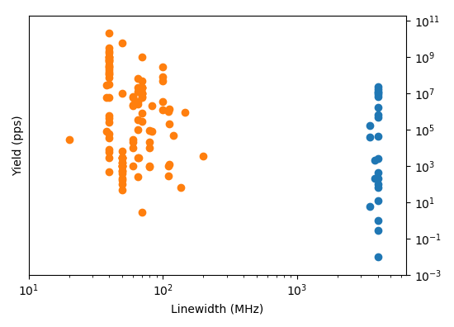
Let’s take stock of where we are
Predominantly collinear fast-beam experiments
Status ~2010
Optical spectroscopy for nuclear structure research
In-source
experiments

Slide 78
Let’s take stock of where we are
Predominantly collinear fast-beam experiments
Status ~2010
Optical spectroscopy for nuclear structure research
Pushing to lower production cross sections
  Mercury shape staggering
In-source
experiments

Slide 79
Let’s take stock of where we are
Predominantly collinear fast-beam experiments
Optical spectroscopy for nuclear structure research
Pushing to lower production cross sections
  Mercury shape staggering
When more precision is needed: collinear fast-beam laser spectroscopy
  Laser spectroscopy of zinc
Status ~2010
In-source
experiments

Slide 80
Let’s take stock of where we are
Predominantly collinear fast-beam experiments
Optical spectroscopy for nuclear structure research
Pushing to lower production cross sections
  Mercury shape staggering
When more precision is needed: collinear fast-beam laser spectroscopy
  Laser spectroscopy of zinc
When even more precision is needed: beyond conventional optical spectroscopy
  Future directions?
Status ~2010
In-source
experiments

Slide 81



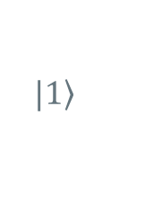
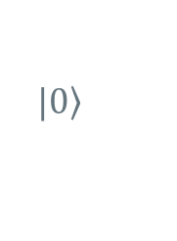


Currently used methods @RIB labs
$$Γ=Δν$$
= 10s of MHz
+ Fast ( can be performed on short-lived isotopes ~ ms)
+ Sensitive (~ few ions/s)
+ Able to reach natural linewidth of strong transitions
Very short laser-ion interaction time O(μs) because the beam is in-flight or because of characteristics of the lasers, environment, …
$$|\left.1\right\rangle$$
$$ν$$
$$|\left.0\right\rangle$$
Strong transition
-> Short half-life O(ns)
-> Broad linewidth

Slide 82
Currently used methods @RIB labs
$$Γ=Δν$$
= 10s of Hz
+ Fast ( can be performed on short-lived isotopes ~ ms)
+ Sensitive (~ few ions/s)
+ Able to reach natural linewidth of strong transitions
Very short laser-ion interaction time O(μs) because the beam is in-flight or because of characteristics of the lasers, environment, …
$$|\left.1\right\rangle$$
$$ν$$
$$|\left.0\right\rangle$$
Strong transition
-> Short half-life O(ns)
-> Broad linewidth
ATOM/ION TRAPS!

Slide 83
Wider context: higher-precision spectroscopy of radioactive ions
GHz
In-source optical spectroscopy
Magnetic dipole moments
Electrical quadrupole moments and charge radii
Hyperfine anomaly
  Relates to the distribution of magnetization inside nuclear volume
Higher-order moments
  Magnetic octupole, electric hexadecapole, …
Higher-order moments of the charge radii
  E.g. <r⁴> relates to surface thickness of nuclear density
Beyond-standard model physics from Hz-level isotope shift spectroscopy
Collinear, in-gas-jet, …
Current state-of-the-art
Laser-rf methods on fast ion beams and thermal beams in traps
Feasible on RIB
Atom/ion traps + laser cooling + ultra-narrow lines
Currently only on stable species
sub-Hz

Slide 84
Part I
Precision frontier

Slide 85
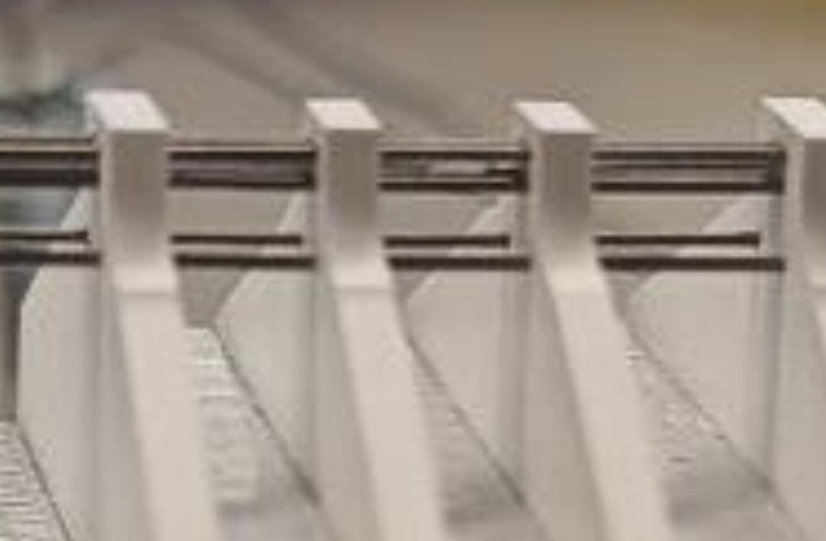
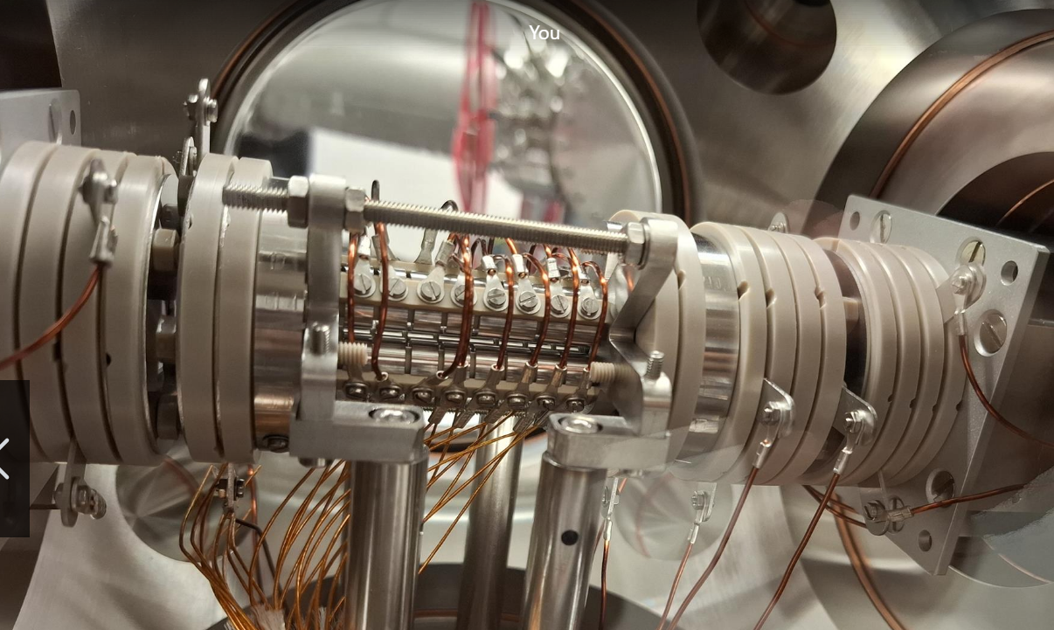
Precision measurements in ion traps
3 mm
In order to perform measurements with long interaction times, we need to store atoms or ions into a trap
Typically Paul traps, but penning traps are
also possible.
Once in the trap, the ions can be carefully
prepared and studied non-destructively!
10 cm

Slide 86
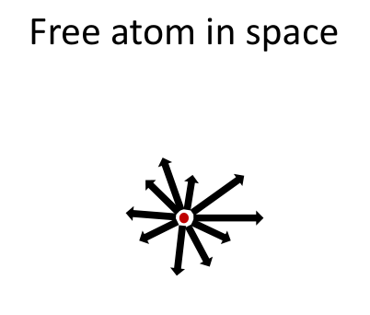
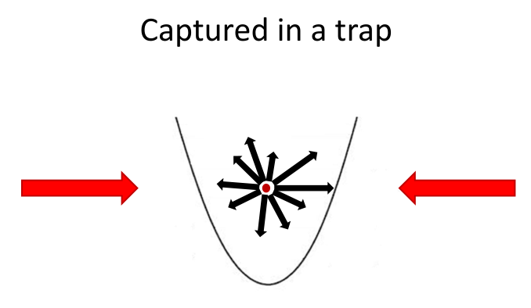
Laser cooling
Ground state cooling via Sideband cooling, Fabian Flassig (TUM)

Slide 87
Laser cooling
Ground state cooling via Sideband cooling, Fabian Flassig (TUM)

Slide 88
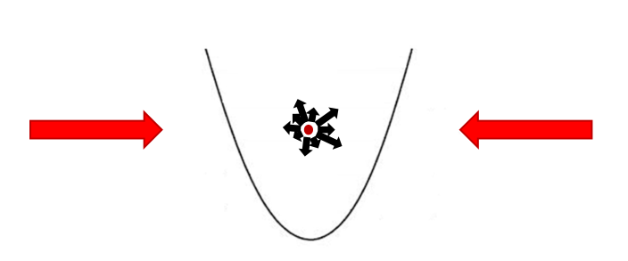
Laser cooling
Ground state cooling via Sideband cooling, Fabian Flassig (TUM)

Slide 89


Precision measurements in ion traps
T = 10 mK ➔ ions form a ‘coulomb crystal’
Storage time: seconds – days – forever… (depending on vacuum)
Fluorescence signal emitted forever
=> optical ‘amplifier’: one ion emits millions of photons
~ 15 μm

Slide 90


Slide 91

Precision measurements in ion traps
Strontium has a simple atomic structure
By using only two lasers, we can cool the ion down
Once the ion has been cooled, precise spectroscopy is possible
  Radiofrequency excitations can be used to precisely measure splittings of the D states

Slide 92

Precision measurements in ion traps
The atom now sits very still, and can be gently examined with a laser beam
Scanning over the optical transition…
~ 1 MHz
Lewty, Nicholas C., et al. Optics Express 20.19 (2012): 21379-21384.

Slide 93

Precision measurements in ion traps
Direct radiofrequency excitations…
~ 50 Hz
20 ms
excitation
Lewty, Nicholas C., et al. Optics Express 20.19 (2012): 21379-21384.
So precise it Herz.

Slide 94
The isotope-dependent hyperfine structure of the atom + nucleus!
The most general form:
Infinite expansion… Each term is significantly smaller than the
previous one.
k = 1: interaction with magnetic dipole moment
k=2: interaction with electric quadrupole moment
…
Fields generated by the electrons
Nuclear electromagnetic moment

Slide 95


Precision measurements in ion traps
Combining the data with
precise calculations by B. Sahoo
  Relativistic coupled cluster (CCSD(T) method)
Consistent value obtained from the two metastable D-states
Nuclear theory interpretation of the result is yet to be made…
Lewty, Nicholas C., et al. Optics Express 20.19 (2012): 21379-21384.

Slide 96
Part I
Wrapping up

Slide 97
Wider context: higher-precision spectroscopy of radioactive ions
GHz
In-source optical spectroscopy
Magnetic dipole moments
Electrical quadrupole moments and charge radii
Hyperfine anomaly
  Relates to the distribution of magnetization inside nuclear volume
Higher-order moments
  Magnetic octupole, electric hexadecapole, …
Higher-order moments of the charge radii
  E.g. <r⁴> relates to surface thickness of nuclear density
Beyond-standard model physics from Hz-level isotope shift spectroscopy
Collinear, in-gas-jet, …
Current state-of-the-art
Laser-rf methods on fast ion beams and thermal beams in traps
Feasible on RIB
Atom/ion traps + laser cooling + ultra-narrow lines
Currently only on stable species
sub-Hz

Slide 98
Summary
Predominantly collinear fast-beam experiments
Optical spectroscopy for nuclear structure research
Pushing to lower production cross sections
  Mercury: shape staggering
When more precision is needed: collinear fast-beam laser spectroscopy
  Laser spectroscopy of zinc
When even more precision is needed: beyond conventional optical spectroscopy
  Future directions?
Missing third axis: elements which are difficult to extract, and/or have complex atomic structure
Status ~2010
In-source
experiments

Slide 99
Summary
Predominantly collinear fast-beam experiments
Optical spectroscopy for nuclear structure research
Pushing to lower production cross sections
  Mercury: shape staggering
When more precision is needed: collinear fast-beam laser spectroscopy
  Laser spectroscopy of zinc
When even more precision is needed: beyond conventional optical spectroscopy
  Future directions: application to RIB!
Missing third axis: elements which are difficult to extract, and/or have complex atomic structure
Status ~2010
In-source
experiments
Ongoing @KULeuven

Slide 100



Refractory elements and very light elements remain a huge challenge
A key role will be played by facilities who can produce these elements in good quantities!
  GSI/FAIR, NSCL/FRIB, GANIL, …
Still, significant work will need to be done to handle the complex atomic structure of these elements

Slide 101
Summary
Next lecture: fundamental physics
Atomic electrons ‘spy’ on the properties of the nucleus
Atoms can be precisely manipulated and interrogated
Atomic spectroscopy is a powerful probe for many properties of nuclei
Observables are generally nuclear-model independent!
Important note: any experiment always measures a product of an atomic matrix element and a nuclear property
  Atomic matrix elements: can be calculated…
    but this is not easy!
    Precision is limited, accuracy can be unknown.

Slide 103
Part I: nuclear physics

Slide 104
Part I: nuclear physics a.k.a. my career so far

Slide 105
Last lecture…
r
Potential is slightly deeper for the
smaller isotope: s-electrons more
tightly bound
Electrons probe nuclear properties
  HFS: spin, moments
  Isotope shifts: size
V(r)
Point nuclear charge:
Coulomb potential (-1/r)
δν_{IS} =
δν_{MS}
+
δν_{FS}
Fields generated by
the electrons
Ze²
Nuclear electromagnetic
moment
Δ|ψ_{e}(0)|²
6hε₀
EXPERIMENT
THEORY

Slide 106
But that’s not the whole story…
Point nucleus + Finite size + Magnetic dipole + Electric quadrupole
F₁
+ higher order perturbative HFS
+ higher multipole order HFS
+ higher order radial moment isotope shift
+ Zeeman effect
+ Bohr Weisskopf effect
+ Breit-Rosenthal effect
+ isotope shift of the atomic
g_{J}-factor
+ ….
Isotope A
F₂
Isotope (A-1)
F₃
Isotope (A-1)
Isotope A
All of this is not ‘new’ physics. It is (in practice often poorly!) known.
Mass shift + Field shift
These energy shifts of may be only a few parts per million of the energy of an optical atomic transition. Optical techniques provide the sensitivity and precision required to measure these effects.

Slide 107

More to learn
Nuclei certainly are complex quantum systems
But so far, we have only 2 parameters to constrain their shape and size
  Q: assuming axial symmetry, oblate/prolate?
  d<r²>: what is the size of only the charge distribution?

Slide 108


More to learn
Nuclei certainly are complex quantum systems
But so far, we have only 2 parameters to constrain their shape and size
  Q: assuming axial symmetry, oblate/prolate?
  d<r²>: what is the size of only the charge distribution?
Triaxiality?
Hexadacapole
deformation?
Matter radii? Neutron distribution? Skin thickness?

Slide 109



Slide 110
Part II: fundamental interactions a.k.a. speculative stuff

Slide 111


But that’s not the whole story…

Slide 112
But that’s not the whole story…
Well-understood (for some definition of ‘well’)
Known, but poorly understood
‘New’, so far only constrained

Slide 113
Plan for the lecture
I want to give you a feeling for what is currently possible
King plots – what, why, how?
Experiment 1: Strontium: Focus on the experiment itself: quantum control.
Experiment 2: Ytterbium: Focus on the result: ‘known’ and ‘new’ physics.
Time permitting: molecular probes for eEDM?

Slide 114
Part II.
King plots

Slide 115


King plots
Two transitions:
y = m x + b

Slide 116


Slide 117
Non-linear king plots
King plot will no longer be linear
Hunt for non-linearities!
  G⁽²⁾: Purely atomic physics; second-order field shift
  G⁽²⁾ d<r⁴ >: nuclear physics information as well
  ‘h’: new boson

Slide 118
Part II.
Experiment 1: Sr

Slide 119





Strong transition
-> Short half-life O(ns)
-> Broad linewidth
-> e.g., Dipole S->P transitions
Weak transition
-> Long half-life O(ms > s > h)
-> Narrow linewidth
-> e.g., Quadrupole S->D transitions
$$Γ=Δν$$
$$Γ=Δν$$
= 10s of MHz
< Hz
$$|\left.1\right\rangle$$
$$|\left.1\right\rangle$$
$$ν$$
$$ν$$
$$|\left.0\right\rangle$$
$$|\left.0\right\rangle$$

Slide 120
Sr⁺ isotope shifts
‘Normal’ way: measure transition frequency in two different isotopes one after the other and subtract
This has many issues:
  Drift in the laser frequency
  Drift of external field
  Changes in trapping potentials
  Total frequency: 10¹⁵ Hz; desired accuracy: < 1 Hz ➔ performance of best optical clocks required…

Slide 121

Sr⁺ isotope shifts
Better way:
Measurement with both isotopes simultaneously
  Remove drift
Measure isotope shift directly
  Shift: O(100 MHz) ➔ lessen requirement by 6 orders of magnitude
Measurement with a clever entangled state
  Remove remaining common-mode noise

Slide 122

Sr⁺ isotope shifts
Better way:
Measurement with both isotopes simultaneously
  Remove drift
Measure isotope shift directly
  Shift: O(100 MHz) ➔ lessen requirement by 6 orders of magnitude
Measurement with a clever entangled state
  Remove remaining common-mode noise
Time evolution

Slide 123
How to produce an entangled state?
Ground state cooling via Sideband cooling, Fabian Flassig (TUM)

Slide 124
How to produce an entangled state?
Ground state cooling via Sideband cooling, Fabian Flassig (TUM)

Slide 125
Precision measurements in ion traps
T = 10 mK ➔ ions form a ‘coulomb crystal’
Storage time: seconds – days – forever… (depending on vacuum)
Fluorescence signal emitted forever
=> optical ‘amplifier’: one ion emits millions of photons
~ 15 μm

Slide 126

How to produce an entangled state?
$$\text{|}ψ⟩\text{ =} |internal⟩⊗|harmonic oscillator⟩$$
Ground state cooling via Sideband cooling, Fabian Flassig (TUM)

Slide 127



Coherent 2-level dynamics
Rabi oscillations

Slide 128


Coherent 2-level dynamics
Rabi oscillations
$$π$$
$$π/2$$

Slide 129

2
1
Ground state cooling via Sideband cooling, Fabian Flassig (TUM)

Slide 130
2
1
Ground state cooling via Sideband cooling, Fabian Flassig (TUM)

Slide 131
1
Ground state cooling via Sideband cooling, Fabian Flassig (TUM)

Slide 132

Ground state cooling via Sideband cooling, Fabian Flassig (TUM)

Slide 133
Ground state cooling via Sideband cooling
Ground state cooling via Sideband cooling, Fabian Flassig (TUM)

Slide 134

How to produce an entangled state?
Sequence of carefully crafted laser pulses
$\left|0\right\rangle ⊗\left|g, g\right\rangle$

Slide 135



How to produce an entangled state?
$$π$$
Sequence of carefully crafted laser pulses
$\left|0\right\rangle ⊗\left|g, g\right\rangle$
$$→ \left|0\right\rangle ⊗\left|e, g\right\rangle$$
Isotope 1
Isotope 2

Slide 136


How to produce an entangled state?
Sequence of carefully crafted laser pulses
$\left|0\right\rangle ⊗\left|g, g\right\rangle$
$$→ \left|0\right\rangle ⊗\left|e, g\right\rangle$$
$$→ \left|0\right\rangle ⊗\left|e, g\right\rangle +\left|1\right\rangle ⊗\left|g, g\right\rangle$$
$$π/2$$
Isotope 1
Isotope 2

Slide 137

How to produce an entangled state?
$$π$$
Sequence of carefully crafted laser pulses
$\left|0\right\rangle ⊗\left|g, g\right\rangle$
$$→ \left|0\right\rangle ⊗\left|e, g\right\rangle$$
$$→ \left|0\right\rangle ⊗\left|e, g\right\rangle +\left|1\right\rangle ⊗\left|g, g\right\rangle$$
$$→ \left|0\right\rangle ⊗\left|e, g\right\rangle +\left|0\right\rangle ⊗\left|g, e\right\rangle$$
Isotope 1
Isotope 2

Slide 138

Measure the phase…
Some really clever trick is then played (which still feels like black magic to me)
Compare the oscillation frequency of this isotope-shift-oscillator to your own ‘local oscillator’ (= a laser)

Slide 139

Measure the phase…
24hrs of data with the same two ions…

Slide 140

Measure the phase…
Oh-oh…

Slide 141
Measure the phase…
Oh-oh…
Turns out the atomic g-factor is isotope-dependent!?

Slide 142


Results from the Sr⁺ measurements
Isotope shift of g-factor:
  Test of atomic many-body methods! Purely an electron correlation effect.
Isotope shift of the optical transition:

Slide 143


Current status of King-plot nonlinearity with Sr
Sr has 3 stable I = 0 isotopes and 1 stable I=9/2 isotope
=> Three isotope shifts = three points in the King plot
King plot shows clear non-linearity!
  Deviation: due to ⁸⁷Sr

Slide 144
Current status of King-plot nonlinearity with Sr
Sr has 3 stable I = 0 isotopes and 1 stable I=9/2 isotope
=> Three isotope shifts = three points in the King plot
King plot shows clear non-linearity!
  Deviation: due to ⁸⁷Sr
New physics? No… due to higher-order hyperfine structure effect ☹
Currently no evidence for remaining non-linearities.

Slide 145


The nuclear physics advantage…
Semi-random example: indium (30 isotopes!)

Slide 146
Part II.
Experiment 2: Yb

Slide 147

A comment about which elements are suitable…
Requirement to laser-cool and to be able to drive these narrow transitions pushes you to ‘column two’
Ytterbium: quasi-two valence electron

Slide 148


Sr⁺
Yb⁺

Slide 149


Sr⁺
Yb⁺

Slide 150

Ytterbium
Accurate nuclear masses are also required!
arXiv:2403.07792

Slide 151
King plots
Two transitions:
y = m x + b

Slide 152

arXiv:2403.07792

Slide 153
Ytterbium
Accurate nuclear masses are also required!
How do we now interpret this nonlinearity?
arXiv:2403.07792

Slide 154

Decompose the non-linearity in λ₊ λ₋ - space
Do this for many different pairs of optical transitions
arXiv:2403.07792

Slide 155

arXiv:2403.07792

Slide 156

arXiv:2403.07792

Slide 157

arXiv:2403.07792

Slide 158
Key points
It’s possible to control the internal and motional state of atoms
This control can be leveraged into better measurement protocols.
Looking for ‘new’ physics invariably means discovering new features of the ‘known’ physics.
Lines between nuclear-atomic-fundamental-quantum become blurry.

Slide 159
Part II.
Molecular probes for eEDMs

Slide 160
Radioactive-molecule spectroscopy towards searches for BSM physics
Slides by:
Michail Athanasakis-Kaklamanakis
Centre for Cold Matter
Imperial College London

Slide 161

How are molecules different from atoms?
Chemical bond(s) $→$ extra degrees of freedom
Bonds vibrate and rotate
  For some bonds, the vibrations themselves also “rotate”!
Vibrational & rotational energy on top of electronic

Slide 162


High-resolution spectroscopy in ¹³⁸BaF
Steimle et al., Phys. Rev. A 84, 012508 (2011)

Slide 163


Molecules for fundamental physics
Nature Materials 9, 649–654 2010
Search for the permanent electric dipole moment of the electron (eEDM)
Non-zero eEDM in laboratory is signature of CP violation in the fundamental forces
Exceptionally small eEDM in the Standard Model ~10⁻³⁵ e cm
P,T-violating nuclear forces can induce a nuclear EDM, manifesting on the molecule via electron-nucleus interaction
Lots of efforts for searches of hadronic, leptonic, nuclear EDMs
Jörg Pretz, RWTH-Aachen

Slide 164



How to look for an EDM? Put it in a strong electric field
$\vec{d}$ in $\vec{E}$ is similar to $\vec{μ}$ in $\vec{B}$
  Spin precession about field axis
Electron with both $\vec{μ}$ and $\vec{d}$ placed in magnetic and electric fields
  If $\vec{E}$ and $\vec{B}$ parallel, precession is faster
  If $\vec{E}$ and $\vec{B}$ antiparallel, precession is slower
$\vec{d}$ is exceptionally small $→$ need to maximize $\vec{E}$ to increase chance of seeing something

Slide 165

Electric field in molecules is enormous!
Electric field $E_{eff}$ in the order of a few GV / cm along molecular axis
Molecular axis can be aligned with laboratory axes using moderate ${\vec{E}}_{ext}$
So, what if we use the molecular electric field to measure eEDM?
${\vec{E}}_{ext}$ is used only to polarize molecules along lab axes

Slide 166







$γ$: How well molecules are polarized
For the eEDM:
$E_{eff}$ / $W_{S}$: Molecular sensitivity to property of interest
Statistical uncertainty scales as $\frac{1}{γE_{eff} τ \sqrt{N}}$
$\sqrt{N}$: Total # of molecules probed in the measurement campaign
For nuclear CP violation,
slight modification:
$τ$: Coherence time – how long molecular states were allowed to evolve freely
Statistical uncertainty scales as $\frac{1}{γW_{S}S_{int} τ \sqrt{N}}$
$S_{int}$: Nuclear CP-violating moment in the intrinsic, body-fixed frame

Slide 167


Benchmarks of Beyond-the-Standard-Model (BSM) theories with the eEDM
https://cfp.physics.northwestern.edu/gabrielse-group/acme-electron-edm.html

Slide 168






Statistical uncertainty scales as $\frac{1}{γE_{eff} τ \sqrt{N}}$
First experimental approach
Intense, slow, and polarized molecular beams
Example: Ultracold YbF experiment @ Imperial College London Courtesy: Michael Tarbutt
$$\sqrt{N}$$
$$τ$$
$$γ$$
$$E_{eff}$$

Slide 169







Statistical uncertainty scales as $\frac{1}{γE_{eff} τ \sqrt{N}}$
Next generation of techniques
Efficiently produced, trapped, and polarized molecules
$$\sqrt{N}$$
$$τ$$
$$γ$$
$$E_{eff}$$
Ion trapping
MOT $→$ Optical lattice
Roussy et al., Science 381, 46 (2023)
Fitch et al., Q.Sci.T. 6, 014006 (2021)

Slide 170



Why go radioactive?
Statistical uncertainty scales as $\frac{1}{γE_{eff} τ \sqrt{N}}$
Practically stable Th
$E_{eff}$ scales with Z³
Naturally, heavier molecules are more sensitive
There is a limit to nuclear stability!
Pa
Ac
Ra

Slide 171




Proposals of radioactive molecules
RaF
AcF
AcF⁺
AcO⁺
PaF³⁺
RaOH
RaOCH₃
RaOCH₃⁺
AcOH⁺
Open-shell molecule
Closed-shell molecule
Laser-coolable

Slide 172

Proposals of radioactive molecules
Schiff moment compared to ²²⁵Ra
Isotope
RaF
AcF
AcF⁺
AcO⁺
PaF³⁺
RaOH
RaOCH₃
RaOCH₃⁺
AcOH⁺
Open-shell molecule
Closed-shell molecule
Laser-coolable
Flambaum and Dzuba, PRA 101, 042504 (2020)

Slide 173

Proposals of radioactive molecules
RaF
AcF
AcF⁺
AcO⁺
PaF³⁺
RaOH
RaOCH₃
RaOCH₃⁺
AcOH⁺
PRA 104, 062801 (2021)
Open-shell molecule
Closed-shell molecule
Laser-coolable

Slide 174
Main challenges: (1) No prior information
Except for U and Th molecules, no spectroscopic information
Production not always obvious, high-temperature chemistry unknown
Theory proposes a molecule. Can we study it experimentally?
RaF and AcF with CRIS!

Slide 175

First spectroscopy: RaF
Collinear Resonance Ionization Spectroscopy at ISOLDE
In-flight neutralization $→$ resonant ionization
Broadband and narrowband lasers, wide tunability, great signal-to-noise
Discover new electronic states with multi-photon excitations

Slide 176

2018: First spectroscopy, broadband
Garcia Ruiz et al., Nature 581, 396-400 (2020)

Slide 177

2021: Rotational structure
²²⁶RaF, no Ra spin
Rotational structure
Propose a realistic laser-cooling scheme
Collaborative project with groups of A. Borschevsky,
L. Skripnikov, R. Berger, T.F. Giesen
Udrescu et al., Nature Physics 20, 202-207 (2024)

Slide 178

2021: Rotational structure
²²⁶RaF, no Ra spin
Rotational structure
Propose a realistic laser-cooling scheme
Can scatter ~1 million photons with only 3 cooling lasers
Udrescu et al., Nature Physics 20, 202-207 (2024)

Slide 179

2021: Rotational structure
²²⁶RaF, no Ra spin
Rotational structure
Propose a realistic laser-cooling scheme
Can scatter ~1 million photons with only 3 cooling lasers
M.A.-K. et al., PRA, Accepted (2024)

Slide 180



2021: Magnetic dipole hyperfine structure
²²⁵RaF
$I$(²²⁵Ra) = 1/2
Magnetic dipole hyperfine structure due to ²²⁵Ra
Observable Bohr-Weisskopf effect
Wilkins et al., arXiv 2311.04121 (2023), Under review

Slide 181



2023: Electric quadrupole interaction
²²³RaF: $I$(²²³Ra) = 3/2
Not finalized
Analysis by Justus Berbalk and Carlos Fajardo-Zambrano, IKS

Slide 182

Main challenges: (2) Scarcity and radioactivity
Not naturally abundant $→$ Can you be competitive in statistics?
  Still powerful for nuclear CP violation
Largely incompatible with ablation sources
  Developments in source technology are necessary
Existing production methods create fast, hot beams, but not intense enough
What is the best direction towards the precision frontier?

Slide 183


Precision experiments with radioactive molecules: Where do we go from here?
Statistical uncertainty scales as $\frac{1}{γE_{eff} τ \sqrt{N}}$
Realistically: incompatible with beam experiments
Ion trapping
MOT $→$ Optical lattice
Technologically ready
Path to polyatomic molecules
Requires rotational cooling
No Coulomb-induced decoherence
Needs starting with a lot of very slow neutrals ( < 100 m/s)
Roussy et al., Science 381, 46–50 (2023)
Fitch et al., Q.Sci.T. 6, 014006 (2021)

Slide 184
Precision experiments with radioactive molecules: Where do we go from here?
Statistical uncertainty scales as $\frac{1}{γE_{eff} τ \sqrt{N}}$
Realistically: incompatible with beam experiments (IGLIS adaptation?)
Biggest limitation right now is production
Need sources for:
Colder (<50 K)
Slower (<1 km/s)
Intense (>10⁶ s⁻¹)
radioactive molecules
Ion trapping
MOT $→$ Optical lattice
Technologically ready
Path to polyatomic molecules
Requires rotational cooling
No Coulomb-induced decoherence
Needs starting with a lot of very slow neutrals ( < 100 m/s)
Roussy et al., Science 381, 46–50 (2023)
Fitch et al., Q.Sci.T. 6, 014006 (2021)

Slide 185
Key points
Molecular probes may be the way forward for e.g. eEDM
Radioactive molecules offer considerable advantages, but we do face even larger challenges
Looking for ‘new’ physics invariably means discovering new features of the ‘known’ physics.
Lines between nuclear-atomic-fundamental-particle-molecular-quantum become blurry.

Slide 186
Conclusions
Atomic/Molecular/Muonic systems provide extremely compelling probes for
  Many-body methods
  ➔ Treatment of electron correlations
  Nuclear physics
  ➔ Model-independent access to several observables
  ➔ New observables on the horizon
  Fundamental interactions
  ➔ Dark bosons? eEDM? …
Multi-disciplinary dialogue will be crucial to fully take advantage of all of these opportunities.
The time has come for coherent manipulation of radioactive species!

Slide 188
Part II
Complimentary methods to probe charge distributions

Slide 189
It all comes back together…
Nuclear physics from and for king plots
Comment about the need for a cross-discipline study of nuclear shape and size
Mu-X as an example of an independent measure for dr^2

Slide 190
But that’s not the whole story…
How can we access the ‘new physics’ among the ‘background’ of atomic and nuclear effects?
More transitions, more isotopes.
Improve atomic and nuclear theory
Different experiments to constrain terms

Slide 191



Muonic atoms: probes of nuclear radii
Bohr model
  $E_{n}∝\frac{mZ^{2}}{n^{2}}$
  $r_{n}∝\frac{n^{2}}{mZ}$
Muons:
  $m_{µ}≈207 m_{e}$
  $τ_{μ}≈2.2 µs$
Effect:
  Enhanced binding energy
  Closer to the nucleus → More sensitive to nuclear effects
K
$$e$$
$$μ$$

Slide 192

Muonic atoms: probes of nuclear radii
Bohr model
  $E_{n}∝\frac{mZ^{2}}{n^{2}}$
  $r_{n}∝\frac{n^{2}}{mZ}$
Muons:
  $m_{µ}≈207 m_{e}$
  $τ_{μ}≈2.2 µs$
Effect:
  Enhanced binding energy
  Closer to the nucleus → More sensitive to nuclear effects
K
$$e$$
$$μ$$

Slide 193

Muonic atoms: probes of nuclear radii
Bohr model
  $E_{n}∝\frac{mZ^{2}}{n^{2}}$
  $r_{n}∝\frac{n^{2}}{mZ}$
Muons:
  $m_{µ}≈207 m_{e}$
  $τ_{μ}≈2.2 µs$
Effect:
  Enhanced binding energy
  Closer to the nucleus → More sensitive to nuclear effects
µK
µ⁻
$$e$$
$$μ$$

Slide 194

Muonic atoms: probes of nuclear radii
Bohr model
  $E_{n}∝\frac{mZ^{2}}{n^{2}}$
  $r_{n}∝\frac{n^{2}}{mZ}$
Muons:
  $m_{µ}≈207 m_{e}$
  $τ_{μ}≈2.2 µs$
Effect:
  Enhanced binding energy
  Closer to the nucleus → larger overlap with nuclear wf
µK
µ⁻
$$e$$
$$μ$$
Muon n = 14 orbital is inside electron n = 1 orbital → electron correlation is negligible

Slide 195


Extracting radii
Finite size correction scales with $\frac{1}{r^{3}}≈{10}^{7}$
Calculate transition energy for many radii → Compare with experiment
Typical limitations:
  Nuclear polarization (theory)
  Nuclear shape (electron scattering)
  Energy calibration
Simple calculations with mudirac code [1]
[1] Sturniolo, Simone, and Adrian Hillier. "Mudirac: A Dirac equation solver for elemental analysis with muonic X‐rays." X‐Ray Spectrometry 50.3 (2021): 180-196.

Slide 196


PSI – High intensity proton accelerator facility (HIPA)

Slide 197


Setup

Slide 198

Setup
Not at all tabletop!
µ beam
Gas inlet

Slide 199

Example: mu-X of silver
Isotope shift
Fine structure

Slide 200
Key points
New physics searches are challenging in part due to contributions of atomic and nuclear effects.
While performing more and better King Plot measurements can help, complimentary information is required.
Muonic atoms may provide one avenue to support this type of research.
Lines between nuclear-atomic-fundamental-particle-quantum become blurry.

Slide 202

Laser spectroscopy
What determines the width of these peaks?
Natural broadening:
Finite lifetime means the energy spread cannot be zero
Dipole-allowed transitions: ~10 MHz

Slide 203

Laser spectroscopy
What determines the width of these peaks?
Natural broadening:
Finite lifetime means the energy spread cannot be zero
Dipole-allowed transitions: ~10 MHz
Power broadening
As we increase the laser power, the electron bounces up and down faster and faster.
Effectively, we decrease Δt for the states involved in the transition.
$$Γ_{power}=Γ_{nat}\sqrt{1+I/{I_{sat}}}$$

Slide 204
Laser spectroscopy
What determines the width of these peaks?
Natural broadening
Power broadening
Pressure broadening: many collisions perturb the energy levels (which also leads to energy shifts…)
These three all give rise to a Lorentzian contribution.
Doppler broadening: atoms moving at different speeds have a different frame of reference. The frequency in that reference frame is different!
This is yields a gaussian contribution.

Slide 205


Power broadening

Slide 206






Pressure broadening
147(20) MHz/mbar
-21(3) MHz/mbar
122(29) MHz/mbar
-51(2) MHz/mbar

Slide 207


Doppler broadening
Hot cavity
Crossed beams
²³²Th

Slide 208


Laser spectroscopy
For a simple two-level atom with states a and b, and a sinusoidal field
Luckily, resonance at the exact energy difference!

Slide 209



Laser spectroscopy
For a simple two-level atom with states a and b, and a sinusoidal field
Luckily, resonance at the exact energy difference!
Selection rules: has to be nonzero
Fine structure:
Hyperfine structure: ΔF = 0, +-1 (but not 0 -> 0).

Slide 210

Laser spectroscopy
For a simple two-level atom with states a and b, and a sinusoidal field
In real-world atoms, we have to consider spontaneous decay and other perturbations as well
These incoherent processes will smear out the beautiful quantum dynamics, and the result is a smooth Voigt profile

Slide 212


A note on high angular momenta…
A transition involving high angular momenta is good for sensitivity to spins and moments
But it comes at a cost! Signal strength is spread over many peaks.
Even with super high production rates, these kinds of measurements on radioactive isotopes are simply not feasible.
R. Heinke, PhD thesis Mainz (2019)

Slide 213


Brief aside about tunable cw lasers…
We want to match the Doppler width of the resonance (few MHz), so we use lasers with a similar bandwidth (<MHz for ring cavity continuous-wave lasers)
Depending on the wavelength we need different laser gain mediums
Frequency doubling and even quadrupling is used to make blue and UV wavelengths as well

Slide 214


Slide 215

Case study – zinc isotopes
1. production
Nuclear reactions induced by high-energy beam hitting a target
Fission of uranium or thorium provides access to many neutron-rich isotopes, including e.g. Zn!
Picking a suitable reaction is one thing, but the next issue is how to get those reaction products from the target to the experimental setup quickly
Spallation
²³⁸U
Fission
Proton beam
hits the target
Fragmentation

Slide 216
Case study – zinc isotopes
1. production
extractor
target
ion source
mass separation
Nuclear reactions induced by high-energy beam hitting a target
Fission of uranium or thorium provides access to many neutron-rich isotopes, including e.g. Zn!
Laser ionization and mass separation is used to only select the isotope of interest, and reduce the amount of unwanted isotopes, molecules,… in the beam
to experiments
kV
projectiles
target material
neutrals
ions

Slide 217

Case study – zinc isotopes
1. production
Nuclear reactions induced by high-energy beam hitting a target
Fission of uranium or thorium provides access to many neutron-rich isotopes, including e.g. Zn!
Laser ionization and mass separation is used to only select the isotope of interest, and reduce the amount of unwanted isotopes, molecules,… in the beam
Laser ionization is an important tool in an RIB lab’s toolbox

Slide 218
Case study – zinc isotopes
3. physics discussion
5/2⁺
0⁺
9/2⁺
Observations?
  Some g-factors positive, some negative
  => relative alignment of l and s
  Two I=1/2 states have very different g-factor
  g-factors line up very nicely ⁶⁹⁻⁷⁹Zn
We can now easily suggest some configurations
Note that g((j^{n}) I ) = g(j)
Thus, suggestion is that e.g. ^{73m}Zn has a
(g_{9/2})⁻³_{5/2} configuration
dashed line: single-particle magnetic moment with g_{s} = 0.7g_{s,free}
C. Wraith et al. / Physics Letters B 771 (2017) 385–391

Slide 220

Pushing towards the edges of production
¹⁰⁰Sn and the neighbouring isotopes are important isotopes to study in our quest to understand the atomic nucleus
Producing these very neutron-poor isotopes is challenging.
Reactions offer only small cross section, and other isotopes with the same mass (but closer to stability) are produced in much larger quantities.
M. Reponen, R. P. de Groote et al, Nature Communications 12 (1), 1-8

Slide 221
Pushing towards the edges of production
I’d like to walk you through a recent experiment to show what it takes to perform measurements at the edges of our production capabilities
Red: published work to date
Gray: N=Z line, where nuclei have the same number of protons and neutrons
M. Reponen, R. P. de Groote et al, Nature Communications 12 (1), 1-8

Slide 222
Pushing towards the edges of production
I’d like to walk you through a recent experiment to show what it takes to perform measurements at the edges of our production capabilities
Red: measured isotopes, some not yet published (look at how me have achieved over the past years!)
Gray: N=Z line, where nuclei have the same number of protons and neutrons
M. Reponen, R. P. de Groote et al, Nature Communications 12 (1), 1-8

Slide 223
Pushing towards the edges of production
Why does silver push out so much further than the other isotopes?
At the heart of the answer: the atomic properties of silver.
M. Reponen, R. P. de Groote et al, Nature Communications 12 (1), 1-8

Slide 224

Pushing towards the edges of production
Why does silver push out so much further than the other isotopes?
At the heart of the answer: the atomic properties of silver.
M. Reponen, R. P. de Groote et al, Nature Communications 12 (1), 1-8

Slide 225

Lines and levels of
Ag I

Slide 226
Structure is alkali-like:
easy to understand, easy to
perform spectroscopy on!
P
D
Lines and levels of
Ag I
S

Slide 227

Lines and levels of
Ag I
Lines and levels of
Ru I

Slide 228

Lines and levels of
Ag I
Lines and levels of
Ru I

Slide 229

In-source laser spectroscopy of ⁹⁶Ag
1. Production
¹⁴N(⁹²Mo, 2p xn) Ag
Ag ions stopped in graphite catcher foil
Diffuse into hot cavity (few ms)
M. Reponen, R. P. de Groote et al, Nature Communications 12 (1), 1-8

Slide 230

49 mm
⌀=8 mm
Catcher
Transfer tube
Recoils
20 mm
OD/ID=4/3 mm
Target Wheel
Primary beam
M. Reponen, R. P. de Groote et al, Nature Communications 12 (1), 1-8

Slide 231


In-source laser spectroscopy of ⁹⁶Ag
Production
Laser ionization spectroscopy
Detection
Count ions as function of laser frequency
Different gates on detector area select different nuclear state
Result:
Ultra clean background conditions
⁹⁶Ag studied with an ”on resonance” detection rate of 1 ion per 5 mins
Demonstrated for ⁹⁵Ag, too!
M. Reponen, R. P. de Groote et al, Nature Communications 12 (1), 1-8

Slide 232
In-source laser spectroscopy of ⁹⁶Ag
1. Production
2. Spectroscopy
Laser ionization spectroscopy
Possible to measure dipole moments and radii because the S_{1/2} ground-state of silver possesses a very large A/μ-ratio
M. Reponen, R. P. de Groote et al, Nature Communications 12 (1), 1-8

Slide 233
In-source laser spectroscopy of ⁹⁶Ag
Production
Laser ionization spectroscopy
3. Detection and removal of contaminants
Ions are injected into Penning trap
Excitations of the ion motion in the trap
  Kick out isobars
  States in silver land on different areas of 2D-MCP detector
M. Reponen, R. P. de Groote et al, Nature Communications 12 (1), 1-8

Slide 234
In-source laser spectroscopy of ⁹⁶Ag
Production
Laser ionization spectroscopy
Detection
Count ions as function of laser frequency
Different gates on detector area select different nuclear state
Result:
Ultra clean background conditions
⁹⁶Ag studied with an ”on resonance” detection rate of 1 ion per 5 mins
Demonstrated for ⁹⁵Ag, too!
M. Reponen, R. P. de Groote et al, Nature Communications 12 (1), 1-8

Slide 235

In-source laser spectroscopy of ⁹⁶Ag
⁹⁵Ag
Production
Laser ionization spectroscopy
Detection
Preliminary
Count ions as function of laser frequency
Different gates on detector area select different nuclear state
Result:
Ultra clean background conditions
⁹⁶Ag studied with an ”on resonance” detection rate of 1 ion per 5 mins
Demonstrated for ⁹⁵Ag, too!
M. Reponen, R. P. de Groote et al, Nature Communications 12 (1), 1-8

Slide 236


In-source laser spectroscopy of ⁹⁶Ag
Closest crossing of N=50 in this region to date
  2nd closest: Mo (Z=42)
Event rate at the end of Penning trap: 0.005 events/s
Background rate: … 0?
Remarkably sharp increase in radius observed
  Comparison to state-of-the-art nuclear Fayans DFT is ongoing – but seems hard to explain with current theoretical tools
M. Reponen, R. P. de Groote et al, Nature Communications 12 (1), 1-8

Slide 238


