Slide 1
Performance of very high-energy electron therapy delivered in conventional and FLASH conditions:
the case of Stereotactic treatments
PhD in Accelerator Physics
Candidate:
Dott. Daniele Carlotti
Thesis Advisor:
Prof. Alessio Sarti
Daniele Carlotti
31/01/2024

Slide 2
Index
RADIOTHERAPY,
FLASH EFFECT & VHEE

Slide 3
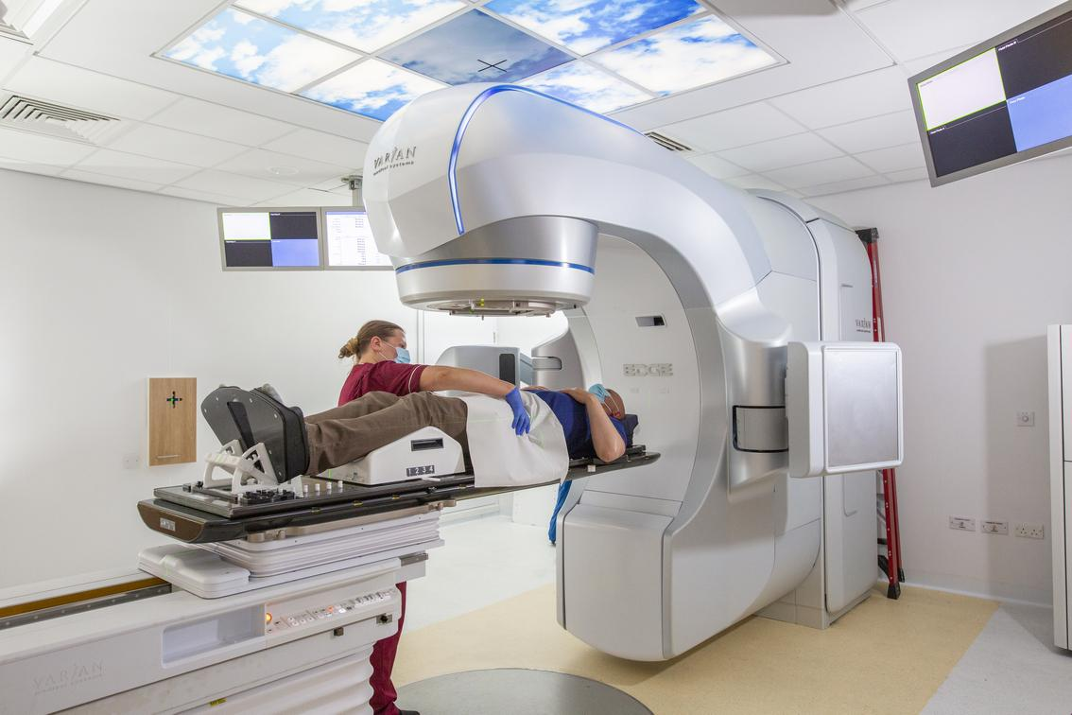
Conventional Radiotherapy
Conventional Radioterapy:
Absorbed dose (2 Gy x Fraction)
Conventional Dose Rate (0.08 Gy/s)
Radiotherapy is a localised, non-invasive, painless therapy, mostly carried out on an outpatient basis, capable of inducing necrosis or the death of tumour cells through the use of high-energy radiation called ionising radiation.
It is estimated that about 60 per cent of cancer patients undergo at least one course of radiotherapy during their care pathway.
Photon radiotherapy is the gold standard in the clinic
Daniele Carlotti

Slide 4
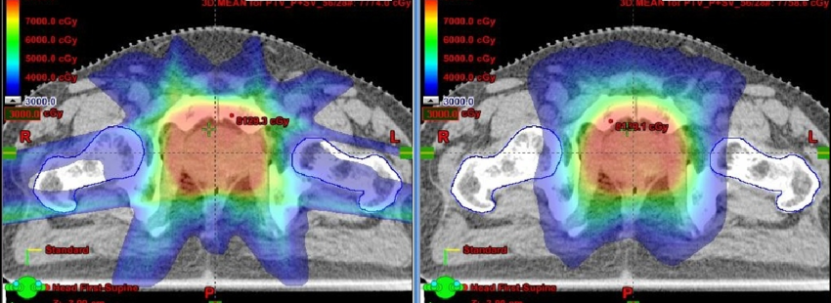
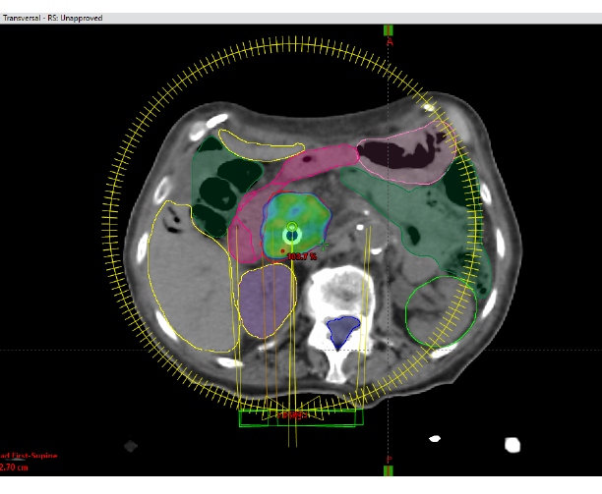
Irradiation techniques:
IMRT and VMAT
Conventional Radiotherapy:
Absorbed dose (2 Gy x Fraction)
Conventional Dose Rate (0.08 Gy/s)
Intensity-modulated radiation therapy (IMRT)
allows for the radiation dose to conform more precisely to the three-dimensional (3-D) shape of the tumor by modulating or controlling the intensity of the radiation beam in multiple small volumes
Intensity-modulated radiation therapy (IMRT)
Volumetric Modulated Arc Therapy (VMAT)
Volumetric modulated arc therapy (VMAT) is a form of radiation therapy used to treat cancer. During treatment, a machine rotates around the patient body, sending multiple energy beams of varying strengths to kill cancer cells and destroy tumors.
Daniele Carlotti

Slide 5
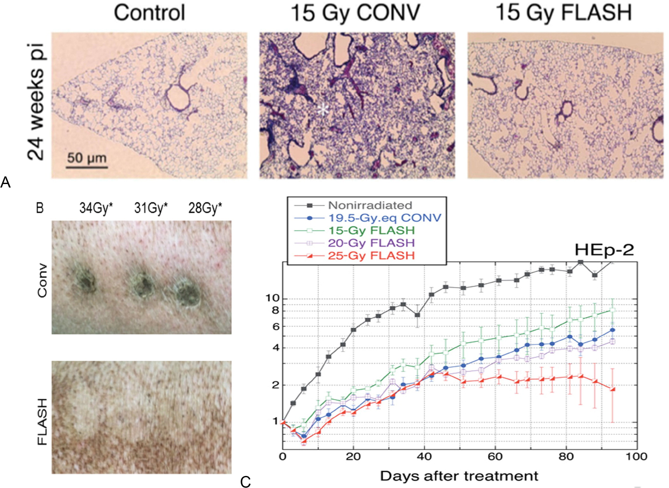
FLASH Effect in radiotherapy
FLASH Effect activation:
High absorbed dose per each fraction (> 3 Gy)
Ultra High Dose Rate (> 40 Gy/s)
FLASH radiotherapy is a technique involving the delivery of ultra-high dose rate radiation to the target. FLASH-RT has been shown to reduce radiation-induced toxicity in healthy tissues without compromising the anti-cancer effects of treatment compared to conventional radiation therapy.
[1] V. Favaudon, L. Caplier, V. Monceau, F. Pouzoulet, M. Sayarath, C. Fouillade, M. F. Poupon, I. Brito, P. Hupé, J. Bourhis, J. Hall, J. J. Fontaine, and M. C. Vozenin. Ultrahigh dose-rate flash irradiation increases the differential response between normal and tumor tissue in mice. Sci Transl Med, 6(245):245ra93, 2014.
[2] J. Bourhis, W. J. Sozzi, P. G. Jorge, O. Gaide, C. Bailat, F. Duclos, D. Patin, M. Ozsahin, F. Bochud, J. F. Germond, R. Moeckli, and M. C. Vozenin. Treatment of a first patient with flash-radiotherapy. Radiother Oncol, 139:18–22, 2019. ISSN 1879-0887. doi: 10.1016/j.radonc.2019.06.019.
Daniele Carlotti

Slide 6
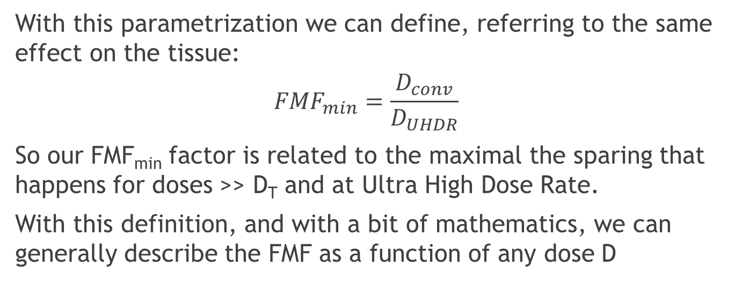
FLASH Effect model
All the parameters (FMF_{min}, DT) can be tissue specific and must be extracted from fit to the data. Currently the error bars are really huge: radiobiological data are badly needed
FLASH Effect activation:
High absorbed dose per each fraction (> 3 Gy)
Ultra High Dose Rate (> 40 Gy/s)
Mouse
Lungs
[3] T. T. Böhlen, J. F. Germond, J. Bourhis, M. C. Vozenin, E. M. Ozsahin, F. Bochud, C. Bailat, and R. Moeckli. Normal tissue sparing by flash as a function of single fraction dose: A quantitative analysis. Int J Radiat Oncol Biol Phys, 114(5):1032– 1044, 2022. ISSN 1879-355X.
Daniele Carlotti

Slide 7
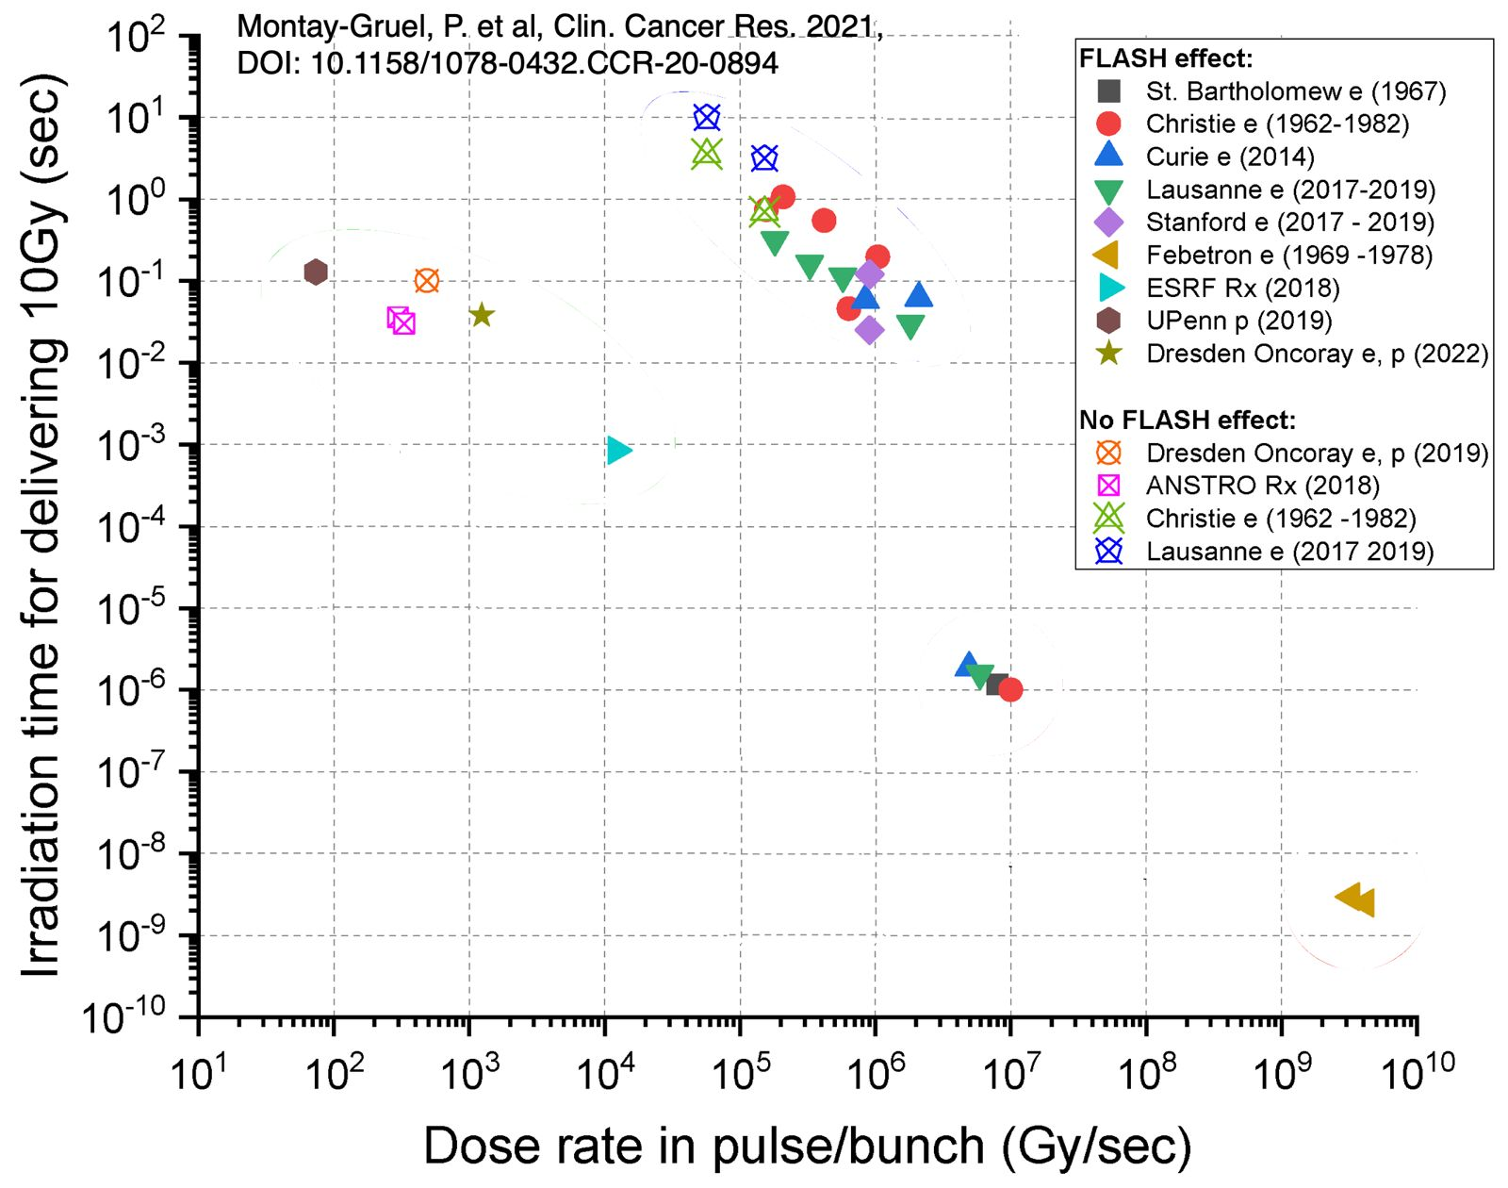
FLASH: the beam delivery
Going FLASH’ is not just a matter of ‘total absorbed dose’. One has also to deliver the dose within a given total time.
Changing the beam energy with protons becomes really difficult
VHEE have the nice advantage that with a ‘single energy’ a complete field can be delivered!
The points marked with an x in the graph are related to experiments not observing a significant FLASH effect
Need to explore the ‘active scanning’ solution
[4] Montay-Gruel P, Acharya MM, Jorge PG, et al. Hypofractionated FLASH-RT as an effective treatment against glioblastoma that reduces neurocognitive side effects in mice. Clin Cancer Res. 2021;27(3):775-784.
Daniele Carlotti

Slide 8
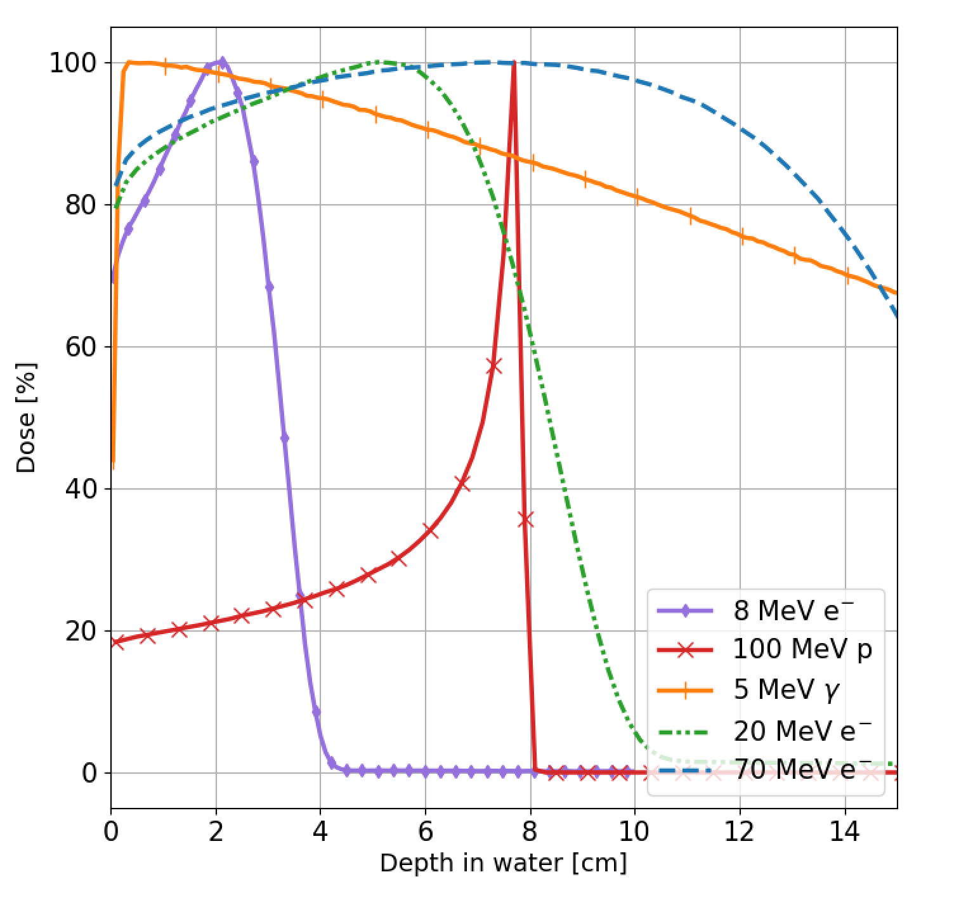
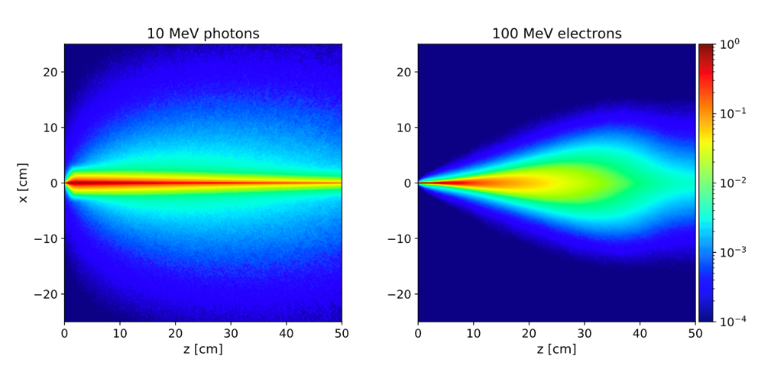
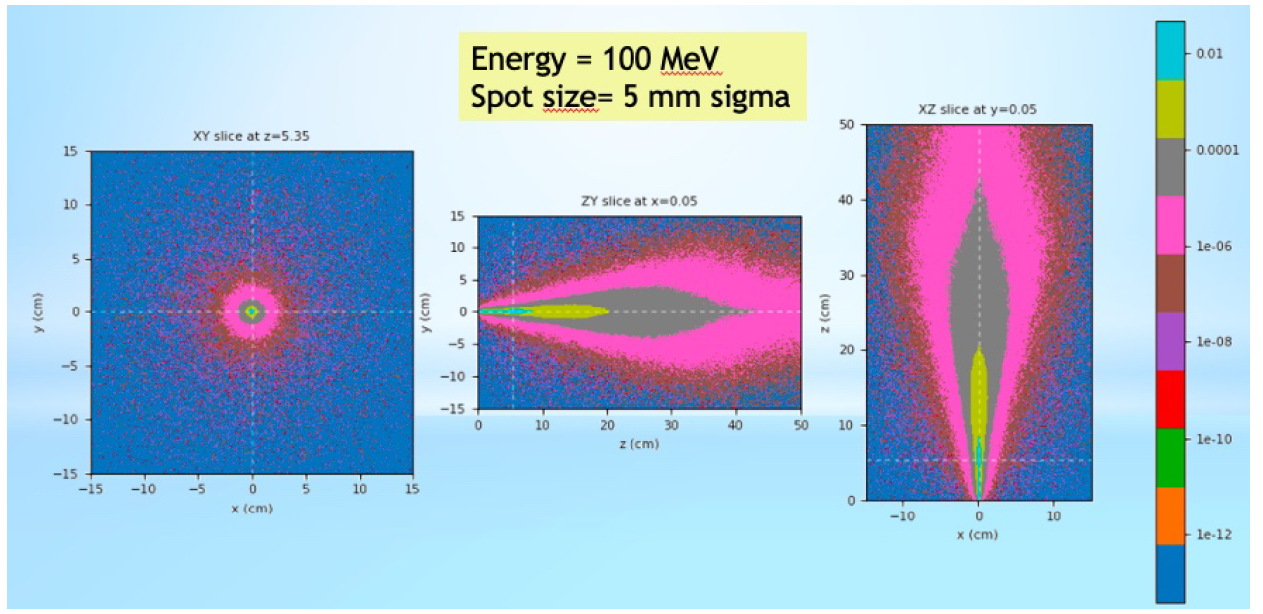
Very High-Energy Electron (VHEE)
When discussing VHEE one needs to keep in mind:
VHEE are suitable for FLASH delivery
Machine dimension
Electron energies never tested in the clinic
The commercial availability of C-band accelerators makes it possible to build compact machines,
if clinical applicability is demonstrated VHEE may have a new chance over protons in the treatment of tumours precisely because the FLASH effect with electrons is facilitated.
But it must be proved that with these energies and with this type of Pencil beam it is possible to have a quality comparable to VMAT.
𝛾
e⁻
Daniele Carlotti

Slide 9
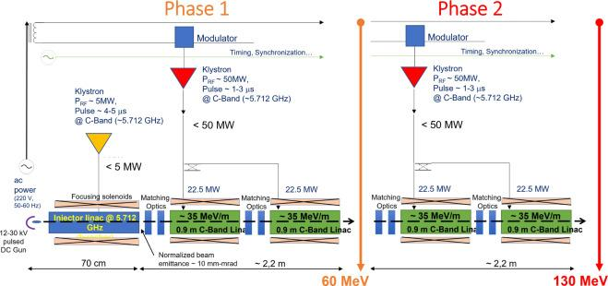
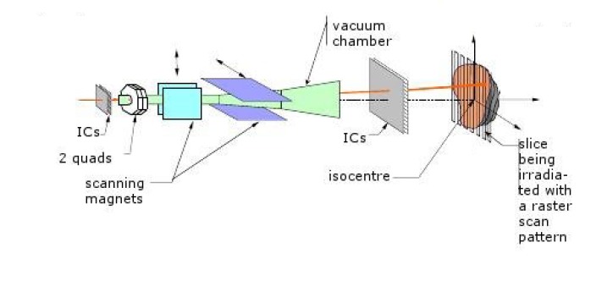
Prototype VHEE Accelerator
A possible implementation being explored in Sapienza
High-lines:
To move from superficial (4-12 MeV) to deep-seated (up to 130 MeV) tumors.. a ‘new’ compact accelerator is needed
[5] L. Giuliano, D. Alesini, M. Behtouei, F. Bosco, M. Carillo, G. Cuttone, D. De Arcangelis, L. Faillace, V. Favaudon, L. Ficcadenti, S. Heinrich, M. Migliorati, A. Mostacci, L. Palumbo, A. Patriarca, B. Spataro, and G. Torrisi. Preliminary Studies of a Compact VHEE Linear Accelerator System for FLASH Radiotherapy. In Proc. IPAC’21, number 12 in International Particle Accelerator Conference, pages 1229– 1232. JACoW Publishing, Geneva, Switzerland, 08 2021.
Daniele Carlotti

Slide 10
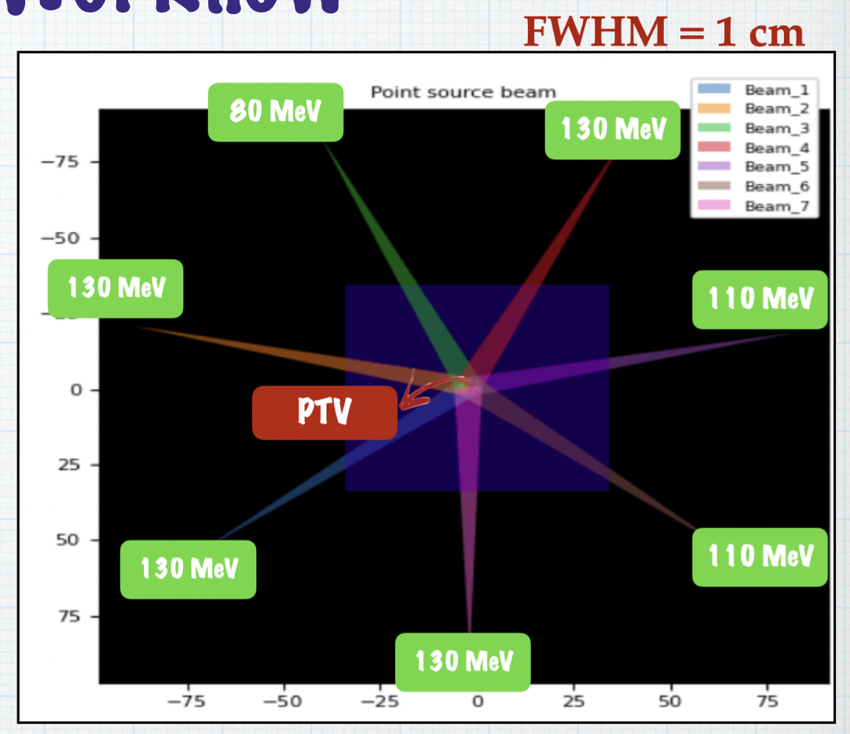
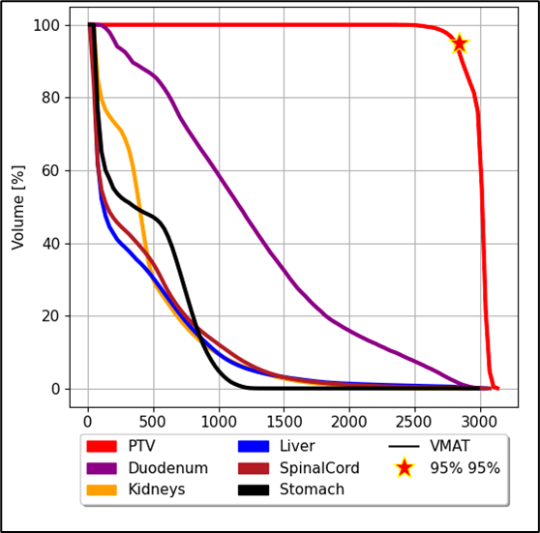
Building a treatment plan
To develop the first treatment plans:
I used the infrastructure in the SBAI department
I spent about six months constructing each treatment plan for each patient.
constructing a treatment plan is a process involving several competencies: as it is necessary to find the best way to treat the patient while keeping the risk of irradiation of healthy organs acceptable. Dose prescription will also be of paramount importance as the FLASH technique prefers high dose prescriptions per single fraction.
Simulate the dose per pencil beam with 10^5 events per pencil beam taking into account the particle path on the Patient's CT scan and optimise the fluence of each pencil beam
Choose the direction of the field and energy so that they spare healthy organs and intercept the tumour
Distribute the pencil beams for each field so that they cover the entire surface of the tumour
Evaluate the results obtained using the Dose-Volume Histogram estimating the dose absorbed by each organ
Beam field of view of the tumor
Daniele Carlotti

Slide 11
Treament Planning System
We consider a basic, “general” Treatment Planning System working on a multi-spots, multi-field delivery system. The different description of the beam model (flat beam, pencil beam , etc etc) adapts the TPS to the different beam. The algorithm we currently use for the optimization of a treatment with VHEE is based on the Proton Therapy algorithm (LOMAX) for pencil beam, rearranged for electrons.
Radioterapy:
[6] A. Mairani, T. T. Böhlen, A. Schiavi, T. Tessonnier, S. Molinelli, S. Brons, G. Battistoni, K. Parodi, and V. Patera. A monte carlo-based treatment planning tool for proton therapy. Phys Med Biol, 58(8):2471–90, 2013. ISSN 1361-6560. doi: 10.1088/0031-9155/58/8/2471.
Daniele Carlotti

Slide 12
Index
FIRST CASE STUDY
STEREOTACTIC PANCREAS

Slide 13
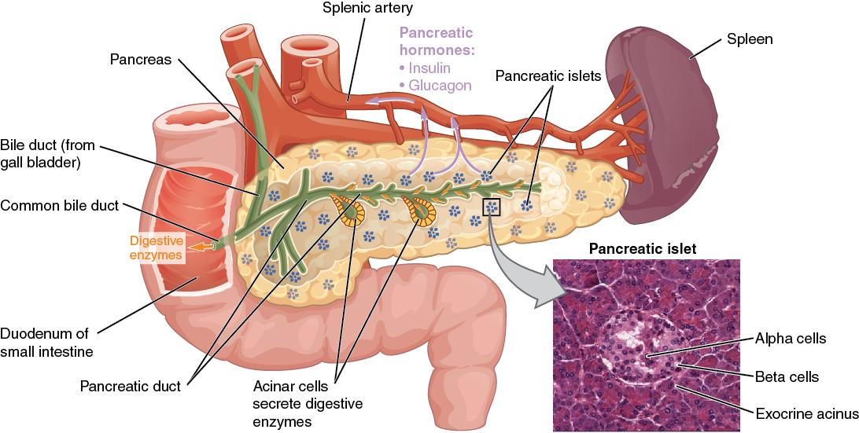
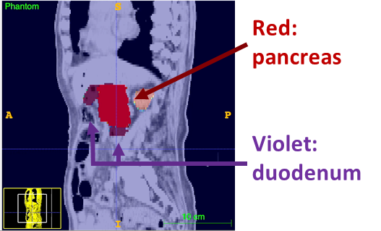
STEREOTACTIC PANCREAS
PATOLOGY
Pancreas is a difficult tumour to treat, dose prescribed in current treatment plans is not sufficient because being a very aggressive disease it would require high prescriptions but constraints on the duodenum limit the prescription.
High-lines:
Tumor Prescription 6 Gy x 5 fr =30Gy
Duodenum Constraints: Dmax 35 Gy
Spinal cord Constraints: Dmax 35 Gy
Kidneys Constraints: Mean Dose 10 Gy
The geometry of the patient limits the possibility of treatment with external beam radiotherapy because the duodenum is anatomically attached to the pancreas.
In order to evaluate the doses absorbed by each organ, we use international guidelines as a reference to quantify the probability of occurrence of toxicity to an organ as a function of the dose absorbed by it. There are therefore reference constraints for each specific organ.
Patient 1 pancreas
Anatomy
Daniele Carlotti

Slide 14
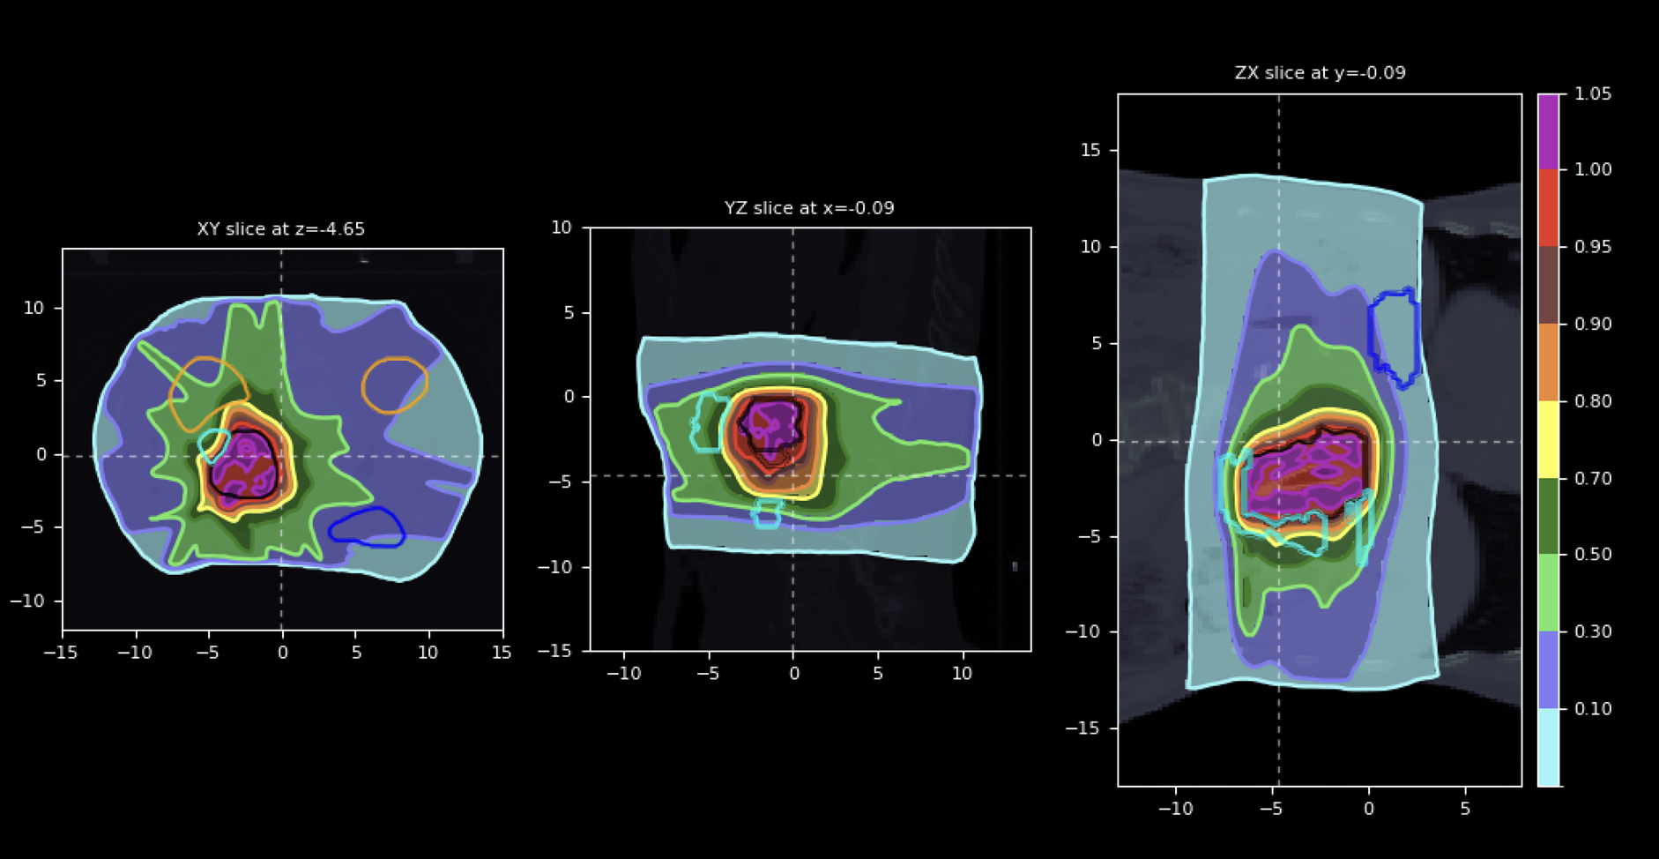
Dose distribution VHEE PANCREAS
High-lines:
Tumor Prescription 6 Gy x 5 fr =30Gy
Duodenum Constraints: Dmax 35 Gy
Spinal cord Constraints: Dmax 35 Gy
Kidneys Constraints: Mean Dose 10 Gy
Beam field of view of the tumor
Workflow to build plan
Kidneys Duodenum
Dose distributions on the patient were simulated and optimized in order to assess tumor coverage and preservation of healthy organs.
The isodose is the line connecting the points on a subject's body where the absorbed dose of radiation has the same value, i.e., isoline of absorbed dose.
The graph shows isodose curves expressed as a percentage of the prescription dose.
in red 28.5 Gy in dark green 15 Gy in blu 3Gy
Daniele Carlotti

Slide 15
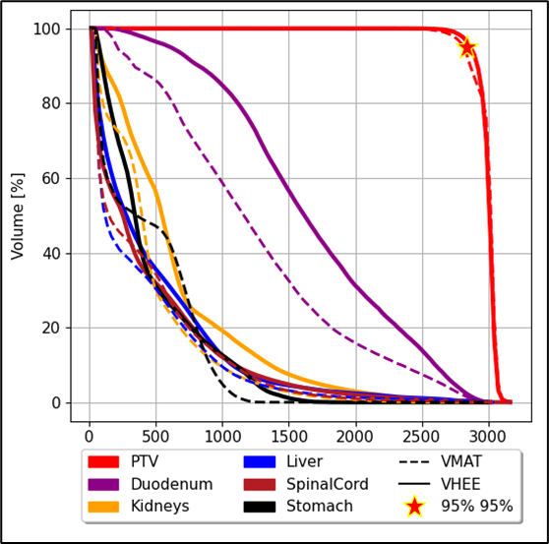
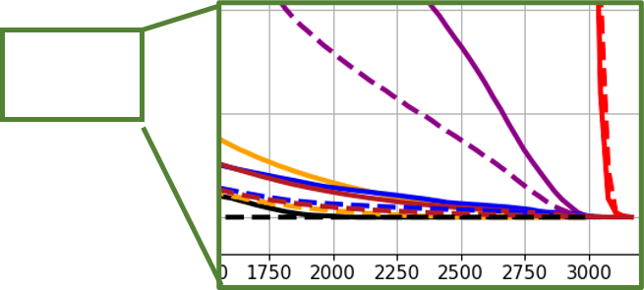
DVH RESULTS PANCREAS VMAT VS VHEE
A dose-volume histogram (DVH) is a histogram relating radiation dose to tissue volume in radiation therapy planning. DVHs are most commonly used as a plan evaluation tool and to compare doses from different plans or to structures.
Organ | Constraint | VMAT | VHEE
Tumor (PTV) | V95%>95% D_{max} < 107% | 97% 0.04% | 98.4% 0.01%
Duodenum | D_{max} < 33 Gy (optimal) V25(Gy) < 6% | 30.3 Gy 7.4 % | 30.2 Gy 16.4 %
Stomach | D_{max} < 33 Gy (optimal) V25(Gy) < 6% V12(Gy)< 31% | 13.4 Gy 0% 0.4% | 20.7 Gy 0% 9.8%
Spinal Cord | D_{max} < 35 Gy (mandatory) | 8.6 Gy | 9.6 Gy
Kidneys | D_{mean}<10 Gy | 4.5 Gy | 6.7 Gy
Liver | D_{mean}<13 Gy V10(Gy)< 70% | 3.6 Gy 9.4 % | 5.0 Gy 15.4 %
Daniele Carlotti

Slide 16
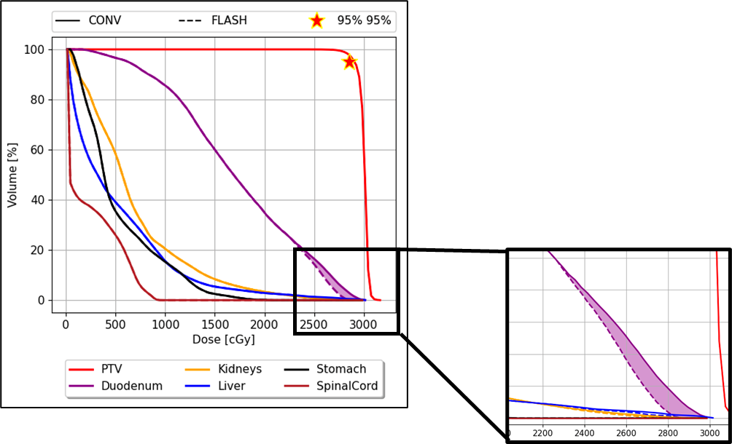
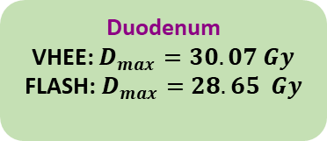
DVH RESULTS PANCREAS WITH FLASH
D_{th} = 4.5 Gy/fraction FMF_{min} = 0.8
The threshold on 5 fractions adds up to 22.5 Gy
The FLASH effect mitigate exactly the critical high dose region of duodenum
Due to the threshold, no effect can be seen elsewhere
Daniele Carlotti

Slide 17
Index
DOSE RATE STUDY
FOR FLASH APPLICATION

Slide 18
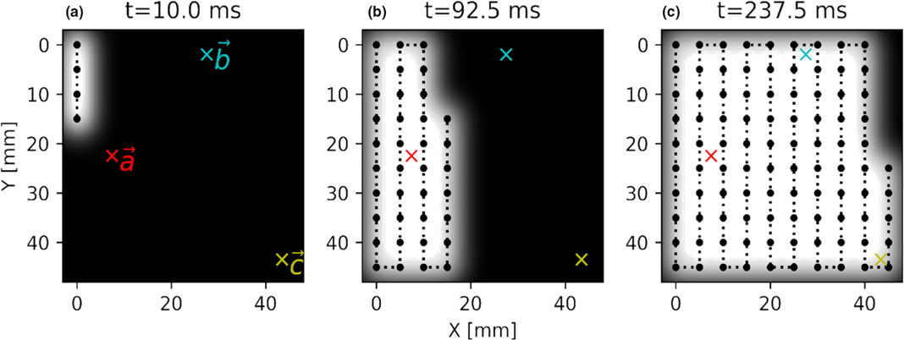
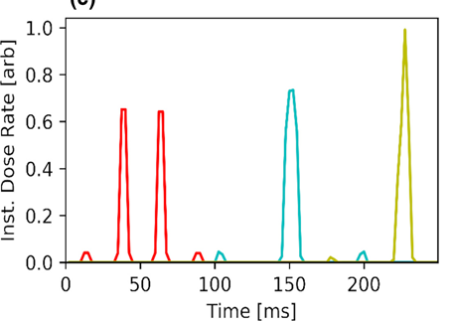
Dose rate for FLASH effect
As example we take a proton therapy spot scanning as use case.
The time for a voxel to accumulate the max dose is a fraction of the total time of irradiation.
Instantaneous dose rate
The dose rate depends on the scanning pattern and the relative position between the spots.
[7] Medical Physics, Volume: 47, Issue: 12, Pages: 6396-6404, First published: 10 September 2020, DOI: (10.1002/mp.14456)
Daniele Carlotti

Slide 19
Average Dose Rate
The ADR consider the bulk of the dose release (from the very near PBs) to evaluate a “robust”dose rate
d* preset dose-threshold that determines the effective irradiation time
Daniele Carlotti

Slide 20
Average Dose Rate For Pancreas
Highlines:
Although hypofractionation makes treatment of the pancreas very attractive for FLASH, beam delivery is still challenging because it is complicated to achieve an Average Dose Rate that is greater than 40 Gy/s.
But the beam delivery challenge is still open…
no healthy tissue achieves 40 Gy/s
Daniele Carlotti

Slide 21
Clinical difficulties
If we use 7 treatment fields in order to ensure healthy organs are spared, from the dose rate study, it is more difficult to apply the FLASH effect because given the large tumor volume and the dose per fraction limited by the prescription of 6 Gy, pencil beams do not simultaneously guarantee exceeding the 3Gy threshold and the dose rate of 40 Gy/s per single field
High-lines:
Tumor Prescription 6 Gy x 5 fr =30Gy
High absorbed dose per each fraction (> 3 Gy)
Ultra High Dose Rate (> 40 Gy/s)
Tumor Prescription 6 Gy x 5 fr = 30Gy
6 Gy / 7 Fields ~ 0.86 Gy per field
we need, in order to put ourselves in a safer state than FLASH activation, a pathology that offers:
a higher dose per fraction,
a relatively small tumor volume,
and a number of treatment fields that is concordant with at least the 3 Gy per single field
That's why we went to the second case study: the lung
Daniele Carlotti

Slide 22
Index
SECOND CASE STUDY
LUNG LESIONS
NON-SMALL-CELL-LUNG CANCER (NSCLC)

Slide 23
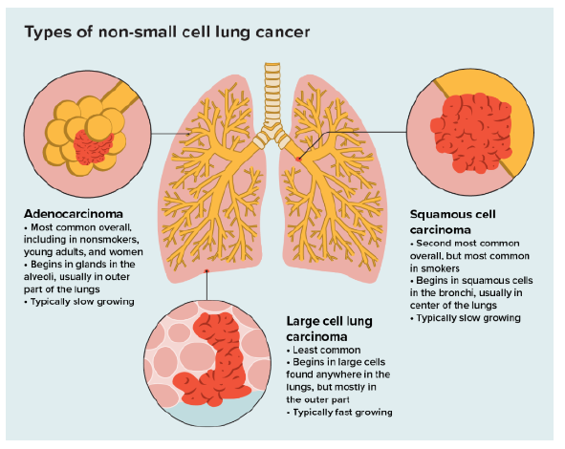
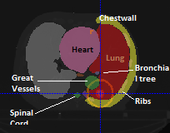
LUNG LESIONS NSCLC
High-lines:
Tumor Prescription 12Gy x 4 fr =48Gy
Ribs Constraints: Dmax 43 Gy
Spinal cord Constraints: Dmax 23 Gy
Patient 1 lung tumor
Lung cancer is another very difficult disease because if taken at an advanced stage it is difficult to treat, our specific case are tumors taken at an early stage and in fact the treatment volume does not exceed 5 cm^3.
This will allow us to be able to guarantee a safeguarded FLASH activation in a better way, moreover, the case was studied with 4 treatment fields precisely with a view to being FLASH on each individual field.
Daniele Carlotti

Slide 24
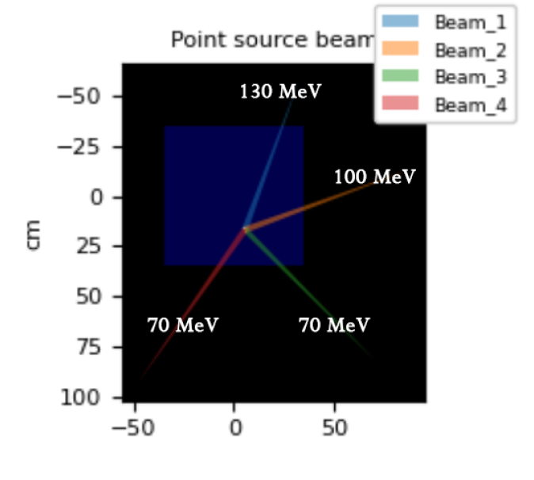
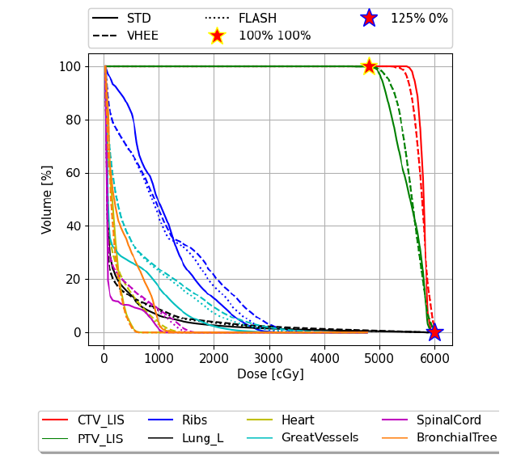
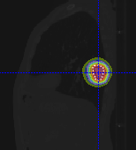
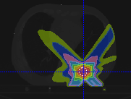
Lung VHEE isodose
High-lines:
Tumor Prescription 12Gy x 4 fr =48Gy
Ribs Constraints: Dmax 43 Gy
Spinal cord Constraints: Dmax 23 Gy
Beam field of view of the tumor
Workflow to build plan
The plan was built and optimized so that the 50% prescription isodose was all contained within a maximum area of 2 cm from the tumor.
Respecting constraints and trying to give less dose to the lungs and also the directions of the beams avoid the spinal cord.
48 Gy
38.4 Gy
28.8 Gy
24 Gy
19.2 Gy
14.4 Gy
9.6 Gy
4.8 Gy
Daniele Carlotti

Slide 25
DVH RESULTS
VMAT, VHEE and VHEE FLASH
Organ | Constraint | VMAT | VHEE | VHEE FLASH FMF 0.8
Tumor (PTV) | V100%>95% D_{max} < 125% | 99.87% 0.002% | 99.79% 0.2% | 99.19% 0.2%
Bronchial Tree | D_{max} < 30 Gy (mandatory) | 14.1 Gy | 6.2 Gy | 6.01 Gy
Ribs | D_{max} < 40 Gy (optimal) | 32.2 Gy | 41.2 Gy | 37.6 Gy
Spinal Cord | D_{max} < 23 Gy (mandatory) | 11.3 Gy | 16.6 Gy | 15.5 Gy
Heart | D_{max}<26 Gy (mandatory) | 6.7 Gy | 14.6 Gy | 13.5 Gy
Lungs - tumor | V20(Gy)< 15% (mandatory) | 1.12% | 1.7% | 1.5%
The DVH shows that the dose per single organ compared in the 3 treatment cases (VMAT, VHEE and VHEE FLASH) is comparable and thus that all 3 plans for this case are approvable because international constraints are met.
Daniele Carlotti

Slide 26
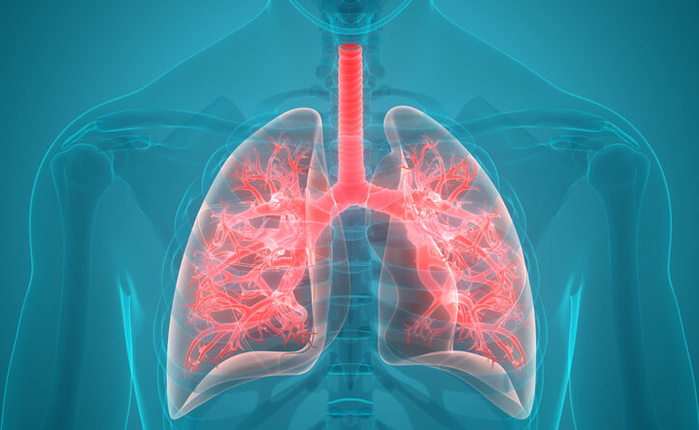
DVH RESULTS
Don’t show the real Toxicity for the lungs
Although the 3 treatment plans are all acceptable as dose to healthy organs and as dose coverage of the tumor, the dose distribution does not provide direct access to the advantages that FLASH may imply in this type of treatment
To evaluate the possible FLASH benefit, dose calculation is not sufficient, one needs the prediction of biological damage in various scenarios.
Biological damage in the case of the lung are fibrosis and pneumonia, so I studied these effects according to the dose and the fractionation used.
Daniele Carlotti

Slide 27
Index
FROM DOSE TO BIOLOGICAL DAMAGE

Slide 28
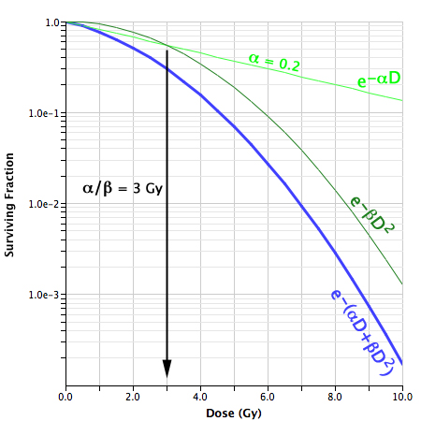
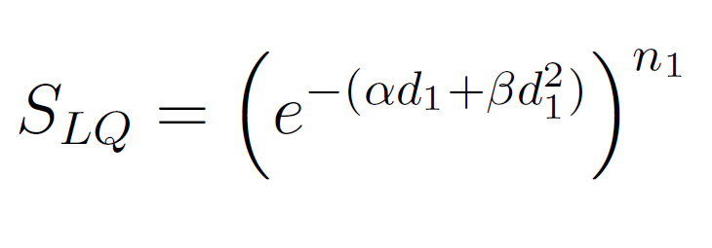
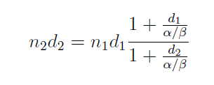
Linear quadratic radiobiological model
The linear quadratic model (LQ) was developed as a mechanistic model to describe the radiobiological effects of cell killing and sublethal repair. The LQ describes the probability of DNA double-strand breaks (DSBs), considered to be the lethal radiation-induced damage. This probability is governed by a linear component representing the single-track damage that causes a DSB, while the quadratic component arises from two separate actions on DNA that lead to DSBs.
S = Cell survival fraction
d1 = dose per fraction
n1 = number of fractions
α =linear component representing the single-track damage
β =DSB by breaking both strands of DNA in a single event
From this equation it follows that n1 fractions given with d1 Gy per fraction is converted to a second fractionation scheme with n2 fractions given with d2 Gy per fraction by:
we can then correlate biological effects at different fractionations and for different doses
Daniele Carlotti

Slide 29
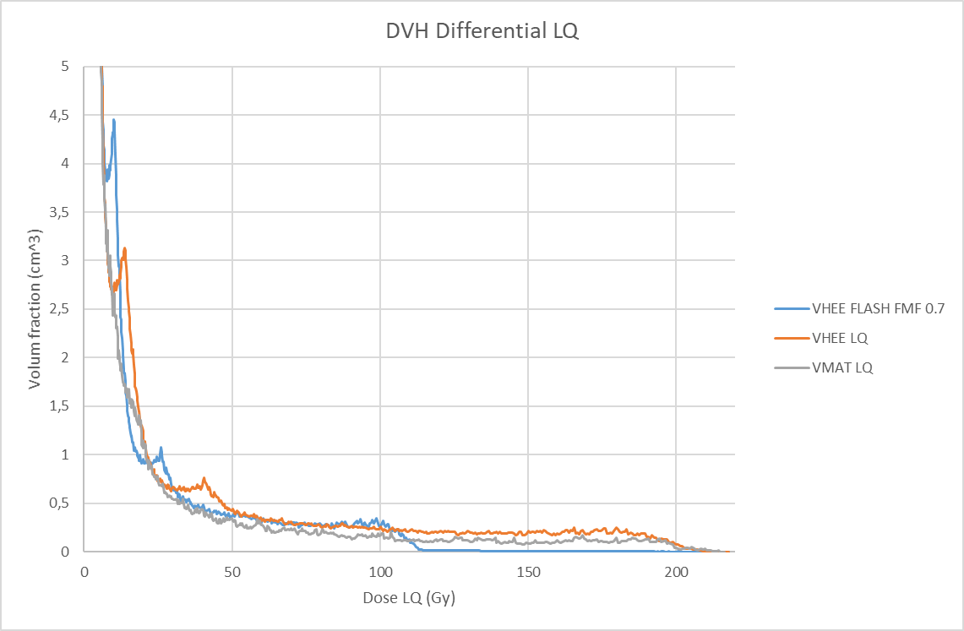
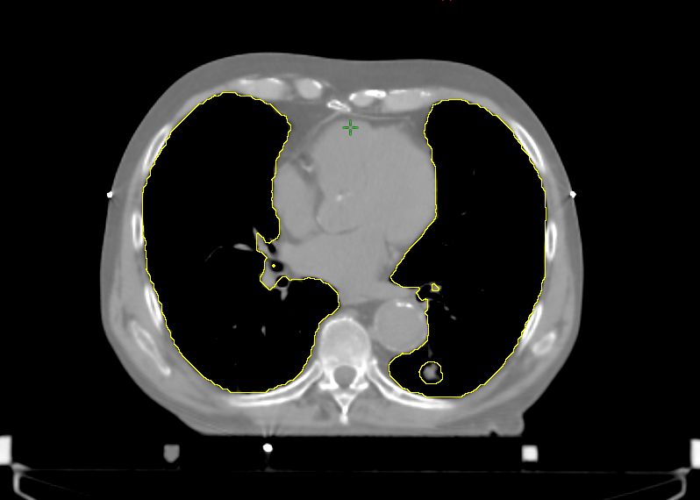
Total equieffective dose in 2 Gy
With the this formula, it was then possible to correct the dose absorbed by the lungs in order to equate the biological damage received as if it had been received in 2 Gy fractions (EQD2). It was necessary to transform the dose because then we could compare each portion of the lung.
DVH differential is the frequency distribution within the volume of interest (In our case, the lungs).
In the DVH the corrected dose in EQD2 is shown.
Flash effect evidence in blu curve
Daniele Carlotti

Slide 30
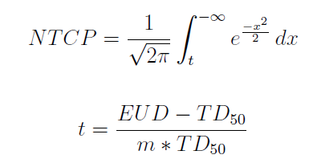
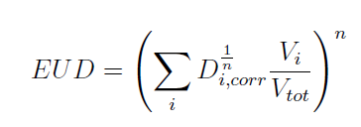
Normal tissue complication probability (NTCP)
The Lyman-Kutcher-Burman (LKB) [120] models in particular, is the most well-known and traditionally accepted method for predicting toxicity after EBRT. That model basically relies on dose volume histograms (DVHs) to account for dose distribution inside the OARs under consideration, and implicitly treat them as homogeneous in their response to radiation.
Were Equivalent Uniform Dose (EUD) is defined as the absorbed dose that, if homogeneously delivered to a tissue, causes the same expected number of clonogens to survive as the actual non-homogeneous absorbed dose distribution does.
m = curve steepness
TD50 = the dose for which the probability of a selected response is 50%
n = a volume dependence parameter
Comes from a Swedish phase II study
Radiobiological parameters
[8] B. M. Wennberg, P. Baumann, G. Gagliardi, J. Nyman, N. Drugge, M. Hoyer, A. Traberg, K. Nilsson, E. Morhed, L. Ekberg, L. Wittgren, J. Lund, N. Levin, C. Sederholm,
R. Lewensohn, and I. Lax. Ntcp modelling of lung toxicity after sbrt comparing the universal survival curve and the linear quadratic model for fractionation correction. Acta
Oncol, 50(4):518–27, 2011. ISSN 1651-226X. doi: 10.3109/0284186X.2010.543695
Daniele Carlotti

Slide 31
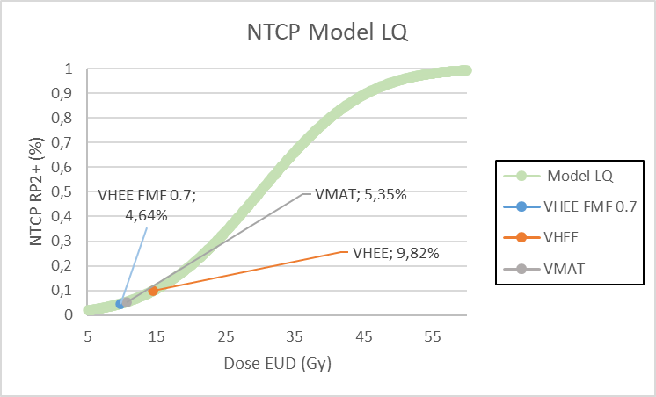
Results
To summarise the results, it can be seen from the table that VHEEs have a probability of radiation pneumonitis around 10% coherent with the international study. With an equivalent uniform dose reflecting the results of 14.4 Gy for VHEE, 10.6 Gy for VMAT and 4.6 Gy for VHEE with FLASH.
With this modeling, FLASH could overcome VMAT.
VHEE
FMF 0.7
VMAT
Lungs-CTV | EUD | NTCP
VHEE FLASH FMF 0.7 | 9,8 | 4,6%
VHEE | 14,4 | 9,8%
VMAT | 10,6 | 5,3%
~4.6%
く
~5.3%
Daniele Carlotti

Slide 32
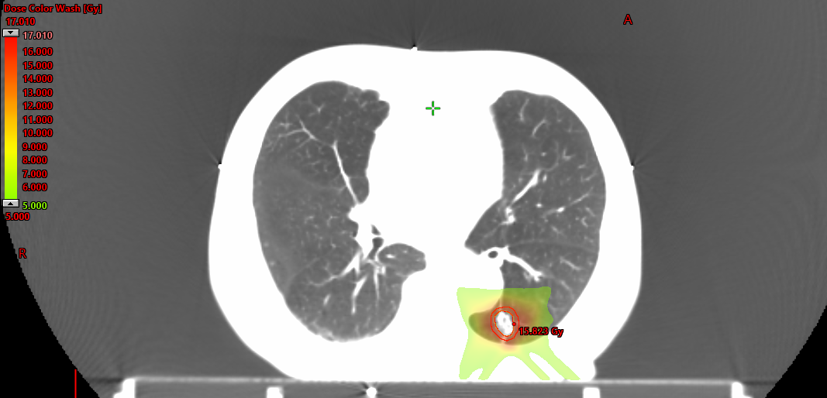
FLASH Dose
From radiobiological models is clear that the contribution of FLASH in stereotactic treatments has an effect especially on high doses, and the results obtained, with current knowledge, could allow better sparing of organs at risk than VMAT.
The FLASH dose image on the left was obtained by subtracting the VHEE dose map from the VHEE FLASH dose map in order to highlight the healthy tissue preservation applied by FLASH modeling.
FLASH benefit = Dose VHEE - Dose VHEE FLASH FMF 0.7
Daniele Carlotti

Slide 33
Conclusions
The evaluation of FLASH VHEE potential in the treatment of selected pathologies, plays a fundamental role in shaping the future accelerating, delivery, monitoring technologies that will have to be implemented. The conclusion are:
I studied the issue of how to clinically trigger the flash effect for the treatment of deep-seated tumours: after studying the pancreas, I identified the lung as the best candidate.
For the first time, starting from zero, I planned a VHEE treatment of the lungs, achieving results comparable to conventional radiotherapy.
In the case of the lung, I made use of recent experimental data in the FLASH field to see how much would be the gain in terms of pneumonia in the VHEE field.
Treatments of early-stage NSCLCs could be one of the first field of application for FLASH with VHEE.
An article is in preparation
Daniele Carlotti

Slide 34
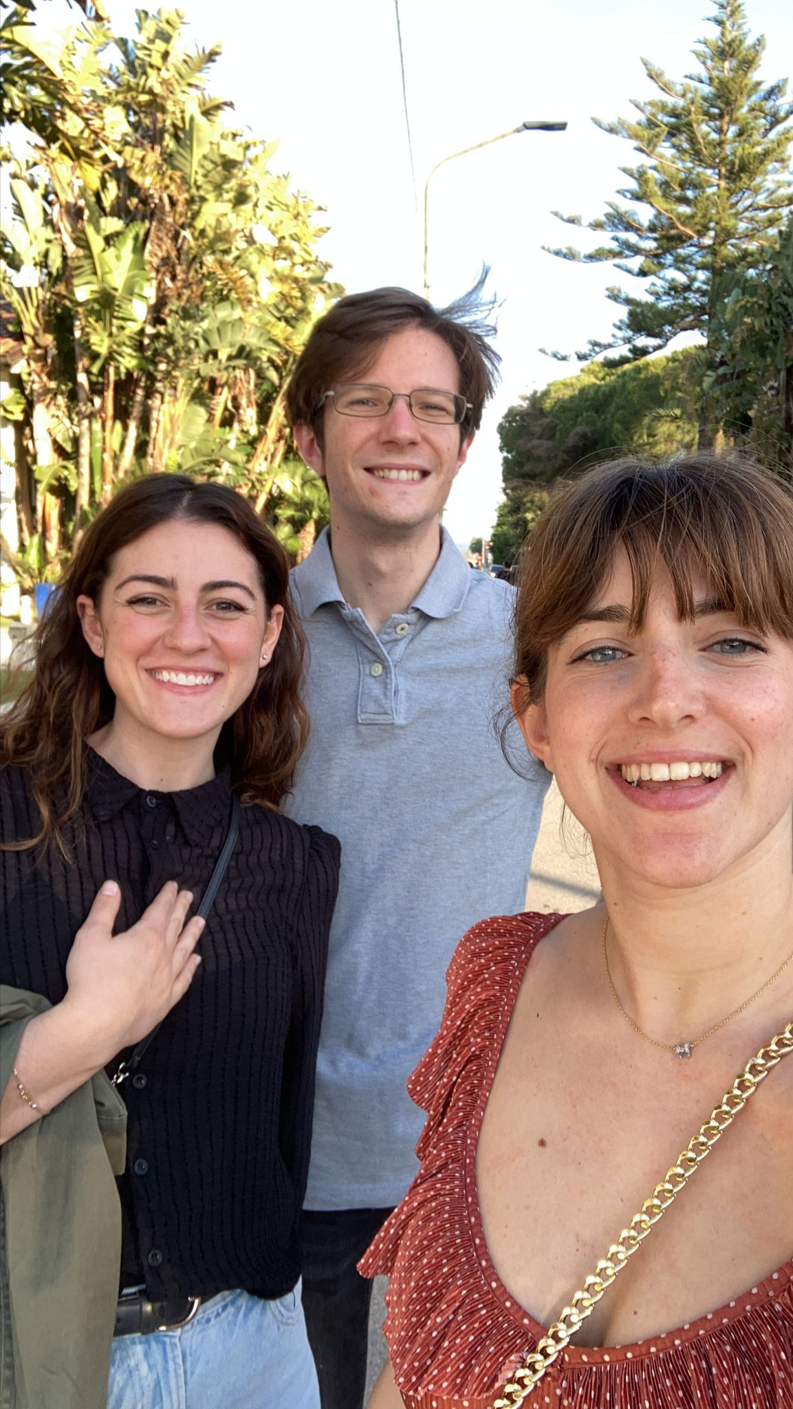
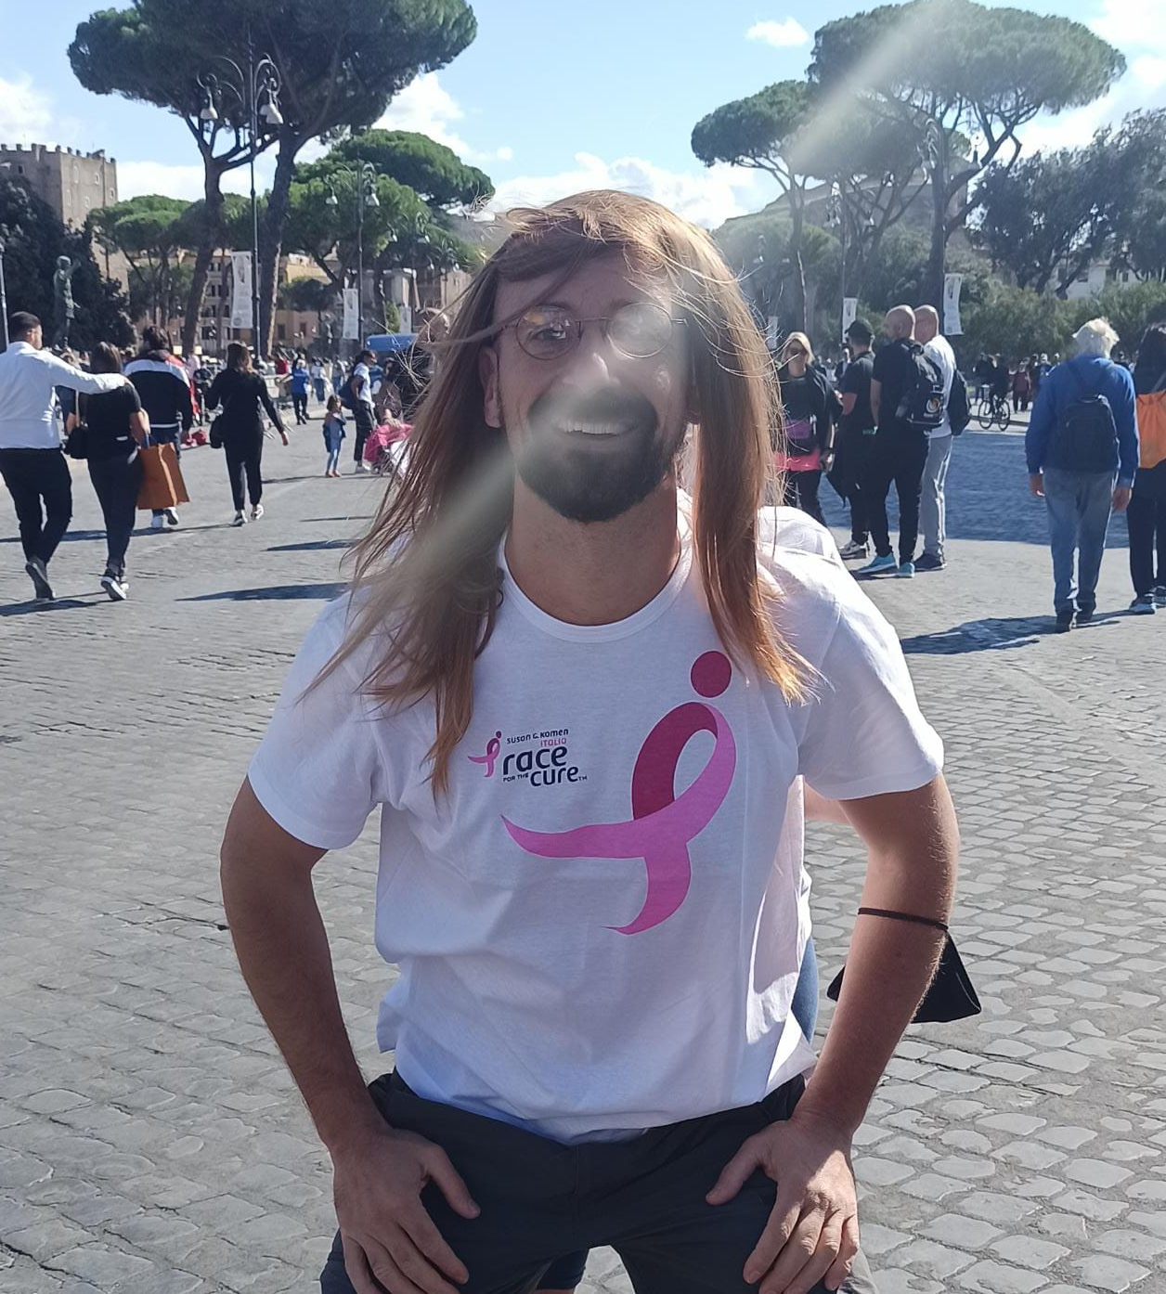
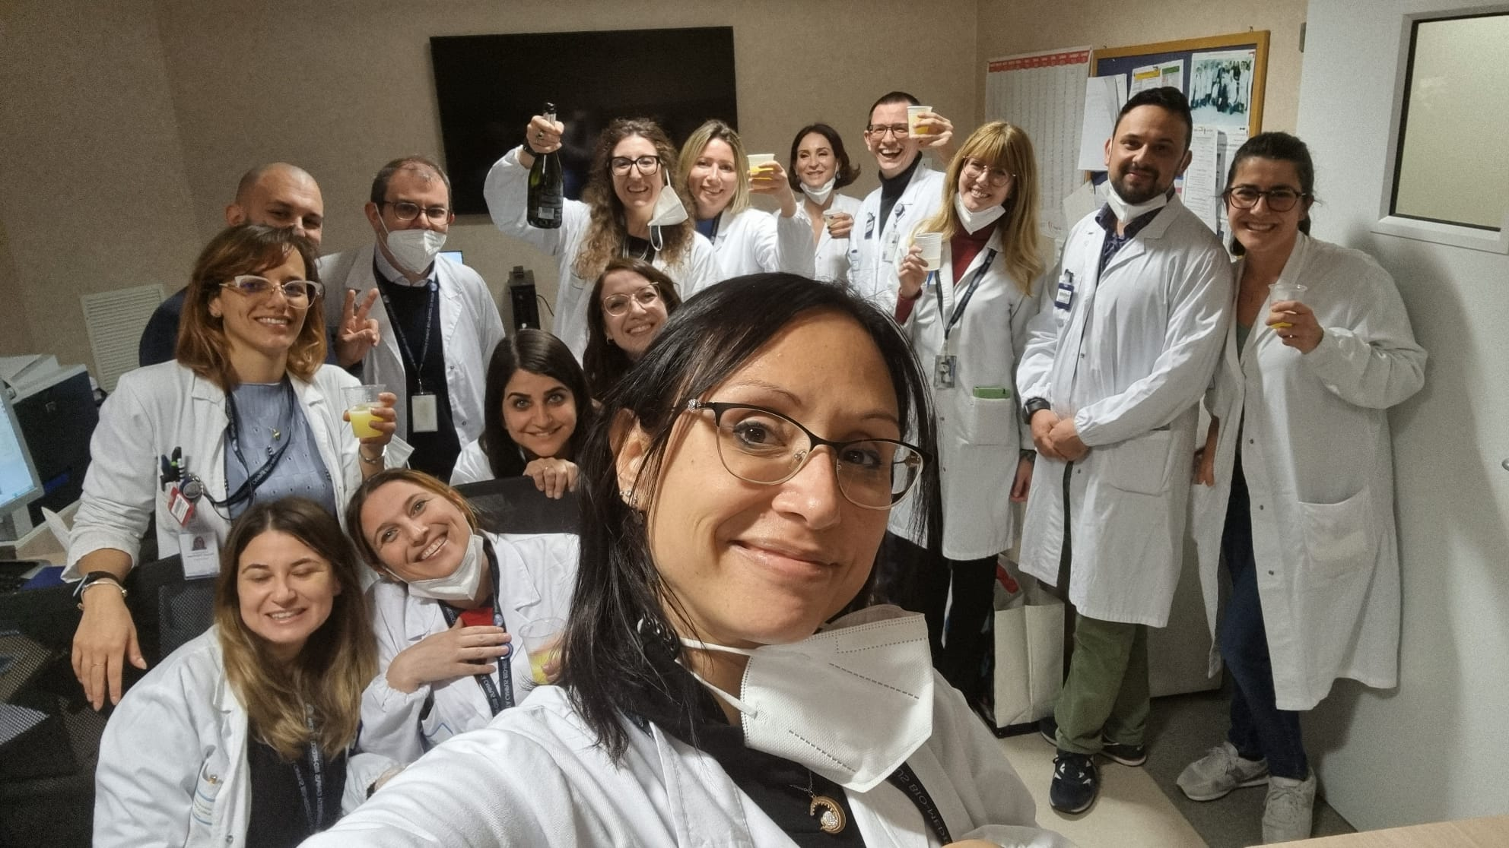
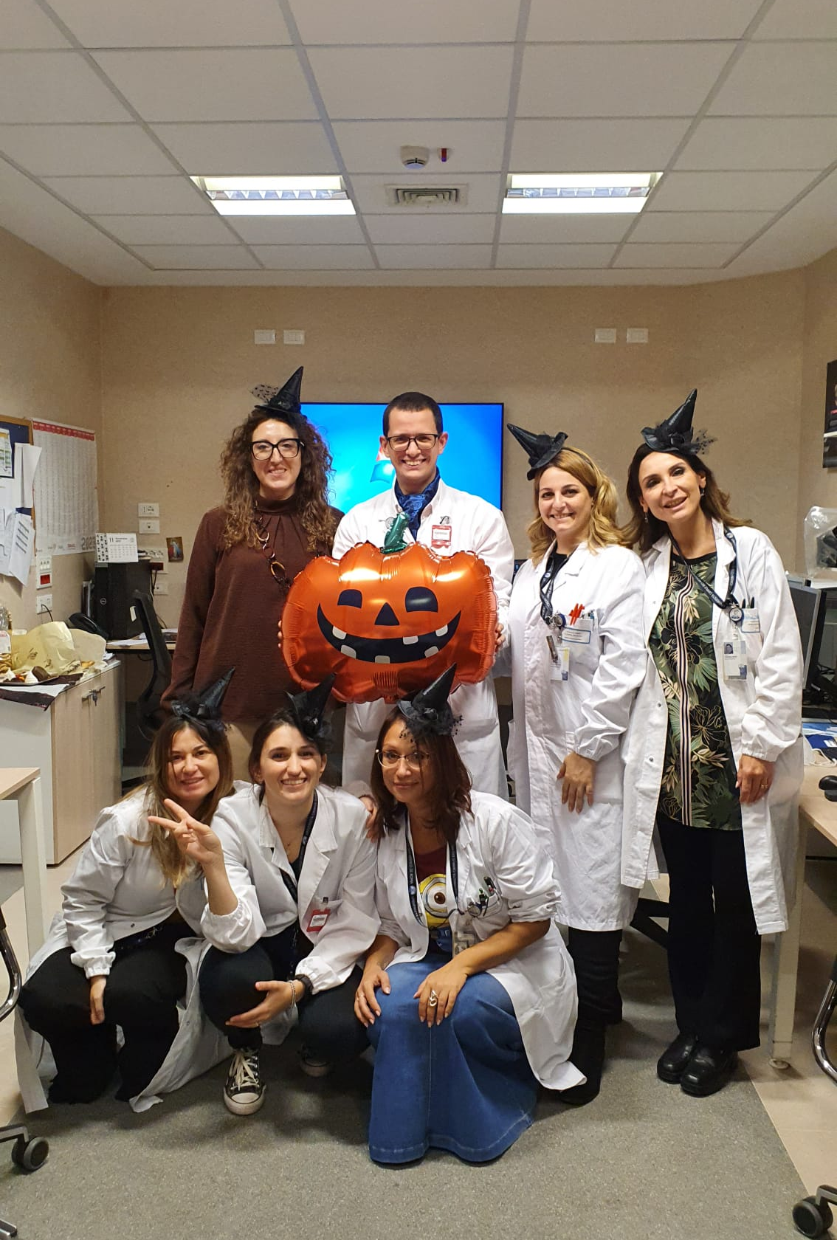
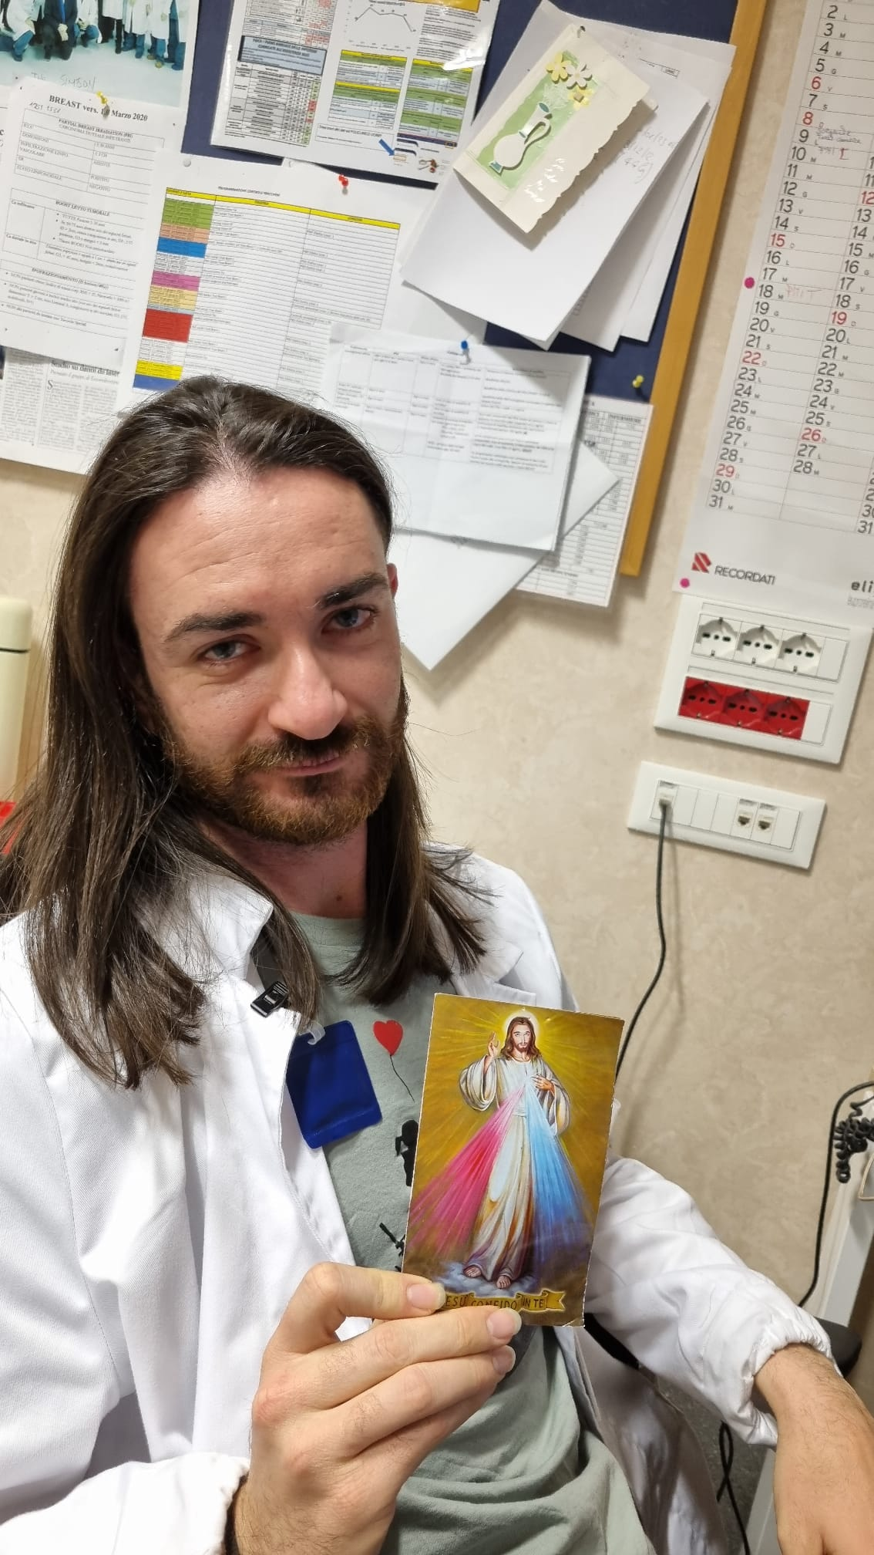
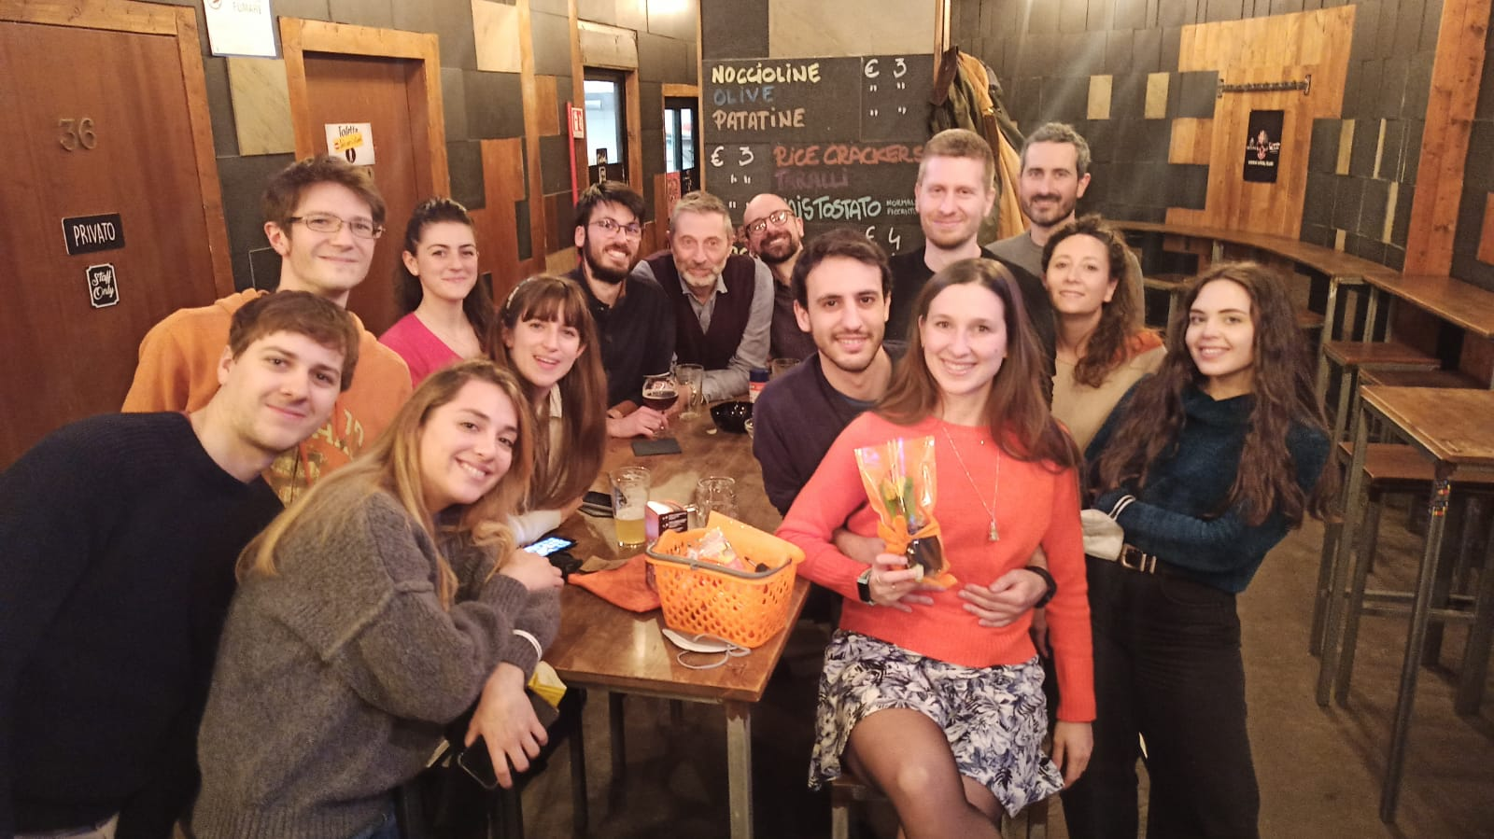
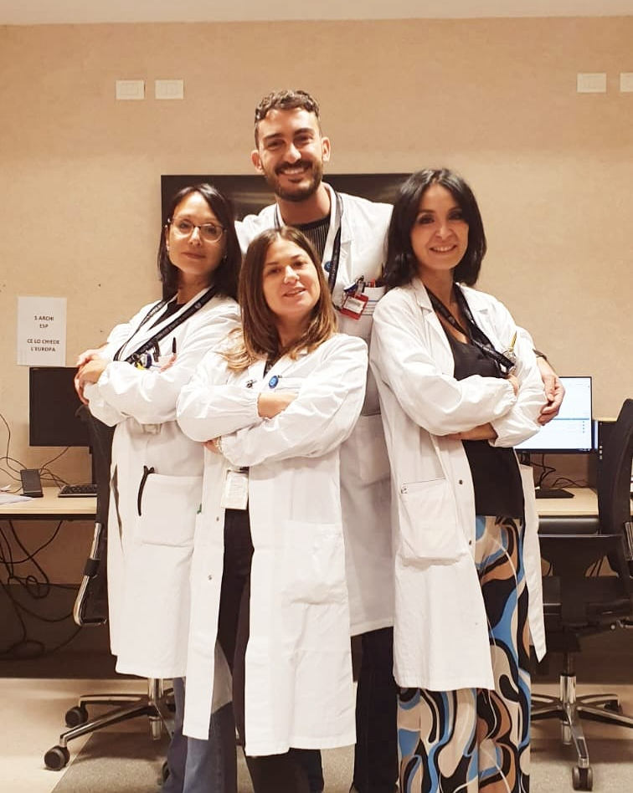
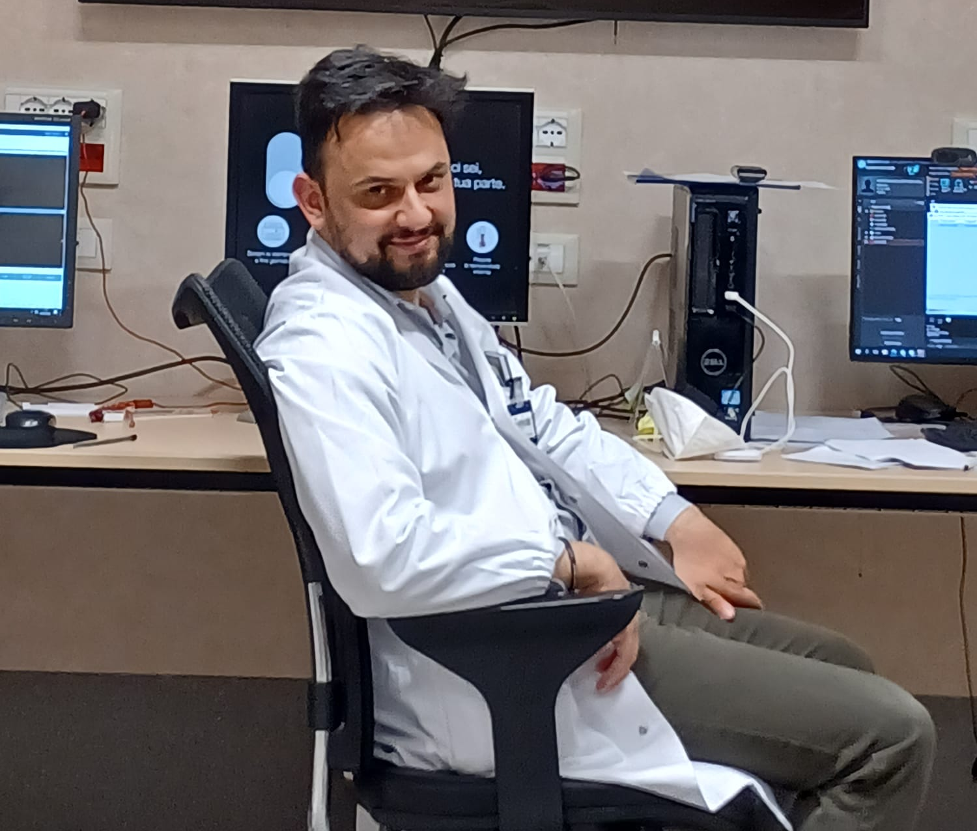
Acknowledge
Thanks to Gaia Antonio Angelica Annalisa Micol Giacomo Teresa e Valerio

Slide 35
Index
SPAN

Slide 36
FLASH Fibrosis reduction
High-lines:
Pulmonary fibrosis is a late-stage injury that typically manifests in the time period from six to 24 months post irradiation
While currently there is no good therapeutic intervention for fibrosis available
[7] M. D. Wright, P. Romanelli, A. Bravin, G. Le Duc, E. Brauer-Krisch, H. Requardt, S. Bartzsch, R. Hlushchuk, J. A. Laissue, and V. Djonov. Non-conventional ultra-high dose rate (flash) microbeam radiotherapy provides superior normal tissue sparing in rat lung compared to non-conventional ultra-high dose rate (flash) radiotherapy. Cureus, 13(11):e19317, 2021. ISSN 2168-8184.
[8] V. Favaudon, L. Caplier, V. Monceau, F. Pouzoulet, M. Sayarath, C. Fouillade, M. F. Poupon, I. Brito, P. Hupé, J. Bourhis, J. Hall, J. J. Fontaine, and M. C. Vozenin. Ultrahigh dose-rate flash irradiation increases the differential response between normal and tumor tissue in mice. Sci Transl Med, 6(245):245ra93, 2014. ISSN 1946-6242. doi: 10.1126/scitranslmed.3008973.
Daniele Carlotti

Slide 37
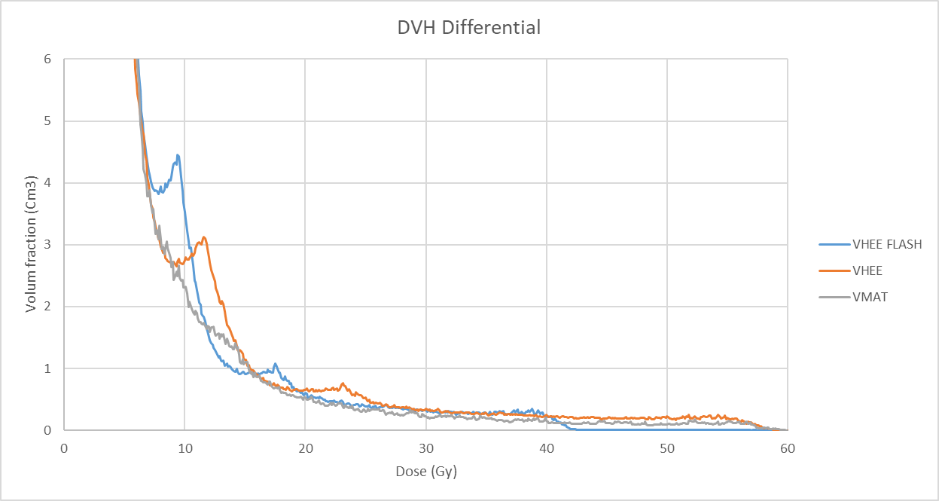
DVH Differential data
High-lines:
We will considered lung-CTV OAR
The main information came from the DHV differential i.e. the dose absorbed from each voxel
The biologically effective dose and equivalent dose in 2Gy calculators are based on the Linear Quadratic Model. The doses are calculated to allow conversion and comparability of different fractionation schemes.
The uniform equivalent dose (EUD) is the absorbed dose which, when administered homogeneously, produces the same average number of surviving clonogens as a non-homogeneous irradiation.
Daniele Carlotti

Slide 38
FLASH News
Daniele Carlotti

Slide 39
Dose correction
Linear Quadratic
Daniele Carlotti

Slide 40
Retrospective court
High-lines:
Model data ar fit with an retrospective study, the patients were treated with SBRT with 15 Gy × 3 prescribed to the 67% isodose at the periphery of the PTV
A multi institutional phase II trial
Stage I NSCLC treated with SBRT
from 2003 to 2005
57 Patients
mean age of the patients was 74.3 year (range 63–82 years)
Universal Survival Curve
a/b | n | m | TD50 | a | n barra | D0
3 | 0,71 | 0,4 | 30 | 0,206 | 10 | 1
Linear Quadratic
a/b | n | m | TD50
3 | 0,87 | 0,4 | 30
Daniele Carlotti

Slide 41
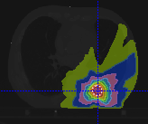
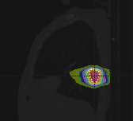
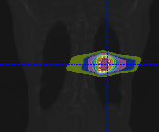
Lung Cancer – isodose distribution
VMAT
VHEE
Daniele Carlotti

Slide 42
Average Dose Rate
Beam field of view of the tumor
Daniele Carlotti

Slide 43
Dose correction
Linear Quadratic
Universal Survival Curve
Daniele Carlotti

Slide 44
Lung Cancer – Energy Beam
Daniele Carlotti

Slide 45
Radiobiological model
Linear Quadratic
Universal Survival Curve
hybridizing two classical radiobiological models:
the LQ model in the low-dose range and the Single Hit Multi-Target (SHMT) model in the high-dose range
Daniele Carlotti

Slide 46
Radiobiological Parameters
High-lines:
The radiobiological models used are based on 3 parameters:
“TD50” which denotes the dose for 50% complication probability.
“m” which is inversely proportional to the slope at the steepest part of the response curve.
“n” parameter controls the volume effect. If it is small, (e.g., ≈ 0.1 for late rectal bleeding). Serial complications are most affected by the hottest portion of the DVH.
Daniele Carlotti

Slide 47
Lung Cancer
High-lines:
Tumor Prescription 12Gy x 4 fr =48Gy
Ribs Constraints: Dmax 43 Gy
Spinal cord Constraints: Dmax 23 Gy
VMAT
VHEE
48 Gy
24 Gy
Daniele Carlotti

Slide 48
Normal tissue complication probability NTCP
Daniele Carlotti

Slide 49
Dosimetric application in Radiobiological model
To predict the probability of radiation
pneumonitis NTCP
Radiobiological model for cell survive
LQ/USC
Dosimetric
Information
Daniele Carlotti

Slide 50
Results
Universal Survival Curve
Lungs-CTV | dose fraction | number of fraction | EUD | NTCP
VHEE FLASH FMF 0.7 | 12 | 4 | 11,1 | 5,82%
VHEE | 12 | 4 | 16,0 | 12,20%
VMAT | 12 | 4 | 12,2 | 6,94%
Linear Quadratic
Lungs-CTV | dose fraction | number of fraction | EUD | NTCP
VHEE FLASH FMF 0.7 | 12 | 4 | 9,8 | 4,64%
VHEE | 12 | 4 | 14,4 | 9,82%
VMAT | 12 | 4 | 10,6 | 5,35%
VHEE
VHEE
FMF 0.7
VMAT
~11%
~5.2%
~6.1%
Daniele Carlotti

Slide 51
FLASH Effect
Highlines:
deliver high doses (>4-6 Gy)
very short period of time (<200 ms)
[5]. doi.org/10.1016/j.radonc.2021.12.045
Daniele Carlotti

Slide 52
FLASH Effect
Daniele Carlotti

Slide 53
Very High-Energy Electron (VHEE)
Highlights:
70-130 MeV
Daniele Carlotti

Slide 54
HUMAN Trials need more data
FAST-01 completed proton FLASH RT for sintomatic bone mets (Univ. Cinn): 8Gy x 1 (Mascia et al, JAMA Onc, 2022)
FAST-02 ongoing proton FLASH RT for thoracic bone mets (Univ. Cinn): 8Gy x 1, up 7,3 x 30 cm
IMPulse ongoing electron FLASH RT for skin metastases from melanoma (CHUV): 2Gy increments from 22-34 Gy x1, <=5,5cm
LANCE ongoing electron FLASH RT and CONV RT for localized cutaneous SCC e BCC (CHUV): 22Gy x1 if <2cm, 5Gy x6 if >2cm but <= 4cm
SURFACE planned face I Study on Ultra-hight dose rate Radioterapy For Any Cutaneus or subcutanEous tumor to assess safety & efficacy of electron FLASH RT (MD Anderson)
Daniele Carlotti

Slide 55
DADR - Dose Average Dose Rate
Accelerator hypothesis
Daniele Carlotti

Slide 56
Index
Radiotherapy, FLASH effect & VHEE
Clinical aspects in stereotactic pancreas treatments
FLASH effect: activation & critical aspects
Lung lesions: the case of Non-Small-Cell-Lung Cancer (NSCLC)
Daniele Carlotti

Slide 57
PERSONALIZED PRESCRIPTION
J Radiat Res, Volume 62, Issue 3, May 2021, Pages 448–456, https://doi.org/10.1093/jrr/rrab015
The content of this slide may be subject to copyright: please see the slide notes for details.
Daniele Carlotti

Slide 58
NTCP Lyman Kutcher Burman (LKB) model
https://doi.org/10.3109/0284186X.2010.543695
Daniele Carlotti

