Slide 1
PhD Defense PS Impedance Model and Related Beam Stability
Sébastien Joly
University supervisor : Mauro Migliorati
CERN supervisors : Nicolas Mounet and Benoit Salvant
31/01/2024

Slide 2
Outline
Introduction
Refinements of the Post-LIU PS transverse impedance model
Beam-based validation of the PS impedance model
Conclusion, next steps and additional studies

Slide 3
Context
Goal of the CERN accelerator chain: accelerate proton or ion beams to experiments.
In preparation of High Luminosity LHC (HL-LHC), upgrade of its injectors during the LHC Injectors Upgrade (LIU).
Goal : doubling of beam intensity & transverse emittance preservation
LIU success relies on beam stability in the Proton Synchrotron (PS)
→ Update of the impedance model of the PS following its hardware changes
→ Assessment of the changes’ impact on the beam stability

Slide 4
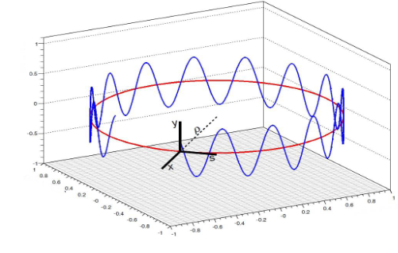
Introduction to beam dynamics in a synchrotron
A bunch traveling around a synchrotron undergoes transverse (betatron) oscillations…
→ transverse tune (Q_{x,y})
The horizontal motion of a particle x(s) at a location s around the synchrotron can be defined as:
$$x\left(s\right)∝ \sqrt{β_{x}(s)} cos\left(μ_{x}\left(s\right)+φ\right)$$
Its number of transverse oscillations per turn can be expressed as:
$$Q_{x,y}=\frac{μ_{x,y}(L)}{2π}=\frac{1}{2π}. \oint{\frac{ds}{β_{x,y}(s)}}$$
Courtesy of H. Schmickler^{[1]}
…and longitudinal (synchrotron) oscillations
→ synchrotron tune (Q_{s})
[1] Recap Transverse Beam Dynamics I, CAS 2022, H . Schmickler

Slide 5
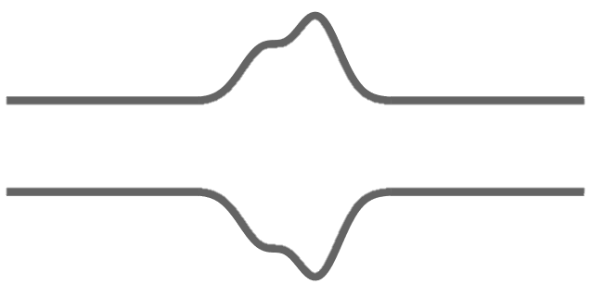
Wake fields and wake function^{[1]}
L
Source, q_{s} (x_{s}, y_{s,} s_{s})
Test, q_{t} (x_{t}, y_{t,} s_{t})
z = s_{s} – s_{t}
z
Wake field is defined as the integrated Lorentz force $\vec{F}$ over an accelerator element:
For two point-like particles, we have: $\int{\vec{F}\left(x_{s},x_{t},x_{s},x_{t},z,s_{s}\right) ds_{s}}=−q_{s}q_{t}\vec{w}(x_{s},x_{t},y_{s},y_{t},z)$ q_{s} and q_{t} are respectively the electric charge of the source and test particles. $\vec{w}$ is the generalized wake function. It can be projected over the longitudinal and transverse directions.
[1] Wakefields and Impedances, CAS 2022, K. Li

Slide 6
Taylor expansion of the wake function
L
Source, q_{s} (x_{s}, y_{s,} s_{s})
Test, q_{t} (x_{t}, y_{t,} s_{t})
z = s_{s} – s_{t}
z
Taylor series of the generalized wake yield the wake components. Up to the first order in transverse offsets of the source and test particle, we obtain in the horizontal plane:
$$w_{x}\left(x_{s},x_{t},y_{s},y_{t},z\right)≈w_{x}^{const}\left(z\right)+x_{s}.w_{x}^{dip}\left(z\right)+x_{t}.w_{x}^{quad}(z)$$
Zeroth order for
asymmetric structures
Dipolar wakes –
depends on source particle
Quadrupolar wakes –
depends on test particle

Slide 7
From wake function to beam coupling impedance
The beam coupling impedance^{[1]} is obtained by performing the Fourier transform of the wake function:
$$Z_{∥}\left(x_{s},x_{t},y_{s},y_{t}, ω\right)=\frac{1}{βc}\int_{−∞}^{∞}{w_{∥}}\left(x_{s},x_{t},y_{s},y_{t}, z\right)e^{\frac{−jωz}{βc}}dz$$
$$Z_{⊥}\left(x_{s},x_{t},y_{s},y_{t}, ω\right)=\frac{j}{βc}\int_{−∞}^{∞}{w_{⊥}}\left(x_{s},x_{t},y_{s},y_{t}, z\right)e^{\frac{−jωz}{βc}}dz$$
$$w_{∥}\left(x_{s},x_{t},y_{s},y_{t}, z\right)=\frac{1}{2π}\int_{−∞}^{∞}{Z_{∥}}\left(x_{s},x_{t},y_{s},y_{t}, ω\right)e^{\frac{jωz}{βc}}dω$$
$$w_{⊥}\left(x_{s},x_{t},y_{s},y_{t}, z\right)=−\frac{j}{2π}\int_{−∞}^{∞}{Z_{⊥}}\left(x_{s},x_{t},y_{s},y_{t}, ω\right)e^{\frac{jωz}{βc}}dω$$
(Fourier transform and normalization conventions^{[2]} might differ in litterature)
^{[1]} L. Palumbo, V.G. Vaccaro, M. Zobov 10.5170/CERN-1995-006.331
^{[2]} N. Mounet 10.5075/epfl-thesis-5305

Slide 8
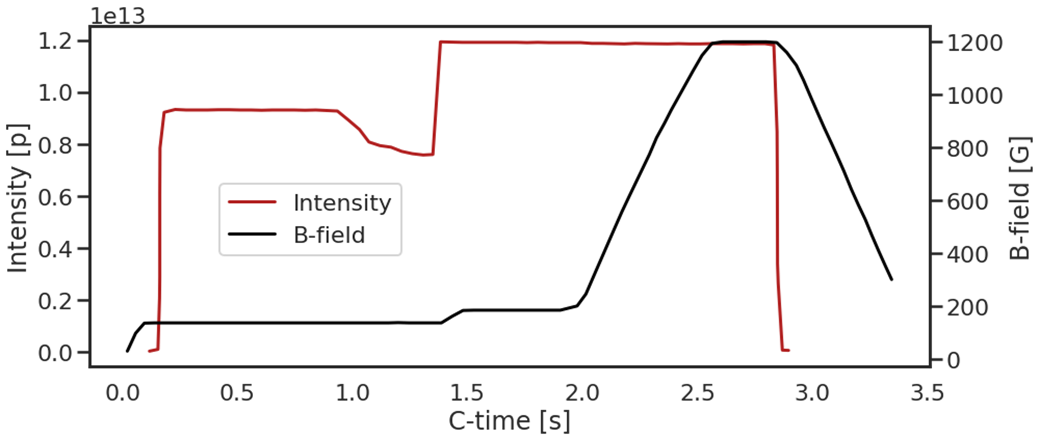
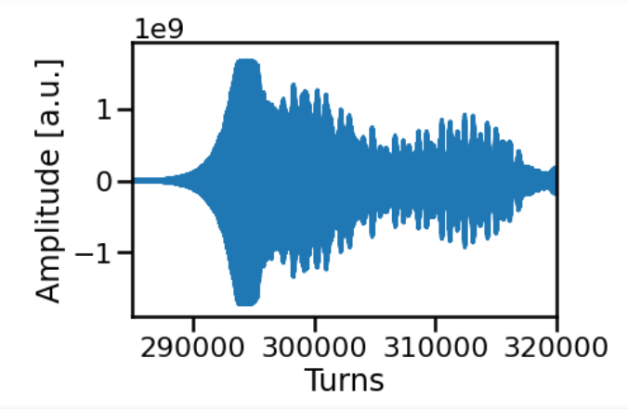
Example of limitations due to impedance
LHC beam in the CERN Proton Synchrotron
Flat bottom,
1st injection
Instability occurring towards the end of the flat bottom leading to losses.
Exponential growth of the horizontal beam center of mass in BPM signal.
Beam intensity could not be pushed to the goal set by the LIU project without a mitigation strategy.
Notes:
Explain each line and where the flat bottom is
« Fast » losses can be a sign of an instability or a resonance, too early to jump to conclusions
Insist the intensity limitation due to this was preventing operation from reaching its goals

Slide 9
Outline
Introduction
Refinements of the Post-LIU PS transverse impedance model
Beam-based validation of the PS impedance model
Conclusion, next steps and additional studies

Slide 10
Goal of an impedance model
Impedance sources
(simulations)
Impedance model/
Wake model
Synchrotron and beam parameters
Beta function weighting
Optics model (Beta functions)
PS transverse impedance model
PyHEADTAIL^{[1]}
(macroparticle tracking code)
Turn-by-turn data
Impedance sources
(analytical)
Spectral analysis
Exponential fit
Tune shift
Instability growth rate
^{[1]}PyHEADTAIL

Slide 11
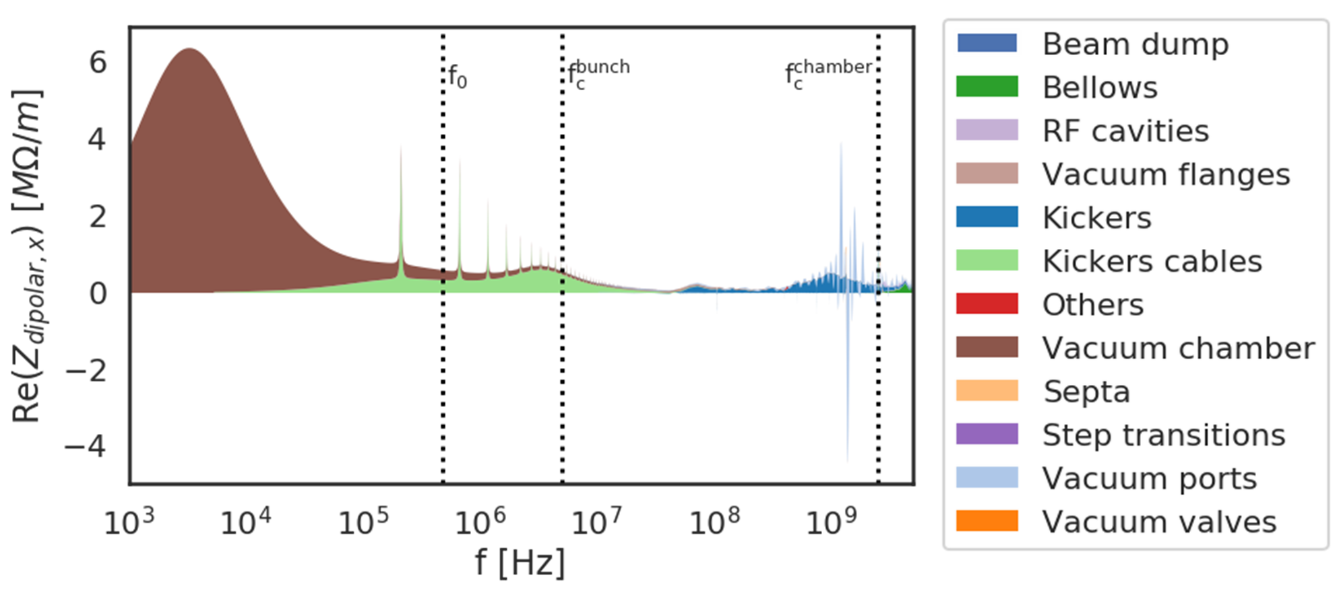
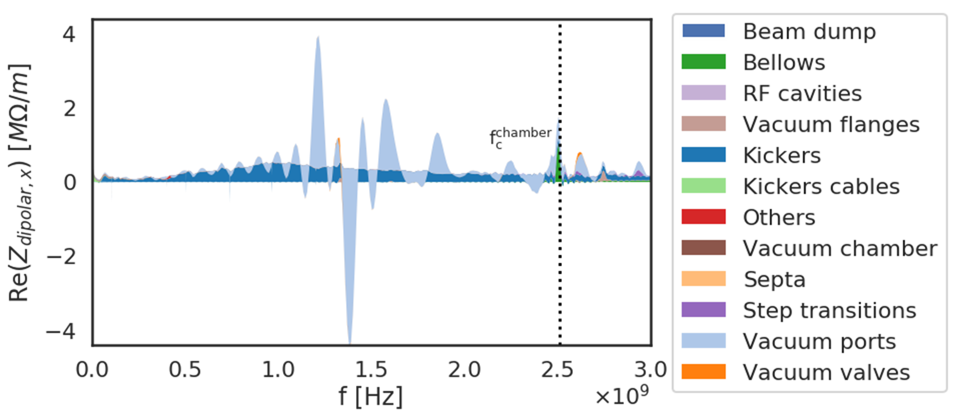
PS transverse impedance model^{[1]} (E_{kin} = 2 GeV)
An impedance model is the (weighted) sum of all the elements’ impedances.
Main contributor at low frequency:
Kicker cables
Vacuum chamber
Main contributor at high frequency:
Kicker magnets
Vacuum ports
The first contribution was introduced during the PhD, whereas the next two were refined during this period.
^{[1]}PS impedance model
Notes:
At E_{kin} = 2 GeV, the bunch excites impedance whose frequencies spans until f_{c}^{bunch}.
TE mode travels freely above the vacuum chamber cutoff frequency f_{c}^{chamber}, impedance not expected to couple with the beam.

Slide 12
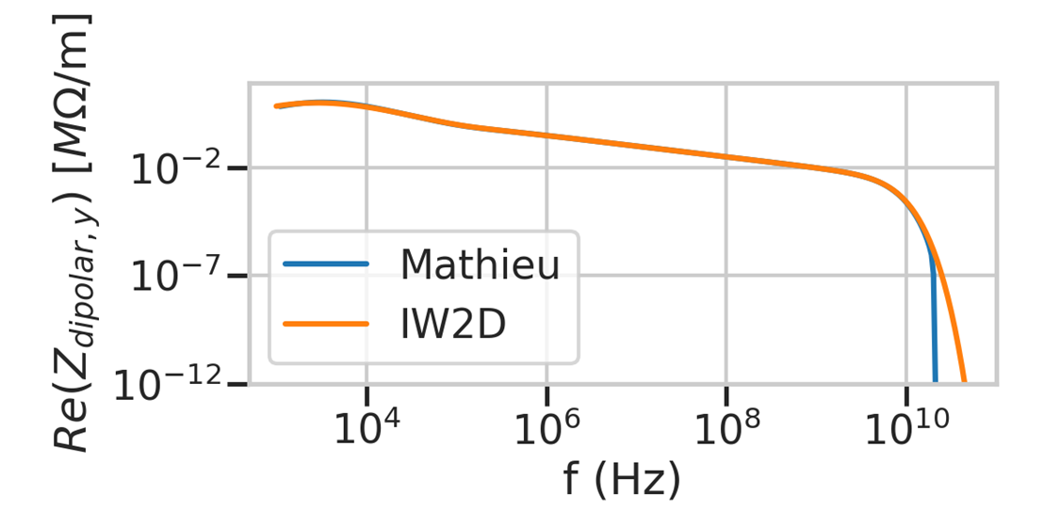
Non-relativistic elliptical vaccum chamber impedance (1/2)
β_{relativistic} < 1
β_{relativistic} < 1
Novel formalism^{[1]} relying on Mathieu’s functions can describe $Z_{∥}$ and $Z_{⊥}$ of an elliptical vacuum chamber for any beam energy.
Reimplementation of the Mathieu’s functions calculation and addition of a new convergence algorithm to prevent numerical instabilities.
e = 1.5 mm
e = 1.5 mm
b = 70 mm
b = 70 mm
a = 70 mm
a = 146 mm
Before
After
^{[1]} M. Migliorati et al. 10.1103/PhysRevAccelBeams.22.121001

Slide 13
Non-relativistic elliptical vaccum chamber impedance (2/2)
The transverse impedance of the elliptical vaccum chamber of the PS was calculated for the first time for a non-relativistic beam energy
$$Z_{dipolar,y}^{elliptic}<Z_{dipolar,y}^{round}$$
$$Z_{quadrupolar,y}^{round} \sim 0$$
$$Z_{quadrupolar,y}^{elliptic}≠0$$
Compared to previous round geometry, the new impedance yields:
→ Predicted impact on beam dynamics
~30% smaller dipolar impedance
Non-zero quadrupolar impedance

Slide 14
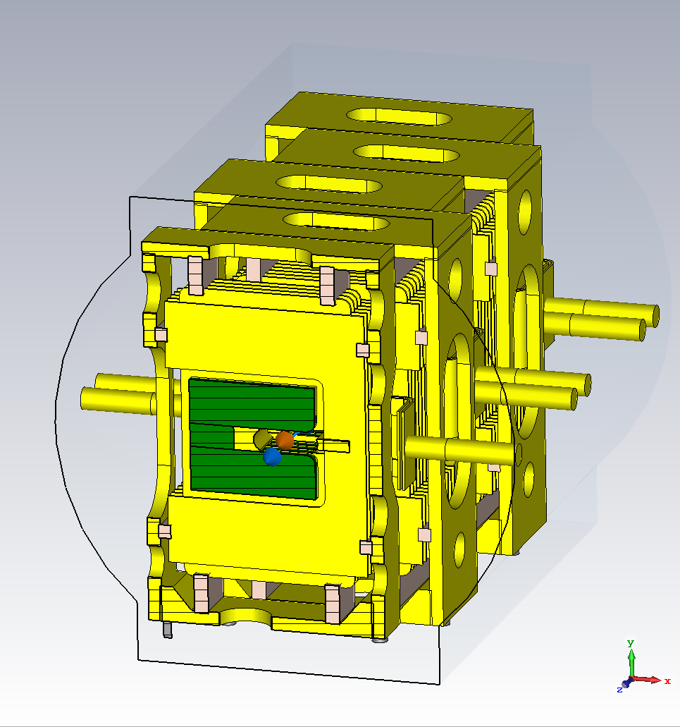
Refined kicker magnets modeling
PS kicker magnets simulated using 3D EM solver CST Studio.
Latest models were simulated with an increased number of meshcells and a larger explored frequency range.
→ Better resolution of the peak around 1 GHz
→ Broadband behaviour fully resolved for >1 GHz

Slide 15
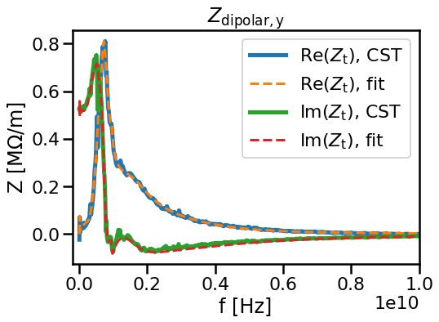
Impedance fitting with resonators
An accelerator component impedance can be expressed as a sum of resonators:
$$Z_{⊥}\left(ω\right)= \sum_{n=1}^{N}{Z_{⊥}^{resonator}}(ω,R_{shunt,n},Q_{n},f_{resonant,n})$$
The kickers’ impedance was fitted with a differential evolution algorithm developed during this thesis, GARFIELD.
→ Impedance can be evaluated for any frequency
→ Analytical formulas to convert impedance to wake function instead of Fourier Transform

Slide 16
Impedance of a kicker magnet connecting cables and external circuits (1/2)
Total impedance of a kicker magnet can be split in two contributions:
Geometry and material properties (Z_{kicker})
Coupling with connecting cables and external circuits (Z_{TL})
Z_{TL} depends on the magnet inductance, self-inductance, connecting cables and external circuits.
It can be calculated analytically using the transmission line theory^{[1]}.
→ formalism extended to C and H-shape magnets and applied for the first time to PS magnets
Approximation of the kicker magnet as an ideal transformer
^{[1]} C. Zannini 10.5075/epfl-thesis-5737

Slide 17
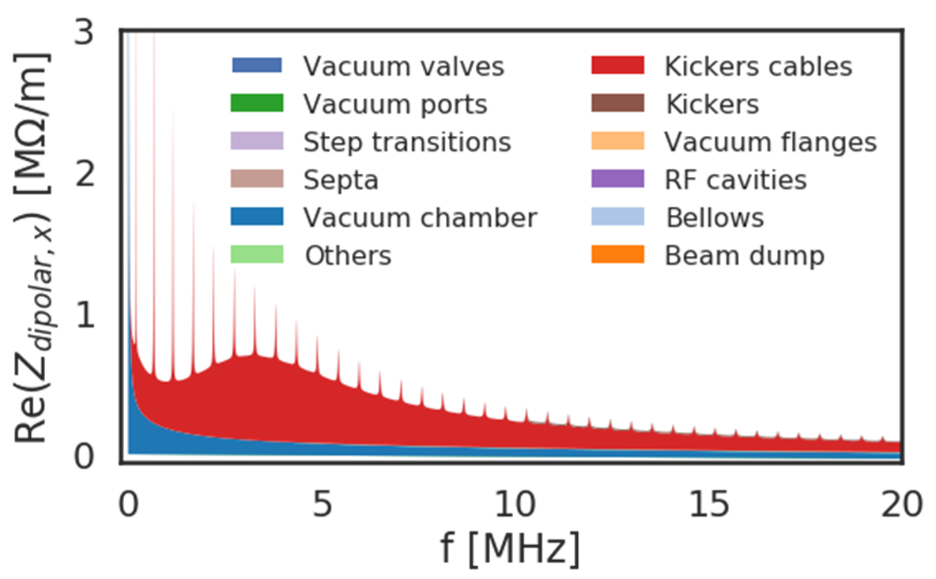
Impedance of a kicker magnet connecting cables and external circuits (2/2)
Larger contribution than vacuum chamber in the >1 MHz range.
New contribution characterized by:
Broadband behaviour in MHz range
Sharp peaks caused by the open termination of a kicker magnet cable (BFA09S)

Slide 18
Outline
Introduction
Refinements of the Post-LIU PS transverse impedance model
Beam-based validation of the PS impedance model
Conclusion, next steps and additional studies

Slide 19
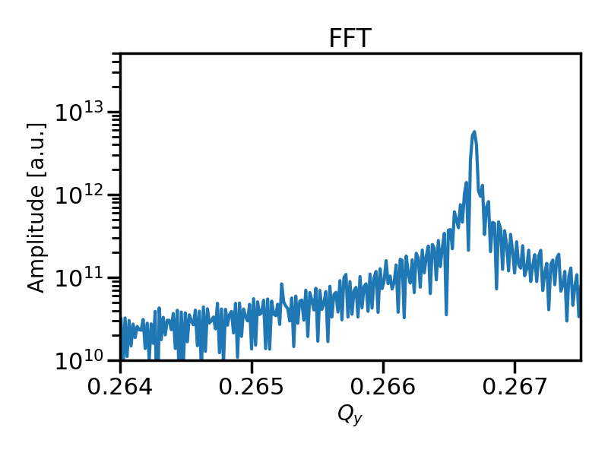
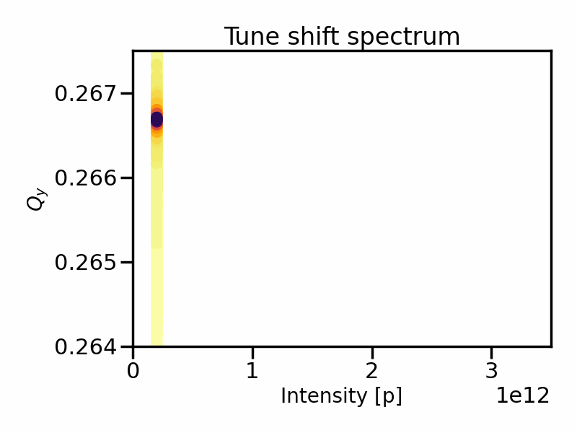
From turn-by-turn data to tune shift spectrum
The (imaginary part of the) transverse impedance causes an intensity dependent tune shift
$$ΔQ ∝{I_{beam}⋅𝓘(Z}_{y})$$
Calculating the FFT of the turn-by-turn data during an intensity scan yield the tune shift slope, which is proportional to the imaginary part of the transverse impedance
The consequences of two main effects are studied through simulations first: the beam energy and the chromaticity
Notes:
Animation?

Slide 20
Macroparticle tracking code
A macroparticle tracking code, such as PyHEADTAIL, simulates beam dynamics of a bunch in presence of impedance
It can includes the effects of transverse motion, synchrotron motion, chromaticity, non-linearities, space charge, etc
Macroparticle
Slice
PyHEADTAIL
approximations
For numerical efficiency, individual particles are aggregated as ‘macroparticles’, sharing their averaged properties (charge, transverse and longitudinal positons)
In addition, the bunch is longitudinally divided along a equidistant grid of ‘slices’ → effect of impedance/wakefield applied to each slice instead of individual particle
[1] M. Schenk, PyHEADTAIL and PyECLOUD

Slide 21
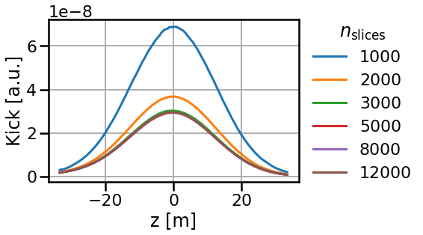
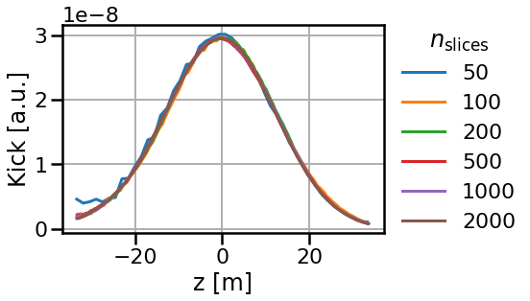
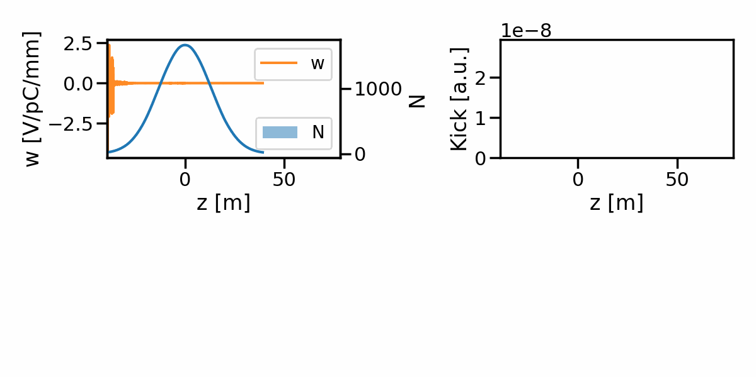
Wake kick calculation in tracking codes
Stepwise method (standard method)
Integrated method (alternative method)
Wake evaluated at center of each slice
Wake integrated over the slice, assuming $N_{n}\overline{x_{n}}$can be considered constant in each slice
Wake kick p results from the convolution of the wake function with the bunch moment $N.\overline{x}$
Application to PS wake at injection energy, reduction of required slices by a factor ~10.
→ Simulation time reduced from a week to 8 h.

Slide 22
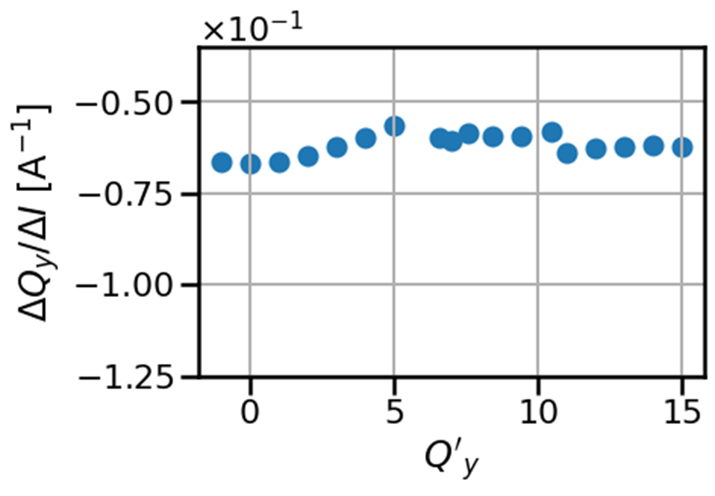
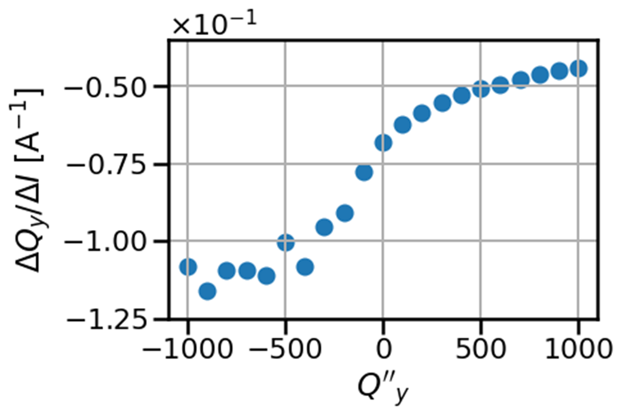
Impact of chromaticity on tune shift slope
Q’’_{y} = 0
Chromaticity introduces incoherent tune shift accordingly to the particle momentum deviation δ:
$$ΔQ_{ξ}=Q^{′}δ+Q^{′′2}δ^{2}+𝓞(δ^{3})$$
Interplay of chromaticity with transverse impedance leads to a coherent effect
→ Change of impedance-induced tune shift
Contrary to previous understanding of the role of chromaticity, simulations demonstrate:
Small effect of first-order chromaticity
Second-order chromaticity strongly affecting the tune shift slope
Q’_{y} = 0

Slide 23
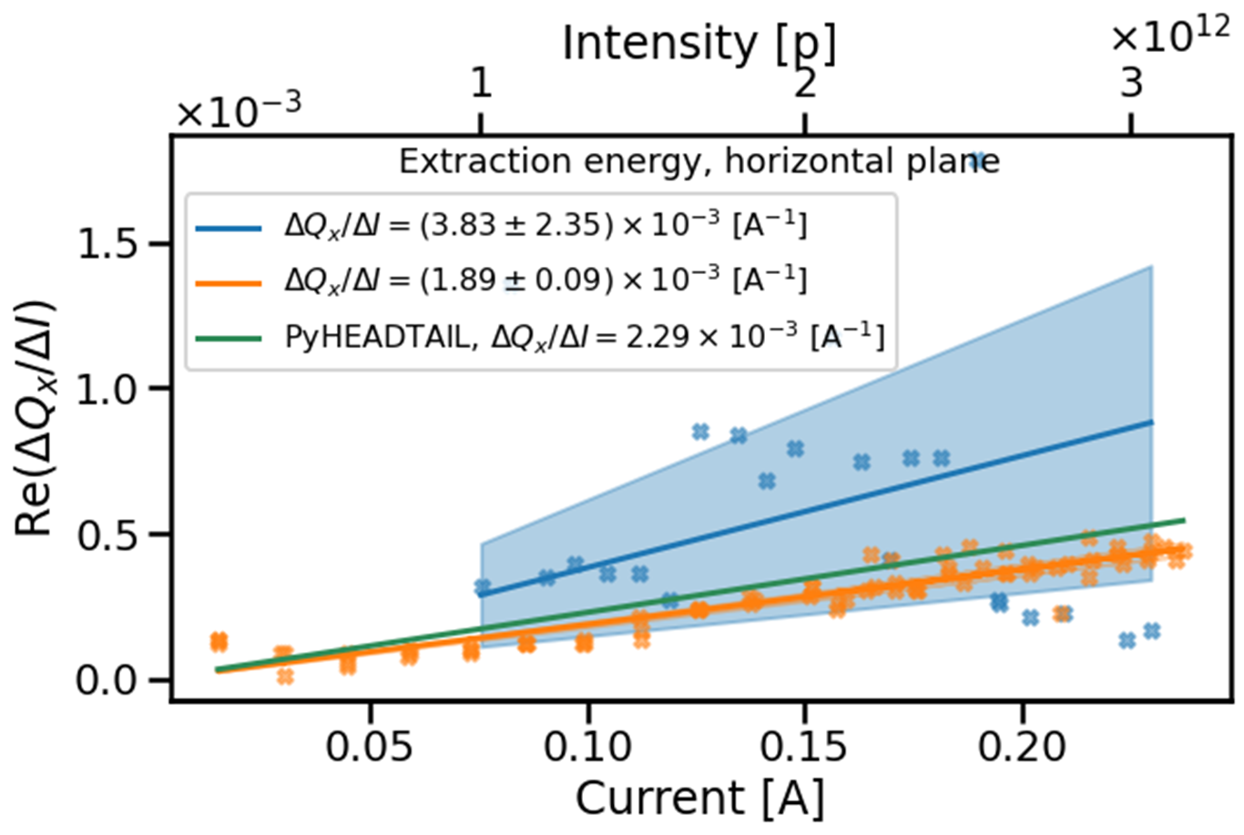
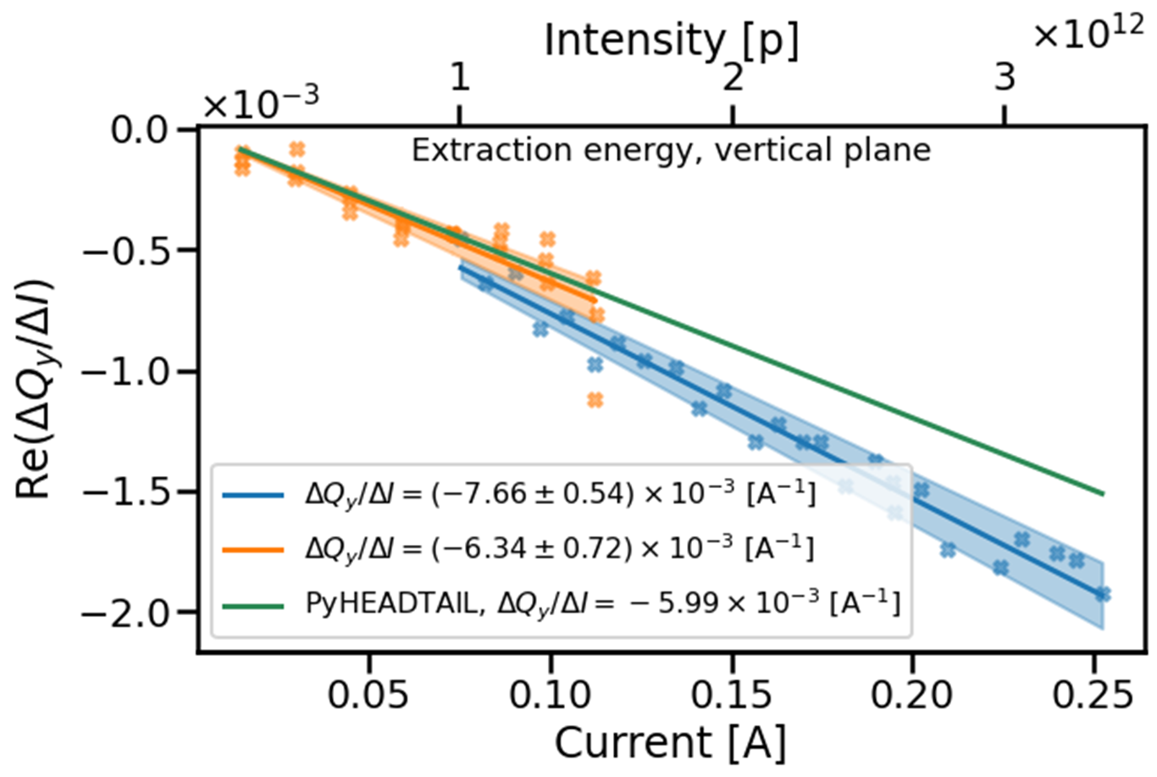
Comparison measurements at extraction energy
2021 measurements (Q’’_{x} = 365, Q’’_{y} = -407)
2022 measurements (Q’’_{x} = -182, Q’’_{y} = -212)
Simulations use 2022 measurements parameters
Agreement between 2022 measurements and simulations in both planes
Difference between 2021 and 2022 can be attributed to Q’’
40 %
7 %
6 %
22 %

Slide 24
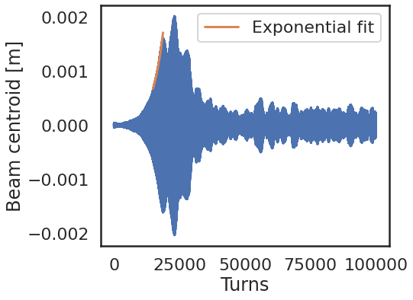
Instability and growth rate
The (real part of the) transverse impedance also causes instabilities resulting in beam intensity losses and transverse emittance blow-up
Instability strength is quantified by its growth rate.
It is obtained by fitting an exponential on the first increase of the bunch centroid envelope.

Slide 25
Instability prediction at injection energy
The blue envelope represents the statistical uncertainties of the measured growth rates
A valid impedance model can predict the instability growth rate in various scenarios (once the simulations include the relevant mechanisms (first and second-order chromaticity, synchrotron motion, etc)
The measurements and simulations show a fair agreement for the different Q’_{x} and beam intensity regimes

Slide 26
Outline
Introduction
Refinements of the Post-LIU PS transverse impedance model
Beam-based validation of the PS impedance model
Conclusion, next steps and additional studies

Slide 27
Conclusion
Update to Post LIU version and improvements of the PS impedance model:
Elliptical vacuum chamber impedance calculation
Refined kicker magnets’ impedance and resonator fitting with GARFIELD
Addition of kicker magnets connecting cables and external circuits impedance
Impedance-induced beam observable measurements and understanding of significant interplays with other mechanisms:
Novel wake kick computation method to overcome limitation in simulations due to beam energy
Demonstration of the effect of chromaticity on tune shift slope
Validation of the PS transverse impedance model with reference measurements

Slide 28
Next steps
Further possible contributions to the PS impedance model:
Local evaluation of the vacuum chamber impedance based on the aperture model
SPICE (electronic circuit simulator) simulations of the kicker magnets connecting cables and external circuits
Simulations of missing septa and beam instrumentation
Complementary reference measurements:
Vertical growth rate measurements
Impedance localization measurements with improved tune acquisition procedure
Application of the updated PS impedance model to predict stability of Physics Beyond Colliders (PBC) beams.

Slide 29
Additional contributions made during the PhD
Additional chromaticity control method in the PS using sextupoles
Partially decayed wake formalism and applications
Landau damping from space charge and non-linearities
Impact of space charge on impedance-induced tune shift and instability growth rates
Narrowing down of the frequency range responsible for a transverse instability using its power spectrum
Optics measurements campaigns (loss maps)
RF measurements of LHC collimators

Slide 30
List of publications
S. Joly et al., “Recent advances in the CERN PS impedance model and instability simulations”, submitted to JINST
S. Joly et al., “Post Long Shutdown 2 CERN Proton Synchrotron transverse impedance model: description and beam-based validation”, in review by CERN
S. Joly et al., “Recent advances in the CERN PS impedance model and instability simulations”, in Proc. HB’23, Meyrin, Switzerland, October 2023, oral contribution
S. Joly et al., “Impedance-induced beam observables in the CERN Proton Synchrotron”, in Proc. IPAC’23, Venice, Italy, May 2023, paper WEPL149
S. Joly et al., “Overview of transverse instabilities in the CERN Proton Synchrotron”, in Proc. IPAC’23, Venice, Italy, May. 2023, paper WEPL148
S. Joly et al., “Le modèle d’impédance transverse du Synchrotron à Protons du CERN, de la théorie aux mesures”, in Journées Accélérateurs, French Physical Society, Roscoff, France, Oct. 2021 (oral contribution and poster).
S. Joly et al.,“Update of the Transverse Proton Synchrotron Impedance Model”, in Proc. IPAC’21, Campinas, Brazil, May 2021, pp.3149–3152. doi:10.18429/JACoW-IPAC2021-WEPAB224
S. Joly et al.,“Impedance measurements of TDIS collimator”, CERN Technical Note, to be published.
S. Joly, “MD5464, tune shift reference measurements”, CERN Technical Note, to be published.
S. Joly et al., “PS impedance and stability”, in CERN Injectors Performance Panel Machine Development Days, Meyrin, Switzerland, Feb 2022. oral contribution
S. Joly et al., “PS impedance-induced observables and beam stability”, in CERN Injectors Performance Panel Machine Development Days, Meyrin, Switzerland, Jan 2023. oral contribution

Slide 31
Thank you for your attention !

Slide 32
Backup slides

Slide 33
CERN Proton Synchrotron
The CERN Proton Synchrotron is an alternating-gradient accelerator, part of the LHC injectors chain and delivering beam to several experiments.
LHC beam parameters | Injection | Extraction
Total energy [GeV] | 2.9 | 26
Circumference [m] | 628
Number of bunches | 4 + 2 | 72
Beam intensity [p] | ~1.9 x 10¹³
Q_{x}, Q_{y} | 6.21, 6.245 | 6.217, 6.28
τ_{b} [ns] | 200 | 1~1.5
η | -0.074 | 0.026

Slide 34
Wake potential for a distribution of particles^{[1]}
L
Source, q_{s} (x_{s}, y_{s,} s)
Test, q_{t} (x_{t}, y_{t,} s_{t})
z = s – s_{t}
z
Replacing the source particle for an arbitrary particle distribution yields:
$$\int{F\left(x_{s},x_{t},x_{s},x_{t},z,s_{s}\right) ds}=\int_{−∞}^{∞}{λ_{s}\left(x_{s}, y_{s},s\right) w\left(x_{s},x_{t},x_{s},x_{t},s_{t}−s\right)dx_{s}ds=−e^{2}W\left(x_{s},x_{t},x_{s},x_{t},s_{t}\right)}$$
Dependance on the particle distribution function
Wake potential

Slide 35
Resistive wall impedances in terms of Mathieu’s functions sums
Each Mathieu’s function (ce, se, Ce, Se) has three parameters m, x, q :
$$ce_{2m}\left(x, q\right)=f\left({x,A}_{2n}^{2m}\left(q\right)\right)$$
$$ce_{2m+1}\left(x, q\right)=f\left({x,B}_{2n}^{2m}\left(q\right)\right)$$
m is the order of the function and x, q are respectively the first and second argument of the function.
$$q∝f^{2}\text{(}\frac{q_{geometric}}{(1−q_{geometric})²}\text{)}$$
$$q→0 if f,q_{geometric}→0 (round geometry)$$
$$q→∞ if f→∞ or{ q}_{geometric}→1(flat geometry)$$
$A_{2n}^{2m},B_{2n}^{2m}$, eigenvectors obtained from solving recurrence relations.
$F=\sqrt{H^{2}−V²}$ the focal distance of the ellipse, $k_{0}= \frac{ω}{c}$wave number in free space and$μ_{b}=arccos(\frac{H}{F})$ the boundary (position) of the beam pipe.
$q_{geometric}=\frac{H−V−1}{H−V+1}$, H and V are respectively the major and minor semiaxis of the beam pipe.

Slide 36
Impedance of a kicker magnet connecting cables and external circuits, derivations
$L= \frac{aμ_{0}l}{b}$ $M\left(x\right)= \left\{\begin{aligned}\frac{xμ_{0}l}{2b}, (H−shape magnet) \\ &\frac{\left(x+a\right)μ_{0}l}{2b}, (C−shape magnet)\end{aligned}\right.$
$$Z_{g}\left(l\right)=Z_{0}\frac{Z_{L}+Z_{0}tanh(kl)}{Z_{0}+Z_{L}tanh(kl)}$$
(Only connecting cables as example)
$$Z_{TL}= \frac{M\left(x\right)M(x_{0})}{L^{2}}\frac{jωLZ_{g}}{jωL+Z_{g}}$$
Longitudinal and transverse impedances can be calculated for H and C-shape magnets:
$Z_{l}=Z_{TL}{\left.​\right|}_{x=x_{0}}= \left\{\begin{aligned}0, (H−shape magnet) \\ &\frac{1}{4}\frac{jωLZ_{g}}{jωL+Z_{g}}, (C−shape magnet)\end{aligned}\right.$ $Z_{x}=\frac{c}{ω}\frac{∂^{2}Z_{TL}}{∂x∂x_{0}}{\left.​\right|}_{x=x_{0}}=\frac{c}{4ωa^{2}}\frac{jωLZ_{g}}{jωL+Z_{g}}$
All connecting cables (and external circuits) information in Z_{g.}
Additional information in Nassibian, Zannini

Slide 37
Acquisition with the Qmeter
The turn by turn data is acquired using the Qmeter application.
The excitation gain and frequency range can be defined through the application.
Same for the acquisition start and end time and the number of acquisitions.
The “Long” pick up is chosen for its sensitivity and accuracy.

Slide 38
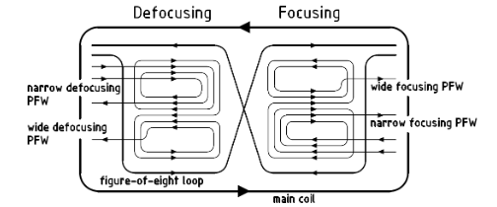
Chromaticity control in the PS
Chromaticity in the PS is controled by Pole Face Windings (PFW) surrounding the main units.
/!\ Introduction of non linear chromaticity and change of the other plane chromaticity
Recently we tried to use the MTE sextupole (XNO39) to control chromaticity with success
1
Trim of Q’_{y} = +1
PFW
XNO39
¹ Mariusz Juchno

Slide 39
Cycles parameters
Transverse parameters | Q_{x} | Q_{y} | ξ_{x} | ξ_{y}
Flat bottom | 6.06 | 6.31 | -0.85 | -1.1
Flat top | 6.23 | 6.27 | 0.12 | 0.05
Longitudinal parameters | τ_{b} [ns] | Q_{s} | h, V_{RF} [kv]
Flat bottom | 131 | 1.36 10⁻³ | 8, 50
Flat top | 42 | 5 10⁻⁴ | 8, 200
These are the cycles parameters using the sextupoles or PFWs only to flatten chromaticity.
Chromaticity was mostly changed using MTE sextupole (XNO39) and corrected in some cases with the PFWs. This allowed to minimize the non linear chromaticity while still changing the linear one.

Slide 40
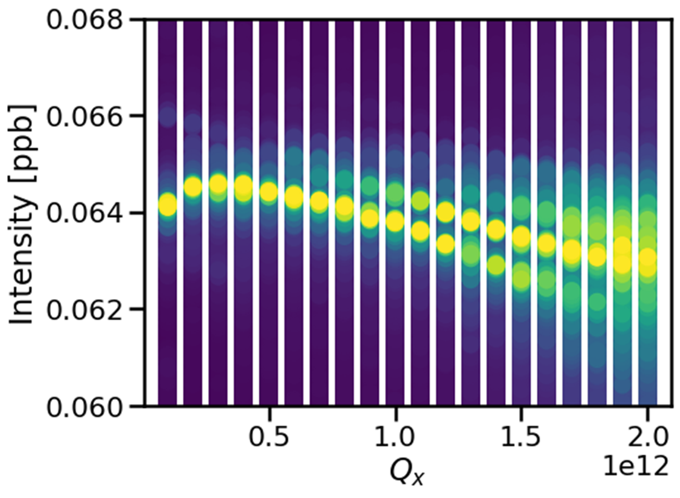
Examples of tune shift spectrum at flat bottom
Q_{s}
Q_{s}
New measurement method with larger acquisition window allows to acquire the horizontal tune shift and to observe azimuthal modes

Slide 41
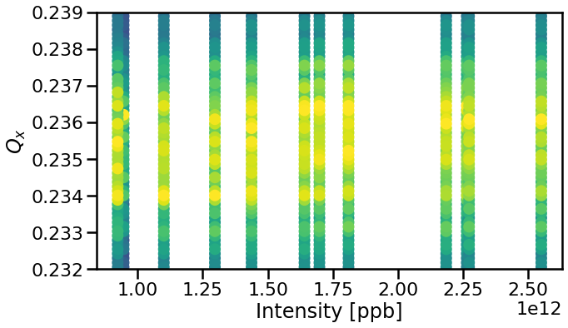
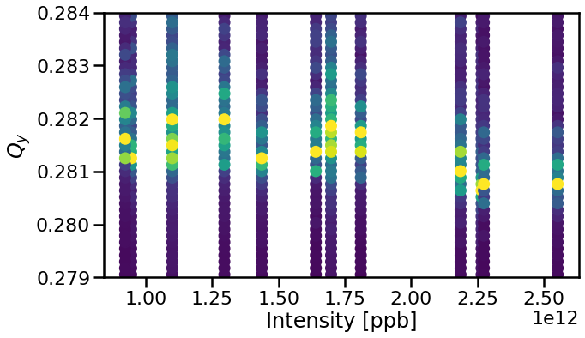
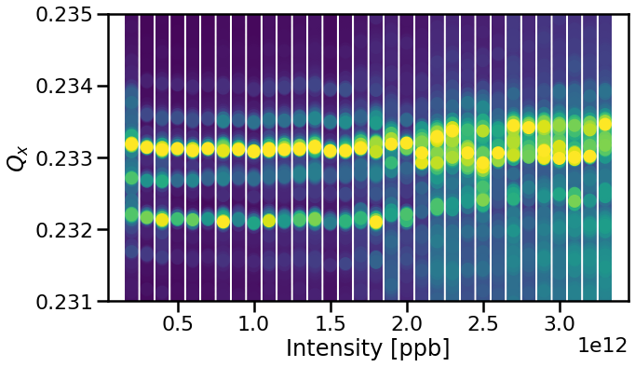
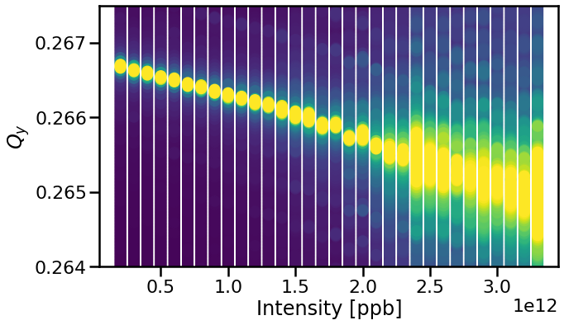
Examples of tune shift spectrum at flat top
2021
2022
Improved measurement method with larger acquisition window allows to acquire the horizontal tune shift and to observe azimuthal modes

Slide 42
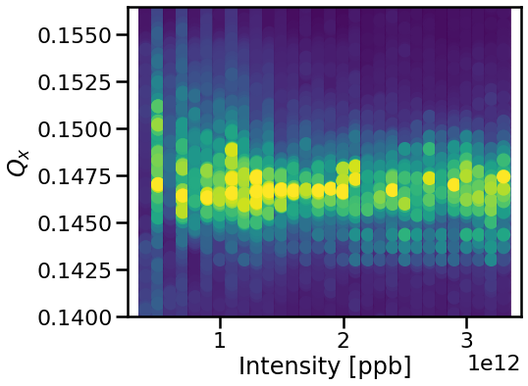
Chromaticity impact on tune shift measurements
ξ_{x} = 0
ξ_{x} = -0.8
A non-zero chromaticity blurs the picture and make it hard to discern the tune shift slope.
What is the impact of linear (and non-linear chromaticity) on the slope itself ?

Slide 43
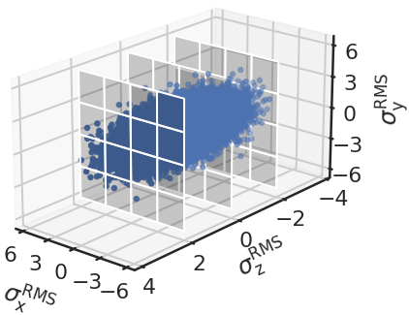
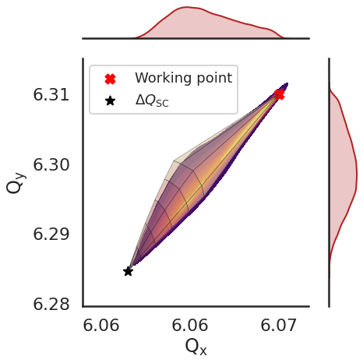
Modeling of space charge
In the beam rest frame, space charge is Coulombian interaction between charged particles.
It introduces an incoherent tune shift based on the particle energy and position within the bunch.
Modeled in simulations (PyHEADTAIL¹) with a 3D Particle In Cell (PIC) solver.
Simulated tune footprint agrees with theoretical predictions in wireframe.
¹ PyHEADTAIL

Slide 44
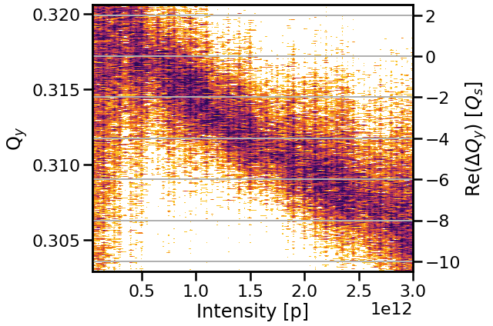
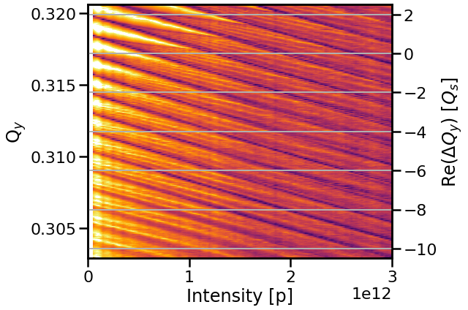
Impact of space charge on tune shift slope
Space charge does not impact the value of the tune shift slope, only its visibility.
Crucial to observe it for a wide range of beam intensities.
Simulations,
w/ SC
Simulations, wo/ SC

Slide 45
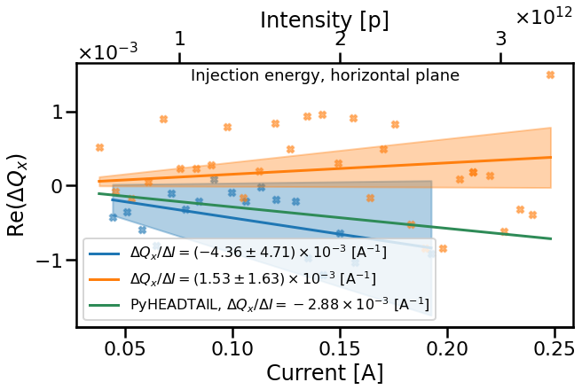
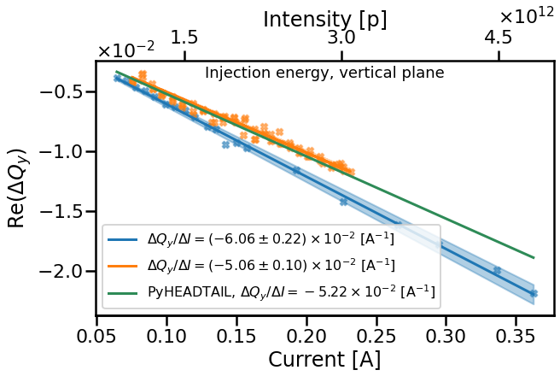
Comparison measurements at injection energy
2021 measurements (Q’’_{x} = 215, Q’’_{y} = -207)
2022 measurements (Q’’_{x} = -236, Q’’_{y} = 178)
Simulations use 2022 measurements parameters
At low energy, the vacuum chamber impedance is responsible for a near zero horizontal tune shift
Tune spread larger than slope → poor agreement with simulation
Difference between 2021 and 2022 can be attributed to Q’’
34 %
2 %
14 %

Slide 46
Instability prediction at injection energy (with space charge)
The blue envelope represents the statistical uncertainties of the measured growth rates
A valid impedance model can predict the instability growth rate in various scenarios (once the simulations include the relevant mechanisms: first and second-order chromaticity, synchrotron motion, etc)
The measurements and simulations agree well for the different Q’_{x} and beam intensity regimes

