Slide 1
Construction and tests of new Resistive Plate Chambers
for the Upgrade of the CMS Endcap system
L. M. Pant
Nuclear Physics Division
Bhabha Atomic Research Centre
Mumbai 400 094, India
on behalf of the CMS collaboration

Slide 2
Plan of the talk
RPCs in CMS end-cap
Prototype production at CERN
QC for chamber assembly
Gap delivery from KODEL
Production schedule in India
Cu Cooling system
Leak and spacer tests for gaps
DAQ status
Storage facilities
Outlook

Slide 3
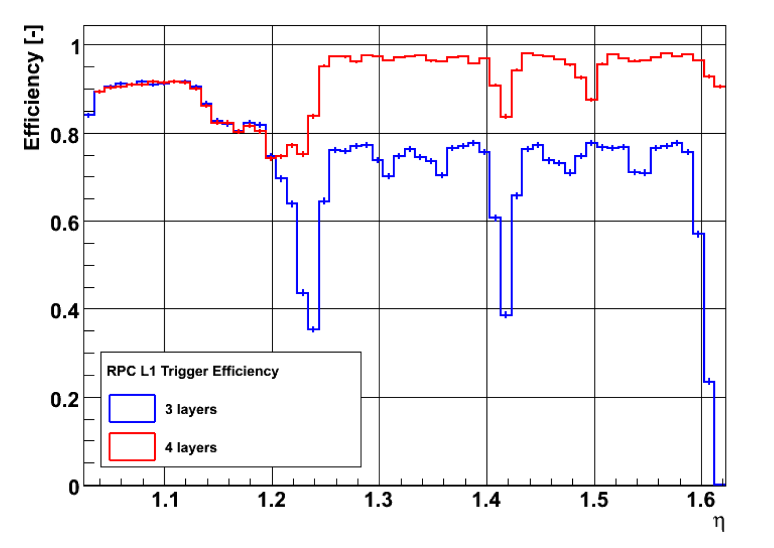
Trigger efficiency : CMS end-caps
Simulations : Piet Verwilligen

Slide 4
RPCs in CMS end-cap
 | RE1/1 | RE1/2 | RE1/3 | RE2/1 | RE2/2 | RE3/2 | RE3/1 | RE3/2 | RE 3/3 | RE4/1 | RE4/2 | RE4/3
No. of RPCs | 36 x 2 | 36 x 2 | 36 x 2 | 18 x 2 | 36 x 2 | 36 x 2 | 18 x 2 | 36 x 2 | 36 x 2 | 18 x 2 | 36 x 2 | 36 x 2
Total | 72 | 72 | 72 | 36 | 72 | 72 | 36 | 72 | 72 | 36 | 72 | 72
432 | Installed (η < 1.6)
144 | Upscope (η < 1.6)
180 | Yet to be instrumented (1.6 < η < 2.1) : high η upgrade
RPC Upscope : Build and install 144 RE4 chambers upto η = 1.6
Restoration of TDR version of CMS : RE4 RPCs on Yoke YE3

Slide 5
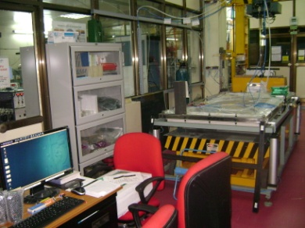
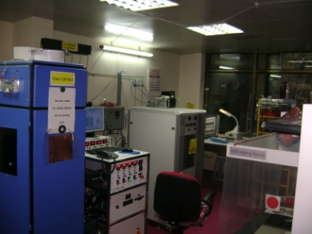
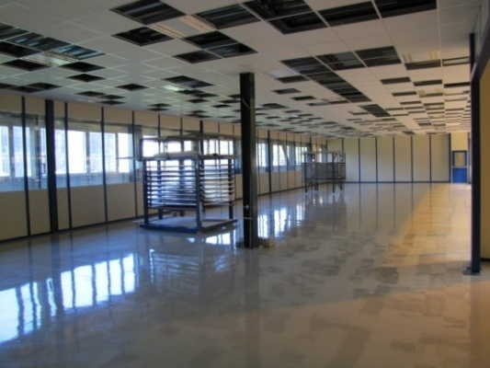
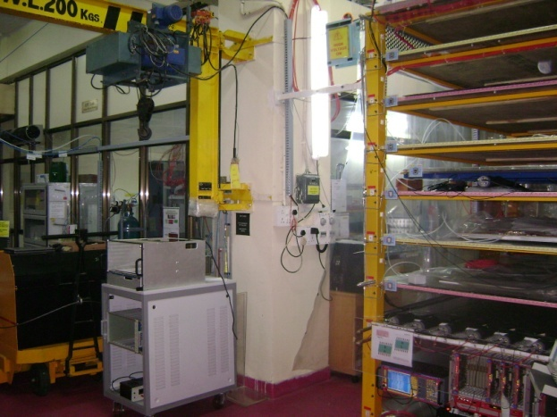
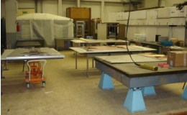
QC for chamber assembly
Production on three different sites : CERN, GHENT, BARC (50/50/50)
CERN site (904) will coordinate logistic & setting up protocols for QA / QC
Common technical specification and protocols for production and QC discussed and agreed among the three sites
Detailed DB for production and test in preparation
BARC
CERN 904
GHENT

Slide 6
The QC scheme
QC1 : Chamber components validation : completed
QC2 : GAPS certification : KODEL, Korea
QC3 : Chambers test (at assembly sites) : CERN, Ghent, India
QC3_A Chamber assembly validation
QC3_B Tests on Cosmic stand
QC4 : Chamber reception from sites : CERN (904)
: Super-module assembly and final test : CERN (904)
QC5 : Installation and commissioning a P5 : CERN (P5)

Slide 7
The production schedule
Engineering Design Review : 24 Nov 2011
Productions at sites to start : Feb / Mar 2012
Site review by CERN team : Feb / Mar 2012
First ten chambers from each site : Apr / May 2012
Validation and SM assembly : July / Aug 2012
Remaining production at sites : Nov/ Dec 2012

Slide 8
Prototype assembly of RE4 chambers
Oct. '2010
(positive results → green signal for mass production)
Validation of bakelite quality
    Surface smoothness
    Bulk resistivity
Validation of gas gap fabrication procedures
a. mechanical and electrical QCs
b. gluing of gaps
c. bonding strength of spacers
d. efficiency in a cosmic hodoscope

Slide 9
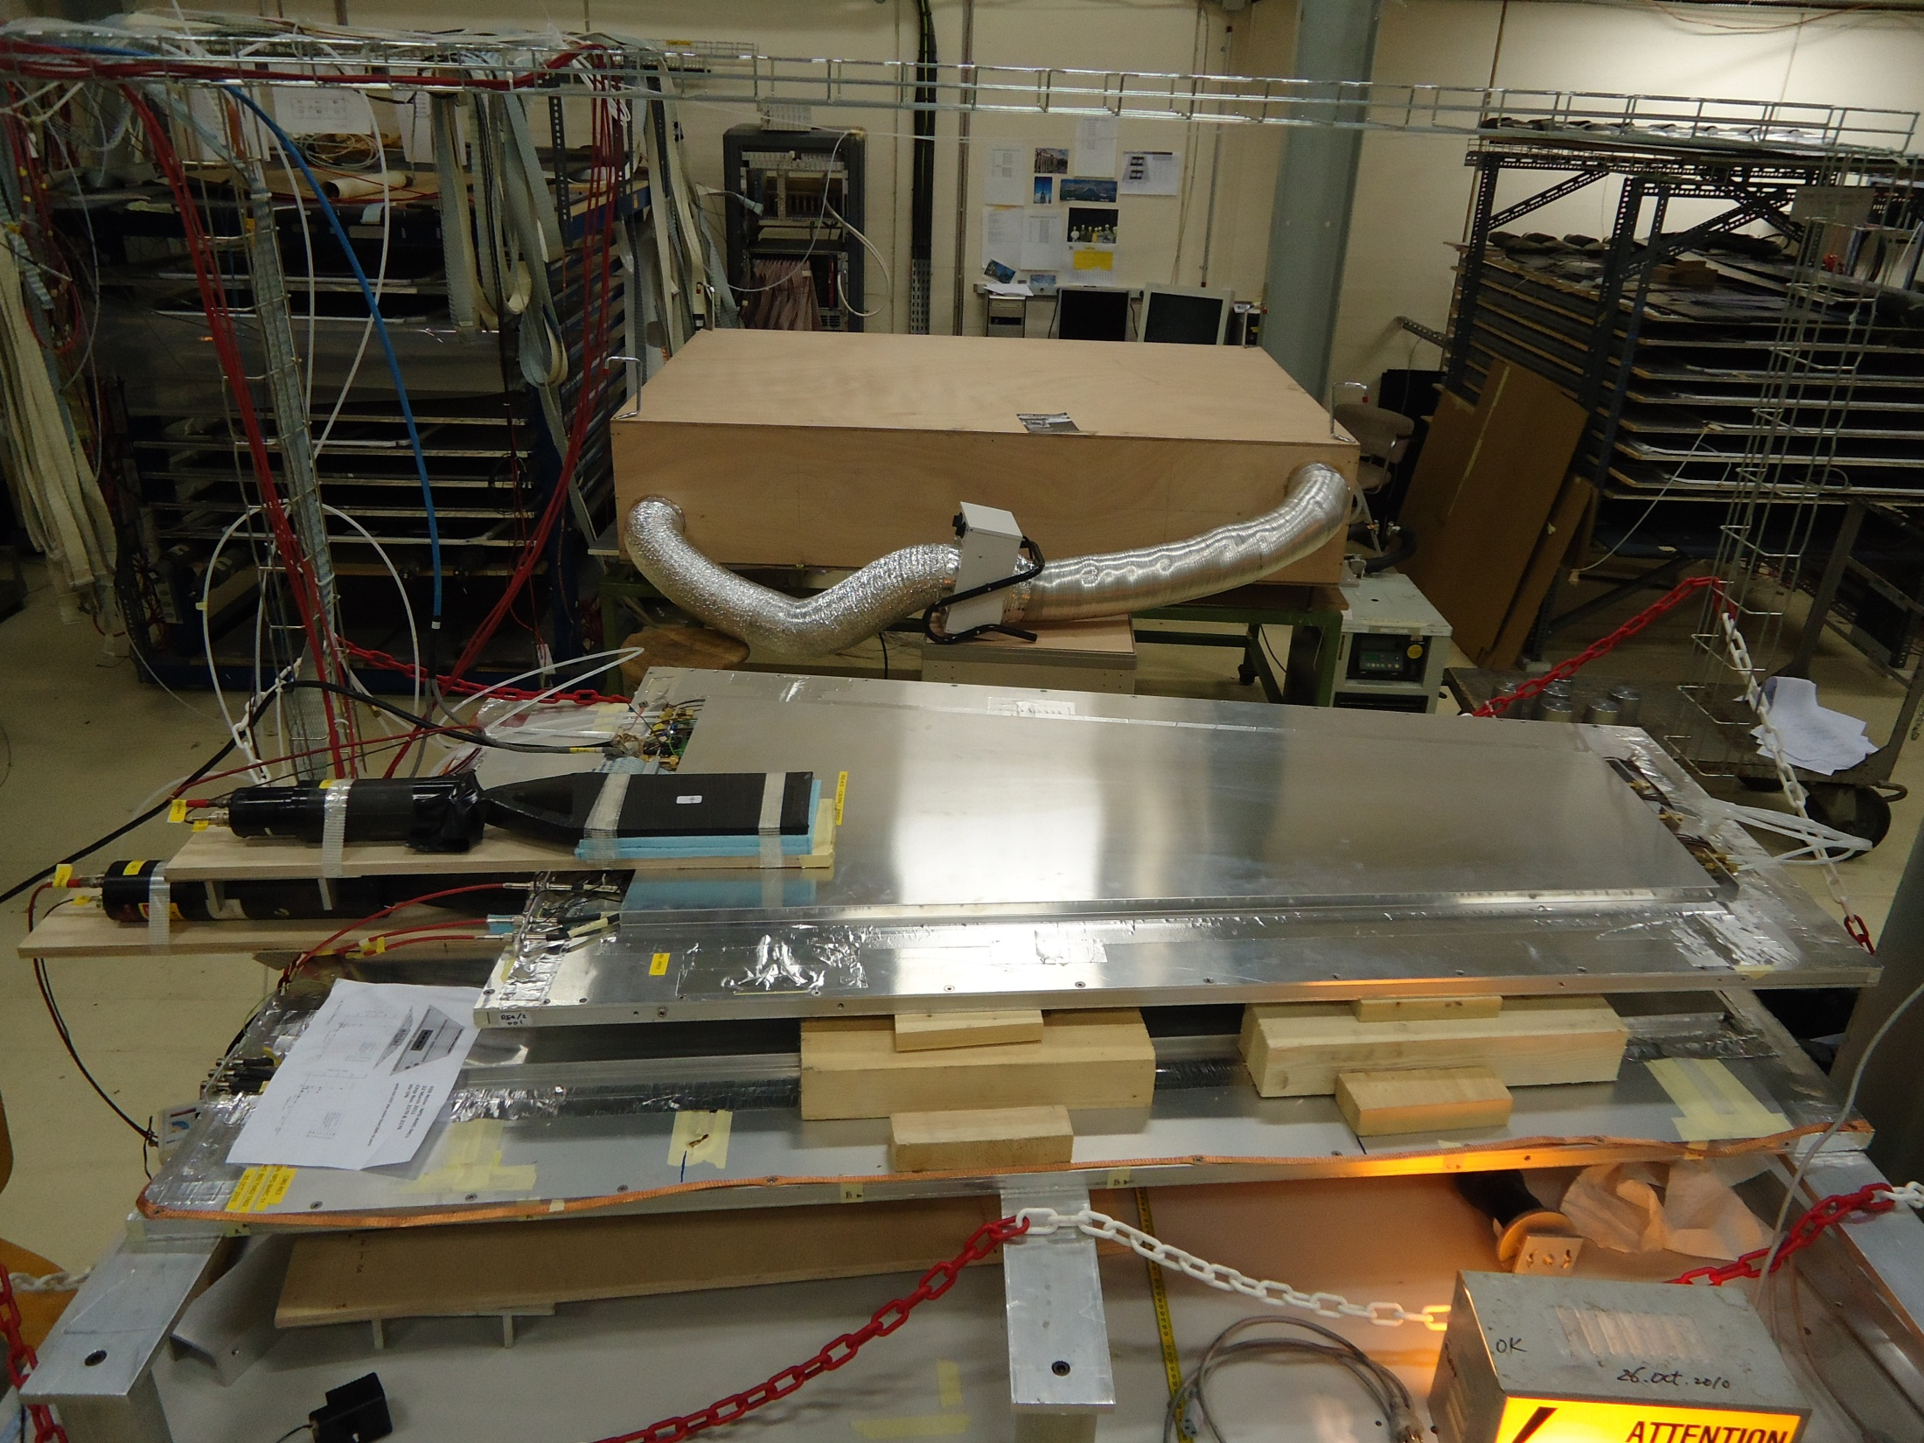
First prototype for RE4
ISR Lab., CERN
Apr 2011
S2 ∼ 5 Hz, Th ∼ -180 mV
S1 ∼ 3 Hz, Th ~ -120 mV

Slide 10
QC2 : gaps at KODEL
660 gaps to be produced for 200 chambers
12 months for complete production
60 gaps per month
One shipment, each, to the three assembly sites per month
One shipment per month for any assembly site
= 30 gaps = 10 RPCs

Slide 11
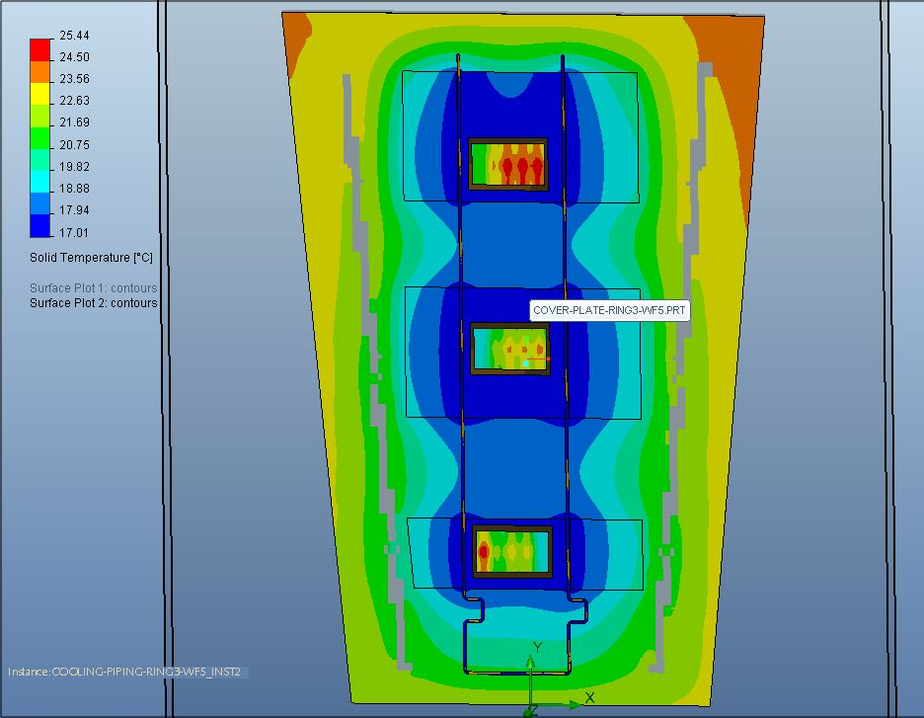
Improvement in cooling for RE4 : Yasser
particular position facing the CSC electronics
Extreme case :
T_{gap} < 24 °C
lncreased Cu surface
soldered to 2 pipes

Slide 12
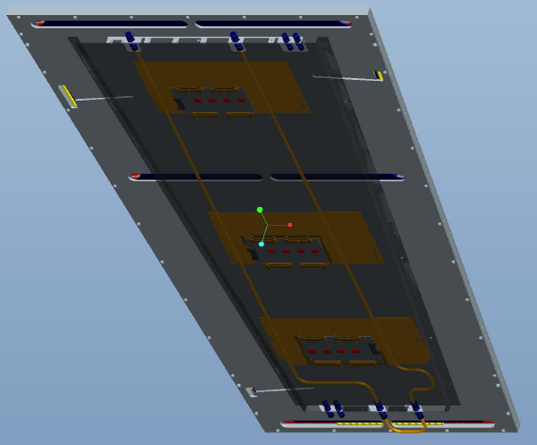
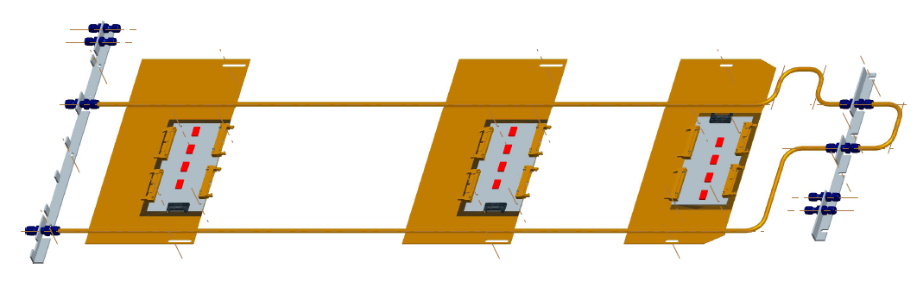
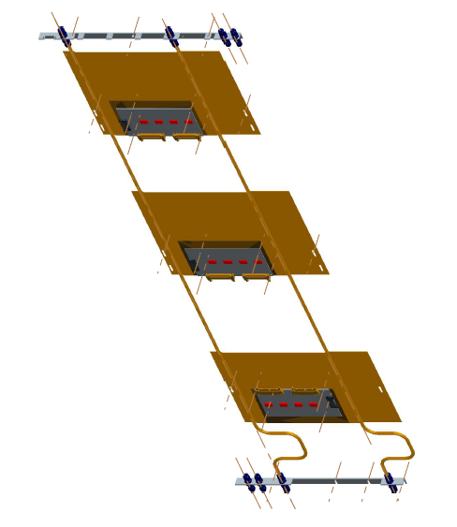
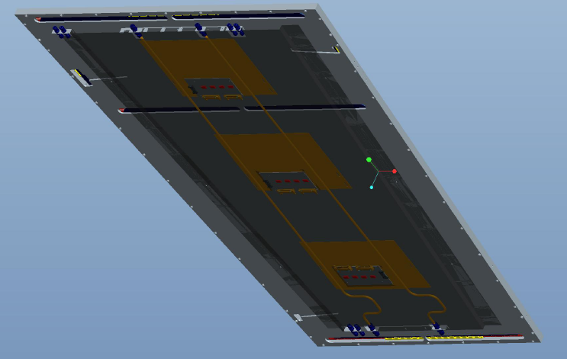
Cu cooling system for RE4/2 & RE4/3 type RPC
1504.34 mm
1766.22 mm

Slide 13
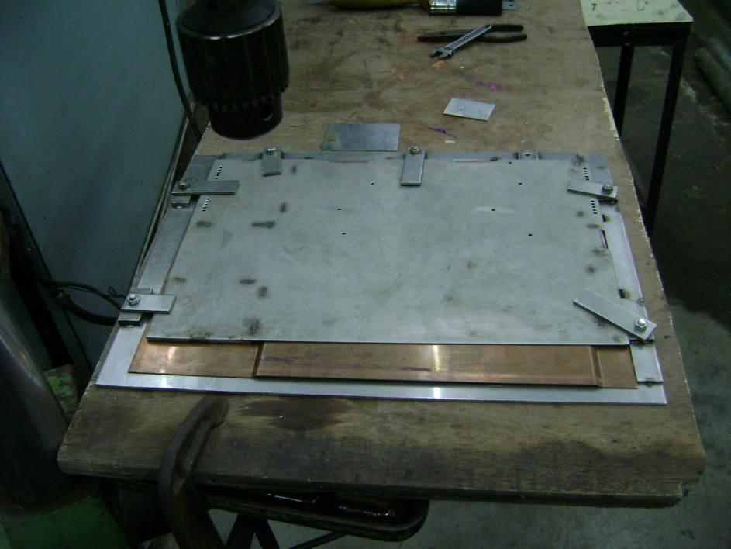
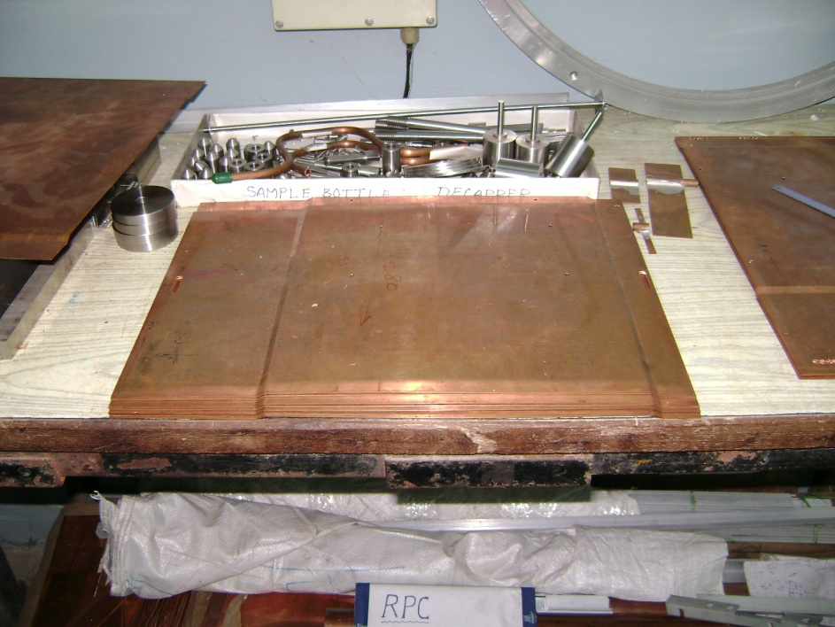
Cu plates (DHP) : cutting, bending and drilling : BARC, Mumbai
DHP copper being used for the
plates and pipes (semi-hard)
DHP : Deoxidized High Residual Phosphorous

Slide 14
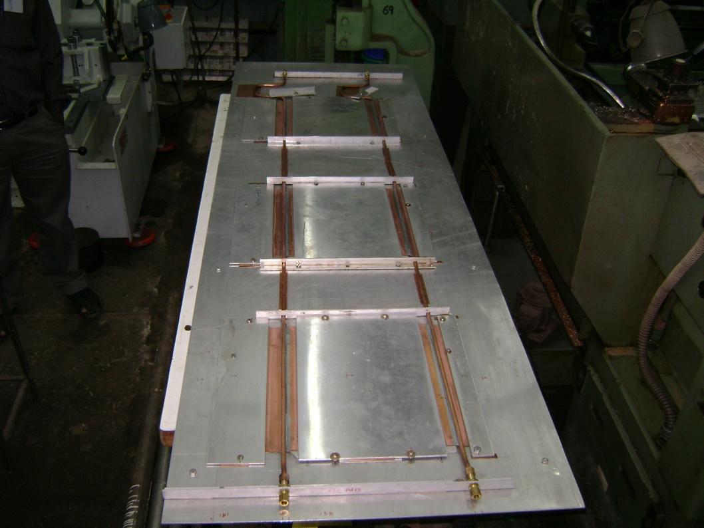
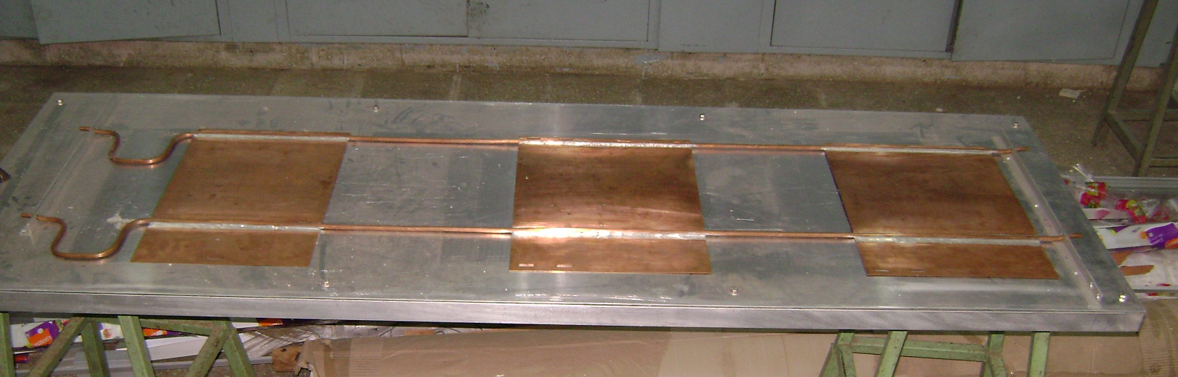
Cu pipes (semi-hard) soldered to Cu plates (Sn:Pb::60:40 @ 200ºC) : Mumbai
Cu cooling set on jig while soldering
Finished product (for type RE4/3)
yet to undergo leak test with Argon at 20 bar

Slide 15
Cu cooling system for 200 chambers
Cu cooling circuits for the first 30 chambers under fabrication
at Mumbai :
RE4/2 type 10 sets for Mumbai
RE4/3 type 10 sets for CERN &
RE4/3 type 10 sets for Ghent
Delivery expected by end-March 2012
Fabrication of remaining 170 sets, to be completed in a
phased manner, by end-Oct 2012

Slide 16
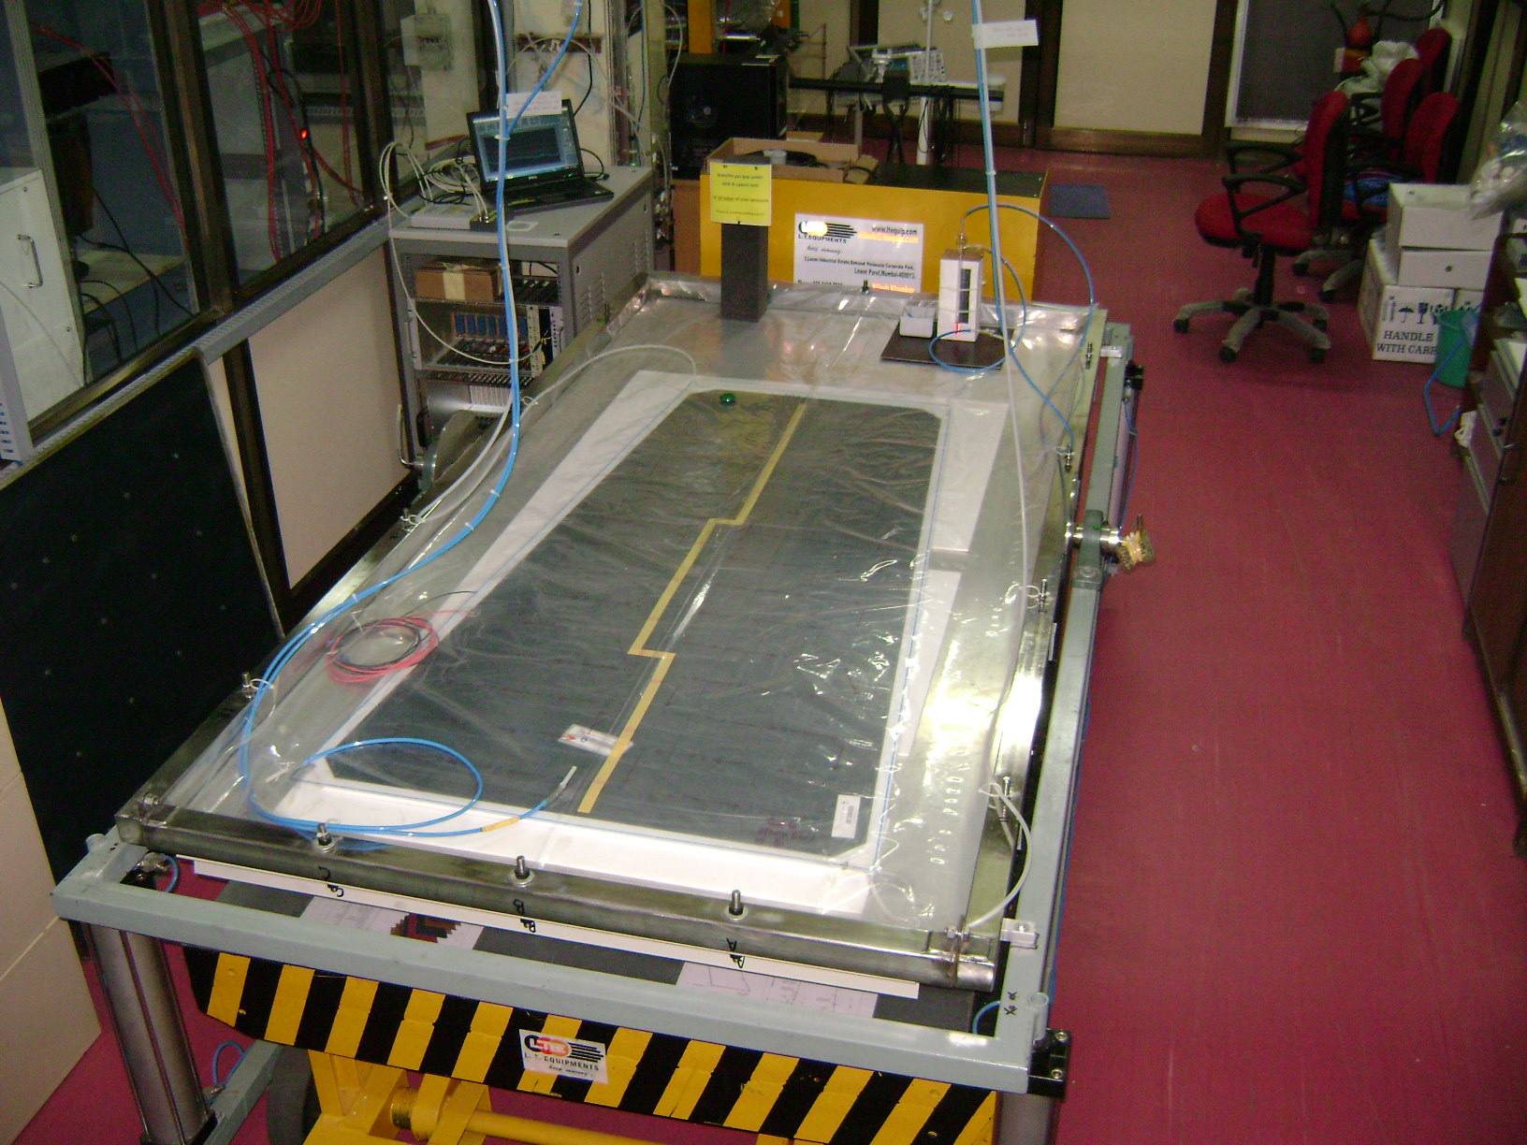
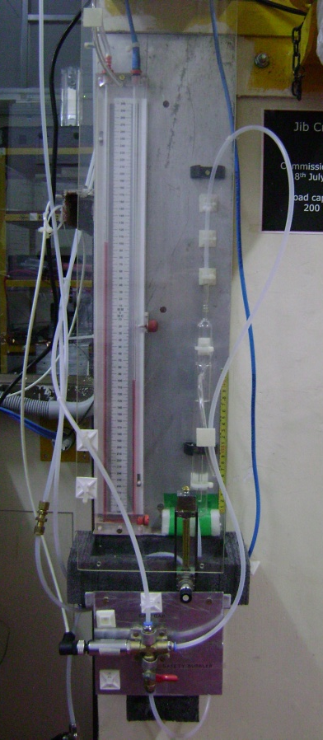
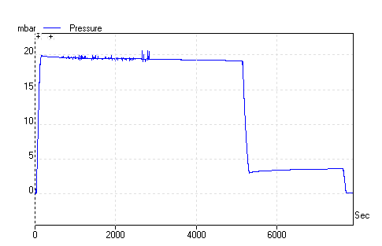
Leak and Spacer test facility at NPD-BARC, Mumbai
“Bottom Gap” of RE*/2 type from old stock (2007)
20 cm
20 mbar of
overpressure
with water column

Slide 17
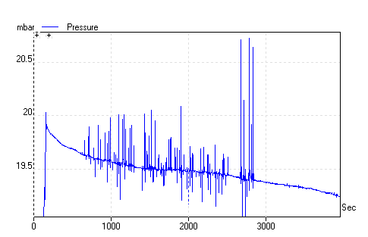
Pressure Transducer : Sensor Technics (CTE7000)
with a 20 bit ADC Picolog (20 mbar of overpressure)
Leak rate : 2.3 x 10⁻⁴ mbar . litre / sec
bottom gap of RE*/2 type
mbar
non-spacer
region
102 intact spacers in
a bottom gap of RE*/2 type
sec
11th Jan 2012

Slide 18
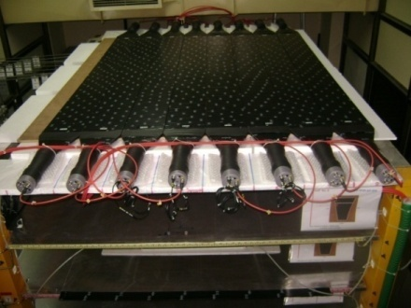
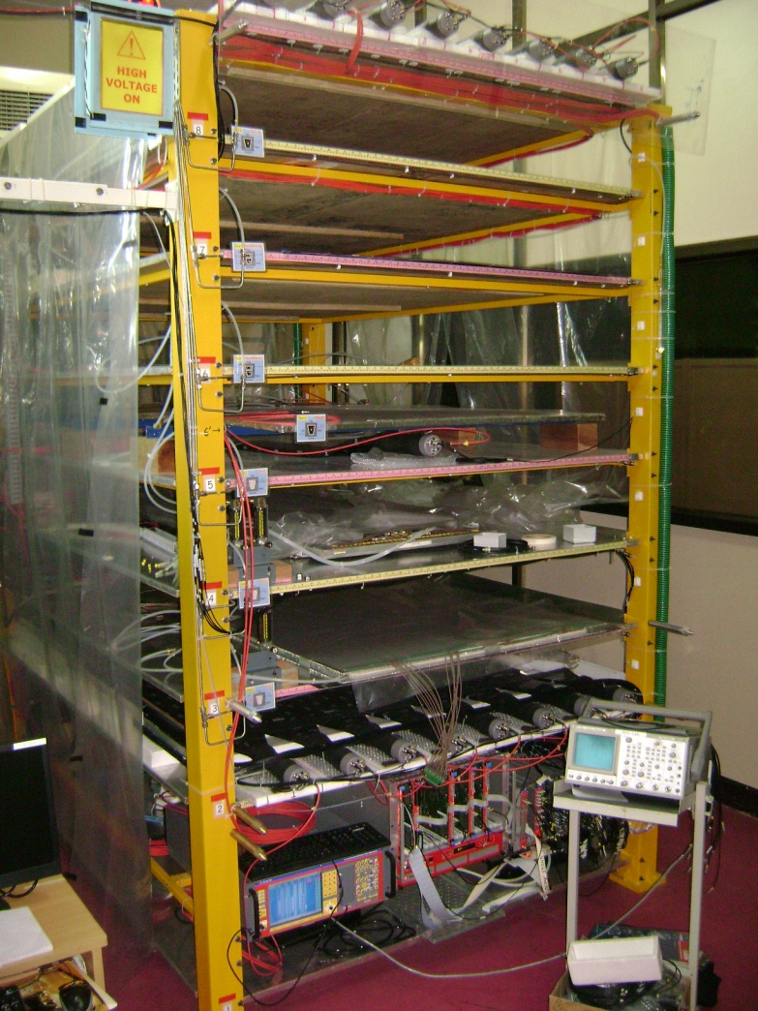
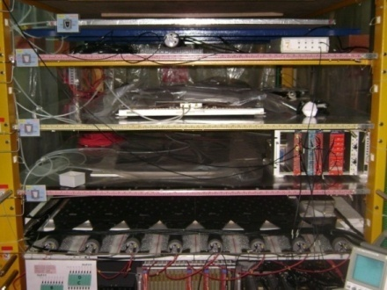
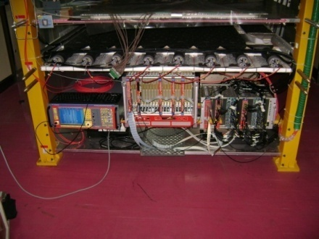
Hosocsope and VME-DAQ status at Mumbai
Top Plane
Test paddle
Bottom Plane
VME-DAQ

Slide 19
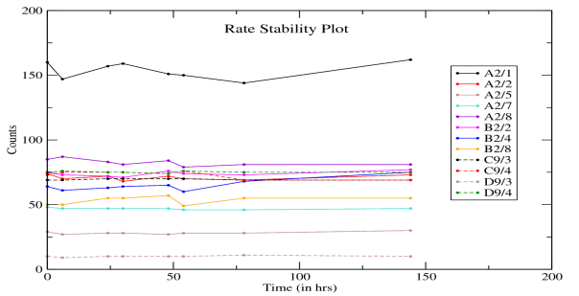
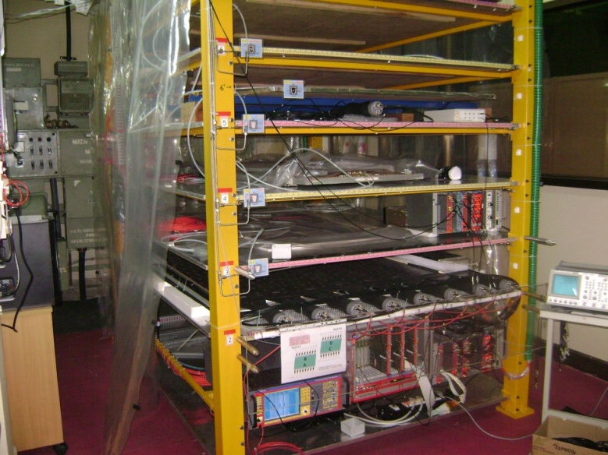
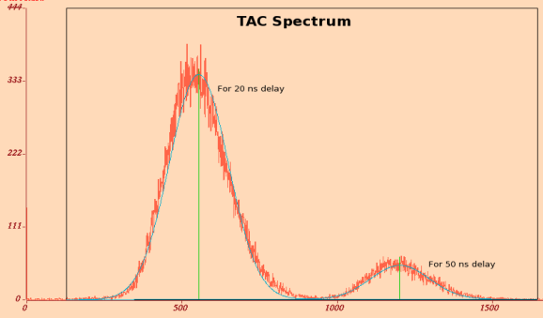
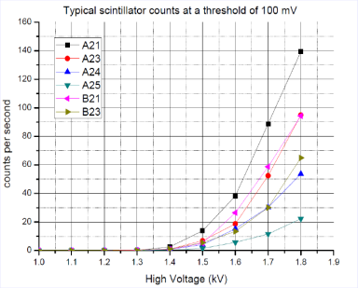
Hodoscope : scintillator counts, rate stability & TAC spectrum
TAC spectrum between top and bottom planes for two delays

Slide 20
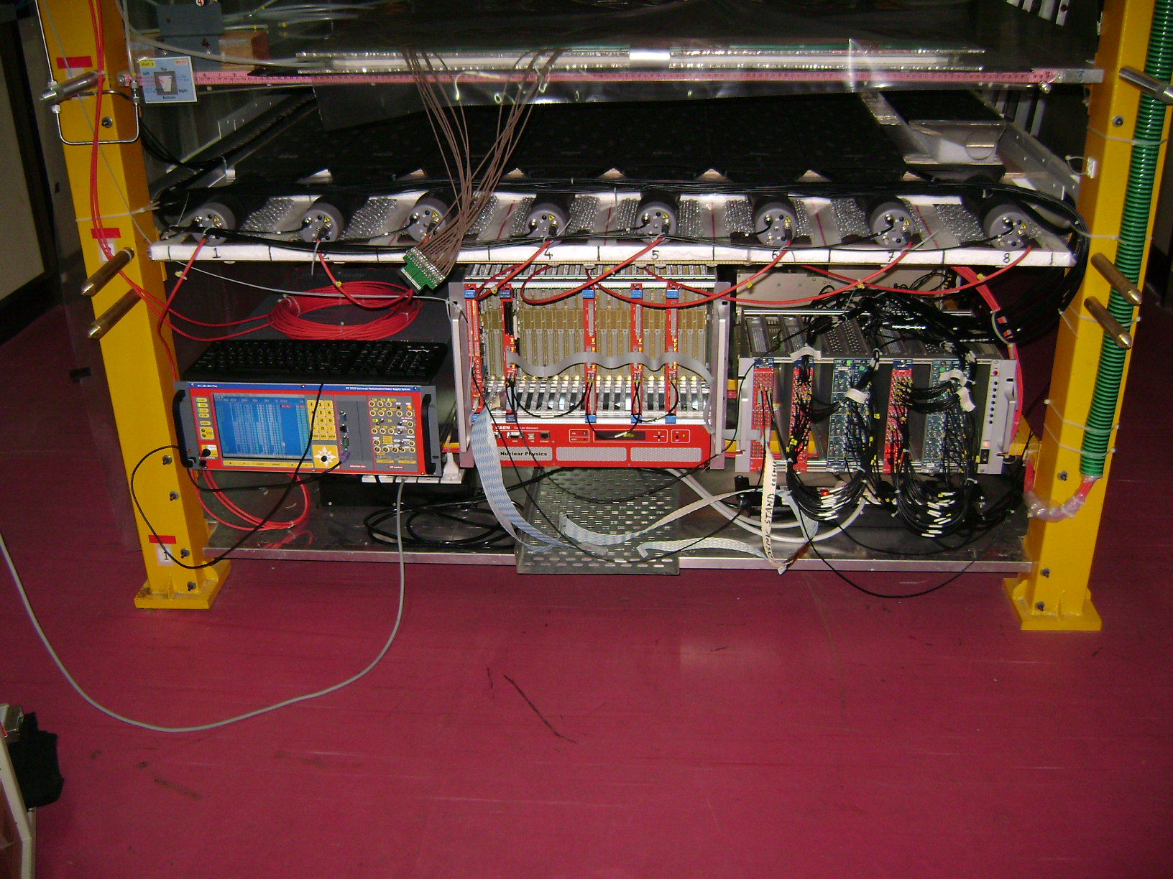
VME-DAQ status at Mumbai
VME-DAQ with
One unit of V1190A (128 ch) TDC and
Three units of V1290 (32 ch) TDC
synchronized with the 25 ns clock from V2718 VME bridge
3 x V1190A expected by Feb 2012

Slide 21
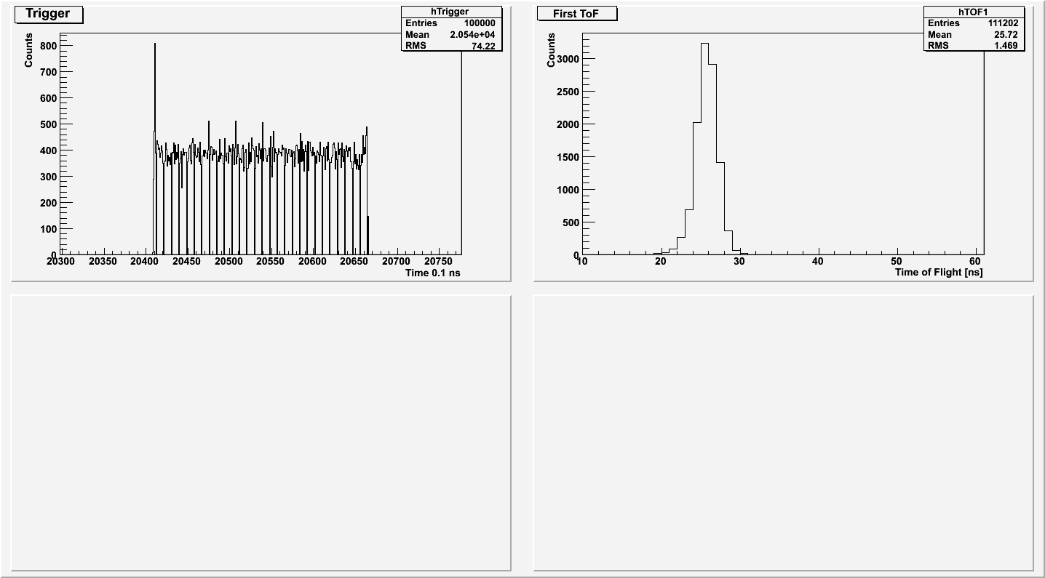
Cosmic Trigger : 0.1 Million events
13th Jan 2012

Slide 22
The test paddle
13th Jan 2012

Slide 23
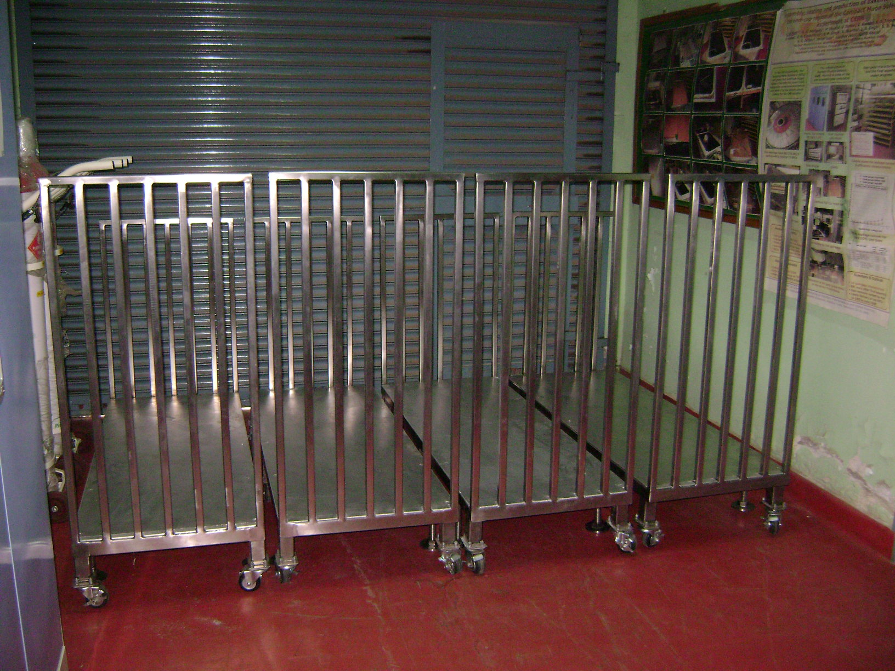
Storage facilities in AC environment 10 x 10 sq feet
Trolleys for stacking the Honey Comb Panels for type 4/2 chambers

Slide 24
Outlook -1
Following can be handled simultaneously at BARC, Mumbai
Three RPCs on RPC gas mixture,
Three gas-gaps on RPC gas mixture &
Three gas-gaps on Argon for bakelite resistivity
measurements, if required
Site ready with hodoscope, HV, LV and RPC gas mixture
(humid gas with 40% RH at a flow rate of 5 litres per hour) &
storage facilities in AC environment (temp = 21ºC, RH ~ 40%)
Site inspection by CERN team : March/April 2012
VME-DAQ is functional with online data taking application
Offline – Under development - 10% done
Database coupling – Under development
Web interface – Under development

Slide 25
Outlook -2
BARC and PU would collectively have :
Two Physicists & Two Engineers
Three technicians & Four Tradesmen and
Three students for assembling the chambers
Once all the accessories are made available :
Three RPCs can be fully assembled and characterized
in a week’s time
First ten RPCs (RE4/2) could be dispatched to CERN
by May 2012

