Slide 1
CMS RPC project overview from the present system to the upgrade
CMS RPC Web page
Dr. Pierluigi Paolucci
Istituto Nazionale di Fisica Nucleare &
CERN

Slide 2
Outline
Muon system description
RPC collaboration
Brief history of the detector construction
Online tool and data analysis
Results 2010-2011 with collision data
2012-2013 Upgrade
Conclusions
Much more details in the CMS talks

Slide 3
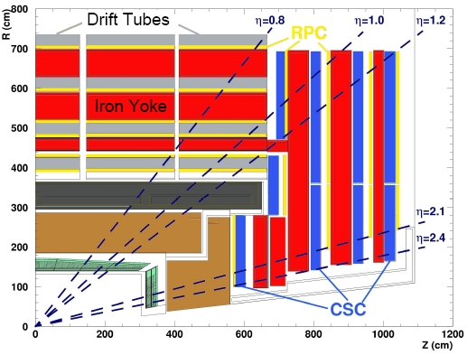
Muon system overview
BARREL (0 < |η| < 1.2):
250 - Drift Tube
480 - Resistive Plate Chamber
About 3.000 m² of RPC detectors
ENDCAP (0.9 < |η| < 2.4):
540 - Cathode Strip Chamber
432 - Resistive Plate Chamber

Slide 4
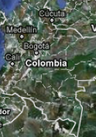
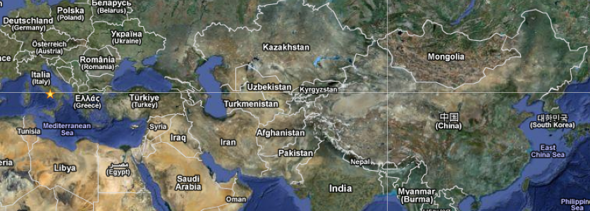
RPC collaboration
CHINA | 2
KOREA | 16
INDIA | 4
BELGIUM | 10
COLOMBIA | 2
PAKISTAN | 6
EGYPT | 3
CERN | 4
ITALY | 28
BULGARIA | 12
TOTAL | 84
Barrel | Italy | Bulgaria | China | Colombia
Endcap | Korea | Pakistan | China | Belgium | CERN
Upgrade | Italy | Pakistan | India | Colombia | CERN
 | Korea | China | Belgium | Finland | Egypt
Belgium
CERN
Bulgaria

Slide 5
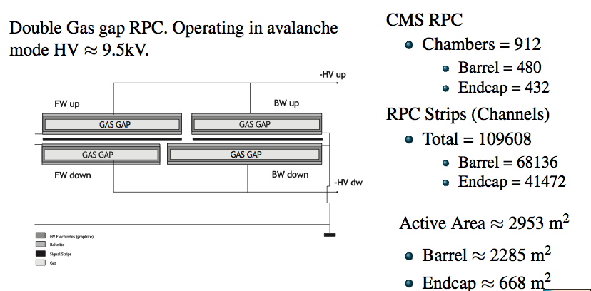
RPC system: few numbers
RPC info
Bakelite thickness | 2 mm
Bulk resistivity | 1-2 10¹⁰ Ω cm
Gas mixtures | 96.2%C2H2F4 + 3.5%C4H10 + 0.3%SF6
Operating HV | 9.4 – 9.8 kV

Slide 6
Past Construction lines (2004-2007)
Two parallel lines have been developed to build gaps:
Barrel gaps in Italy for 480 chambers
Endcap gaps in Korea for 432 chambers
Chamber assembly:
Barrel chamber - Italy
Endcap chamber – China, Pakistan and CERN
Front-end electronics – Italy
Off-chamber electronics – Warsaw, Finland

Slide 7
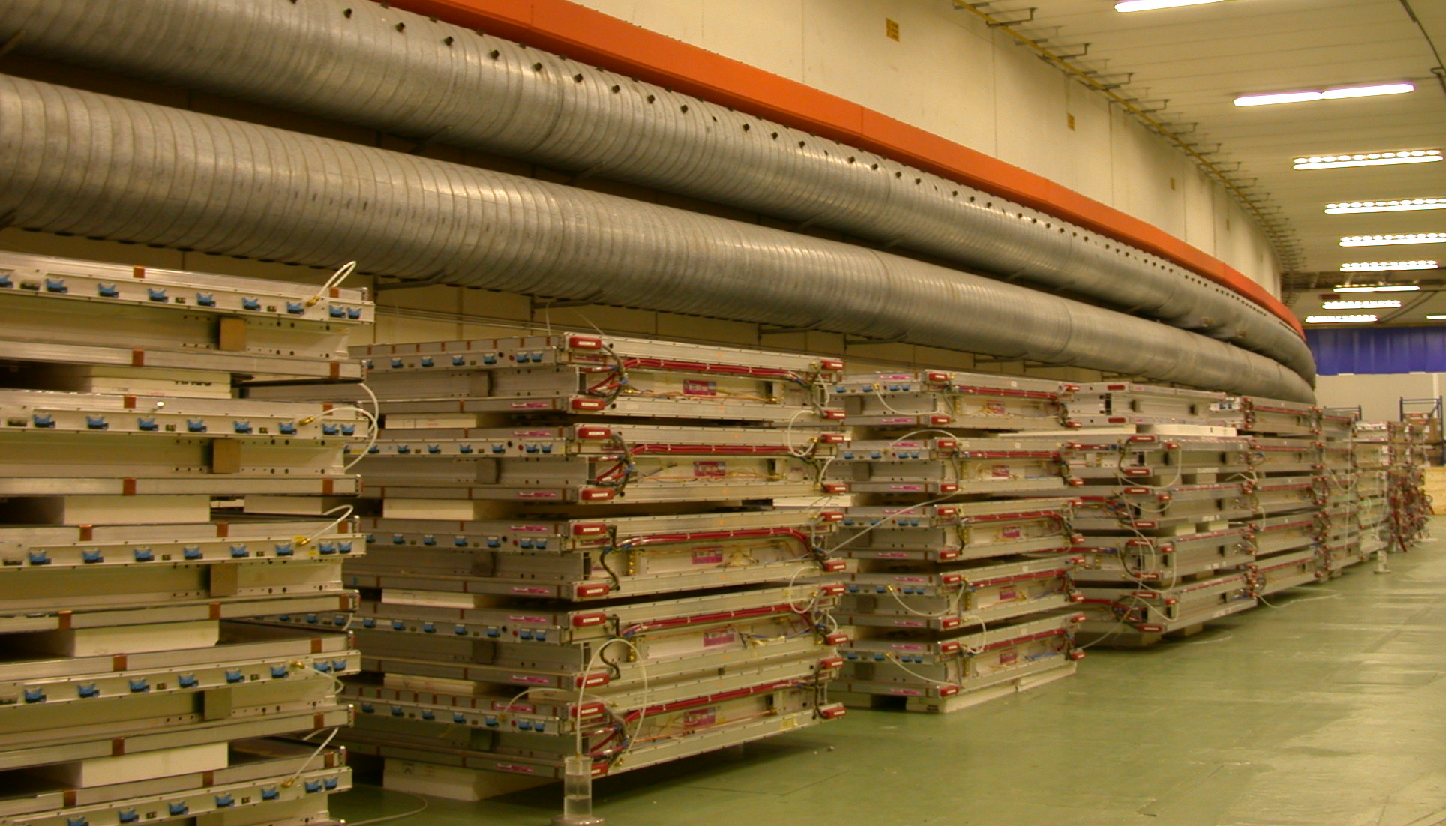
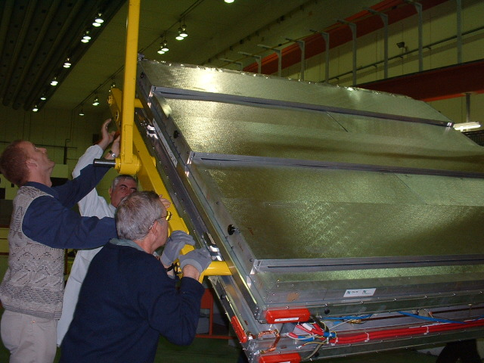
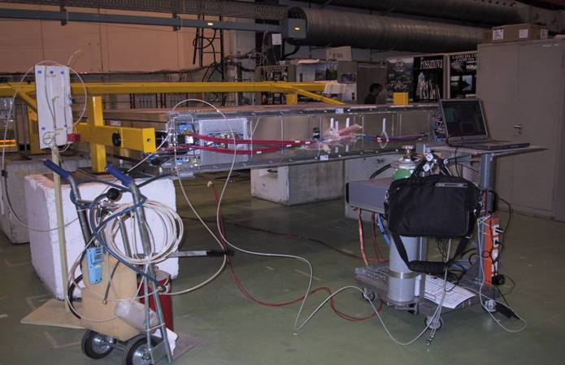
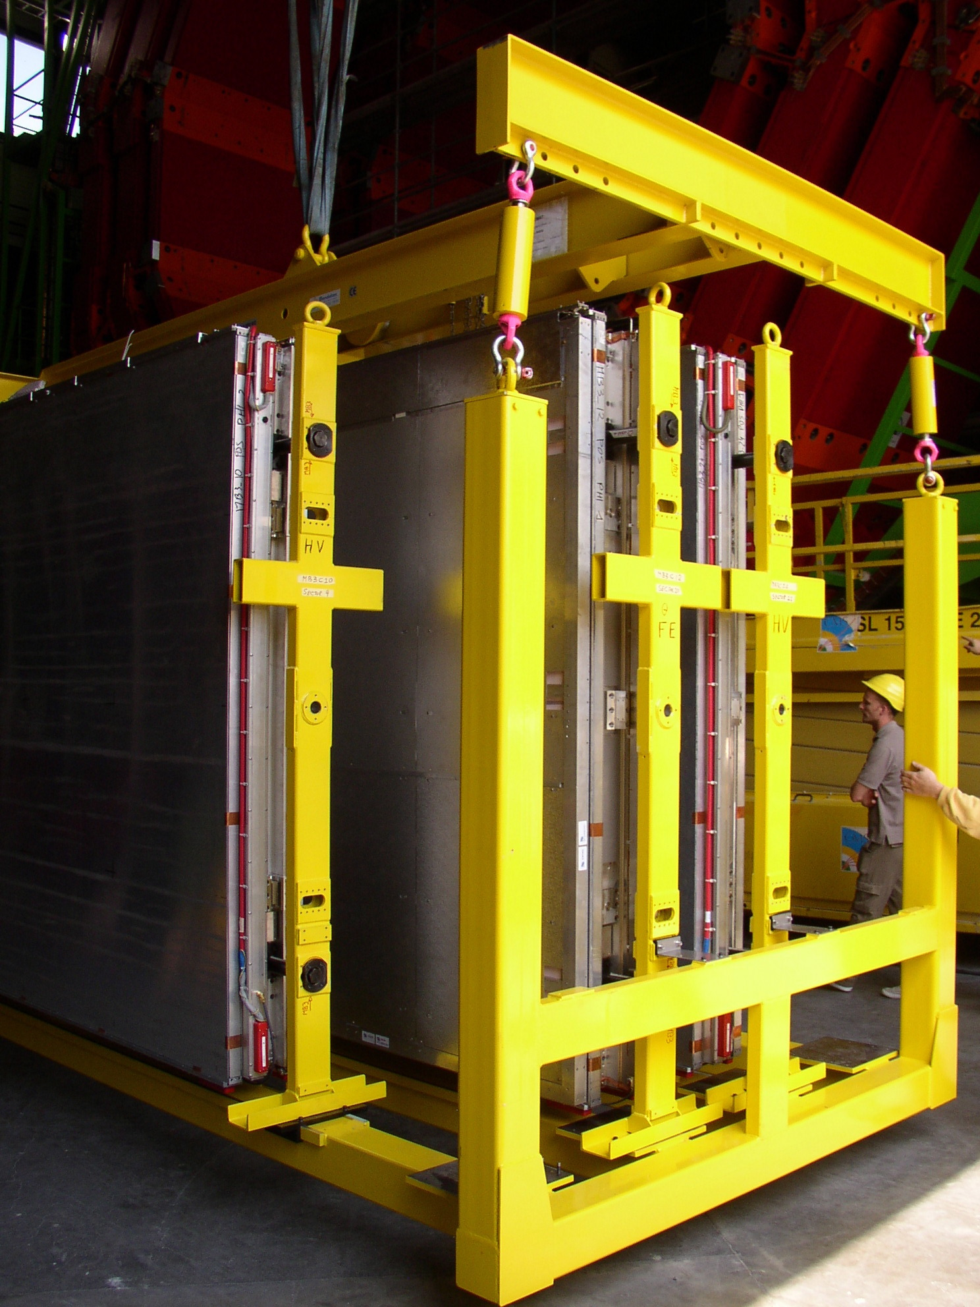
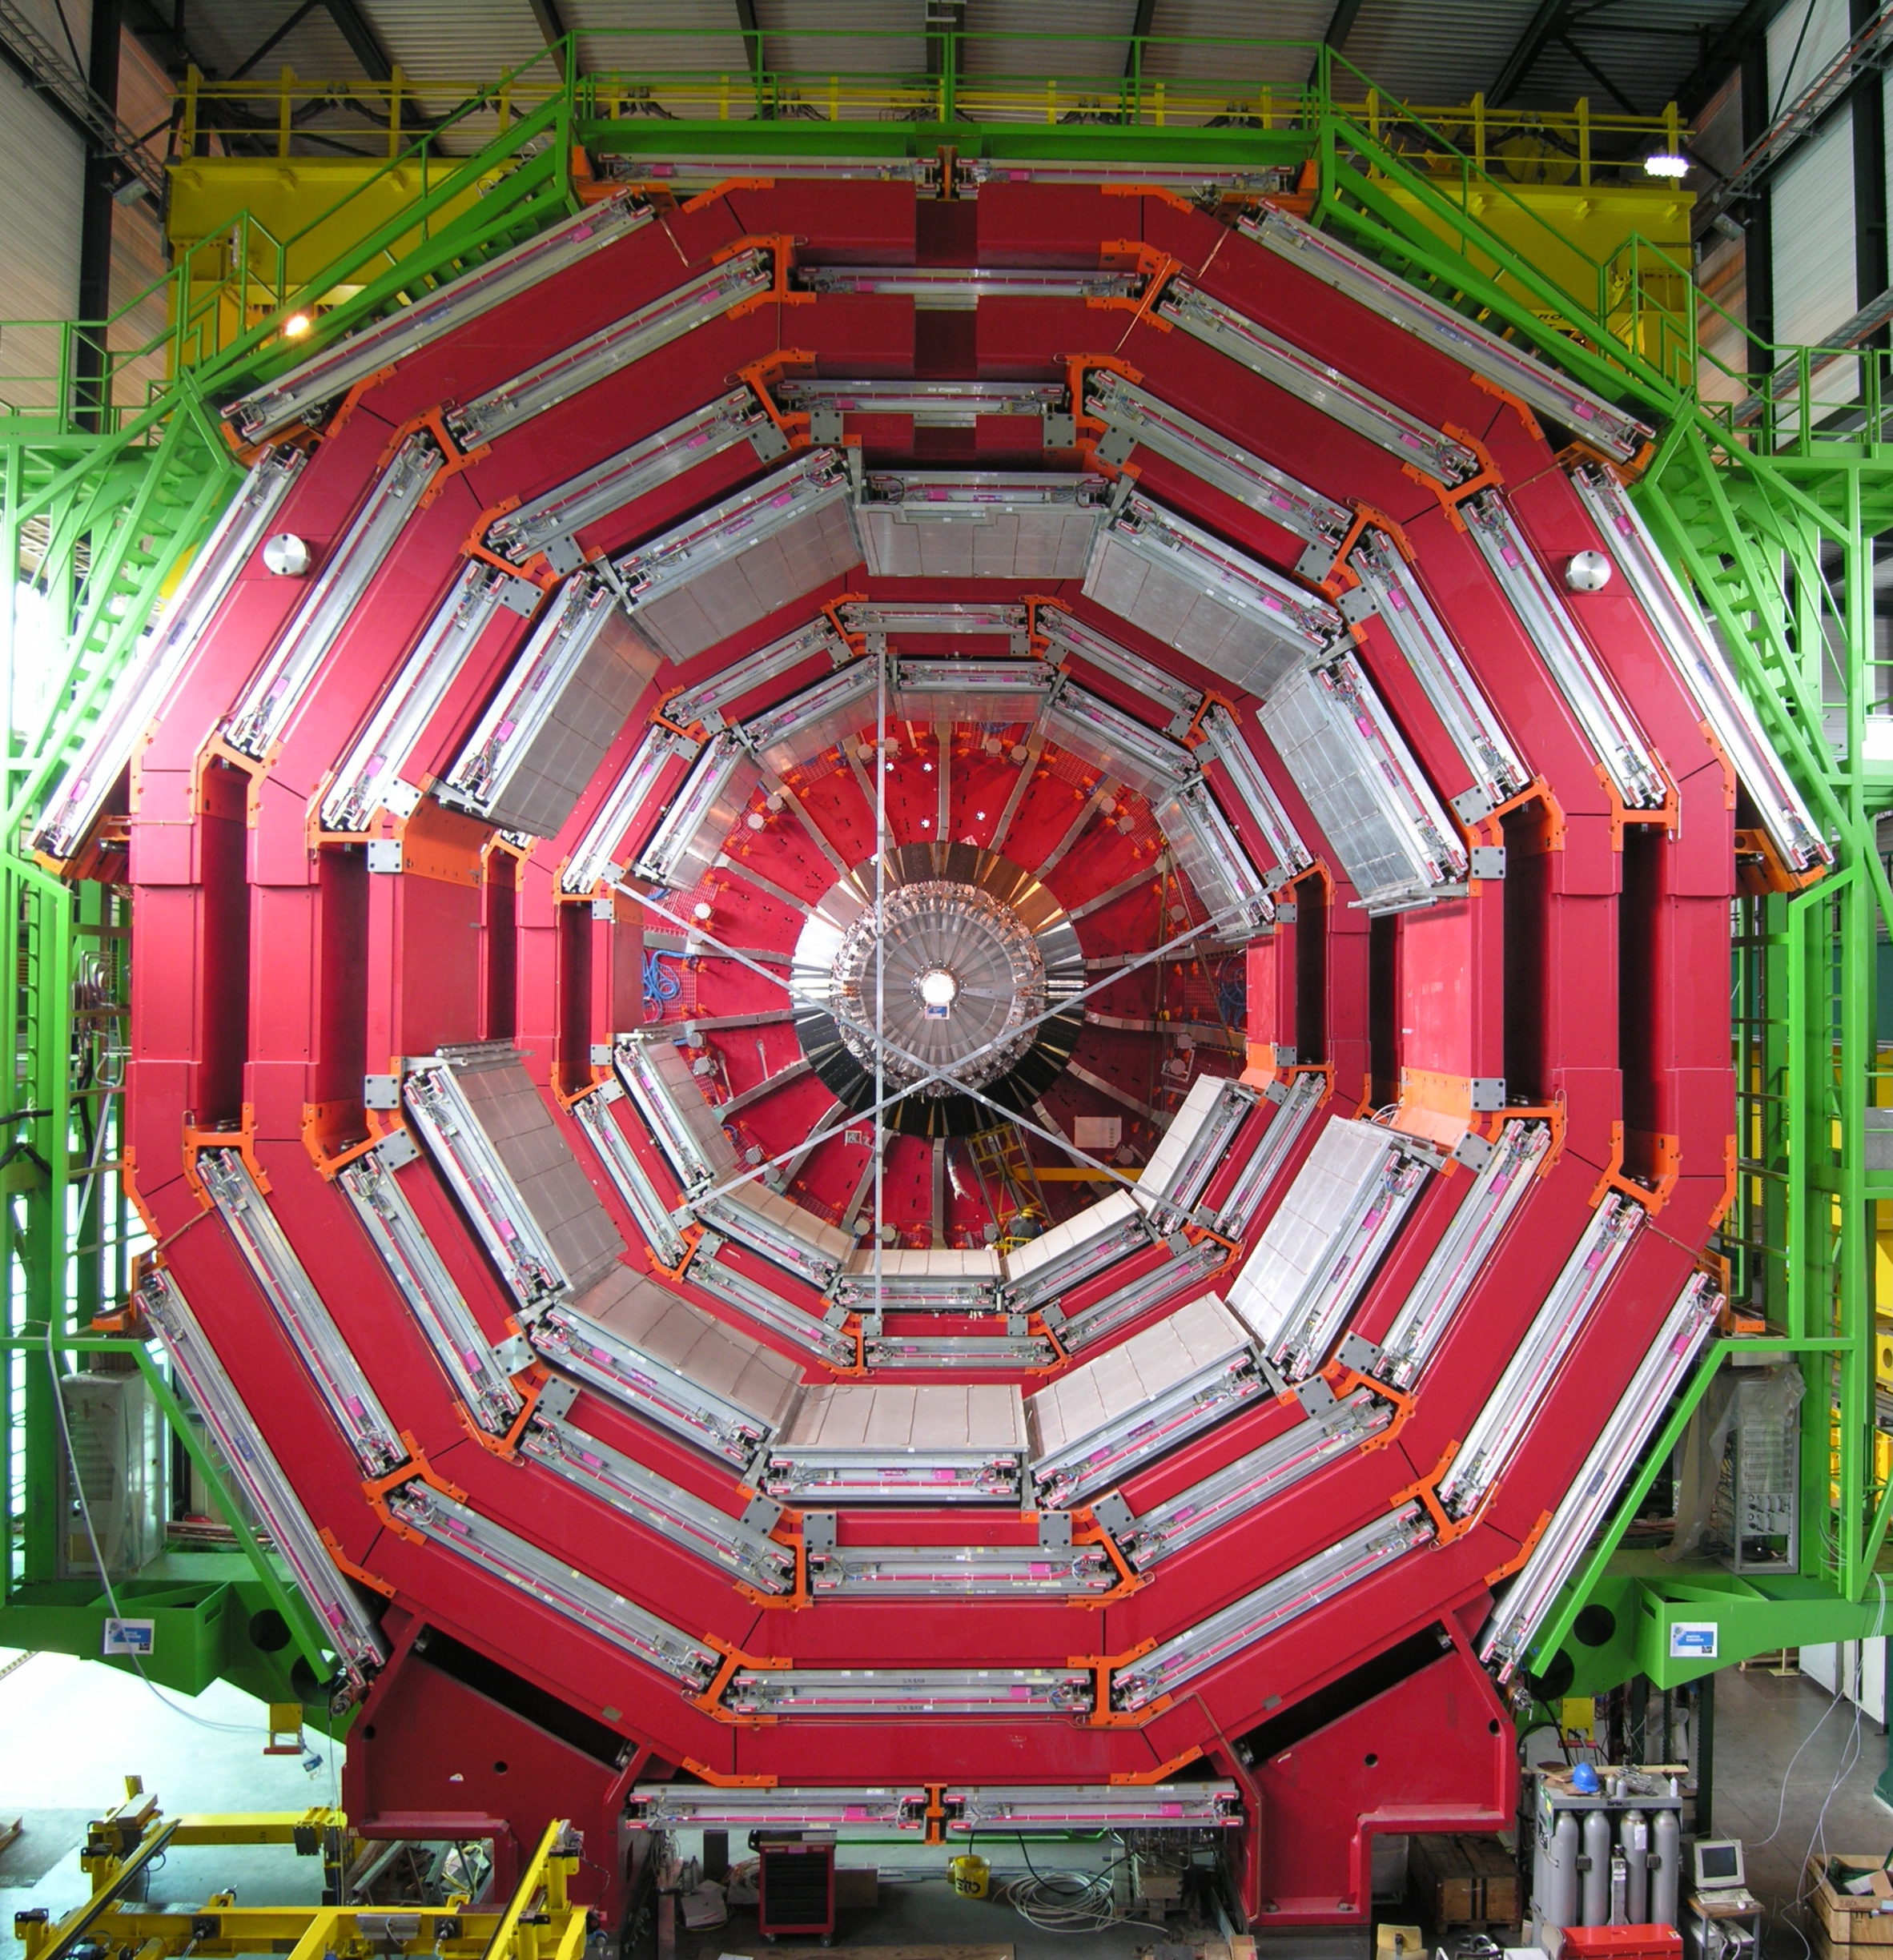
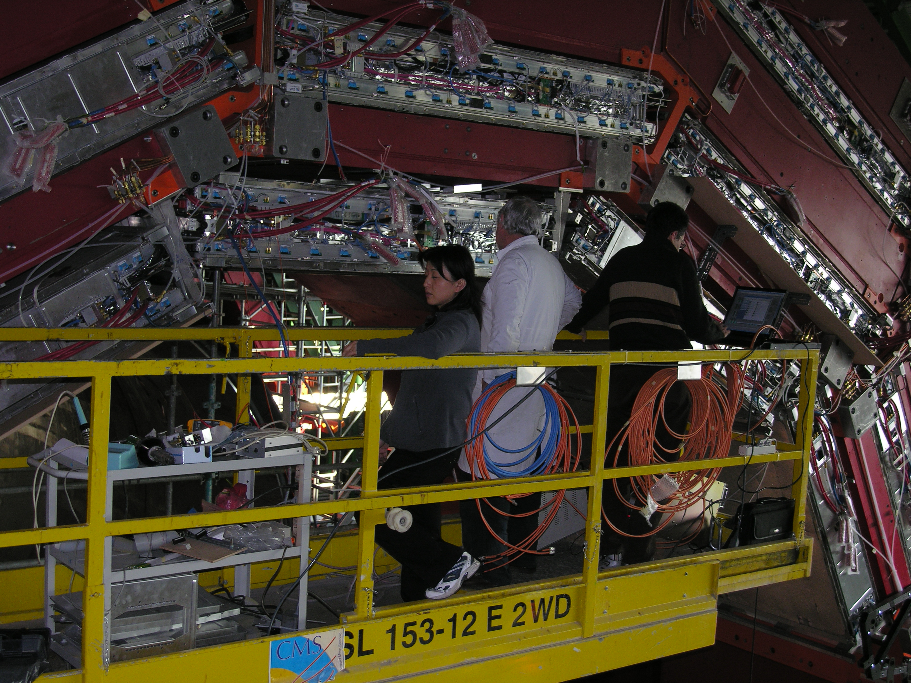
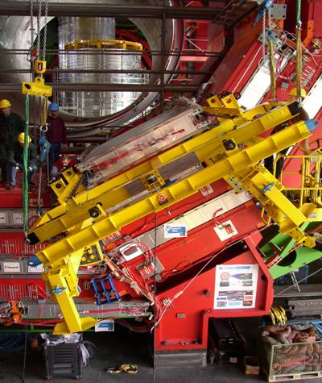
from construction to commissioning
ISR
DT-RPC coupling
DT-RPC test at ISR
DT-RPC envelope
2004-2008
DT-RPC installed
DT-RPC at SX5
DT-RPC commissioning
7

Slide 8
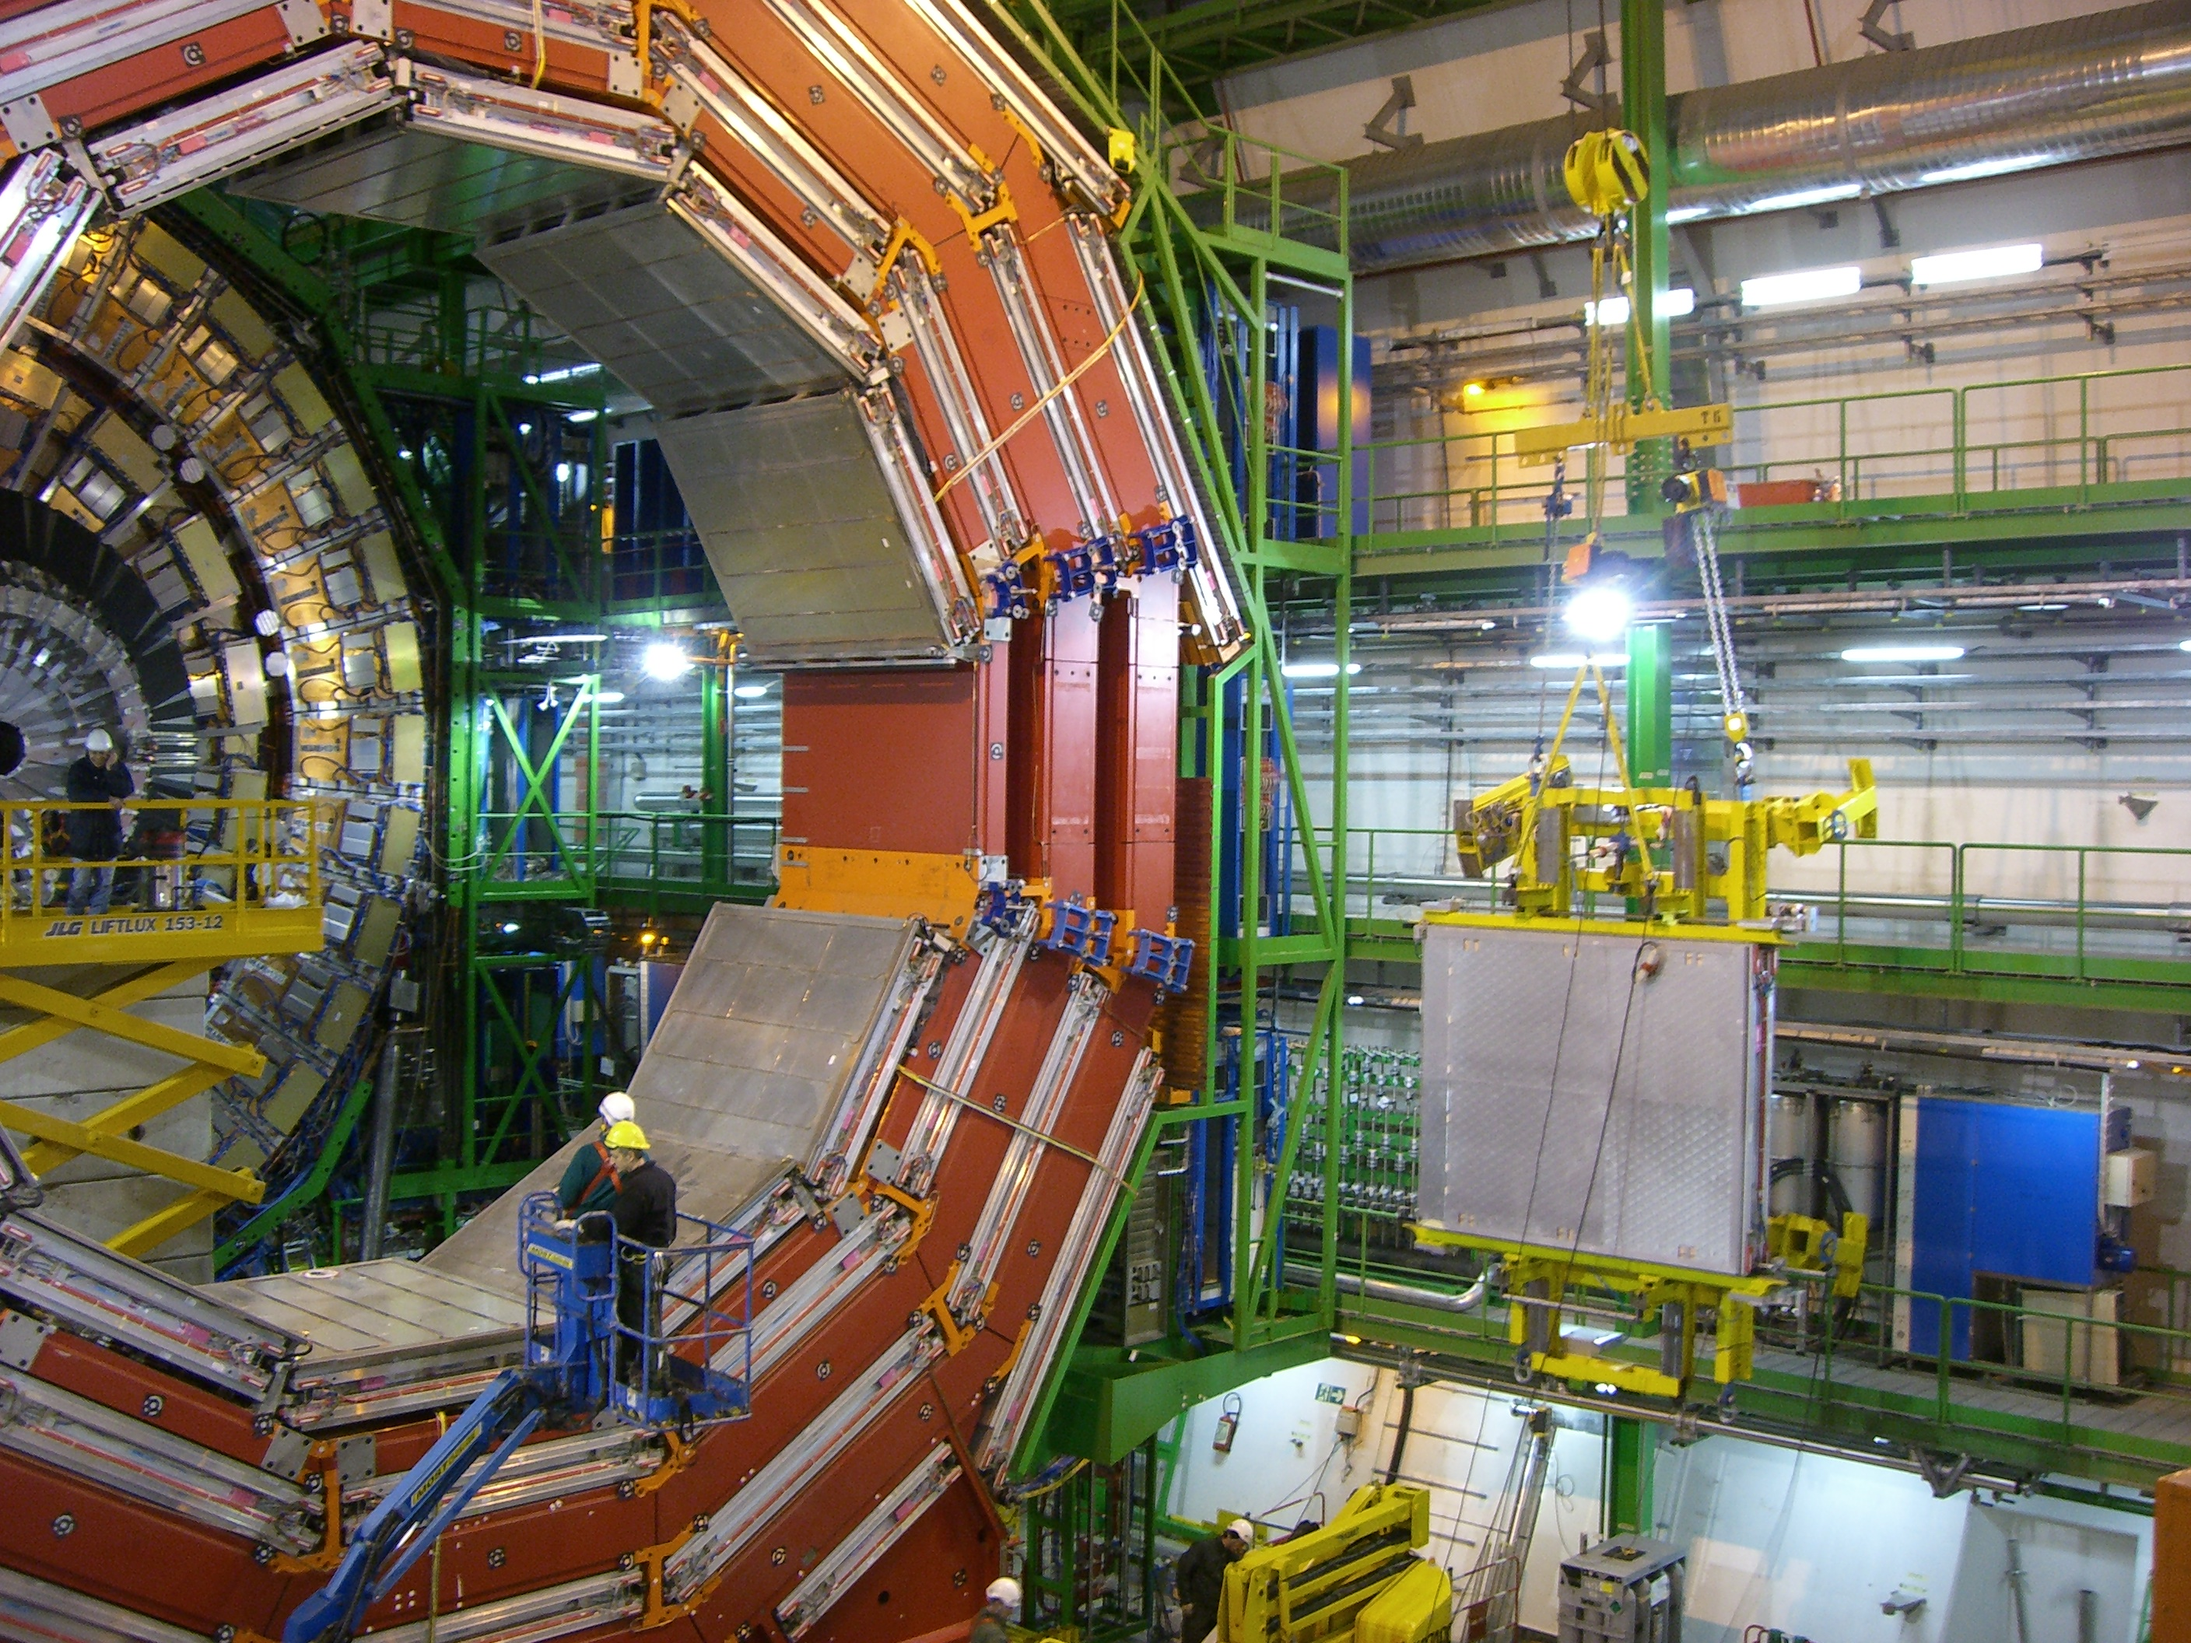
RPC chambers installation

Slide 9
Endcap disk ready to work

Slide 10
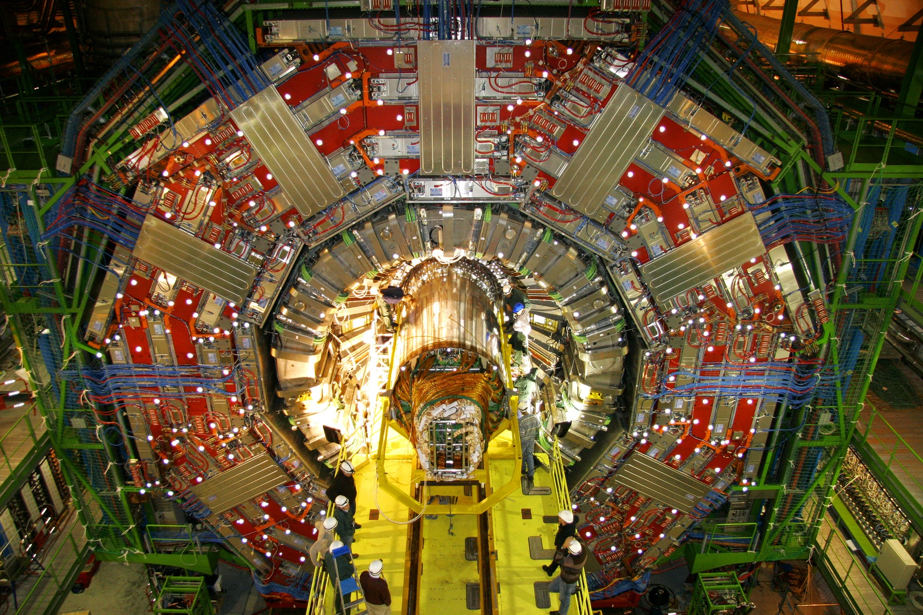
A photogenic and powerful “detector”

Slide 11
How judge the RPC muon system ?
Detection efficiency and stability
Plateau curves
Overall efficiency
Background:
Noise rate & Dark current
Trigger rate & efficiency stability
Aging effect:
Dark current & noise rate
Plateau position (HV at 50% eff)
Muon Radiographies
high Luminosity 10³³
millions of muons
many runs (time)
high beam intensity
time
sophisticated analysis

Slide 12
RPC online Monitoring tools
Detector
OMDS
ORCOFF
PVSS
POPCON
ONLINE
OFFLINE
Noise
scalers
WBM
Online
DQM
Trigger
Link sys
DATA
Plot and results

Slide 13
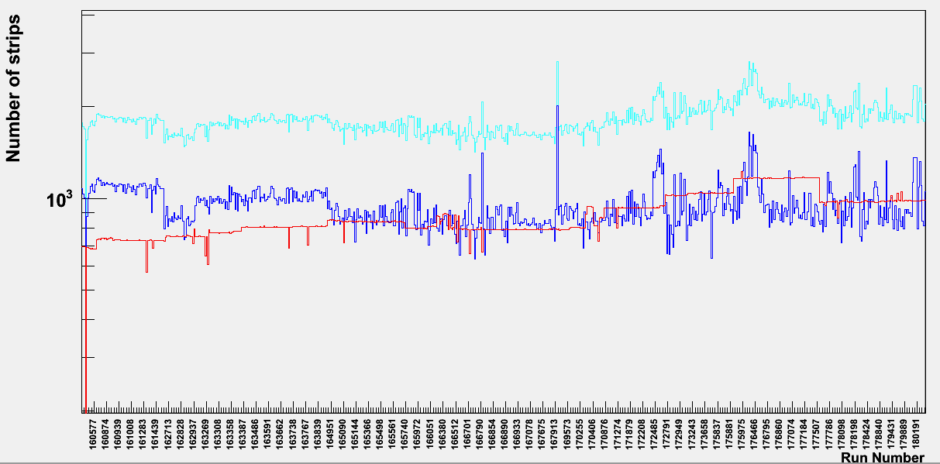
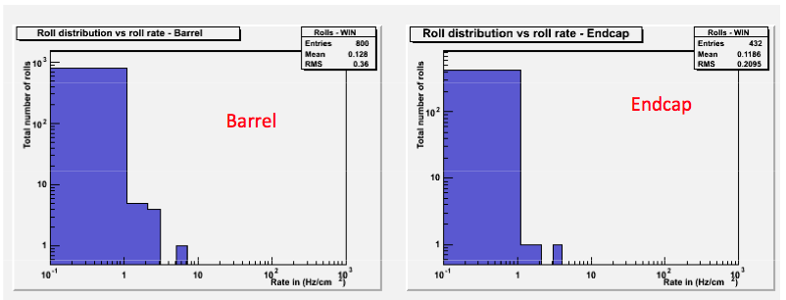
Hardware Status
dead channels
Inactive channels: ~1.6%
(~0.9% masked, ~0.7% dead)
Masked channels
Averge noise
Rate 0.1 Hz/cm2
Averge noise
Rate 0.1 Hz/cm2
Intrinsic electronic noise is indeed
subtracted in the background studies

Slide 14
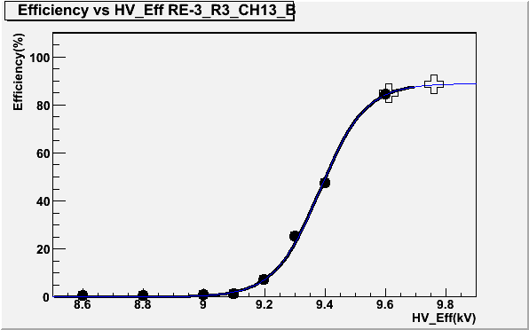
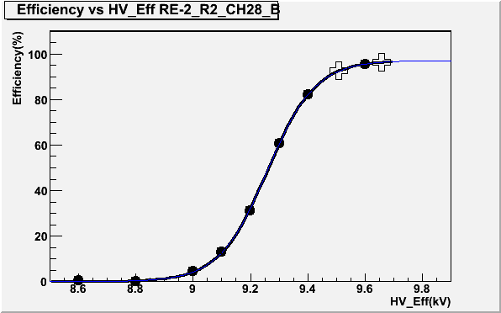
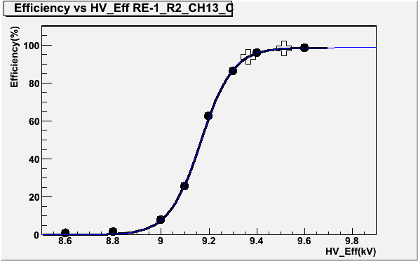
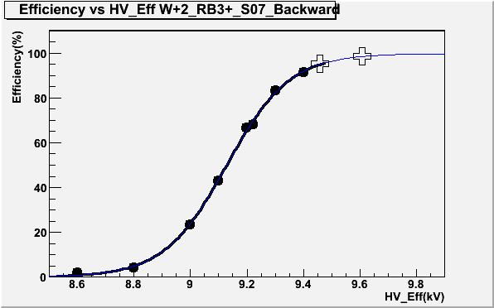
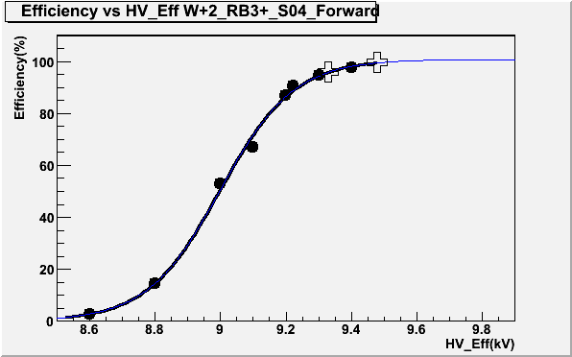
efficiency: 2172 plateau
endcap
endcap
endcap
barrel
barrel
barrel
99% of the 2172 rolls (half-chamber) have a perfect plateau
After about 5-7 years from the gap construction and 3 years of data taking
TO BE DONE EVERY beginning of the YEAR

Slide 15
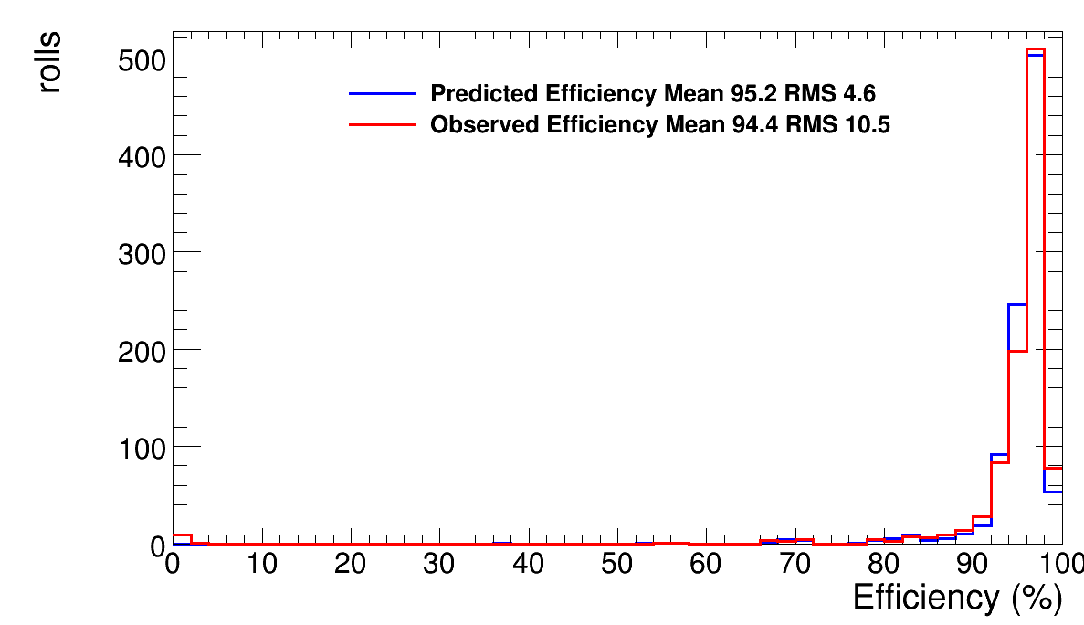
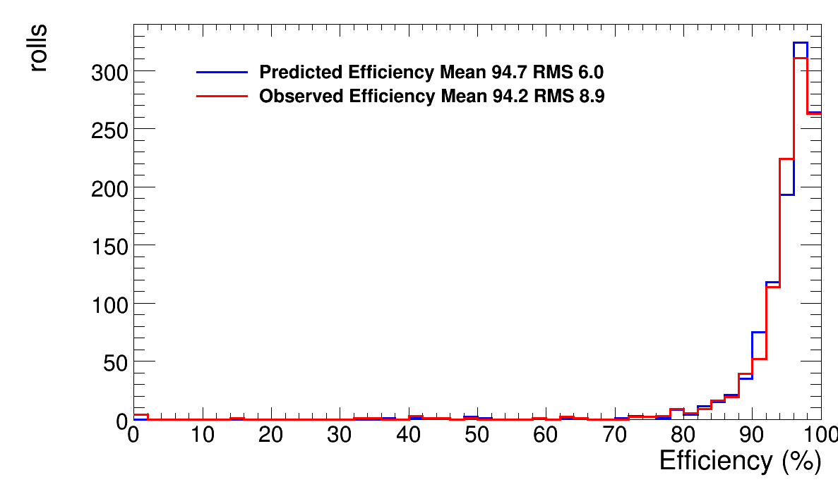
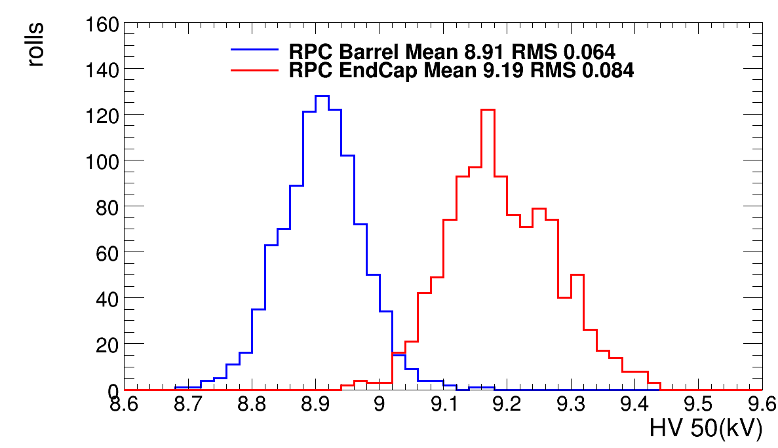
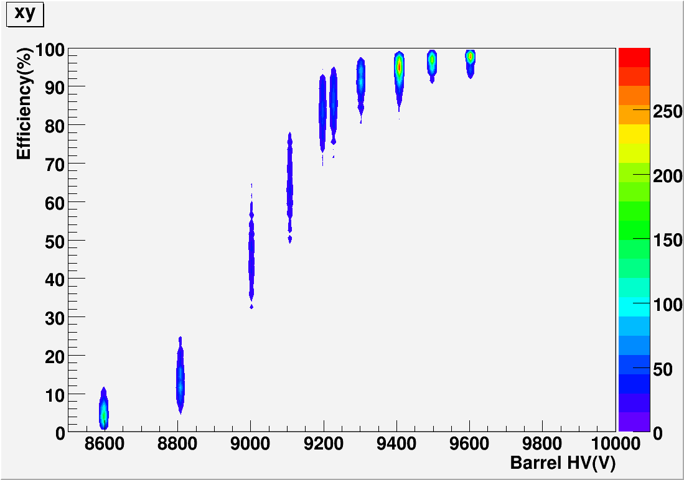
Efficiency: more results
BARREL
ENDCAP
Barrel
RMS 64 Volts
Endcap
RMS 84 Volts
All barrel plateau

Slide 16
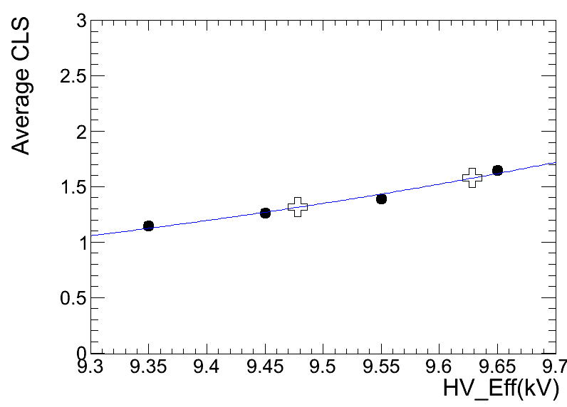
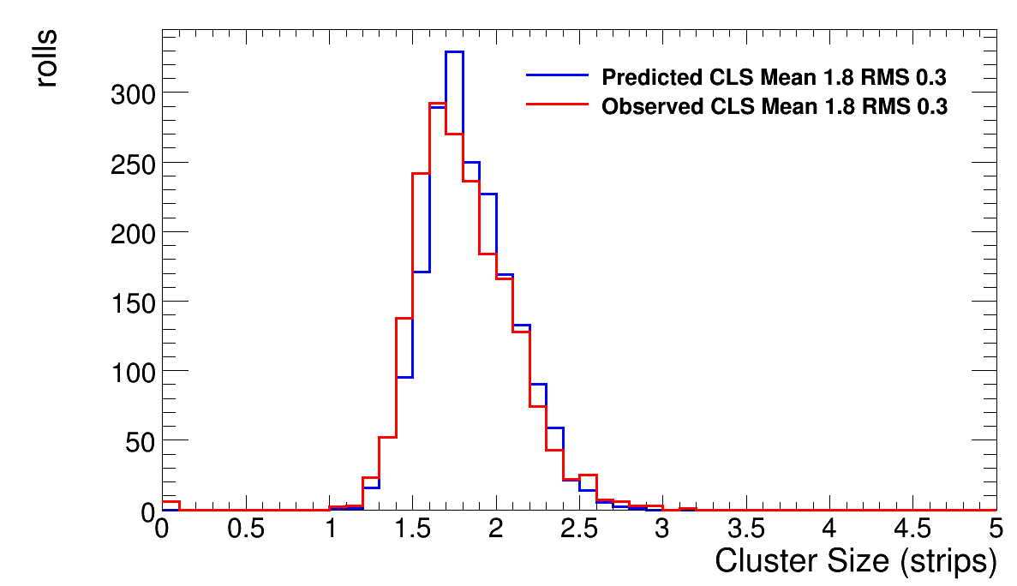
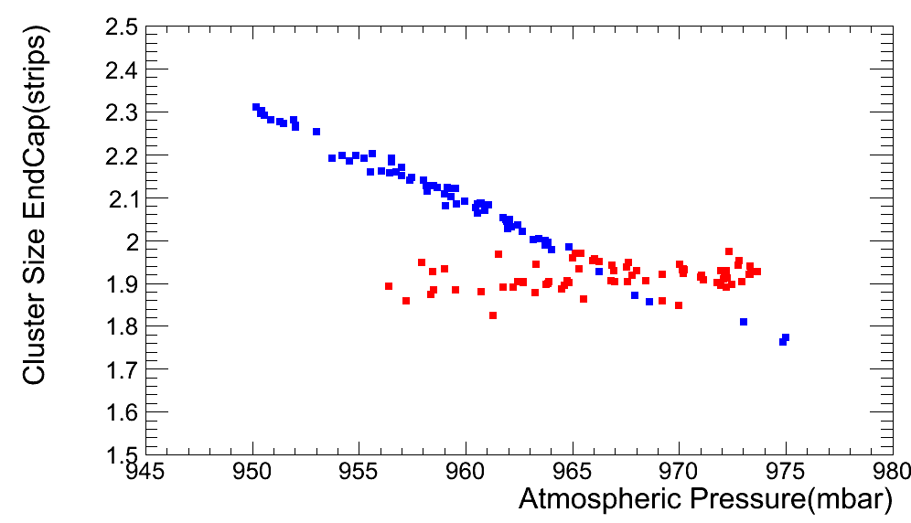
Stability: cluster size .vs. pressure
Cluster size .vs. HV
Cluster size
distribution
After having studied the performance
of the system we decided to remove one of the last source of instability (3-5%):
HV working point is now corrected with the atmospheric pressure
Cluster size .vs. Pressure
2010 (pressure dependence)
2011 (HV normalized to P)

Slide 17
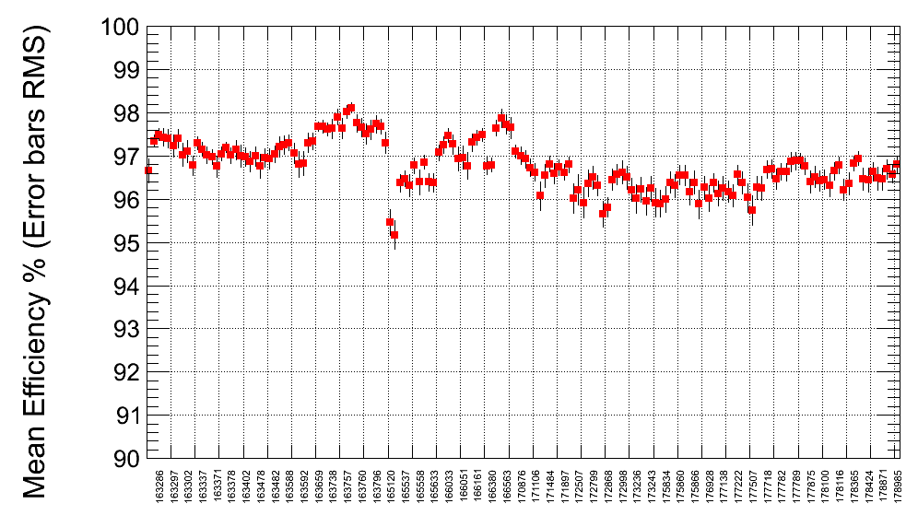
Stability in time
CMS Preliminary 2011
Without Pressure correction
With Pressure correction
April 2011
October 2011

Slide 18
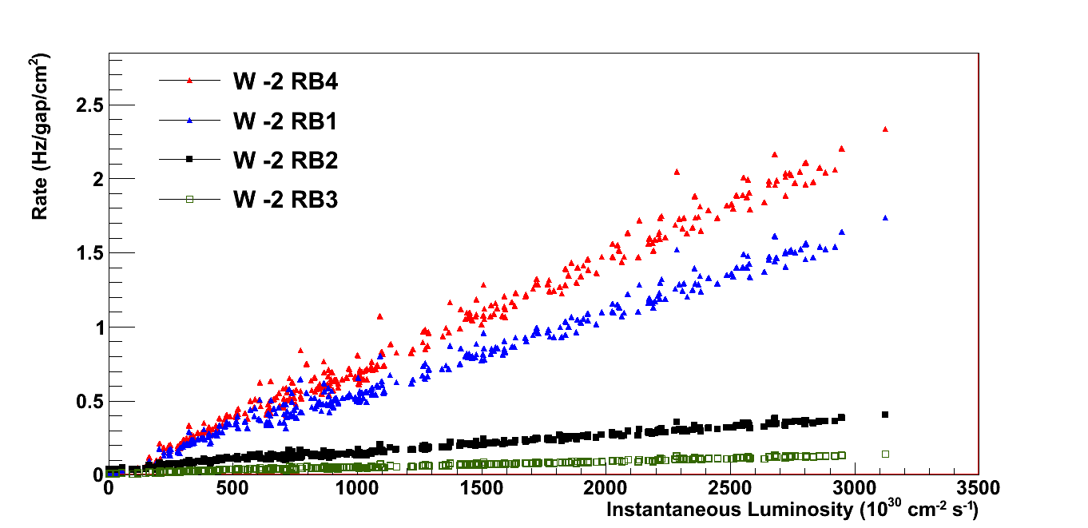
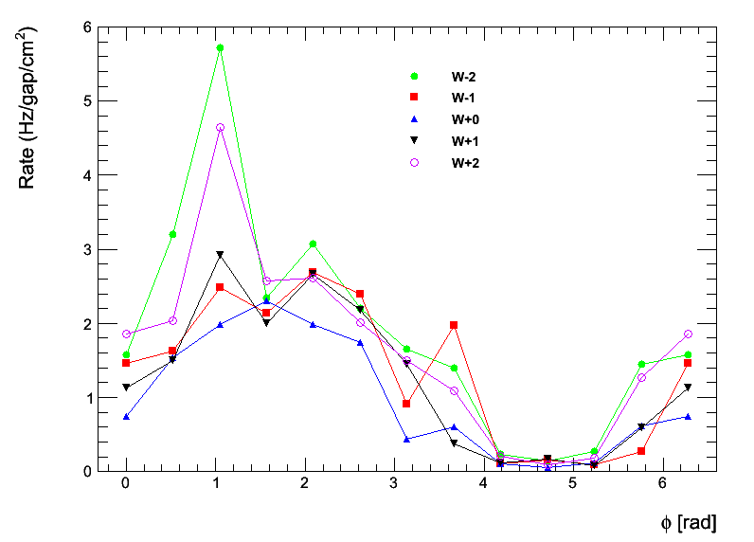
Background studies
CMS Preliminary 2011
External chambers have rate greater than internal chambers (closer to the beam)
Outermost station
Innermost station
CMS Preliminary 2011
Bottom sectors are less affected by neutron background due to the shielding
of the cavern floor
Outermost station

Slide 19
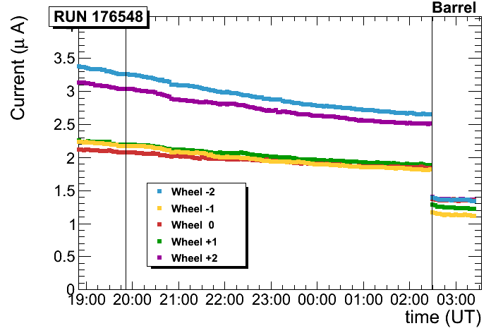
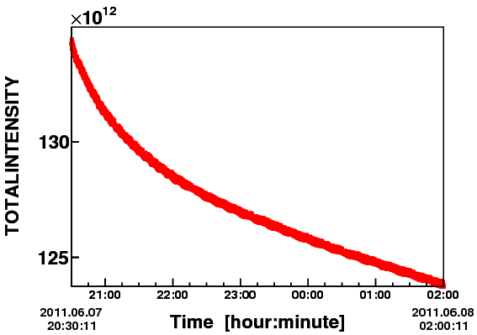
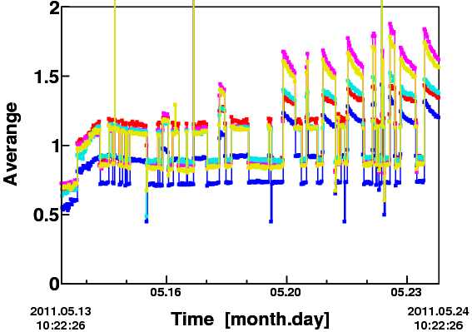
Dark Current .vs. luminosity
Average Current trend .vs. time
Beam Intensity in a single fill
beam
No beam
No beam
Current is correlated to the beam intensity
Current without beam is stable in time
Max Current < 5-6 μA (few cases)
beam

Slide 20
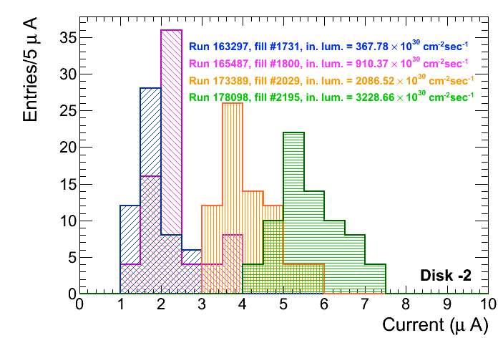
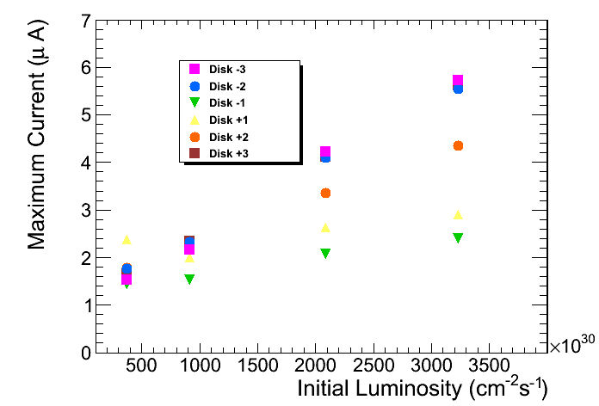
Current .vs. luminosity
Current distribution shift
Versus luminosity
CMS Preliminary
CMS Preliminary
Linear correlation between
current and luminosity
from 1.8 μA to 6.0 μA
when L increase 8-times

Slide 21
Summary performance table
 | Single gap | Dead chamber
Barrel | 7 | 5
Endcap | 24 | 3
Data Loss for RPC 19 pb^{‐1} – 0.37%
Overall Operating Channels 98.4%
Average Efficiency 95%
Average Cluster Size < 2
Average Noise rate (3 ·10³³ cm⁻² s⁻¹) 1.3 Hz/cm²
Max Noise rate (3 ·10³³ cm⁻² s⁻¹) RE-2/2/C < 7 Hz/cm²
Average intrinsic noise (no-beam) ~ 0.1 Hz/cm²
Average current (no-beam) ~ 1 μA
Average current (with beam) ~ 1.5 μA
Temperature < 21.5 ºC

Slide 22
Do we believe to the statistic ? ☺
I showed you how well the RPC system is working showing many results and plots
BUT
We can also have a different and more statistic-independent approach (visual approach) and ASK for events and visual inspections
AND HERE THEY ARE

Slide 23
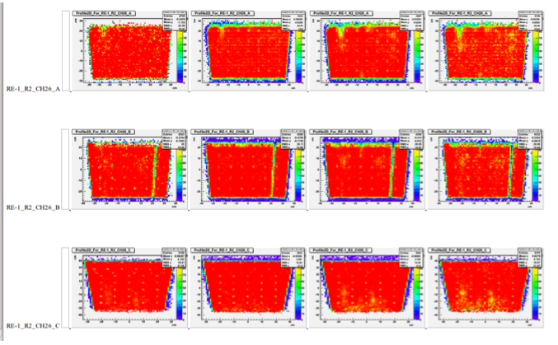
Visual inspection of the chambers
Even with the visual inspection it is clear we are running very well our system and no aging effect are visible until now

Slide 24
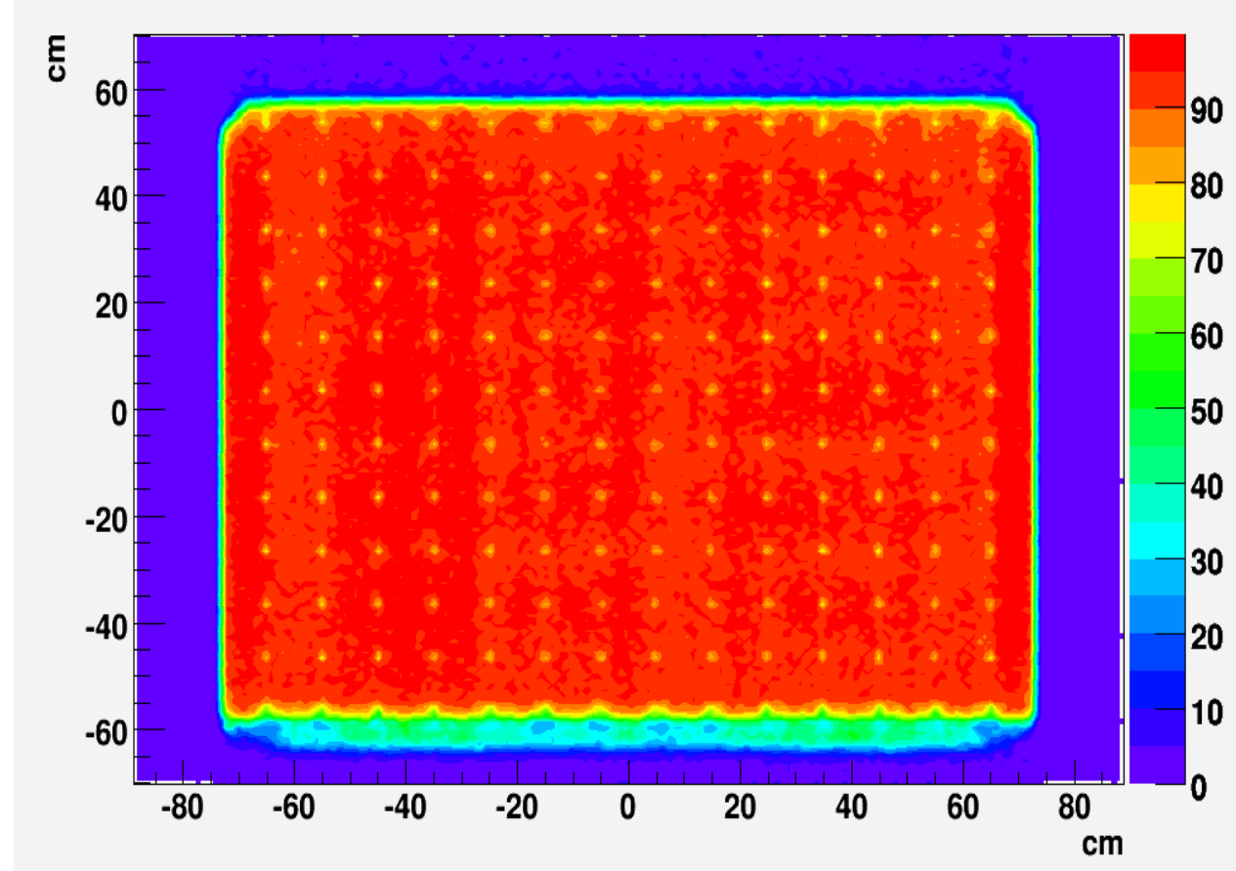
Visual inspection of the chambers
Here you see the spacers and the corner ☺

Slide 25
RPC trigger results
RPC Trigger rate is much more stable after pressure correction of the WP

Slide 26
RPC Upgrade: station 4 + Ring 1
Upgrade
2013-2014
Upgrade
2017-2018

Slide 27
Upgrade Trigger improvements

Slide 28
Conclusions
RPC system construction was an incredible adventure done by only 9 institutions.
We are now 15 institutions (90 FTE)
All the chambers are working very well
Very few leaky chamber but still running
2011 has been an important year; thanks to the millions of muon, we were able to study in details our system and learn a lot about it.
Let me thanks Pino Iaselli for leading in the best way this project, from the first nanosecond to the 2010

Slide 29
Conclusions
I would like to remember and thanks Beppe Belli (Pavia University) not only for the great job done in the RPC project since the production of the first Bakelite sheet but especially for his outstanding
Humanity, Willingness and Honesty
Thanks Beppe

