Slide 1
Phenolic Multigap RPCs
for High-rate Particle Triggers
K. S. Lee
for the CMS Collaboration
(Korea University & Korea Detector Laboratory)

Slide 2
Contents
1. Motivation
2. Constructions of prototype detectors
3. Test results for cosmic muons & gamma rays
4. Conclusions and future R&D scopes

Slide 3
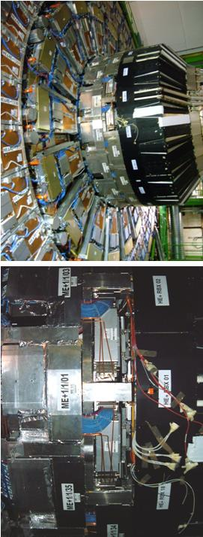
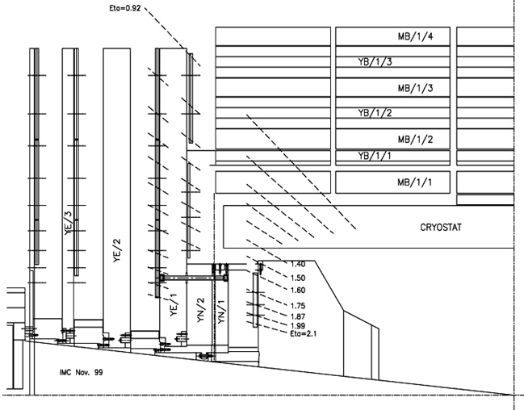
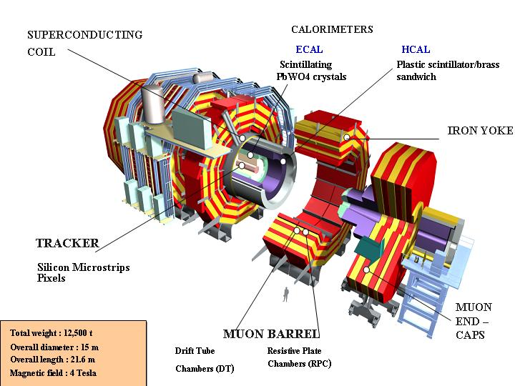
1. Motivation
RE1/1 RPCs
at CMS nose
R&D aiming to develop multi-gap panel-type HPL trigger RPCs
working with high background rates (a few kHz cm⁻²)
Double-gap 2-mm thick RPCs for the current CMS muon system
Forward RPCs defined in TDR (LHCC 97-32) composed of
- 2 wings (RE+, RE-), 4 stations (RE1, RE2, RE3, RE4)
- Pseudorapidity covering : 0.9 < |η| <2.1 (currently upto 1.6)
Low-η
Forward
RPCs
4-th Station
(on going)
RE4/3
RE3/3
RE2/3
Barrel RPCs
RE1/3
RE4/2
RE3/2
RE2/2
RE1/2
High-η Forward
RPCs (Plan)
RE3/1
RE2/1
RE3/1
RE2/1
RE1/1

Slide 4
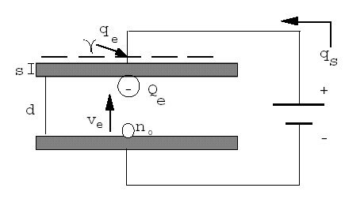
R & D of HPL multi-gap RPCs
Direction → Smaller detector charges
To reduce aging at high rate background
To enhance high rate capability
Higher rate capability ← lower avalanche charge
- Rate capability ~ 1/ ρ
- Smaller q_{e} → higher rate capability
(actually related to Q_{e})
Typical glass multi-gap RPCs
- q_{e} < 1 pC (~ 0.5 pC)
- ρ = 10¹² ~ 10¹³ Ω cm for normal glass
= 10⁹ ~ 10¹⁰ Ω cm (ceramic & low res. glass)
Then, what if multi-gap RPCs with
high-pressure laminated (HPL) plates ?
- q_{e} ~ 1 pC
- Phenolic HPL → ρ = 10¹⁰ ~ 10¹¹ Ω cm
- Oiling required to reduce noises

Slide 5
4- or 6-gap RPCs in high-η region of the CMS ?
- Same gas system → same gas mixture
- Same electronics → same front-end-electronics (FEE) and so on
Timing RPCs
q_{e}
Other characteristics
Construction method
Electronics
2-mm thick 2-gap RPCs
 | 2-gap RPCs | 4-gap RPCs | 6-gap RPCs
Each gap thickness | 2.0 mm | 1.0 mm | 0.66 mm
Total gap thickness | 4.0 mm | 4.0 mm | 4.0 mm
<q_{e}> at ~ mid of plateau | 4.0 pC (Thr~200 fC) | 1.5 pC (Thr~150 fC) | 0.9 pC (Thr~100 fC)
Type of resistive plates | HPL | HPL | HPL
Thickness of HPL | 2.0 mm | 2.0 mm | 1.0 mm
Resistivity of HPL | 1 ~ 6 ⅹ10¹⁰ Ωcm (for CMS) | ~ 10¹⁰ Ωcm (Italian HPL) | ~ 10¹¹ Ωcm (Korean HPL)

Slide 6
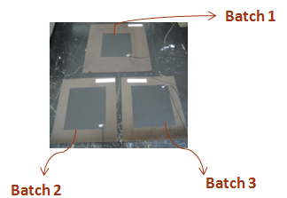
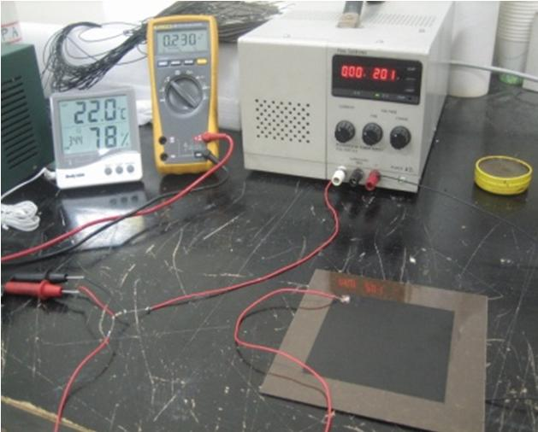
Phenolic HPLs 1-mm thick HPL for 6-gap RPCs Korean production 1 mel sheet + 3 phenol sheets + 1 mel sheet Resistivity ~ 10¹¹ Ωcm at 20ºC 2-mm thick HPL for 4-gap RPCs Italian product (CMS) 1 mel sheet + ~ 8 phenol sheets + 1 mel sheet Resistivity ~ 1.0 ⅹ10¹⁰ Ωcm at 20ºC
α = 0.12/°C

Slide 7
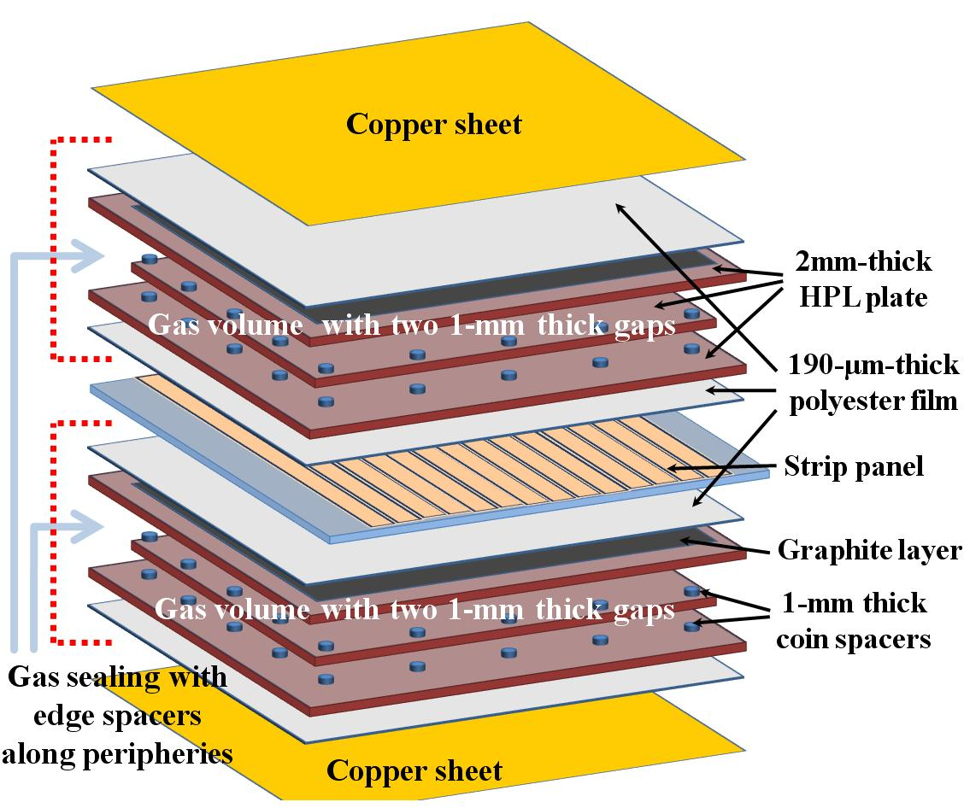
2. Constructions of prototype detectors
Detector structures
Oiled Phenolic Multigap Panel-type
RPCs for CMS high-η triggers
Panel-shape multigap RPCs
~ Two separated gas envelopes + a strip panel
Each gas envelope ~ 2 gaps in 4-gap RPCs
3 gaps in 6-gap RPCs
Prototype detectors
4-gap RPC: 45 x 45 cm² (active area)
- HPL : 2 mm
- Coin spacers : 1000 ± 10 μm (Polycarbonate)
- Strip pitch = 27 mm
6-gap RPC: 15 x 29 cm² (active area)
- HPL : 1 mm
- Coin spacers : 660 ± 10 μm (Polycarbonate)
- Strip pitch = 20 mm
4-gap RPC
6-gap RPC
Edge spacer
PET two layers
~ 0.40 mm
Graphite
HPL~ 1.0 mm
25 mm
10 mm
7.5 mm
0.65 mm gaps
0.66 mm
thick spacers
Strips with 20 mm pitches
0.2 mm PET
16.0 mm
0.65 mm gaps

Slide 8
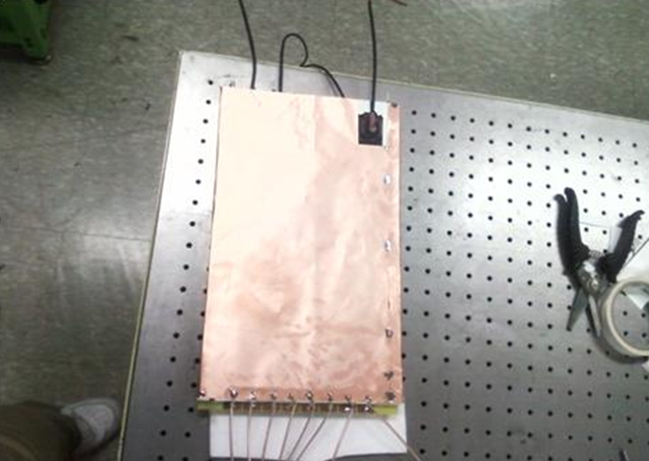
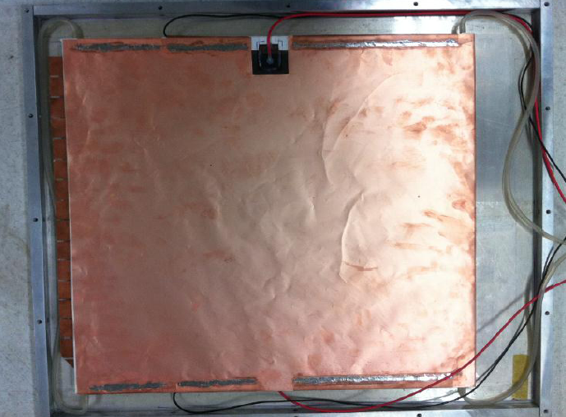
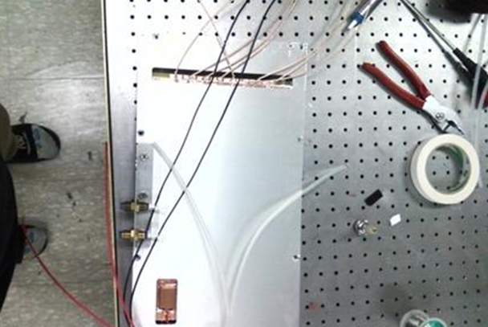
Constructions
of prototypes
6-gap RPC
4-gap RPC

Slide 9
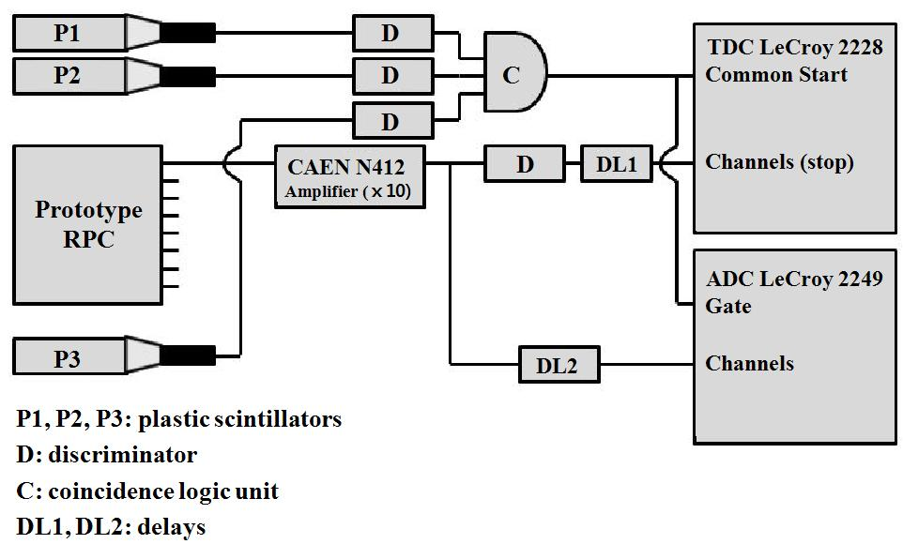
Electronics setup for test
Data measured with 1 ADC + 1 TDC
→ Did NOT used the current dedicated FEBs for CMS RPCs
A linear amp → linearly ⅹ10 for raw detector pulses
Gate widths for selection of avalanche pulses (FWHM < 10 ns)
40 ns for 4-gap RPCs
30 ns for 6-gap RPCs
Triggers ←3 plastic scintillators
time resolution ~ 500 ps
Thresholds for raw pulses
TDC thresholds
for the ⅹ10 amplified raw pulses
- 13 mV for 4-gap RPCs (~ 150 fC)
- 10 mV for 6-gap RPCs (~ 100 fC)
ADC thresholds in offline analysis

Slide 10
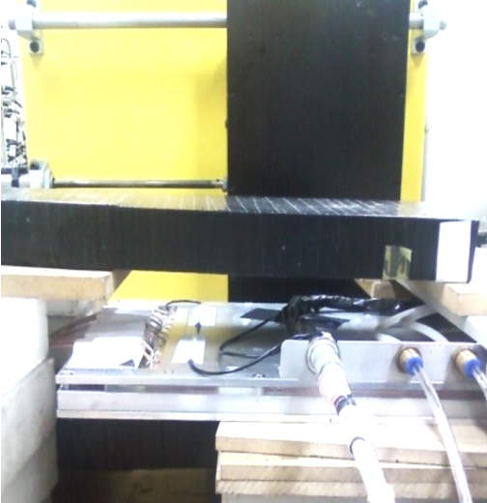
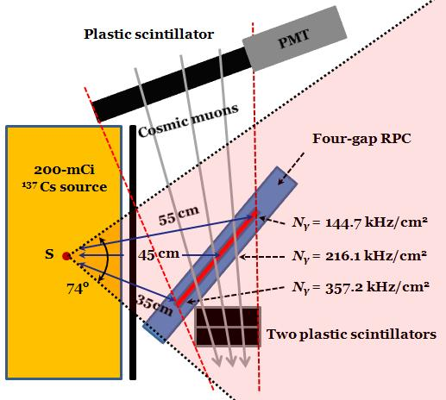
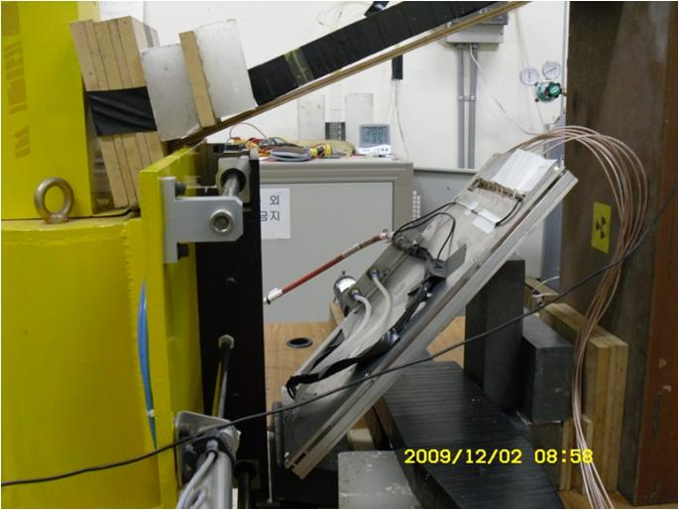
Gas mixture
95.7% C₂H₂F₄ + 3.5% iC₄H₁₀ + 0.5% SF₆
+ 0.3% water vapor in mass ratio
Flow rates ~ 1.8 l/h
Gamma rays source
200-mCi ¹³⁷Cs (born in Nov. 2001)
- 5.5 GBq for the 4-gap RPC test (2011)
- 5.8 GBq for the 6-gap RPC test (2009)
Mean distance ~ 45 cm
- Max. gamma-rates in the test
1.50 kHz cm⁻² for 4-gap RPC
N_{γ} = 145 kHz cm⁻²
ε_{γ} = 0.0103
2.02 kHz cm⁻² for 6-gap RPC
N_{γ} = 152 kHz cm⁻²
ε_{γ} = 0.0133
200 mCi
¹³⁷Cs
Plastic
scintillator
Cosmic
muon test
without
gammas
Prototype detector
Plastic
scintillators

Slide 11
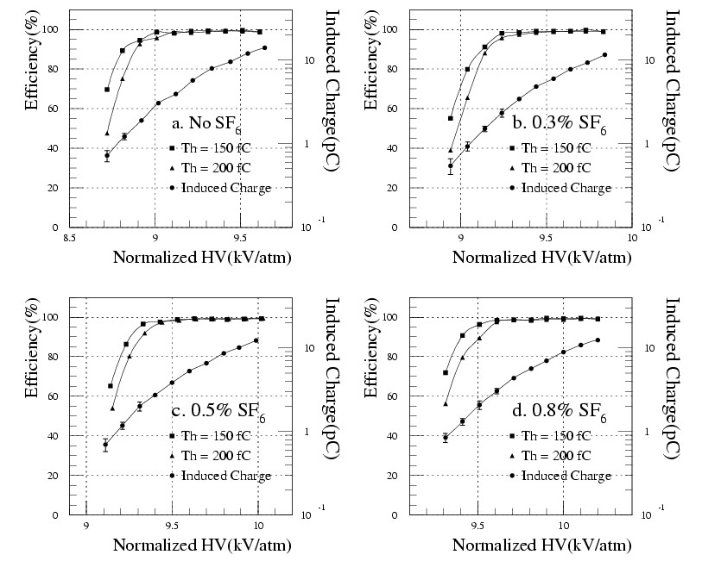
3. Test Results for cosmic muons and gamma rays
Efficiency & mean charges for 2-gap RPCs in a previous study
Usable size in HV
Obtained experience for 2-mm double-gap RPCs
q_{e} ~ 2.5 pC at starting point of plateau (ε=0.95) for avalanche mode
q_{e} ~ 4.0 pC at the mid of the efficiency plateau
Adding 0.3% SF₆
to obtain an avalanche plateau size of ~ 400 V
Shift in HV ~700 V/%
by adding SF₆
Effective HV

Slide 12
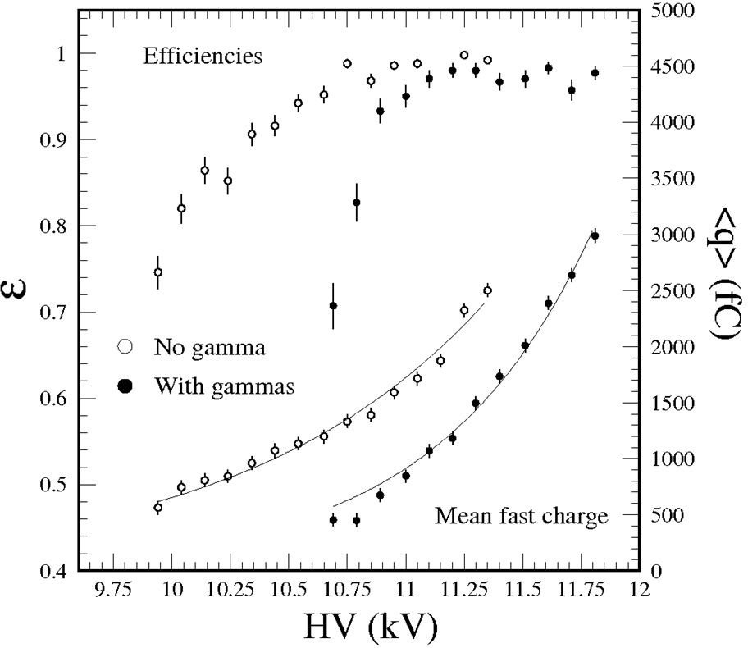
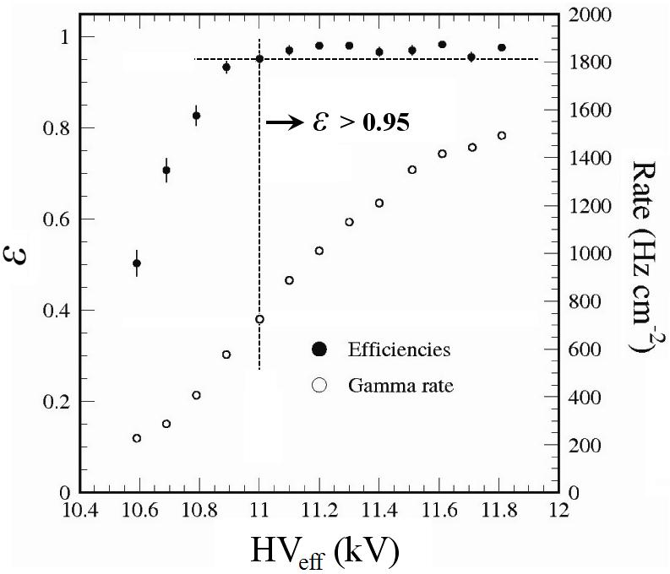
Efficiencies & mean fast charges for a 4-gap RPC
TDC threshold = 13 mV (~ ADC threshold of 150 fC)
40-ns ADC gate → Resolution broadening of ~ 20 fC for each channel
Mean q_{e} (avalanches only) at the efficiency plateau region
- At 10.65 kV, ε = 0.95 (by TDC) and q_{e} = 1.20 ± 0.05 pC (no irradiation)
- At 10.95 kV, ε = 0.98 (by TDC) and q_{e} = 1.51 ± 0.06 pC (no irradiation)
- At 11.00 kV, ε = 0.95 (by TDC) and q_{e} = 0.84 ± 0.05 pC (with N_{γ} ~ 0.7 kHz/cm² )
- At 11.30 kV, ε = 0.98 (by TDC) and q_{e} = 1.50 ± 0.06 pC (with N_{γ} ~ 1.1 kHz/cm² )
Mean fast charges
Gamma rates
ε=0.95
q_{e} = 1.20 pC
@ε=0.95
q_{e} = 0.84 pC
@ε=0.95

Slide 13
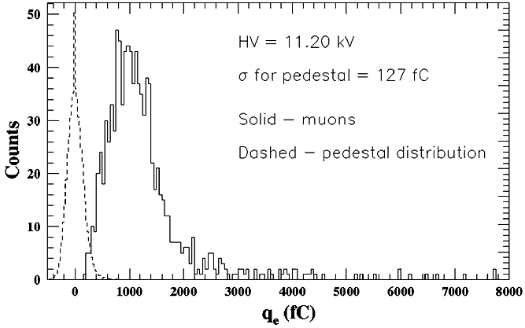
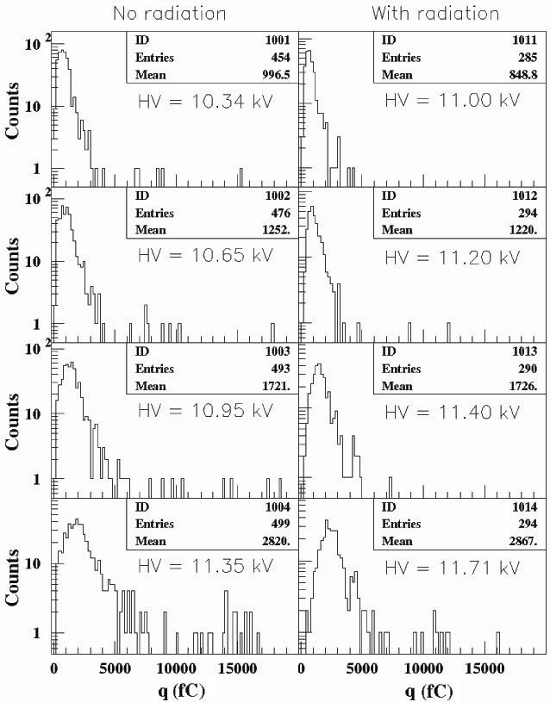
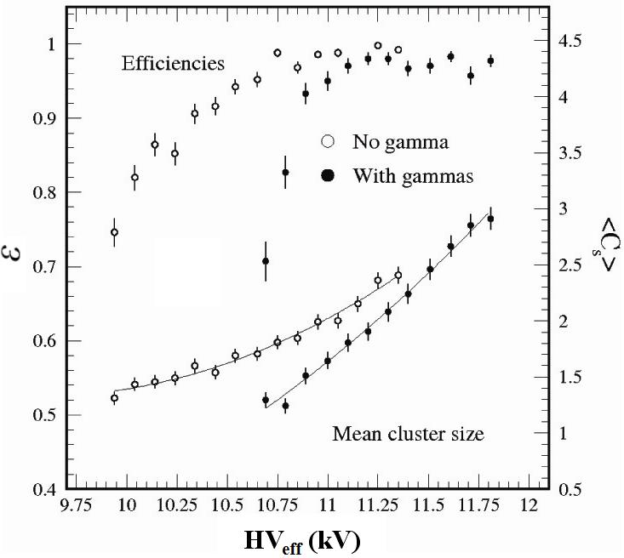
Charge distributions & Mean cluster sizes for 4-gap RPC
σ = 127 fC
ε = 0.95
C_{s} ~ 1.7

Slide 14
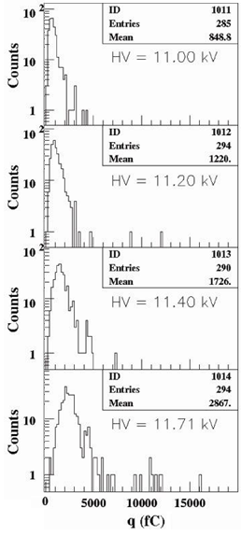
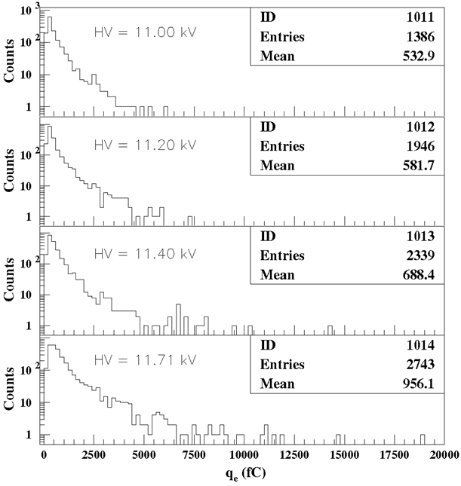
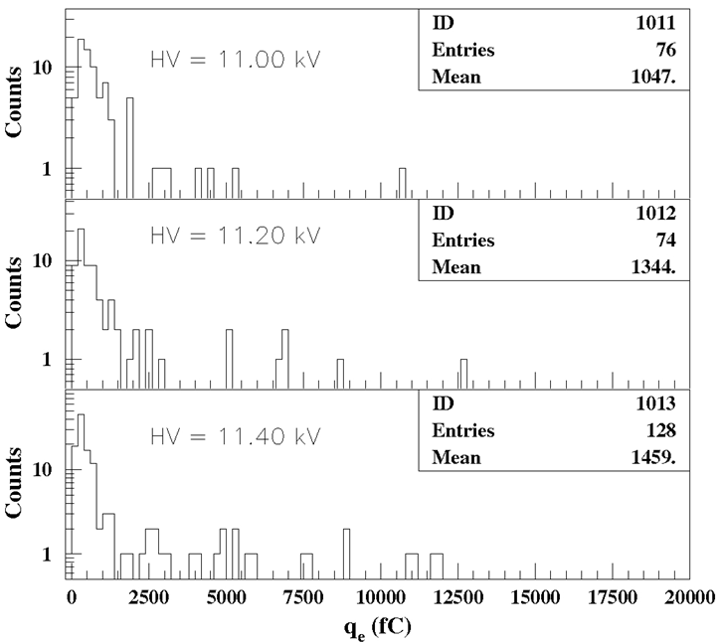
4-gap RPC
Charge distributions @ 11.2 kV
Mean q_{e} = 0.58 pC @ N_{γ} = 1.0 kHz cm⁻² for 662-keV gammas
= 1.22 pC @ N_{γ} = 1.0 kHz cm⁻² for cosmic muons
Muons
Gamma rays
Noises

Slide 15
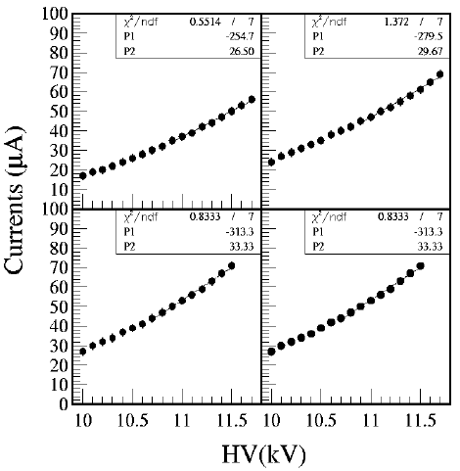
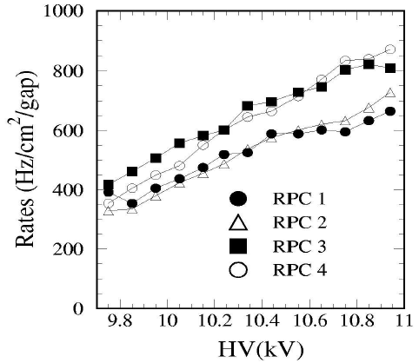
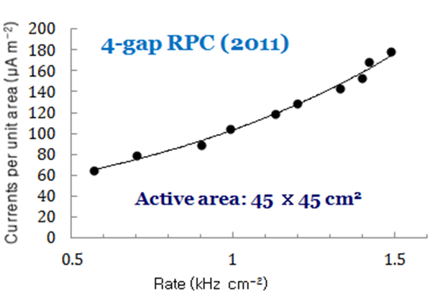
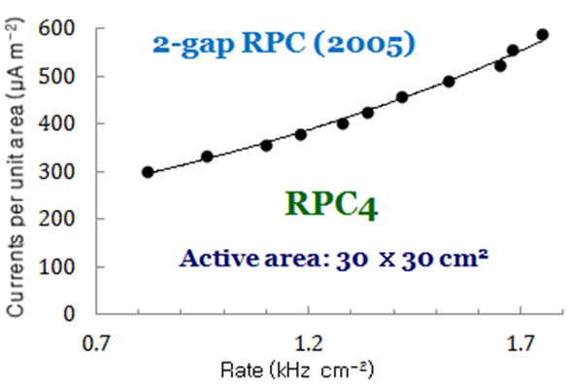
Gamma-induced currents/unit area
↔ Q_{e} (avalanche charge)
2-gap RPC data measured in 2005
96.2% C₂H₂F₄ + 3.5% iC₄H₁₀ + 0.3% water, Active area: 30 ⅹ30 cm²
At ~ 1.0 kHz cm⁻²
~ 105 μA m⁻²
for 4-gap RPCs
→ i ~ 200 μA in a 2-m² RPC
~ 330 μA m⁻²
for 2-gap RPCs
→ i ~ 600 μA in a 2-m² RPC
RPC1
RPC2
RPC3
RPC4

Slide 16
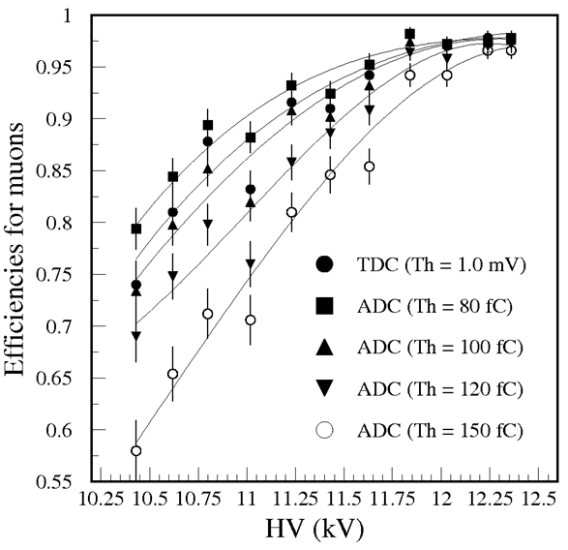
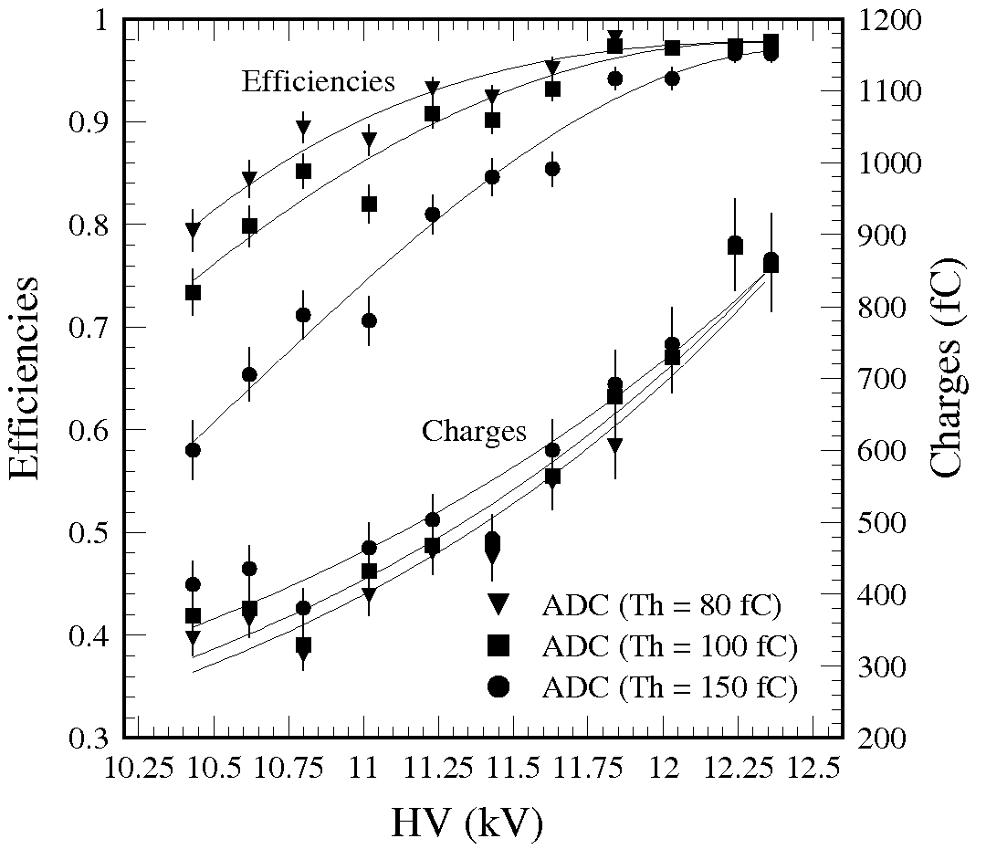
Efficiencies & mean fast charges for a 6-gap RPC (RPC2010)
TDC threshold = 10 mV (~ 100 fC)
30-ns ADC gate → Resolution broadening of ~ 15 fC for each channel
Mean q_{e} at the efficiency plateau region
- At 11.80 kV, ε = 0.96 (by TDC) and q_{e} = 0.67 ± 0.05 pC (no gamma)
- At 12.24 kV, ε = 0.97 (by TDC) and q_{e} = 0.88 ± 0.05 pC (no gamma)
ε = 0.95
ε = 0.95

Slide 17
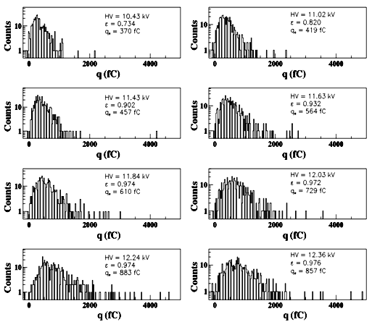
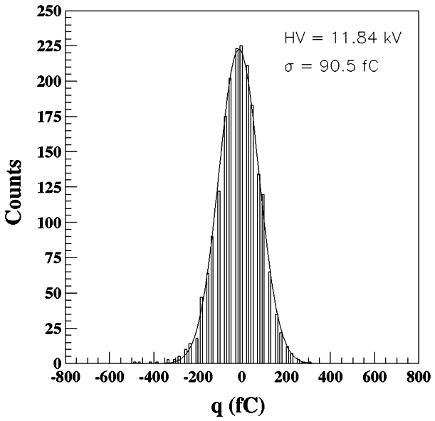
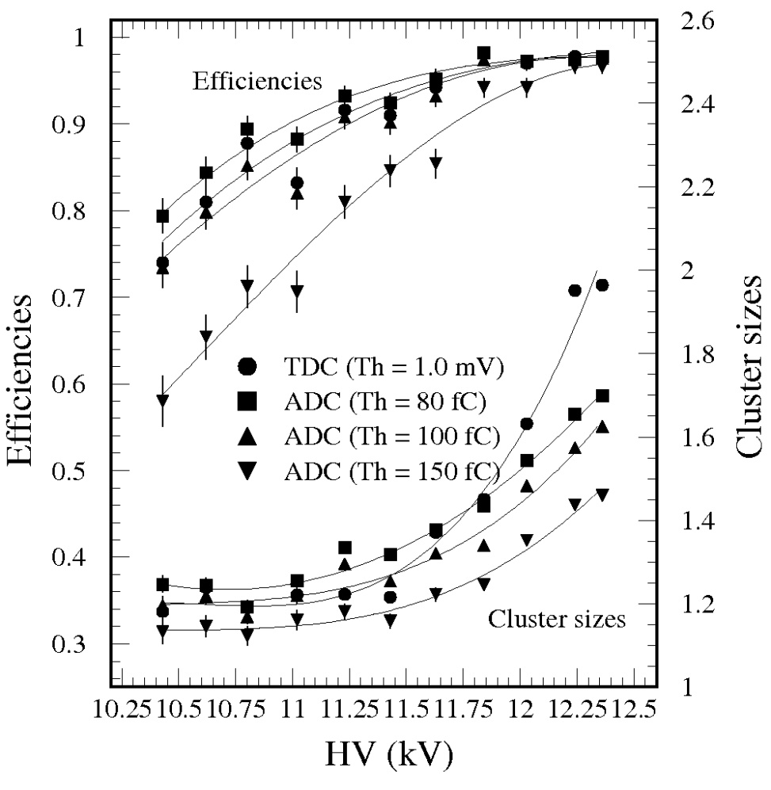
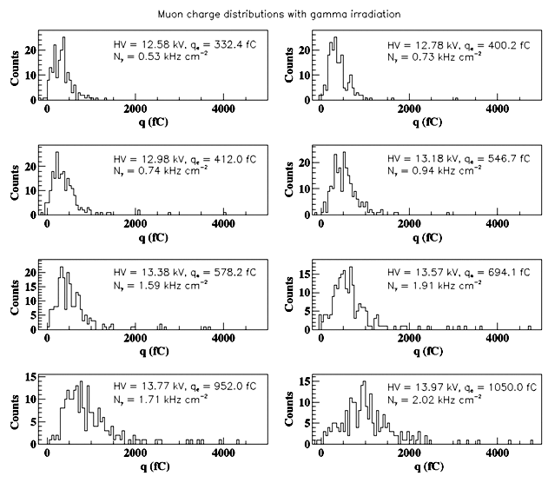
6-gap RPC
(RPC 2010)
Charge measurement
σ ~ 90 fC
No radiation
Mean cluster sizes
ε = 0.95
With radiation
C_{s} ~ 1.4

Slide 18
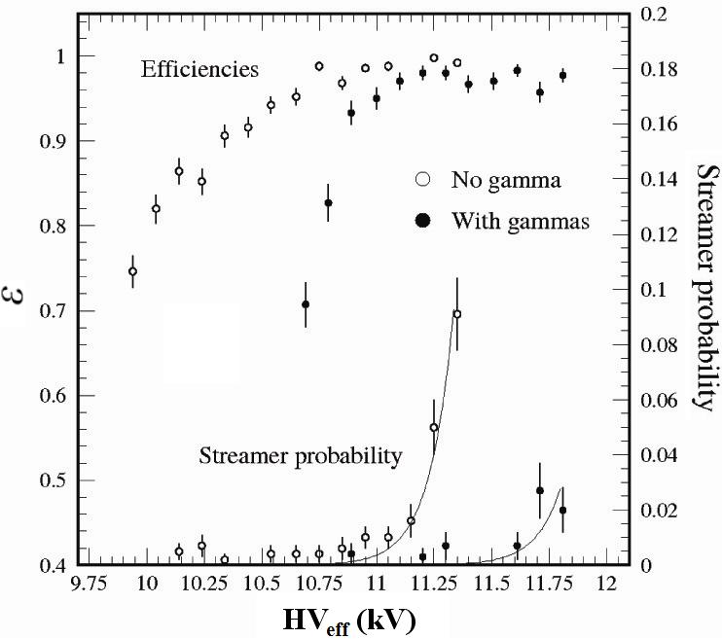
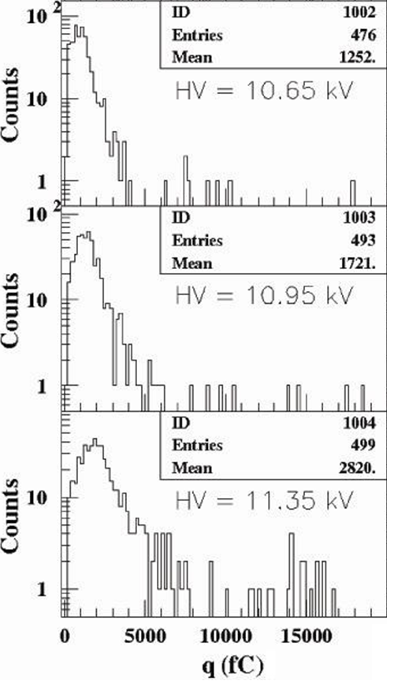
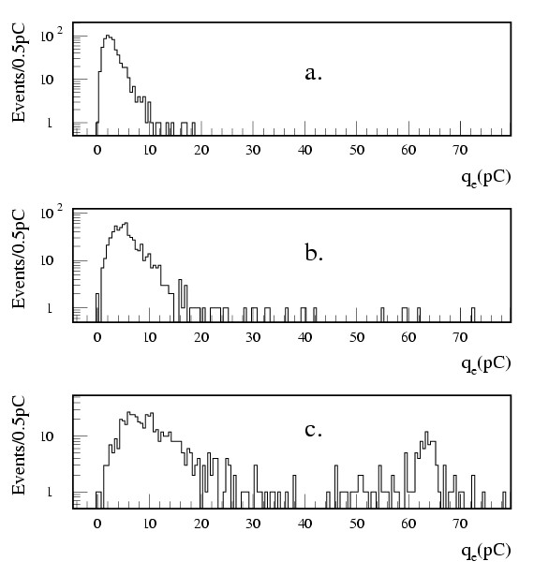
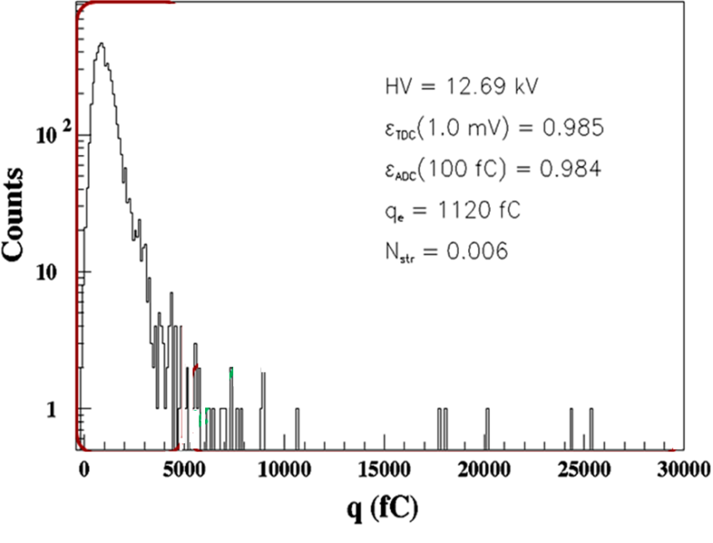
Avalanche pulse limit
- For 2-gap RPCs
q_{e} < 10 pC for CMS Barrel RPCs
q_{e} < 20 pC for CMS Forward RPCs
(no termination)
- For 4-gap RPCs: q_{s} < 10 pC (no termination)
- For 6-gap RPCs: q_{e} < 5 pC (no termination)
ε=0.95
4-gap RPC
4-gap RPC
2-gap RPC
8.97kV/atm, 0.3% SF6
6-gap RPC
Avalanches
Transition
region
Streamers
9.17kV/atm, 0.3% SF6
Avalanches
Transition
region
Transition
region
Avalanches
Streamers
9.36kV/atm, 0.3% SF6
Streamers
2012-02-07
RPC2012@INFN-Frascati, Italy

Slide 19
4. Conclusions and Milestones
Conclusions
R&D on Oiled Phenolic 4- and 6-gap Panel-type RPCs
Prototype detectors: manufactured with the same technology as the one
applied for the double-gap RPCs for the CMS experiments.
(2) For 2-gap RPCs (Thr. ~ 200 fC), mean q_{e} ~ 4.0 pC at the mid of the plateau
For 4-gap RPCs (Thr. ~ 150 fC), q_{e} ~ 1.5 pC
For 6-gap RPCs (Thr. ~ 100 fC), q_{e} ~ 0.9 pC
(3) Size of efficiency plateaus ≥ 600 V for both 4- & 6-gap RPCs
(4) Technical issue: 6-gap structure seems to be marginal to manufacture real size panel–type detectors.
- Low stiffness of HPL → Technical difficulty in manufacturing gaps
- Adding water vapor deforms the thin HPLs (1.0 mm) → lost the gap uniformity

Slide 20
(6) Aging issue: Small pulses will be really conductive to reduce radiation-induced aging at high rate environments
For 2-gap RPCs, aging study with an intensive gamma rate > 3 kHz cm⁻²
→ The high gamma rate caused Fast Degradation of gaps
(H. C. Kim et al., NIM A602 (2009) 771)
Future R&D scopes
(1) QC based R&D for the manufacture procedure and parts
(2) Real-size prototype detector for high-η RE (RE1/1, RE2/1, RE3/1) RPCs with the 4-gap structure & the FEBs for the CMS RPCs

Slide 21
Backup slides

Slide 22
The operation for typical double-gap RPCs
9.0 mm⁻¹ < η < ~ 10.0 mm⁻¹
η d ~ 20.0 mm⁻¹: Raether condition → Streamer mode
For avalanche operations
q_{e} < 10 pC
for CMS Barrel RPCs
q_{e} < 20 pC
for CMS Forward RPCs
(no termination for strips)
8.97kV/atm, 0.3% SF6
9.17kV/atm, 0.3% SF6
Avalanches
Transition
region
Streamers
9.36kV/atm, 0.3% SF6

Slide 23
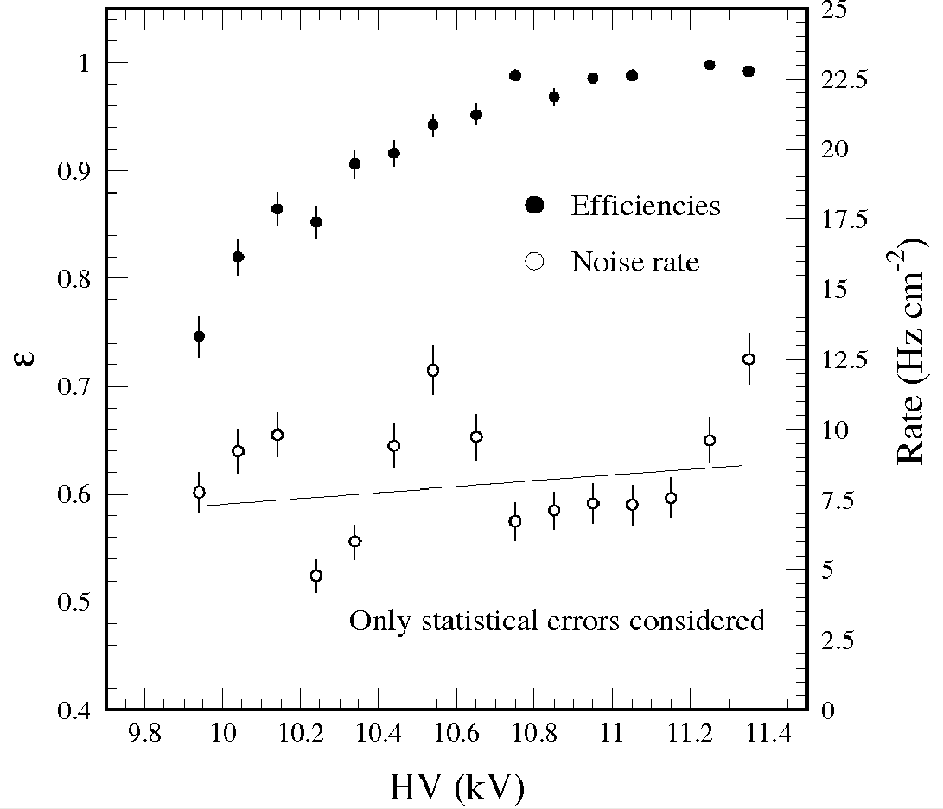
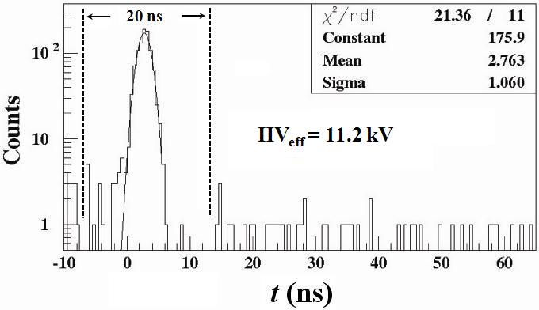
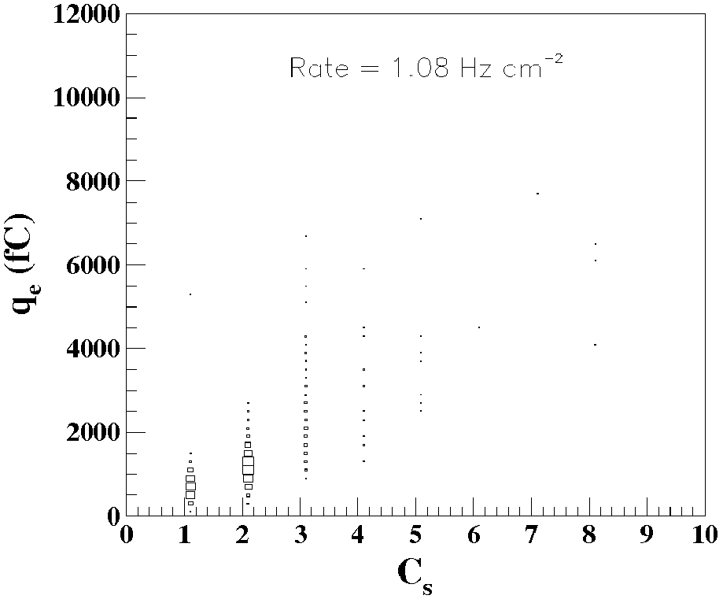
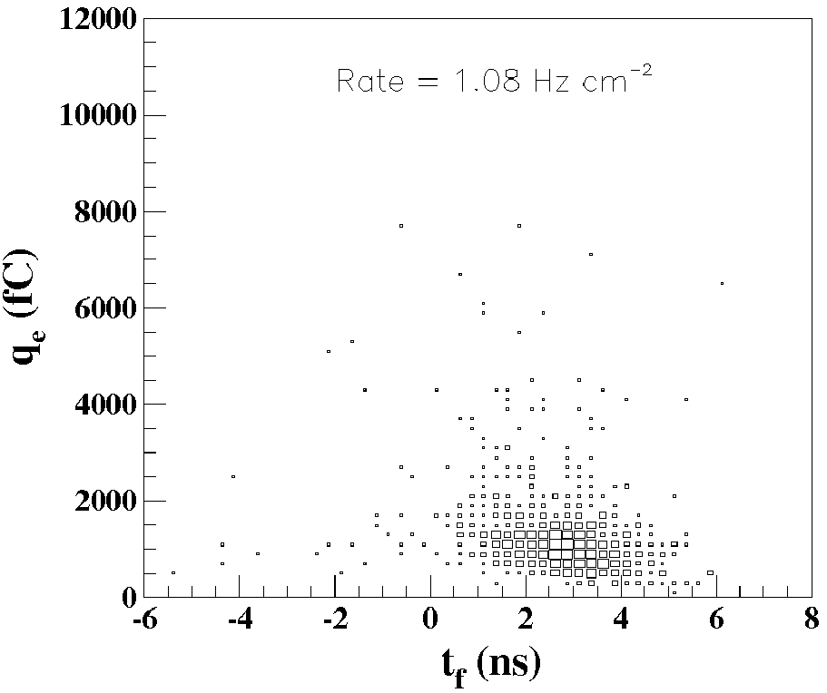
4-gap RPC
Noise rates ~ 8 Hz/cm⁻²
Time distribution
@ ε = 0.98 and N_{γ} = 1.0 kHz cm⁻²
muons
Gammas
Mean charges vs. cluster sizes
Mean charges vs. arrival times

Slide 24
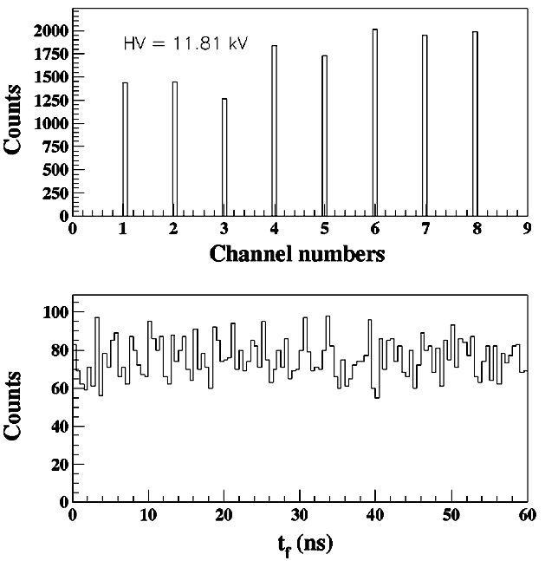
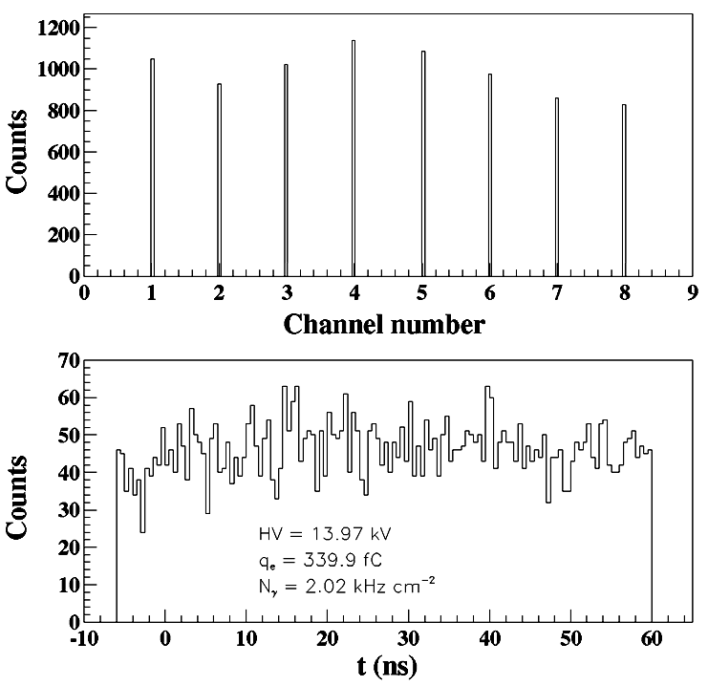
Gamma & muon hits
TDC Channel distributions
TDC Channel distributions
TDC time distributions
TDC time distributions
4-gap RPC
6-gap RPC

Slide 25
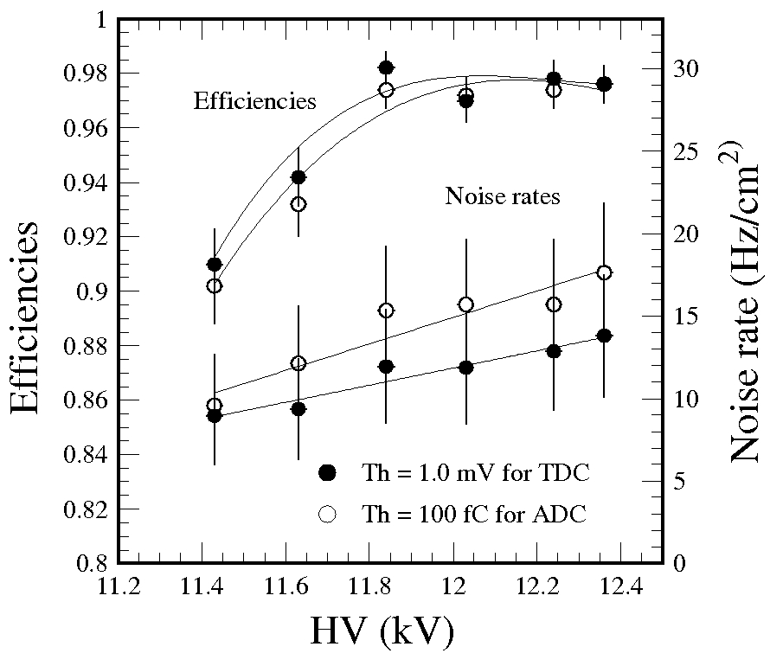
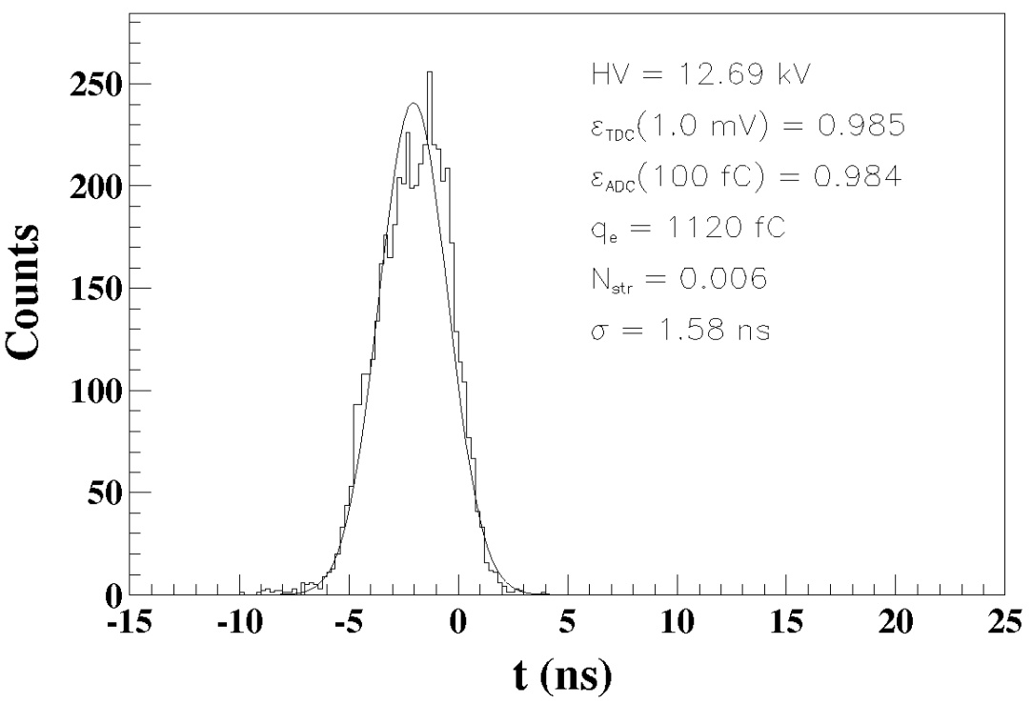
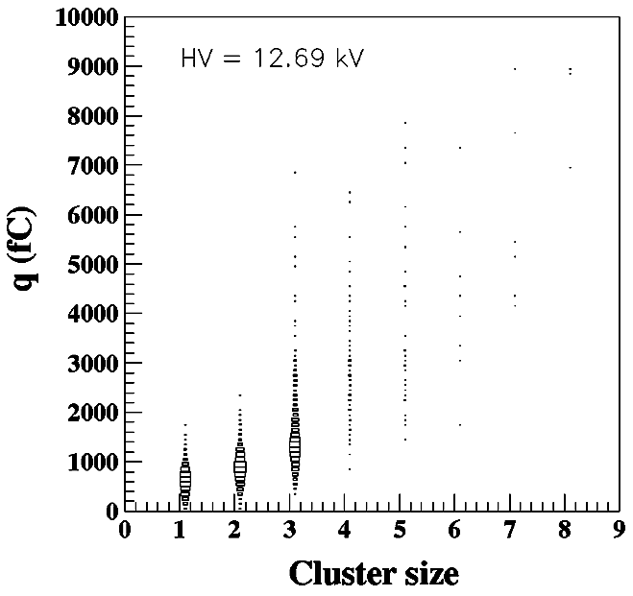
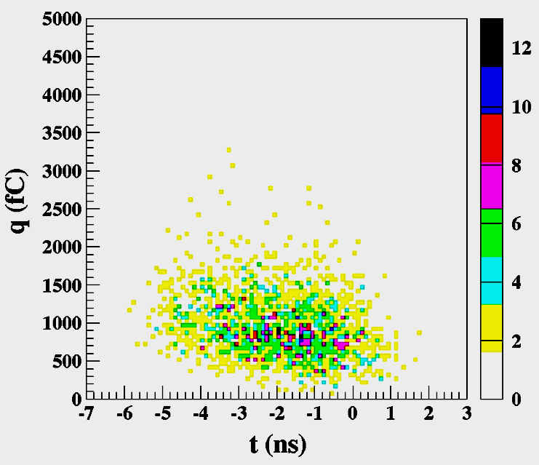
6-gap RPC
Cluster size vs mean charge
Fast time vs. fast charge
(12.69 kV)
Large pulses
~ 1%
Avalanches
Fastest arrival time

Slide 26
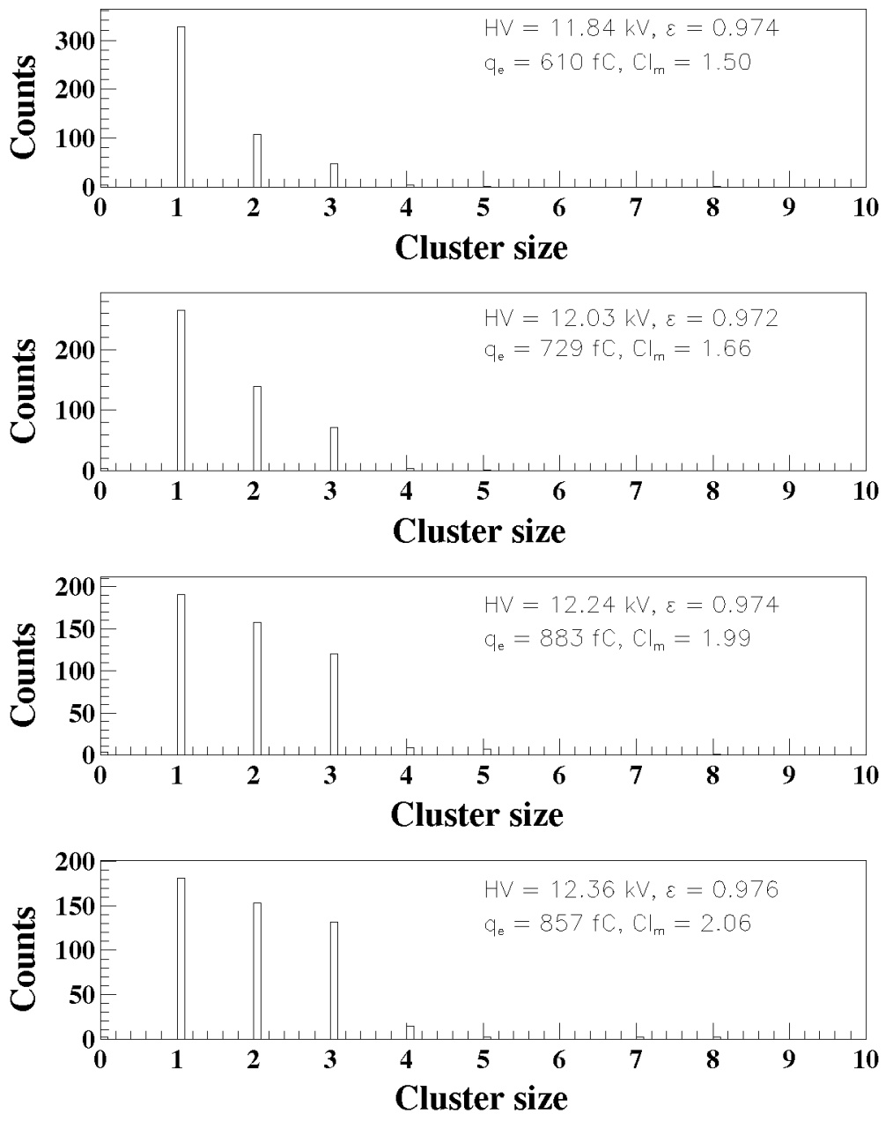
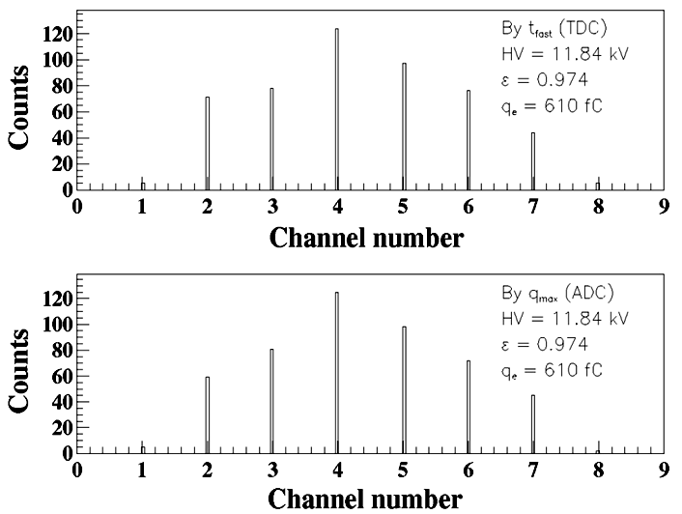
6-gap RPC
Large pulses
1 mV thresholds for TDC data
~ 1%
Avalanches
Fastest arrival time
RPC2010, GSI, Darmstadt

Slide 27
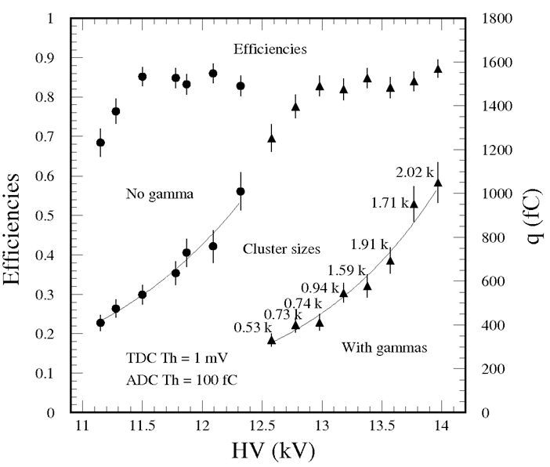
Large shift in HV for 6-gap RPC (RPC2010)
- Shifts in HV ~ 1.5 kV at 2.02 kHz/cm²
- Caused by increase in resistivity of HPL
ρ₂₀ = (7.0 ± 3.5)ⅹ10¹⁰ Ωcm (at H = 75%), measured right after the production
ρ₂₀ = (3.0 ± 0.8)ⅹ10¹¹ Ωcm (at H = 47%), measured 4 months later
- Resistivity of the HPL should be ≤ 10¹¹ Ωcm after fully polymerized.
Efficiencies & mean charges
Efficiencies & cluster sizes
Mean charges

Slide 28
- Resistivity measured at relatively high humidity
H = 65 ~ 90 % during summer.
Mean humidity ~ 75 %
Batch 1 : ρ = 3.9ⅹ10¹⁰ Ωcm (σ = 1.8ⅹ10¹⁰ Ωcm) Batch 2 : ρ = 5.1ⅹ10⁹ Ωcm (σ = 4.4ⅹ10⁹ Ωcm) Batch 3 : ρ = 6.9ⅹ10¹⁰ Ωcm (σ = 3.5ⅹ10¹⁰ Ω cm)
- At T=20ºC and at H=50 %
The expected value for the 1-mm thick HPL
~ 1.0 x 10¹¹ Ωcm selected

