Slide 1
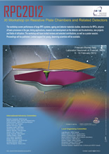
Challenges for RPCs and resistive micropattern detectors in the nearest years
V. Peskov
CERN and UNAM, Mexico

Slide 2
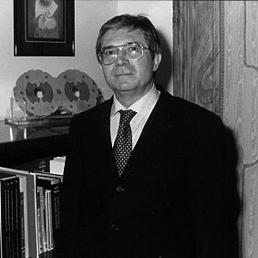
It was a great pleasure to be in Frascati –the world known scientific center!
A new momentum will be given to Frascati soon due to the SuperB
-a high luminosity e⁻ e⁺(10³⁶/cm²s) asymmetric collider- so a new great science will be concentrated here
We should acknowledge that, the first massively used gaseous detectors with resistive electrodes - Iarroci tubes -were developed here, in Frascati

Slide 3

for the first time the RPC performance in the LHC enviroment as well as physics data obtainned with the RPC are presented,
(in the previous conferenes, designs, test, LHC comissioning and cosmic ray data were only available).
Moreover, our commnu is facing now very challenging upgrades at LHC and new challenging experments at GSI and elswheer
This RPC conference is unique with respect to the previous
conferences, not only due to the very rare snow event,
but because:

Slide 4
This conference is a triumph in overcoming of previous challenges:
I guess everybody remembered them: oil, oil bumps, temperature effect, humidity, aging.. At some moments it looked like the RPC will never work in real experiments ...
However, today we celebrate the full success of RPCs!

Slide 5
Main breakthrougts: avalanche mode, small gap, multigaps.
These three improvements made RPC capable to face old challengers

Slide 6
These new challenges which RPCs are facing were already identified in the talks given at this conference:
RPC performance at LHC
RPCs for upgrades
GSI RPC and new GSI projects
RPCs at RHIC
LEPS2/SPring-8,Japan
Triggering at high rates
Astrophysics experiments
Gases, aging, materials
Electronics, software, integration
Simulations
New ideas
Applications
Why these challenges appeared? Because RPC were successful so far in the past
and present!
So we al should appreciate the efforts of the RPC community invested to the successfully
running experiments

Slide 7
Running experiments
LHC, OPERA, HADES, ARGO…

Slide 8
Running experiment even at present have a lot of challenges on daily basis.
Reaction on environment (p,T), gas leaks and purifications , stability in long term operation, dead channels, connectors, electronics and so on…just to mention few

Slide 9
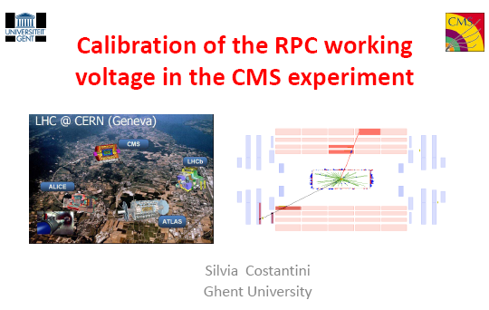
Some examples showing the necessity of corrections on environment variations
This requires a sophisticated
monitoring and control system
Some of them were not foreseen
from the very beginning…

Slide 10
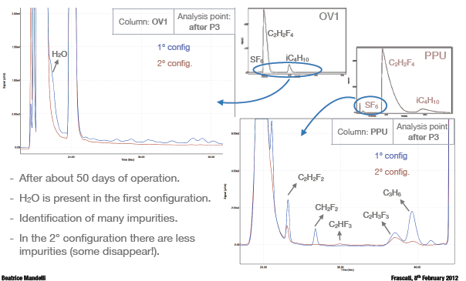
Various online monitoring +intellectual input allow to put all these problems under control
A few examples:
Gas purification and
monitoring system

Slide 11
Due to the monitoring+ intelligence of the teams RPCs in presented running system dong excellent job:
See, for example talks:.
Operational experience of the GGM at the CMS Experiment
by Mr. Stefano COLAFRANCESCHI
ATLAS RPC time-of-flight performance
by Gabriele CHIODINI
Performance of the ALICE muon trigger system in Pb–Pb collisions
by Massimiliano MARCHISONE
Performance of the MRPC-based Time-Of-Flight detector of ALICE at LHC
by Andrea ALICI
ATLAS RPC detector as Luminosity monitor
by Marcello BINDI
The on-line monitoring of the ALICE Muon Trigger at LHC
by Mr. yongwook BAEK
RPC monitoring tools in the CMS experiment
by Umberto Maria
Resistive Plate Chambers in the ARGO-YBJ experiment: operational
features, monitoring and control
by Dr. Paolo CAMARRI
An improved gas distribution system for the ATLAS RPCs
by Enrico PASTORI
Tests of gas contaminants and interaction with materials in
closed loop recirculation systems
by Stefano COLAFRANCESCHI
A study of gas mixtures and HV feedback in a RPC single-gap monitoring system
by Cristian VENDITTOZZI

Slide 12
Some highlights

Slide 13
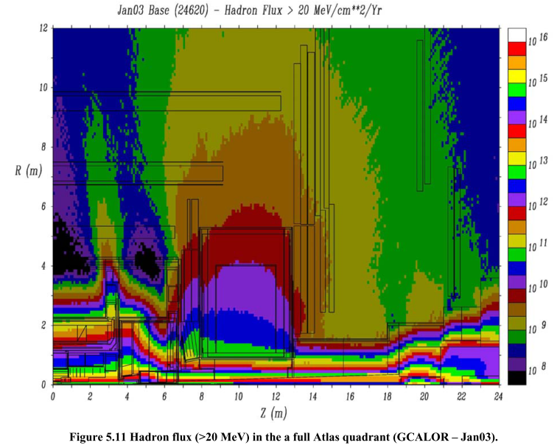
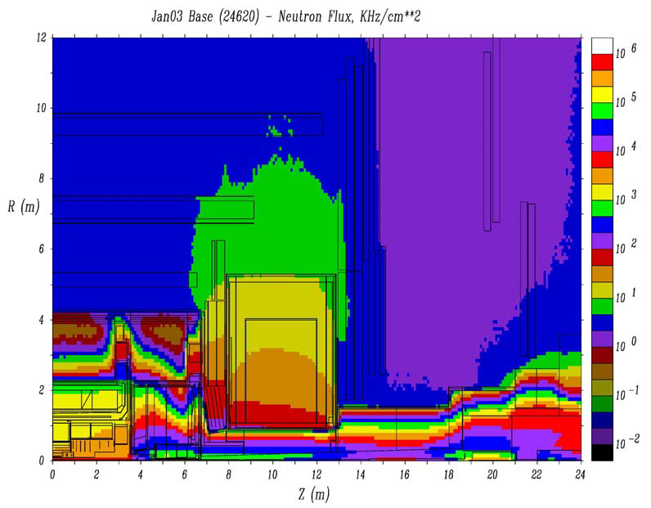
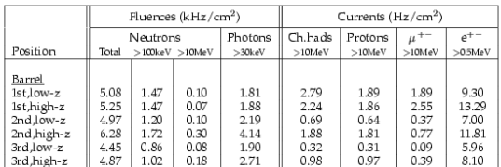
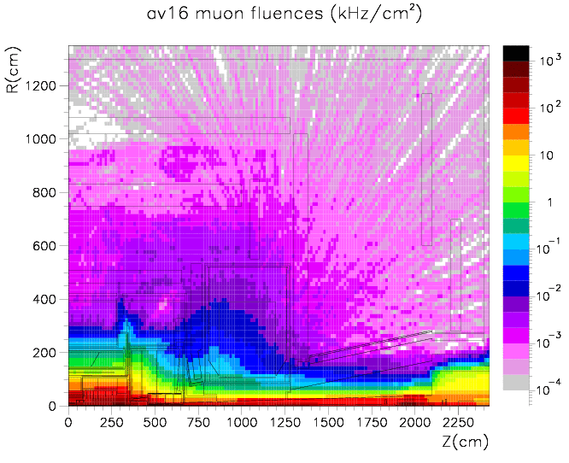
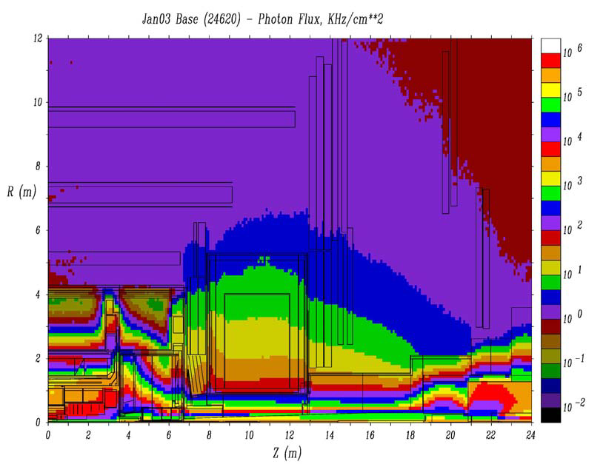
Cavern background simulation L=10³⁴ (early)
Giulio Aielli
Hadrons
Neutrons
RPC
RPC
RPC
RPC
RPC
Photons
Muons
In the RPC region at L=10^34:
2 kHz/cm^2 N
4 kHz/cm^2 photons
3-4 Hz/cm^2 hadrons and muons
Applying the known sensitivities we expect ~10-20 Hz/cm^2 of hits, dominated by photons
RPC
RPC
RPC
RPC

Slide 14
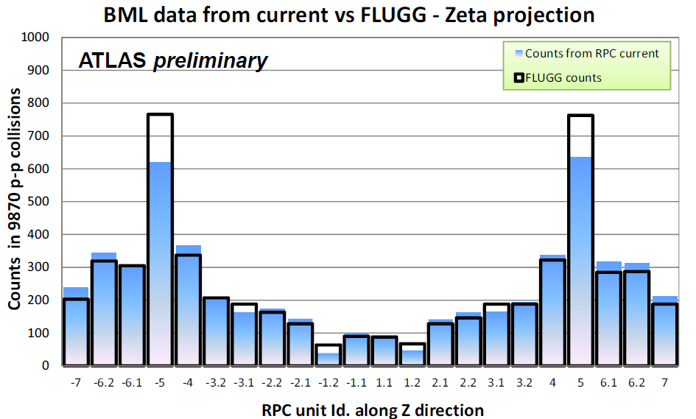
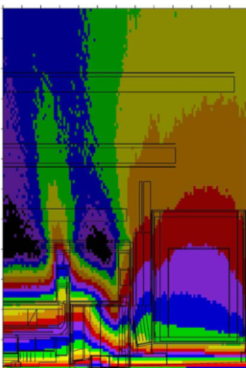
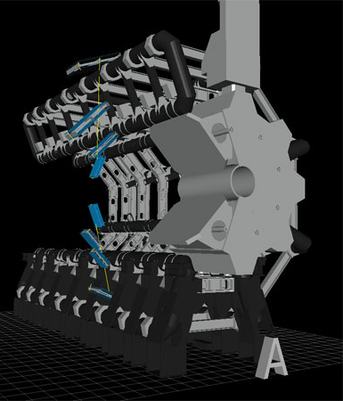
Comparison with MC (FLUGG) prediction
The maps have been used to verify the MC performance. Current data from run 189366 at L=2.94*10³³ cm⁻²s⁻¹
The counting rate is converted in terms of counts in 9870 pp collisions to compare to the FLUGG counts.
Zeta and Phi projections of the maps have been compared to MC results binned with the RPC chamber granularity
The histograms represent the total counts integrated on all the BML chambers respectively with the same z position id (zeta projection) and the same semi-sector (Phi projection).
The excess in bin +-5 corresponds to a shielding protection crack at +-7 m along z coordinate.
The description in the feet region and lower sectors is still to be improved
14
Giulio Aielli - University of Roma Tor Vergata RPC 2012 - Frascati
8/2/2012

Slide 15
…of course
CMS people also working hard on this topic
Analysis of the radiation background in the CMS RPCs
by Mr. Mircho RODOZOV

Slide 16
To acknowledge the success in overcoming previous challenges , let me give a few examples of “smoothly” or almost “smoothly” running experiments in which RPCs are used

Slide 17
FOPI Experiment (GSI)

Slide 18
The FOPI experiment has upgraded its Time-of-Flight detection system with a glass based RPC detector. This implementation is unique since readout electrodes are 1.64 mm narrow strips 90 cm long. Each counter is composed of 16 strips and referred to as the Multi-strip Multi-Gap Resistive Plate Counter (MMRPC). Counters are placed around the Central Drift Chamber of FOPI forming a cylindrical shell – the Barrel. Full MMRPC Barrel has 2400 strips that are readout from both ends. We will discuss its performance in recent HI experiments.

Slide 19
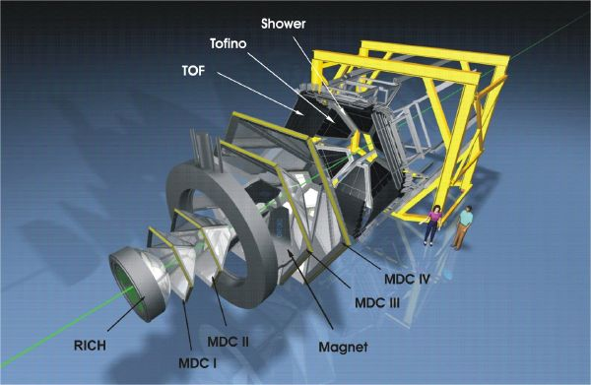
HADES
Analysis of the front structure of EAS with the HADES tRPC wall
by Mr. Georgy KORNAKOV
Performance of the HADES-TOF RPC wall in a Au-Au beam
by Mr. Alberto BLANCO CASTRO

Slide 20

Some experiments , for example OPERA and ARGO already touched something unknown, which requires clarification
Performance and aging of OPERA bakelite RPCs.
by Alessandro PAOLONI
Results from the ARGO-YBJ experiment
by Roberto IUPPA

Slide 21
Let’s now look on the future:
Challenges of the running experiments and beyond

Slide 22
LHC
The basic proposal for the LHC upgrade is, after seven years of operation, to increase the luminosity by up to a factor of 10, from the current nominal value of 10³⁴ cm⁻² s⁻¹ to 10³⁵ cm ⁻² s⁻¹.

Slide 23
Request from upgrades/new experiments

Slide 24
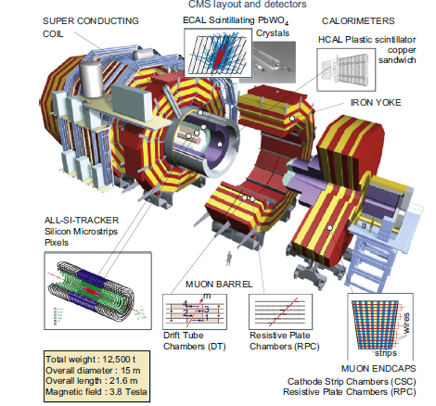
CMS
The CMS muon endcap
system (dedicated
muon triggering system)
presently comprises
three disks of RPCs,

Slide 25
Challenge for 2013-2014
The RPC based muon trigger
of the CMS Experiment
by Mr. Karol BUNKOWSKI
CMS RPC project overview
by Pierluigi PAOLUCCI
Add (was not insatlled earier due to the financial problems) 4th endcup station(RE4) of 144 « standard » bakelite RPC in order to increase triger efficiencyη<1.6(2013-2014).
Work in progress: trigger simulation, studies for the extended system, details on the new HPL production, the chambers assembly and quality control procedures
The new RPCs developed for this upgrade, based on lessons learnt from the earlier work.

Slide 26
RPCs in CMS end-cap
 | RE1/1 | RE1/2 | RE1/3 | RE2/1 | RE2/2 | RE3/2 | RE3/1 | RE3/2 | RE 3/3 | RE4/1 | RE4/2 | RE4/3
No. of RPCs | 36 x 2 | 36 x 2 | 36 x 2 | 18 x 2 | 36 x 2 | 36 x 2 | 18 x 2 | 36 x 2 | 36 x 2 | 18 x 2 | 36 x 2 | 36 x 2
Total | 72 | 72 | 72 | 36 | 72 | 72 | 36 | 72 | 72 | 36 | 72 | 72
432 | Installed (η < 1.6)
144 | Upscope (η < 1.6)
180 | Yet to be instrumented (1.6 < η < 2.1) : high η upgrade
RPC Upscope : Build and install 144 RE4 chambers upto η = 1.6
Restoration of TDR version of CMS : RE4 RPCs on Yoke YE3
L. M. Pant
RPC 2012, Laboratori Nazionali di Frascati dell'INFN, 5-10 Feb 2012
26

Slide 27
The QC scheme
QC1 : Chamber components validation : completed
QC2 : GAPS certification : KODEL, Korea
QC3 : Chambers test (at assembly sites) : CERN, Ghent, India
QC3_A Chamber assembly validation
QC3_B Tests on Cosmic stand
QC4 : Chamber reception from sites : CERN (904)
: Super-module assembly and final test : CERN (904)
QC5 : Installation and commissioning a P5 : CERN (P5)
L. M. Pant
RPC 2012, Laboratori Nazionali di Frascati dell'INFN, 5-10 Feb 2012
27

Slide 28
Production of RPC gaps for CMS upgrade by Prof. Sung Keun PARK
(Example of challenges:why barrel and forwards RPC have different oparting voltages???)

Slide 29
Construction and tests of new Resistive Plate Chambers
for the Upgrade of the CMS Endcap system
L. M. Pant
Nuclear Physics Division
Bhabha Atomic Research Centre
Mumbai 400 094, India
on behalf of the CMS collaboration
L. M. Pant
RPC 2012, Laboratori Nazionali di Frascati dell'INFN, 5-10 Feb 2012
29

Slide 30
Problems, work to be done:
Chamber production and test sites
QC and commissioning,
electronics: Front-end/Trigger/Readout
electronics,
link system,
temperature and Humidity sensors
cooling of new modules and so on…

Slide 31
Electronics
The 144+spares new chambers have to be equipped with FEB, Link board, power systems.
Good opportunity to improve the existing system and built new spares for all system
1) FEB and distribution boards (DB) will be produced under Bari supervision. Some modifications in distribution board will be implemented.
2) Power system for RE4 will be ordered to the CAEN under the Napoli supervision (India, Belgium budget)
3) Link system:
The CMS electronic/trigger groups have strongly recommended to review to “old” project and to implement all the protections and improvements needed (comes from the experience accumulated in these years).
The main goals are: build an updated and more robust system and involve more groups in the RPC trigger project in order to compensate for the Warsaw dependence and gain experience for the design of trigger system for upgrade at high eta.
New design includes: LV regulators + critical component protections
Back-compatibility:
  mechanical, electrical and firmware compatibility with the present system.
  has to work in both new and old (protected) link box
  possibility to have both protected and not protected boards in the same box
31
Notes:
31

Slide 32
CMS-RPC challenges in 2017-2018

Slide 33
R. Santonico gudelines:
Operation at very high rates
RPC proved to bean excellent detector for muon triggering even in the most difficult forward regions of LHC
Recent MC results strongly support the importance of an accurate timing showing that in the end cap regions the muons arrive in a few ns window after the bunch crossing time whereas the background is uniformly distributed or peaked elsewhere
The most difficult problem is the very high background which produce a counting rate of the order of 10 kHz/m² over very large areas
The RPC rate capability depends on a number of intercorrelated parameters:
  Electrode resistivity
  Gas gap size and multiplicity (multigap structure)
  Front end electronics sensitivity and signal to noise ratio
  Electrode thickness
To combine these parameters in such a way to operate the RPCs at high rate with modest current is of crucial importance for this purpose

Slide 34
Works on high-rate RPCs

Slide 35
Phenolic Multigap RPCs
for High-rate Particle Triggers
K. S. Lee
for the CMS Collaboration
(Korea University & Korea Detector Laboratory)
35
RPC2012@INFN-Frascati, Italy
2012-02-10

Slide 36
Aging test of high rate MRPC
by Mr. Xingming FAN
With conductive glass rate up to 10kHz/cm2
without loss of efficiency was achieved(Laktinen)

Slide 39
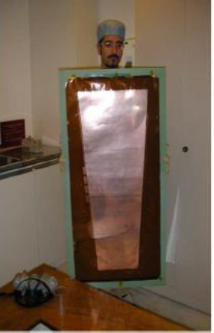
GEM vs. RPC at high η
RPC
Rate cababilty at least up to 10kHz/cm2
No destruction by “sparks”, the same elctronics, gas.sysrem., pos.resoll at least 270μm
Good time rsolution
Probabaly, lower price
GEM:
super-high rate capablity, high. pos resol.
Time rsolution???

Slide 40
ATLAS

Slide 41
ALICE-RPC challenge in 2017
Small wheel
The RPC based proposal for the ATLAS forward muon trigger upgrade in view of super-LHC
by Prof. Junjie ZHU
Thin-gap RPC Test Results
by Prof. Liang HAN
Test for upgrading the RPCs at very high counting rate
by Lorenzo PAOLOZZI

Slide 42
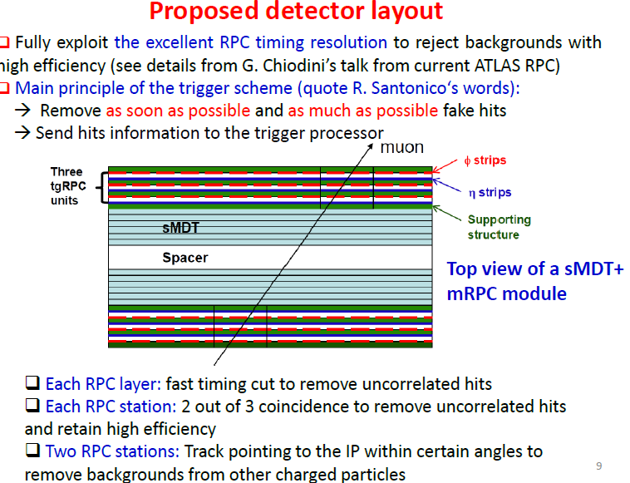

Slide 44
These upgrade effords include the development of new very sensitive and fast electronics
A fast electronics for RPC based precision tracking muon trigger at high luminosity LHC
by Roberto CARDARELLI

Slide 45
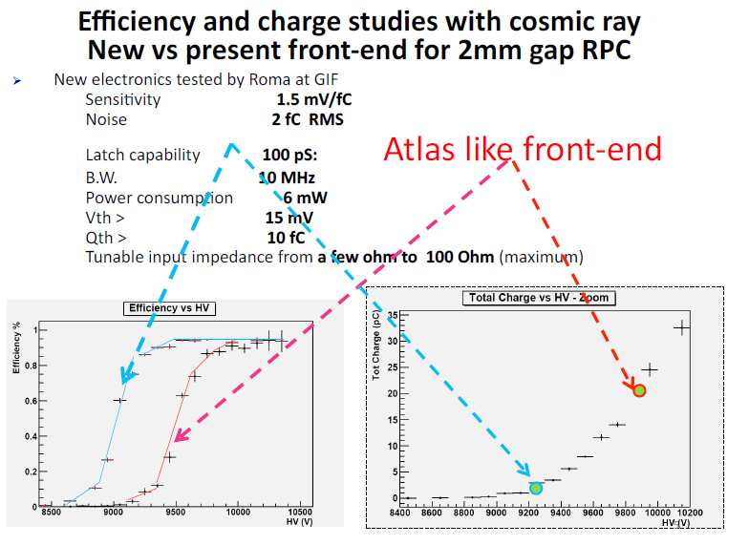
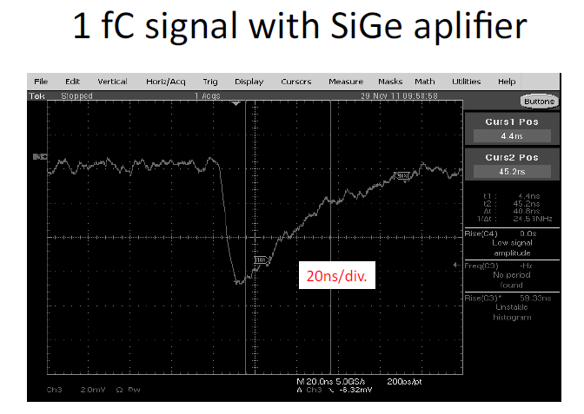
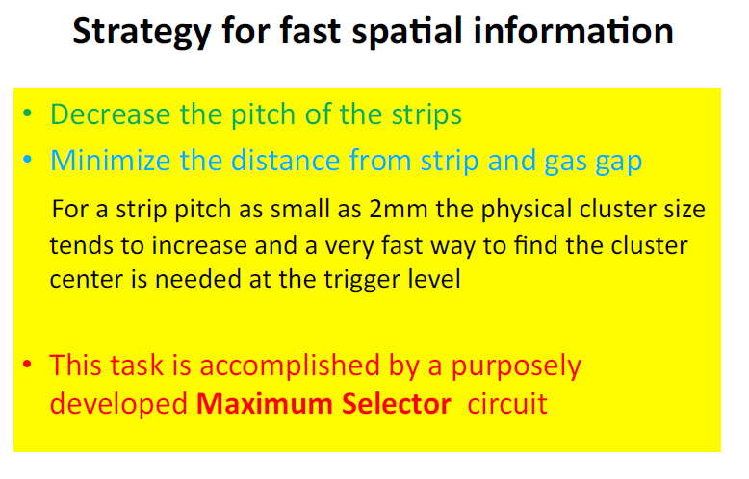

Slide 46
ALICE
Contains single gap RPCs (muon forward spectrometer) and multigap TOF

Slide 47
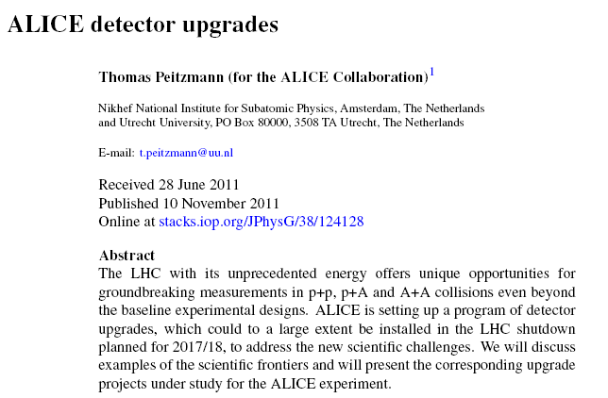
ATLAS RPC time-of-flight performance by Gabriele CHIODINI
Performance of the ALICE RPC-based muon trigger system in the first two years of data taking at the LHC
by Dr. Martino GAGLIARDI Mr. Francesco BOSSU
Considerations for UPGRADE: switch to avalanche mode , correspondingly change the electronics

Slide 48
Interesting R&D performed by ALICE group with timing RPCs
1) A 20 ps timing device—A Multigap Resistive Plate Chamber with 24 gas gaps
2) High counting rate, differential, strip read-out, multi gap RPC
by Prof. Mihai PETROVICI

Slide 49
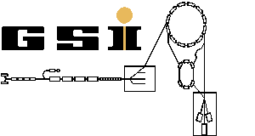
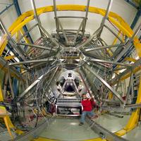
GSI upgrades.

Slide 50
FAIR GSI
In the next few years the new international accelerator facility FAIR, one of the largest research projects worldwide, will be erected at GSI. At FAIR an unprecedented variety of experiments will be possible. Thereby physicists from all around the world will be able to gain new insights into the structure of matter and the evolution of the universe from the Big Bang to the present.
FAIR will provide antiproton and ion beams with unprecedented intensity and quality. In the final construction FAIR consists of eight ring colliders with up to 1,100 meters in circumference, two linear accelerators and about 3.5 kilometers beam control tubes. The existing GSI accelerators serve as a pre-accelerators.
In October 2010 nine countries in Wiesbaden have signed the international agreement on the joint construction of FAIR in Darmstadt.

Slide 51
New challenges for timing RPCs: CBM TOF wall
(The Compressed Baryonic Matter spectrometer (CBM) is expected to be operational in the year 2018 at the Facility for Anti-proton and Ion Research (FAIR) in Darmstadt, Germany).
Conceptual design of the CBM-TOF wall with real-size high-rate MRPC modules based on the newly developed chinese doped glass
by Mr. Jingbo WANG
(A Multistrip-MRPC prototype for the CBM Time-of-Flight wall
by Mr. Ingo DEPPNER

Slide 52
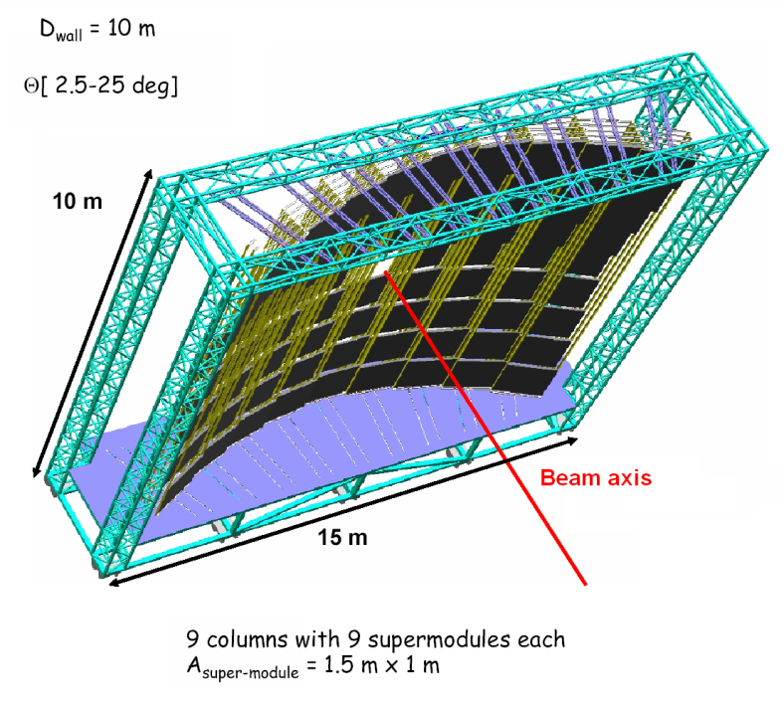
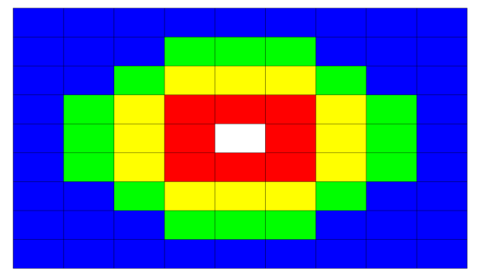
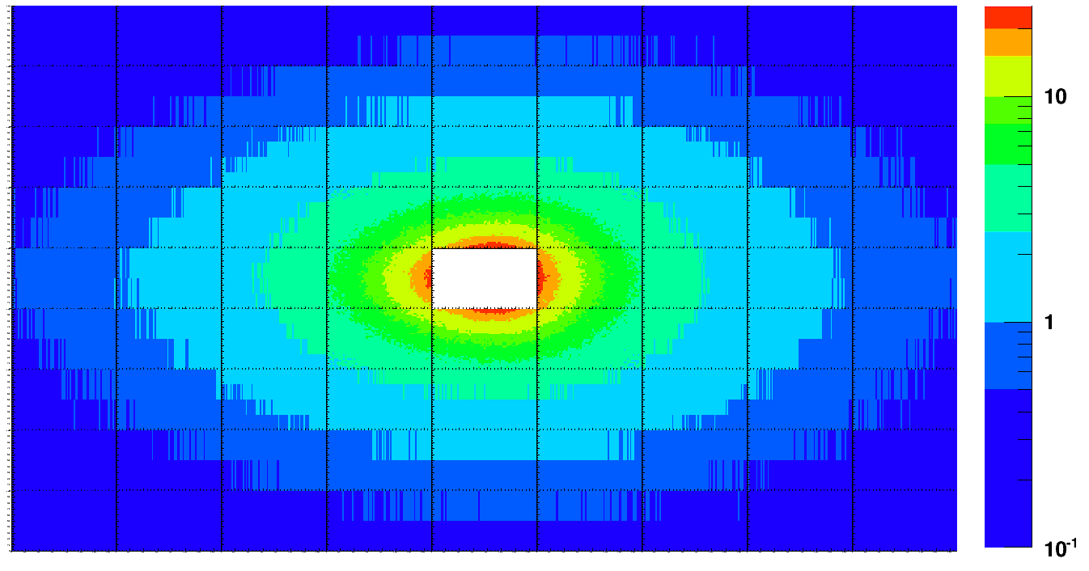
Current conceptual design of CBM-TOF
Timing RPC with:
wall area: A = 150 m²
intrinsic time resolution: σ_{T} ~ 50 ps
rate capability: R ~ 0.5 – 25 kHz/cm²
granularity: ΔA ~ 4 – 30 cm²
operation mode: free running
Rate profile (Au-Au(minimum bias) at E=25 GeV/A)
Rate profile (Au-Au(minimum bias) at E=25 GeV/A)
4
3
2
1
1
8.0-25 kHz/cm², #SM: 8 (low resistive glass/ceramic)
2
3.8-8.0 kHz/cm², #SM: 12 (low resistive glass)
A. Kiseleva, P.-A. Loizeau
3
1.5-3.5 kHz/cm², #SM: 16 (low resistive glass)
4
0.5-1.5 kHz/cm², #SM: 44 (float glass, warming up)
Low resistive glass
I. Deppner, et al., Nucl. Instr. and Meth. A (2010), doi:10.1016/j.nima.2010.09.165
52
Notes:
52

Slide 53
Ideas are still comming...
M.Loizeue et al, today talk
2. Free-streaming readout
Motivation:
CBM interaction rate: up to 10⁷ Hz Au+Au @ 25AGeV
Rate + need to inspect full event for decision => free streaming!
Principle:
Each front-end chip must detect hits and timestamp them
The data are pushed through the readout chain toward the First Level Event Selector
Data pre-processing as soon as possible => Bandwidth!
Synchronization of all front ends critical!
Error recovery, Data loss detection, Pre-processing
Event
Building &
Selection
Pre-Processing
Aggregation
FEE
Readout
Clocks
Goal = build a full readout chain for each sub-detector working at the full rate
Notes:
1 Interaction: 700-1000 charged tracks every 100 ns to be reconstructed fully! => all must be pushed to FLES for correlation
53

Slide 54
R3B, FAIR GSI
R3B is an acronym for Reactions with Relativistic Radioactive Beams.
It is the name of the forthcoming upgrade of the actual LAND experimental setup at the GSI

Slide 55
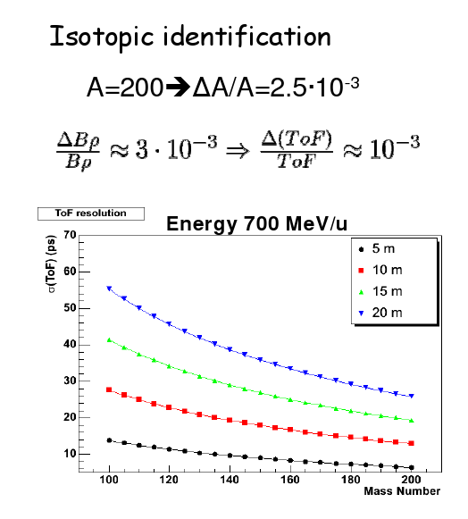
Introduction
Performance of timing-RPC prototypes with relativistic heavy ions
by Dr. Carlos PARADELA DOBARRO
The use of RPCs was proposed within the R³B experiment of FAIR for building a time-of-flight wall for relativistic heavy ions (iTOF).
Large-area tRPCs present excellent time resolution for minimun ionization particles (~ 50 ps σ), but their performance with heavy ions is almost unknown.
iTOF main requirements:
30 ps for the full iTOF (50 ps for one RPC)
Efficiency for heavy ions close to 100 % [1,2].
In this work, we complete the R&D studies providing the time resolution obtained with double-gap and single-gap prototypes.
[1] Y. Ayyad et al., Nucl. Instrum. Meth. 661, S141
[2] E. Casarejos et al. Nucl. Instrum Meth. in press
Notes:
55

Slide 56
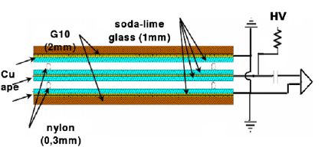
Conclusions
Two different type of tRPCs have been tested in beams for studying their time resolution performances.
Resolutions close to 40 ps have been obtained for reduce ion rates (a few Hz/cm²), but they are worse for increasing rates.
Time resolution also worsens drastically for the high voltage region where streamers are expected (above 100 kV/cm).
For a HV plateau about 2.9 kV, the single-gap RPC prototype we have tested fulfill the main requirements: 95 % efficiency and 50 ps σ for one detector at less than 10 Hz/cm².
Tests with short electron bunches are a good option to characterize the RPC electronics performance in similar charge conditions than ions, but cleaner beam conditions.
Notes:
56

Slide 57
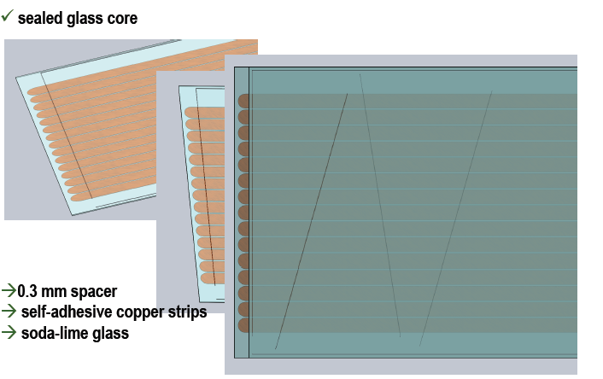
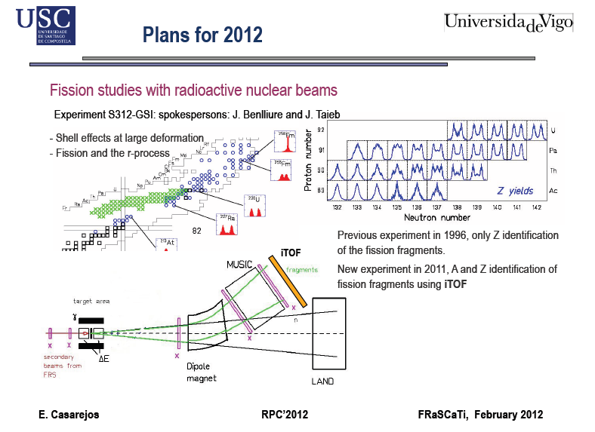
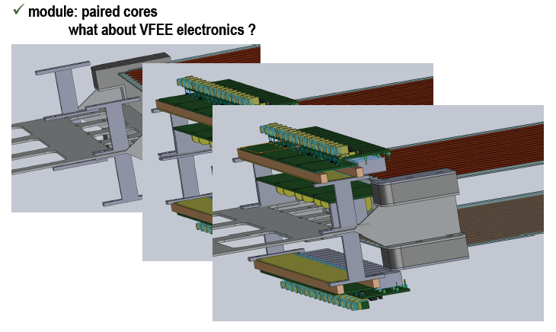

Slide 58
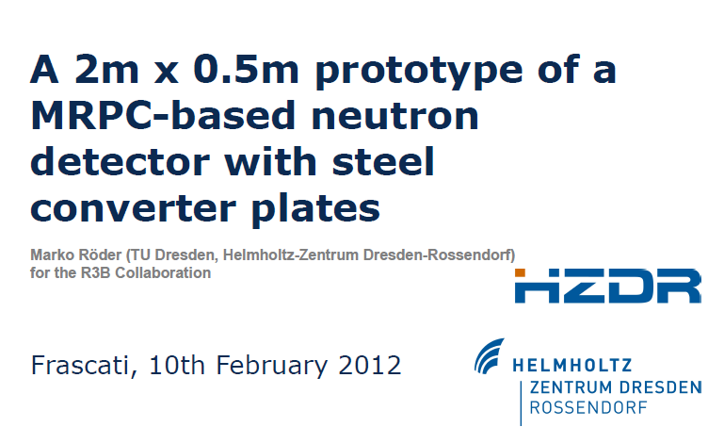
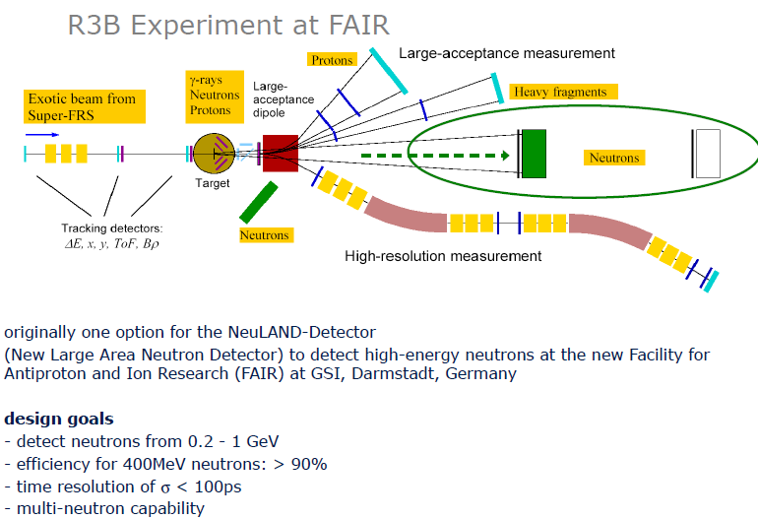
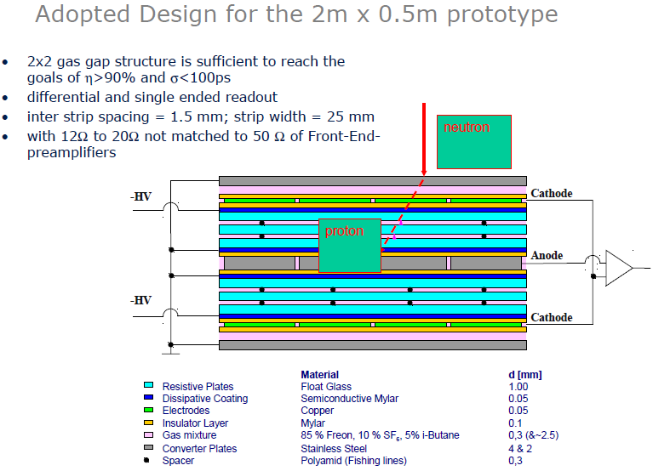
New ideas and developments(today presentation)

Slide 59
Other experiments

Slide 60
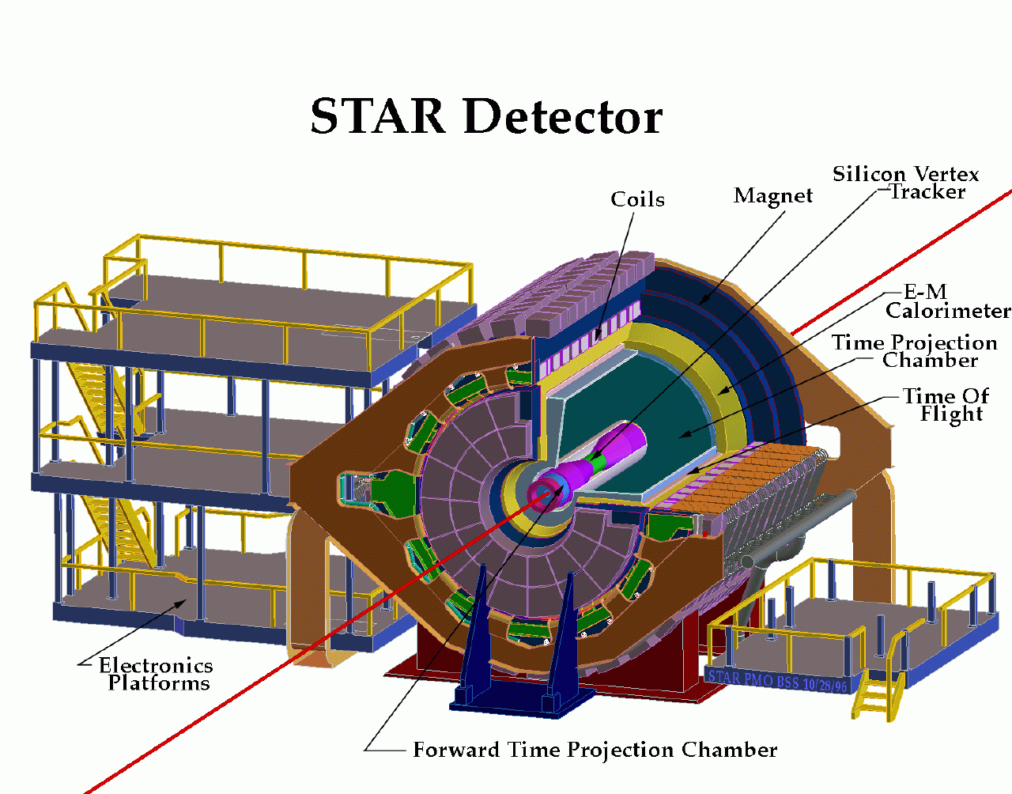
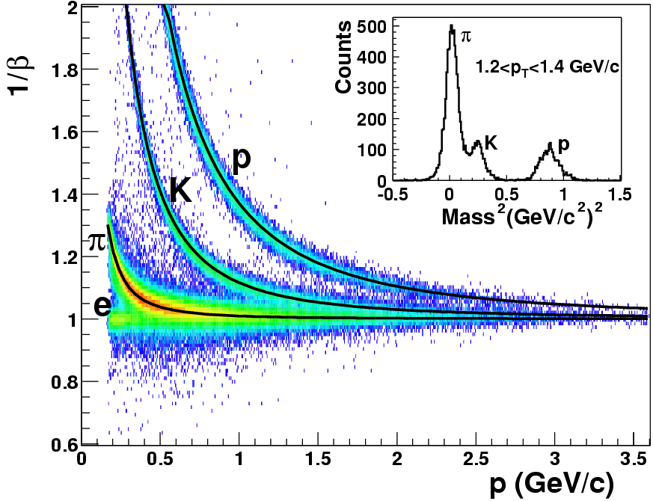
Hadron identification:
STAR Collaboration, nucl-ex/0309012
Time Projection Chamber: 45 padrow, 2 meters (radius), σ(dE/dx)≈8%, -1<η<1
Multi-gap Resistive Plate Chamber TOFr: 1 tray (~1/200), σ(t)=85ps

Slide 61
Next challenge: STAR MTD

Slide 63
LEPS2/SPring-8,
Japan
A new project to construct the second beamline for the laser‐electron photon beam at SPring‐8 (LEPS2) has started

Slide 64
A new project to construct the second beam line for the laser‐electron photon beam at SPring‐8 (LEPS2) has started

Slide 65
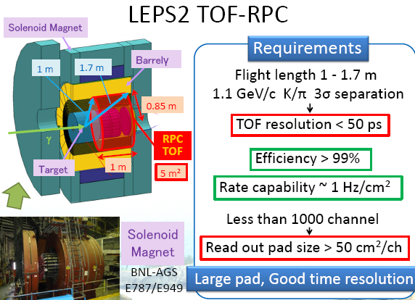

Slide 66
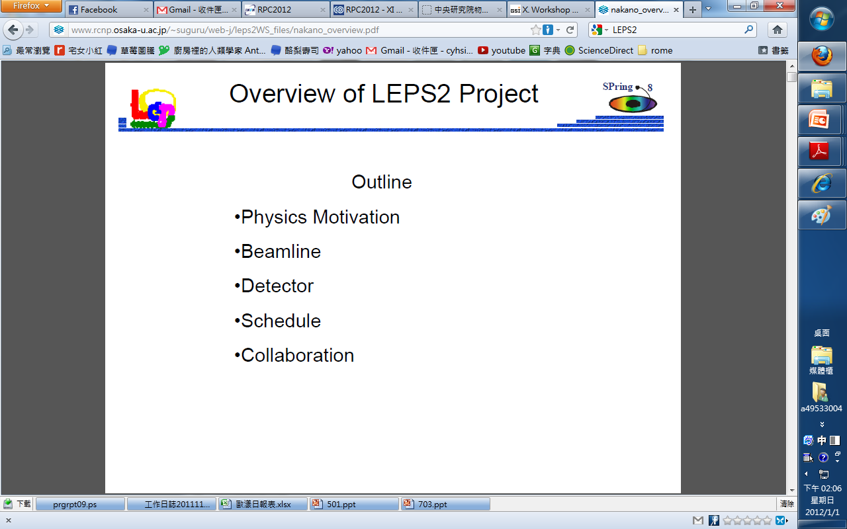
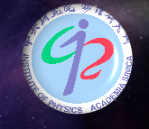
Hit-Rate Dependence and Gas Mixture of Prototype MRPC for LEPS2
Chia-Yu Hsieh 謝佳諭
Institute of Physics , Academia Sinica , Taiwan
For LEPS2 Collaboration
66
Notes:
Hello , everyone . I'm Chia-Yu Hsieh from Academia Sinica,Taiwan.
Today I am going to talk about the prototype MRPC we made for the LEPS2 experiment.
66

Slide 67
Summary & Future work
MRPC for LEPS2
We almost achieve the request of LEPS2 experiment.
Future work
(1) Impedance of strip and amplifier
(2) Longer strip( > 2.5 x 40 cm²)
(3) 10x100cm² glass
Configuration | 260 μm x 5 gaps x 2 stacks
Strip size | 2.5 x 40 cm² (~1000 channels)
Gas mixture | R134a:iso-butane:SF₆ =90%:5%:5%
Efficiency | ~99 % (~20 Hz/cm²)
Time resolution | ~60 ps (~20 Hz/cm²) → improve to 50ps
67
Notes:
MRPC for LEPS2
After investigating many things, we chose MRPC has 10 gaps with 260um gap width.
The strip size is 2.5*40cm^2
The gas mixture of chamber is 90%R134a,5%iso-butane,and 5%SF6 is in the ratio of 90 ,5,and 5.
Under these conditions the 98% efficiency and about 60-65ps time resolution can be achieved under hit rate of 20Hz/cm2.
Future work
In the future we will study further the effect of the impedance of pad and develop the amplifier for the readout of MRPC.
And we will try longer strip with a real size chamber with total area of 10*100cm2.
67

Slide 68
Taking gears astroparticle experiments…

Slide 69
EEE
M. ABBRESCIA
INO-ICAL Prototype by Mr. Sumanta
RPCs are the key elements of these projects and discoveries for sure will come

Slide 70
A lot of challeneges...
Just a few examples:
gases and their distribution, posible leaks
RPC long term satbility,
triger schemes and so on...
(See talks :Study of RPCs for autonomous stations in cosmic ray research
by Luis LOPES
Preliminary results on optimization of gas flow rate for RPCs
by Mr. Suresh KALMANI,
QUALITY ASSURANCE OF LARGE AREA RPC DETECTOR :
TECHNIQUES FOR MEASUREMENT OF GAS LEAK RATE
by Mr. AVINASH JOSHI
Electronics and data acquisition systems for the RPC based INO ICAL detector
by Dr. Satyanarayana BHEESETTE
Proposed Trigger Scheme for the ICAL Detector of India-based Neutrino Observatory
by Ms. Sudeshna DASGUPTA

Slide 71
New ideas/new challenges related to RPCs

Slide 73
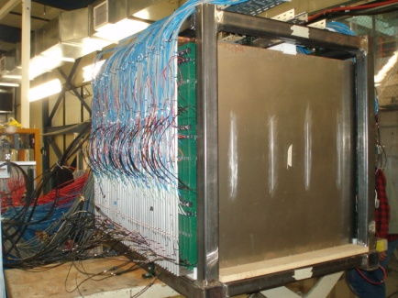
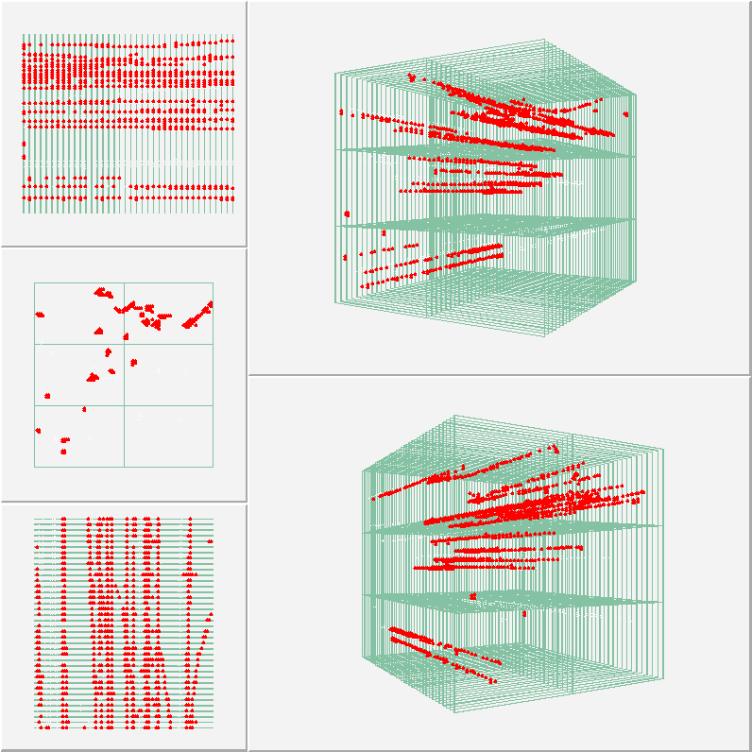
Construction of a Digital Hadron Calorimeter with Resistive Plate Chambers
Lei Xia
Calibration of the DHCAL
by Jose REPOND
Development of large GRPC for
an ultra-granular Semi-Digital Hadronic Calorimeter
by Mr. imad LAKTINEH
Response of the DHCAL to Hadrons and Positrons
by Dr. Burak BILKI

Slide 74
Various technological challenges

Slide 75
Gases: challenges, problems
Freon replacement?
Optimization of the gas circulation, purification, leaks,monitoring, low gas consumption,
role of SF6
aging... and much more
(see, for example, Gas purifiers for closed-loop gas systems
by Carla LUPI
SiOx coated plastic fiber optic sensor for gas monitoring in RPC
by Dr. Sabrina GRASSINI
Use of fiber optic technology for Relative Humidity monitoring in RPC detectors
by Dr. michele CAPONERO
Development of small, easy to build and low gas consumming timing RPCs
by Miguel MORALES)

Slide 76
Materials: challenges, problems
We are progressing*, but still a lot of studies should be done to undersatnd:
charge transport, resistivity, temperatrute effect, aging, outgasing and so on
*Ageing and conductivity of electrodes of high rate RPCs from an ion conductivity approach
by Mr. Miguel MORALES
Study on Surface Asperities in Bakelite-RPC
by Prof. Nayana MAJUMDAR
A model for the chemistry of defects in bakelite plates exposed to high-radiation environment
by Ferdinando FELLI

Slide 77
Simulations

Slide 78

Review of simulation and modelling
P.Fonte

Slide 79
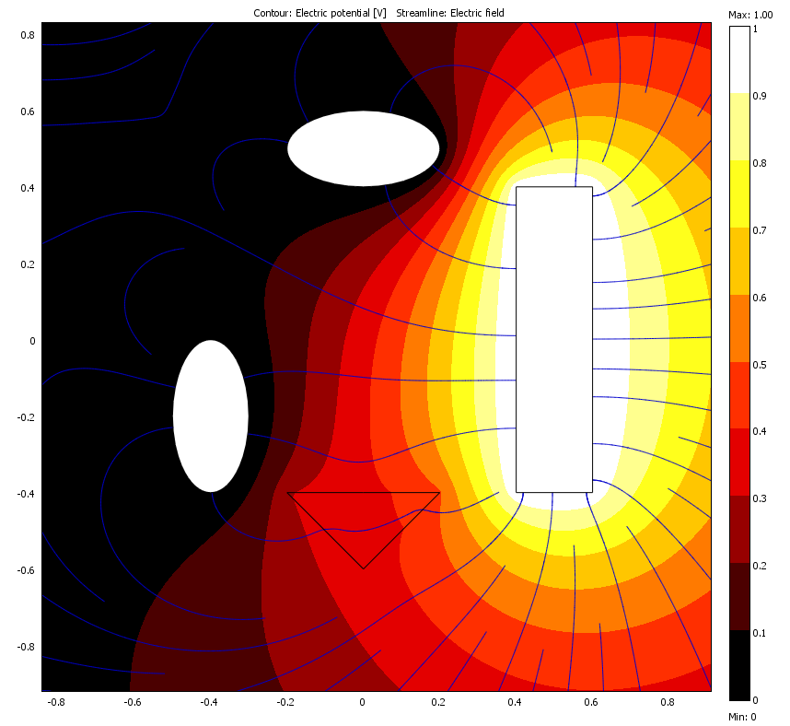
Signal induction – Ramo’s theorem
To find the induced charges and currents to one electrode apply 1 V to this electrode and 0 V to the others, generating the weighting potential V_{w} and the weighting field E_{w}.
V=0
V=1V
q₁
● ●
q
V=0
There are plenty of ways to do such electrostatics calculations.
Dielectrics DO matter.

Slide 80
Challenges in simulations:
Great progress, however still a lot of work should be done;
For example,undersatnding of streamers, detector+electronics and so on...
Simulation studies on the Effect of SF6 in the RPC gas mixture
by Dr. Bheesette SATYANARAYANA
RPC simulations from a current stand-point
by Dr. Diego GONZALEZ-DIAZ
Charge signal diffusion through resistive strip read-outs.
by Dr. Javier GALAN
The CMS RPC performance and simulation
by Mrs. Roumyana Mileva HADJIISKA
The RPC hits in the CMS muon reconstruction
by Mr. Minsuk KIM

Slide 81
Electronics, DAC, integration, and cetera:
The rising requirements concerning the time resolution, the channel density, the accepted hit rate and finally the price per channel, force the development of new and versatile solutions which can be used in many applications... can these efford be optimized within the RPC comunity?
(as examples, see presentations at this conference:
Readout Board v3
by Mr. Grzegorz KORCYL
CAD: A Current-Mode Amplifier and Discriminator ASIC for MRPC-TOF Detectors
by Ms. XIN ZHOU

Slide 82
Other important problems and challenges

Slide 83
A lot was done and currently under the progress, but even more should be done
Aging

Slide 84
Aging test of high rate MRPC
by Mr. Xingming FAN

Slide 85
(6) Aging issue: Small pulses will be really conductive to reduce radiation-induced aging at high rate environments
For 2-gap RPCs, aging study with an intensive gamma rate > 3 kHz cm⁻²
→ The high gamma rate caused Fast Degradation of gaps
(H. C. Kim et al., NIM A602 (2009) 771)
Future R&D scopes
(1) QC based R&D for the manufacture procedure and parts
(2) Real-size prototype detector for high-η RE (RE1/1, RE2/1, RE3/1) RPCs with the 4-gap structure & the FEBs for the CMS RPCs
85
RPC2012@INFN-Frascati, Italy
2012-02-10

Slide 86
Applications and associated to them challenges

Slide 87
PET

Slide 89
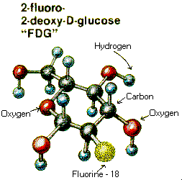
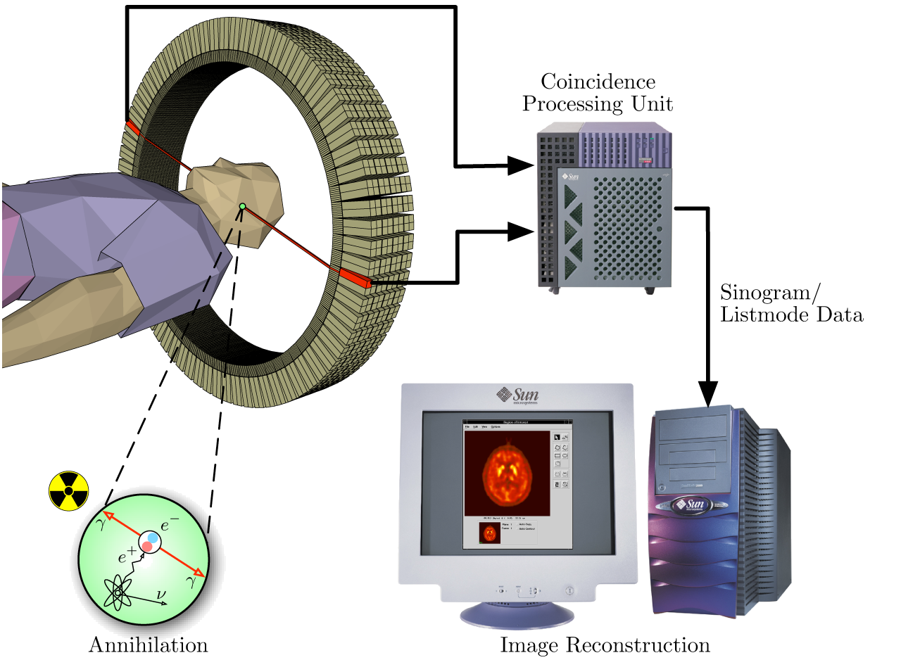
Positron-Emission Tomography (PET)
Isotope half-life
¹¹C 20.3 min
¹⁵O 2.03 min
¹⁸F 109.8 min
⁷⁵B 98.0 min
¹³N ~10 min
The concept of emission and transmission tomography was introduced
by David E. Kuhl, Luke Chapman and Roy Edwards in the late 1950s.
A multigap RPC based detector for gamma rays
by Dr. Borislav PAVLOV

Slide 90
Interest from our Indian RPC collegues

Slide 91
The challenge is to make a real device with reduce dose and commercialize it.. And this is along way to go!

Slide 92
Tomography

Slide 93
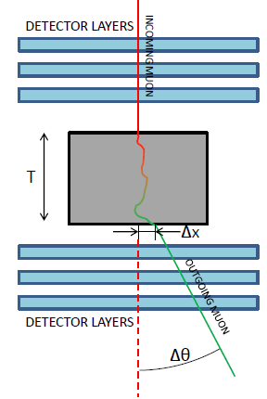

Slide 94
Medical applications

Slide 95
More challenges

Slide 96
Motivation
1 - PID by TOF is a combination of tracking and timing. To have both measurements in a single detector may have advantages. For instance, each particle would be measured several times, improving accuracy (although on a shorter path) and there is no need for an external T₀ detector (frequently problematic).
2 – Explore the limits of RPC position resolution by classical charge interpolation (for which there is ample hardware support) and combine it with accurate timing in a limited number of channels.
t₀
t₁
t₂
t₃
P.Fonte et al, today talk

Slide 97
Micropattern detectors with resistive electrodes
(young “brothers” of RPCs)

Slide 98
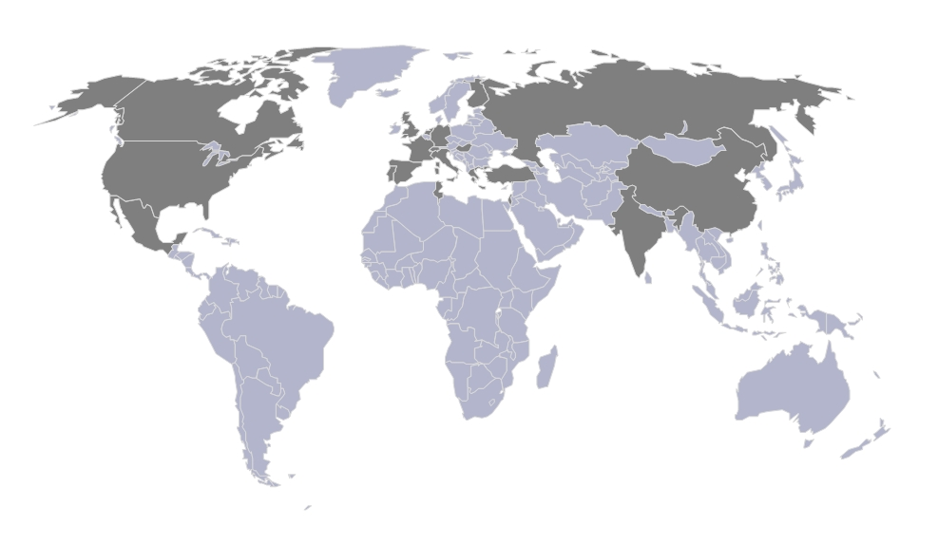
In the last couple of years several groups, in the framework of RD51collaboration, tried to develop spark protective micropattern gaseous detectors

Slide 99
This activity was triggered by the article of R. Oliveira, NIM A576, 2007, 362, who developed first spark protective micropattern detector-GEM with resistive electrodes instead of metallic one

Slide 100
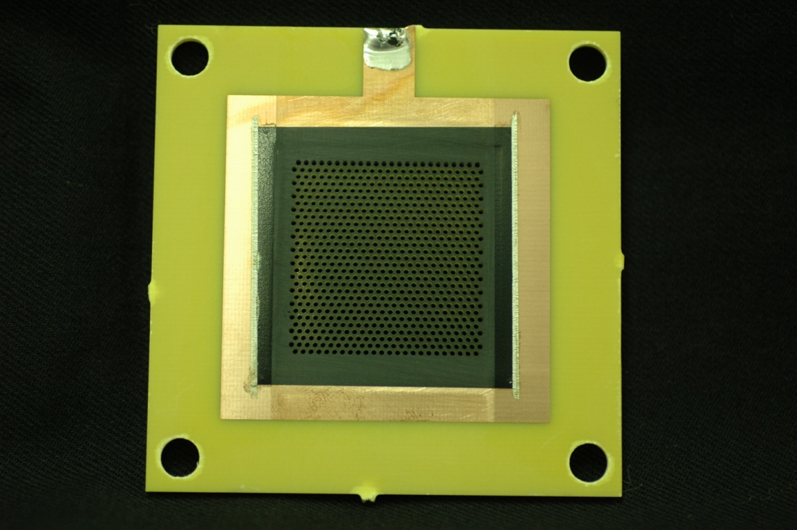
First design of Resistive GEM (RETGEM)
It was a GEM-type detector featuring resistive electrodes instead of metallic ones.
The resistive electrodes limit the current during the sparks and make them “mild”.
Metallic frame
for electrical
contacts
Example of robustness:
10 minutes of continuous discharge did not destroy the detector (a photo made by a mobile phone)!
Holes
Resistive electrodes
R. Oliveira, NIM A576, 2007, 362

Slide 101
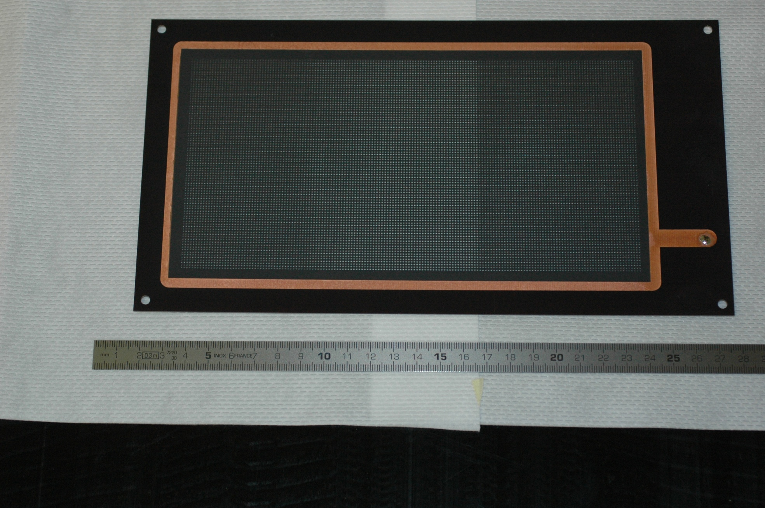
We have developed quite a lot of different prototypes of RETGEMs
Example: large-area (10x20cm²) RETGEM with inner metallic strips

Slide 103
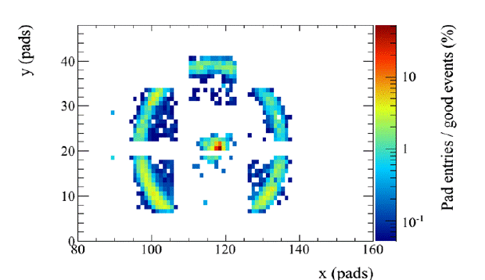

Slide 104
Nowadays, beside GEM several other resistive micropattern detectors were successfully developed by our and other groups:
WELL/CAT detector (A. Di Mauro, et al., 2006 IEEE Nucl. Sci. Conf. Record 6, 2006, 3852.V. Peskov, arXiv:0906.5215, 2010, Hugo Natal da Luzet et al., : report on the R5iMini-week, CERN,Jan 18, 2011) resistive mesh detectors (R. Oliveira et al.,, IEEE Trans. Nucl. Sci., 57,2010, 3744) and, of course, Micromegas (R. Oliveira et al.,, IEEE Trans. Nucl. Sci., 57,2010, 3744, T. Alexopoulos J.Burnens, et al.,. NIM. A 640, 2011, 110)
See also recent reports at the 2nd Intern. Conf. on Micro Pattern Gaseous Detectors,
August 2011, Kobe, Japan (to be published in JINST)
(http://ppwww.phys.sci.kobeu.ac.jp/%7Eupic/mpgd2011/abstracts.pdf)

Slide 105
See for example: a photo of RETGEM from: R. Akimoto et al, presentation at 1st MPGDs conference in Crete,2009
RETGEMs developed by other groups:
Several groups (mostly
Japanese) are now successfully
developing various designs of
RETGEMs

Slide 106
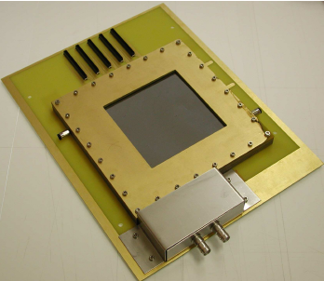
Latest design of “bulk”-MICROMEGAS with resistive mesh cathode and position-sensitive anode
Connectors to anode readout strips
10cm
HV

Slide 107
By the way, this is RPC!

Slide 109
Let me highlight the impressive work of ATLAS group who developed large –are resistive MICROMEGAS
100μm
T. Alexopoulos J.Burnens, et al.,. NIM. A 640, 2011, 110.
See talk of M. Byszewski

Slide 111
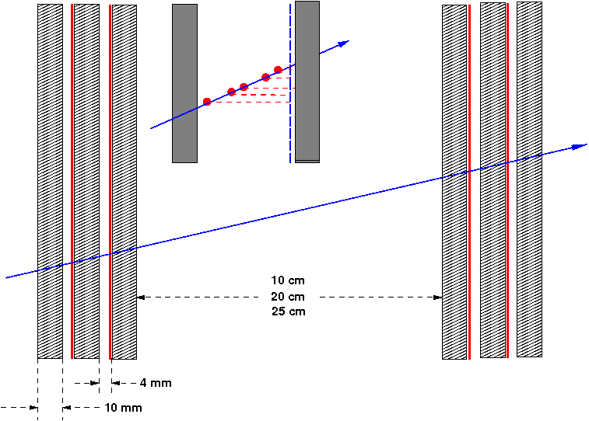
MicroMegas
Mesh
Resistive strips
y strips
2-layer + 2-layer (4 gaps in total) mMegas is foreseen.
  Charge information for precision measurement.
Two-dimensional readout per gap (2D MM)
  2 M channels in total.
Strips with 0.5mm pitch.
  The pitch is fine enough for LVL-1 trigger to reconstruct and find a track with the required resolution using simple discriminator outputs of hit signals. (Information of charge is not necessary.)
  25cm lever arm achieves 1mrad angular resolution.
PCB
x strips
CERN, 9 March, 2011
ACES 2011 SOS
111

Slide 112
This is RPC!

Slide 113


Slide 114
M. Newcomer

Slide 116


Slide 117
This is RPC!

Slide 118
After a long and fruitful “wire detectors era” two major breakthroughs happened in the field of gaseous detectors: developments of RPCs and invention of micropattern detectors. There is a tendency to merge...

Slide 119
Let’s conclude: the challenges for the nearest years

Slide 120
For LHC RPC community: develope RPC and electronics for Phase 1 upgrade,
Start preparations for Phase 2. Gases?
For TOF community
To achiev their ambision goals: high time and position resoltion together wth high efficiency and high-rate capability
Daily challenges: careful design,cabling, electronics
Astrophysics community
Constrauction of large area RPCs
Ensure stable lomg-term opration
Gases
Electronics
“Application” comunity
Commrcialization ( a very difficult task!)
For micropattern community:
large area, timing, long-term stability, aging

Slide 121
Of couse, I presented my personall point of view and my aim was to provoke you for the dicussion, so it will be very imporat to hear comments from my collegies

