Slide 1
Study on Surface Asperities
in Bakelite-RPC
N. Majumdar¹, S. Mukhopadhyay¹, P. Bhattacharya¹, S. Biswas³, S. Bhattacharya¹, S. Saha¹,
S. Chattopadhyay²
¹Saha Institute of Nuclear Physics, Kolkata, India
²Variable Energy Cyclotron Centre, Kolkata, India
³GSI, Dermstadt, Germany
RPC2012 Workshop, 5-10 February, 2012
INFN Frascati

Slide 2
Introduction
The active detector in India-based Neutrino Observatory (INO) RPC
Main goal of the study
To develop large bakelite RPC without linseed oil coating for the experiment in India-based Neutrino Observatory
&
For operation in streamer mode
S. Biswas et al., RPC2010

Slide 3
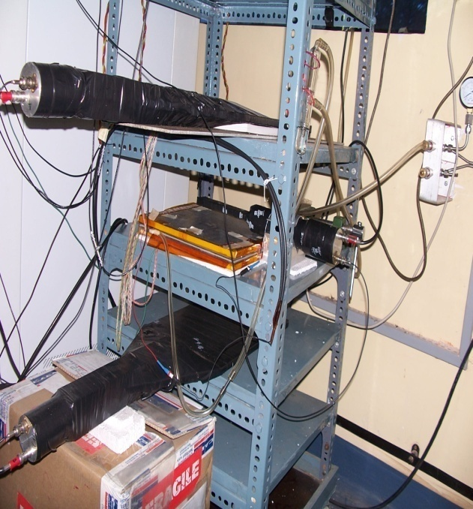
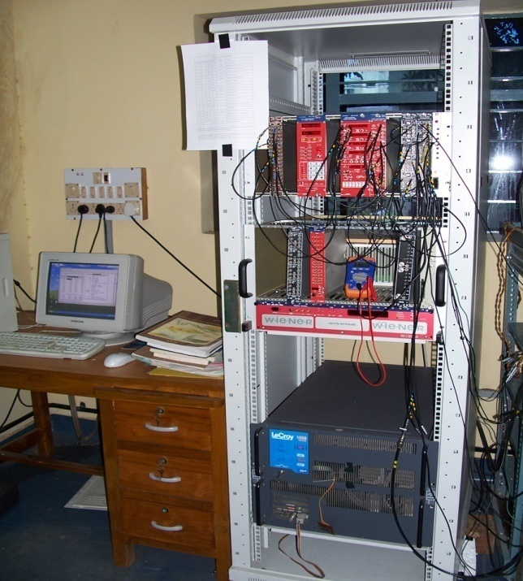
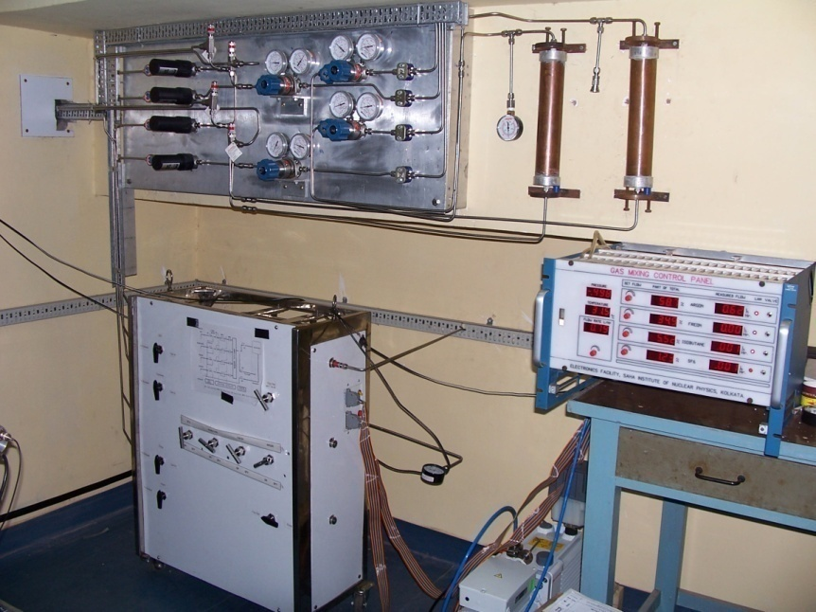
Cosmic ray test bench
Flow rate: 0.4 ml/min
(3 detector volume/day)
Arrangement of the scintillators and the RPC
Power supply, front-end electronics and DAQ
S. Bose et al., Nucl. Instr. and Meth. A 602 (2009) 839.
4 gas mixing unit
S. Biswas et al., RPC2010
Notes:
3
3

Slide 4
Initial results
A few small prototypes have been tested.
Without silicone coating
Current increases rapidly.
After a certain voltage efficiency decreases in all cases.
With silicone coating
Efficiency plateau >90% obtained.
Counting rate decreased.
Current decreased,
S. Biswas et al., RPC2010
S.Biswas, et al., Nucl. Instr. and Meth. A 602 (2009) 749

Slide 5
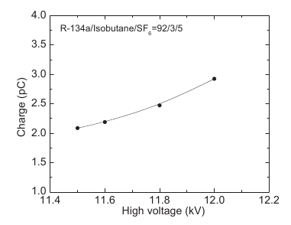
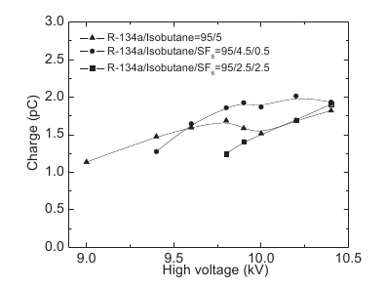
Induced Charge Measurements
Gas Mixtures:
TFE + Isobutane (95:5))
TFE + Isobutane +SF6 (95:4.5:0.5, 95:2.5:2.5, 92:3:5)
Measured charge in avalanche mode of operation of silicone coated RPC
Ph. D. Thesis, S. Biswas

Slide 6
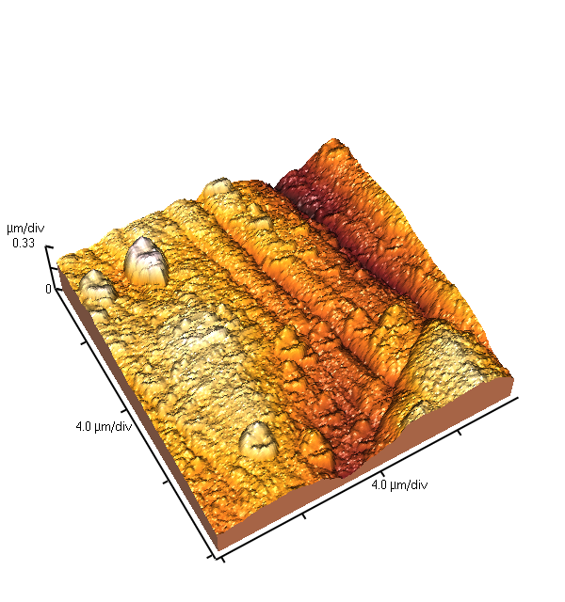
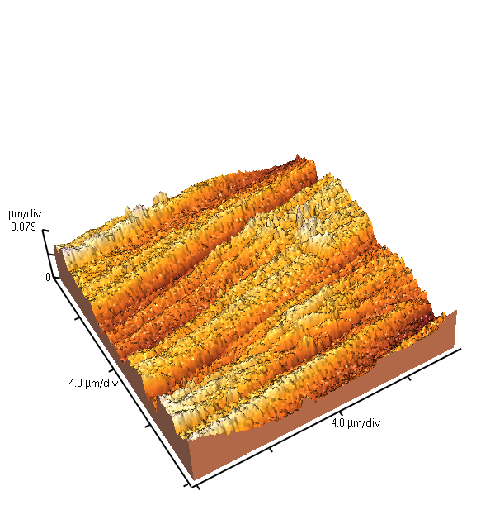
AFM Images and Analysis of Bakelite Surfaces
2 mm thick
S. Biswas et al., RPC2010
1.6 mm thick (Smoother surface)
This material was selected for most of the RPC fabrication

Slide 7
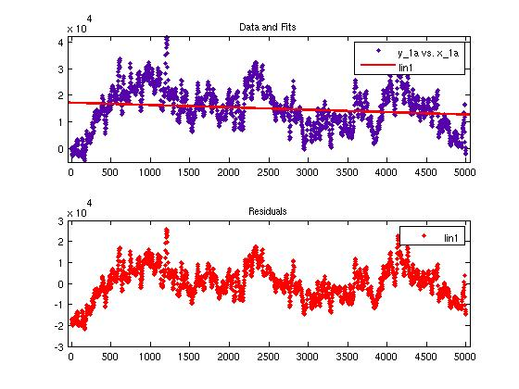
Estimation of Surface Roughness
Least square fitting of profilometer data and plot of residuals
S. Biswas et al., RPC2010
7
Notes:
7

Slide 8
Modeling of Surface Asperities
Electric field configuration inside the gas gap and in close proximity to a square pillar of height 4 micron and base 100x100 micron²
Voltage: 9kV
Analytic field: 29.67 kV/cm

Slide 9
Modeling of Surface Asperities
Electric field configuration inside the gas gap and in close proximity to a cone-shaped asperity of height 4 micron and base 100x100 micron²
Voltage: 9kV
Analytic field: 29.67 kV/cm

Slide 10
Transport Properties
TFE + Isobutane mixture (95:5)
Operating voltage: 8.9 kV – 10.39 kV
Analytic Field: ~ 29.34 – 34.26 kV/cm
Operating region
Amplification by a few tens of electrons accompanied by negligible attachment !!

Slide 11
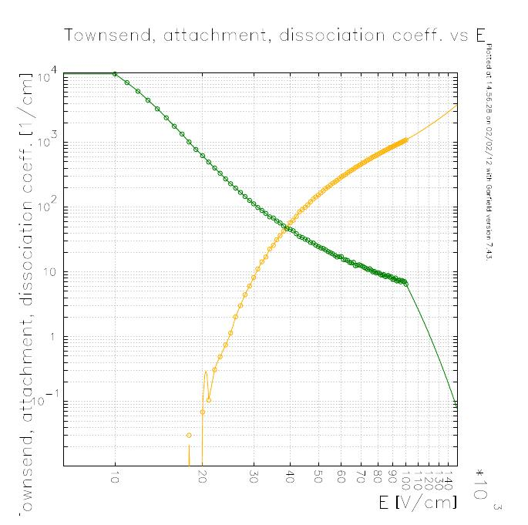
Transport Properties
TFE + Isobutane + SF6 (95:4.5:0.5)
Operating voltage: 8.91 – 10.39 kV
Analytic field: 29.37 – 34.56 kV/cm
Operating region
Amplification by a few tens of electrons accompanied by a few hundreds of attachment !!

Slide 12
Electron Avalanche
Avalanche of an electron released at the centre
Operating voltage 9.86 kV
Gas: TFE + Isobutane (95:5)

Slide 13
Electron Avalanche
Avalanche of an electron released at the centre
Operating voltage: 12 kV
Gas: TFE + Isobutane (95:5)

Slide 14
Effect of Surface Asperity
Simulated electric field with 12 kV potential applied to the RPC
With a cone shaped asperity on Bakelite
With silicone-treated
Bakelite
A sharp rise in the field near asperity which can alter the induced charge or signal. Surface treatment removes the spike and the field is larger throughout!!

Slide 15
Effect of Surface Asperity
Simulated induced current with 12 kV potential applied to the RPC
With a cone shaped asperity on Bakelite
With silicone-treated
Bakelite
Larger signal is induced in surface treated Bakelite which follows the field configuration.

Slide 16
Concluding Remarks
The present simulation in general seems to under-predict the induced signal in Bakelite RPC in comparison to the measurements.
Possible reasons for the disagreement of the simulation with experiment may be: i) improper field simulation ii) underestimated transport properties, iii) experimental uncertainties.
Field has been simulated by neBEM V1.8.7 which produced field values in agreement with analytical ones. However, more accurate configuration can be achieved by introducing more precise geometrical and physical parameters.
The transport properties of TFE based mixtures may require some attention since Magboltz 8.9.3 indicates very low amplification in the relevant parameter space.
Experimentally, there can be uncertainties arising in the geometrical parameters, as well as electrical permittivity of various dielectric media.
The presence of surface asperities has been found to significantly distort the otherwise uniform field configuration depending on their shape and amplitude.
The distorted field can be responsible for localized large currents following larger amplification.
Present calculation shows slightly larger induced current in surface-treated RPC in comparison to that without surface treatment
Further detailed investigation is underway.

