Slide 1
Innovative calorimeters with optical readout
Crystal detectors (Sub-task 8.3.1):
Results from beam tests of fast crystals and nanocomposite scintillators
Matthew Moulson, INFN Frascati
For the Frascati, Torino, Glass To Power groups
with contributions from Ferrara, Napoli, Insubria, and CERN
AIDAinnova WP8 Face-to-Face Meeting
18 January 2024

Slide 2
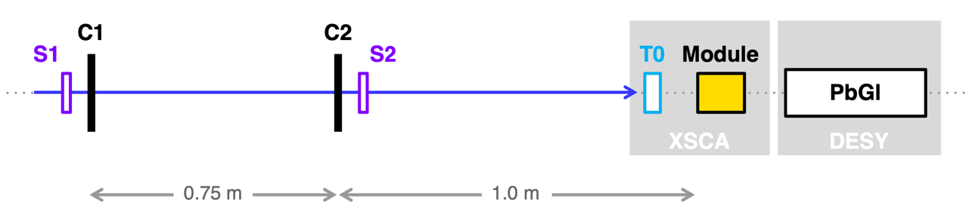
Beam tests and measurement program
Setup:
S1, S2 Trigger scintillators
C1, C2 Si-strip trackers, 10×10 cm², σ = 50 μm
T0 Timing reference, σ_{t} = 25-50 ps
Module Device under test, with goniometer
PbGl Lead-glass calorimeter
Facilities and beams:
Topics to investigate:
SPS H2 e⁻, mips, 20-150 GeV
PS T9 e⁻, mips, 1-10 GeV
Frascati BTF e⁻, 450 MeV
Crystals for fast, compact calorimeters (WP8.3.1)
Nanocomposite scintillators for calorimetry (WP8.3.1 + 13.5)

Slide 3
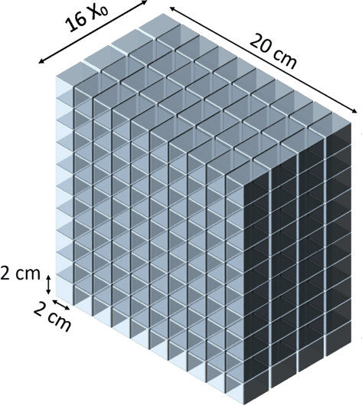
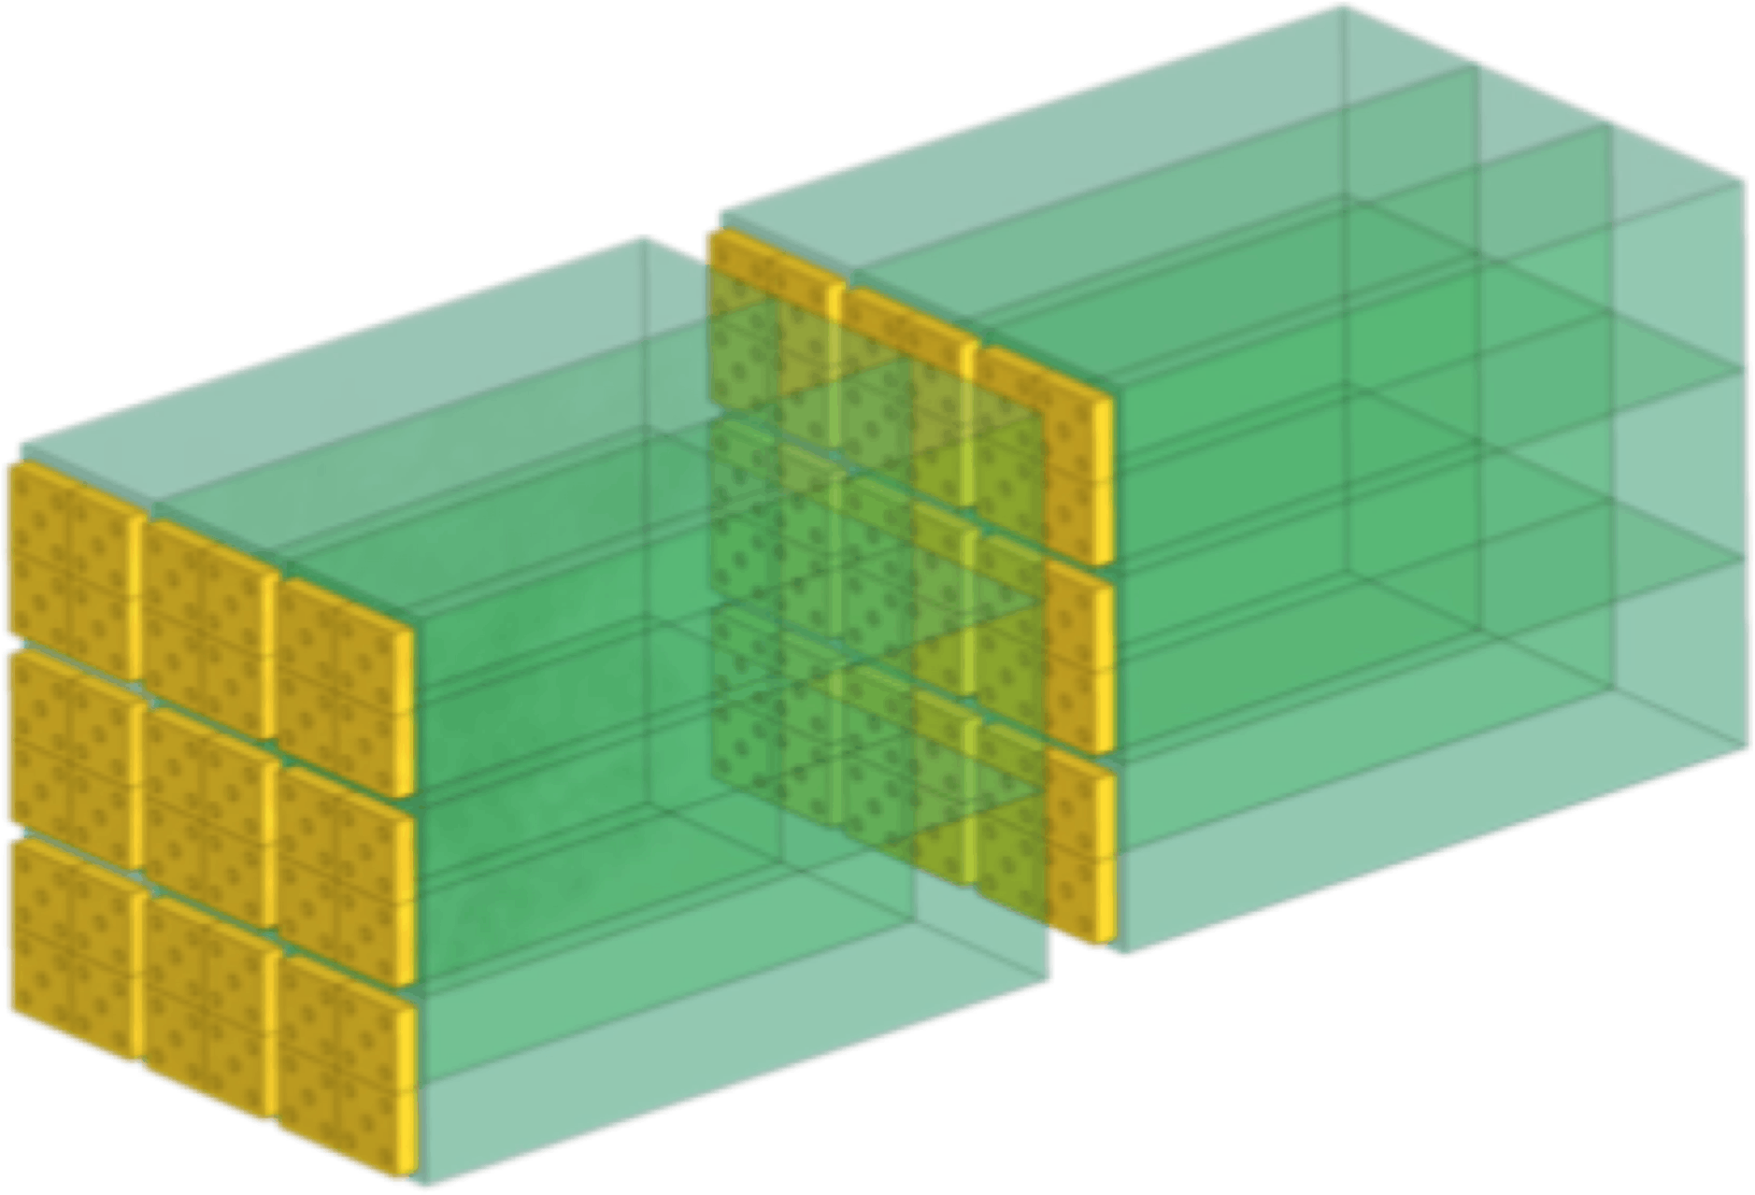
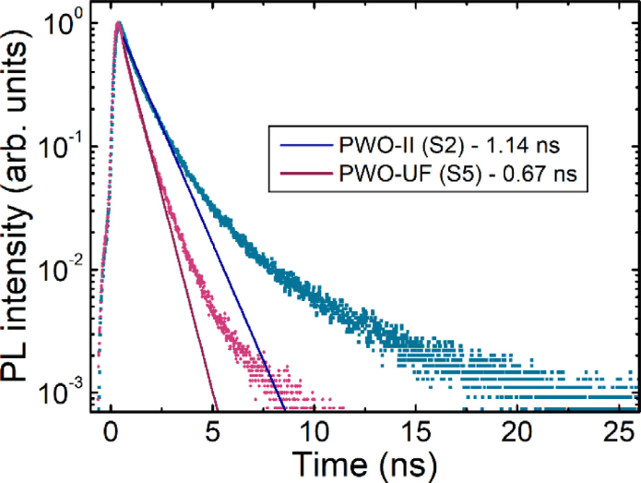
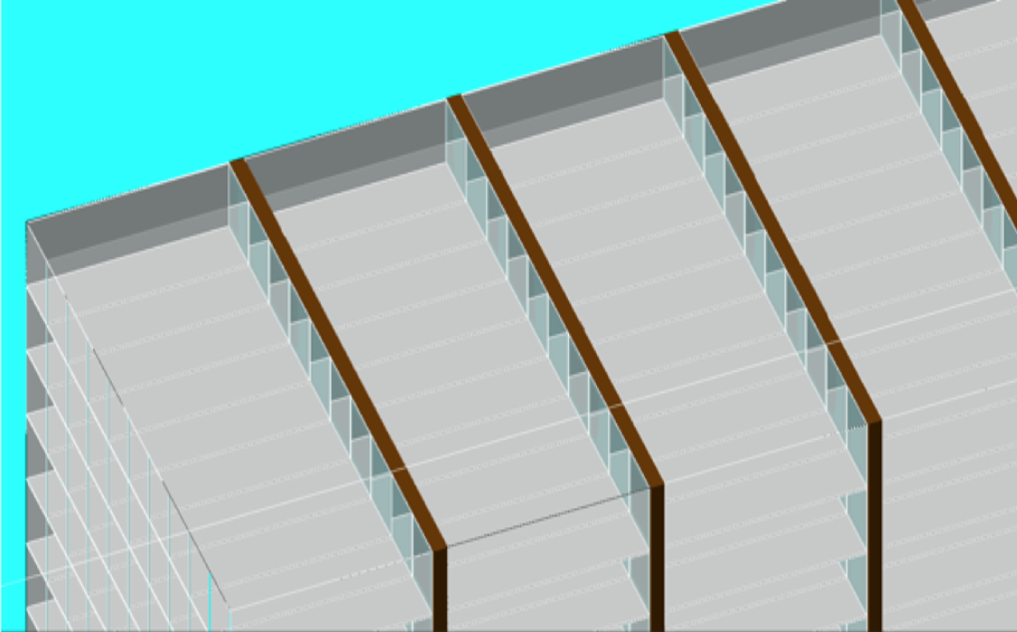
Fast, compact crystal calorimetry
R&D for future experiments to develop new concepts for crystal calorimeters
    Cerenkov radiators like PbF₂ or ultra-fast scintillators such as PWO-UF
  Transverse and longitudinal segmentation for γ/n discrimination
  Exploit coherent interactions in crystals to reduce thickness?
HIKE small-angle calorimeter
4 layers
40x20x20 mm³
CRILIN calorimeter for muon collider
arXiv:2206.05838
5 layers
40x10x10 mm³
PWO-UF (ultra-fast):
Dominant emission with τ < 0.7 ns
M. Korzhik et al., NIMA 1034 (2022) 166781

Slide 4
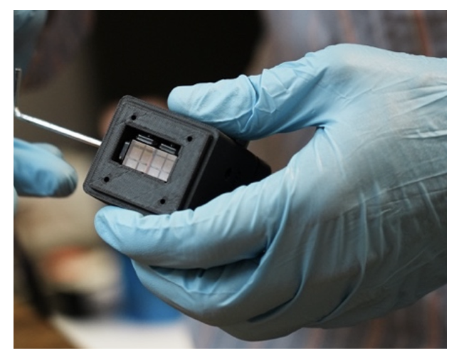
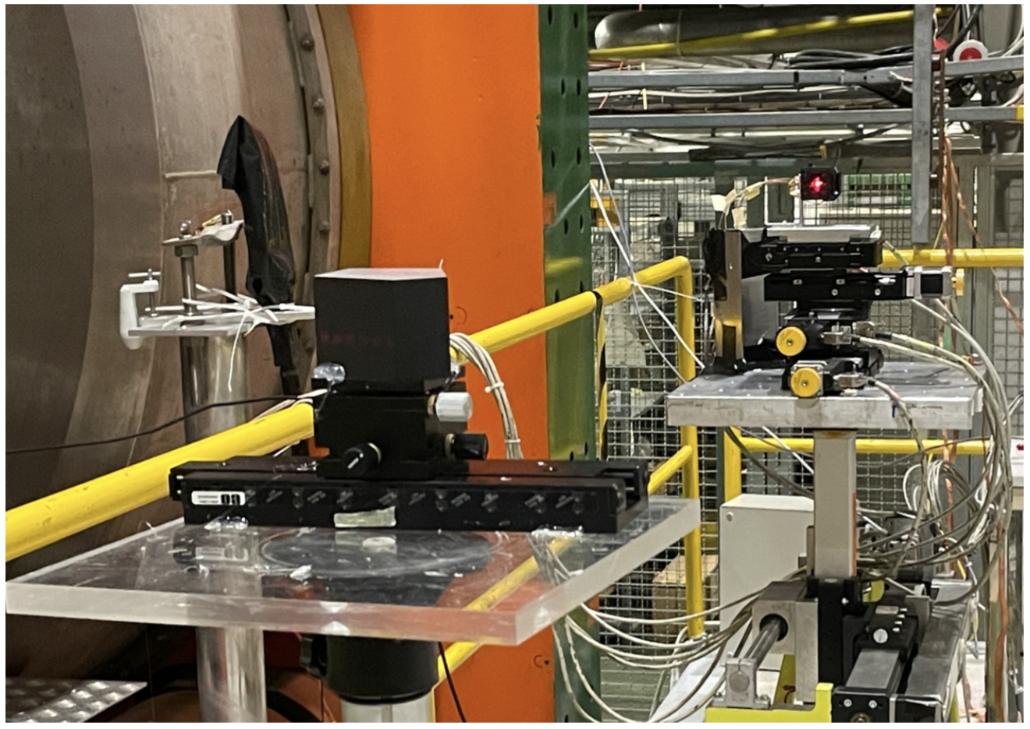
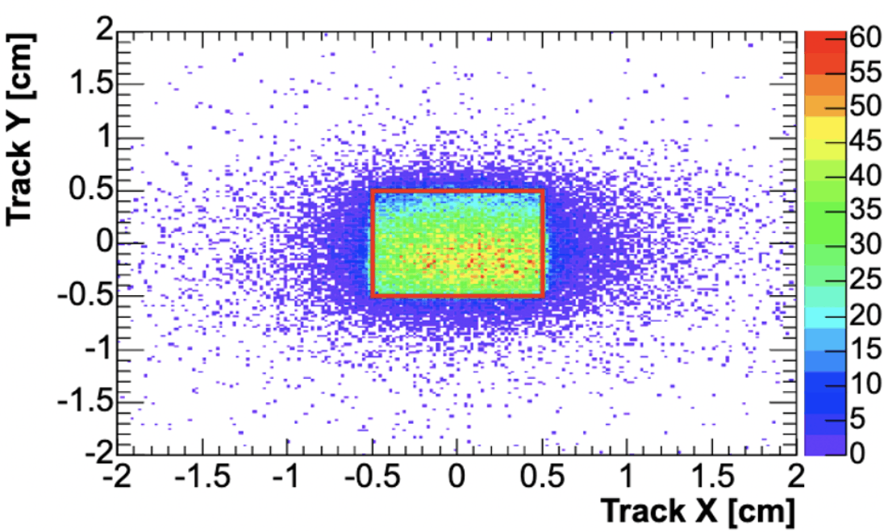
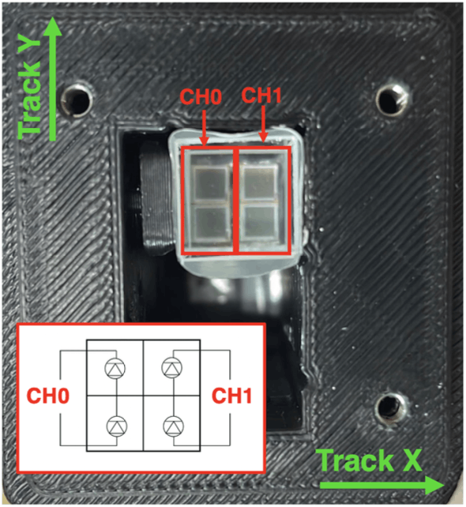
Tests with single crystals in 2022
Sept/Oct 2022 run at SPS H2 beamline:
20-120 GeV e− and MIPs (150 GeV π)
Validate CRILIN readout electronics
Study systematics of light transport in small crystals with high n
Measure time resolution achievable for PbF₂ and PWO-UF
CRILIN 2-crystal module
SiPM readout scheme
Beam image from Si-strip tracker with condition on signal from crystal
Positioning of module on beamline

Slide 5
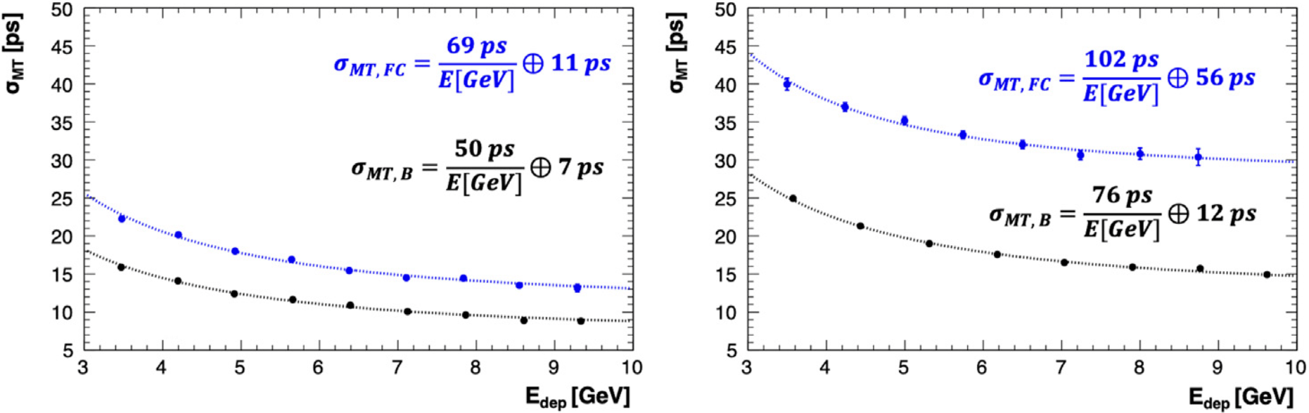
Time resolution for single crystals
PbF₂
PWO-UF
Front. Phys 11 (2023) 1223183
Conclusions:
Effects of light transport degrade timing resolution for frontal incidence, despite higher light yield
PbF₂ provides better time resolution due to pure Cerenkov emission, even with 50% light yield of PWO-UF
Both single crystals give σ_{t} < 30 ps for E_{dep} > 3 GeV!
σ_{MT} = σ(t_{ch0} – t_{ch1})/2
FC Beam incident from front
BC Beam incident from back
(SiPM side)

Slide 6
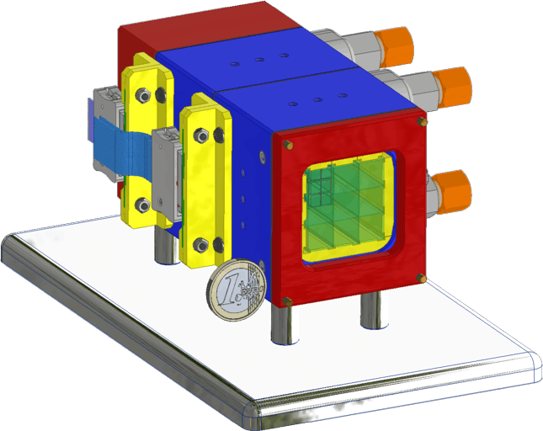
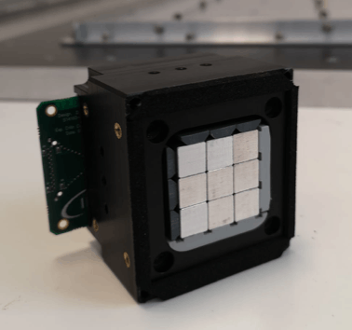
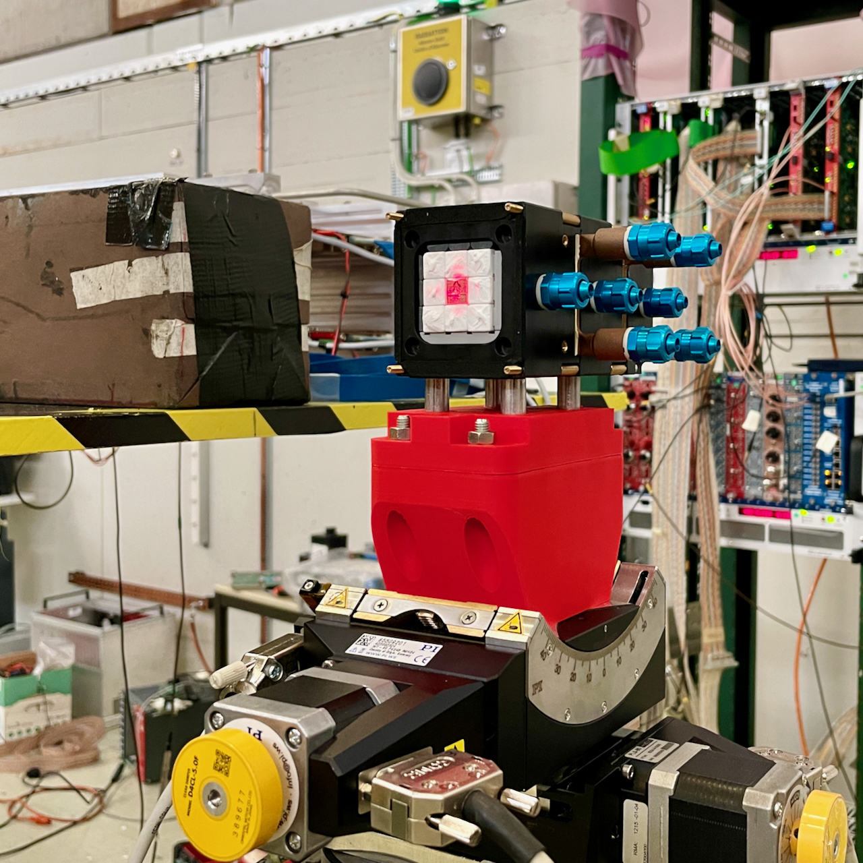
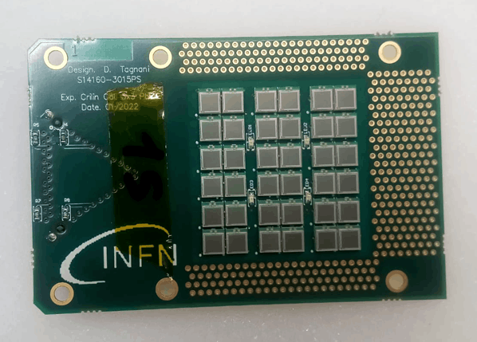
Tests of CRILIN prototype in 2023
From single crystals to first calorimeter prototype:
New prototype with two 3x3 CRILIN test layers
Load layers with different crystals: PbF₂, PWO-UF
  Different surface treatments to damp internal reflections
Test objectives:
Perform complete operational test
Test cluster reconstruction capability
Conceptual test of longitudinal segmentation
Study angular effects: align beam with central crystal
Test beam runs in 2023:
June: Commissioning
1-4 GeV e⁻, mips in T9
450 MeV e⁻ at BTF
Aug: Data taking
20-120 GeV e⁻ in H2
Oct: Alignment studies
4 GeV e⁻ in T9

Slide 7
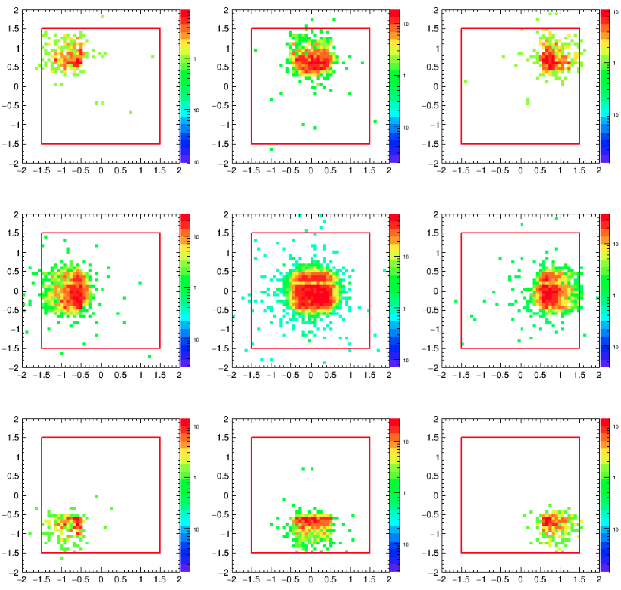
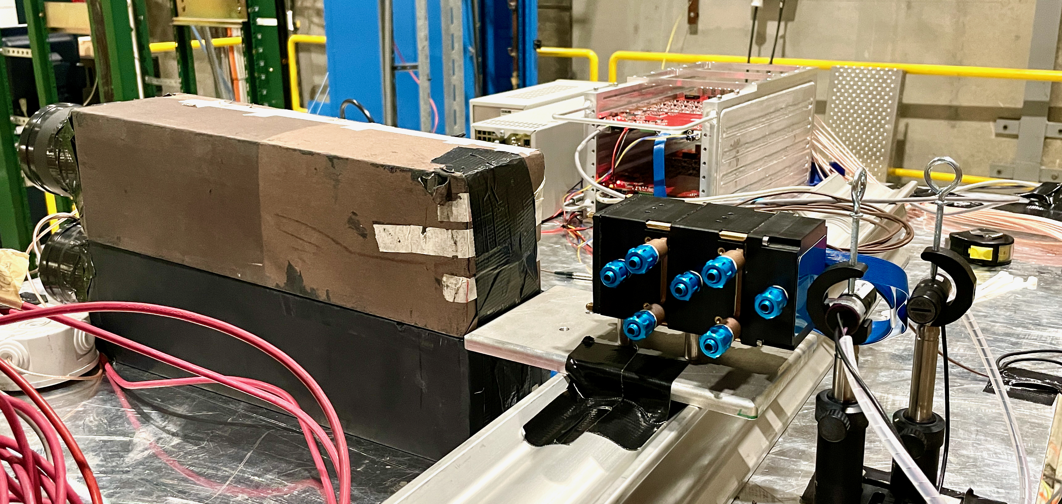
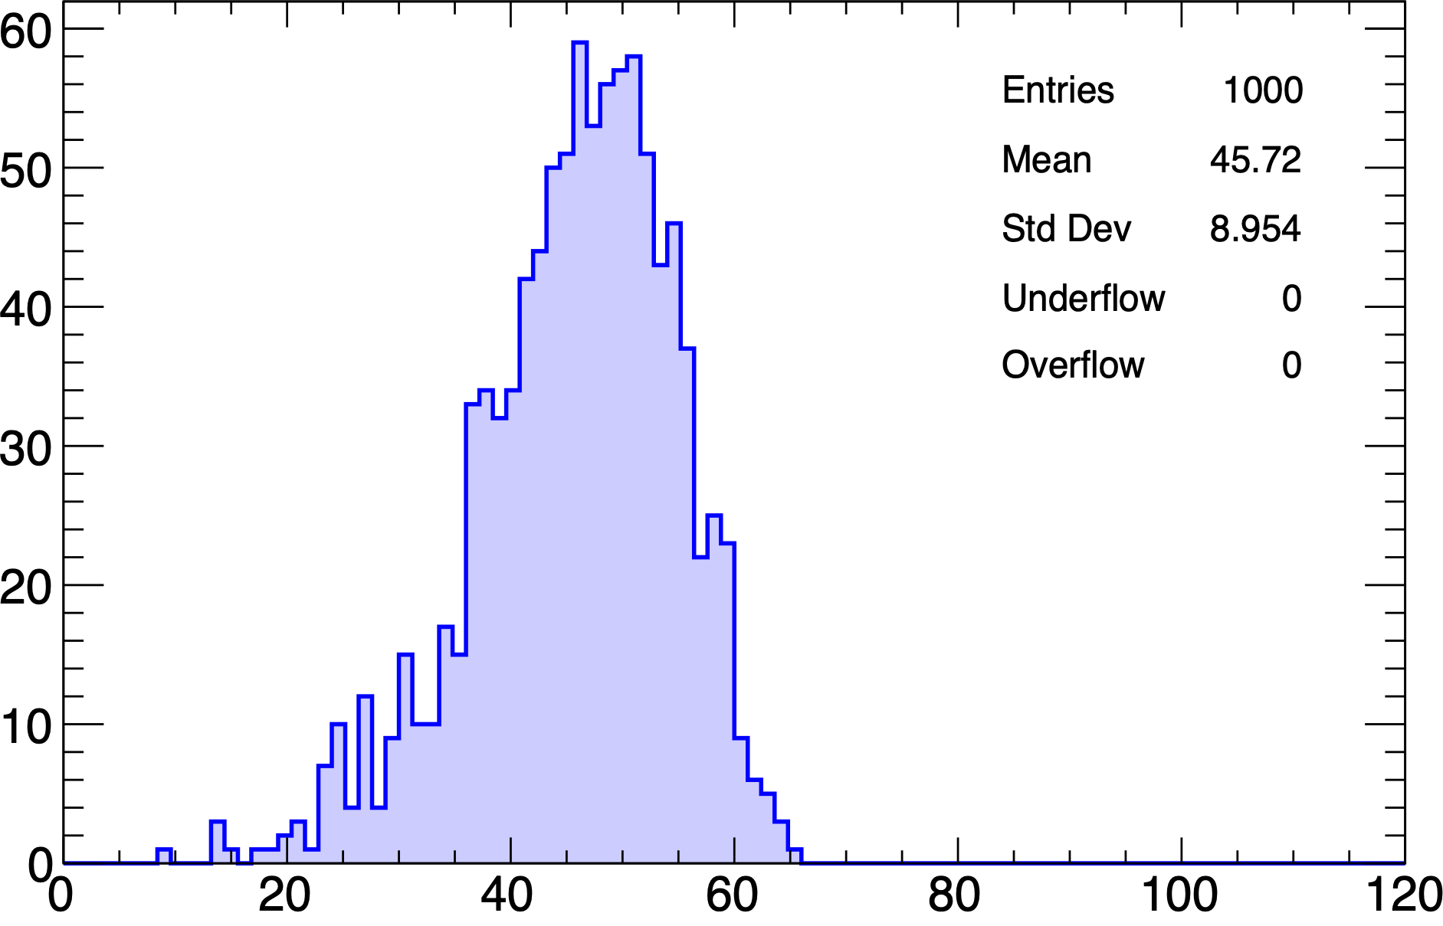
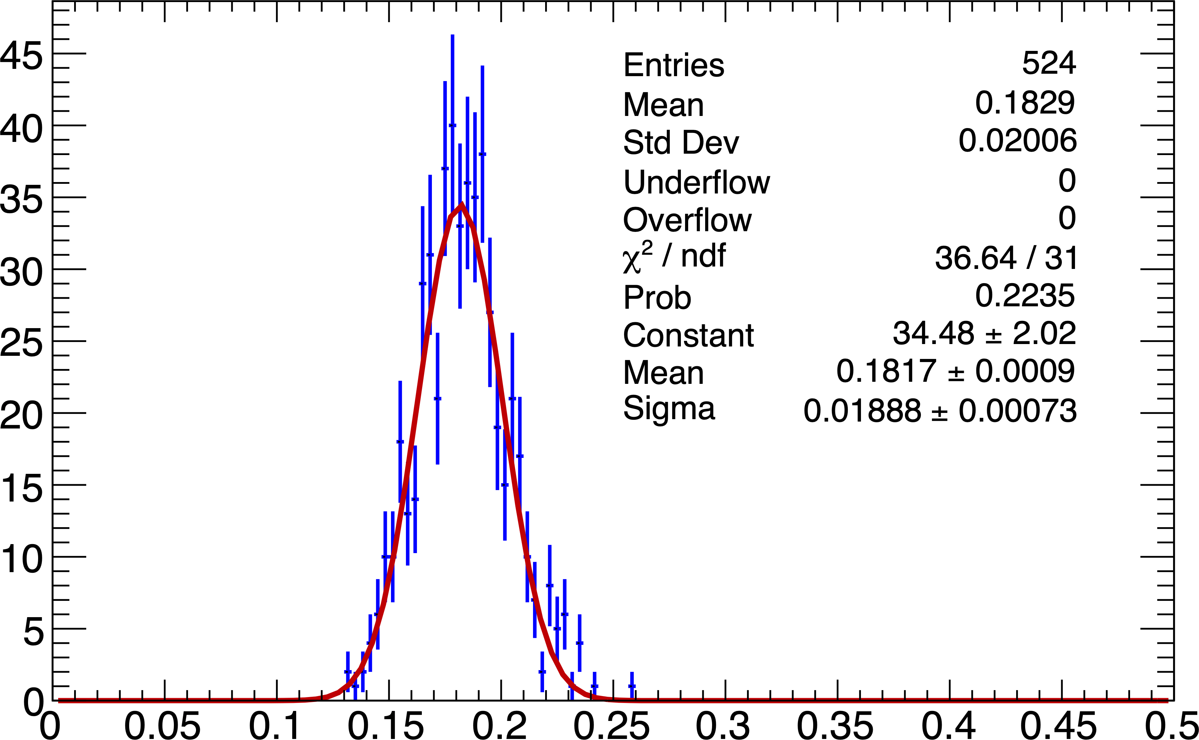
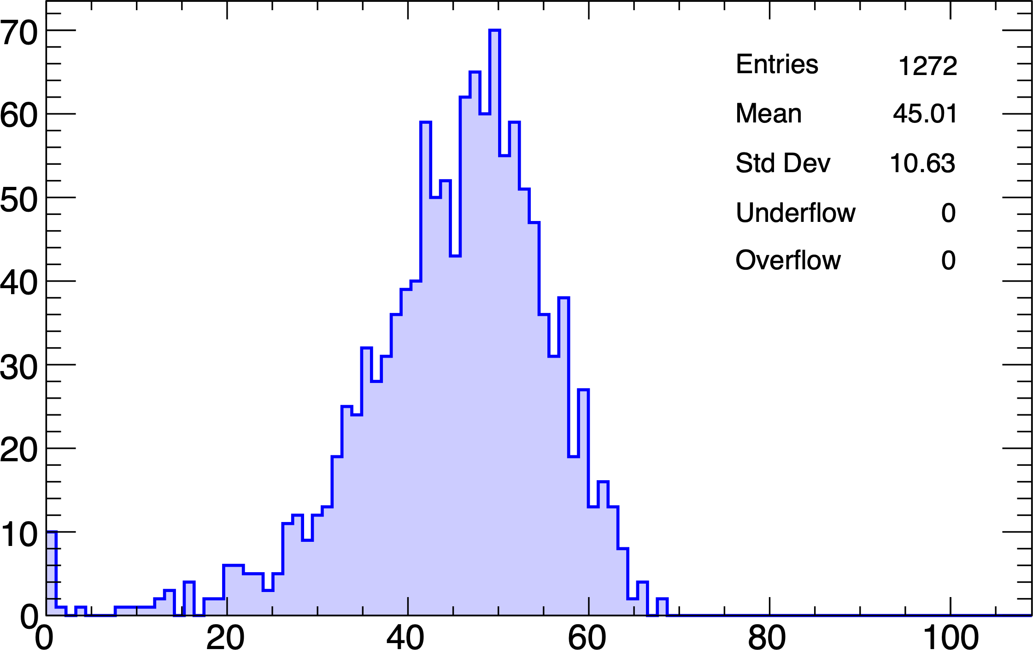
CRILIN results
Tracking data with cuts on each crystal
H2 beamline, Aug 2023
Total energy
MC 120 GeV e⁻
Total energy
Data 120 GeV e⁻
Central crystal layer 1
σ_{t} = 9 ps!

Slide 8
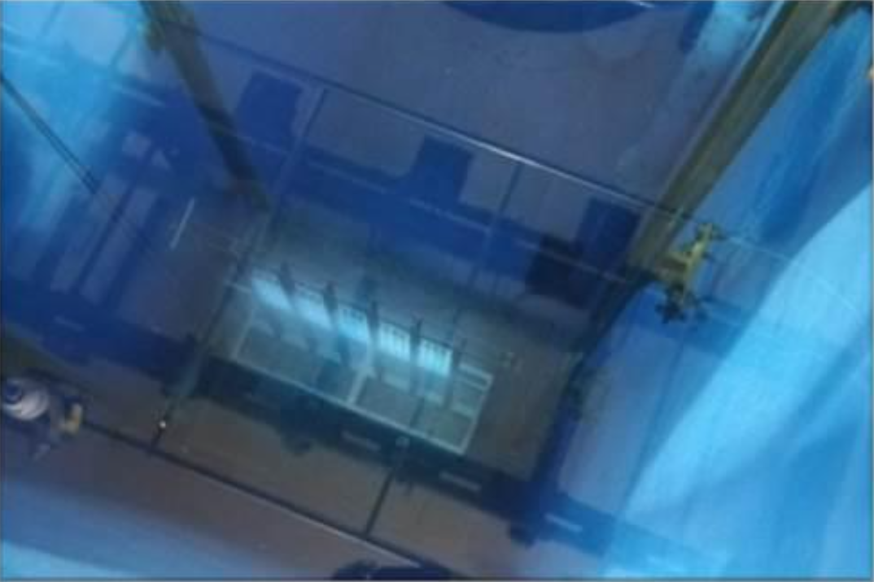

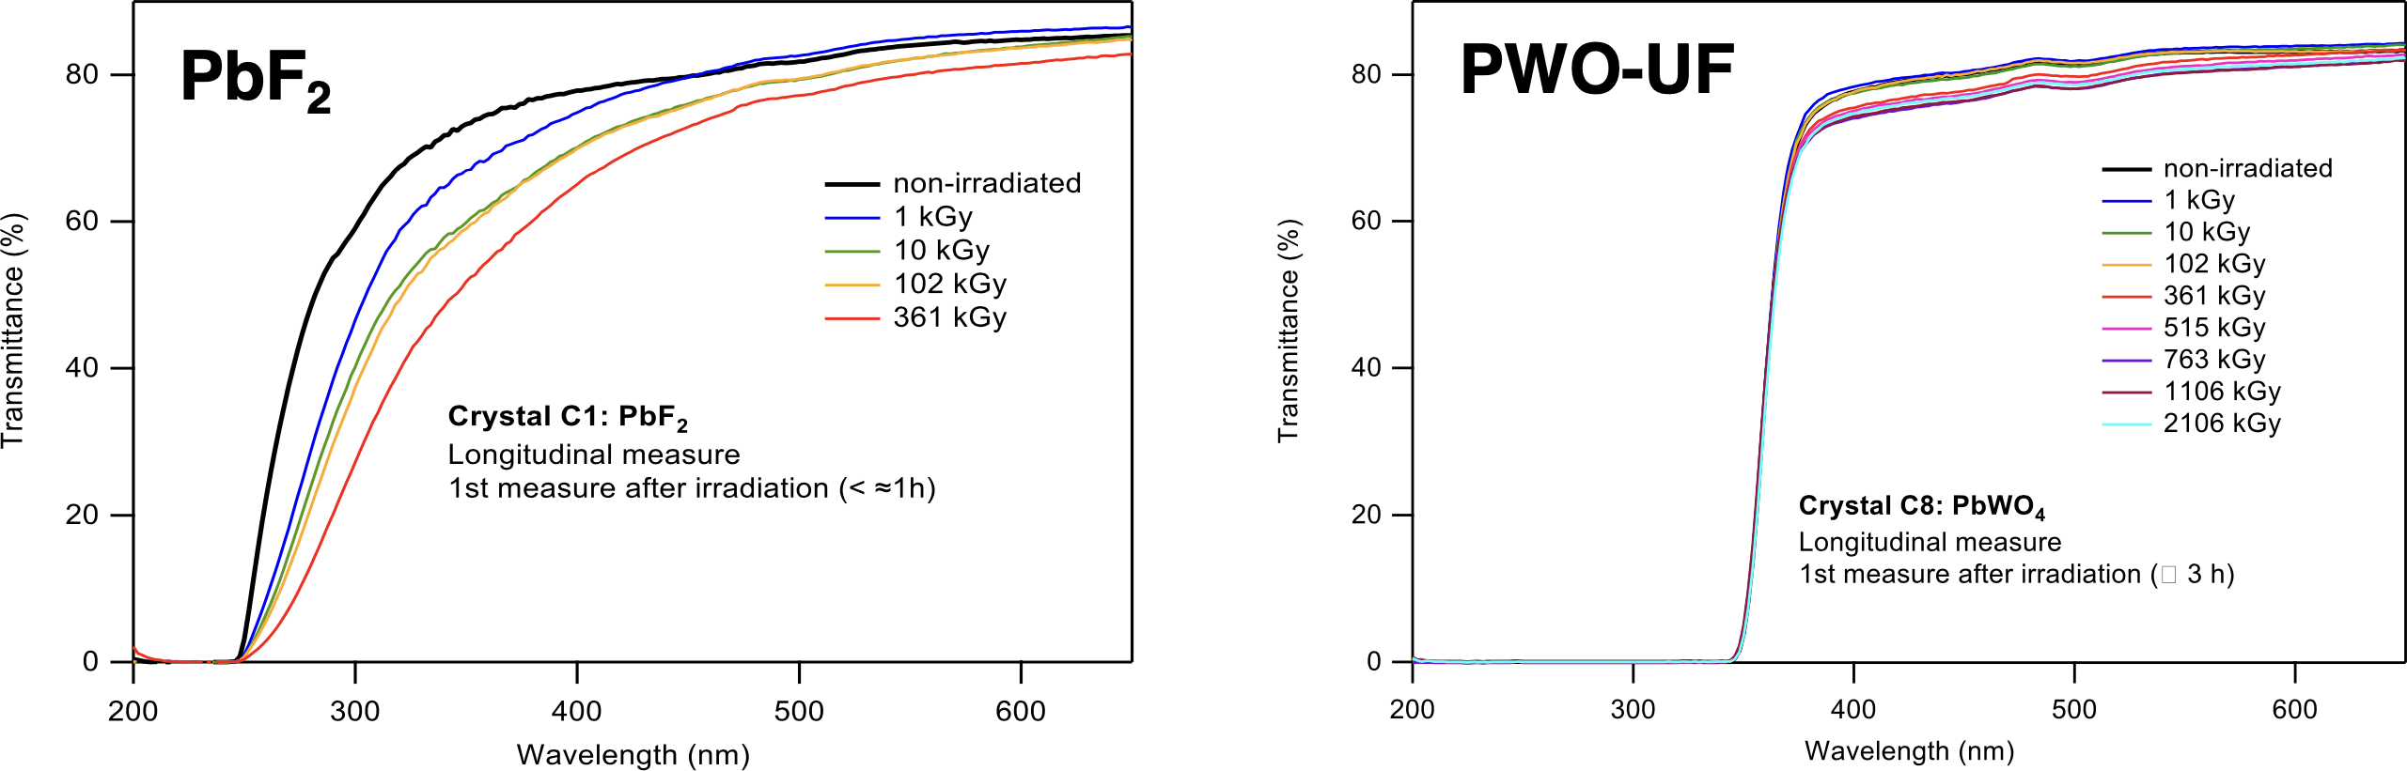
Radiation resistance of crystals
⁶⁰Co γ irradiation at Calliope, ENEA Casaccia, June 2023
Easy to accumulate MGy doses, full dosimetry support
Support with transmission, light yield, fluorescence spectrometry measurements
Preliminary results:
At 360 kGy ~ 20% transmission loss at λ = 400 nm
Substantial recovery after annealing several days in ambient light
At 2100 kGy ~ 5% transmission loss at λ = 400 nm
Only modest recovery after annealing several days in ambient light

Slide 9
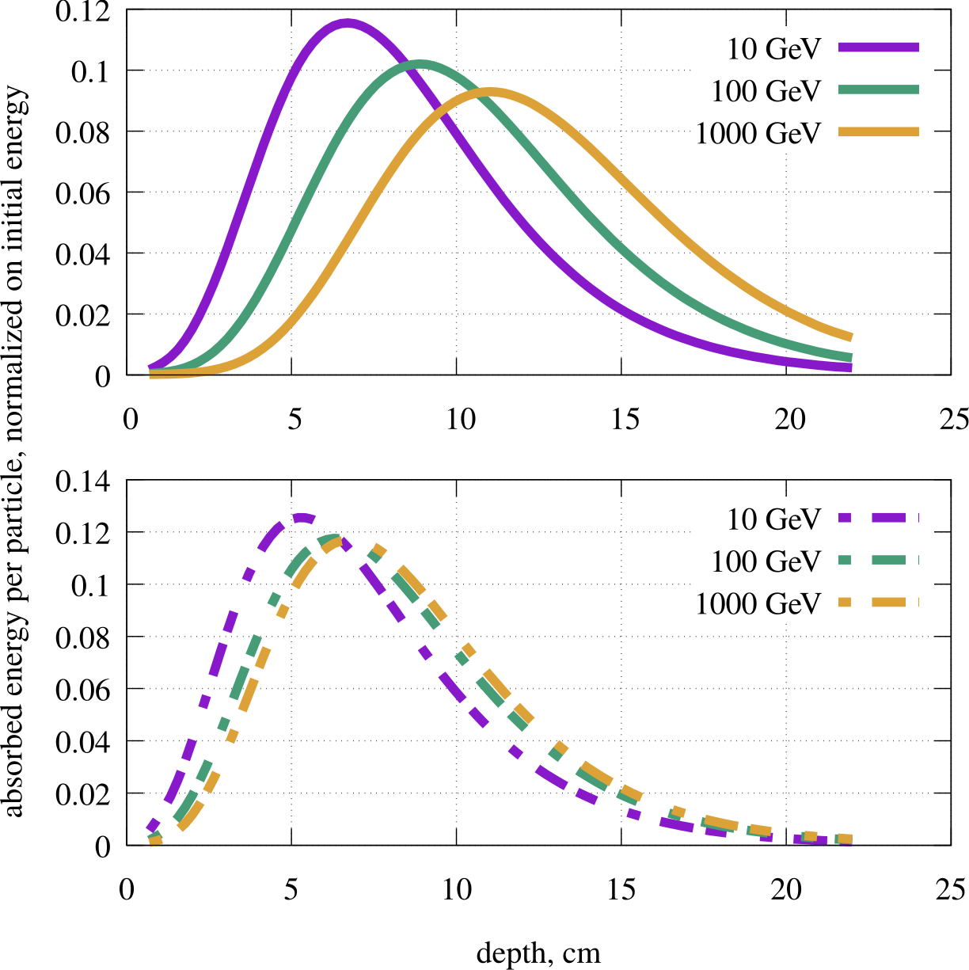
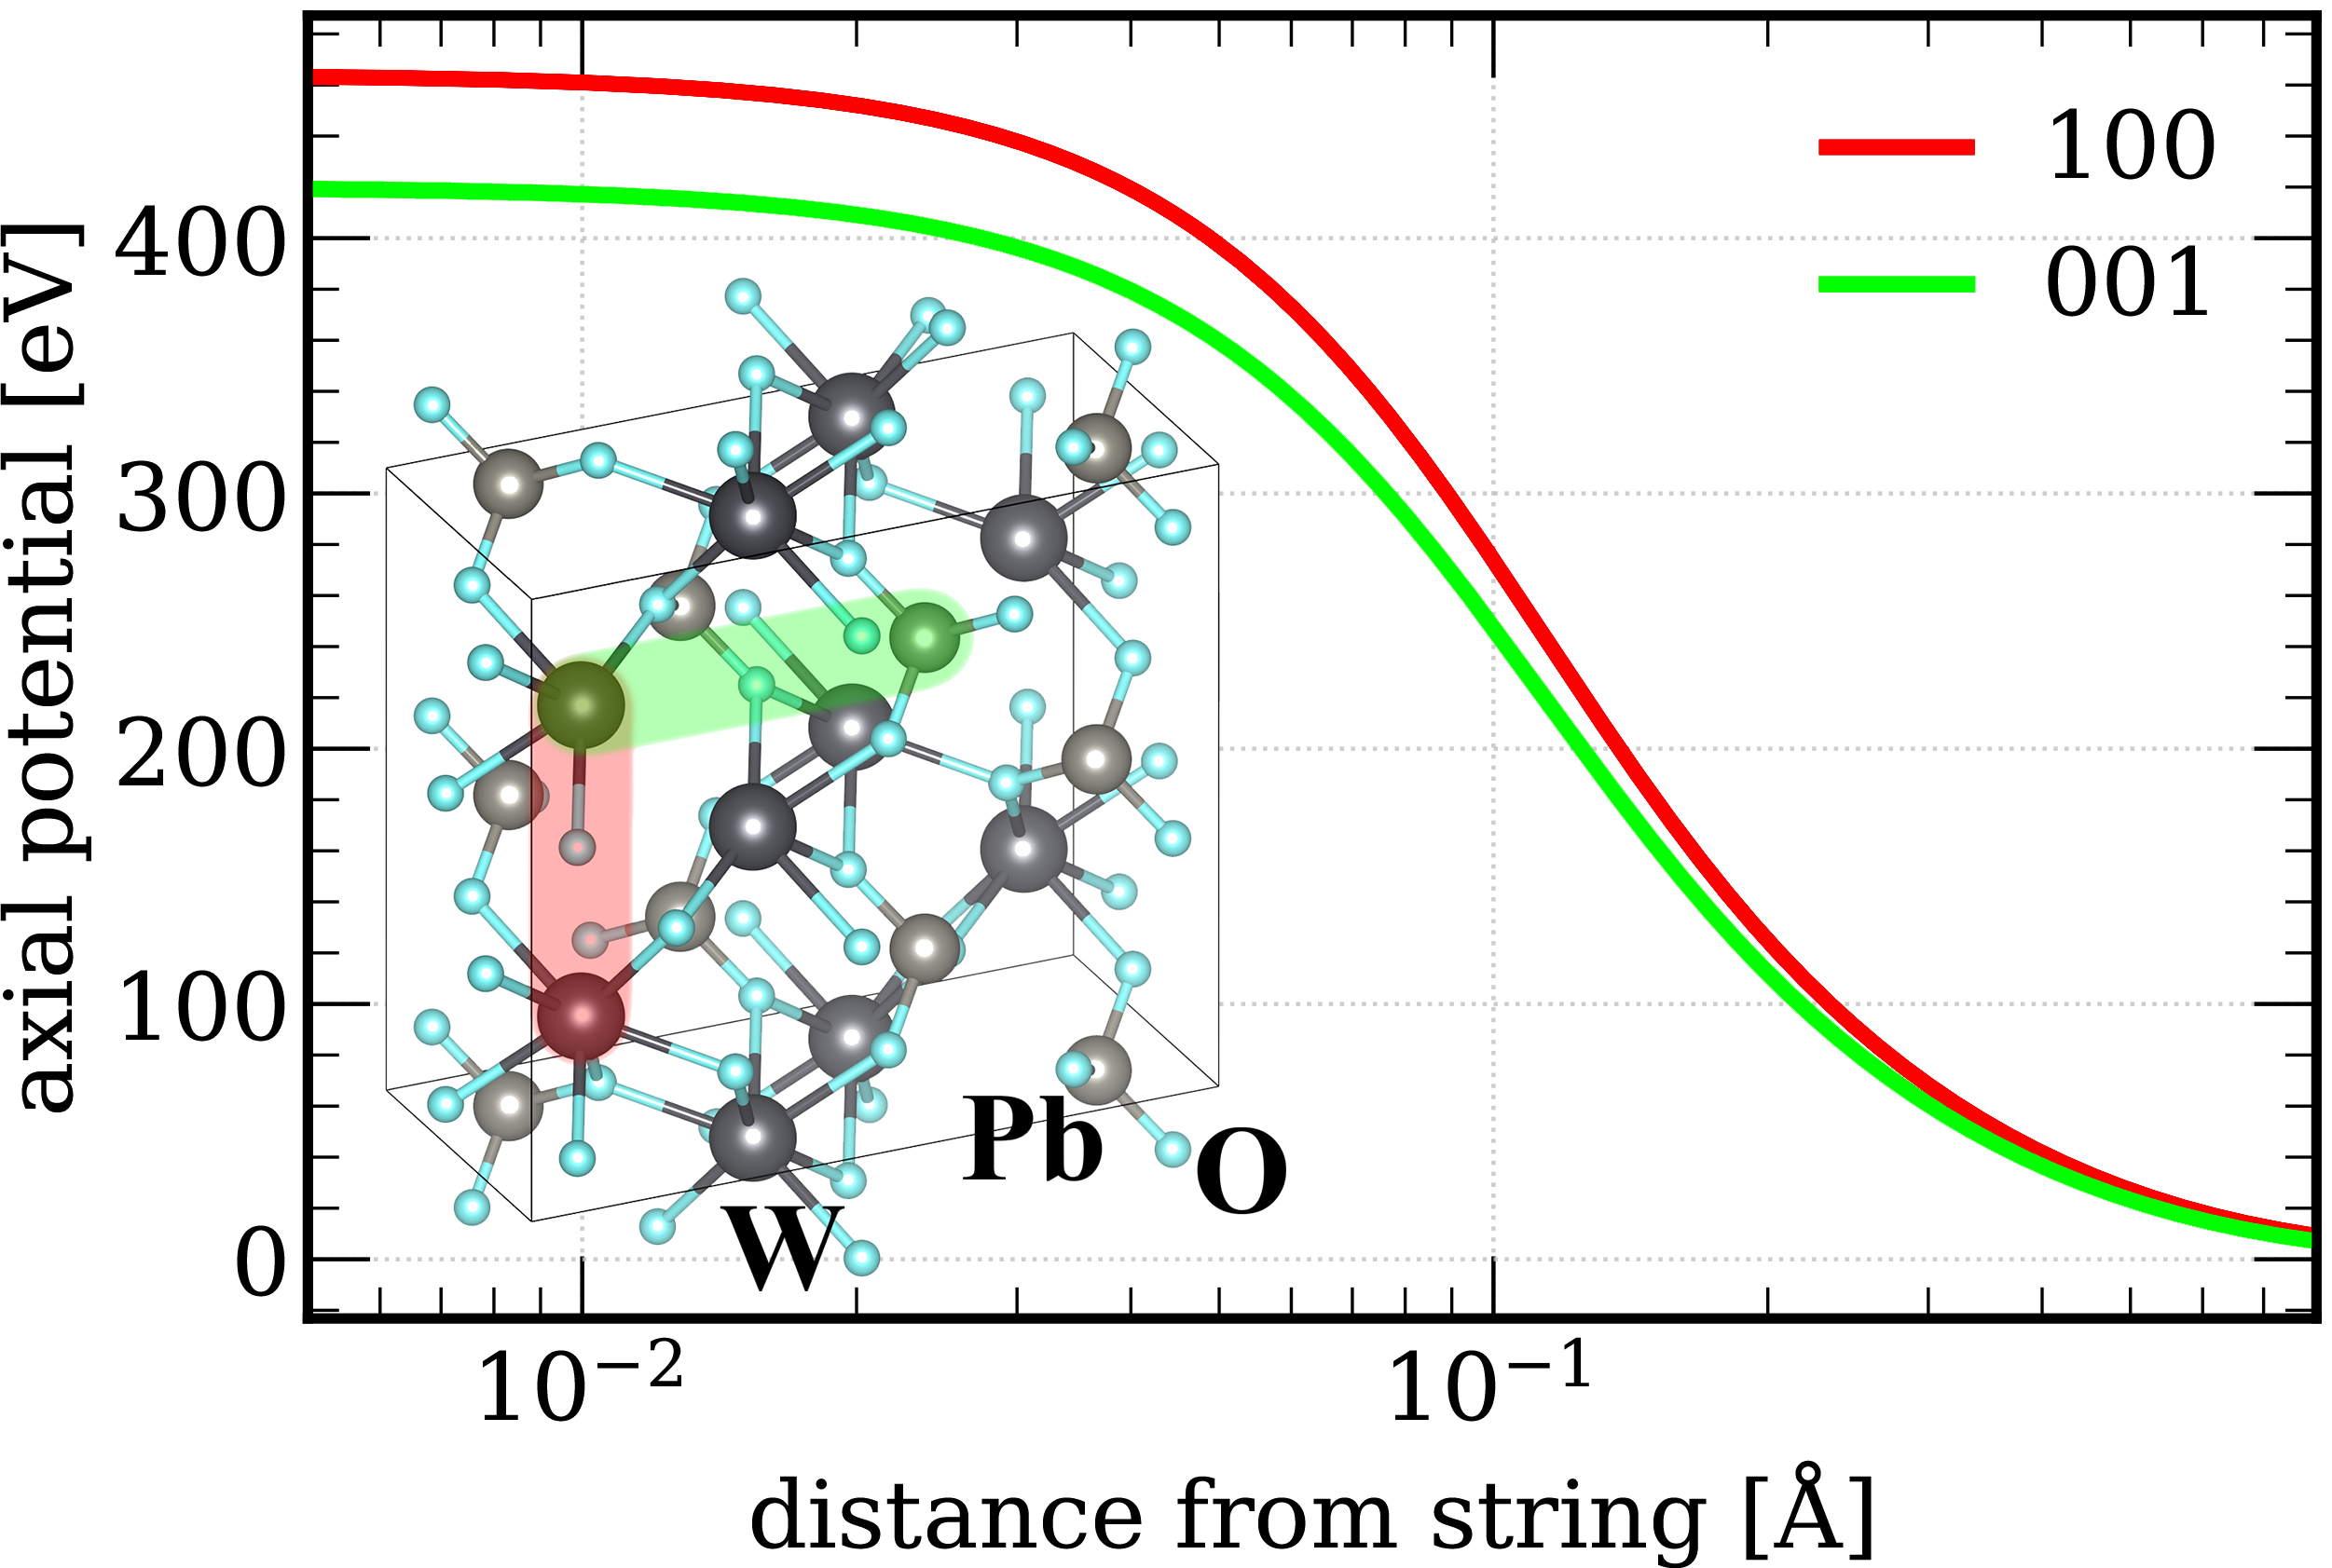
Coherent effects in crystals
Coherent effects increase cross-section for electromagnetic shower processes (bremsstrahlung, pair production)
Decrease effective value of X₀
Exploit coherent effects for calorimetry?
Geant4 simulation: e⁻ on PWO
Bandiera et al., NIMA 936 (2019)
Amorphous
Aligned
Coherent superposition of Coulomb fields
Electric field ε approx. const. ~ 10¹⁰-10¹² V/cm
Effective field ε′ = γ_{eff} (γ_{eff} = E/m_{e}c)
For ε′ ~ ε₀ = 2πm²c³/eh virtual pairs disassociate
Pair production enhanced by coherent effects at small θ_{γ} and high E_{γ}
Early initiation of EM showers
Minimize fluctuations of deposited energy vs depth

Slide 10
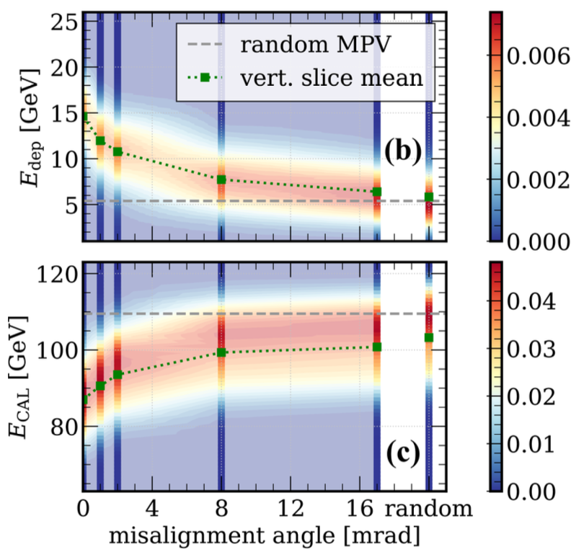
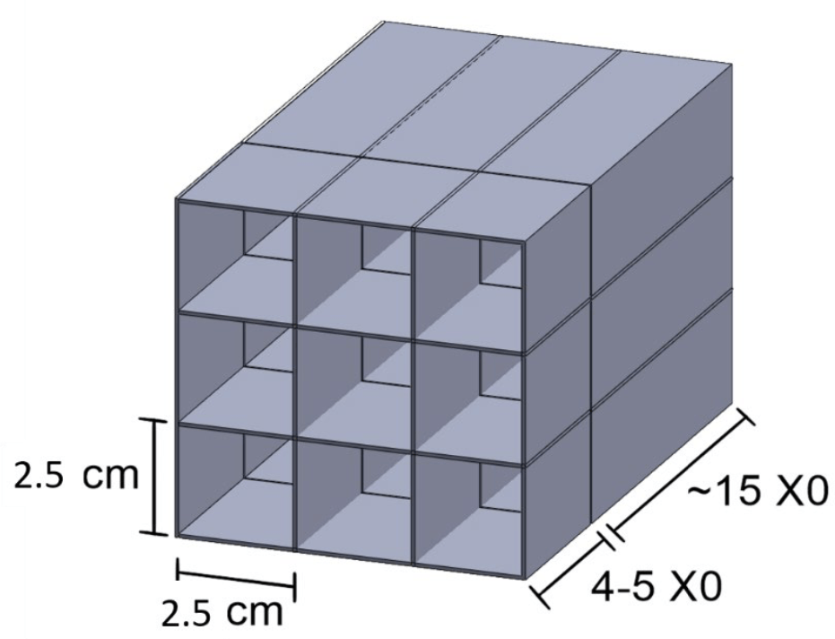
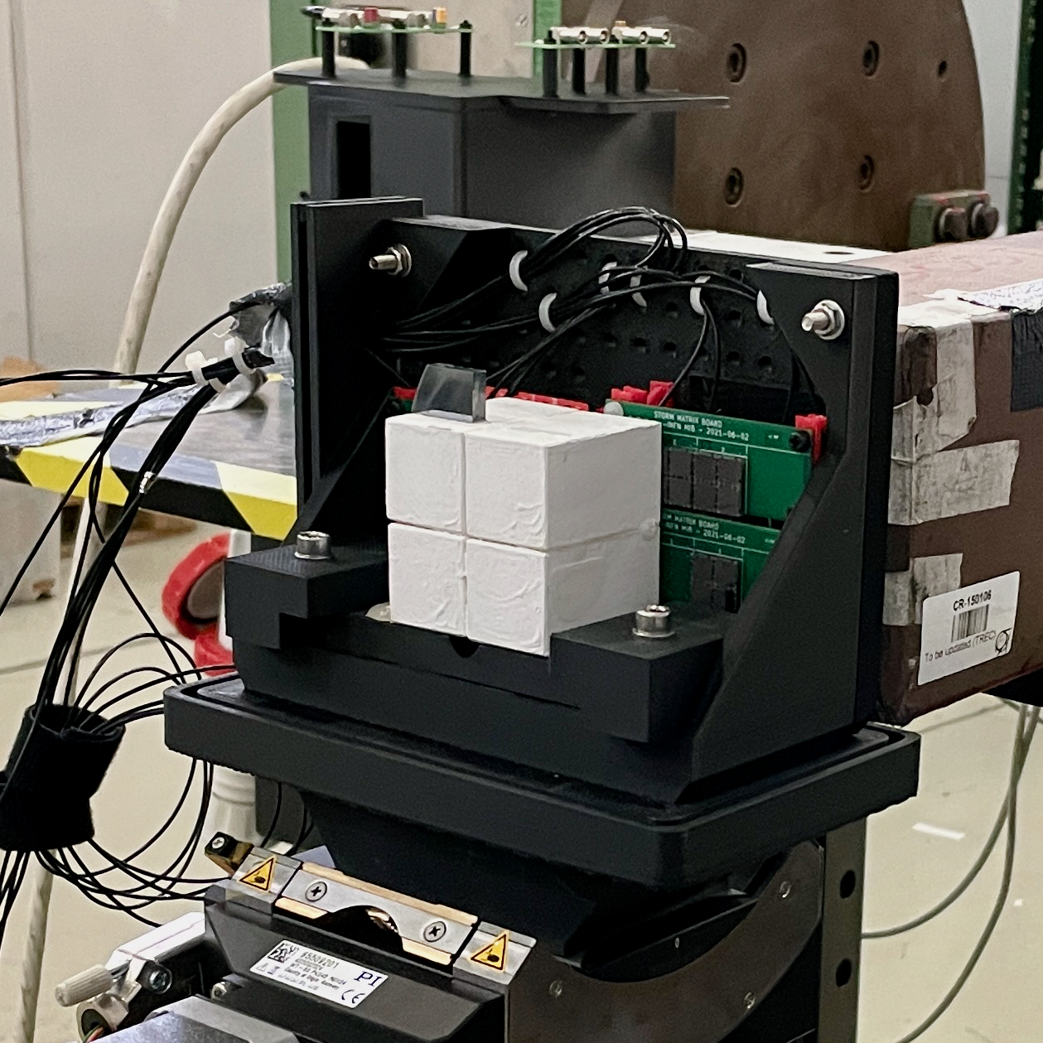
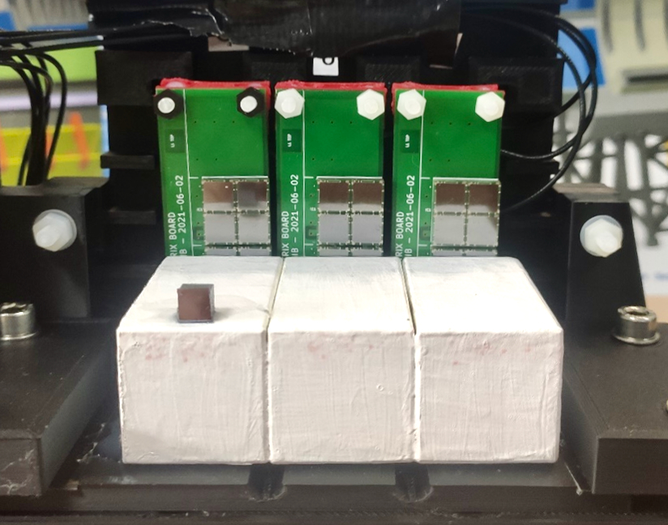
Calorimetry with aligned crystals
E deposited vs absorbed
120 GeV e⁻ on 4.6X₀ PWO
Exploit effects of coherent interactions in crystals to develop a highly compact calorimeter
Excellent response to photons
  Enhanced probability for γ conversion
High transparency to hadrons
γ/n discrimination
Aligned layer
STORM collab
In preparation
OREO prototype
OREO project for aligned PWO-UF crystal calorimeter
Developed techniques for crystal characterization, shaping, alignment and assembly
  Front. Phys, 11 (2023) 1254020
Obtained alignment of 1-dim and 2-dim matrices to ~ 0.2 mrad

Slide 11
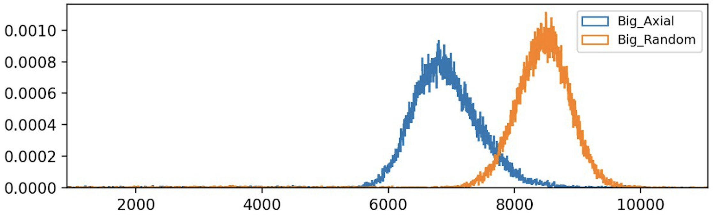
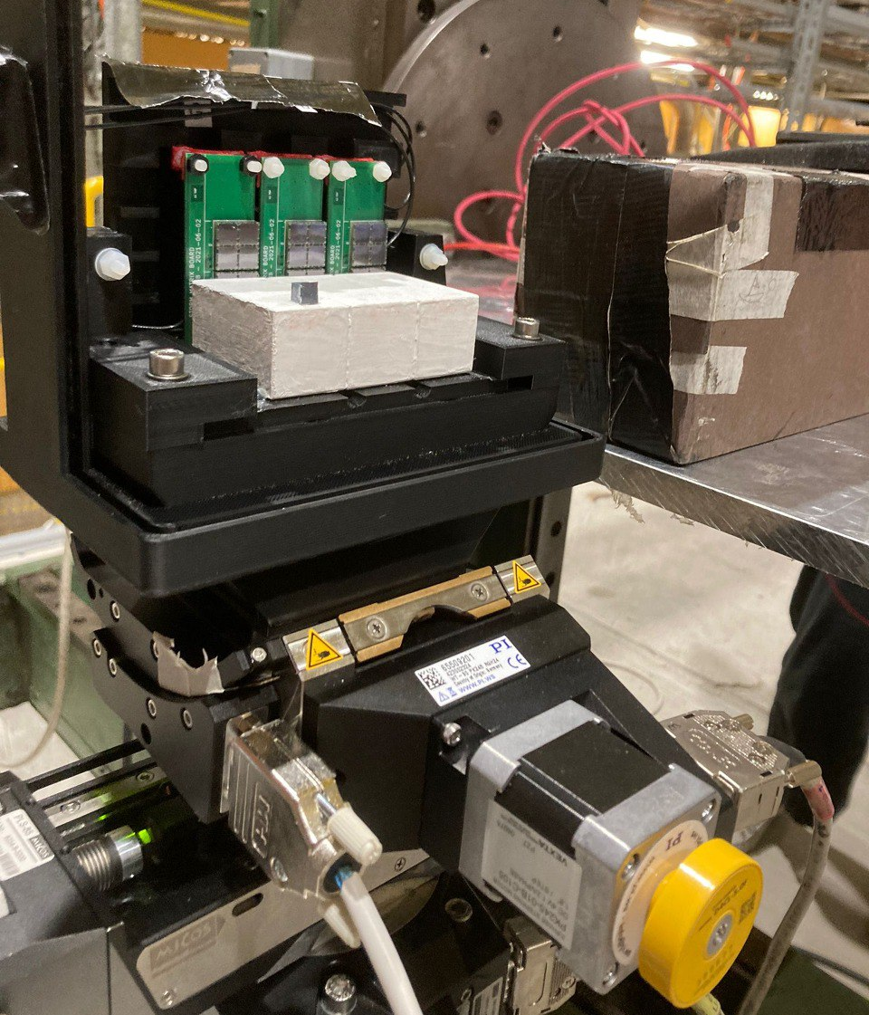
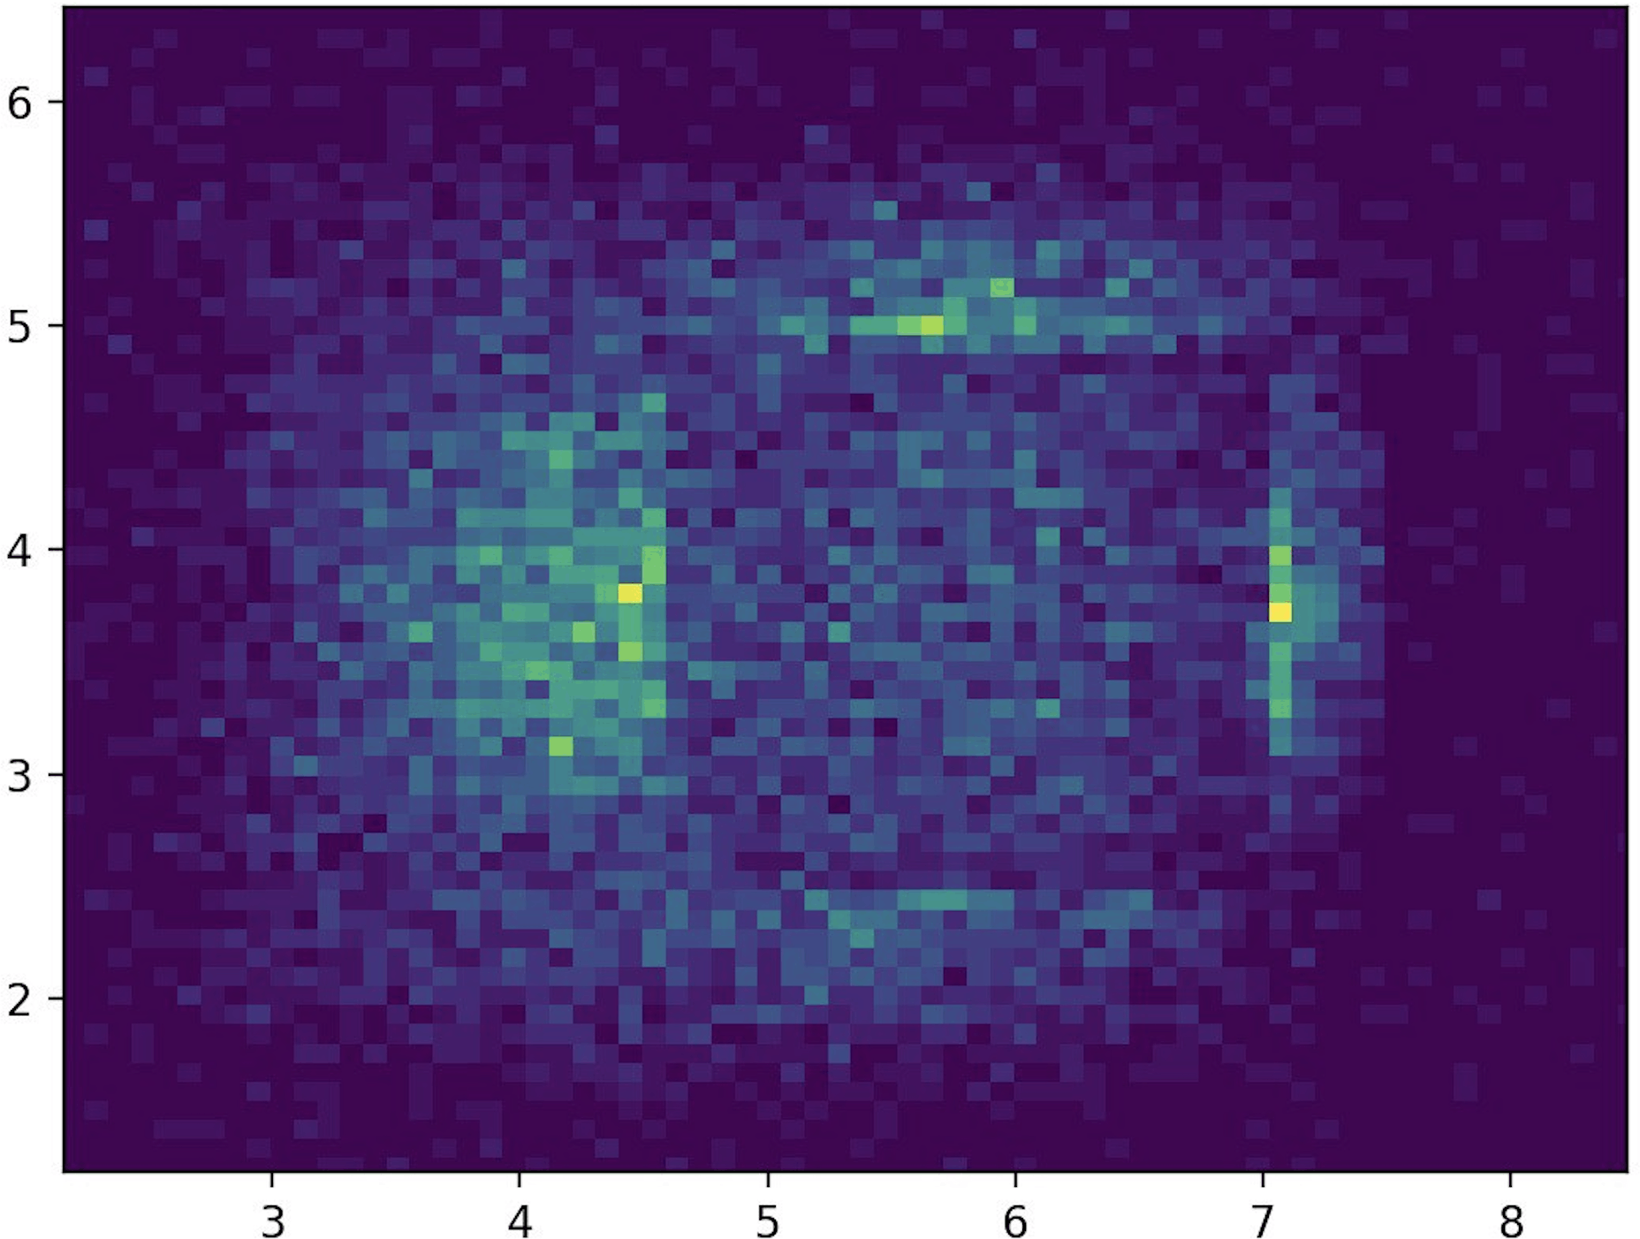
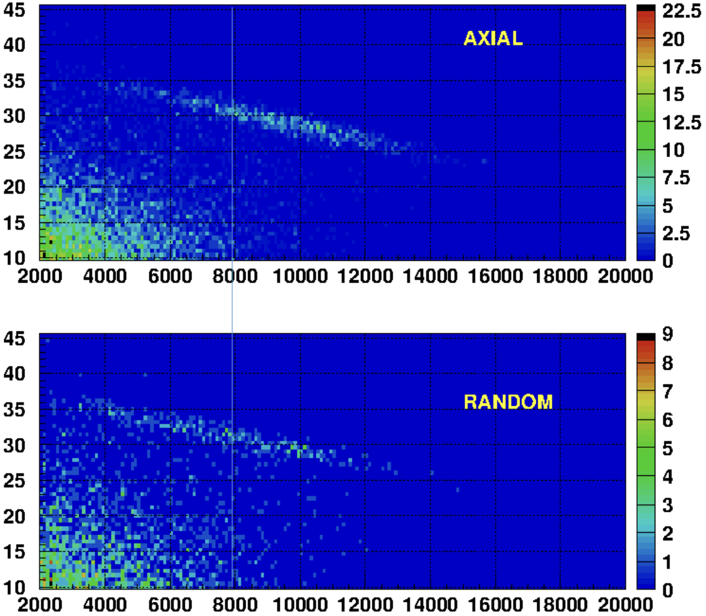
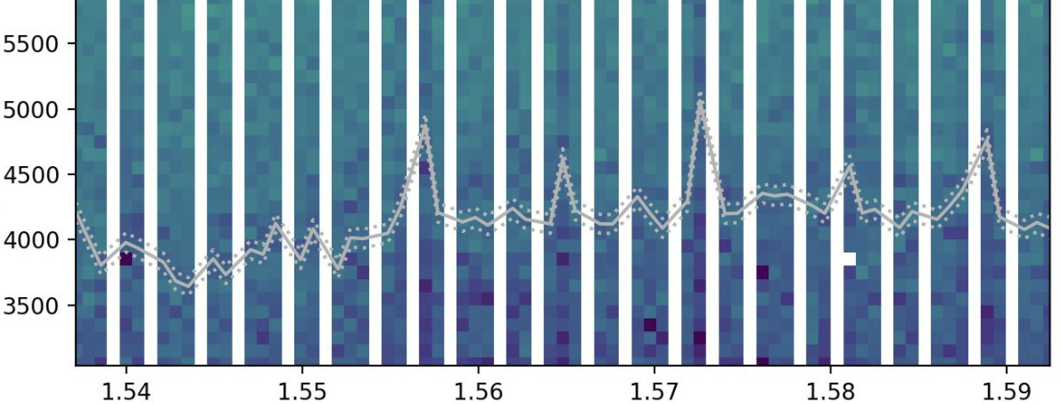
OREO results
Energy loss
PWO-UF
Axial vs. random
3x1 crystals with SiPM on goniometer
Forward energy [MeV]
Mixed beam: Anticorrelation for e⁻ between forward energy and light from crystals
y [cm]
Crystal imaged with beam
Lead glass energy [GeV]
x [cm]
40 GeV mips + e⁻
Crystal planes in PWO-UF revealed by scintillation light read out from crystals
Lead glass energy [GeV]
rotation [rad]
OREO ADC [cts]

Slide 12
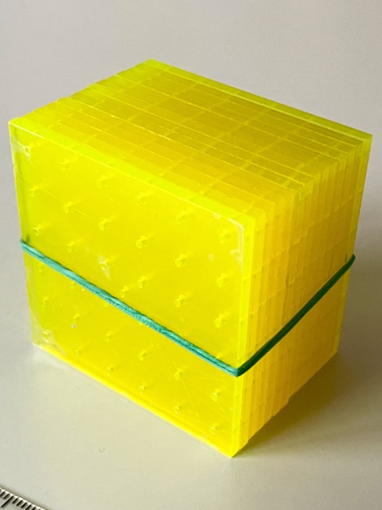
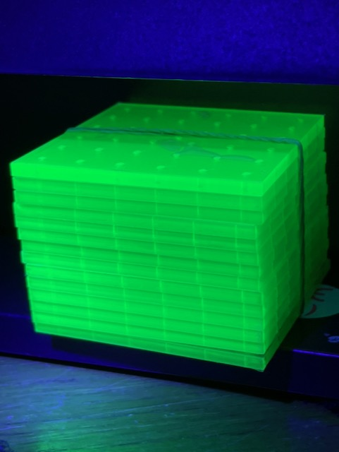
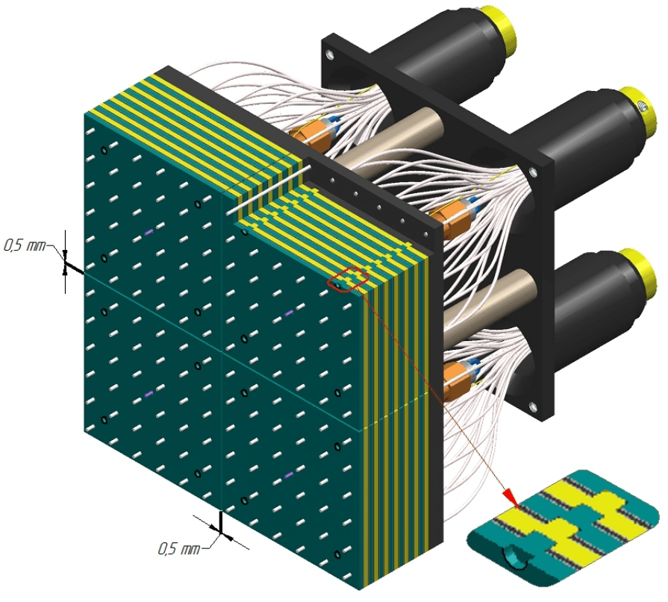
Nanocomposite scintillators for calorimetry
Semiconductor nanostructures can be used as sensitizers/emitters for ultrafast, robust scintillators:
Perovskite (typically CsPbX_{3,} X = Br, Cl…) nanocrystals cast into polymer matrix
  Cast with polymer matrix
  Emission components with τ << 1 ns
  Radiation hard to O(1 MGy)
NanoCal project: Construct a calorimeter prototype with NC scintillator and test with high-energy beams
Shashlyk design naturally ideal as a test platform:
Easy to construct with very fine sampling
Primary scintillator and WLS materials required: both can be optimized using NC technology
Additionally exploring:
New dyes for optimized conventional scintillators
Fast, bright green scintillators for additional radiation hardness
KOPIO/PANDA design
Fine-sampling shashlyk

Slide 13
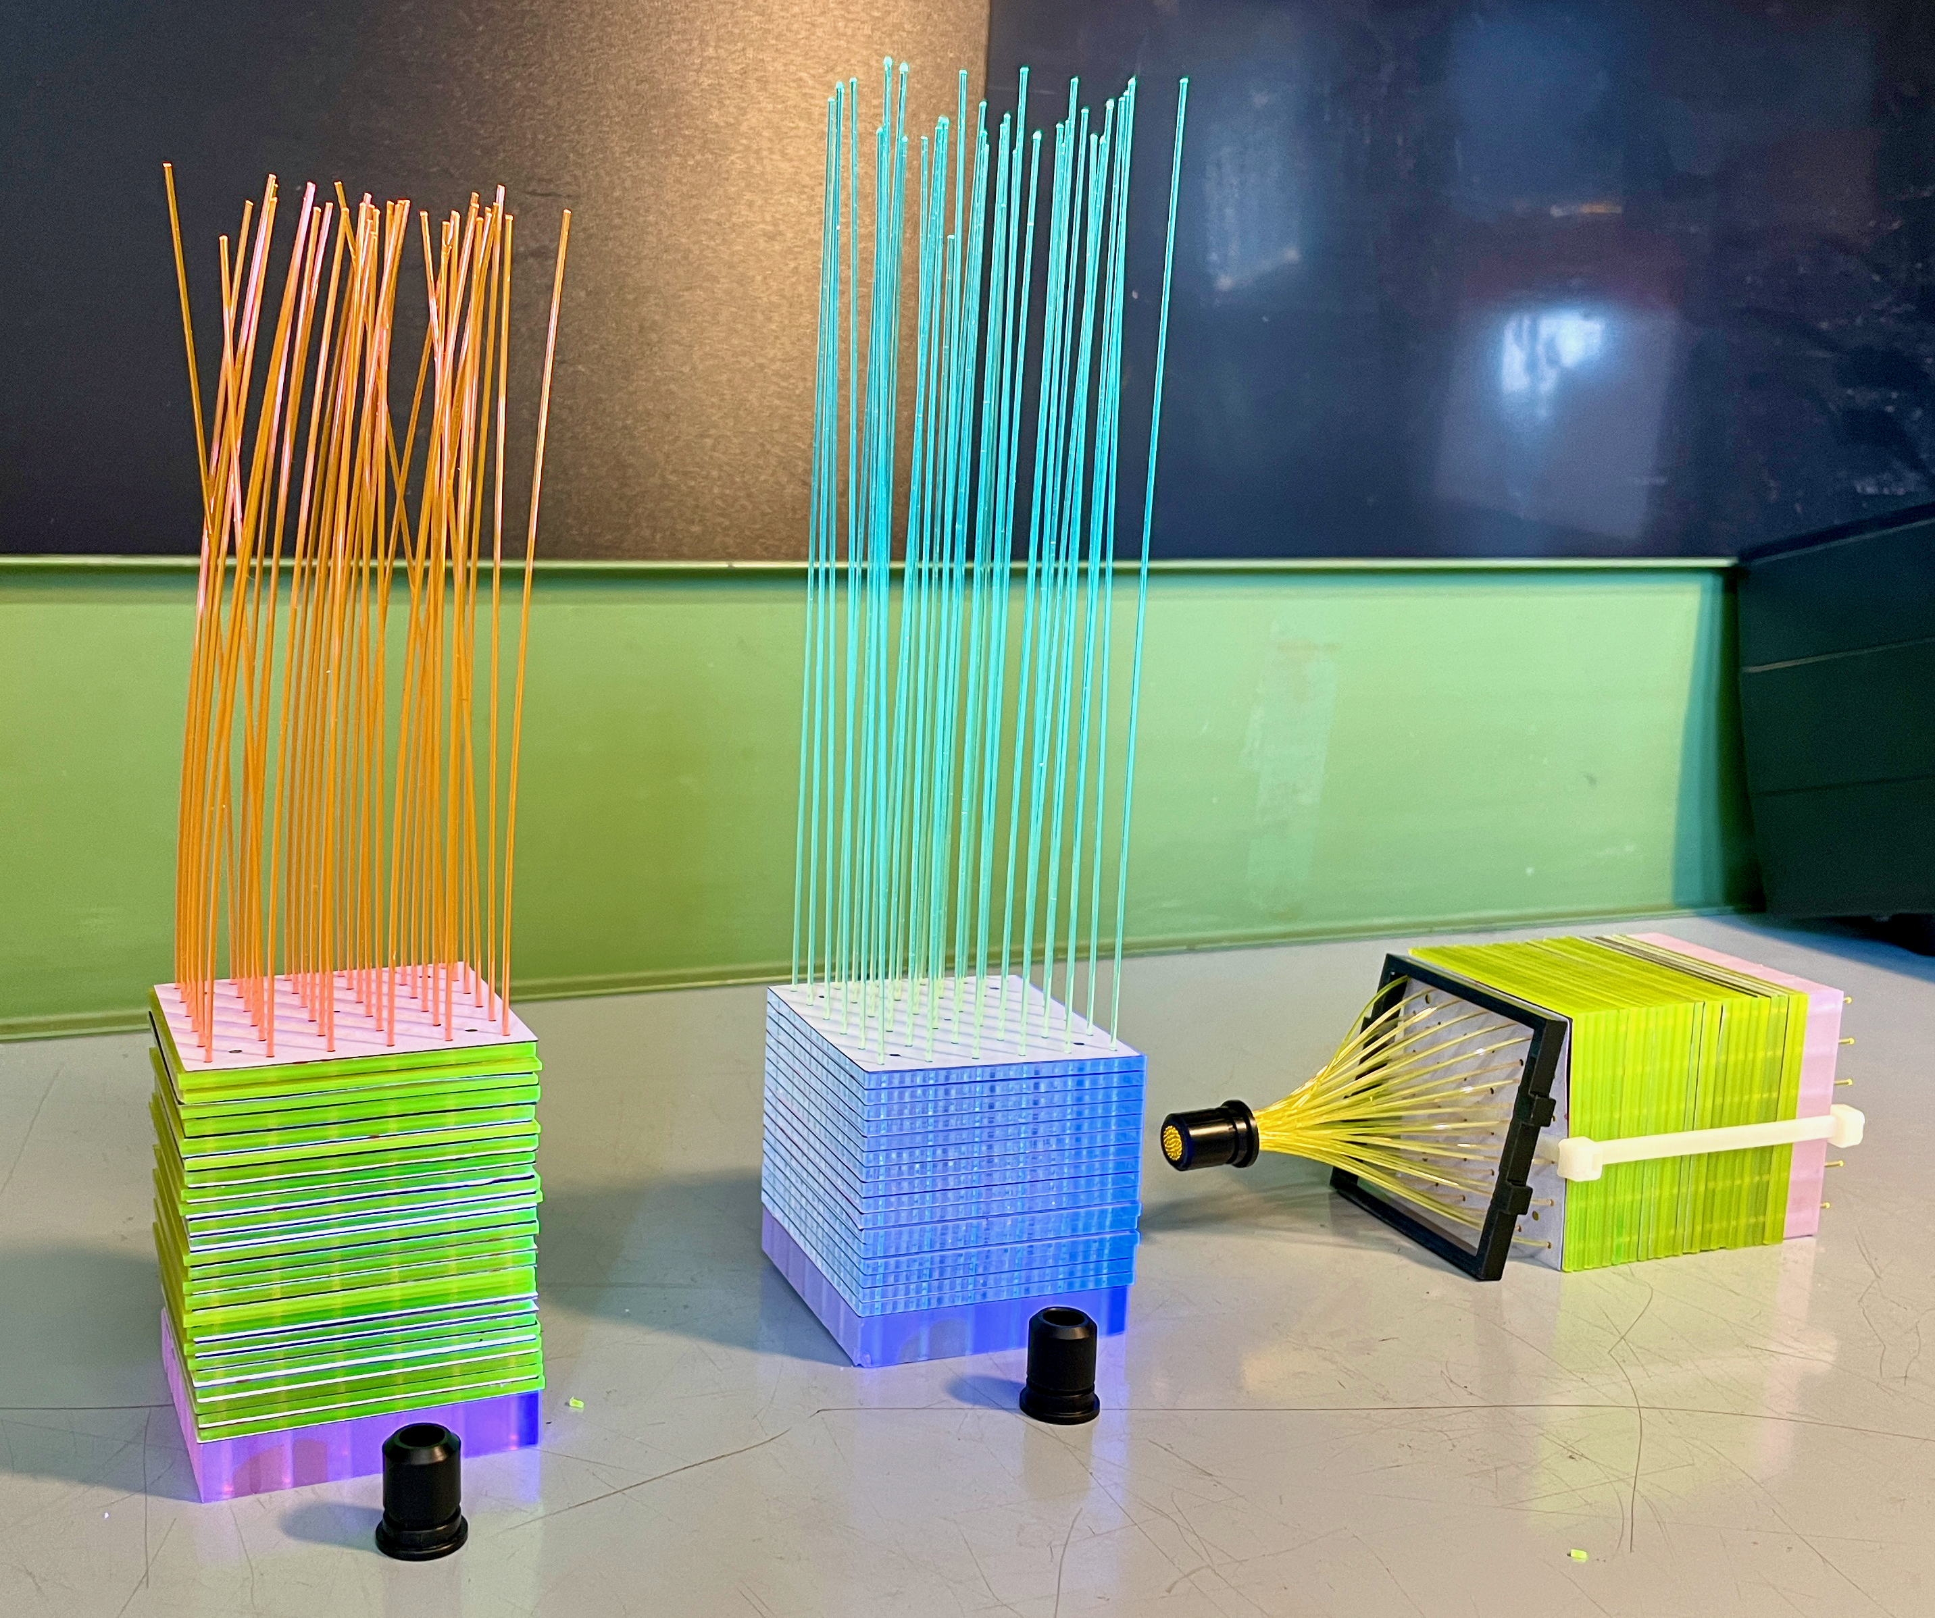
NanoCal project goals and status
Oct 2022: First shashlyk component test at CERN: fibers/tiles/SiPMs
2023: Further iterations to improve performance of NC scintillator prototype
2024: Construction of full-scale shashlyk modules; performance comparison
Possible application for construction of HIKE (future NA62) calorimeter
Prototypes tested in summer 2023:
Conventional scintillator (Protvino), Y-11 fibers
Conventional scintillator (PVT + DDB), Y-11 fibers
PMMA + CsPbBr₃ 0.2%, O-2 fibers
PMMA + CsPbBr₃ 0.2%, Custom NCA-1 fibers
PMMA + CsPb(Br,Cl)₃ + coumarin-6, NCA-1 fibers

Slide 14
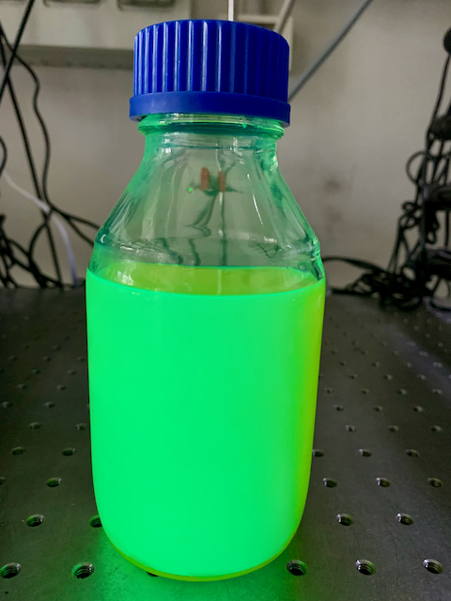
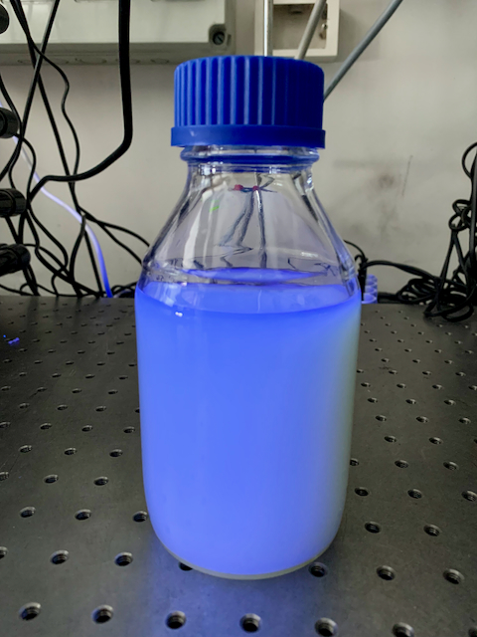
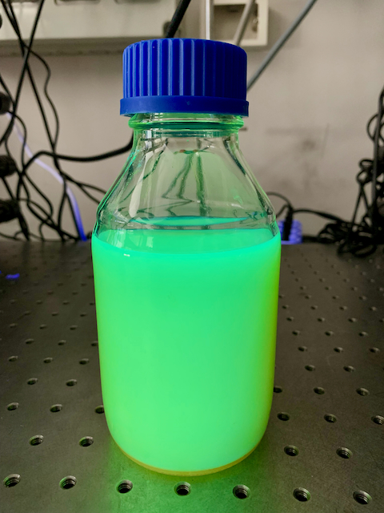
Example of nanocomposite optimization
Previously used CsPbBr₃ in PMMA (green emission) → too much self absorption
A promising solution:
Use CsPb(Br,Cl)₃: Substitution of some Br with Cl shifts emission to blue
Add coumarin-6 as a high-Stokes-shift WLS → shifts emission back to green
Synthesis of CsPbBr₃
Substitution of 50% of Br with Cl
Addition of coumarin-6
However, surface passivation of nanocrystals destroyed during substitution reaction, leading to aggregation (milky appearance, poor transparency)
First prototype tested anyway with custom (NCA-1) fibers at June test beam

Slide 15
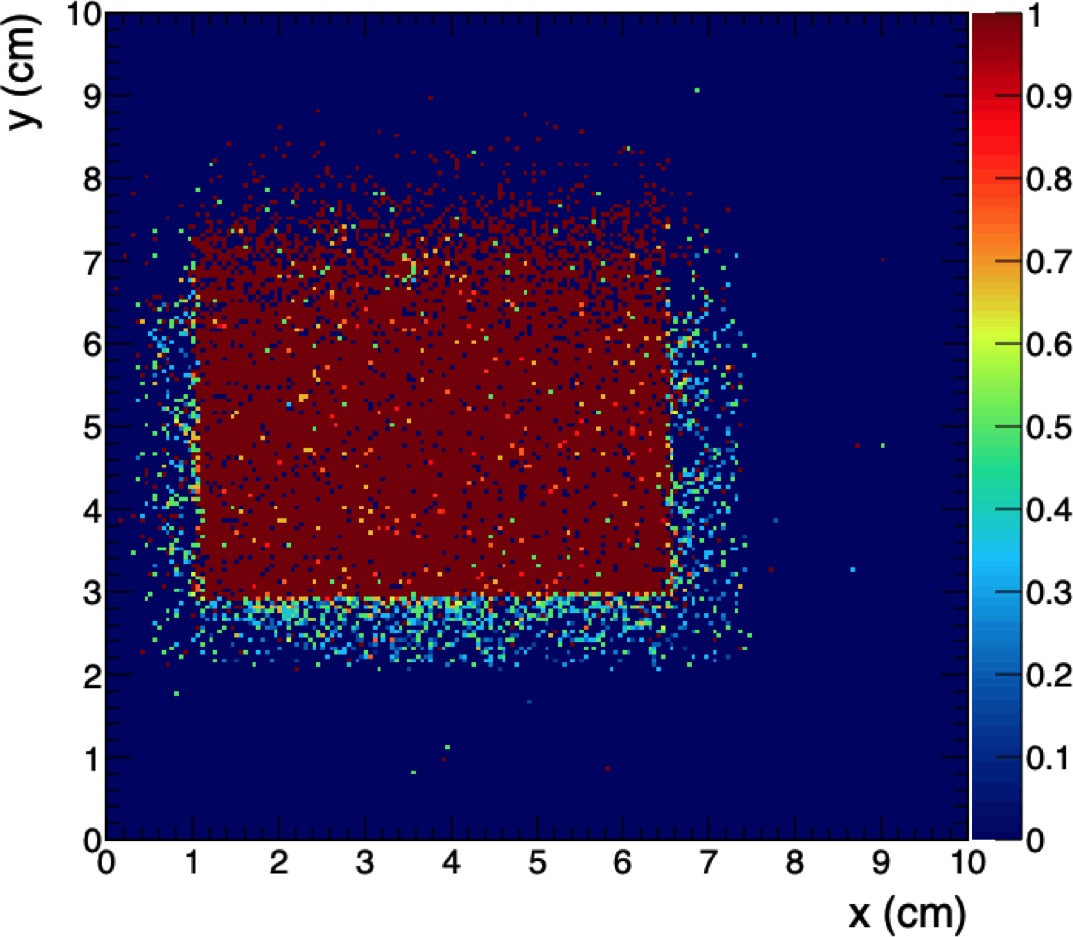
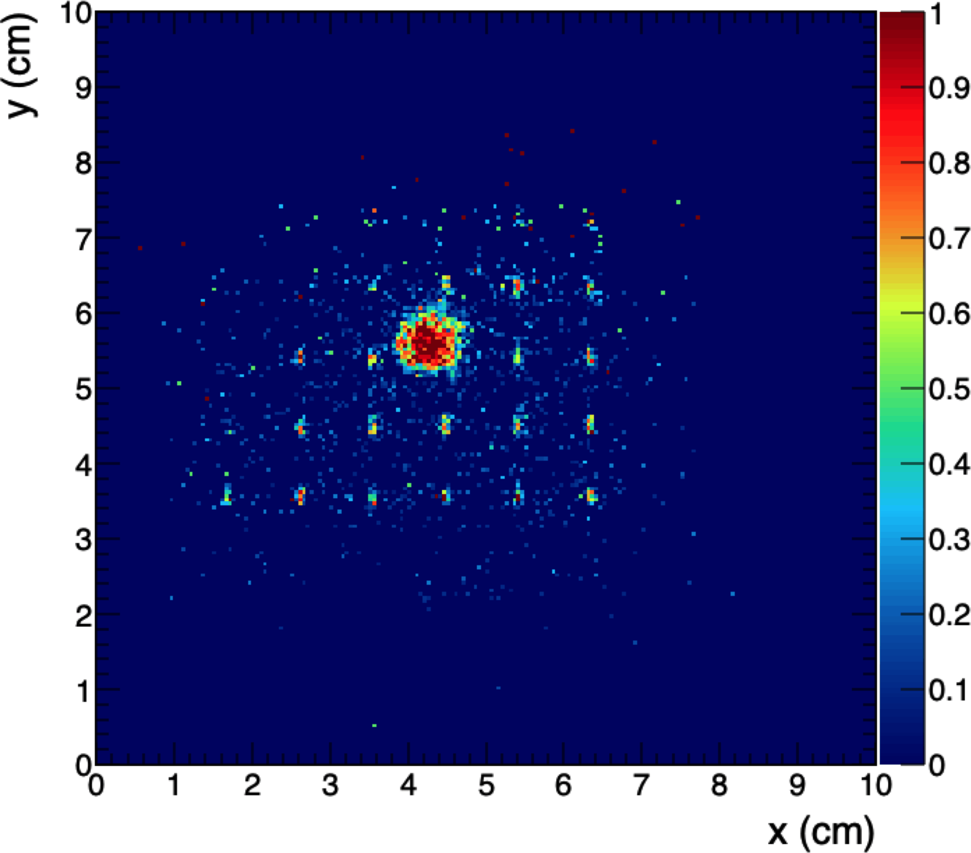
Results from shashlyk prototypes
June test beam: Efficiency maps with 10 GeV μ, threshold = 5σ_{noise}
Disappointing result from new nanocomposite: only light is from readout fibers
Protvino
CsPb(Br,Cl)₃ + WLS
However: Lots of good ideas for next steps
Direct synthesis of CsPb(Br,Cl)₃ to preserve surface passivation
Use of an aromatic matrix material, e.g., PVT as in conventional scintillator
  Current formulations use PMMA: gives no primary scintillation contribution
  Now have new protocol to use perovskites with thermally polymerized matrix, with or without additional WLS
New samples synthesized and tested in fall 2023:
  Develop scintillator to test in beam at BTF in spring 2024

Slide 16
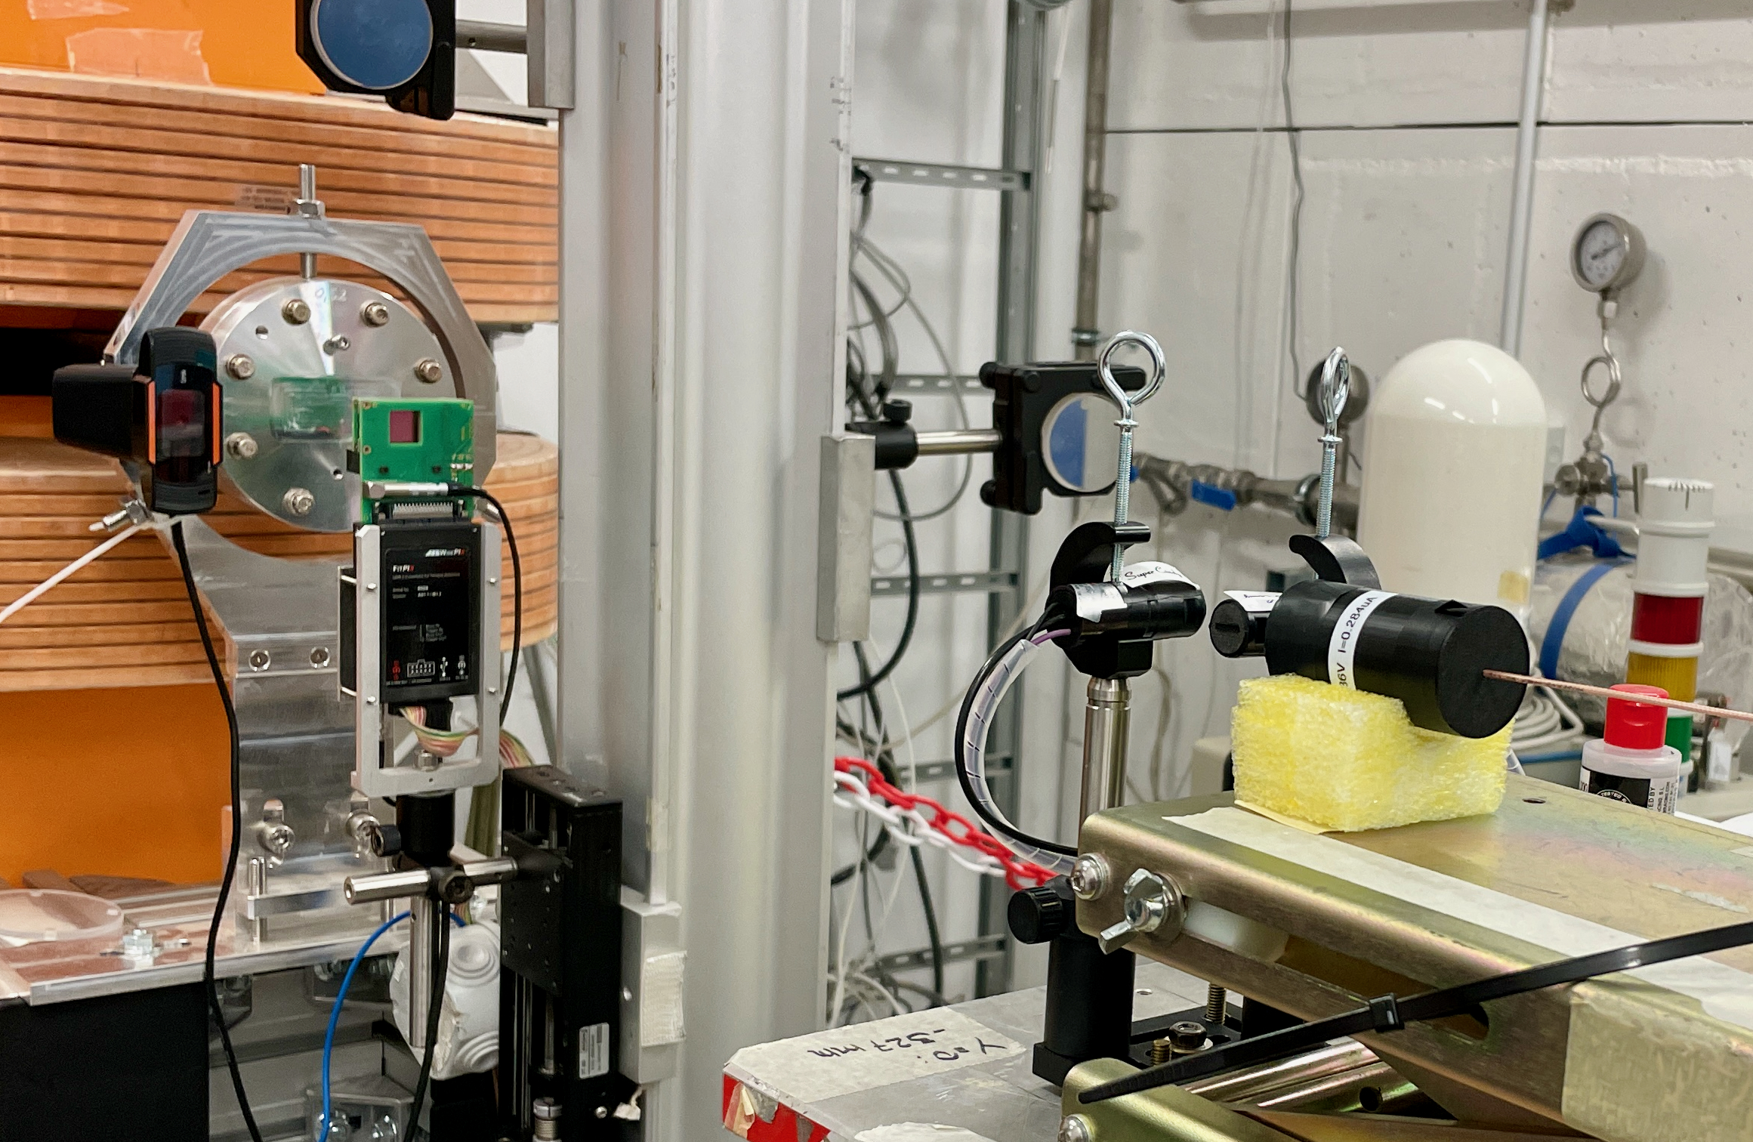
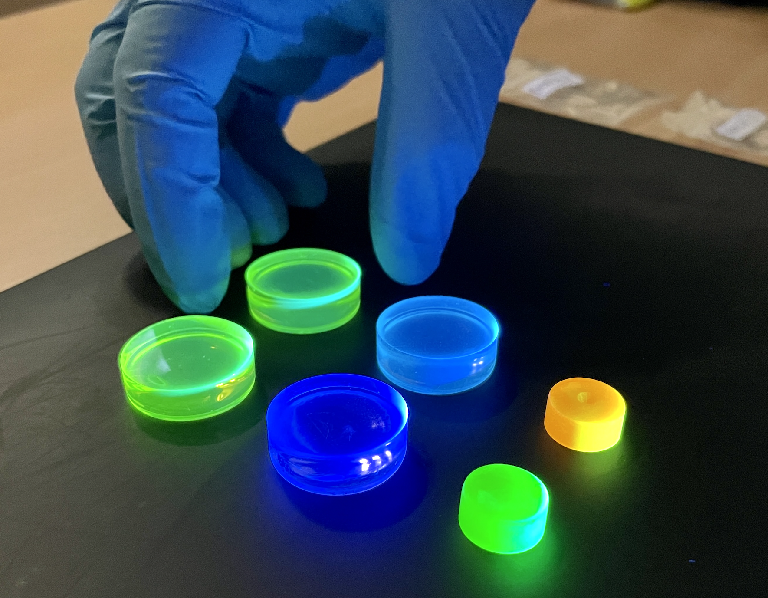
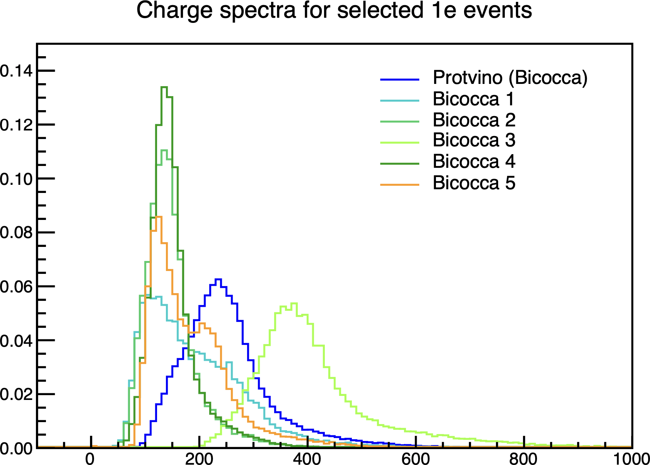
Light yield tests with new samples
Frascati BTF, Nov 2023
Tests with mip and e⁻ beams at PS and BTF:
Reference sample:
  1.5% PTP + 0.04% POPOP in PVT (“Protvino”)
Bicocca 4, 5: CsPbBr₃:Yb perovskites in PVT
  ~50% light yield of ref. sample
  Our first nanocomposites with good mip response!
Bicocca 3: Coumarin-6 in PVT with PTP + BTP
  ~160% light yield of ref. sample!
Normalized counts
Bic 3
Normalized charge spectra
Single 450 MeV e⁻ events
Frascati BTF, Nov 2023
Bic 1
Bic 2
Bic 5
Protvino
Bic 4
Charge [pC]

Slide 17
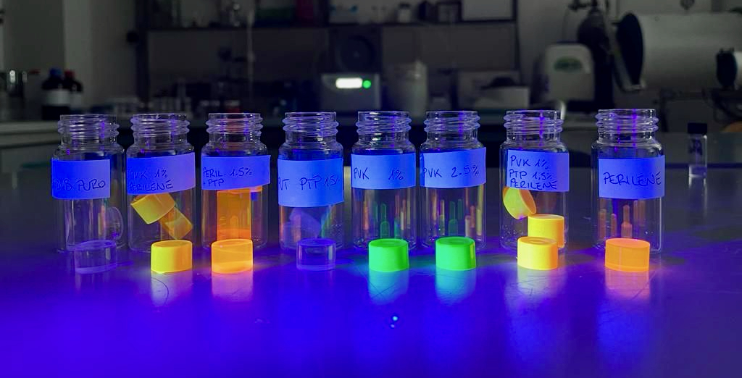
New scintillators and future directions
New samples with 1-2.5% CsPbBr₃:F in PVT with/without additional dyes to be tested at BTF in Feb 2024!
Surface passivation with fluorine allows use of thermally polymerized matrix (PVT) and higher nanocrystal concentration
Additional BTF beam time reserved for Apr 2024 if needed (new ideas?)
Ready to build new prototypes as soon as optimized candidates are ready

