Slide 1
MSCA Doctoral Network

Slide 2
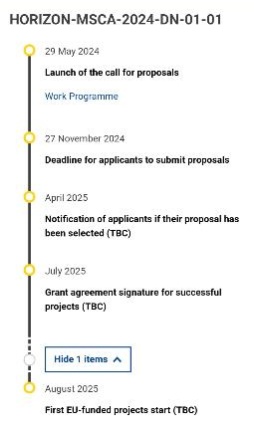
General Information
General information
Next call opens on May 29th 2024
Next call closes on November 27th 2024
Project/Action duration: Up to 48 months
Fellowship duration: Up to 36 months
Participating organizations
At least 3 beneficiaries (of three different countries) and no minimum for associated partners
Organizations need to be in EU member states (or Horizon Europe associated countries)
Max. 40% of the total budget can go to beneficiaries of the same country
Potential candidates
Max. 540 person-months per network (e.g. 15 Doctoral candidates for 36 months each)
May not have been awarded with a doctoral degree
Candidates can be of any nationality
Must be enrolled in a doctoral programme leading to a doctoral degree in at least one EU Member State (or Horizon Europe Associated Country)
Mobility rule: Recruited researchers must not have resided or carried out their main activity (work, studies, etc.) in the country of recruiting beneficiary for more than 12 months in the 36 months immediately before their recruitment date.

Slide 3
Structure of the program
1) Beneficiaries
Responsible for recruiting, supervising, hosting, training or seconding researchers/research staff or managing and/or funding programmes
Every beneficiary must recruit, host at their premises &
supervise at least 1 researcher
They also sign the grant agreement
2) Associated partners
Participation in training and/or hosting seconded researchers
They don’t sign the grant agreement

Slide 4
Criteria of evaluation
Scoring system
Each criterion is scored from 0 (failed) to 5 (excellent)
Each criterion needs a score of ≥3 in 1st stage of evaluation
1. Excellence
Quality and pertinence of the project’s research and innovation objectives
Extent to which the DN is ambitious and goes beyond the state of the art
2. Impact
Magnitude and importance of the project’s contribution to scientific, societal & economic impacts
Developing sustainable elements even after the end of the DN funding
3. Quality and efficiency of the implementation
Quality & effectiveness of each working package (deliverables, milestones, assessment of risks…)
Quality, capacity & role of each participant, each participating organization & the consortium as a whole
Additional key factors
Quality of supervision, training & open science practices (Open access, data management etc)
Focus on inter-/multidisciplinarity, inter-sectorality, career guidance, diversity aspects
Supervisory Board, Career development plan, Gender equality plan, environmental aspects
Weighting
Excellence | Impact | Quality
50% | 30% | 20%

Slide 5
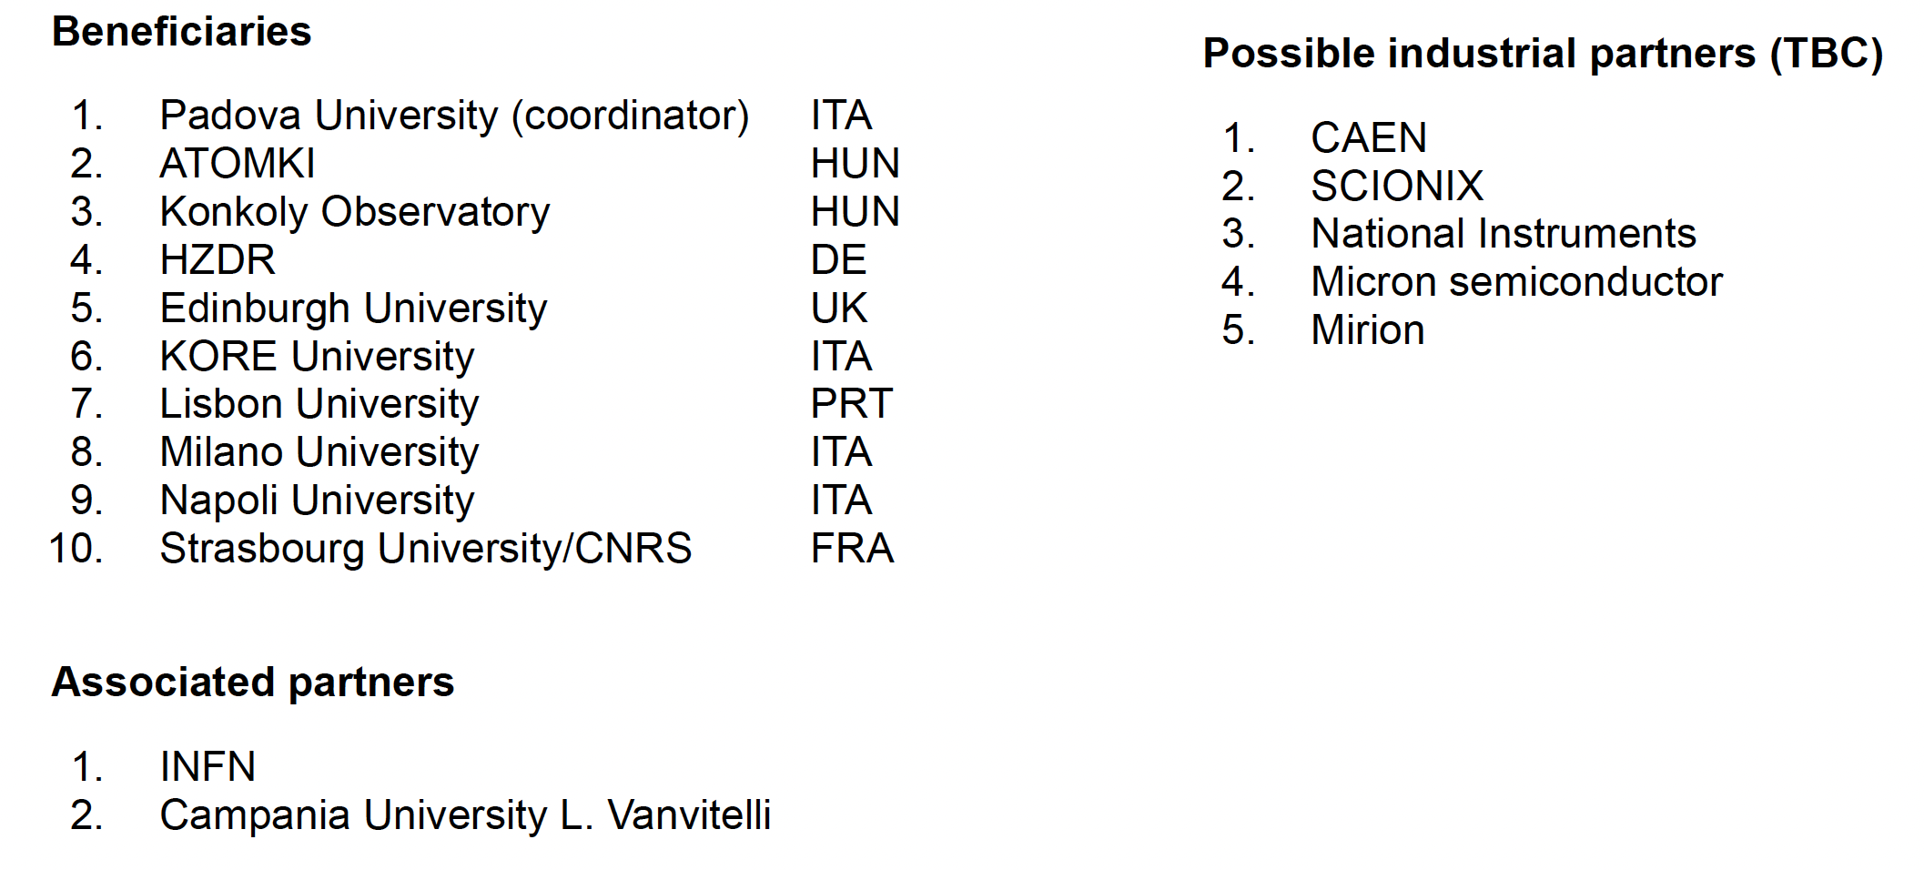
Participants

Slide 6
Selected topic: He and C burning
We started collecting ideas from each beneficiary for activities for each doctoral canidates

Slide 7
Selected topic: He and C burning

Slide 8
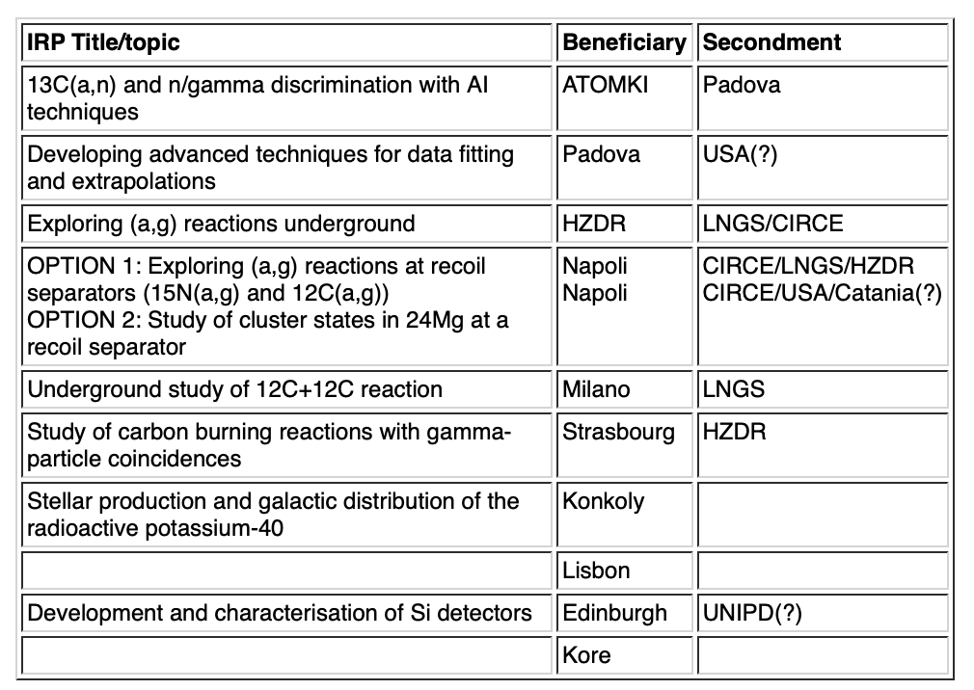
Selected topic: He and C burning

Slide 9
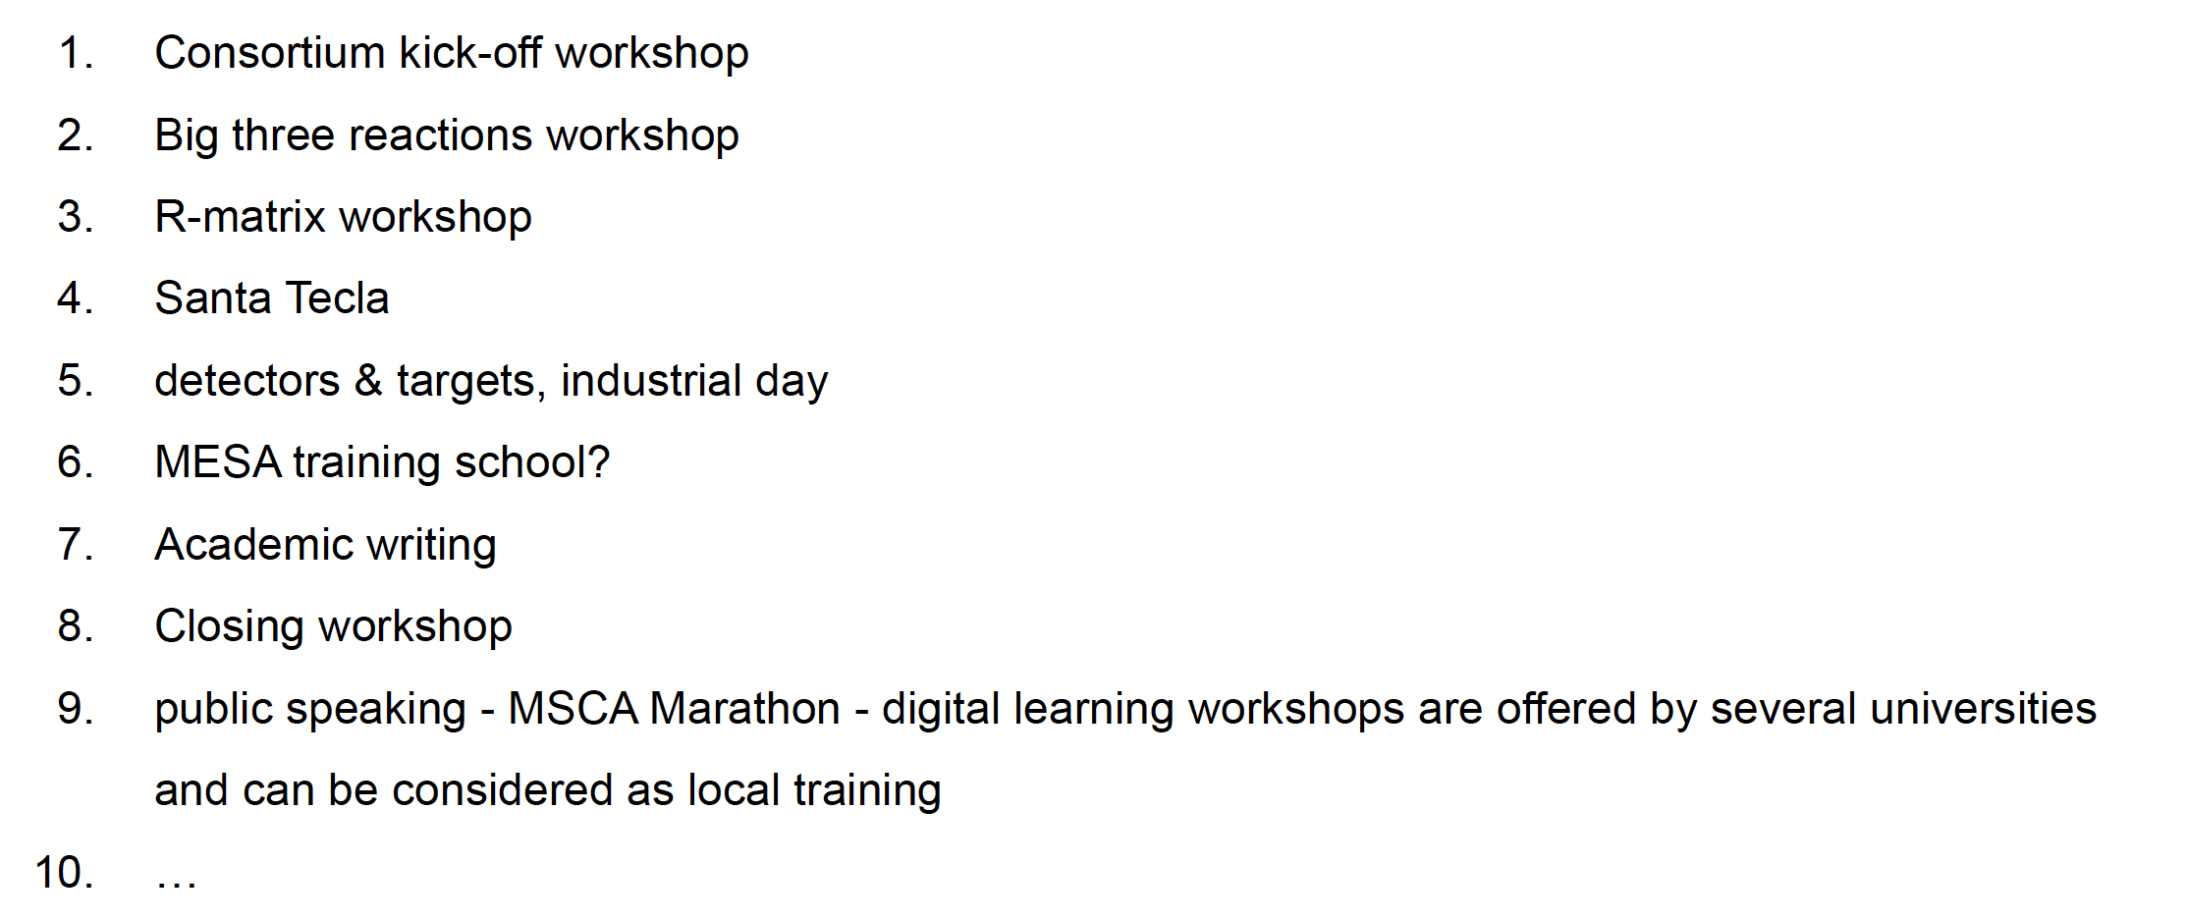
Training activities provided by the network

