Slide 1
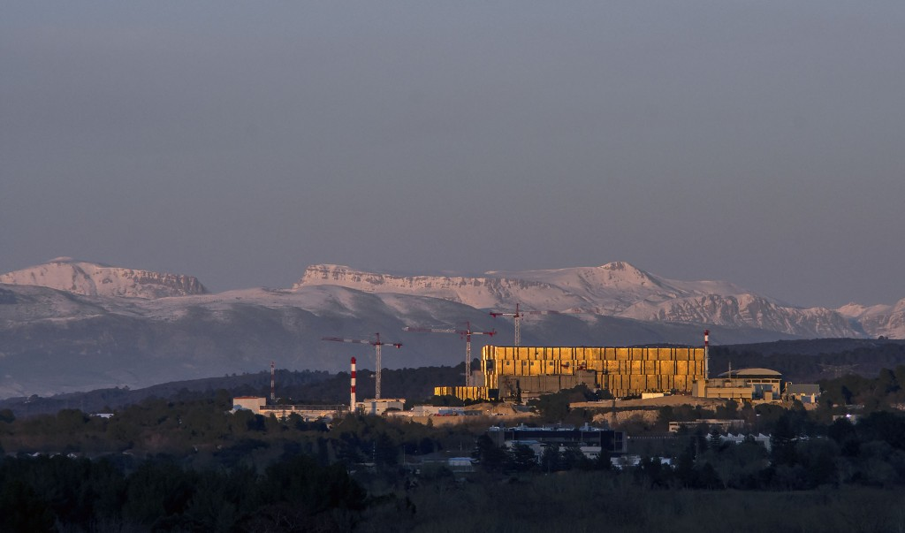







Making and being ready to take key measurements in Fusion Power Plants
The views and opinions expressed herein do not necessarily reflect those of the ITER Organization.
By Michael Walsh
October 23rd 2024

Slide 2
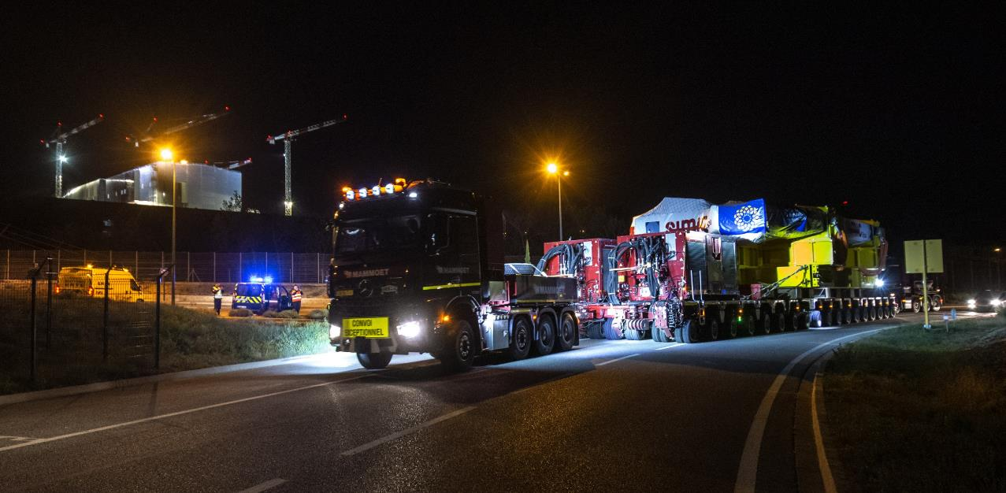

text
text
text
Major COMPONENT DELIVERIES completed
19 TF coils (18 + 1 spare)
2 PF coils (plus 4 manufactured onsite)
3 vacuum vessel sectors (out of 9), with 2 more en route
4 Central solenoid modules (out of 6+1 spare)
Most First Plasma Diagnostics
2
text

Slide 3
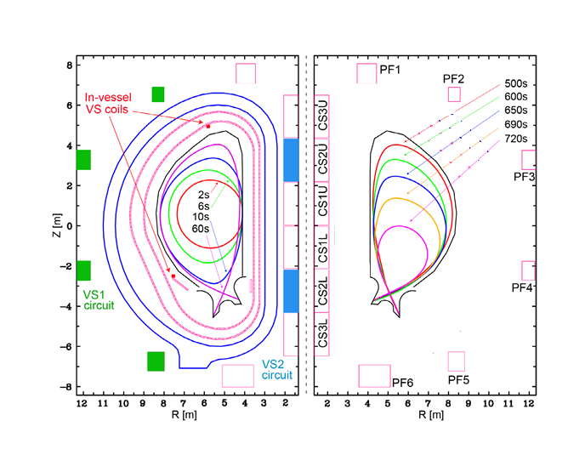
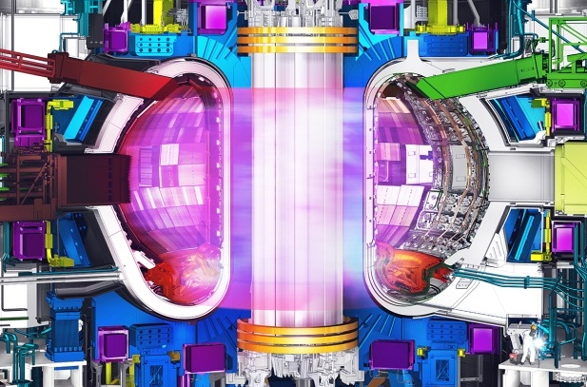
What kind of measurements do we need to make?
Q=10 scenario with (ELMy H-mode ):
I_{p}= 15MA, P_{aux}= 50MW, H_{98(y,2)} = 1
No other way to know what is happening?

Slide 4
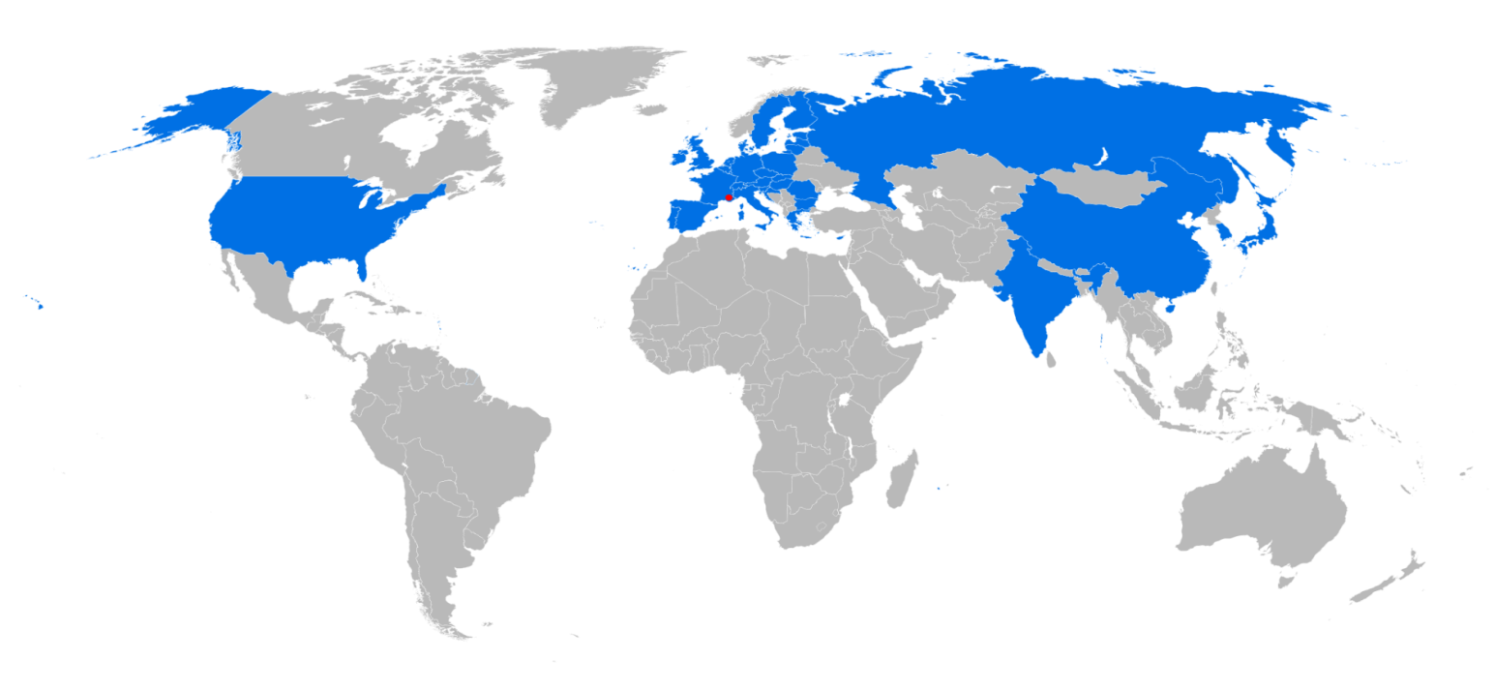



Wide contribution-needs careful coordination
We are here
All 7 Parties directly contributing
Many direct projects from ITER going on around the world,
Several very successful International Collaborations ongoing

Slide 5
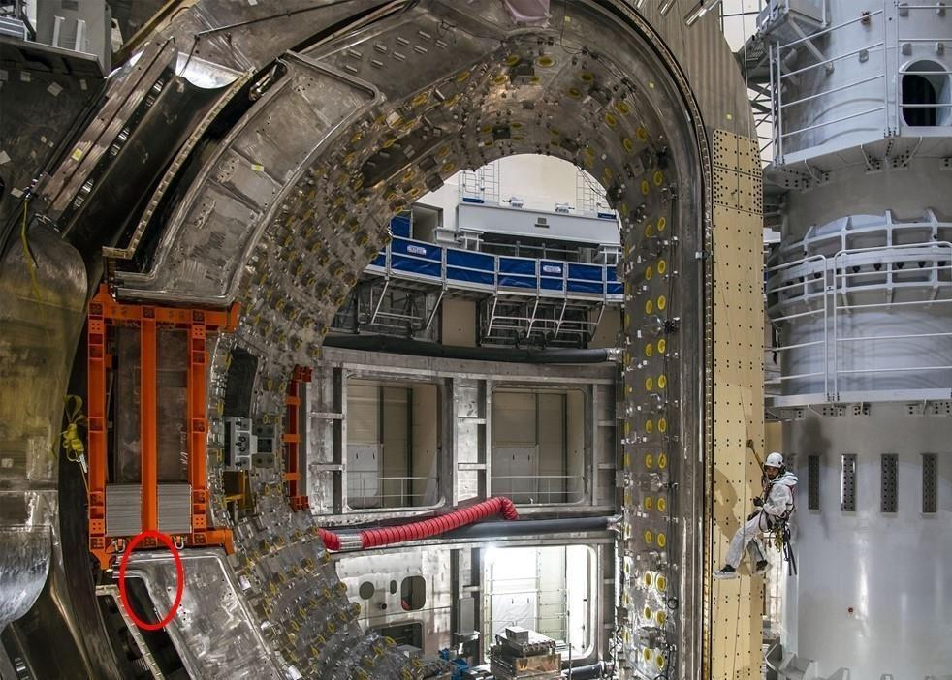

text
CHALLENGES OF
FIRST-OF-A-KIND COMPONENTS
Vacuum Vessel sectors have geometric non-conformities in the field bevel joints.
text
text
5
text

Slide 6
What are the Challenges to making these happen?
Very Large Project
Technical
Coordination
Cost
Protection of equipment once installed!

Slide 7
In/Ex-vessel Cabling for diagnostics

Slide 8
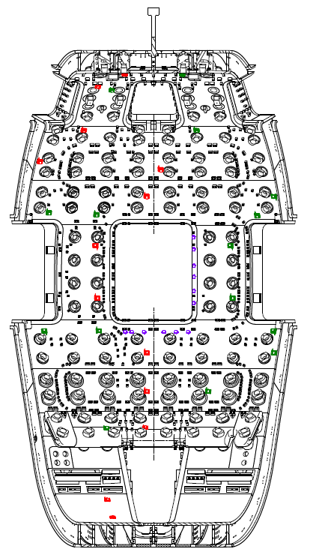
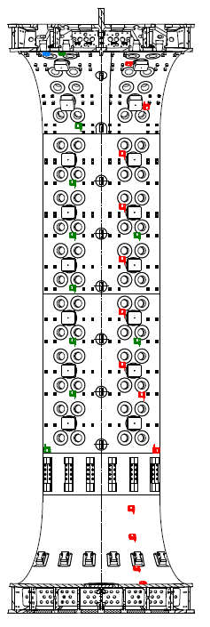
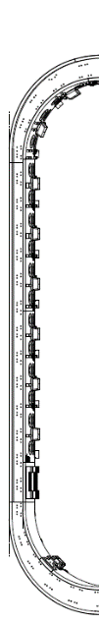
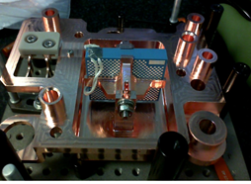

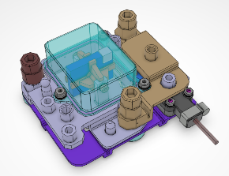

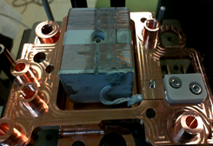
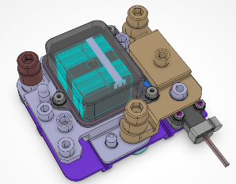

Distribution of Sensors on the Vessel and Divertor
Real Magnetic Coil Example
Outboard
Inboard
High Frequency (MHD)
Components delivered

Slide 9
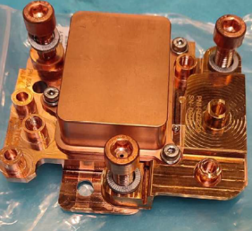
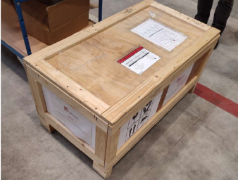
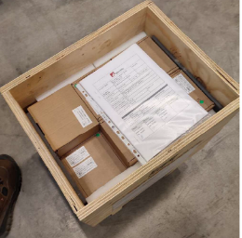
Delivery of Integrated Sensor Housing [size for each is 15cmX15cmX10cm]
Site delivery of integrated Sensor Housing (all delivered)
Items packaged in zip plastic bags and carton boxes
Carton boxes stacked and loaded into wooden crates
These can be replaced by Remote Handling

Slide 10
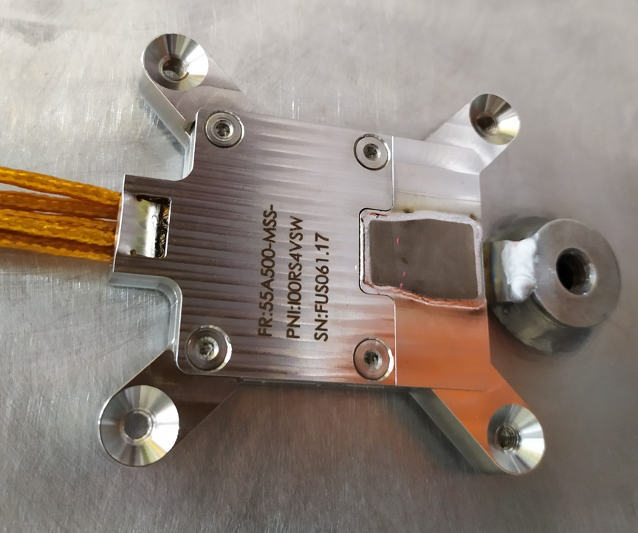
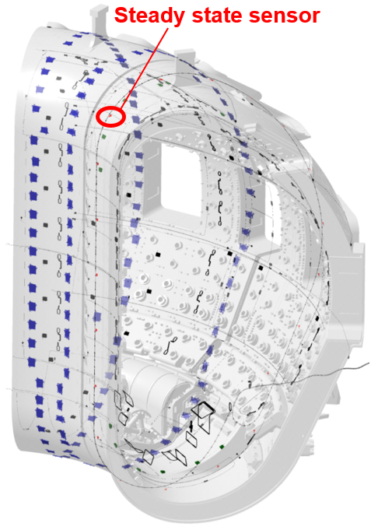
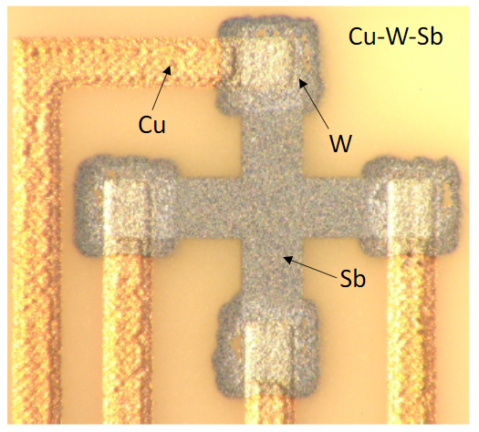
New Generation of all Metal Radiation Hard Hall Sensors
Antimony Hall sensors 70 x 60 mm
Many installed already
6 x 6 mm

Slide 11
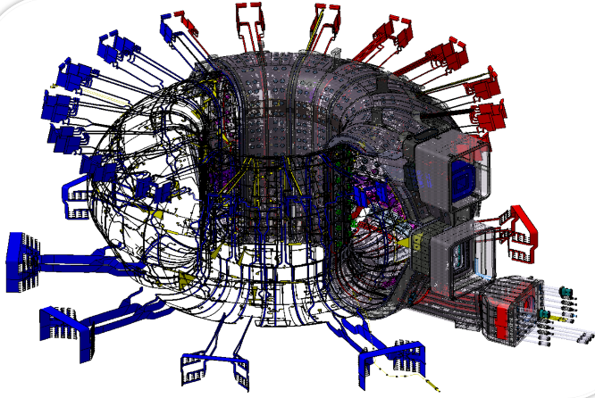
Cabling and supports for wire vessel-mounted systems needs special attention
In-vessel wiring needs to be cooled
This is achieved using welded attachments called bosses and clips, 60000 clips of one type and 30000 bosses
Delivered
Will be installing in a few months

Slide 12
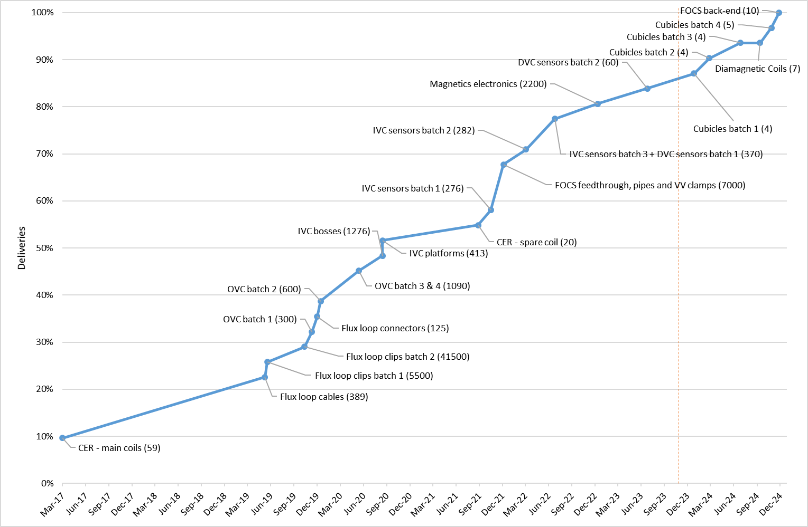
Status of 55.Ax magnetics by delivery milestone fraction (parts quantity in brackets)

Slide 13
Examples of Large Infrastructure Developments

Slide 14
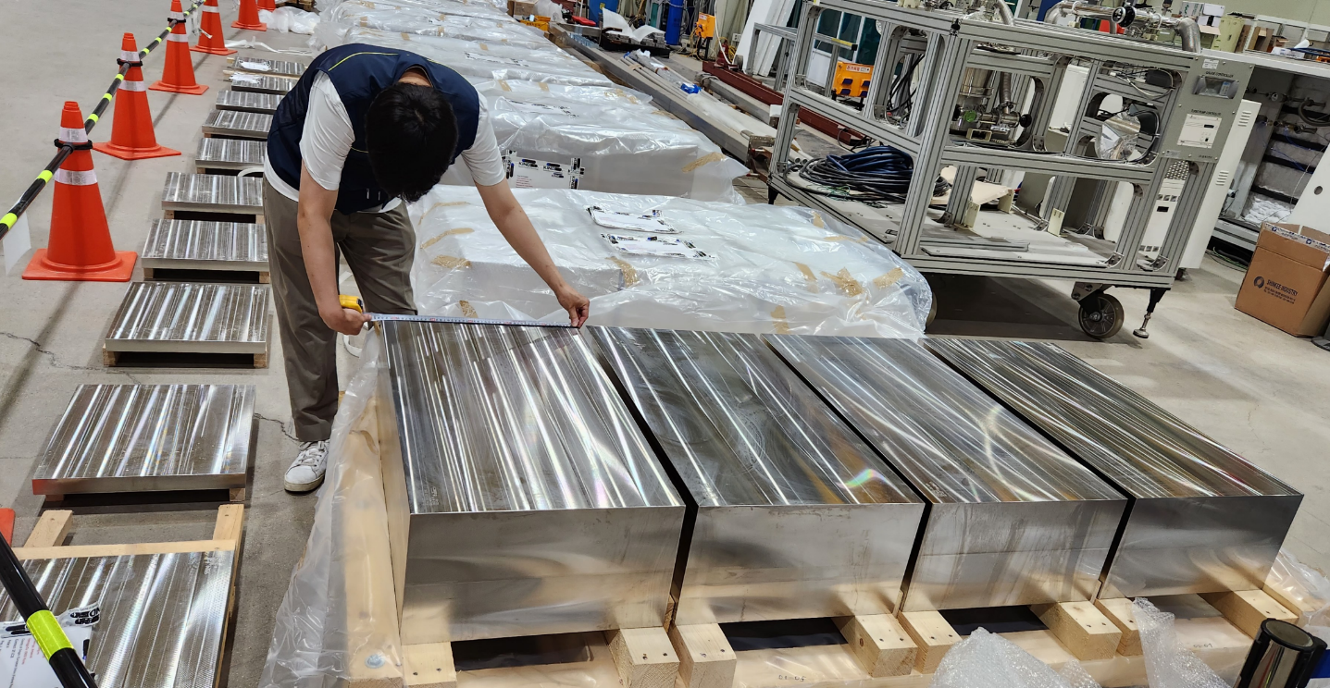
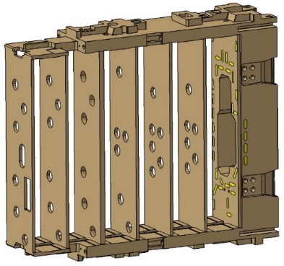
Diagnostic First Wall in Manufacturing
Many DFWs on the line and several in manufacture

Slide 15
Installation in the Buildings

Slide 16
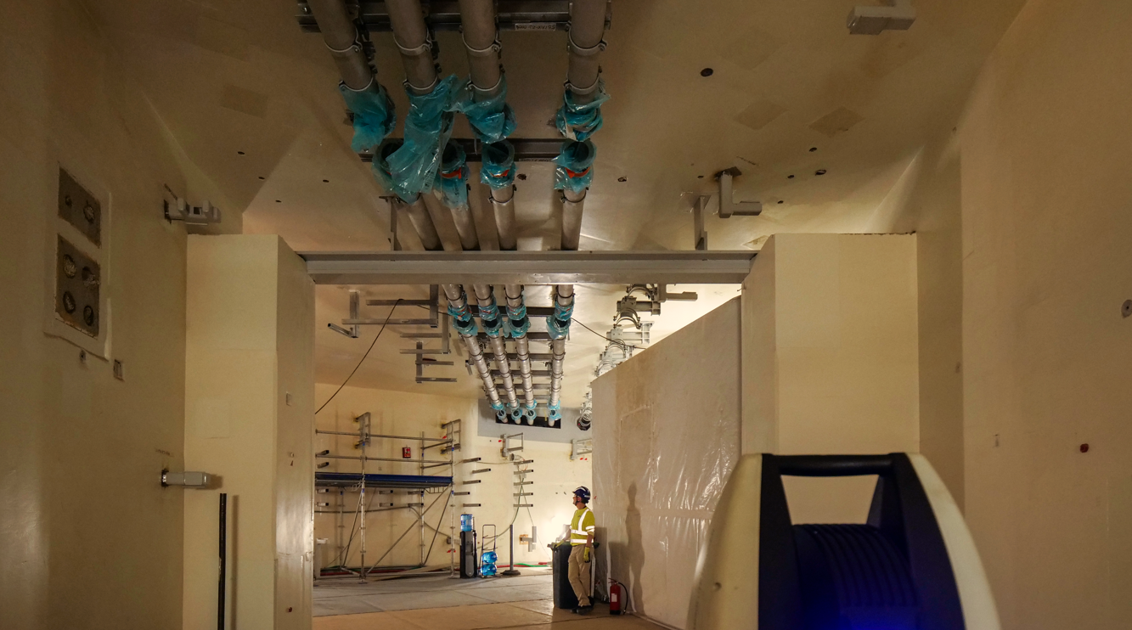
Light Pipes for the Density Measurement
Thousands of these bits installed- more on the way

Slide 17
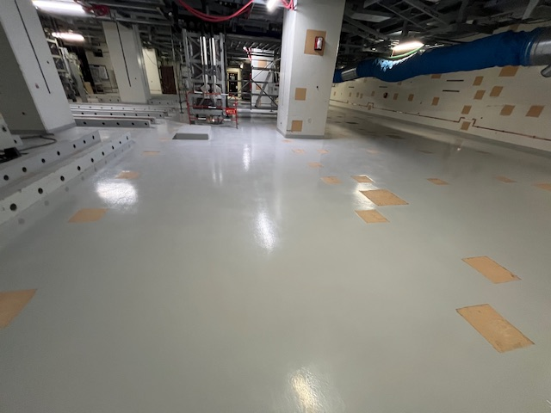
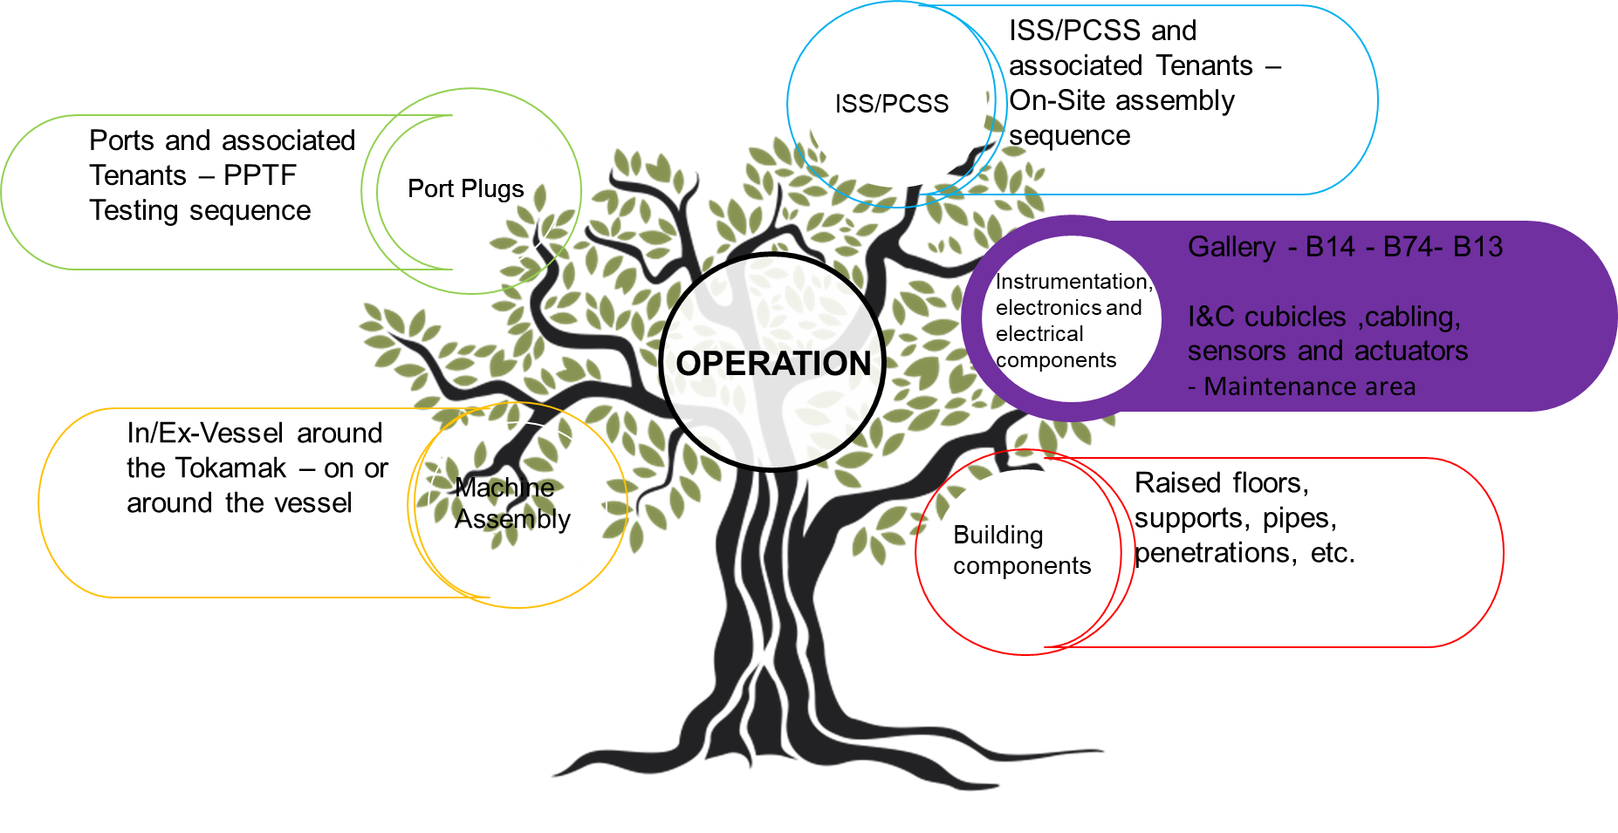
Soon starting back-end installation!
Building 74 [Diagnostic Building] readiness
B1 now under cleanliness Protocol
  Cleaning and painting of the floor
  Use of Cover shoes mandatory!
Raised Floor installation ready to start

Slide 18
Instrumentation & Control and Simulation

Slide 19
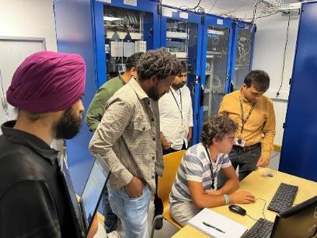
I&C for the Diagnostics
The power line monitoring diagnostics I&C is being tested here
I&C in production line approach- first systems tested in test centre

Slide 20
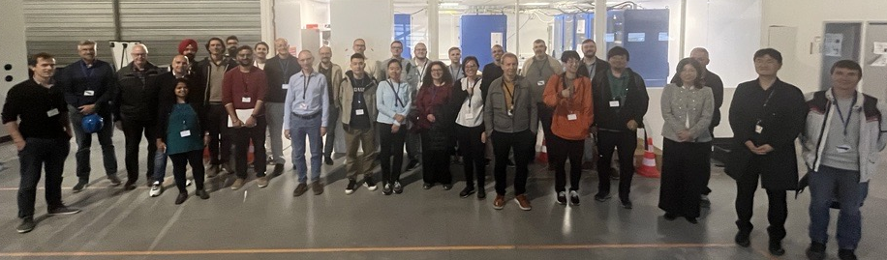
I&C for the Diagnostics is Moving
I&C worldwide team working together

Slide 21
Generating Synthetic ITER Diagnostic Data for System Development
Use forward models with IMAS predictive simulations of ITER plasmas to create synthetic diagnostic data
Scenario Database
equilibrium
pf_active
pf_passive
core_profiles
Synthetic Diagnostic Data
magnetics
inteferometer
…
Synthetic “Processed” Data
equilibrium
core_profiles
…
Forward models
Predict magnetics →
Predict interferometer
etc
…
Calculate/infer
plasma
→ parameters →
Equilibria
Profiles
etc
…
Include realistic noise
Test IMAS software
Database of “synthetic” diagnostic measurement data
Can be compared with original simulations
Use with CODAC for complete end-to-end tests of data processing pipeline

Slide 22
Maintenance

Slide 23
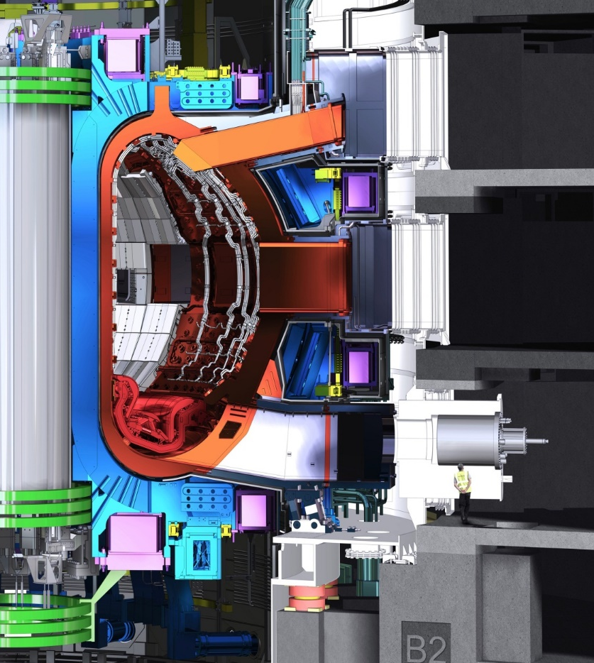
ITER-Diagnostics Maintenance
Managing activation levels is very important
In port equipment needs remote-handling maintenance
Port Interspace and port cell very important for diagnostics
Hourly activation targets and annual limits
Cobalt and Tantalum control (impurity) is paramount
Simple operations needed

Slide 24
Fusion Power Developments and the Future

Slide 25
Fusion Reactor Instrumentation-Future
Diagnostics now moving to Fusion Reactor Instrumentation
Fusion Reactors will need lots of Instrumentation like any large power plant
Fusion Reactor Control loop with measurement capability as a by-product
Some special needs for ITER but more for DEMO
Important area to push for the future to ensure plant integrity

Slide 26
Examples of Fusion Plasma Diagnostic evolutions in Development or being Developed?
Steady State Detectors – ongoing in ITER
Fibre Optics Current Sensor – ongoing in ITER
Tokamak System Monitor – ongoing in ITER
Electron Cyclotron Sensor – ongoing – Version developed for ITER
For ECE- again- how to improve? – relativistic effects impact spatial resolution- can it be reduced by post-processing- challenge for ECE analysis expert
Fast Wave Reflectometry – ongoing and looking very promising now for D/T ratios
Auto/Active-alignment systems – general request and very critical for ITER and beyond.
Above is only a sample of evolutions – there are many more, interesting and important items to work on and help the Fusion Mission

Slide 27
Global coordination and New Baseline 2024

Slide 28

Diagnostic High Level Installation and hence delivery Strategy
ISS/PCSS and associated Tenants – On-Site assembly sequence
Port plugs and associated Tenants – PPTF Testing sequence
ISS/PCSS (C)
Port Plugs (B)
Gallery - B14 - B74- B13
I&C cubicles ,cabling, sensors and actuators
- Maintenance area
Instrumentation, electronics and electrical components (D)
OPERATION
In/Ex-Vessel around the Tokamak – on or around the vessel
Machine Assembly(A)
Raised floors, supports, pipes, penetrations, etc.
Building components (E)
Pushing on multiple fronts and working to improve deliveries

Slide 29

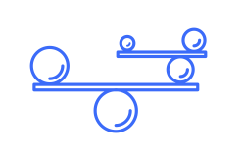










High Level Picture of Delivering Diagnosticss?
Funding (getting enough!)
Managing budgets and projects and Administration
System Engineering (essential for big projects!)
Hiring (the right people!)
Safety & Training (takes time in new industries!)
Managing people (everyone is different!)
Each team needs this and if not, they need to combine to have it- it is “we” and not “I” or my lab!
Leading and Team Building (developing a positive culture)
Conflict management
Overall Design and Ideas (collaborative!)
Mechanical and Electrical Engineering and Physics – codes and standards
Computer Aided Design (CAD) and Diagrams
Instrumentation & Control (I&C) and real-time programming
Notes:
Check animation order for the new stuff

Slide 30
Efficiencies
Mindset change to work more in close cooperation [big impact but not easy to implement and needs top level support]
In some case Dual Hat TROs
Look for commonalities [share tools and facilities]
Then principle of marginal gains- improve where possible
Incremental Deliveries to flatten the resource need and show progress

Slide 31
Summary
Diagnostics allow us to run the machine safely and reliably
Many systems already delivered
Many more systems now need to be finalized and delivered
Global coordination and cooperation is a critical aspect if we are to be successful – for this WE need your help
Ack: Special thanks to all colleagues in ITER across the world who are supporting the diagnostics

Slide 32
Backup

Slide 33
 | Functional Payload |  |  |  |  |  |  |  |  |  | Captive payload
 | Essential |  |  |  |  |  | DMS | GDC | Important
EP #2 | E5 - CXRS Core |  |  |  |  |  | 2 x DMS
EP #7* | B4 NFM
EP #8 | FA - DIP | E6 - VSVR | GE- BIS |  |  |  | DMS | GDC |  | F9 - HFSR |  | B9 - LAM | B4 - NFM
EP #9 | G1 - EWAVS | F1 - ECE | C5 - TIP |  |  |  |  |  |  |  | GL - IVL
EP #10 | C1 - CPTS | C2 - ETS | G3 - Pgauge |  |  |  |  | GDC |  |  |  | C6 - PoPola
EP #11 | G4 - RGA | E2 - H-alpha | E3 - VUV Survey | ED - XRCS Survey | EG - Div VUV | B8 - NAS |  |  | F2 - LFSR |  |  |  | E8 - NPA
EP #12 | G1 - EWAVS | E2 - H-alpha | E7 - RXR + 55.NB filter | EE - HXR |  |  |  | GDC |  |  | GL - IVL | C7 - CTS** | E7.D0 RXR adv. Det.
EP #17 | G1 - EWAVS | G6 - IR TH | B8 - NAS |  |  |  | DMS | GDC | GC - TM |  | GL - IVL |  | B4 - NFM
UP #2 | GA - UWAVS |  |  |  |  |  | DMS | GDC |  |  | GL - IVL
UP #8 | GA - UWAVS |  |  |  |  |  | DMS | GDC |  |  | GL - IVL
UP#11 | GA - UWAVS | B8 - NAS |  |  |  |  |  | GDC |  |  | GL - IVL
UP#14 | GA - UWAVS |  |  |  |  |  | DMS | GDC |  |  | GL - IVL
UP #18 | EH - VUV edge | B8 - NAS |  |  |  |  |  |  |  |  | B2 - VNC
UP #4/5/6/7
LP #2 rack installed for AFP | E4 DIM** | 55.BC DNFM | G2 DTC | G7 LP | Ax Mag | NE.V0 service | NE.X0 service
GDB
Essential and Important for SRO [DT1 is the rest and not shown here]
8(11) GDC , 7 DMS
Captive payload: (PP and where appropriate Interspace, PC, buildings etc)
EVD scope
IVD scope
DMS
GDC

Slide 34
LP #2 rack installed for AFP | E4 DIM** | 55.BC DNFM | G2 DTC | G7 LP | Ax Mag | NE.V0 service | NE.X0 service
LP #4 | G3 - PG |  |  |  | Ax Mag | NE.V0 service | NE.X0 service
LP #6 | G3 - PG | G9 Dust |  |  | Ax Mag | NE.V0 service | NE.X0 service
LP #8 no rack for AFP | G3 - PG | G7 LP | 55.BC DNFM |  | Ax Mag | NE.V0 service | NE.X0 service |  |  |  |  |  | C4 DTS | G8 ERM
LP #10 | G3 - PG |  | G2 DTC |  | Ax Mag | NE.V0 service | NE.X0 service |  |  |  |  |  | C6 PoPola RR
LP #12 | G3 - PG | G4 RGA | G9 Dust |  | Ax Mag | NE.V0 service | NE.X0 service
LP #14 no rack for AFP | G7 LP |  | 55.BC DNFM |  | Ax Mag | NE.V0 service | NE.X0 service
LP #16 |  |  |  |  | Ax Mag | NE.V0 service | NE.X0 service
LP #18 | G3 - PG |  |  |  | Ax Mag | NE.V0 service | NE.X0 service
Divertor casssettes | D1 _ Bolo | E4 - DIM** | Ax Mag | G7 LP | G2 DTC | G9 Dust | NE.D0 service |  |  |  | 55.B2 VNC | G9 Dust monitor | C4 DTS | G8 ERM | C6 Popola RR
VV | D1_Bolo | 55.BC DNFM | 55.B8 NAS | Ax Mag | FA - DIP | G3 - PG | GB- ECH Detectors | G9 Dust monitor | F9 - HFSR |  | 55.B3 MFC
 |  |  |  | NE.V0 service | GF-TF Map
Blanket First wall mounted | C1 - CPTS | C2 - ETS | C5 - TIP | E2 - H-alpha | FA - DIP | GD Samples |  |  |  |  |  | C6 - PoPola
In Cryo/TFC | Ax Magnetics | A1 Cer
Building | Z4.2 Storage for sources | NE.X0 | GT TSM | GG Cal
Calibration | Neutron calibration | Optical Calibration
SRO Diagnostic Scope also includes systems in VV, Divertor cassettes, FW, buildings e etc and also Including captives

