Slide 1
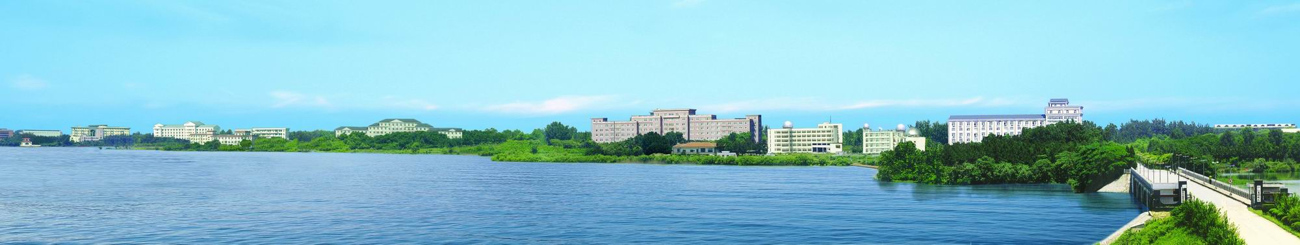
7th International Conference Frontiers in Diagnostics Technologies
21-23 Oct. 2024, Frascati, Rome, Italy
#58 Short talk
Extreme Ultraviolet Spectrometers for fast observation of high-Z impurity line emissions and their density radial profiles in Experimental Advanced Superconducting Tokamak
Yunxin Cheng¹, Ling Zhang¹, Shigeru Morita², Ailan Hu¹, Chengxi Zhou¹, Jihui Chen¹,
Wenmin Zhang^{1,3}, Fengling Zhang^{1,3}, Zhengwei Li^{1,4}, Yiming Cao^{1,4}, Jiuyang Ma^{1,3}, Haiqing Liu¹
¹ Institute of Plasma Physics Chinese Academy of Sciences, Hefei 230031, China
² National Institute for Fusion Science, Toki, 509-5292, Japan
³ University of Science and Technology of China, Hefei 230026, China
⁴Anhui University, Hefei 230601, China
  Email: yunxin.cheng@ipp.ac.cn
Institute of plasma physics, Chinese Academy of Sciences

Slide 2
Outline
  Introduction and motivation
  Fast-time-response EUV spectrometers
  Space-resolved EUV spectrometers
  Summary

Slide 3
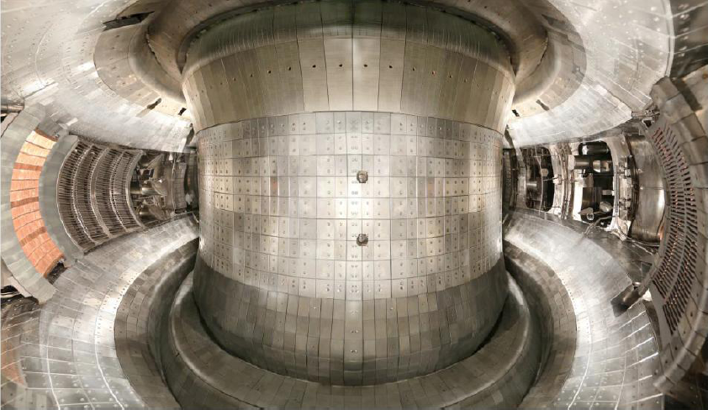
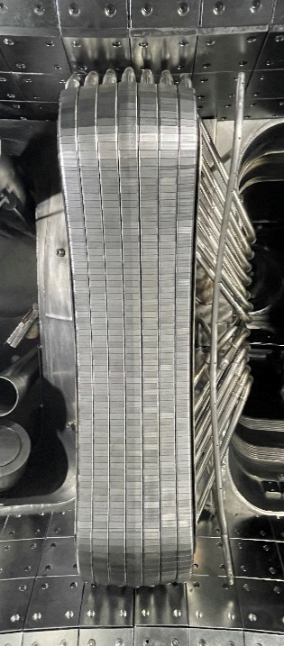
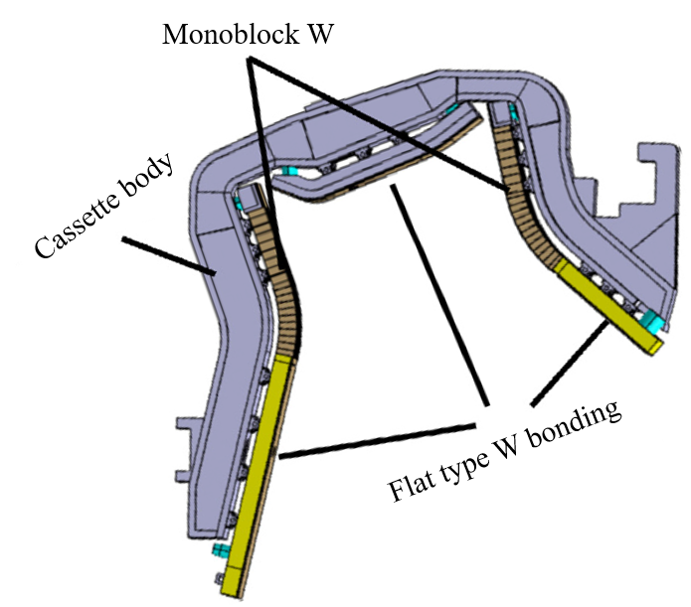
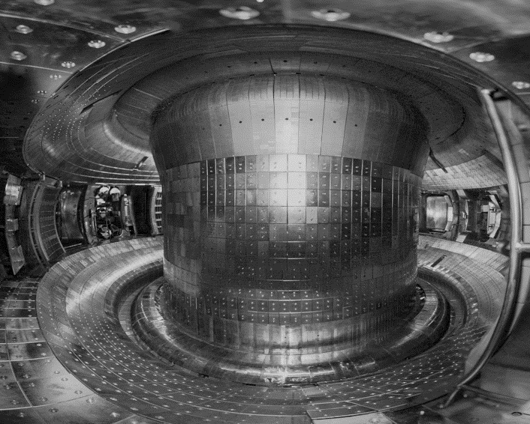
EAST plasma facing components
W
Mo
Full metal wall from May 2021
First Wall: TZM (Titanium-Zirconium-Molybdenum) alloy
Upper divertor: ITER-like W/Cu monoblock
Lower divertor: W/Cu monoblock
Main Limiter: W/Cu monoblock
Guard Limiter of LHW: Tungsten block
Mo
C
Mo
2014 - 2020
DIVERTOR
W/Cu Divertor
W
Monoblock
Flat-type
Mo
Mo
Intrinsic & extrinsic impurities;
He, Li, (B), C, N, O, (Ne), (Si), (Ar), Fe, Cu, Mo, W…
Main Limiter
Monoblock
W/Cu
Mo
W

Slide 4
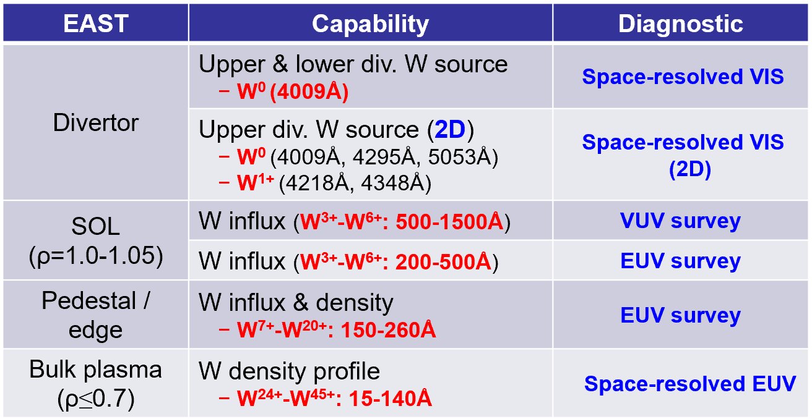
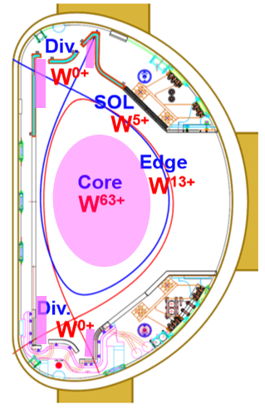
Overview of tungsten spectroscopy diagnostics in EAST
Quantitative analysis for study on W production and transport
  W source mainly from W⁰ (4009 Å)
  W influx from weekly ionized W ions at edge ( ~ W³⁺-W²⁰⁺ )
  W density profiles in bulk plasma ( ~ W²⁴⁺-W⁴⁵⁺ or higher)
Observation of W⁰-W²⁸⁺ ions existing in Div.-SOL-pedestal of ITER or EAST plasma is crucial important for tungsten production, penetration and edge transport study.

Slide 5
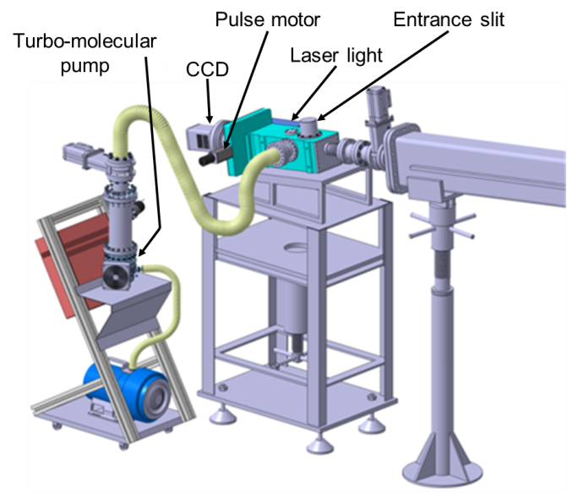
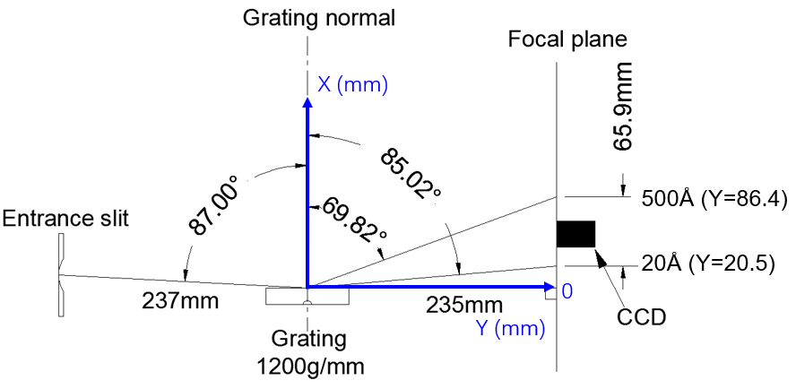
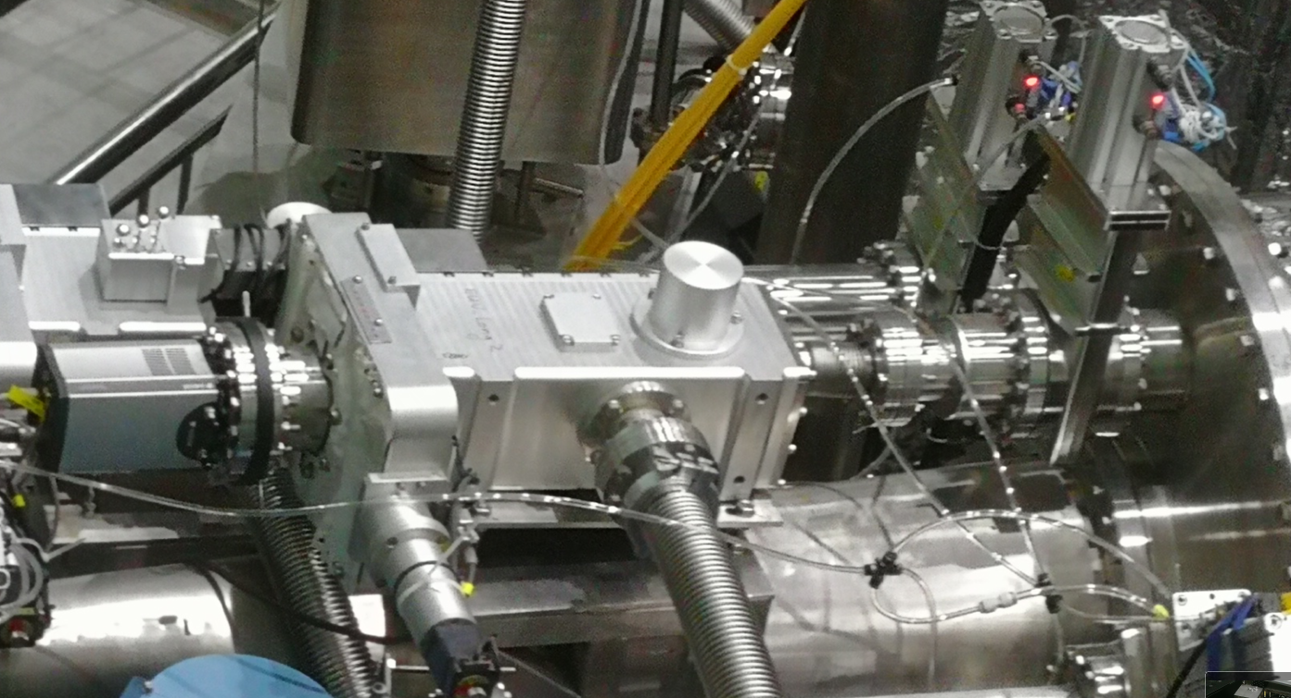
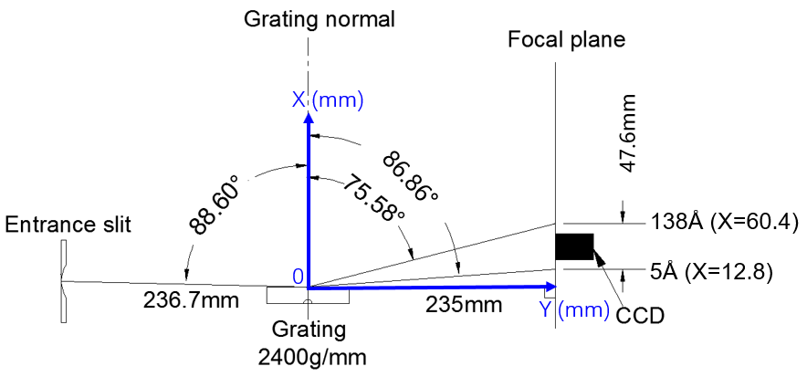
EUV (Extreme ultraviolet) spectrometers
Grazing incidence flat-field EUV spectrometers
Optical layout of EUV spectrometers
Laminar-type varied-line-spacing concave holographic grating
  1200 g/mm (20-500 Å) & 2400 g/mm (5-138 Å)
Back-illuminated charge-coupled device (Andor CCD)
Pulse motor for wavelength scan
Laser light for optical alignment
Turbo-molecular pump for vacuum system

Slide 6
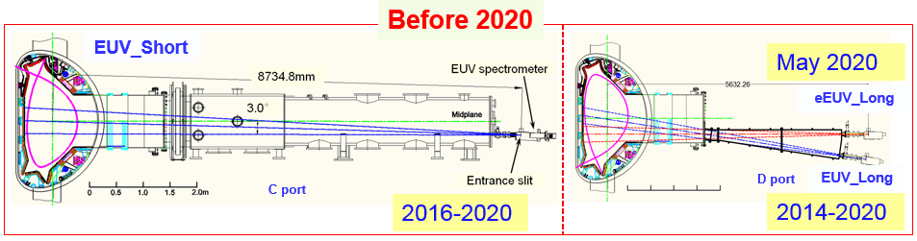
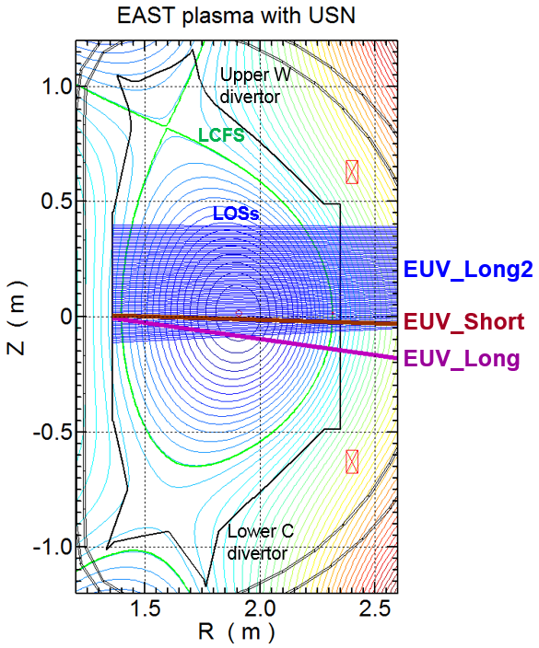
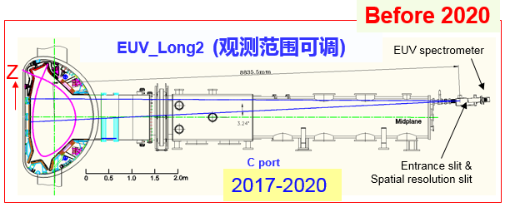
Development of EUV system on EAST
Fast-time response EUV (5ms)：
Pasma core
Limited wavelength range
Difficulty to observe lowly charge ions
EUV_Long2
Space-resolved EUV：
Limited observation range
Low time resolution (200ms/frame)

Slide 7
Outline
  Introduction and motivation
  Fast-time-response EUV spectrometers
  Space-resolved EUV spectrometers
  Summary

Slide 8
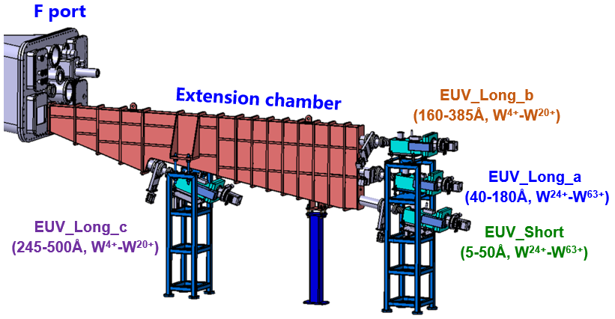
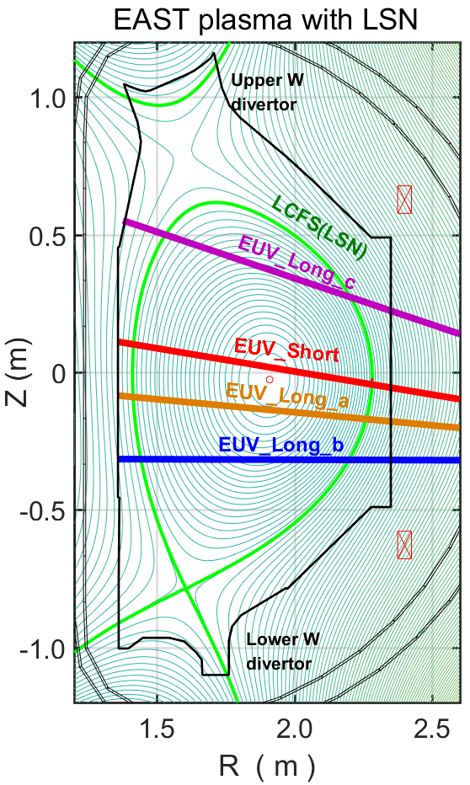
EUV survey: Fast-time-response spectrometers (5ms/frame)
4 grazing incidence Flat-field spectrometers (Arrangement since 2021)
Spectrometer Name | λ range | Working λ range | Observation range | Resolution |  | Ions (Identified)
 |  |  |  | Spectral | Temp.
EUV_Short | 5-138Å | 5-50 Å | core | 0.1@20 Å | 5 ms | He⁺, Li⁺-Li²⁺, B³⁺-B⁴⁺, C²⁺-C⁵⁺，O²⁺-O⁷⁺，Ne⁺-Ne⁹⁺，Al³⁺-Al¹²⁺, Si⁴⁺-Si¹¹⁺， Ar⁹⁺-Ar¹⁵⁺, Fe⁴⁺-Fe²³⁺，Cu⁹⁺-Cu²⁶⁺，Mo⁴⁺-Mo³¹⁺， W³⁺-W⁴⁵⁺，…
EUV_Long_a | 20-500Å | 40-180 Å | ρ=0.1 | 0.22@200 Å
EUV_Long_b | 20-500Å | 130-335 Å | ρ=0.4 | 0.22@200 Å
EUV_Long_c | 20-500Å | 235-485 Å | ρ=0.7 | 0.22@200 Å
L. Zhang Rev. Sci. Instrum. 86 (2015) 123509
X. Zong Nucl. Instrum. Meth. A 1010 (2021) 165545

Slide 9
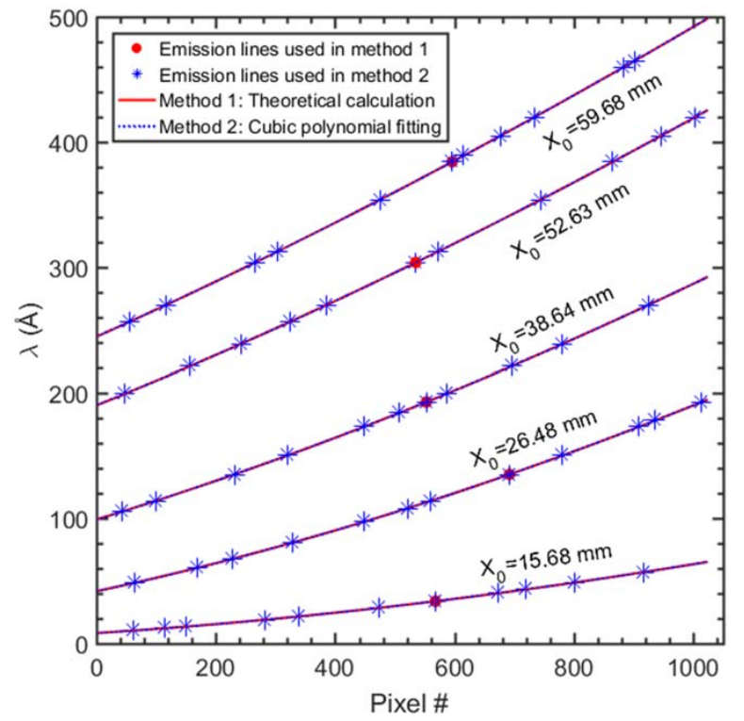
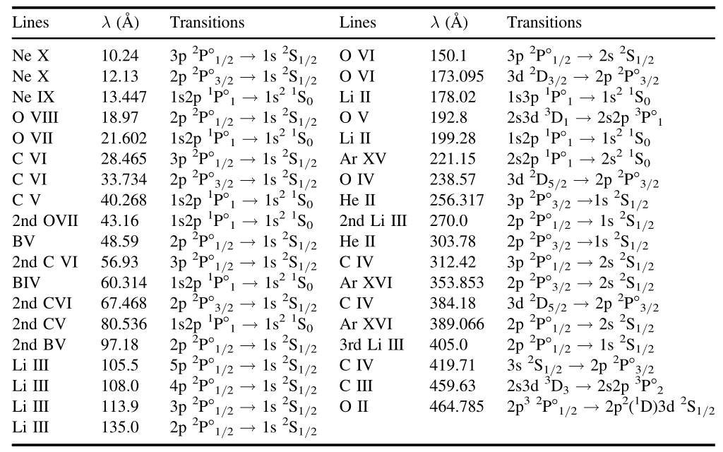
Wavelength Calibration
  Method 1: Calibration based on grating equation
Calibration results based on method 1 and 2
  d: grating grove spacing
  α: incidence angle
  X: CCD position
  Method 2: Cubic polynomial fitting with well-known spectral lines
  Method 3: Linear regression model with spectral line shape fitting
W. Zhang Phys. Scr. 99 (2024) 105609
L. Li Plasma Sci. Technol. 23 (2021) 075102
The uncertainty in wavelength reduce tenfold from ±0.05 Å to ±0.005 Å
Detailed Method 3 please refer the Zhenwei Li #92 Short talk 2004/10/23 15:25

Slide 10
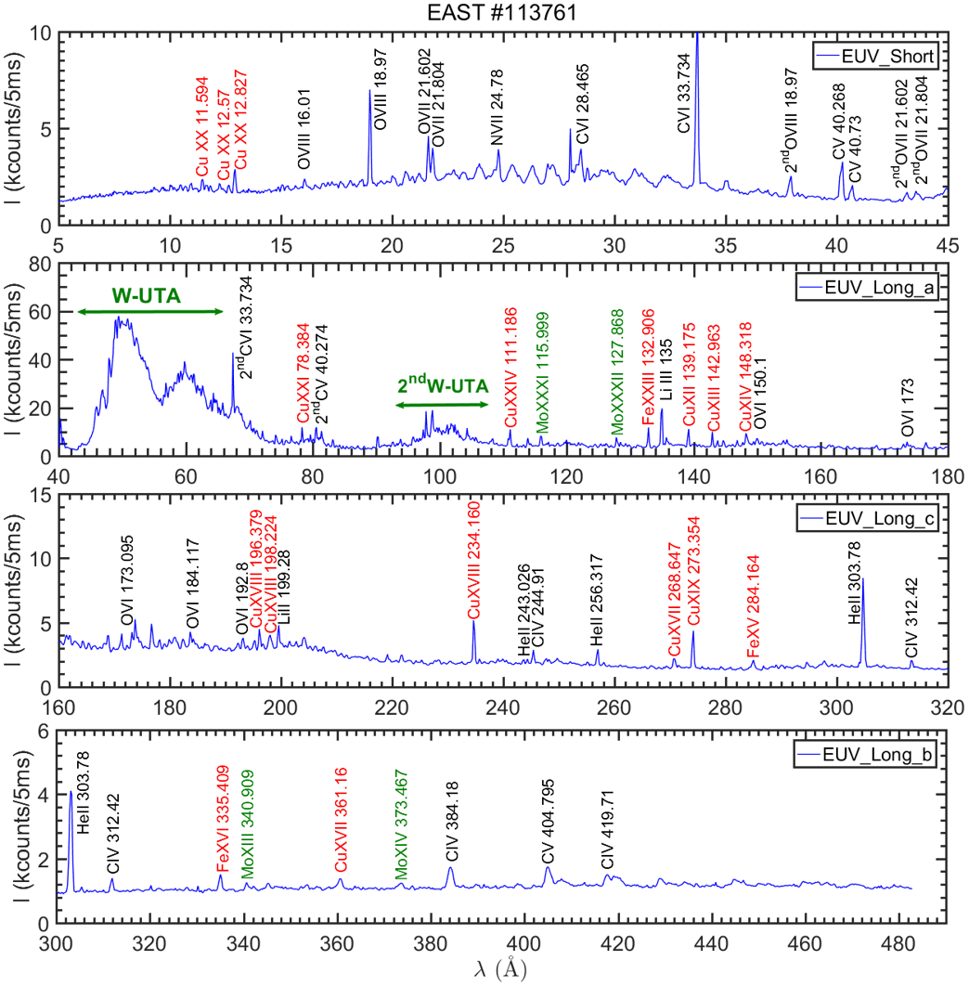
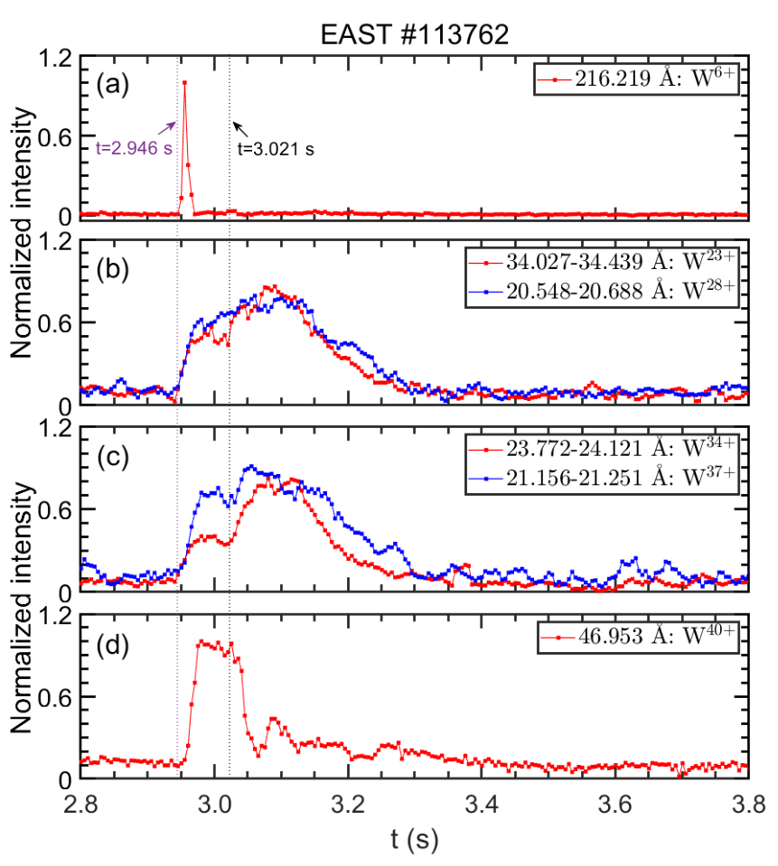
Observation results
Typical EUV spectra at 5-480 Å in EAST plasma with tungsten PFCs
Time evolution of tungsten line intensity in a typical tungsten sputtering event
Vertical dash-dotted lines at t=2.946 s and 3.021 s indicate start and end of first W burst,respectively.
10
W-UTA: tungsten-unresolved transition array
W. Zhang Phys. Scr. 99 (2024) 105609

Slide 11
Outline
  Introduction and motivation
  Fast-time-response EUV spectrometers
  Space-resolved EUV spectrometers
  Summary

Slide 12
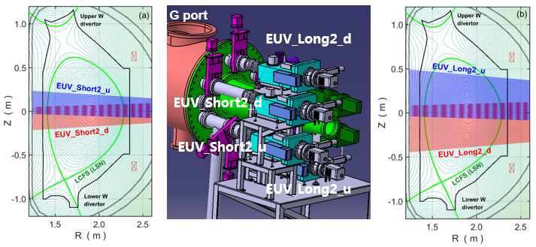
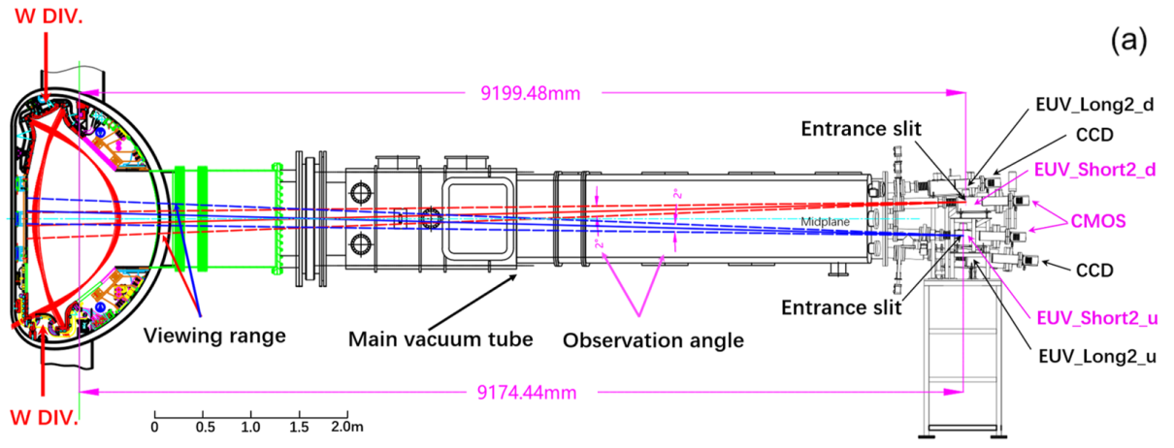
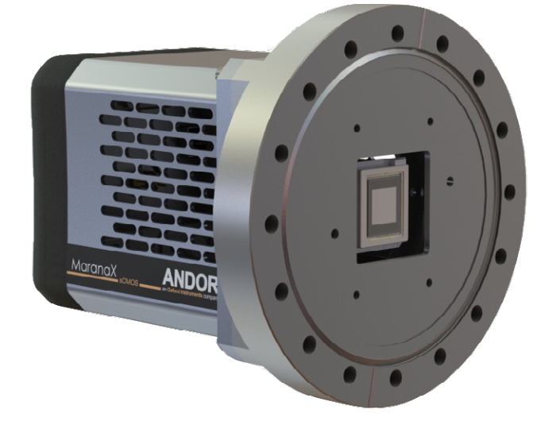
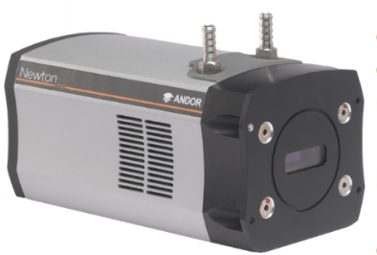
High-Z Impurity density profile measurement:
Space-resolved EUV spectrometers
4 space-resolved EUV spectrometer (arrangement since 2021)
CMOS
CCD
 | λ range | Temporal Reso. | Spatial Reso. | Viewing range | Detector | Pixel Size
EUV_Short2 | 5-138 Å | 15 ms/frame | 2.5 cm | ±25 cm | CMOS (2048 × 2048) | 6.5 μm
EUV_Long2 | 30-520 Å | 50 ms/frame | 2.5 cm | ±45 cm | CCD (1024 × 255) | 26 μm
Ions (ρ≤0.7) | W²⁴⁺-W⁴⁵⁺, Mo²⁴⁺-Mo³¹⁺, Cu¹⁹⁺-Cu²⁶ ⁺, Fe¹⁸⁺-Fe²³⁺…
L. Zhang Nucl. Instrum. Meth. A 916 (2019) 169
Y.X. Cheng Rev. Sci. Instrum. 93 (2022)123501
Y.X. Cheng Nucl. Instrum. Meth. A 1057 (2023) 168714

Slide 13
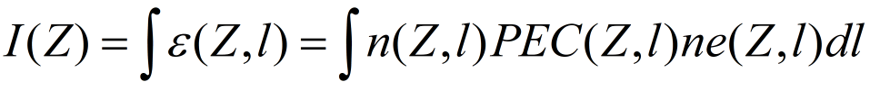
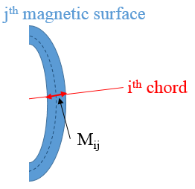
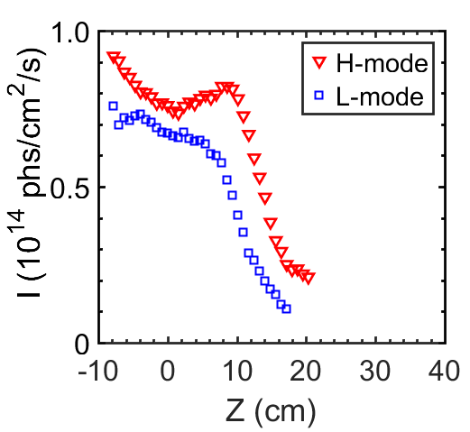
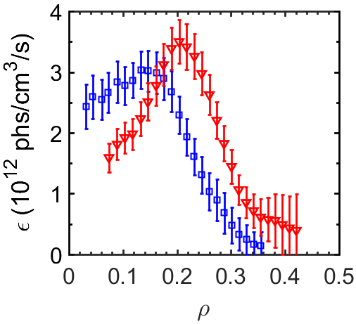
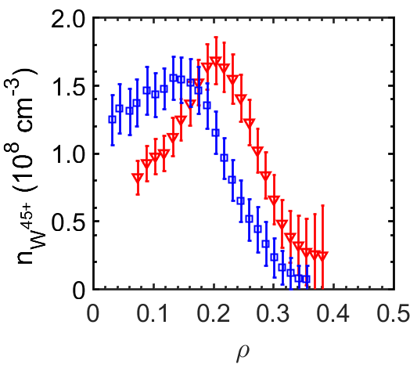
Calculation of radial profile of impurity ion density based on Abel inversion
M · E = I E = M⁻¹ · I
I: Chord-integral intensity measured by space-resolved EUV spectrometer
M: Length matrix of sightlines, M_{ij} : length of sightline i at magnetic surface j
E: Local emissivity, E_{j} : emissivity at magnetic surface j
PEC: Photon Emissivity Coefficients (from ADAS database)
Intensity profile of W⁴⁵⁺ 126.998 Å
Local Emissivity profile
Density profile
Abel inversion
PEC
Y.X. Cheng IEEE Trans. Plasma Sci. 50 (2022) 691

Slide 14
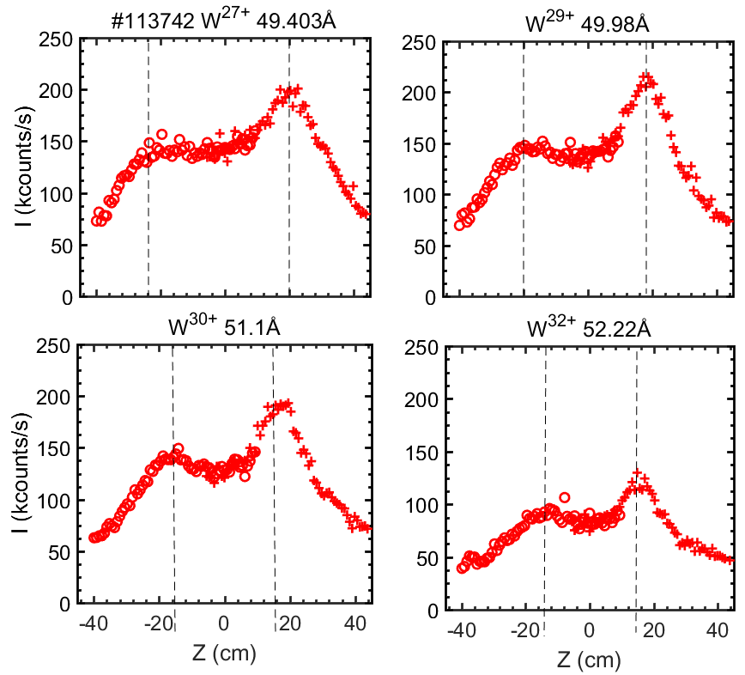
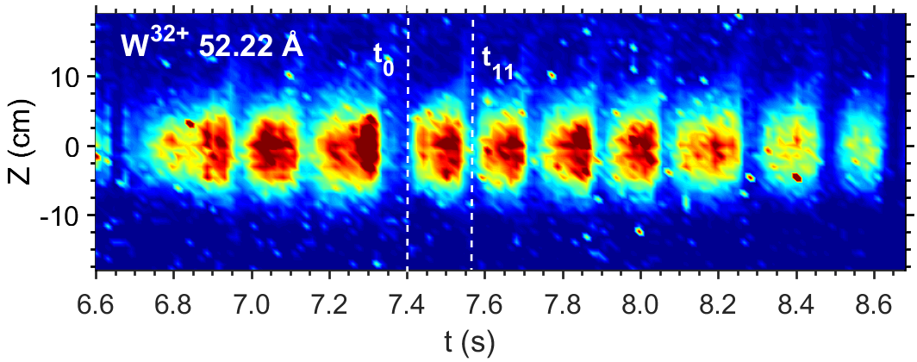
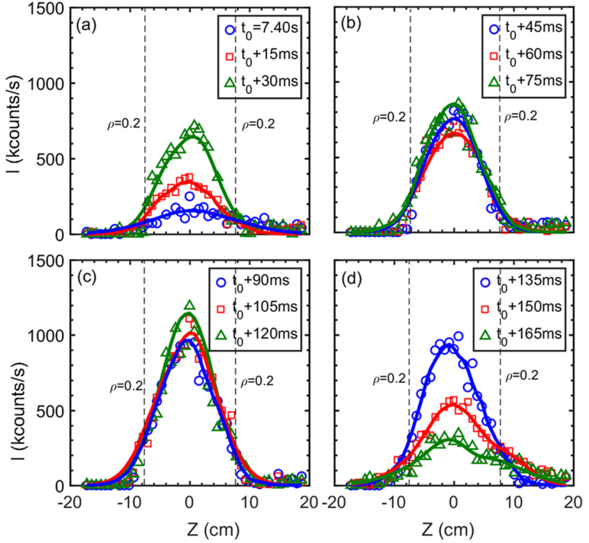
High-Z Impurity density profile measurement:
Space-resolved EUV spectrometers
Full Vertical profile of different tungsten ions
Variation of W³²⁺ ion profile during sawtooth
Y.X. Cheng Rev. Sci. Instrum. 93 (2022)123501

Slide 15
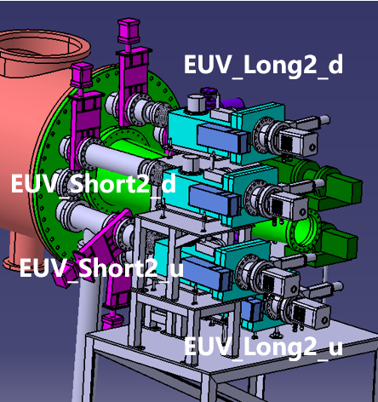
Summary
  Multiple Systems for Comprehensive Analysis: Sets of EUV spectrometers with high performance have been developed covering the full wavelength and space range to observe the behavior of impurity ions at different regions of the plasma.
  Wide coverage of wavelength with high spectral resolution : The system covers a wide range from 5 Å to 500 Å, allowing for observation of multiple impurities ions in different ionization states, including low-Z impurities (C, N, O, B, Ar, Ne…) and high-Z impurities (W, Mo, Fe, Cu…).
  High Temporal Resolution: Capture impurity variations induced by rapid events in the plasma, such as impurity sputtering, disruptions, and MHD instabilities.
  Spatial Resolution: Track the spatial distribution and transport of impurities.
  Multiple observation lines : Giving a more complete picture of impurity transport from the edge to the core.

Slide 16
Summary
Spectrometer | Observation range | Time Reso. Δt | Wavelength range | Grating (gr/mm) | Ions
EUV_Short | core | 5 ms | 5-138 Å | 2400 (VLS) | He⁺, Li⁺-Li²⁺, B³⁺-B⁴⁺, C²⁺-C⁵⁺，O²⁺-O⁷⁺，Ne⁺-Ne⁹⁺，Al³⁺-Al¹²⁺, Si⁴⁺-Si¹¹⁺， Ar⁹⁺-Ar¹⁵⁺, Fe⁴⁺-Fe²³⁺，Cu⁹⁺-Cu²⁶⁺，Mo⁴⁺-Mo³¹⁺，W³⁺-W⁴⁵⁺，…
EUV_Long_a | ρ=0.1 | 5 ms | 20-500 Å | 1200 (VLS)
EUV_Long_b | ρ=0.4 | 5 ms | 20-500 Å | 1200 (VLS)
EUV_Long_c | ρ=0.7 | 5 ms | 20-500 Å | 1200 (VLS)
EUV_Short2_u | -7≤Z≤19 cm | 13.5 ms | 5-138 Å | 2400 (VLS)
EUV_Short2_d | -18≤Z≤8 cm | 13.5 ms | 5-138 Å | 2400 (VLS)
EUV_Long2_u | -6≤Z≤44 cm | 50 ms | 20-500 Å | 1200 (VLS)
EUV_Long2_d | -40≤Z≤10 cm | 50 ms | 20-500 Å | 1200 (VLS)
Visible 1D | -66 ≤Z≤71 cm | 25 ms | 300-1300 nm | 300, 1200, 2400 | W⁰ , W⁺ , Mo⁰ , B⁺ -B²⁺ , C⁰-C²⁺ …..
Visible 2D | Adjustable | 25 ms | 300-1300 nm | 300, 1200, 2400
*VLS: varied-line-spacing
#43 Short talk. First observation of full radial profile of Zeff using high-performance visible spectrometer in EAST tokamak.
#62 Poster. A space-resolved visible spectroscopic platform based on compact endoscopic optics for full radial profile measurement of impurity line emissions in EAST tokamak.

Slide 17


