Slide 1
7th International Conference on Frontier in Diagnostic Technologies,
21-24 Oct 2024 at Roma, Italy
ASIPP
First observation of full radial profile of Z_{eff}
using high-performance visible spectrometer
in EAST tokamak
Jiuyang Ma^{1,3} ,Yunxin Cheng¹ ，Ling Zhang¹*,,Ailan Hu¹ , Shigeru Morita² , Jihui Chen^{1,4}
Chengxi Zhou¹ ,Masahiro Kobayashi² , Haiqing Liu¹ , Xiang Gao¹*and Haotian Wu^{1,3}
¹ Institute of Plasma Physics, Chinese Academy of Sciences, Hefei 230031, China
² National Institute for Fusion Science, Toki 509-5292, Gifu, Japan
³ University of Science and Technology of China, Hefei 230026, China
⁴ Anhui University, Hefei 230026, China
* E-mail: jiuyang.ma@ipp.ac.cn
Short talk #43
Institute of plasma physics, Chinese Academy of Sciences
Notes:
Hello, professors and students, today I'm going to report on the work of First observation of full radial profile of Zeff using high-performance visible spectrometer in EAST tokamak

Slide 2
Outline
Introduction
Visible spectrometers and calibrations
Preliminary observation of full radial profile of Z_{eff} in EAST
Summary and future work
Notes:
The sfirst section is Introduction

Slide 3
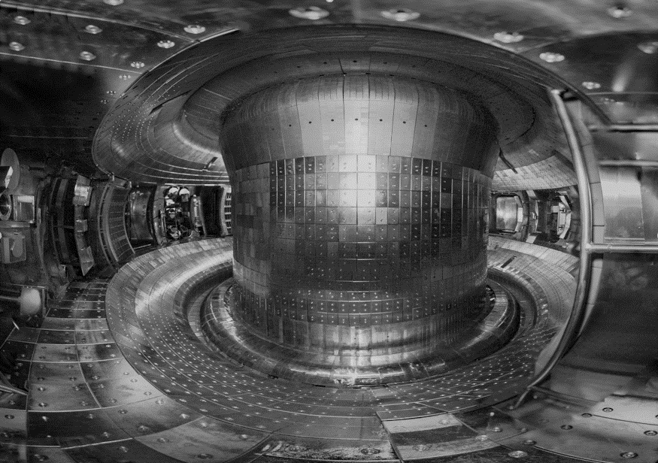
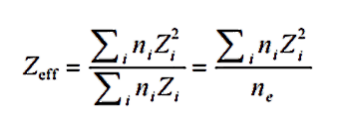
Introduction
First Wall: TZM (Titanium-Zirconium-Molybdenum) alloy
Upper divertor: ITER-like W/Cu monoblock
Lower divertor: W/Cu monoblock
The definition of Z_{eff}:
W
Mo
Mo
Mo
W
Z_{eff}:The effective ion charge
Quantifying the average ionization state of impurities.
Assessing plasma impurity level.
Assessing radial impurity distribution.
Higher levels of impurities can cause significant radiation losses, especially under tungsten divertor conditions.
The primary contribution comes from low-Z impurities.
Sources of Impurities in EAST
C,O,Fe,Cu,Mo,W: Water and oxygen adsorbed when the vacuum vessel is exposed to air, and impurities generated through interactions between the plasma and the first wall materials, divertor, and wave-heating antenna during discharges
He: Glow discharge cleaning
Li,B,Si: Interactions between the plasma and the coating materials on the first wall
Ne,Ar: Actively injected impurities
ITER: Z_{eff} is around 1.8±0.2
Notes:
Since 2010, the first wall of the EAST tokamak has been upgraded with a molybdenum alloy. In addition, the upper divertor of the EAST has been replaced with a tungsten monoblock since 2014 and the lower divertor since 2021. From 2021 , the EAST was operated in an all-metal environment. The excellent physical properties of tungsten have led to its selection for the design of ITER and CFETR. selected for the construction of the diveror and first wall.
The achievement of full radial profile of Zeff is essential not only for impurity level assessment, impurity control, plasma scenario development but also for the in-situ absolute intensity calibration of existing EUV spectrometers
The effective ion charge, Zeff, is a key parameter in magnetic confinement fusion plasma, quantifying the average ionization state of impurities and is critical for assessing plasma impurity level and radial impurity distribution.较高的杂质水平会引起很强的辐射损失，尤其是在钨偏滤器条件下。 In ITER tokamak, the expected Zeff is around 1.8, with permissible variations limited to ±0.2.
Zeff 的诊断手段在现阶段来说主要有可见轫致辐射、电荷交换复合光谱（CXRS ）、CXRS 背景光谱等常用的方法。其中，利用可见光谱分析的方法来测量Zeff 比较成熟可靠。等离子体中自由电子的运动速度发生变化时会产生电磁波辐射，就是轫致辐射。The visible bremsstrahlung measurement is a useful tool for measuring Zeff and therefore is widely used in many tokamak devices, including EAST [1], DIII-D [2], ASDEX Upgrade [3].

Slide 4
Outline
Introduction
Visible spectrometers and calibrations
Preliminary observation of full radial profile of Z_{eff} in EAST
Summary and future work
Notes:
The subsequent section is Impurity composition before and after boronization

Slide 5
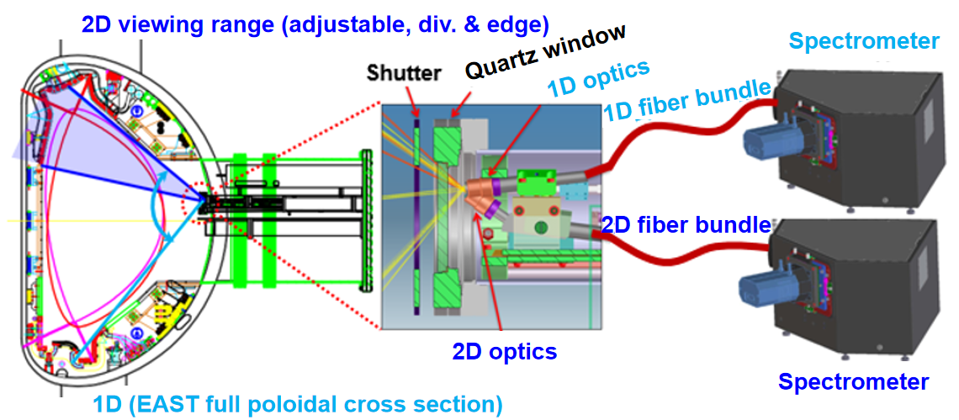
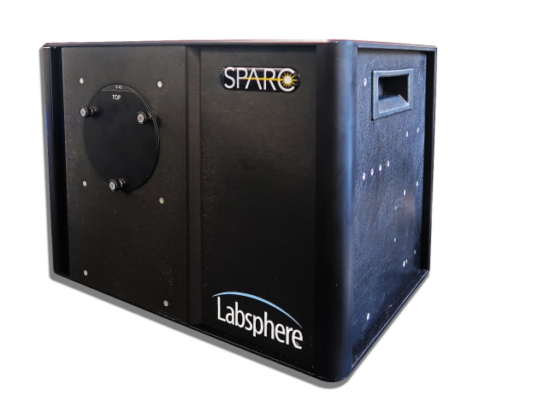
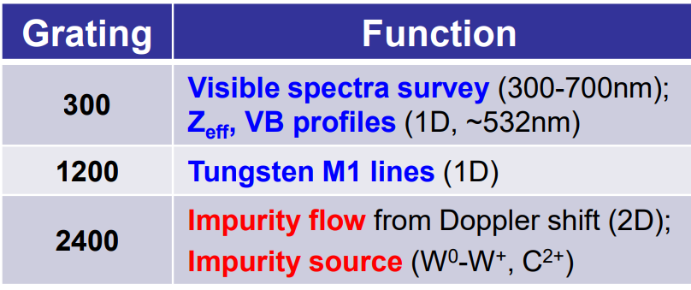
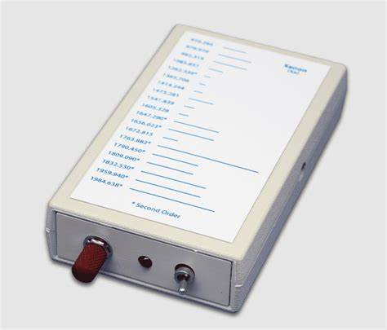
Visible Spectrometers
ASIPP
Endoscopic optics
- 1D full radial profile: ∆Z=145 cm
Working wavelength
- 370-850nm
Fiber bundles
- 1D:60(115/125um)
Spectrometers (Mk-300)
- Entrance slit: 0.01-4.0mm
- Gratings: 2400,1200,300 g/mm
Detector: Andor Marana CMos
- 2048 x 2048 pixel,
- 11um,22.53 x 22.53 mm
• Wavelength and Absolute Intensity calibration:
5
Details in AL Hu poster (#62, 2024/10/21 18:05)
Notes:
in EAST, based on the endoscopic optic design a space-resolved visible spectrometer working at 370-850 nm has been newly developed to observe full radial profile of line emissions from lowly charged impurity ions and visible bremsstrahlung continua.
The visible spectrometer system consists 1d和2d两套系统，都配备了three different gratings with groove densities of 300, 1200, and 2400 grooves per millimeter, a，实现不同的分辨率nd a CMOS detector (Andor Marana 4.2B). The detection system CMOS with an effective area of 22.53 × 22.53 mm^2 and a pixel resolution of 2048 × 2048。
The 1D visible spectrometers, operational within the wavelength range of 370-850 nm，designed to probe the full cross-sectional area of the EAST device spanning a ΔZ of approximately 145 cm.

Slide 6
Outline
Introduction
Visible spectrometers and calibrations
Preliminary observation of full radial profile of Z_{eff} in EAST
Summary and future work
Notes:
The subsequent section is Impurity composition before and after boronization

Slide 7
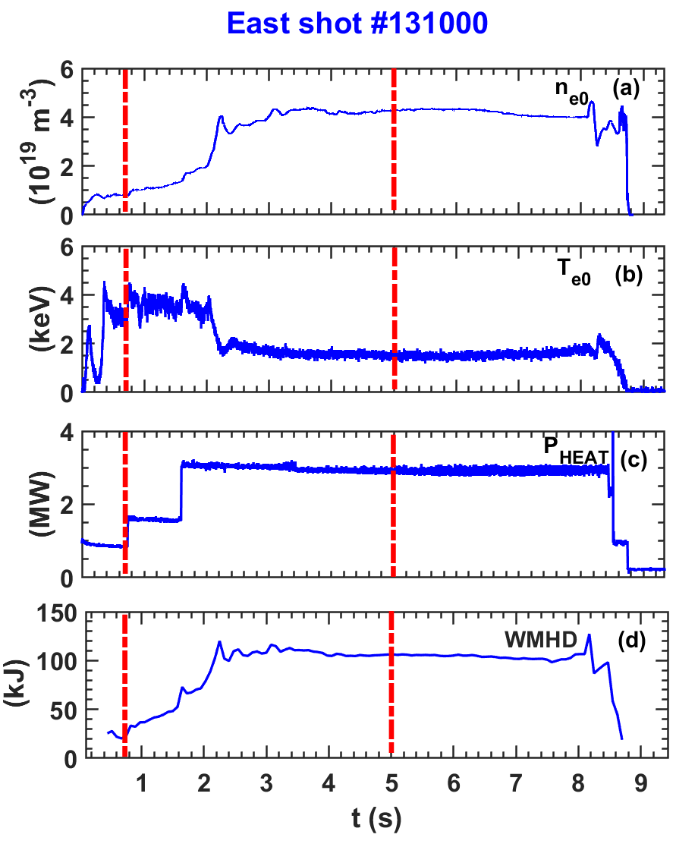
Viewform of discharge used in measurement of Z_{eff}
ASIPP
The #131000 plasma parameters:
I_{p} = 400 kA,
n_{e0} = 4.0×10¹⁹ m⁻³,
T_{e0} = 2.0 keV,
P_{ECRH} = 3MW,
A double null configuration,
Vertical field orientation (B×∇B): upper.
Operation of the spectrometers:
Entrance slit : 50 µm width,
Grating : 300 grooves/mm @ 500nm,
Cycle time : 100 ms/frame.
7
Notes:
The typical discharge (#131000) plasma parameters 如图上所示 . The plasma current (Ip) was maintained at 400 kA, with a double null configuration. Concurrently, the line-averaged electron density and the temperature profiles分别为4.0×10^19 m^-3， 2.0keV在flat时期.选取5s附近作为剖面研究时间段。
In this work, the entrance slit with 50 µm width, a grating with 300 grooves/mm, cycle time of 100 ms/frame is set respectively for the observation. And the bremsstrahlung at central wavelength of 597.3 nm with a bandwidth of 0.3 nm is selected for the calculation of Zeff profiles.
在这项工作中，分别为观察设置了50微米宽的入口狭缝、300线/mm的光栅和100毫秒/帧的循环时间。并选择中心波长为523纳米、带宽为0.2纳米的制动辐射来计算 Zeff轮廓。

Slide 8
Results of full spectrum measurements
The selected wavelength bands for Z_{eff} measurement : 600.3 nm.
• 0.7-0.9s:
mid plane
• 0.7-0.9s:
lower divertor
8
Notes:
The typical discharge (#131000) plasma parameters 如图上所示 . The plasma current (Ip) was maintained at 400 kA, with a double null configuration. Concurrently, the line-averaged electron density and the temperature profiles分别为4.0×10^19 m^-3， 2.0keV在flat时期.选取5s附近作为剖面研究时间段。
In this work, the entrance slit with 50 µm width, a grating with 300 grooves/mm, cycle time of 100 ms/frame is set respectively for the observation. And the bremsstrahlung at central wavelength of 597.3 nm with a bandwidth of 0.3 nm is selected for the calculation of Zeff profiles.
在这项工作中，分别为观察设置了50微米宽的入口狭缝、300线/mm的光栅和100毫秒/帧的循环时间。并选择中心波长为523纳米、带宽为0.2纳米的制动辐射来计算 Zeff轮廓。

Slide 9
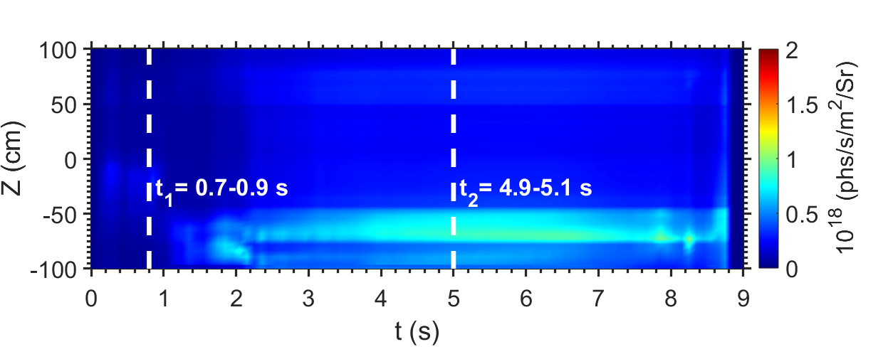
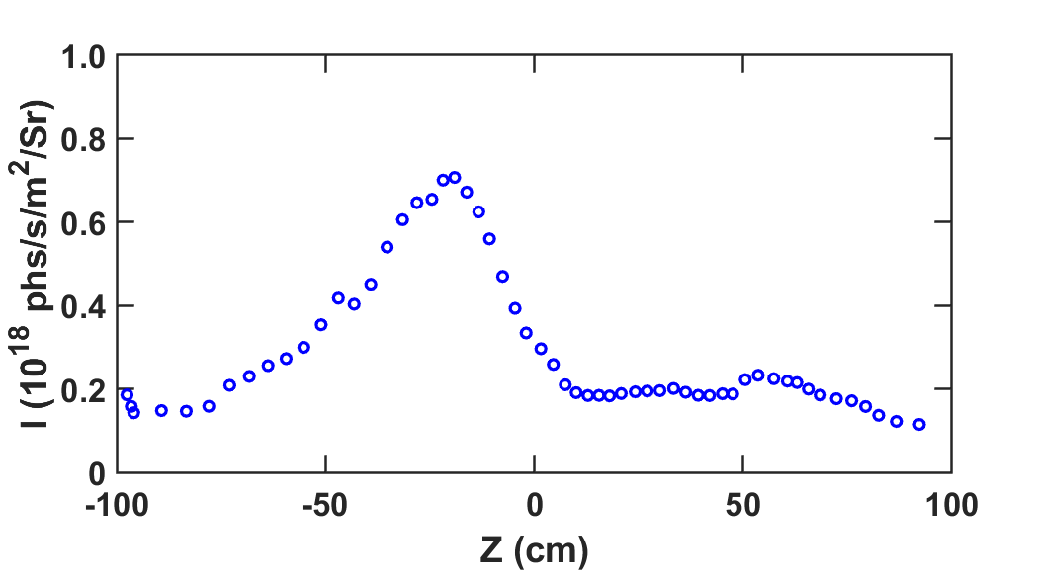
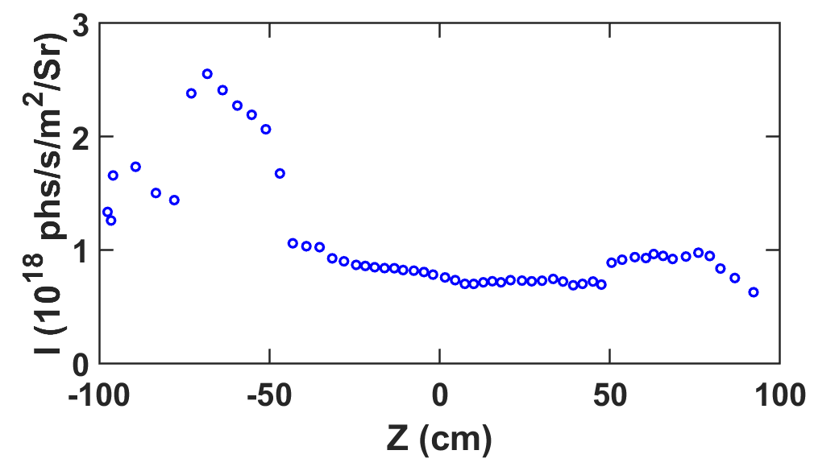
Vertical profile of visible bremsstrahlung intensity
ASIPP
Time evolution of bremsstrahlung profile:
Bremsstrahlung profile: (593±1nm)
t₁ = 0.7-0.9s:
t₂ = 4.9-5.1s:
Strong asymmetry is observed in VB profiles
Double peak positions in full vertical profiles of VB intensity
t≤1.1s: VB peaked at core region due to limiter configuration
t>1.1s: VB peaked at plasma edge due to formation of divertor configuration
9
Notes:
Precise wavelength and absolute intensity calibration enables an accurate determination of bremsstrahlung intensity across all channels.结合可见谱仪对数据进行进一步处理，可以得到 full radial profile of visible bremsstrahlung intensity at 523nm. The time evolution and spatial distribution at the moments from 4.95 to 5.05 are shown above.It is observed that during the initial phase of the discharge, the intensity of the visible bremsstrahlung is weak and primarily located in the core. A significant enhancement at the boundary is caused by the injection of ECRH at 1.6 seconds. After entering the flat-top phase around 2.2 seconds, the intensity peaks, with a more pronounced increase at the boundary compared to the core, and is mainly concentrated near the lower divertor.

Slide 10
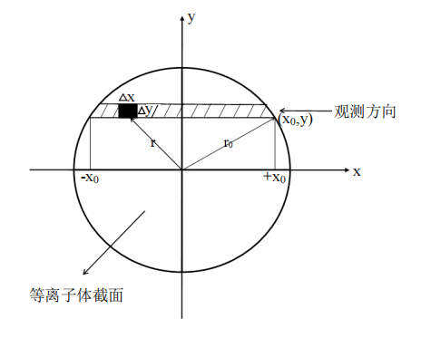
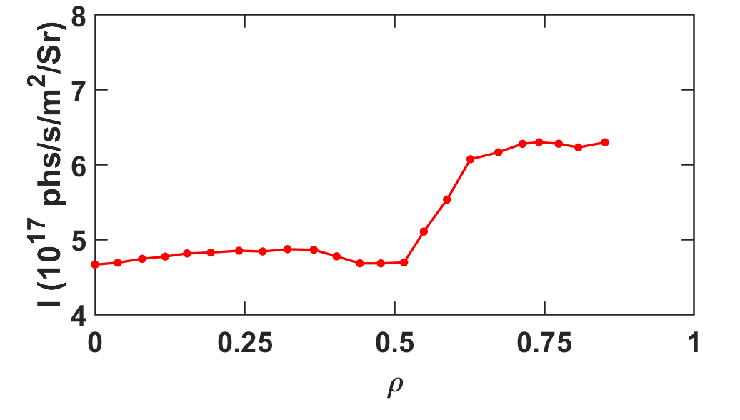
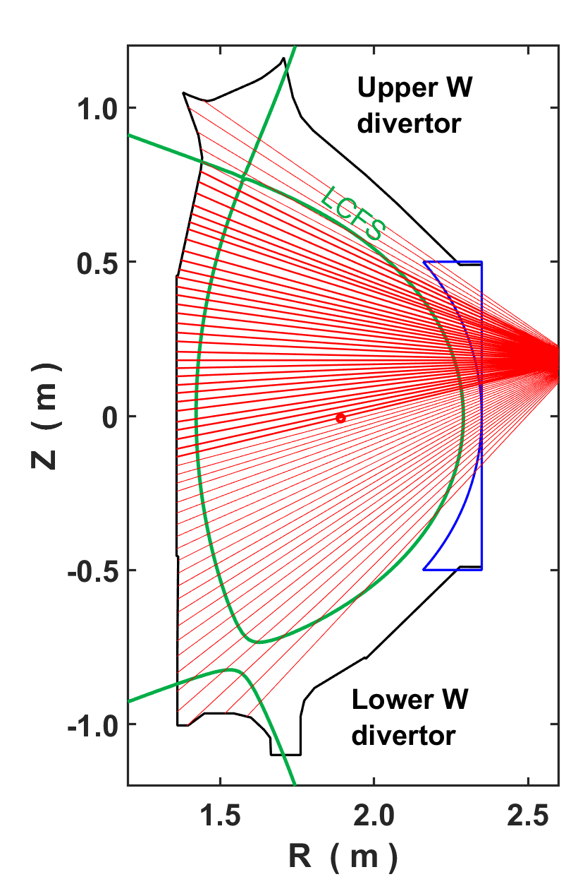
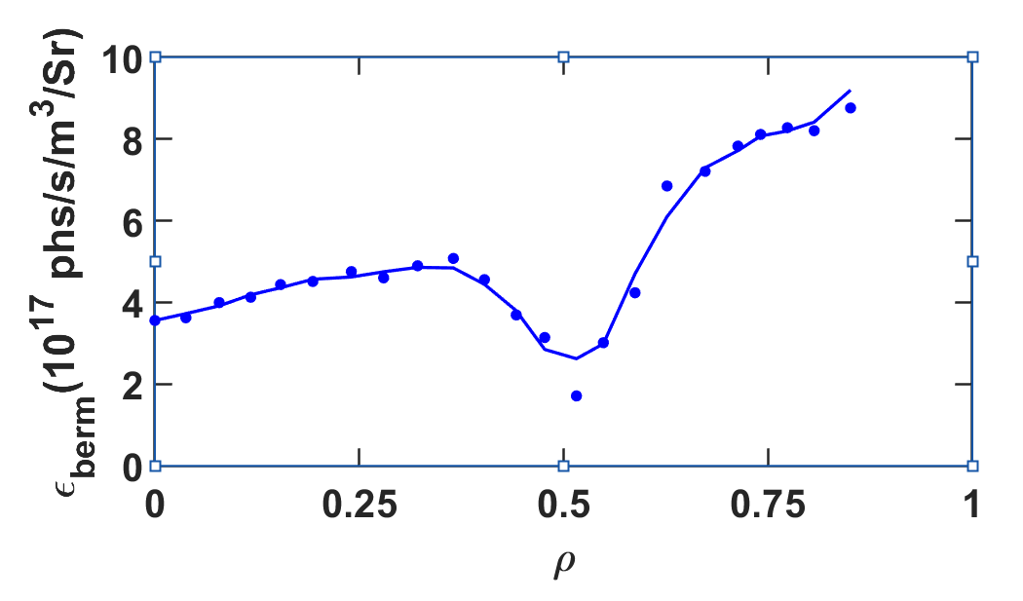
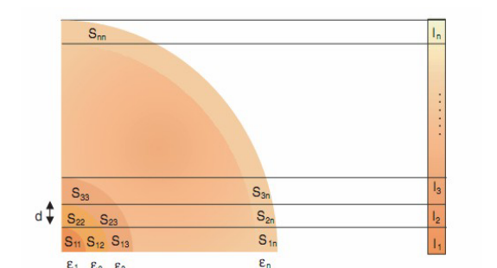
Bremsstrahlung emissivity and intensity spatial distribution
ASIPP
Intensity spatial distribution:
Abel inversion: (4.9-5.1s)
Viewing
direction
Plasma cross
section
Bremsstrahlung emissivity：
Plasma cross
section
10
Notes:
Local bremsstrahlung emissivity profile is then derived from the space-resolved measurement of these chord-integrated bremsstrahlung intensity by Abel inversion methods based on the EFIT magnetic equilibrium calculation and measurement of electron density and electron temperature profiles. 通常计算得到的系数矩阵L的条件数都比较大，矩阵是病态的，给方程求解带来困难
根据基于EFIT磁平衡计算的Abel反演方法以及电子密度和电子温度轮廓的测量，从这些弦积分的制动辐射强度测量中导出局部制动辐射发射率轮廓。解表现出不稳定性甚至不能求解。通常采用正则化方法[24,28-34]米求解不适定问题。这里我们采用奇异值分解的方法束求解轫致辐射的分布。
Local bremsstrahlung emissivity profile is then derived from the space-resolved measurement of these chord-integrated bremsstrahlung intensity by Abel inversion methods based on the EFIT magnetic equilibrium calculation and measurement of electron density and electron temperature profiles.
The local bremsstrahlung emissivity and the spatial distribution pattern of the bremsstrahlung intensity are similar, which further demonstrates the reliability of the inversion.轫致辐射功率随小半径的变化如图 4-11 所示。In the regions where impurities accumulate, the bremsstrahlung emissivity is higher.This also confirms the reliability.
这一张讲局部发射率的图

Slide 11
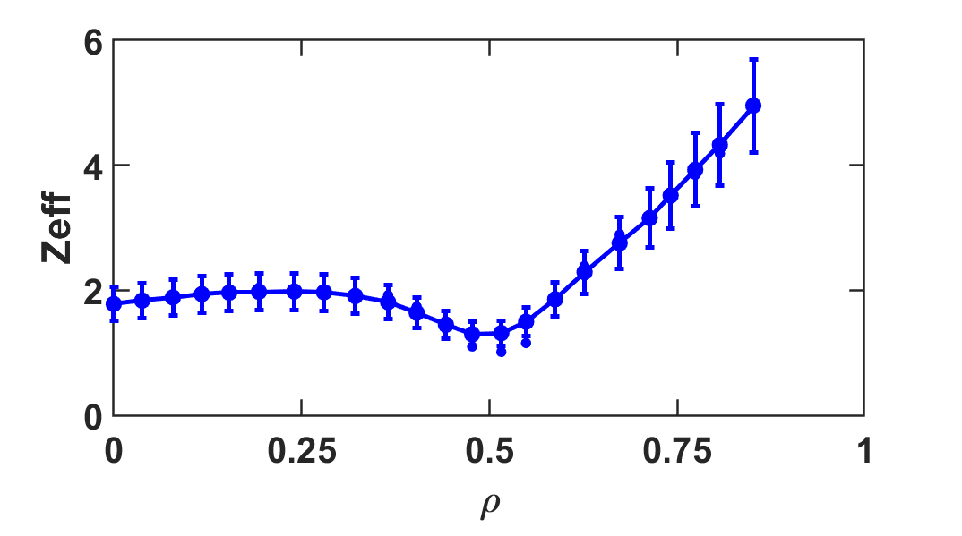
Preliminary observation of full radial profile of Z_{eff} in EAST
ASIPP
Profile of n_{e} and T_{e} :
Radial profile of Z_{eff}: (597.3±0.1nm)
ρ<=0.5: Z_{eff} is relatively flat
ρ >0.5: Z_{eff} increase quickly
11
Notes:
取相同时间相同半径的电子密度与电子温度和上面的得到的轫致辐射功率带入公式 2-4。由此就得到了不同小半径的有效电荷数。Under the configuration of the divertor, the distribution of the effective charge number is relatively flat, while due to the elongation of the plasma in the divertor configuration, a slightly higher effective charge number is measured at the boundary position.

Slide 12
Outline
Introduction
Visible spectrometers and calibrations
Preliminary observation of full radial profile of Z_{eff} in EAST
Summary and future work
Notes:
The subsequent section is Impurity composition before and after boronization

Slide 13
Summary and Future work
Summary
Visible spectra include line emission and VB continua at 370-850nm has been observed successfully by the newly developed space-resolved visible spectrometer. Full profiles of VB intensity has been analyzed for the first time.
A strong asymmetry has been observed in VB intensity profiles.
Using Abel inversion, the local emissivity profile has been derived from VB intensity, and the radial profile of Z_{eff} is obtained preliminarily.
Future work
Quantitative study on the contribution of impurity species to Z_{eff}
Study on asymmetric distribution of Z_{eff}
Study on Impact of wall reflection on VB intensity measurement

Slide 14
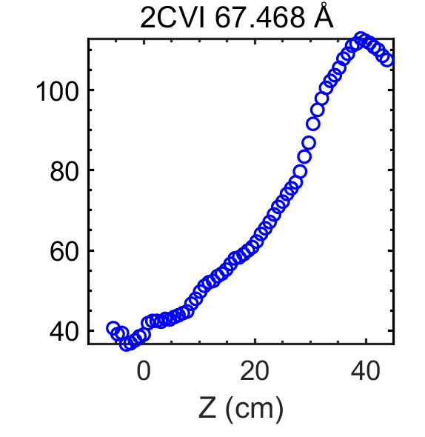
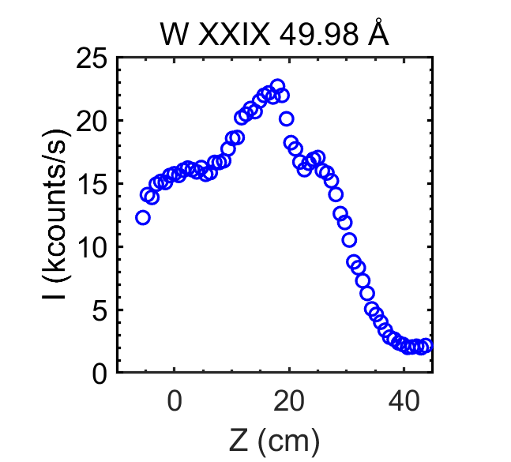
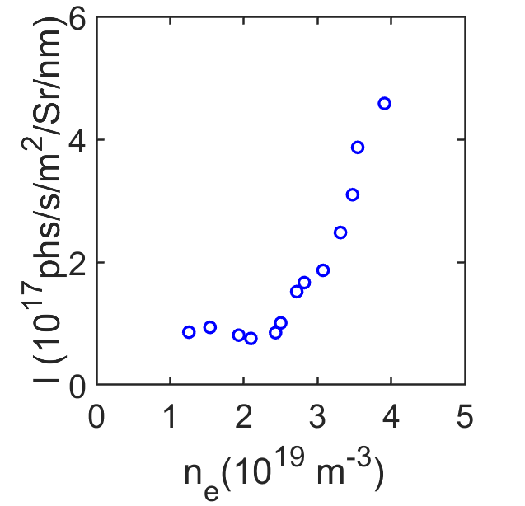
Impurity spectra and distribution measured by space-resolved EUV spectrometer

Slide 15
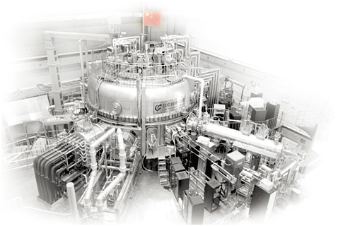
Thank you！
Notes:
Thank you!

