Slide 1


7th International Conference on Frontiers in Diagnotics Technologies
Oct. 21 2024−Oct. 23 2024
A novel terahertz line array detection scheme of solid-source interferometer system on EAST
Huihui Yan^{1,2}，Haiqing Liu¹, Shouxin Wang¹, Xuechao Wei¹, Yuan Yao¹,
Hui Lian¹, Weiming Li¹, and Yinxian Jie¹
1. Institute of Plasma Physics, Hefei Institutes of Physical Science (ASIPP)
2. University of Science and Technology of China (USTC)
E-mail: huihui.yan@ipp.ac.cn
2023年03月25日

Slide 2
outline
1 Introduction
2 SSI system on EAST and
Line array detection scheme
3 Experiment results and discussion
4 Summary

Slide 3
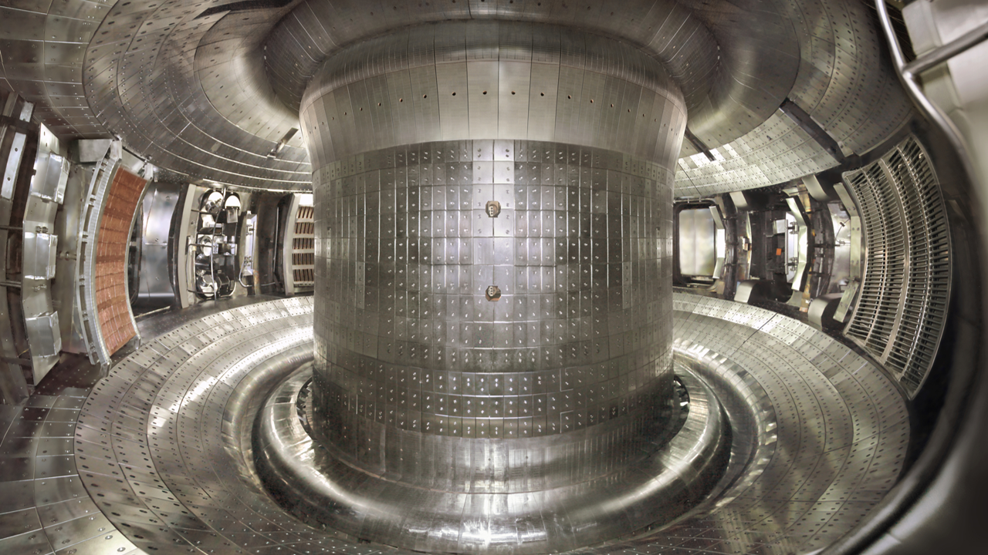
1. Introduction

Slide 4
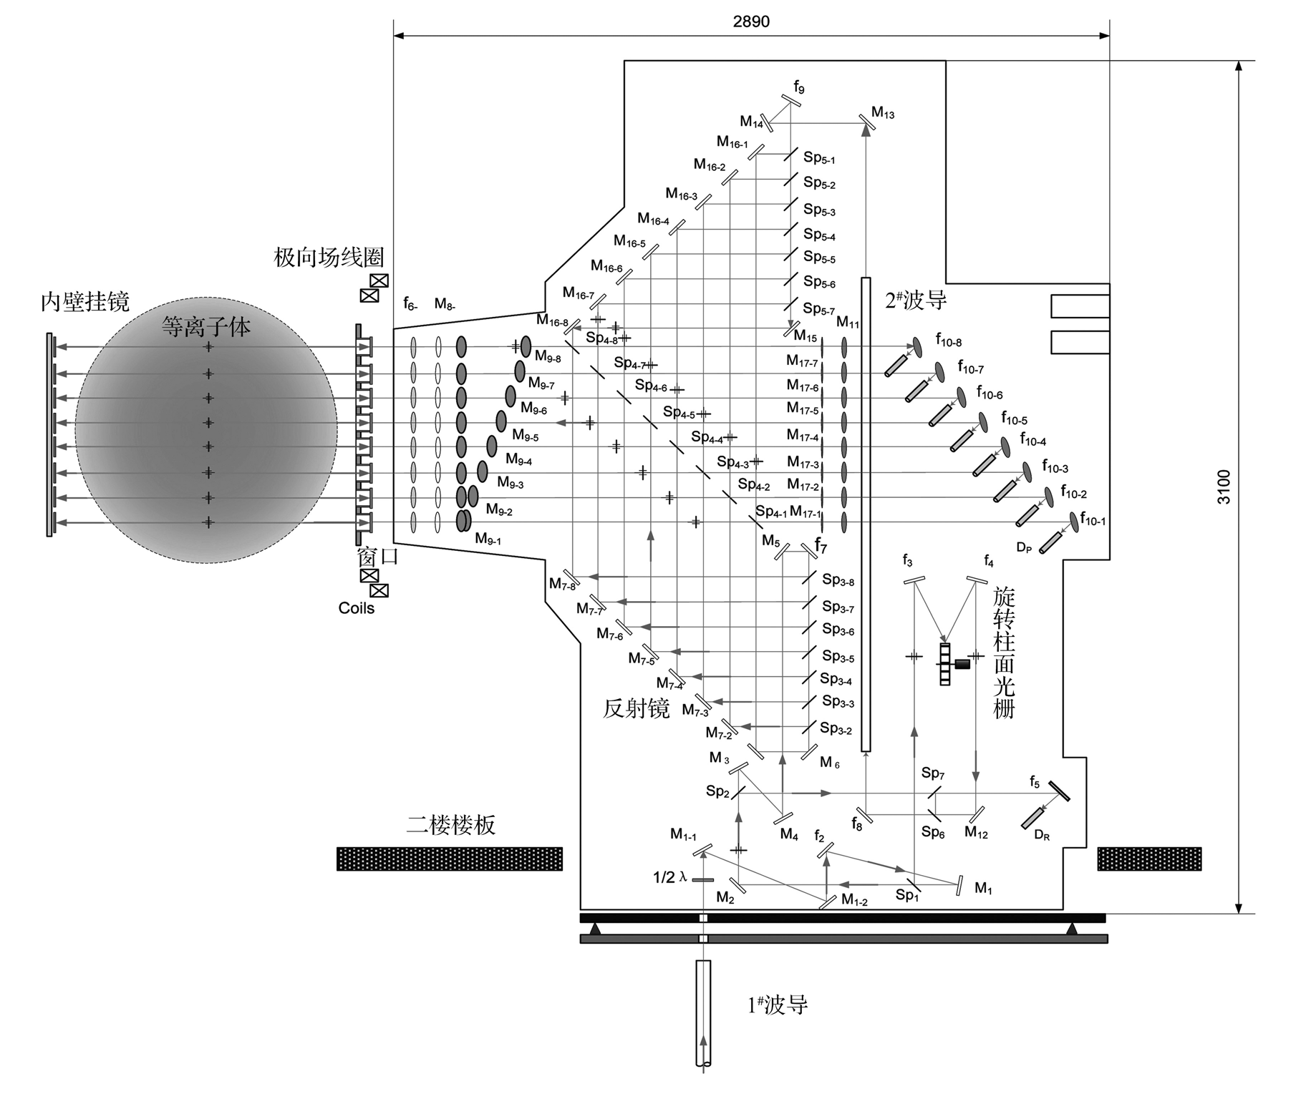
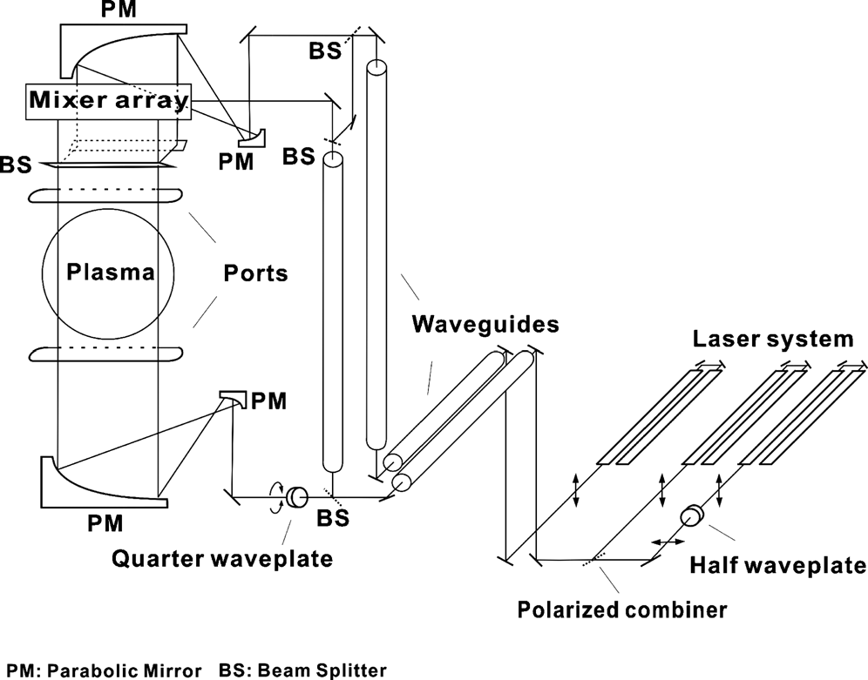
electron density diagnotics-Interferometry
plasma electron density is one of the most importamt parameter on tokamak
Interferometry has become a standard diagnostic means for measuring electron density profile on fusion devices.
J-TEXT
HL-2A
continuous multi-channel detection system
discrete multi-channel detection system

Slide 5
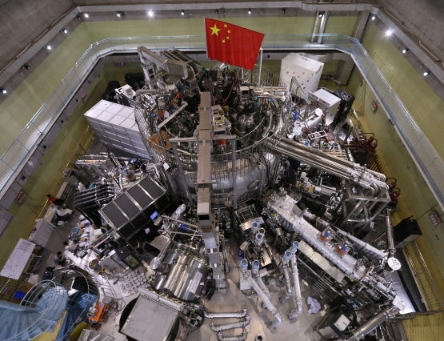
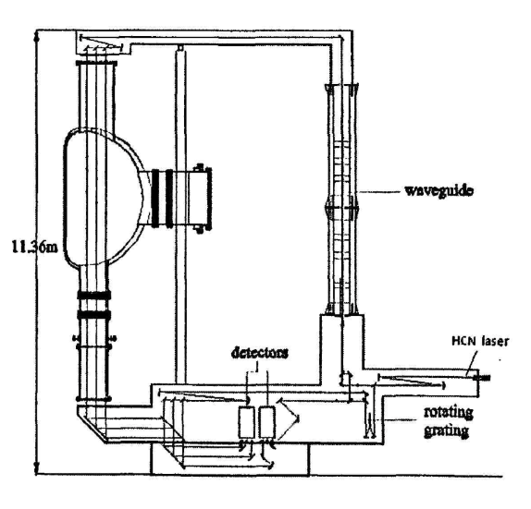
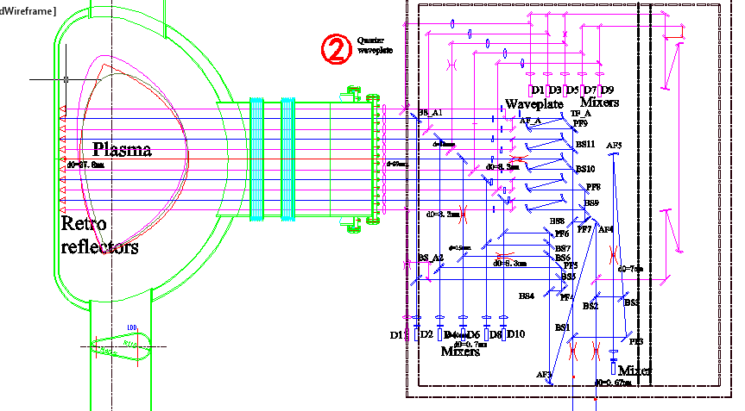
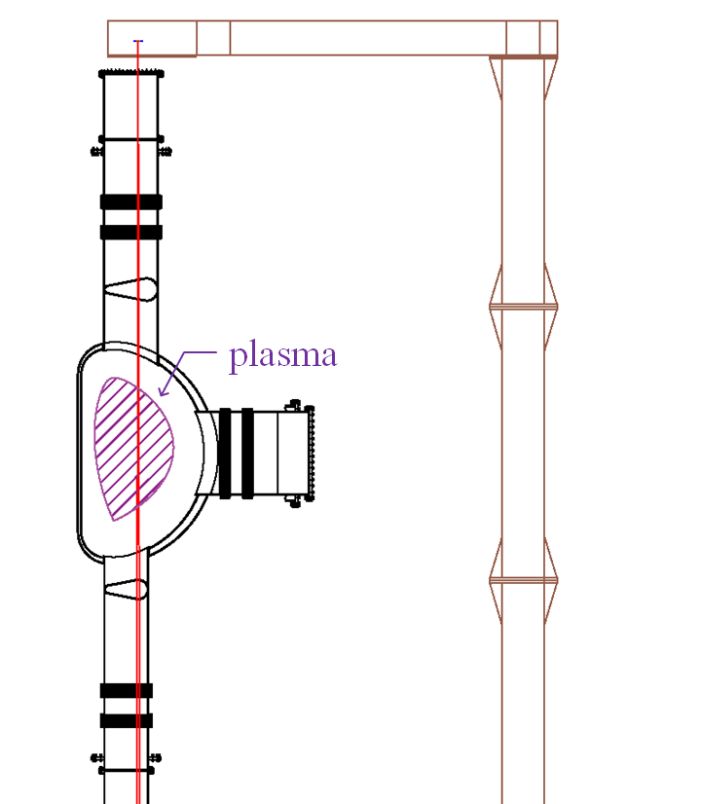
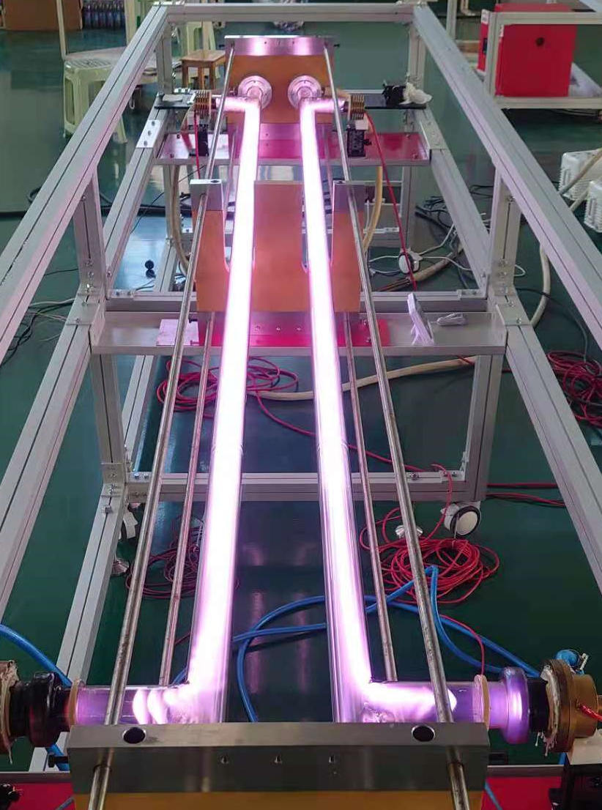
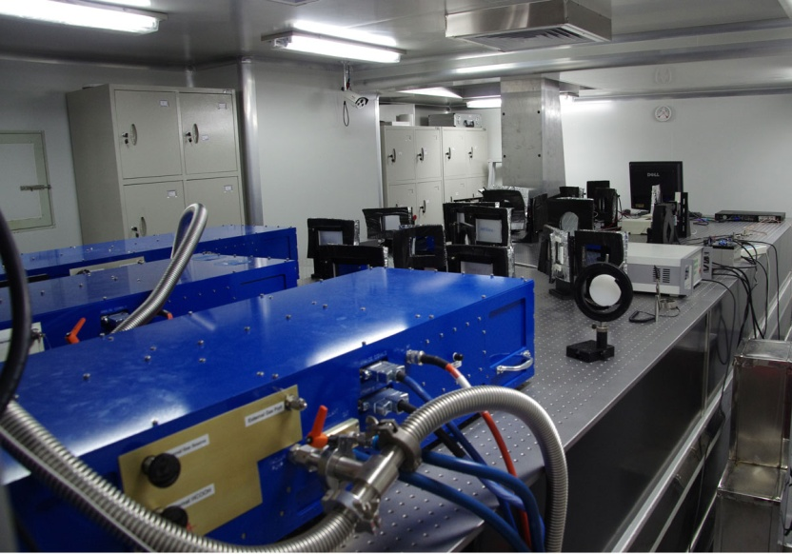
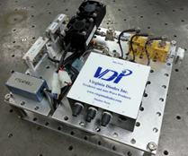
FIR interferometers on EAST
HCN interferometer
Polarimeter-INTerferometer
(POINT)
Solid-source interferometer
（SSI）
plasma
Hydrogen cyanide gas laser (HCN)
（0.89THz）
CO₂-pumped HCOOH lasers
（0.694THz）
Solid-state source
（0.65THz）
Notes:
considered as a promising diagnostic technique for future tokamak devices.

Slide 6
FIR interferometers on EAST
EAST
The study of particle confinement and transport in the plasma core region is critical in recent physics experimental research on EAST.
The three interferometer systems on EAST have probe beams designed to measure electron density through the plasma core region.
HCN 2
（HCN3）SSI
POINT_N6 ：horizintal O port (Z=0 m）
HCN_N2：vertical K port（R=1.82 m）
SSI：vertical K port (R=1.91 m)
POINT 6
Interferometer | Wavelength | Manufacture
HCN | 337μm | Vertical, single path; 3 chord
POINT | 432μm | Horizontal, double path; 11 chords
SSI | 461.5μm | Vertical, single path, 1 chord
Information about interferometers on EAST

Slide 7
motivation
The spatial resolution of the single-channel and multi-channel interferometer system is limited by the current optical system arrangement.
The core region plasma is the key to the particle confinement and transport on EAST. Motivated by improving the spatial resolution and providing technological means for the study of non-global physical phenomena induced by MHD instabilities effects, a higher spatial resolution measurement is needed.
A line array detection scheme is proposed for spatial resolution upgrade on the core region of plasma.
Notes:
In previous studies, it was found that the core region plasma is the key to the particle confinement and transport on EAST. Motived by exploring the small-scale density phenomenon in the core plasma induced by MHD instabilities effects such as sawtooth oscillations and Mirnov, a higher requirement for the core plasma diagnostics is required, thus a new scheme needs to be designed to improve the spatial resolution of POINT.

Slide 8
2. SSI system on EAST and Line array detection scheme

Slide 9
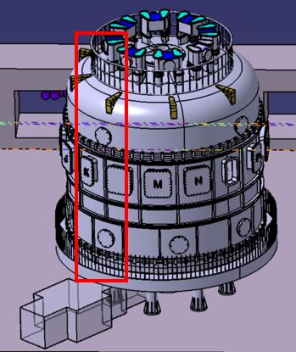
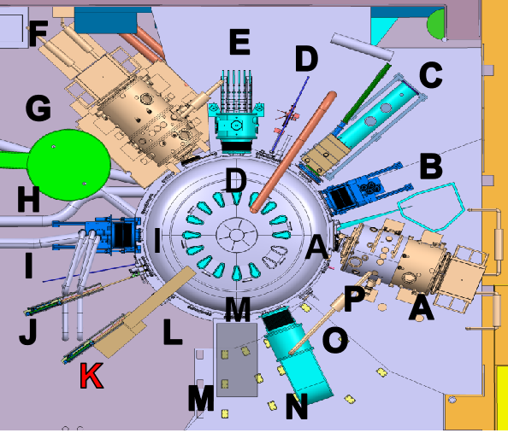
03
The layout of the SSI system on EAST
a vertical single-channel 0.65 THz solid-source interferometer (SSI) system, installed at the K port of the EAST device.
K
radiation-shielded laser room

Slide 10
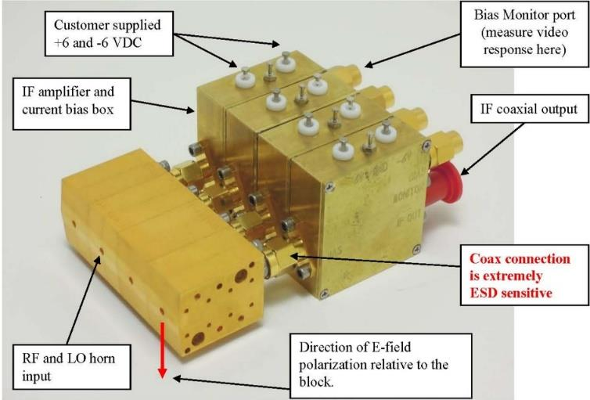
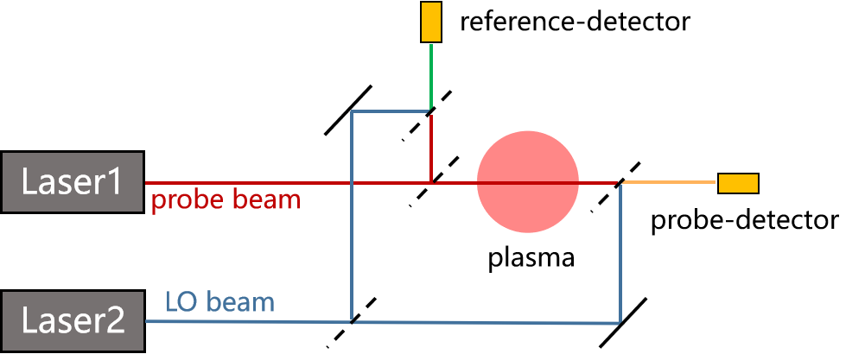
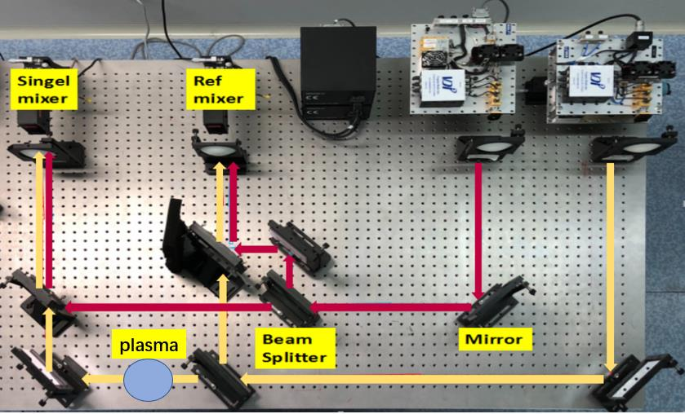
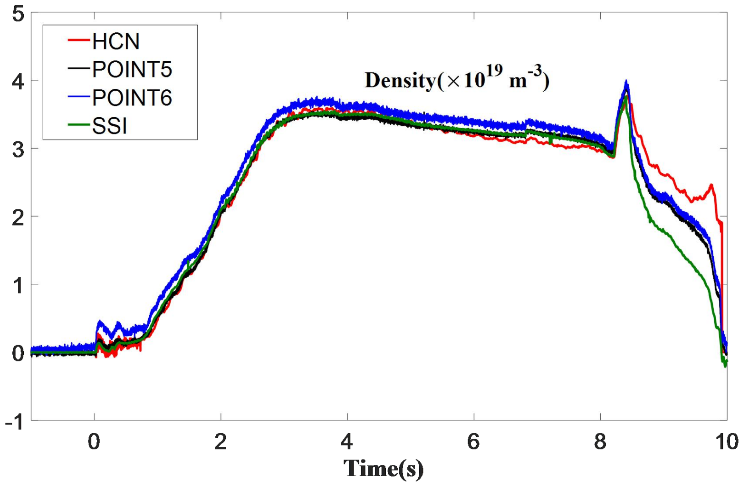






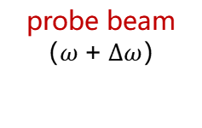
0.65THz SSI system
Schottky barrier diode mixer
responsivity of 750V/W
Mach-Zehnder interferometer
($∆ω=850kHz$)
VDI solid-state source
output power 2.5mW
frequency range
640-660GHz
probe beam
（$ω+∆ω$）
LO beam
（$ω$）
EAST #84085
real-time electron density measurement and feedback control
I_{r} = A₀ cos$∆ω$t
I_{d} = B₀ cos($∆ω$t+φ)
$$φ=\frac{π}{λn_{c}}\int{n_{e}dl}$$
$$\int{n_{e}dl}=\frac{φλn_{c}}{π}$$

Slide 11
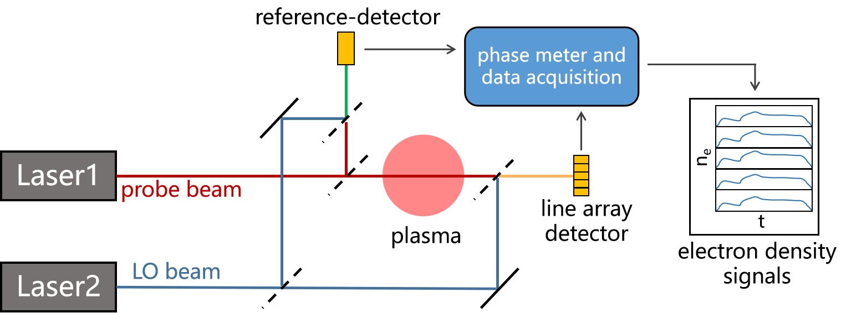
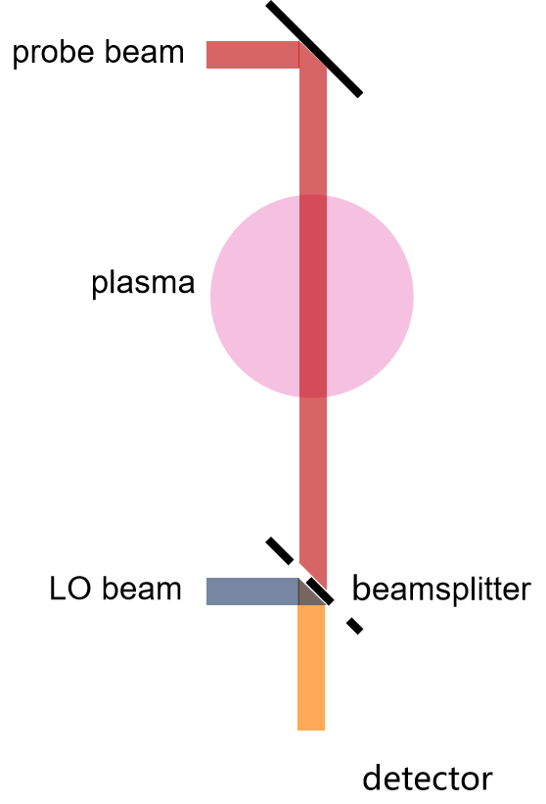
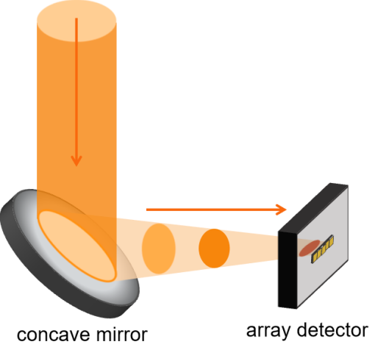
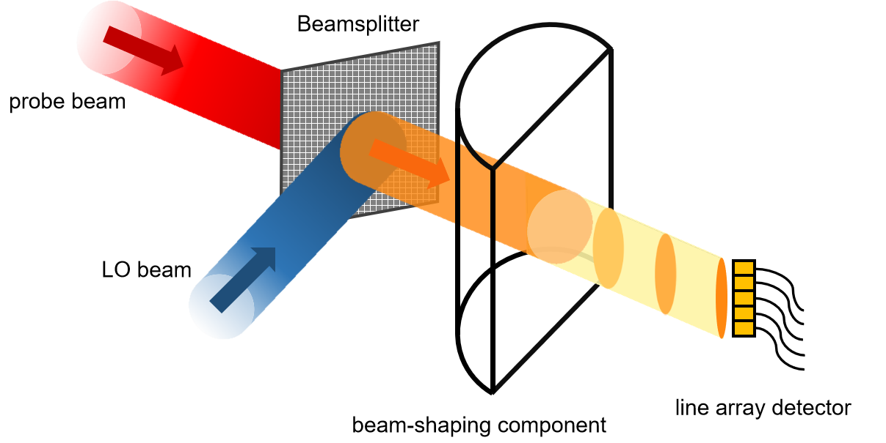
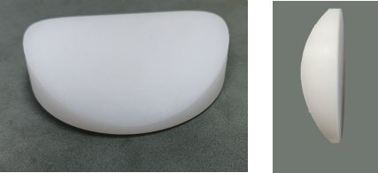
The conceptual design of the line array detection scheme
line array detector
Notes:
concave mirror is tilted at a certain angle to achieve a better coupling between the beam and the line array detector

Slide 12
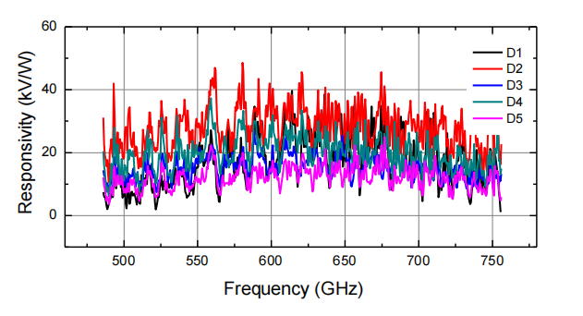
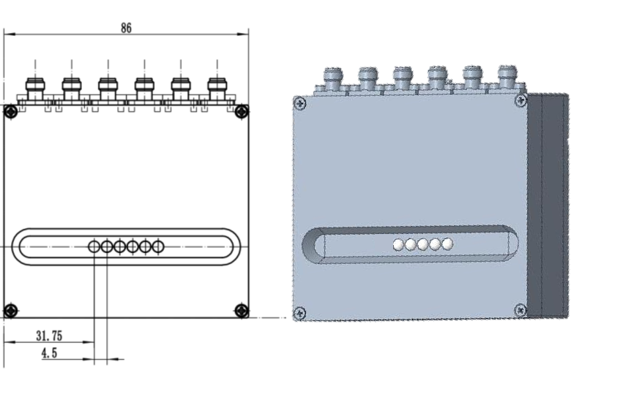
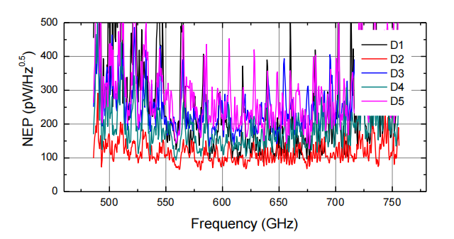
HEMT line array detector
The IF signals are detected by an AlGaN/GaN line array high electron mobility transistors (HEMT) detector
polarization direction
D1 ~ D5
high responsivity of array element, average is 40kV/W
4mm diameter silicon lens on a row with 0.5mm spacing
powered by a ±6.5V/0.5A linear DC voltage regulator
Notes:
The high responsivity and low noise of the detector can meet the essential requirements of coherent signal measurement.

Slide 13
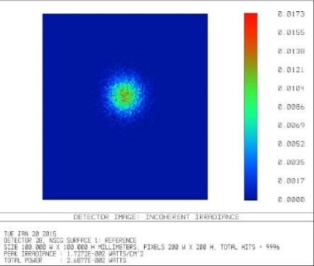
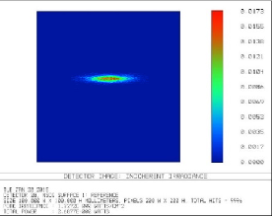
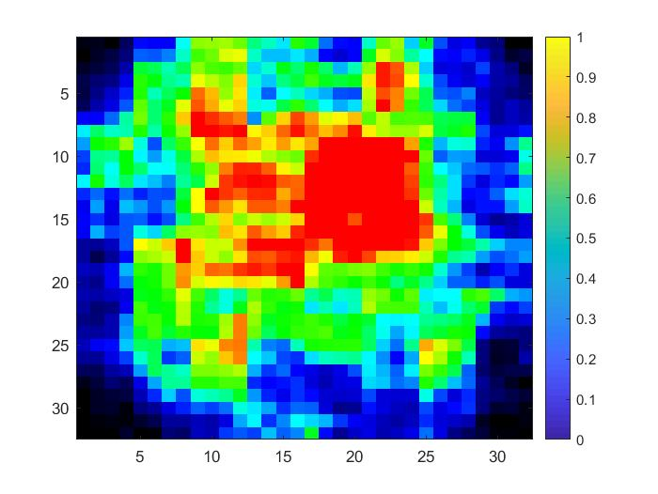
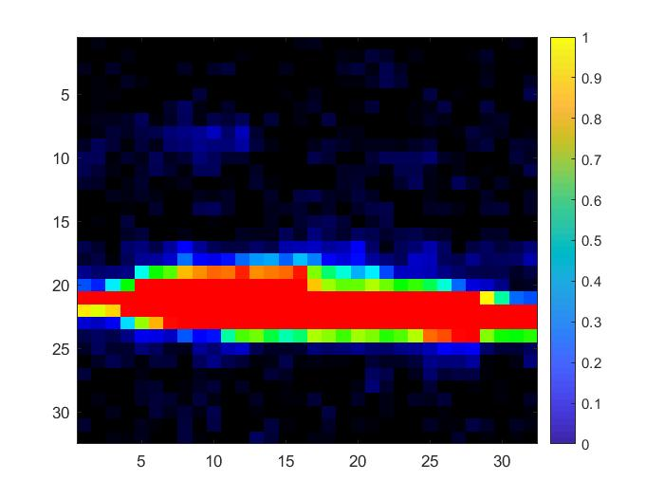
beam-shaping compenent
ZEMAX optical simulation results
bench test results
the laser beam through the cylindrical lens is compressed into a stripe within 4 mm
bench test results are consistent with simulation results
good performance of the lens
Notes:
compress the Gaussian beam into a stripe.
Bench test results displayed the good performance of the cylindrical lens, which is consistent with the simulation results.

Slide 14
3. Experiment results and discussion

Slide 15
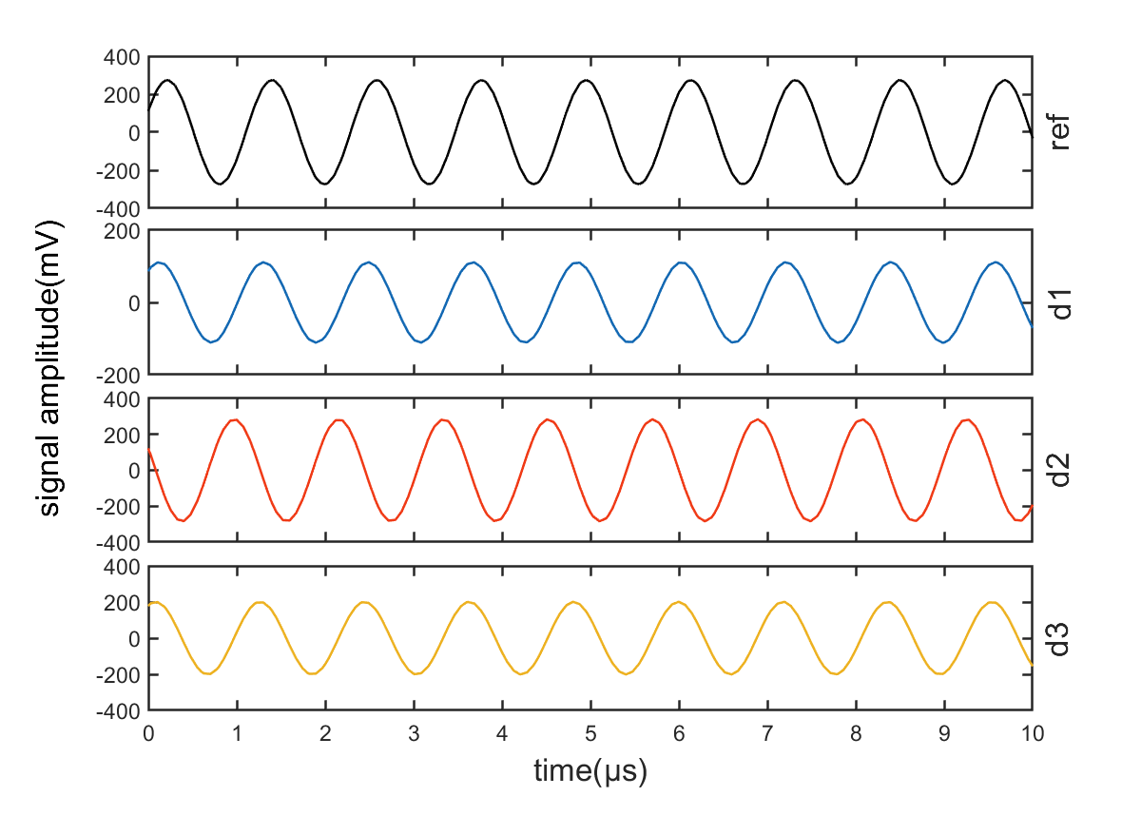
Intermediate Frequency (IF) signals
key evaluation parameter for an interferometer system
IF signals detected by the reference-detector and line array detector without plasma discharge
The results indicate a good response to 850 kHz signals from both the ref-detector and line array detector.
Differences in the amplitude levels of d1, d2, d3, consistent with the expected result.
Notes:
The response of the detection module to the Intermediate Frequency (IF) signal is the key evaluation parameter for an interferometer system. To assess this parameter, data acquisition is carried out without plasma discharge.
By comparing the IF signals from the reference-detector and probe-detector, the phase shift (ϕ) of the probe beam induced by the plasma can be obtained. This phase shift is then used to calculate the plasma electron density.
There are some differences in the amplitude levels of d1, d2, d3. Since the Gaussian beam energy distribution is strong at the center and weak at the edge of the beam, the beam energy received by the single elements of the line array detector is correspondingly different. The amplitude levelof d2 is higher than d1 and d3, which is consistent with the expected result.

Slide 16
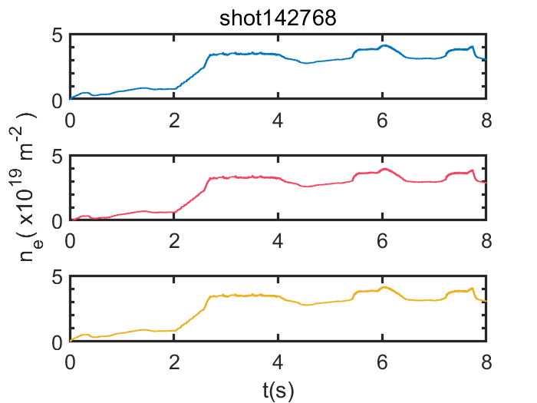
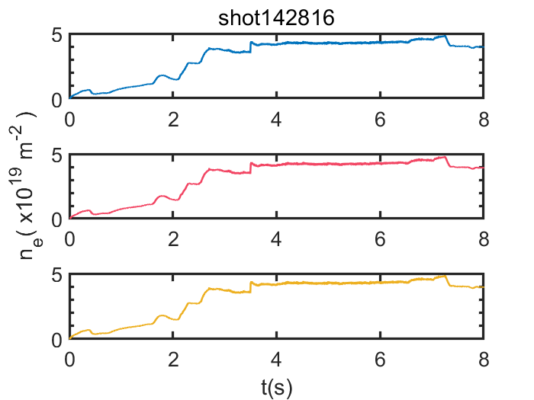
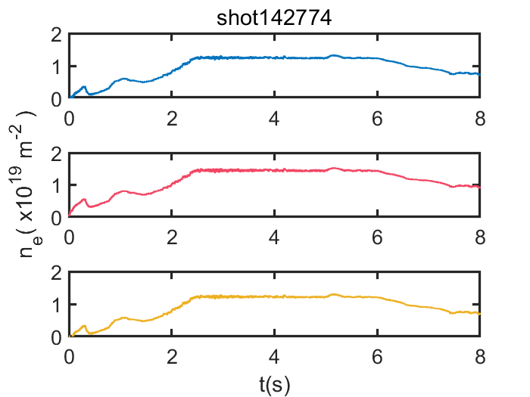
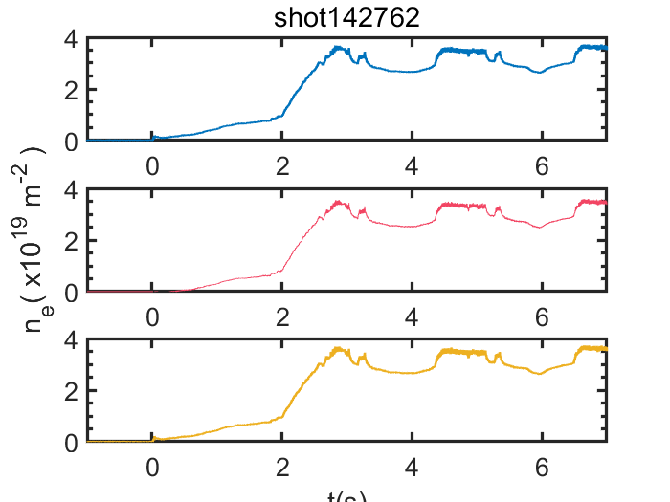
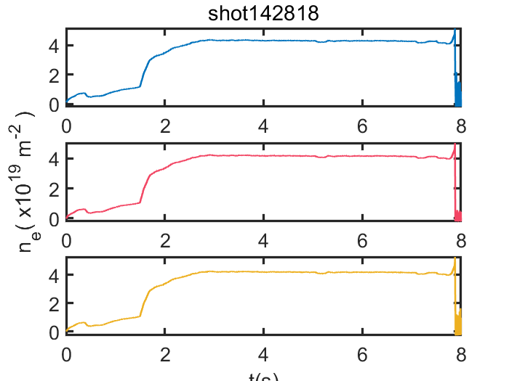
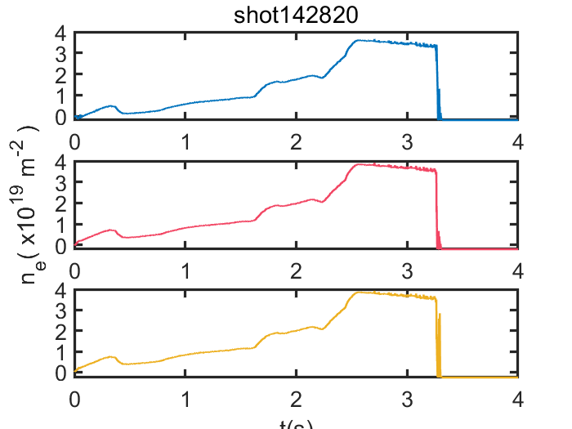
off-line calcution results of electron density
The three channels density signals can be obtained by off-line phase comparison calculations.

Slide 17
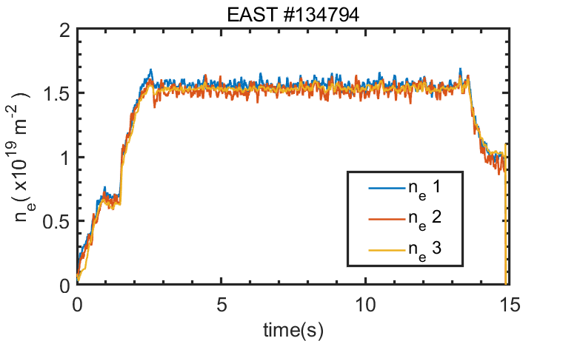
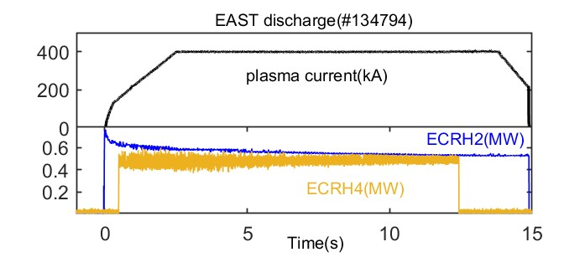

Density measurement by the line array detection scheme
Ip=400kA， n_{e}= $\text{1}\text{.}\text{5} × \text{10}\text{19}\text{m}\text{−}\text{3}$
With the successful application of the phase meter and data acquisition module, real-time array electron density measurements can be implemented during plasma discharge.
Notes:
With the successful application of the phase meter and data acquisition module, real-time array electron density measurements can be implemented during plasma discharge.
Figure.7 provides an example of measured density data during a plasma discharge. In shot #134794 of EAST, the plasma current Ip is 400 kA as shown in Figure. 7(a). Figure. 7(b) is the power of Electron Cyclotron Resonance Heating (ECRH), including 0.6 MW ECRH2 and 0.5 MW ECRH4. Figure. 7(c) shows the array electron density of shot #134794, with the line-integrated electron density measured at approximately 1.5×1019 m-2.

Slide 18
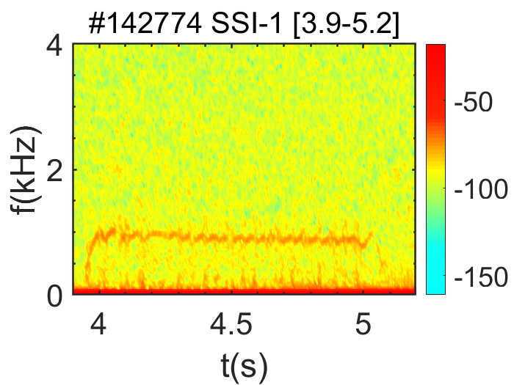
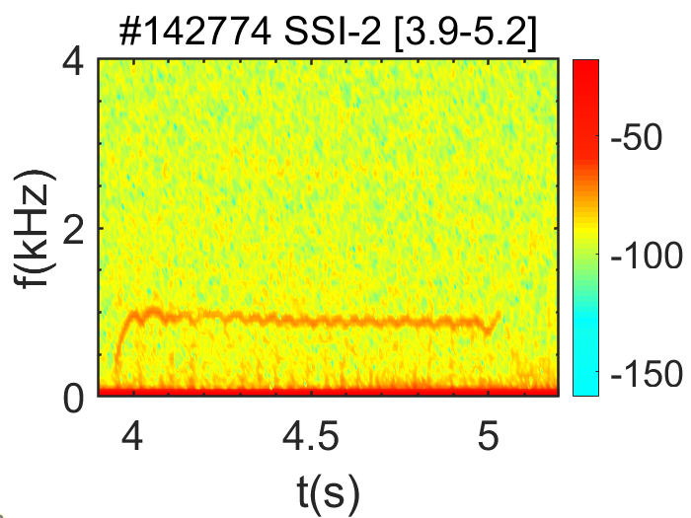
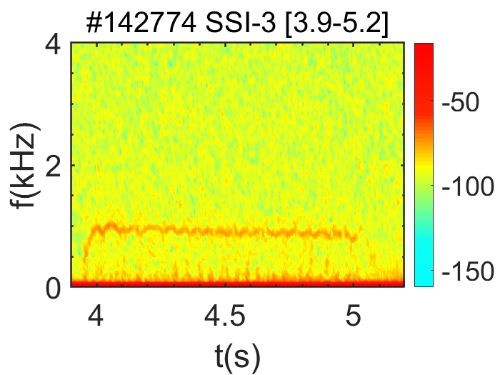
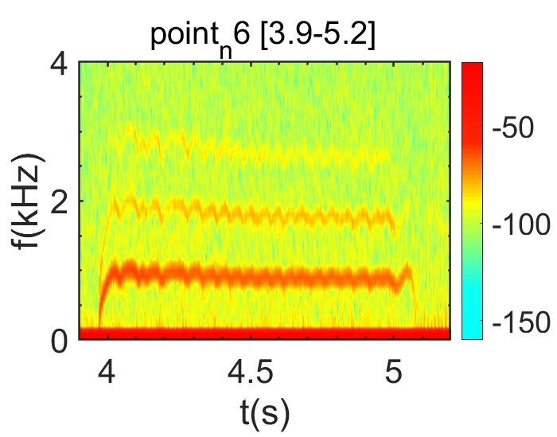
Density perturbation phenomenon
EAST #142774
Spectra of SSI and POINT line-integrated electron density signals
The two systems show consistency in the observation of the 1 kHz electron perturbation signal
Notes:
二氧化碳色散干涉仪已在EAST上搭建完成，并成功运行取得了初步实验数据。我们以110733，114739和低密度的114731为例，可以看出色散干涉仪的结果与HCN和POINT的数据有较好的一致性。

Slide 19
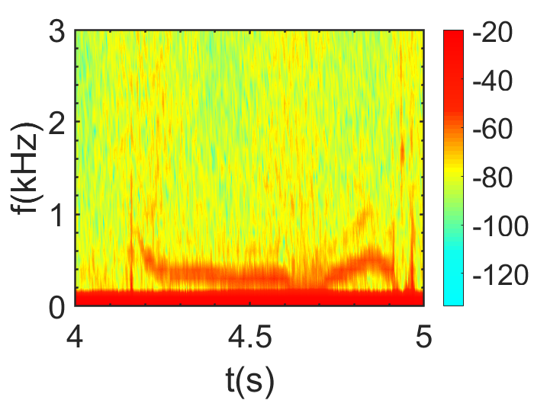
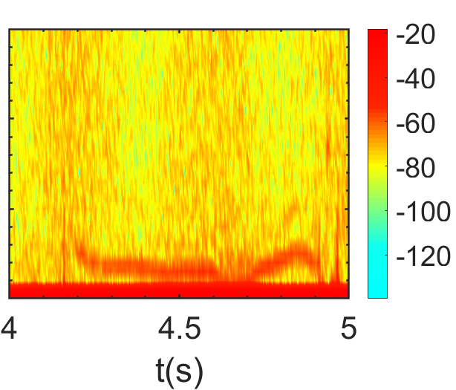
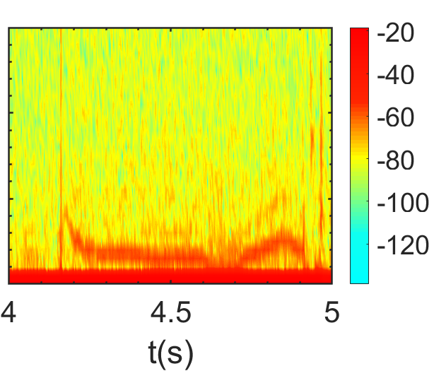
Density perturbation phenomenon
EAST #134788
Spectra of SSI three channel line-integrated electron density signals
ch1
ch2
ch3
4-5s，0.3 kHz electron perturbation signal
a fundamental capability to observe density fluctuation phenomenon.
（4.3-4.4s）
Notes:
The mode of electron density perturbation signal of the SSI system can be analyzed with other different diagnostic system.
a fundamental capability to observe density fluctuation phenomenon.

Slide 20
Summary
Line array detection scheme is proposed to improve the spatial resolution of the SSI system, and it has been successfully applied for the first time on EAST.
Three channels line-integrated electron density signals are detected during plasma discharge by line array detection SSI system.
The electron density perturbation phenomena are also observed in the spectra of three channels electron density signals, which shows a good capability of the line array detection system to study small-scale spatial MHD phenomena.
Future work
By optimizing the optical system and improving the channel of the line array detector, the precise measurement of a large coverage area in plasma core region will be realized.

Slide 21
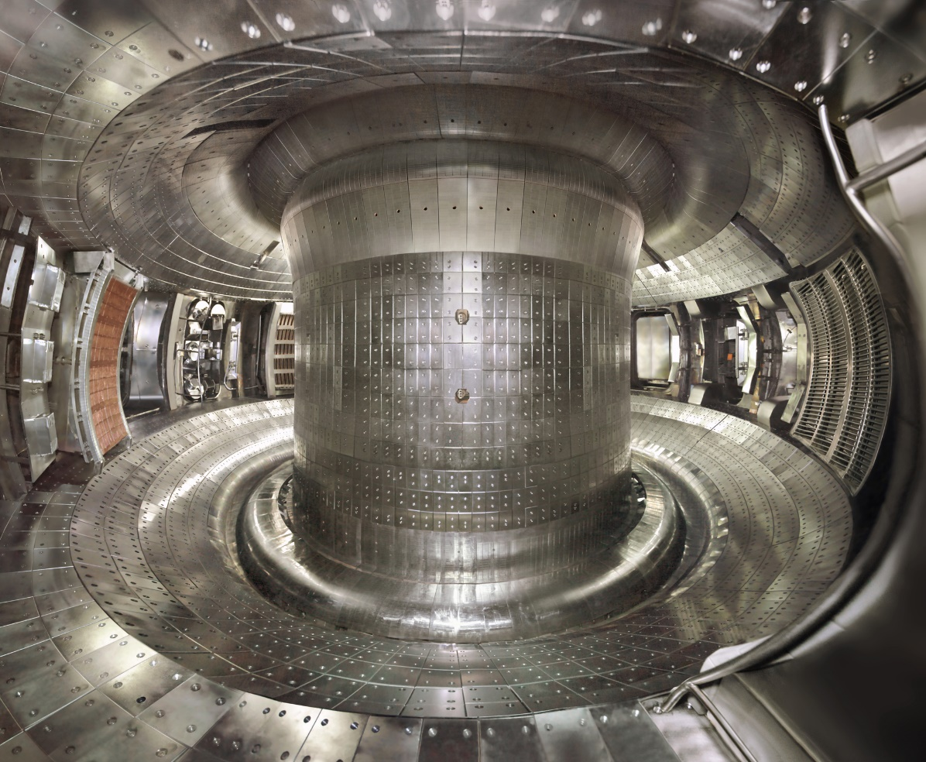
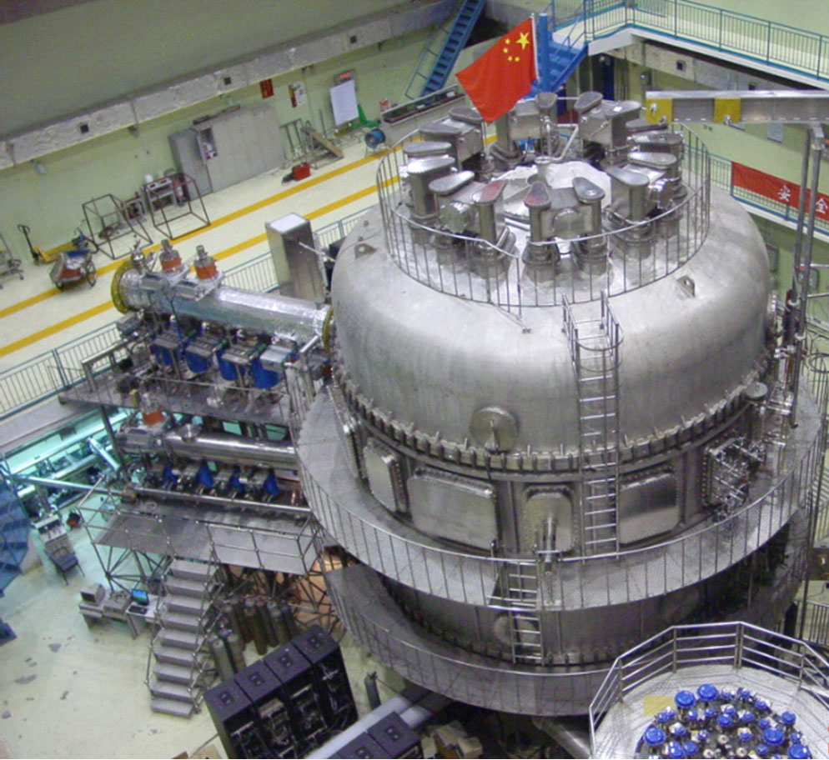
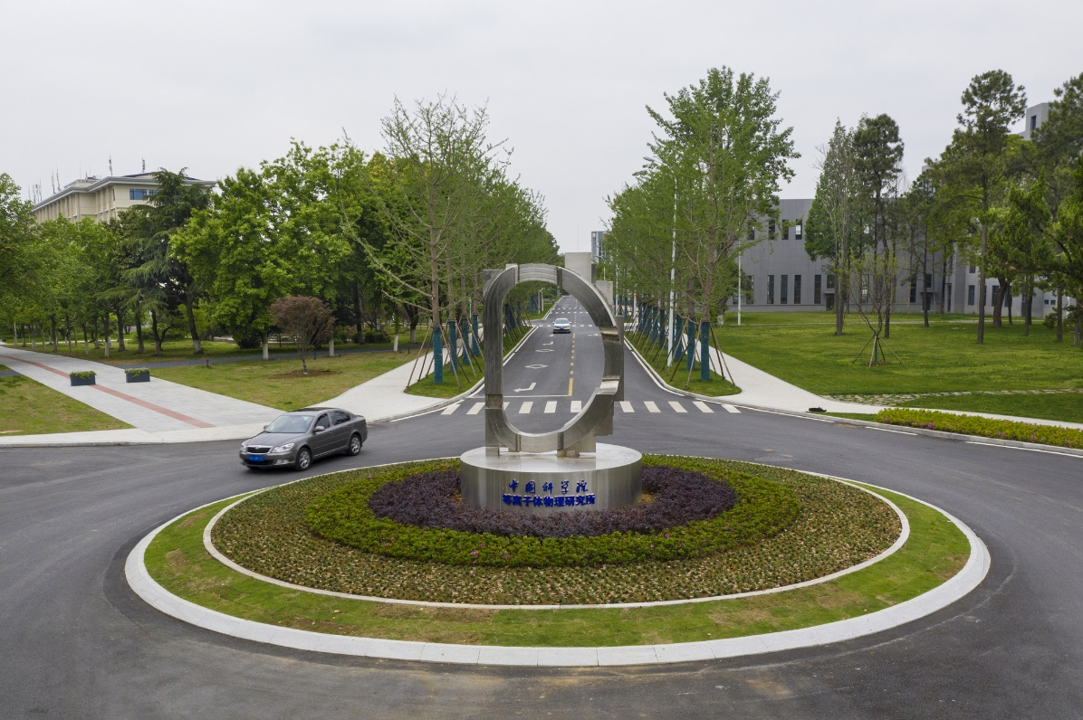
THANK YOU FOR YOUR ATTENTION

