Slide 1
Exploitation of neutron spectroscopy measurements for assessment of DT fusion power without in-vessel calibration
L. G. Tedoldi¹, D. Rigamonti², S. Colombi¹, G. Marcer^{1,2}, A. Dal Molin², J. Eriksson³, A. Muraro², M. Rebai², G. Croci^{1,2},
Z. Ghani⁴, G. Gorini^{1,2}, G. Grosso², M. Nocente^{1,2}, E. Perelli Cippo², M. Tardocchi²
¹Department of Physics, University of Milano-Bicocca, Milan, Italy
²Institute for Plasma Science and Technology, National Research Council of Italy, Milan, Italy
³Department of physics and astronomy, Uppsala University, Sweden
⁴Culham Centre for Fusion Energy, Abingdon, United Kingdom of Great Britain and Northern Ireland

Slide 2
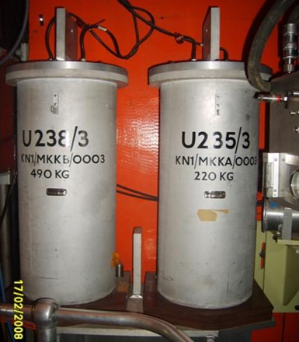
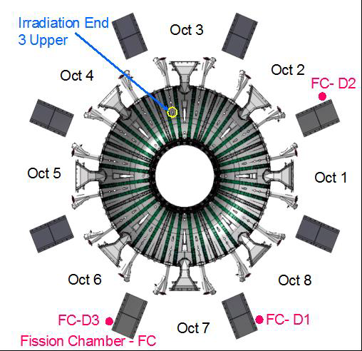
Standard method for fusion power measurements
Absolute 14 MeV neutron counting with fission chambers and activation foils placed around the reactor. It has different challenges:
Difficult neutron transport that requires complex Monte Carlo simulations
In-vessel calibrations with 14 MeV neutron source moved inside the reactor are needed to validate MC simulations
Calibrations must be repeated whenever modifications to the machine are made
The flat response of fission chambers make it challenging to separate 2.5 MeV and 14 MeV neutrons and difficult to distinguish direct and scattered neutrons

Slide 3
Alternative DT fusion power assessment via neutron spectroscopy measurements
Spectroscopy measurements are done along a well-known collimated line of sight
Fraction of scattered/direct fluxes are measured
No need of intensive transport simulations
No need of new calibration factors when machine changes are made
Demonstrated at JET in DTE1 with the MPR spectrometer
4
7
MPR
Neutron yield
$$Y_{n}=\frac{detected neutrons}{transport factor}=\frac{C_{n}}{T∙A∙ε}$$
$C_{n}$: neutron count rate
T: geometric factor
A: attenuation factor
ε: absolute efficiency

Slide 4
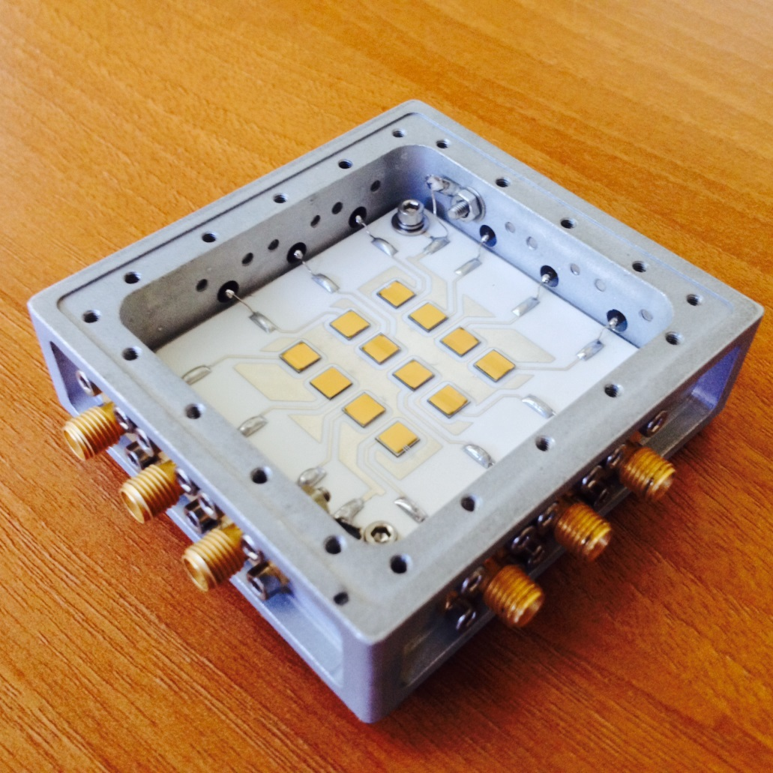
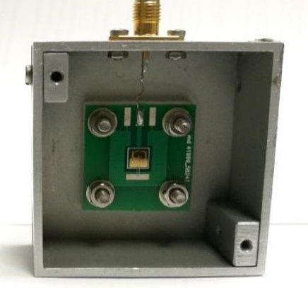
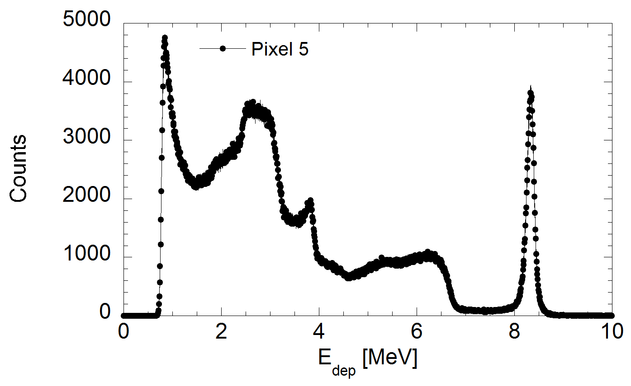
Fusion power assessment with single crystal diamond detectors
Three diamond detectors are installed at JET along 3 collimated lines of sight.
Characteristics
High radiation hardness
Not sensitive to magnetic field
Room temperature operation
Compact size
MHz capability
Properties
Spectral separation of 2.5 MeV and 14 MeV neutrons
Spectral separation of direct and scattered neutrons
Reaction channels
${}_{}^{12}{C(n, n^{′}){}_{}^{12}C}$
${}_{}^{12}{C\left(n, n^{′}\right)3α}$
${}_{}^{12}{C(n, α){}_{}^{9}{Be}}$
Only events under the n-α
peak are considered
77 mm
82 mm
¹²C(n,α)⁹Be
Elastic
scattering
¹²C(n,n’)3α
Diamond response to 14 MeV neutrons.

Slide 5
Fusion power assessment with single crystal diamond detectors
JET diamonds are not absolutely calibrated → data compared with fission chambers
When T percentage is >10% there is linear correlation
When T percentage is <3%, the total neutron emission by FCs is affected also by 2.5 MeV neutrons → DD fusion reactions are significant → total neutron emission is not due only to 14 MeV neutrons

Slide 6
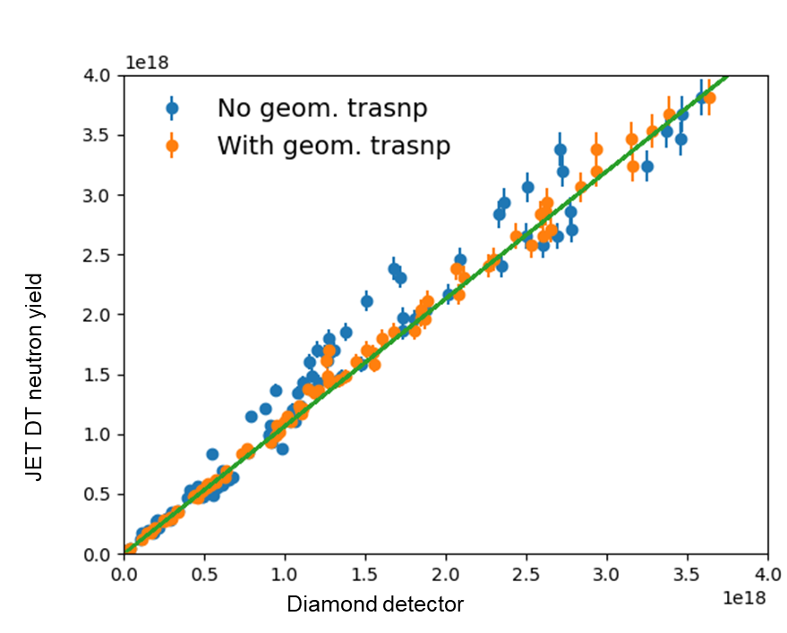
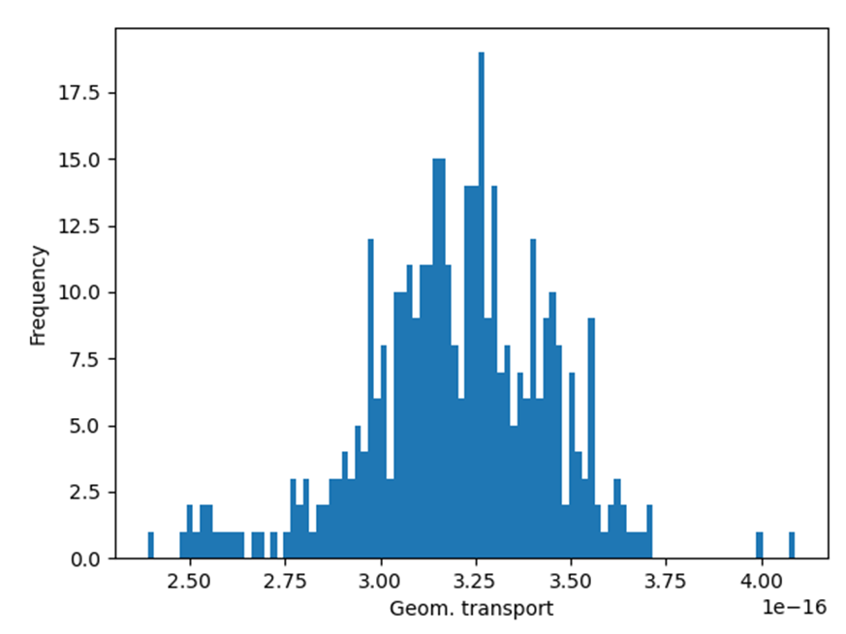
Geometrical factor calculation
Ongoing activity to calculate the geometrical transport factor.
Tomographic inversion of the neutron camera data
Emission profile to assess the total plasma neutron emission compared with the line integrated measured one
Transport variations of ±15% due to spatial profile variation between discharges
MCNP simulations to benchmark the analytical geometrical transport ongoing
$$Y_{n}=\frac{C_{n}}{T∙A∙ε}$$
[
Still under calculation

Slide 7
Conclusions
Diamonds acquired neutron data during the whole DTE2 and DTE3 campaigns providing unique 14MeV data
Diamonds measured the JET fusion power record via cross-calibration with fission chambers
An alternative method for fusion power measurement has been proposed and is under implementation
The geometric transport factor is being studied also with MCNP simulations

Slide 8
Thank you

