Slide 1


Diagnostics for plasma acceleration and secondary radiation sources for EuAPS project at FLAME laser facility
Federica Stocchi
University of Rome Tor Vergata & INFN-LNF
On behalf of SPARC_LAB collaboration

Slide 2

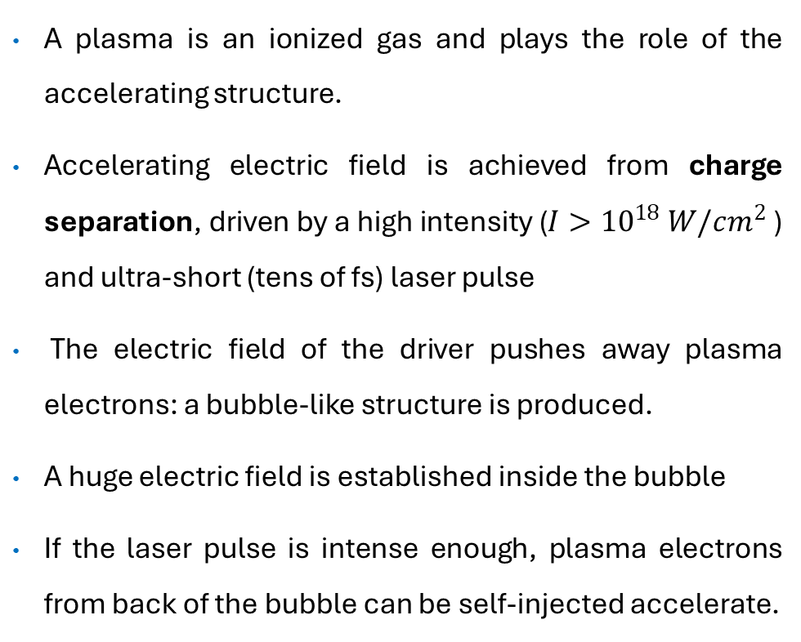
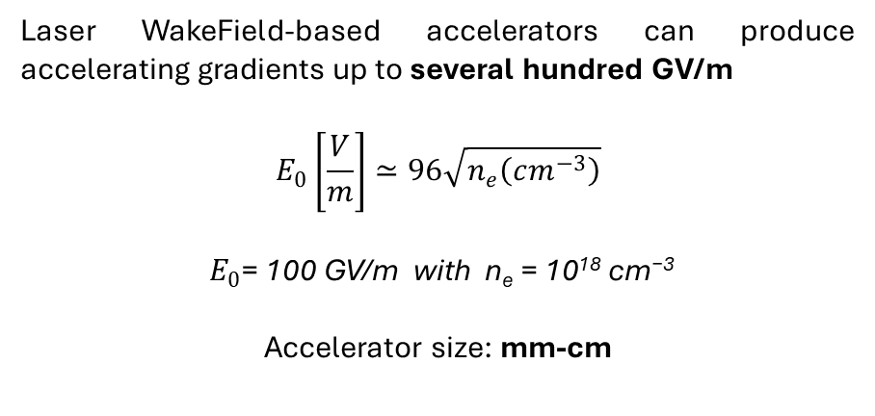
Laser WakeField Acceleration (LWFA)
A plasma is an ionized gas and plays the role of the accelerating structure.
Accelerating electric field is achieved from charge separation, driven by a high intensity ($I>{10}^{18} W/cm^{2}$ ) and ultra-short (tens of fs) laser pulse
The electric field of the driver pushes away plasma electrons: a bubble-like structure is produced.
A huge electric field is established inside the bubble
If the laser pulse is intense enough, plasma electrons from back of the bubble can be self-injected accelerate.
Laser WakeField-based accelerators can produce accelerating gradients up to several hundred GV/m
$$E_{0}\left[\frac{V}{m}\right]≃96\sqrt{n_{e}\left(cm^{−3}\right)}$$
$$E_{0}\text{= }\text{100 }\text{GV}\text{/}\text{m} \text{with} \text{n}\text{e}\text{ = 10}\text{18} \text{cm}\text{−3}$$
Accelerator size: mm-cm

Slide 3
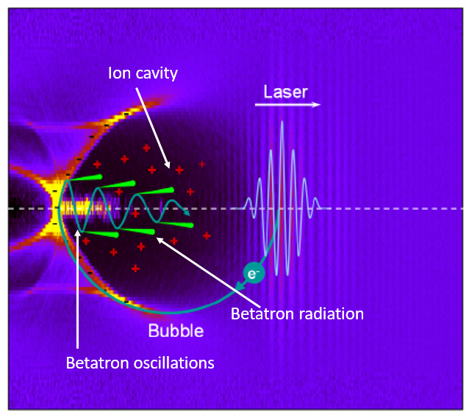
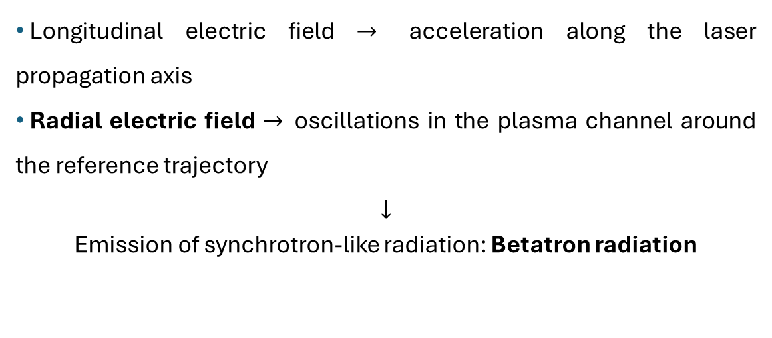
Betatron radiation from LWFA
Longitudinal electric field $→$ acceleration along the laser propagation axis
Radial electric field $→$oscillations in the plasma channel around the reference trajectory
$$↓$$
Emission of synchrotron-like radiation: Betatron radiation

Slide 4
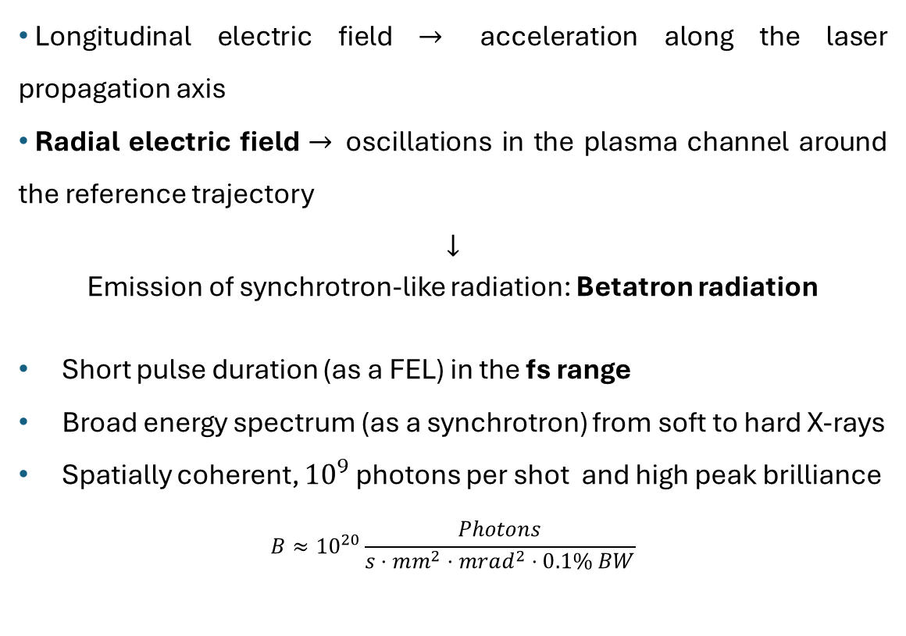
Betatron radiation from LWFA
Longitudinal electric field $→$ acceleration along the laser propagation axis
Radial electric field $→$oscillations in the plasma channel around the reference trajectory
$$↓$$
Emission of synchrotron-like radiation: Betatron radiation
Short pulse duration (as a FEL) in the fs range
Broad energy spectrum (as a synchrotron) from soft to hard X-rays
Spatially coherent, ${10}^{9}$ photons per shot and high peak brilliance
$$B≈{10}^{20}\frac{Photons}{s⋅mm^{2}⋅mrad^{2}⋅0.1\% BW}$$

Slide 5
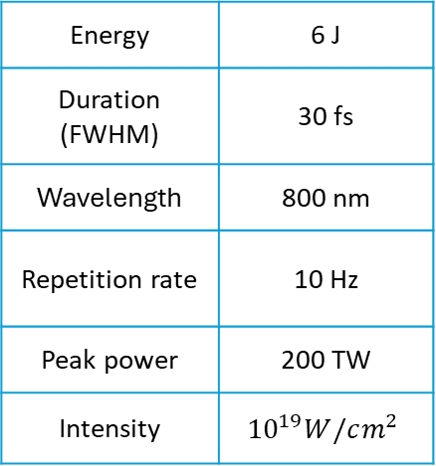
SPARC_LAB facility
SPARC_LAB: Source for Plasma Accelerators and Radiation Compton with Lasers And Beams. It is a multidisciplinary TEST Facility composed by a high-brightness LINAC and the high-power laser FLAME (Frascati Laser for Acceleration and Multidisciplinary Experiments).
FLAME Bunker
Laser parameters
Energy | 6 J
Duration (FWHM) | 30 fs
Wavelength | 800 nm
Repetition rate | 10 Hz
Peak power | 200 TW
Intensity | $${10}^{19}W/cm^{2}$$
FLAME facility
SPARC Bunker
M. Ferrario, et al. NIM B 309 (2013): 183-188
M. Galletti, F. Stocchi, et al. Appl.Sci 2024, 14, 8619

Slide 6



EuAPS project
Principal Investigator
M. Ferrario (INFN)
22.350.588,00
High repetition lasers
L. Labate (CNR)
Betatron X rays source
A. Cianchi (Tor Vergata)
High power lasers
P. Cirrone (INFN)
4.863.150,00
9.457.088,00
7.864.500,00
Management & Financial office
A. Falone (INFN)
The EuPRAXIA Advanced Photon Sources project, includes the development of a high-power laser at INFN-LNS, a high repetition rate laser at CNR Pisa and a radiation source will be hosted at LNF-INFN
Courtesy A. Cianchi

Slide 7
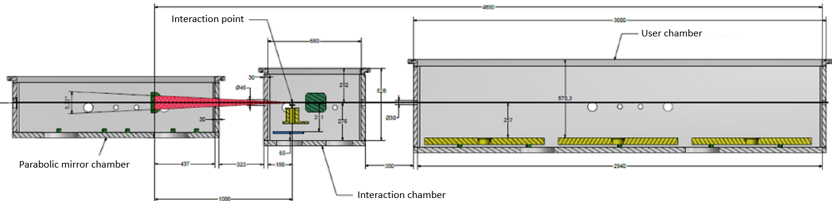
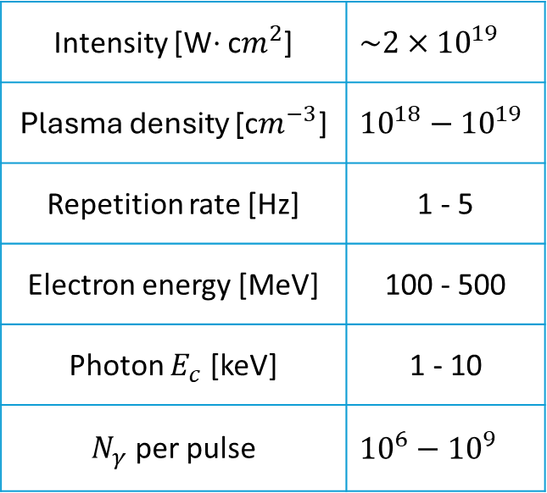
EuAPS project
Expected parameters
In the EuPRAXIA Advanced Photon Sources project, the high-power laser FLAME will be the driver of the plasma-based accelerator for the “betatron” X-ray user facility at the SPARC_LAB laboratory.
Intensity [W$⋅$ c$m^{2}$] | $$\sim 2×{10}^{19}$$
Plasma density [$\text{c}m^{−3}\text{]}$ | $${10}^{18}−{10}^{19}$$
Repetition rate [Hz] | 1 - 5
Electron energy [MeV] | 100 - 500
Photon $E_{c}$ [keV] | 1 - 10
$N_{γ}$ per pulse | $${10}^{6}−{10}^{9}$$
Layout of the interaction and user chamber in SPARC bunker
Courtesy V. Lollo

Slide 8
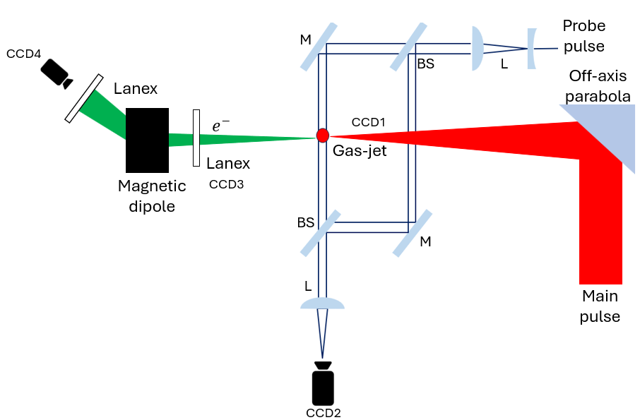

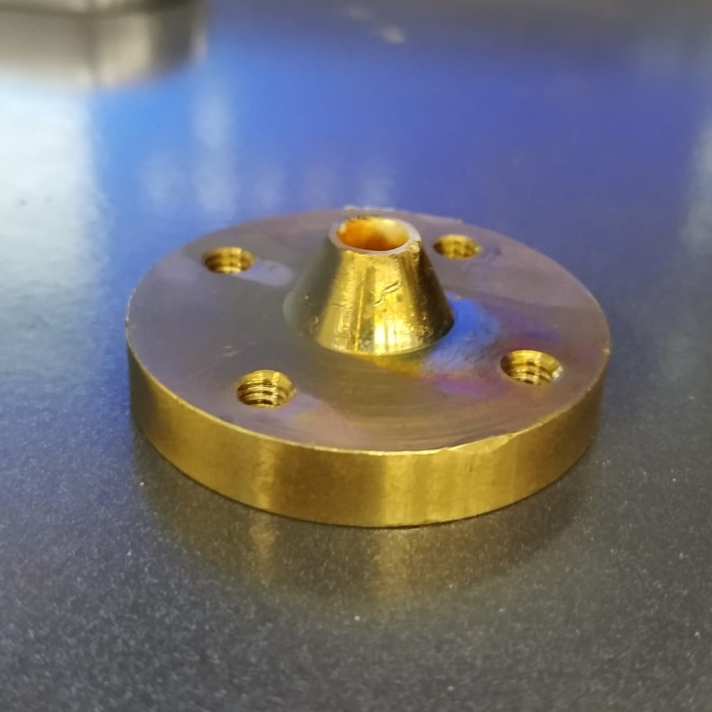
Experimental setup @FLAME
X-ray
Al filter
CCD-X
Nozzle
Beam charge monitor

Slide 9
Experimental setup @FLAME
Nozzle

Slide 10

Experimental setup @FLAME
Laser diagnostics in the interaction chamber:
laser pulse is focused using a gold-coated, 15-degree OAP mirror with $f=1 m$ at the target (gas-jet) position;
a camera, equipped with a 10x microscopic objective is used to measure the spot;
transverse diameter of 18 $μ$m.
Nozzle

Slide 11
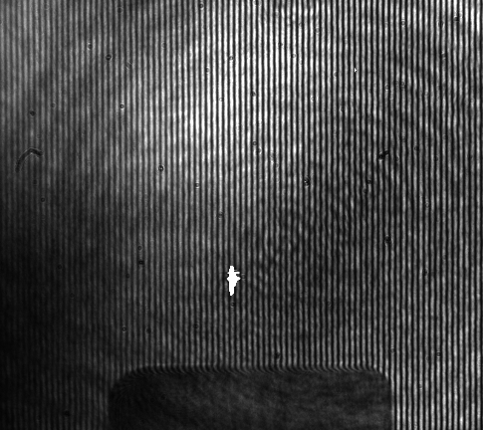
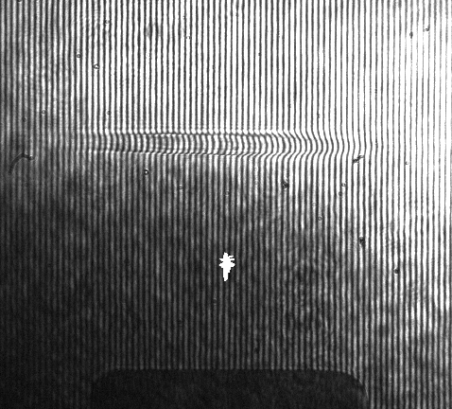
Experimental setup @FLAME
(a)
(b)
3 mm nozzle

Slide 12

Experimental setup @FLAME
(a)
(b)
3 mm nozzle
Plasma diagnostics in the interaction chamber:
a Mach-Zehnder interferometer coupled with a probe beam ( 40 mJ, 40 fs, 10 Hz) is used for plasma diagnostics;
a CCD camera detects the resulting interference fringes
  uniform fringes without the plasma channel;
  fringes with different shapes with the plasma channel;
$n_{e}∼{10}^{19} cm^{−3}$

Slide 13
Experimental setup @FLAME
Electron diagnostics in the interaction chamber

Slide 14
Experimental setup @FLAME
Electron diagnostics in the interaction chamber
Electron beam profile: 30 mrad FWHM divergence at 12.5 cm from the interaction point.

Slide 15
Experimental setup @FLAME
Electron diagnostics in the interaction chamber
Electron beam profile: 30 mrad FWHM divergence at 12.5 cm from the interaction point.
An Integrating Current Transformer (ICT) with a Beam Charge Monitor (BCM) is used to measure the accelerated bunch charge at 1m from the target.

Slide 16
Experimental setup @FLAME
Electron diagnostics in the interaction chamber
Energy spectrometer: magnetic dipole with a lanex screen and a camera;
uniform magnetic field B=1 T;
good resolution for low-energy of 0.5 MeV.

Slide 17
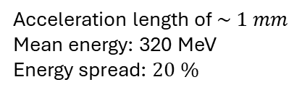
Experimental setup @FLAME
Electron diagnostics in the interaction chamber
Energy spectrometer: magnetic dipole with a lanex screen and a camera;
uniform magnetic field B=1 T;
good resolution for low-energy of 0.5 MeV.
Energy spectrum of electrons
Acceleration length of $\sim 1 mm$
Mean energy: 320 MeV
Energy spread: $20 \%$

Slide 18
Experimental setup @FLAME
Radiation diagnostics in the interaction chamber
X-ray
Al filter
CCD-X

Slide 19
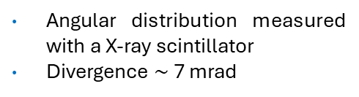

Experimental setup @FLAME
Radiation diagnostics in the interaction chamber
X-ray
Al filter
CCD-X
Angular distribution measured with a X-ray scintillator
Divergence $\sim$7 mrad
$\sim {10}^{8}$ photons per pulse
critical energy $≲4$ keV

Slide 20
Outlook
  Development of analysis techniques to optimize the radiation
  Study of different configurations for the LWFA
  Complete characterization of the secondary radiation (spectral-angular distribution, temporal length, spatial coherence etc.)
  X-ray Phase Contrast Imaging experiments
  First betatron source for user-oriented applications (EuAPS program)
Thank you for your attention

