Slide 1

The EuPRAXIA project
F. Villa, INFN-LNF
On behalf of the EuPRAXIA@SPARC_LAB collaboration
ICFDT7

Slide 2
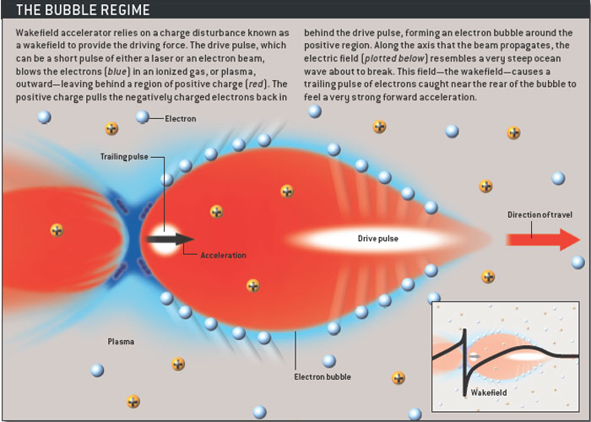
Principle of plasma acceleration
Laser Wakefield Accelerator (LWFA):
Drive beam = laser beam
Plasma WakeField Accelerator (PWFA):
Drive beam = high energy electron or proton beam
Courtesy Sci. Am.

Slide 3
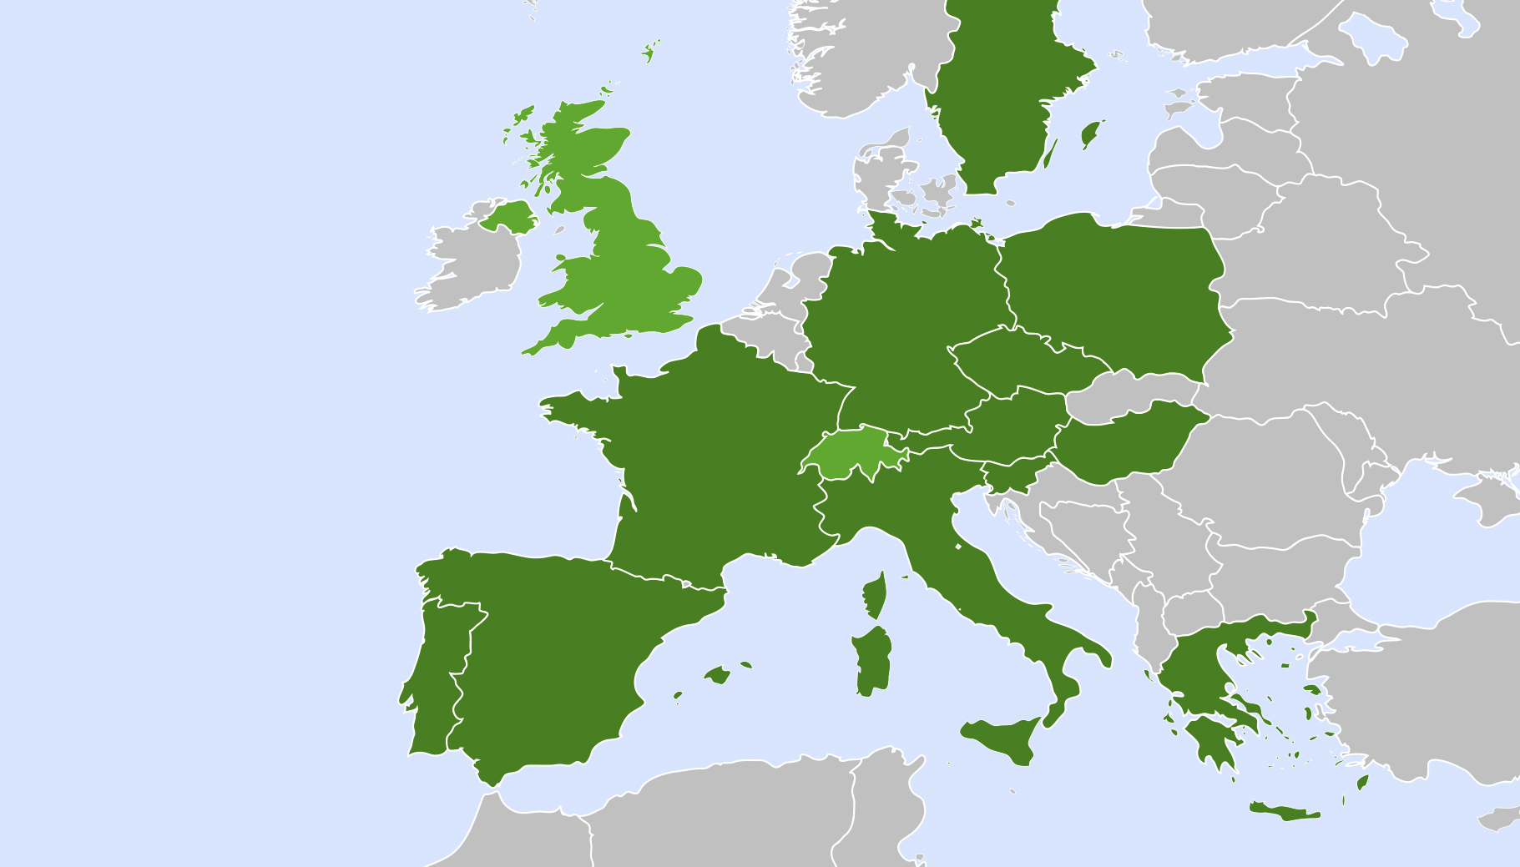


Distributed Research Infrastructure
Beam-driven plasma user facility
EuPRAXIA Headquarter
Laser-driven plasma user facility: candidates
Excellence Center
Advanced Applications Beamlines (UK)
Plasma Acc. & High Rep. Rate Dev. (D)
2
2
3
4
Technology Incubator (CZ - ELI)
Second site will be decided in Preparatory Phase project.
Excellence centers (EC) perform technical developments, prototyping and component construction. Number of EC’s, locations, roles, responsibilities reviewed in Prep. Phase.
2
5
2
6
User Data Center (H)
Laser-Plasma Acc. & 1 GeV FEL (F)
Beam-driven plasma user facility
EuPRAXIA Headquarter
2
1
2
Theory & simulations (P)
Horizon Europe

Slide 4
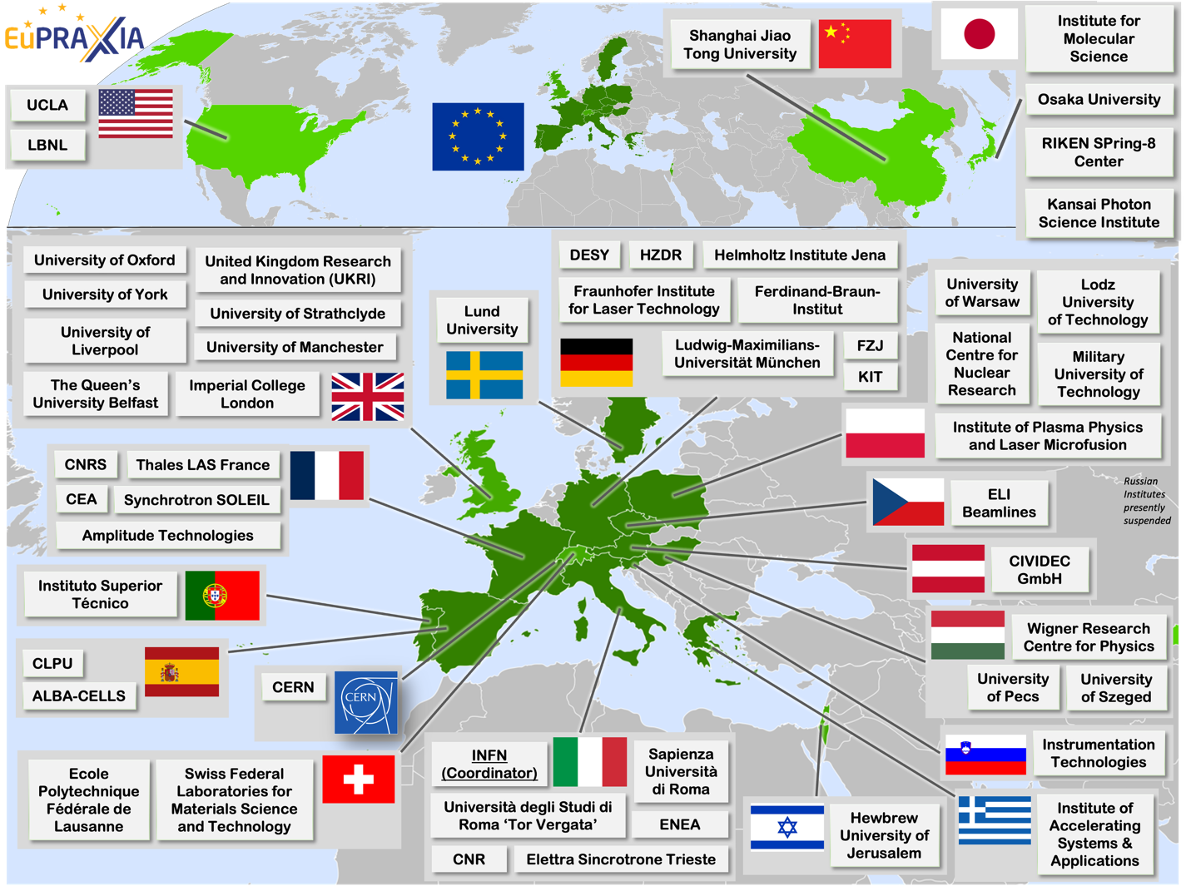
Wide International Collaboration
The EuPRAXIA Consortium today: 54 institutes from 18 countries plus CERN
Included in the ESFRI Road Map
Efficient fund raising:
  Preparatory Phase consortium (funding EU, UK, Switzerland, in-kind)
  Doctoral Network (funding EU, UK, in-kind)
  EuPRAXIA@SPARC_LAB (Italy, in-kind)
  EuAPS Project (Next Generation EU)
EuAPS project and diagnostics: see talk form F. Stocchi tomorrow

Slide 5
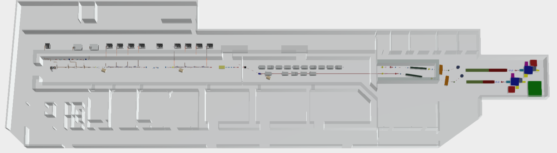
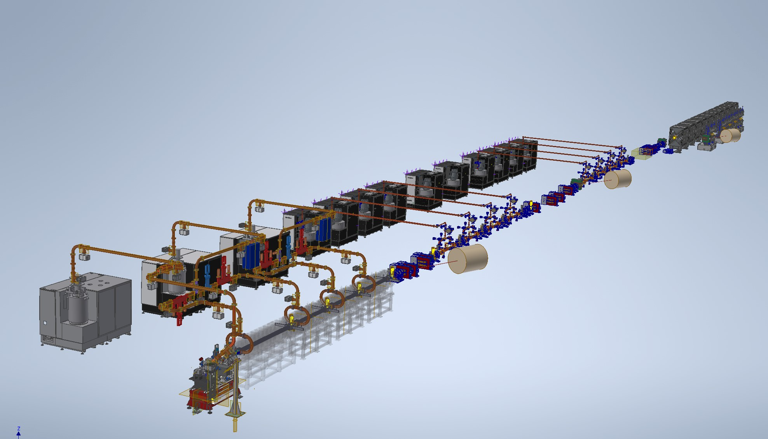
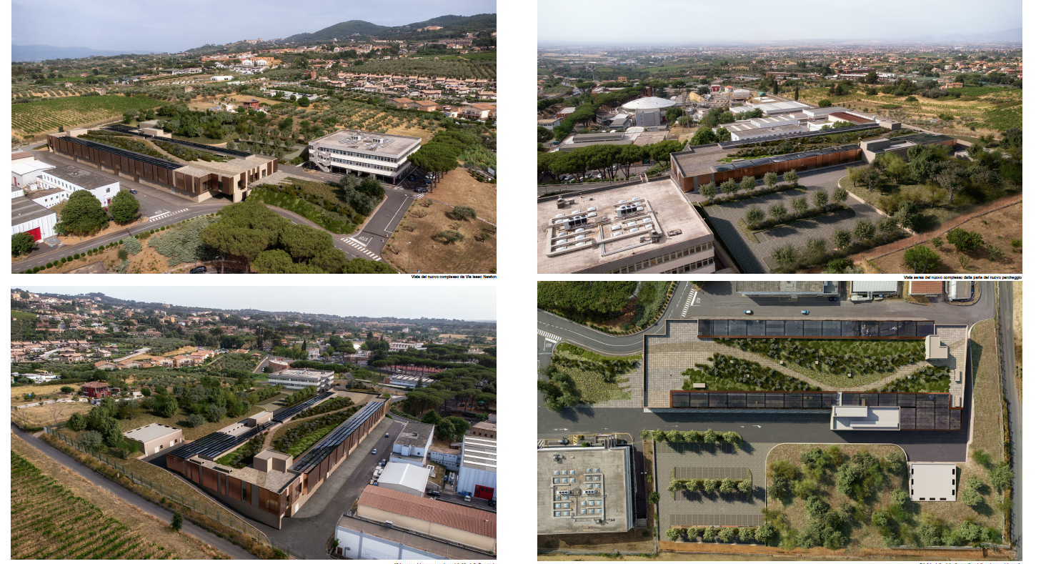
EuPRAXIA@SPARC_LAB
159 m
Technical rooms
Klystron & power supplies hall
Preparations labs
AQUA beamline
45 m
Accelerator tunnel
Plasma
module
Undulator tunnel
ARIA beamline
Experimental hall
Lasers clean rooms
Laser and particle user rooms

Slide 6
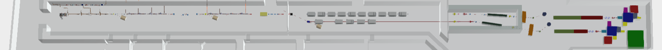
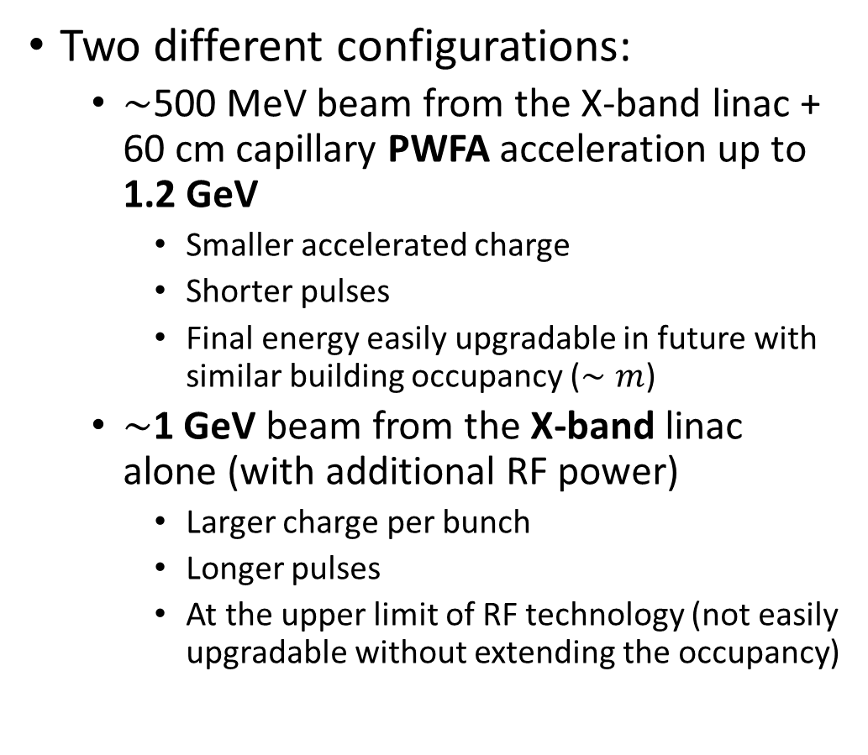
Expected electron parameters
Two different configurations:
  $∼$500 MeV beam from the X-band linac + 60 cm capillary PWFA acceleration up to 1.2 GeV
    Smaller accelerated charge
    Shorter pulses
    Final energy easily upgradable in future with similar building occupancy ($∼m$)
  $∼$1 GeV beam from the X-band linac alone (with additional RF power)
    Larger charge per bunch
    Longer pulses
    At the upper limit of RF technology (not easily upgradable without extending the occupancy)
Parameter | Unit | PWFA | Full X-band
Electron Energy | GeV | 1-1.2 | 1
Bunch Charge | pC | 30-50 | 200-500
Peak Current | kA | 1-2 | 1-2
RMS Energy Spread | % | 0.1 | 0.1
RMS Bunch Length | 𝜇m | 6-3 | 24-20
RMS norm Emittance | 𝜇m | 1 | 1
Slice Energy Spread | % | ≤0.05 | ≤0.05
Slice norm Emittance | mm-mrad | 0.5 | 0.5
55 m

Slide 7
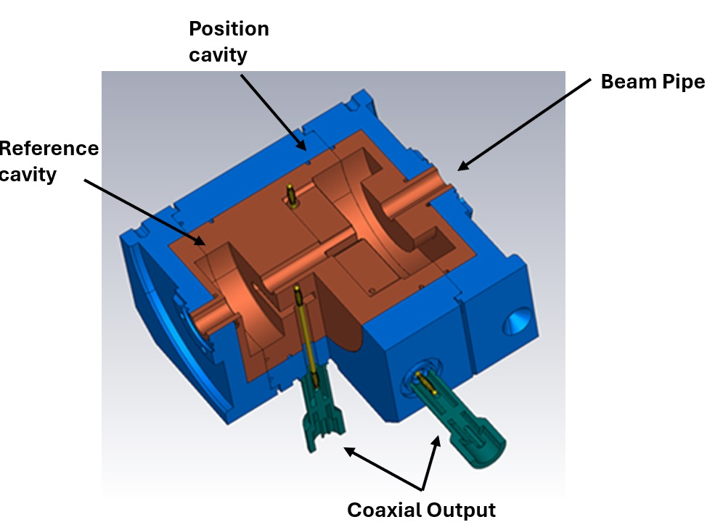
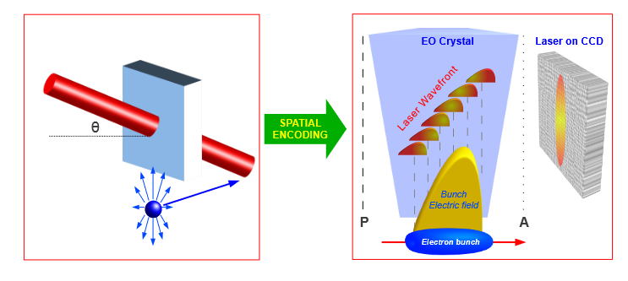
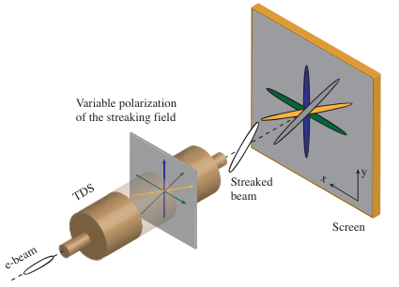
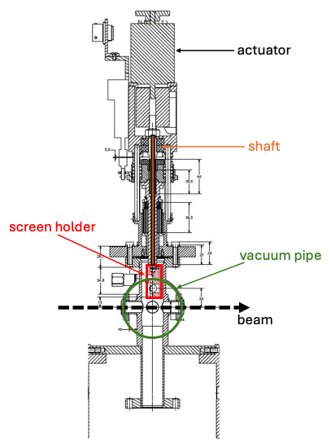
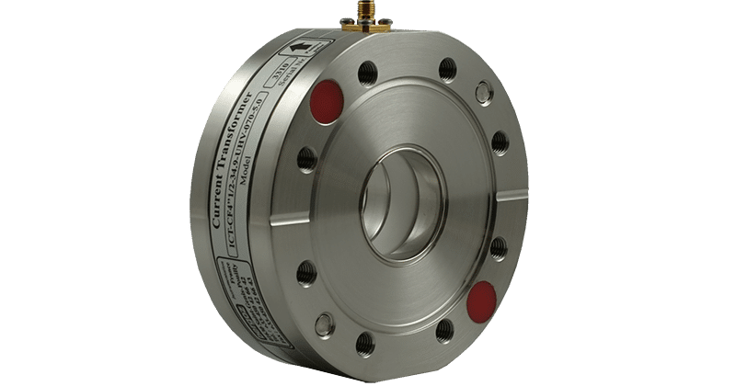
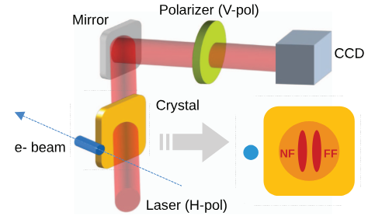
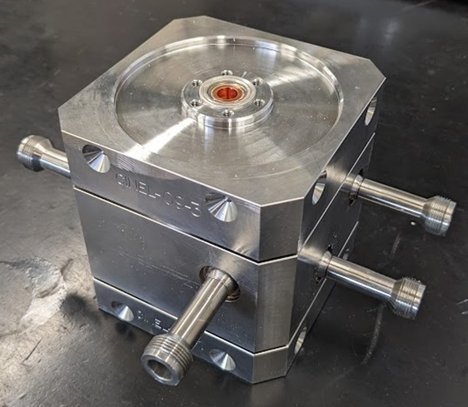
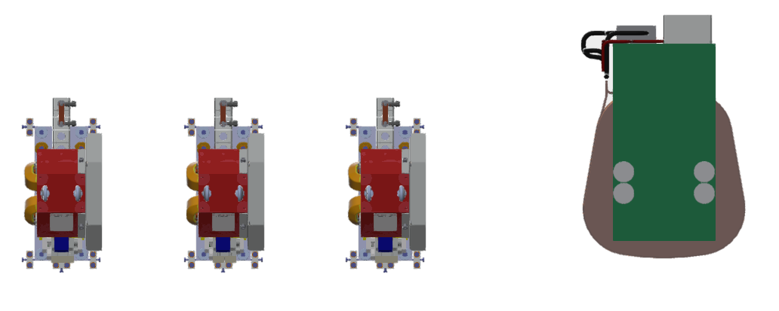
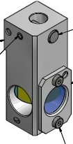
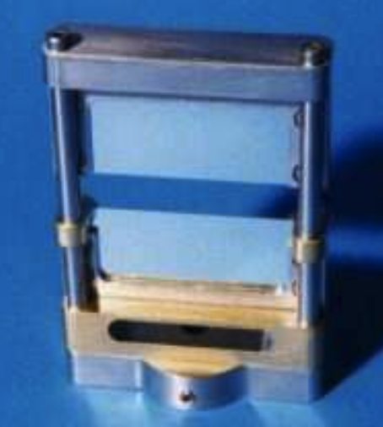
Electron diagnostics in EuPRAXIA@SPARC_LAB
Cavity BPM
Electro-Optical Sampling
Transverse Deflecting Structure
PolariX
Integrated
Current
Transformer
YAG screen
Emittance and LPS measurements
Coherent
Diffraction
Radiation
Quadrupole Triplet
Dipole
PolariX TDS
Plasma diagnostics: see talk form L. Crincoli tomorrow
Screen

Slide 8
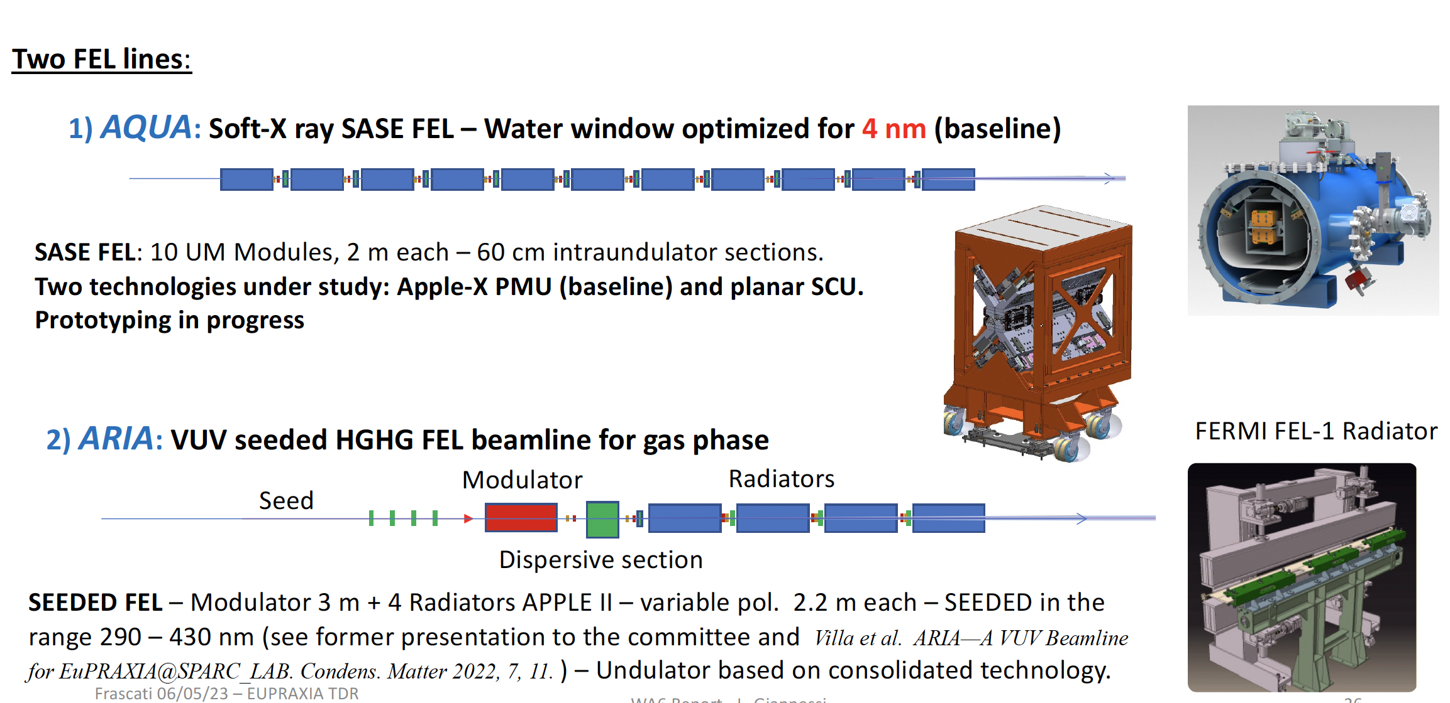
Radiation Generation: FEL
40 m

Slide 9
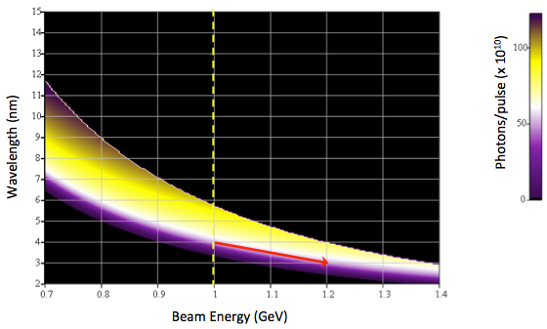
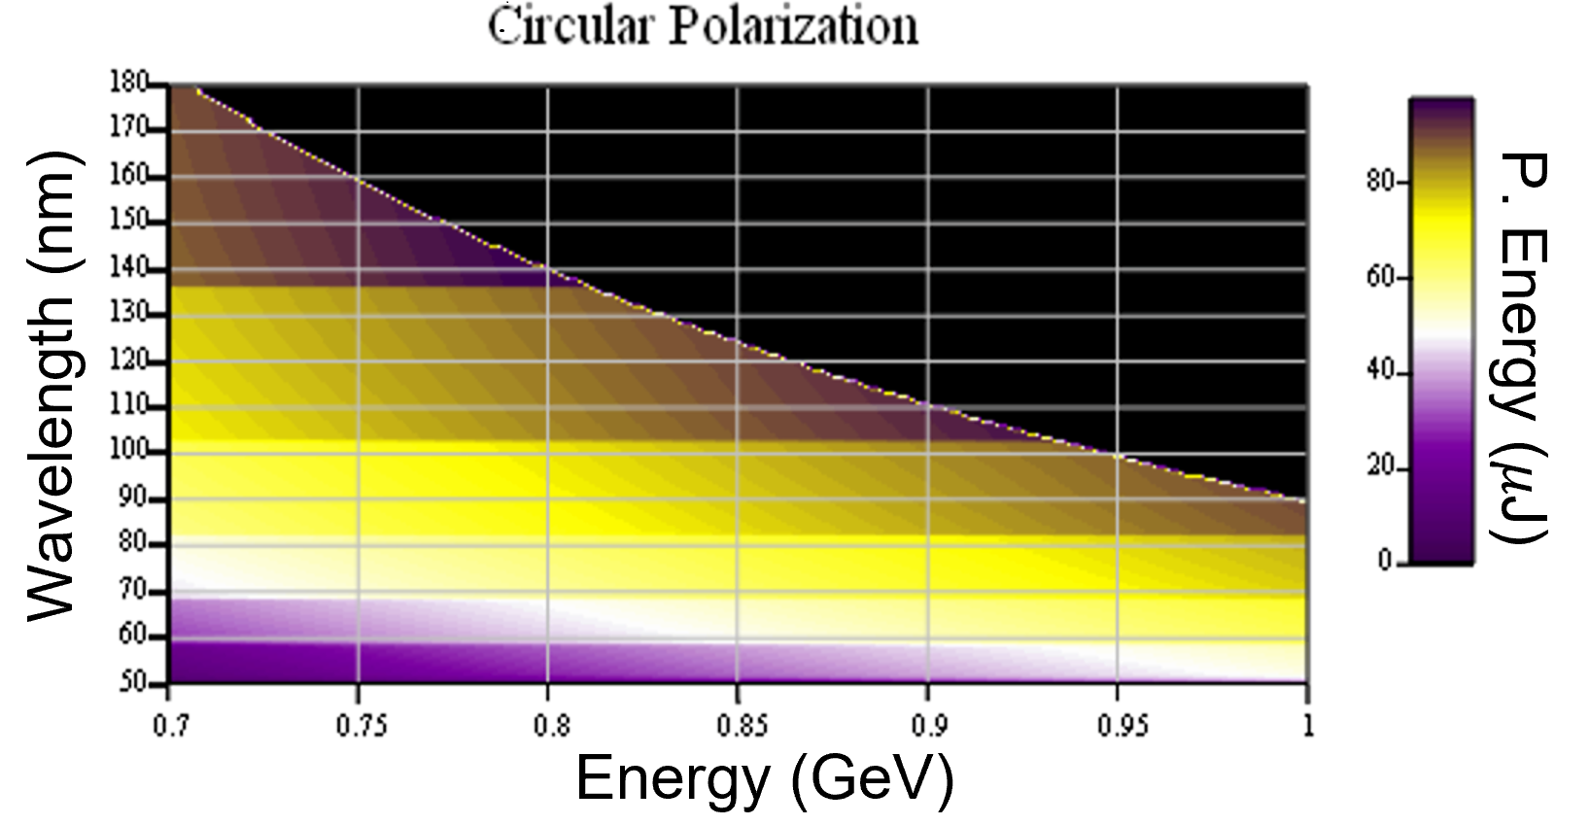
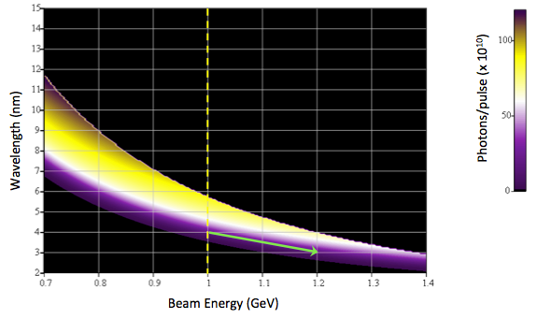
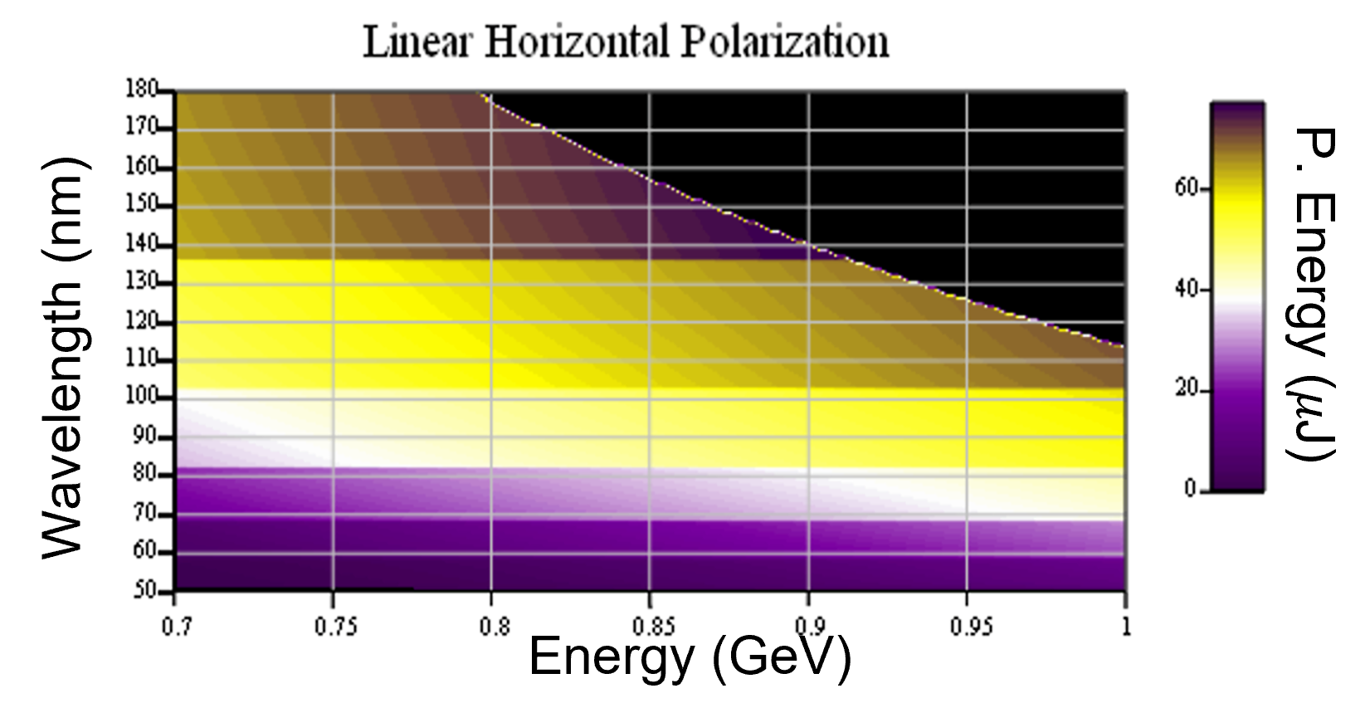
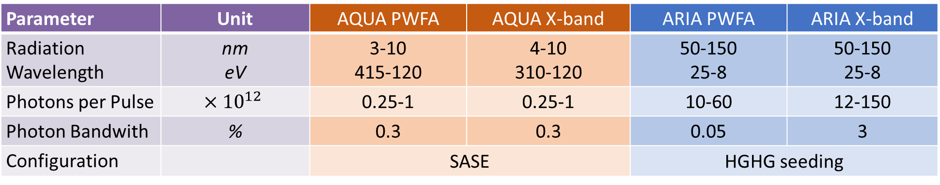
Expected FEL radiation at undulators end
Parameter | Unit | AQUA PWFA | AQUA X-band | ARIA PWFA | ARIA X-band
Radiation Wavelength | nm eV | 3-10 415-120 | 4-10 310-120 | 50-150 25-8 | 50-150 25-8
Photons per Pulse | $$×{10}^{12}$$ | 0.25-1 | 0.25-1 | 10-60 | 12-150
Photon Bandwith | % | 0.3 | 0.3 | 0.05 | 3
Configuration |  | SASE | 30 | HGHG seeding | 30
AQUA PWFA
circular
ARIA PWFA configuration
AQUA PWFA
linear
40 m

Slide 10
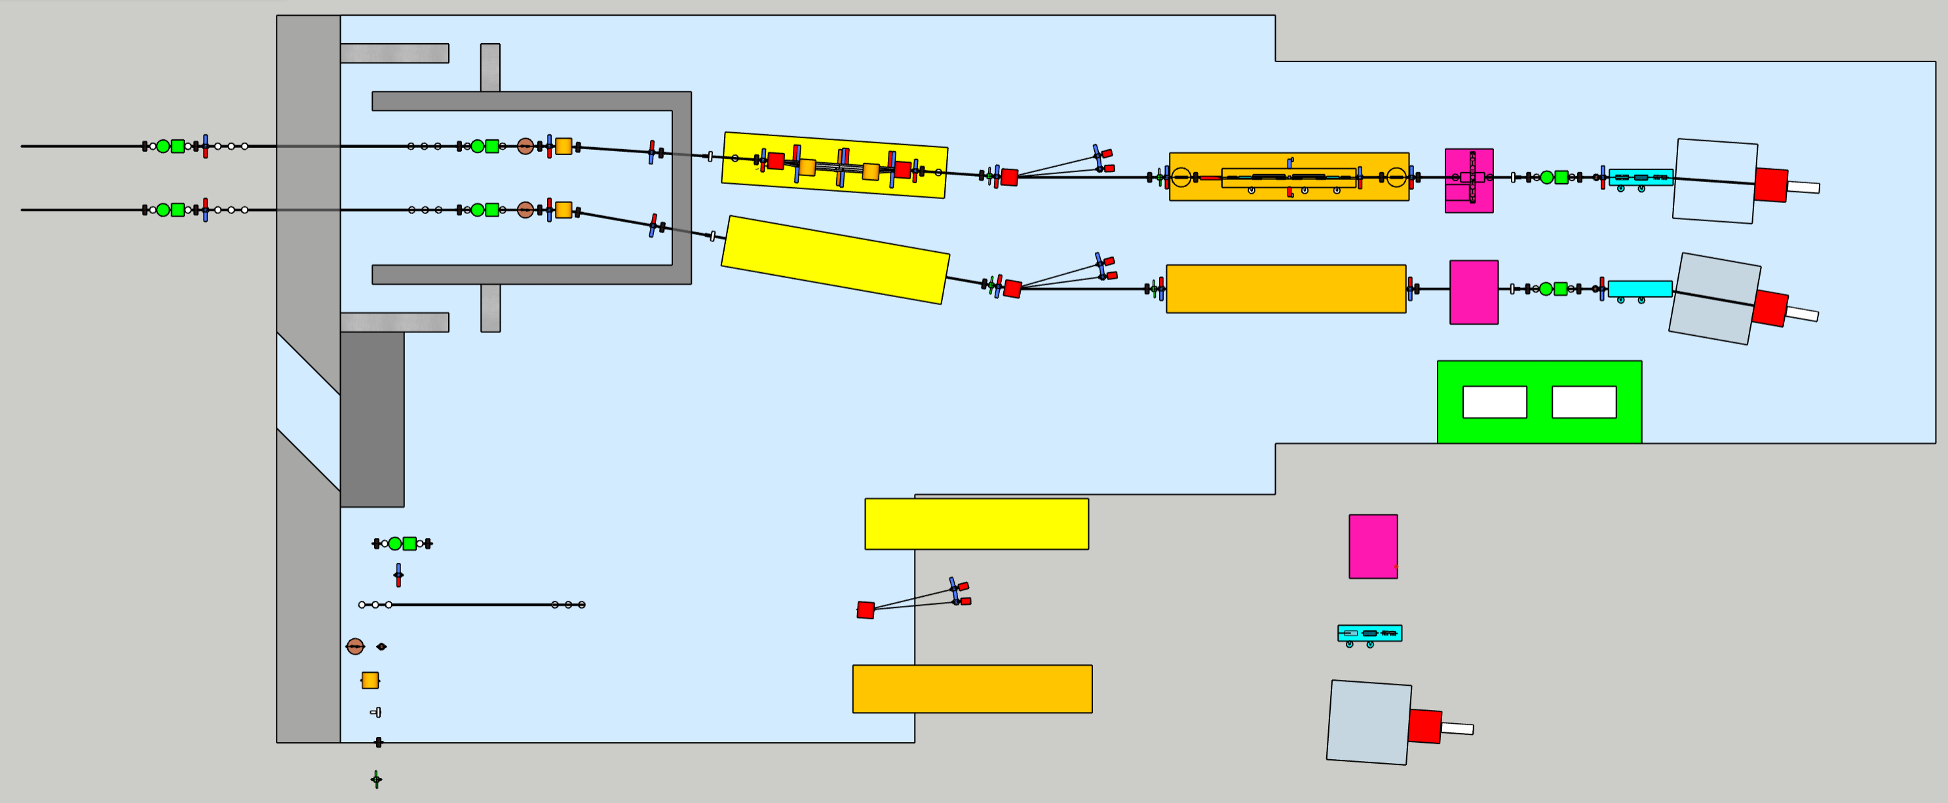
FEL Beamlines
10m
30m
20m
AQUA beamline
12m
ARIA beamline
Monochromator area
Laser hutch
GDM
Polarization/time measure area
Screens
Gas absorber
Spectrometer
Apertures
K-B mirrors
Mirror
Solid attenuators/filters
Exp. Chamber area
Valves
Split & delay line area
BPM
50 m

Slide 11
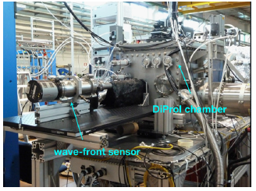
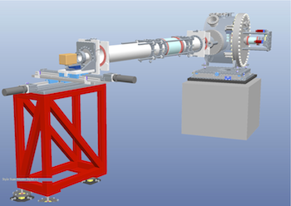
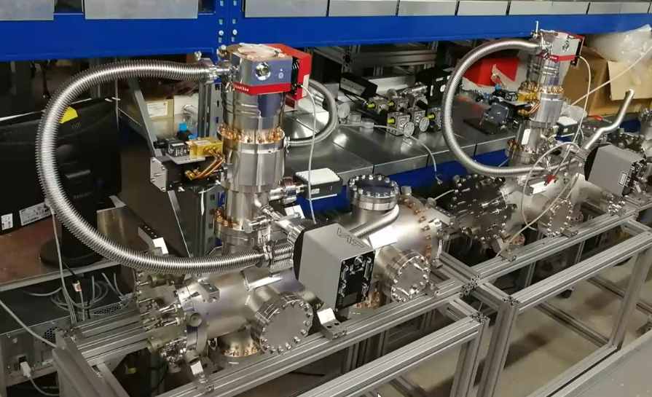
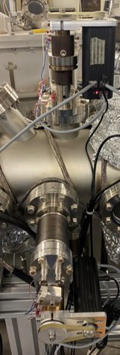
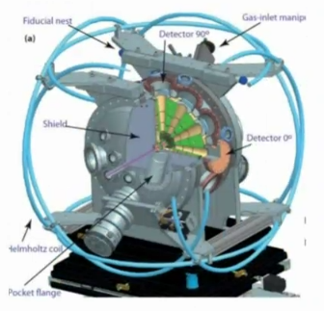
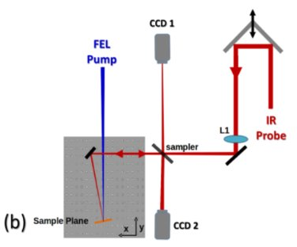
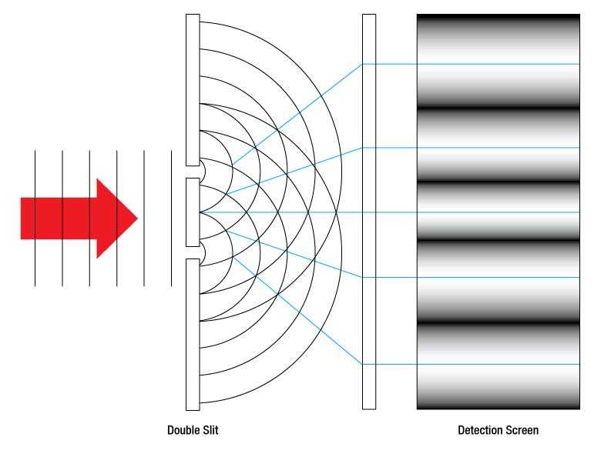
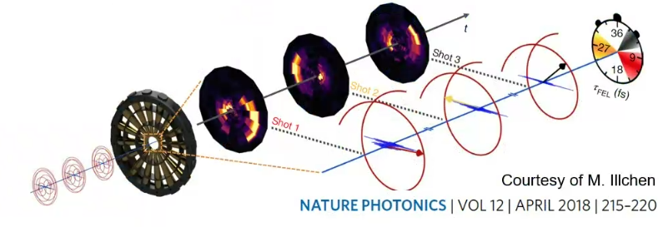
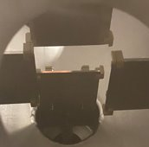
FEL Photon diagnostics
Wavefront sensors
Grating spectrometer
YAG screen
Gas Intensity Monitors and BPMs
Bladed BPM
Ionization streaking
Transient reflectivity
Coherence measurements (transverse and longitudinal)
Longitudinal photon and virtual diagnostic workshops LNF, 6th-8th November 2024
https://agenda.infn.it/event/41662/overview

Slide 12

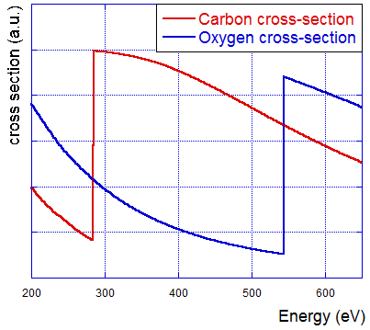
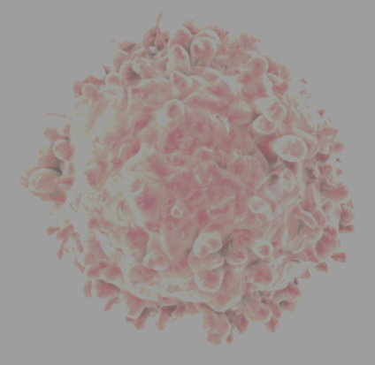
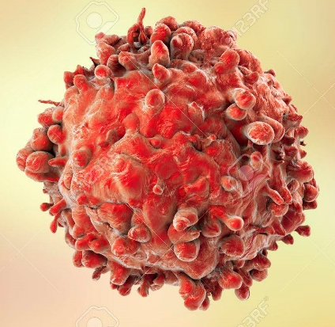
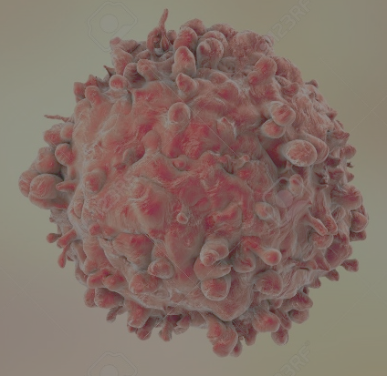
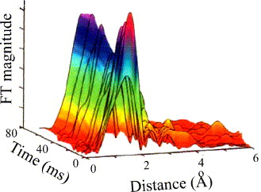
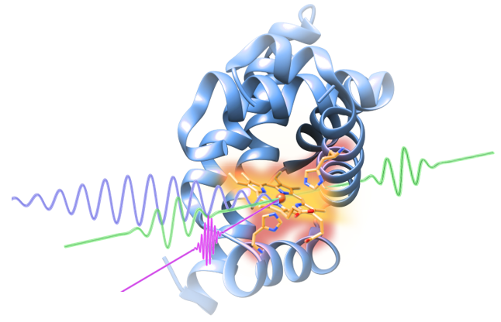
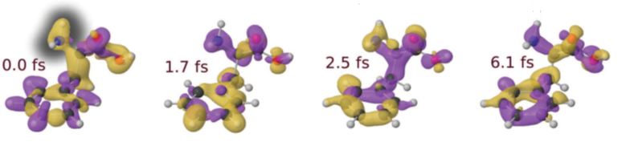
AQUA beamline scientific case
Experimental techniques and typology of samples
4 nm
3 nm 2 nm
(Large) Viruses
Organelles
Bacteria/Cells
Organic molecules
Metals
Semiconductors
Superconductors
Magnetic materials
Coherent imaging
X-ray spectroscopy
Raman spectroscopy
Photo-fragmentation of molecules
50 m

Slide 13
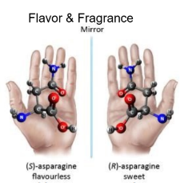
ARIA beamline scientific case
Defining experimental techniques and typology of samples (and applications)
Gas phase & Atmosphere
(Earth & Planets)
Aerosols
(Pollution, nanoparticles)
Molecules & gases
(spectroscopies, time-of-flight)
Proteins
(spectroscopies)
Surfaces
(ablation & deposition)
Photoemission
Spectroscopy
Photoelectron Circular
Dichroism
Raman spectroscopy
Photo-fragmentation of molecules
Time of Flight Spectroscopy
Fundamental research and applications with the EuPRAXIA facility at LNF
LNF, 4th-6th December 2024
https://agenda.infn.it/event/42474/overview
50 m

Slide 14
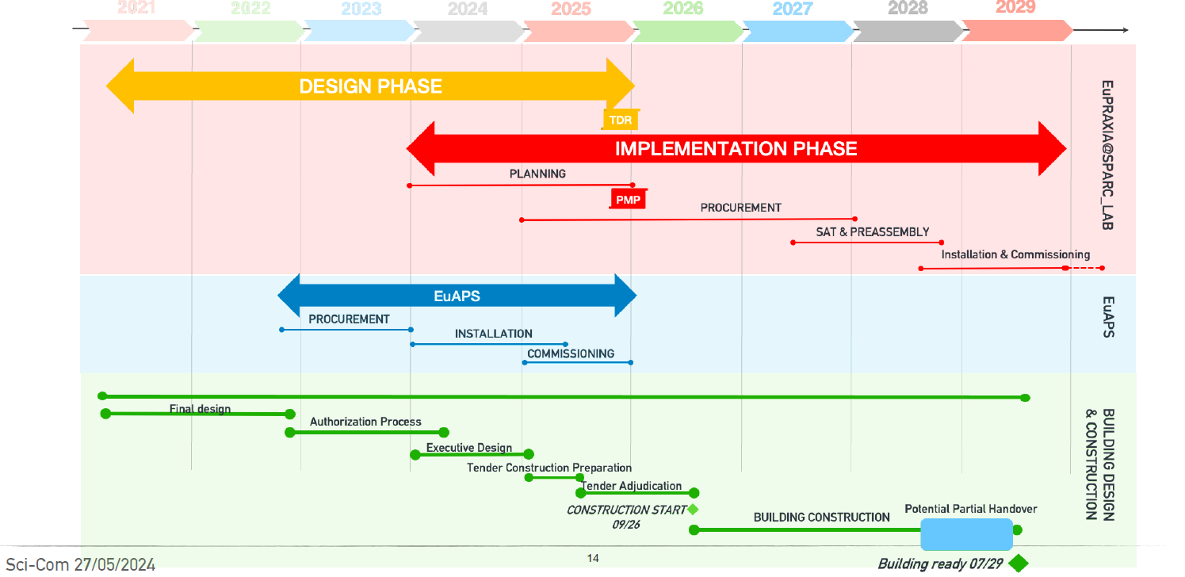
Timelines
Courtesy A. Falone

Slide 15
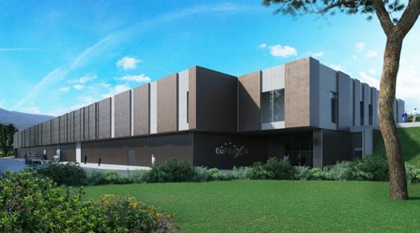
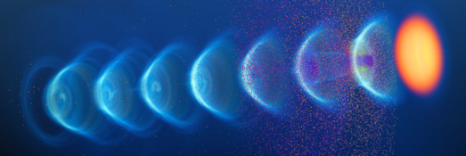
Conclusions & Acknowledgements
Plasma accelerators have advanced considerably in beam quality,
achieving FEL lasing.
EuPRAXIA is a design and an ESFRI project for a distributed European Research Infrastructure, building two plasma-driven FELs in Europe.
EuPRAXIA FEL site in Frascati LNF-INFN is sufficiently funded for
first FEL user operation in 2029.
Aim at making EuPRAXIA an example of European innovation: new science to new applications and new areas in particle and photon physics
Greatly appreciate slides from and discussions with: A. Cianchi, F. Cioeta, M. Del Franco, E. Di Pasquale, A. Falone, A. Ghigo, L. Giannessi, M. Ferrario, S. Lauciani, R. Pompili, F. Stellato and
THE ENTIRE EuPRAXIA@SPARC_LAB and EuAPS TEAMS

Slide 16
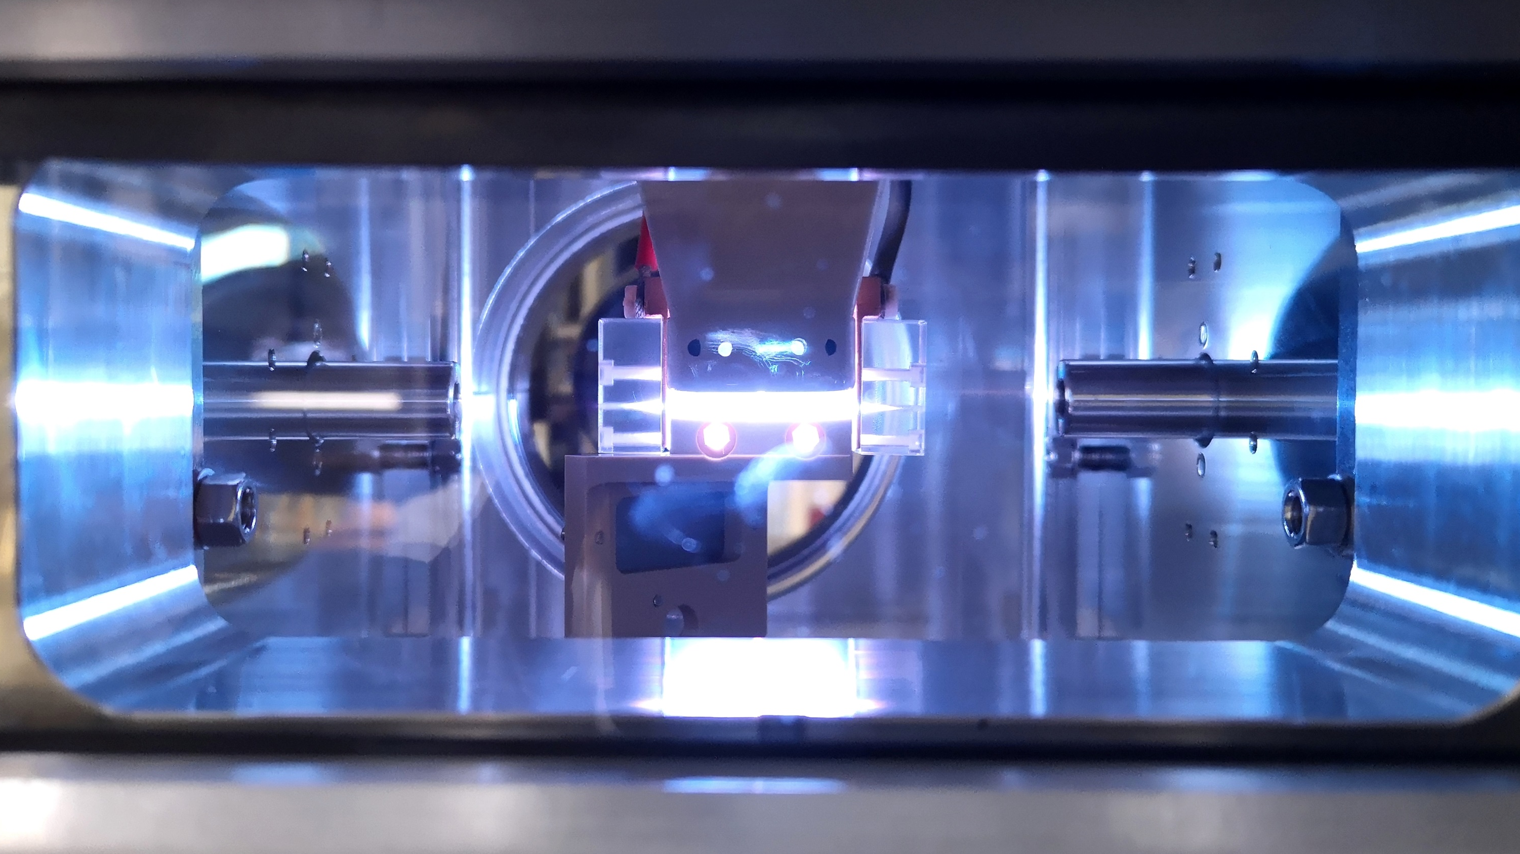
Thank for your attention

