Slide 1
7th International Conference on Frontier in Diagnostic Technologies
Diagnostics and control at FCC
Daniele Butti, CERN – Beam Instrumentation group
with many thanks to
B. Paroli, M. A. C. Potenza, M. Siano (Università degli Studi di Milano)
U. Iriso, A. A. Nosych, J. Nunez, E. Solano, L. Torino (ALBA-CELLS)
T. Lefevre, S. Mazzoni, A. Schlögelhofer, G. Trad (CERN)
22nd October 2024

Slide 2
Outline
Future Circular Collider
Diagnostics for FCCee
transverse diagnostics
synchrotron radiation diagnostics
X-ray Heterodyne Near Field Speckles
measurements at undulator beamline
future dipole beamline
development of optimized target materials
Conclusion

Slide 3
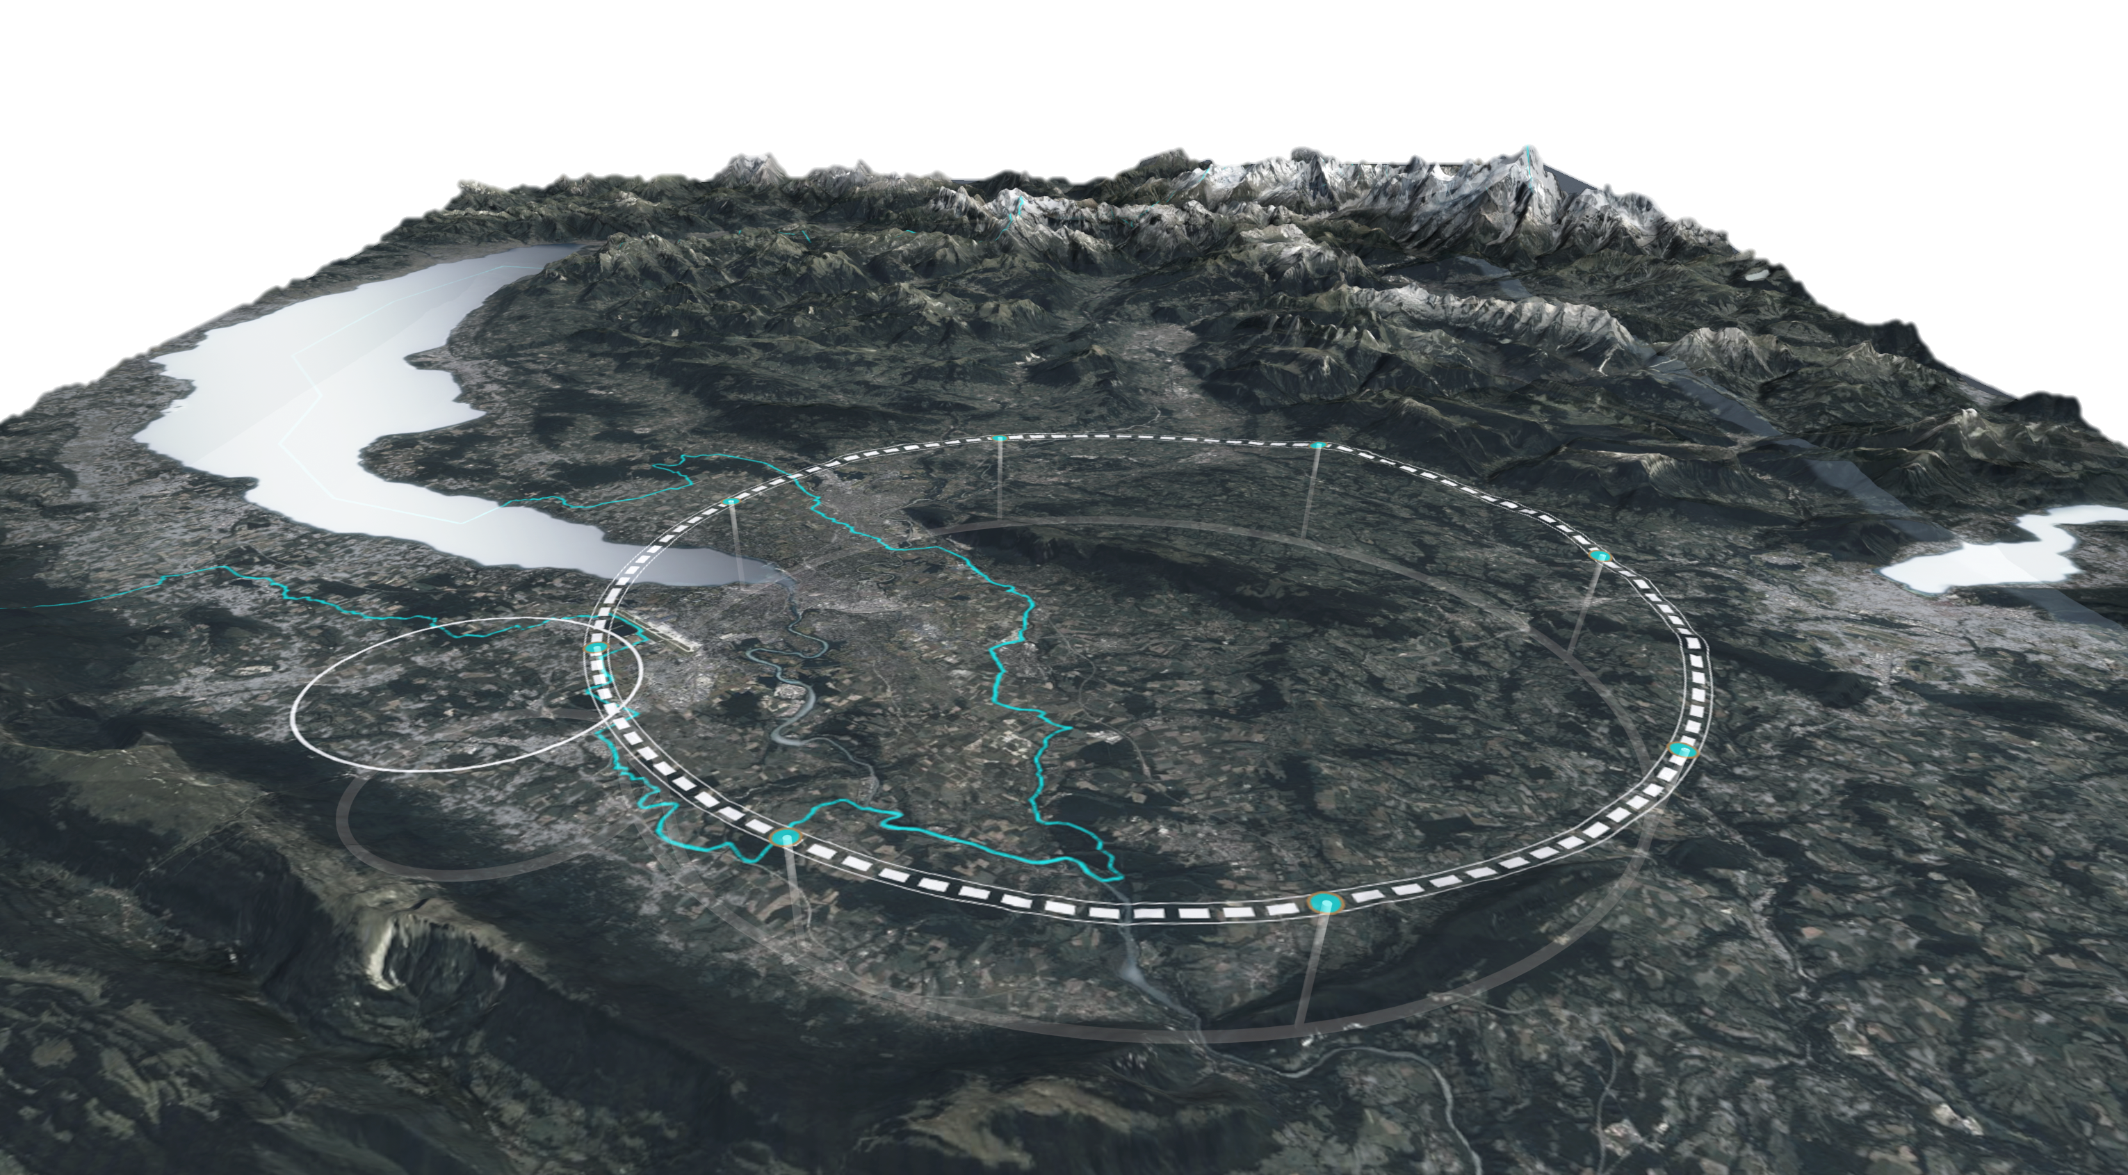
Future Circular Collider
Proposal for CERN next-generation flagship collider after LHC era
Circular machine with four major experiments, commensurate to the size of the current CERN community
Multi-stage facility
FCCee a ~100 GeV electron-positron collider for ultra-precise measurements of Higgs and EW parameters
FCChh a ~100 TeV hadron collider for direct exploration of next energy frontier
Project timeline
2025
~ 2030-2045
~ 2045-2060
> 2070
end of Feasibility Study
Geneva
FCCee construction
LHC
27 km
FCC
90 km
FCCee operation
F. Gianotti
FCC week 2024
FCChh

Slide 4
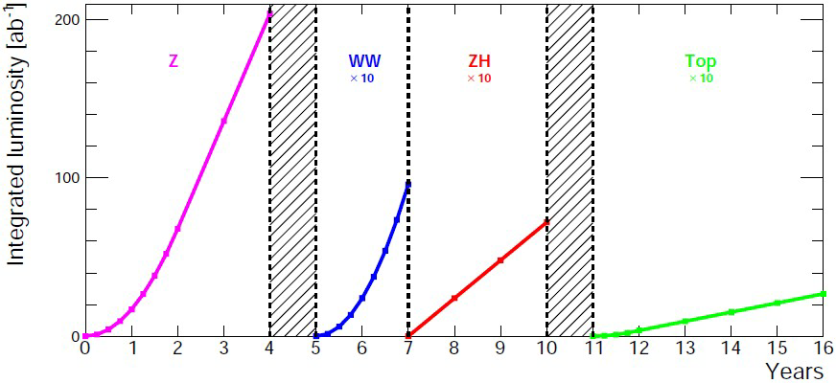
FCCee machine parameters
Four operational modes to maximize physics output
→ changing energy (and current) at fixed SR power
Parameter | Unit | Z | WW | HZ | ttbar
synchrotron radiation power | MW | 50
beam energy | GeV | 45.6 | 80 | 120 | 182.5
beam current | mA | 1270 | 137 | 26.7 | 4.9
number bunches |  | 11200 | 1780 | 440 | 60
horizontal emittance | nm | 0.71 | 2.17 | 0.71 | 1.59
vertical emittance | pm | 1.9 | 2.2 | 1.4 | 1.6
bunch length with SR / BS | mm | 5.6 / 15.5 | 3.5 / 5.4 | 3.4 / 4.7 | 1.8 / 2.2
luminosity | 10³⁴ cm⁻²s⁻¹ | 140 | 20 | 5.0 | 1.25
integrated luminosity | ab⁻¹/yr/IP | 17 | 2.4 | 0.6 | 0.15
4 years
5x10¹² Z
LEP x10⁵
2 years
>10⁸ WW
LEP x10⁴
3 years
2x10⁶ H
5 years
2x10⁶ tt pairs
M. Benedikt
FCC week 2024

Slide 5
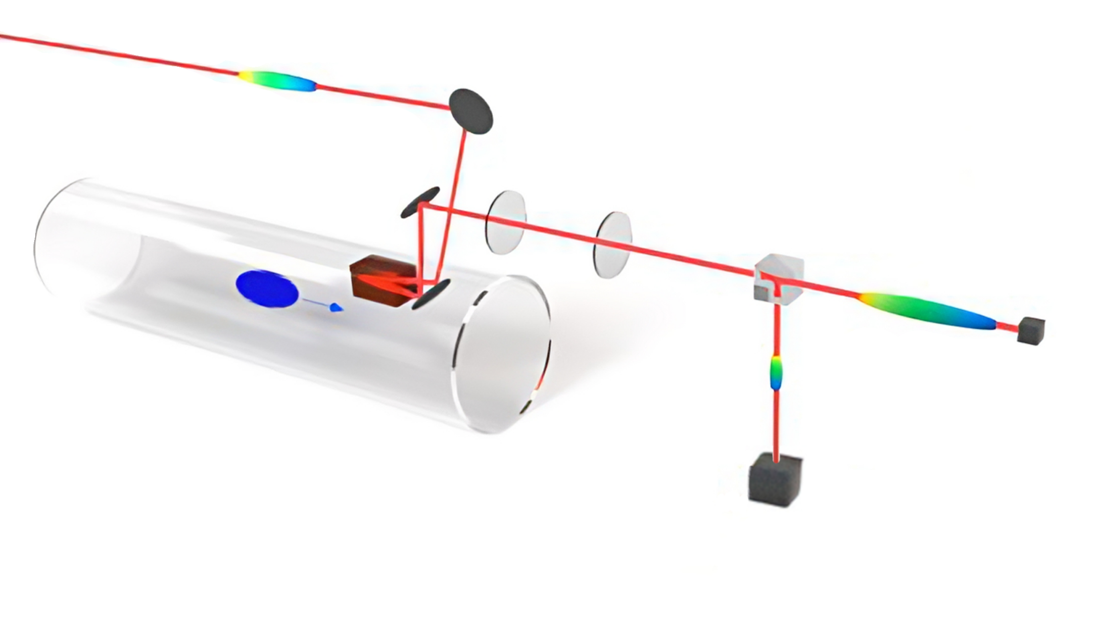
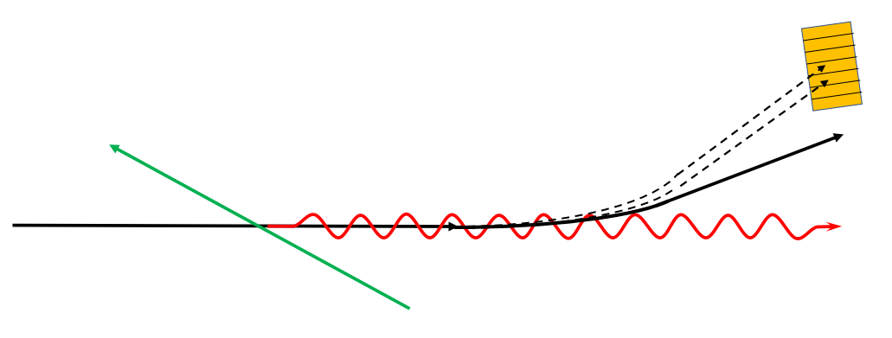
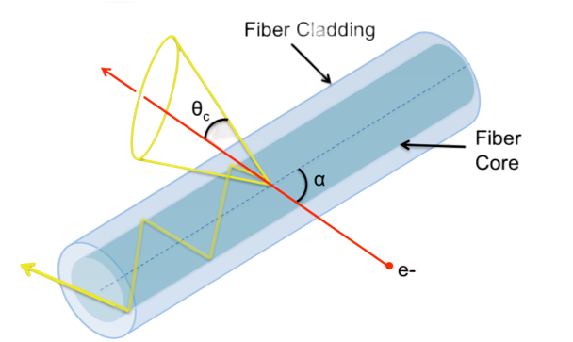
Diagnostics for FCCee
Electro-Optical techniques for longitudinal diagnostics
laser pulse
EO crystal
Many challenges for diagnostics
scale → huge distributed systems
high radiation environment and power loads → critical rad-hardness and stability
high precision measurements → same or better demands than smaller facilities
high reliability → critical for smooth operation
cost and sustainability → little margin with such big machine
bunch
Compton electrons
Inverse Compton Scattering for polarimetry and energy calibration
beam
laser
Compton photons
Cherenkov radiation in fibres for losses diagnostics
cladding
core
Conventional instrumentation employed but novel diagnostics necessary to achieve all requirements
Cherenkov light
lost electron

Slide 6
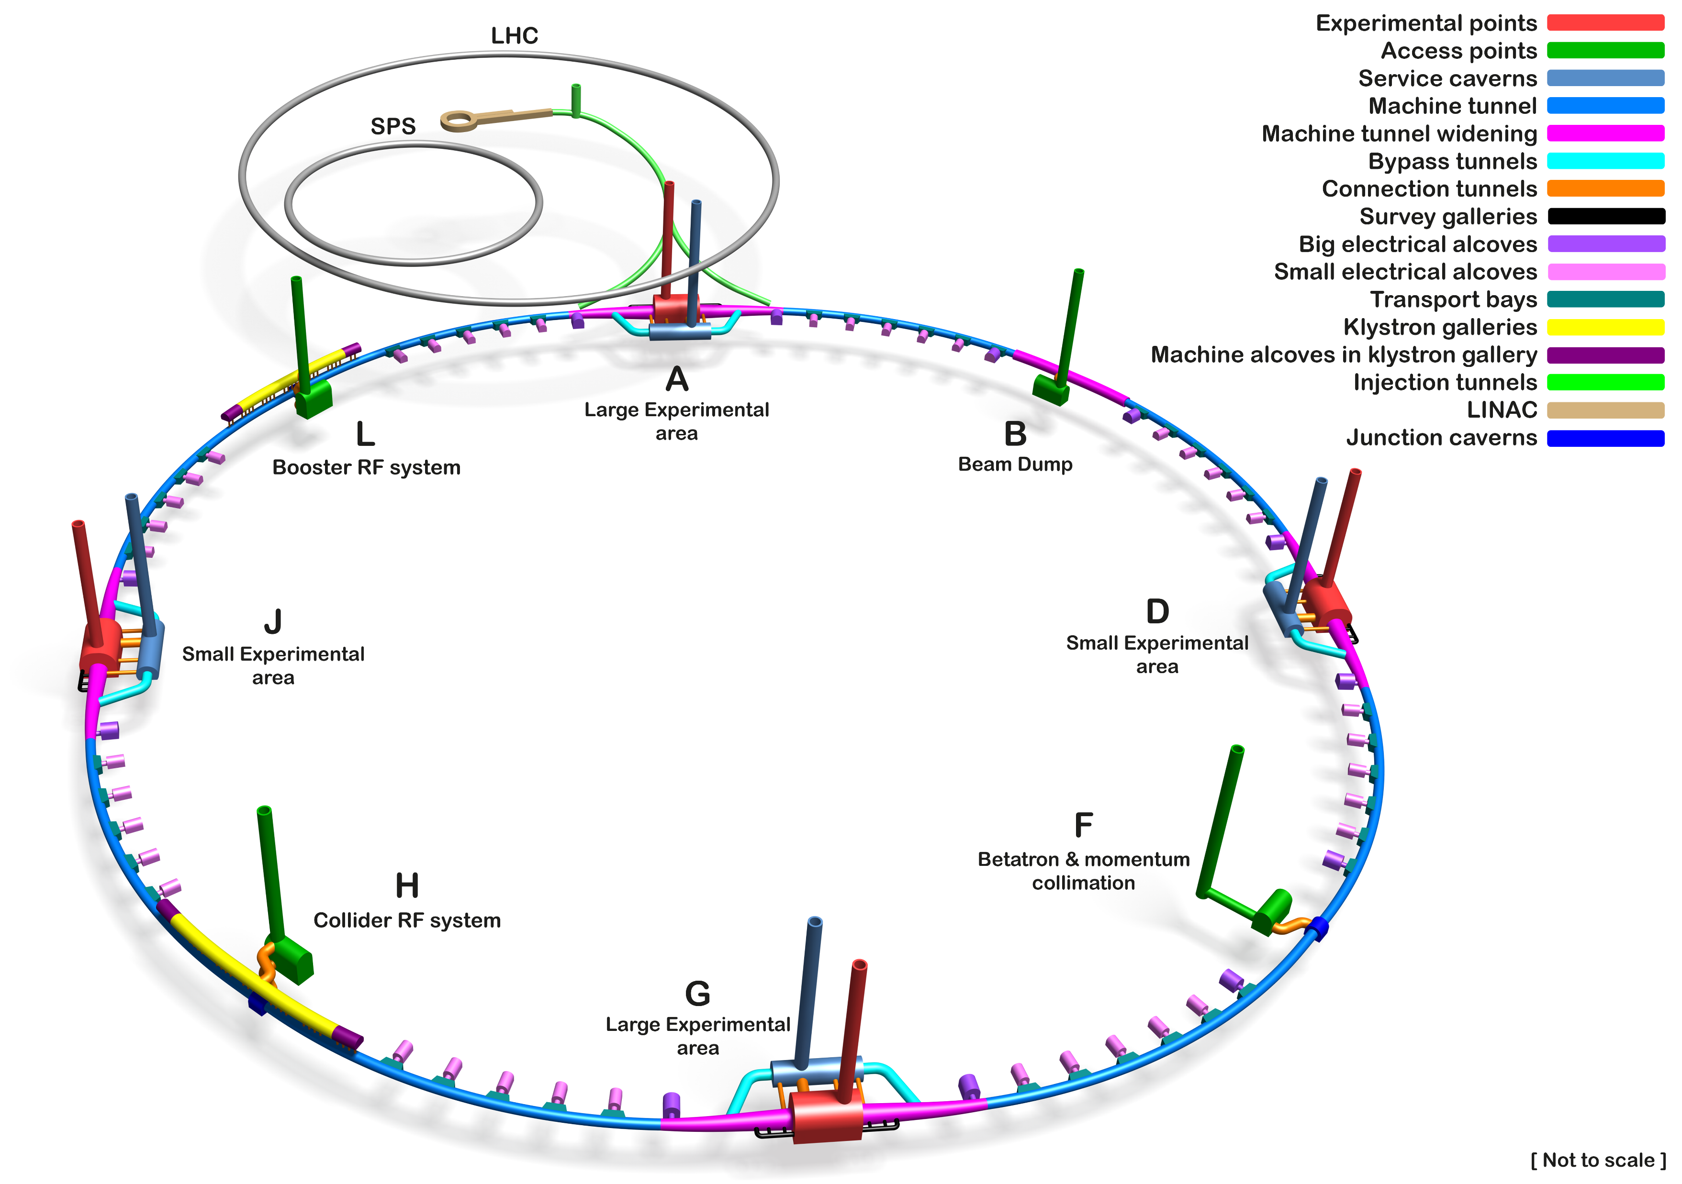
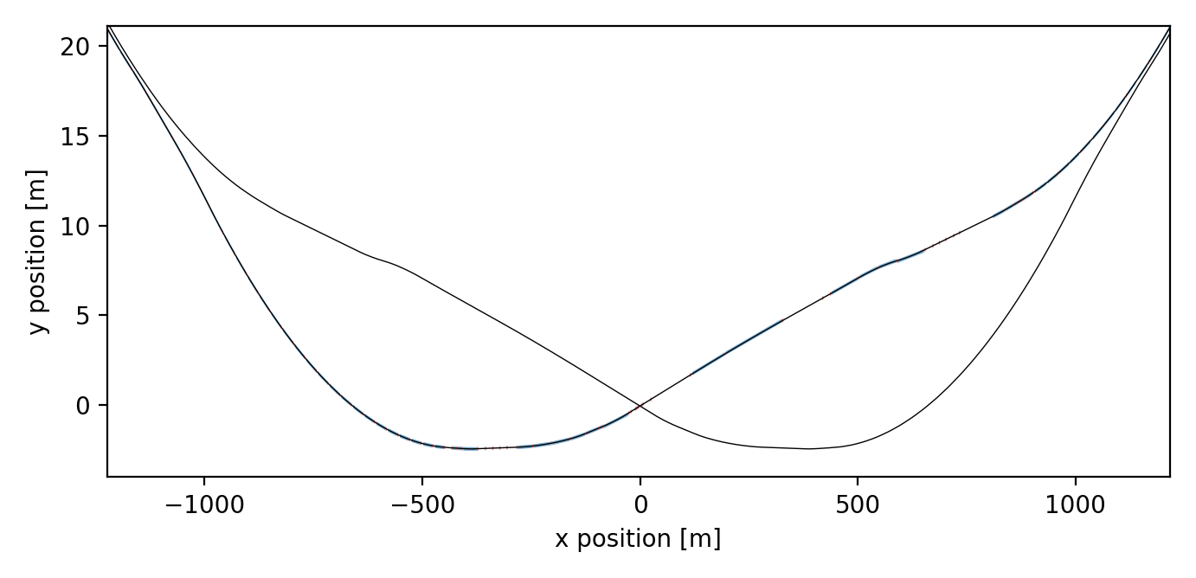
Transverse diagnostics for FCCee
Transverse beam size (emittance) affects collision rate (luminosity)
→ transverse diagnostics crucial for performance optimisation
FCCee is a high-energy circular accelerator
→ synchrotron radiation natural choice for diagnostics
Beam sizes in the order of $10 μm$ (vertical)
→ X-ray diagnostics to maximize resolution
Smaller beam sizes and higher radiation levels in arcs
→ install diagnostics close to experimental regions
Beam 2
Beam 1
Interaction Point
Conventional instrumentation (pinhole and screens) will be installed but more advanced diagnostics needed to meet accuracy requirements
SR extraction

Slide 7
Synchrotron radiation techniques for transverse diagnostics
SR imaging
$$σ_{image}$$
$$σ_{beam} \sim σ_{image}$$
focusing optics
SR interferometry
$$σ_{coherence}$$
$$σ_{beam} \sim 1/σ_{coherence}$$
monochromator
interference target
Imaging and interferometry often combined in synchrotron radiation diagnostics
imaging provides robust and precise relative measurements
interferometry used for accurate absolute measurements

Slide 8
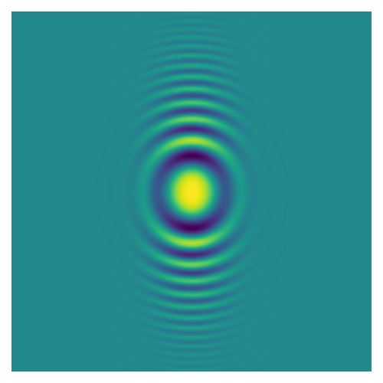
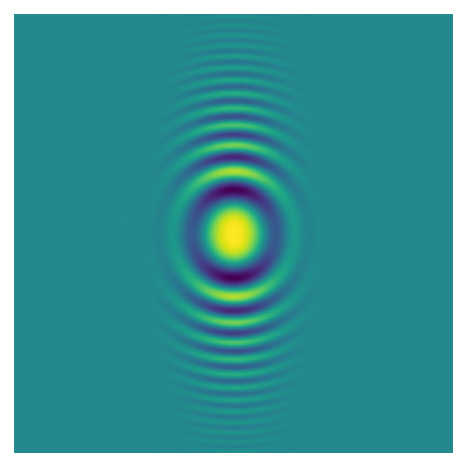
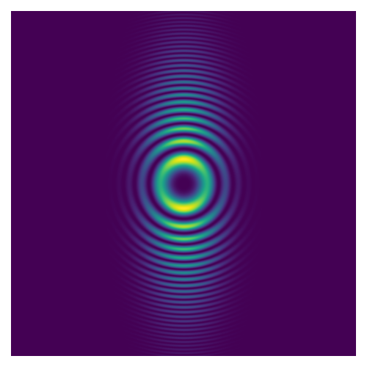
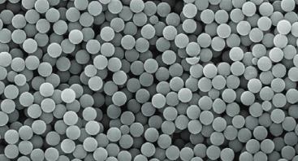
X-ray Heterodyne Near Field Speckles (HNFS)
Interference target is a dispersion of light-scattering nanospheres
$$\sim 1/σ_{y}$$
$$\sim 1/σ_{y}$$
$$ℱ$$
$$\sim 1/σ_{x}$$
$$\sim 1/σ_{x}$$
monochromator
scatterers
single scatterer
many scatterers
power spectrum
Key features for implementation in FCCee
intrinsically two-dimensional measurement
compact, no need of long distances downstream of target
Silica spheres (500 nm)

Slide 9
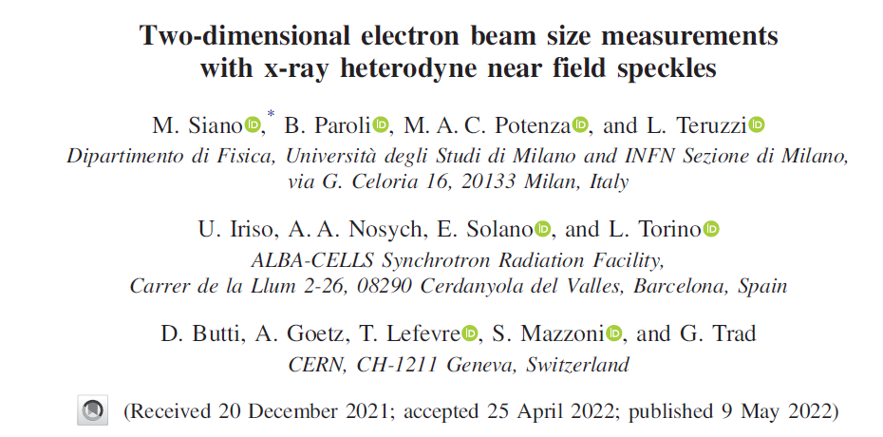
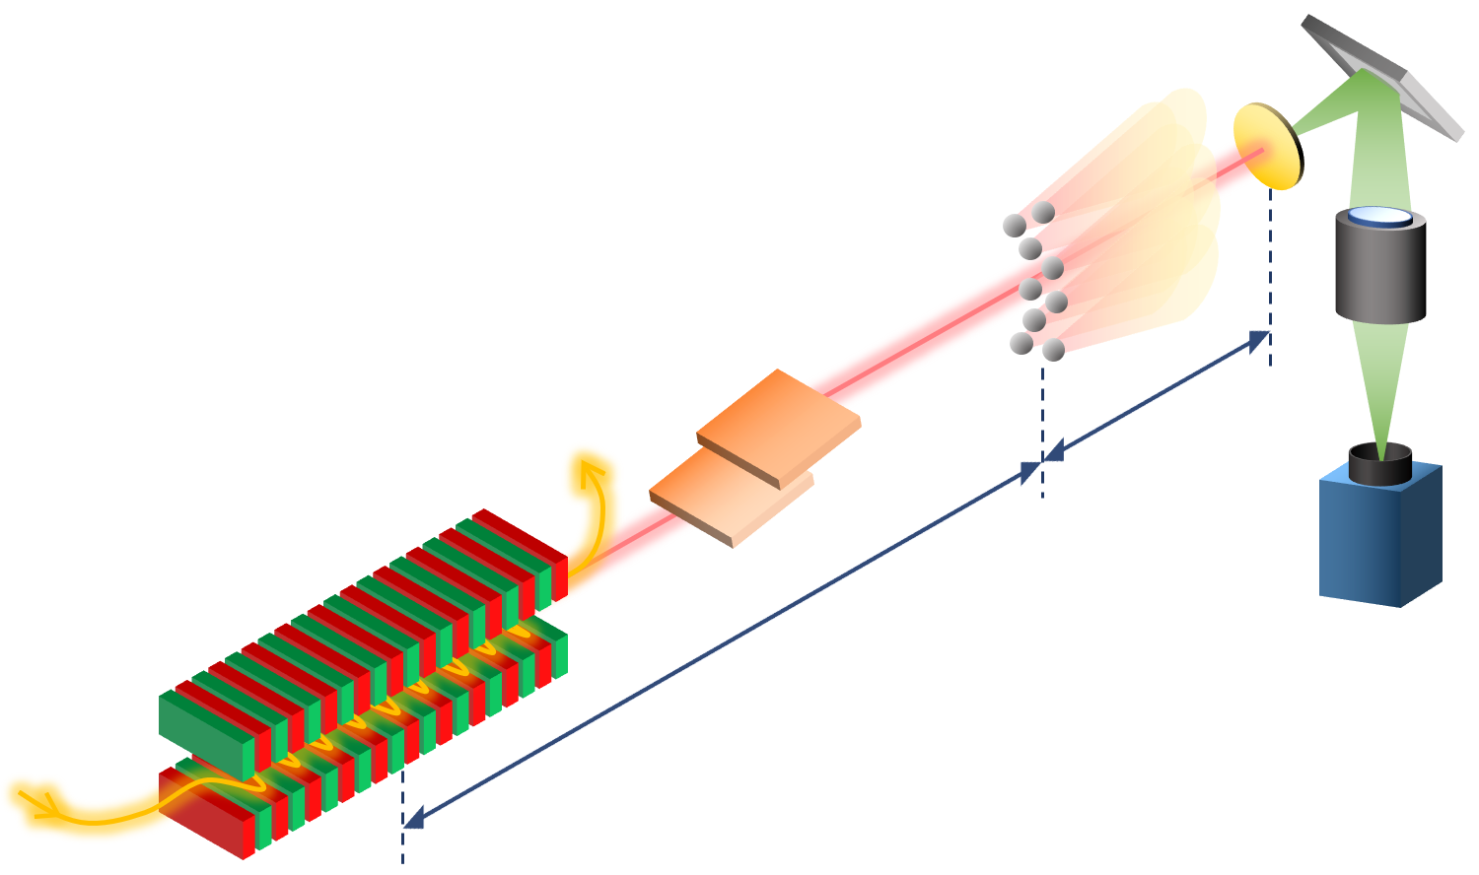
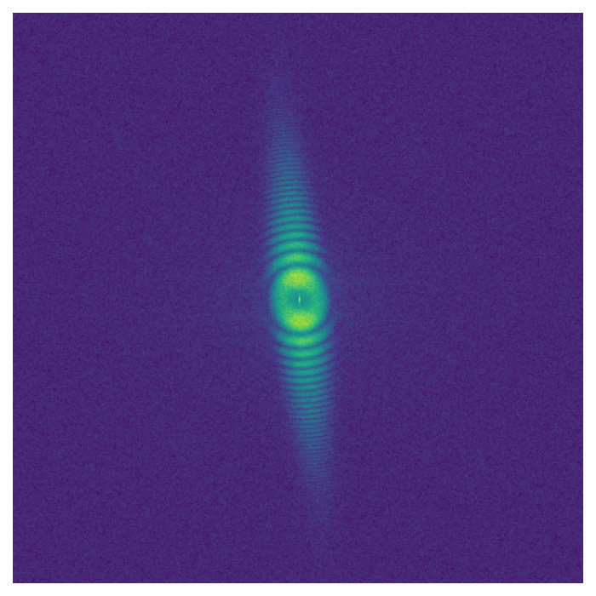
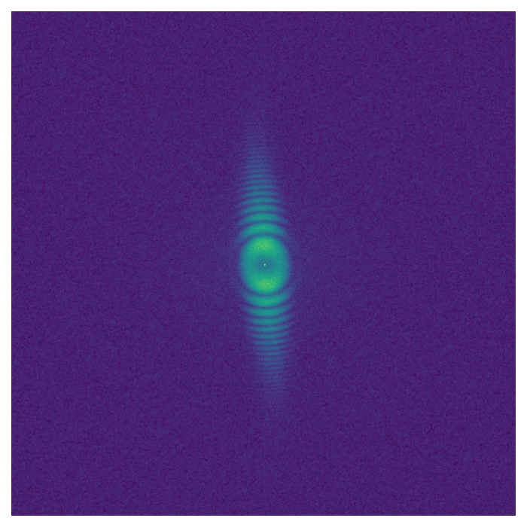
Beam size measurements with x-ray HNFS
Measurements at ALBA synchrotron (Spain)
systematic validation at undulator beamline
measured beam size as small as $5 μm$
nanospheres
Si(111) monochromator
$$E_{ph}≃12 keV$$
$$1.2 m$$
$κ=0.50$ %
undulator source
$$33 m$$
$κ=2.80$ %
Credit: M. Siano

Slide 10
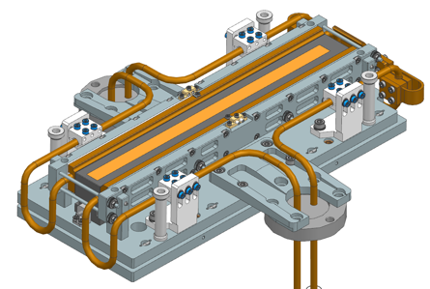
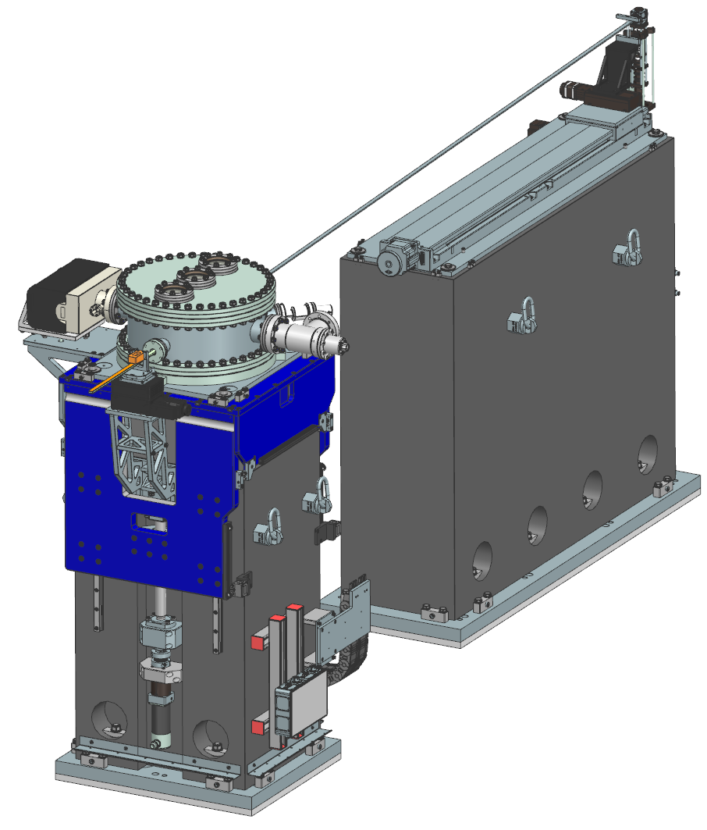
Future tests with dipole source
In-vacuum multilayer monochromator
Challenges to deploy technique at FCCee
high energy photons $E_{ph}>20 keV$
broadband (dipole) SR source
new dipole line being equipped at ALBA for HNFS tests using dipole synchrotron radiation
Detector
Scatterers
Layout of FE21 at ALBA, equipped for HNFS studies
Credit: U. Iriso

Slide 11
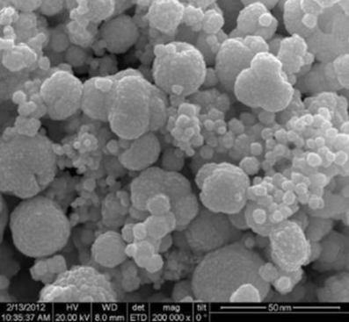
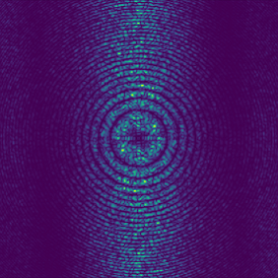
Development of new target materials
Nanostructured gold target
Silica nanospheres not usable in regular FCC operation
poor contrast of SiO₂ with hard x-rays
stability issues such as sedimentation and aggregation of colloids
need to develop and study novel target materials
Credit: S. Mazzoni
Numerical simulations
(SRW, preliminary)
Ongoing R&D to design and manufacture gold-based scatterers, optimized for FCC applications, to be tested in new ALBA beamline
Credit: J. Nunez

Slide 12
Conclusion
FCC is a frontier machine that needs frontier diagnostics to maximize physics output
→ novel techniques under study in several diagnostic domains
X-ray Heterodyne Near Field Speckles successfully tested at ALBA light source
→ promising option for accurate beam size measurement at FCCee
Challenges to implement HNFS as operational diagnostics at FCCee
→ work in progress for test beamline at ALBA and R&D for optimized target materials

Slide 13
Thank you for your attention!
13

