Slide 1







Diagnostic Challenges for European DEMO: A Case Study in Optical Diagnostics
Dániel Dunai
I. Katona, M. Cavedon, C. Baumann, R. Luis, C. Pastor, F. Subba, S. Wiesen, W. Biel
and contributors to EUROfusion WPDC

Slide 2
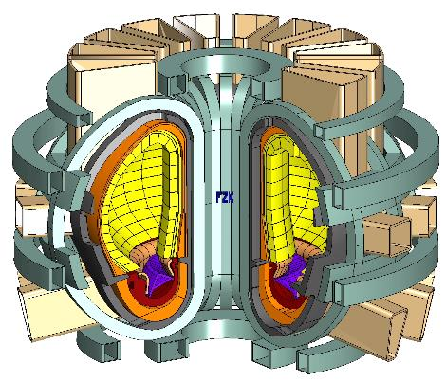
European DEMO – Fusion Power Plant
“Demonstration fusion power plant (DEMO)
will be operational around 20 years after high power burning plasmas are demonstrated in ITER.”
Main EU DEMO parameters:
R₀, a ~ 9 m, 2.9 m
B₀ ~ 5 T
P_{therm} ~ 2 GW
P_{el,net} ~ 300…500 MW
t_{pulse} > 2 h
European Research Roadmap to the Realisation of Fusion Energy - https://euro-fusion.org/eurofusion/roadmap/

Slide 3
European DEMO – Fusion Power Plant
“Demonstration fusion power plant (DEMO)
will be operational around 20 years after high power burning plasmas are demonstrated in ITER.”
  Pulsed DEMO tokamak as baseline
  Machine size ~ 1.5 times of ITER
  Lower Single Null Divertor
  High plasma density with fully detached divertor plasma operation
Main EU DEMO parameters:
R₀, a ~ 9 m, 2.9 m
B₀ ~ 5 T
P_{therm} ~ 2 GW
P_{el,net} ~ 300…500 MW
t_{pulse} > 2 h
  Fusion Power Plant
  – Diagnostics are for control
W. Biel et al. Fusion Engineering and Design Volume 179, June 2022, 113122

Slide 4
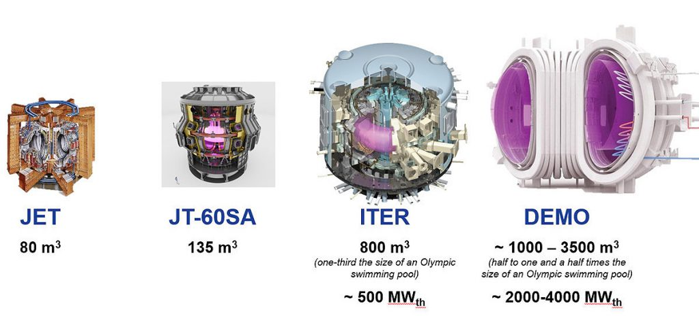
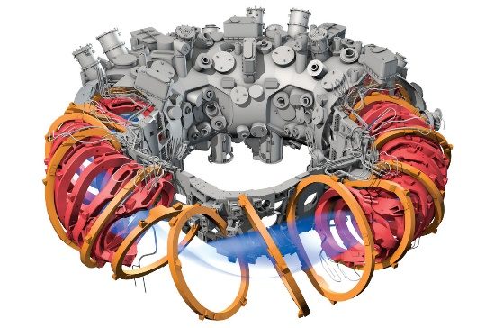
Diagnostics developments for various machines
Wendelstein 7-X
30 m³
ITER
800 m³
DEMO
~1000 - 3500 m³
Status
Operational
First plasma 2015
Under Construction
First plasma 2034
Conceptual Design
First plasma 20xx
Many advanced diagnostics and continuous development
From conceptual design, prototypes,
manufacturing
Conceptual design
(feasibility study)
Diagnostics
ICFDT7: M. Otte et al.: Diagnostic Capabilities at Wendelstein 7-X Stellarator

Slide 5
Diagnostics requirements for experiments and Fusion Power Plant
Device | Experiments (W7-X, JT60SA, ….., ITER*) | Fusion Power Plant (EU-DEMO)
Relevance of Diagnostics | Precise quantitative measurements with high(est) resolution and accuracy (that the budget allows): - enhance the understanding of physics - inputs for detailed offline simulations - Maximum information for all discharges | Control signal for actuators: - Sufficient resolution and accuracy, but - High reliability (also in off-normal events) - Cost effective solution - Minimum number of diagnostics for reliable control
Control system: nuclear safety, investment protection and stable energy production
Diagnostics → Control system → Power plant

Slide 6
Diagnostics requirements for experiments and Fusion Power Plant
Device | Experiments (W7-X, JT60SA, ….., ITER*) | Fusion Power Plant (EU-DEMO)
Diagnostics location | The vacuum vessel is full of ports, in-vessel diagnostics components, accessible all directions + special views for divertors | Limited space allocation for actuators and diagnostics – maximize the tritium breeding Integration – design driver
Maintenance and reliability | Accessible during campaigns (with restrictions) (*ITER no accessibility in nuclear operation ) In case of core diagnostic failure → shut down | Not accessible. Remote handling compatibility. diagnostics port might be removed during shut down. Redundancy for all actuators and diagnostics.
Data analysis and modelling | Analysis is after the experiments. Checked against simulation results → virtual diagnostics | Real time compatibility → Real-time data analysis → Virtual diagnostics implemented in a flight simulator
Environmental constraints | Magnetic field, Vacuum, moderate radiation level (if any) (*ITER high neutron dose in D-T) | All previous + Neutron and Gamma dose is primary design driver

Slide 7

Diagnostics Designs for DEMO – Limitations
DEMO is still in the early phase of the design (change of baseline is expected in 2024)
Limited information (incomplete CAD design, plasma modelling, irradiation data…)
High level requirements based on physics considerations
(like detect an ELM, or successful pellet launch)
Diagnostic relevant requirements are deduced and compiled by the designers
(signal, resolution,…..)
Diagnostics design not final (by far) - Off normal events, maintenance, cost effectivity, ….
will be design drivers but the design cannot be optimized for all these yet.
Control system design would need realistic inputs (even if it is incomplete)

Slide 8
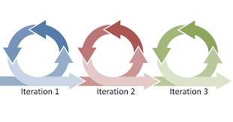
Design process and scope in a conceptual design
What is the main goal of the design process?
Concentrate on DEMO (FPP) specific challenges.
Understand the physics requirements and deduce the diagnostics requirements
Identify missing bits: physics knowledge, simulation code, manufacturing technology, material choice
Setup a workflow where the iterations can be performed
Provide a conceptual design based on the actual DEMO design and requirements
A conceptual design
from physics basics -> engineering design -> expected signal to the control system
(with large uncertainties, still better than only wait for more precise inputs)
Transferable solution between FPP variants

Slide 9
DEMO Divertor Monitoring Diagnostics – High level physics requirements
Detachment control: plasma near the strike-points. Loss of detachment detection – 200ms
Measurement property: Occurrence of spectral lines which provide an unambiguous indication of the existence of a cold plasma region with significant neutral particle densities.
Divertor local W-erosion: inner and outer VT surface. Detection of spectral lines that indicate strong tungsten fluxes from the target into the divertor plasma.
Measurement property: intensity of tungsten lines relative to lines from hydrogen isotopes
Thermography on divertor wall, 500°C to 1200°C: inner and outer VT surface.
Measurement property: relative photon count between wavelengths.
Plasma temperature near the divertor targets: inner and outer VT parallel views.
Measurement property: Doppler broadening and/or line intensity ratios (relative photon count between wavelengths).
Detect MARFEs: central divertor plasma near X-point.
Measurement property: radial intensity distribution of spectral lines from impurities or from hydrogen isotopes.
ELM detection: DEMO should not exhibit ELMs, but in case ELMs occur, they have to be detected to protect the machine.
+1 High resolution image of the Vertical Targets to identify possible damages
D. Dunai et al.: EFDA_D_2QES79

Slide 10
DEMO Divertor Monitoring Diagnostic - Detachment Control
Two different objectives – not independent
An optical diagnostic system (with multiple line of sights) can fulfil the high-level requirements – identify the control signal
- Simulations, simplified virtual diagnostics
Optical diagnostic system (meeting the requirements of 1. objective) can be realized in DEMO conditions.
- First mirror protection
- Optics design
- Opto-mechanics design
- Material selection
- Radiation doses – design is compatible with expected neutron and gamma flux

Slide 11
DEMO Divertor Monitoring Diagnostic - Detachment Control
Two different objectives – not independent
An optical diagnostic system (with multiple line of sights) can fulfil the high-level requirements – identify the control signal
- Simulations, simplified virtual diagnostics
Optical diagnostic system (meeting the requirements of 1. objective) can be realized in DEMO conditions.
- First mirror protection
- Optics design
- Opto-mechanics design
- Material selection
- Radiation doses – design is compatible with expected neutron and gamma flux

Slide 12

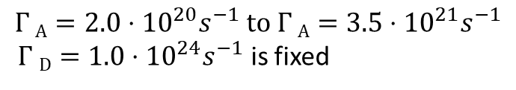
Simulation results for Detachment Control
Loss of detachment defined as a temperature increase above 3 eV of the high-density plasma in front of the target
Dedicated SOLPS-ITER modelling of detached plasmas Injected gas puff scan Deuterium and Argon
$$Γ A=2.0⋅{10}^{20}s^{−1} to Γ A=3.5⋅{10}^{21}s^{−1}$$
$Γ D=1.0⋅{10}^{24}s^{−1}$ is fixed
Simulation results are used to identify the plasma volume, where a detached plasma reaches T_{e} < 3 eV and provide information on the required spatial resolution.
2D electron temperature at the outer divertor – colormap is top limited 3eV – Argon gas puff scan
Simulation analysis is performed by Marco Cavedon - University of Milano-Bicocca
F. Subba et al 2021 Nucl. Fusion 61 106013

Slide 13
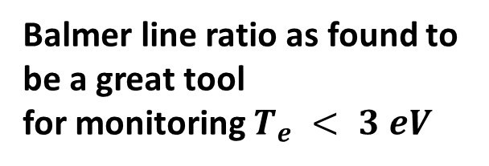
Line ratio as control signal – Deuterium lines
Emission ratio of $D_{α}$ (656 nm) and $D_{γ}$ (434 nm)
Light emission depends on the local plasma parameters and the detachment can be observed from the measured spectra
Simulation results are also used to calculate the intensity of various emission lines to determine the sensitivity in detachment conditions
Which emission lines?
Only VIS and near UV emission lines are considered
Hydrogen and Helium lines
Brightest lines were considered – easier detection
Balmer line ratio as found to be a great tool
for monitoring $T_{e} < 3 eV$
A.G. Meigs: Journal of Nuclear Materials Volume 438, Supplement, July 2013, Pages S607-S611
Divertor spectroscopy design must be capable to resolve relatively small volumes
K Verhaegh et al 2019 Plasma Phys. Control. Fusion 61 125018

Slide 14
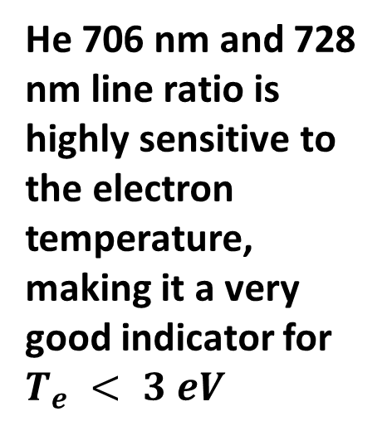
Line ratio as control signal – Helium lines
Emission ratio of He 706 nm and He 728 nm
He 706 nm and 728 nm line ratio is highly sensitive to the electron temperature, making it a very good indicator for $T_{e} < 3 eV$
D. Dunai et al.: EFDA_D_2QES79

Slide 15
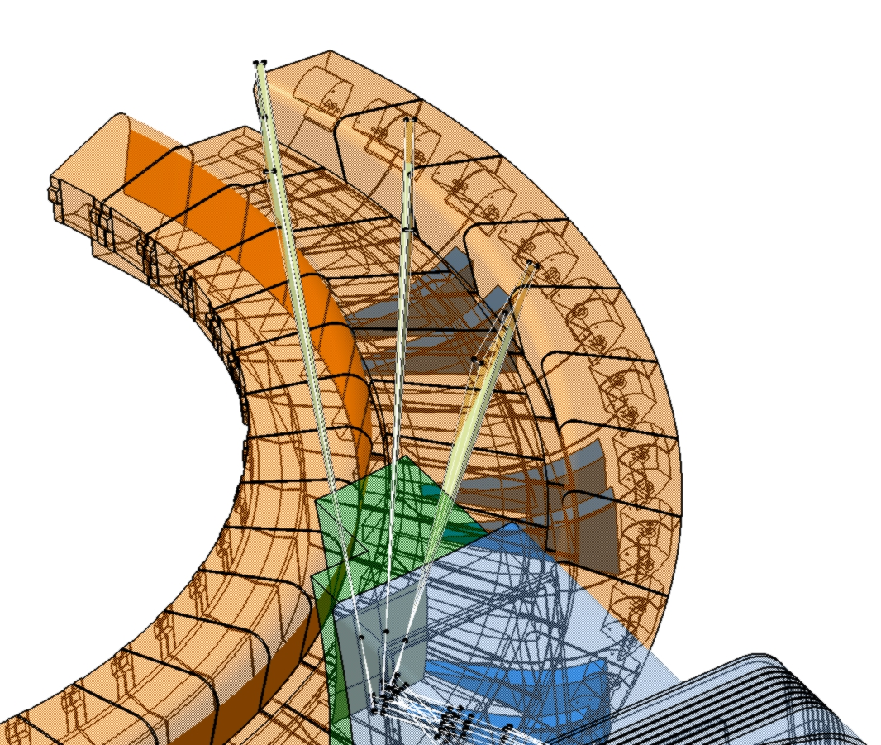
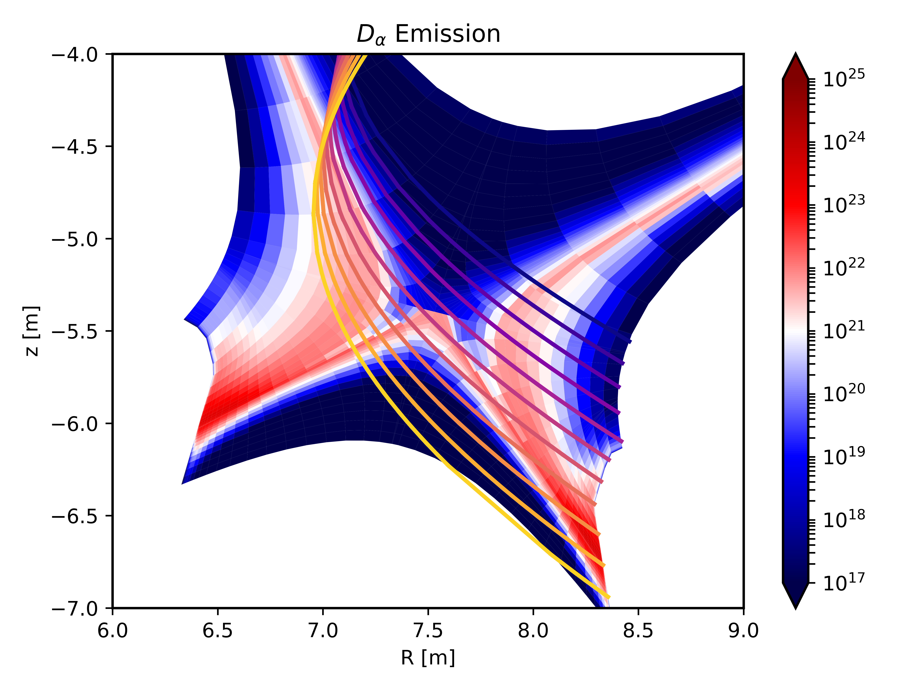
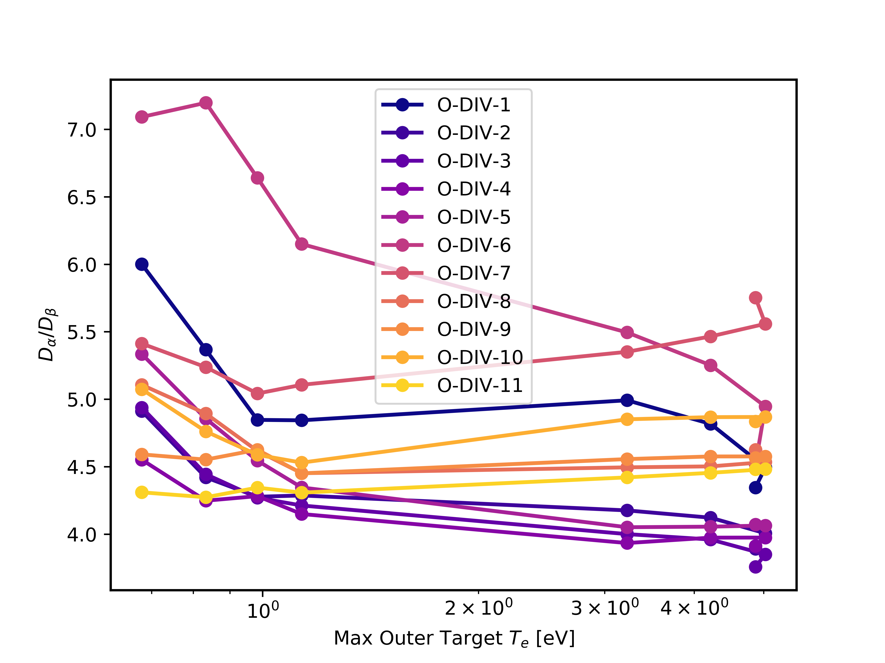
Line of sight optimization
Selection of optimal line of sight is an important for the measurable line ratio signal
The diagnostic provides a line integrated measurement
The achievable spatial resolution is limited by the line integration
Avoid plasma volumes of high visible emission
Line ratio as control signal
Future plans
Consider opacity for both Helium and Hydrogen lines
Consider reflections
Consider strike point sweeps
Line of sight integration

Slide 16
DEMO Divertor Monitoring Diagnostic - Detachment Control
Two different objectives – not independent
An optical diagnostic system (with multiple line of sights) can fulfil the high-level requirements – identify the control signal
- Simulations, simplified virtual diagnostics
Optical diagnostic system (meeting the requirements of 1. objective) can be realized in DEMO conditions.
- First mirror protection
- Optics design
- Opto-mechanics design
- Material selection
- Radiation doses – design is compatible with expected neutron and gamma flux

Slide 17
Diagnostics schematics – Divertor Monitoring diagnostics
DEMO (FPP) Divertor Monitoring Diagnostics
Imaging detectors (IR, VIS)
Shielding
Real-time compatibility
Port Plug Optics
First Mirror
Erosion
Deposition
Radiation
Relay optics
Radiation
Vacuum
Opto-mechanics
Vacuum window
Ex-vessel optics
Radiation
Thermal expansion
Remote Handling compatibility
Light
Spectrally resolved detection
Fiber bundle
Real-time compatibility
Signal levels

Slide 18

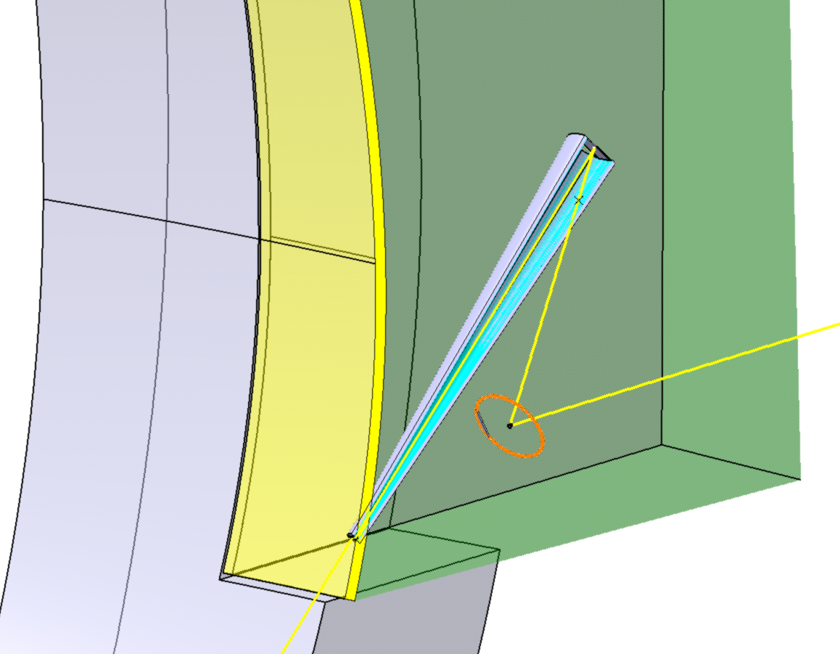
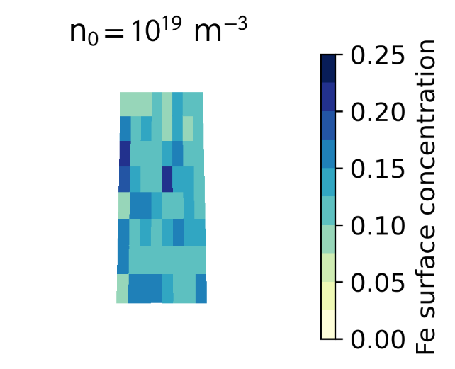
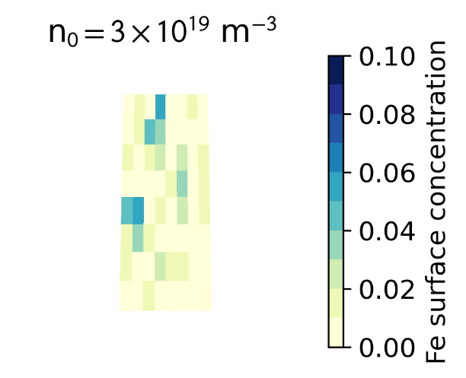
Durability of optical mirrors for DEMO
First mirrors are subject to erosion and deposition fluxes from the plasma side – gas target can protect the surface
M. Z. Tokar, Nucl. Fusion 58, 096007 (2018)
Single crystal Rhodium / Molybdenum as first mirror material
D=30 mm, L=2000m cone shaped duct in simulation
Mirror size was maximized at 180x60mm
D₂ background densities (n₀ = 1x10¹⁹ m⁻³, 3x10¹⁹ m⁻³).
ERO 2.0 was use for the simulation, includes release of sputtered particles from the duct wall. Only the effect of CX neutrals from plasma is taken into account.
First
wall
First mirror
Duct filled with D2
Metal mirror
Aperture
Mirror deposition after 1 year of DEMO operation
Shielding block
High energy neutrals
Molybdenum and Rhodium are both acceptable
as first mirror material
Mirror deposition after 1 year of DEMO operation:
averaged Fe surface concentration in the interaction layer 1.4%
C. Baumann: EFDA_D_2RF7UX

Slide 19
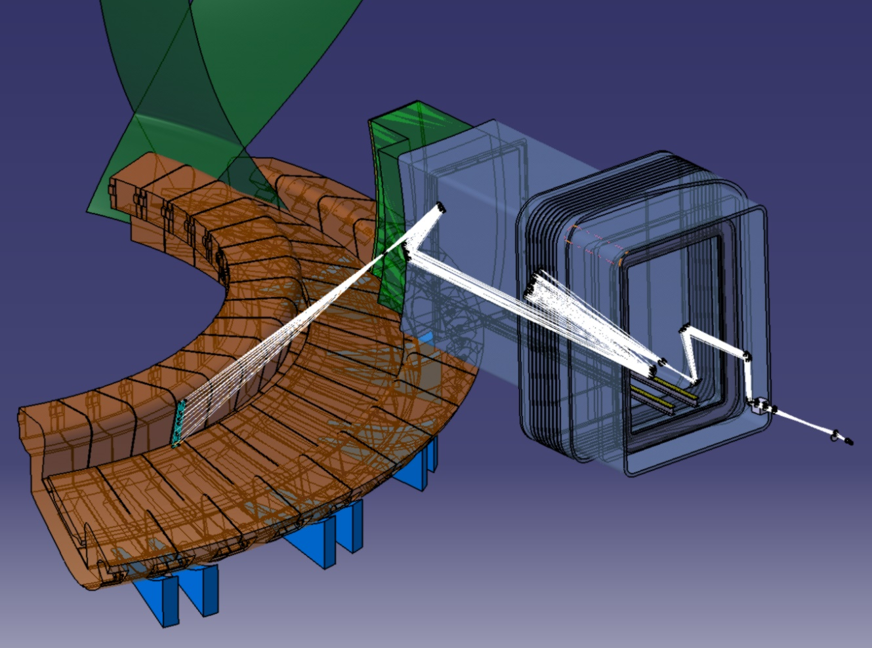
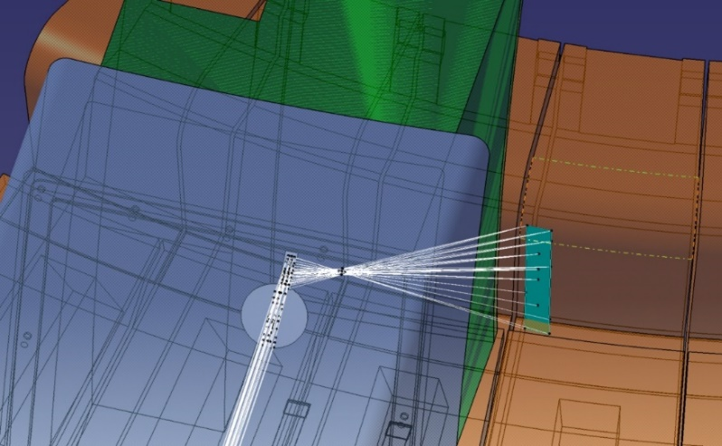
Inboard Vertical Target optics design
Optics design was performed in ZEMAX
- Only metal mirrors in the port in relay optics
(aluminium substrate with silver coating )
- Fused silica double vacuum window
- Radiation hard glass outside of bio-shield
- Flat first mirror
Maximize FOV with the given first mirror constraints
- Visible imaging - 500-700nm
- IR imaging - λ=2-3µm
Achieved Spatial resolution :
~0.5 mm for visible imaging
~1 mm for Infra-red imaging
~10 mm for the detachment control
Additional design parameters
Remote Handling compatibility to be able
replace the Vacuum window
Bioshield width 2m
Imaging Detectors behind the bio-shield in a neutron shielded box.
Thermal expansion must be compensated
Field of View : 120x900mm
Aperture D=30mm
Aperture distance – 2000mm
First mirror - 60x180mm flat mirror
Distance of object: ~ 7500mm
D. Dunai et al.: EFDA_D_2QES79

Slide 20
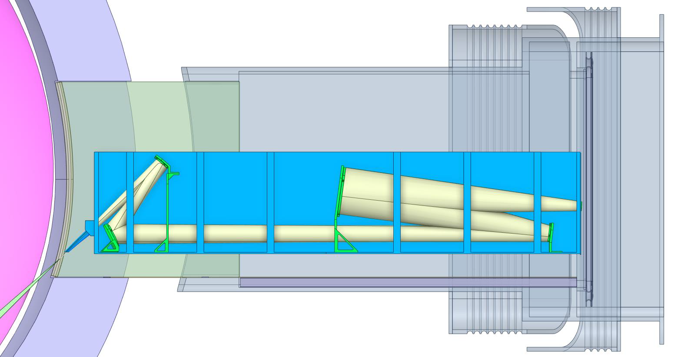
Opto-mechanical design
Imre Katona: SOFT 2024 - P1-42
Engineering Considerations for Optical
Diagnostics of European DEMO
New Challenge :
Integration of gas filled duct
Open aperture
Optical path free
Continuous flow to the Vacuum Vessel
Multiple options were considered.
The optics is installed in a box
Box-mounted version advantages:
Simplest, and robust optomechanical design
Vacuum Window is RH maintainable
Easier to integrate multiple opical diagnostics into one larger box
Easier to incorporate the shielding
V=6,7 m³
1,4 m
Duct
0.5 m
7 m
The duct is only 0.5m in this solution, and the Fe sputtering and erosion is expected to be reduced - ERO 2.0 simulations are on going
Smaller aperture and first mirror – Changes the optics design
Lower duct gas density – operation advantage
Box-mounted version disadvantages:
Large, uncontrolled gas volume
Large space requirement

Slide 21
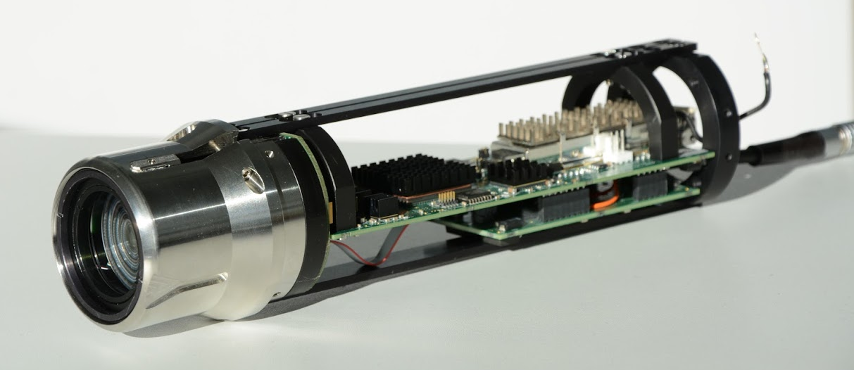
Detector considerations
The detector technology will develop, but could be solved with present technology
Imaging cameras – Visible and Infra-red cameras
Relatively simple visible camera is sufficient with real-time capabilities
EDICAM development is a good candidate
~500x500 pixel IR camera is sufficient, and would be available
Installed relatively close to the bioshield utilizing additional shielding
Other detectors
The detachment control and W erosion diagnostic -> spectrometers or filtered single detector solutions
Spectrometers in a diagnostics cubicle,
The light would be transmitted by fiber bundle – no reliable fiber bundle technology for DEMO
[Zoletnik, Fus Eng Des 88 (2013) 1405]
Dichroic mirror
Beam splitter
Incoming light
Visible Branch
Fibre plate
Fibre bundle
Spectrometers
IR branch
High resolution camera
IR Camera

Slide 22
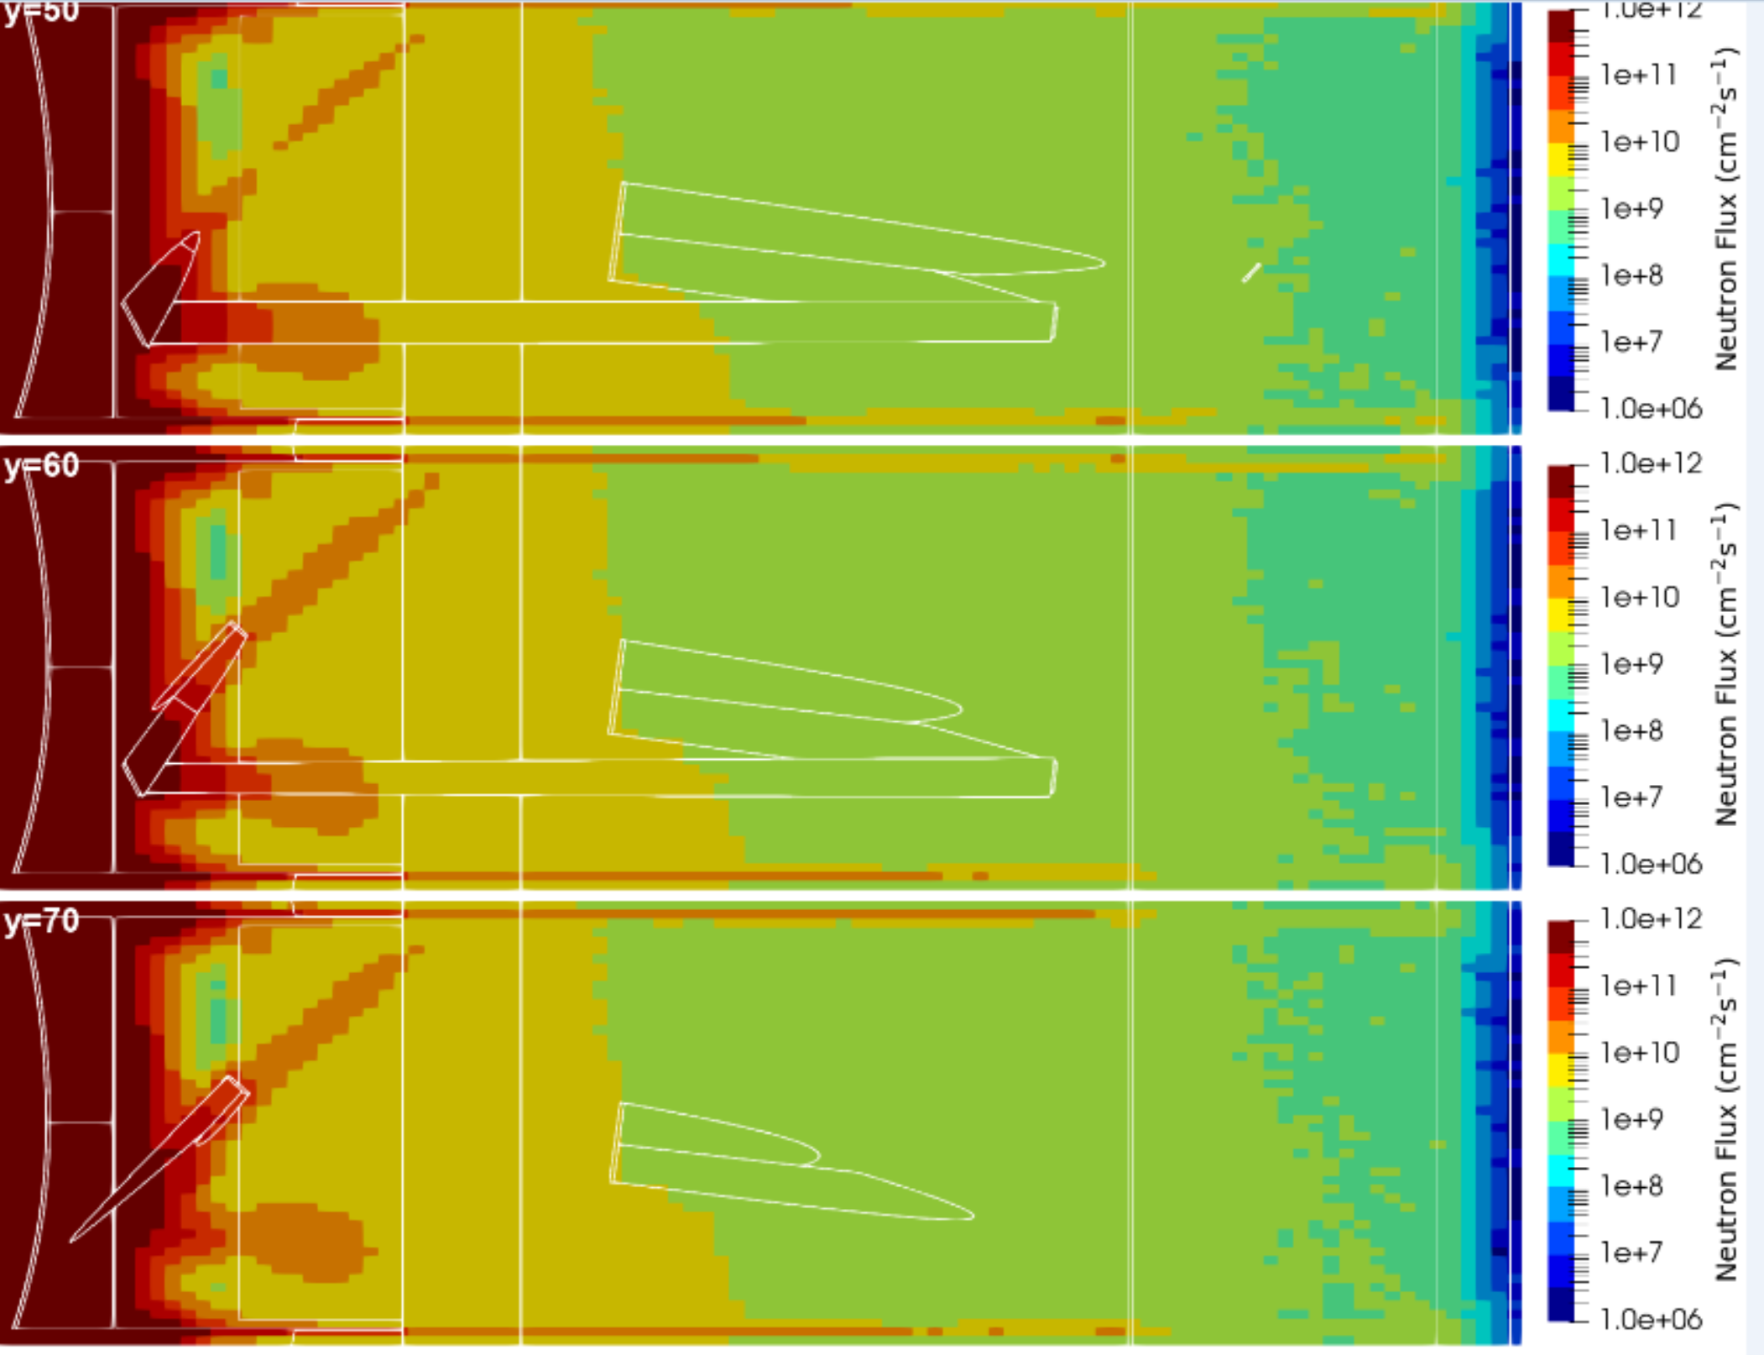
Neutronics simulation
Preliminary neutronics simulations:
Increased radiation originated from tubular optical path
Additional doglegs in the shielding block can decrease flux
The applicable neutron shielding is limited due to weight restrictions
The sensitive electronics (high resolution camera, IR camera) outside the bioshield needs additional protection – size limitations
The spectrometers are planned to be installed in diagnostics cubicles 100+ meters
R. Luís et al. Neutronics Simulations for DEMO Diagnostics. Sensors 2023, 23, 5104.

Slide 23
Conclusions
Diagnostic design activity for DEMO is possible with limitations
Concentrate on DEMO (FPP) specific challenges.
- First mirror protection
- Gas filled optics container
- Mirror based port-plug optics
Understand the physics requirements and deduce the diagnostics requirements
- Simulation of various line intensities
- Line of sight optimization
Identify missing bits: physics knowledge, simulation code, technology, material
- More detailed detachment modelling
- Opacity and Reflections
- Irradiation material information (IR- optics, mirrors, etc…)
- General DEMO design and requirements, …
Transferable results and expertise between DEMO variants and FPP designs
Test the developed diagnostic and control techniques on present day and near future devices - Divertor Test Tokamak (DTT)

Slide 24
Thank you for your attention!

