Slide 1
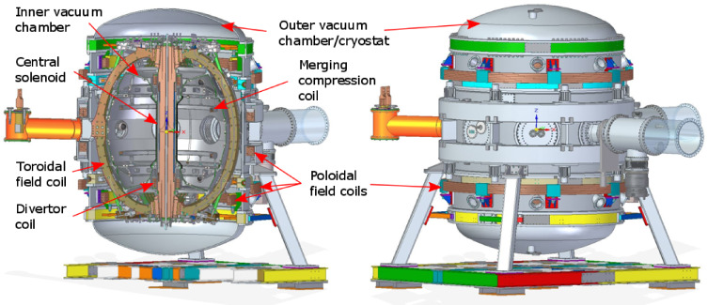
A new Near InfraRed Dispersion Interferometer for ST40 and future fusion reactors
Tadas Pyragius, Graham Naylor

Slide 2
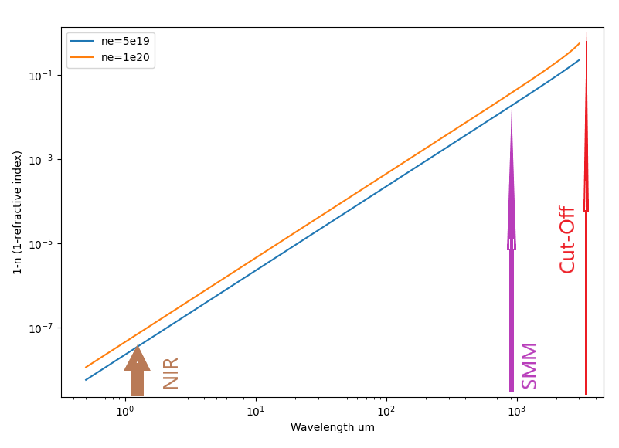
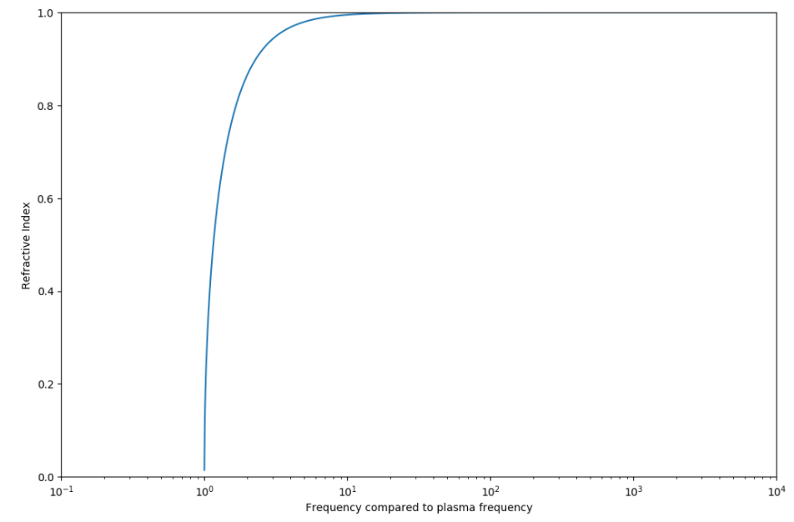
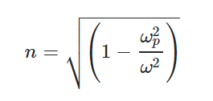
Effect of the plasma density on refractive index (speed of light)
SMM
NIR
(Sub milli-meter wave interferometer)
(Near Infra-red laser interferometer)
Refractive index
of plasma
$$n=\sqrt{1−\frac{λ^{2}}{λ_{p}^{2}}}$$

Slide 3
Interferometer measures plasma density
An interferometer can measure the plasma density by measuring
the change in path length of a light beam when propagating
through the plasma.
This is due to the change in refractive index with electron density
Approximation for frequencies
Well above the plasma frequency
Parasitic contribution to phase measurement
Bigger for smaller wavelengths
(Systematic error caused by thermal drifts and vibrations)
Phase shift is smaller
for shorter wavelengths

Slide 4
Two wavelength (colour) interferometry
The systematic error caused by geometric path lengths can be compensated
by measuring at two wavelengths and using the wavelength dependence

Slide 5
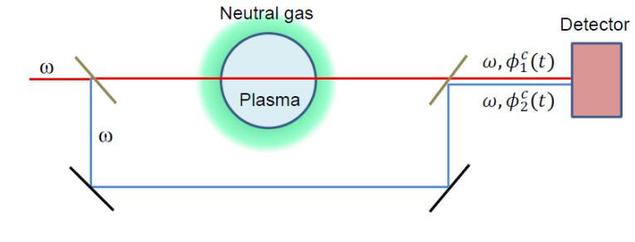
How to measure phase change with an interferometer?
AOM
Window
λ1,λ2
ω1,ω2
(λ1,λ2)
+2πδd/λ
(vibration)
AOM
ω+δω
=> Phase measurement at optical frequencies converted to a phase measurement at the IF (typically ~100MHz)
AOM=Acousto-Optic Modulator
Measurement = Signal - Reference
Interference fringe= Scene Beam Reference Arm
Density phase shift = Beat Note phase - AOM drive phase
Differential phase shift= Phase shift λ1 - Phase shift λ2

Slide 6
Dispersion Interferometer benefits
Two wavelength interferometers are used to compensate for systematic errors, but normally require independent reference arms that also need to be kept very stable otherwise they will contribute geometric path length changes that are not compensated
A dispersion interferometer does not need a separate reference beam as it launches two wavelengths (the main laser beam and its second harmonic) that are in phase. The phase differential between these can be taken to measure the dispersion due to the plasma.

Slide 7
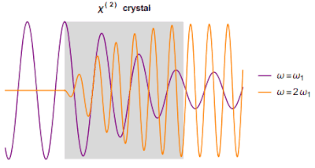
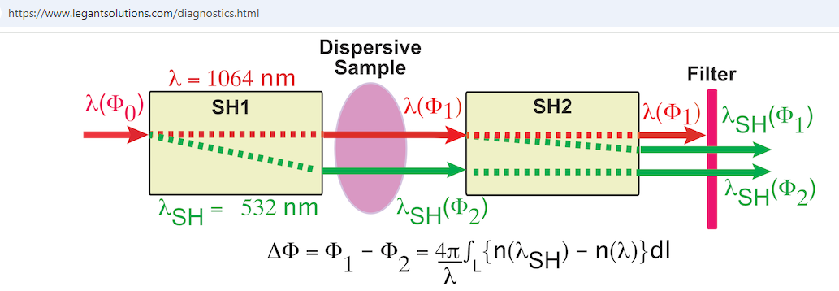
Second Harmonic generation
Two wavelengths in phase and co-linear
https://en.wikipedia.org/wiki/Second-harmonic_generation

Slide 8
Why go to shorter wavelength?
Advantages:
Sources and detectors commonly available
Frequency doubling much more efficient
Reduced chance of loss of signal and phase due to refraction of the beam away from the detector by the plasma (aka ‘fringe jump’)
Beams can go through small openings: propagate over long distances with small transverse dimensions
Disadvantages:
Phase shift is smaller (Need to measure phase to high precision)
Subject to perturbation due to refraction in air
(Second source of systematic error)
But note this is also a problem around 5μm!

Slide 9
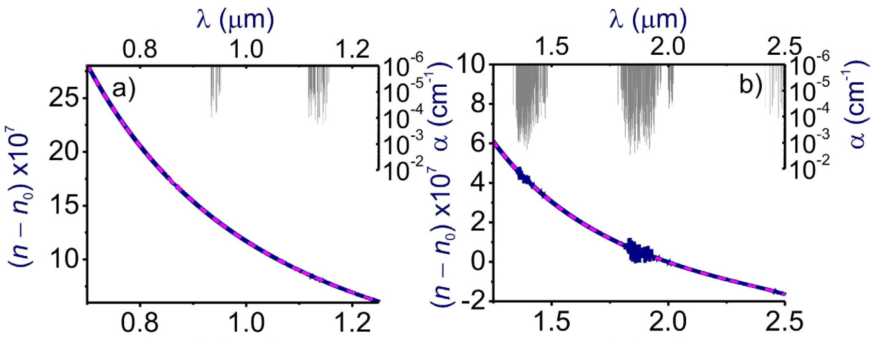
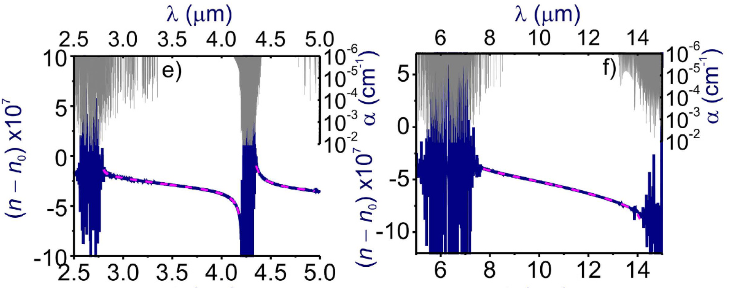
Effect of the refractive index (dispersion) of air
From:
A. Voronin & A. M. Zheltikov
” The generalized Sellmeier equation
for air” Nature Scientific reports DOI: 10.1038/srep46111

Slide 10
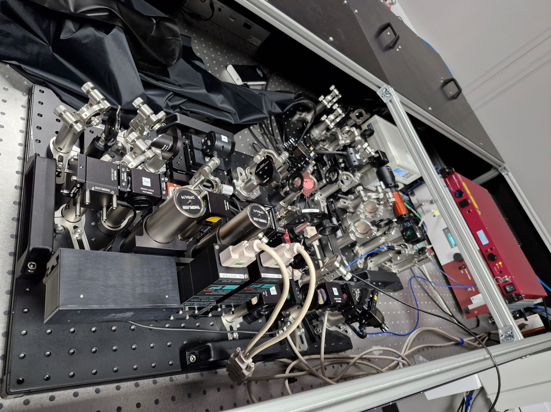
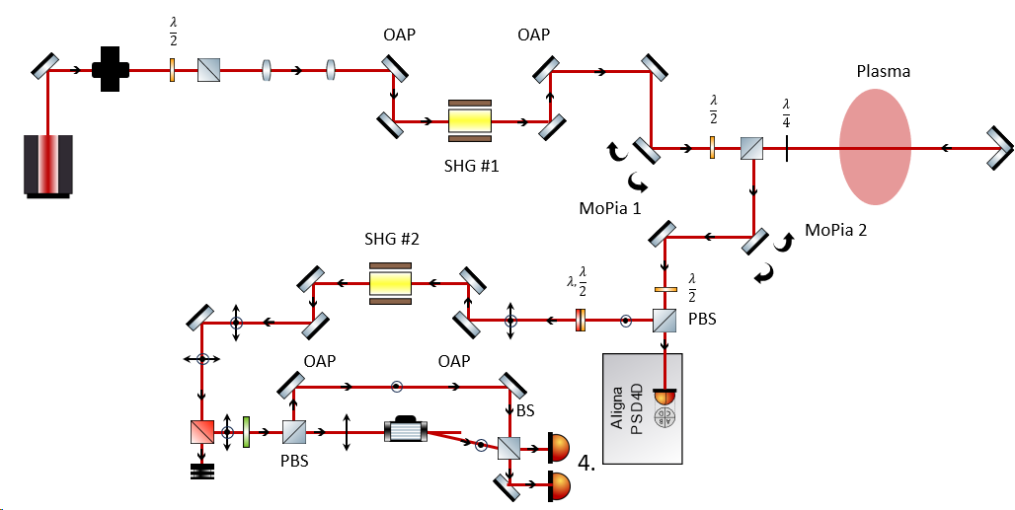
A NIR Dispersion Interferometer (NIRDI) operating at 1.56μm
NIRDI beat signal

Slide 11
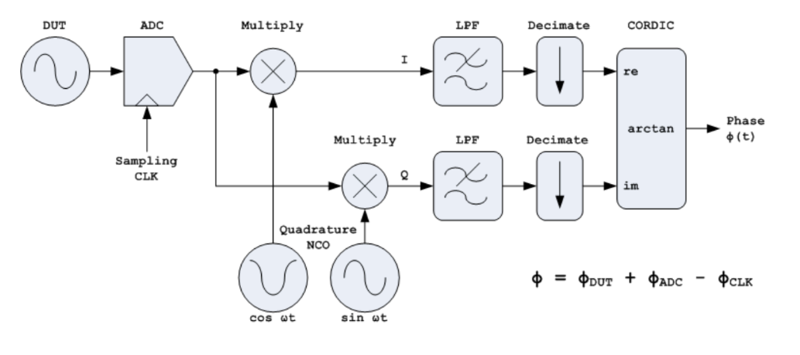
Software Defined Radio on FPGA
- for phase measurement

Slide 12
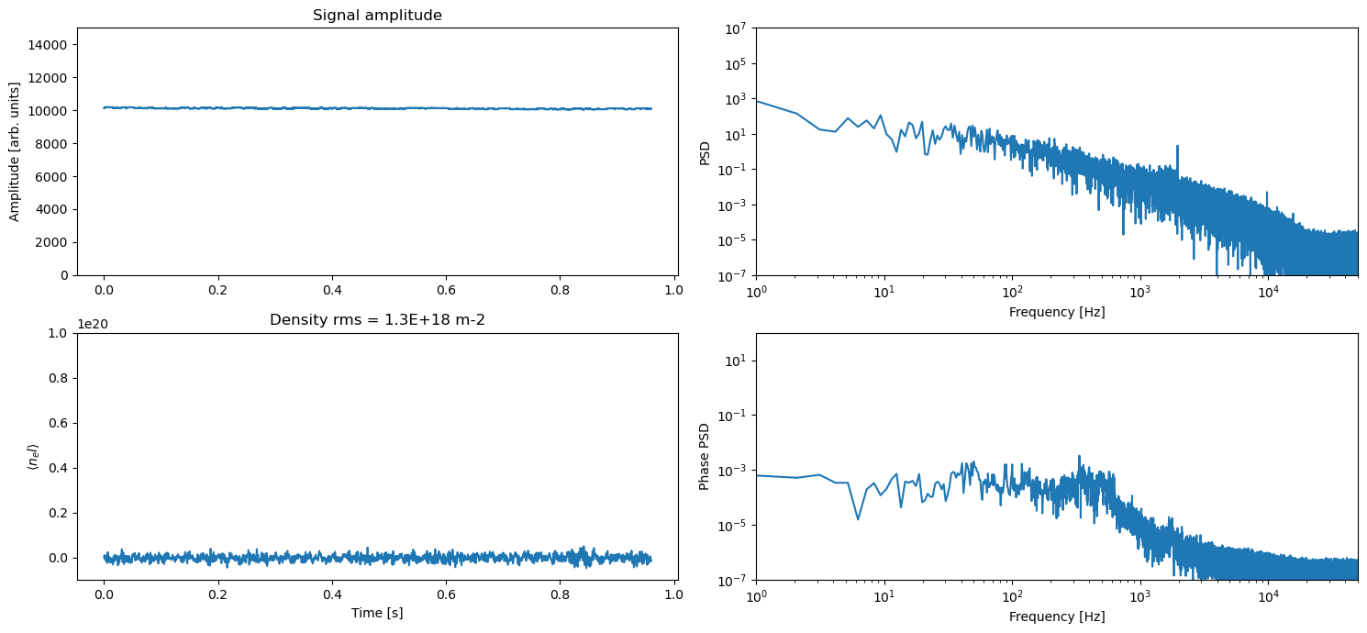
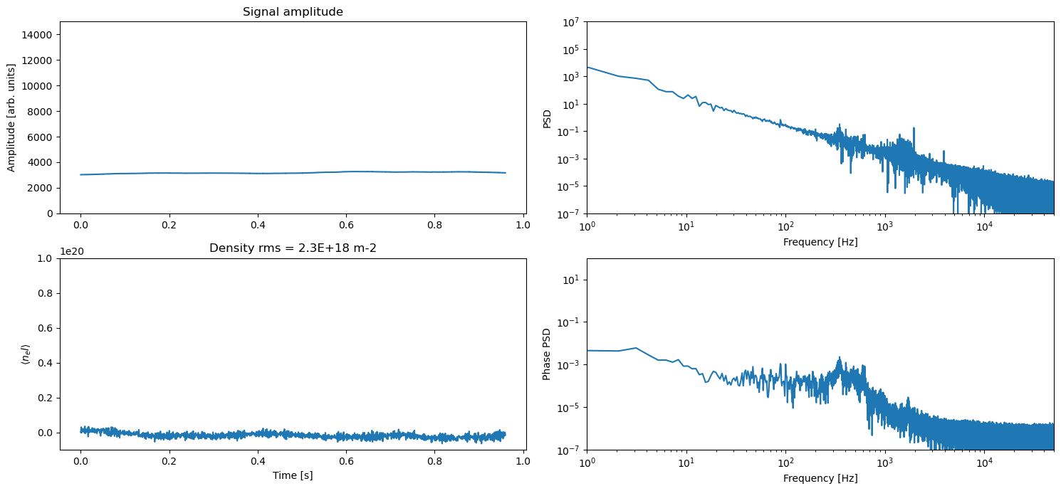
NIRDI Performance:
( 17m path in air )

Slide 13
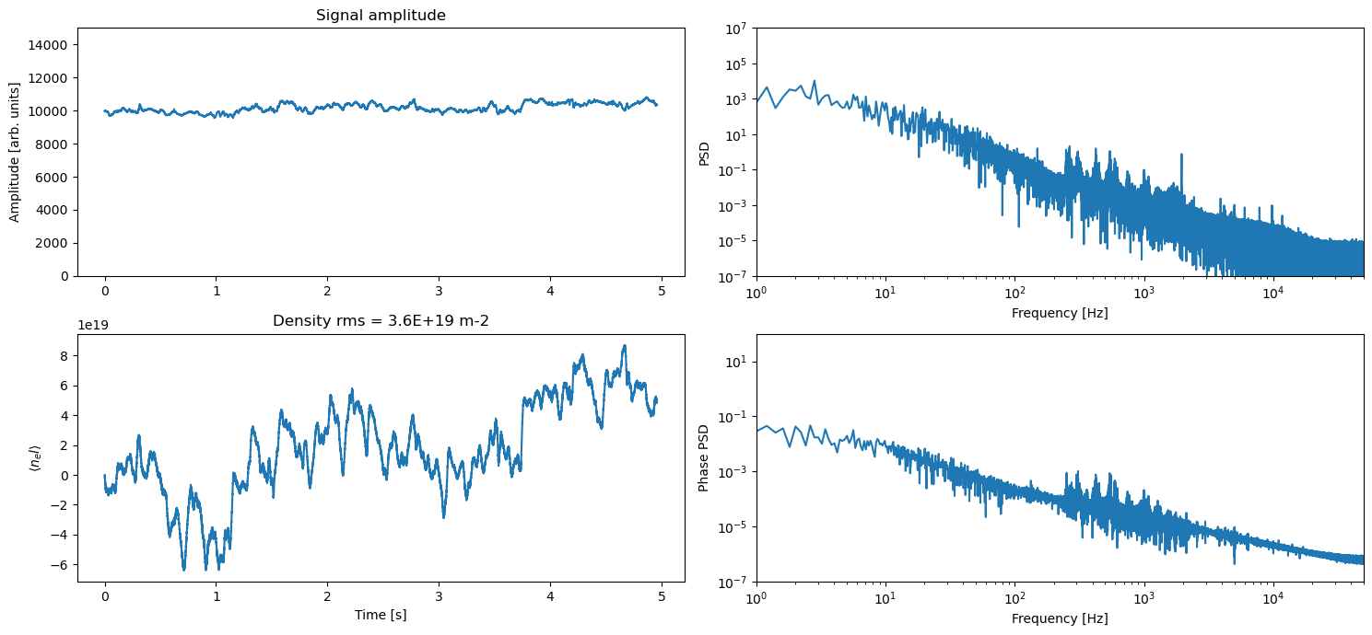
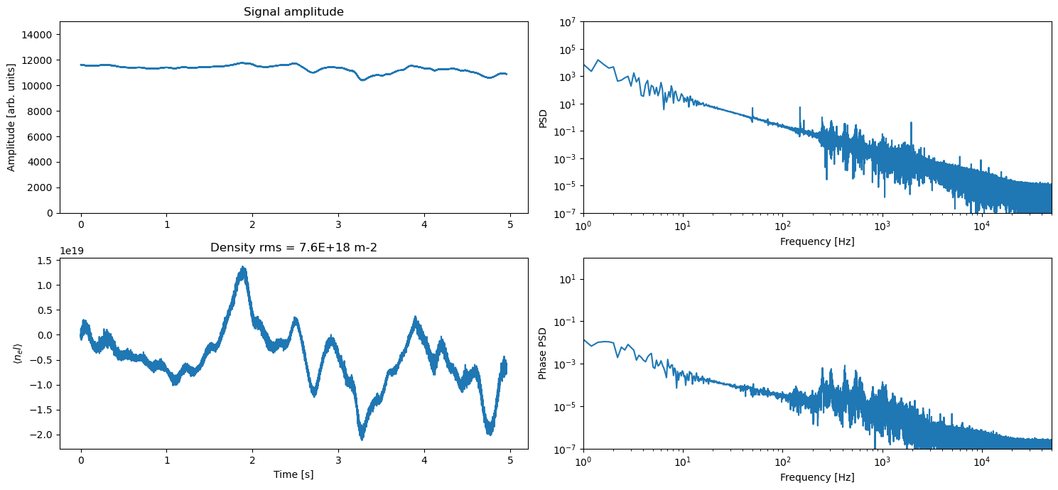
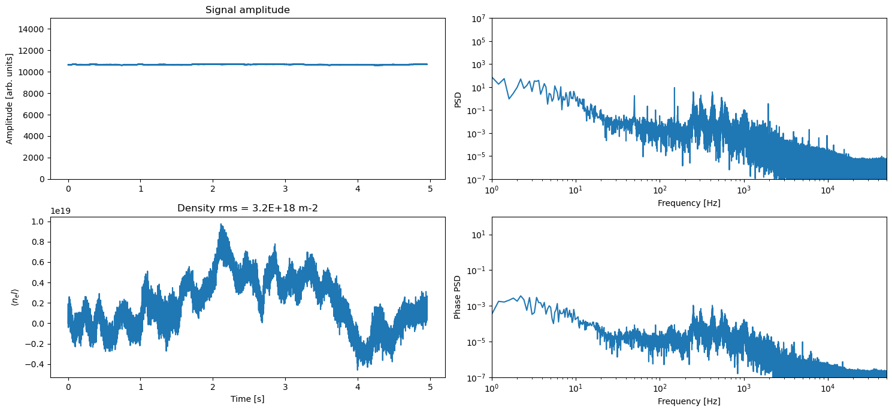
Systematic errors – ii) Air turbulence, beam stability
Optical table covers off (aggressive air conditioning
Optical Covers On no beam stabilisation
Optical table covers on, beam stabilisation on

Slide 14
Summary and conclusions
The dispersion interferometer configuration cancels almost completely systematic errors due to mechanical motion of mirrors (eg vibrations)
A residual systematic error is still present due to atmospheric dispersion (this is tolerable for short path lengths such as ST40, but long paths will need to be carefully controlled using beam path tubes and perhaps windows/baffles to minimise air current across the laser beam path).
Operating a dispersion interferometer at a Near Infra-Red wavelength produces a robust and compact method for determining plasma density

