Slide 1
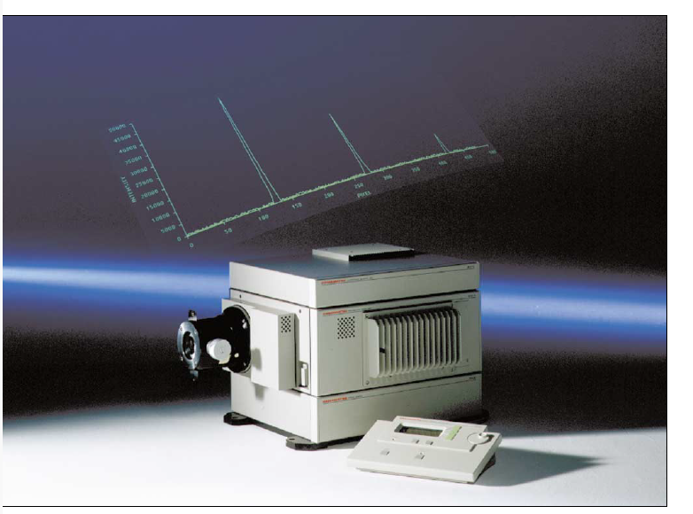
Streak camera diagnostic for
high-power laser-matter interactions
J. Filardi¹, D. Giulietti¹,
M. Cipriani², M. Scisciò², F. Consoli²
¹University of Pisa, Physics Department
²ENEA, Fusion and Technologies for Nuclear Safety Department

Slide 2
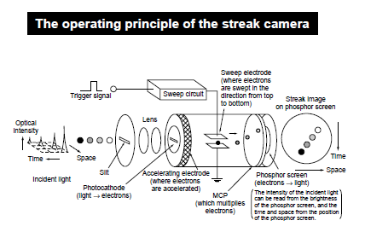
Streak cameras
Time-resolved information on plasma evolution
Problem: converting streaked image into quantitative data
Accurate emission modeling required
Emission dependency on electron density, temperature and wavelength
Further extracted information:
  Ion sound speed
  Plasma position
Bottom right: raw streak data from Ref.[1]

Slide 3
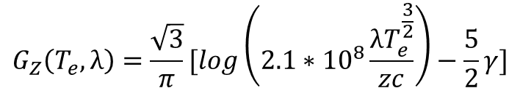
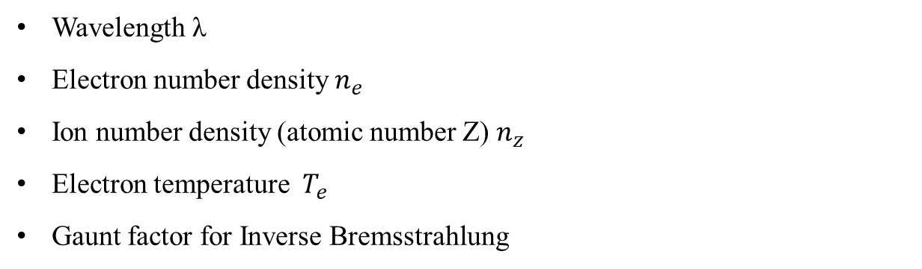
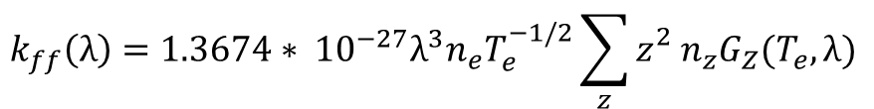
Plasma emission
Free-free absorbtion coefficient
$$k_{ff}\left(λ\right)=1.3674∗ {10}^{−27}λ^{3}n_{e}T_{e}^{−1/2}\sum_{z}{{z_{}^{2}n}_{z}G_{Z}(T_{e},λ)}$$
Wavelength λ
Electron number density $n_{e}$
Ion number density (atomic number Z) $n_{z}$
Electron temperature $T_{e}$
Gaunt factor for Inverse Bremsstrahlung
$$G_{Z}\left(T_{e},λ\right)=\frac{\sqrt{3}}{π}[\log\left(2.1∗{10}^{8}\frac{{λT}_{e}^{\frac{3}{2}}}{zc}\right)−\frac{5}{2}γ]$$
with γ=0.544

Slide 4
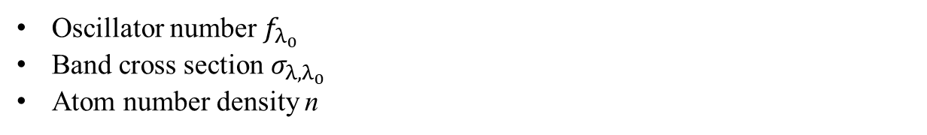
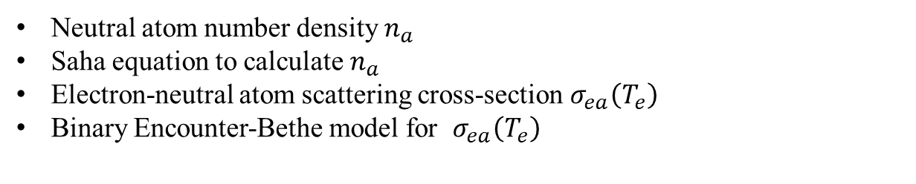
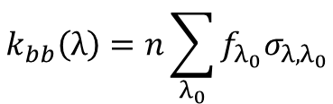
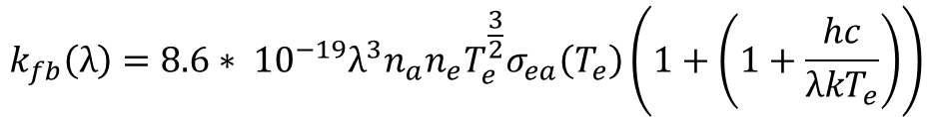
Plasma emission
Free-bound absorbtion coefficient (per neutral atomic species)
$$k_{fb}\left(λ\right)=8.6∗ {10}^{−19}λ^{3}n_{a}n_{e}T_{e}^{\frac{3}{2}}σ_{ea}\left(T_{e}\right)\left(1+\left(1+\frac{hc}{λkT_{e}}\right)\right)$$
Neutral atom number density $n_{a}$
Saha equation to calculate $n_{a}$
Electron-neutral atom scattering cross-section $σ_{ea}\left(T_{e}\right)$
Binary Encounter-Bethe model for $σ_{ea}\left(T_{e}\right)$
Bound-bound absorbtion coefficient (for relevant bands centered on $λ_{0}$)
$$k_{bb}\left(λ\right)=n\sum_{λ_{0}}{f_{λ_{0}}σ_{λ,λ_{0}}}$$
Oscillator number $f_{λ_{0}}$
Band cross section $σ_{λ,λ_{0}}$
Atom number density n

Slide 5

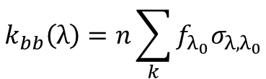
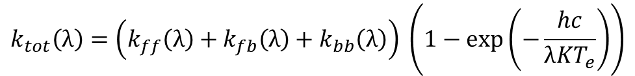
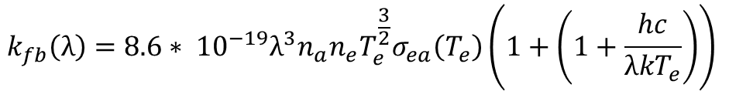
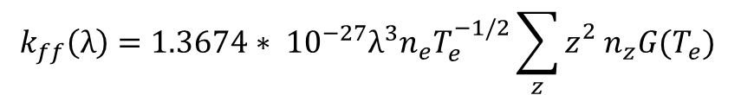

Plasma emission
$\frac{η\left(λ\right)}{k_{tot}\left(λ\right)}=\frac{2KT_{e}}{λ^{2}}$
Detailed balancing in Local
Thermal Equilibrium
Luminous intensity I variation
per plasma unit length dl
Bound-bound cross section can be neglected for visible spectra
with η(λ) emissivity
per unit wavelength
$$\frac{dI_{λ}}{dl}=\left(η\left(λ\right)−k\left(λ\right)I_{λ}\right)$$
$$k_{tot}\left(λ\right)=\left(k_{ff}\left(λ\right)+k_{fb}\left(λ\right)+k_{bb}\left(λ\right)\right) \left(1−exp\left(−\frac{hc}{λKT_{e}}\right)\right)$$
$$k_{ff}\left(λ\right)=1.3674∗ {10}^{−27}λ^{3}n_{e}T_{e}^{−1/2}\sum_{z}{{z_{}^{2}n}_{z}G(T_{e})}$$
$$k_{fb}\left(λ\right)=8.6∗ {10}^{−19}λ^{3}n_{a}n_{e}T_{e}^{\frac{3}{2}}σ_{ea}\left(T_{e}\right)\left(1+\left(1+\frac{hc}{λkT_{e}}\right)\right)$$
$$k_{bb}\left(λ\right)=n\sum_{k}{f_{λ_{0}}σ_{λ,λ_{0}}}$$

Slide 6
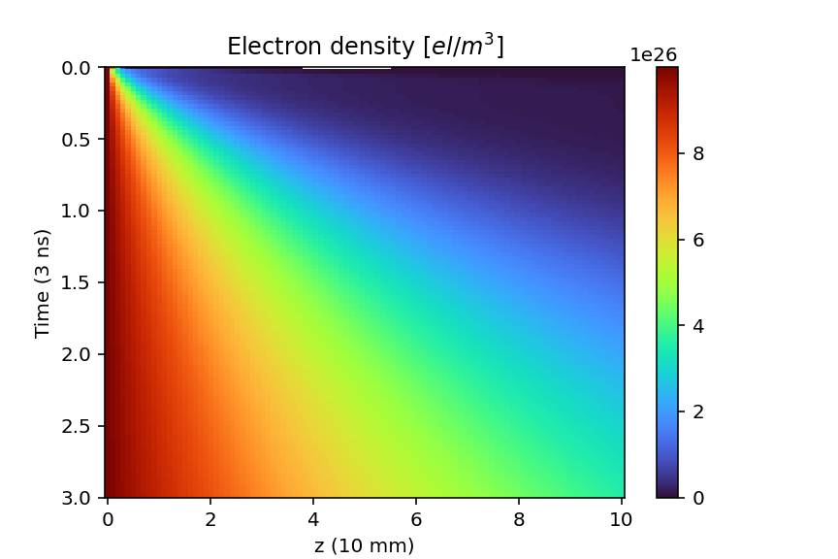
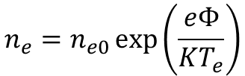


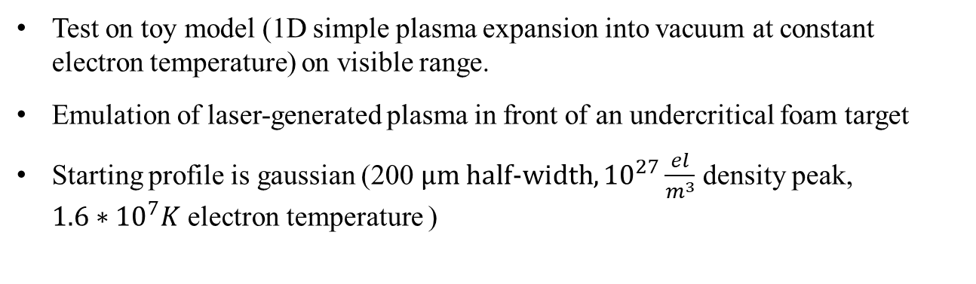
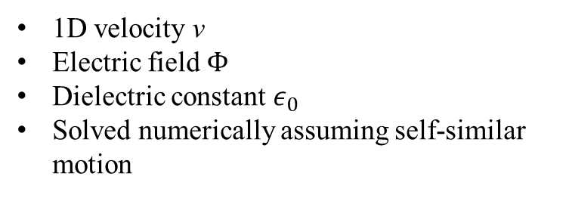

Developing a Synthetic
Test on toy model (1D simple plasma expansion into vacuum at constant electron temperature) on visible range.
Emulation of laser-generated plasma in front of an undercritical foam target
Starting profile is gaussian (200 μm half-width, ${10}^{27}\frac{el}{m^{3}}$ density peak,
$1.6∗{10}^{7}K$ electron temperature )
$$\left(dt+v∇\right)v=−\frac{ze}{m_{i}}\frac{dΦ}{dx},$$
$$n_{e}=n_{e0}\exp\left(\frac{eΦ}{KT_{e}}\right)$$
$$\left(dt+v∇\right)n_{z}=−n_{z}\frac{dv}{dx},$$
$$ε_{0}\frac{d^{2}Φ}{dx^{2}}=e\left(n_{e}−zn_{z}\right)$$
1D velocity v
Electric field Φ
Dielectric constant $ε_{0}$
Solved numerically assuming self-similar motion

Slide 7
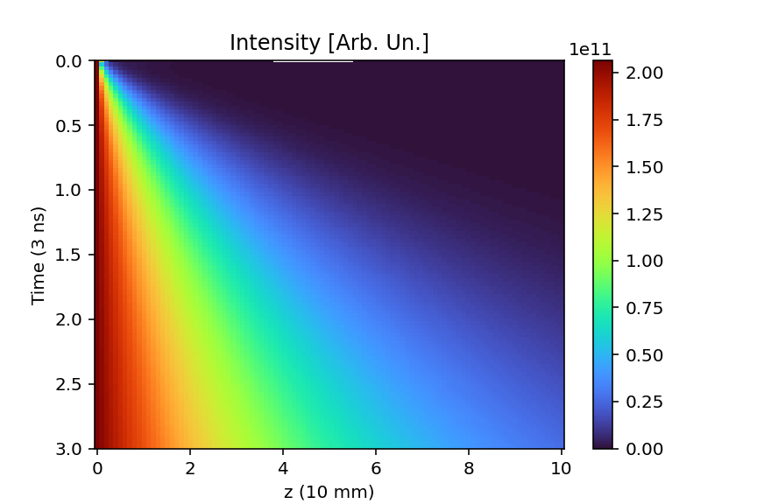
Developing a Synthetic
Calculate absorbtion coefficients and emissivity from density and temperature profile
Integrate over specral range sampled from streak camera datasheet
(model C5680-N5716)

Slide 8
Conclusions
Relative orders of magnitude in luminous intensity for different parameters are compatible with experimental data [1]
Free-free and free-bound effects scale correctly for commonly used plasma chemical compositions (4-5 orders of magnitude for visible light)
Dominant density and temperature scaling
How to proceed?
Test x-ray emission for relevant atomic species and ions
Test with simulation profiles and compare to experiments
Account streak pixel overlap
Direct integration in simulation code (FLASH code)

Slide 9
Thank you for your attention
References:
-[1] Cipriani, M., Gus’kov, S. Yu., De Angelis, R., Consoli, F., Rupasov, A. A., Andreoli, P., Cristofari, G., & Di Giorgio, G. (2018). Laser-driven hydrothermal wave speed in low-Z foam of overcritical density. In Physics of Plasmas (Vol. 25, Issue 9). AIP Publishing. https://doi.org/10.1063/1.5041511
-Hoffman, J., Moscicki, T., & Szymanski, Z. (2011). The effect of laser wavelength on heating of ablated carbon plume. In Applied Physics A (Vol. 104, Issue 3, pp. 815–819). Springer Science and Business Media LLC. https://doi.org/10.1007/s00339-011-6420-2
-J. Richter, in Plasma Diagnostics, ed. by A.A. Lochte-Holtgreven (North Holland, Amsterdam, 1968)
-F. Cabannes, J.C. Chapelle, in Reactions Under Plasma Conditions, ed. by M. Venugopalan (Wiley, New York, 1971)
-Tanaka, H., Brunger, M. J., Campbell, L., Kato, H., Hoshino, M., & Rau, A. R. P. (2016). Scaled plane-wave Born cross sections for atoms and molecules. In Reviews of Modern Physics (Vol. 88, Issue 2). American Physical Society (APS). https://doi.org/10.1103/revmodphys.88.025004
-Physics of Shock Waves and High-Temperature Hydrodynamic Phenomena (Zeldovich Ya.B., Rajzer Yu.P.)

