Slide 1
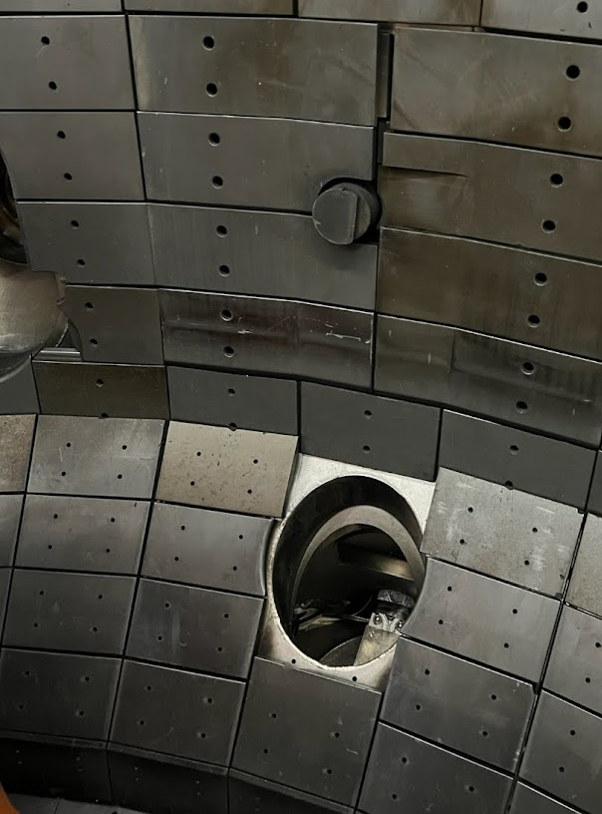
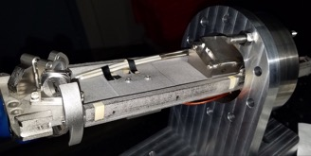
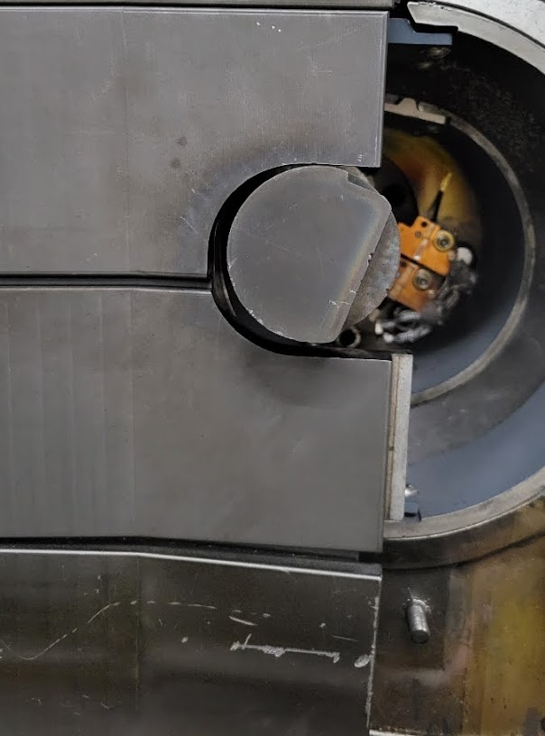
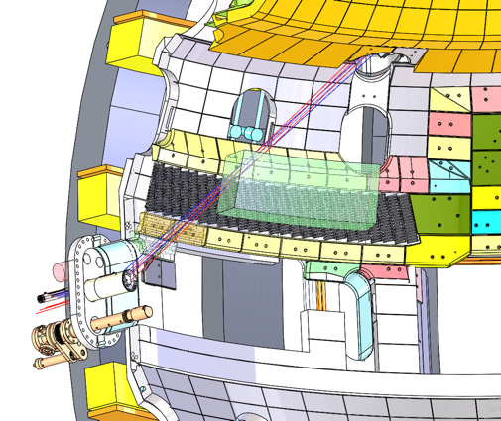
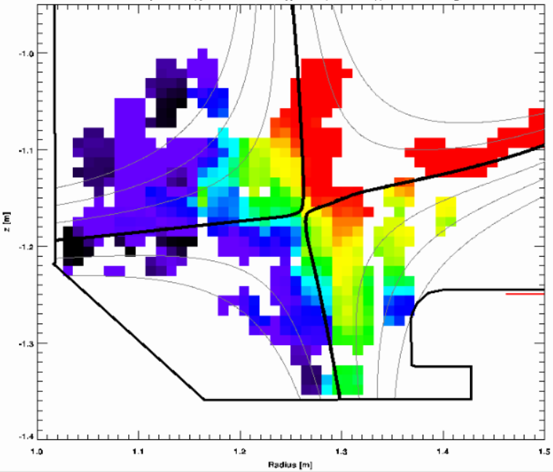
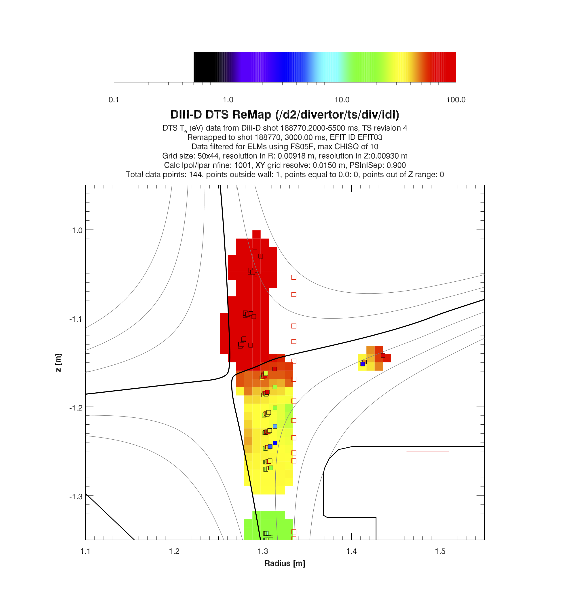

New diagnostic capabilities of DIII-D
by​
Suk-Ho Hong​
General Atomics​
Many thanks to DIII-D team
​
​
​
Presented at the
ICFDT7 Conference
Oct 22, 2024
LLAMA
ITER ECH
Mark 4
ITER ECH Mark 3
DFSS
2D DTS
T_{e} (eV)

Slide 2
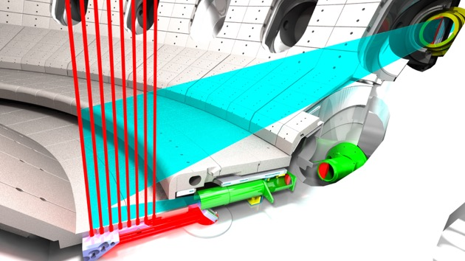
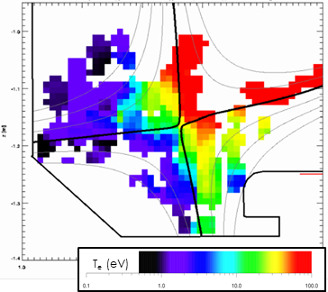
Diagnostic development drives realization of fusion energy
New 2D Divertor TS
The physics measurements are key to the success of the science program
DIII-D excels at developing innovative diagnostic sets for understanding physics and model validation for ITER and FPP
Multiple new diagnostic technologies to be developed in connection with public-private sectors.
Strike point sweeping
Real-time 2D measurement
innovation

Slide 3
Understanding physics and model validation for ITER/FPP are challenging in multiple ways
Multiple challenges arise
Many elements of solution
trade-off against each other
Must explore in reactor
relevant physics regimes
High confinement
Compactness
Exhaust handling
Dissipative divertor
Stable core
Stability, stress
heat loads
Wall
Robust materials, PMI, mitigation
Transients
Disruptions
ELMs, robust control
Core-Edge Integration
Interactions at high opacity,
density & performance
Important to study these issues in an integrated & flexible device with innovative diagnostics, integrated and collaborative efforts
Also, vital to develop new diagnostic technologies for the reactor

Slide 4
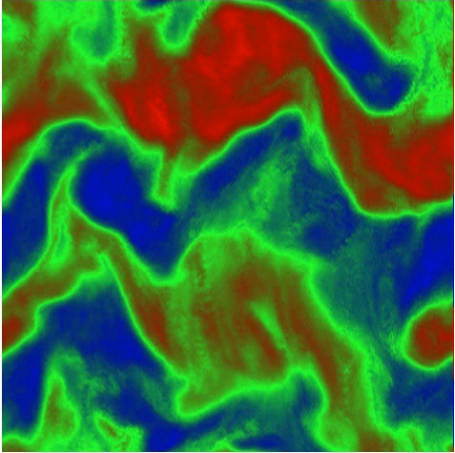
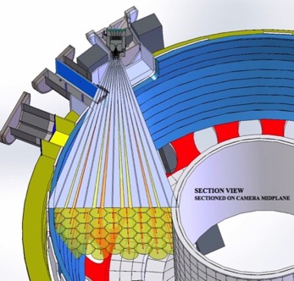
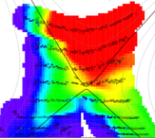
DIII-D has a Leading Diagnostic Set To Test Physics Models
Comprehensive diagnostics
  Profiles: current, rotation, Ti, Te, ne
  Magnetic sensor arrays
  Turbulence suite k=0.1-100cm^{–1}
  Fast ion spectra & losses,
  Neutrons, g-ray imaging, SXR, ICE
  Bolometry, spectroscopy – UV, visible
  Infra red, Langmuir probes
Injectors and interactions:
  D₂, Ar, Ne, Li/B granules, shattered
  Laser blow off system
  Material sample exposure facilities
Turbulence Diagnostics
γ imaging
2D Thomson
scattering
Remotely observe and measure multiple plasma physics phenomena

Slide 5
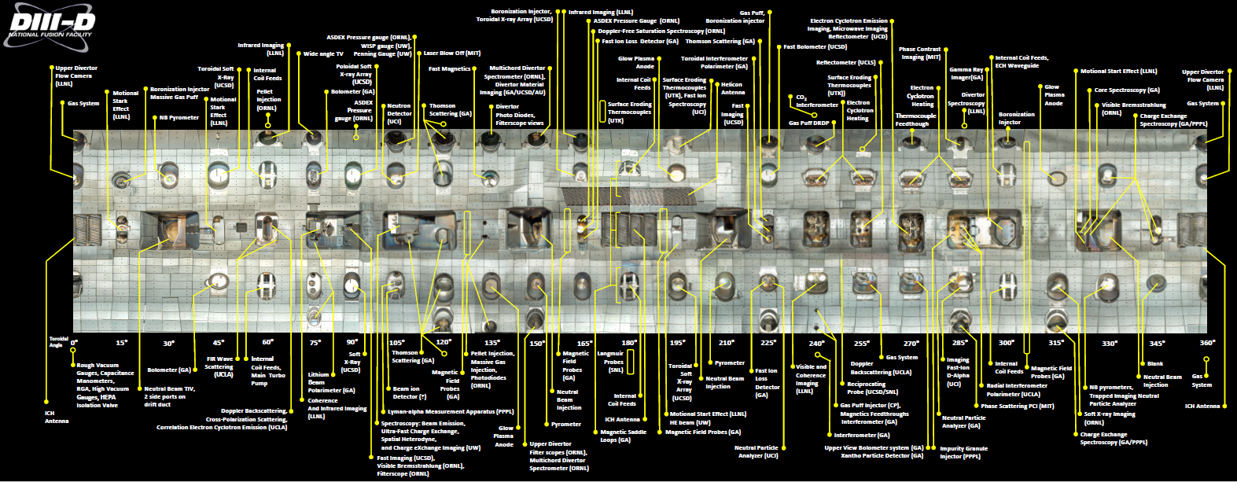
DIII-D diagnostic set is the result of an integrated and collaborative effort
As of May, 2022
Over 130 participating institutions including universities, national laboratories, and industry, 17 institutions provide over 100 diagnostics

Slide 6
Recent Diagnostic Innovation to Enable Research Goals
In DIII-D

Slide 7
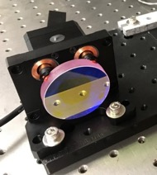
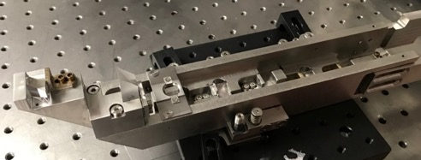
2D real-time Divertor Thomson Scattering System
New 2D Divertor TS
Gain the capability to investigate solutions from divertor detachment to core-edge integration in a wide range of parameters
Real-time 2D measurement of n_{e} and T_{e} at lower divertor down to <1eV
Flexible positioning of 82 measurement positions
More detailed infos in the invited talk of Fenton Glass
In-vessel prism block
re-directs laser vertically
Ex-vessel fast steering mirror directs laser to prism block positions
Paul Schroeder et al. Rev Sci Instrum. 94 (2023) 23504

Slide 8
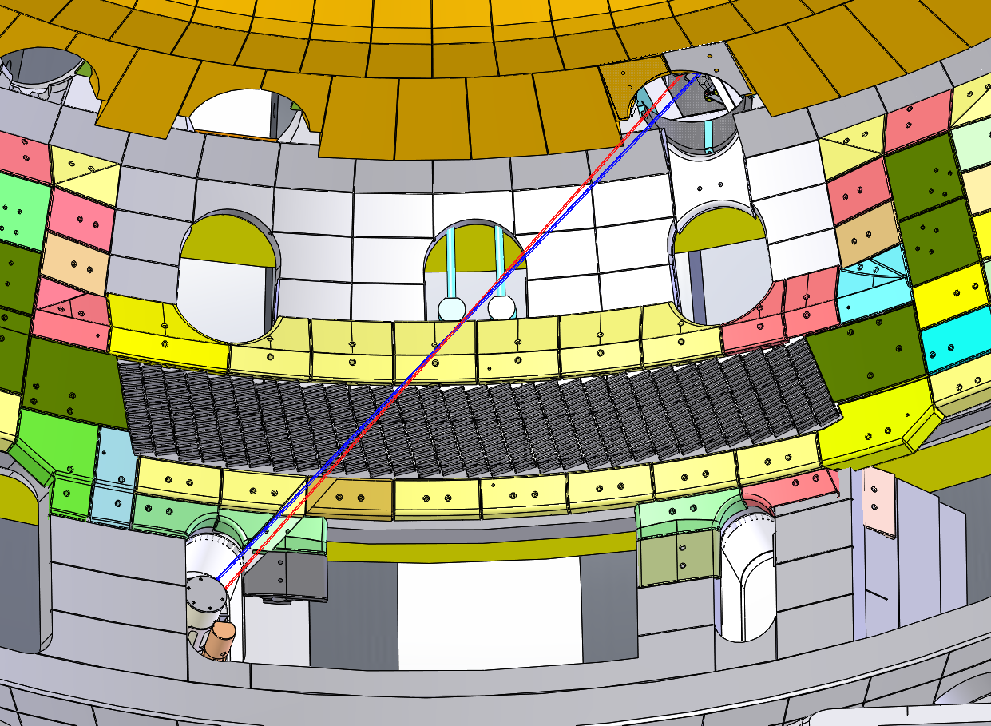
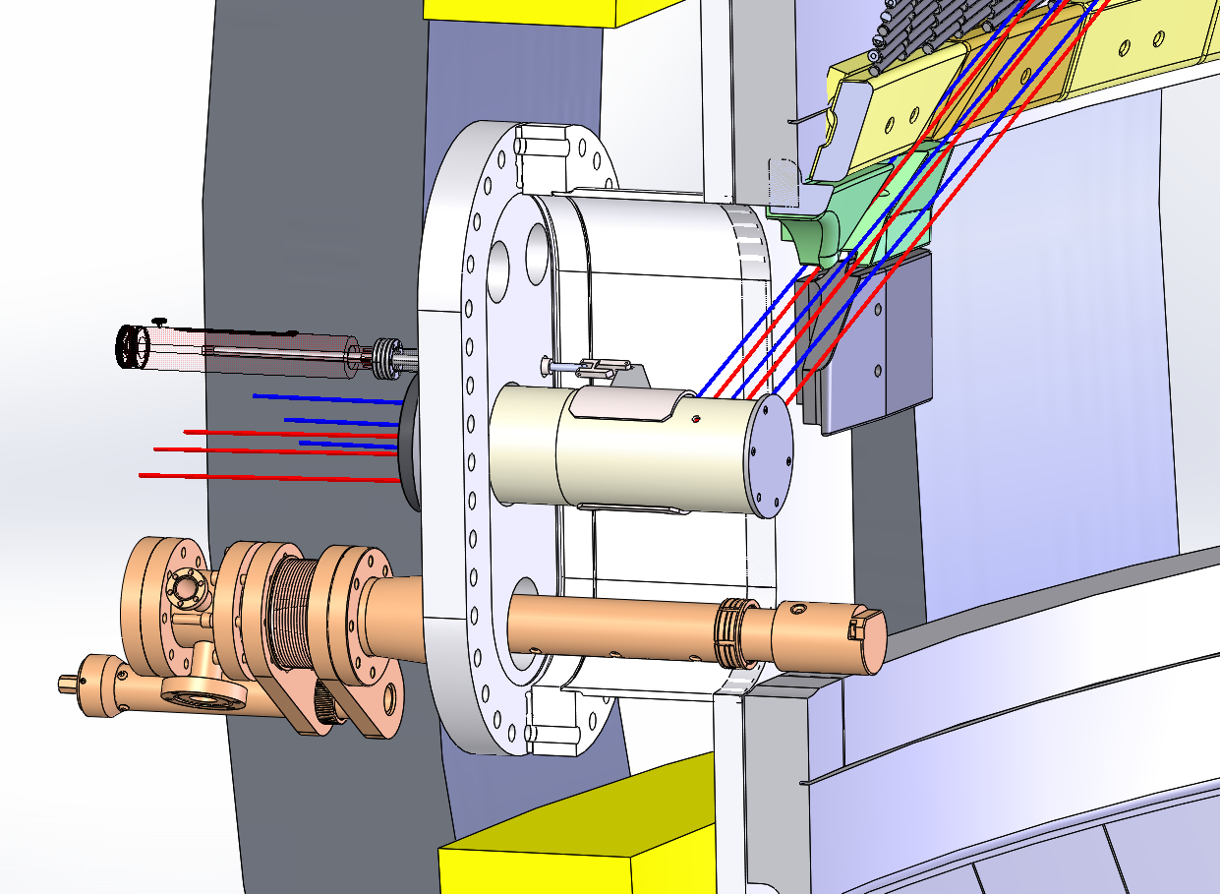
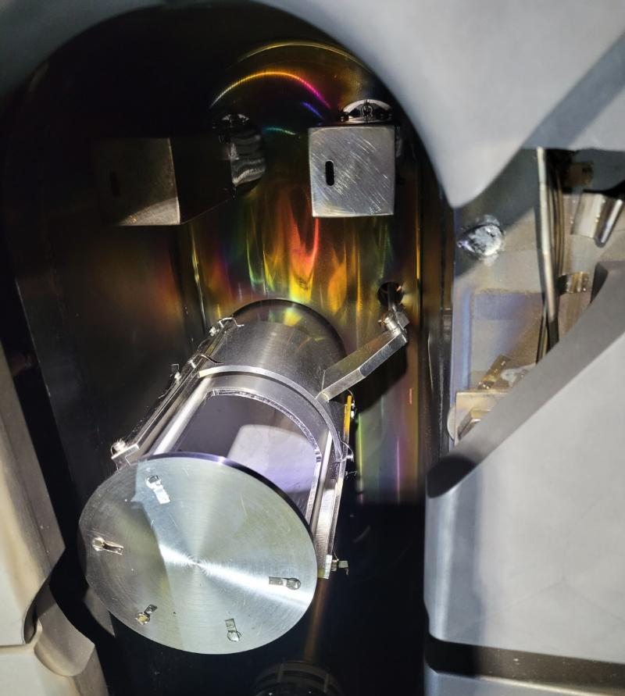
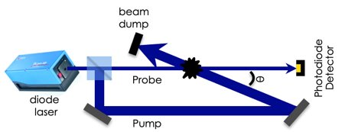
Doppler-free saturation spectroscopy (DFSS)
DFSS is a laser-based technique used to measure spatial resolved, high-resolution spectral data to identify RF structure in SOL and its propagation
Requires two counter-propagating laser beams (pump/probe) that cross at a single point (i.e. the measurement point)
Helicon wave E-field vector and magnetic field vector will be measured
Under commissioning
DFSS Pump and Probe Laser Beams
David Su et al., IEEE Transactions on Plasma Science, doi: 10.1109/TPS.2024.3386594. k

Slide 9
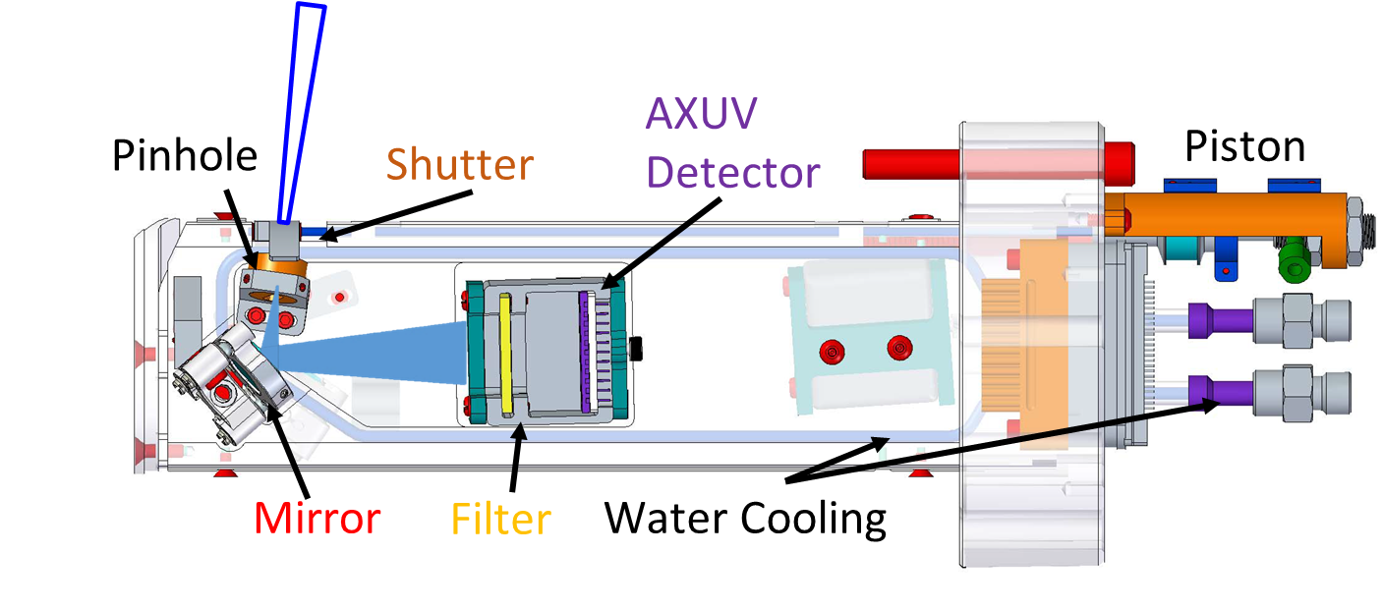
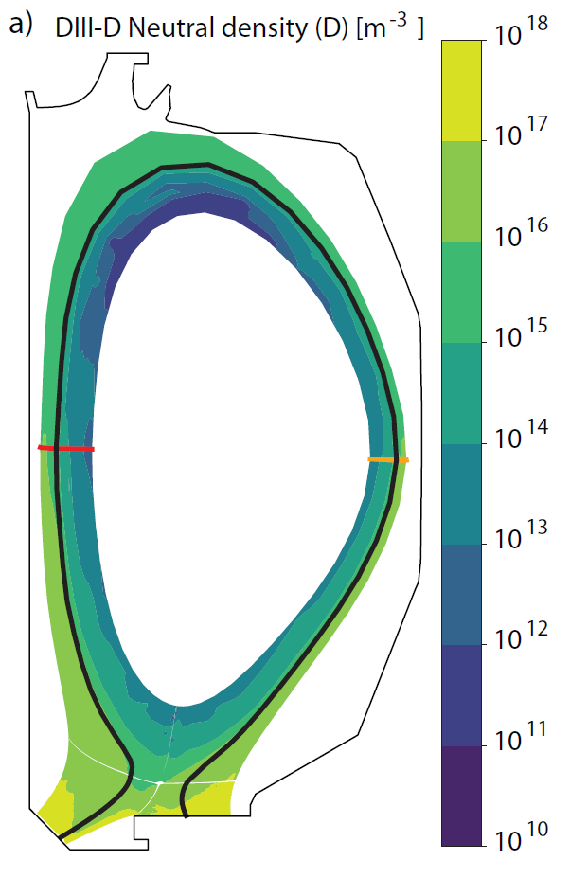
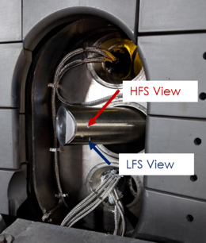

Hydrogenic Lyman alpha measurements to diagnose neutrals (LLAMA and ALPACA)
Investigate neutrals in upper and lower main chamber
Measure Lyman-α spectral line (λ=121 nm) and cut out extra bands
Study pedestal fueling in different divertor configurations
Explore high field/low field asymmetries
LLAMA is in routine operation
ALPACA in commissioning
SOLPS
HFS
LFS
ALPACA
HFS
LFS
LLAMA
A. Rosenthal, et al. Rev. Sci. Instr. (2021)
F.M. Laggner, et al. Rev. Sci. Instr. (2021)

Slide 10
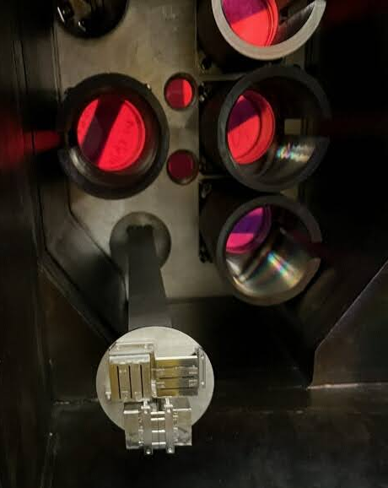
Other new diagnostics installed: ITER ECH detectors, TRIP, Textured tile version 2
Two additional ITER Electron Cyclotron Heating (ECH) detectors have been affixed to a lower port of the vessel.
The Radial Interferometer Polarimeter (RIP) has undergone a successful upgrade to have a toroidally displaced chord to measure high n numbers up to 50.
The textured Tile measures the campaign-integrated effect of the charge exchange neutral on the erosion/redeposition.
ITER ECH
Mark 4
ITER ECH Mark 3
TRIP
Original
RIP array
Textured tile
Version 2

Slide 11
Developing New Reactor
Diagnostic Technology

Slide 12
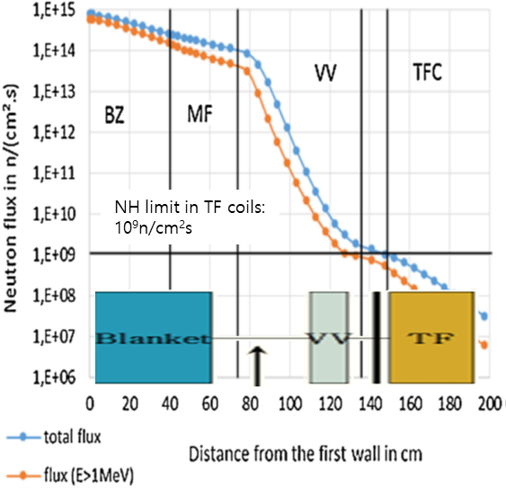
Developing new reactor diagnostic technology:
FPP diagnostics will be very different from present-day and ITER
Diagnostics will be exposed to more harsh environments
  Neutron irradiation, higher heat and particle flux, thermomechanical stresses, relativistic effects
FPP will have a minimum set of diagnostics during the operation
  Very small and restricted spaces due to T breeding
  Miniaturization & modularization of essential diagnostics
J.-C. Jaboulay et al. / Fus Eng Des 124 (2017) 896–900
Operating in the FPP reactor environment brings new challenges to the controls and diagnostics

Slide 13
DIII-D plays essential role in advancing Technology Readiness Levels (TRLs) of diagnostics for plasma controls of FPP
(TRL>6)
(TRL>7)
NASEM report
Conceptual and preliminary
design review
Decision to construct
NASEM report marge engineering design and construction in 5 years.
Start of non-nuclear operation
Start of nuclear operation
Critical point
DIII-D 5-year plan FY24-FY29 (TRL~6)
Feasible plasma scenario, blanket concept, power conversion, fuel cycle, remote handling, safety analysis, machine protection, and diagnostic design must be finalized before the FPP engineering design phase (critical point).
Synthetic diagnostics combined with validated models predict plasma behavior for the plasma control and machine protection.

Slide 14
Diagnostic developments for the commercialization of fusion energy
DIII-D can advance TRLs only up to 6 (or early phase of 7)
  Advancing TRL 7 to 9 will be part of the FPP development and operation
  ITER could cover some of TRL 7
Miniaturization, modularization, and standardization of essential diagnostics are absolutely necessary.
As a new testbed, DIII-D will offer a flexible environment for the miniaturization, modularization, and standardization of essential diagnostics toward the commercialization of fusion energy

Slide 15
Example of advancing TRL: Resolve diagnostic technology compatible with reactor constraints
Technology
Challenges
TRL 2
TRL 3
TRL 4
TRL 5
TRL 6
goal/achievement
goal/achievement
goal/achievement
goal/achievement
goal/achievement
Diagnostic solutions for plasma and burn control
Identify the required control functions and operational control solutions
[link to 3.1 Control functions required for fusion reactor]
Select candidate diagnostics and assessment of new approaches
Develop new diagnostic prototypes, e.g. fast wave interferometer and reflectometer
Qualification test of plasma control, machine protection, and survivability of diagnostics
(TRL 6)
[FY27]
[FY24-FY25]
[FY26]
[FY28]
Diagnostic solutions for Machine protection
Develop new diagnostic prototypes, e.g. microwave thermal imaging
[FY27]
Hands-off and low-maintenance diagnostics
Identify the required maintenance schemes, control functions, and operation
Conceptual design of a prototype remote/robotic hardware
Engineering design of a prototype remote/robotic hardware
Demonstrate the remote maintainability of diagnostics at DIII-D
Remote handling /maintainability of diagnostics
(TRL 6)
[FY25]
[FY27-FY28]
[FY28]
[FY24]
[FY26]

Slide 16
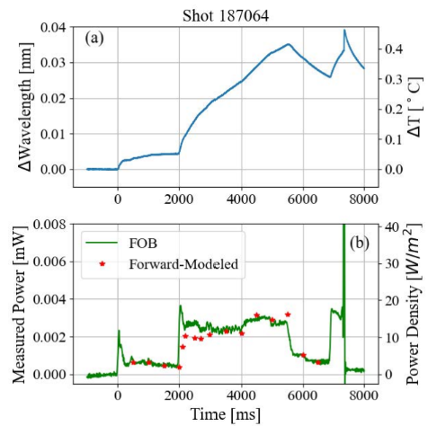
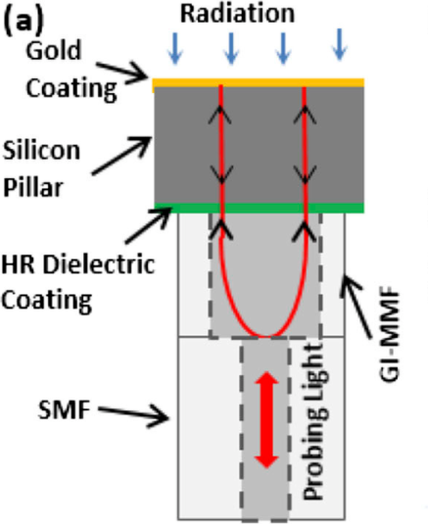
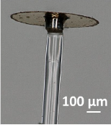
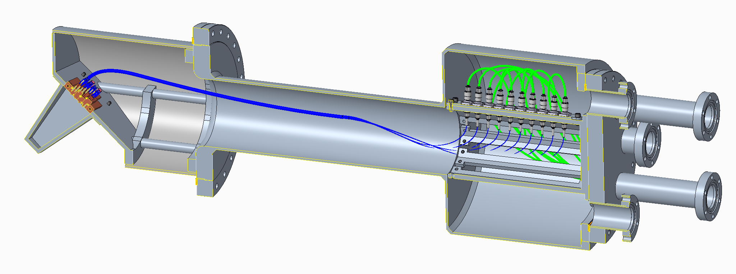
EMI-free radiated power measurements by Fiber-Optic Bolometer (FOB) for FPP
Conventional bolometers suffer from temperature variation and electromagnetic interferences (EMI).
A Fabry-Perot interferometer to convert incident radiation into temperature variations.
Degradation of fibers by neutron irradiation can be calibrated (do not measure light intensity)
Images from Dr. Ming Han, May 2022

Slide 17
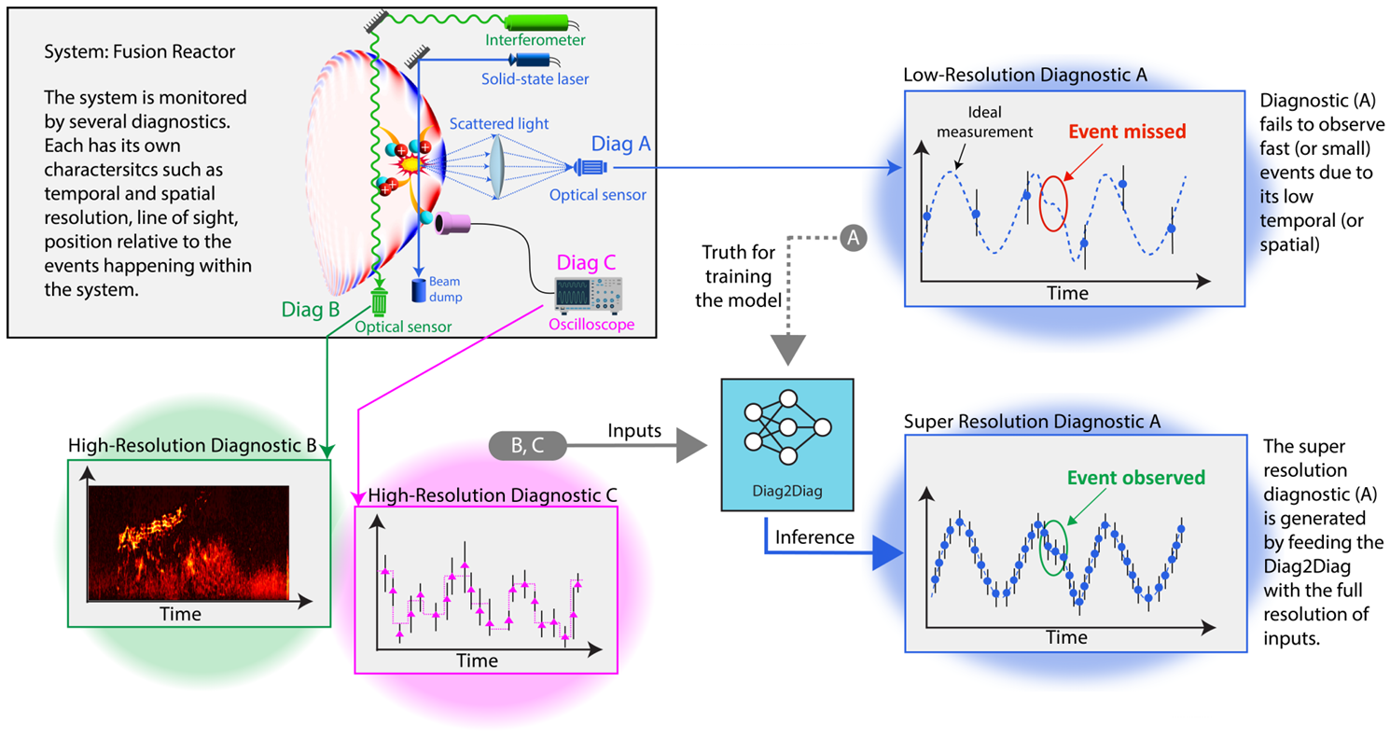
Diag2Diag: Data-First Approach to Prediction of Fusion Dynamics and Reactor Scenario Design
Azarakhsh Jalalvand, SangKyeun Kim, Jaemin Seo, Qiming Hu, Max Curie, Peter Steiner, Andrew Oakleigh Nelson, Yong-Su Na, Egemen Kolemen, submitted to Nature

Slide 18
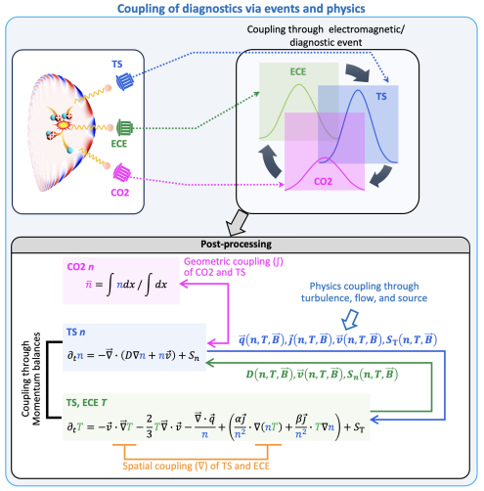
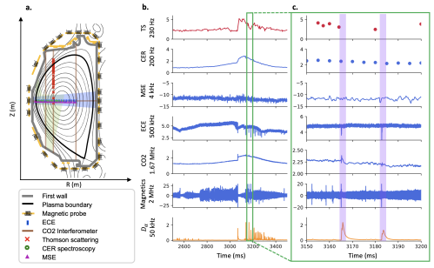
Diag2Diag: Data-First Approach to Prediction of Fusion Dynamics and Reactor Scenario Design

Slide 19
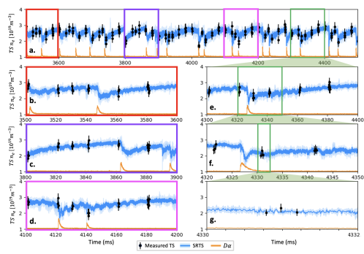
Diag2Diag: Data-First Approach to Prediction of Fusion Dynamics and Reactor Scenario Design
Comparison of the synthetic super resolution Thomson Scattering (SRTS) and the TS fired in “bunch mode” for measuring the electron density in DIII-D shot 153761 at the pedestal (Z=0.71m)
SRTS captures ELMs in comparison to the measured TS even in “bunch mode”.

Slide 20
DIII-D Diagnostic Set is the Essential Key to the Realization of Fusion Energy
DIII-D provides a critical platform to develop vitally needed diagnostics for FPP
Maintaining top-quality diagnostics is important not only for accomplishing the DIII-D’s national mission but also for training the next generation of diagnosticians
Diagnostic innovation will provide critical insights in broader research program

Slide 21
